Slide 1
Getting Travel Funding from NMSU
Kathryn Steakley
AGSO Feb 2017

Slide 2
Funding sources for conference travel
GSC - Graduate Student Council: https://gsc.nmsu.edu/funding/
ASNMSU - Associated Students of NMSU: https://asnmsu.nmsu.edu/government/get-reimbursed/
Graduate School: https://gradschool.nmsu.edu/graduate-forms/
College of Arts and Sciences: http://artsci.nmsu.edu/en/graduate-resources/student-travel-grants
Aggies Go Global: http://aces.nmsu.edu/aggiesgoglobal/

Slide 3
Reimbursement Process
All applications are for reimbursement (except potentially Aggies Go Global)
Submit applications before conference, pay for everything yourself, get reimbursed after
Original receipts required
All receipts must be in student’s name (not advisor or dept card)
Need proof of payment on receipt or bank statement

Slide 4
How much money can you get?
GSC | $400 (1 person) - or - $200 + $200 per person up to $1000
ASNMSU | 40% of (total expenses - GSC $)
Graduate School | $150 in-state, $350 out of state, $600 international
Arts and Sciences | $500
Aggies Go Global | 1 international plane ticket up to $1500

Slide 5
What costs are covered?
GSC | Registration, airfare, hotel, transportation, mileage, parking
ASNMSU | Registration, airfare, hotel, transportation, mileage, parking
Graduate School | Travel, per diem, rentals, other
Arts and Sciences | Registration, airfare, hotel, transportation, mileage, parking, meals, shipping
Aggies Go Global | International airfare only
Notes:
Per diem = lodging, meals, and incidental expenses
Always estimate your costs HIGH - they can’t ever give you more money than you estimated

Slide 6
When do you have to apply?
GSC | By first GSC meeting after trip or second to last meeting of semester, whichever occurs first
ASNMSU | 3 weeks before last ASNMSU session of semester or SAME time/after GSC app
Graduate School | 10 days prior to conference date (July 1 - Apr 15) *Will want $ amounts provided by other sources*
Arts and Sciences | Beginning of semester, watch for announcement *Will want $ amounts provided by other sources*
Aggies Go Global | Prior to trip date Will want you to apply for ASNMSU
Notes:
Places will run out of money - apply sooner rather than later

Slide 7
If multiple students go, do you apply as a group?
GSC | Yes
ASNMSU | Yes
Graduate School | No
Arts and Sciences | No
Aggies Go Global | No

Slide 8
Requirement for student to present?
GSC | If not presenting, must be going somewhere to “conduct research or receive training”
ASNMSU | No, but must submit bills for those presenting and those not presenting.
Graduate School | Yes
Arts and Sciences | No, but preferable
Aggies Go Global | No

Slide 9
How do I apply?
GSC | Submit application to be read/voted on at GSC meeting
ASNMSU | Contact senator to submit bill
Graduate School | Submit application to Graduate School office
Arts and Sciences | Submit application via email
Aggies Go Global | Contact and meet with Gary Lowe

Slide 10
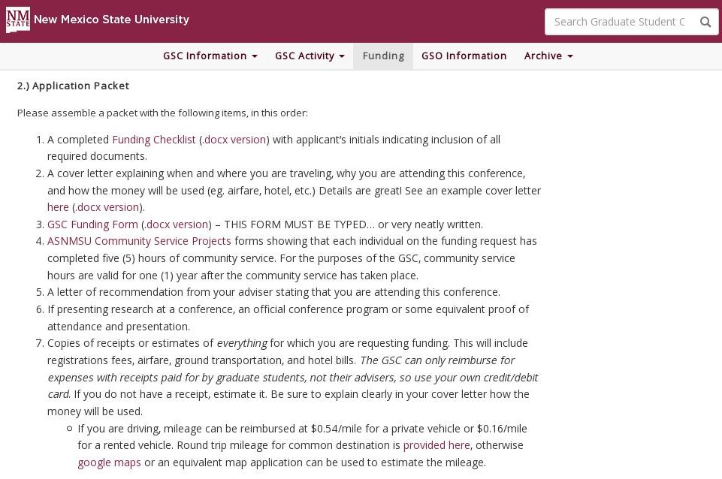
GSC Requirements
Notes:
Need proof of presentation

Slide 11
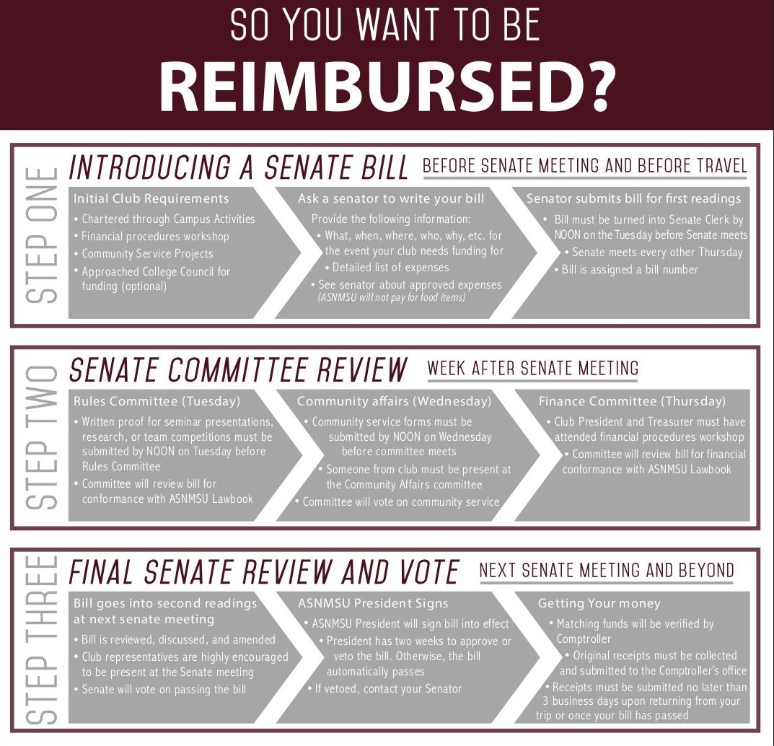
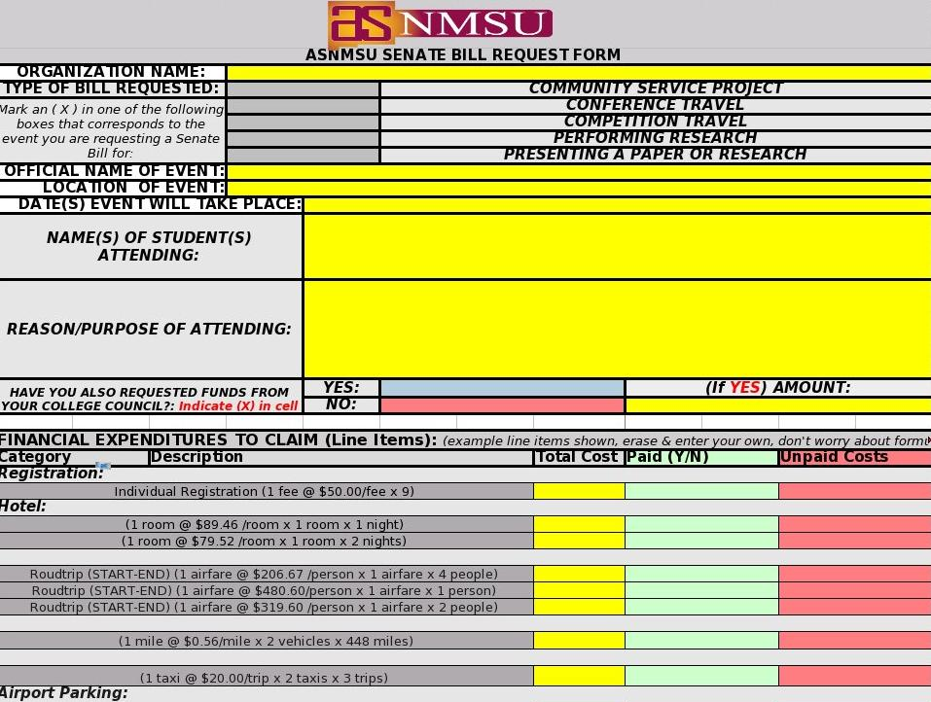
ASNMSU Requirements
See their flow chart
Send this form to student senator

Slide 12
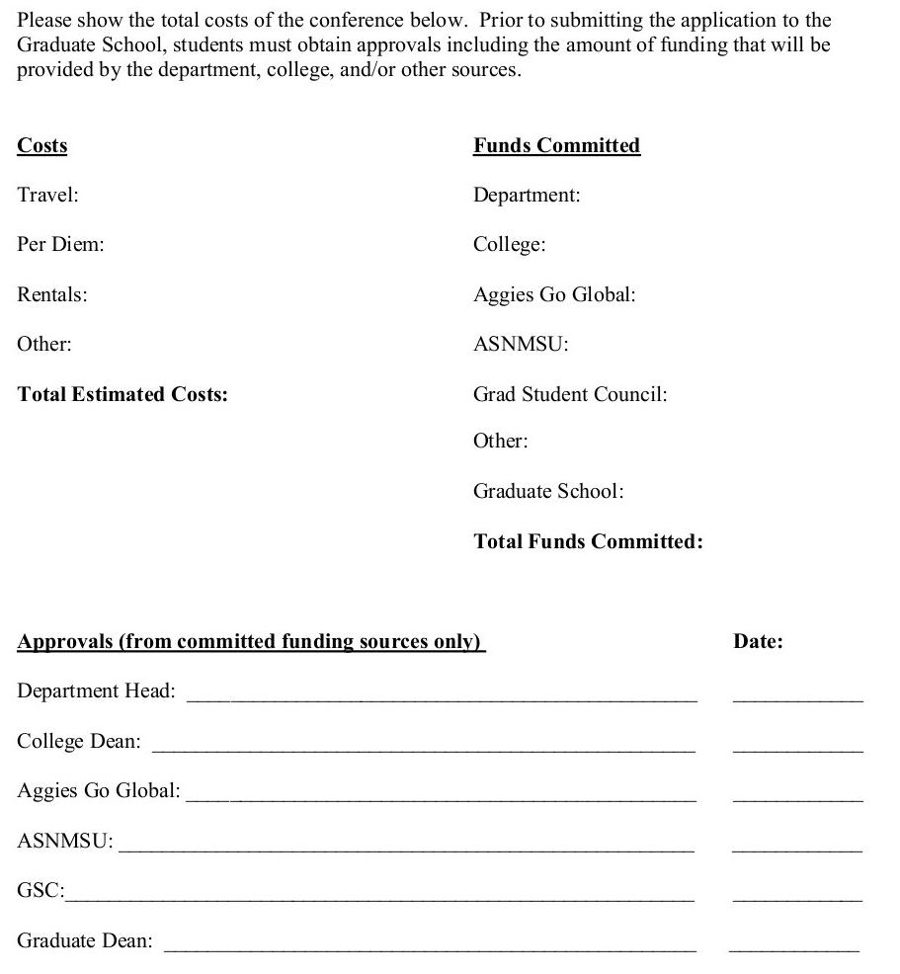
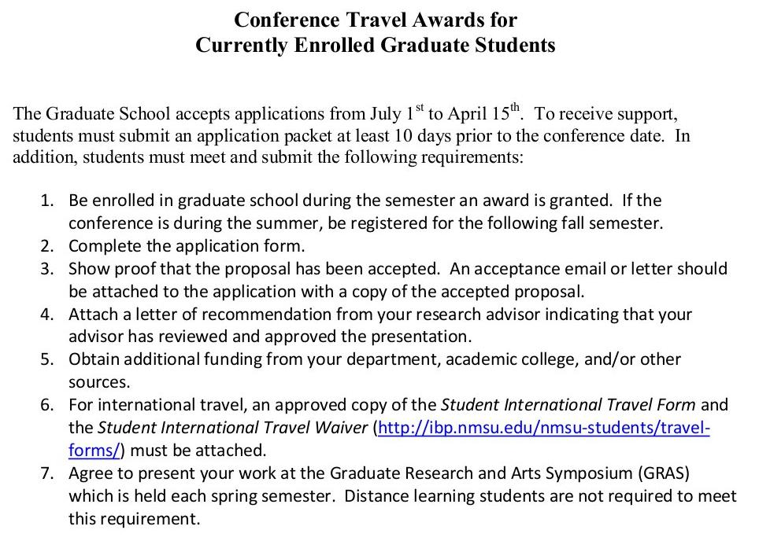
Graduate School

Slide 13
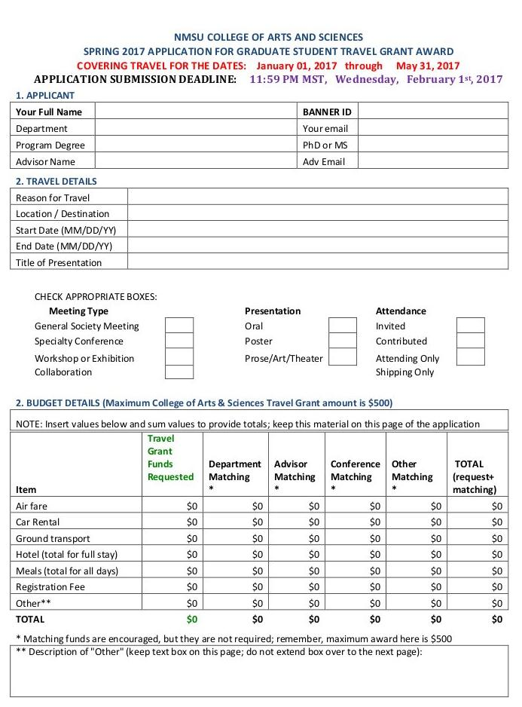
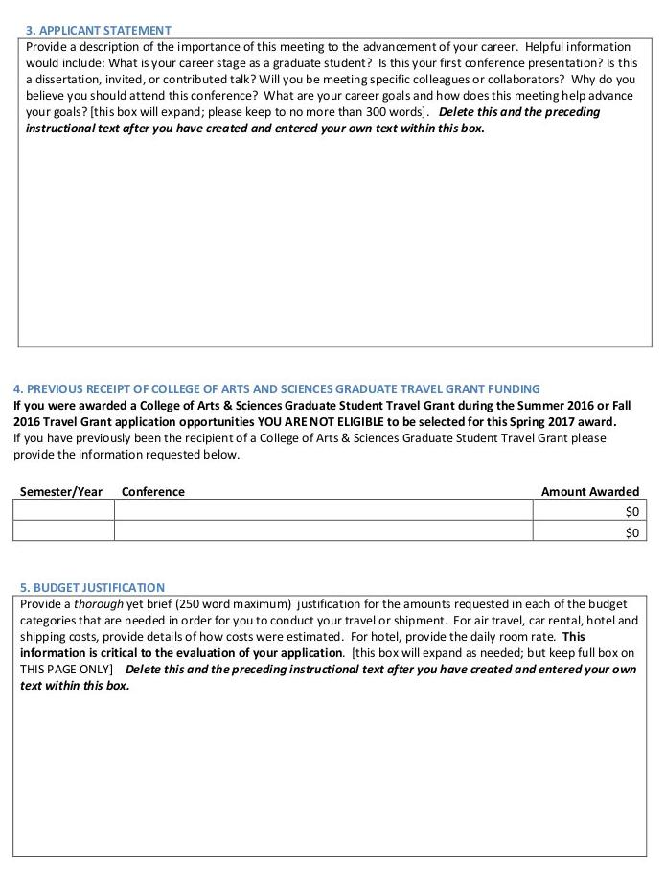
College of Arts and Sciences

Slide 14
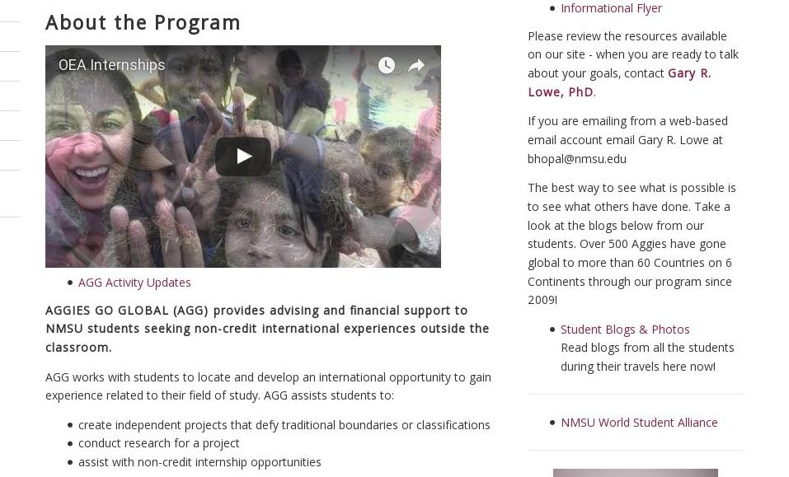
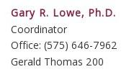
Aggies Go Global

Slide 15
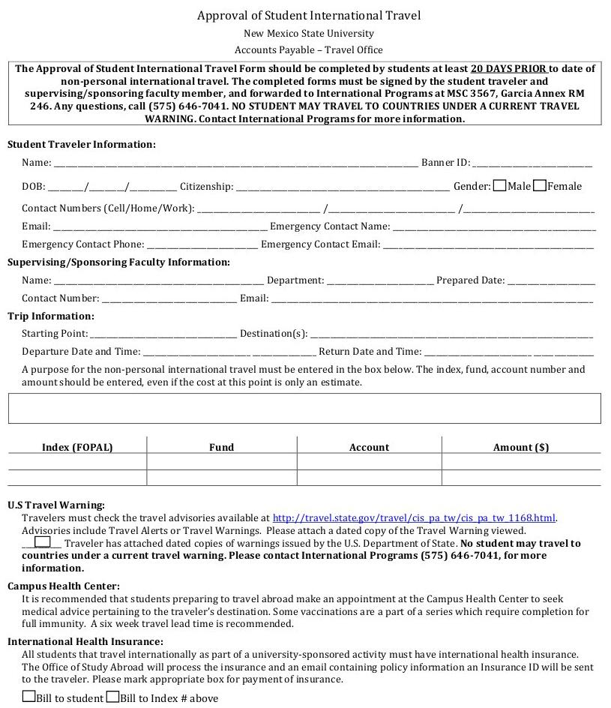
Travel form if going abroad

Slide 16
Getting reimbursed
All receipts must be in YOUR name (if advisor pays or department card is used, cannot get reimbursed)
Submit all receipts after conference in meetings with each group that funded you
They usually need original receipts - Don’t leave original receipts with anyone! Bring them to the meeting, let them make a copy for themselves, and then take those original receipts with you to the next meeting
Need proof of payment on receipt or bank statements

