Slide 1
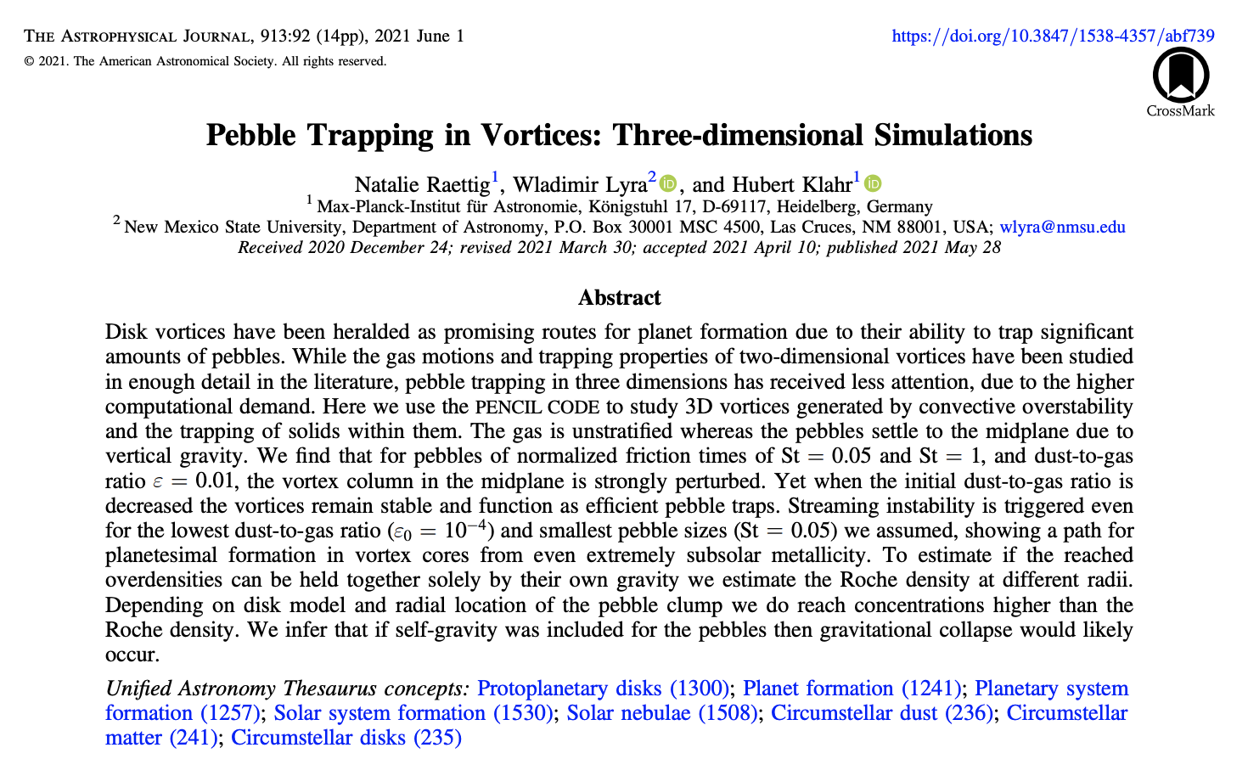
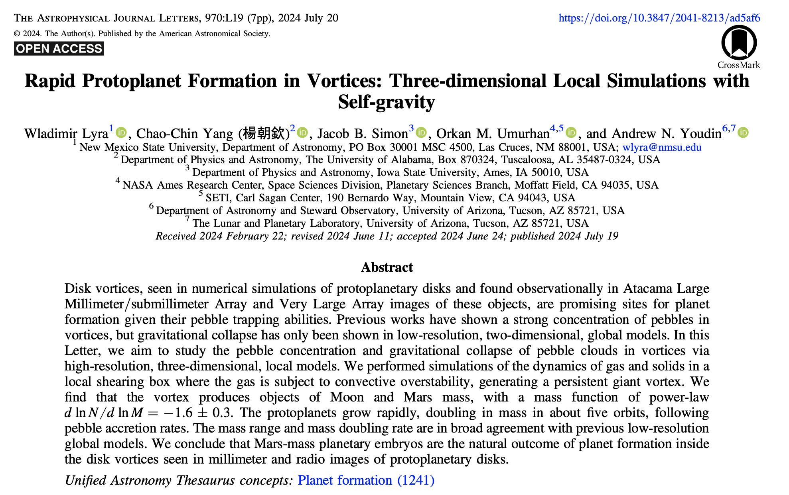
Vortex Trapping: a pathway to planet formation in low metallicities?
Pizza Lunch 09/30/24

Slide 2
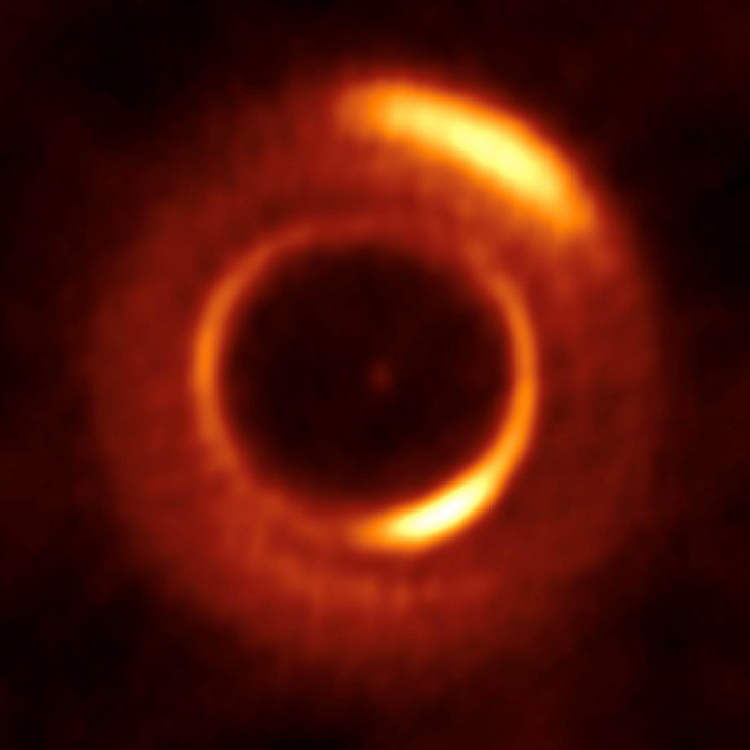
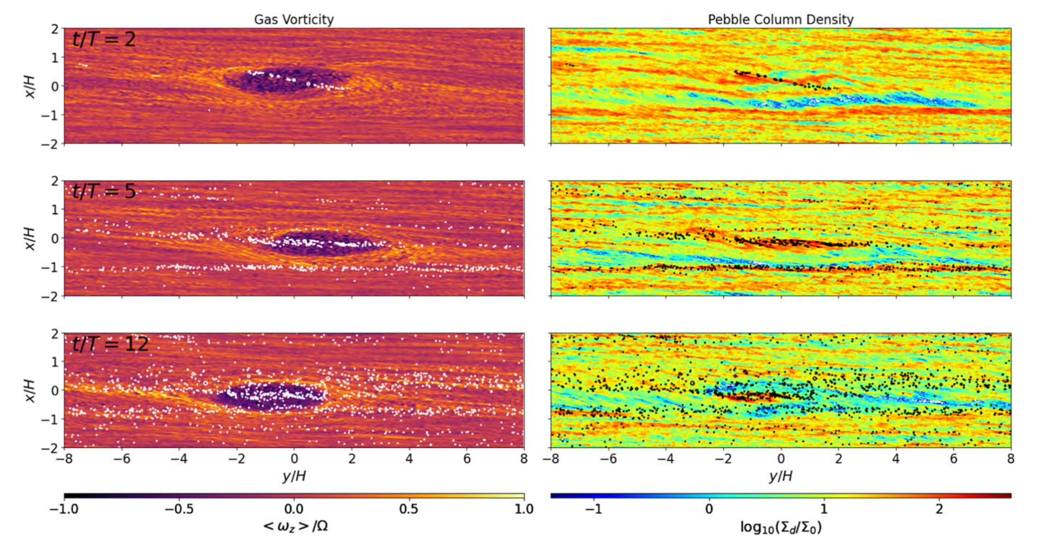
Vortex Trapping: a pathway to planet formation in low metallicities?
Pizza Lunch 09/30/24

Slide 3
Headwind and Dust Drift
Low pressure
Dust
High pressure
The gas has some pressure support (sub-Keplerian).
The dust does not feel gas pressure (Keplerian).
Gas
Star

Slide 4
Streaming Instability
The dust drift is hydrodynamically unstable
Youdin & Goodman ‘05, Johansen & Youdin ‘07, Youdin & Johansen+ ‘07, Kowalik+ ’13, Lyra & Kuchner ‘13,
Schreiber+ ‘18, Klahr & Schreiber ’20, Simon+ ‘16, ‘17, Carrera+ ‘15, ‘17, ‘20, Gole+ ’20, Li+ ‘18, ‘19, Abod+ ’19, Nesvorny+ ’19

Slide 5
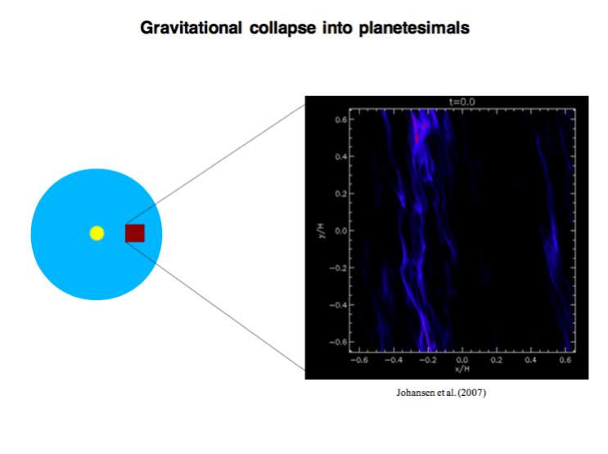

Slide 6
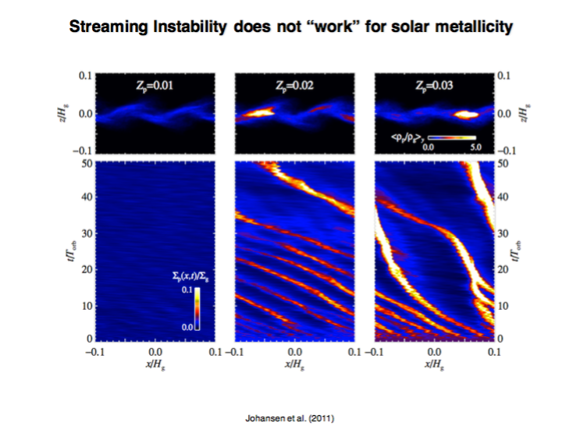
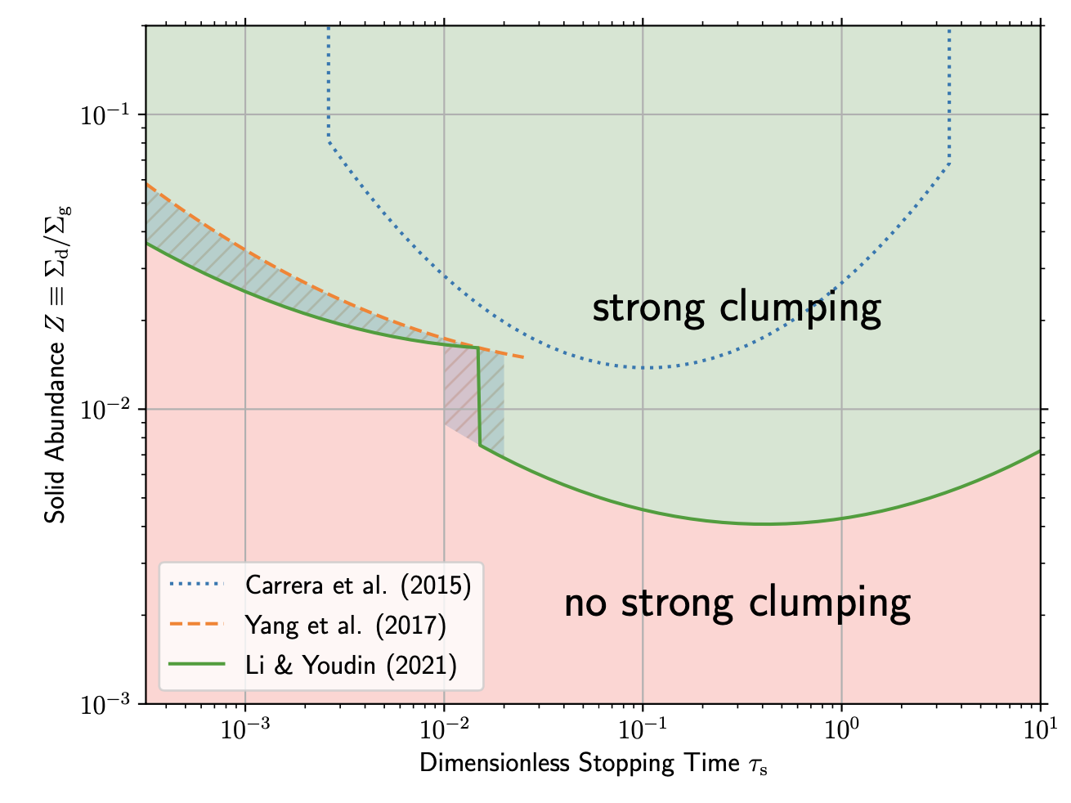
Metallicity threshold?
Metallicity
Lesur et al. 2023
Carrera et al. (2015)

Slide 7
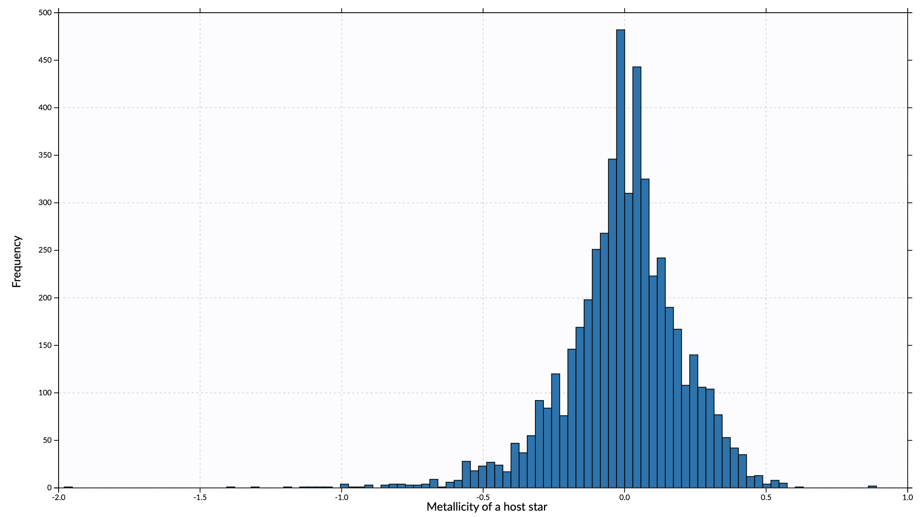
Metallicity threshold?
Z = Z☉ 10^{[Fe/H]}
Planets
No planets
[Fe/H]
Notes:
Z = Z☉ 10^{[Fe/H]}

Slide 8
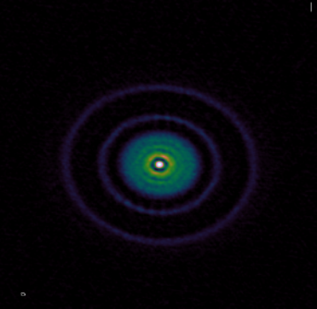
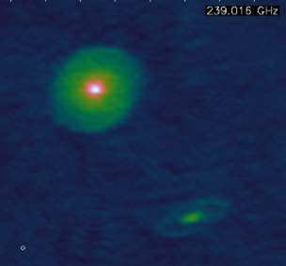
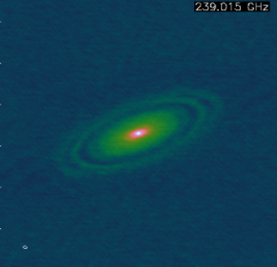
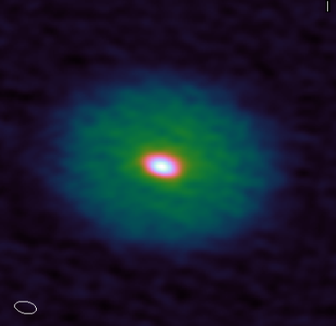
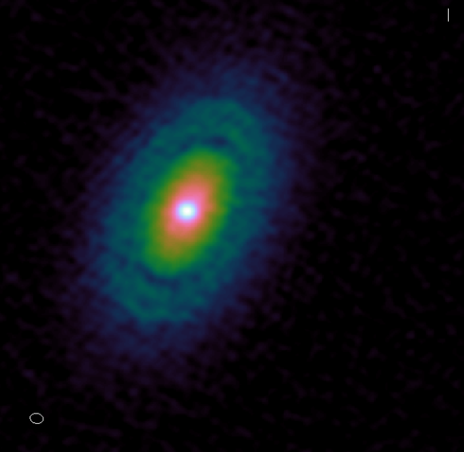
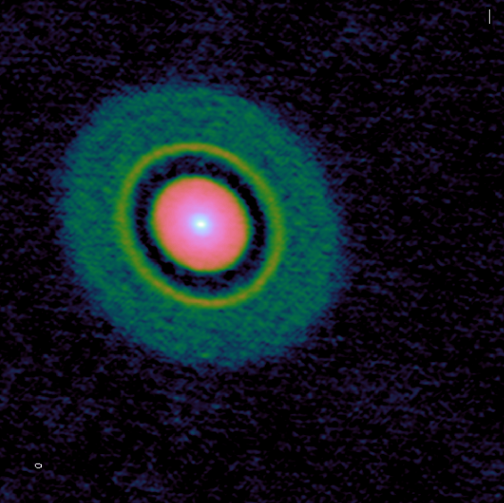
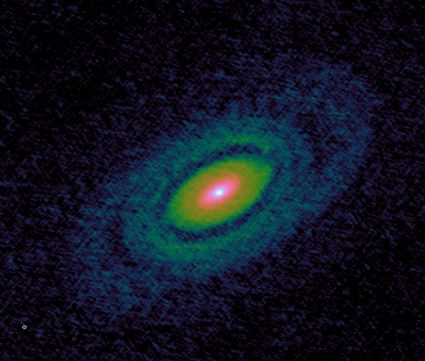
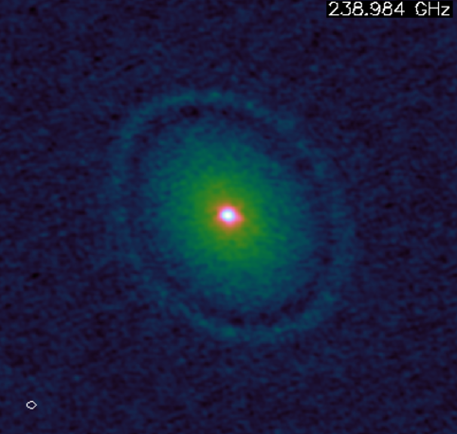
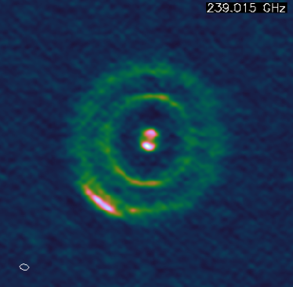
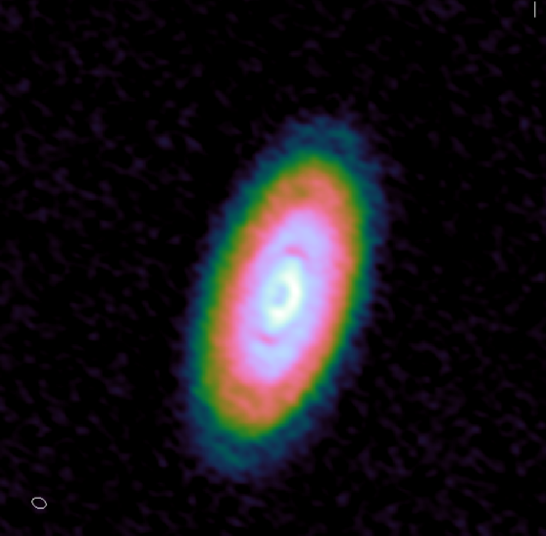
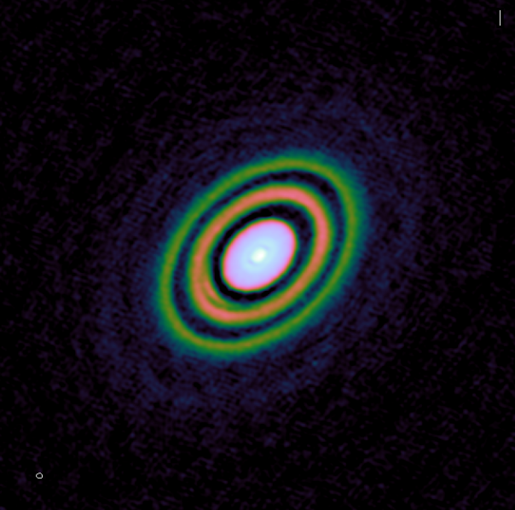
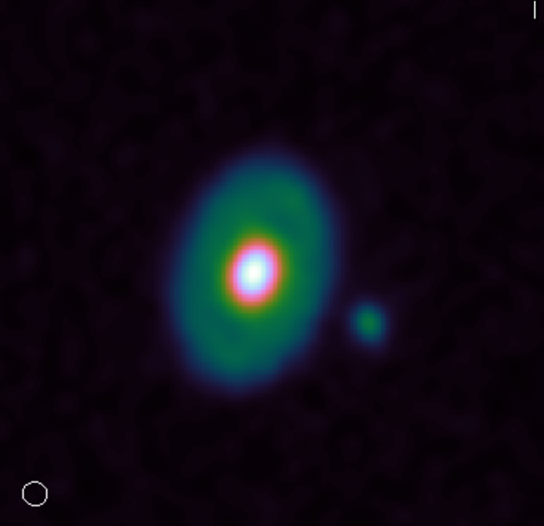
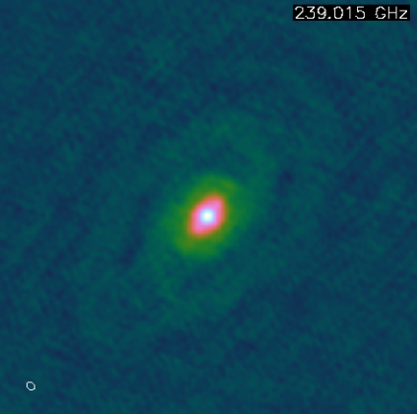
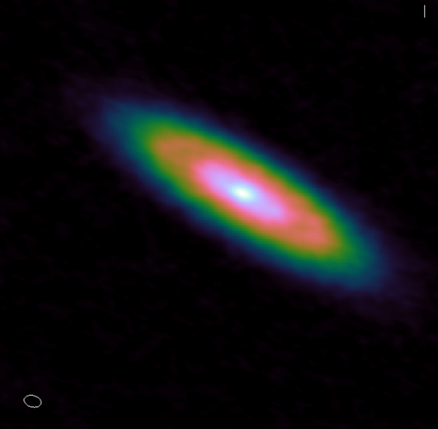
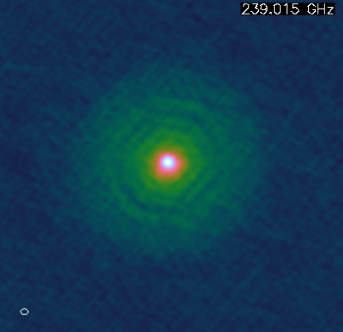
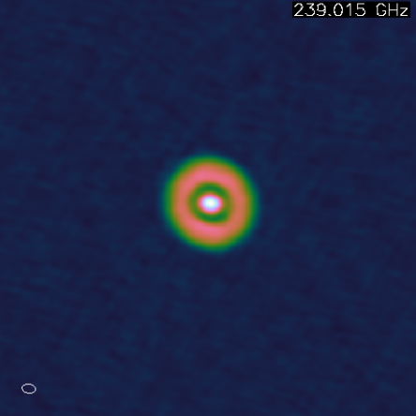
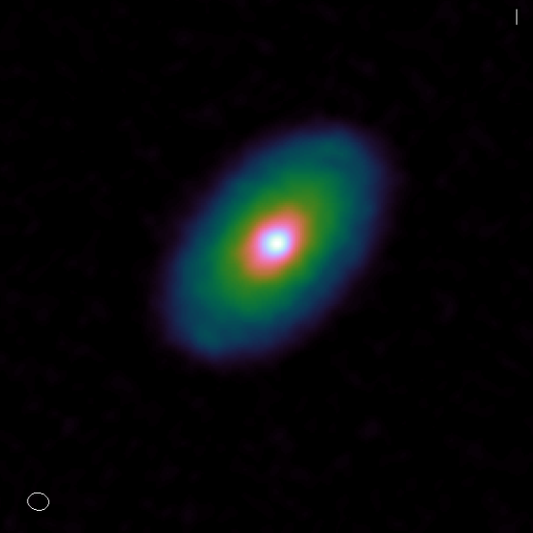
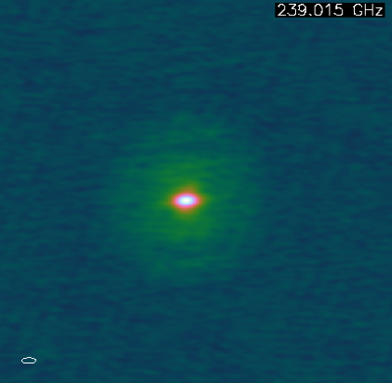
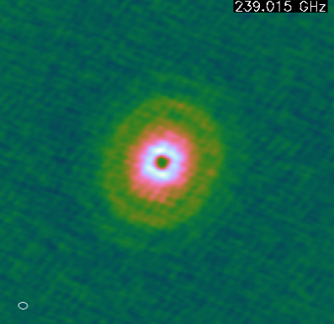
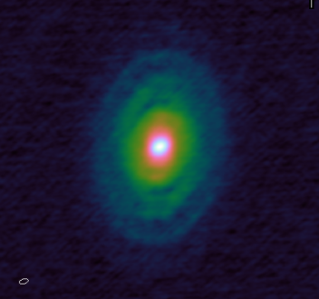
Notes:
~100-1000 Earth masses of pebbles. They (not planetesimals) dominated the mass budget. So pebbles are the primary building blocks.

Slide 9
MWC 758

Slide 10
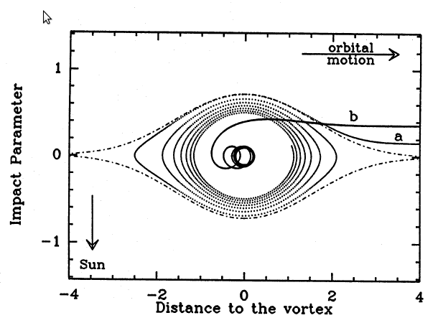
Vortex Trapping
Geostrophic balance:
Coriolis
force
Pressure
force
Vortex
streamline
Barge & Sommeria (1995)
Grains do not feel the pressure gradient.
They sink towards the center, where they accumulate.
Aid to planet formation
(Barge & Sommeria 1995, Tanga et al. 1996, Barranco & Marcus 2005)
Speeds up planet formation enormously
(Lyra et al. 2008b, 2009ab, Raettig et al. 2012)

Slide 11
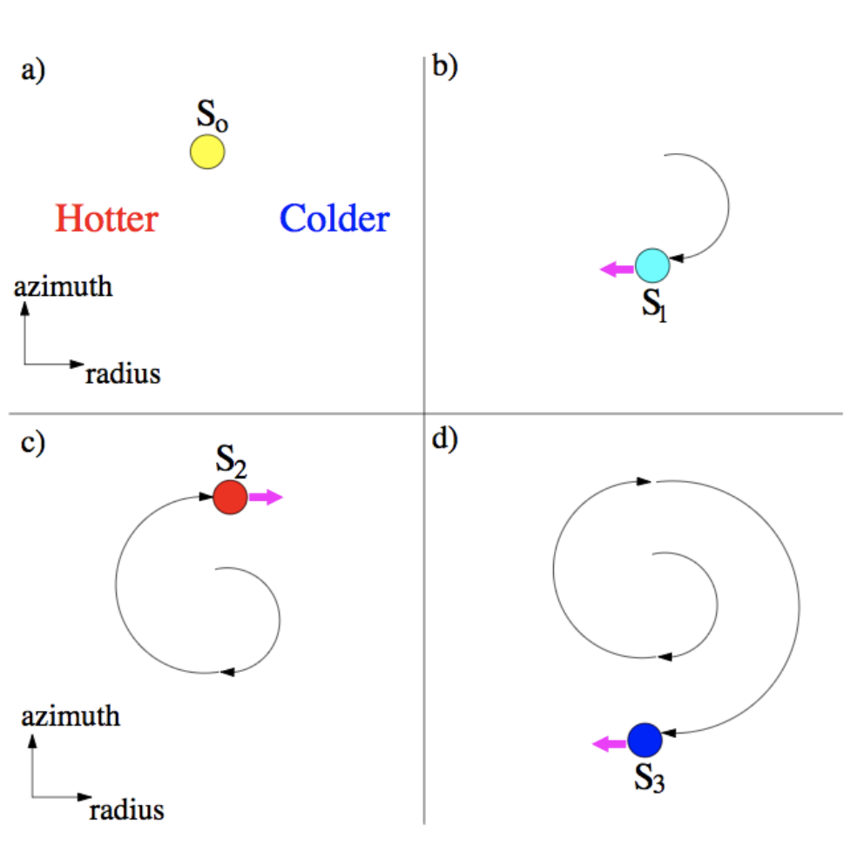
$∇$S
Vortex Formation: Convective Overstability
Sketch of the
Convective Overstability
Lesur & Papaloizou (2010), Lyra & Klahr (2011), Klahr & Hubbard (2014), Lyra (2014), Latter (2016), Volponi (2016), Lyra et al. (2018), Reed & Latter (2021), Raettig et al. (2021)
Lyra et al. (2024)
Latter (2016)
x/H

Slide 12
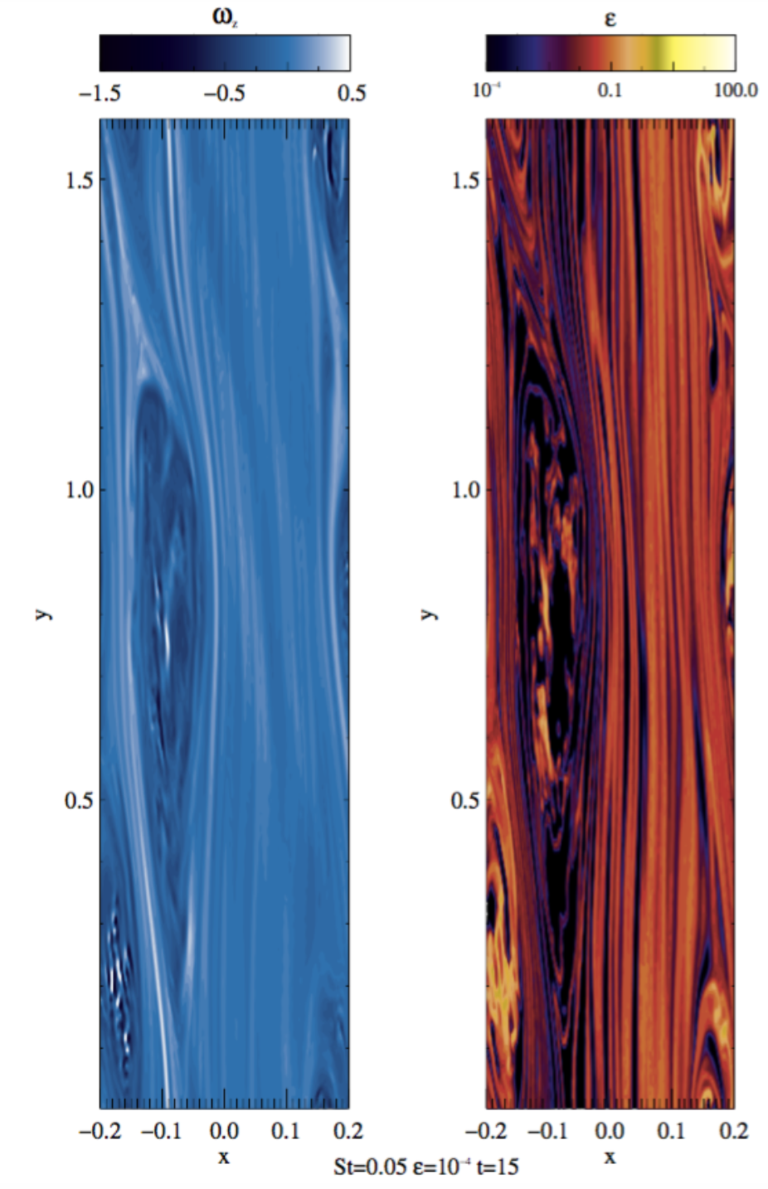
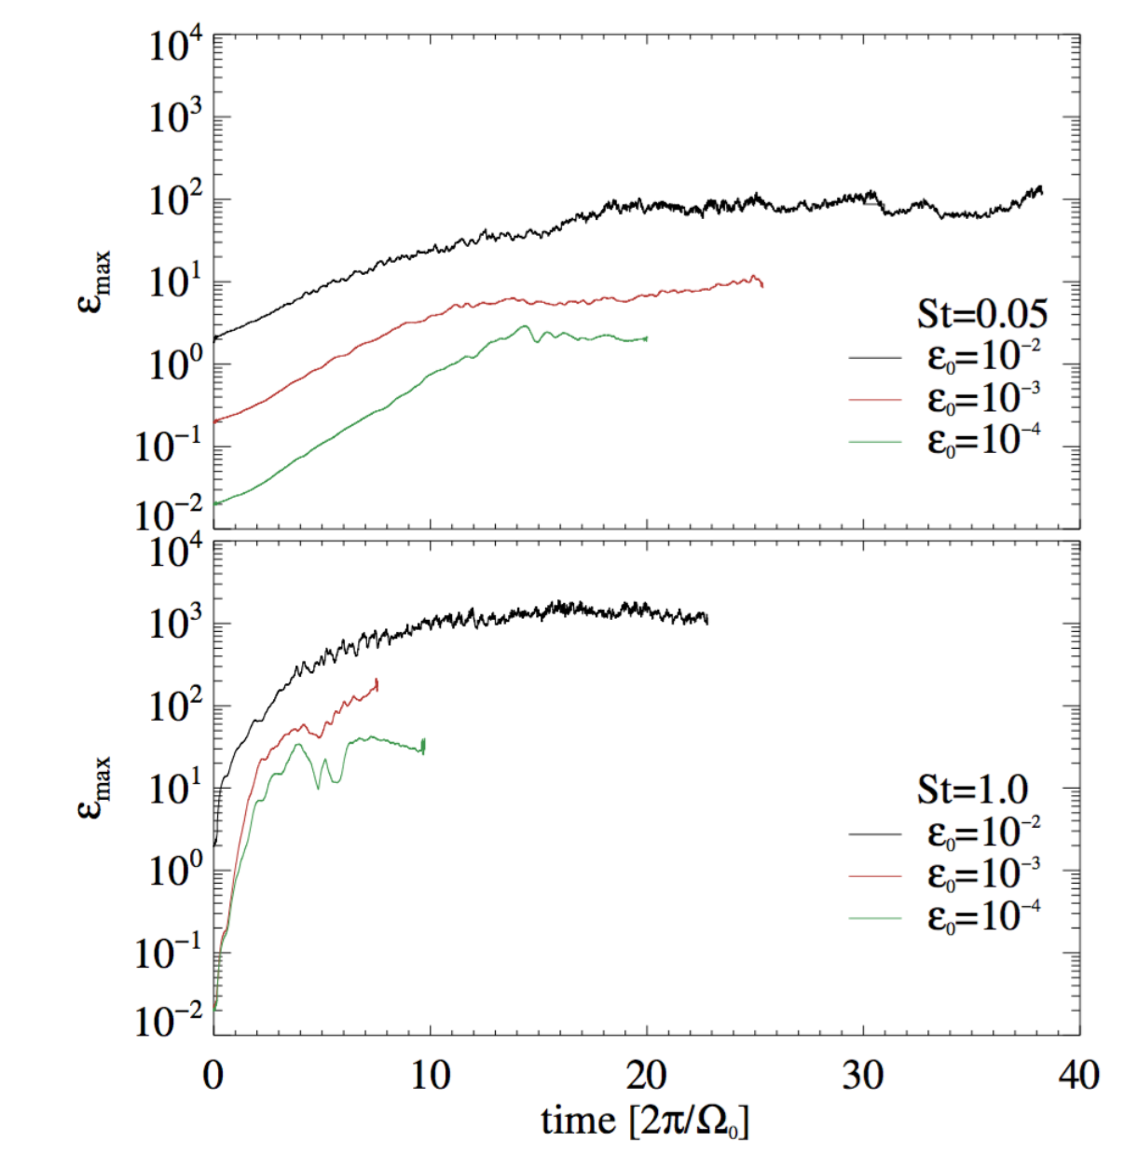
Pebble trapping in 3D vortices
Small grains
(”pebbles”)
Metallicity
Large grains
(”boulders”)
Raettig et al. (2021)

Slide 13
Gravitational Collapse
Lyra et al. (2024)

Slide 15
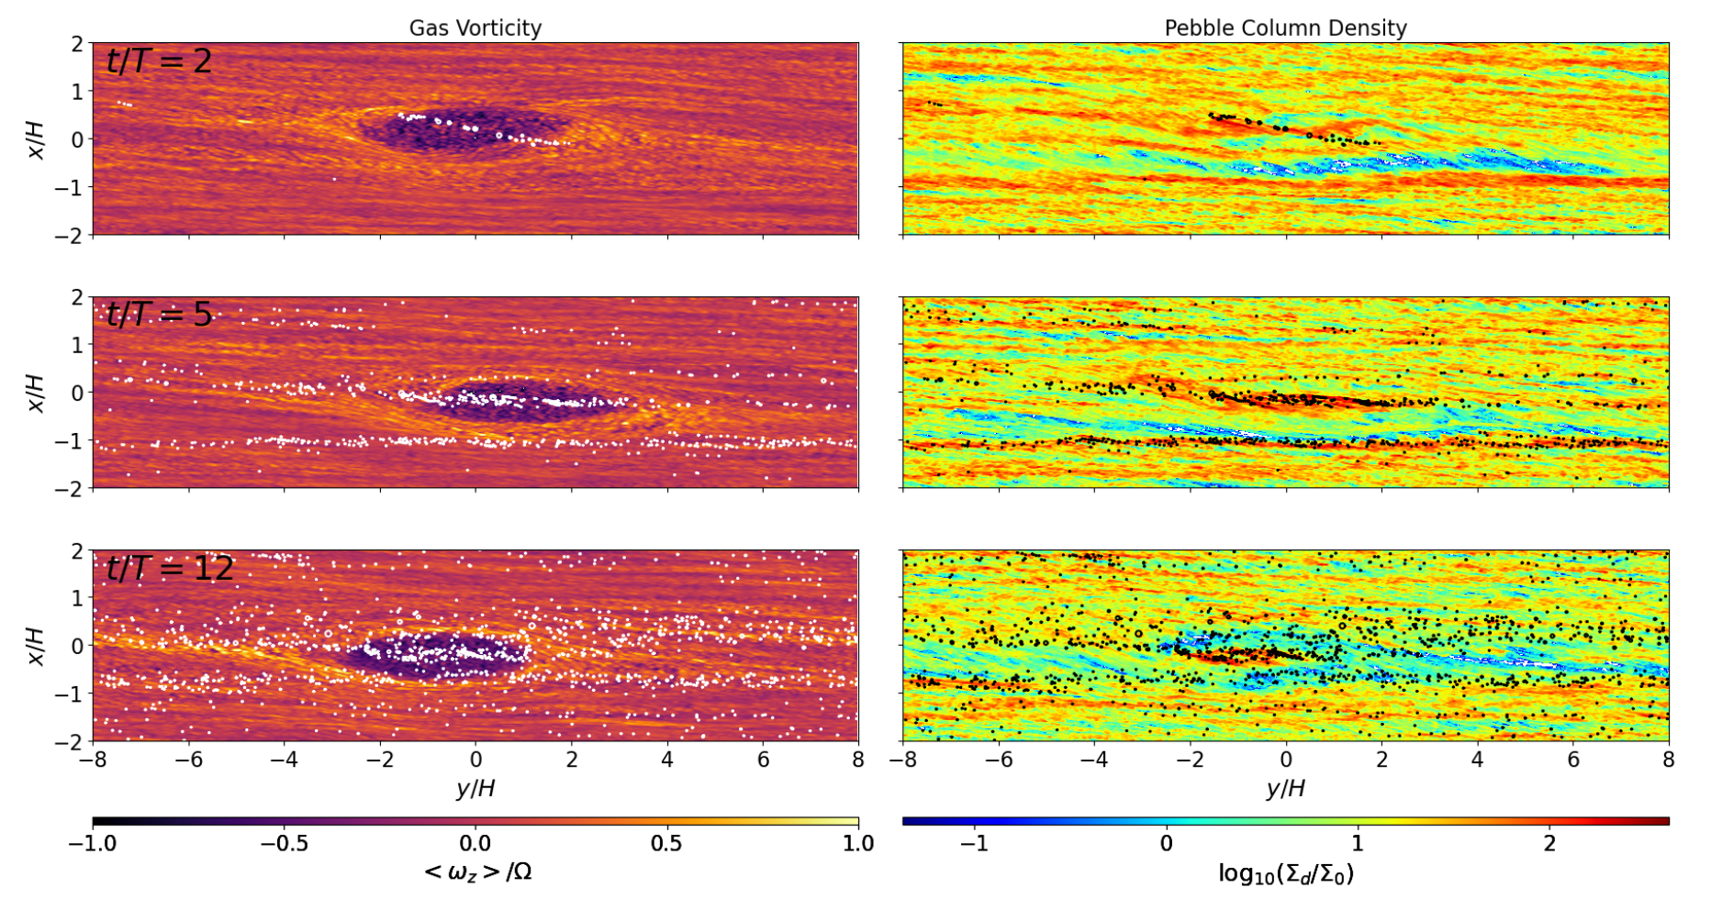
Gravitational Collapse - 512³
Time
Lyra et al. (2024)

Slide 16
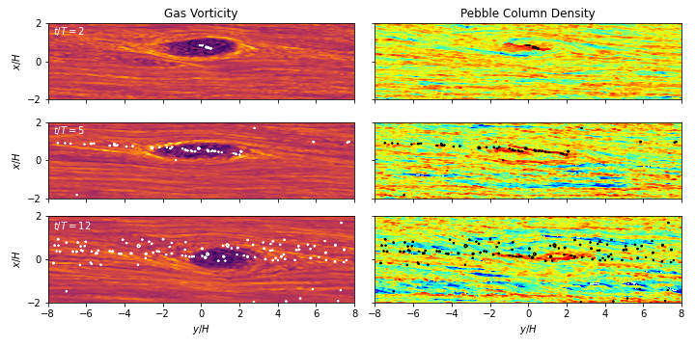
Gravitational Collapse – 256³
Time
Lyra et al. (2024)

Slide 17
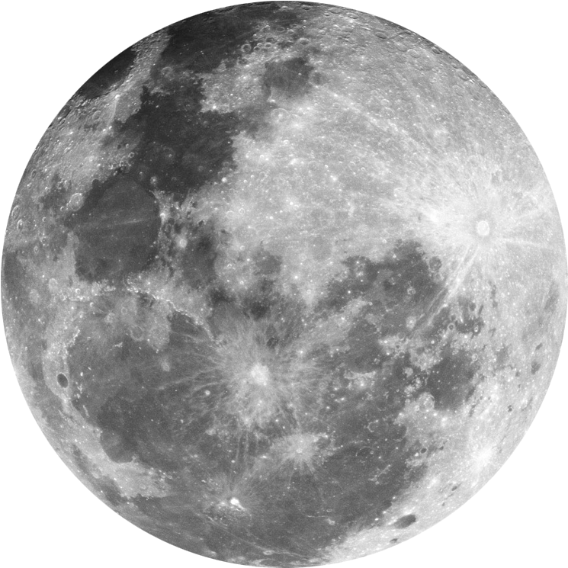
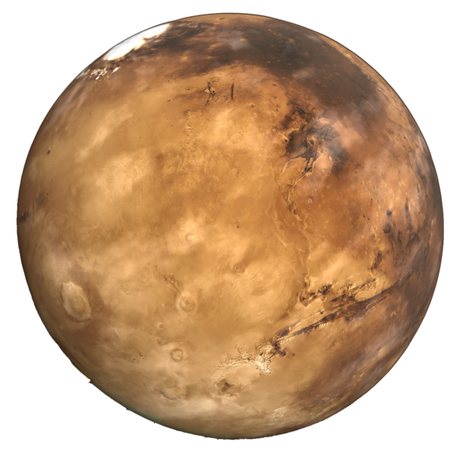
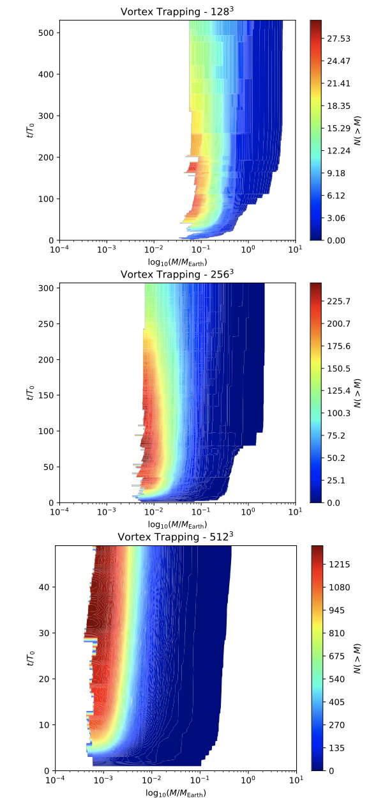
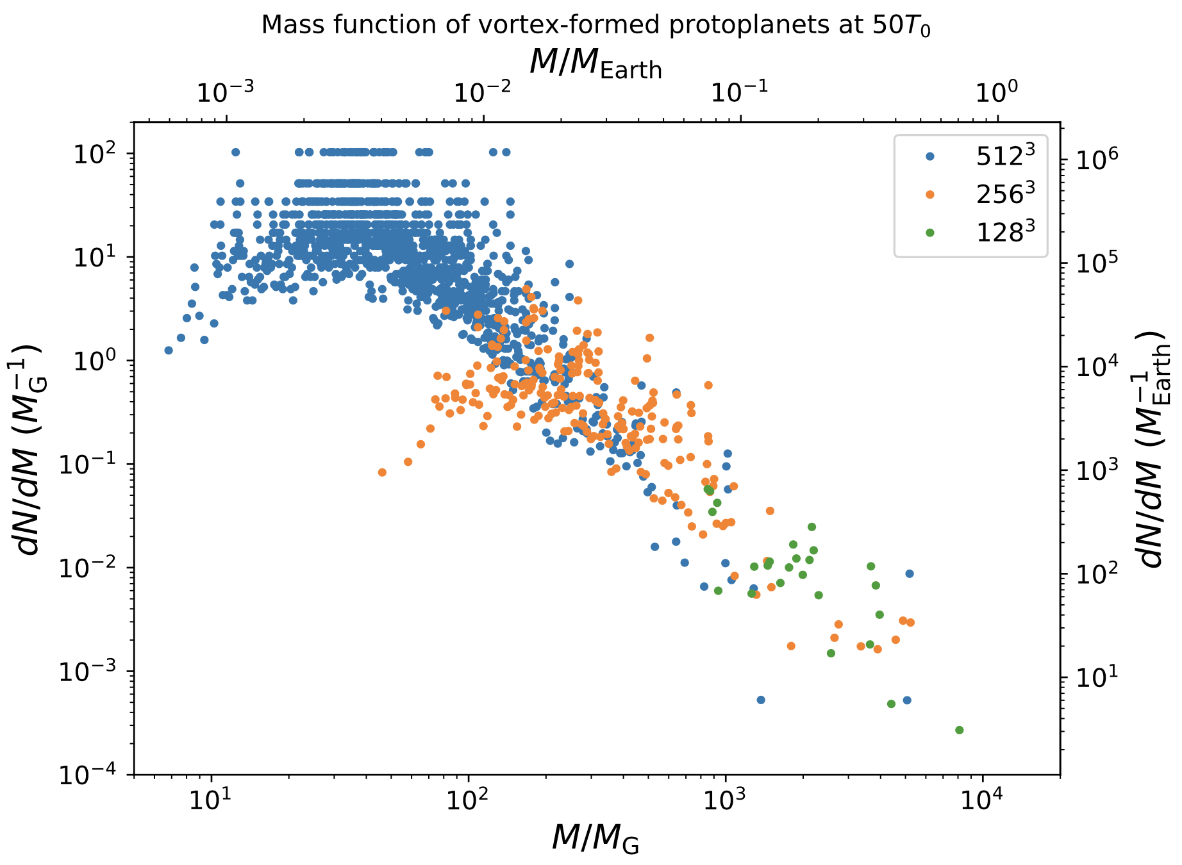
Convergence (or lack thereof)
Lyra et al. (2024)

Slide 18
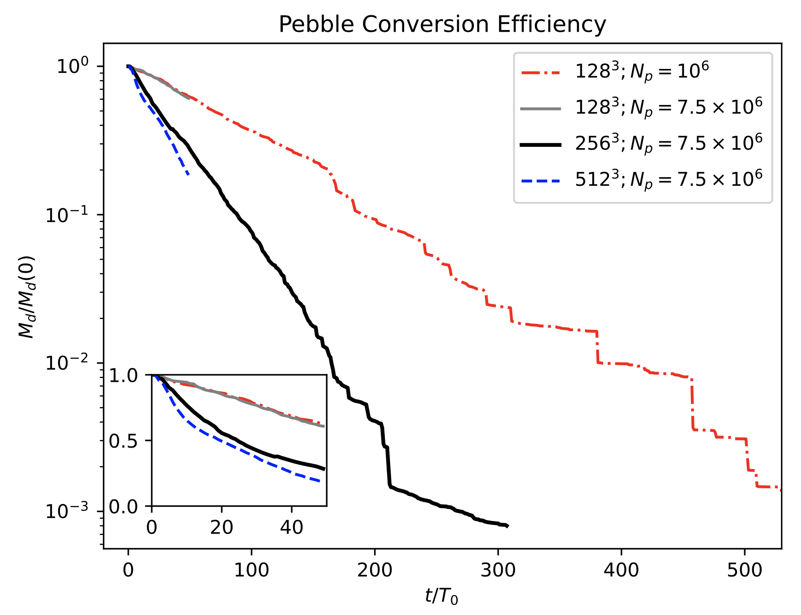
Convergence
Lyra et al. (2024)

Slide 19
Limit to dust loading
Lyra et al. (2024)

Slide 20
Drag-Diffusion Equilibrium
Dust continuity equation
Drag force
Diffusion
compression
advection
diffusion
Trapped pebble
Lyra & Lin (2013)

Slide 21
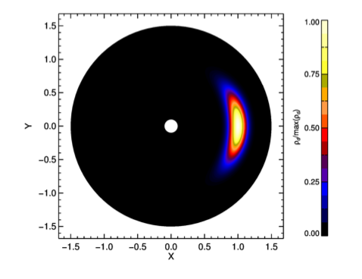
Analytical Solution for dust in Drag-Diffusion Equilibrium
Steady-state solution
Lyra & Lin (2013)
a = vortex semi-minor axis
H = disk scale height (temperature)
χ = vortex aspect ratio
δ = diffusion parameter
St = Stokes number (particle size)
f(χ) = model-dependent scale function
Solution for
H/r=0.1 χ=4 S=1
Lyra & Lin (2013)

Slide 22
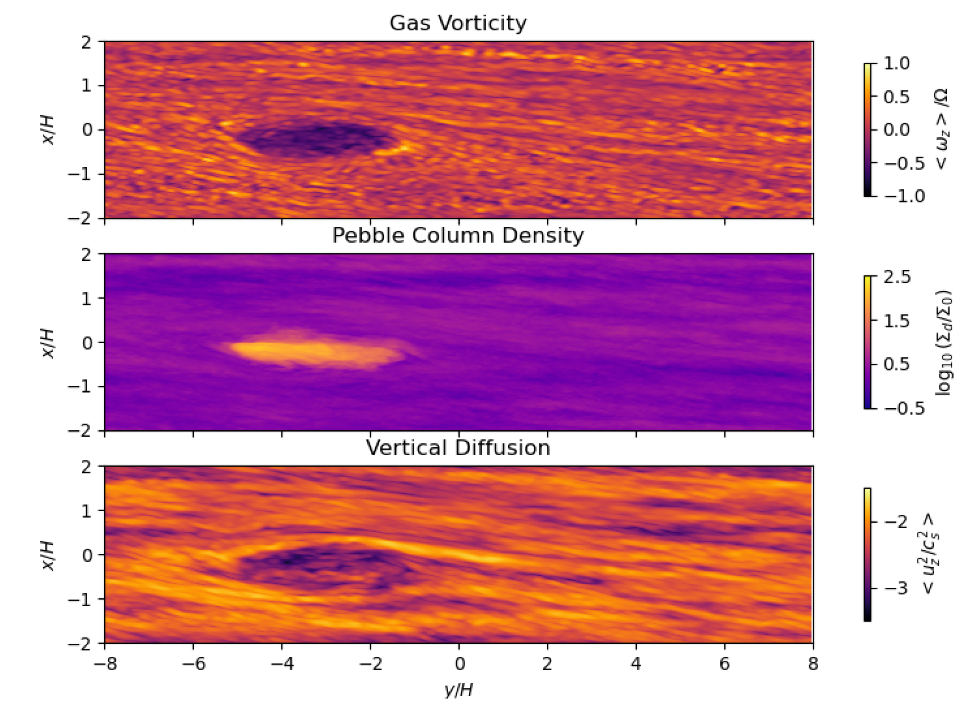
Vortices are quieter than the environment

Slide 23
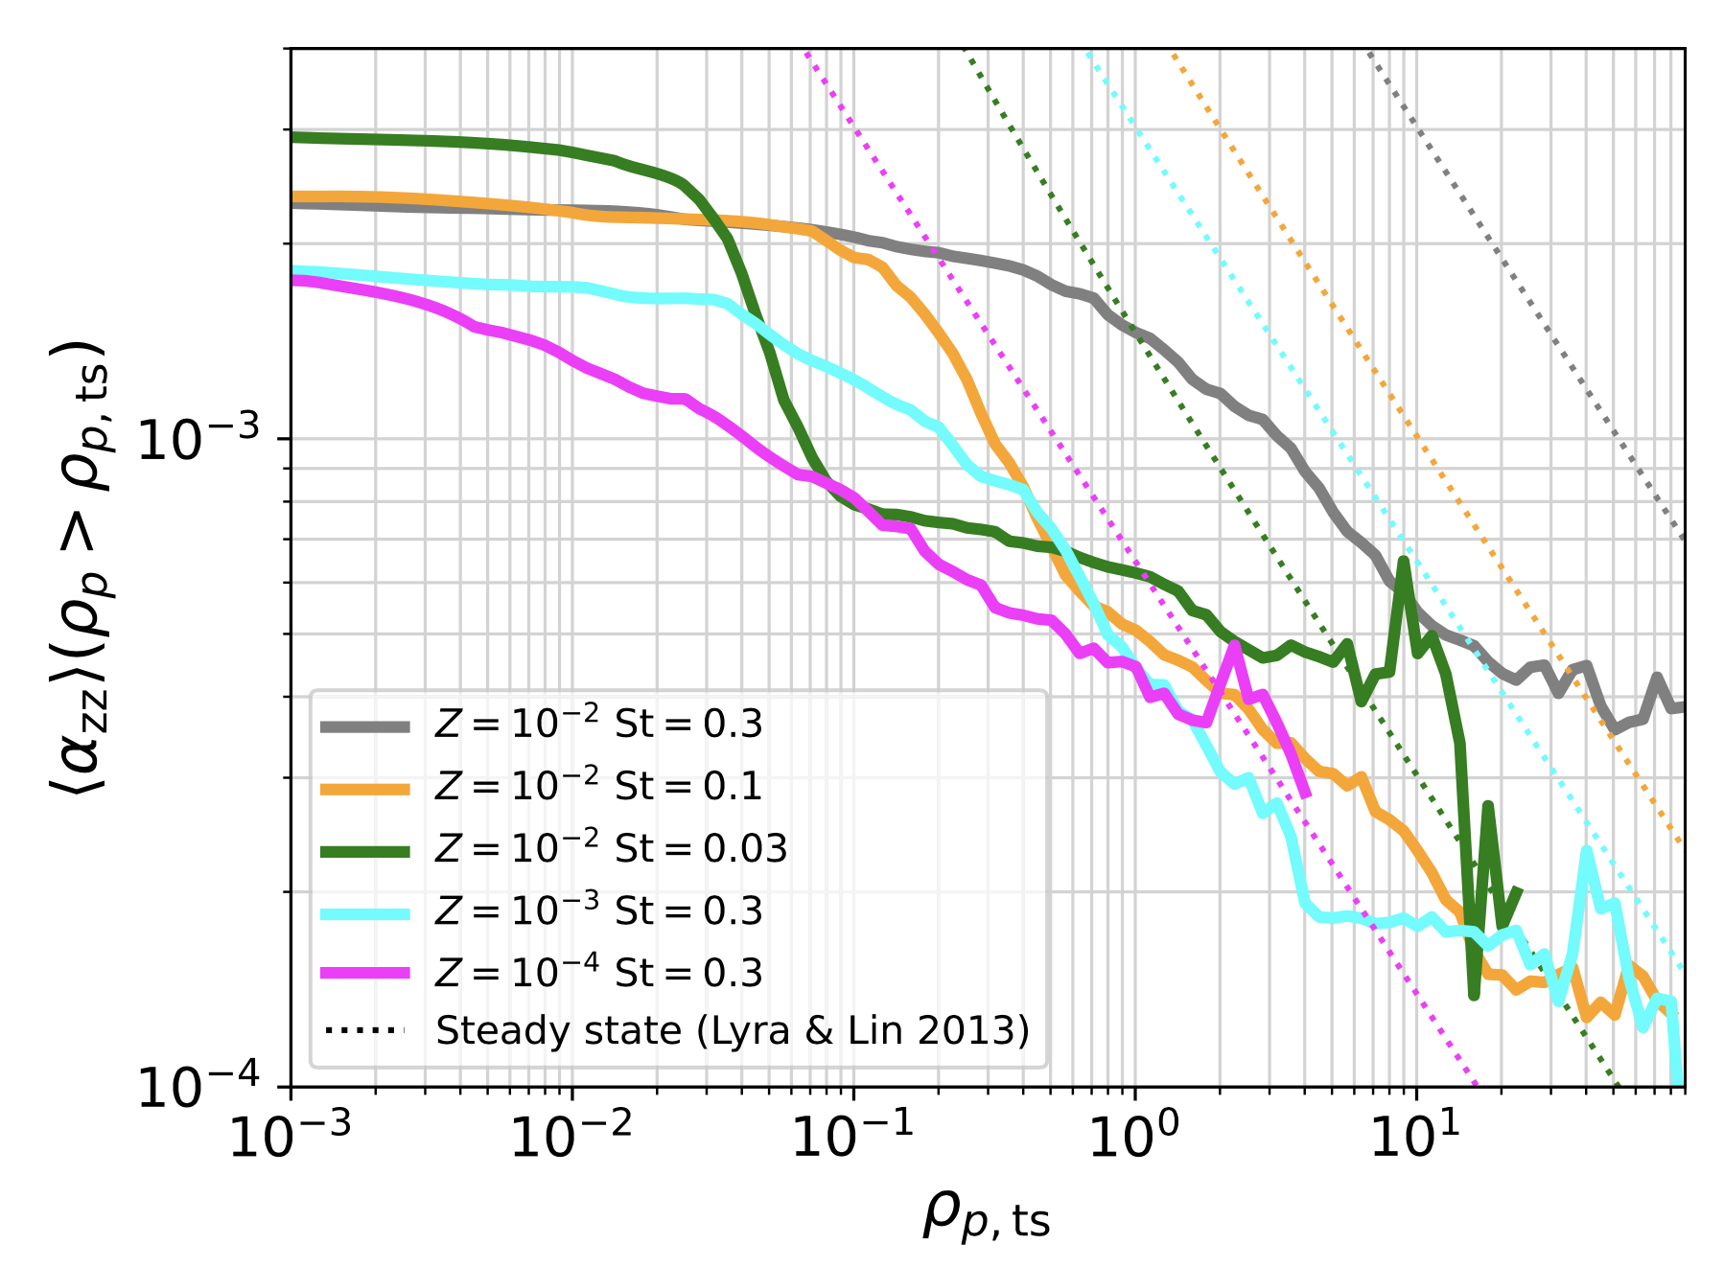
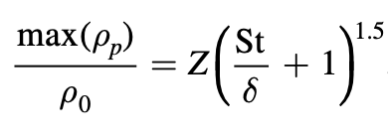
Dust loading dampens the turbulence
Roche Density
Lyra et al. (2024)

Slide 24
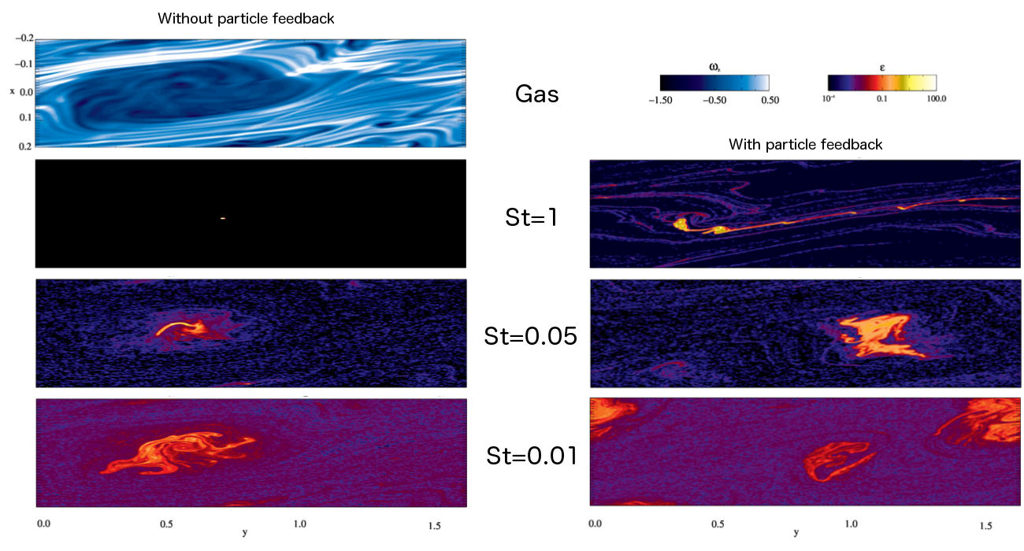
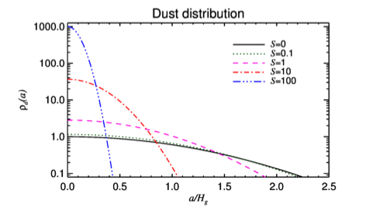
Vortex “Boost” – Z = Z₀ (^{St}/_{δ} + 1)
Easily reaches dust-to-gas ratio > 1
even for solar (and sub-solar) metallicities.
Dust-to-gas Ratio
Distance from vortex center
Lyra & Lin (2013)
Raettig et al (2015)

Slide 25
Population II and Population III stars
Z (pop II): 10 ⁻⁴ Z⊙ ≤ Z < 10 ⁻¹ Z⊙
Z (pop III) ≈< 10⁻⁴ Z⊙
New simulations form solar-mass stars at zero metallicity
When did the first planet form?
When did the Universe start getting populated with planets?
Z = Z☉ 10^{[Fe/H]}
[Fe/H]

Slide 26
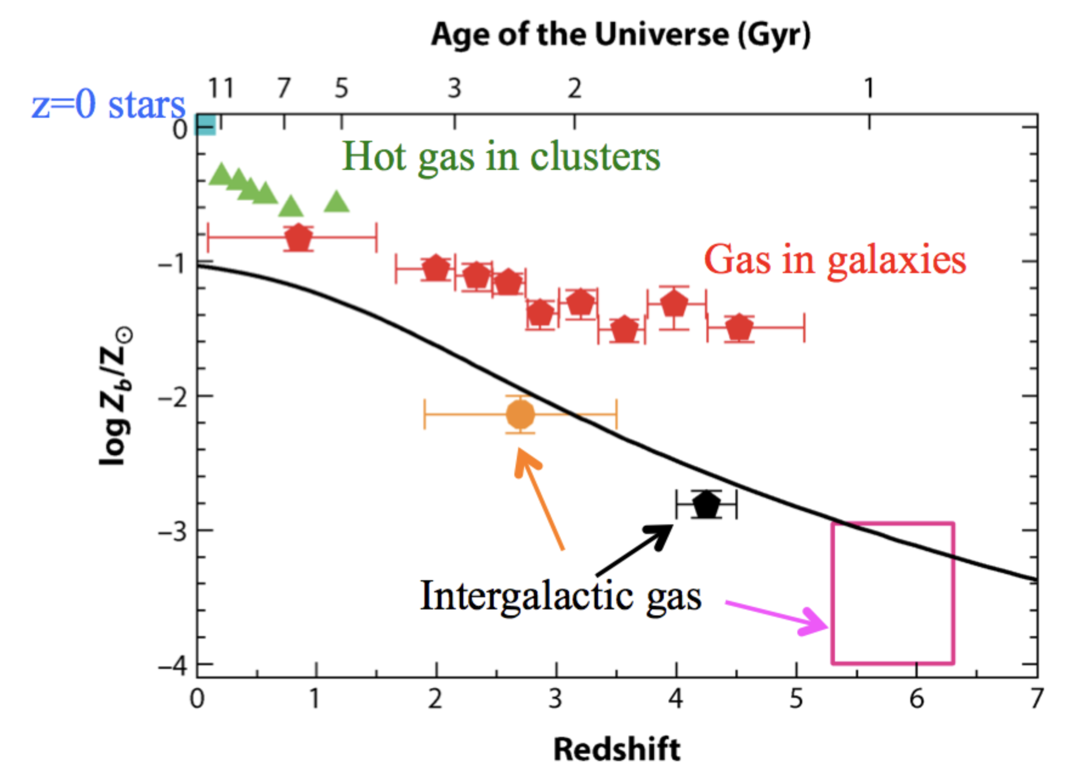
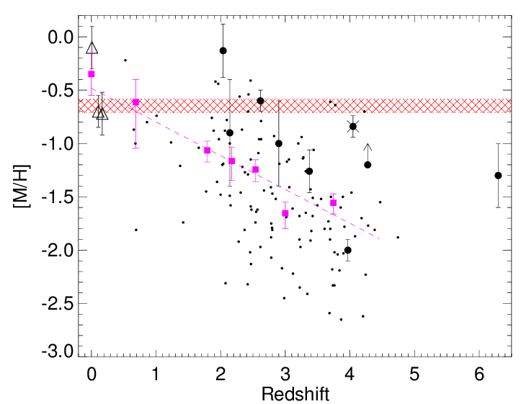
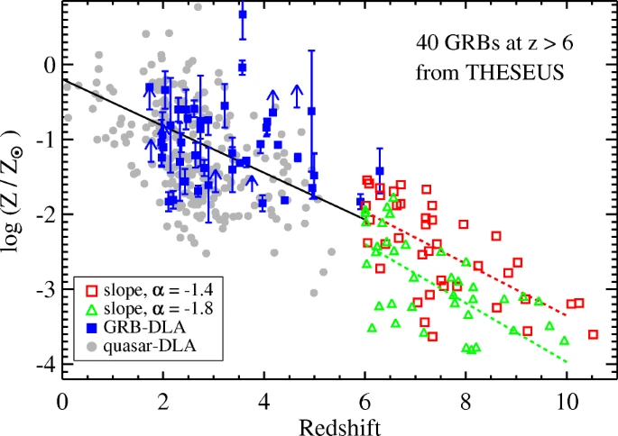
Metallicity – Redshift relationship
Madau & Dickinson (2014)
Tanvir et al. (2021)
Fynbo et al. (2006)

Slide 27
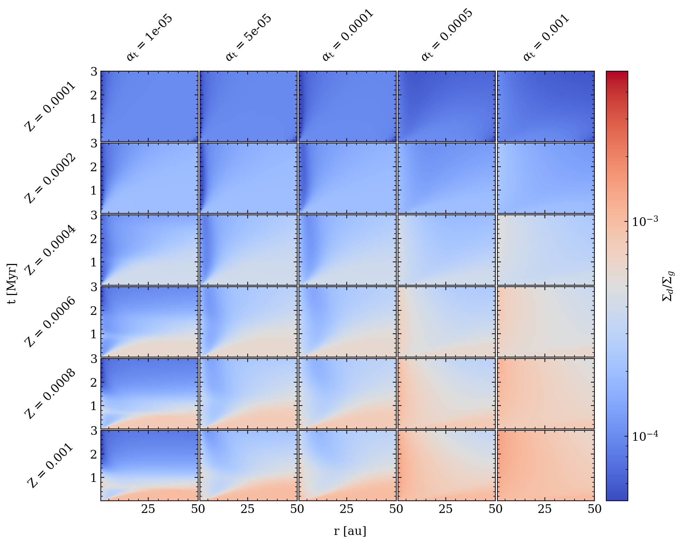
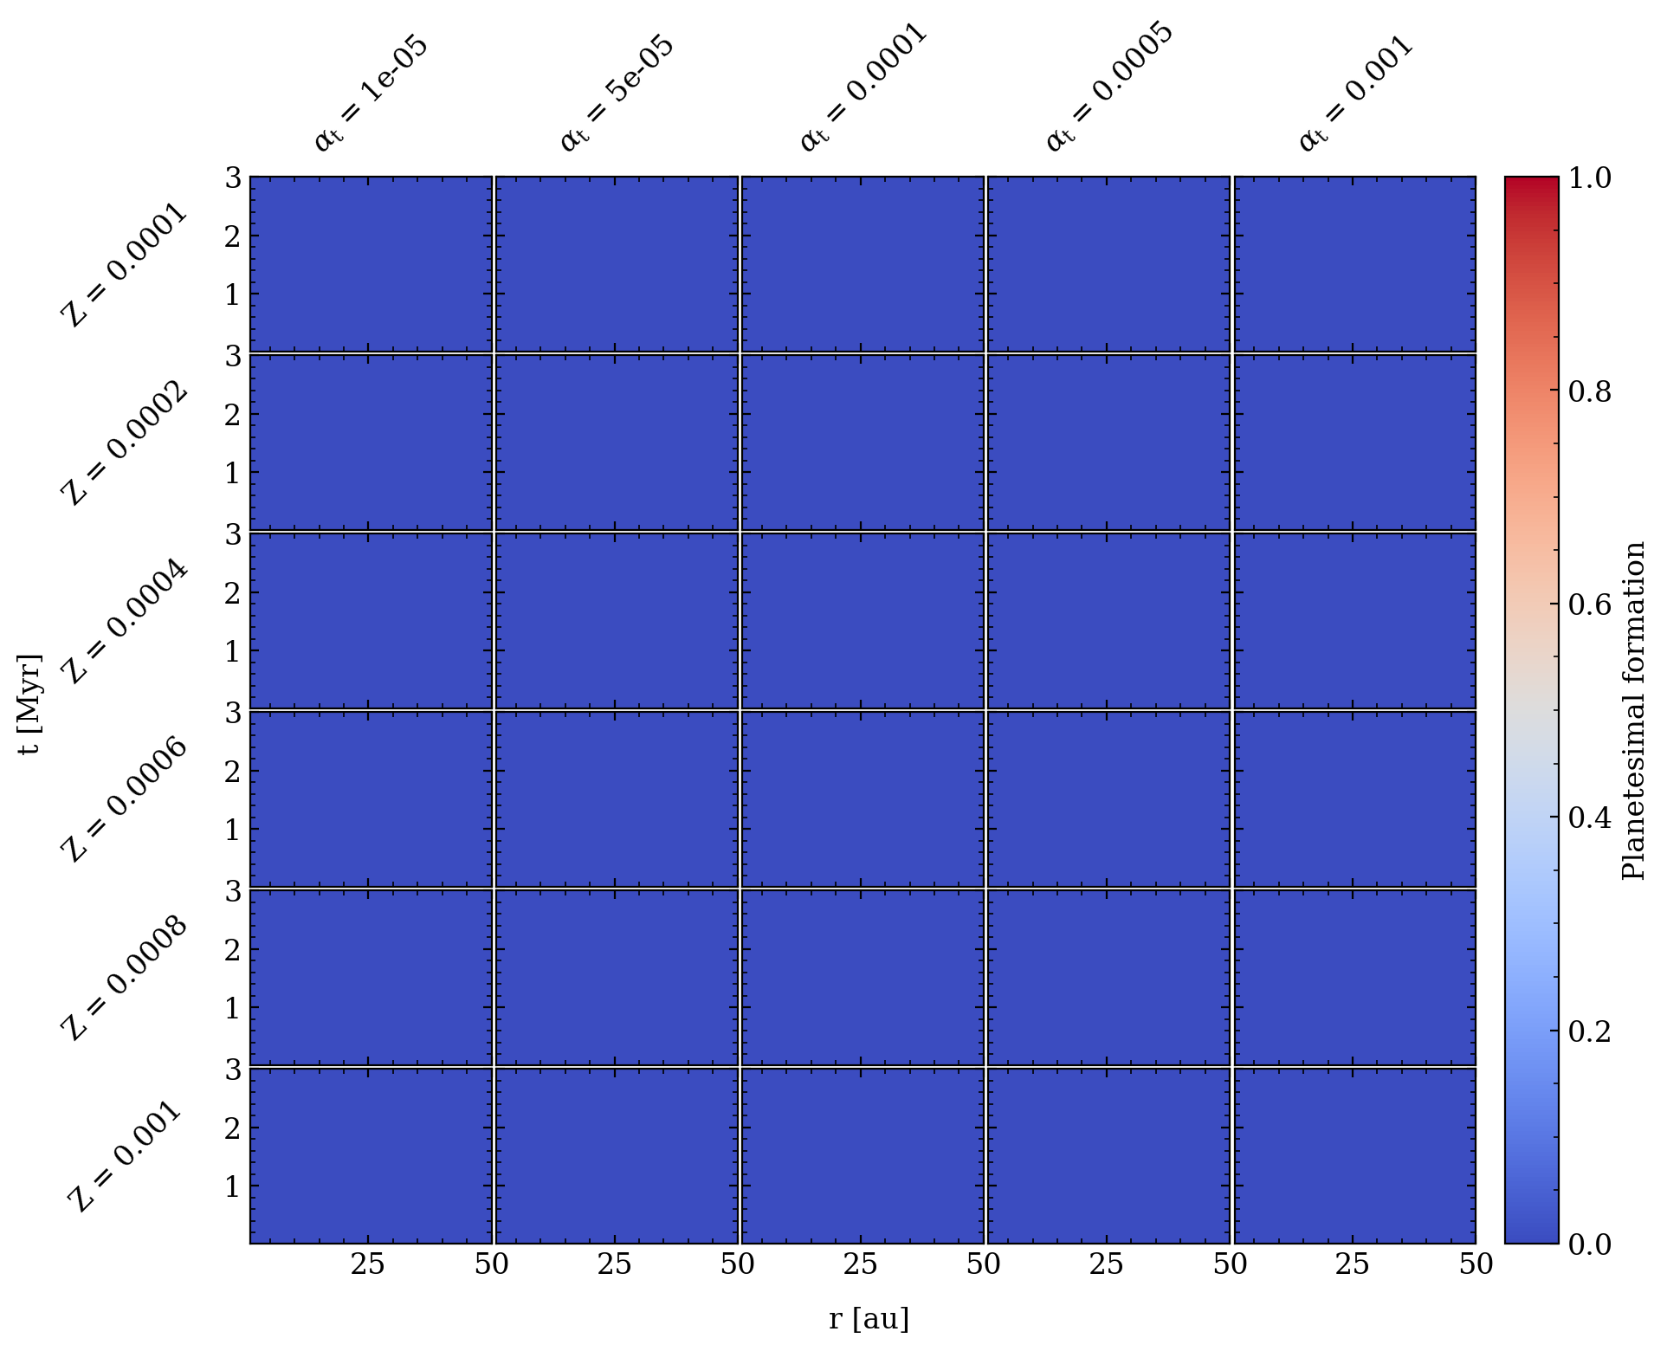
Low Metallicity

Slide 28
Vortex Boost
Z = Z₀ (^{St}/_{δ} + 1)

Slide 29
Low Metallicity + Vortex Boost

Slide 30
Vortex Boost – Effect on St and δ
Z = Z₀ (^{St}/_{δ} + 1)

Slide 31
Positive feedback loop
Vortex trapping increases pebble density
Pebbles dampen turbulence
Lower turbulence increases vortex trapping
Low turbulence decreases fragmentation
Less fragmentation increases pebble size (St)
Larger pebbles concentrate further
Carrera et al. (in prep)

Slide 32
When does the positive feedback loop stop?
Very large grains don’t get trapped
Raettig et al. (2015)
Notes:
The feedback has to stop somewhere, and that seems to be at the vicinity of St=1, due to the grain leaving the vortex / fragmenting.

Slide 33
When does the positive feedback loop stop?
Fragmentation at St ~ 1
Ormel & Cuzzi (2007)

Slide 34
Vortex Boost – Effect on St and δ
ρ_{d,crit}/ ρ_{g} = Z _{crit} (^{St}/_{δ} + 1)^{1.5}
Z _{crit} ~ 6 δ^{1.5}

Slide 35
Low Metallicity + Vortex Boost in Z and St

Slide 36
Z _{crit} ~ 6 δ^{1.5}

Slide 37
Conclusions
Vertical Shear Instability and Convective Overstability may be relevant for planet formation
Vertical Shear Instability: rapid cooling + radial temperature gradient
Convective Overstability finite cooling time + radial entropy gradient
Saturate into vortices
Vortices are very efficient pebble traps
High particle load disrupts vortical motion around midplane, but not the full column
Trapping properties are retained
The pebble load is high enough to lead to direct gravitational collapse
Planet population is of planetary embryo mass
Moon to Mars mass objects
Resolved simulation in both gas and pebbles
Limitations
Streaming Instability not resolved
Coagulation/Fragmentation not modeled

