Slide 1
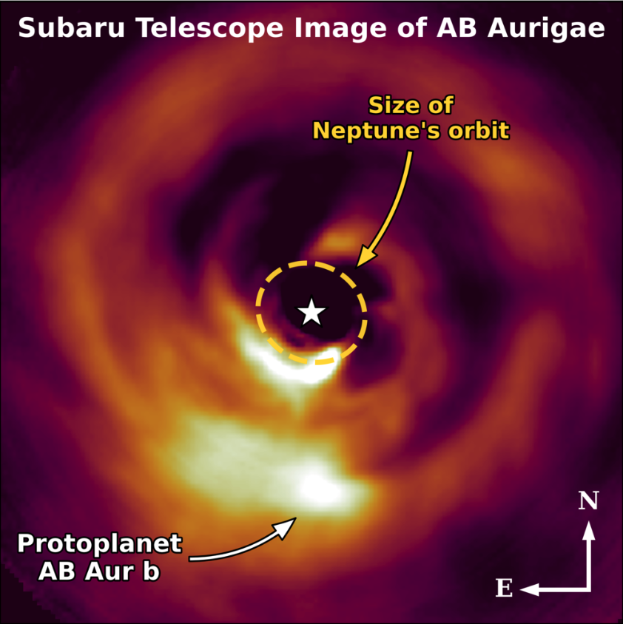
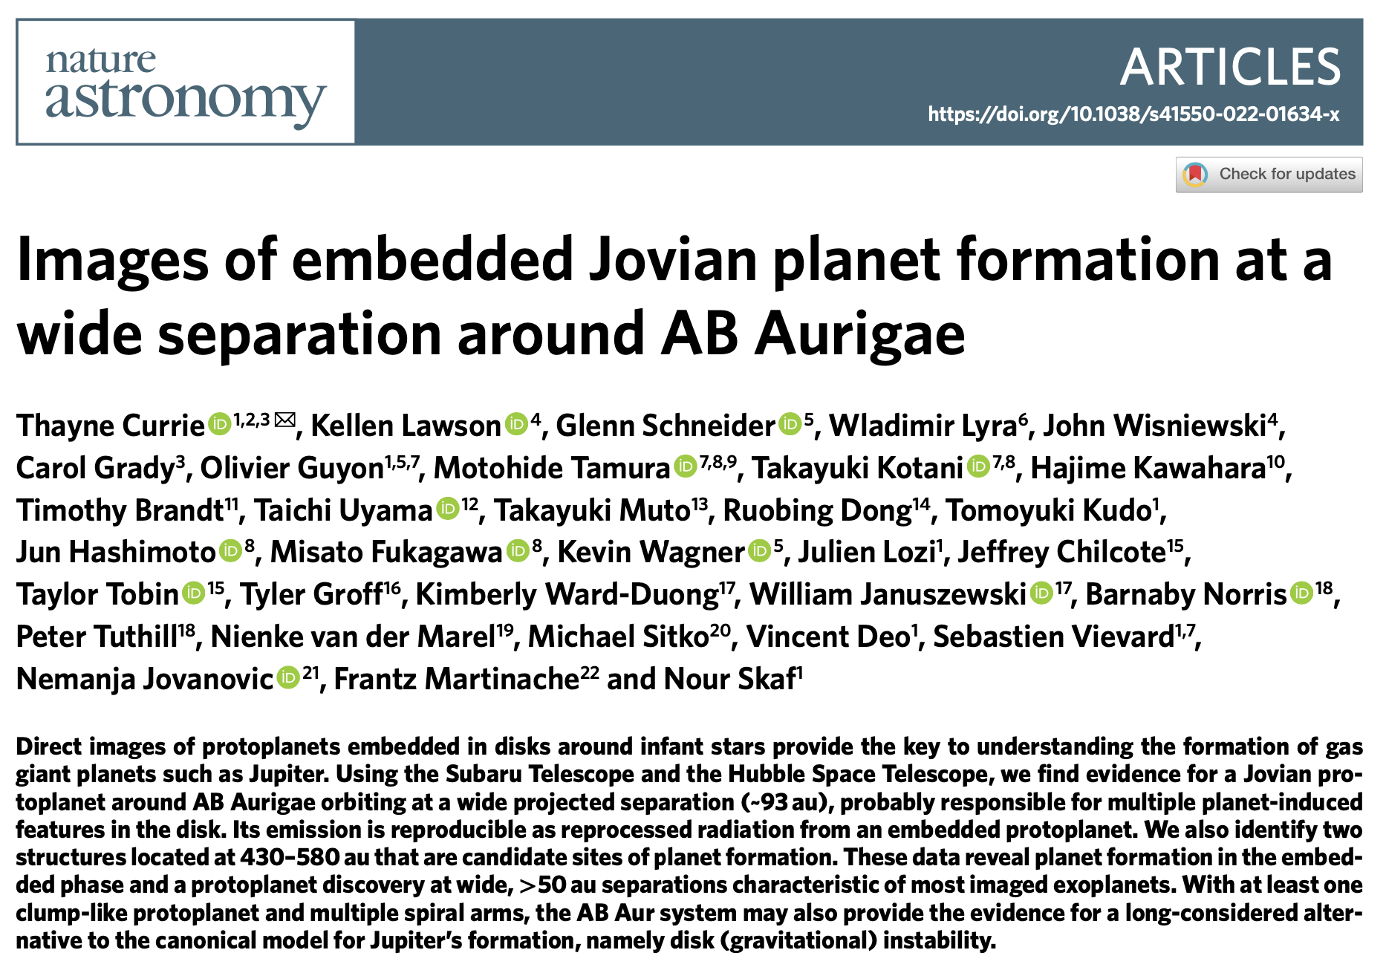
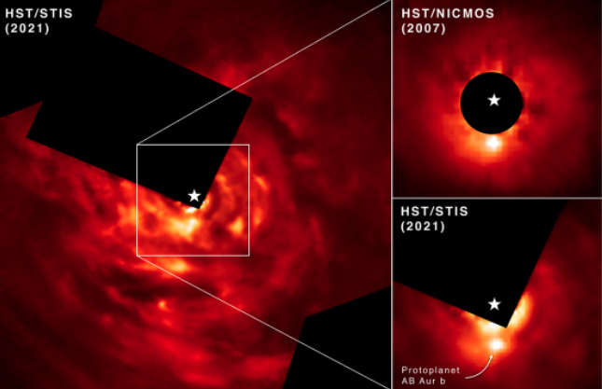
Pizza Lunch 4/25/22

Slide 2
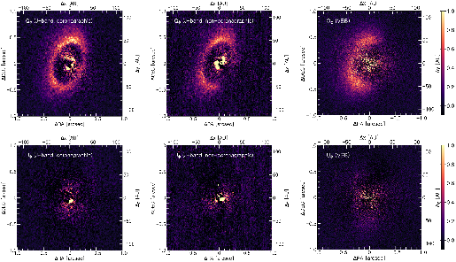
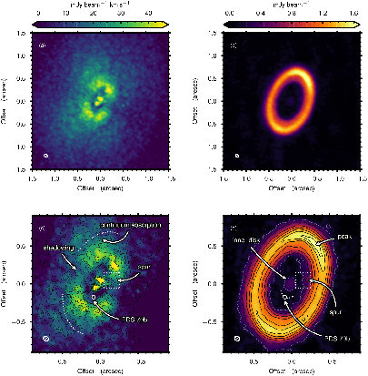
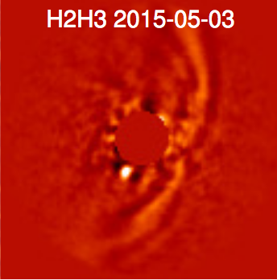
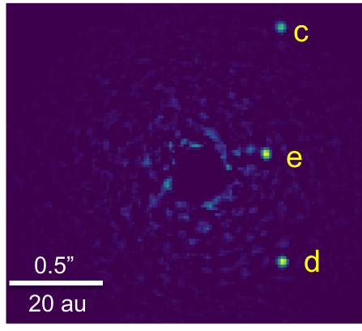
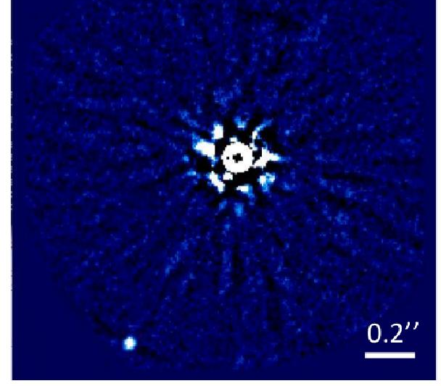
From Imaging Planets to Imaging Planet Formation
PDS70
Embedded planets
Near-IR polarized
sub-mm
Near-IR total intensity
HR 8799 (SCExAO)
HIP 65426 (SPHERE)
Fully-formed Planetary Systems
(Andrews et al. 2018; Keppler et al. 2018, 2019; Chauvin et al. 2017, Currie 2019)

Slide 3
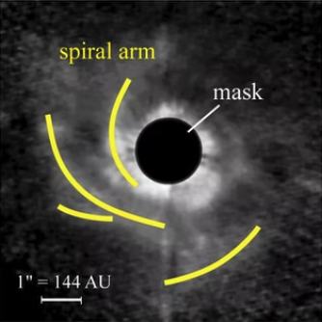
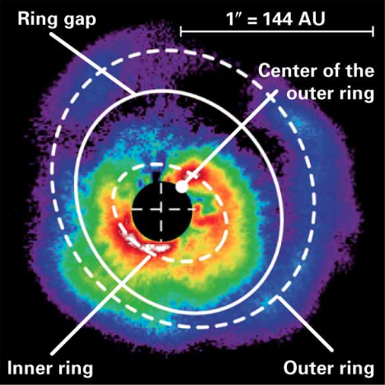
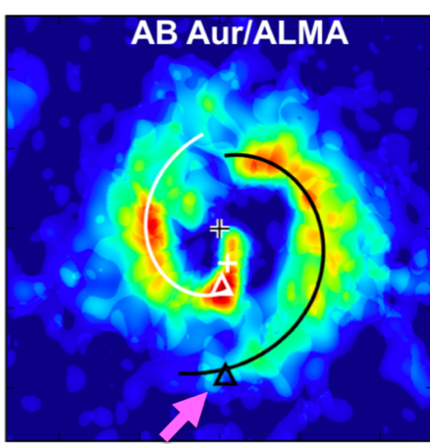
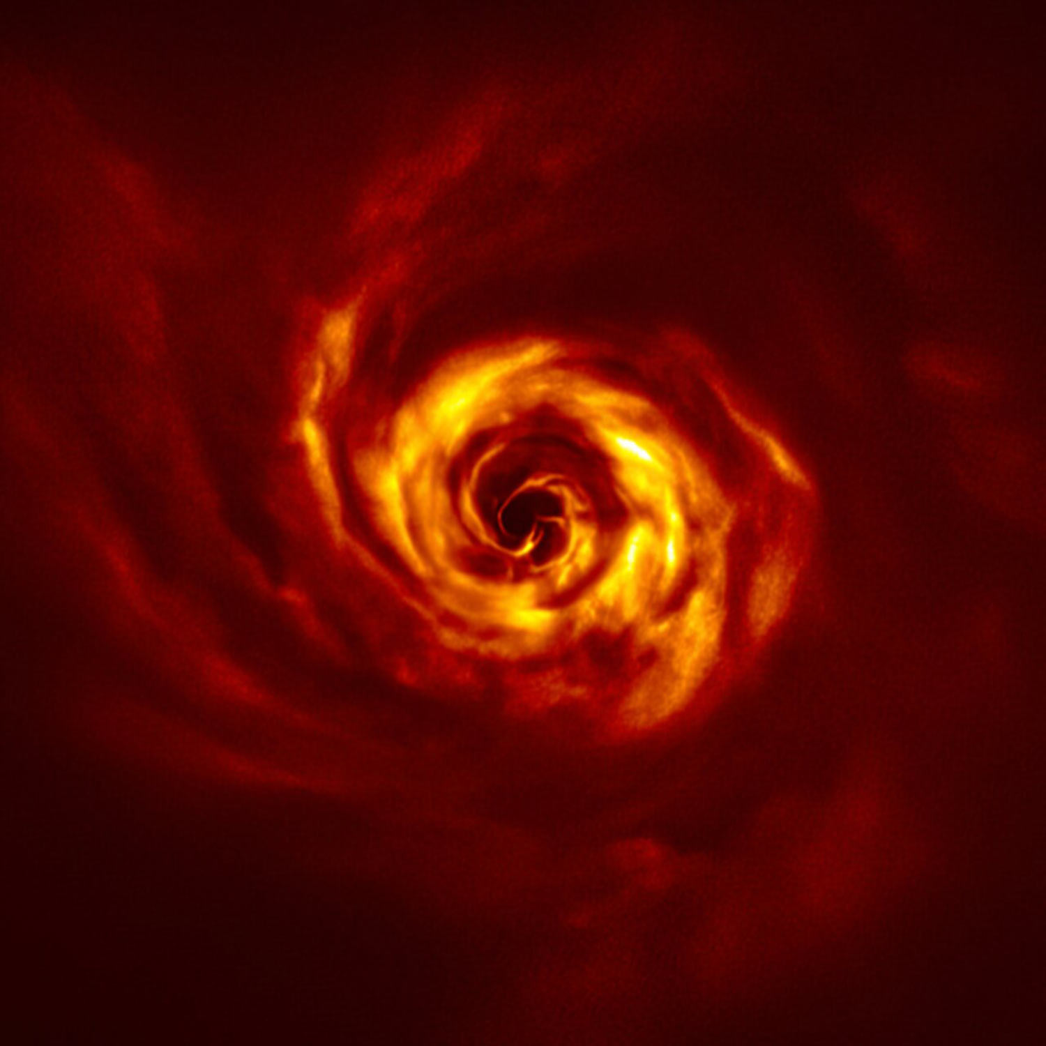
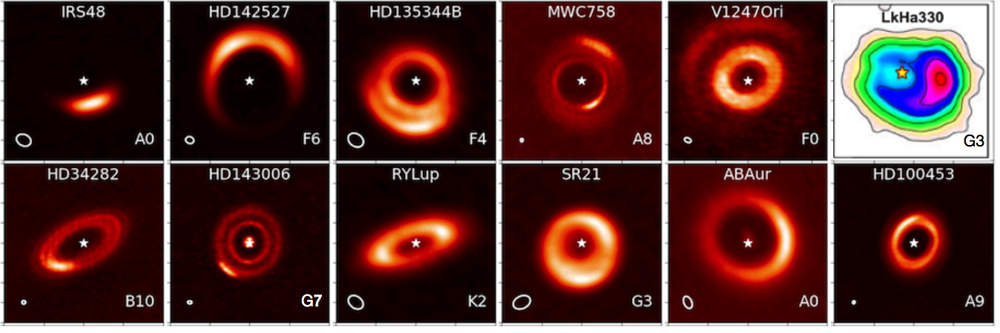
AB Aurigae: Long considered a planet formation laboratory
CIAO+AO36
HiCIAO + AO188
ALMA
SPHERE
ALMA
Sub-mm gas
Sub-mm dust
Fukagawa et al. 2004
Hashimoto et al. 2011
Tang et al. 2017
Boccaletti et al. 2020
Francis & van der Marel 2020

Slide 4

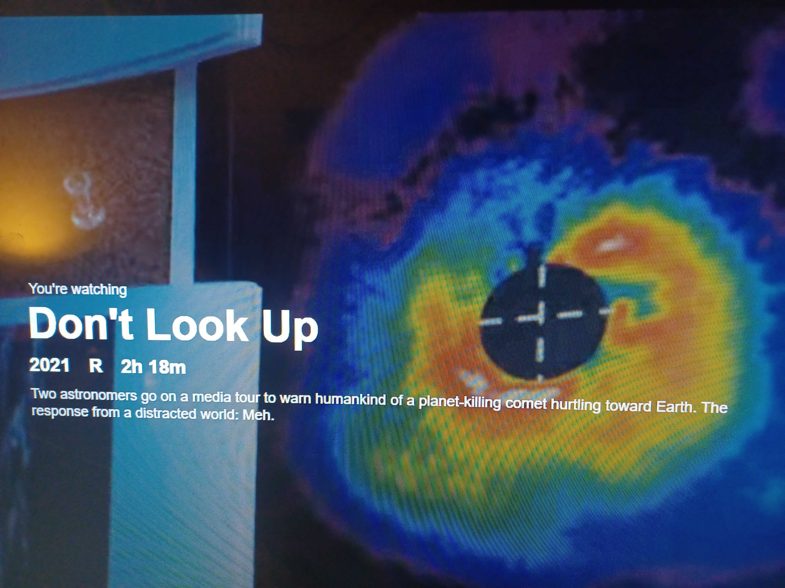
… with film appearances

Slide 5
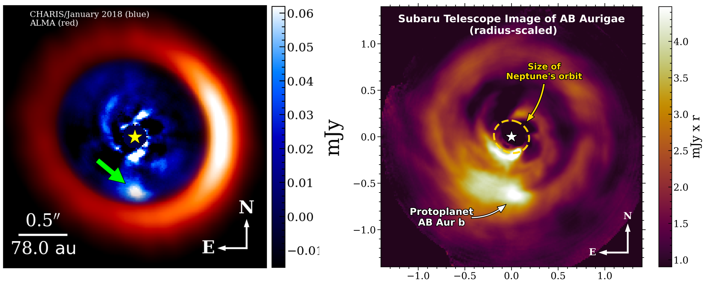
AB Aur b: CHARIS

Slide 6
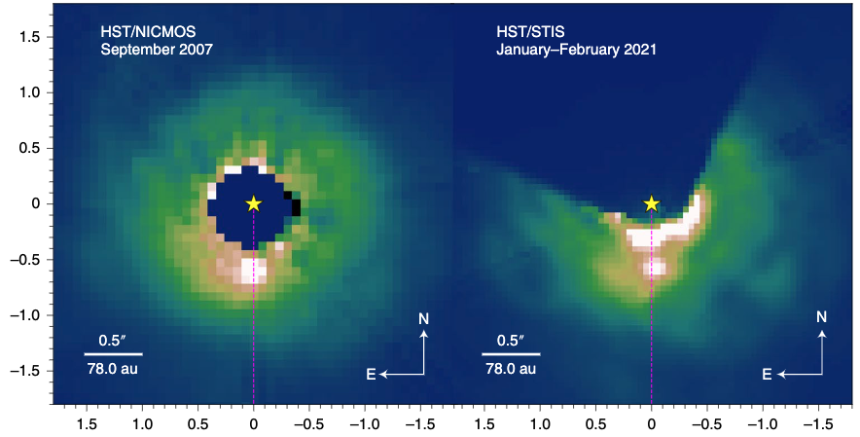
AB Aur b: HST

Slide 7
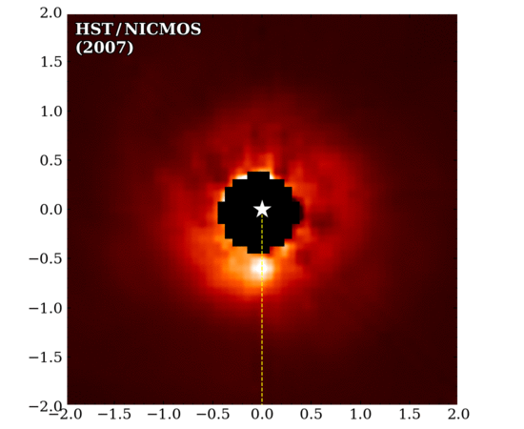
AB Aur b: Evidence for Orbital Motion
HST: Oct 2007 to Jan 2021

Slide 8
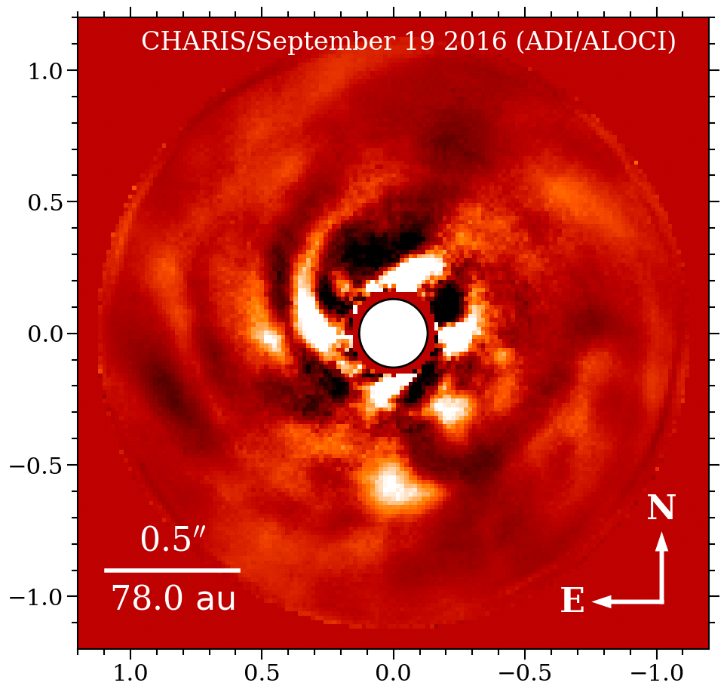
AB Aur b: Evidence for Orbital Motion
SCExAO: Sept 2016 to Oct 2020

Slide 9
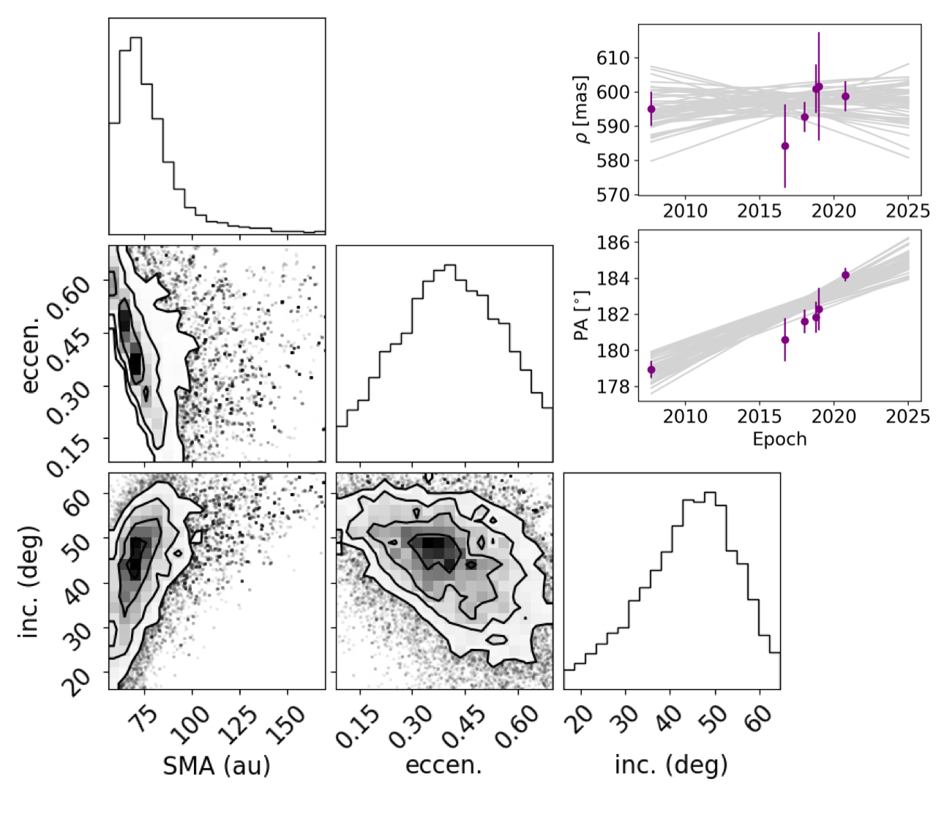
AB Aur b: Orbit

Slide 10
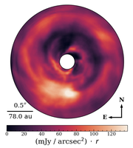
What is it?
Disk feature?
Planet?

Slide 11
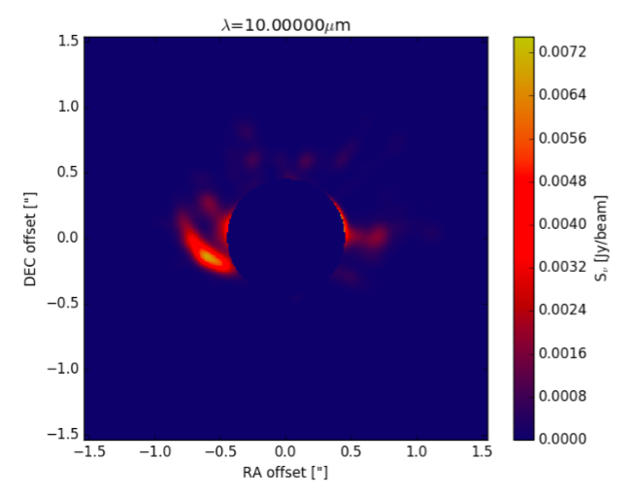
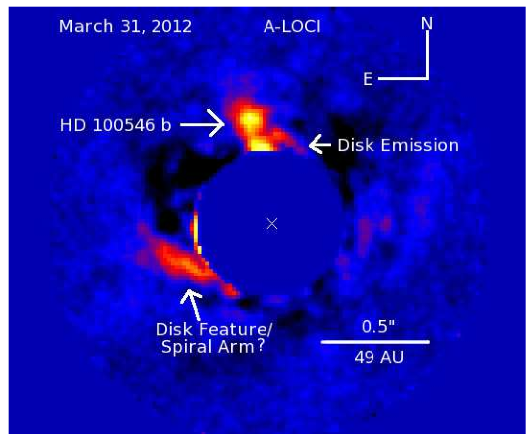
A disk feature?
Observation vs Synthetic Image for HD100546
Currie et al. (2015)
Hord, Lyra et al. (2017)

Slide 12
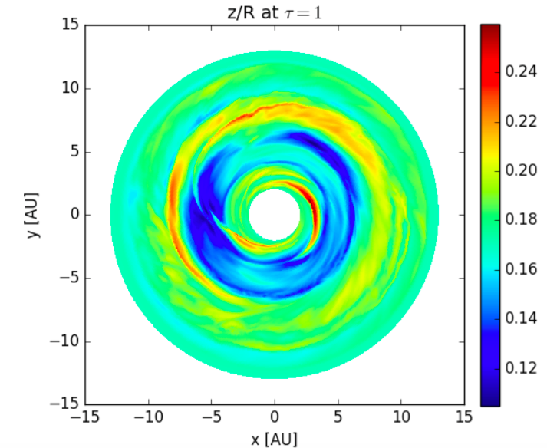
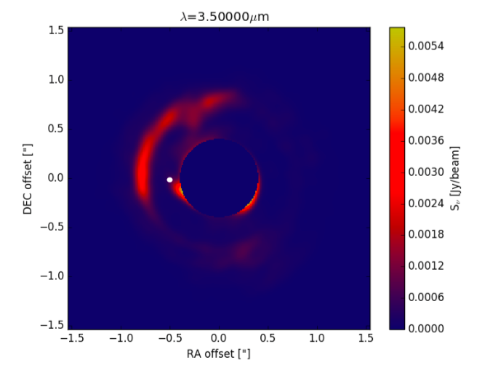
A raised outer gap wall
Hord, Lyra et al. (2017)

Slide 13
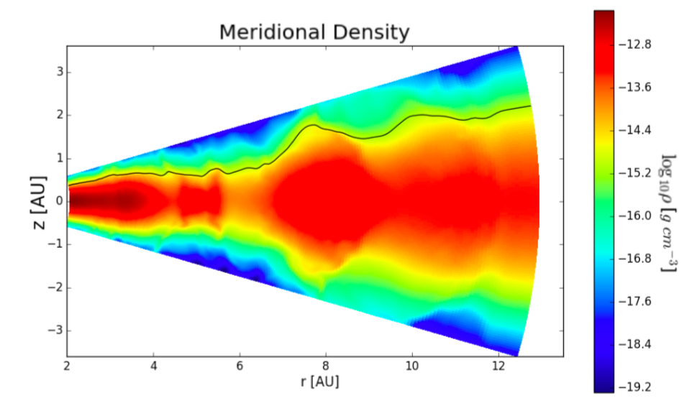
A raised outer gap wall: Scattering
Hord, Lyra et al. (2017)

Slide 14
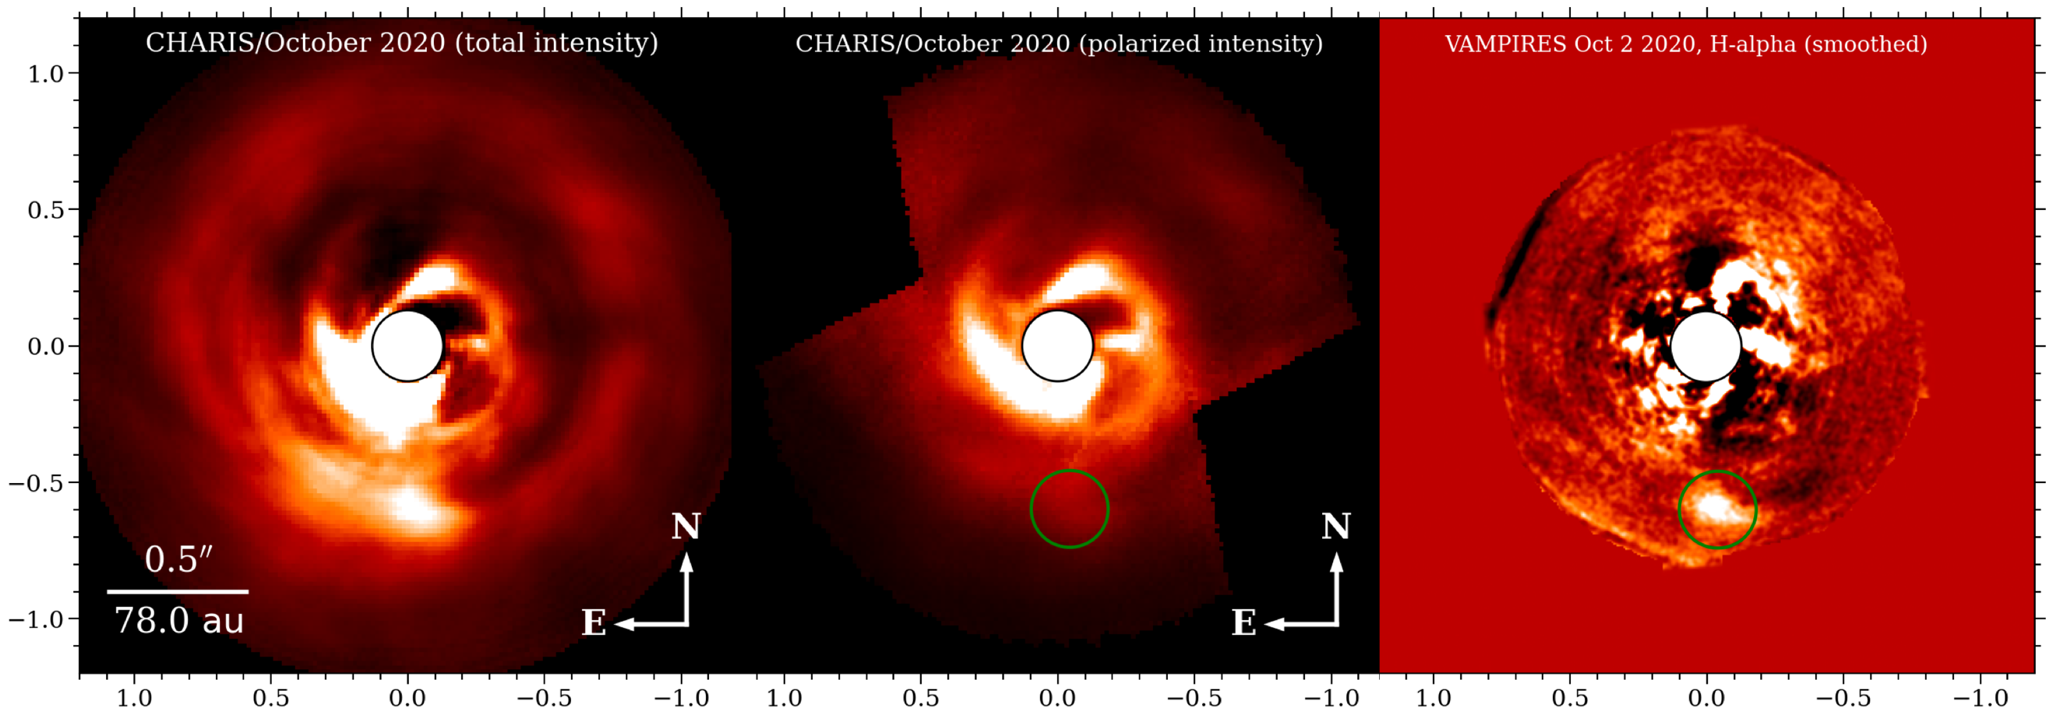
AB Aur b: Emission
Detection in total intensity
Non-detection in polarized light
Detection in H-alpha

Slide 15
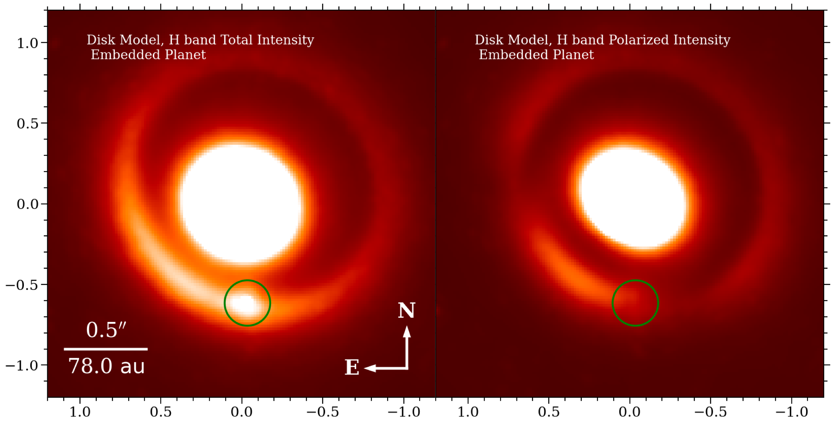
Explaining AB Aur b’s Appearance
Embedded blackbody point source
appears spatially extended because of reprocessing from the disk

Slide 16

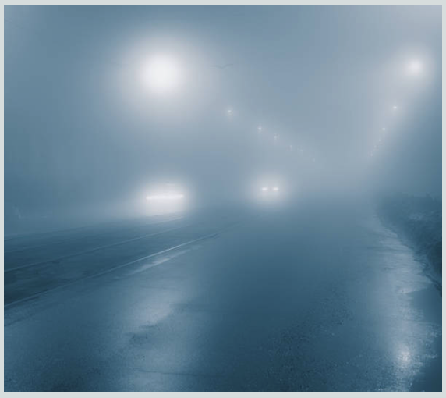
Analogy: seeing a lamp through fog

Slide 17
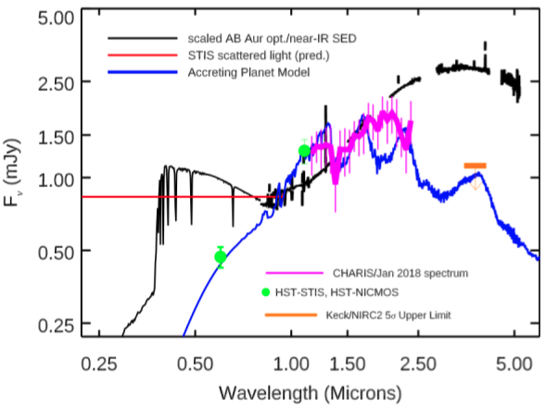
AB Aur b: Spectrum
Inconsistent with pure scattered starlight;
Reproduced by ~2000 K thermal source + ~10,000K magnetospheric accretion source
Luminosity consistent with ~9-12 M_{J} object
Notes:
AB Aur b has an apparent luminosity of log(L/L⊙)≈−2.60 to −2.79, which is comparable to that of 1-Myr-old, 10MJ) planets. Gaia and Hipparcos astrometry set a dynamical mass upper limit of ~0.13 M⊙.

Slide 18
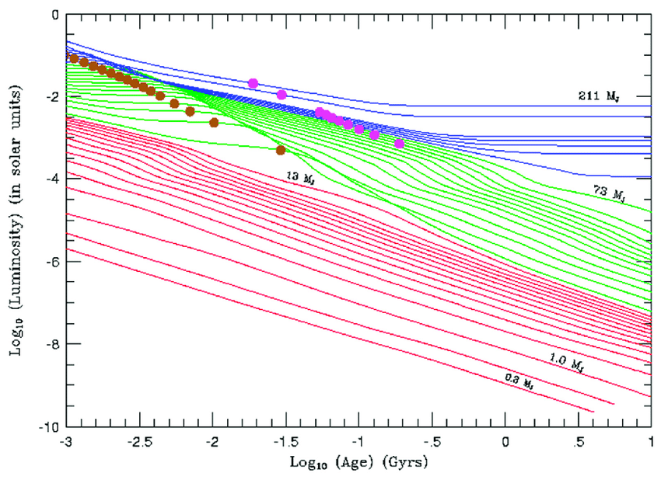
Luminosity of Substellar Objects
Burrow et al. 2012

Slide 19
Photometric constrains
Detection at J (1.25 mm), H (1.65 mm)
Weaker at K (2.2 mm)
No detection at Lp (3.8 mm)
Colors suggest 2300 K
A planet is plausible
  GI or Core Accretion?

Slide 20
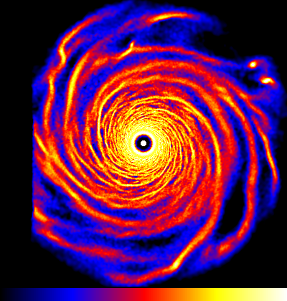
AB Aur
Gravitational Instability model

Slide 21
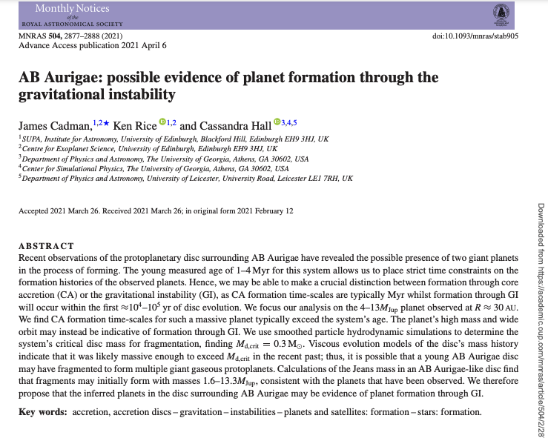
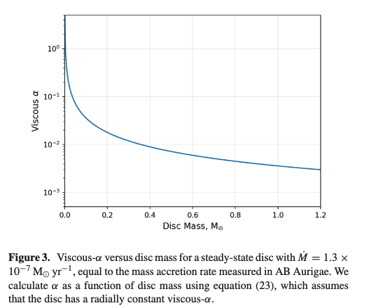
Previous estimates of the disk mass were probably too low

Slide 22
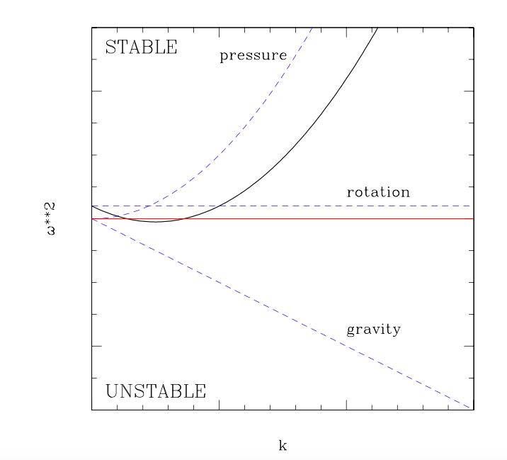
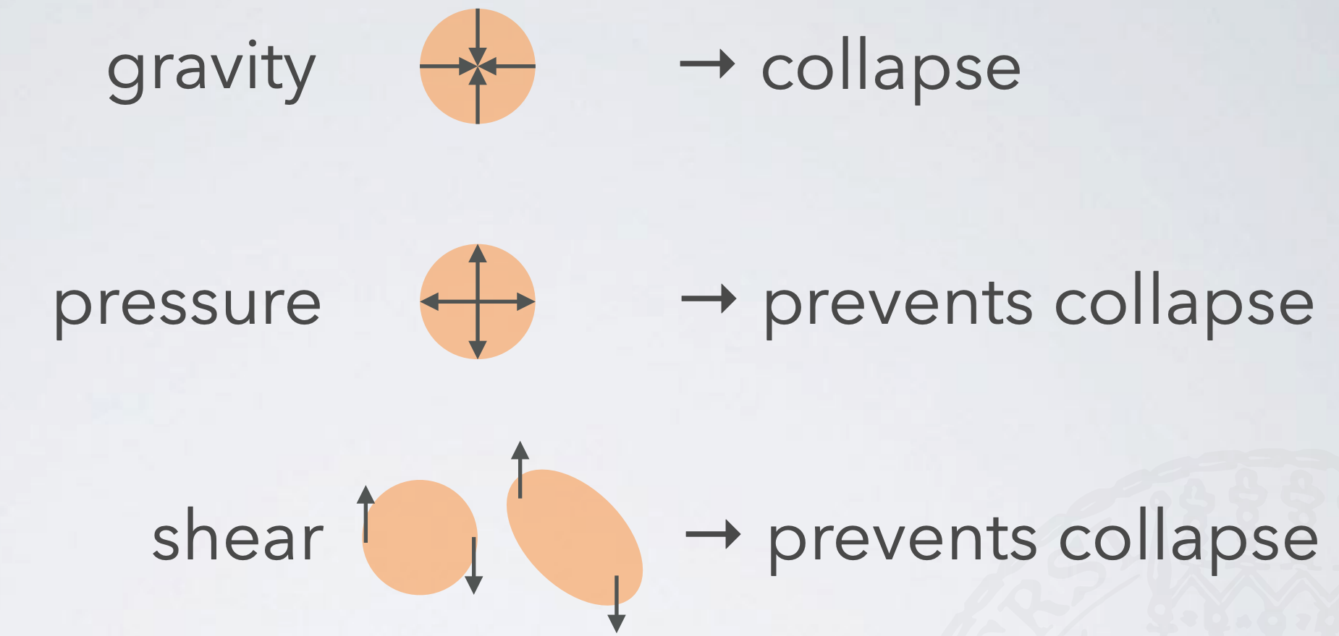
Safronov-Toomre Stability
Q = c_{s} κ / (πGΣ) < 1 (instability)
c_{s} = sound speed
κ = epicyclic frequency
Σ = column density

Slide 23
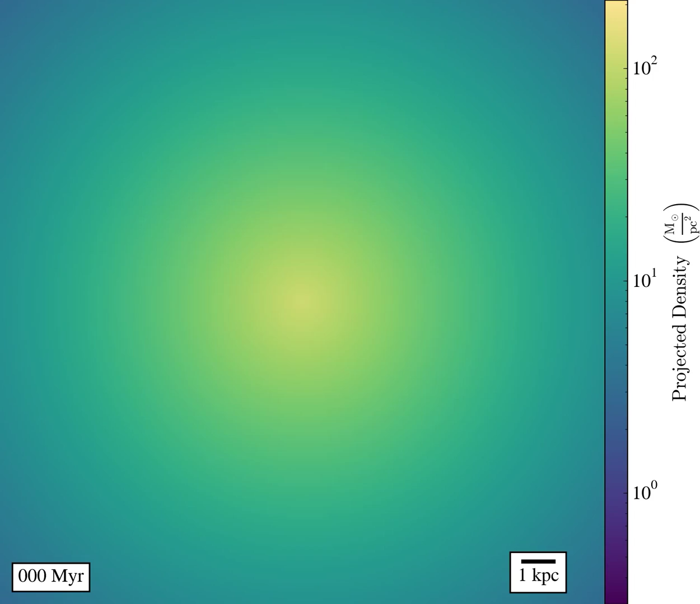

Slide 24
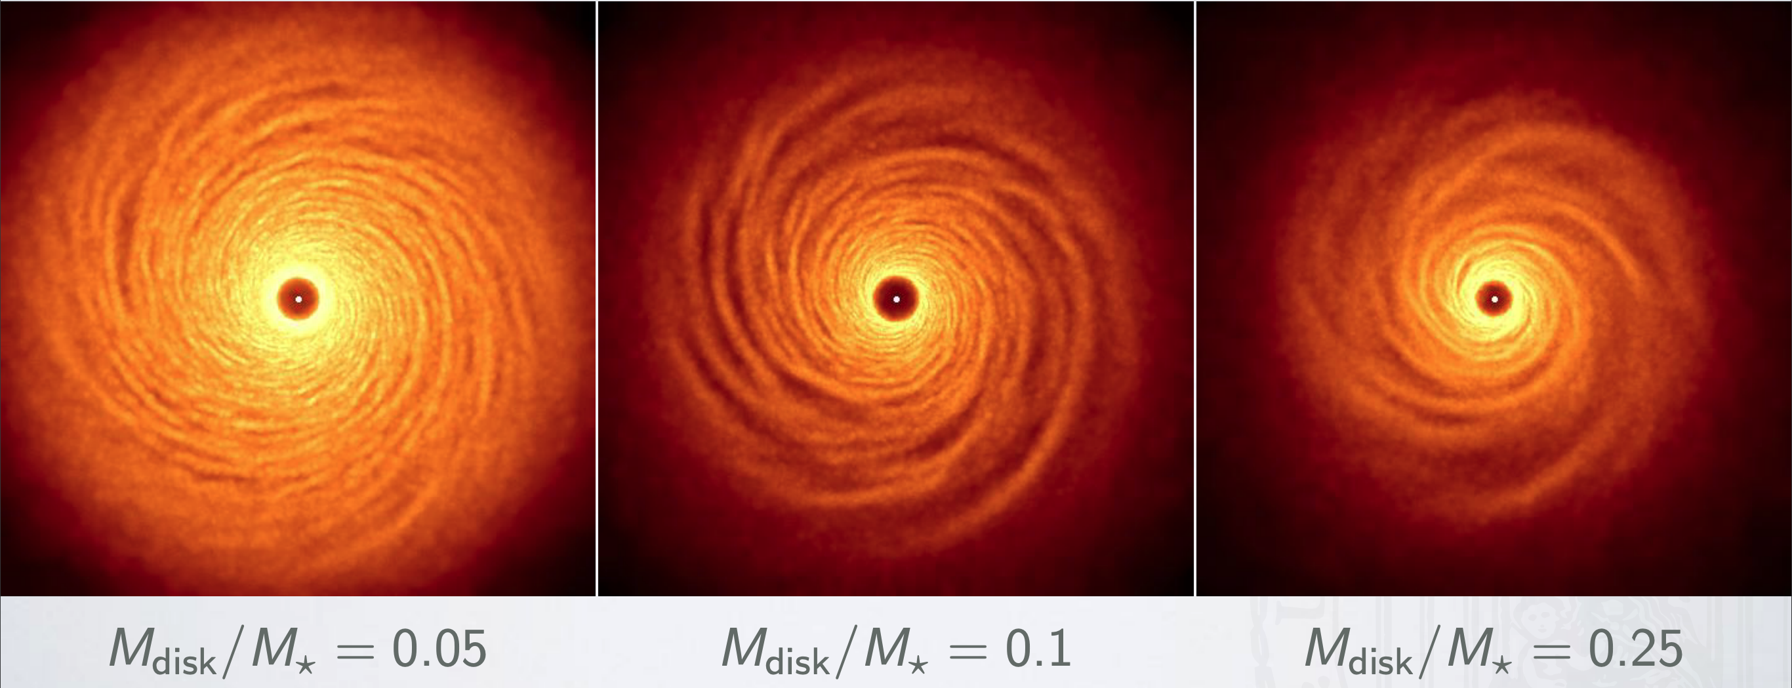
What is the density of the AB Aur Disk?

Slide 25
Density Estimate
if (AB Aur b is a planet seen through haze) then:
optical depth ~ 1
τ = κ ρ_{d} Η
ρ_{d} ~ 1/(κΗ)
~ 10⁻¹⁴ g/cm³
ρ_{g} ~ 10⁻¹² g/cm³
Σ ~ 3 g/cm²

Slide 26
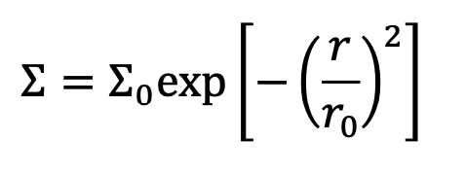
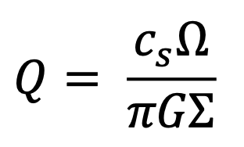
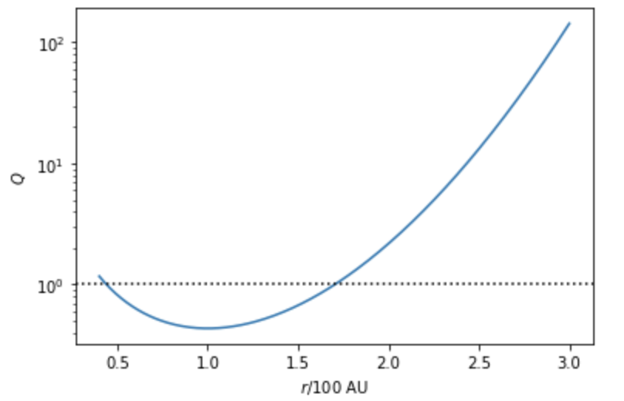
Toomre Q of the disk
Gravitationally
Unstable!

Slide 27
Consistent with the pebble ring

Slide 28
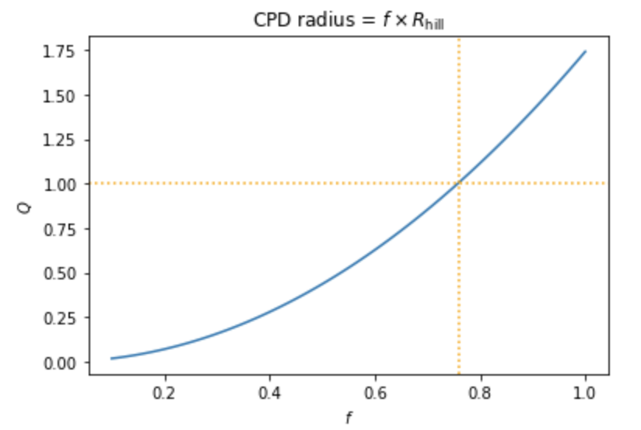
Toomre Q of the clump
10 Jupiter masses, spread over area π(fR_{Ηill})²
T = 2000 K
r = 100 AU
The clump is consistent
with a Q~1 clump filling
its Hill sphere.

Slide 29
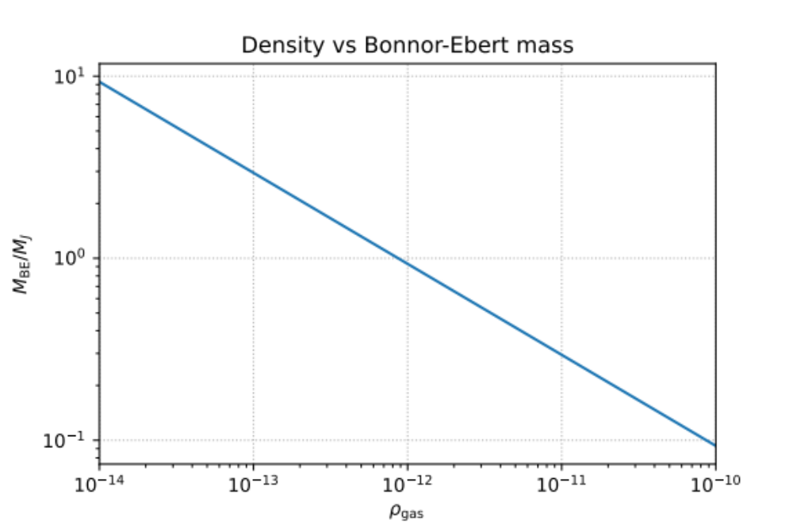
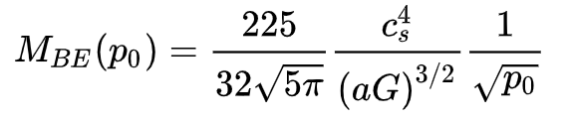
Bonnor—Ebert mass
T = 30K
γ = 1.4
Consistent with Jupiter-mass!

Slide 30
Model
2D rφ Resolution 432 x 864
Log grid Δr / r = const
Radial range 30 – 300 AU
Exponential truncated disk
β-cooling: 10 orbits at 100 AU

Slide 31
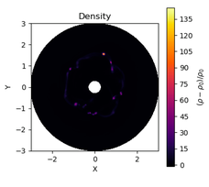
Model
2D rφ Resolution 432 x 864
Log grid Δr / r = const
Radial range 30 – 300 AU
Exponential truncated disk
β-cooling: 10 orbits at 100 AU

Slide 32
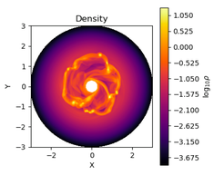
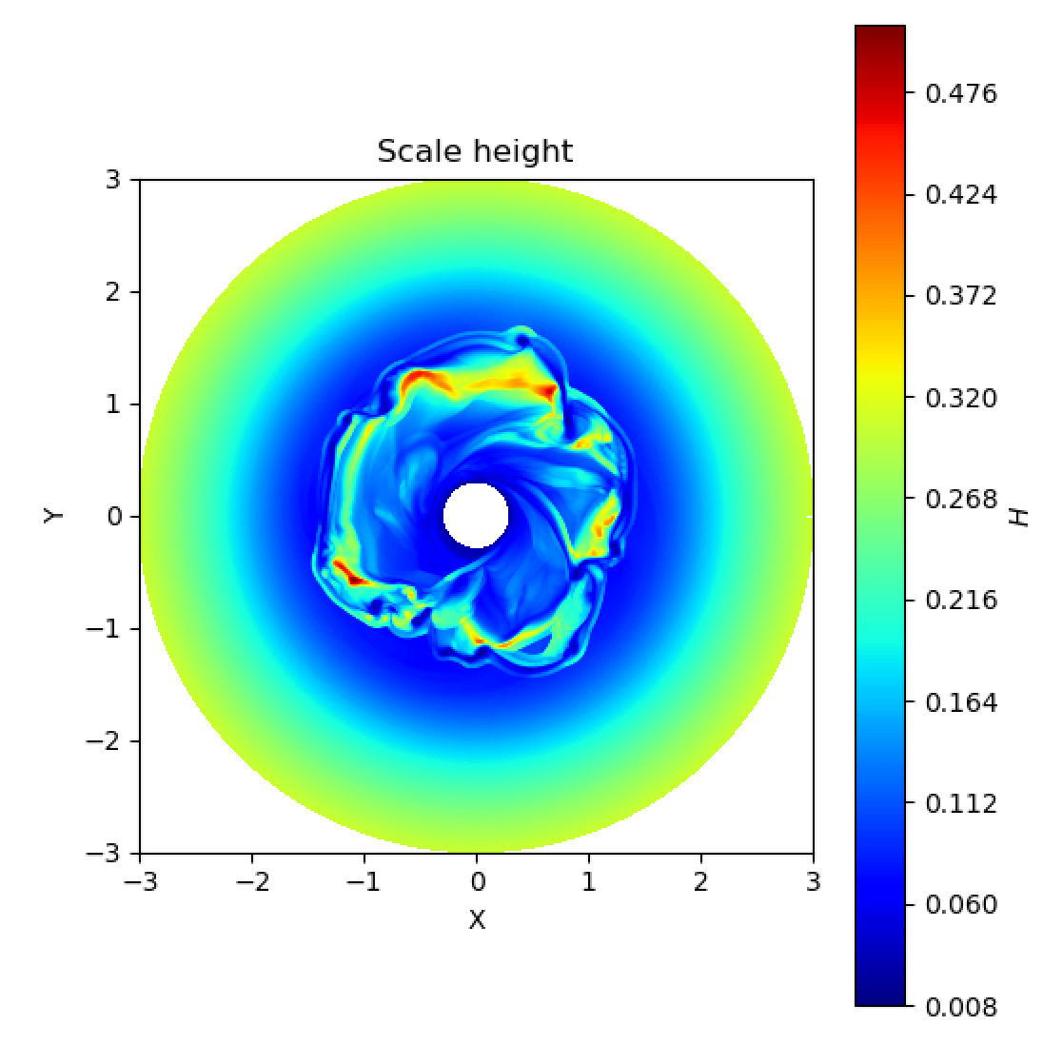

Slide 33
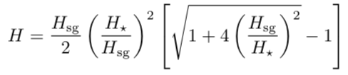
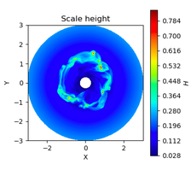
H = c_{s} /Ω

Slide 34
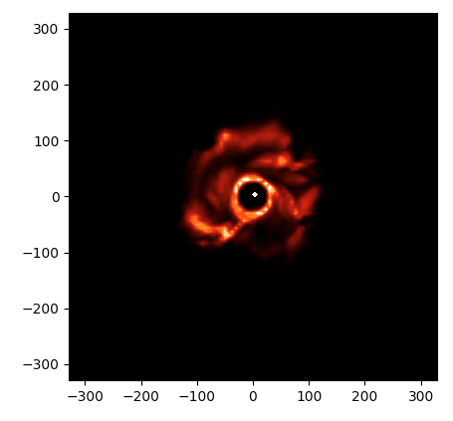
Synthetic Image with RADMC-3D
10⁷ photons
2.2 microns

Slide 35
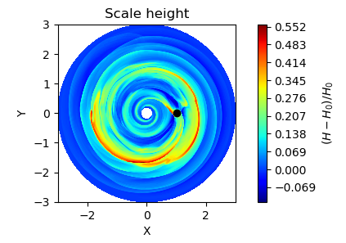




Control Model without Self-Gravity
1.6 micron
3.8 micron

Slide 36
AB Aur model

Slide 38


Slide 39



Synthetic Image + Planet
Star + GI Blob
Star
Subtraction
2.2 microns
1e6 photons
Blob: 2 R_{J}, 5000K, 2.5 x 10⁻³ Lsun

Slide 40


AB Aur b’s Formation

Slide 41


Alternative to GI: Vortex Trapping?
Earth-mass protoplanets!

Slide 42

Convergence

Slide 43
Conclusions
First embedded protoplanet
Compatible with Gravitational Instability
  Disk has spiral structure (infall or GI)
    Possibly high-mass: high mass-accretion (1e-7 Msun/yr) implies
    implausible viscous alpha values (0.1) unless high-mass in invoked (0.3-0.4 Msun).
  Density derived from optical depth ~ 1 implies
    Q~1
      Typical disk model yields Q < 1 between 50 and 150 AU
        Explains inner spirals ~50AU and outer pebble ring ~150 AU
    Bonnor-Ebert mass 1-10 M_{J} for this disk pressure
  10 M_{J} blob spread over ~ 1 Hill radius at measured temperature also implies Q~1.

Slide 44
Outstanding Questions
・Is AB Aur b accreting?
- Detection in H-alpha but not clear that this is from accretion
・Emission Source
- Circumplanetary Envelope is current leading candidate
- Circumplanetary disk? ALMA limits are poor
・How massive is AB Aur b? How massive can it get?
- Best estimate is 9-12 M_{J} (true error bars are probably larger, esp for lower mass range)
- Could this get above ~13-20 M_{J}? (best guess: probably not but need better disk mass constraints
・Are there other planets in the system?
Can core accretion be responsible? Vortex trapping + pebble accretion @ 100 AU?

Slide 45

But what about …
SPHERE? They didn’t detect it, right?
It IS detected in a reanalysis of SPHERE data

Slide 46


But what about …
LBT? They didn’t detect it
Yeah, but their data are not nearly as good and they processed it the wrong way

Slide 47
AB Aur b: Not a Processing Artifact
PSF subtraction using different approaches recover AB Aur b
Notes:
Point-spread function (PSF) subtraction using different approaches, that is, algorithms in combination with either angular differential imaging (ADI) or reference star differential imaging (RDI), recover AB Aur b with minimal evidence of photometric and astrometric biasing

Slide 48


Slide 49

AB Aur b: Emission vs Wavelength
A different spectrum from that of the star

