Slide 1
Funding
Evolution of Arrokoth
from a binary planetesimal into contact
via Kozai-Lidov oscillations and nebular drag
TCAN – 2020
NFDAP – 2019
XRP – 2016, 2018
Wladimir Lyra
New Mexico State University
AAG – 2010, 2020
NRAO - 2017
HST - 2016
Computational Facilities
Universidad de Concepcion, Apr 6nd, 2021

Slide 2
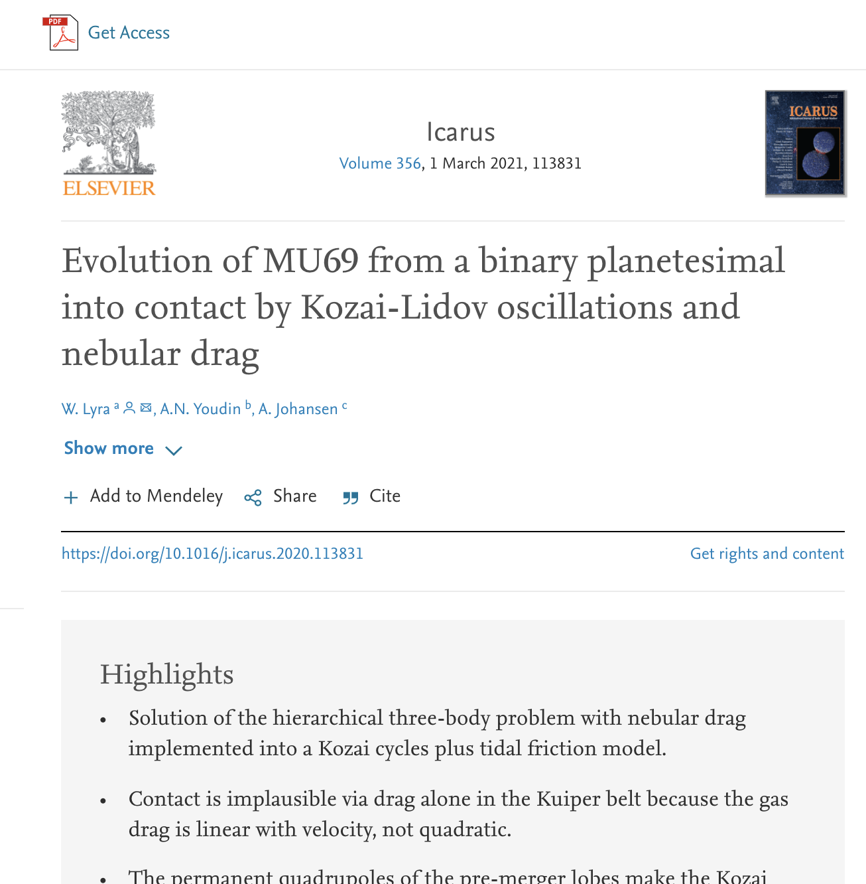

Slide 3
Effect of Drag
Lyra, Youdin, & Johansen (2021)

Slide 4
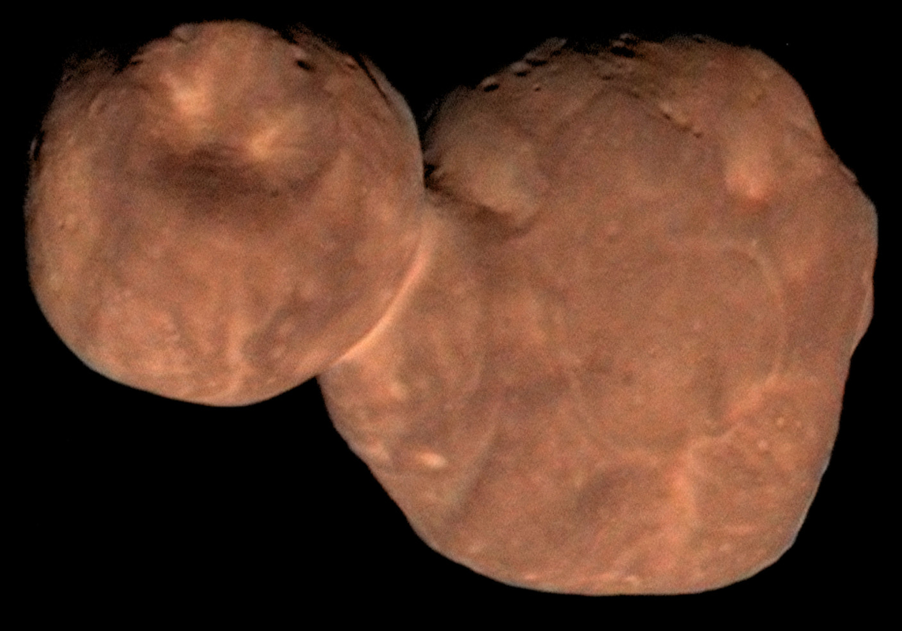
Arrokoth (MU₆₉)
W. Lyra
Lyra, Youdin, & Johansen (2021)

Slide 5
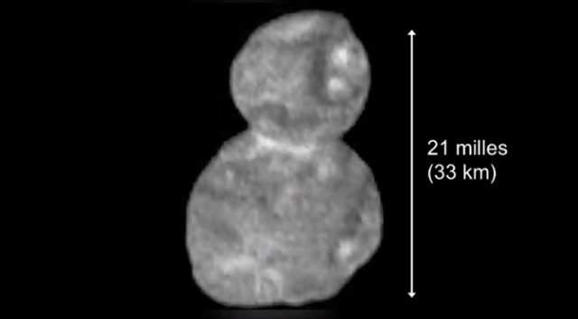
MU₆₉: Dimensions
14km
19km
W. Lyra

Slide 7
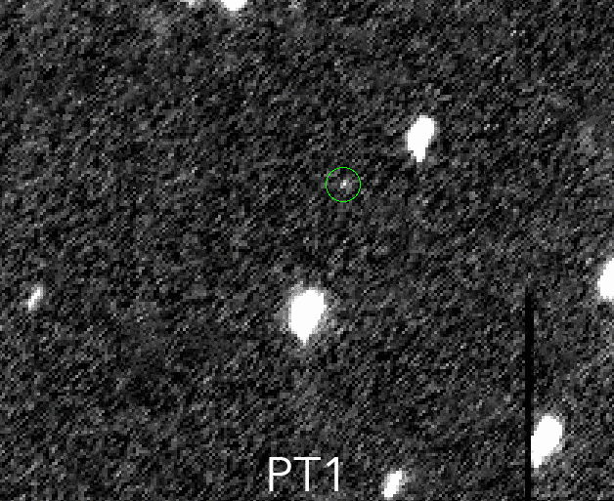
2014 MU₆₉: Discovery
W. Lyra

Slide 8
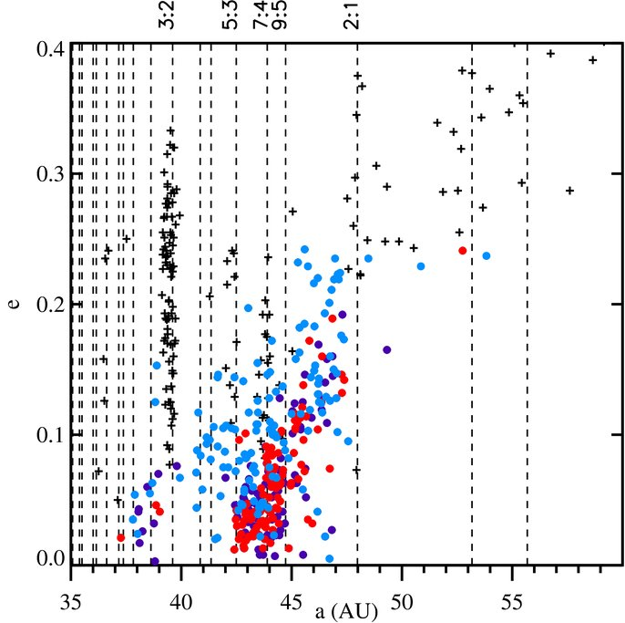
Cold Classical Kuiper Belt Object
+ Resonant and Scattered
Cold Classical i<2º
“Ambiguous” 2º<i<6º
Hot Classicals i>6º
Presumably pristine planetesimals
W. Lyra
Gladman+ ‘08, Batygin+ ’10, Dawson & Murray-Clay ‘12

Slide 9
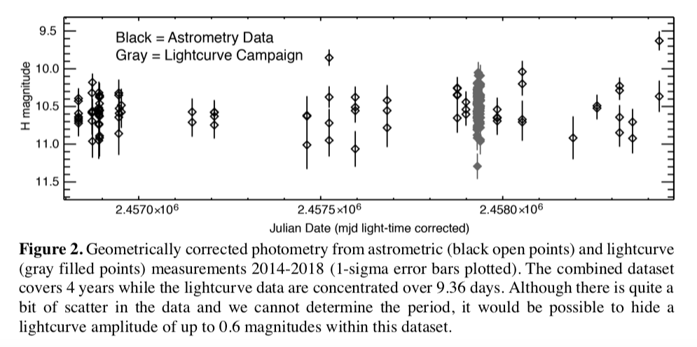
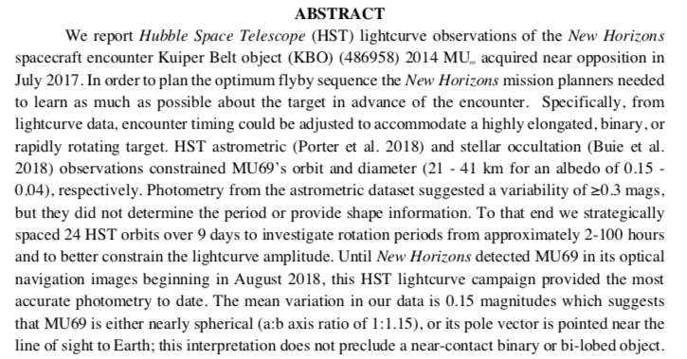

Slide 10
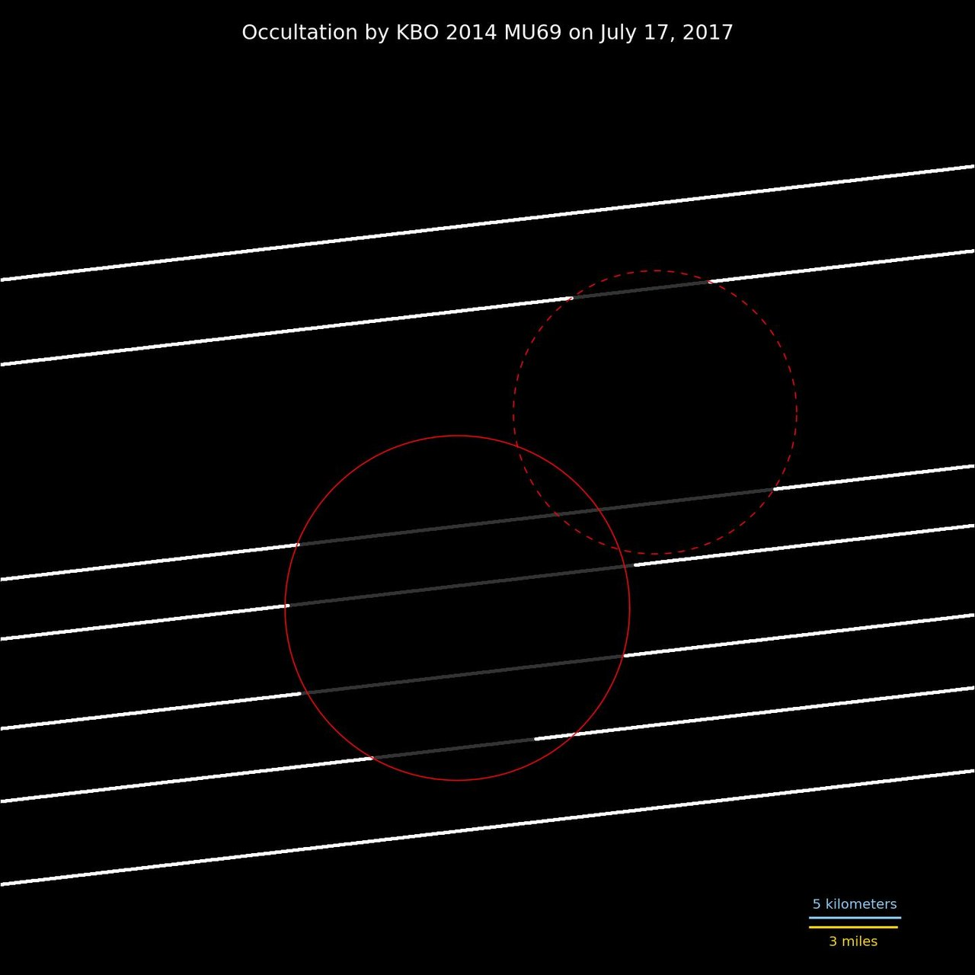
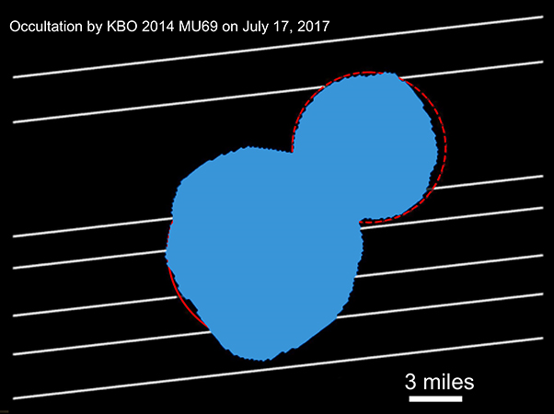
Occultation data suggests binary

Slide 11
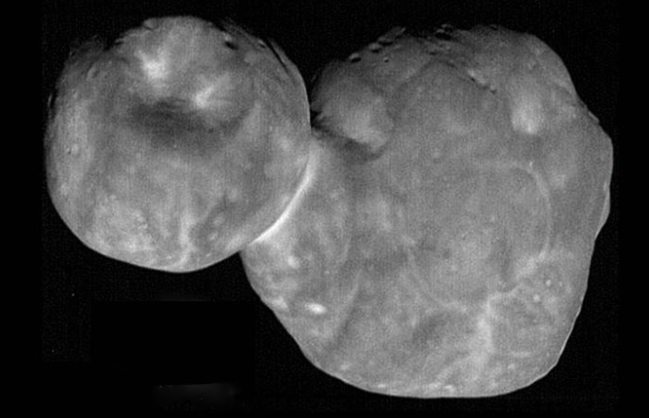
Approach sequence:
Contact binary at inclination 99.3º

Slide 12
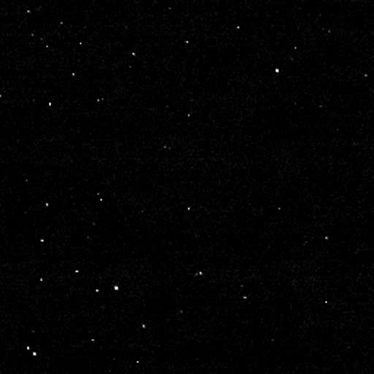
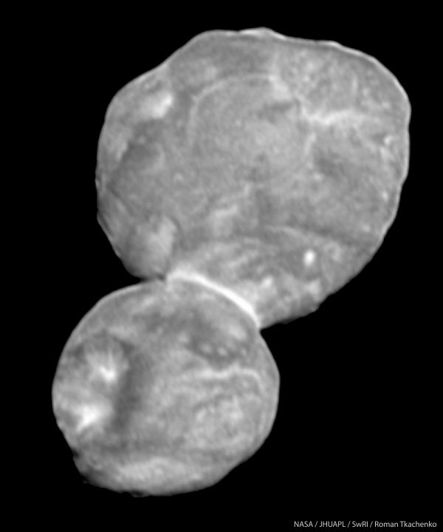
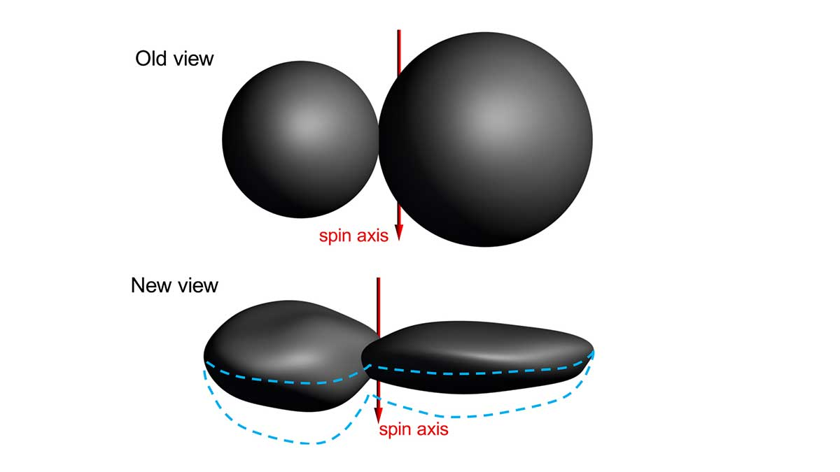
Departure sequence: Shape

Slide 13
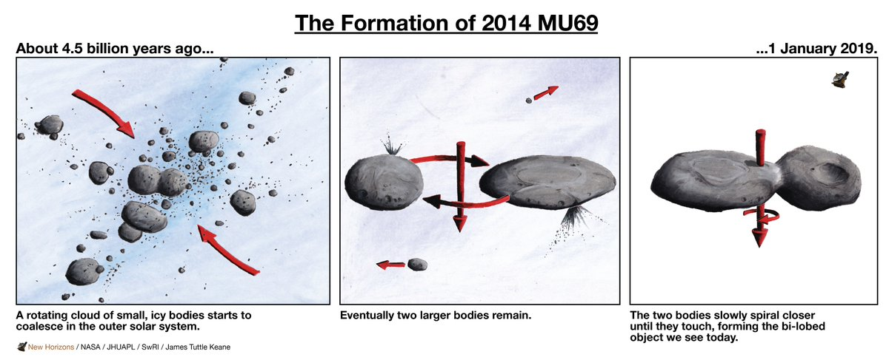
The Cartoon Image
W. Lyra

Slide 14
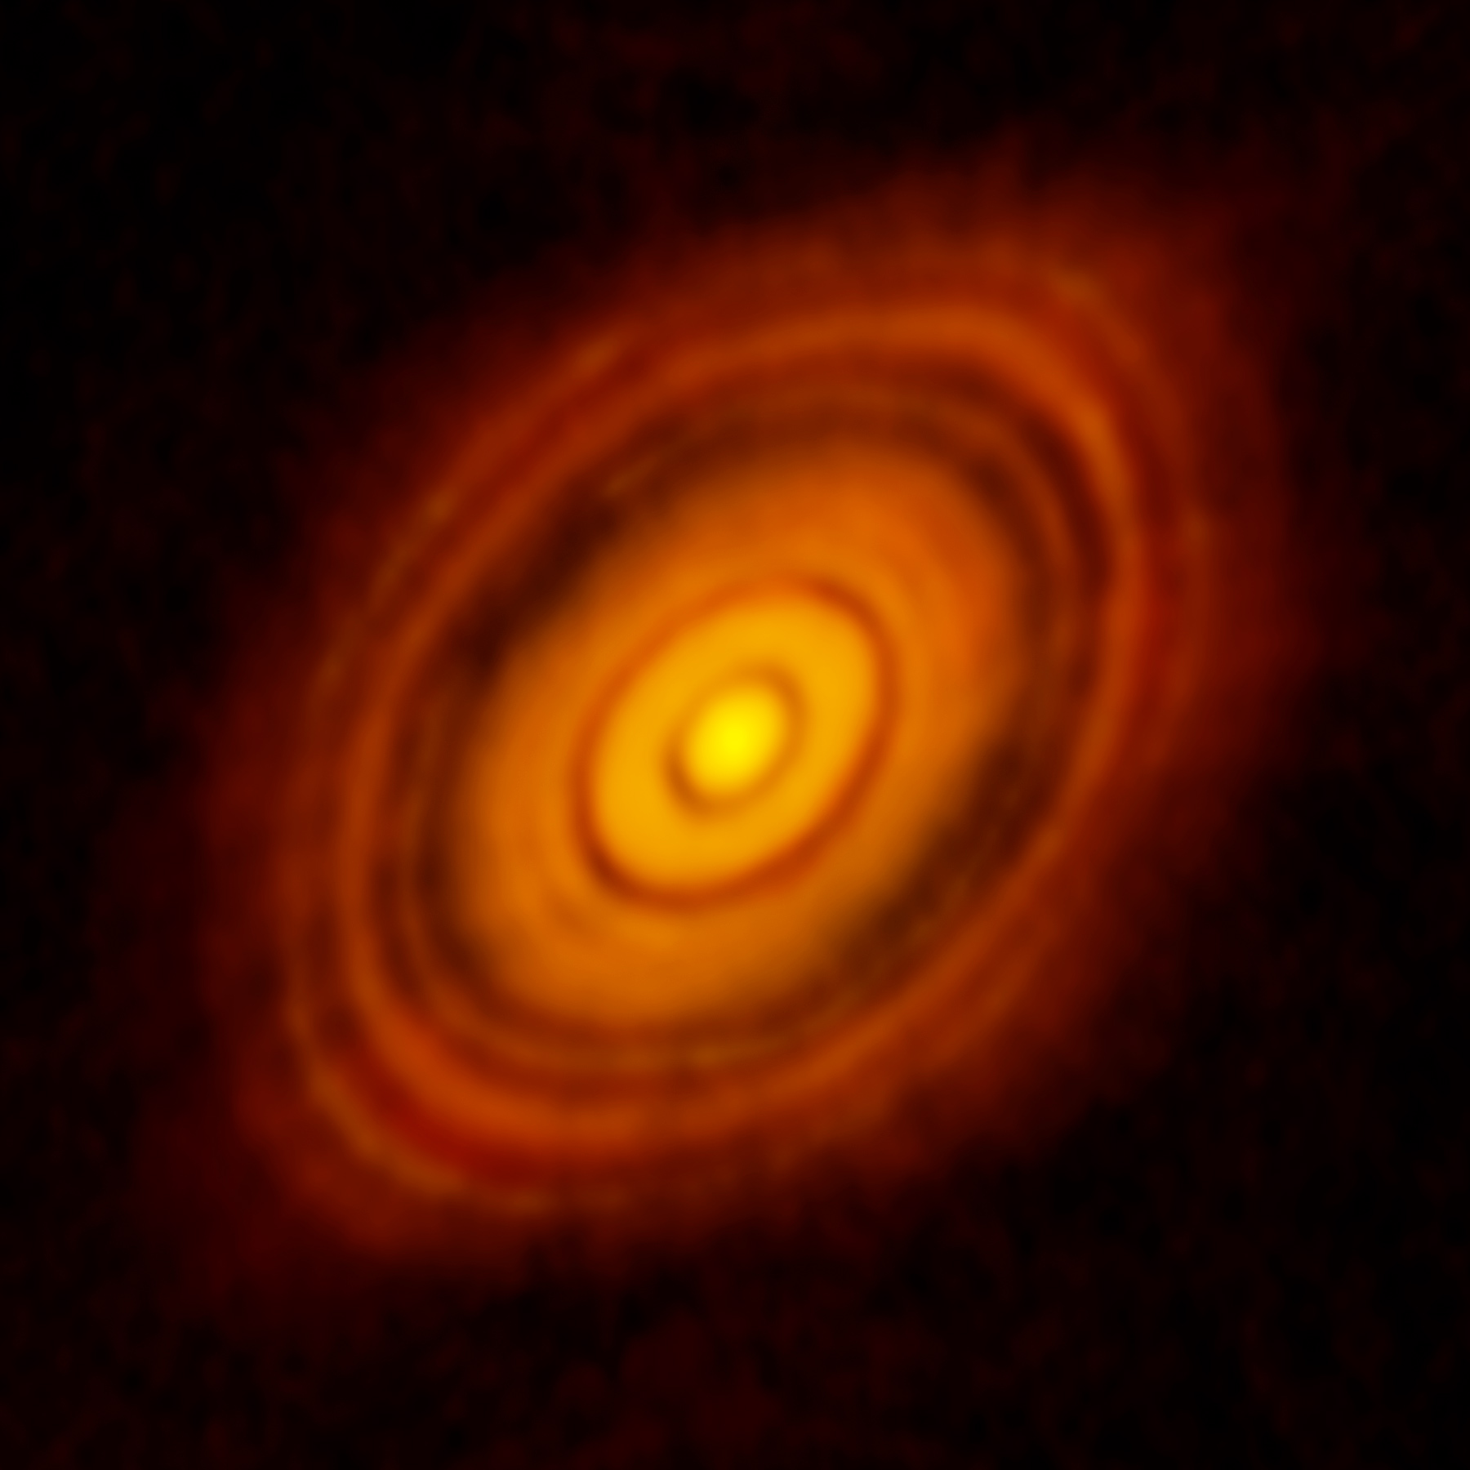
Beyond the cartoon image
How?
W. Lyra

Slide 15
Streaming Instability
The dust drift is hydrodynamically unstable
Youdin & Goodman (2005), Johansen & Youdin (2007),
Youdin & Johansen (2007), Squire & Hopkins (2018)
W. Lyra

Slide 16
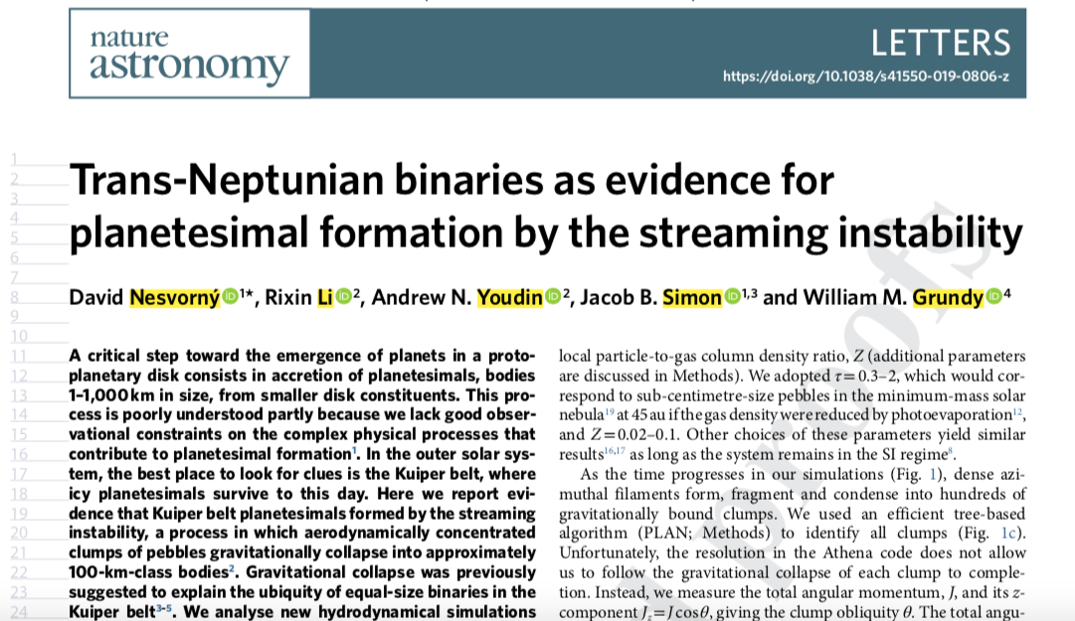
In the lookout for binaries
Nesvorny+’19, model by Rixin Li

Slide 17
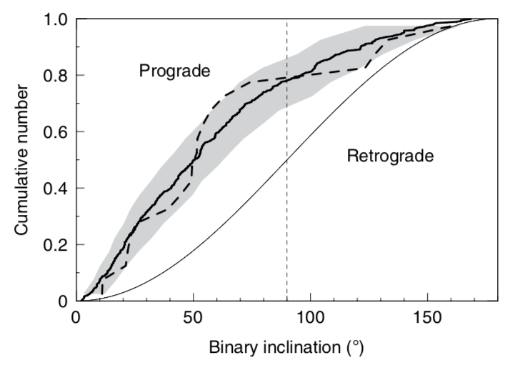
Preference for Prograde (~80%)
SI Model (solid)
KBOs (dashed)
Nesvorny+Li+Youdin ‘19

Slide 18
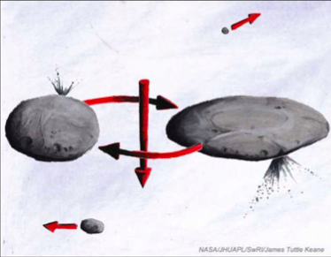
Hardening
Sketch by J.T. Keane

Slide 19
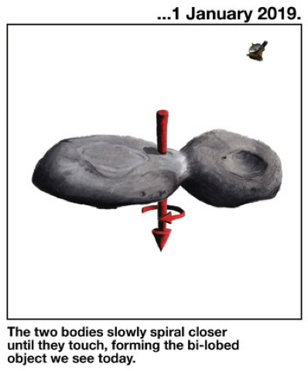
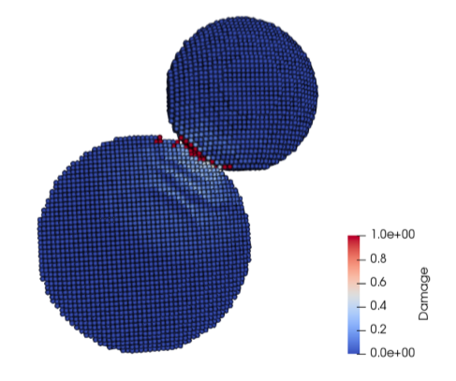
How was angular momentum lost?
Mutual orbit
(i.e., not captured)
Slow merger
(~2 m/s: human walking speed)
Inferred from:
alignment of component minor axes,
small angular momentum,
similar colors.
Inferred from:
Negligible evidence for impact damage

Slide 20
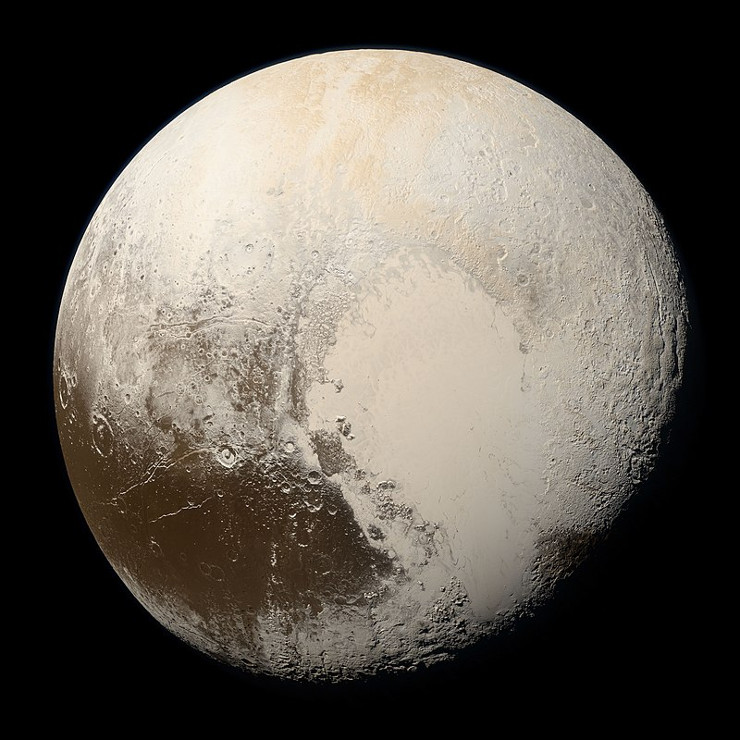

Slide 21
Tombaugh Regio / Sputnik Planitia – N₂ frost
W. Lyra

Slide 22
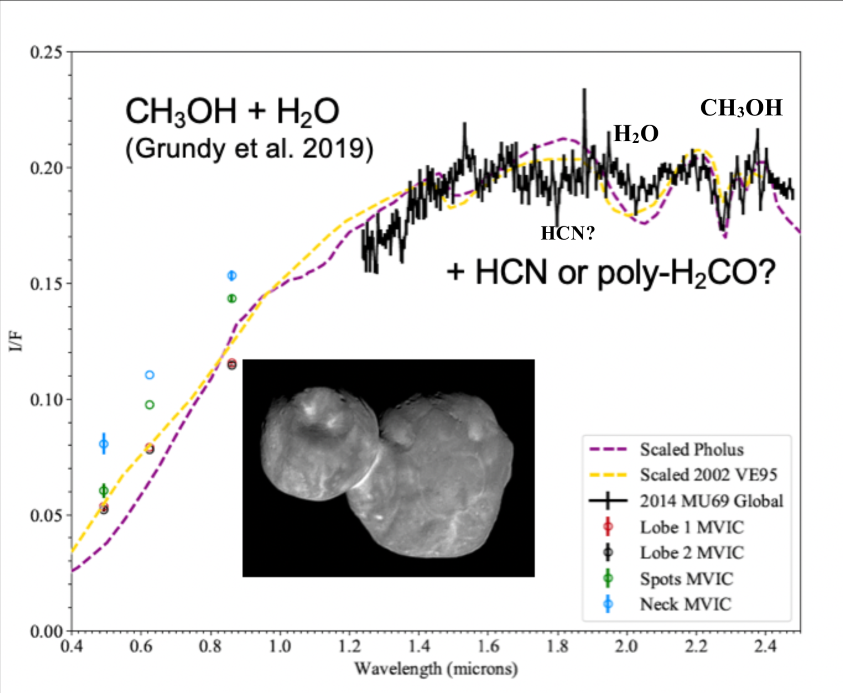
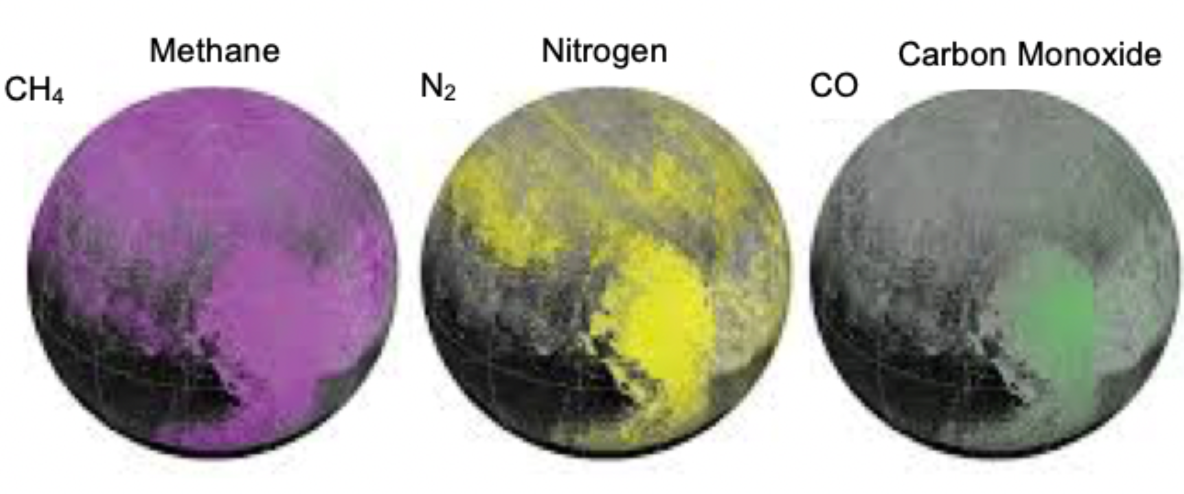
MU69 and Pluto ices are different
MU69 : Methanol, H₂0, HCN
Pluto : CH₄, N₂, CO
Grundy+ ’16, Lisse+Lyra ’20

Slide 23
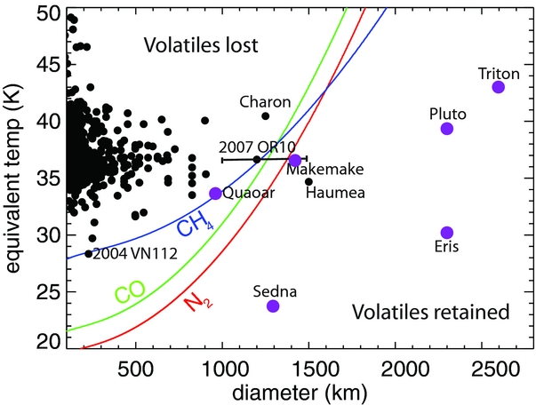
Retention of volatiles
If Pluto is formed from similar bodies to MU69, they must retain N₂
Needs shielding from the sunlight flambé.
W. Lyra
Brown, Burgasser, & Fraser (2011); Lisse+Lyra ‘20

Slide 24
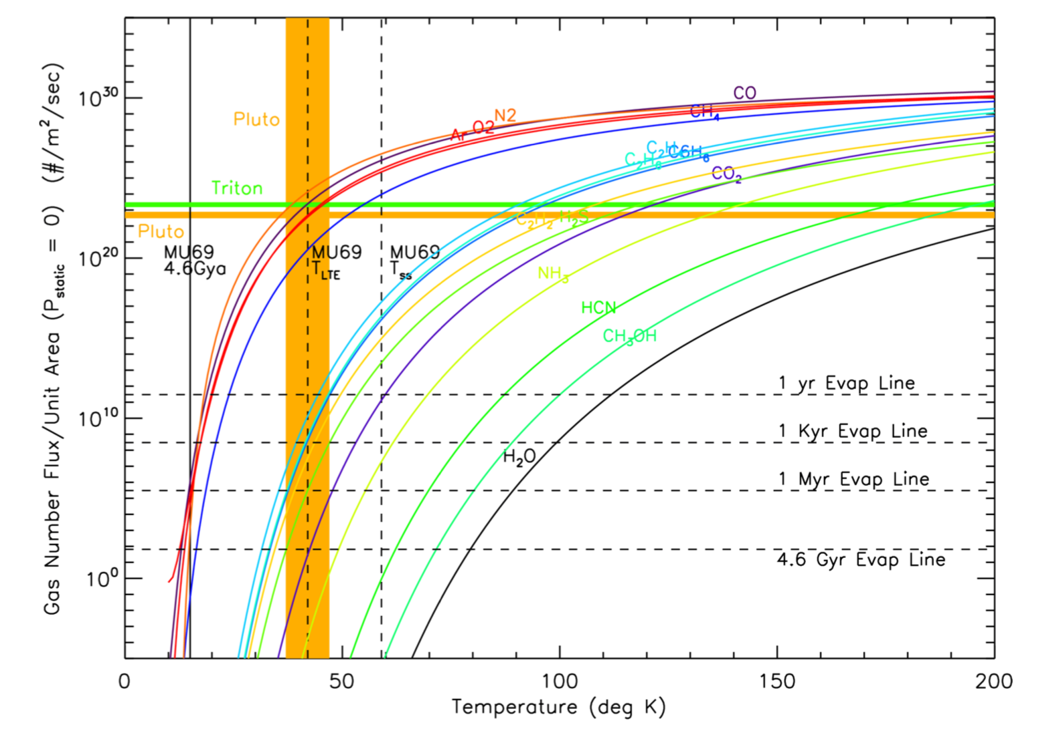
Retention of volatiles
Hypervolatiles (CH₄ / CO / N₂)
lost under vacuum pressure and microgravity in ~1 Myr for 40 K
Retained for long times if formed < 20K
Formation of MU69 in an optically thick disk keeps the interior cold enough to allow the volatiles to remain frozen.
Lisse+Lyra ’20

Slide 25
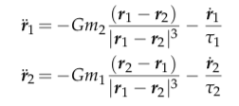
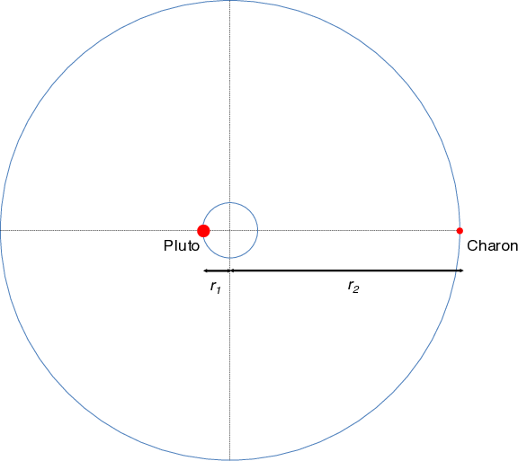
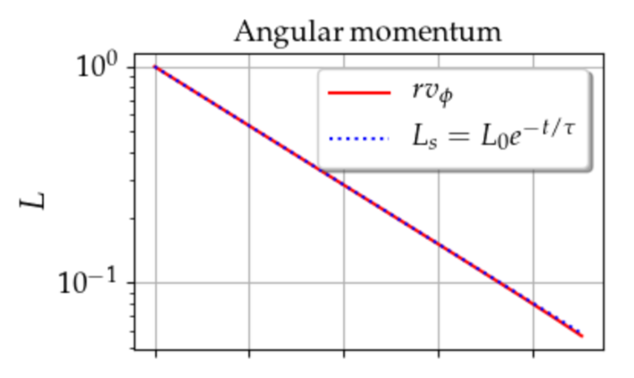
Angular momentum loss via nebular drag
gravity
drag
Can gas drag alone harden the
binary to contact?
For equal mass:
Ultima
Thule
Exponential decay of angular momentum !
W. Lyra
Lyra, Youdin, & Johansen (2021)

Slide 26
Hardening during disk lifetime
For unequal mass the physics is similar, the
drag time is just replaced by an effective drag time:
Effective drag time
Exponential decay of angular momentum
Ultima
Thule
W. Lyra
Lyra, Youdin, & Johansen (2021)

Slide 27
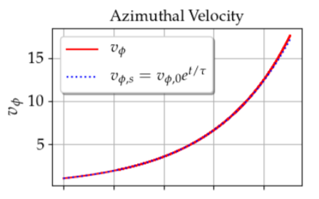
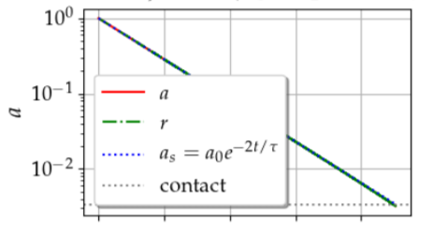
Analytical solution
Exponential decay of angular momentum
Exponential decay of semimajor axis
Exponential increase of orbital velocity
W. Lyra
Lyra, Youdin, & Johansen (2021)

Slide 28
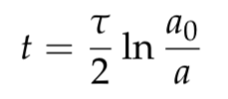
Analytical solution
Time until contact
For a = 0.1 r_{H} (6000 km), hardening to a₀=20km and τΩ=10⁷ …
t ~ 100 Myr
W. Lyra
Lyra, Youdin, & Johansen (2021)

Slide 29
Wind
Low pressure
Planetesimal
High pressure
The gas has some pressure support.
The planetesimal has none.
Gas
Sun

Slide 30
Wind
Binary orbital velocity ~ 10 cm/s
Solar orbit velocity at 42AU ~ 4.5 km/s
Subkeplerian pressure support
Ω = Ω_{k} (1−η) ; η∼1% (50 m/s)
Subkeplerian wind on the binary
= 100 times orbital velocity
v
L1
L2
v
100 v
W. Lyra
Lyra, Youdin, & Johansen (2021)

Slide 31
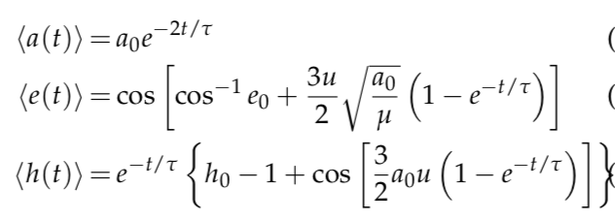
Wind solution
Lyra, Youdin, & Johansen (2021)

Slide 32
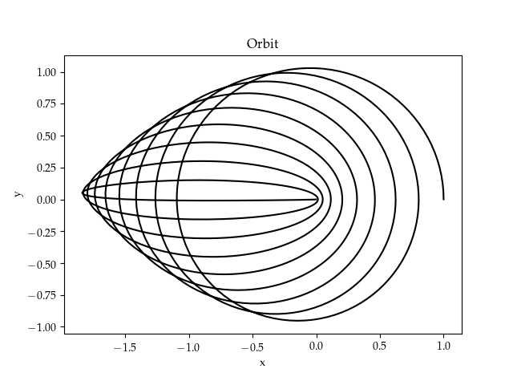
Wind solution
Angular momentum loss at constant energy.
Eccentricity increase at constant semimajor axis
Lyra, Youdin, & Johansen (2021)

Slide 33
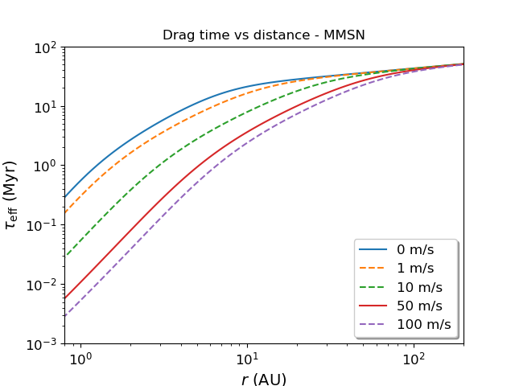
Timescales
Wind has a strong effect in the distances of the asteroid belt.
No effect in the Kuiper belt.
Lyra, Youdin, & Johansen (2021)

Slide 34
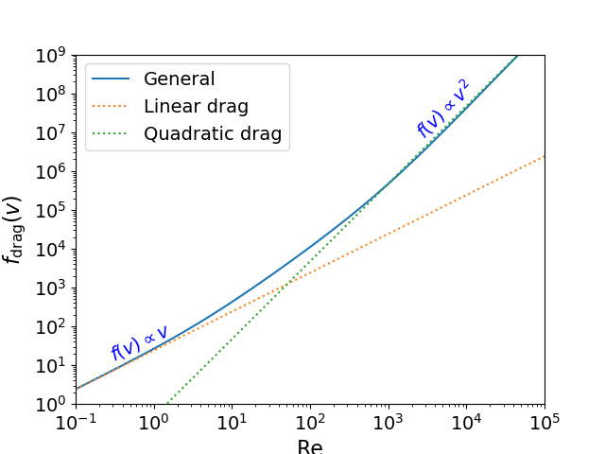
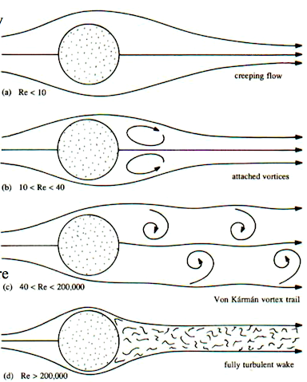
Linear vs quadratic drag
Reynolds number
Viscous
Turbulent
Lyra, Youdin, & Johansen (2021)

Slide 35
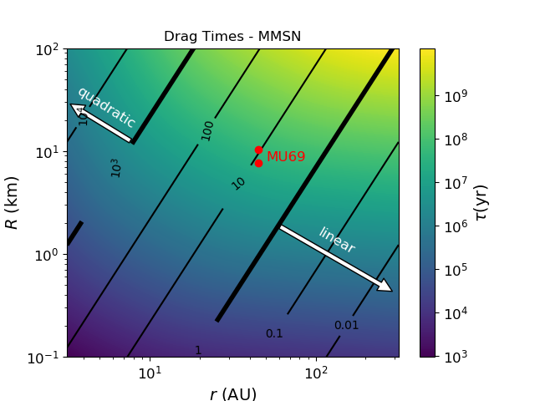
Linear vs quadratic drag
Lyra, Youdin, & Johansen (2021)

Slide 36
Linear vs quadratic drag
v
L1
L2
v
100 v
Lyra, Youdin, & Johansen (2021)

Slide 37
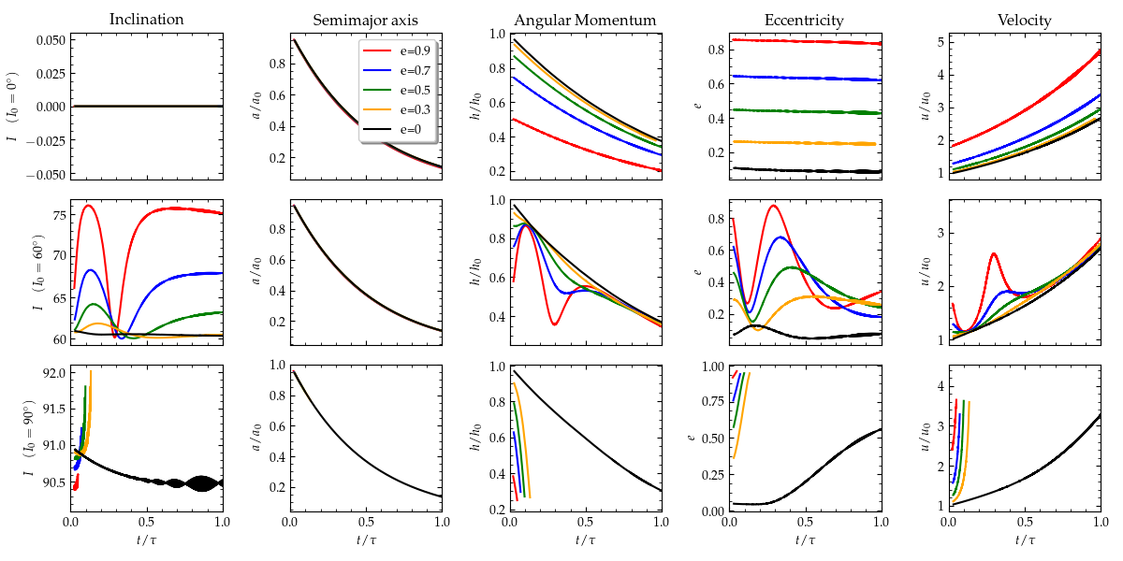
Effect of Inclination
I₀ = 0º
I₀ = 60º
I₀ = 90º
Lyra, Youdin, & Johansen (2021)

Slide 38
I₀ = 90º inclination
Lyra, Youdin, & Johansen (2021)

Slide 39
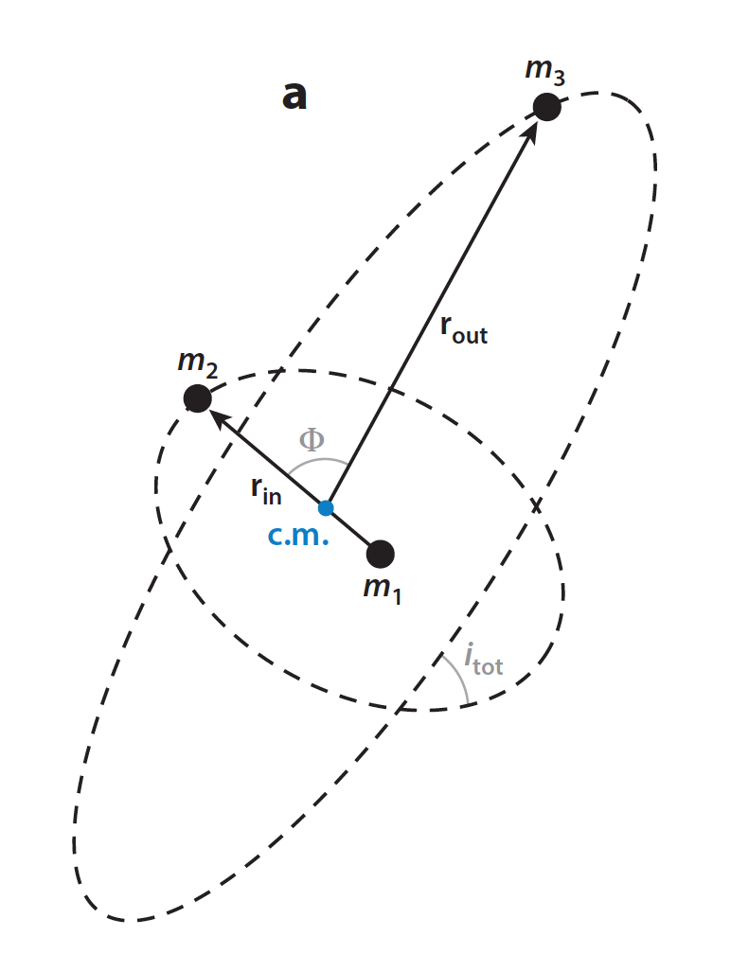
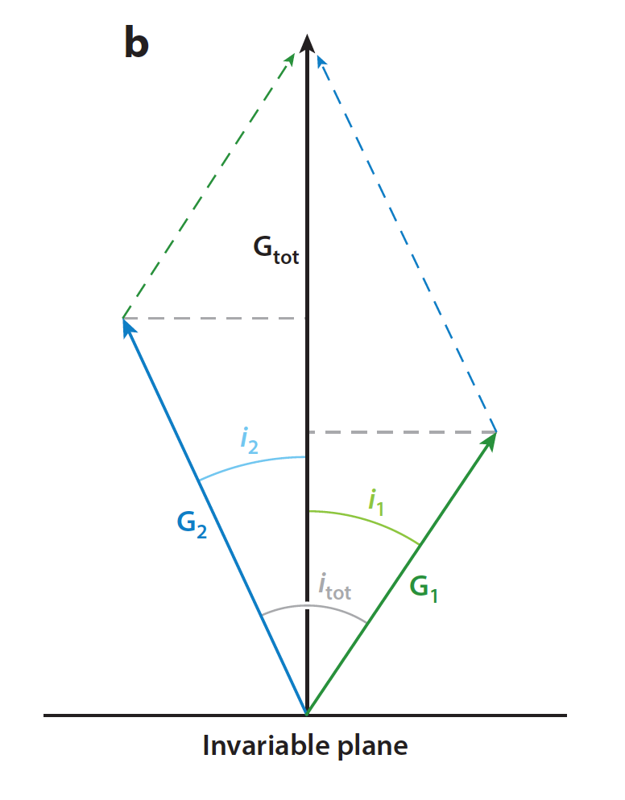
Kozai-Lidov Oscillations
Angular
Momentum
Conserved quantity is not angular momentum, but vertical angular momentum
Naoz 2016

Slide 40
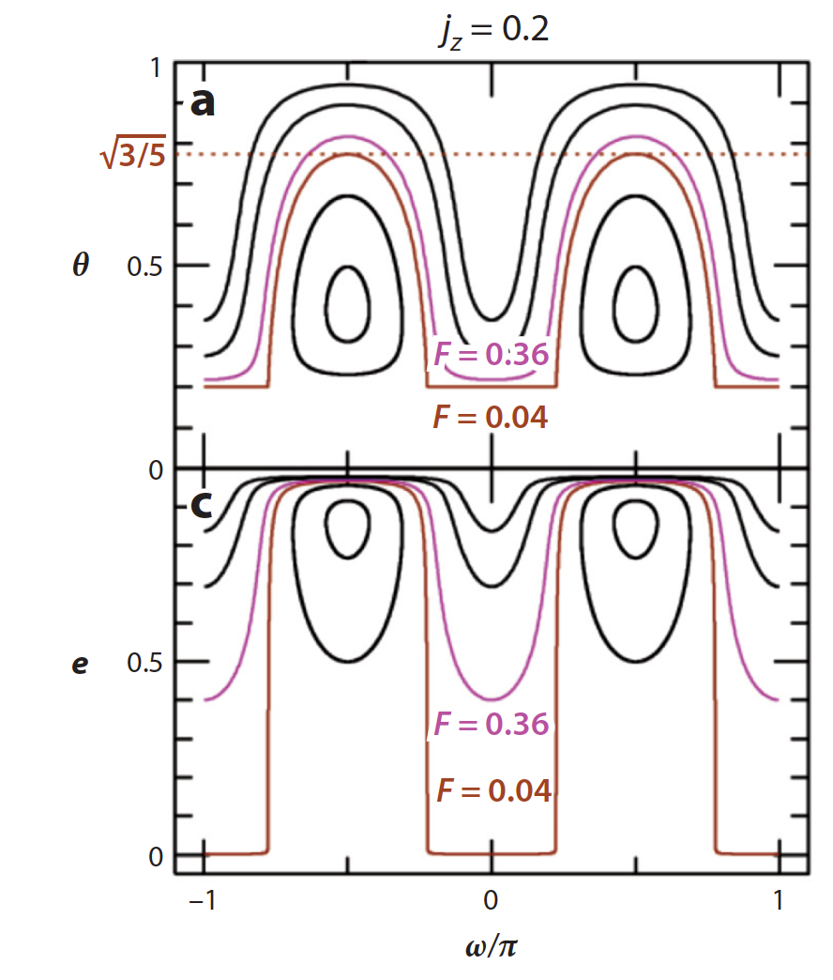
Kozai-Lidov Oscillations
cos I
Conserved quantity is not angular momentum, but vertical angular momentum
j_{z} = (1-e²)^{1/2} cos I
Cycles of inclination and eccentricity.
Naoz 2016

Slide 41
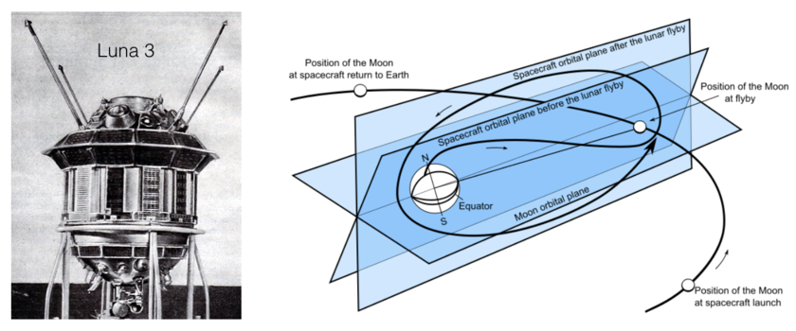
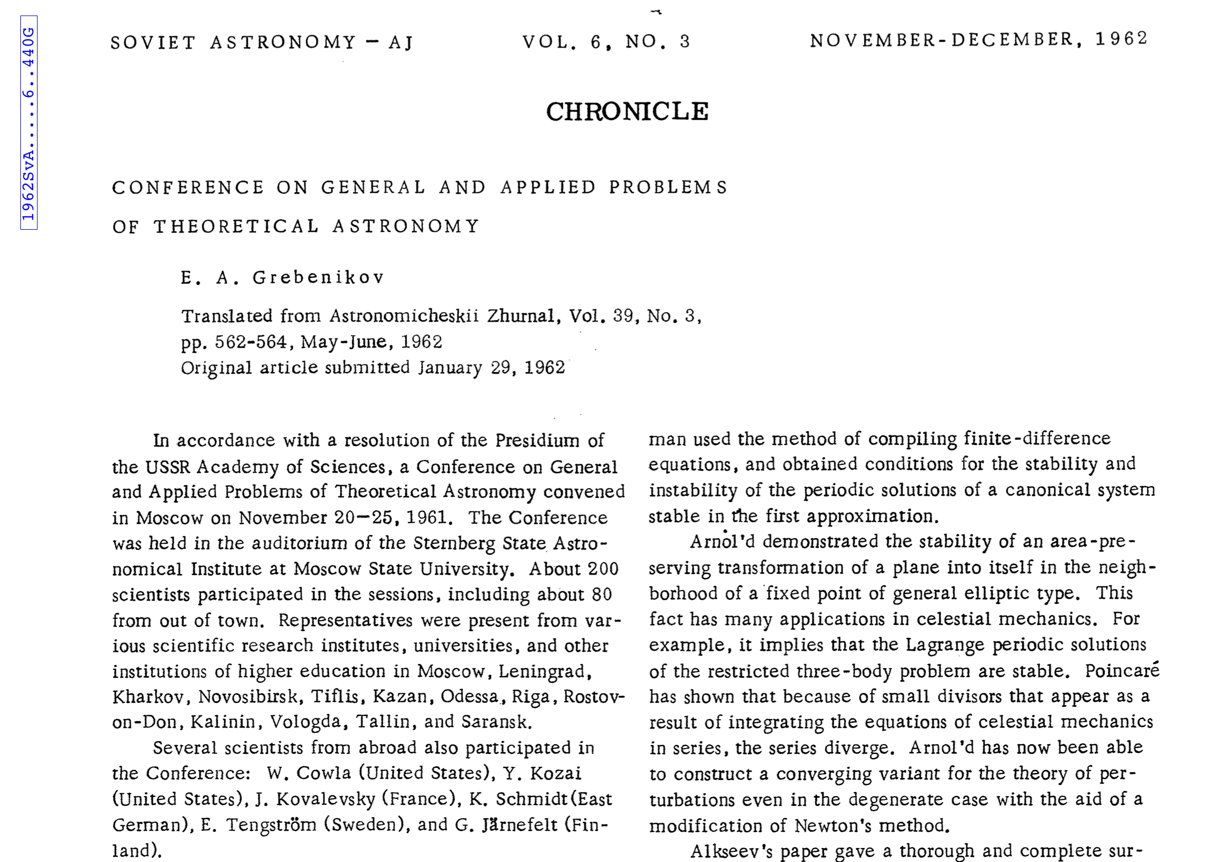
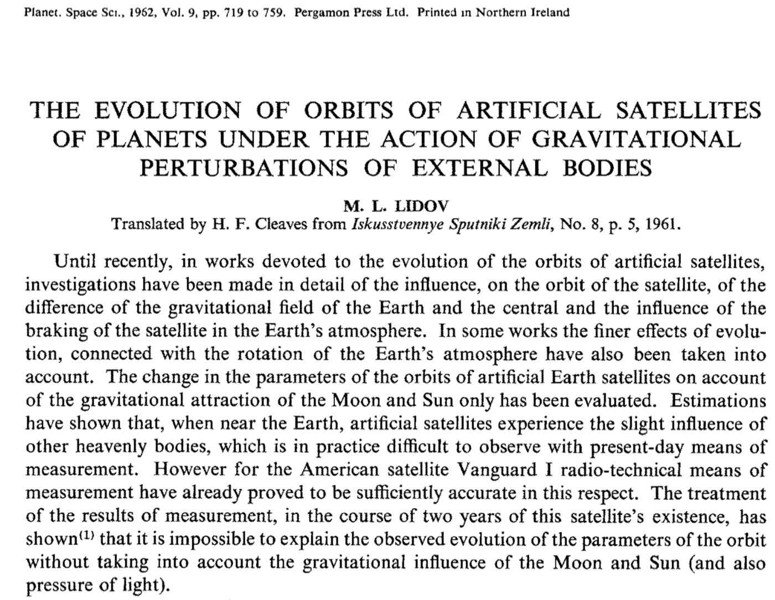
Kozai-Lidov Oscillations

Slide 42
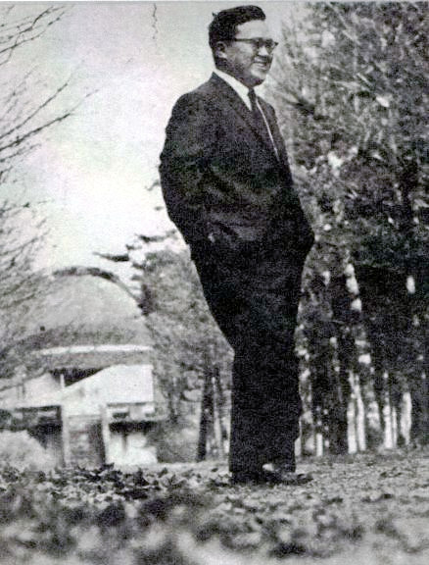
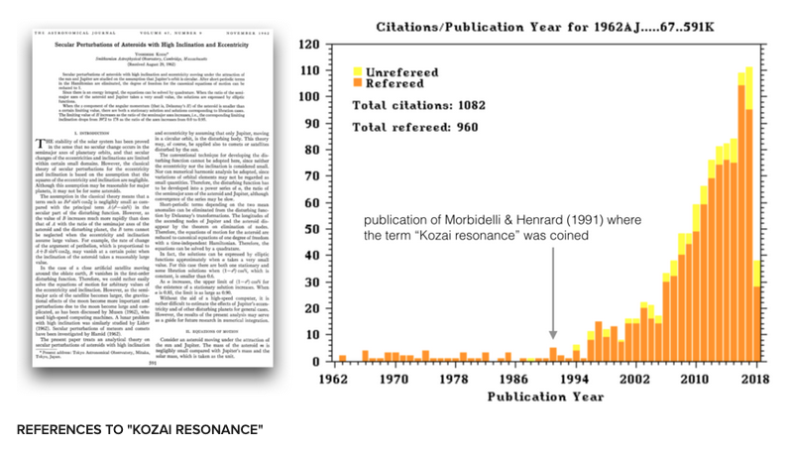
Yoshihide Kozai (1928-2018)

Slide 43
Kozai-Lidov Oscillations

Slide 44
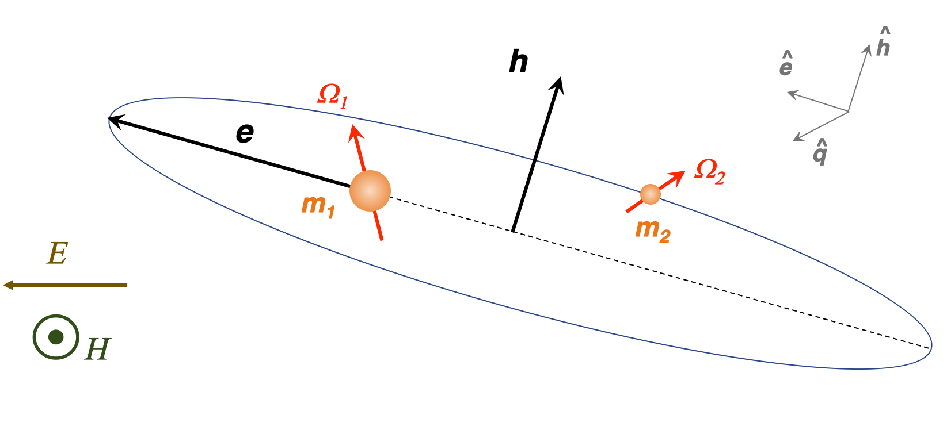
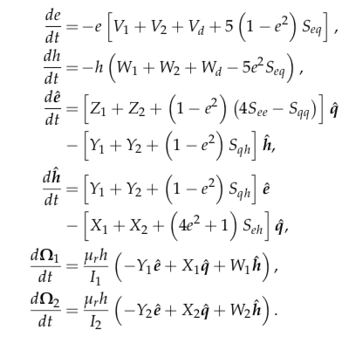
Kozai + Tidal Friction + Drag
Lyra, Youdin, & Johansen (2021)

Slide 45
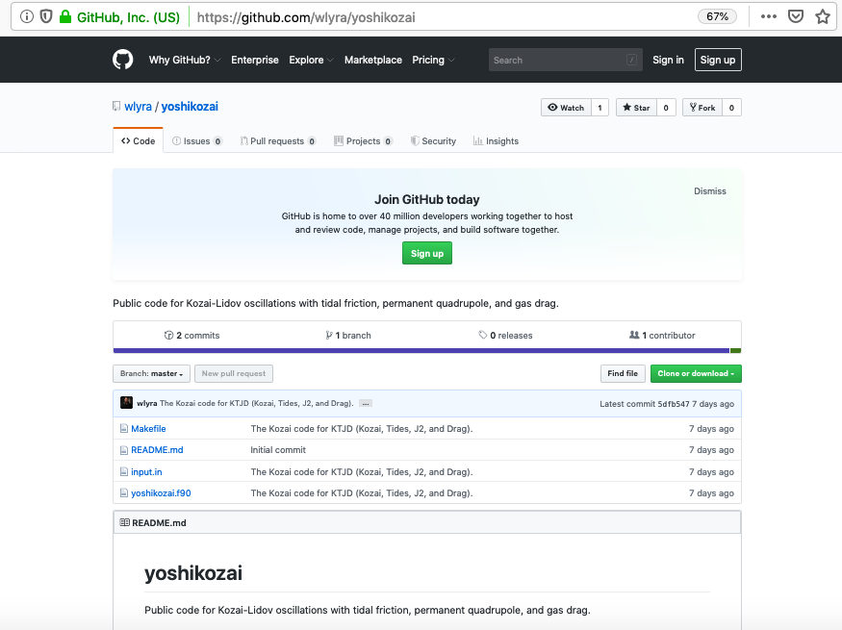
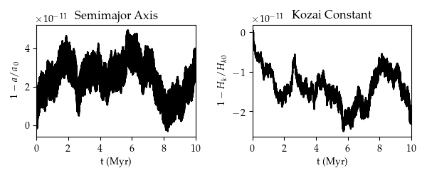
Lyra, Youdin, & Johansen (2021)

Slide 46
Critical Inclination
Lyra, Youdin, & Johansen (2021)

Slide 47
Kozai + Tidal Friction + Drag
Lyra, Youdin, & Johansen (2021)

Slide 48
Effect of Drag
Lyra, Youdin, & Johansen (2021)

Slide 49
Fine Tuning of Initial Inclination

Slide 50
Double-Averaged vs Single-Averaged
Lyra, Youdin, & Johansen (2021)

Slide 51
N-body simulations (no tides, J2, or drag)
Pericenter
Time to contact
Inclination at contact
Speed at contact
Grishin et al. (2020)

Slide 52
N-body simulations (no tides, J2, or drag)
Inclination at contact
Uniform
any inclination (from 40º to 140º) equally likely
Grishin et al. (2020)

Slide 53
N-body simulations (no tides, J2, or drag)
Time to contact
Too short to allow for alignment
Grishin et al. (2020)
Grishin et al. (2020)

Slide 54
Conclusions
Solved the binary planetesimal problem with gas drag
Implemented the solution into a Kozai plus tidal friction code
Contact possible in the asteroid belt within 0.1 Myr (depleted of binaries)
Contact via Kozai cycles in the Kuiper belt, orbits become grazing
Window of contact increased by J₂ and drag
Enough time for the bodies to come to alignment
Model predictions:
~ 10% of KBCC binaries should be contact binaries
Velocities at contact should be about 3-4 m/s
Open questions:
Single-averaged (or N-body) needed to reproduce final inclinations
Combine our model with single-averaged Kozai (or N-body)
Sketch by J.T. Keane
Lyra, Youdin, & Johansen (2021)

