Slide 1
Evolution of MU69
from a binary planetesimal into contact
via Kozai-Lidov oscillations and nebular drag
Funding
NFDAP – 2019
XRP – 2018
XRP - 2016
Wladimir Lyra
New Mexico State University
NRAO - 2017
HST - 2016
Computational Facilities
Tucson, Mar 2nd, 2020

Slide 2
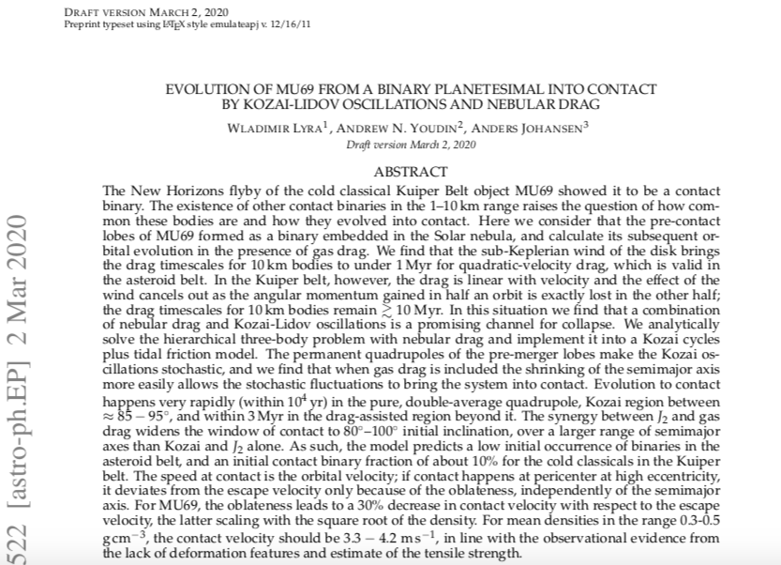

Slide 3
Effect of Drag
Lyra, Youdin, & Johansen 2020 (submitted)

Slide 4
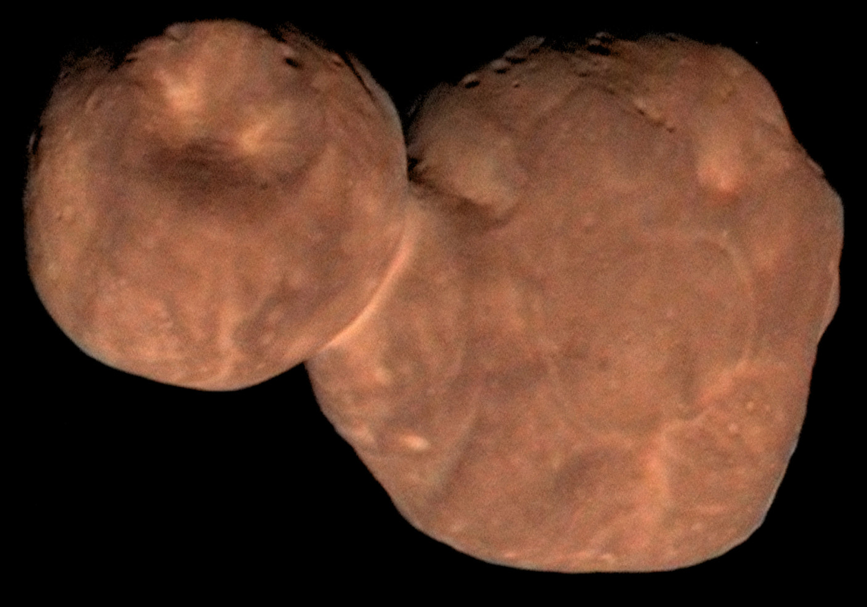
Arrokoth (MU₆₉)
W. Lyra
New Horizons Flyby, Jan 2019

Slide 5
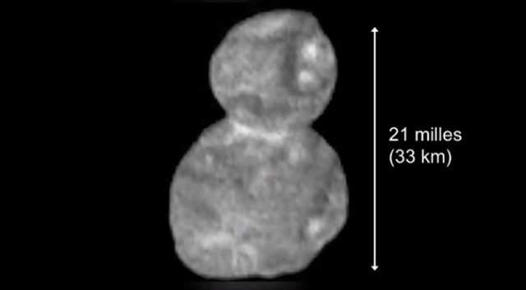
MU₆₉: Dimensions
14km
19km
W. Lyra

Slide 7
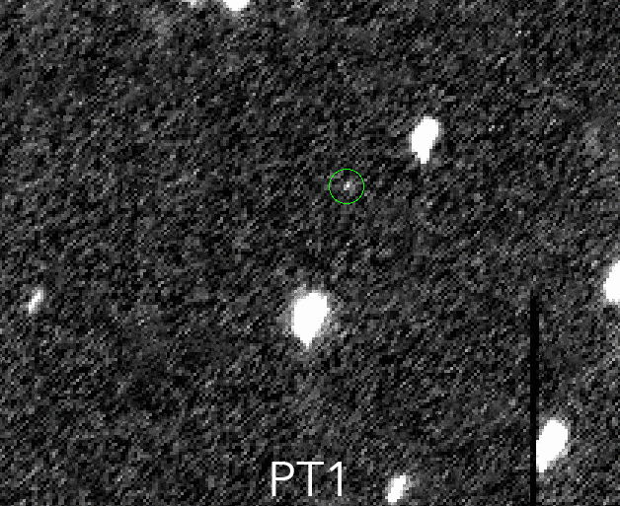
2014 MU₆₉: Discovery
W. Lyra

Slide 8
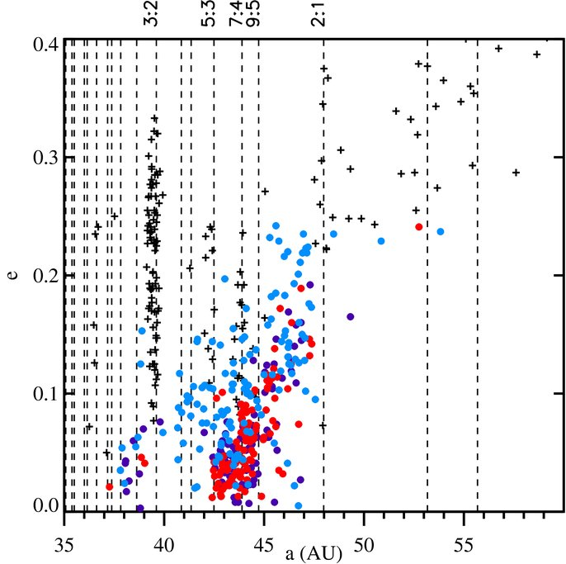
Cold Classical Kuiper Belt Object
+ Resonant and Scattered
Cold Classical i<2º
“Ambiguous” 2º<i<6º
Hot Classicals i>6º
Presumably pristine planetesimals
W. Lyra
Gladman+ ‘08, Batygin+ ’10, Dawson & Murray-Clay ‘12

Slide 9
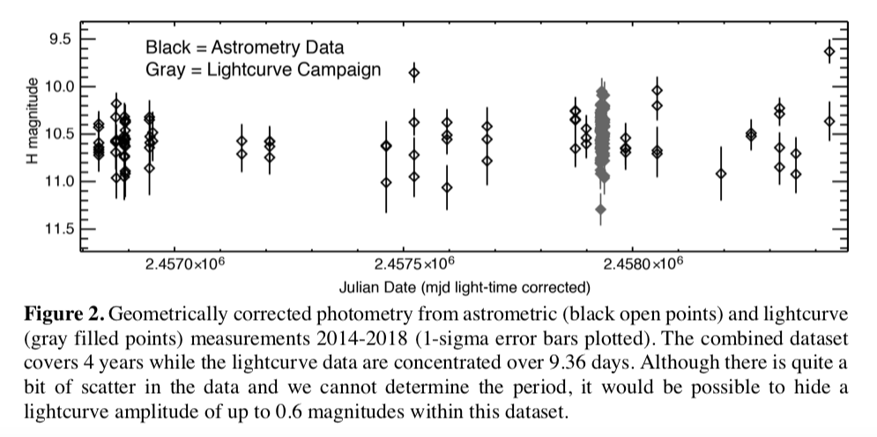
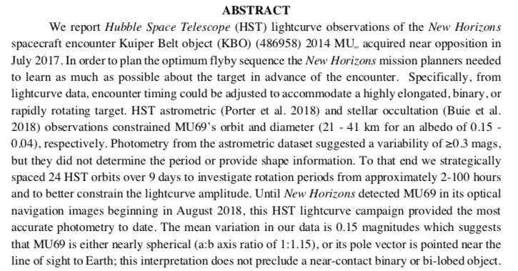

Slide 10
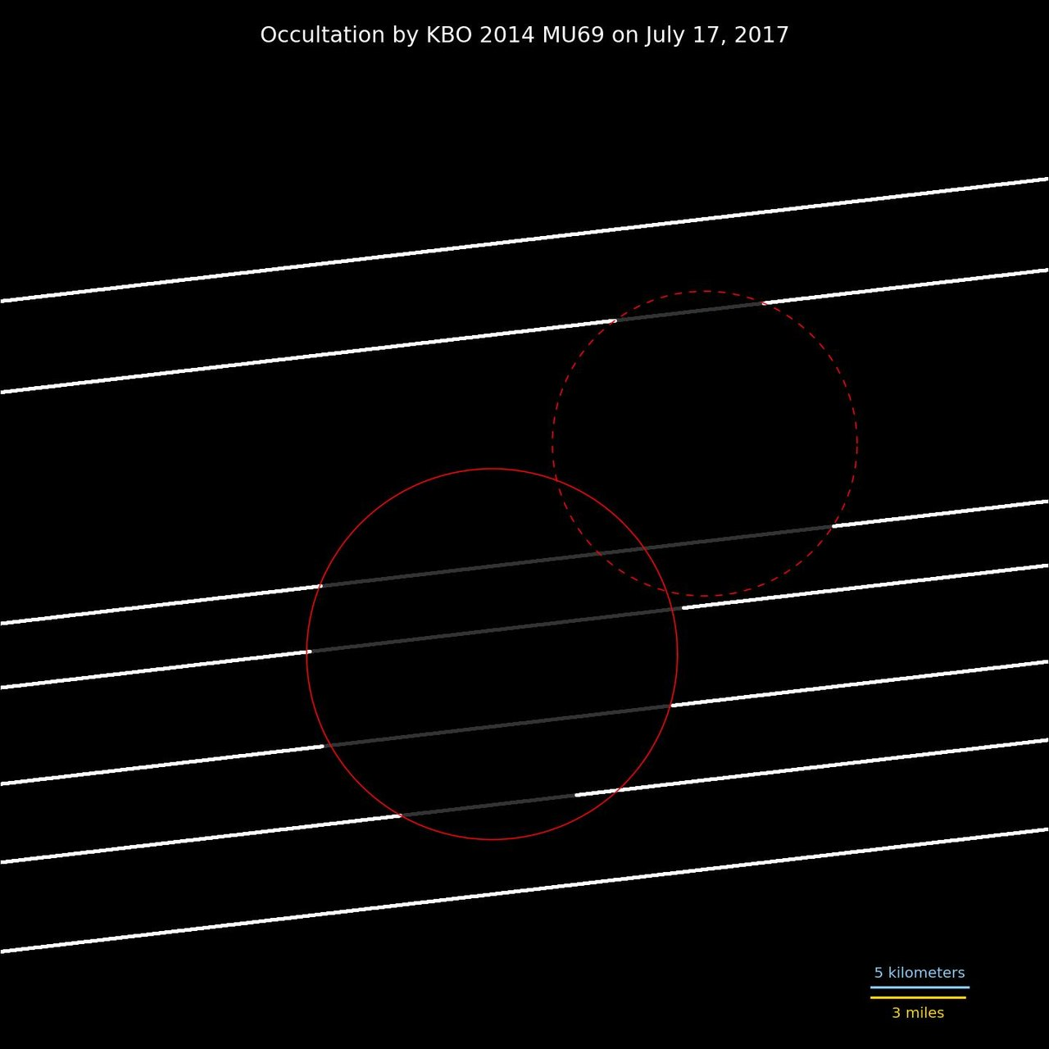
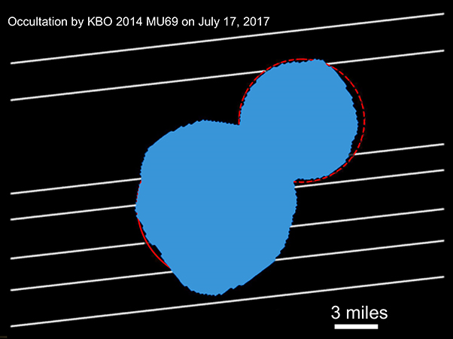
Occultation data suggests binary

Slide 11
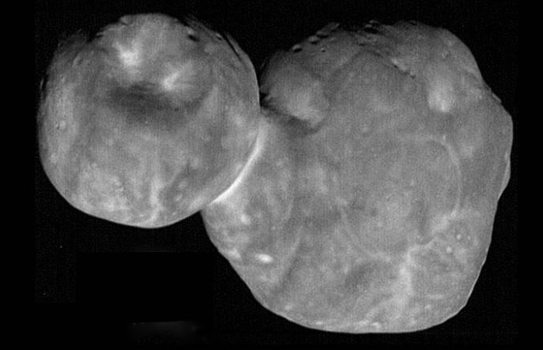
Approach sequence:
Contact binary at inclination 99.3º

Slide 12
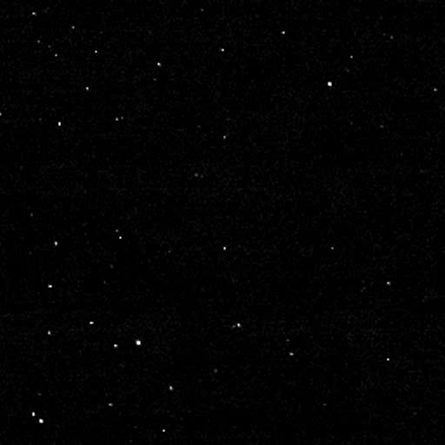
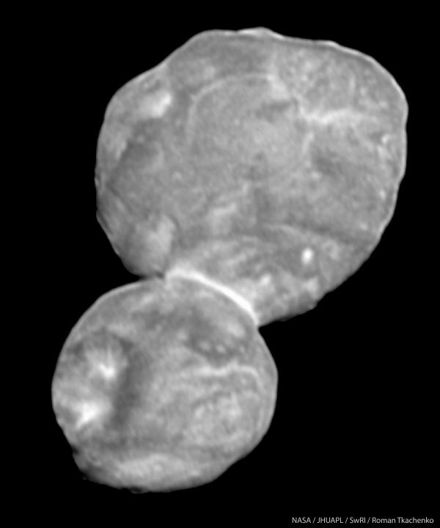
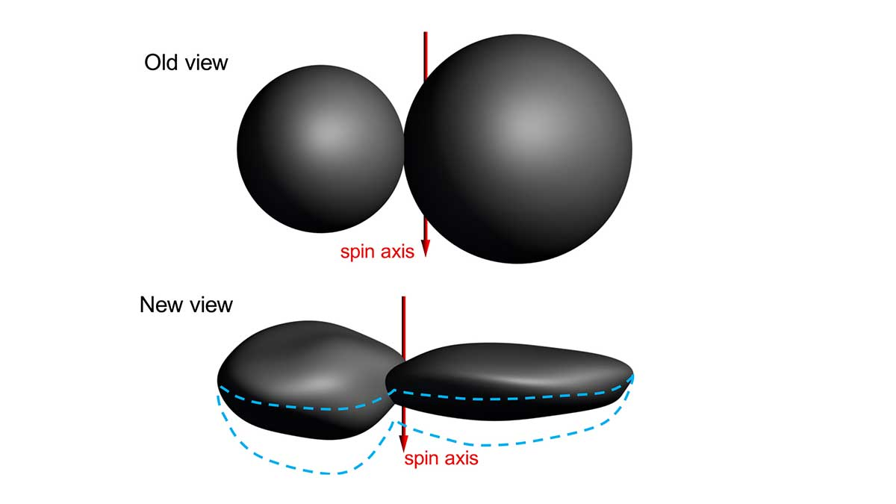
Departure sequence: Shape

Slide 13
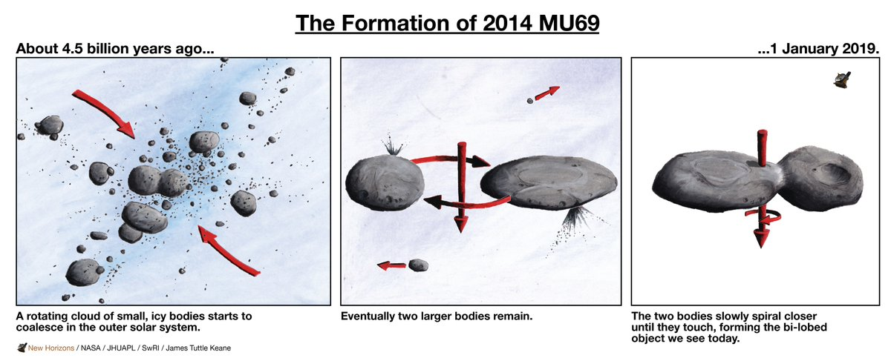
The Cartoon Image
W. Lyra

Slide 14
Beyond the cartoon image
How?
W. Lyra

Slide 15
Streaming Instability
The dust drift is hydrodynamically unstable
Youdin & Goodman (2005), Johansen & Youdin (2007),
Youdin & Johansen (2007), Squire & Hopkins (2018)
W. Lyra

Slide 16
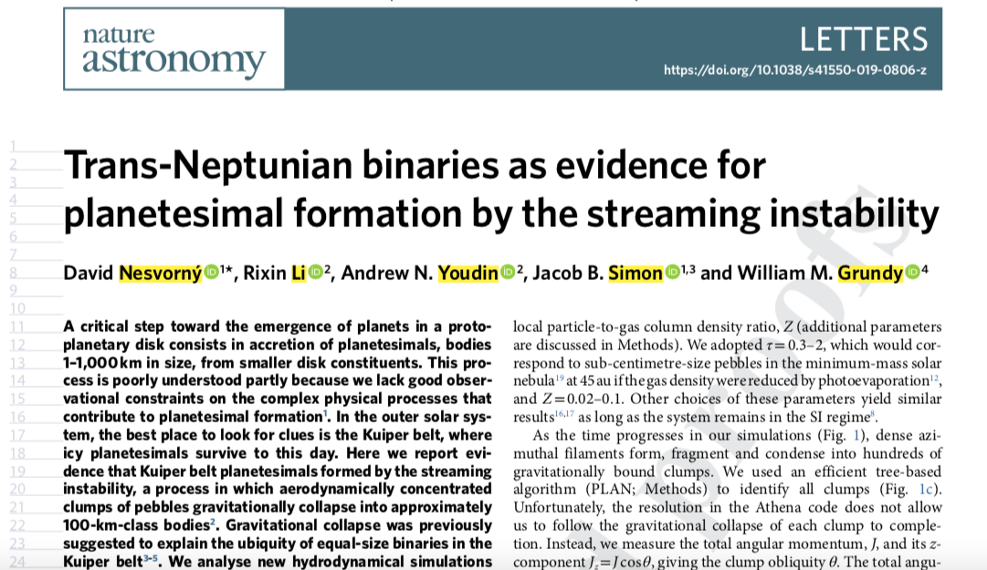
In the lookout for binaries
Nesvorny+’19, model by Rixin Li

Slide 17
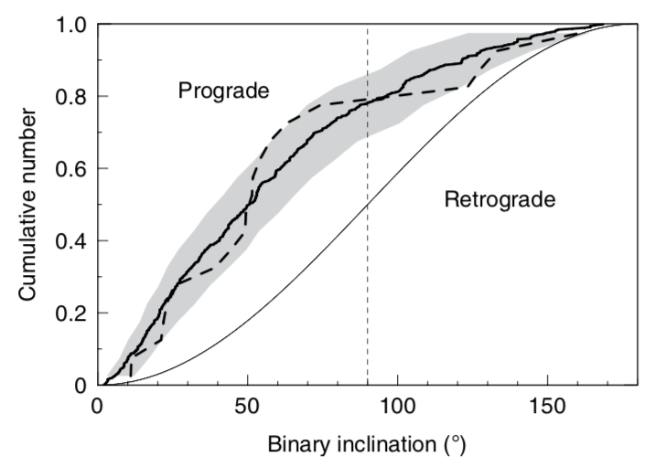
Preference for Prograde (~80%)
SI Model (solid)
KBOs (dashed)
Nesvorny+Li+Youdin ‘19

Slide 18
Notes:
# Fractal presentation

Slide 21
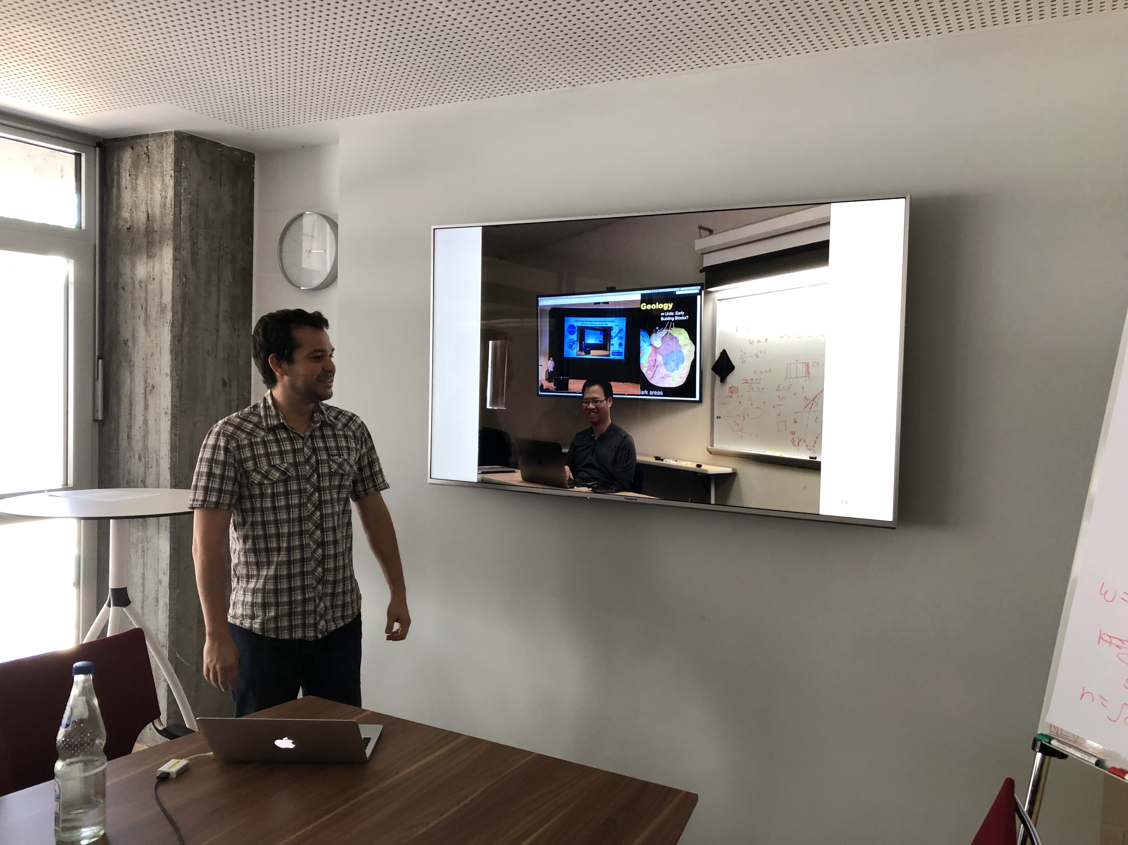

Slide 22
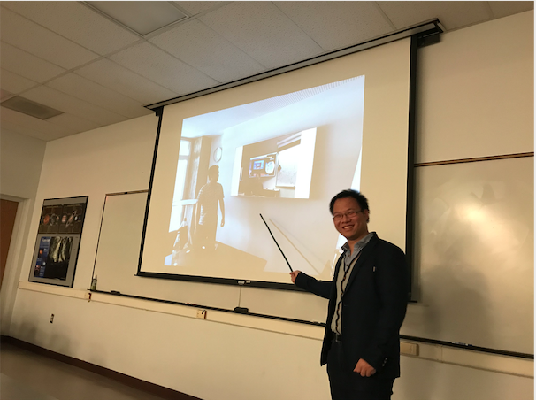

Slide 23
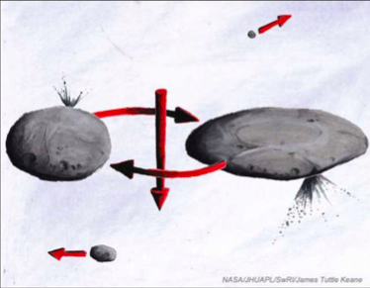
Hardening
Sketch by J.T. Keane

Slide 24
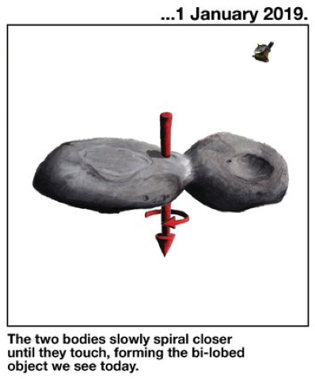
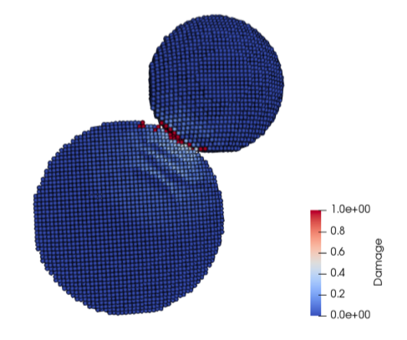
How was angular momentum lost?
Mutual orbit
(i.e., not captured)
Slow merger
(~2 m/s: human walking speed)
Inferred from:
alignment of component minor axes,
small angular momentum,
similar colors.
Inferred from:
Negligible evidence for impact damage

Slide 25
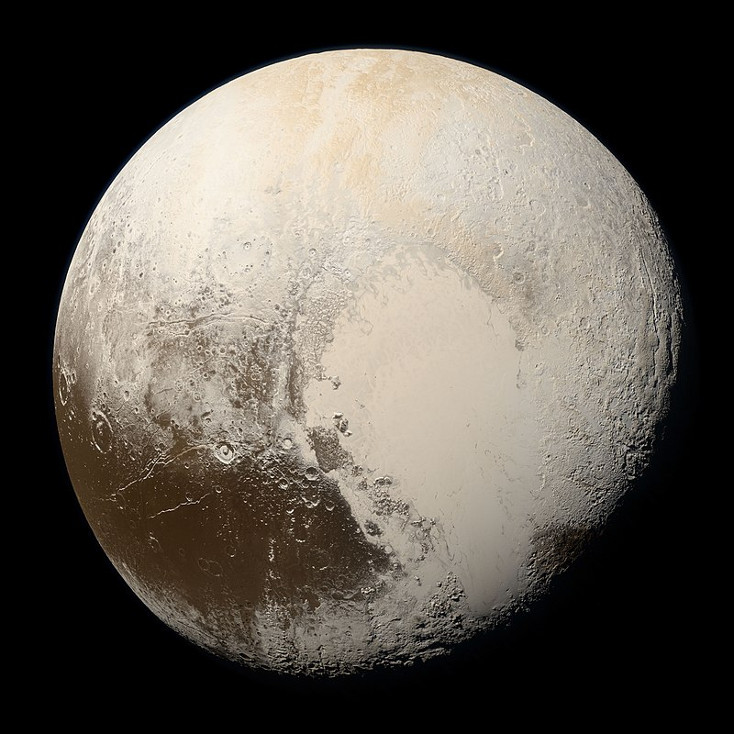

Slide 26
Tombaugh Regio / Sputnik Planitia – N₂ frost
W. Lyra

Slide 27
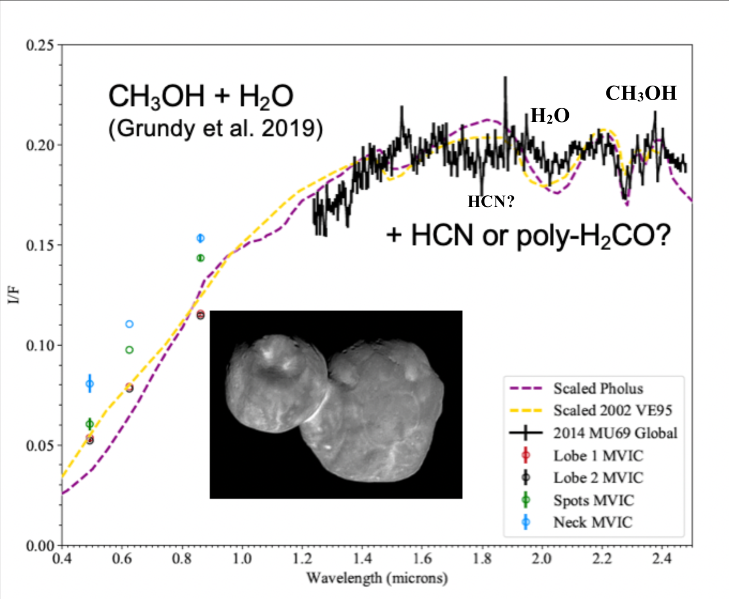
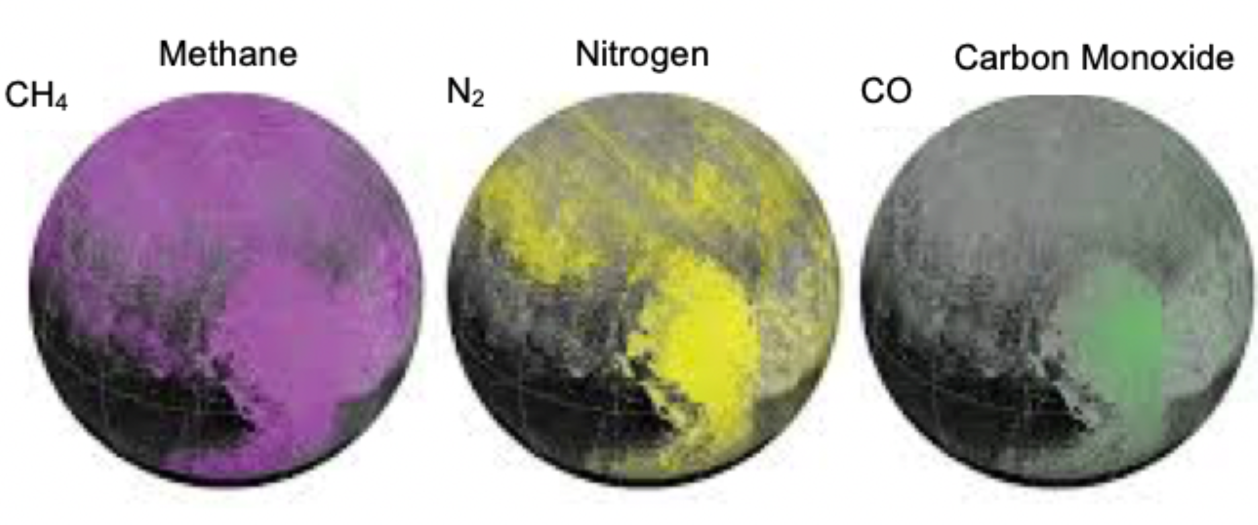
MU69 and Pluto ices are different
MU69 : Methanol, H₂0, HCN
Pluto : CH₄, N₂, CO
Grundy+ ’16, Lisse+Lyra ’20

Slide 28
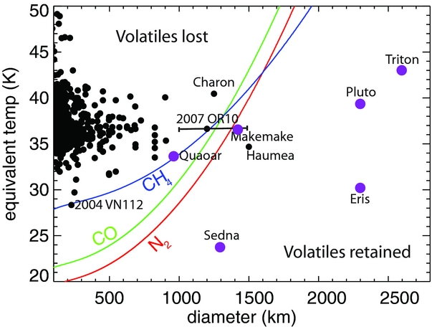
Retention of volatiles
If Pluto is formed from similar bodies to MU69, they must retain N₂
Needs shielding from the sunlight flambé.
W. Lyra
Brown, Burgasser, & Fraser (2011); Lisse+Lyra ‘20

Slide 29
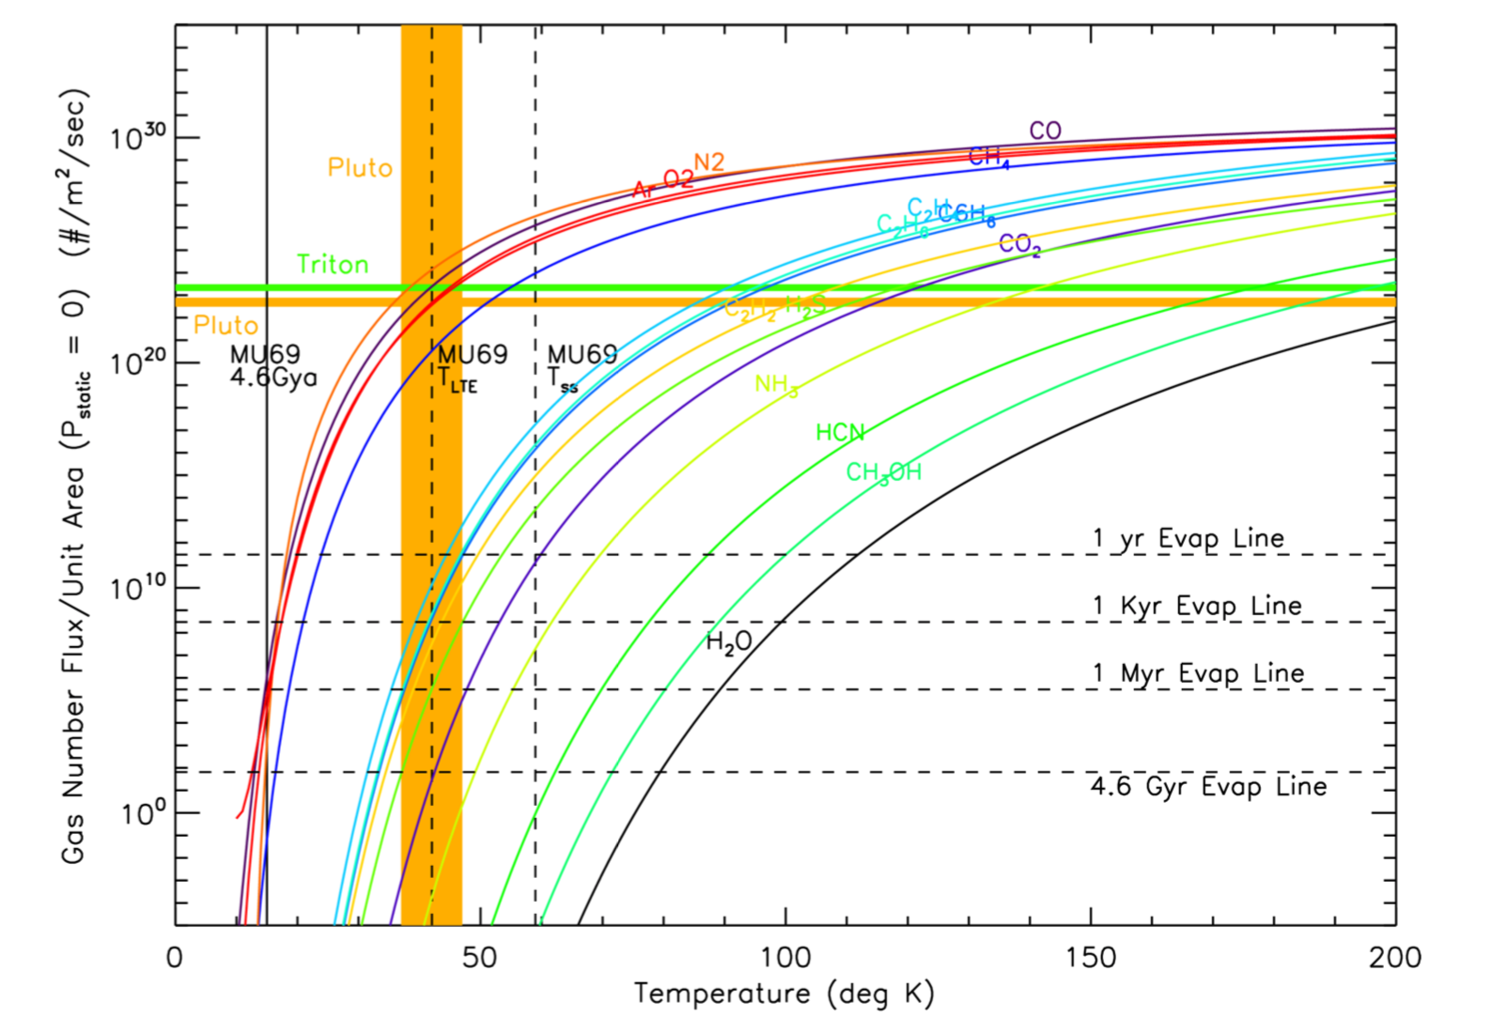
Retention of volatiles
Hypervolatiles (CH₄ / CO / N₂)
lost under vacuum pressure and microgravity in ~1 Myr for 40 K
Retained for long times if formed < 20K
Formation of MU69 in an optically thick disk keeps the interior cold enough to allow the volatiles to remain frozen.
Lisse+Lyra ’20

Slide 30
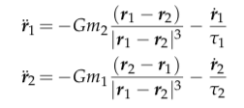
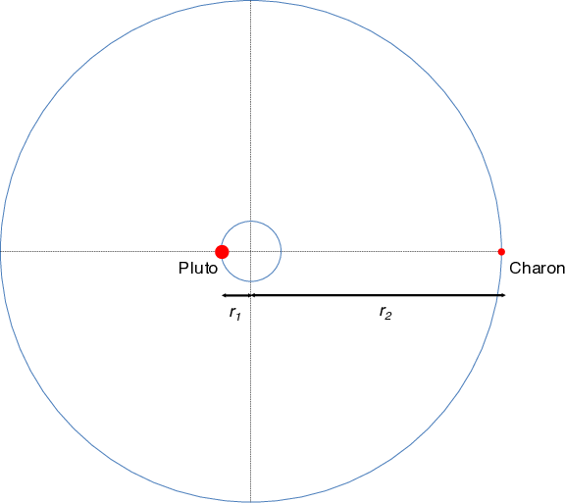
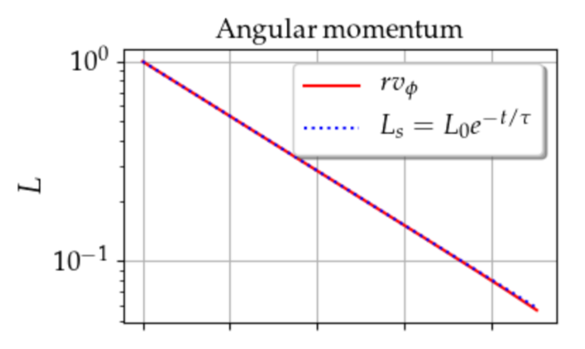
Angular momentum loss via nebular drag
gravity
drag
Can gas drag alone harden the
binary to contact?
For equal mass:
Ultima
Thule
Exponential decay of angular momentum !
W. Lyra
Lyra, Youdin, & Johansen 2020 (submitted)

Slide 31
Hardening during disk lifetime
For unequal mass the physics is similar, the
drag time is just replaced by an effective drag time:
Effective drag time
Exponential decay of angular momentum
Ultima
Thule
W. Lyra
Lyra, Youdin, & Johansen 2020 (submitted)

Slide 32
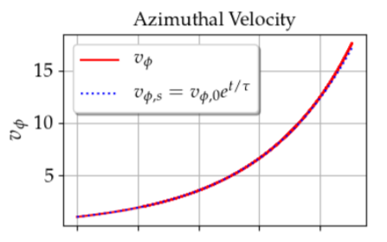
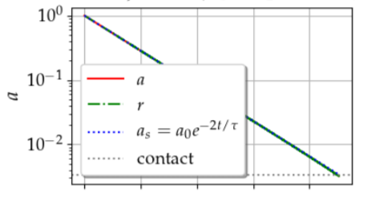
Analytical solution
Exponential decay of angular momentum
Exponential decay of semimajor axis
Exponential increase of orbital velocity
W. Lyra
Lyra, Youdin, & Johansen 2020 (submitted)

Slide 33
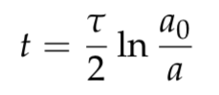
Analytical solution
Time until contact
For a = 0.1 r_{H} (6000 km), hardening to a₀=20km and τΩ=10⁷ …
t ~ 100 Myr
W. Lyra
Lyra, Youdin, & Johansen 2020 (submitted)

Slide 34
Wind
Binary orbital velocity ~ 10 cm/s
Solar orbit velocity at 42AU ~ 4.5 km/s
Subkeplerian pressure support
Ω = Ω_{k} (1−η) ; η∼1% (50 m/s)
Subkeplerian wind on the binary
= 100 times orbital velocity
v
L1
L2
v
100 v
W. Lyra
Lyra, Youdin, & Johansen 2020 (submitted)

Slide 35
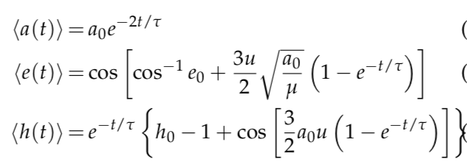
Wind solution
Lyra, Youdin, & Johansen 2020 (submitted)

Slide 36
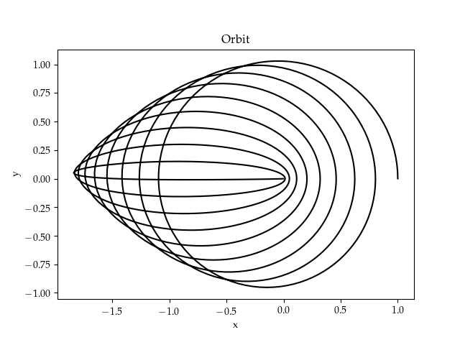
Wind solution
Angular momentum loss at constant energy.
Eccentricity increase at constant semimajor axis
Lyra, Youdin, & Johansen 2020 (submitted)

Slide 37
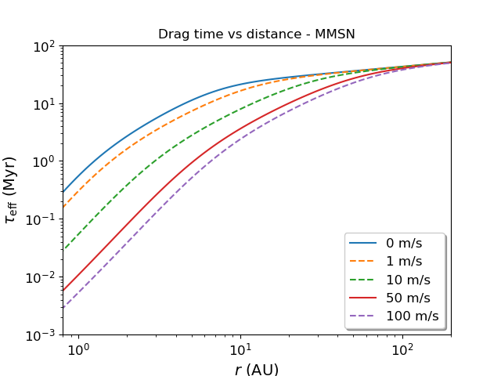
Timescales
Wind has a strong effect in the distances of the asteroid belt.
No effect in the Kuiper belt.
Lyra, Youdin, & Johansen 2020 (submitted)

Slide 38
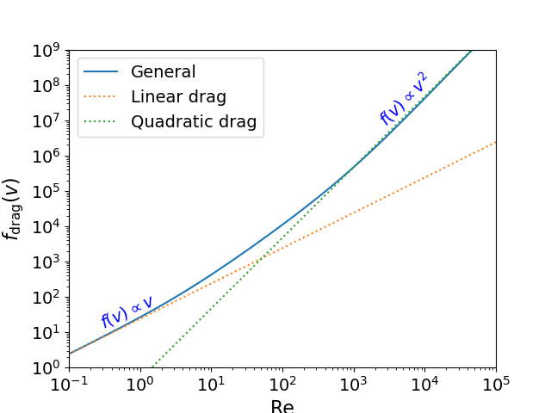
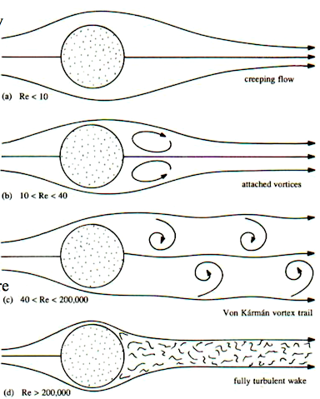
Linear vs quadratic drag
Reynolds number
Viscous
Turbulent
Lyra, Youdin, & Johansen 2020 (submitted)

Slide 39
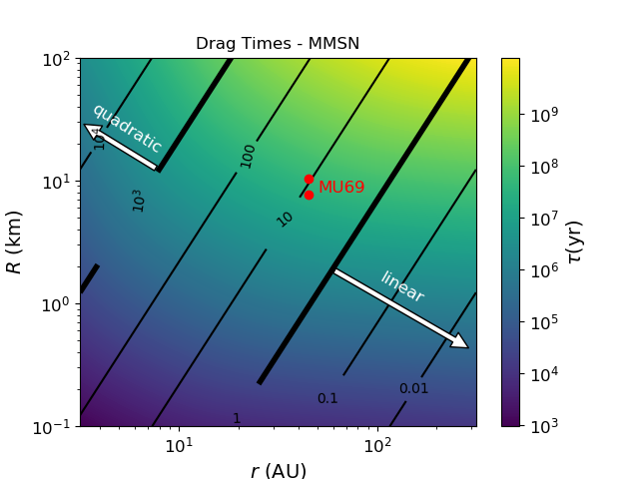
Linear vs quadratic drag
Lyra, Youdin, & Johansen 2020 (submitted)

Slide 40
Linear vs quadratic drag
v
L1
L2
v
100 v
Lyra, Youdin, & Johansen 2020 (submitted)

Slide 41
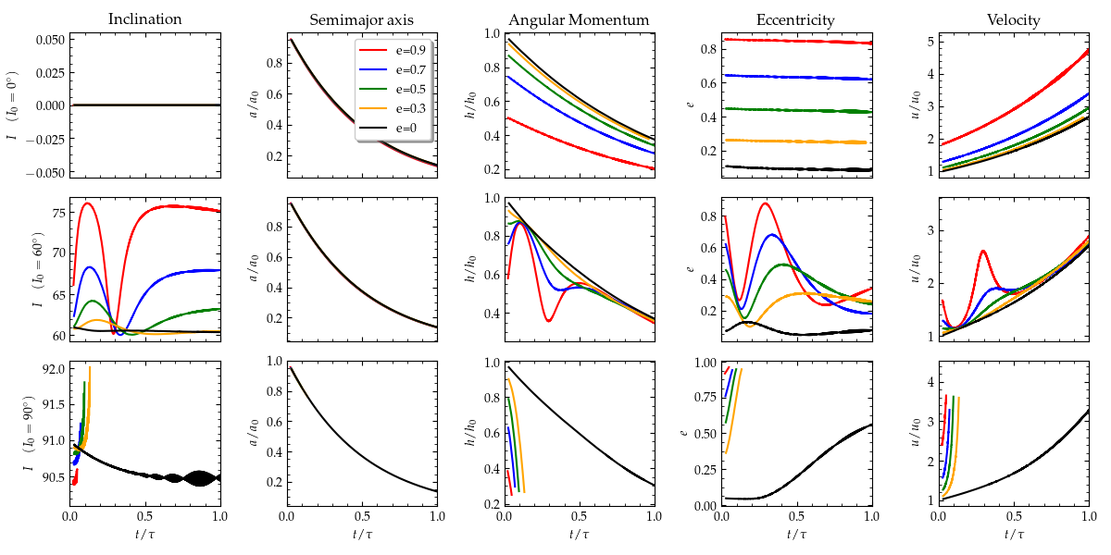
Effect of Inclination
I₀ = 0º
I₀ = 60º
I₀ = 90º
Lyra, Youdin, & Johansen 2020 (submitted)

Slide 42
I₀ = 90º inclination
Lyra, Youdin, & Johansen 2020 (submitted)

Slide 43
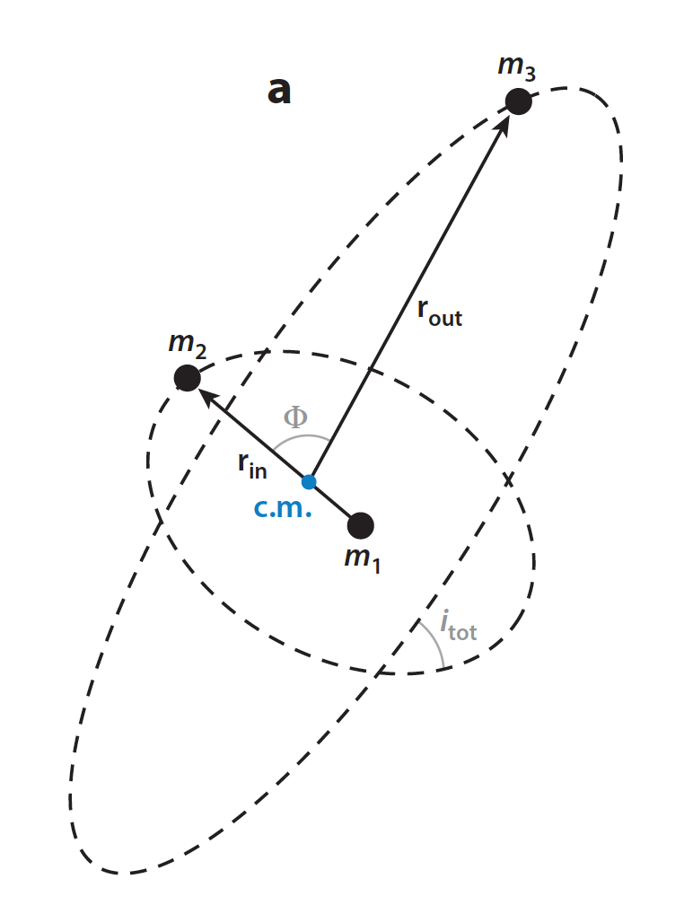
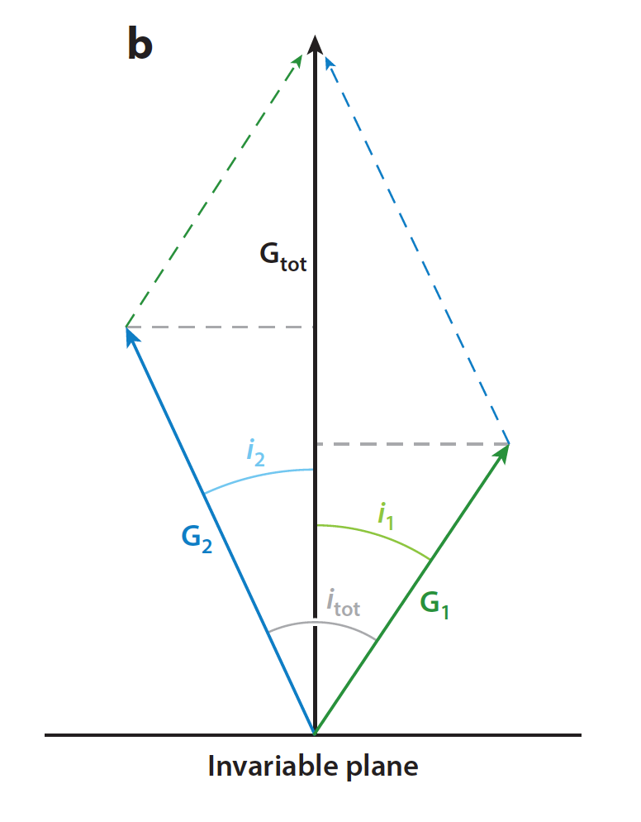
Kozai-Lidov Oscillations
Angular
Momentum
Conserved quantity is not angular momentum, but vertical angular momentum
Naoz 2016

Slide 44
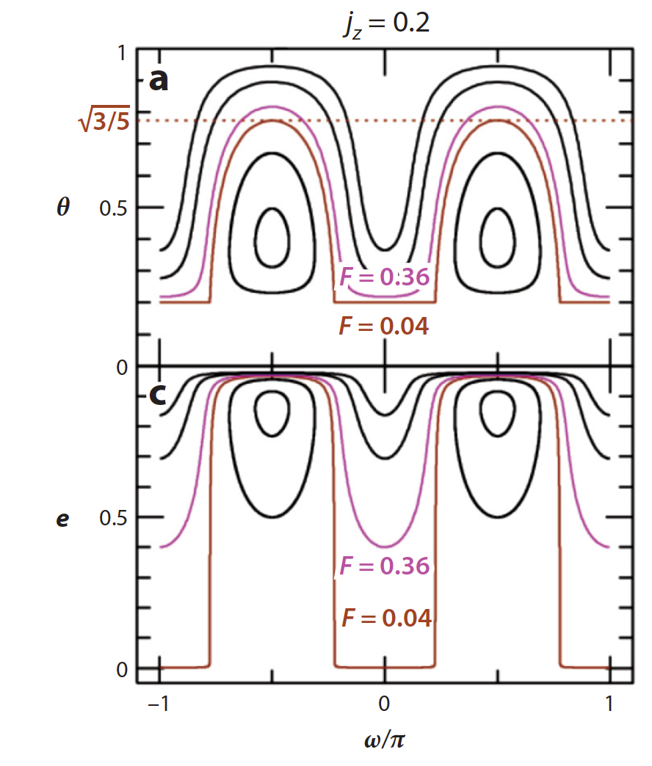
Kozai-Lidov Oscillations
cos I
Conserved quantity is not angular momentum, but vertical angular momentum
j_{z} = (1-e²)^{1/2} cos I
Cycles of inclination and eccentricity.
Naoz 2016

Slide 45
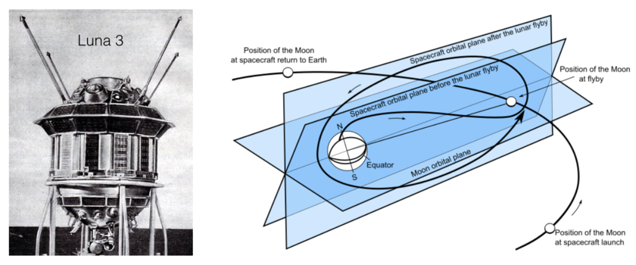
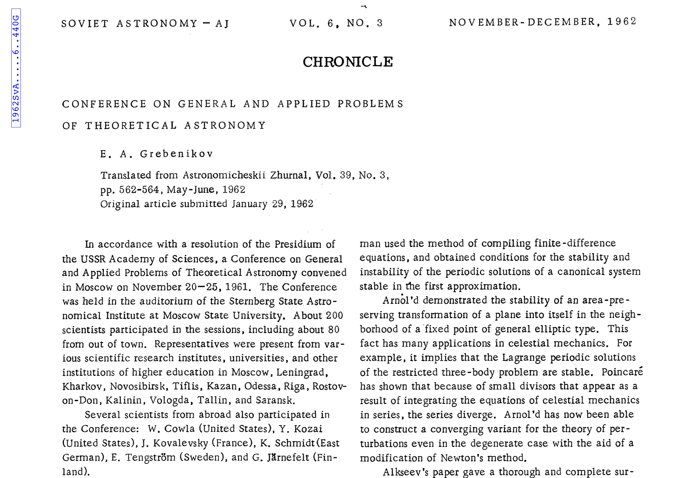
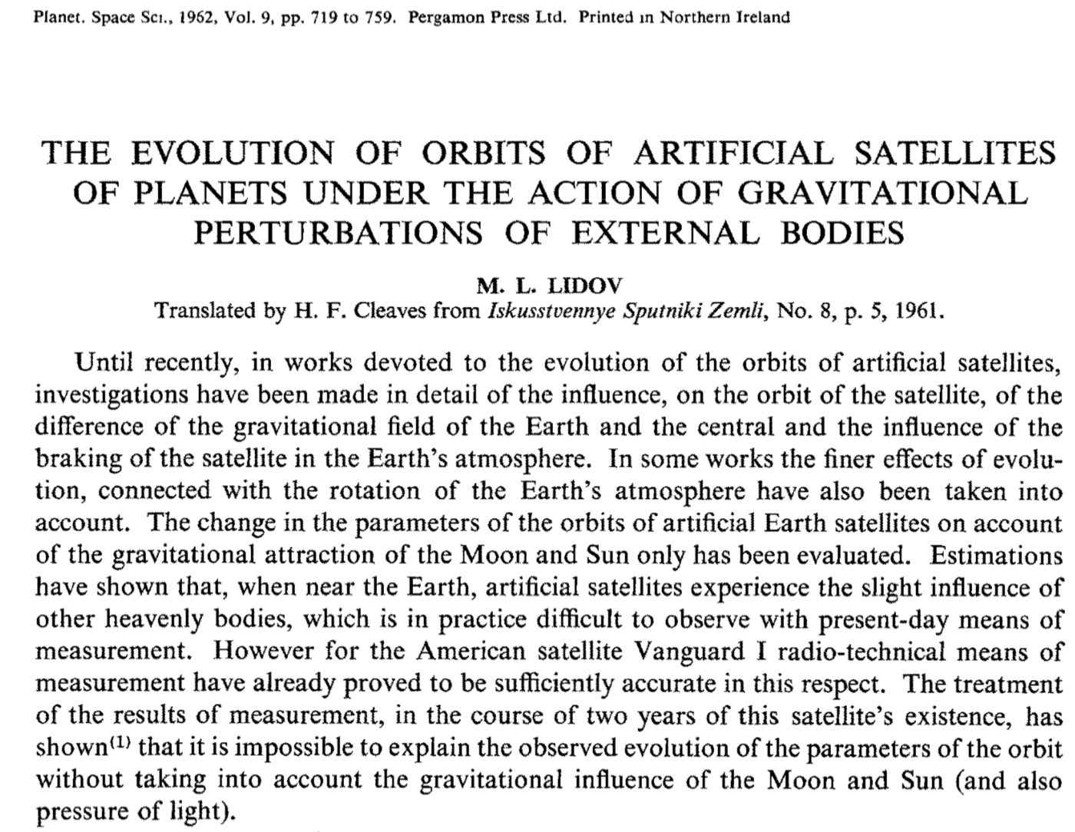
Kozai-Lidov Oscillations

Slide 46
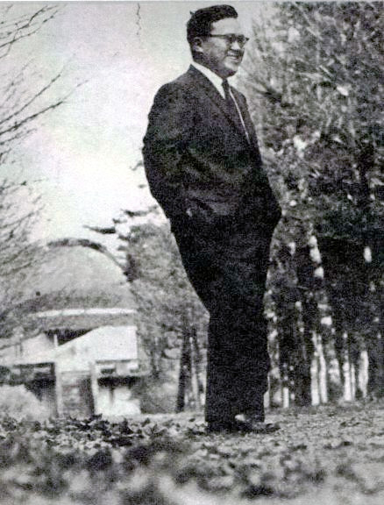
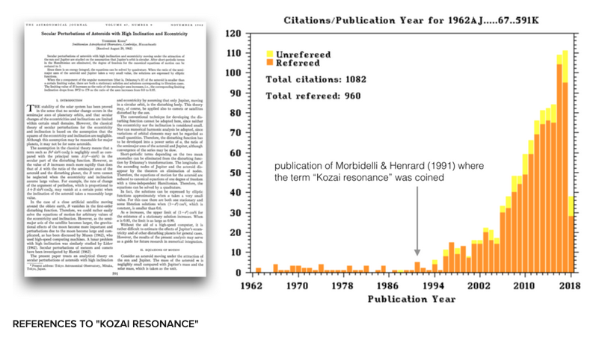
Yoshihide Kozai (1928-2018)

Slide 47
Kozai-Lidov Oscillations

Slide 48
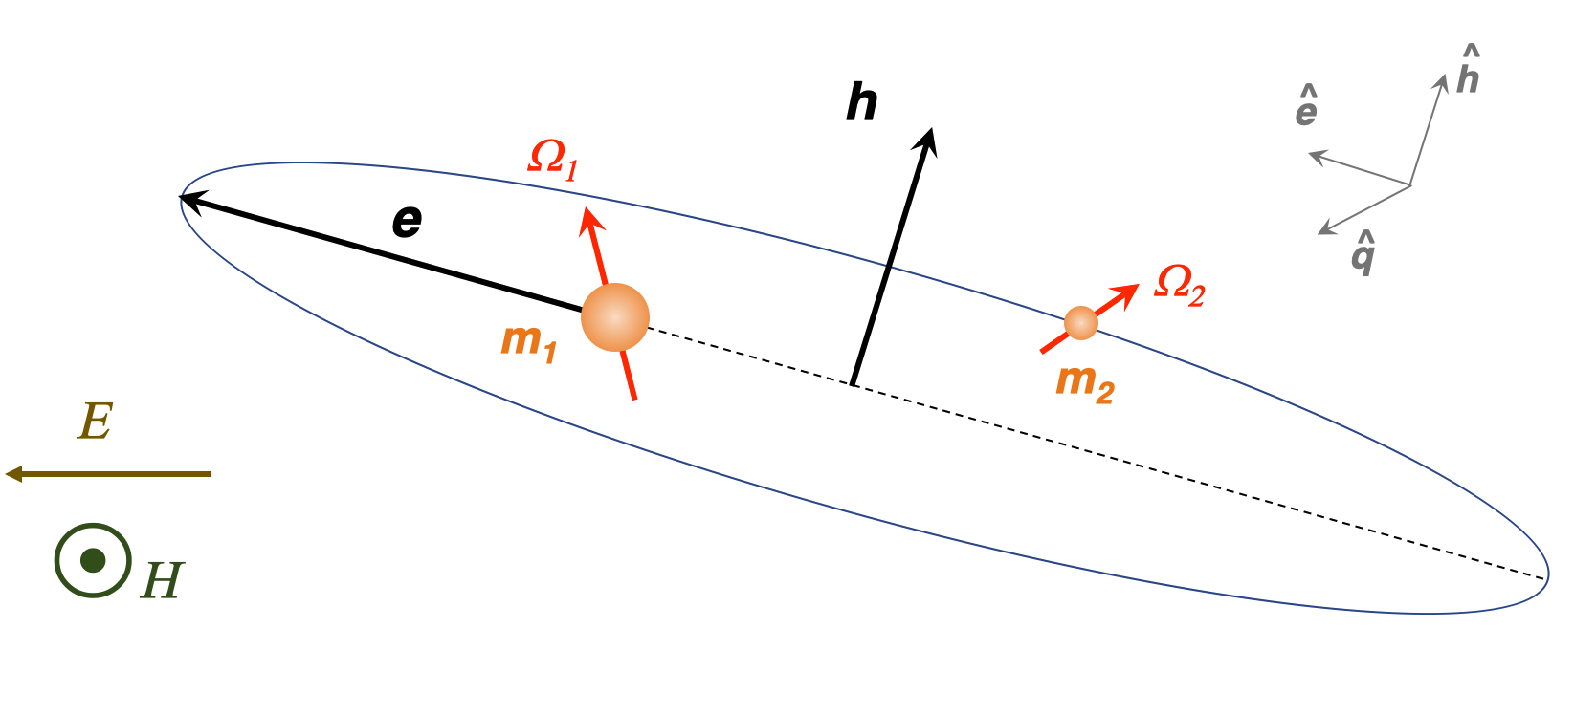
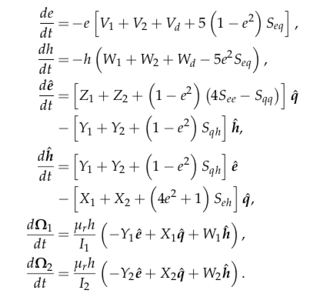
Kozai + Tidal Friction + Drag
Lyra, Youdin, & Johansen 2020 (submitted)

Slide 49
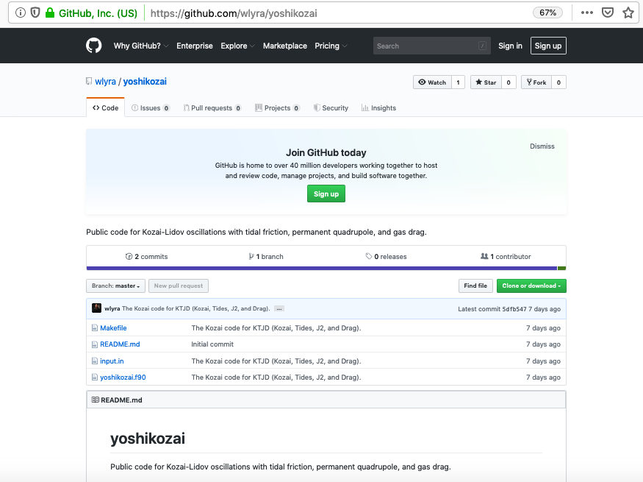
Lyra, Youdin, & Johansen 2020 (submitted)

Slide 50
Critical Inclination
Lyra, Youdin, & Johansen 2020 (submitted)

Slide 51
Kozai + Tidal Friction + Drag
Lyra, Youdin, & Johansen 2020 (submitted)

Slide 52
Effect of Drag
Lyra, Youdin, & Johansen 2020 (submitted)

Slide 53
Fine Tuning of Initial Inclination

Slide 54
Double-Averaged vs Single-Averaged
Lyra, Youdin, & Johansen 2020 (submitted)

Slide 55
Conclusions
Solved the 2-body problem and hierarchical 3-body problem with gas drag
Implemented the solution into a Kozai plus tidal friction code
Contact possible in the asteroid belt within 0.1 Myr (depleted of binaries)
Contact via Kozai cycles in the Kuiper belt, orbits become grazing
Window of contact increased by J₂ and drag
10% of KBCC binaries should be contact binaries
Velocities at contact should be about 3-4 m/s
Lyra, Youdin, & Johansen 2020 (submitted)

