Slide 1
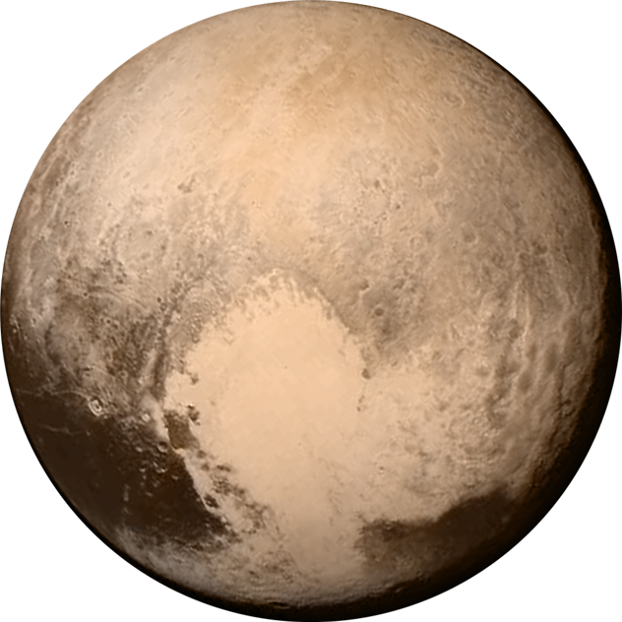





Polydisperse Pebble Accretion
Lessons from the Kuiper belt
Wladimir Lyra
New Mexico State University
Las Cruces NM, USA
Galaxies to planets: an elemental journey – Ringberg Castle – Feb 9th-13th, 2026

Slide 2
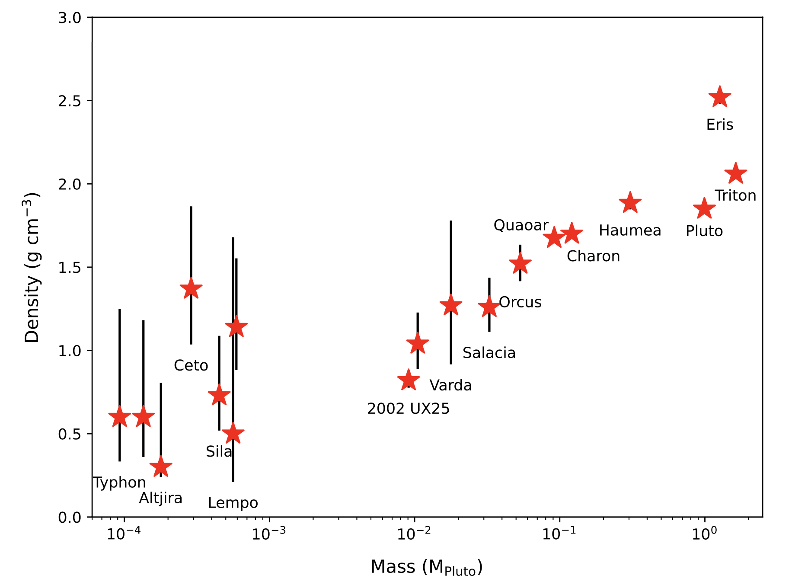
The size-density relationship of Kuiper Belt objects
Data; Thomas (2000), Stansberry et al. (2006), Grundy et al. (2007), Brown et al. (2011), Stansberry et al. (2012), Brown (2013), Fornasier et al. (2013), Vilenius, et al. (2014), Nimmo et al. (2016), Ortiz et al. (2017), Brown and Butler (2017), Grundy et al. (2019), Morgado et al. (2023), Pereira et al. (2023).
2
W. Lyra
Cañas & Lyra + (2024)
Notes:
Problems if you form the high—mass objects from several low mass ones.
Extremely low porosity? Even with the additional compression, would still have a density close to 1 g/cm^3, not the 2.5 g/cm^3 of Eris.
None of these appear likely. Different formation mechanism?

Slide 3
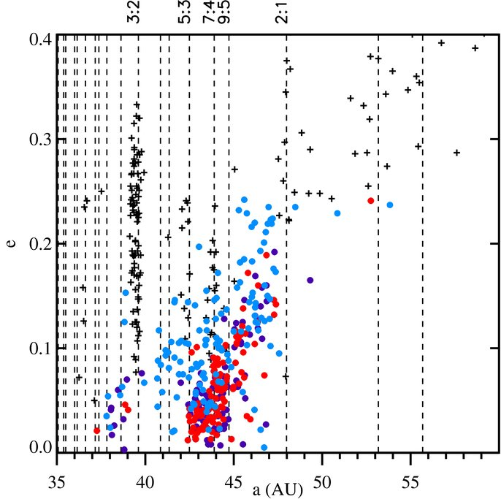
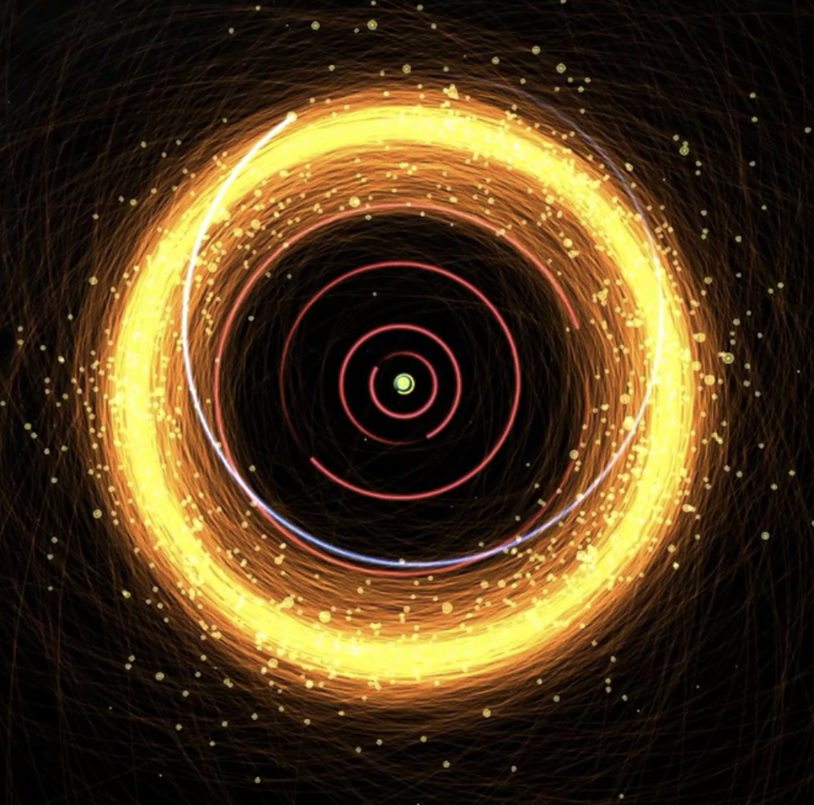
Cold Classicals Kuiper Belt Objects
Presumably pristine planetesimals
+ Resonant and Scattered
Cold Classical i<2º
“Ambiguous” 2º<i<6º
Hot Classicals i>6º
Gladman+ ‘08, Lacerda ‘09, Batygin+ ’10, Dawson & Murray-Clay ‘12
Notes:
Detached (only 9 known): high eccentricity, large sma, can’t be scattered by Neptune. Mystery. Passing star, extra planet, ejected planet, planet 9?

Slide 4
The size-density relationship of Kuiper Belt objects
Streaming
Instability
Pebble
Accretion
Data; Thomas (2000), Stansberry et al. (2006), Grundy et al. (2007), Brown et al. (2011), Stansberry et al. (2012), Brown (2013), Fornasier et al. (2013), Vilenius, et al. (2014), Nimmo et al. (2016), Ortiz et al. (2017), Brown and Butler (2017), Grundy et al. (2019), Morgado et al. (2023), Pereira et al. (2023).
4
W. Lyra
Cañas & Lyra + (2024)
Notes:
Problems if you form the high—mass objects from several low mass ones.
Extremely low porosity? Even with the additional compression, would still have a density close to 1 g/cm^3, not the 2.5 g/cm^3 of Eris.
None of these appear likely. Different formation mechanism?

Slide 5
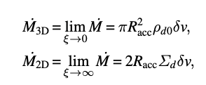
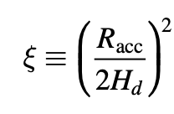
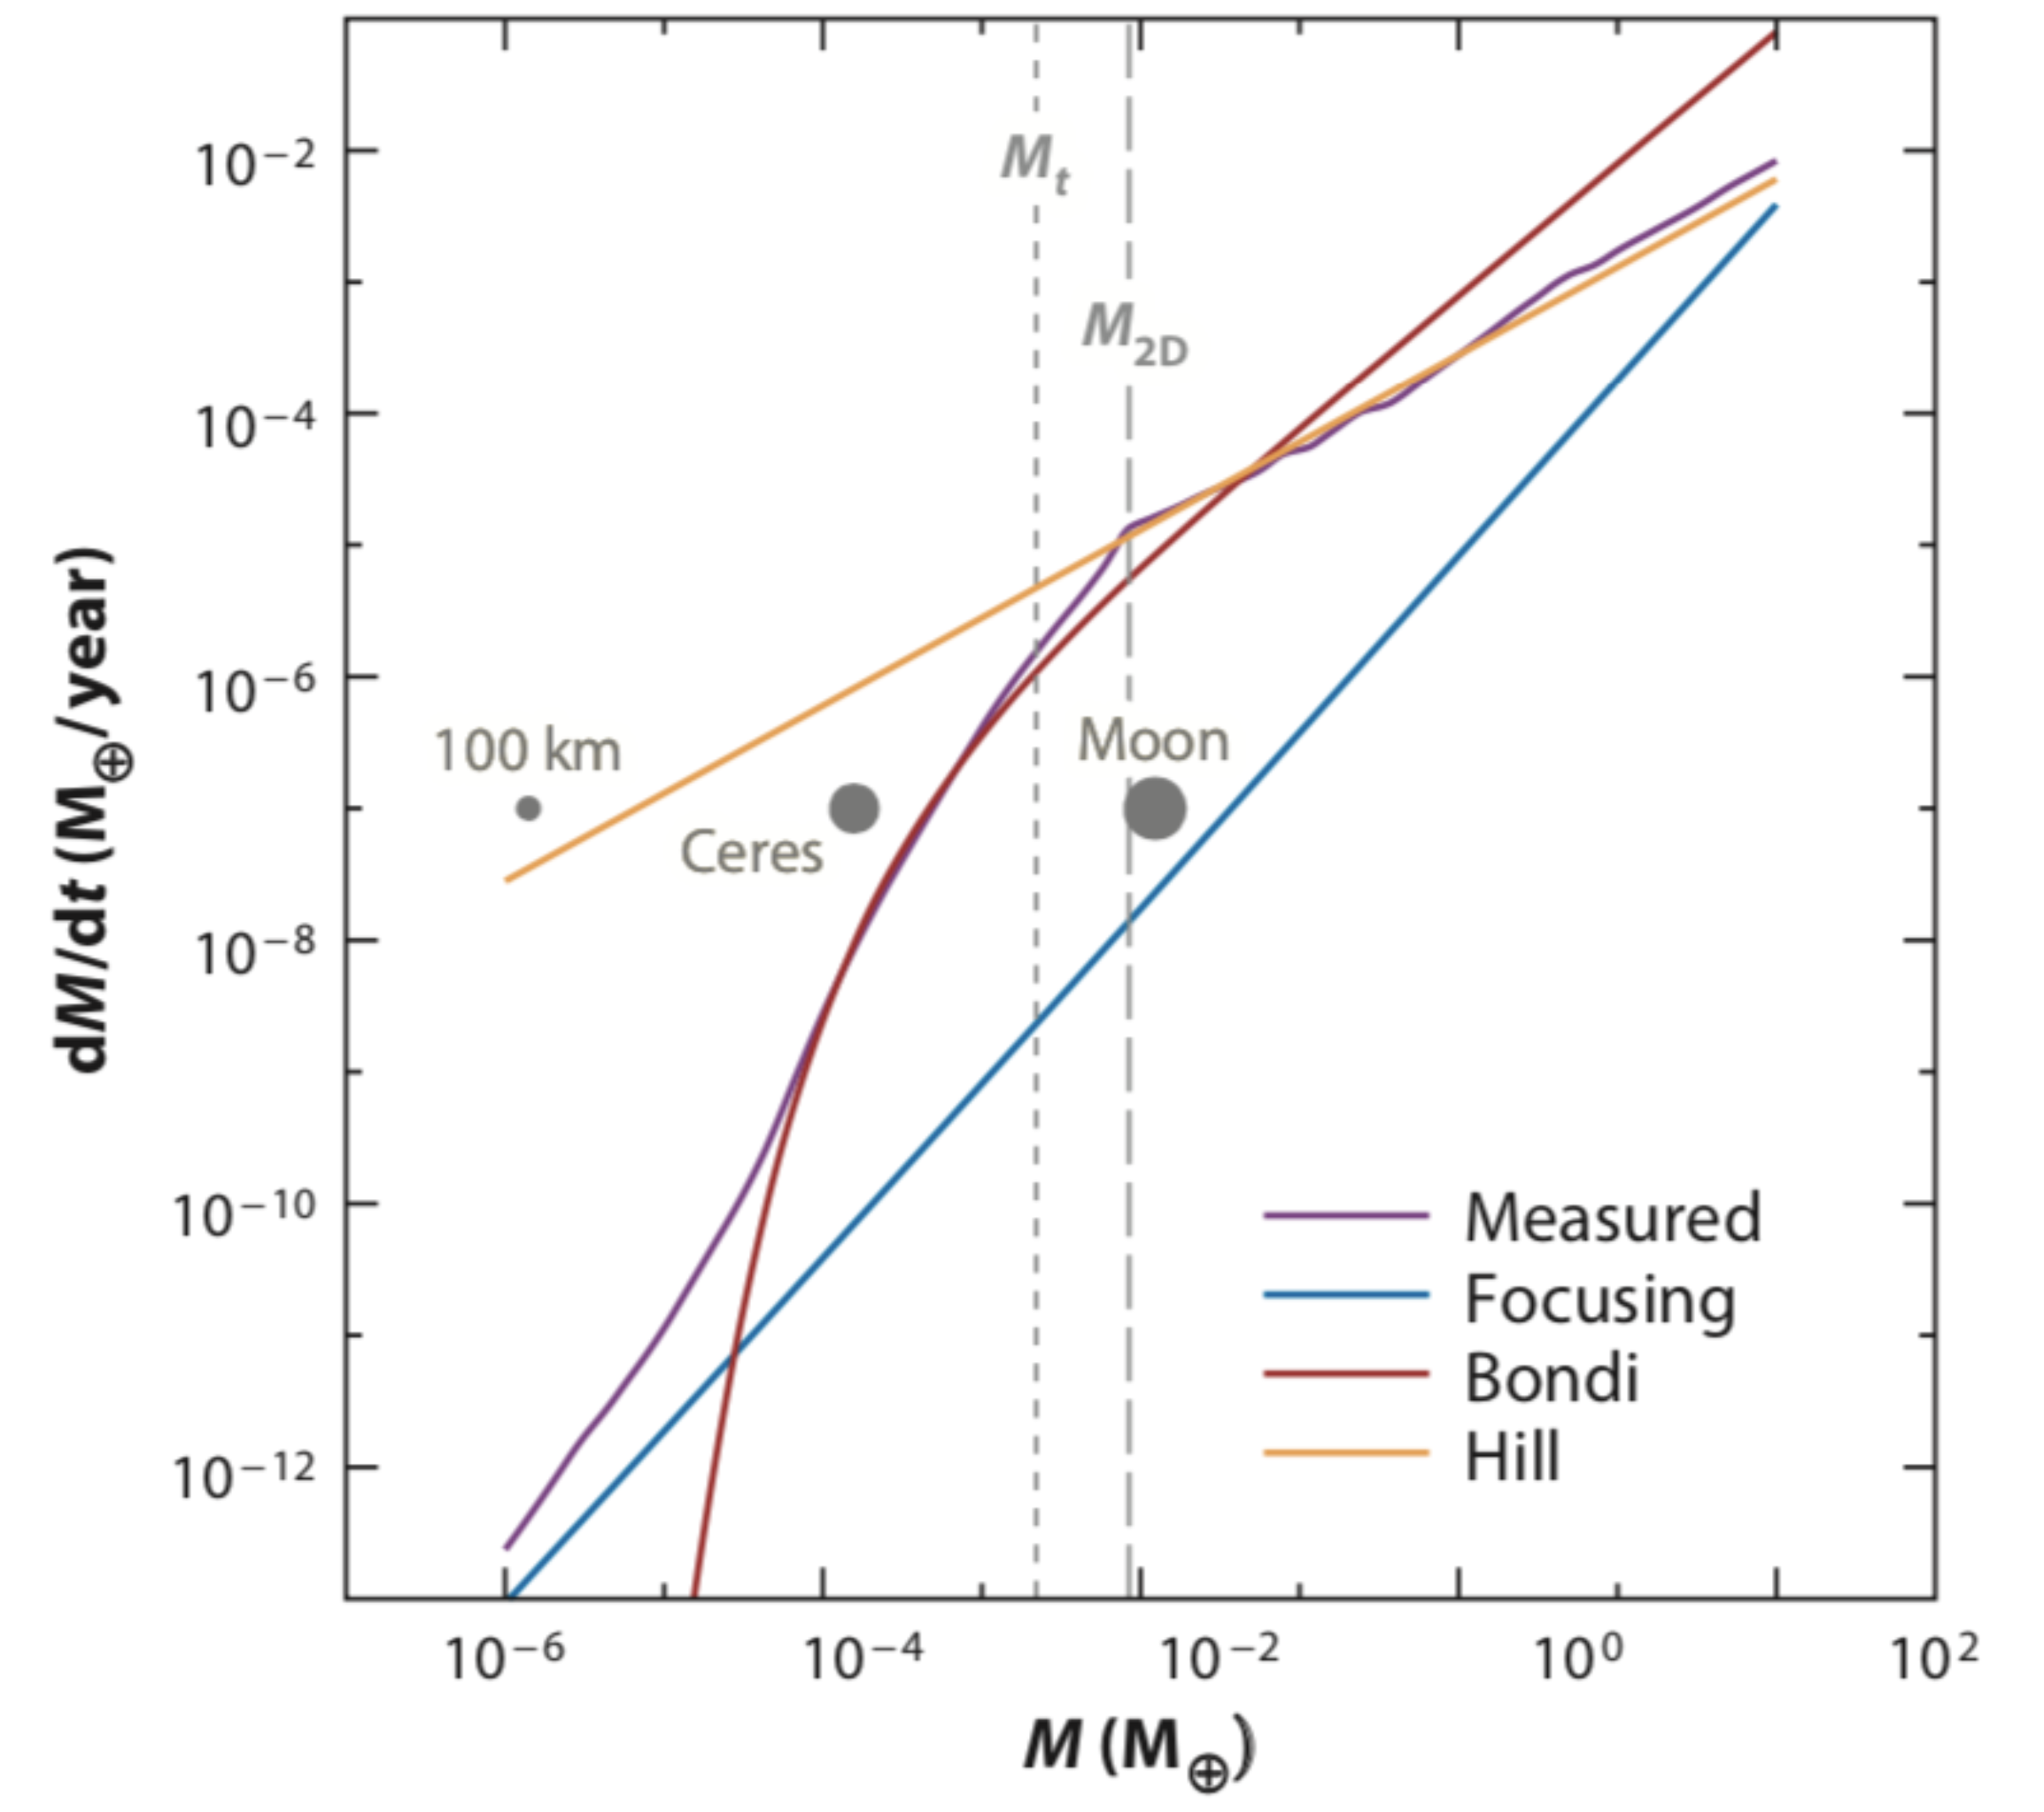
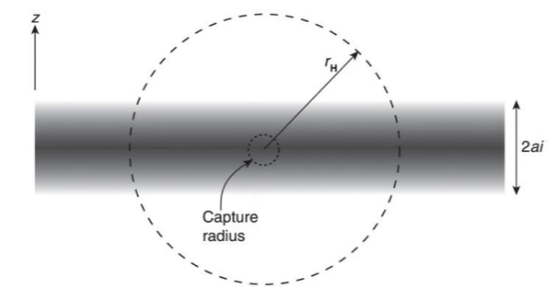
Pebble Accretion: Geometric, Bondi, and Hill regime
Bondi accretion - Bound against headwind
Hill accretion - Bound against stellar tide
Mass Accretion rates
Hill radius
Bondi radius
Pebble scale height
W. Lyra
Johansen & Lambrechts (2017)
Notes:
Then, once formed, an icy planetesimal would capture mostly small pebbles -- these pebbles could be silicate-rich if they lost ice by, e.g. spending a lot of time in the disk atmosphere getting UV irradiated.

Slide 6
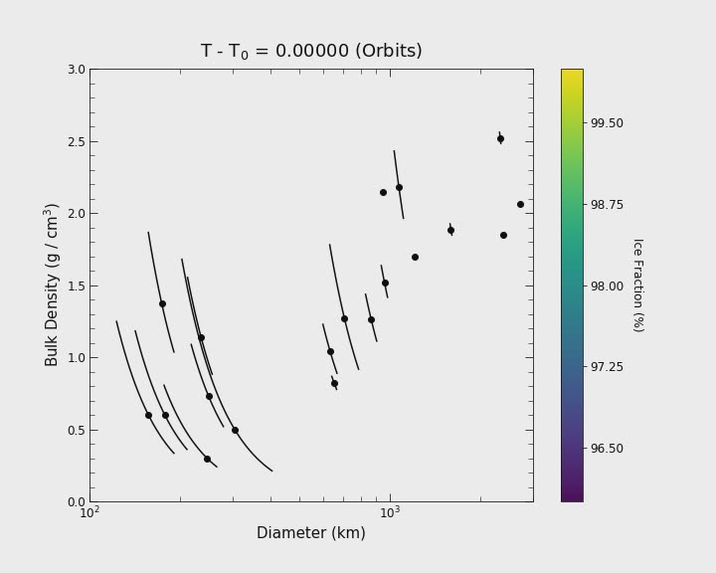
Integrate pebble accretion
W. Lyra

Slide 7
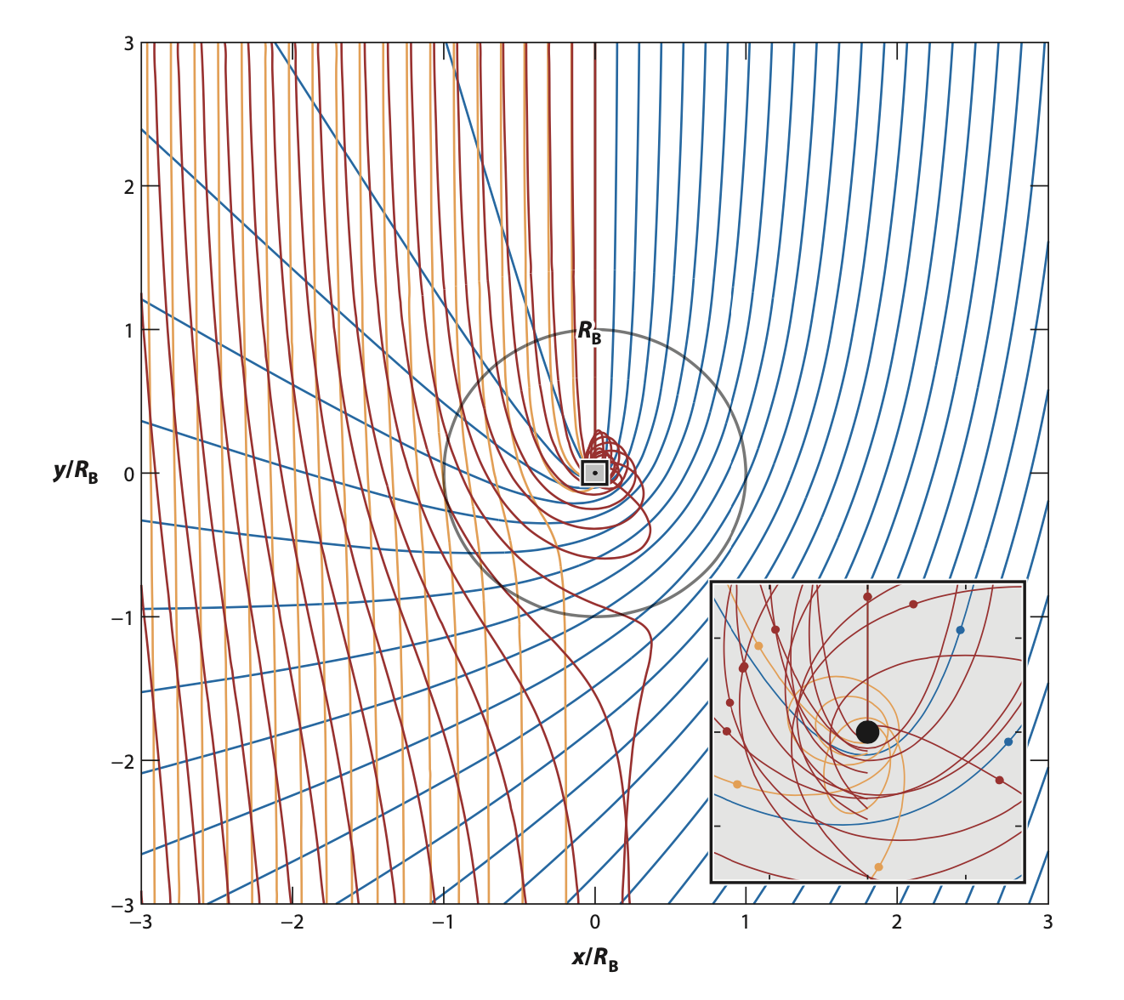
Pebble Accretion: Pebbles of different size accrete differently
“Goldilocks effect”
Bondi Regime
Large (t_{s} >> t_{b})
Medium (t_{s} ~ t_{b})
Small (t_{s} << t_{b})
Pebble size that accretes optimally
Drag time t_{s} ~ Time to cross Bondi sphere t_{b}
t_{b} = GM/Δv³
W. Lyra
Johansen & Lambrechts (2017); Lyra & Johansen + (2023)

Slide 8
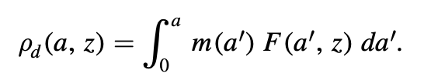

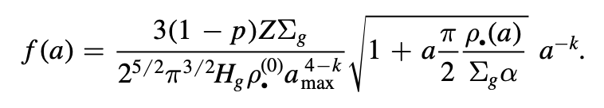
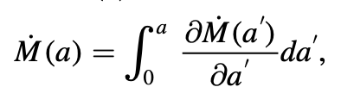
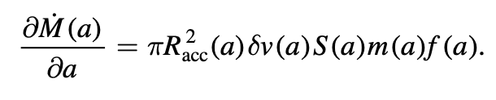
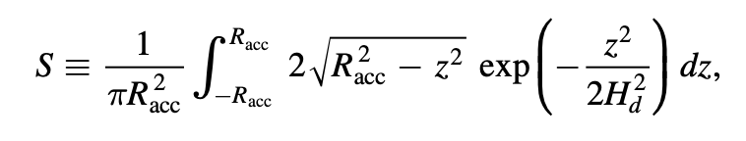
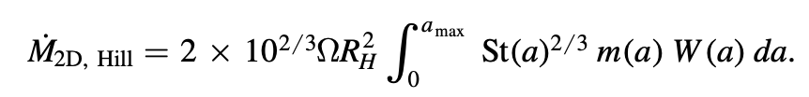
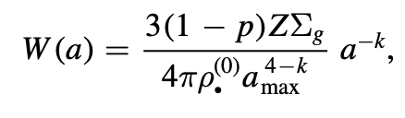
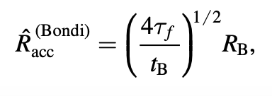
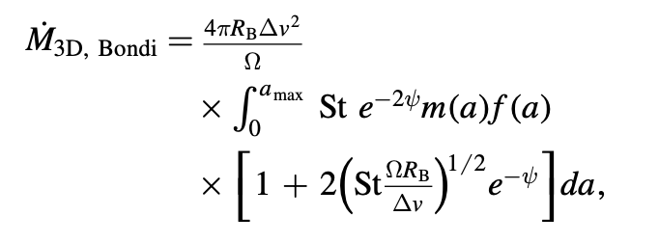

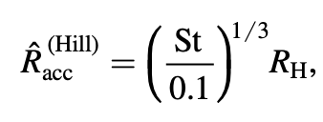


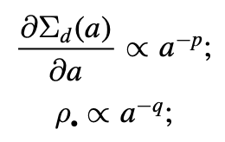
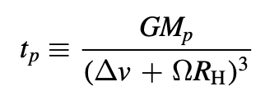
Polydisperse (Multi-Species) Pebble Accretion
W. Lyra
Lyra & Johansen + (2023)
Notes:
Then, once formed, an icy planetesimal would capture mostly small pebbles -- these pebbles could be silicate-rich if they lost ice by, e.g. spending a lot of time in the disk atmosphere getting UV irradiated.

Slide 9
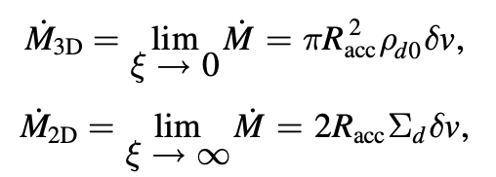
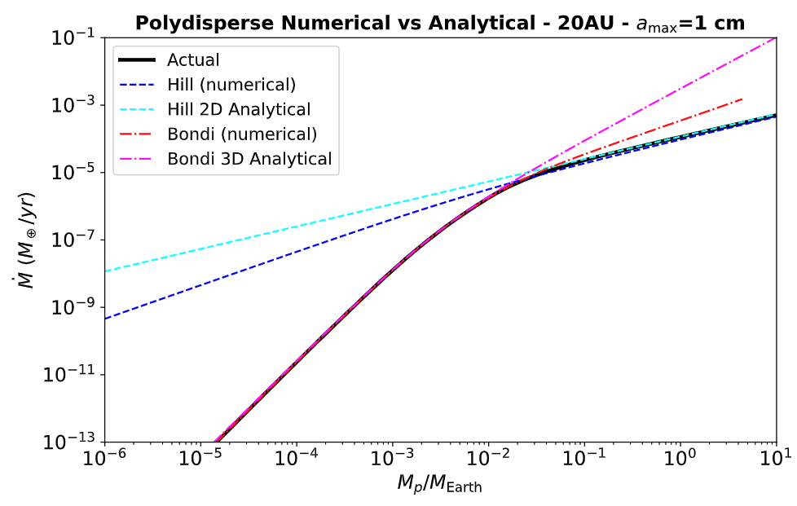
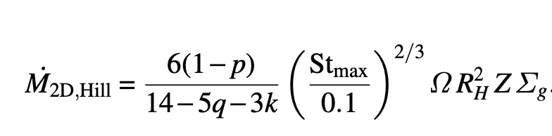
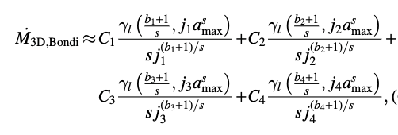
Analytical theory of polydisperse (multi-species) pebble accretion
Monodisperse (single species)
Lambrechts & Johansen (2012)
Polydisperse (multiple species)
Lyra & Johansen + (2023)
9
W. Lyra
Lyra & Johansen + (2023)

Slide 10
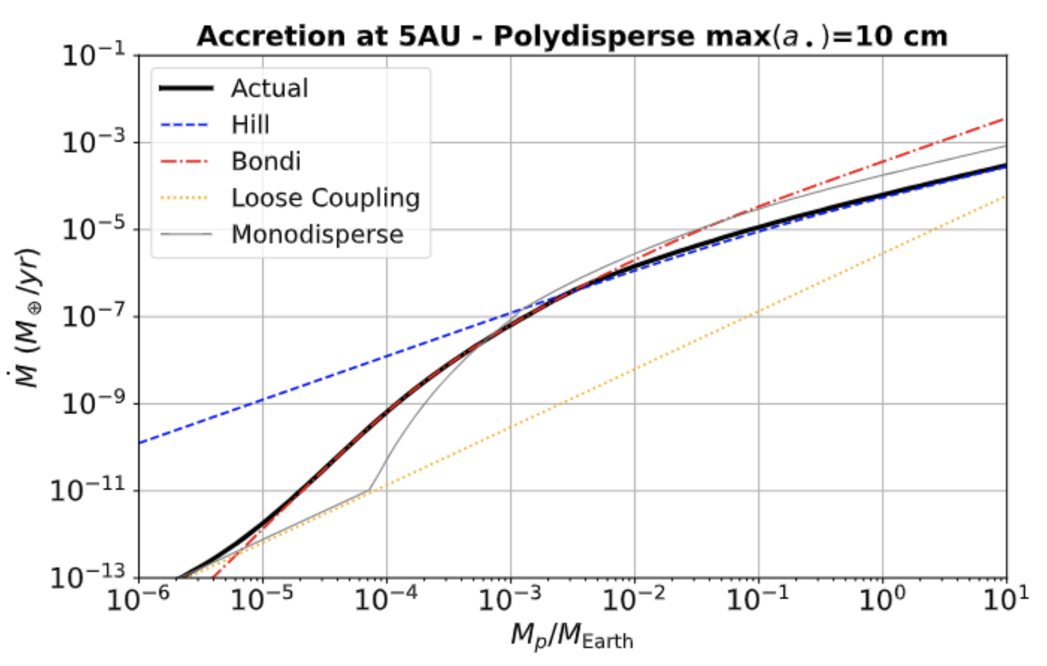
Accretion Rates
W. Lyra
Lyra & Johansen + (2023)

Slide 11
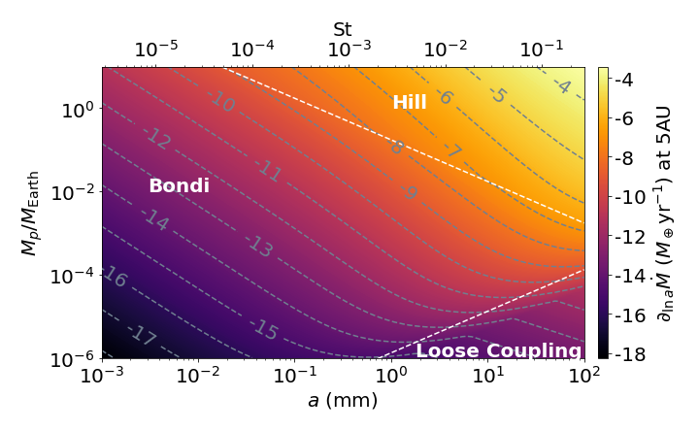
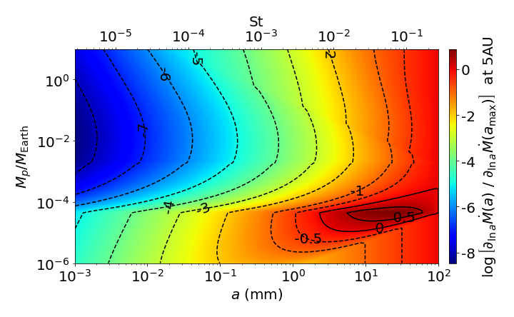
Differential Accretion Rates
W. Lyra
Lyra & Johansen + (2023)

Slide 12
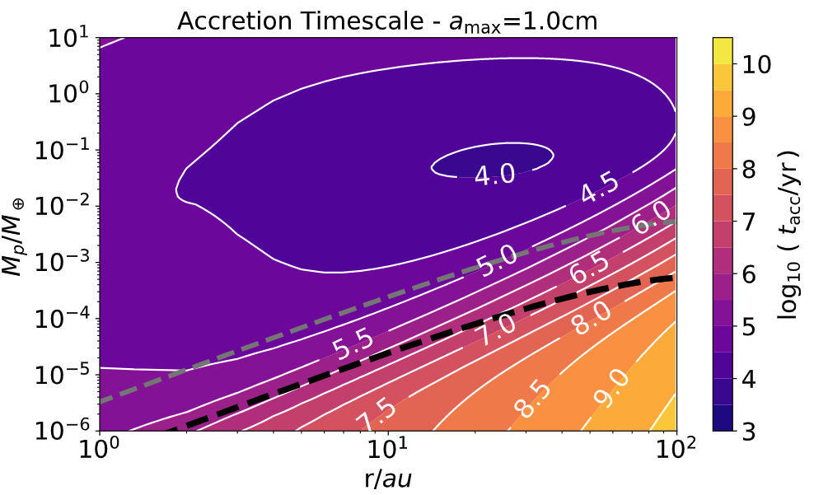
Accretion Timescales
Myr accretion timescales possible on top of planetesimals produces by Streaming Instability
10x typical mass formed
by Streaming Instability
Typical mass formed
by Streaming Instability
W. Lyra
Lyra & Johansen + (2023)

Slide 13
The size-density relationship of Kuiper Belt objects
Data; Thomas (2000), Stansberry et al. (2006), Grundy et al. (2007), Brown et al. (2011), Stansberry et al. (2012), Brown (2013), Fornasier et al. (2013), Vilenius, et al. (2014), Nimmo et al. (2016), Ortiz et al. (2017), Brown and Butler (2017), Grundy et al. (2019), Morgado et al. (2023), Pereira et al. (2023).
13
W. Lyra
Cañas & Lyra + (2024)
Notes:
Problems if you form the high—mass objects from several low mass ones.
Extremely low porosity? Even with the additional compression, would still have a density close to 1 g/cm^3, not the 2.5 g/cm^3 of Eris.
None of these appear likely. Different formation mechanism?

Slide 14
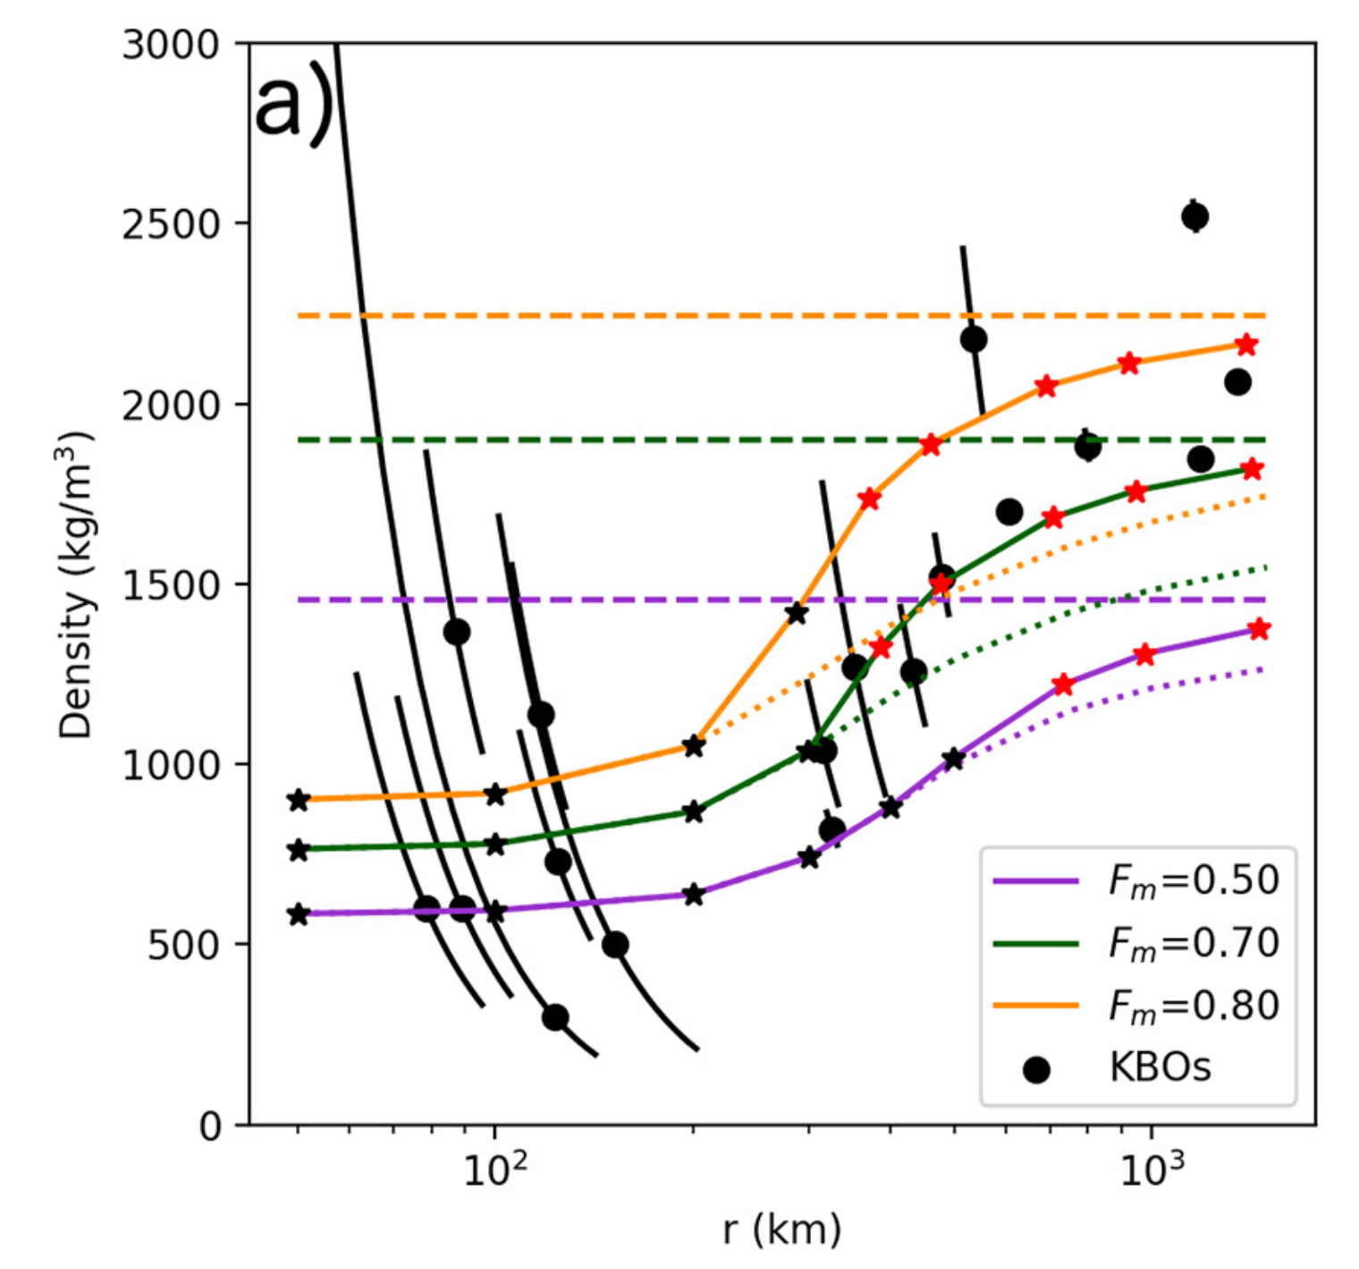

Porosity removal by gravitational compaction
Problem
  Timing! ²⁶Al would melt if formed within 4 Myr
Fully compact
Assumption
  Constant composition at birth and growth
F_{m} = rock mass fraction
14
W. Lyra
Bierson & Nimmo (2019)
Notes:
If the high-mass bodies were formed of many small-mass bodies, why would their densities be so different? Even with gravitational compaction, the low-mass objects would have to be unreasonably porous if they had the same composition of the high-mass ones.

Slide 15
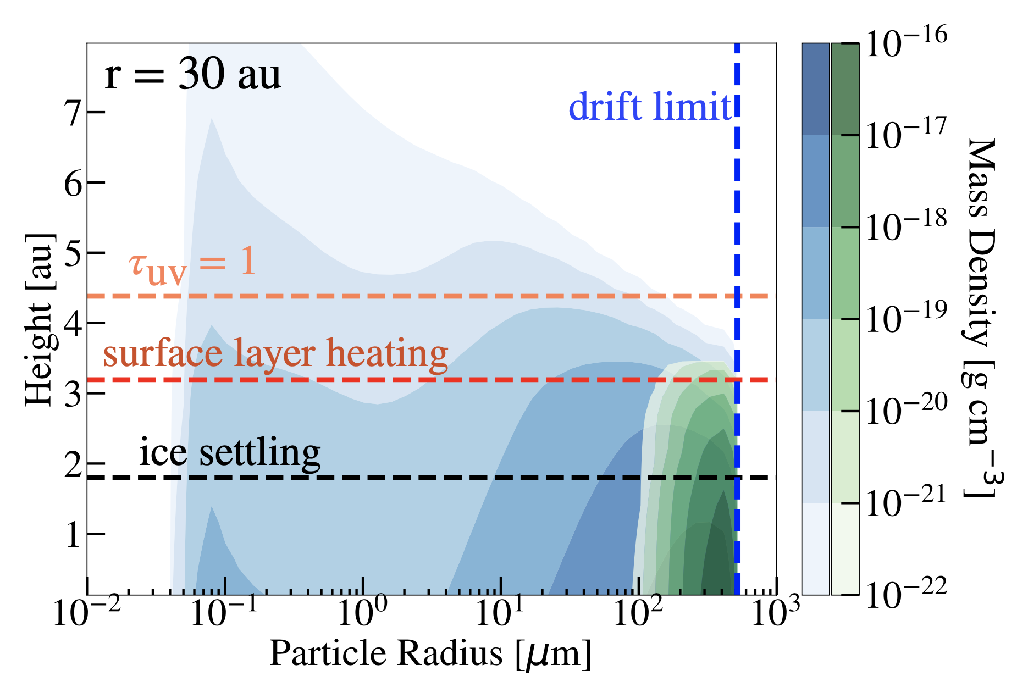
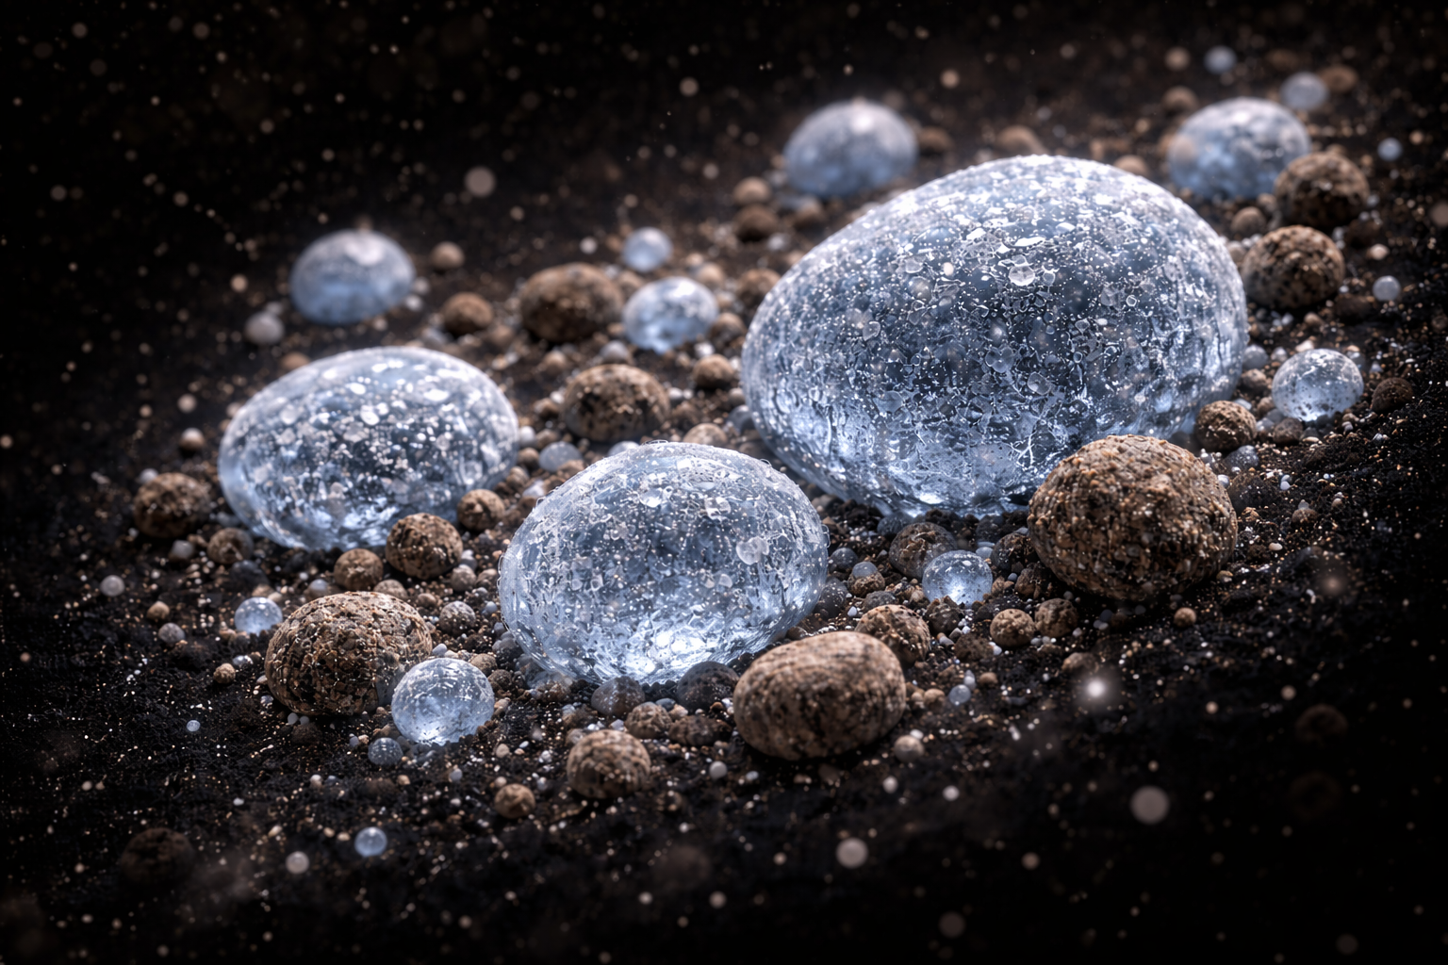
Thermal and photo-desorption
Ice Removal
Heating and UV irradiation remove ice
on Myr timescales (Harrison & Schoen 1967).
Proof-of-concept model
  Small grains lofted in the atmosphere lose ice
  Big grains are shielded and remain icy.
Ice-free grains
Ice coated grains
15
W. Lyra
Powell et al. (2022)
Notes:
The growth of the large particles is limited by particle drift (blue dashed line). The remaining CO ice-coated particles settle to the disk midplane (black dashed line) and are not readily lofted to the upper regions of the disk where surface layer heating occurs (red dashed line) or where the disk becomes optically thin to UV-photons (the UV optical depth, τUV = 1, dashed orange line). The ice particles are thus unable to release their volatile material due to either evaporation or photodesorption.
Evidence: no ice seen in debris disks; water vapor detected at very large distances.

Slide 16
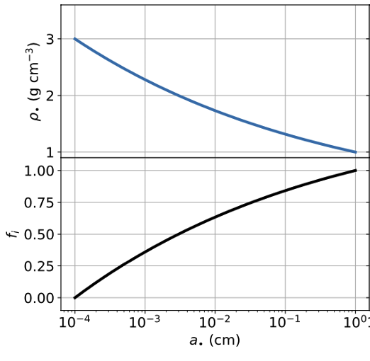
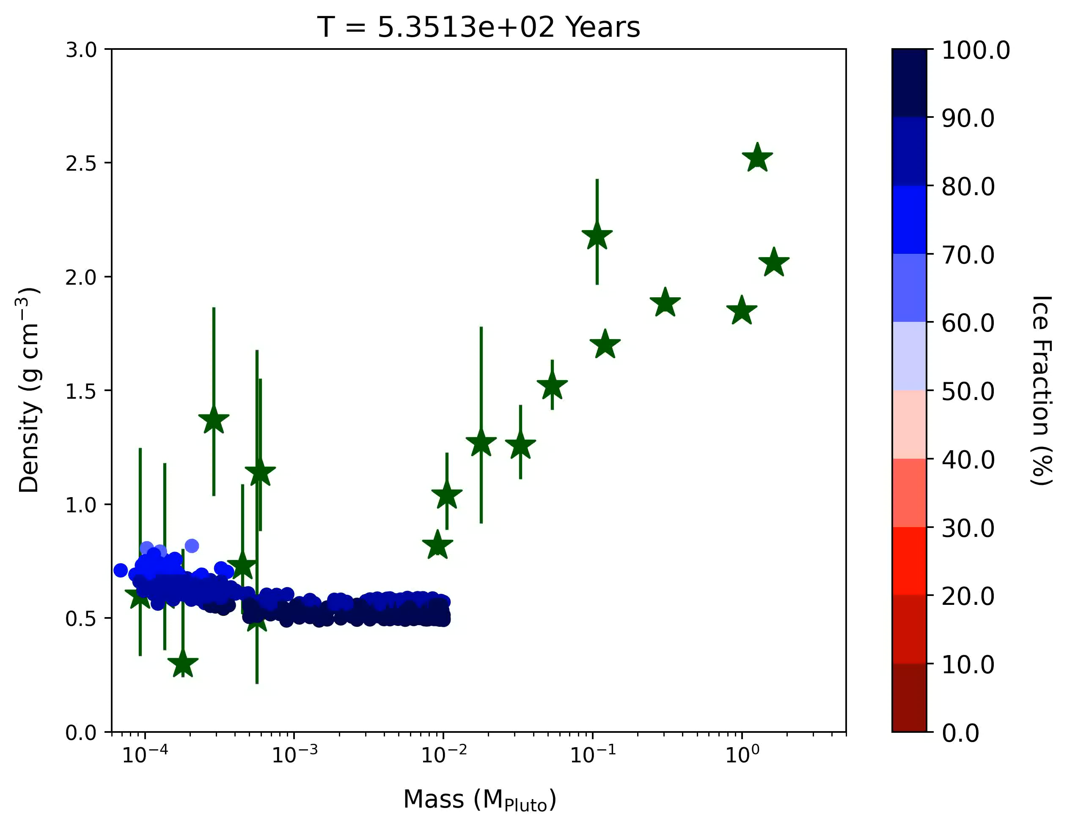
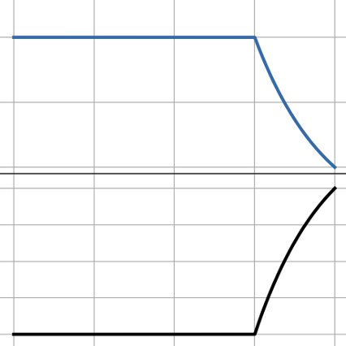
Growing Pluto by silicate pebble accretion
Pebble
Internal
Density
Ice
Volume
Fraction
W. Lyra
Canas & Lyra + (2024)

Slide 17
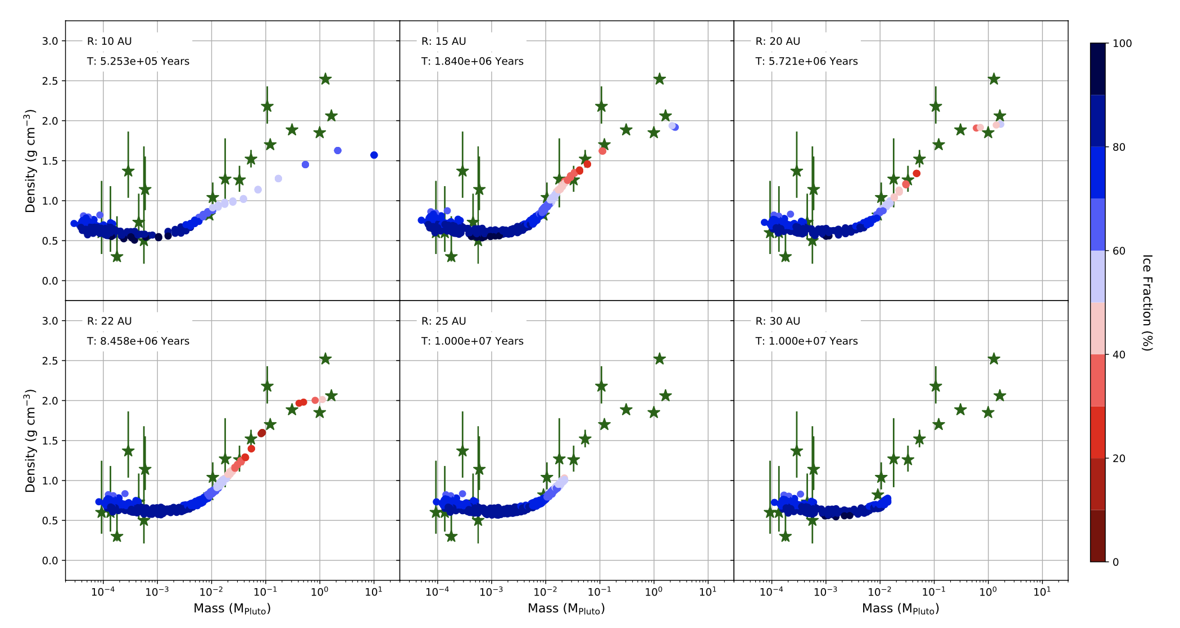
Distance Range
15 - 25AU
Canas & Lyra + (2024)
W. Lyra
Notes:
Too fast accretion at 10 au, and accretion of ices; too slow at 25au

Slide 18
Conclusions
Polydisperse Bondi accretion 1-2 orders of magnitude more efficient than monodisperse
  Best accreted pebbles are those of drag time ~ Bondi time, not the largest ones
  The largest ones dominate the mass budget, but accrete poorly
Onset of Bondi accretion 1-2 orders of magnitude lower in mass compared to monodisperse
  Bondi accretion possible on top of Streaming Instability planetary embryos within disk lifetime
  Reaches 100-350km objects within Myr timescales
Analytical solution to
  Monodisperse general case
  Polydisperse 2D Hill and 3D Bondi
KBO density problem:
  Two different pebble populations, maintained by ice desorption off small grains
  Streaming instability: icy-rich small objects; nearly uniform composition
  Polydisperse pebble accretion: silicate-rich larger objects; varied composition
  Melting avoided by
    ice-rich formation
    ²⁶Al incorporated mostly in long (>Myr) phase of silicate accretion
  KBOs best reproduced between 15-25 AU
18
W. Lyra

