Slide 1
Hydrodynamical Instabilities
in protoplanetary disks: a synthesis.
Funding
Wladimir Lyra
California State University
Jet Propulsion Laboratory
Exoplanet Research Program
XRP - 2018
NRAO 2017
XRP - 2016
HST Cycle 24, 2016
Computational Facilities
Ringberg, Jul 10th, 2019

Slide 3
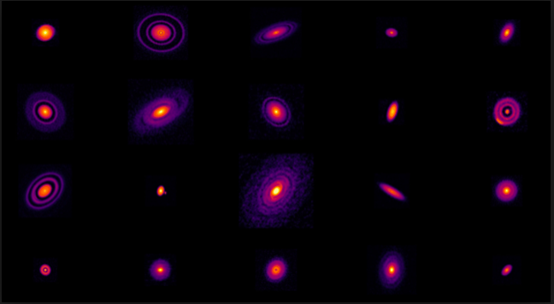

Slide 4
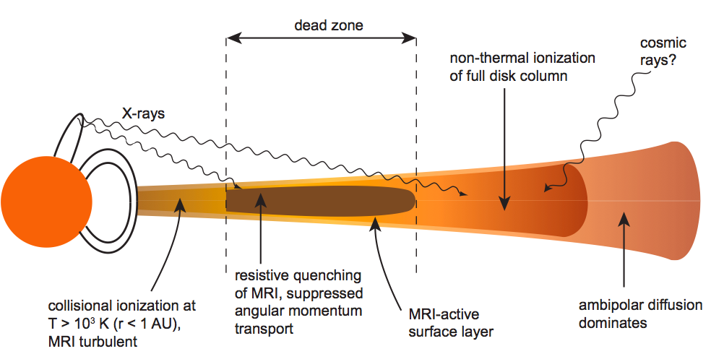
Dead zones
0.1 AU
~30 AU

Slide 5
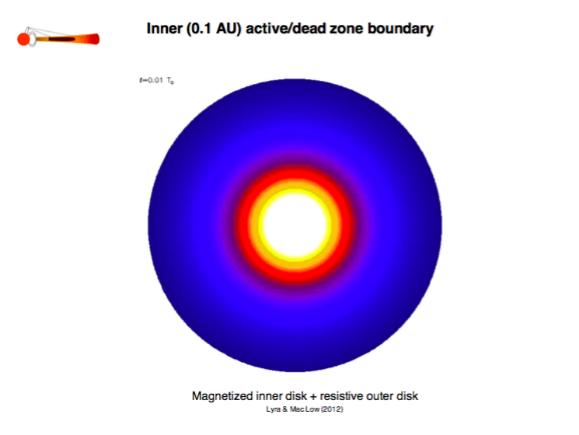
Rossby wave instability
Lovelace+ ’99, Li+ ’00, Tagger ’01, Varniere & Tagger ‘06, de Val Borro+ 07,
Lyra+ 08, Lyra+ ‘09, Meheut+ ’10, Meheut+ ’12, Lin & Papaloizou 2012, Lin 2013, Faure et al. (2014), see also Mario’s talk

Slide 6
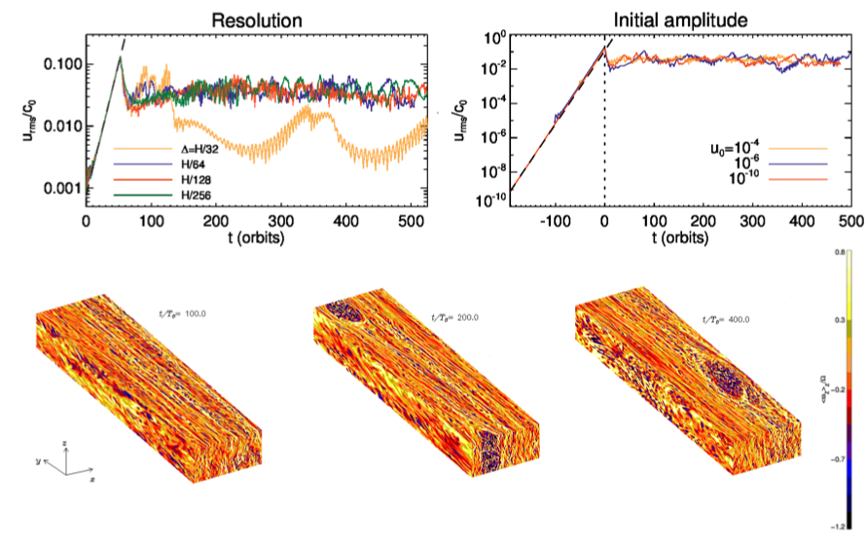
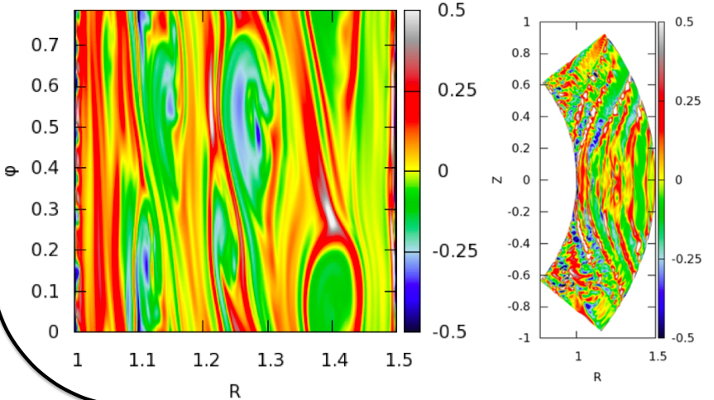
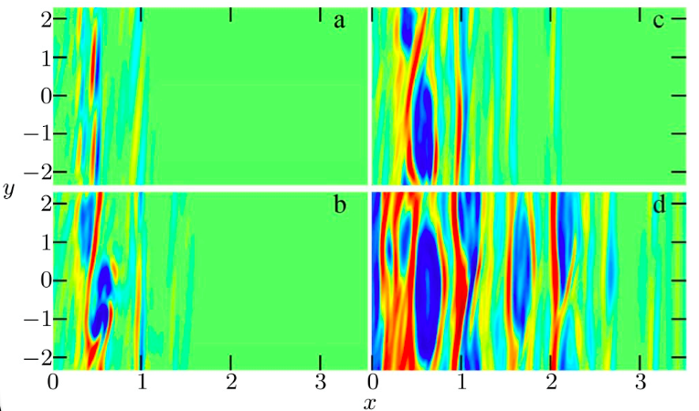
Hydrodynamical Instabilities
Vertical Shear Instability
Convective
Overstability
Zombie Vortex Instability
Nelson et al. 2013, Lin & Youdin 2015, Umurhan et al. 2016
Klahr 2003, Petersen et al. 2007, Lesur & Papaloizou 2010,
Lyra & Klahr 2011, Klahr & Hubbard 2014, Lyra 2014
Marcus et al. 2012, 2013, 2015, 2016
Umurhan et al 2016, Lesur & Latter 2016

Slide 7
Hydrodynamical Instabilities
Vertical Shear Instability
Convective
Overstability
Zombie Vortex Instability
Nelson et al. 2013, Lin & Youdin 2015, Umurhan et al. 2016
Klahr 2003, Petersen et al. 2007, Lesur & Papaloizou 2010,
Lyra & Klahr 2011, Klahr & Hubbard 2014, Lyra 2014
Marcus et al. 2012, 2013, 2015, 2016
Umurhan et al 2016, Lesur & Latter 2016

Slide 8
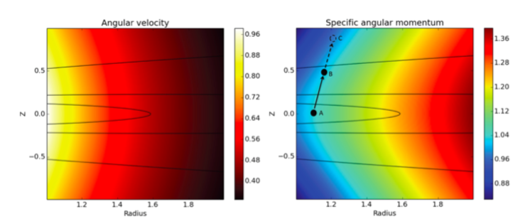
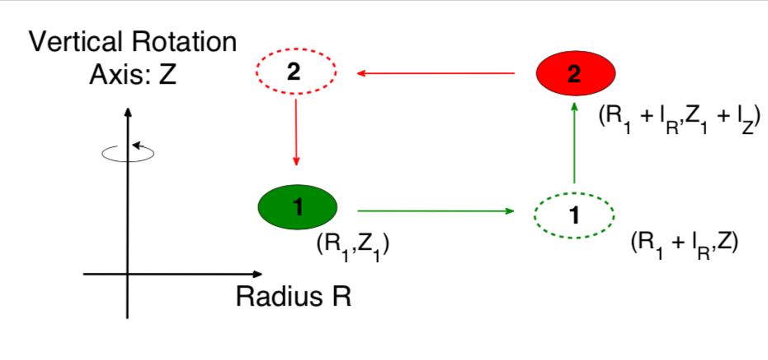
Vertical shear instability
Angular velocity not constant in cylinders: unstable
Fromang & Lesur (2017)
Nelson et al. (2013)
(see also Glen’s talk)

Slide 9
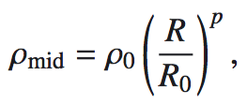
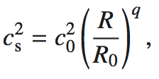
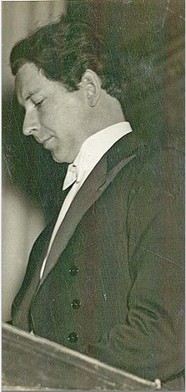
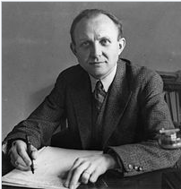
Vertical shear instability
Solberg-Hoiland Criteria
Buoyancy stabilizes!
The most unstable mode is isothermal
Halvor Solberg
Einar Hoiland
dΩ/dz != 0 => dL²/dz < 0
ds/dz=0
3rd criterion violated

Slide 10
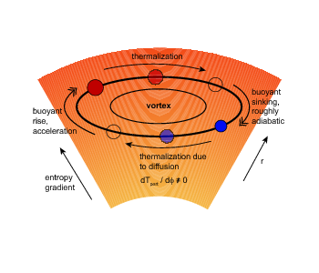
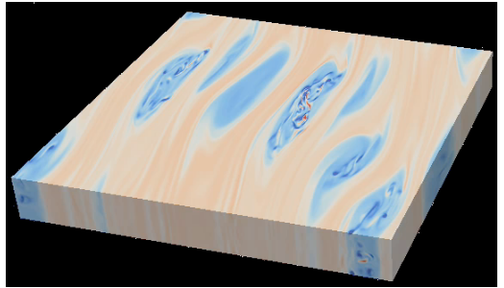
Convective Overstability (née “Subcritic Baroclinic Instability”)
Sketch of the
Subcritic Baroclinic Instability
Lesur & Papaloizou (2010)
Armitage (2010)

Slide 11
Convective Overstability (née “Subcritic Baroclinic Instability”)
Sketch of the
Subcritic Baroclinic Instability
1. Radial entropy gradient
2. Finite cooling time
Lesur & Papaloizou (2010)
Armitage (2010)

Slide 12
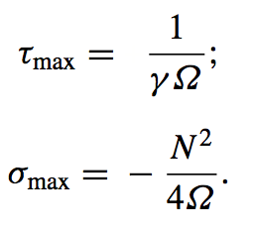
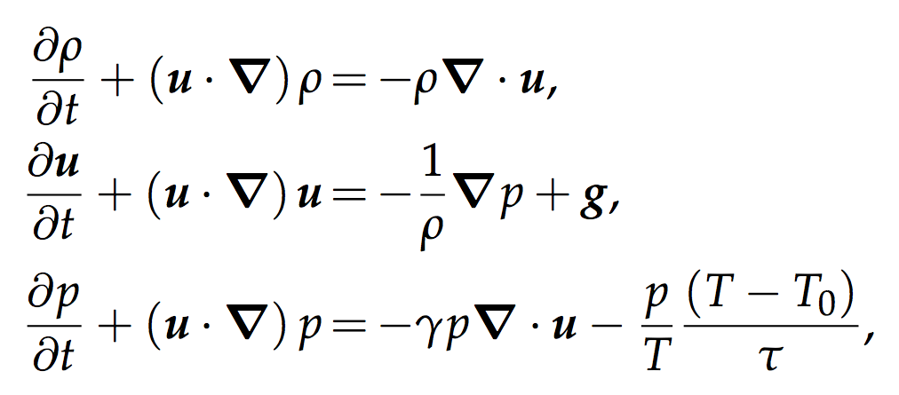
Convective Overstability
Klahr & Hubbard (2014), Lyra (2014), Latter (2015)
Cooling
destabilizes!
Cooling time
of maximum growth
Growth rate
Lyra (2014)

Slide 13
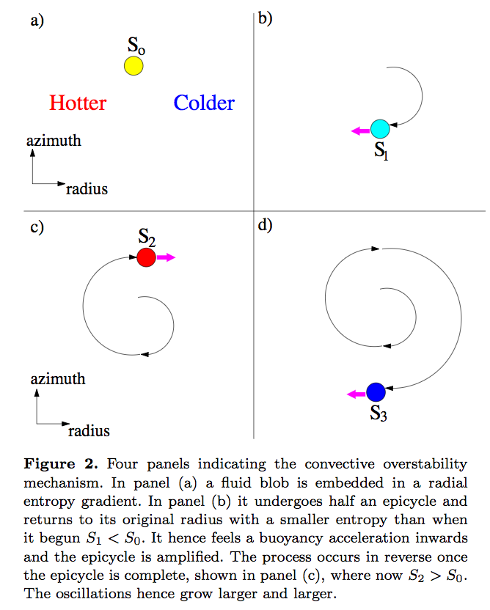
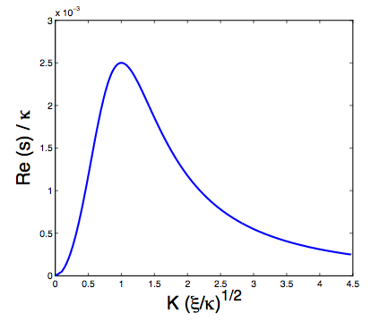
Convective Overstability
Cooling renders the 2nd
Solberg-Hoiland criterion irrelevant
Growth rate
Wavenumber
Latter (2015)

Slide 14
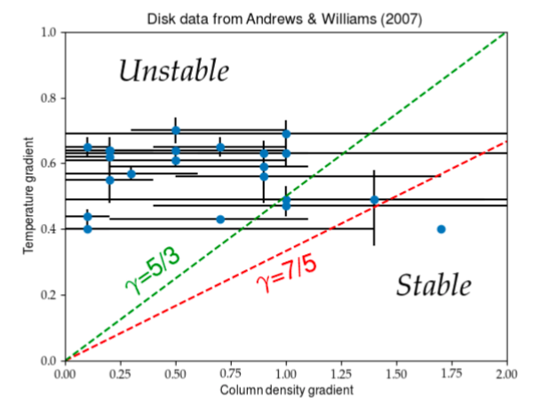
Prevalence of Convective Overstability in actual disks

Slide 15
Zombie Vortex Instability
Cascade of baroclinic critical layers
Marcus et al. (2015, 2016)

Slide 16
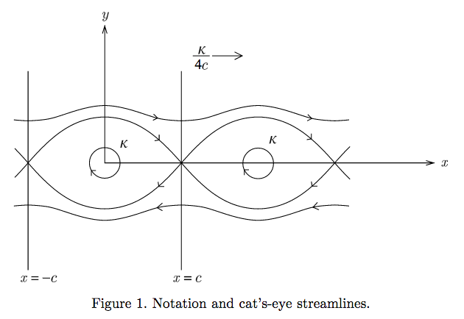
ω
ω
ω

Slide 17
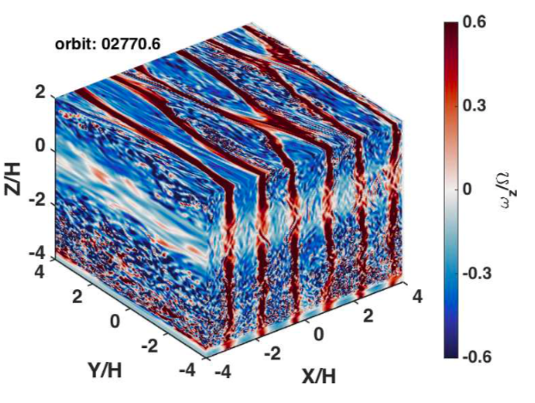
Barranco et al. (2018)

Slide 18
Zombie Vortex Instability
Cascade of baroclinic critical layers
Marcus et al. (2015, 2016)

Slide 19
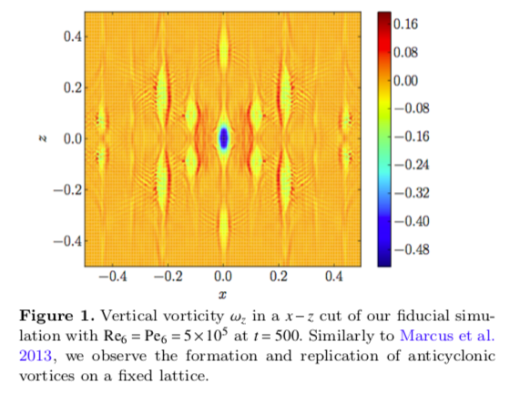
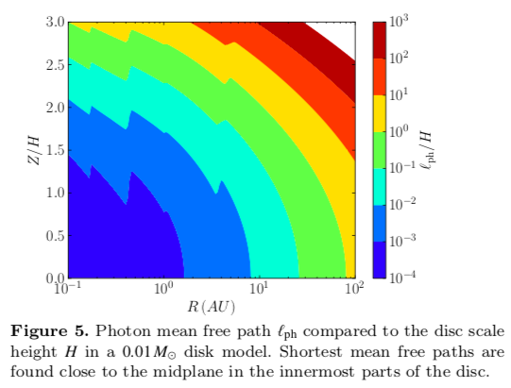
Zombie Vortex Instability
Reproduced with hyperviscosity,
But not with Laplacian viscosity
(needs 2048³, Re ~ 10⁷)
The critical layer should have width
~10⁻⁴H. Buoyancy (near-adiabatic conditions) needs to be maintained over long times at that length.
Only in the very inner disk,
that may be MRI-unstable anyway
Lesur & Latter (2016)

Slide 20
Hydrodynamical Instabilities
Vertical Shear Instability
Convective
Overstability
Zombie Vortex Instability
Nelson et al. 2013, Lin & Youdin 2015, Umurhan et al. 2016
Klahr 2003, Lesur & Papaloizou 2010, Lyra & Klahr 2011, Lyra 2014
Marcus et al. 2012, 2013, 2015, 2016
Umurhan et al 2016, Lesur & Latter 2016
Ωτ << 1
(κ < 1 cm²/g )
Ωτ ∼ 1
(κ ∼ 1−50 cm²/g )
Ωτ >> 1
(κ > 50 cm²/g )
Opacity

Slide 21
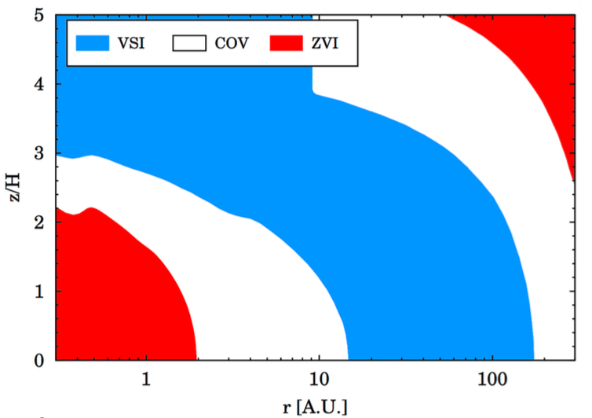
Synthesis
Zombie Vortex
Convective
Vertical shear
Convective
Zombie
Vortex
Malygin et al. 2017, Lyra & Umurhan 2019, Pfeil & Klahr 2019

Slide 22
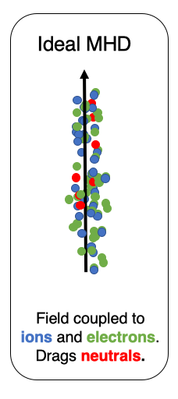
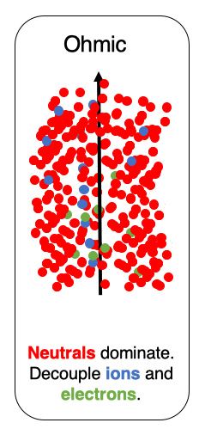
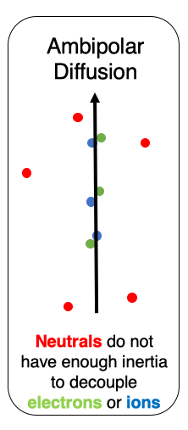
MHD regimes
Hall
Neutrals can drag ions,
But not electrons.
Ion
Neutral
Electron
Wardle 1999, Wardle 2007

Slide 23
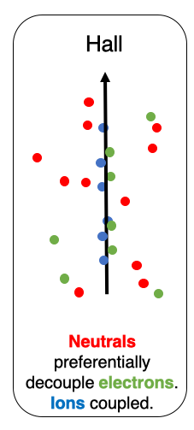
MHD regimes
Ion
Neutral
Electron
Wardle 1999, Wardle 2007, Bai & Stone 2011

Slide 24
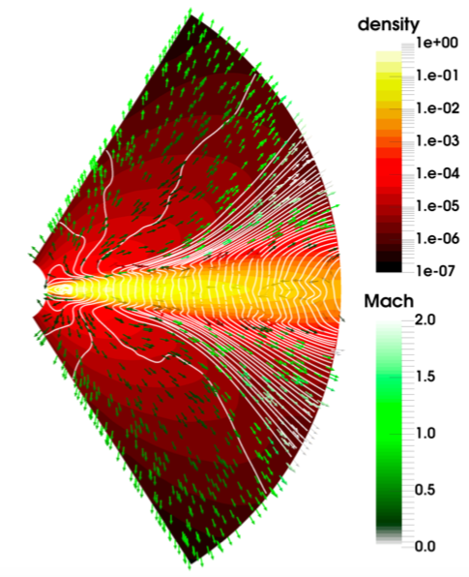
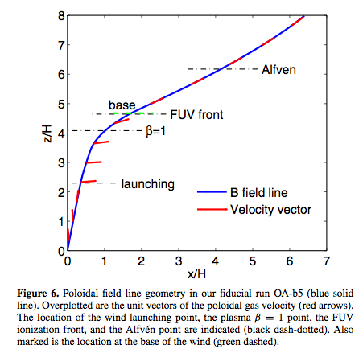
Magnetocentrifugal wind
Bhétune et al. (2017)
Bai & Stone (2013)

Slide 25
MHD regimes
Ion
Neutral
Electron
Wardle 1999, Wardle 2007, Kunz et al 2008

Slide 26
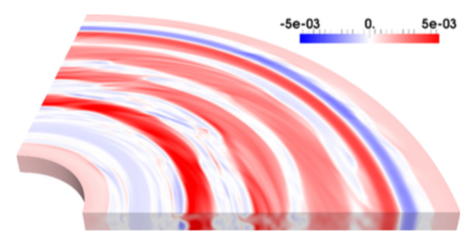
Hall MHD
Self-organization
Bethune et al. (2016)

Slide 27
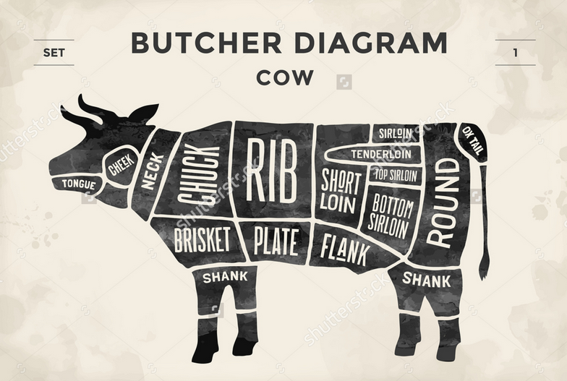
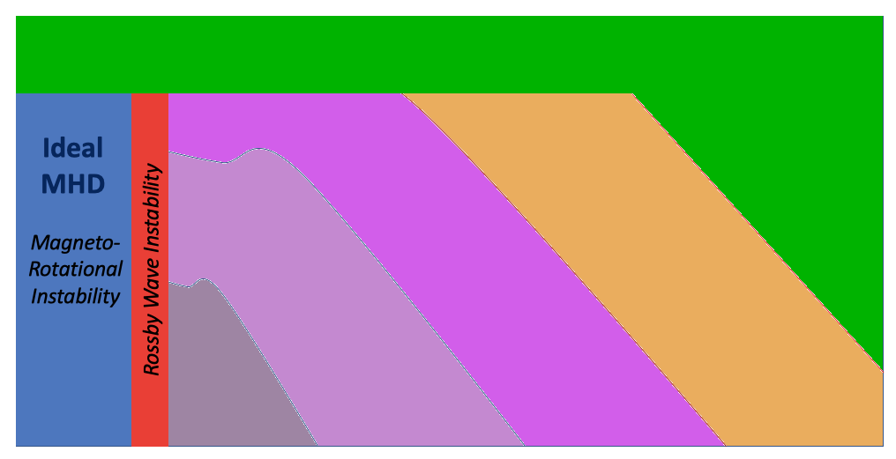
A butcher diagram for
disk instabilities and structure
Photoevaporative and Magnetocentrifugal winds
Ambipolar
Diffusion
Hall MHD
Height
Ohmic Resistivity
Vertical Shear
Instability
Hall Shear
Instability
Convective
Overstability
Zombie
Vortex
Instability
0.1AU
1AU
10AU
100AU
Radius

Slide 28
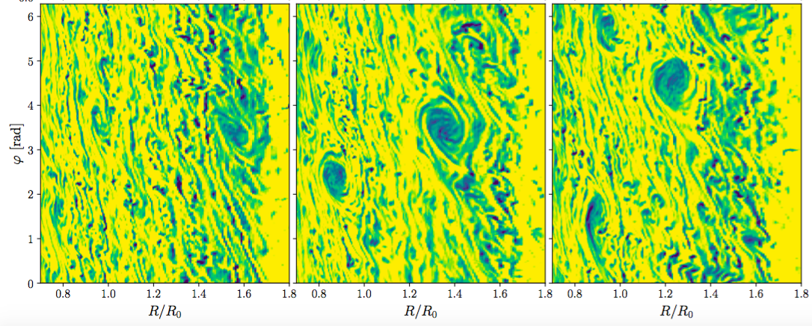
Saturation – vortices and α between 10⁻⁴ and 10⁻³
VSI saturates into vortices
Manger & Klahr (2018)
ZVI saturates into vortices
Barranco et al. (2019)
COV saturates into vortices
Lesur & Papaloizou (2010)

Slide 29
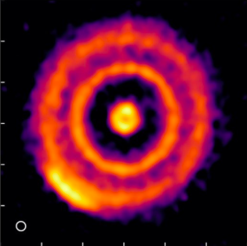
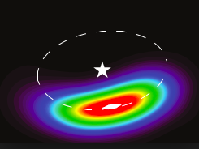
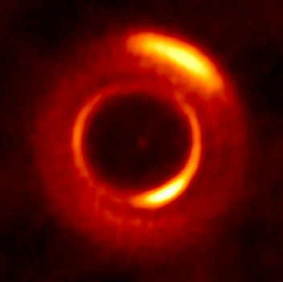
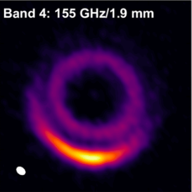

Slide 30
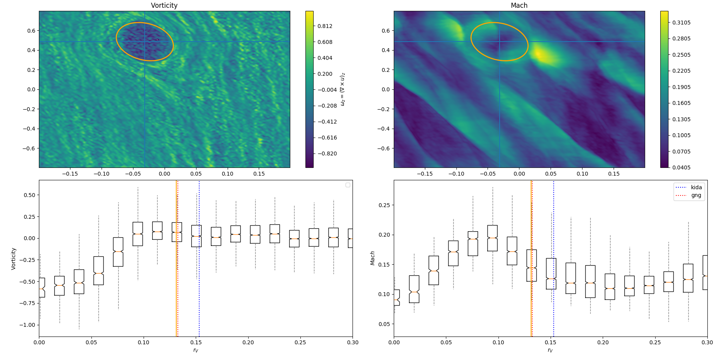
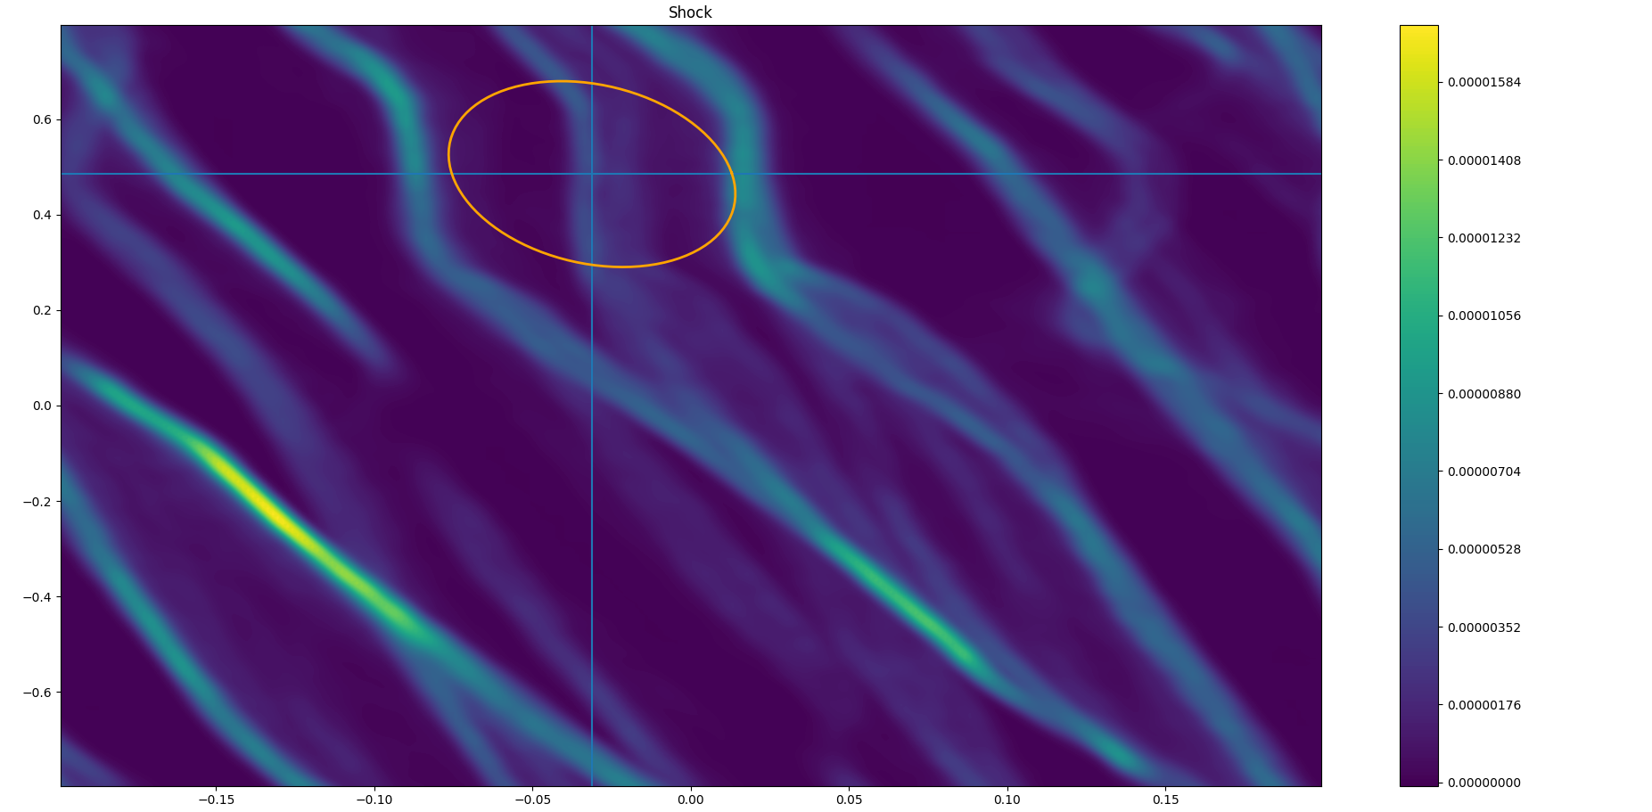
What sets the size of a vortex?
Not shocks….
Vorticity
Mach number
Shocks
Valdelllon & Lyra (in prep)

Slide 31
Outstanding issues
 | ZVI | COV | VSI
Global model
Vertical Stratification
Boundaries with other instabilities
Interaction with dust
Observational Validation/Rule out
Planet Forming Properties

Slide 32
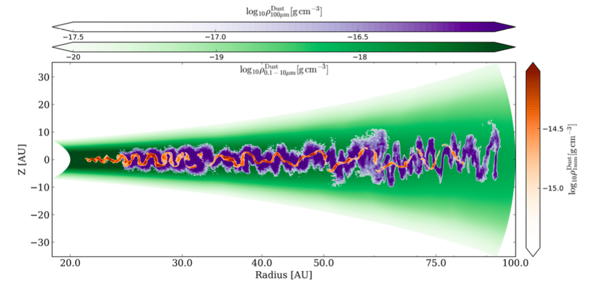
Dust in Vertical-Shear turbulence
Flock et al. (2017); see also Anders’ talk.

Slide 33
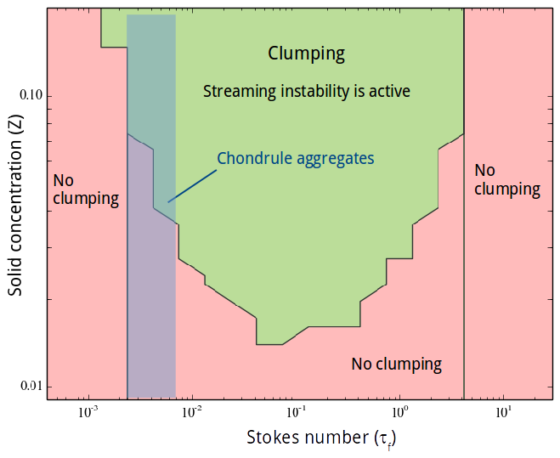
Synergy with streaming instability?
Johansen et al. (2007)
Carrera et al. (2015)

Slide 34
Conclusions
Three dynamical instabilities in the Ohmic dead zone
Vertical Shear Instability
Vertical violation of Solberg-Hoiland criterion
Convective Overstability
Amplification of epicyclic motion by buoyancy
Zombie Vortex Instability
Resonance between epicyclic and buyoancy frequency
Different regimes of opacity, operate in different regions
Saturate into vortices, α ~ 10⁻⁴ – 10⁻³
Issues:
Are they responsible for the observed crescents?
Overlap unclear
Global model of COV needed
Relevance of ZVI unclear/unlikely.
Planet formation properties / Synergy with streaming instability

