Slide 1











Planet signatures
in transition disks
Wladimir Lyra
California State University
Jet Propulsion Laboratory
Collaborators
Aaron Boley (Vancouver), Axel Brandenburg (Stockholm),
Kees Dullemond (Heidelberg), Mario Flock (JPL), Blake Hord (New York) Anders Johansen (Lund), Tobias Heinemann (KITP), Hubert Klahr (Heidelberg), Marc Kuchner (Goddard), Min-Kai Lin (ASIAA), Mordecai-Mark Mac Low (AMNH), Colin McNally (Copenhagen), Krzysztof Mizerski (Warsaw), Richard Nelson (London) Satoshi Okuzumi (Tokyo), Sijme-Jan Paardekooper (London), Nikolai Piskunov (Uppsala), Natalie Raettig (Heidelberg), b, Zsolt Sandor (Budapest) Neal Turner (NASA JPL), Orkan Umurhan (NASA Ames), Miguel de Val-Borro (NASA Goddard), Nienke van der Marel (IfA Hawaii), Andras Zsom (Brown).
State College, Sep 8th, 2017

Slide 2
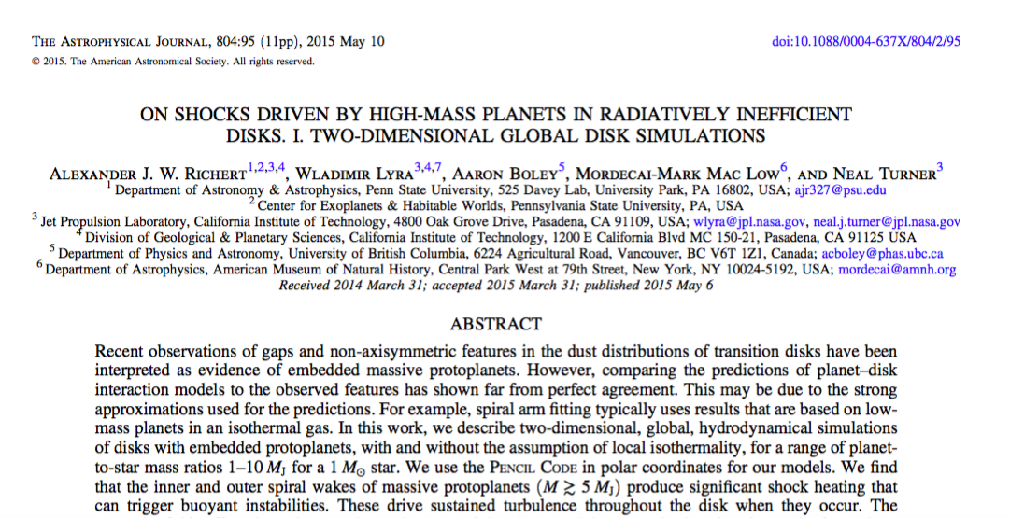
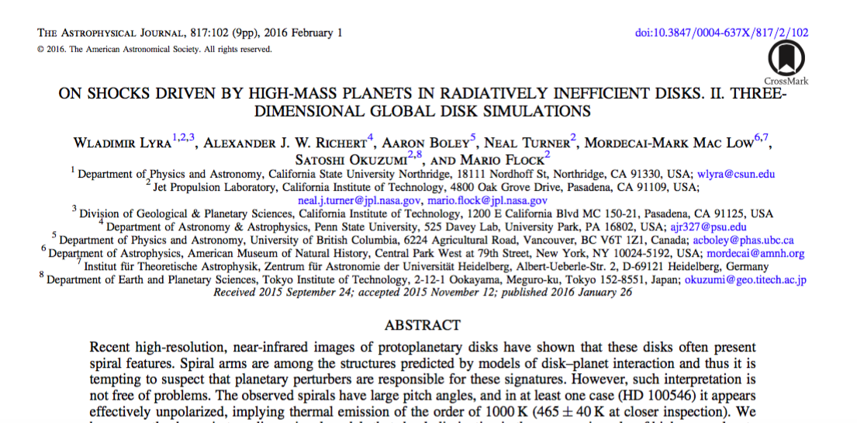
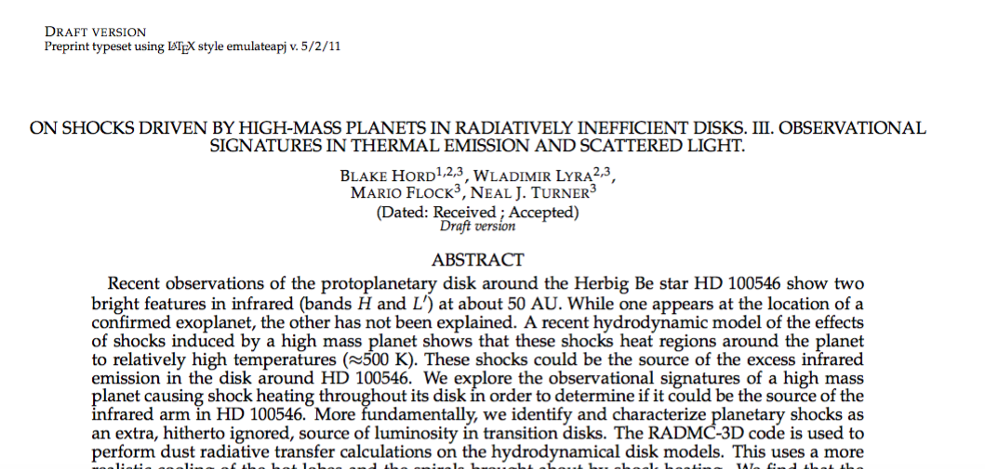
Richert et al. (2015)
Lyra et al. (2016)
Hord et al. (2017)

Slide 3
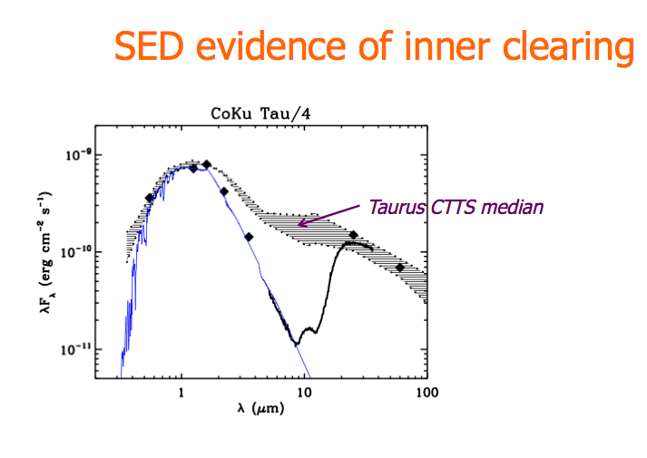
Transition Disks: Disks with missing hot dust.

Slide 4
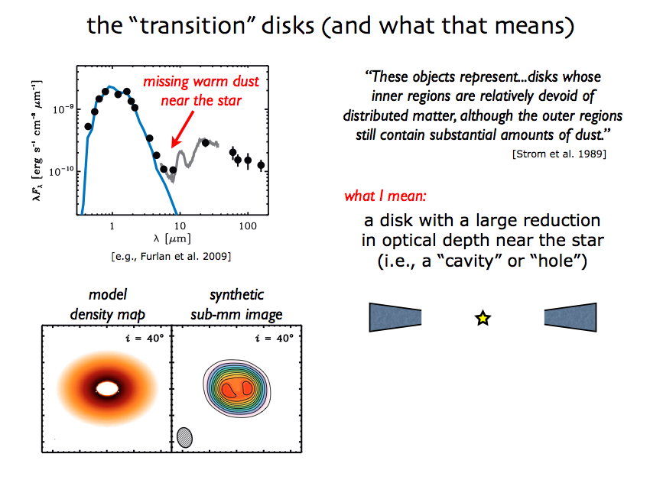
Transition Disks: Disks with missing hot dust.

Slide 5
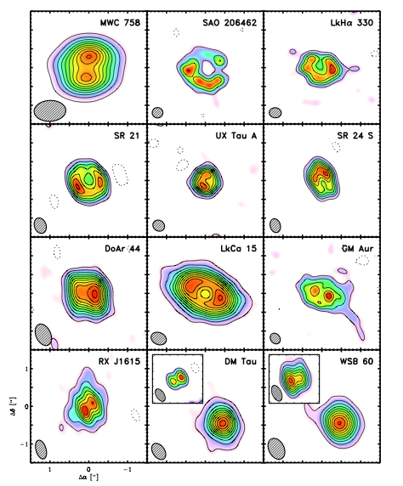
Resolved transition disks with
the Sub-millimeter Array (SMA)
0.85mm
0.3’’ ~ 20 AU resolution

Slide 6
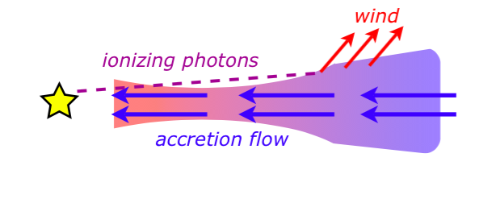
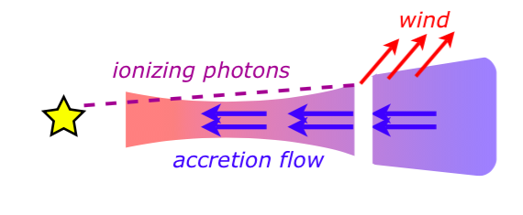
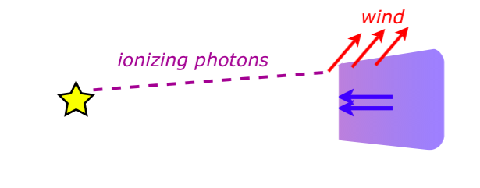
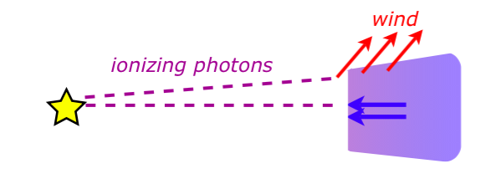
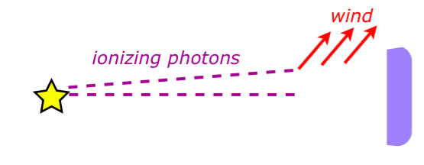
Photoevaporation

Slide 7
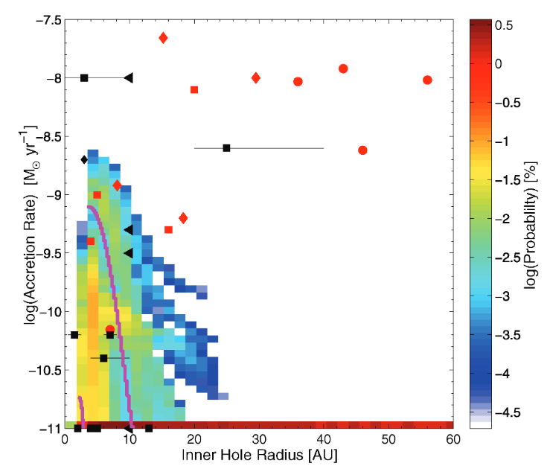
Bimodal distribution of transition disks
(Owen et al. 2011)

Slide 8
Bimodal distribution of transition disks
Not explained by photo-evaporation
Explained by
Photo-
evaporation
(Owen et al. 2011)

Slide 9
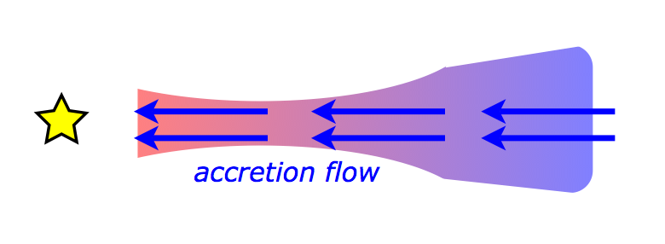
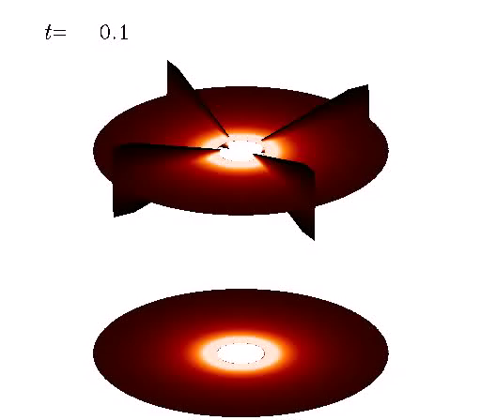
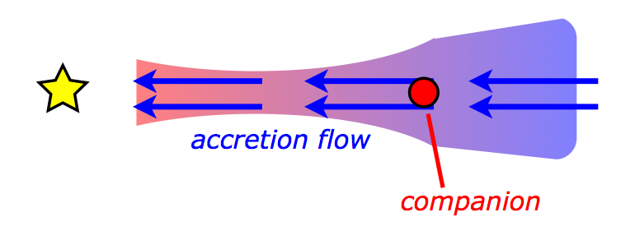
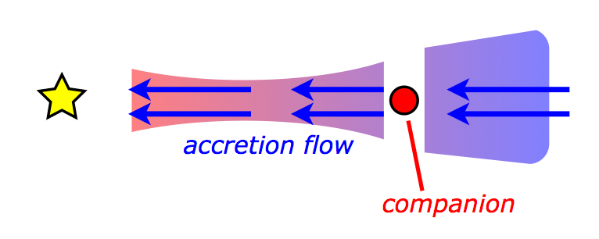
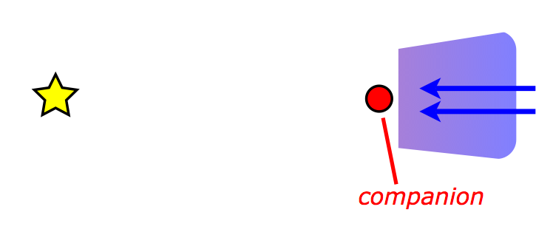
Planetary companion
(Lyra 2009)

Slide 10
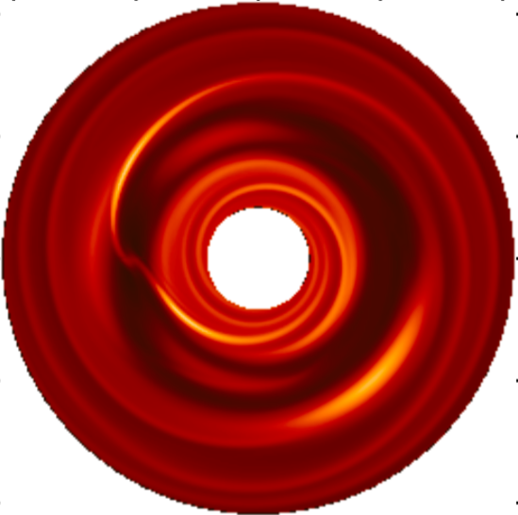
These cavities may be the telltale signature of forming planets
(Lyra et al. 2009b)
A way to directly study planet-disk interaction

Slide 11
Planet-disk interaction: gaps, spirals, and vortices.
(Lyra et al. 2009b)

Slide 12
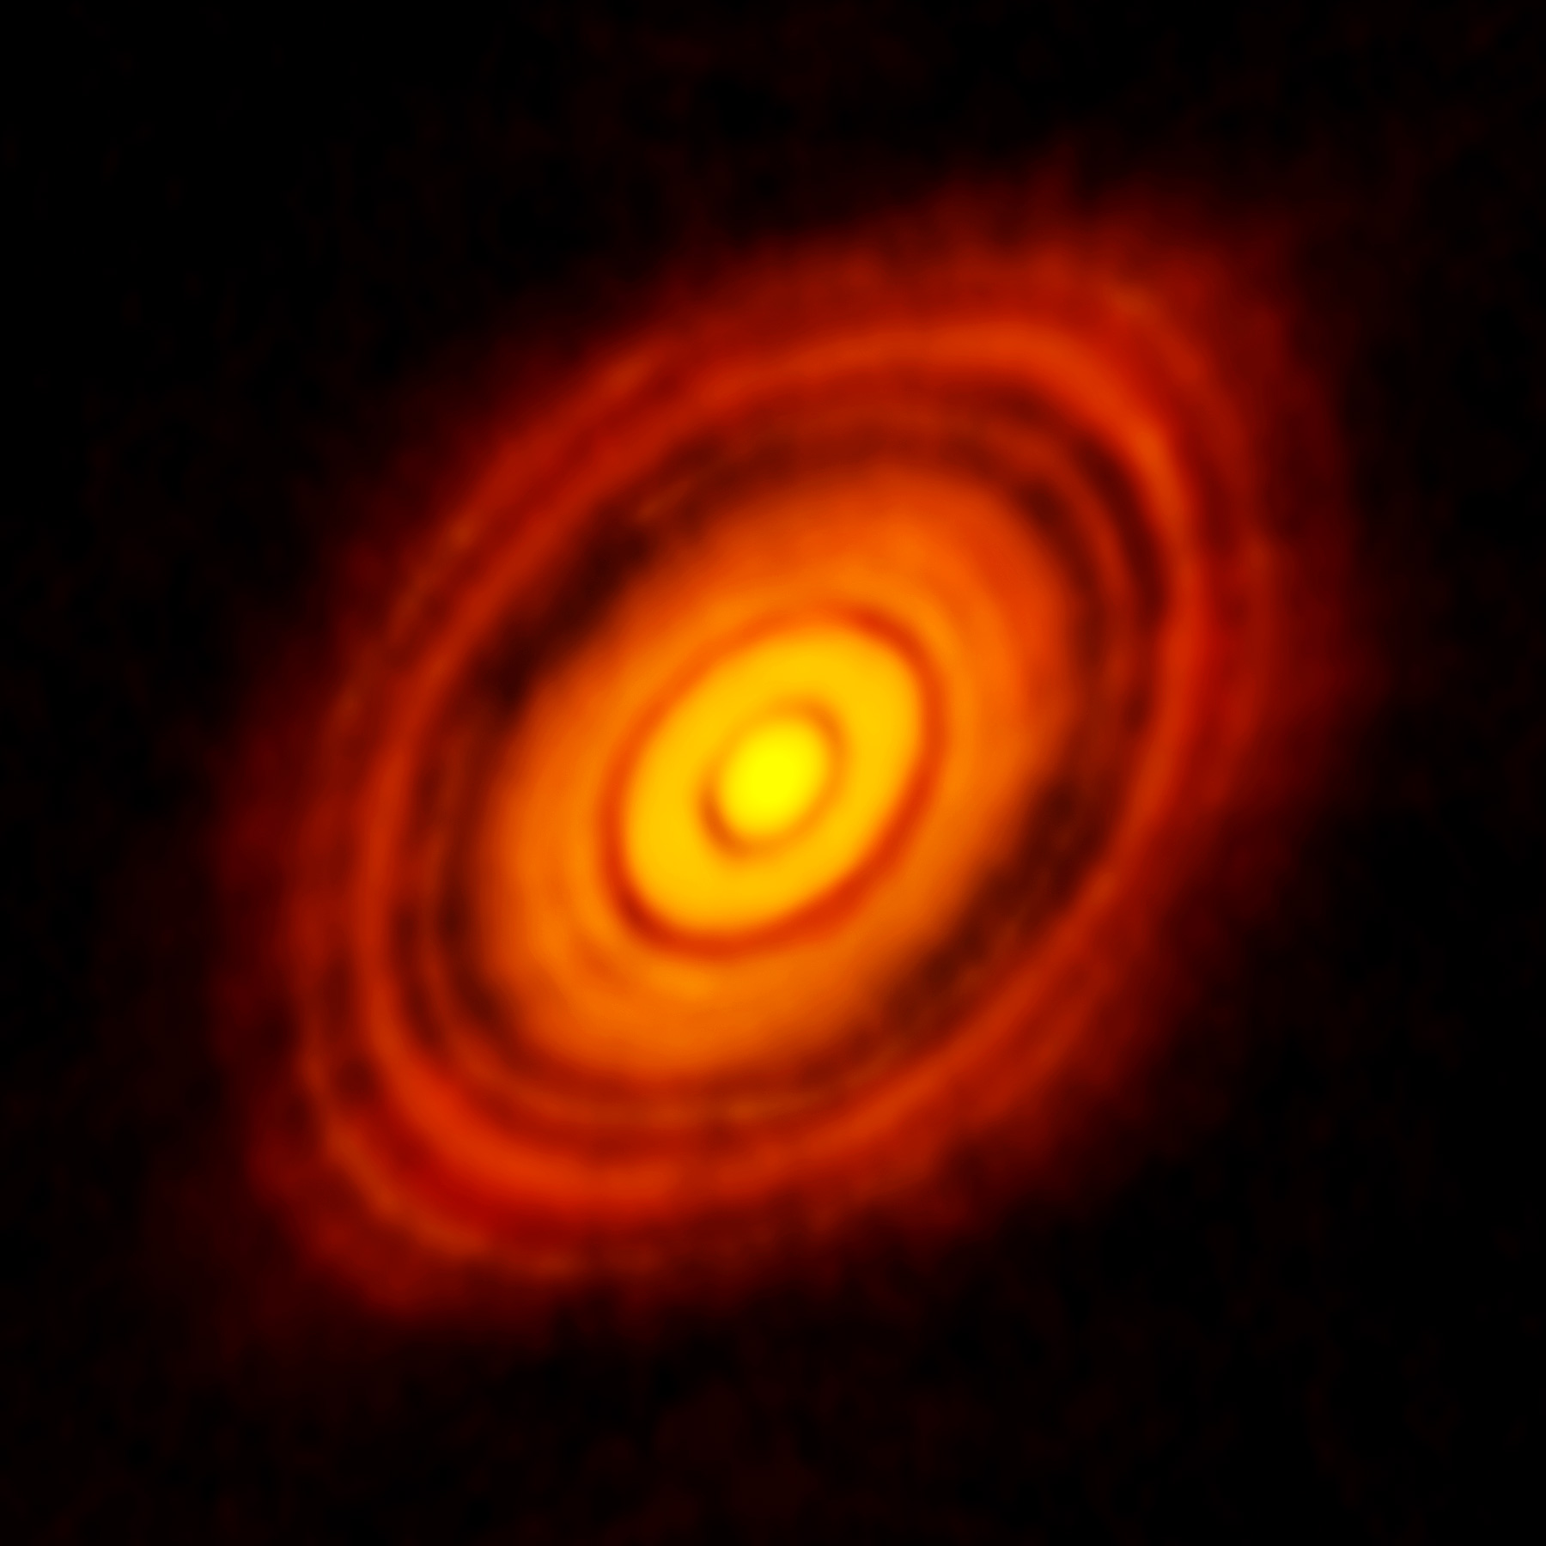
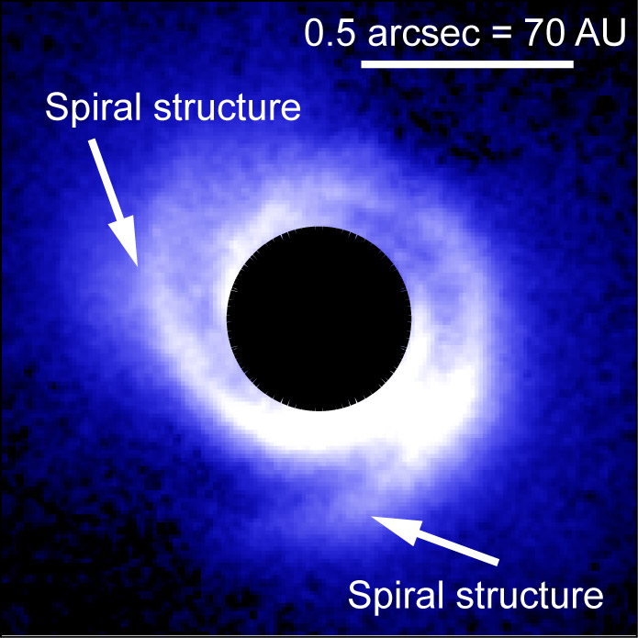
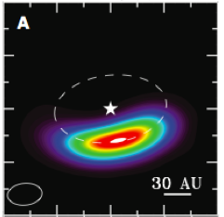
Observational evidence: gaps, spirals, and vortices
HL Tau
SAO 206462
Oph IRS 48
The ALMA Partnership et al. (2015)
Muto et al. (2012)
van der Marel et al. (2013)

Slide 13
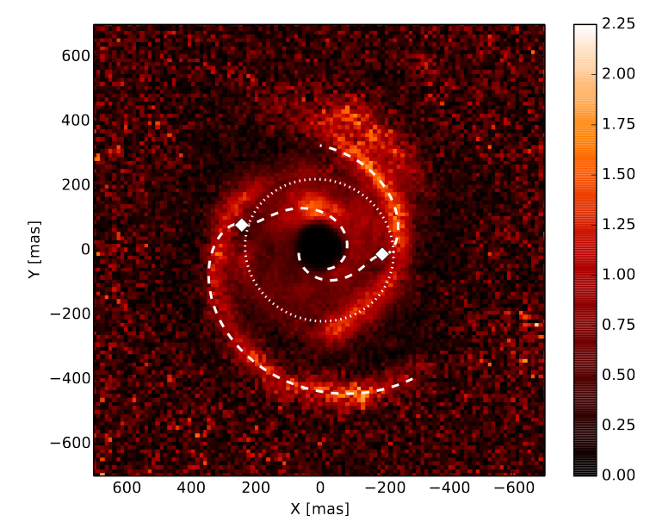
Observational Evidence: Spirals
SAO 206462
MWC 748
Muto et al. (2012)
Benisty et al. (2015)

Slide 14
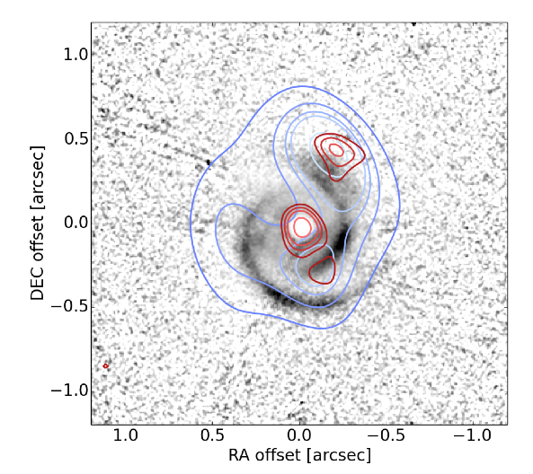
SPHERE-ALMA-VLA overlay of MWC 758
SPHERE (μm)
ALMA ( ~ mm)
VLA (cm-m)
Marino et al. (2015)

Slide 15
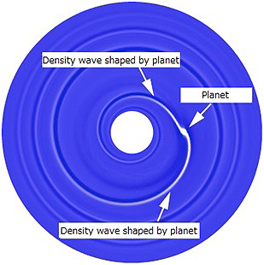
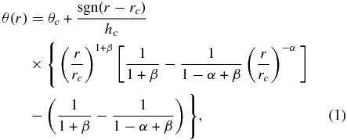
Spiral arm fitting leads to problems
Analytical spiral fit
Spirals are too wide,
hotter (300K) than ambient gas (50K).
Rafikov (2002)
Muto et al. (2012)
Benisty et al. (2015)

Slide 16
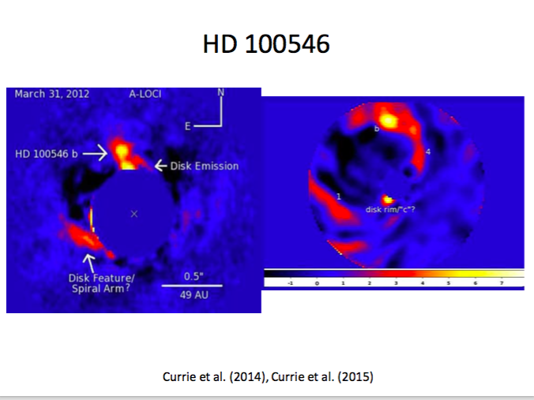
The strange case of thermal emission in HD 100546
L band (~3.5 μm)
H band (~1.6 μm)

Slide 17
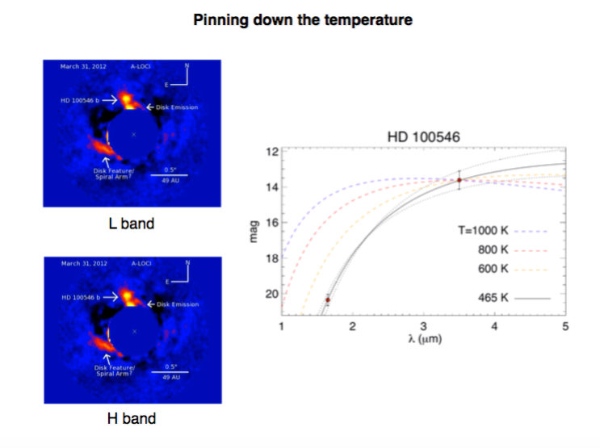
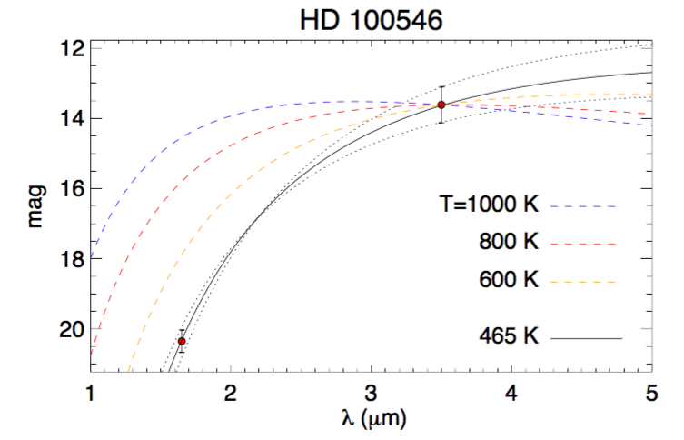
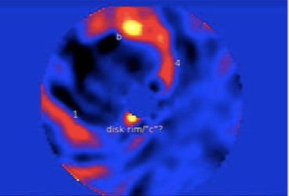
Lyra et al. (2016)

Slide 18
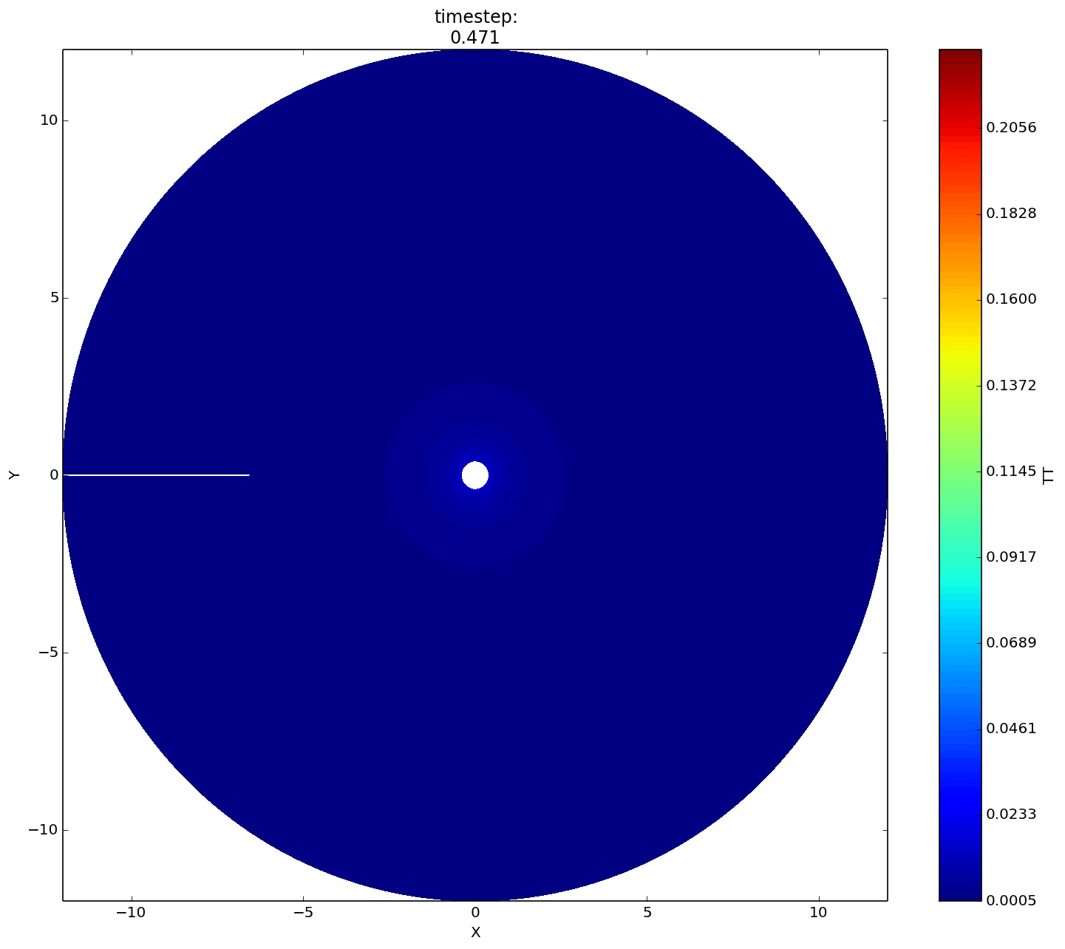
Planet-driven turbulence
Richert et al. (2015)

Slide 19
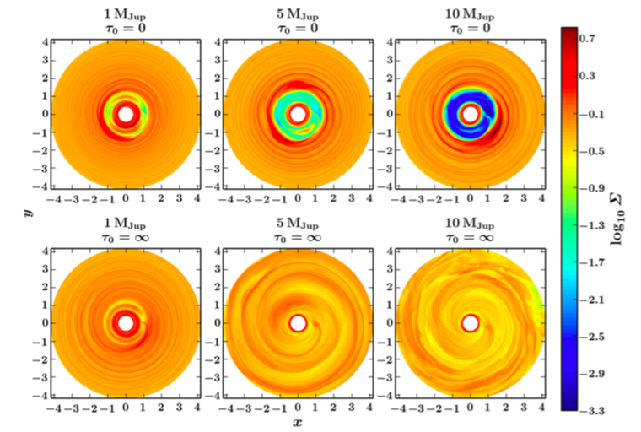
Turbulence in high-mass planets in adiabatic disks
Planet mass
Isothermal
Adiabatic
Richert et al. (2015)

Slide 20
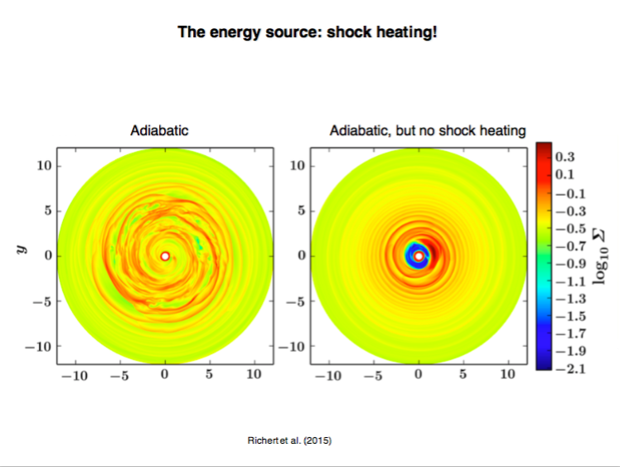

Slide 21
3D: Shock bores
Shocks (velocity convergence)
Temperature
Lyra et al. (2016)

Slide 22
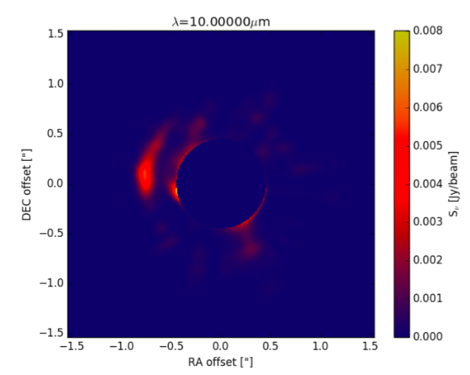
Synthetic image
Hord et al. (2017)

Slide 23
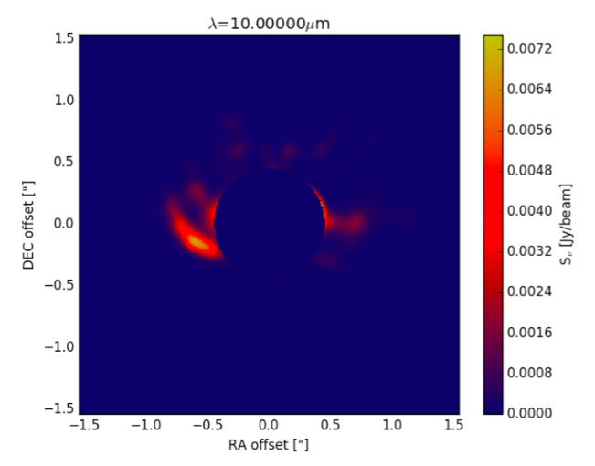
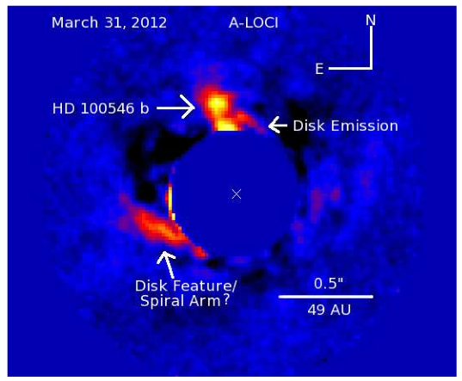
Observation vs Synthetic Image
Hord et al. (2017)

Slide 24
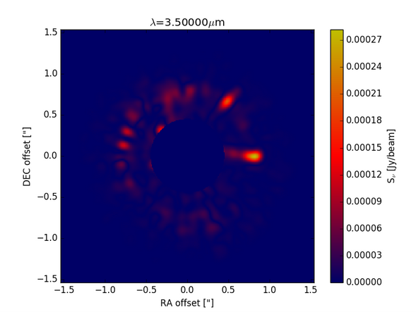
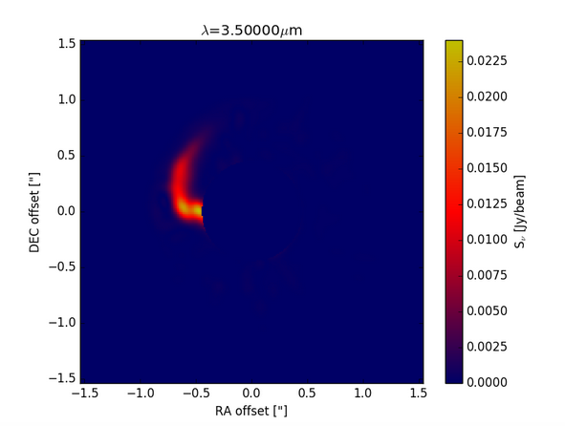
Effect of shocks alone
1 μm
10 μm
Hord et al. (2017)

Slide 25
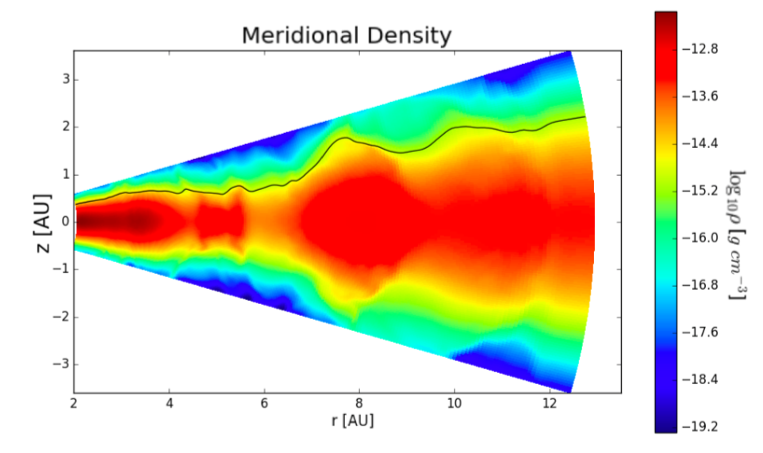
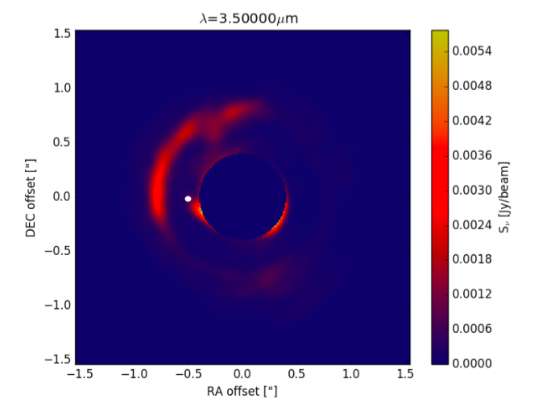
Scattering – A puffed up outer gap
Hord et al. (2017)

Slide 26
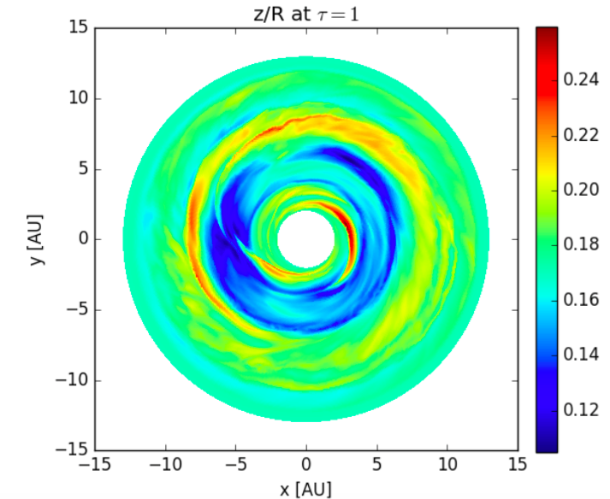
Scattering
Hord et al. (2017)

Slide 27
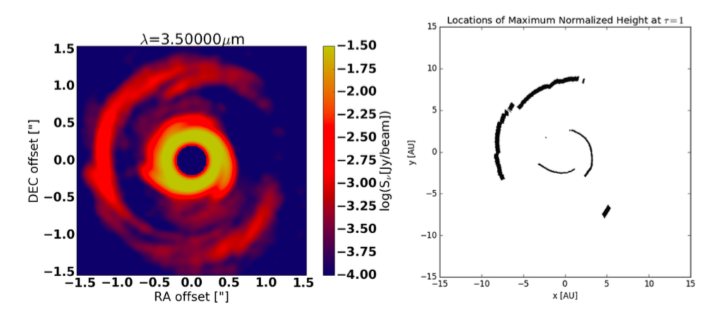
We see what is not in the
shadow of the inner disk spirals
Hord et al. (2017)

Slide 28
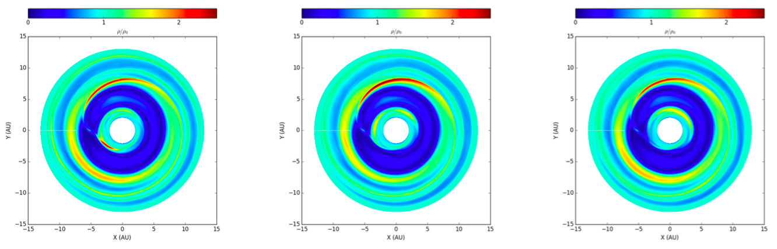
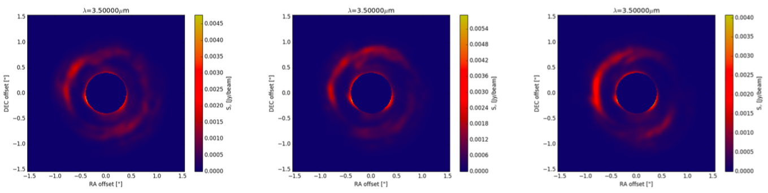
The pattern is stationary
T = 39 orbits
T = 40 orbits
T = 41 orbits
Density
Intensity
Hord et al. (2017)

Slide 29
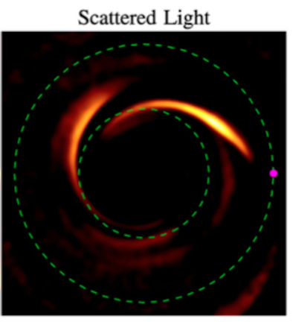
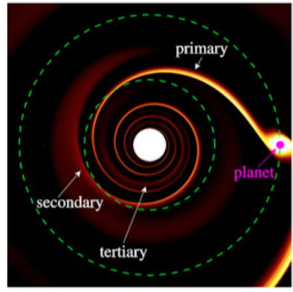
Primary and Secondary spiral arms
Dong et al. (2015)

Slide 30
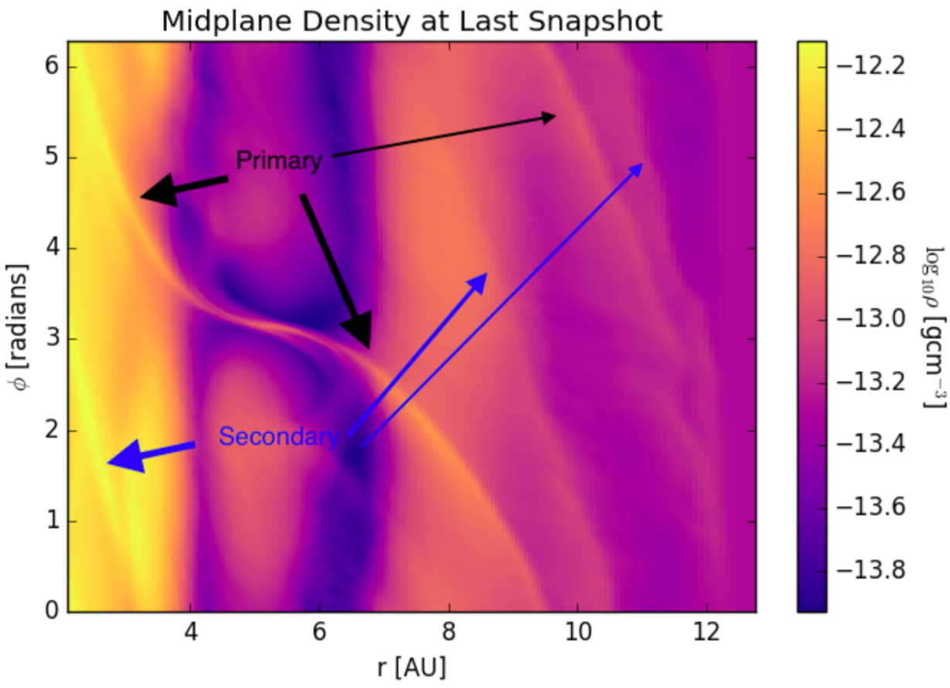
Primary and Secondary spiral arms
Hord et al. (2017)

Slide 31
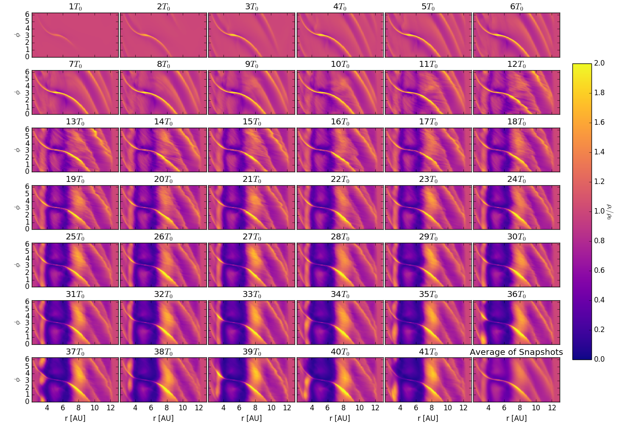
The raised feature has its origins in a secondary spiral arm
Hord et al. (2017)

Slide 32
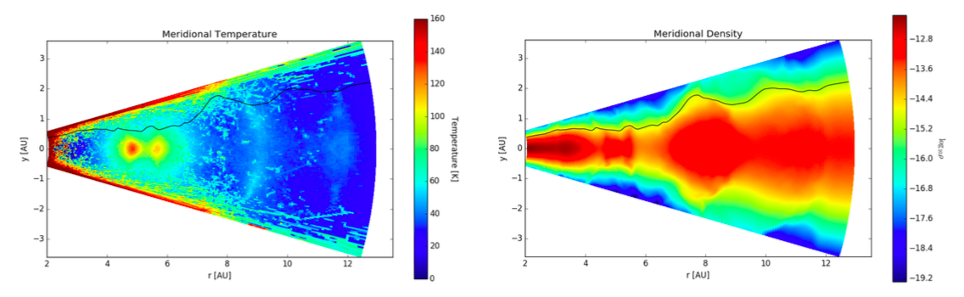
Conclusions
3D radiation-hydro models give results widely different than 2D isothermal
Planet-induced shocks modify disk structure
Hot lobes near high-mass planets in high resolution
Planets puff up their outer gaps – visible in scattered light

Slide 33
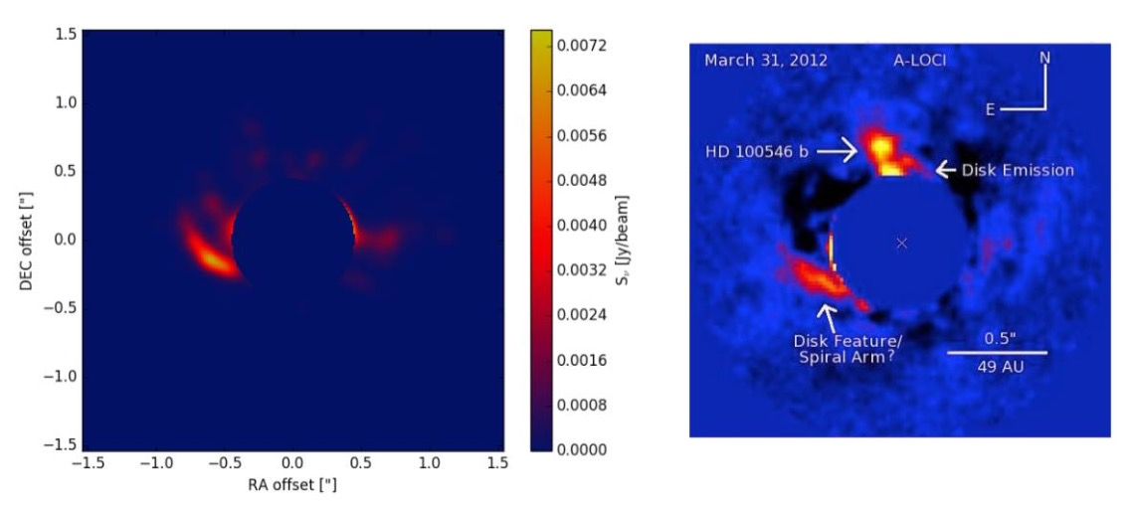
Conclusions
3D radiation-hydro models give results widely different than 2D isothermal
Planet-induced shocks modify disk structure
Hot lobes near high-mass planets in high resolution
Planets puff up their outer gaps – visible in scattered light

