Slide 1
Evolution of MU69
from a binary planetesimal into contact
via Kozai-Lidov oscillations and nebular drag
Current Funding
Wladimir Lyra
New Mexico State University
AAG – 2019
TCAN – 2020
NFDAP – 2019
XRP – 2018
Computational Facilities
Planetesimal Formation Meeting, Nov 2020

Slide 2
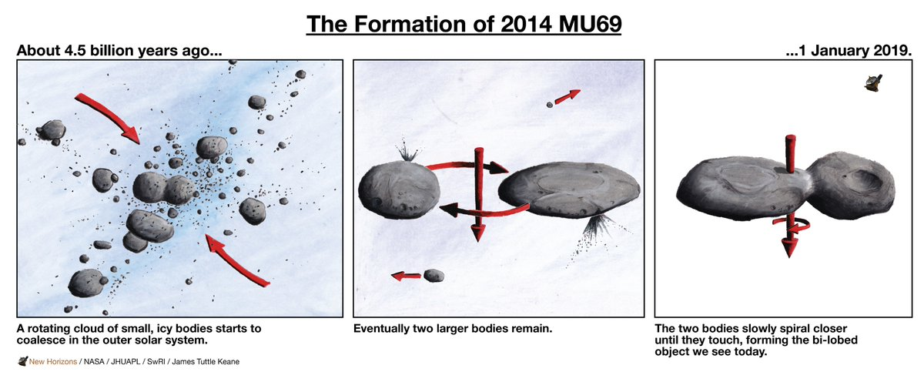
The Cartoon Image
W. Lyra
Sketch by J.T. Keane

Slide 3
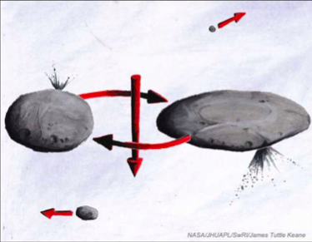
Hardening
Sketch by J.T. Keane

Slide 4
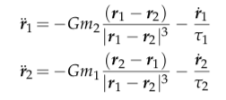
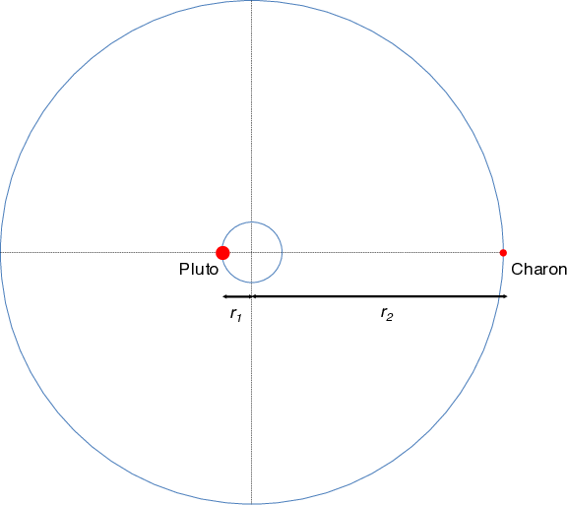
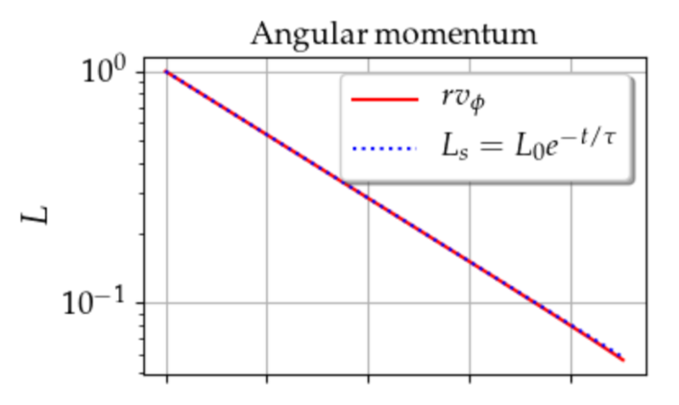
Angular momentum loss via nebular drag
gravity
drag
Solve for angular momentum:
Lobe 1
Lobe 2
Exponential decay of angular momentum !
W. Lyra
Lyra, Youdin, & Johansen 2020

Slide 5
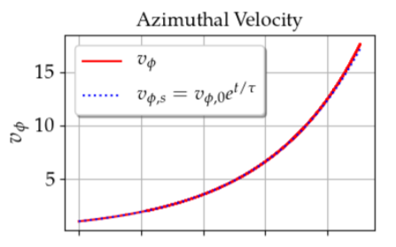
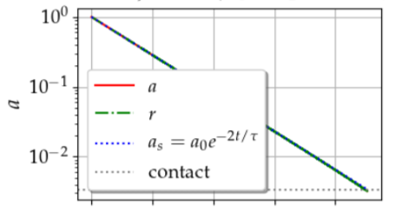
Analytical solution
Exponential decay of angular momentum
Exponential decay of energy
Exponential increase of orbital velocity
W. Lyra
Lyra, Youdin, & Johansen 2020

Slide 6
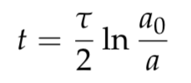
Getting quantitative…
Time until contact
For a = 0.1 r_{H} (4000 km), hardening to a₀=20km and τΩ=10⁷ …
t ~ 100 Myr
W. Lyra
Lyra, Youdin, & Johansen 2020

Slide 7
Wind
At initial separation a ~ 4000 km:
Binary orbital velocity ~ 0.1 m/s
Solar orbit velocity at 45AU
v_{k} ~ 4.5 km/s
Sub-Keplerian pressure support
v = v_{k} (1−η)
η ∼ 0.01
Headwind velocity (v_{k}-v):
ηv ~ 50 m/s
Subkeplerian wind on the binary
= 500 times orbital velocity
v
L1
L2
v
500 v
W. Lyra
Lyra, Youdin, & Johansen 2020

Slide 8
Wind solution
Lyra, Youdin, & Johansen 2020

Slide 9
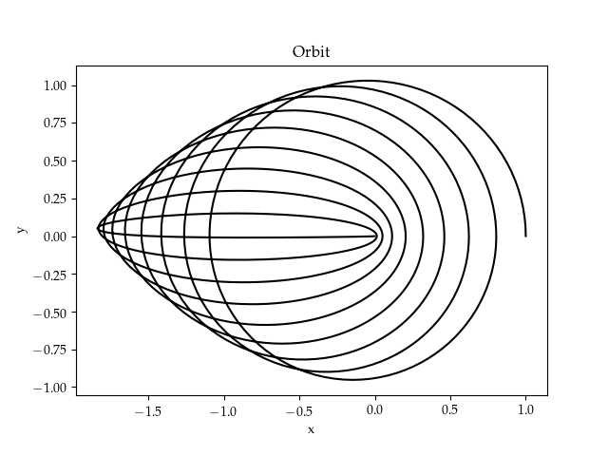
Wind solution
Angular momentum loss at constant energy.
Eccentricity increase at constant semimajor axis
Lyra, Youdin, & Johansen 2020

Slide 10
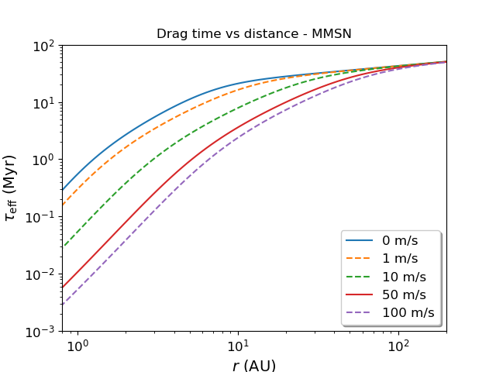
Timescales
No wind
(zero pressure gradient)
Wind has a strong effect in the distances of the asteroid belt.
Little effect in the Kuiper belt.
Typical pressure gradient
Lyra, Youdin, & Johansen 2020

Slide 11
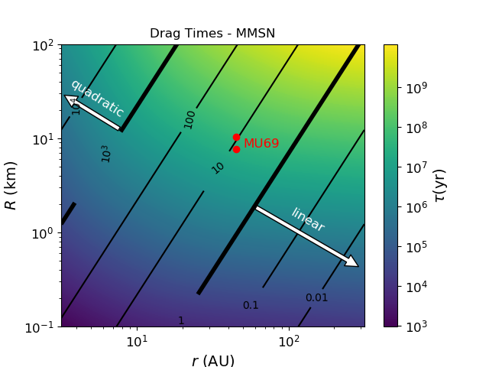
Linear vs quadratic drag
Lyra, Youdin, & Johansen 2020

Slide 12
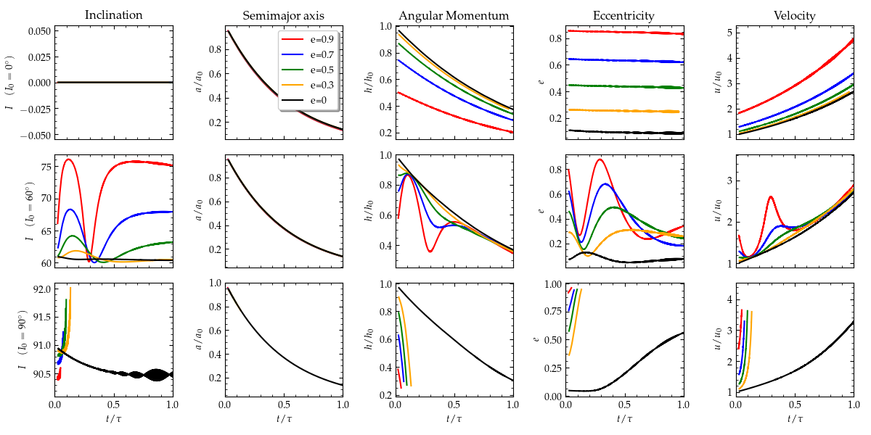
Effect of Inclination
I₀ = 0º
I₀ = 60º
I₀ = 90º
Lyra, Youdin, & Johansen 2020

Slide 13
Kozai-Lidov Oscillations
(Sun)
test particle

Slide 14
Effect of Inclination
I₀ = 0º
I₀ = 60º
I₀ = 90º
Lyra, Youdin, & Johansen 2020

Slide 15
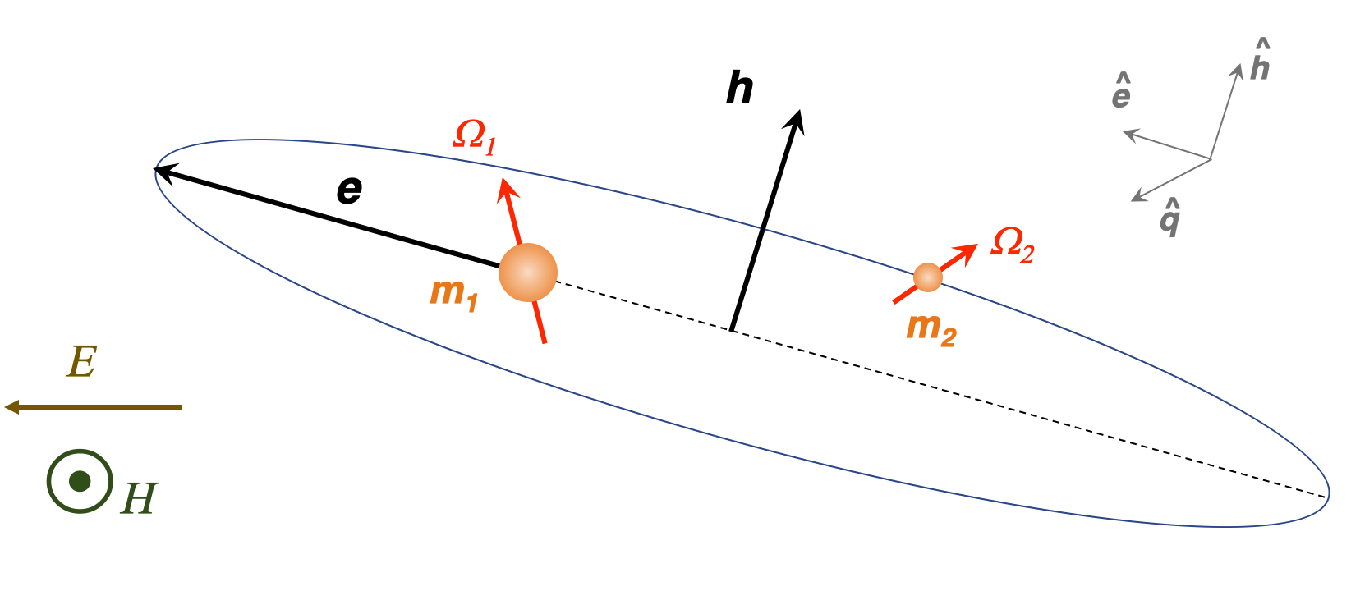
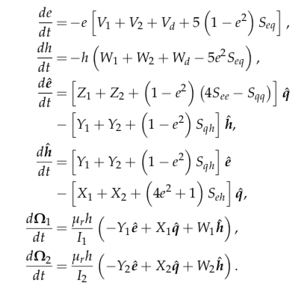
Kozai + Tidal Friction + Drag
Lyra, Youdin, & Johansen 2020

Slide 16
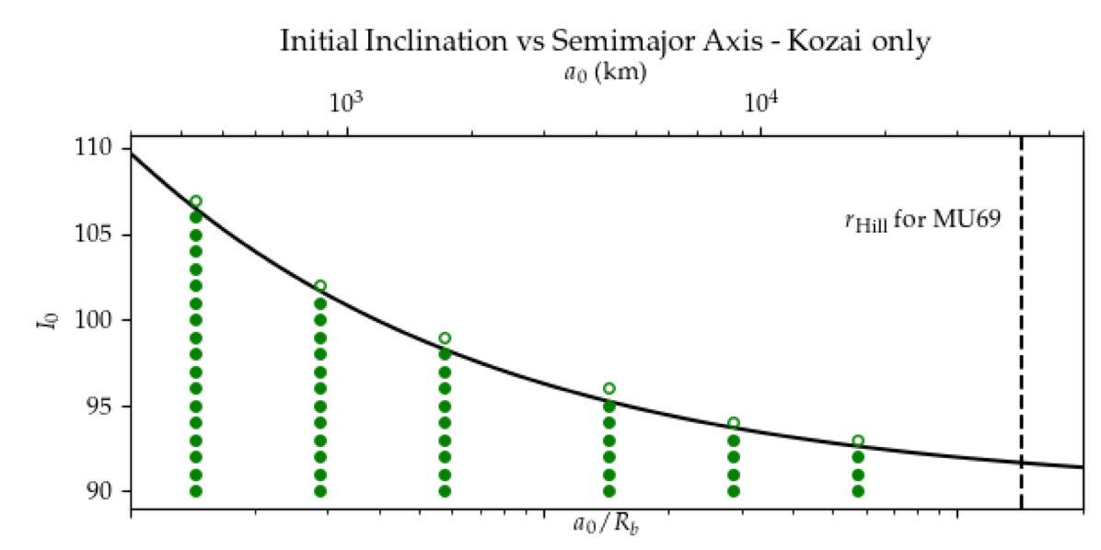
Critical Inclination
Contact
No contact
Lyra, Youdin, & Johansen 2020

Slide 17
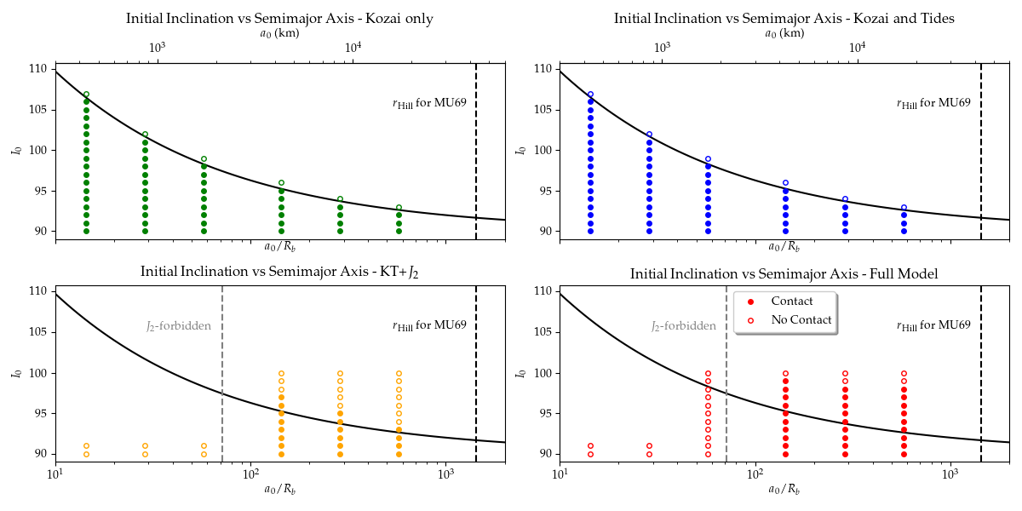
Kozai + Tidal Friction + Drag
Lyra, Youdin, & Johansen 2020

Slide 18
Kozai + Tidal Friction + Drag
Lyra, Youdin, & Johansen 2020

Slide 19
Kozai + Tidal Friction + Drag
Lyra, Youdin, & Johansen 2020

Slide 20
Effect of Drag
Lyra, Youdin, & Johansen 2020

Slide 21
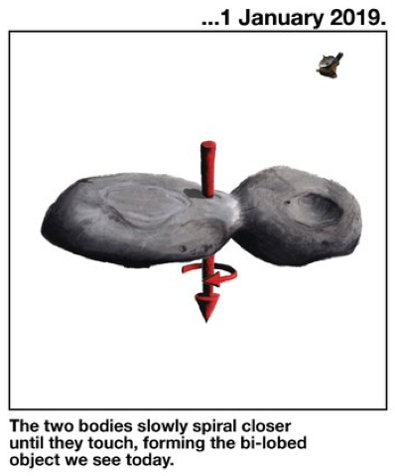
Conclusions
Solved the binary planetesimal problem with gas drag
Implemented the solution into a Kozai plus tidal friction code
Contact possible in the asteroid belt within 0.1 Myr (depleted of binaries)
Contact via Kozai cycles in the Kuiper belt, orbits become grazing
Window of contact increased by J₂ and drag
Model predictions:
~ 10% of KBCC binaries should be contact binaries
Velocities at contact should be about 3-4 m/s
Open questions:
Single-averaged (or N-body) needed to reproduce final inclinations
Combine our model with single-averaged Kozai (or N-body)
Sketch by J.T. Keane
Lyra, Youdin, & Johansen 2020

Slide 22
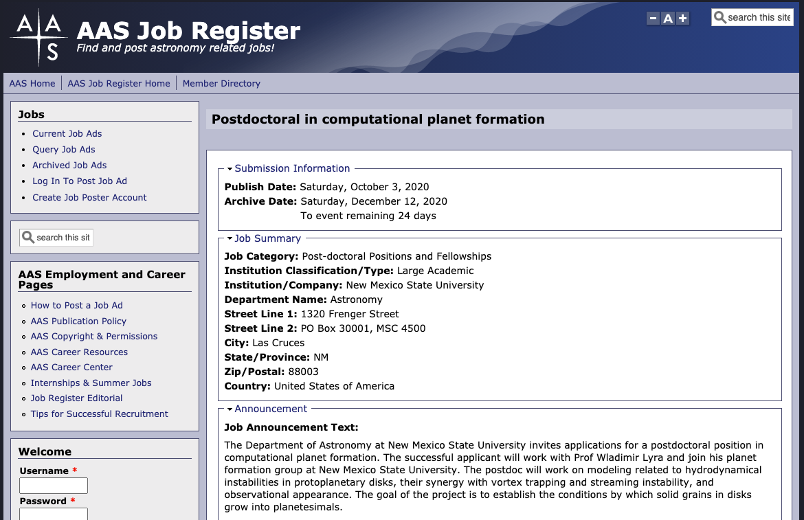
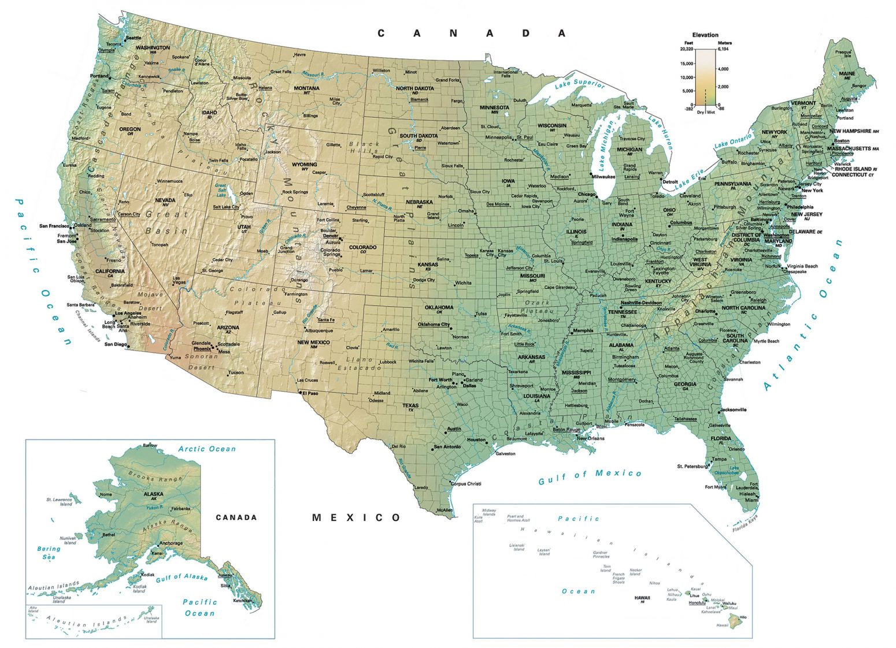
Hiring 2 postdocs and 2 PhD students
Wladimir Lyra – New Mexico State University
Andrew Youdin – University of Arizona
Jake Simon – Iowa State University
Chao-Chin Yang – University of Nevada, Las Vegas
Orkan Umurhan – NASA Ames
AAG
TCAN

