Slide 1
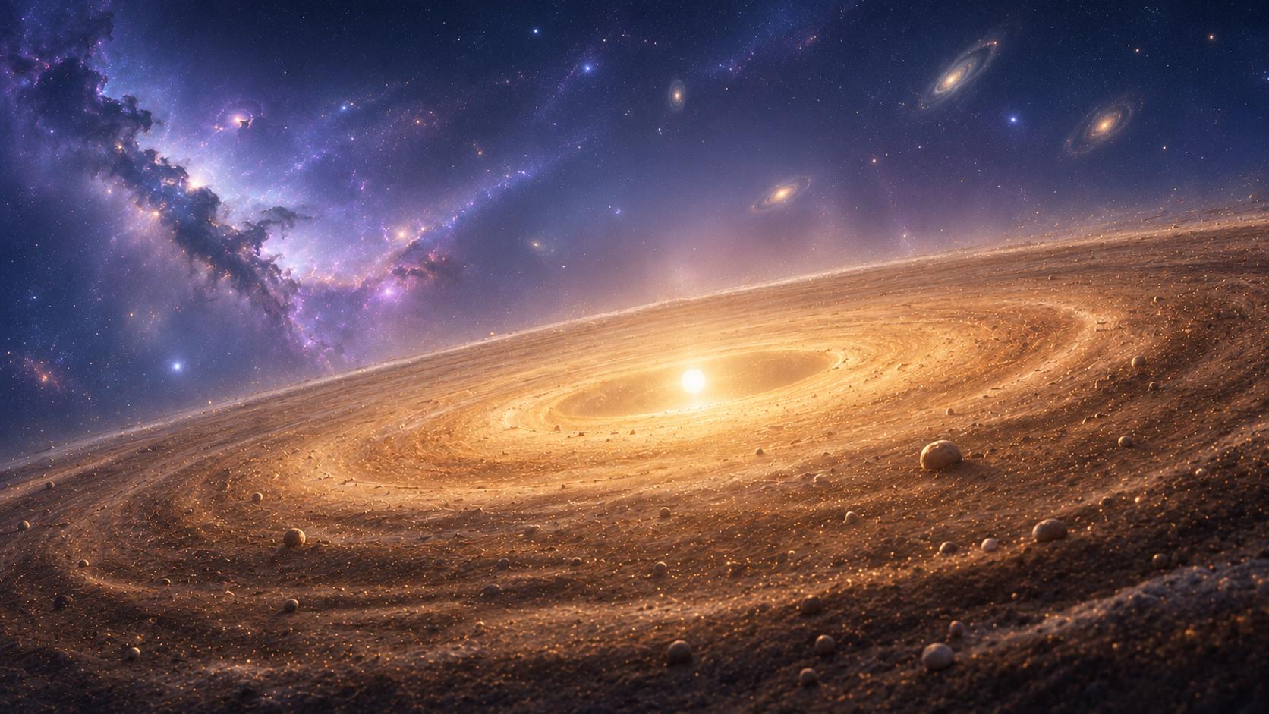





Planet Formation at Cosmic Dawn
Wladimir Lyra
New Mexico State University
Las Cruces NM, USA
The Formation of Stars and Planets in the Evolving Galaxy
Okinawa – Aug 3-7, 2026
W. Lyra

Slide 2
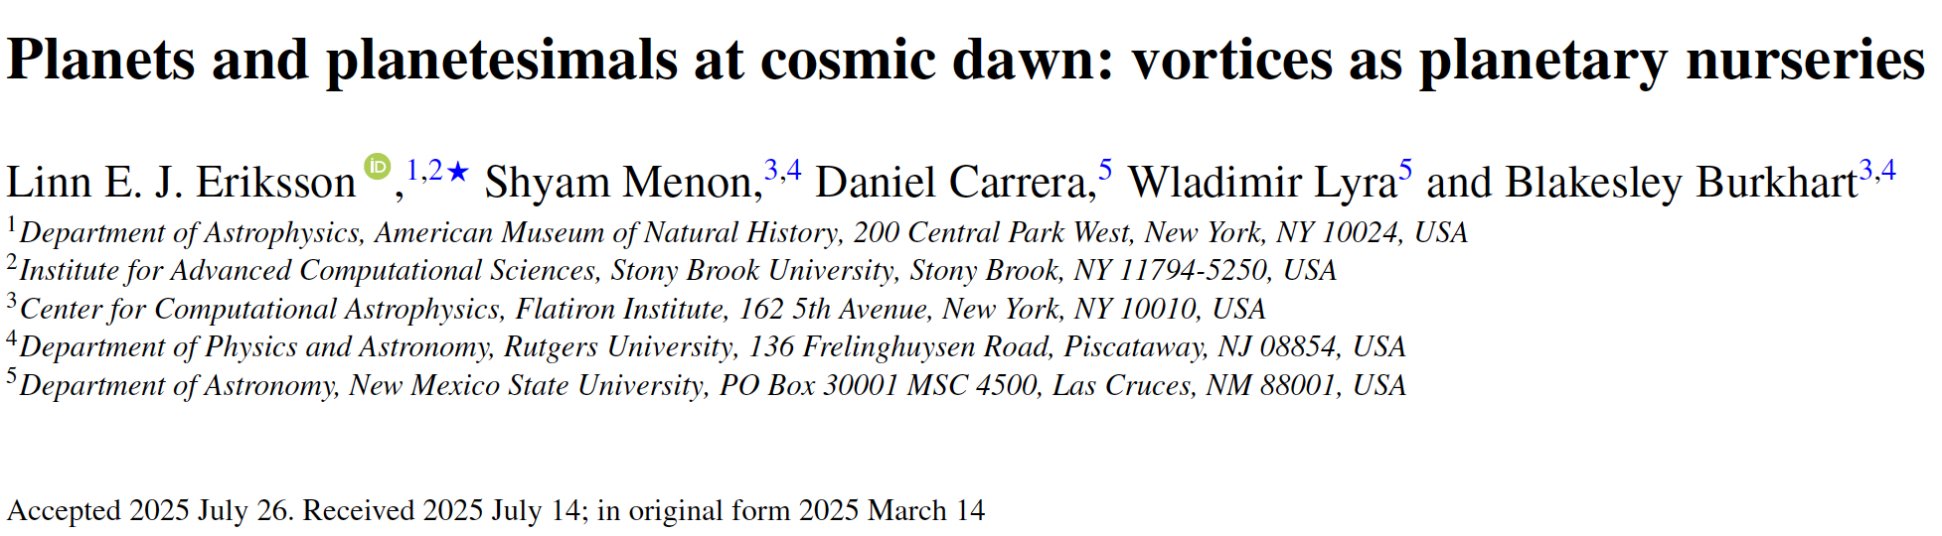


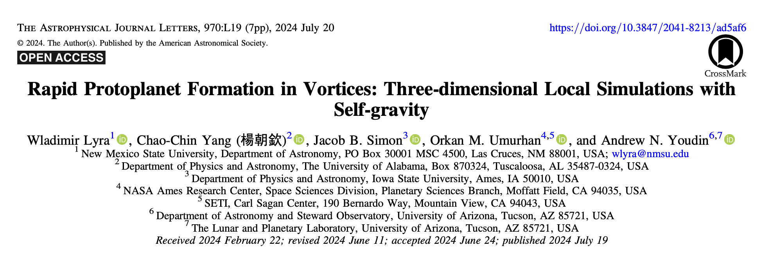
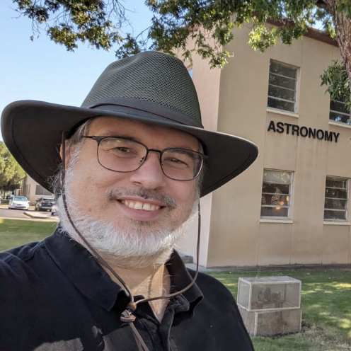

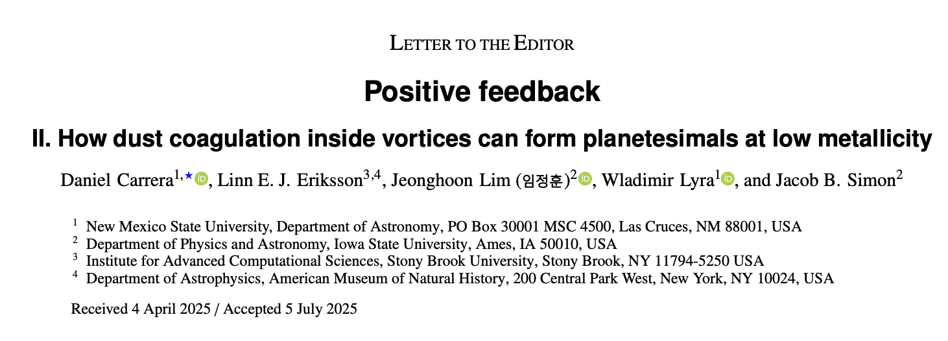
Linn Eriksson
Shyam Menon
Daniel Carrera
Blakesley Burkhart
2/24
W. Lyra
Lyra et al. (2024), Carrera et al. (2025), Eriksson et al. (2025)

Slide 3
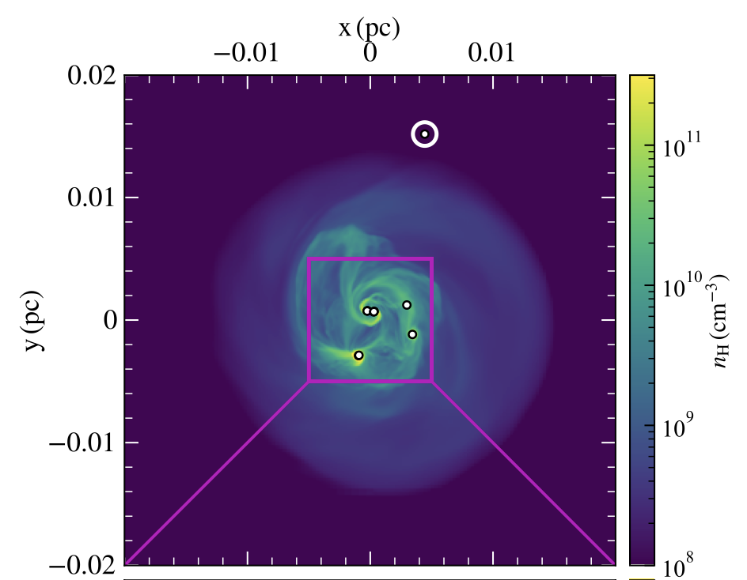
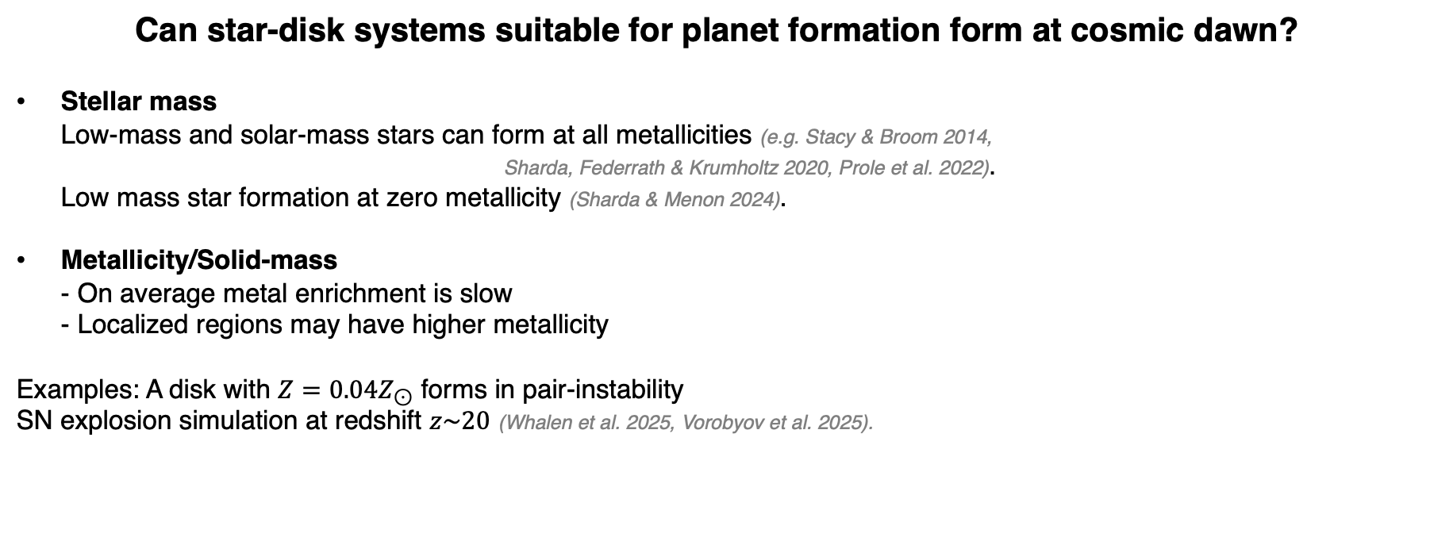
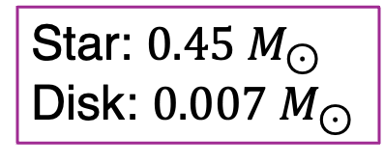
Can star-disk systems suitable for planet formation form at cosmic dawn?
Stellar mass
Low-mass and solar-mass stars can form at all metallicities (e.g. Stacy & Broom 2014,
  Sharda, Federrath & Krumholtz 2020, Prole et al. 2022).
Low mass star formation at zero metallicity (Sharda & Menon 2024).
Metallicity/Solid-mass
- On average metal enrichment is slow
- Localized regions may have higher metallicity
Examples: A disk with $Z={0.04Z}_{⊙}$ forms in pair-instability
SN explosion simulation at redshift $z\sim 20$ (Whalen et al. 2025, Vorobyov et al. 2025).
Star: $0.45 M_{⊙}$​
Disk: $0.007 M_{⊙}$​
When did the first planet form?
When did the Universe start getting populated with planets?
What metallicity do we need to form planets?
3/24
Slide by L. Eriksson
Sharda and Menon (2024)
Notes:
So the first we need to check is if star-disk systems suitable for planet formation can even form at cosmic dawn.
First let’s consider the stellar mass: I had always heard that the first stars that formed where very massive, and thus unsuitable for planet formation, however my co-authors informed me that low-mass and solar-mass stars can form at all metallicities including 0 metallicity, its just that they are rare.
Here I show an example from a primordial star formation simulation by Sharda & Menon, where an isolated low-mass star-disk system ends up forming.
So that’s quite promising, however, this system had 0 metallicity, and we need metals to form planets.
On average it takes quite a while to enrich the universe with metals, however the distribution of metals is not uniform, and localized regions may be present that have higher metallicities.
For example: Vorpbyov et al. (2025) model the formation of a dense cloud core formed in the debris of a pair-instability SN explosion and find that it collapses into a protoplanetary disk with a metallicity of 0.04Zsun.
primordial star formation simulations of Sharda & Menon ( 2024 ) – specifically of a low-mass star that formed through fragmentation within the disc of a massive protostar, and is ejected from the disc via many-body interactions, subsequently evolving quasi-independently as an isolated star-disc system.
However, metal-free gas does not completely preclude the formation of low-mass stars, as dense pockets of gas in the discs of PopIII stars can undergo fragmentation to form low-mass stars –an outcome realized in several numerical simulations (e.g. Stacy & Bromm 2014 ; Sharda, Federrath & Krumholz 2020 ; Prole et al. 2022 ; Sharda & Menon 2024 ).
For instance, Whalen et al. ( 2008 ) show that supernova ejecta from even a single metal-free massive star can locally enrich dense gas to metallicities of Z ∼ 10−4 Z, some of which show signatures of being gravitationally unstable, suggesting that localized metal-enriched star formation may persist out to even higher redshifts.

Slide 4
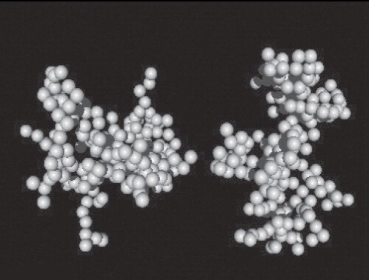
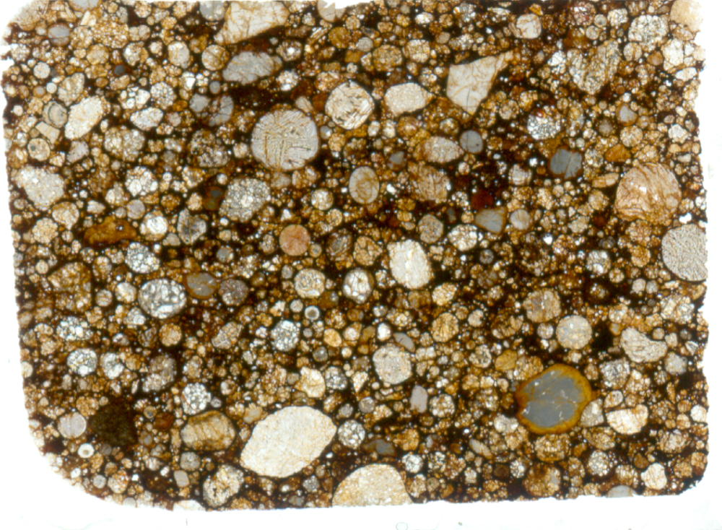
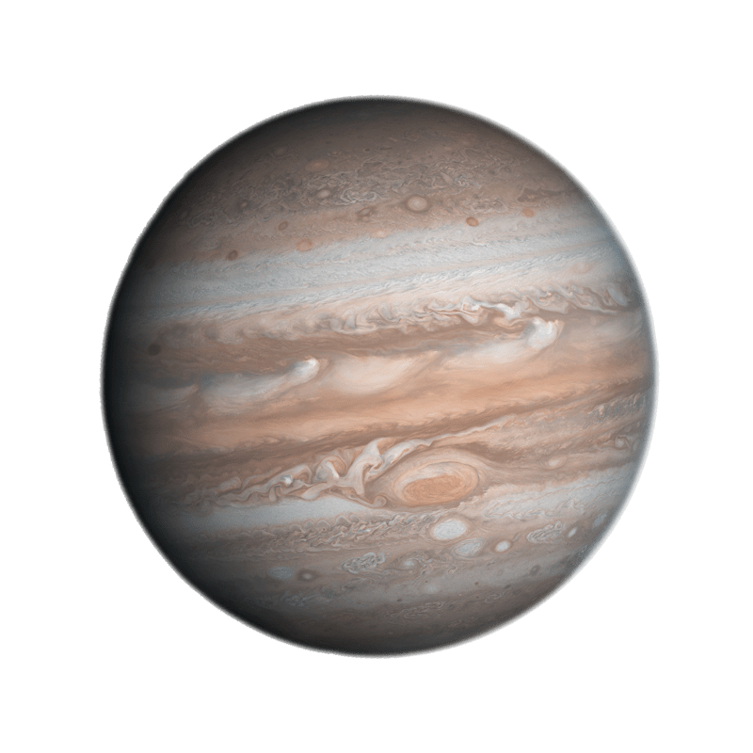
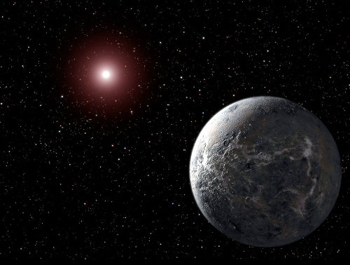
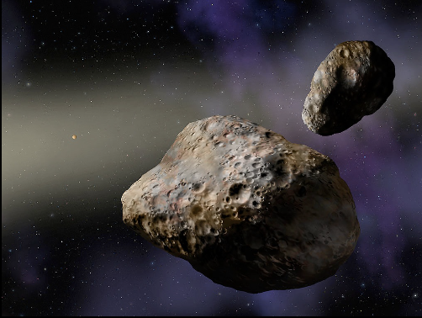
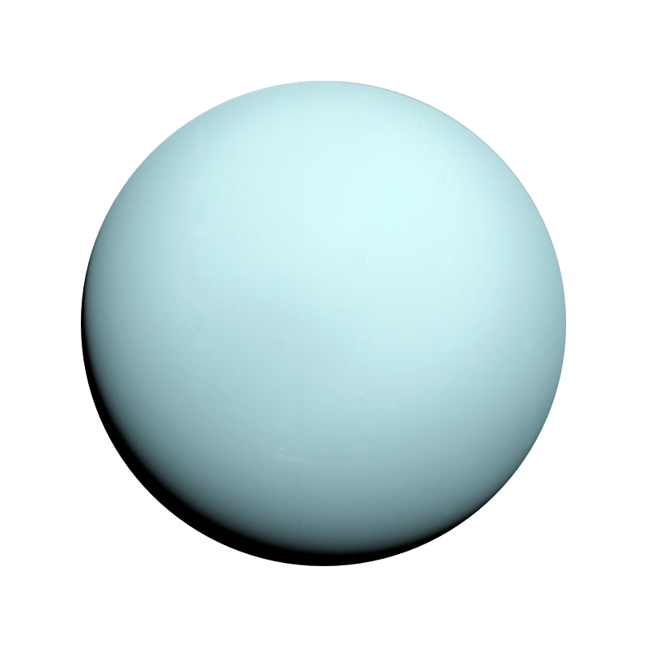
Planet Formation 101
Dust grains
Pebbles
Core Accretion
coagulation
Streaming
Instability
0.1 – 1 μm
mm – cm
Protoplanets
Rocky Planets
Planetary Cores
Pebble
Accretion
Planetesimals
Significant Gas Accretion
Little gas accretion
1-100km
W. Lyra
4/24

Slide 5
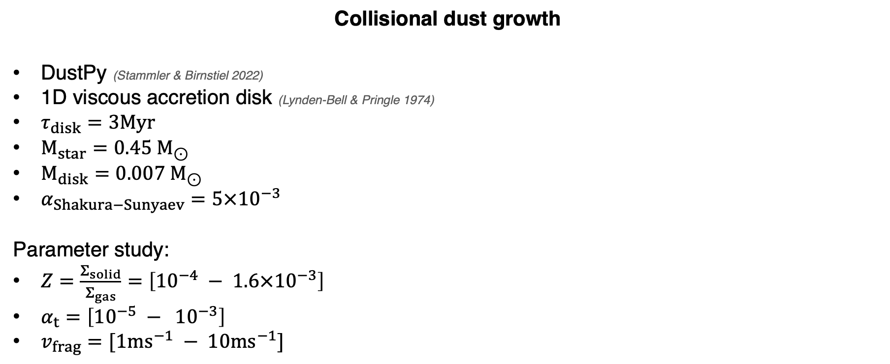
Collisional dust growth
DustPy (Stammler & Birnstiel 2022)
1D viscous accretion disk (Lynden-Bell & Pringle 1974)
$τ_{disk}=3Myr$
$M_{star}=0.45 M_{⊙}$​
$M_{disk}=0.007 M_{⊙}$​
$α_{Shakura−Sunyaev}=5×{10}^{−3}$
Parameter study:
$Z=\frac{Σ_{solid}}{Σ_{gas}}=\left[{10}^{−4} − 1.6×{10}^{−3}\right]$
$α_{t}=\left[{10}^{−5} − {10}^{−3}\right]$
$v_{frag}=[1{ms}^{−1} − 10{ms}^{−1}]$
Particle growth
Bouncing
Sticking
Fragmentation
Settling
Radial drift
Streaming instability (SI)
Slide by L. Eriksson
5/24

Slide 6
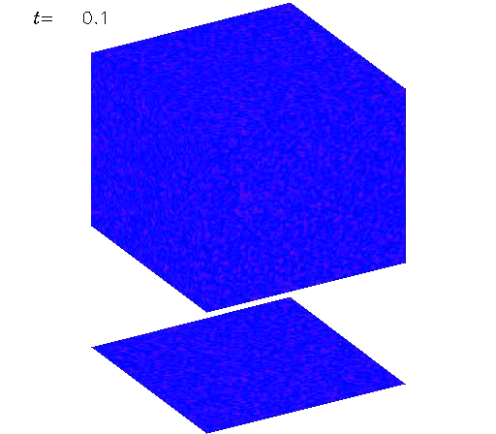
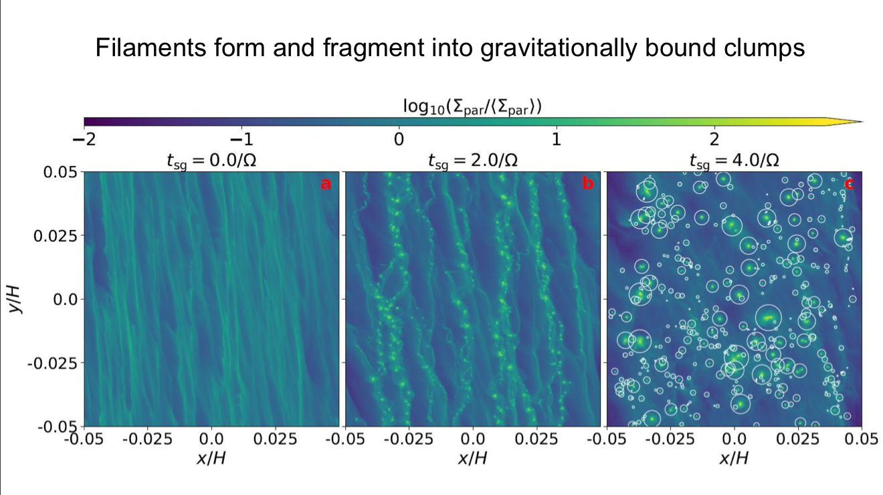
Planetesimal Formation
Streaming Instability: The dust drift is hydrodynamically unstable
(see also Tominaga’s talk)
Nesvorny+’19; model by Rixin Li
animation by A. Johansen
Youdin & Goodman 2005, Johansen & Youdin 2007, Youdin & Johansen 2007, Kowalik+ 2013, Lyra & Kuchner 2013,
Schreiber+ 2018, Klahr & Schreiber 2020, Simon+ 2016, 2017, Carrera+ 2015, 2017, 2020, Gole+ 2020, Li+ 2018, 2019, Abod+ 2019, Nesvorny+ 2019,
Li & Youdin 2021, Carrera & Simon 2022, Canas+Lyra 2024, Lim+ Lyra 2024, 2025, 2026, Godines+Lyra 2026, Baronett+Lyra 2026.
W. Lyra
6/24

Slide 7
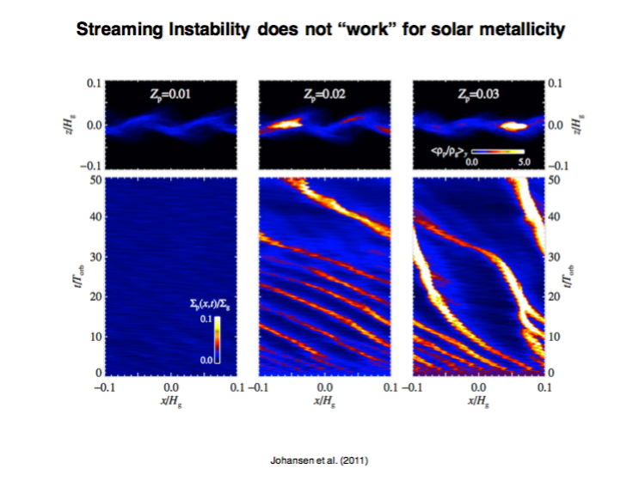
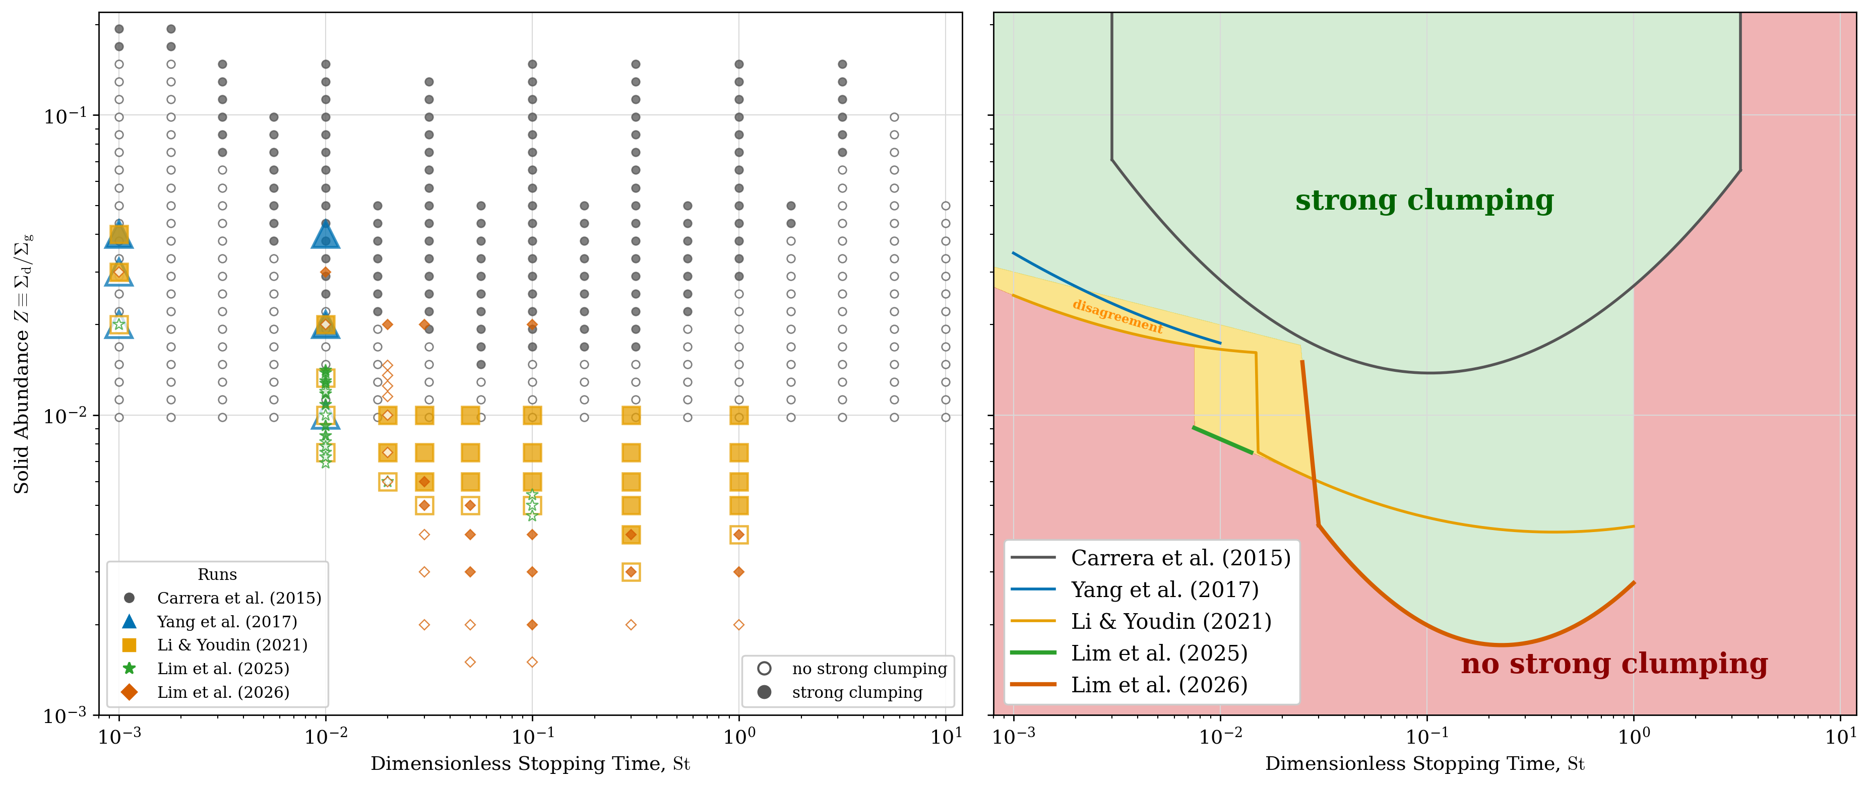
Metallicity and Stokes number
dependency for strong clumping
Metallicity
Lyra, Johansen, Youdin & Ida (in prep)
7/24
see also Tominaga’s talk
W. Lyra
Notes:
The favored mechanism for doing so is the streaming instability, which concentrates particles into dense filaments that can locally reach Roche density.
The million dollar question is when does this happen?

Slide 8
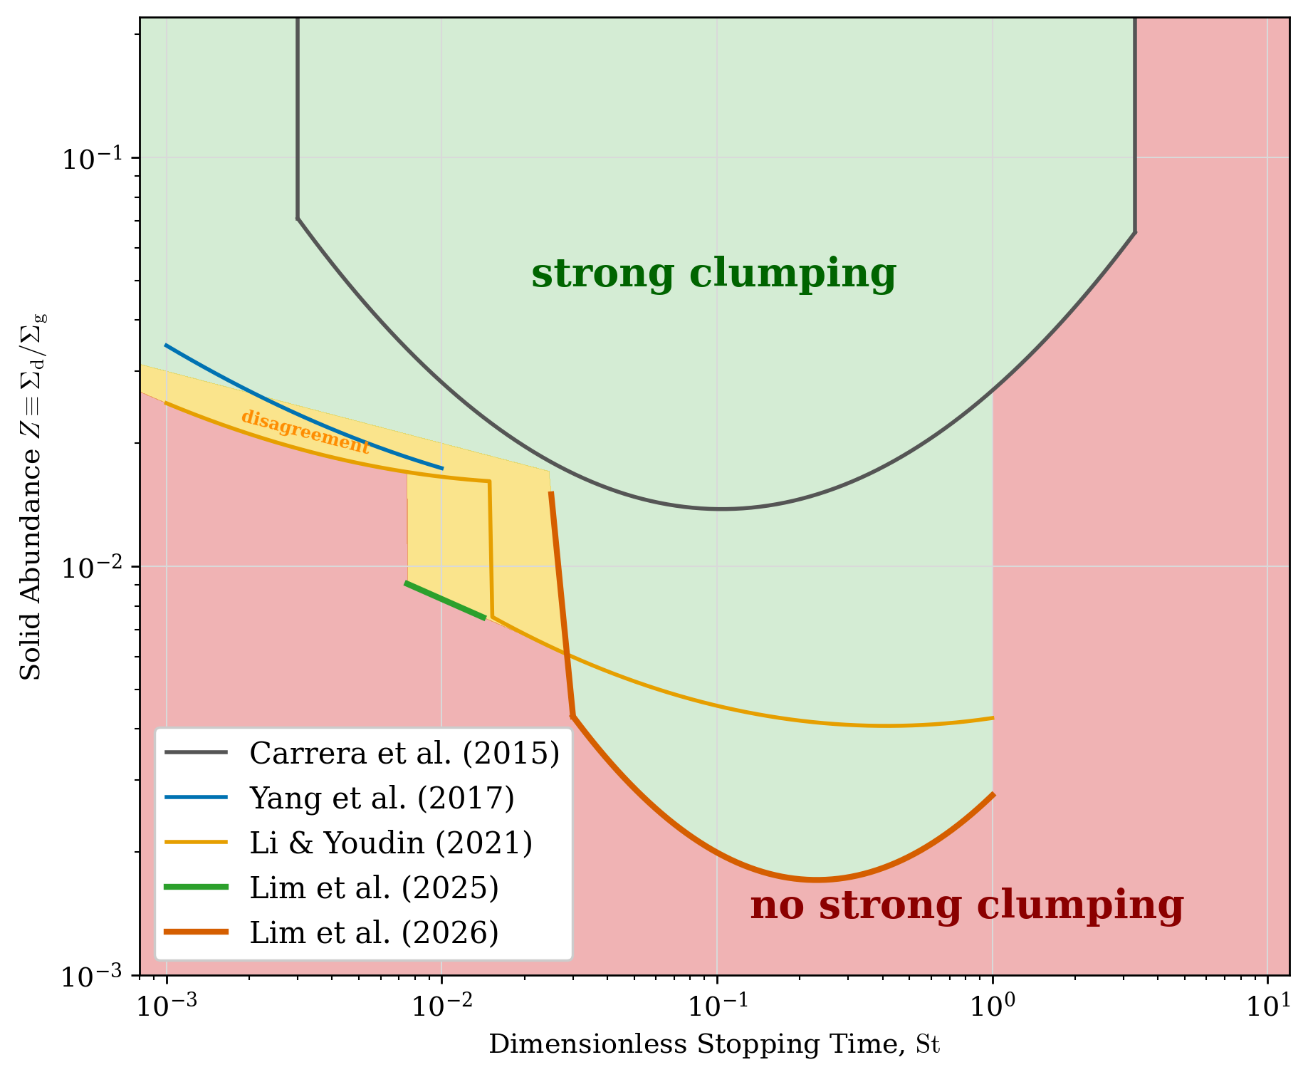
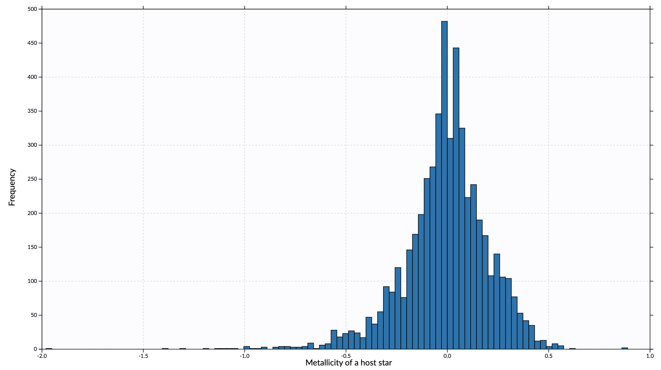
Metallicity threshold?
Z = Z☉ 10^{[Fe/H]}
Planets
[Fe/H]
No Planets
From exoplanet encyclopedia
Lyra, Johansen, Youdin & Ida (in prep)
W. Lyra
see also Stamatellos’s talk
8/24
Notes:
Z = Z☉ 10^{[Fe/H]}

Slide 9
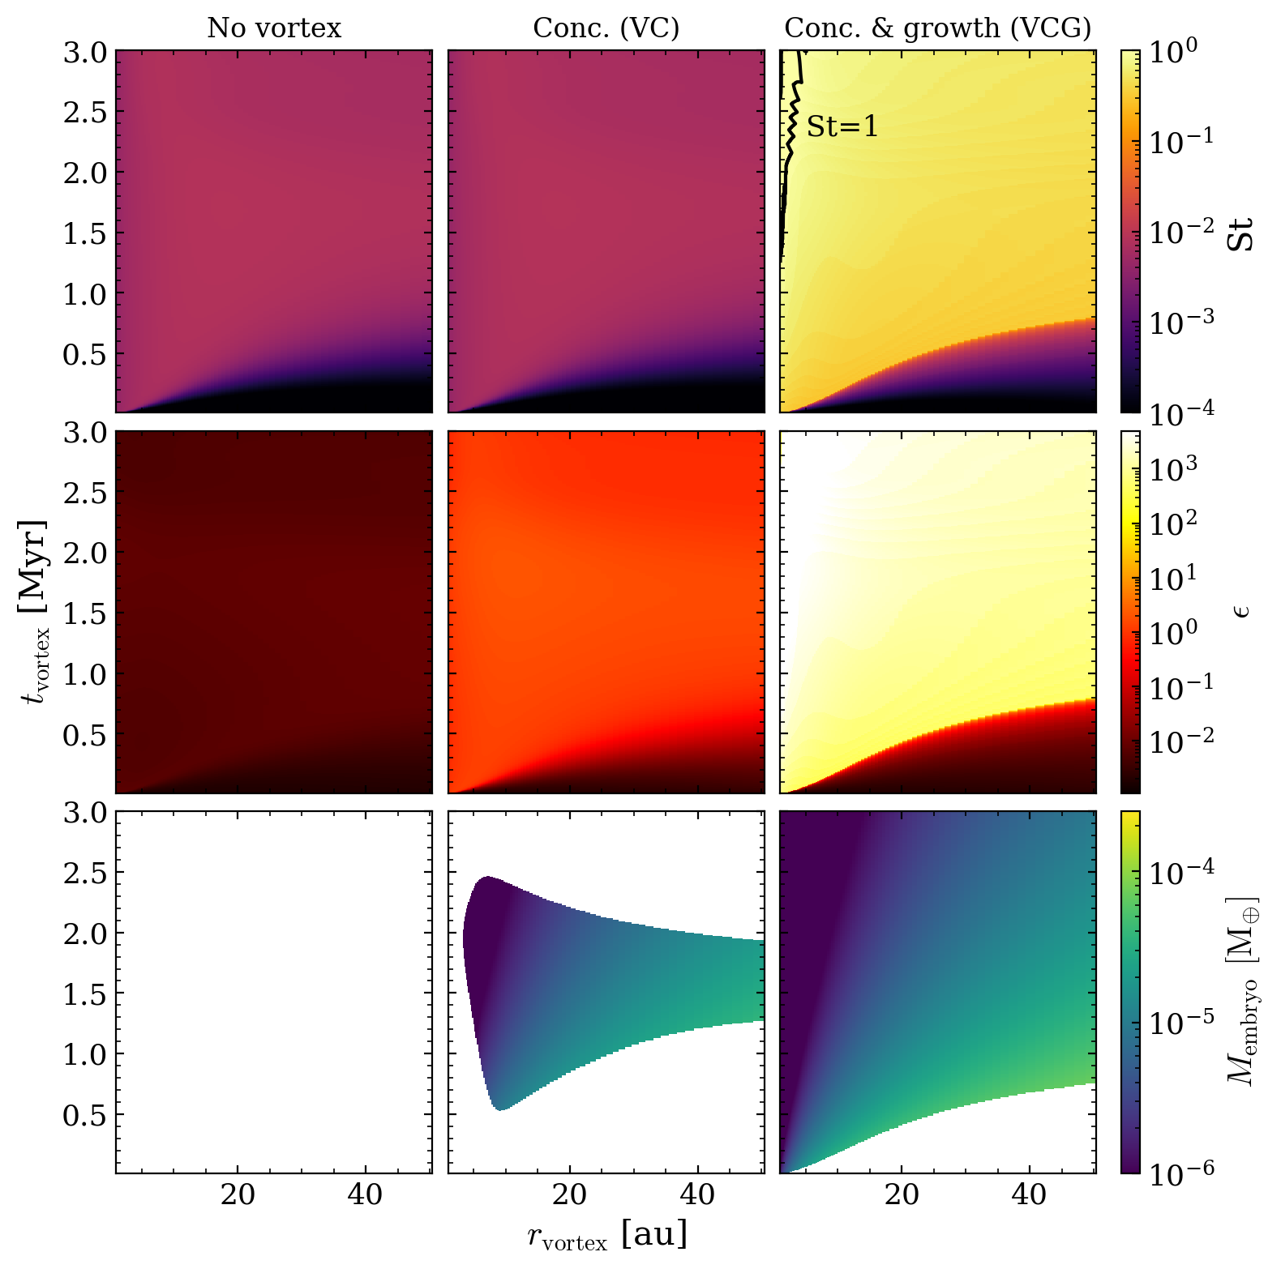
This simulation: $Z=1.6×{10}^{−3}, α_{t}=5×{10}^{−5}, v_{frag}=1{ms}^{−1}$
Dust growth +
Planetesimal formation
No planetesimal formation in smooth, low-metallicity disks
Can we locally increase the
solid-to-gas ratio?
Density-weighted average Stokes number
Time [Myr]
Solid-to-gas midplane density ratio
When and where planetesimals can form
Slide by L. Eriksson
Semimajor axis [au]
9/24
Eriksson et al. (2025)

Slide 10
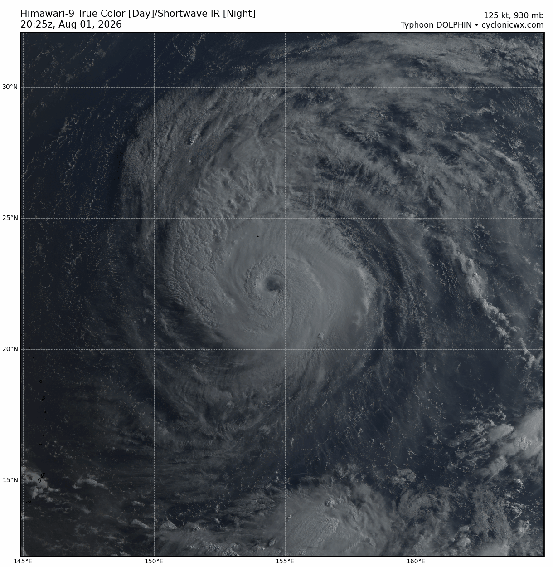
How to increase the solids-to-gas ratio locally?
A vortex!
W. Lyra

Slide 11
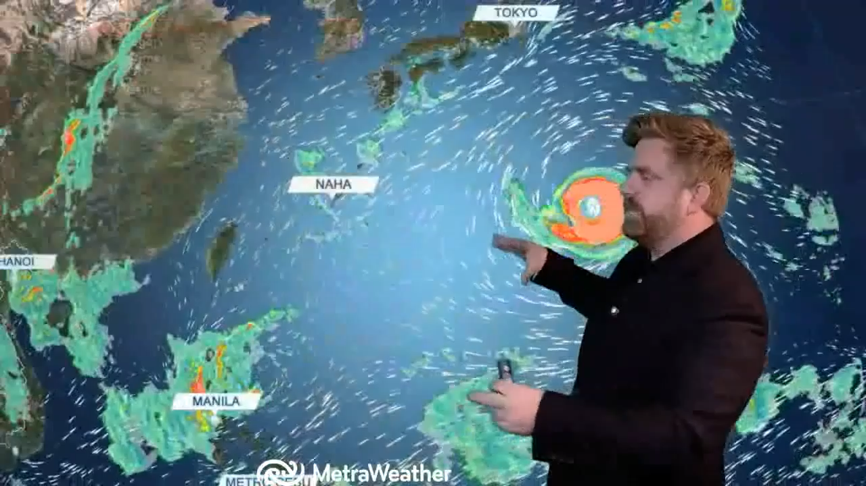

Slide 12
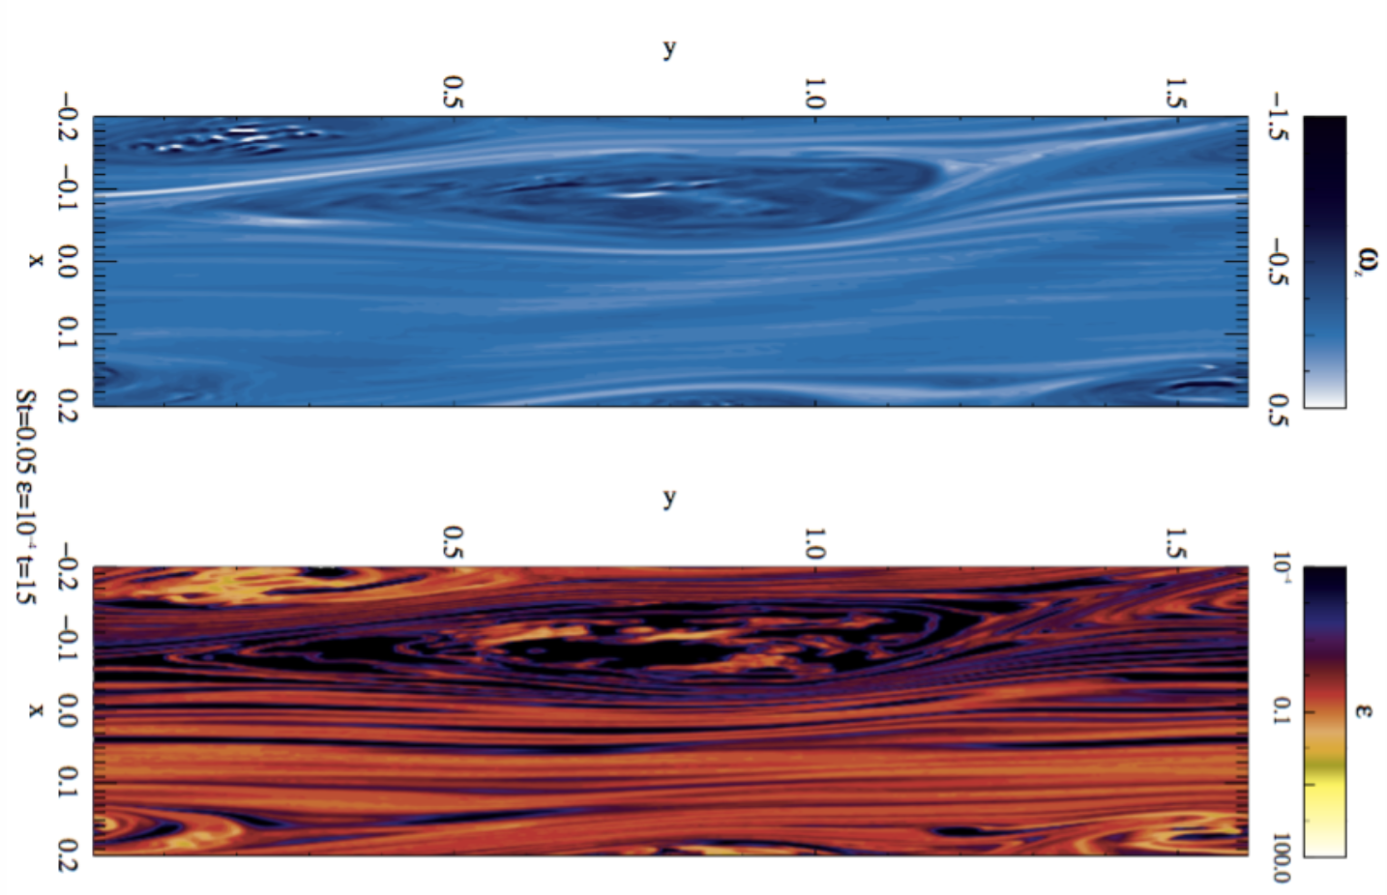
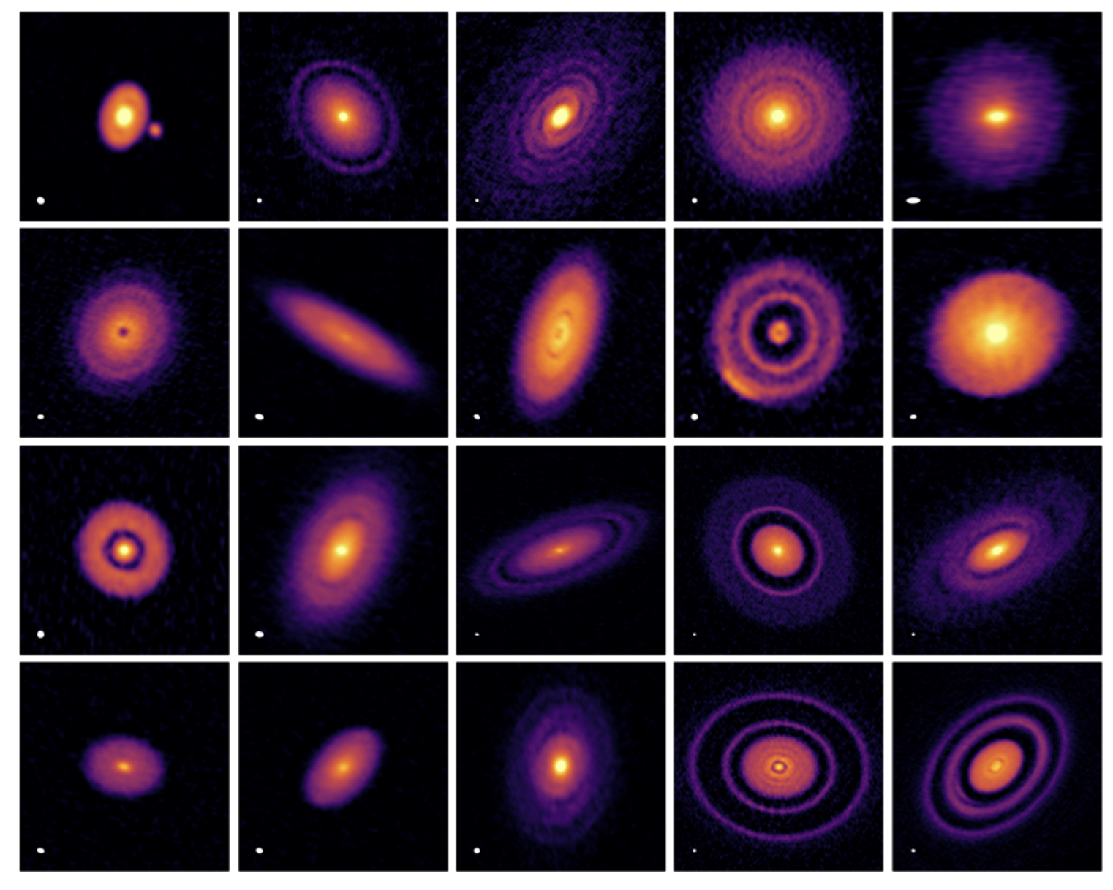
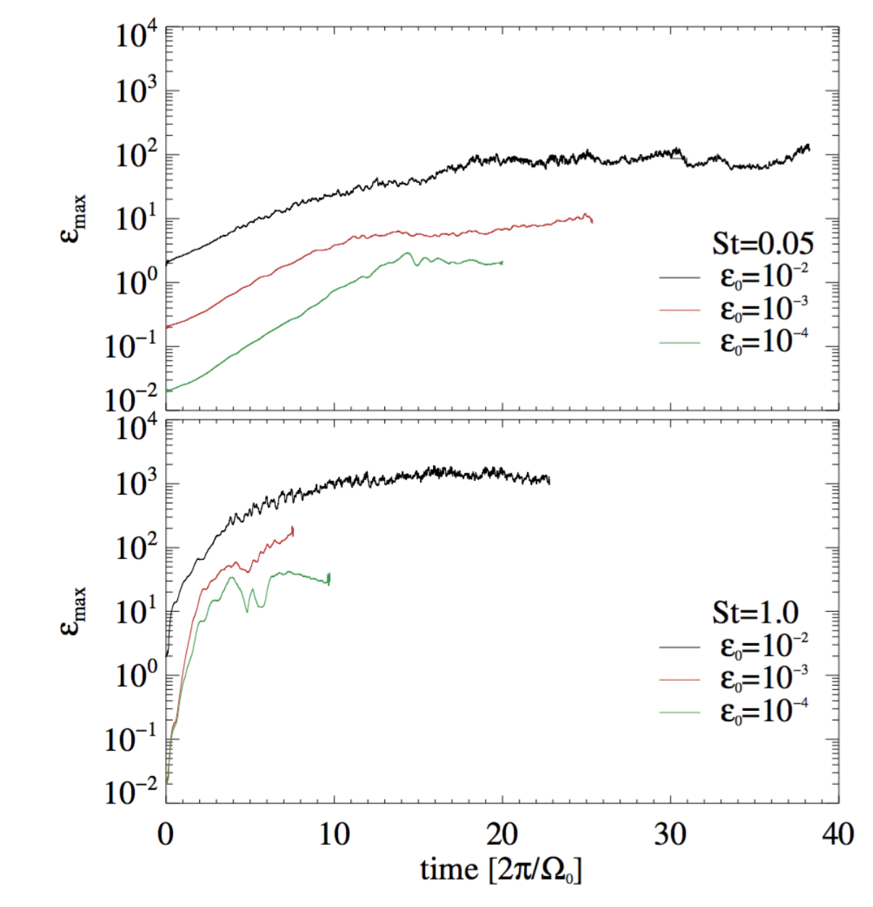
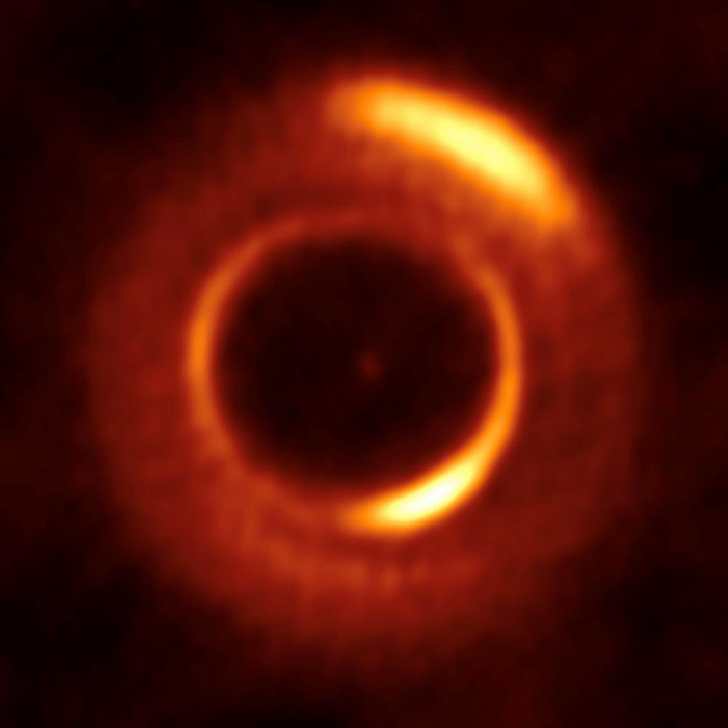
Disk structure
Vortices are the end state of many hydrodynamical instabilities
Dust gets concentrated towards the center
(Barge & Sommeria 1995, Klahr & Henning 1997)
ε = ε₀ (1+ St/α_{t})^{3/2}
Easily reaches dust-to-gas ratio 1 even for sub-solar metallicities
Prime sites for planet formation
(Klahr 2006, Lyra et al. 2008, 2009, 2024, Raettig et al. 2021)
(Lyra & Lin 2013)
α_{t} =v_{rms}²/c_{s}²
DSHARP, Andrews et al. (2018)
Dust-to-gas ratio
Coriolis
force
Pressure
force
Dong et al. (2018), Cassasus+Lyra (2019)
Vortex streamline
Raettig, Lyra, & Klahr (2021)
W. Lyra
12/24
Notes:
~100-1000 Earth masses of pebbles. They (not planetesimals) dominated the mass budget. So pebbles are the primary building blocks.

Slide 13
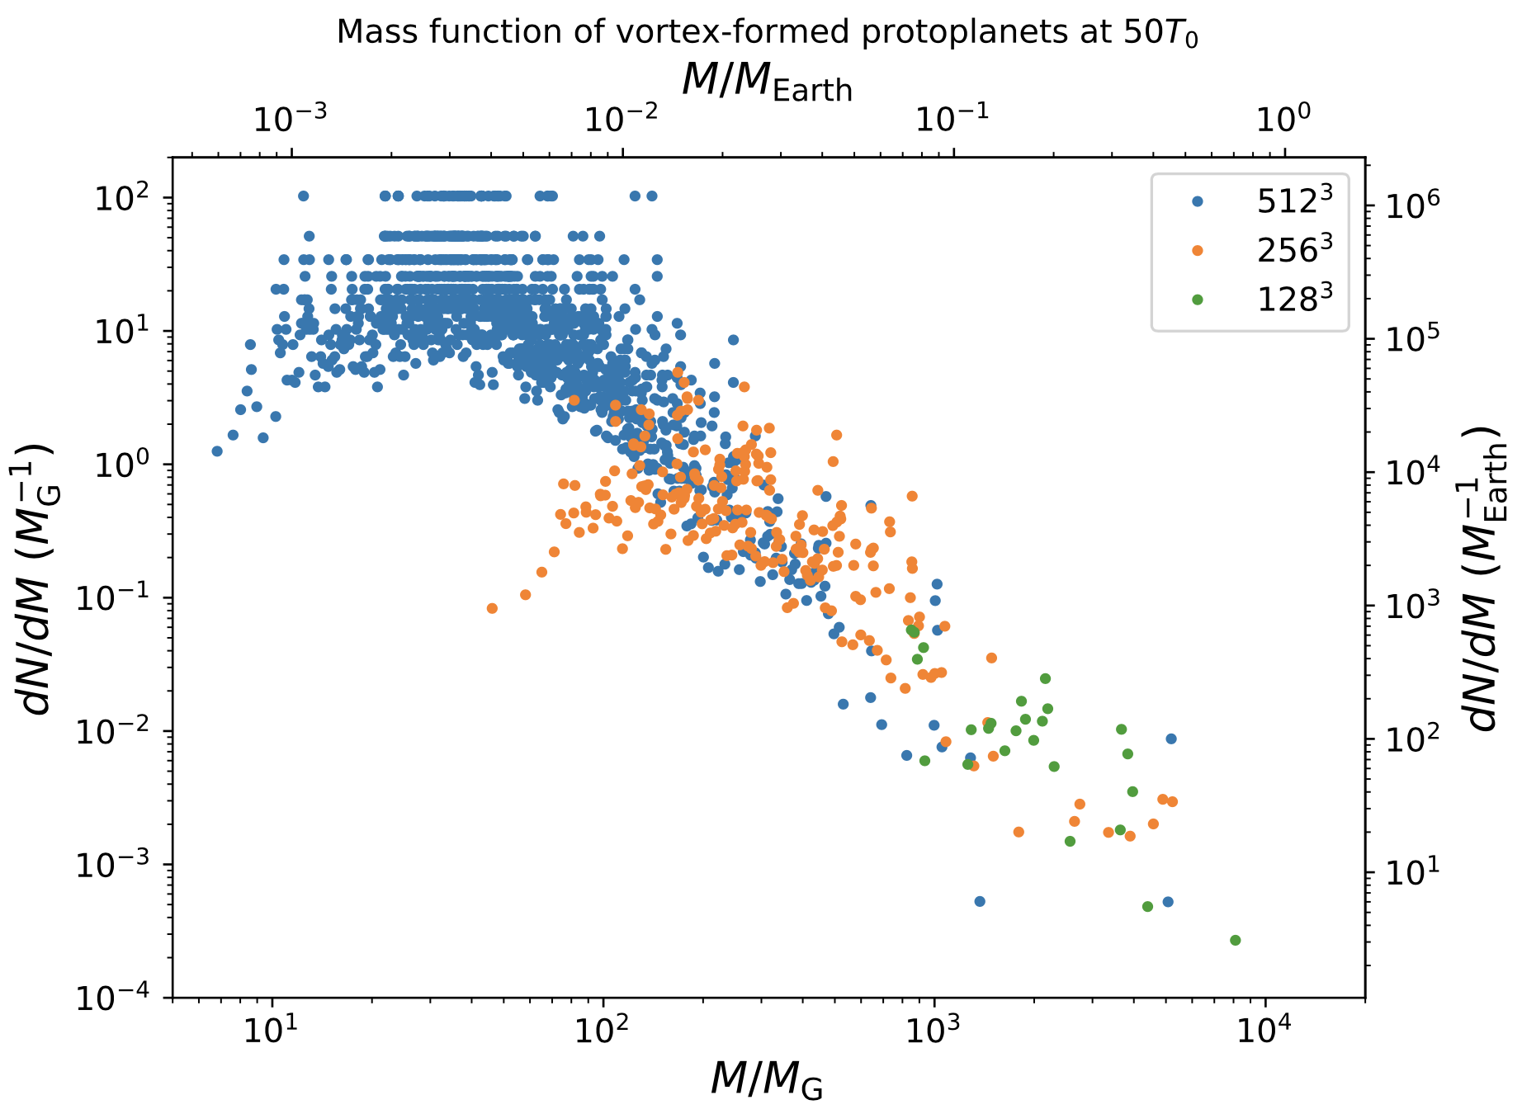
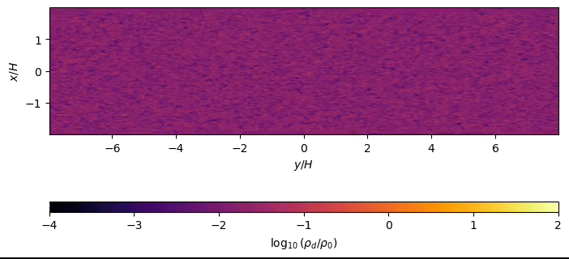
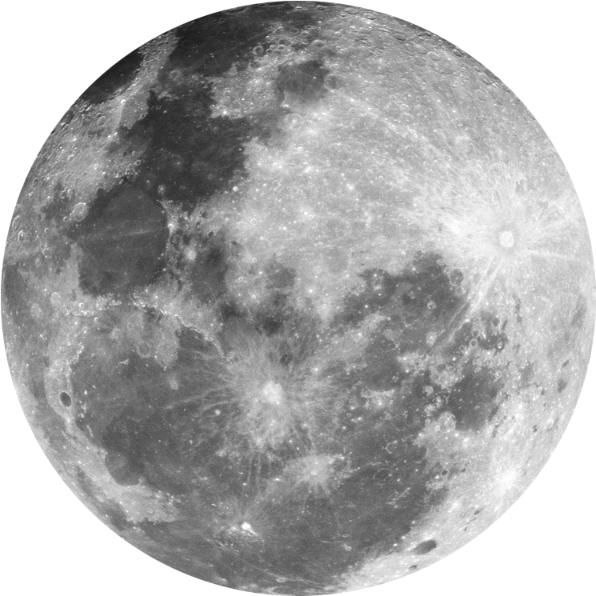
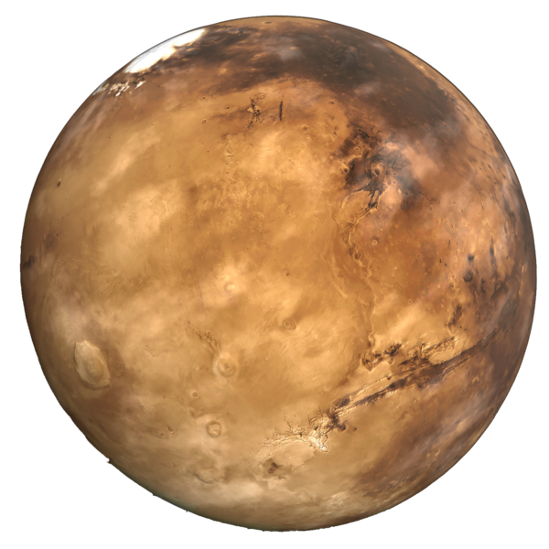
Gravitational Collapse
Lyra et al. (2024)
W. Lyra

Slide 14
This simulation: $Z=1.6×{10}^{−3}, α_{t}=5×{10}^{−5}, v_{frag}=1{ms}^{−1}$
Vortex “Boost” Z = Z₀ (1 + St/α_{t})
For Population II and III stars
Density-weighted average Stokes number
Z (pop II): 10 ⁻⁴ Z⊙ ≤ Z < 10 ⁻¹ Z⊙
Z (pop III) ≈< 10⁻⁴ Z⊙
The boost in dust-to-gas ratio might be able
to get the grains into the strong clumping regime
Post-process DustPy data to find solid-to-gas ratio for all possible vortex formation times and locations
Is the solid-to-gas ratio high enough for planetesimal formation inside the vortex? Yes!
Solid-to-gas midplane density ratio
Z = Z☉ 10^{[Fe/H]}
When and where planetesimals can form
W. Lyra
14/24
Eriksson et al. (2025)

Slide 15
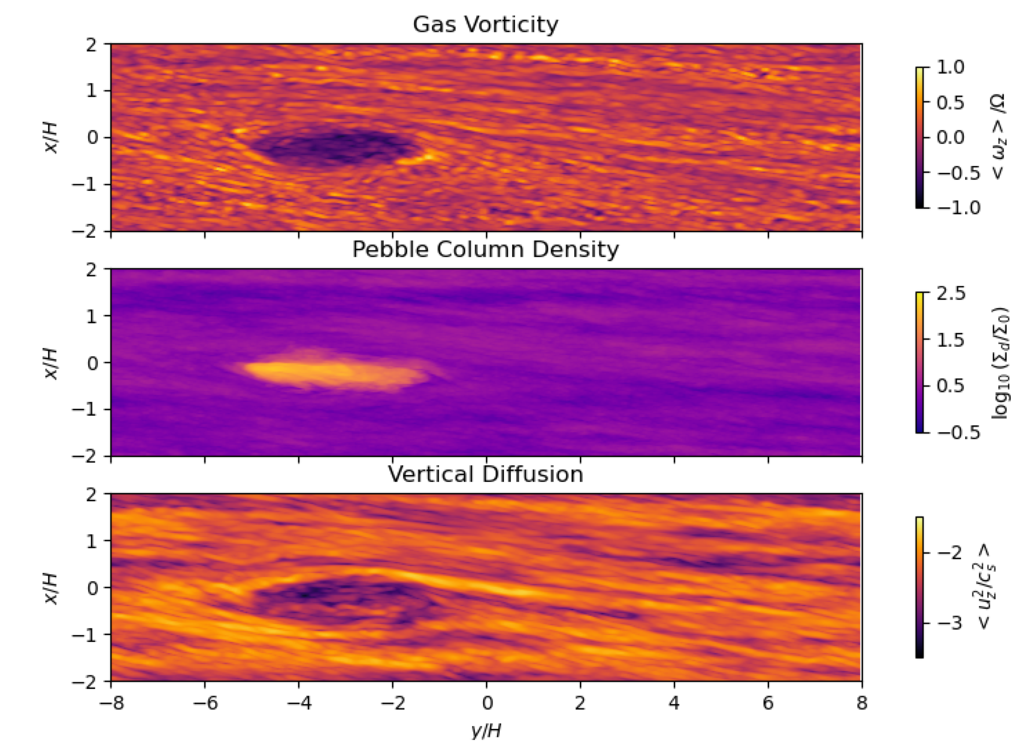
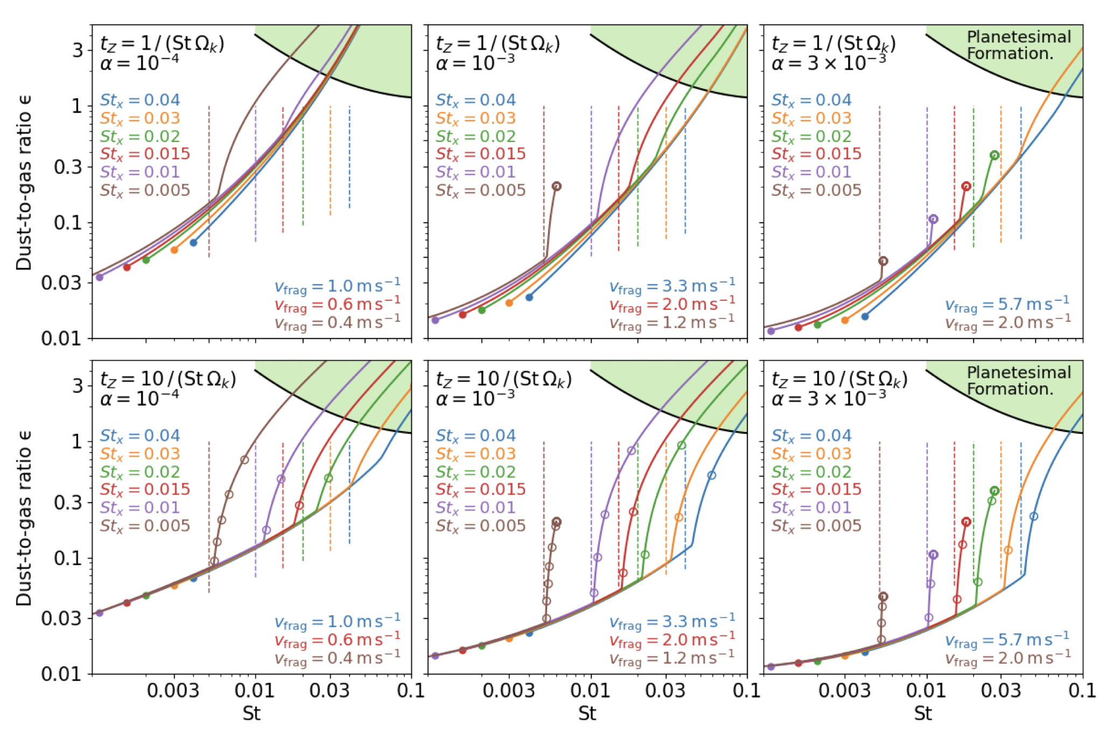
Vortex boost + Dynamical Dust Loading + Coagulation
Positive Feeback
The positive loop (Tominaga et al. 2021, 2022ab, Tominaga & Tanaka 2025, Carrera+Lyra 2025a)
  Higher dust density promotes coagulation t_{coag} ∝ ¹/_{Z}
  Larger grains concentrate better
Dust loading dampens the turbulence (Lyra et al. 2024)
  also leads to positive loop (Carrera+Lyra 2025b)
Both Stokes number St (↑) and diffusion parameter α_{t} (↓) are functions of Z (↑)
Z = Z₀ [1+ St(Z) / α_{t}(Z)]
15/24
Lyra et al. (2024), Carrera et al. (2025)
W. Lyra
Notes:
Vortices can form for multiple reasons, such as through the Rossby wave instability (Lovelace et al. 1999 ; Li et al. 2000 , 2001 ) at planetary gaps (Tagger 2001 ; de Val-Borro et al. 2006 , 2007 ; Lyra et al. 2009a ; Hammer, Kratter & Lin 2017 ), at regions with strong gradients in mass accretion rate (Varni`ere & Tagger 2006 ; Lyra et al. 2008 , 2009b ; Lyra & Mac Low 2012 ; Reg´aly et al. 2012 ; Faure et al. 2015 ; Lyra, Turner & McNally 2015 ; Miranda et al. 2017 ; Reg´aly & Vorobyov 2017 ), through the subcritic baroclinic instability (Klahr & Bodenheimer 2003 ; Lesur & Papaloizou 2010 ; Lyra & Klahr 2011 ), the convective overstability (Klahr & Hubbard 2014 ; Lyra 2014 ; Latter 2016 ; Teed & Latter 2021 ; Lehmann & Lin 2024 , 2025 ), and also as a result of a suggested non-linear resonant buoyant instability (Marcus et al. 2015 , 2016 ; Barranco, Pei & Marcus 2018 ). Tentative evidence also links vortices to the saturated state of the Vertical Shear Instability (Nelson, Gressel & Umurhan 2013 ; Richard, Nelson & Umurhan 2016 ; Latter & Papaloizou 2018 ; Manger & Klahr 2018 ). Taken all in all, these results suggest that vortices are the end state of most purely hydrodynamical disc instabilities (Lyra & Umurhan 2019 ; Lesur et al. 2023 ).
Based on analytical models
Now if I apply this criteria to the dustPy simulation that I showed previously without any vortices, there are no planetesimals forming anywhere in the disk.
So now lets consider vortices.
There are numerous mechanisms in protoplanetary disks that lead to the formation of a vortex: for example the Rossby wave instability and the Vertical Shear Instability.
Dust inside a vortex drift steadily toward the center of the vortex, where they accumulate.
This results in high pebble densities at the center of the vortex, making them very favorable locations for planetesimal formation.
This video from Wlad shows a vortex forming and planetesimals and embryos forming inside of it.
So if we take this extra concentration into account in our simulation, we find that planetesimals can actually form in a large region of the disk.
Now there are some works suggesting that dust also grows larger inside the vortex.
And because larger particles result in larger concentrations, and larger concentrations result in larger particles, this results in a feedback loop. So if we take that into account as well we form planetesimals everywhere.
I should note that this feedback loop has not been tested in numerical simulations though, so its purely from theoretical considerations at the moment.

Slide 16
This simulation: $Z=1.6×{10}^{−3}, α_{t}=5×{10}^{−5}, v_{frag}=1{ms}^{−1}$
Dust growth + Vortices +
Planetesimal formation
Post-process DustPy data using the new feedback loop
Planetesimals can form in vortices almost everywhere!
Slide by L. Eriksson
16/24
Eriksson et al. (2025)

Slide 17
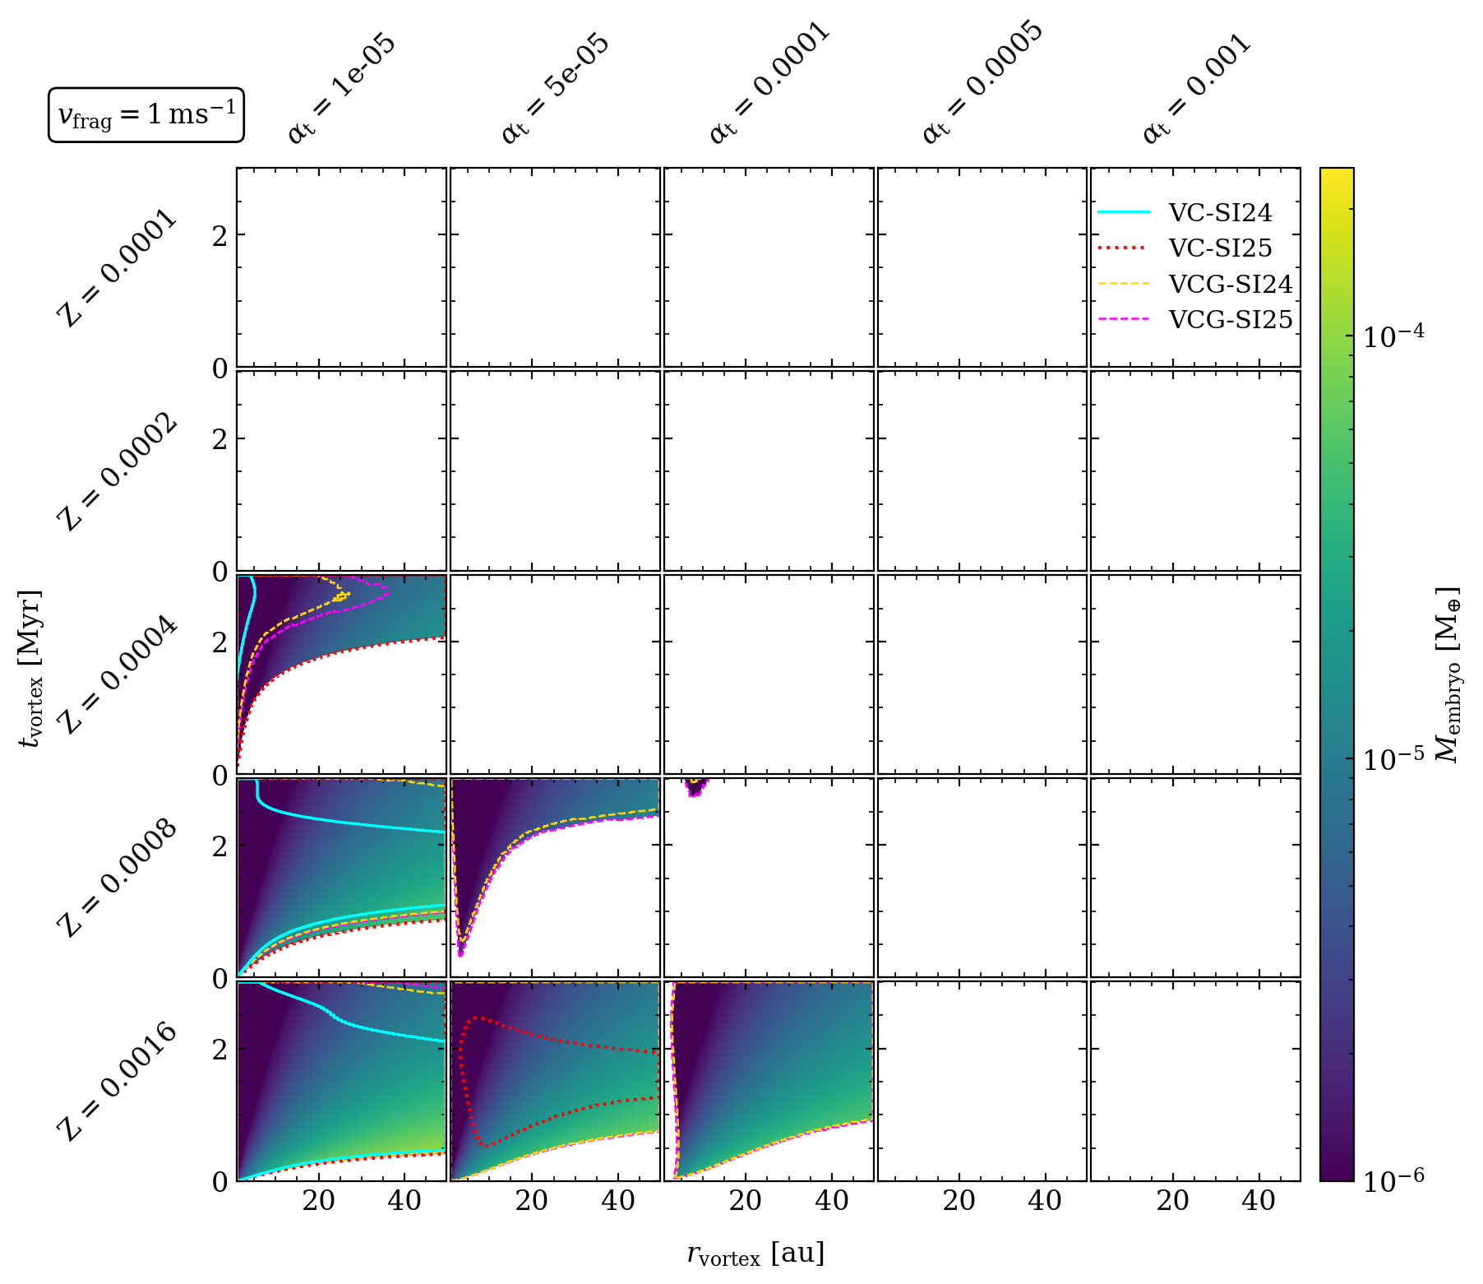
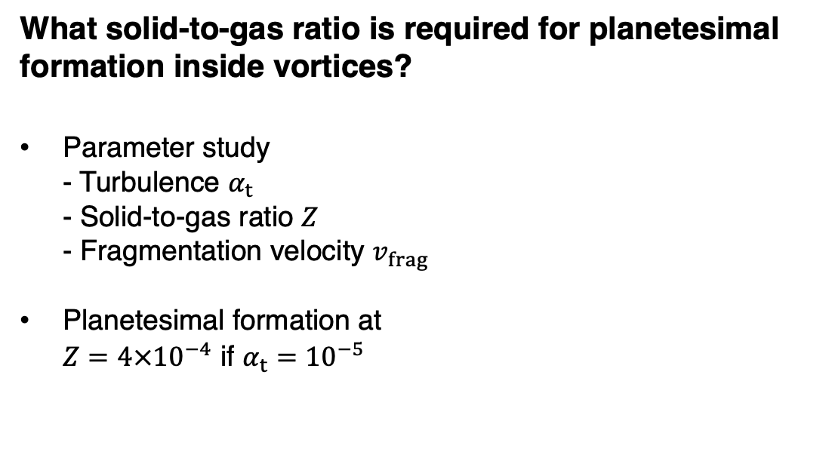
What solid-to-gas ratio is required for planetesimal formation inside vortices?
Parameter study
- Turbulence $α_{t}$
- Solid-to-gas ratio $Z$
- Fragmentation velocity $v_{frag}$
Planetesimal formation at
$Z=4×{10}^{−4}$ if $α_{t}={10}^{−5}$
Slide by L. Eriksson
17/24
Eriksson et al. (2025)

Slide 18
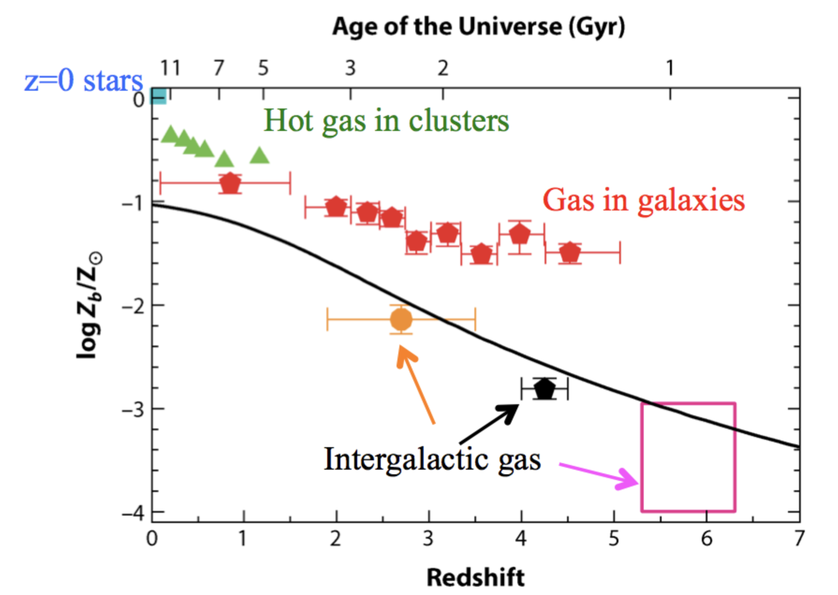
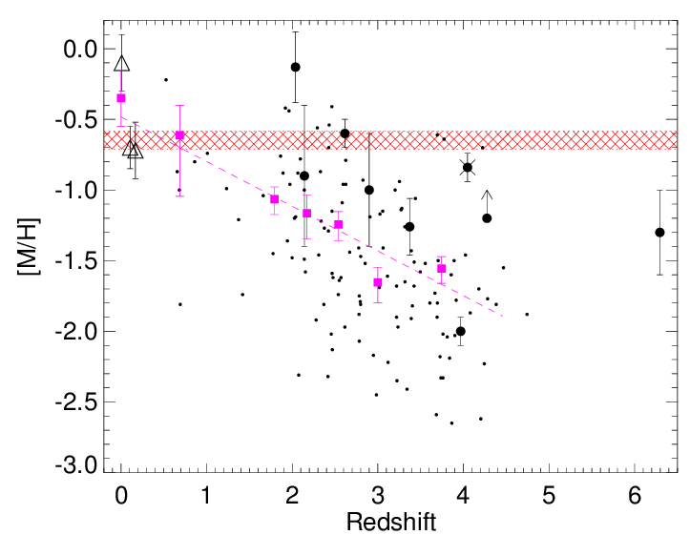
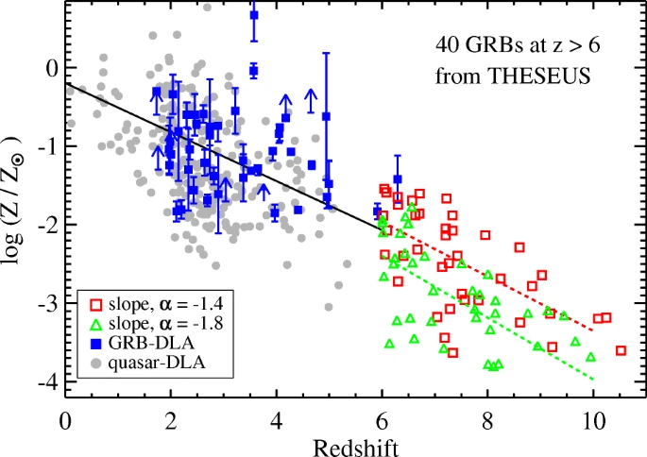
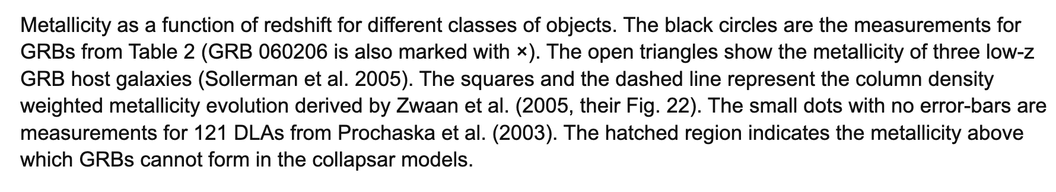
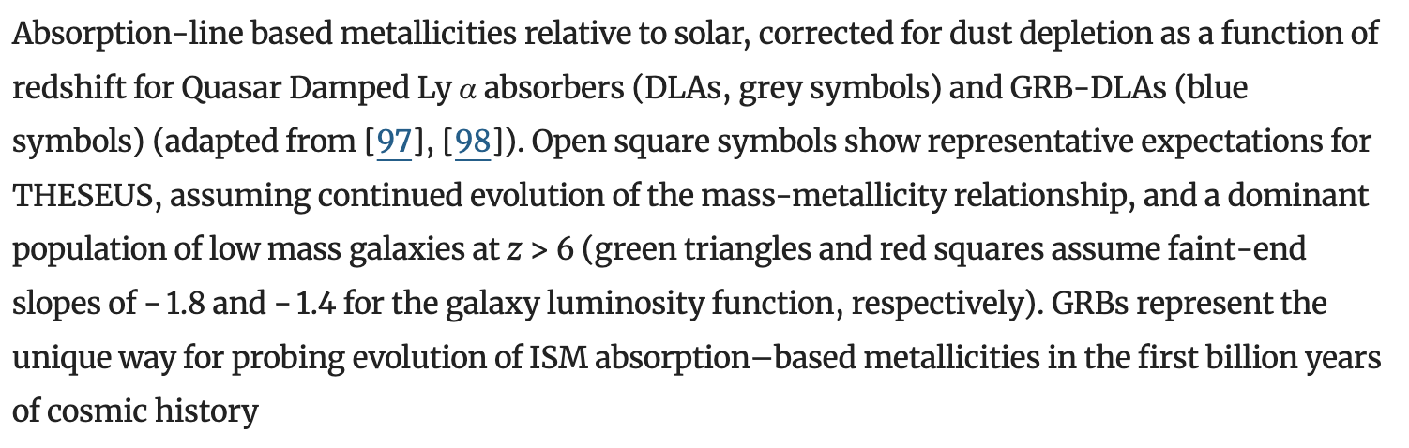
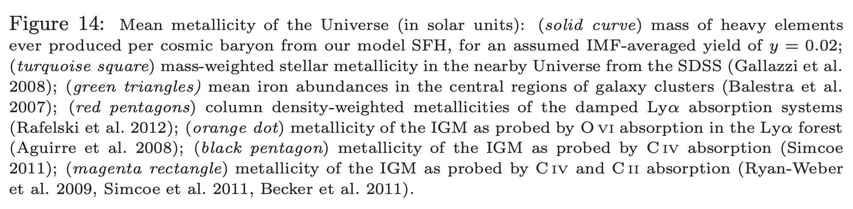
Metallicity vs Redshift
Madau & Dickinson (2014)
Tanvir et al. (2021)
Fynbo et al. (2006)
W. Lyra
18/24

Slide 19
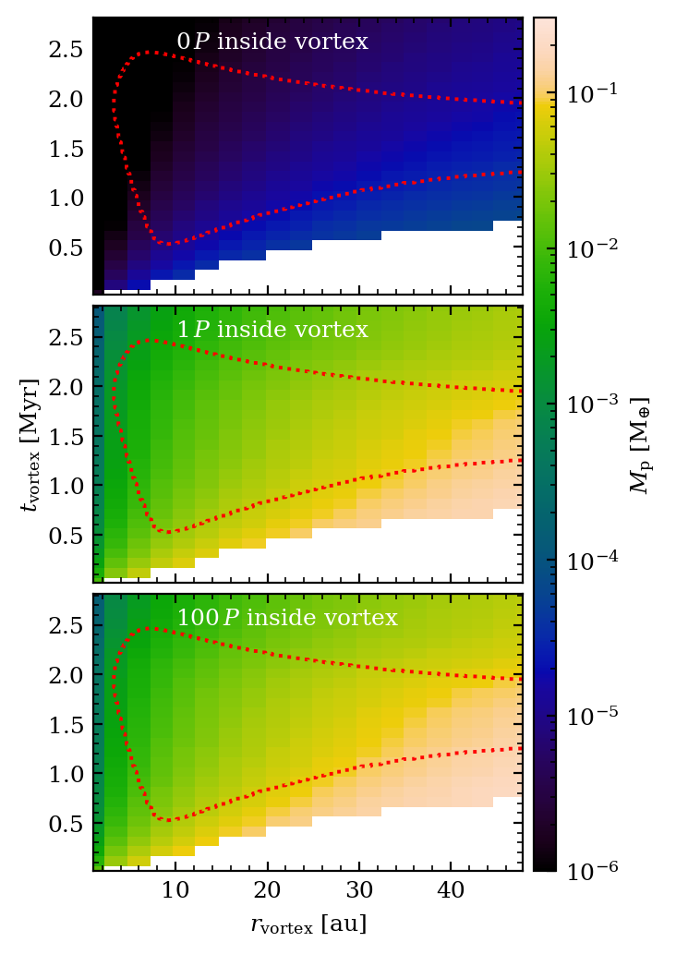
Further growth: Pebble Accretion
Polydisperse pebble accretion (Lyra & Johansen+ 2023)
If planetesimal immediately leave the vortex:
→ No significant growth
If planetesimal remains inside the vortex for a while:
→ Vortex-boosted pebble accretion:
  Very high accretion rates of the trapped pebbles
    Significant growth!
  Most of the final mass attained within one (!) orbit
Slide by L. Eriksson
19/24
Eriksson et al. (2025)

Slide 20
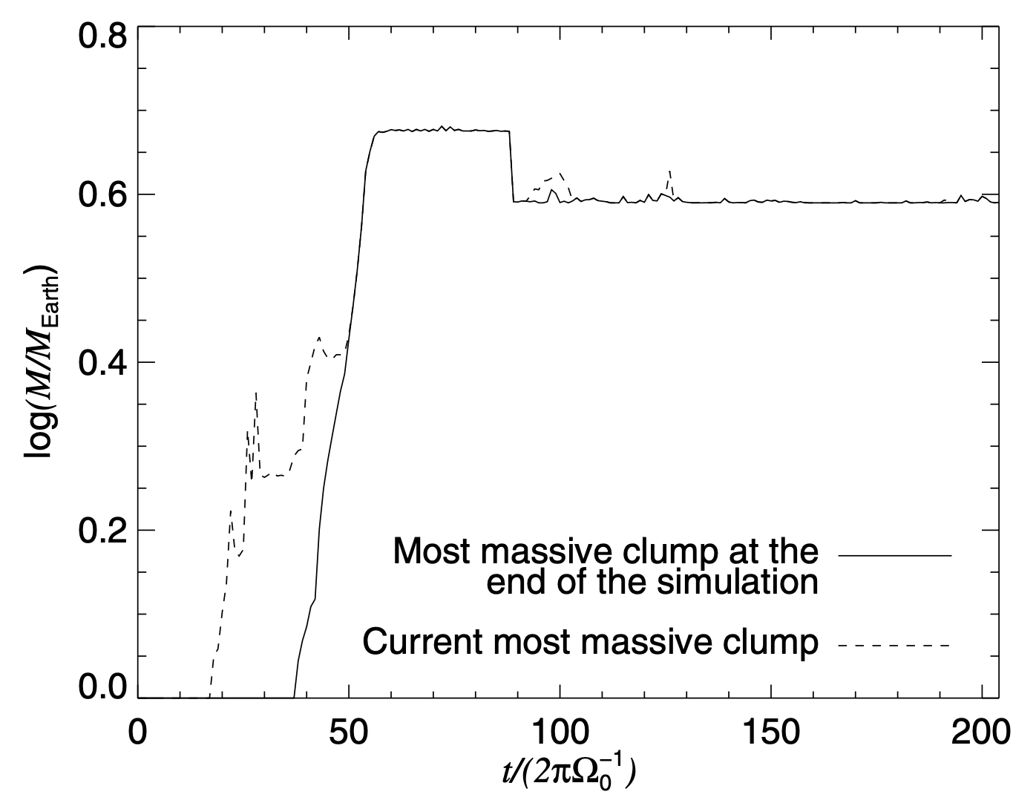
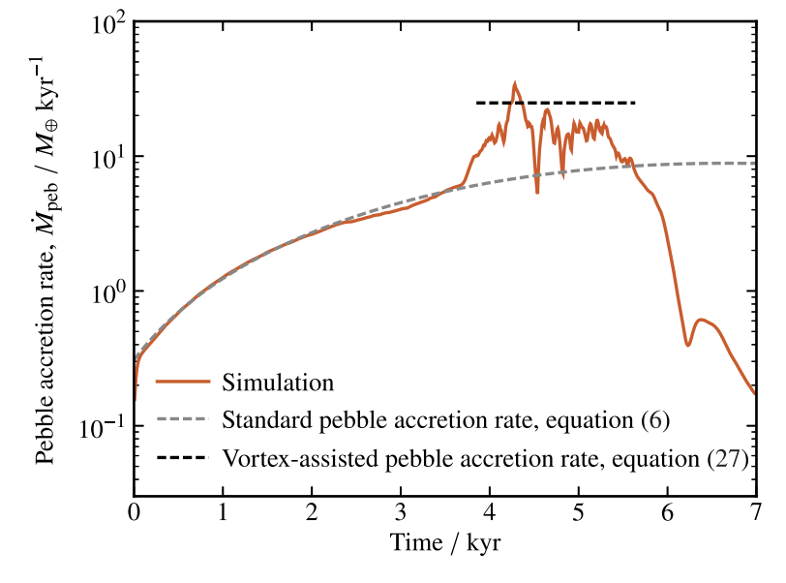
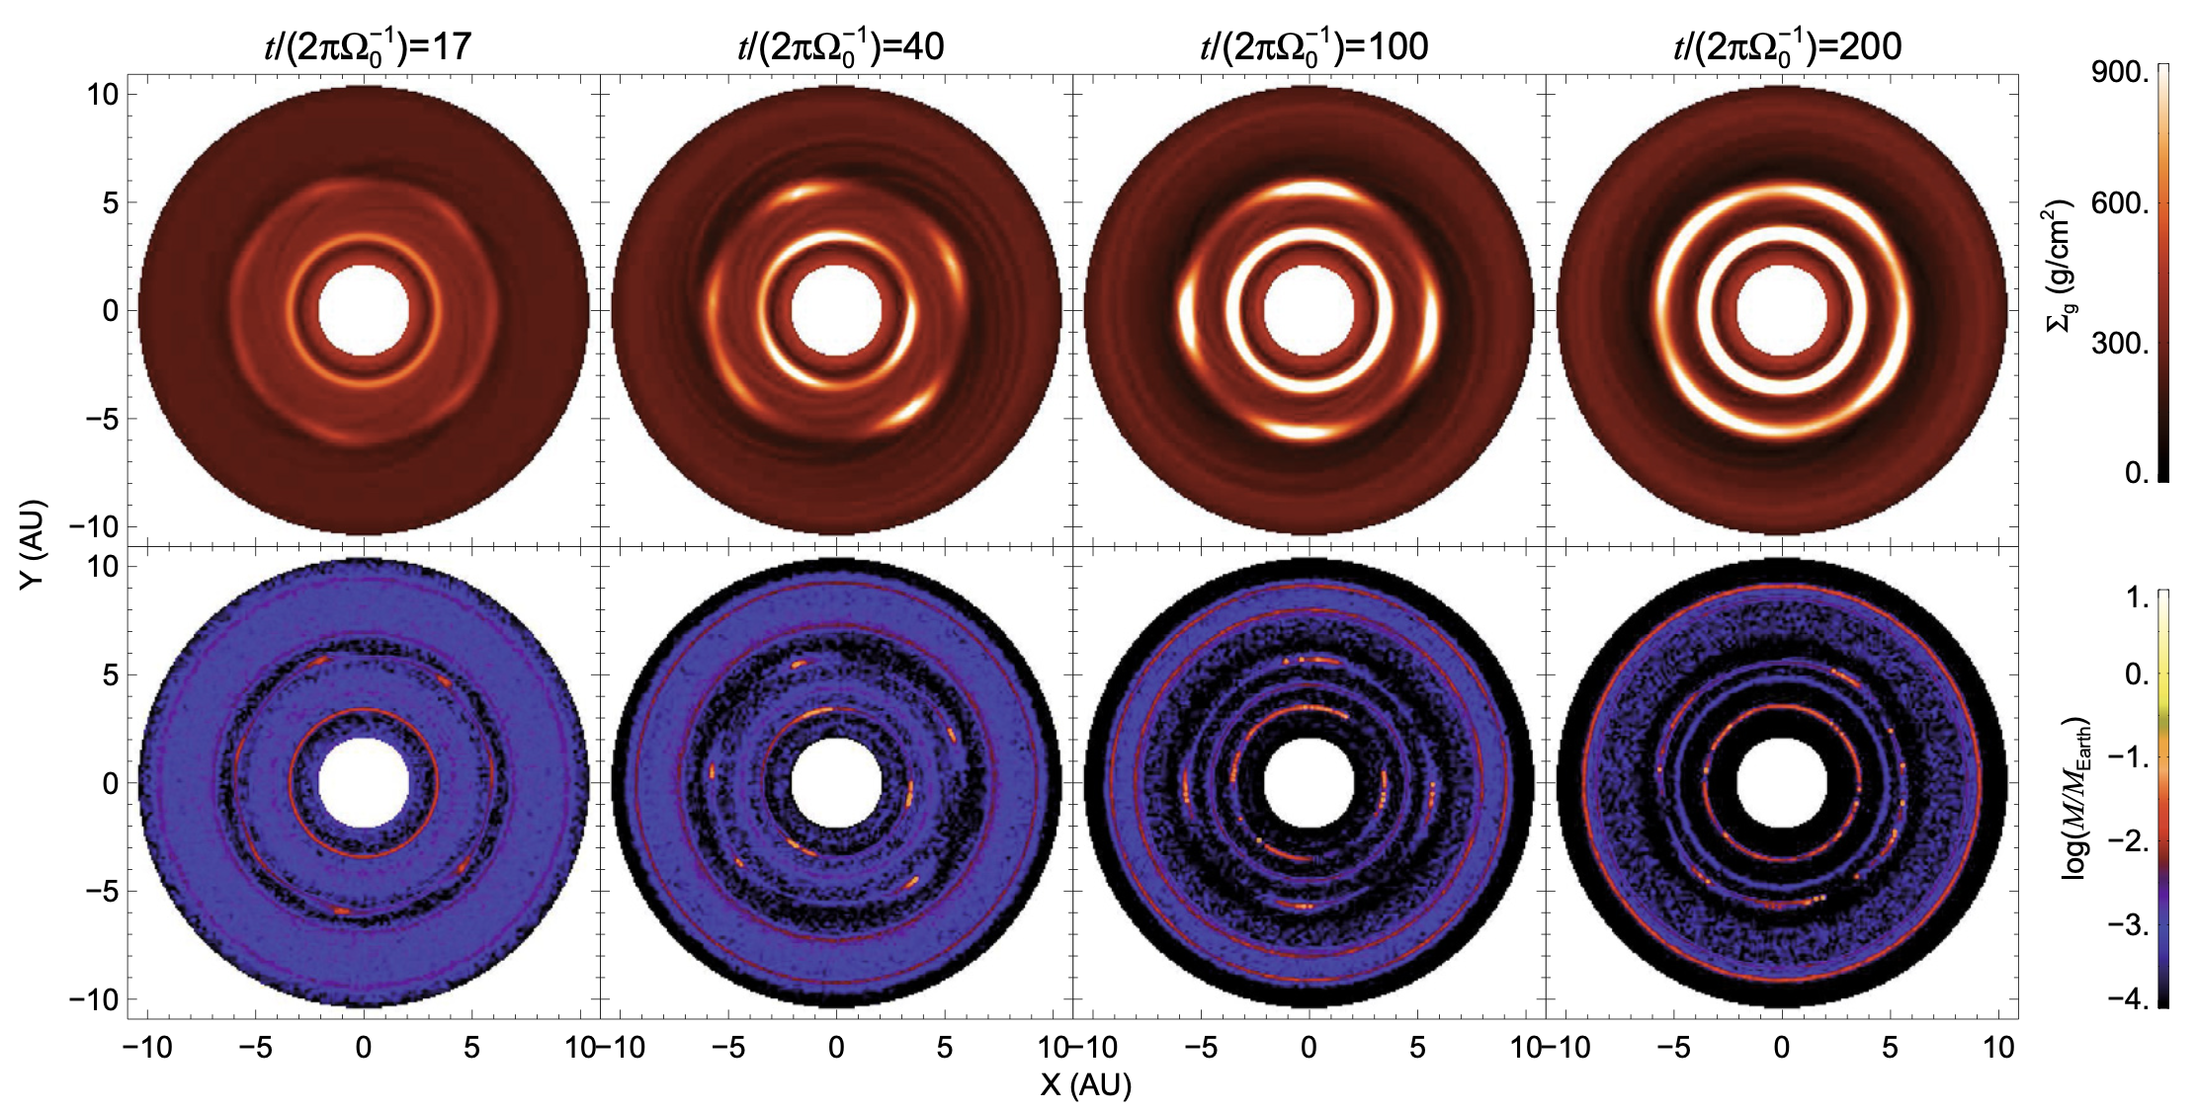
Pebble accretion in vortices
Lyra & Johansen (et al 2008, 2009)
Cummins, Owen, & Booth (2022)
30 M⊕/kyr
For Hill accretion, λ=2R_{H}, δv=ΩR_{Η}
M_{2D,Hill} = 2ΩR_{Η}² Σ_{d}
For a vortex, λ= 4H/3, δv=ΩH
M_{2D,vortex} = ⁴/₃ΩH ² Σ_{d}
.
Lambrechts & Johansen (2012)
M = 2π r v_{r} Σ_{d} ε
(mass flux scaled by efficiency)
For St=1, v_{r} = ηΩr
M ~ 30 M ⊕ kyr⁻¹ x ε
Efficiency ε = 1 (!)
The whole pebble flux accreted!
Pebble Accretion
M_{2D} = λ Σ_{d} δv
Cross section (line segment)
Column density
Approach velocity
.
Capture-limited
.
Lyra & Johansen (et al 2008, 2009), Cummins, Owen, & Booth (2022)
.
.
Transport-limited
(Independent of mass)
W. Lyra

Slide 21
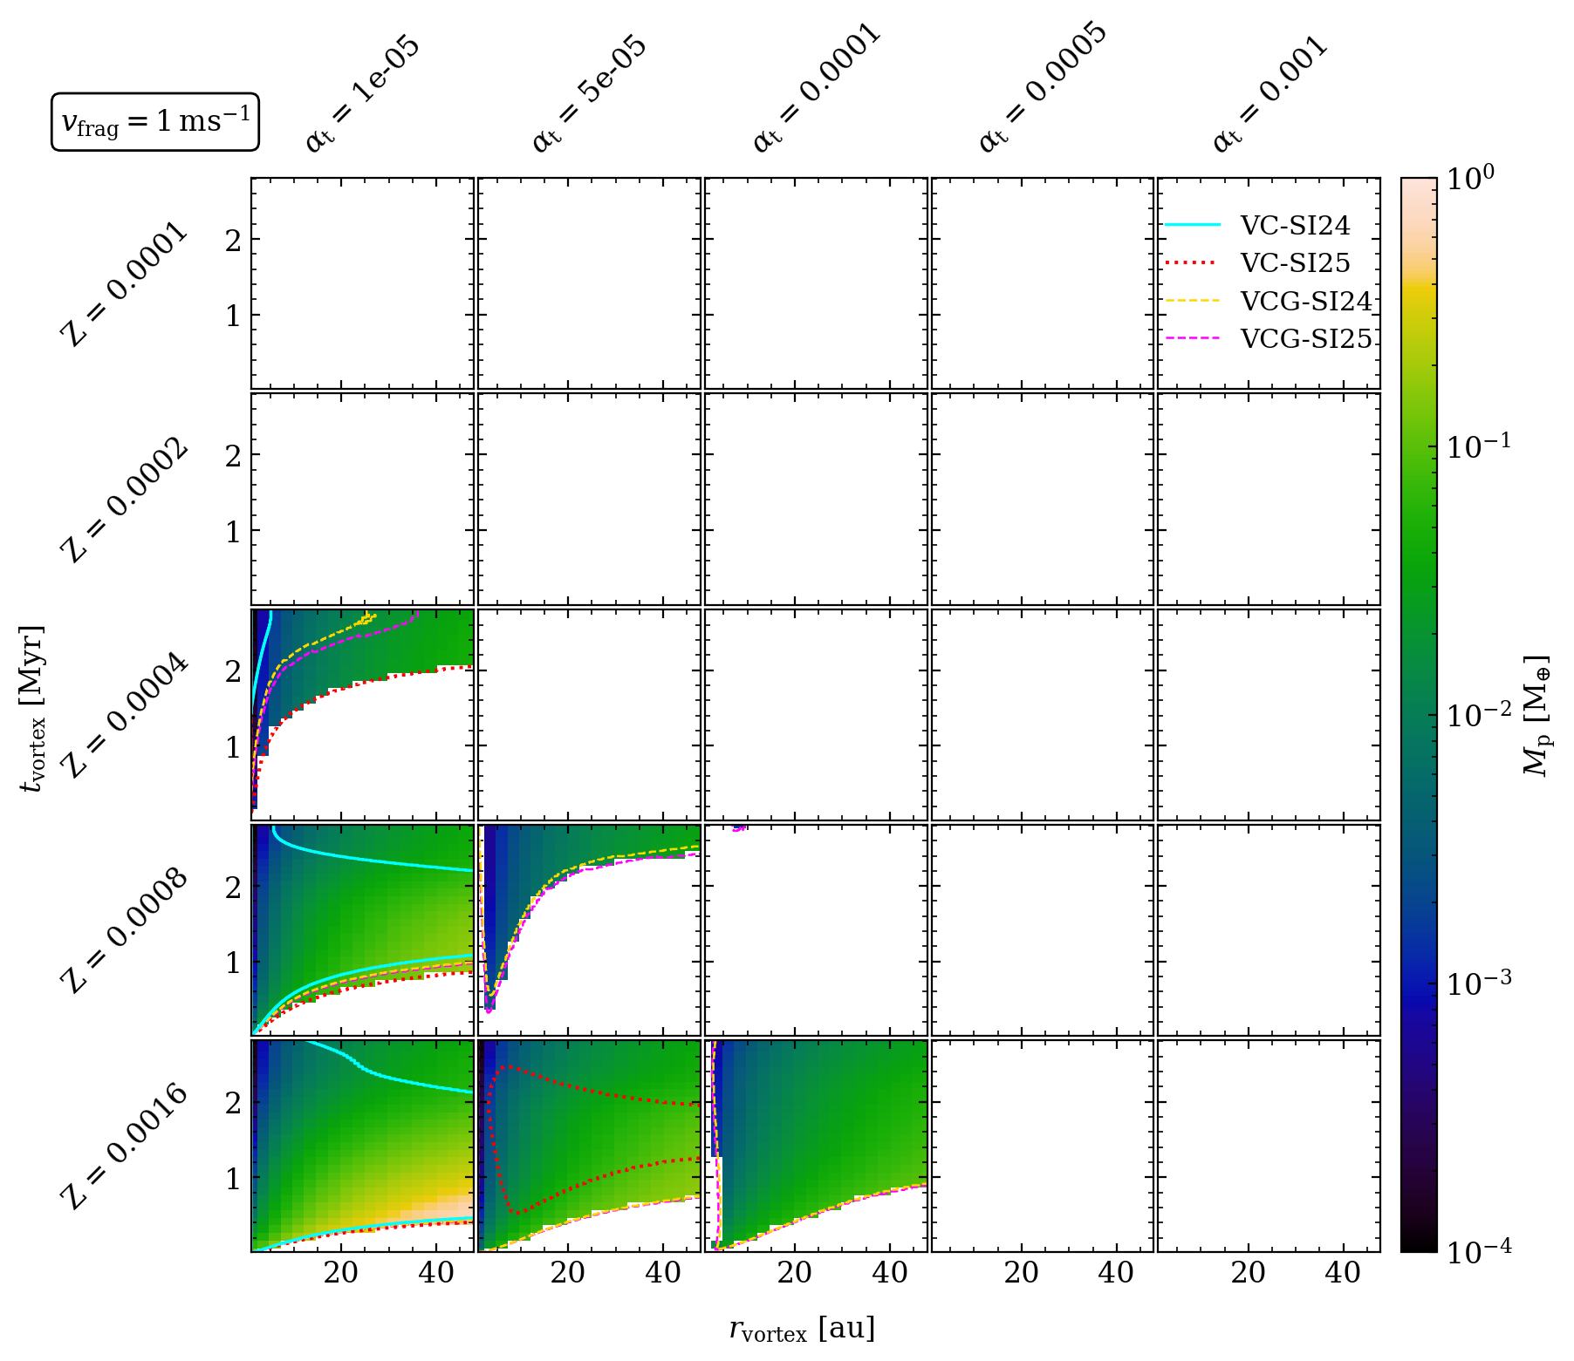
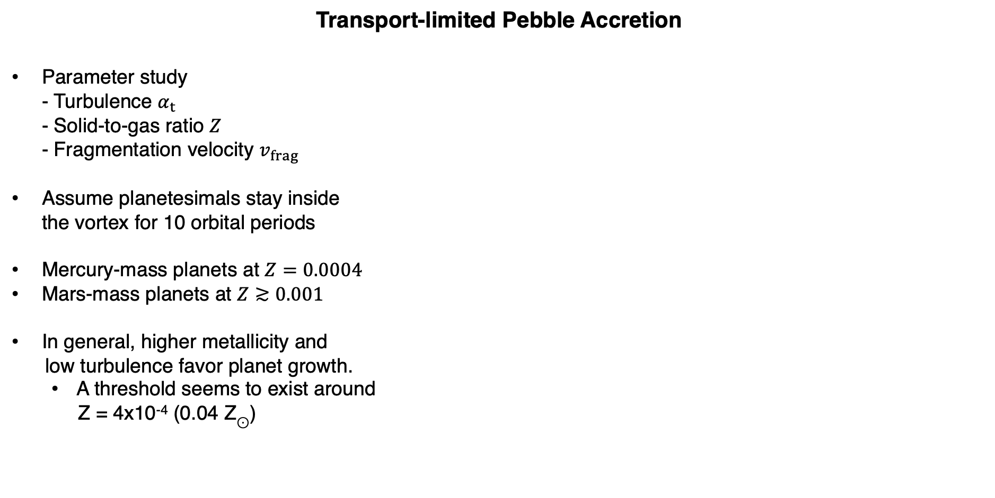
Transport-limited Pebble Accretion
Parameter study
- Turbulence $α_{t}$
- Solid-to-gas ratio $Z$
- Fragmentation velocity $v_{frag}$
Assume planetesimals stay inside
the vortex for 10 orbital periods
Mercury-mass planets at $Z=0.0004$
Mars-mass planets at $Z≳0.001$
In general, higher metallicity and
low turbulence favor planet growth.
  A threshold seems to exist around
Z = 4x10⁻⁴ (0.04 Z$⊙$)
Slide by L. Eriksson
21/24
Eriksson et al. (2025)

Slide 22
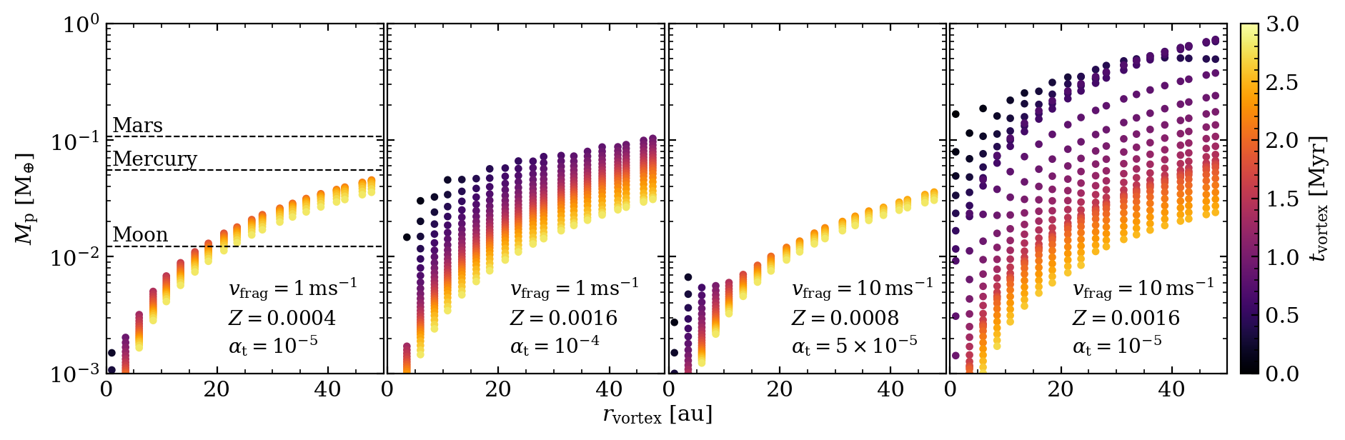
Final Planet Masses vs Distance and Timing
Significant growth by pebble accretion for early formation
Growth stalled at
  Mercury mass for pessimistic conditions
  Earth mass for optimistic conditions
Planet mass increases with distance
  Opposite as expected for capture-limited pebble accretion
  Due to scaling with vortex volume M_{trapped} = (2π)^{3/2} ρ_{d} χ H³ , Mdot ∝ H²
W. Lyra
22/24
Eriksson et al. (2025)

Slide 23
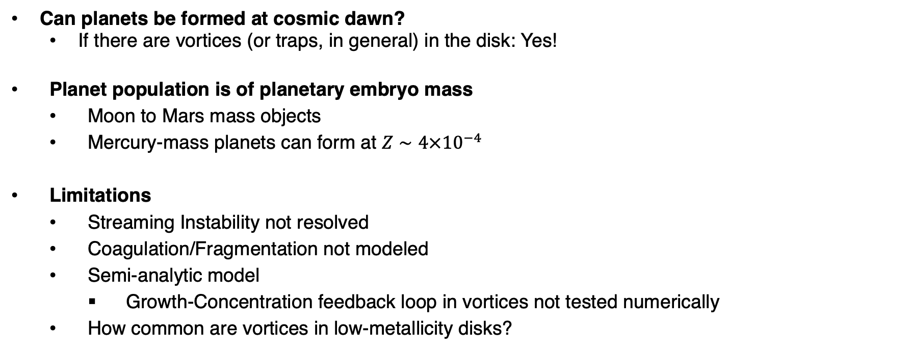
Conclusions
Can planets be formed at cosmic dawn?
  If there are vortices (or traps, in general) in the disk: Yes!
Planet population is of planetary embryo mass
  Moon to Mars mass objects
  Mercury-mass planets can form at $Z∼4×{10}^{−4}$
Limitations
  Streaming Instability not resolved
  Coagulation/Fragmentation not modeled
  Semi-analytic model
    Growth-Concentration feedback loop in vortices not tested numerically
  How common are vortices in low-metallicity disks?
Linn Eriksson
Ringberg, Feb 13, 2026
Andrews et al. (2018)
Dong et al. (2018)

