Slide 1


Planetary shocks and spirals
in transition disks
Wladimir Lyra
California State University, Northridge
Jet Propulsion Laboratory
Blake Hord (Dobbs Ferry High School, Stanford University),
Alex Richert (Penn State University)
Mario Flock (JPL),
Neal Turner (JPL),
Aaron Boley (University of British Columbia)
Mordecai-Mark Mac Low (AMNH)
Satoshi Okuzumi (Tokyo Tech)
NUMPDI, Nov 23rd, 2017

Slide 2
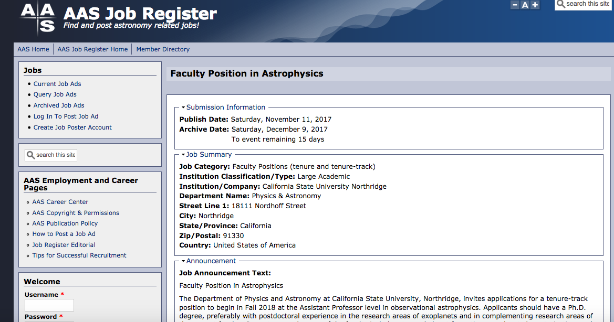
CSUN (pronounced “sea-sun”)
is hiring!

Slide 3
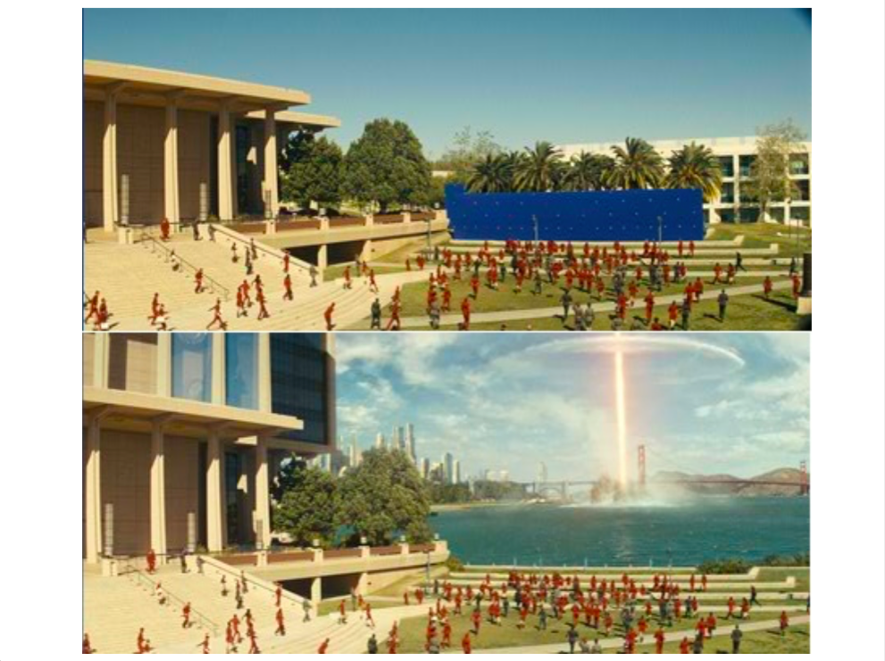
CSUN
aka Starfleet Academy

Slide 4
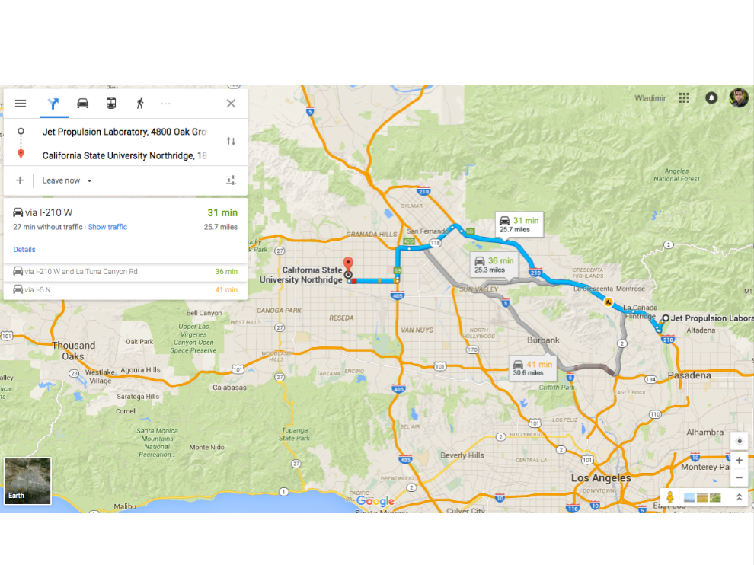

Slide 5
Planetary shocks and spirals
in transition disks
Wladimir Lyra
California State University, Northridge
Jet Propulsion Laboratory
Blake Hord (Dobbs Ferry High School, Stanford University),
Alex Richert (Penn State University)
Mario Flock (JPL),
Neal Turner (JPL),
Aaron Boley (University of British Columbia)
Mordecai-Mark Mac Low (AMNH)
Satoshi Okuzumi (Tokyo Tech)
NUMPDI, Oct 23th, 2017

Slide 6
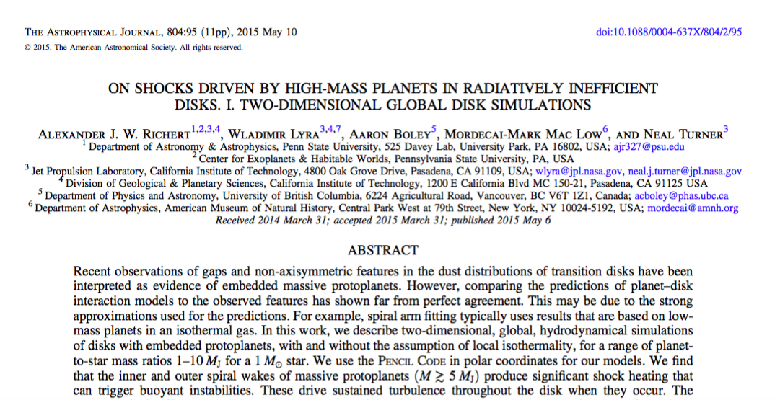
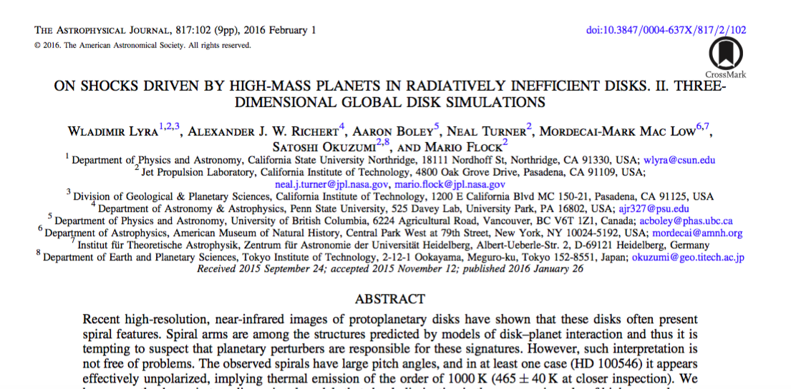
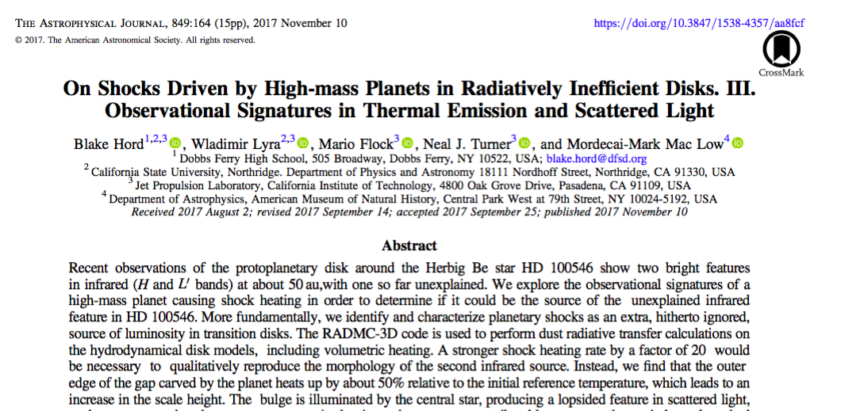
Richert et al. (2015)
Lyra et al. (2016)
Hord et al. (2017)

Slide 7
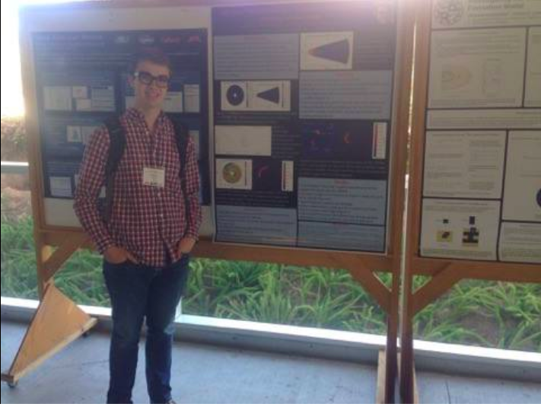
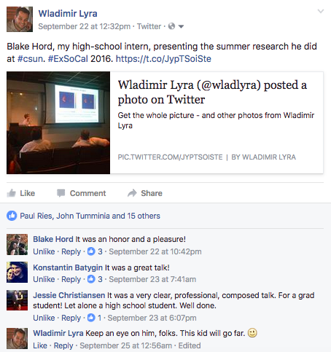
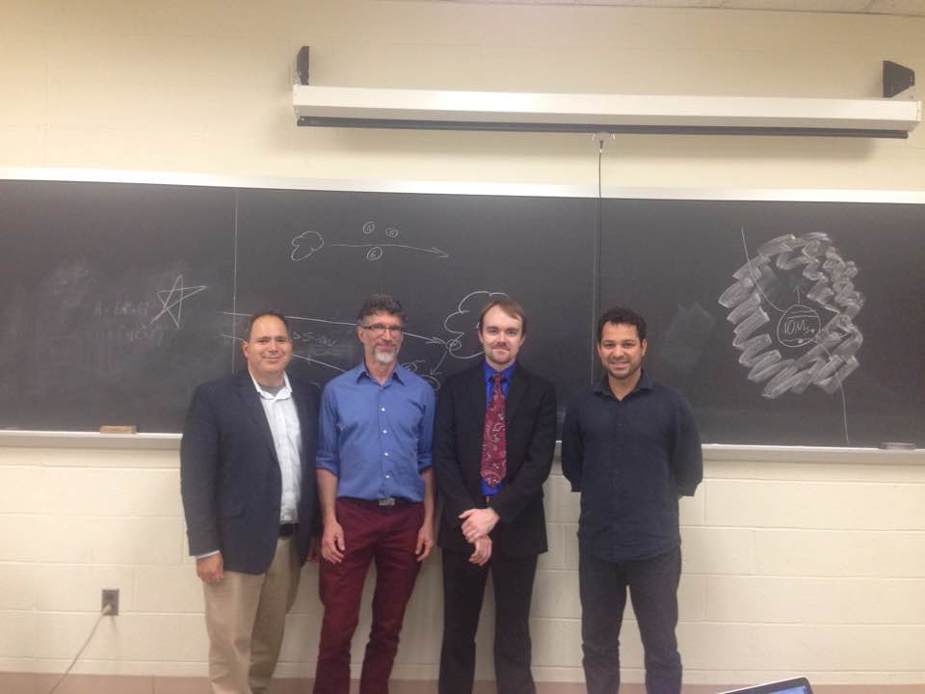
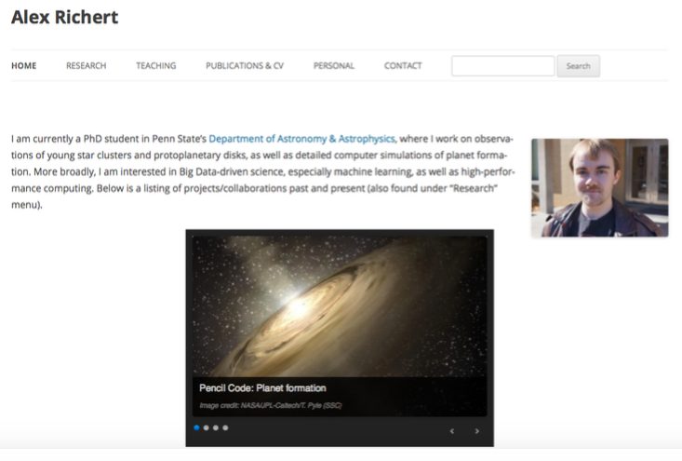
Blake Hord
Associate
Alex Richert

Slide 8
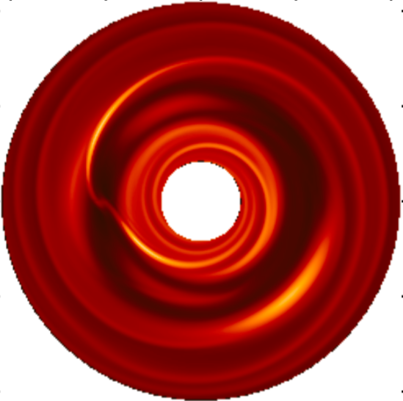
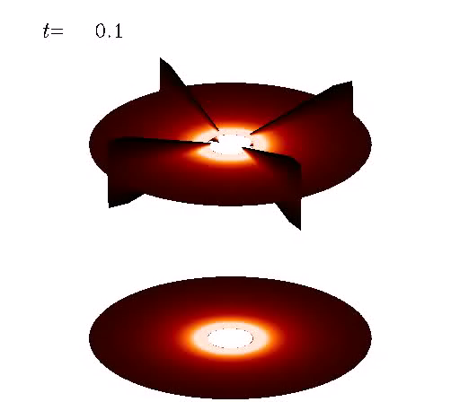
Planet-disk interaction model predictions:
gaps, spirals, and vortices.
(Lyra et al. 2009b)

Slide 9
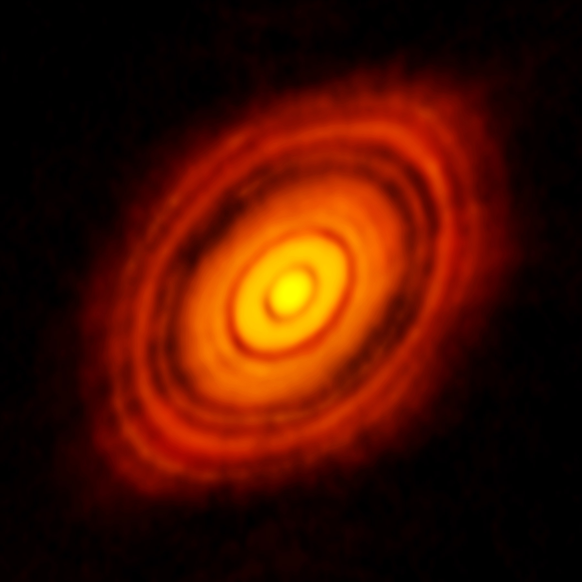
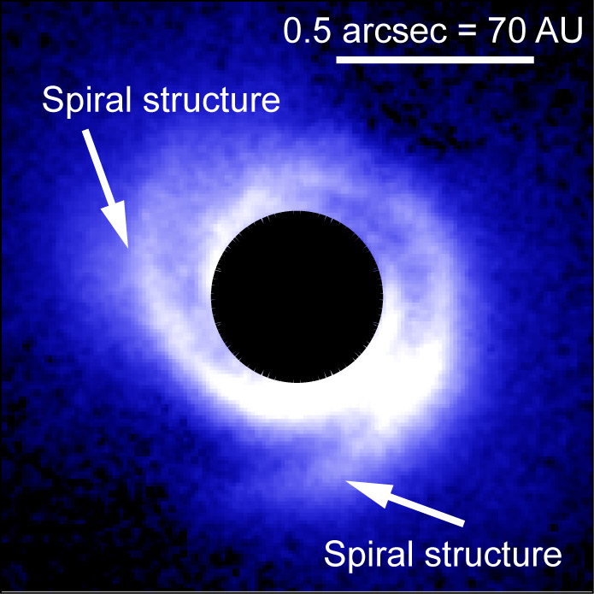
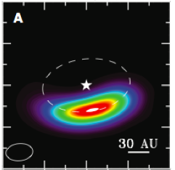
Observational evidence: gaps, spirals, and vortices
HL Tau
SAO 206462
Oph IRS 48
The ALMA Partnership et al. (2015)
Muto et al. (2012)
van der Marel et al. (2013)

Slide 10
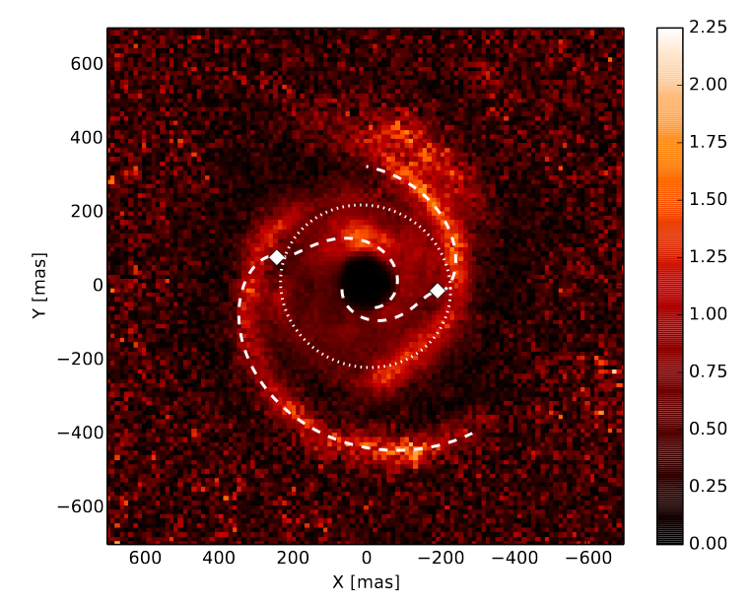
Observational Evidence: Spirals
SAO 206462
MWC 748
Muto et al. (2012)
Benisty et al. (2015)

Slide 11
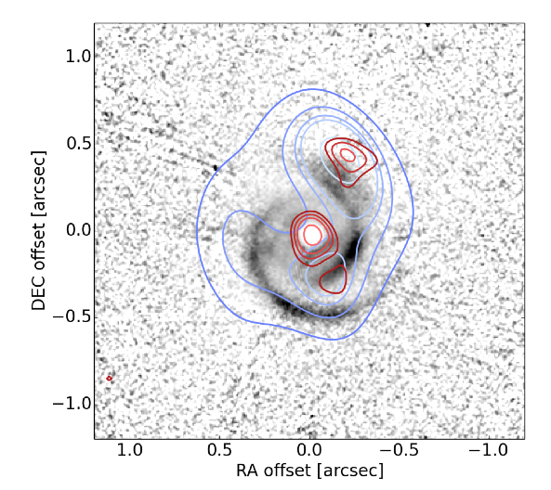
SPHERE-ALMA-VLA overlay of MWC 758
SPHERE (μm)
ALMA ( ~ mm)
VLA (cm-m)
Marino et al. (2015)

Slide 12
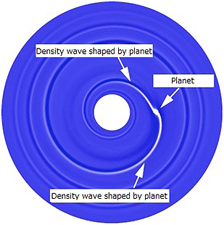
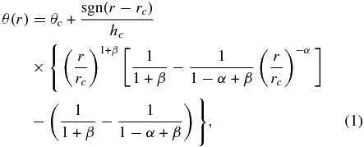
Spiral arm fitting leads to problems
Analytical spiral fit
Spirals are too wide,
hotter (300K) than ambient gas (50K).
Rafikov (2002)
Muto et al. (2012)
Benisty et al. (2015)

Slide 13
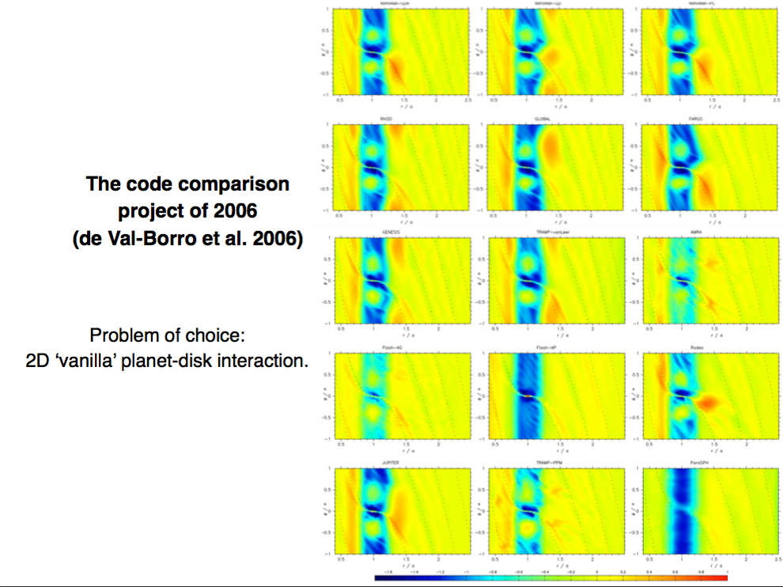

Slide 14
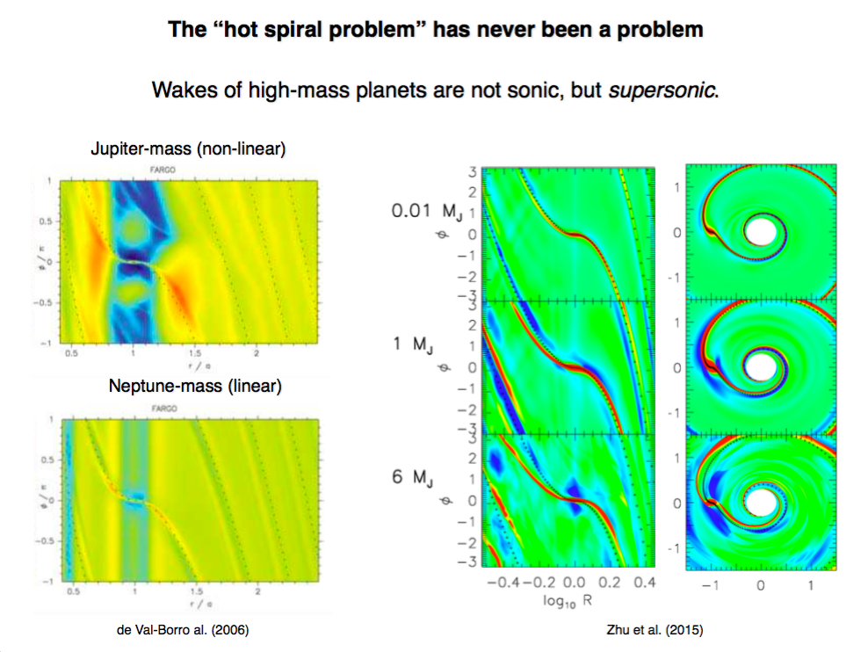

Slide 15
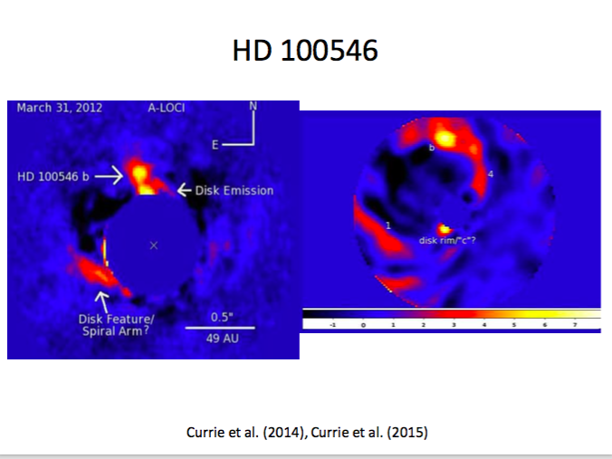
The strange case of thermal emission in HD 100546
L band (~3.5 μm)
H band (~1.6 μm)

Slide 16
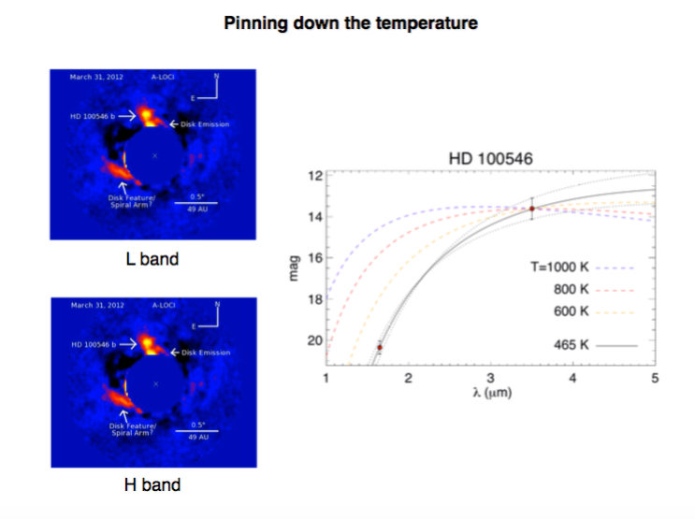
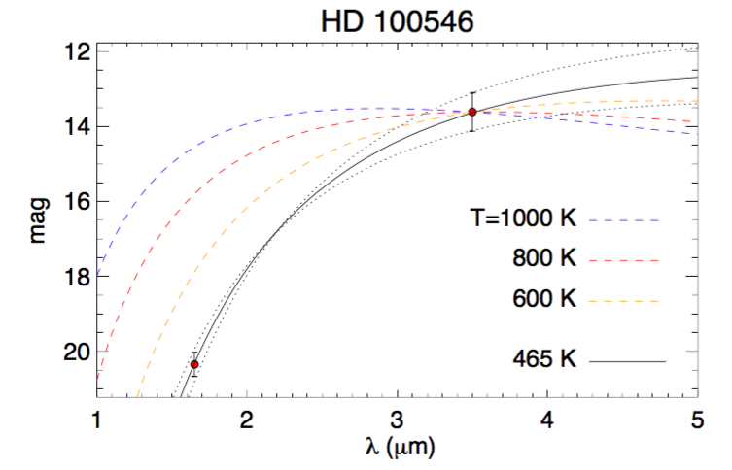
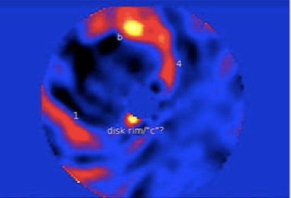
Lyra et al. (2016)

Slide 17
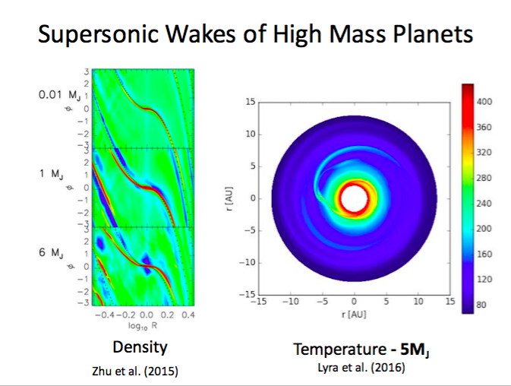

Slide 18
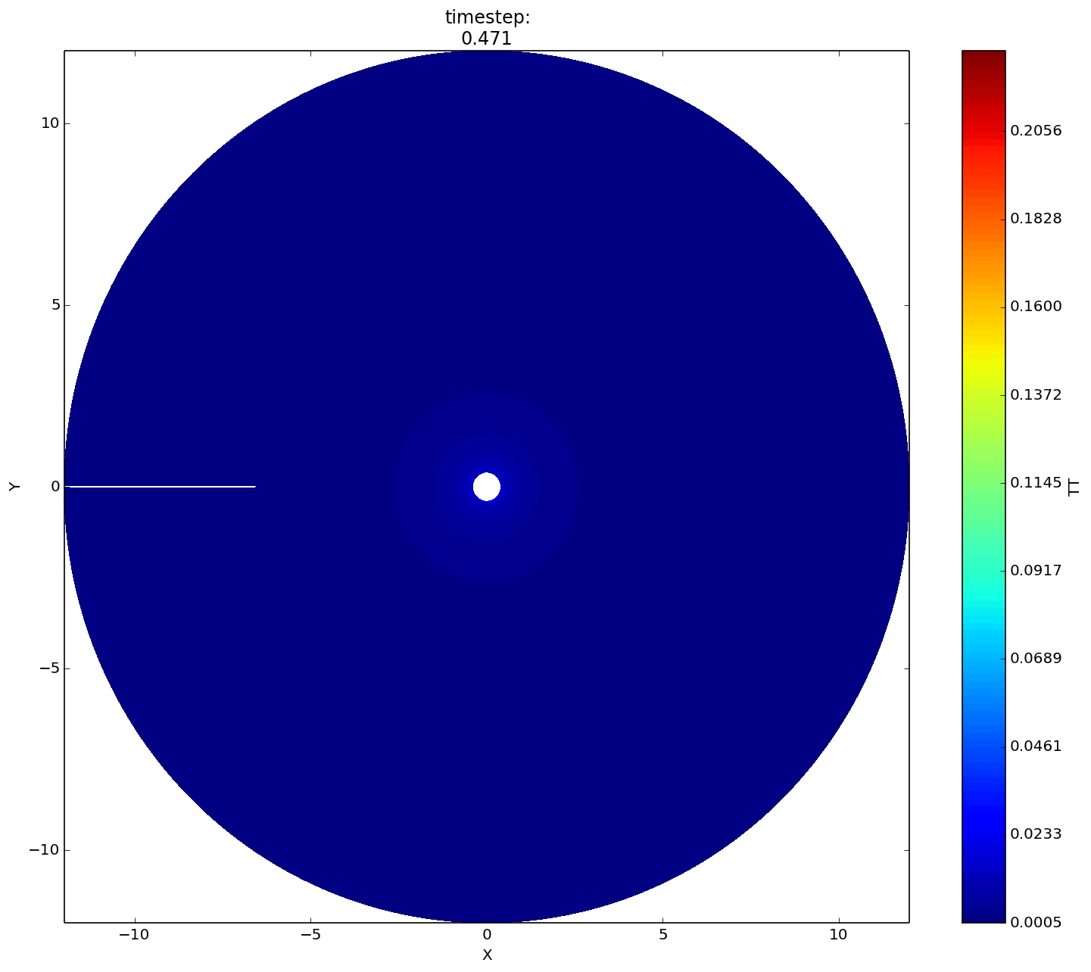
Planet-driven turbulence
Richert et al. (2015)

Slide 19
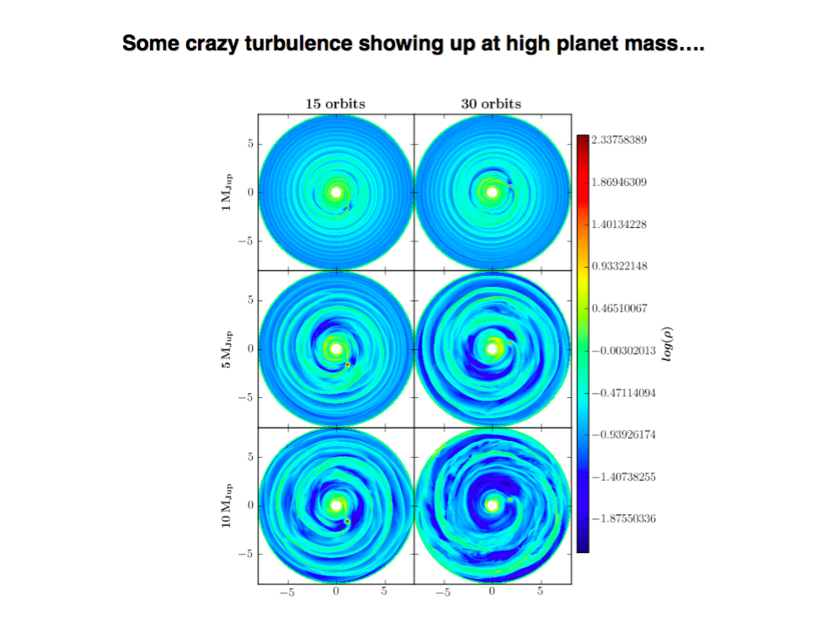

Slide 20
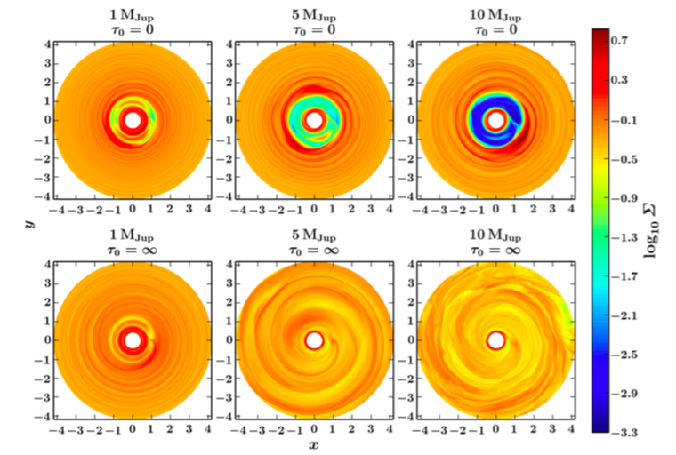
Turbulence in high-mass planets in adiabatic disks
Planet mass
Isothermal
Adiabatic
Richert et al. (2015)

Slide 21
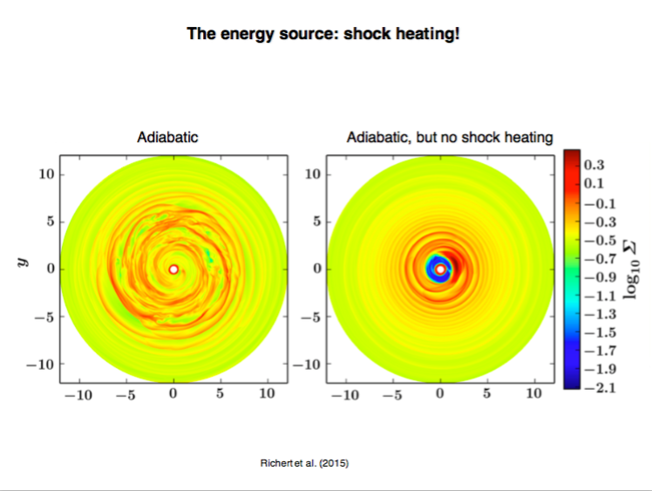

Slide 22
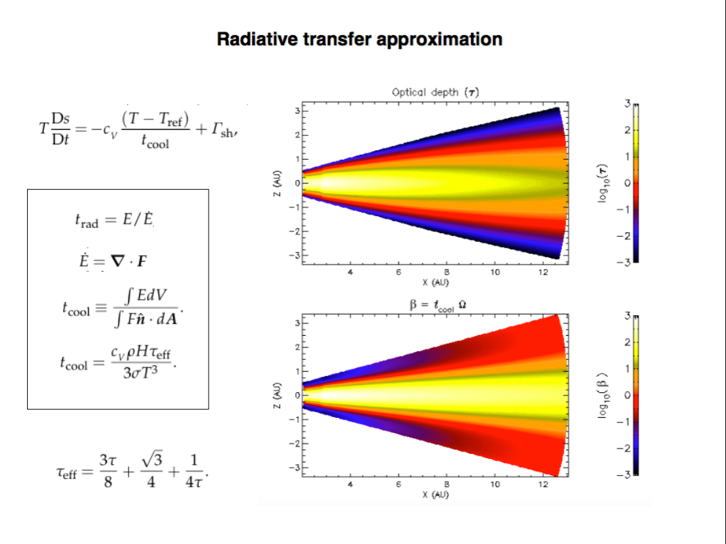

Slide 23
3D: Shock bores
Shocks (velocity convergence)
Temperature
Lyra et al. (2016)

Slide 24
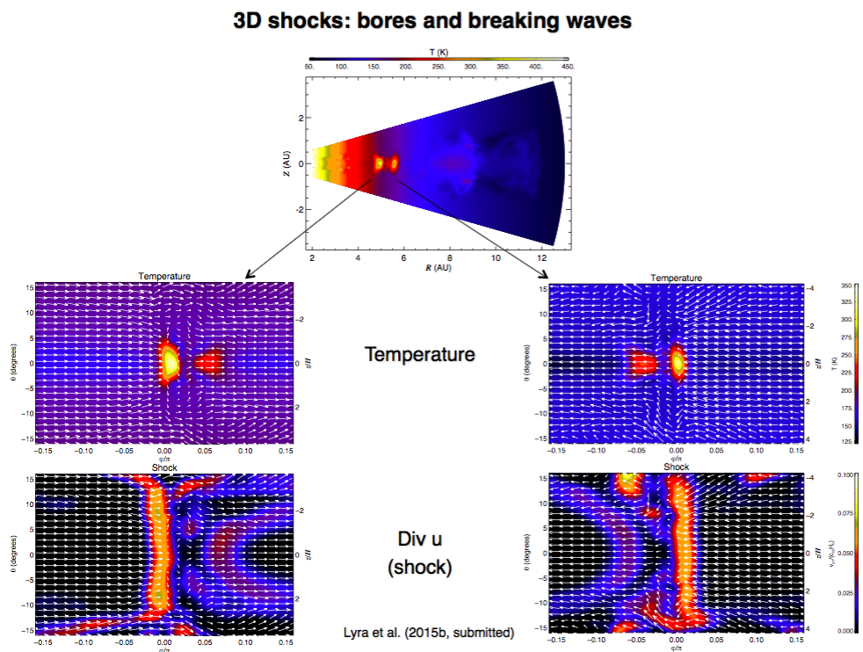
Lyra et al. (2016)

Slide 25
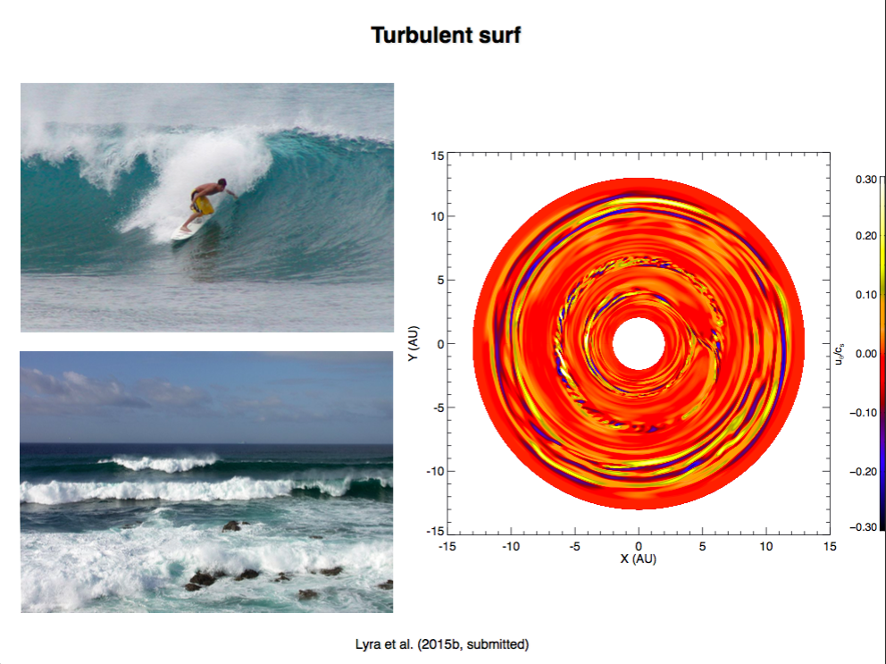
Lyra et al. (2016)

Slide 26
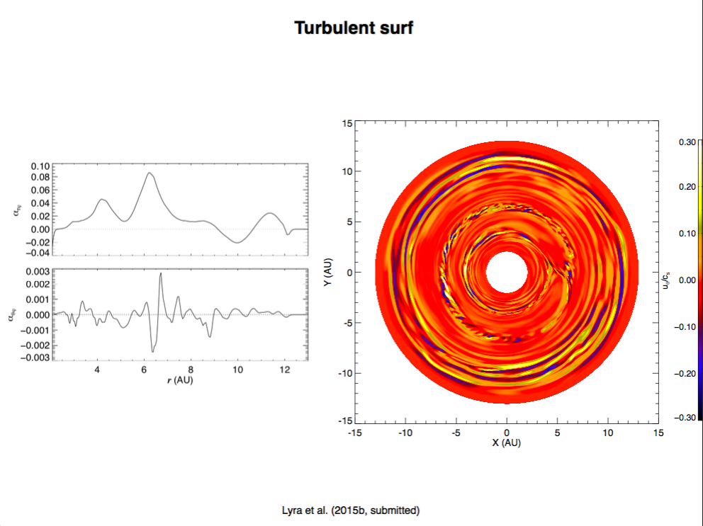
Lyra et al. (2016)

Slide 27
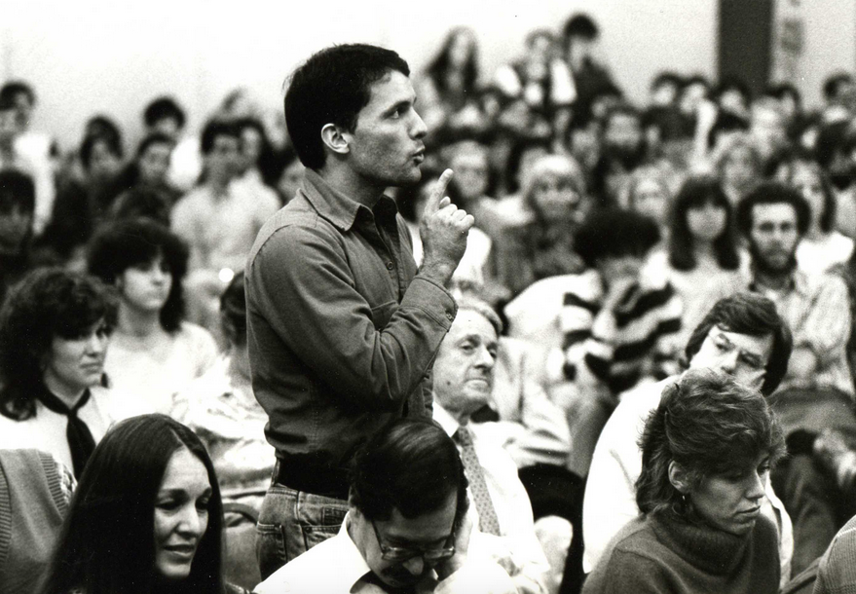
Your model doesn’t look
like my observation.
Why should I care?

Slide 29
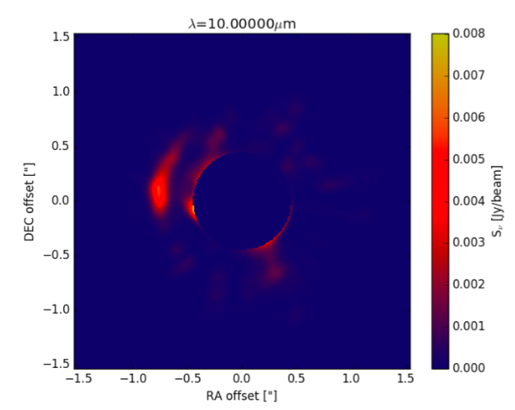
Synthetic image
Hord et al. (2017)

Slide 30
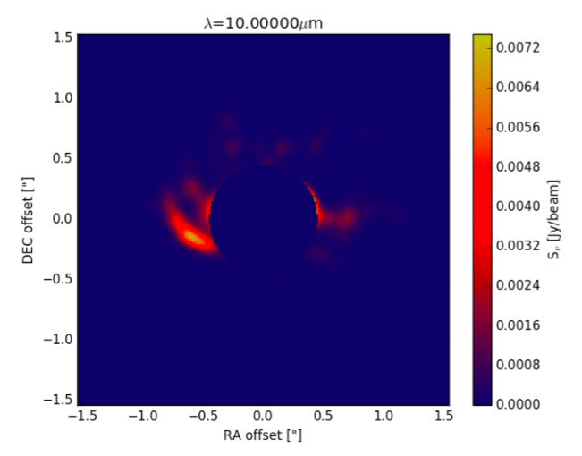
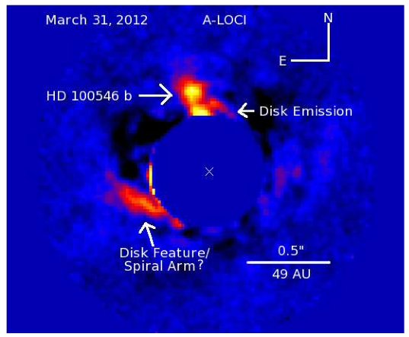
Observation vs Synthetic Image
Hord et al. (2017)

Slide 31
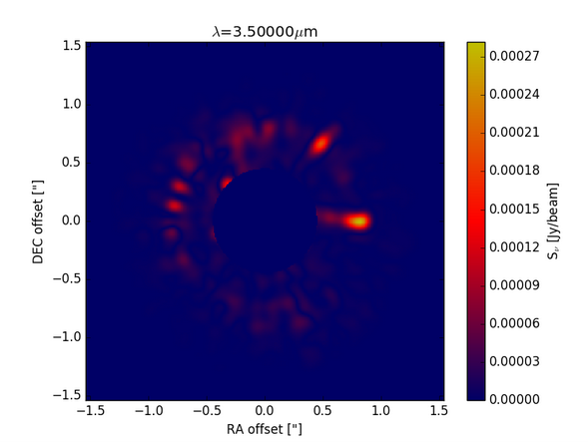
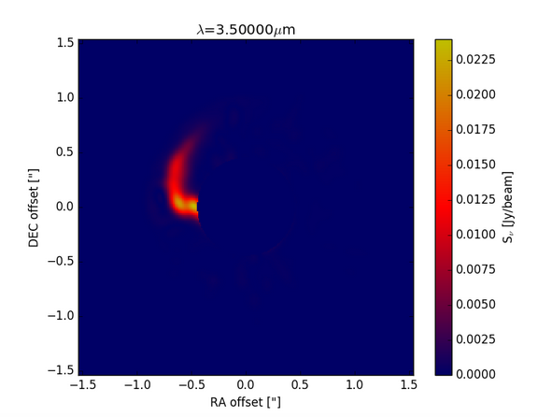
Effect of shocks alone
1 μm
10 μm
Hord et al. (2017)

Slide 32
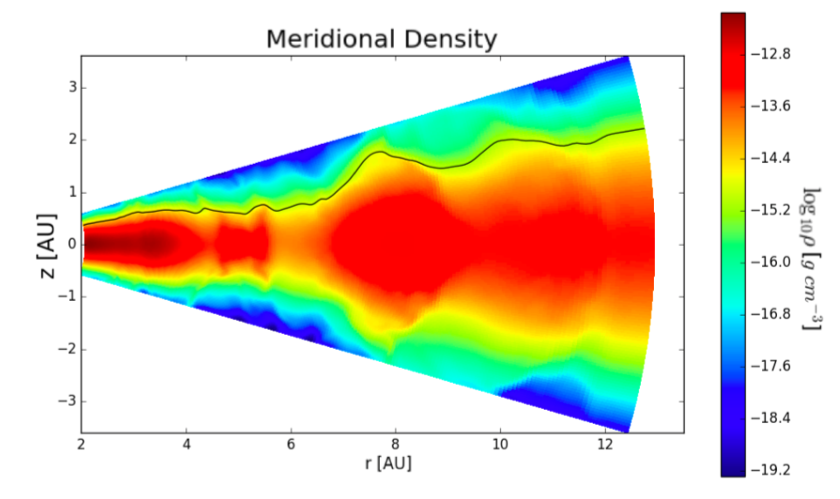
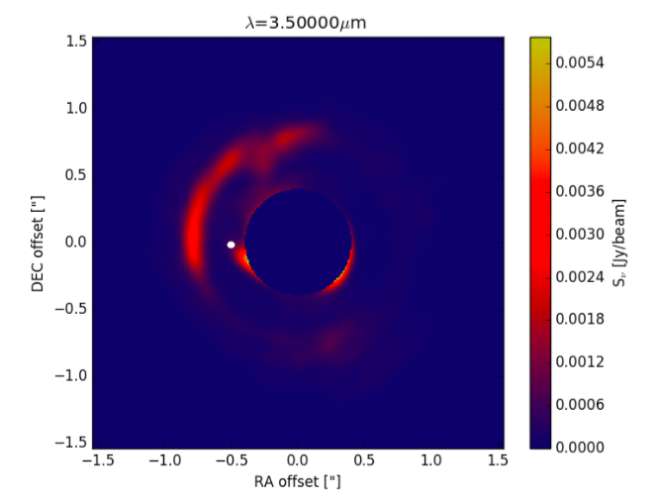
Scattering – A puffed up outer gap
Hord et al. (2017)

Slide 33
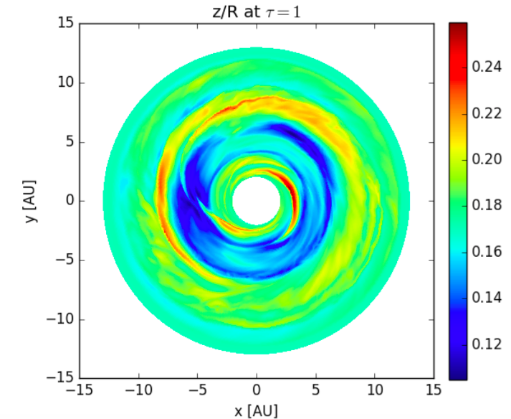
Scattering
Hord et al. (2017)

Slide 34
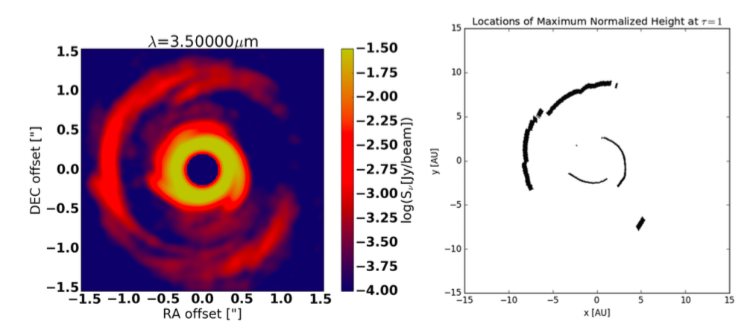
We see what is not in the
shadow of the inner disk spirals
Hord et al. (2017)

Slide 35
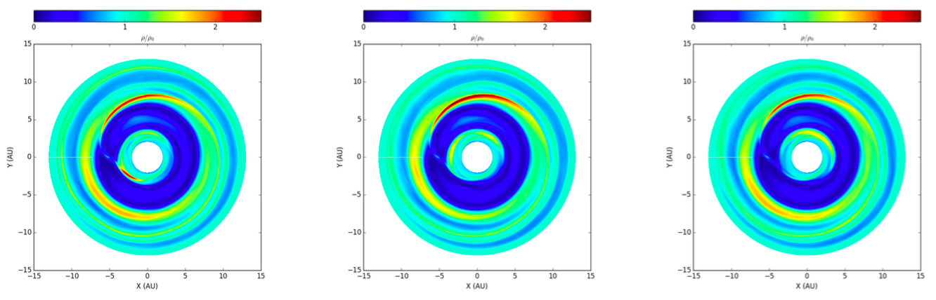
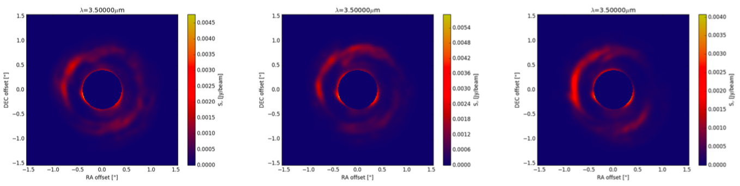
The pattern is stationary
T = 39 orbits
T = 40 orbits
T = 41 orbits
Density
Intensity
Hord et al. (2017)

Slide 36
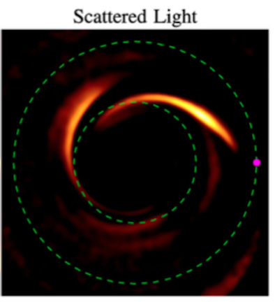
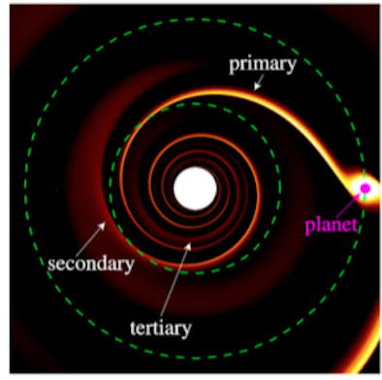
Primary and Secondary spiral arms
Dong et al. (2015)

Slide 37
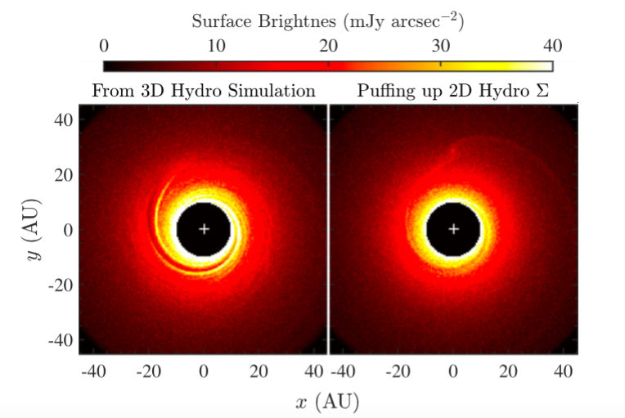
3D is needed
Dong & Fung (2017)

Slide 38
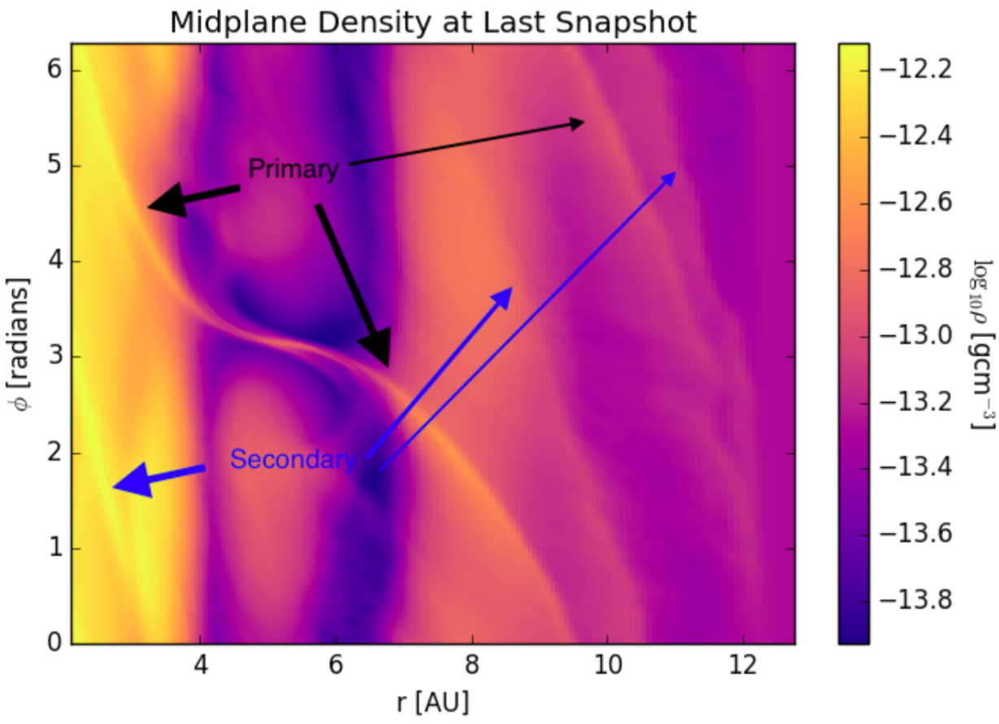
Primary and Secondary spiral arms
Hord et al. (2017)

Slide 39

Is the stationary pattern a secondary spiral arm?

Slide 40

The raised feature has its origins in a secondary spiral arm
Hord et al. (2017)

Slide 41

Conclusions
3D radiation-hydro models give results widely different than 2D isothermal
Planet-induced shocks modify disk structure
Hot lobes near high-mass planets in high resolution
Planets puff up their outer gaps – visible in scattered light

Slide 42

Conclusions
3D radiation-hydro models give results widely different than 2D isothermal
Planet-induced shocks modify disk structure
Hot lobes near high-mass planets in high resolution
Planets puff up their outer gaps – visible in scattered light

