Slide 1
Evolution of MU69
from a binary planetesimal into contact
via Kozai-Lidov oscillations and nebular drag
Funding
NFDAP – 2019
XRP – 2018
XRP - 2016
Wladimir Lyra
New Mexico State University
NRAO - 2017
HST - 2016
Computational Facilities
New Horizons meeting, Mar 10th, 2020

Slide 2
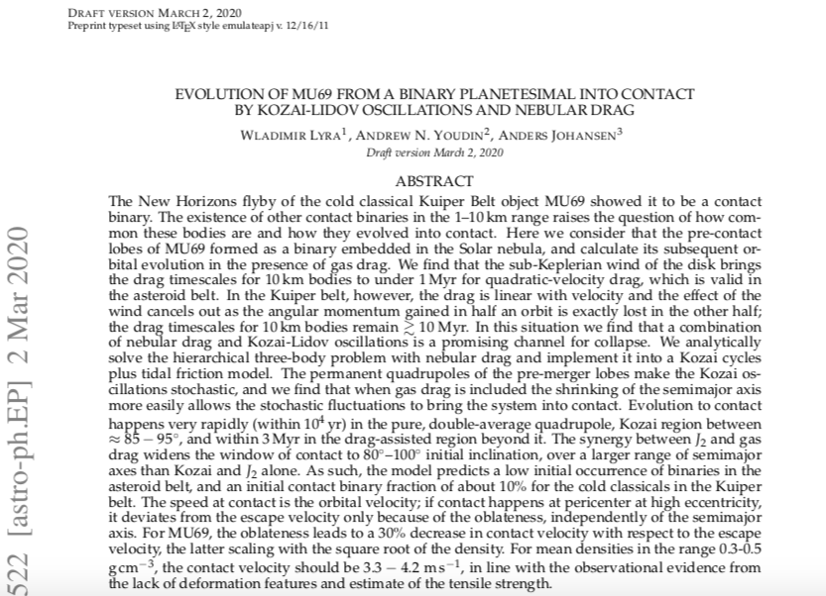

Slide 3
Effect of Drag
30 km
Lyra, Youdin, & Johansen 2020 (submitted)

Slide 4
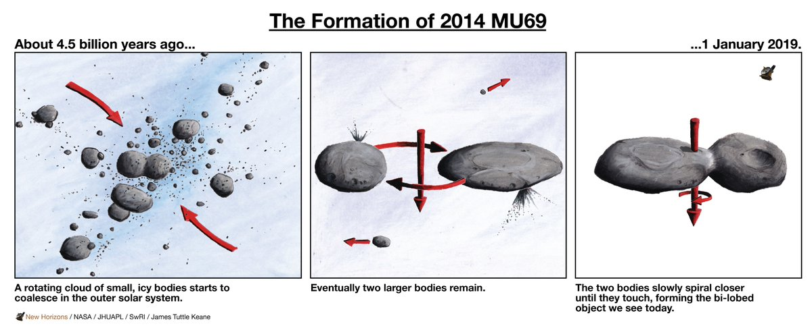
The Cartoon Image
W. Lyra
Sketch by J.T. Keane

Slide 5
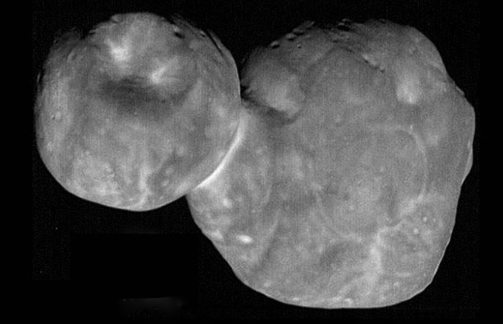
Beyond the cartoon image
How?
W. Lyra

Slide 6
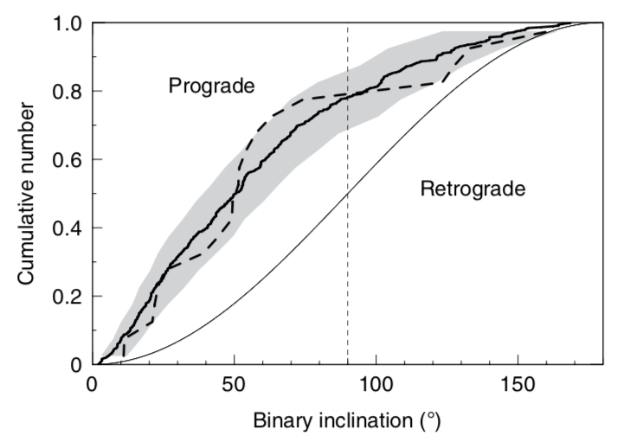
Streaming Instability
The dust drift is hydrodynamically unstable
Youdin & Goodman (2005), Johansen & Youdin (2007)
SI Model (solid)
KBOs (dashed)
Streaming Instability reproduces the
prograde/retrograde distribution of KBO binaries
Nesvorny+’19

Slide 7
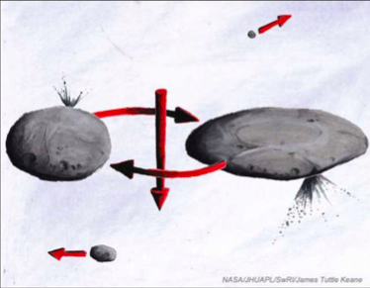
Hardening
Sketch by J.T. Keane

Slide 8
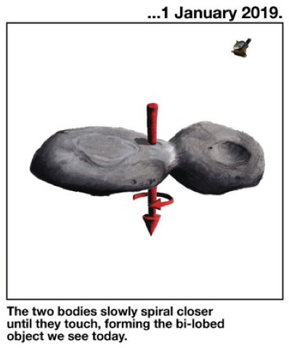
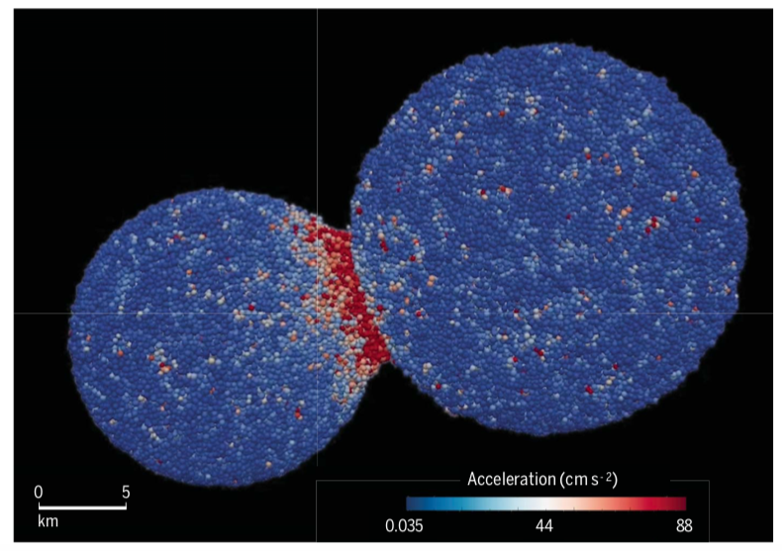
How was angular momentum lost?
Mutual orbit
(i.e., not captured)
Slow merger
(~< 5 m/s)
Inferred from:
Alignment of components’ axes;
Similar colors.
McKinnon et al. (2020)
Inferred from:
Negligible evidence for impact damage
SPH simulations
Sketch by J.T. Keane

Slide 9
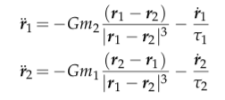
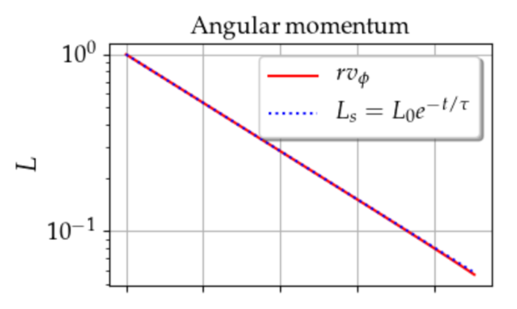
Angular momentum loss via nebular drag
gravity
drag
Solve for angular momentum:
Ultima
Thule
Exponential decay of angular momentum !
W. Lyra
Lyra, Youdin, & Johansen 2020 (submitted)

Slide 10
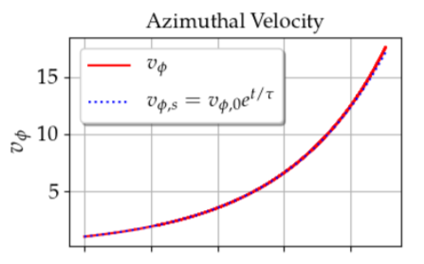
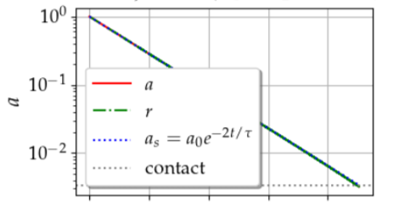
Analytical solution
Exponential decay of angular momentum
Exponential decay of energy
Exponential increase of orbital velocity
W. Lyra
Lyra, Youdin, & Johansen 2020 (submitted)

Slide 11
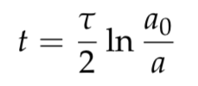
Getting quantitative…
Time until contact
For a = 0.1 r_{H} (4000 km), hardening to a₀=20km and τΩ=10⁷ …
t ~ 100 Myr
W. Lyra
Lyra, Youdin, & Johansen 2020 (submitted)

Slide 12
Wind
Low pressure
Planetesimal
High pressure
The gas has some pressure support.
The planetesimal has none.
Gas
Sun

Slide 13
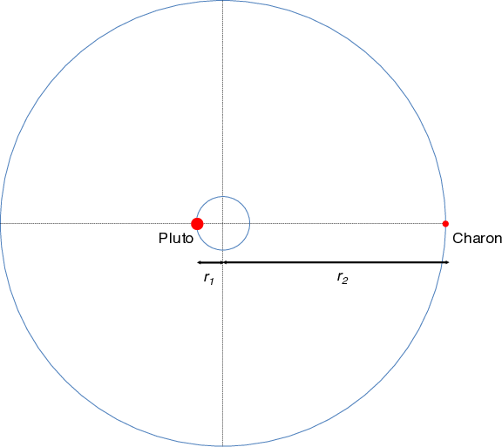
Wind
At initial separation a ~ 4000 km:
Binary orbital velocity ~ 0.1 m/s
Solar orbit velocity at 45AU
v_{k} ~ 4.5 km/s
Sub-Keplerian pressure support
v = v_{k} (1−η)
η ∼ 0.01
Headwind velocity (v_{k}-v):
ηv ~ 50 m/s
Subkeplerian wind on the binary
= 500 times orbital velocity
v
L1
L2
v
500 v
W. Lyra
Lyra, Youdin, & Johansen 2020 (submitted)

Slide 14
Wind solution
Lyra, Youdin, & Johansen 2020 (submitted)

Slide 15
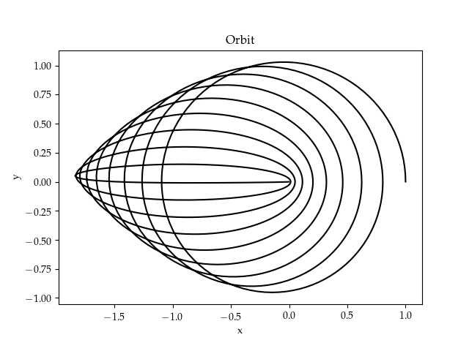
Wind solution
Angular momentum loss at constant energy.
Eccentricity increase at constant semimajor axis
Lyra, Youdin, & Johansen 2020 (submitted)

Slide 16
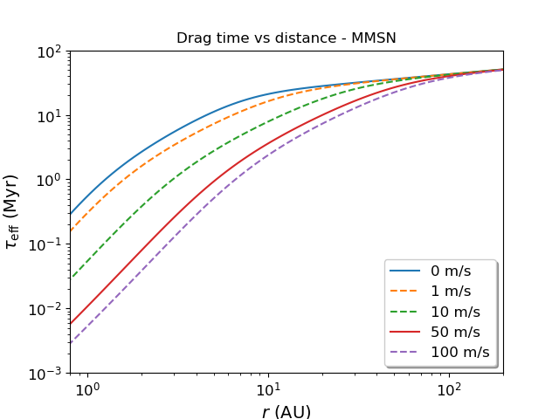
Timescales
No wind
(zero pressure gradient)
Wind has a strong effect in the distances of the asteroid belt.
Little effect in the Kuiper belt.
Typical pressure gradient
Lyra, Youdin, & Johansen 2020 (submitted)

Slide 17
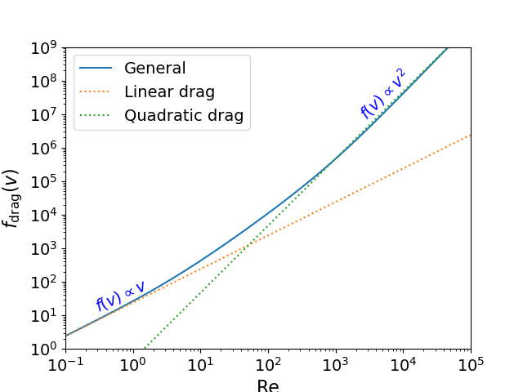
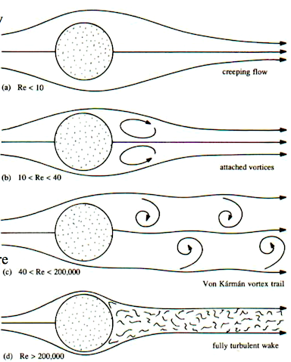
Linear vs quadratic drag
Reynolds number
Viscous
Turbulent
Lyra, Youdin, & Johansen 2020 (submitted)

Slide 18
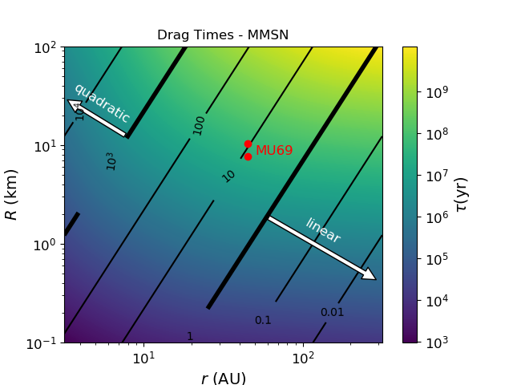
Linear vs quadratic drag
Lyra, Youdin, & Johansen 2020 (submitted)

Slide 19
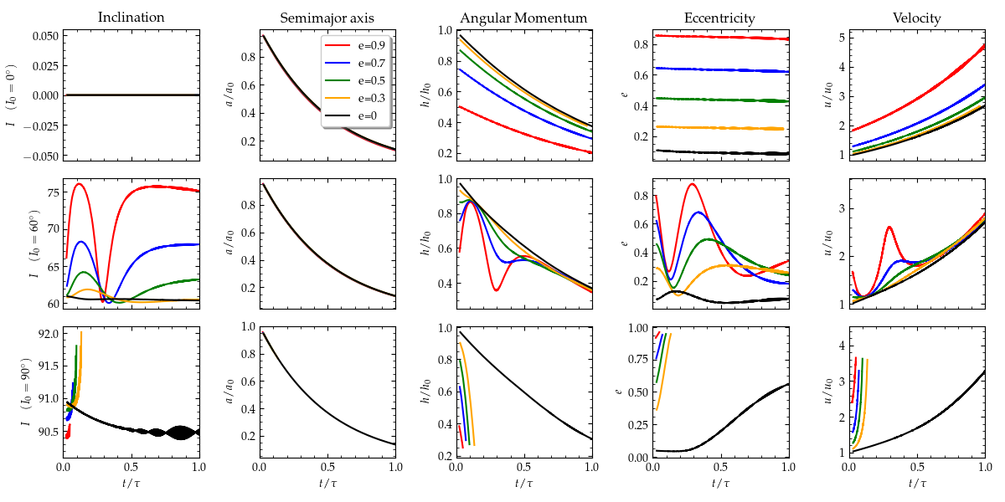
Effect of Inclination
I₀ = 0º
I₀ = 60º
I₀ = 90º
Lyra, Youdin, & Johansen 2020 (submitted)

Slide 20
Kozai-Lidov Oscillations
(Sun)
test particle

Slide 21
Effect of Inclination
I₀ = 0º
I₀ = 60º
I₀ = 90º
Lyra, Youdin, & Johansen 2020 (submitted)

Slide 22
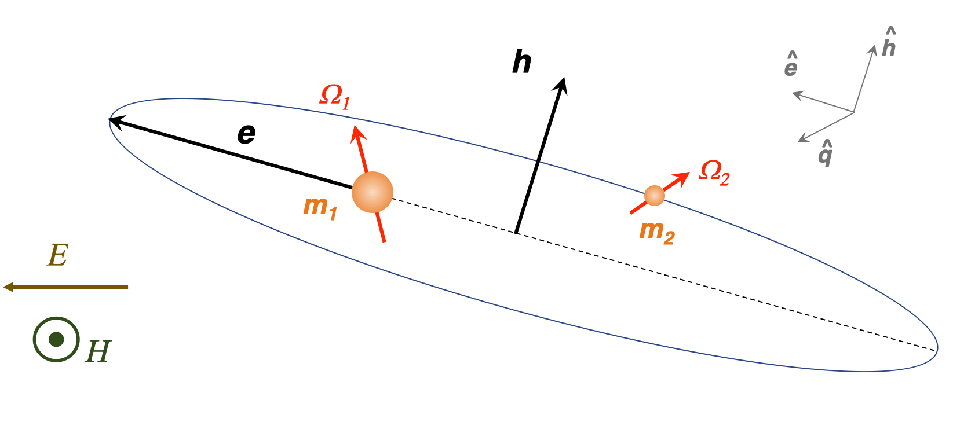
Kozai + Tidal Friction + Drag
Lyra, Youdin, & Johansen 2020 (submitted)

Slide 23
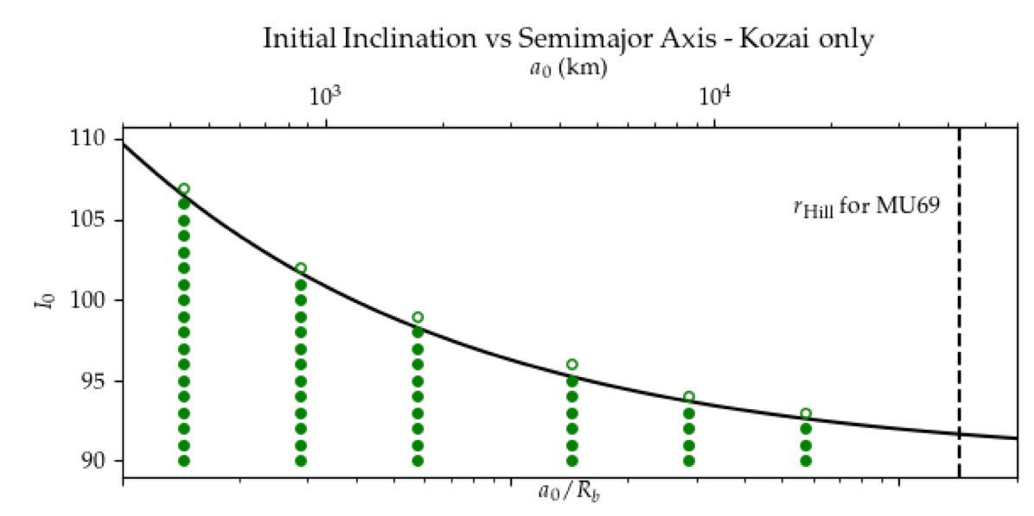
Critical Inclination
Contact
No contact
Lyra, Youdin, & Johansen 2020 (submitted)

Slide 24
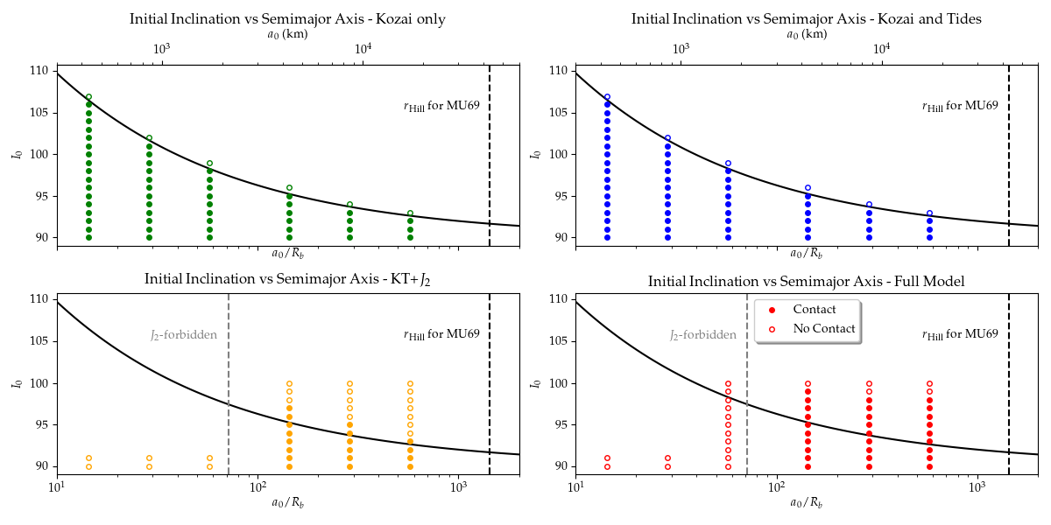
Kozai + Tidal Friction + Drag
Lyra, Youdin, & Johansen 2020 (submitted)

Slide 25
Kozai + Tidal Friction + Drag
Lyra, Youdin, & Johansen 2020 (submitted)

Slide 26
Kozai + Tidal Friction + Drag
Lyra, Youdin, & Johansen 2020 (submitted)

Slide 27
Effect of Drag
Lyra, Youdin, & Johansen 2020 (submitted)

Slide 28
Alignment of the Spin Vectors
Spin vector alignment
Mainly driven by J₂ (permanent quadrupole)
Timescale proportional to a⁴ (4th power of semimajor axis)
5 Gyr for a/R ~ 100
0.5 Myr for a/R ~ 10
Lyra, Youdin, & Johansen 2020 (submitted)

Slide 29
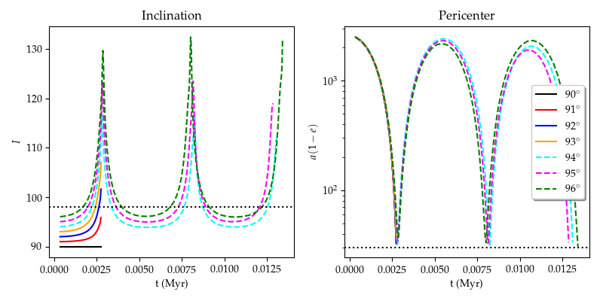
Fine Tuning of Initial Inclination

Slide 30
Double-Averaged vs Single-Averaged
Lyra, Youdin, & Johansen 2020 (submitted)

Slide 31
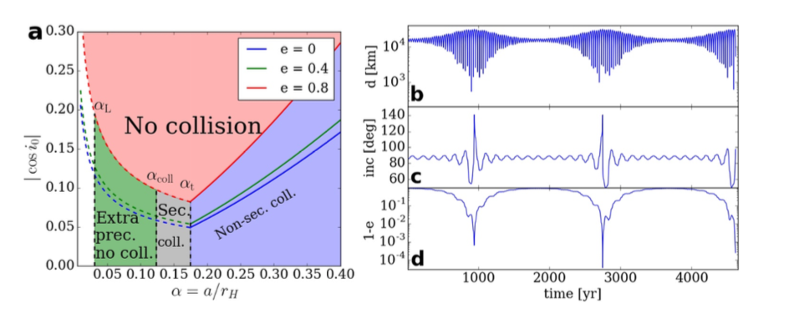
N-body simulations (no tides, J2, or drag)
Inclination not limited to the double-averaged constraint.
Cycles lead to lower inclination than initial.
Prograde/retrograde flipping possible.
Grishin et al. (2020)

Slide 32
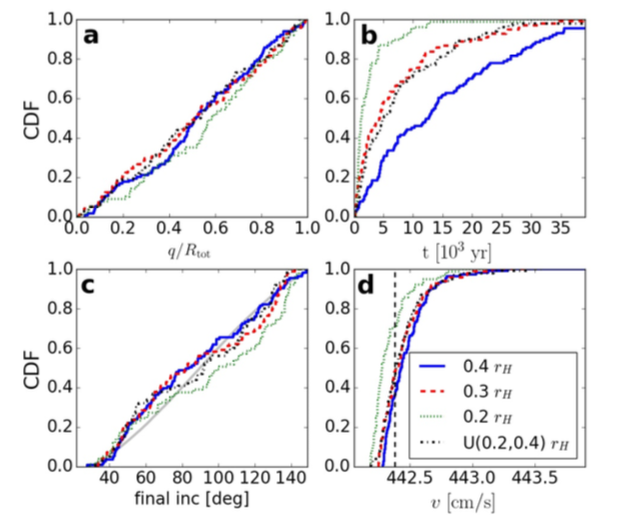
N-body simulations (no tides, J2, or drag)
Pericenter
Time to contact
Inclination at contact
Speed at contact
Grishin et al. (2020)

Slide 33
N-body simulations (no tides, J2, or drag)
Inclination at contact
Uniform
any inclination (from 40º to 140º) equally likely
Grishin et al. (2020)

Slide 34
N-body simulations (no tides, J2, or drag)
Time to contact
Too short to allow for alignment
Grishin et al. (2020)
Grishin et al. (2020)

Slide 35
Conclusions
Solved the binary planetesimal problem with gas drag
Implemented the solution into a Kozai plus tidal friction code
Contact possible in the asteroid belt within 0.1 Myr (depleted of binaries)
Contact via Kozai cycles in the Kuiper belt, orbits become grazing
Window of contact increased by J₂ and drag
Enough time for the bodies to come to alignment
Model predictions:
~ 10% of KBCC binaries should be contact binaries
Velocities at contact should be about 3-4 m/s
Open questions:
Single-averaged (or N-body) needed to reproduce final inclinations
Combine our model with single-averaged Kozai (or N-body)
Sketch by J.T. Keane
Lyra, Youdin, & Johansen 2020 (submitted)

Slide 36
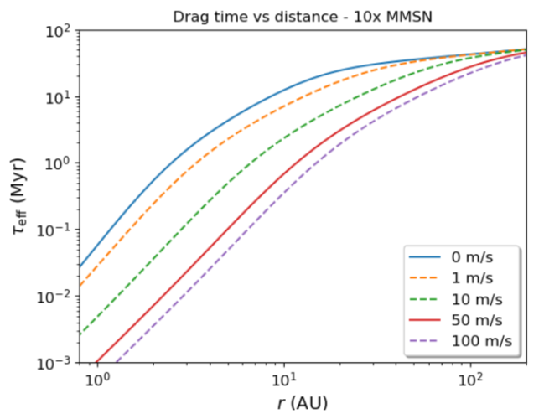
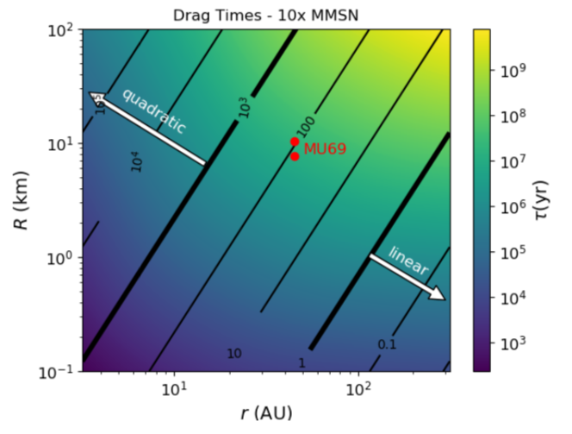

Slide 37
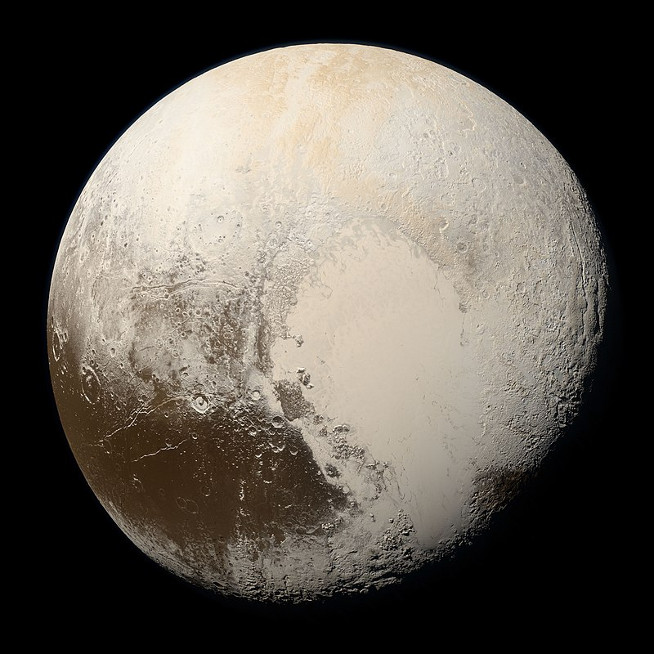

Slide 38
Sputnik Planitia – N₂ frost
W. Lyra

Slide 39
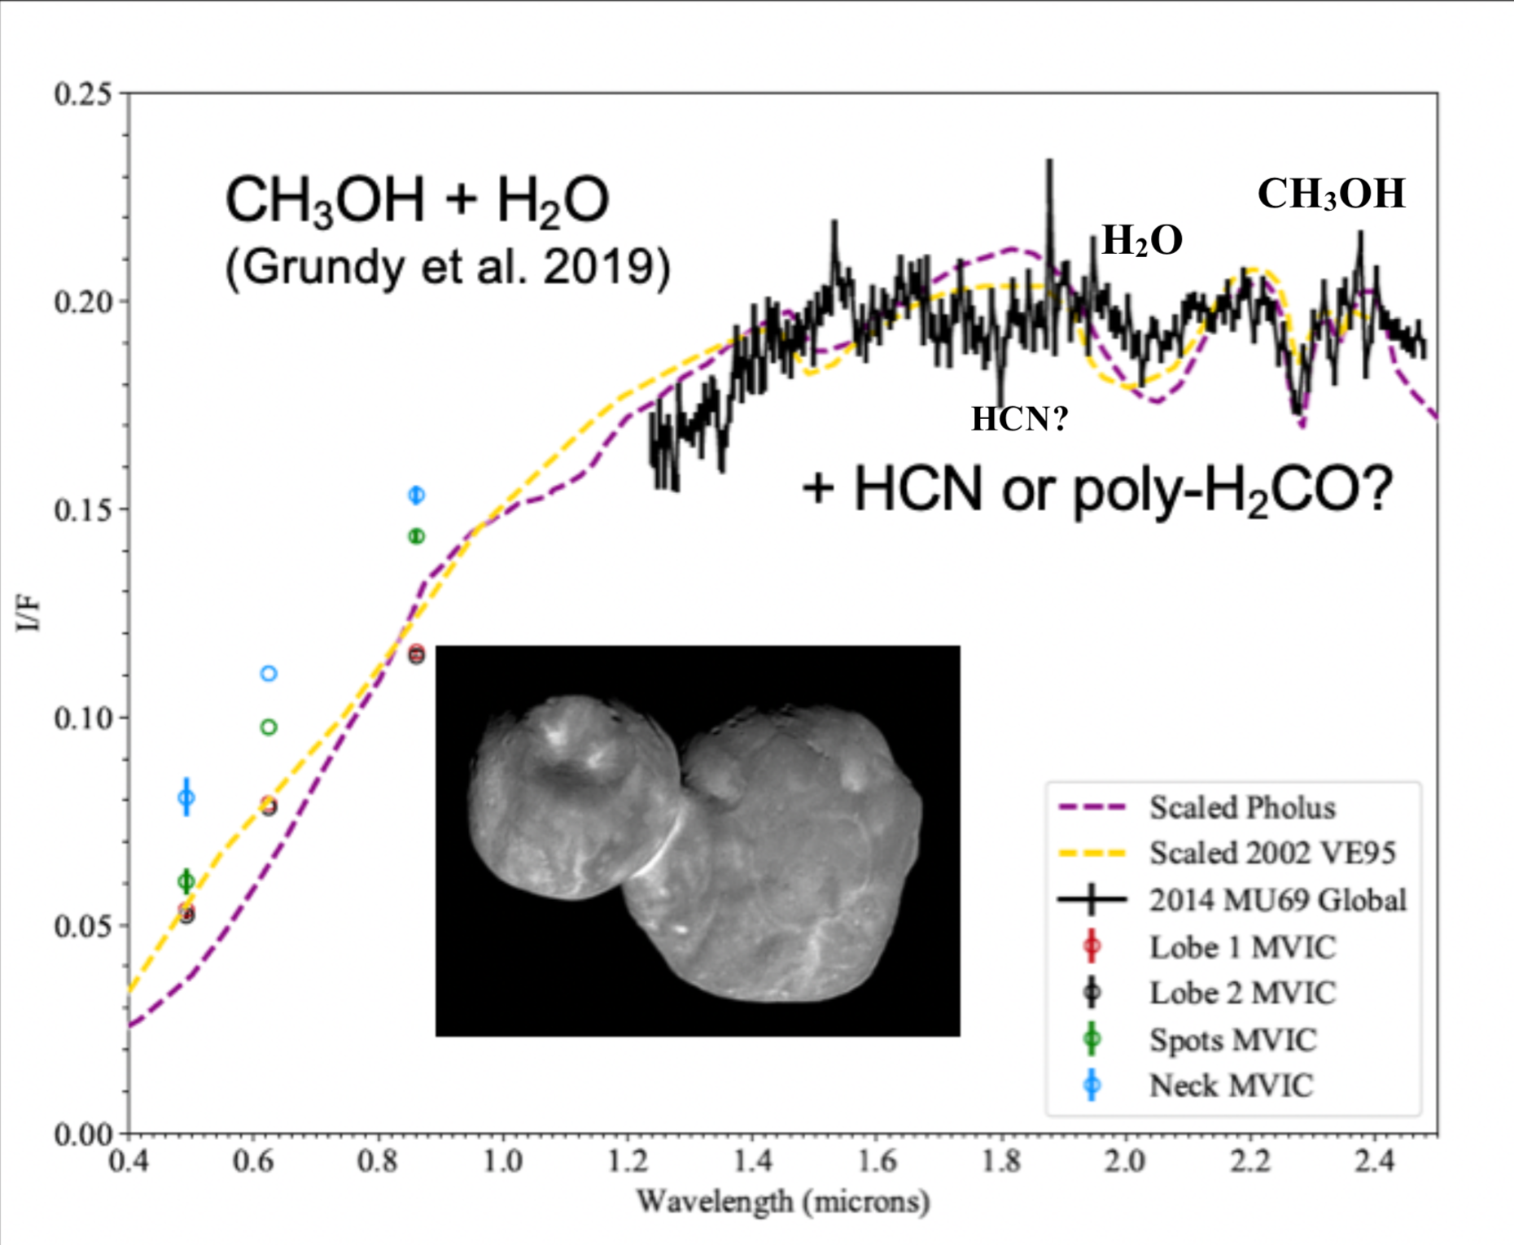
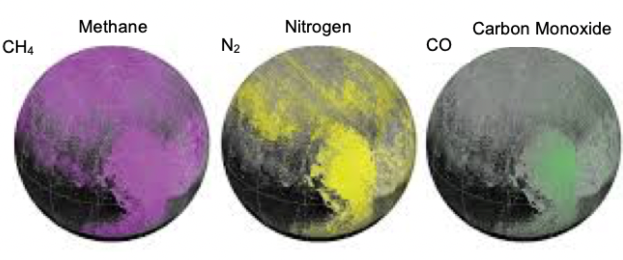
MU69 and Pluto ices are different
MU69 : Methanol, HCN, H₂O (?)
Pluto : CH₄, N₂, CO
Grundy+ ’16, Lisse+ ’20, Grundy+’ 20

Slide 40
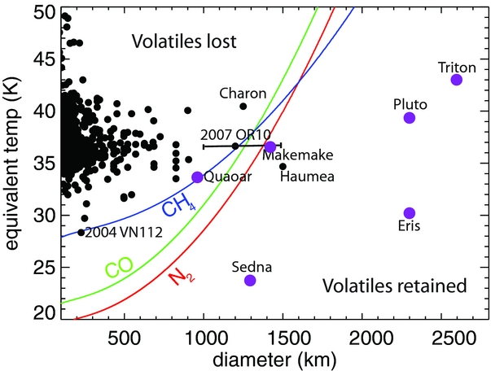
Retention of volatiles
If Pluto is formed from similar bodies to MU69, they must retain N₂
Needs shielding from sunlight
W. Lyra
Brown, Burgasser, & Fraser (2011); Lisse+ ‘20

Slide 41
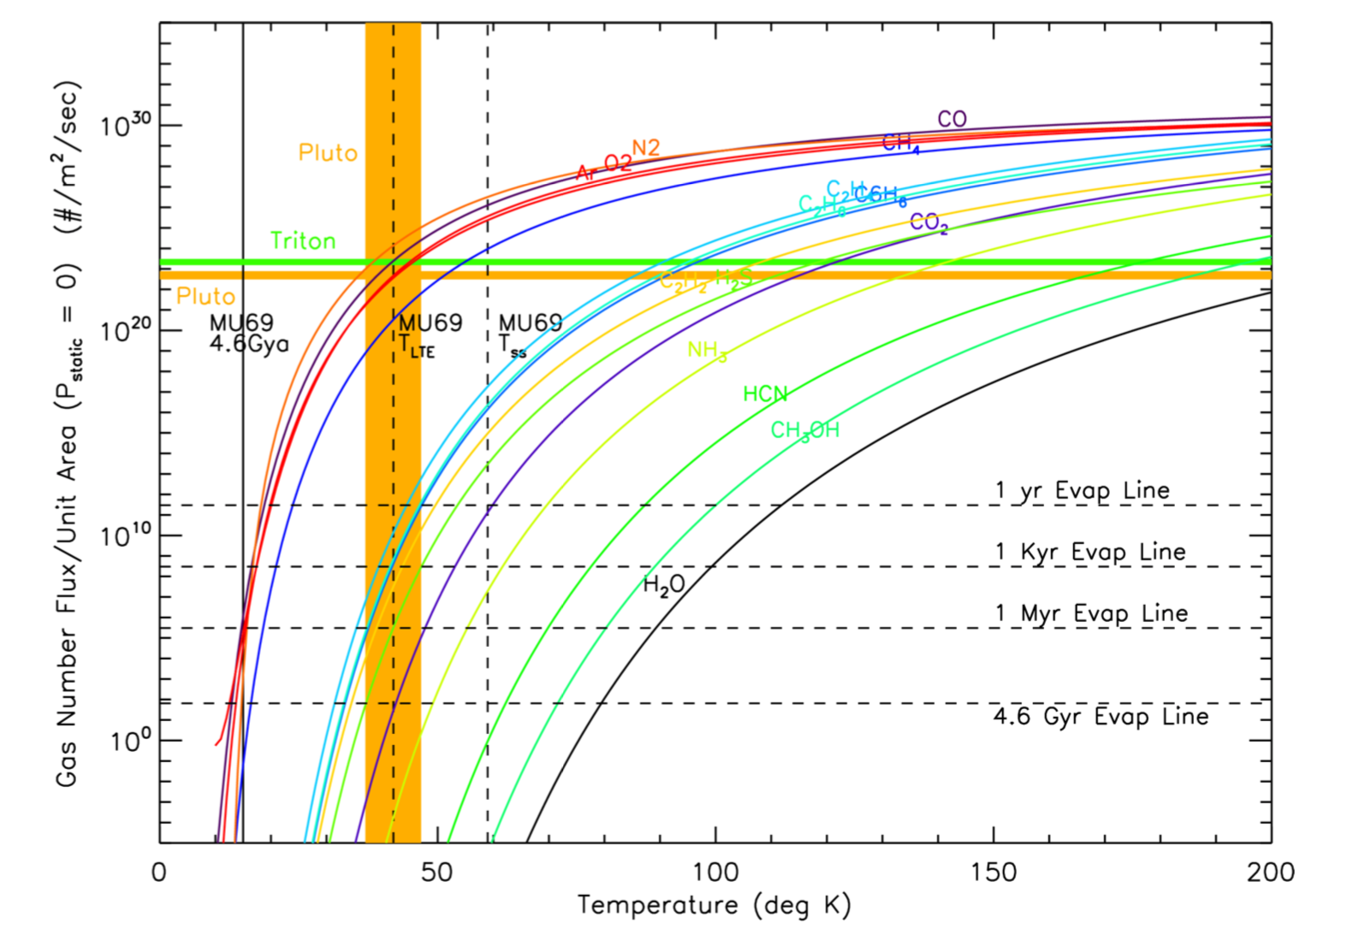
Retention of volatiles
Hypervolatiles (CH₄ / CO / N₂)
lost under vacuum pressure and microgravity in ~1 Myr for 40 K
Retained for long times if formed < 20K
Formation of MU69 in an optically thick disk keeps the interior cold enough to allow the volatiles to remain frozen.
Lisse+’20

Slide 42
Hardening during disk lifetime
For unequal mass the physics is similar, the
drag time is just replaced by an effective drag time:
Effective drag time
Exponential decay of angular momentum
Ultima
Thule
W. Lyra
Lyra, Youdin, & Johansen 2020 (submitted)

Slide 43
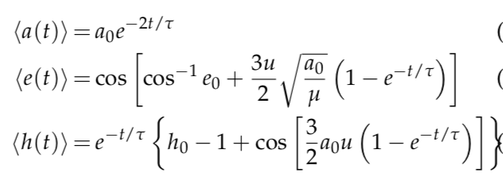
Wind solution
Lyra, Youdin, & Johansen 2020 (submitted)

Slide 44
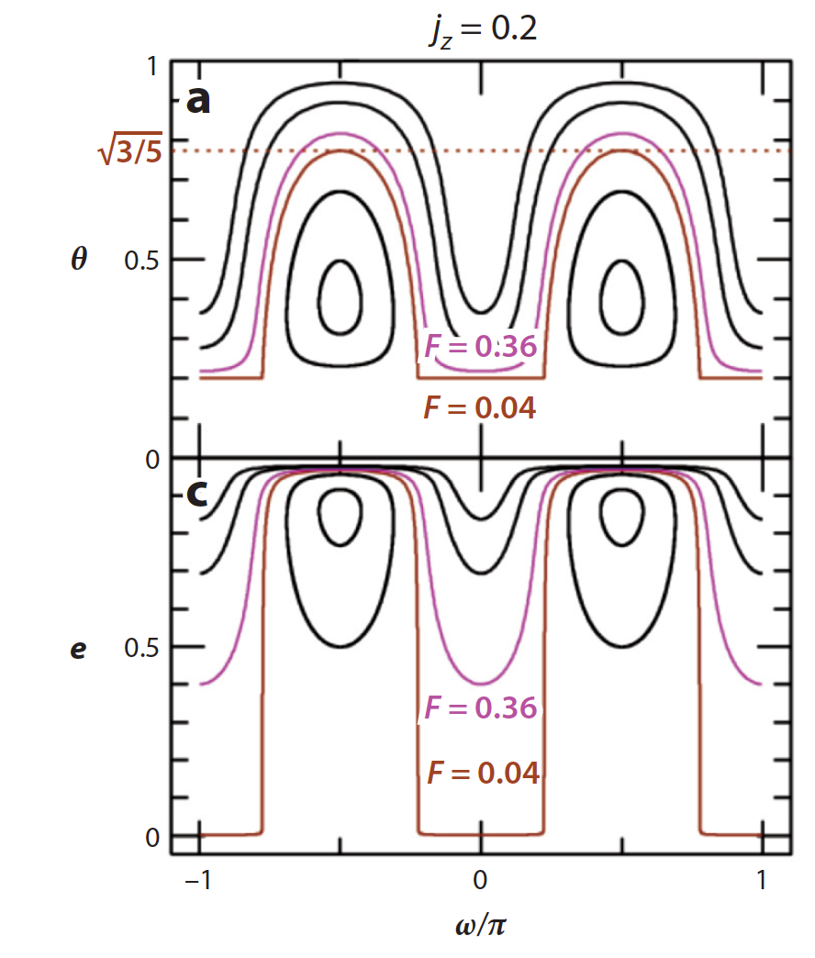
Kozai-Lidov Oscillations
cos I
Conserved quantity is not angular momentum, but vertical angular momentum
j_{z} = (1-e²)^{1/2} cos I
Cycles of inclination and eccentricity.
Naoz 2016

Slide 45
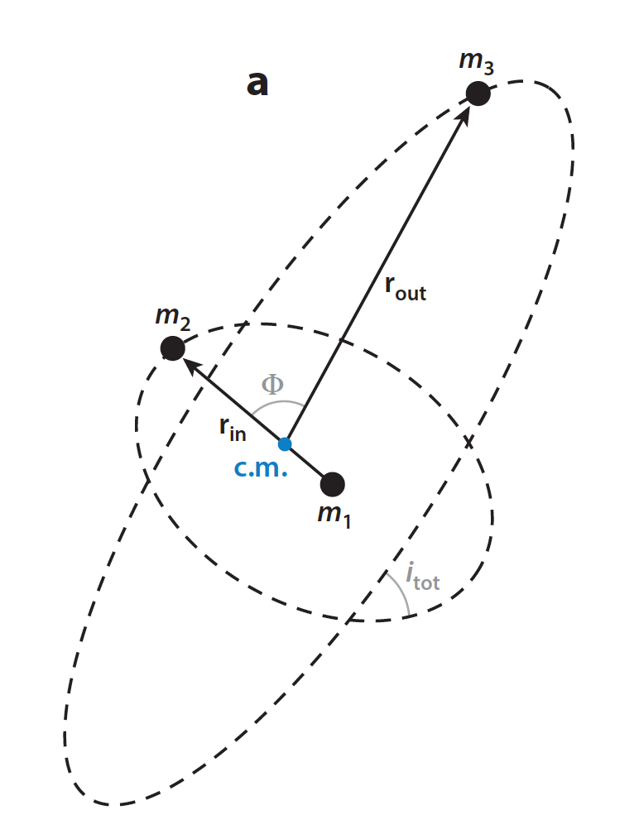
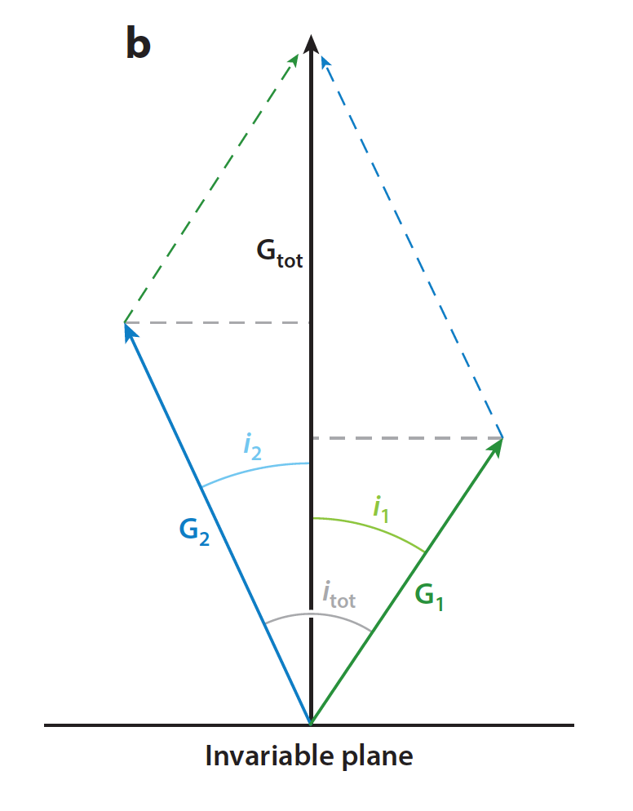
Kozai-Lidov Oscillations
Angular
Momentum
Conserved quantity is not angular momentum, but vertical angular momentum
j_{z} = (1-e²)^{1/2} cos I
Naoz 2016

Slide 46
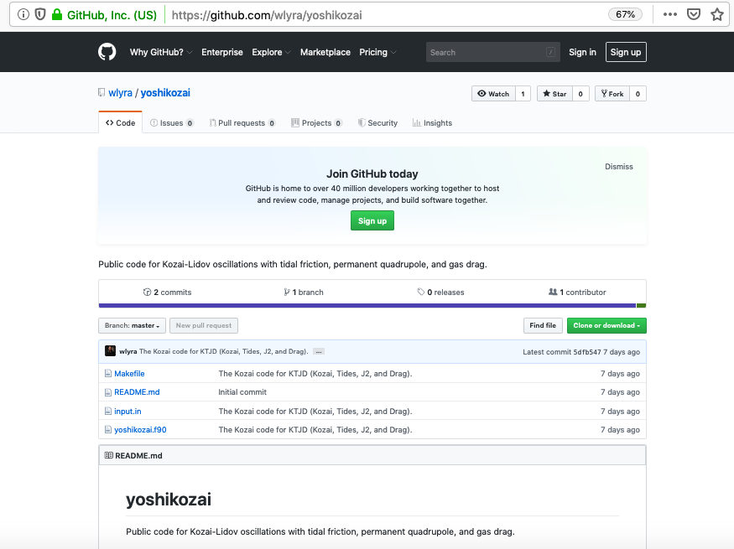
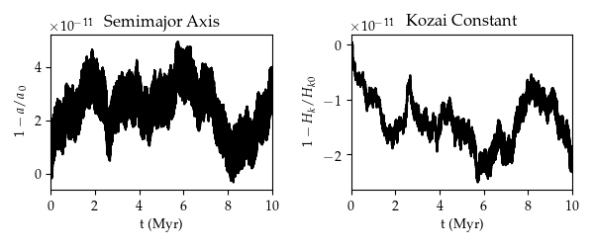
Lyra, Youdin, & Johansen 2020 (submitted)

Slide 47
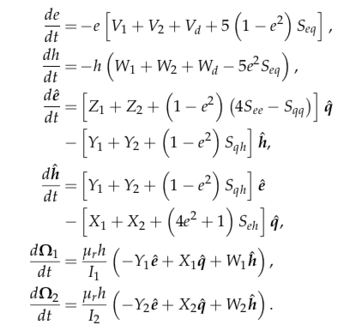
Kozai + Tidal Friction + Drag
Lyra, Youdin, & Johansen 2020 (submitted)

