Slide 1


Polydisperse Pebble Accretion
Doing away with planetesimal accretion
Wladimir Lyra
New Mexico State University
PFITS+
Manuel Cañas (New Mexico State University), Daniel Carrera (New Mexico State University), Anders Johansen (University of Copenhagen), Leonardo Krapp (University of Arizona), Debanjan Sengupta (New Mexico State University), Jake Simon (Iowa State University), Orkan Umurhan (NASA Ames), Chao-Chin Yang (University of Alabama), Andrew Youdin (University of Arizona).
Pebbles in Planet Formation – NAOJ, Japan – Feb 9th-13th, 2025

Slide 2
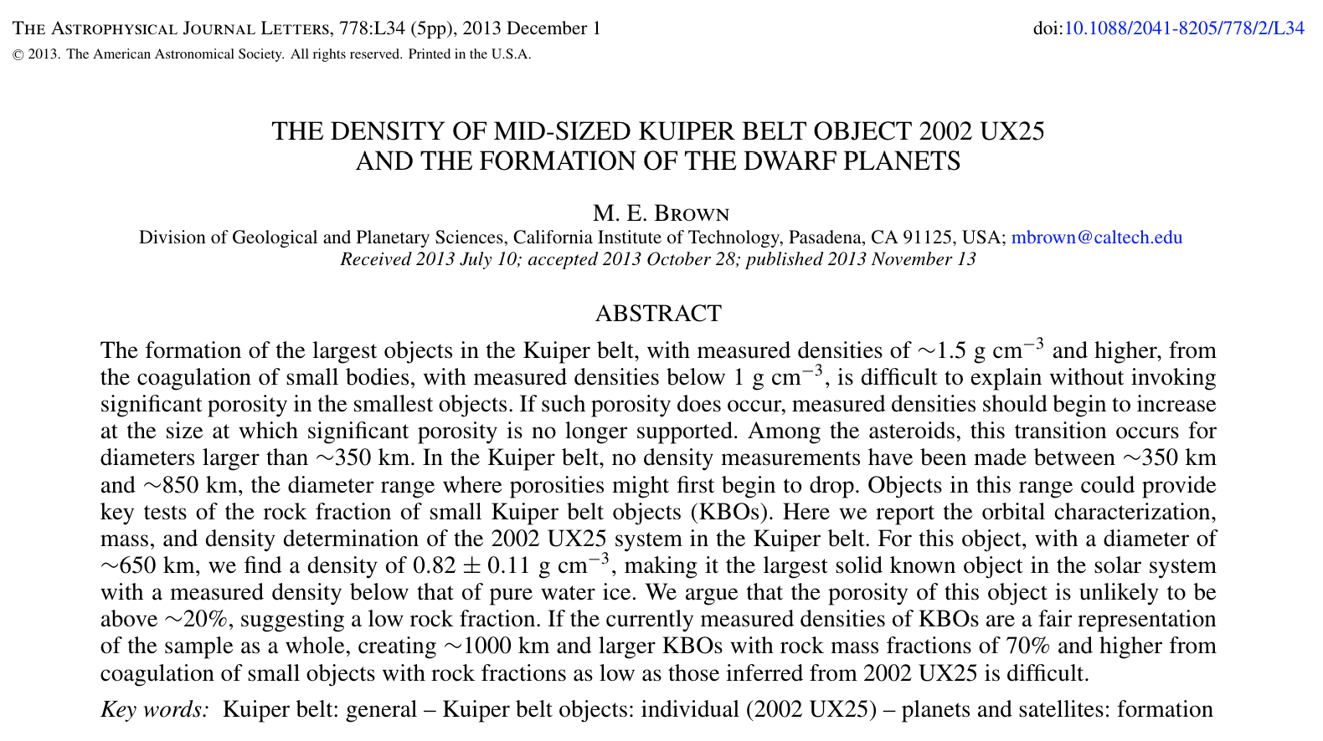
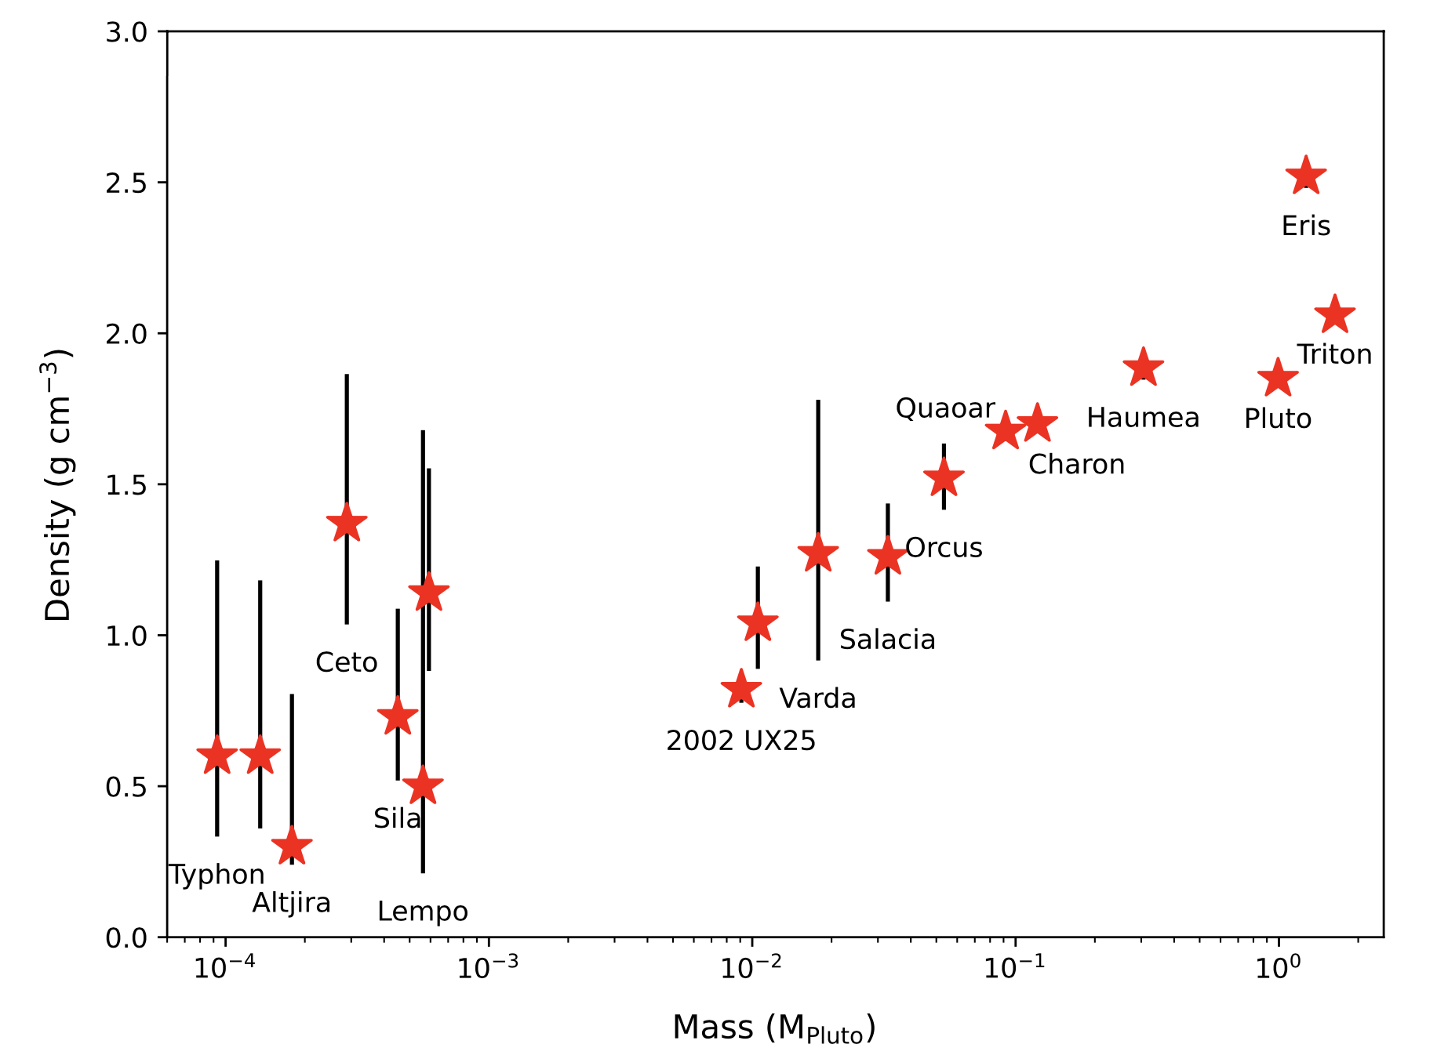
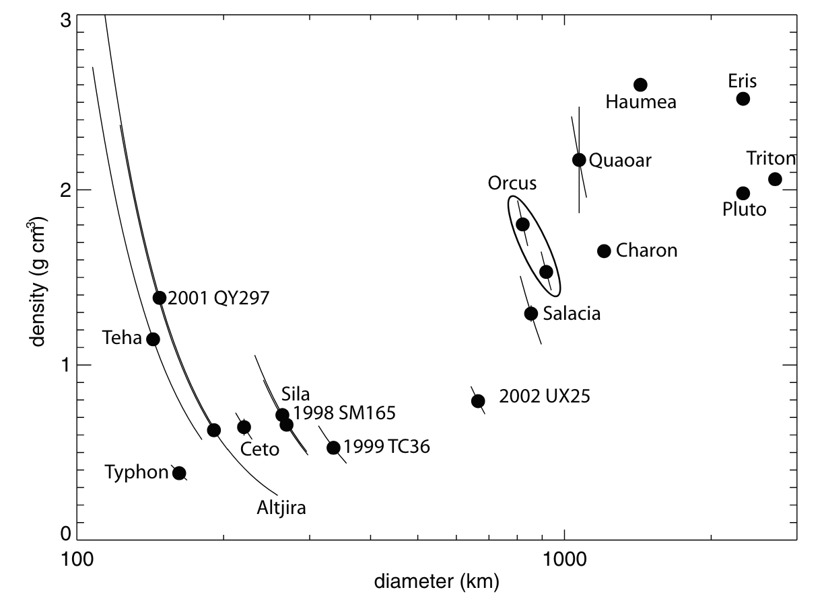
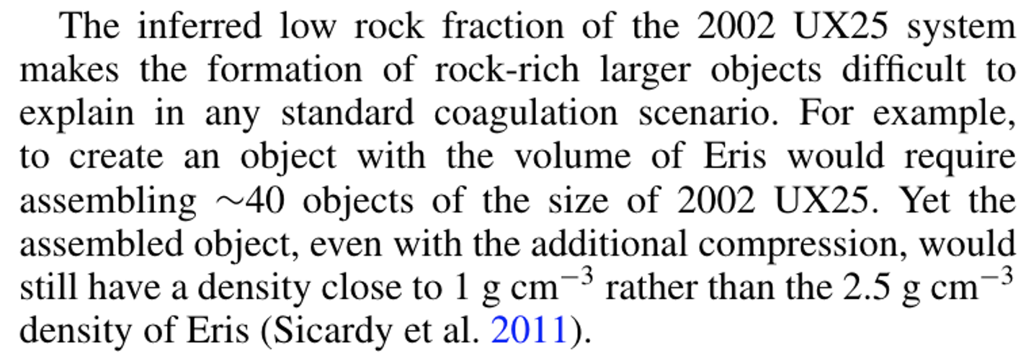
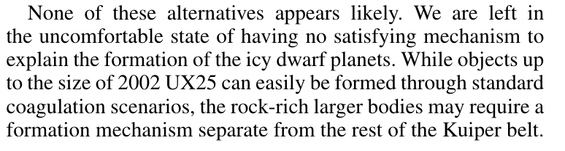
The size-density relationship of Kuiper Belt objects
Extremely low porosity;
Biased sample;
Compaction through giant impacts
Data; Thomas (2000), Stansberry et al. (2006), Grundy et al. (2007), Brown et al. (2011), Stansberry et al. (2012), Brown (2013), Fornasier et al. (2013), Vilenius, et al. (2014), Nimmo et al. (2016), Ortiz et al. (2017), Brown and Butler (2017), Grundy et al. (2019), Morgado et al. (2023), Pereira et al. (2023).
Cañas+Lyra et al. (2024)
Notes:
Problems if you form the high—mass objects from several low mass ones.
Extremely low porosity? Even with the additional compression, would still have a density close to 1 g/cm^3, not the 2.5 g/cm^3 of Eris.
None of these appear likely. Different formation mechanism?

Slide 3
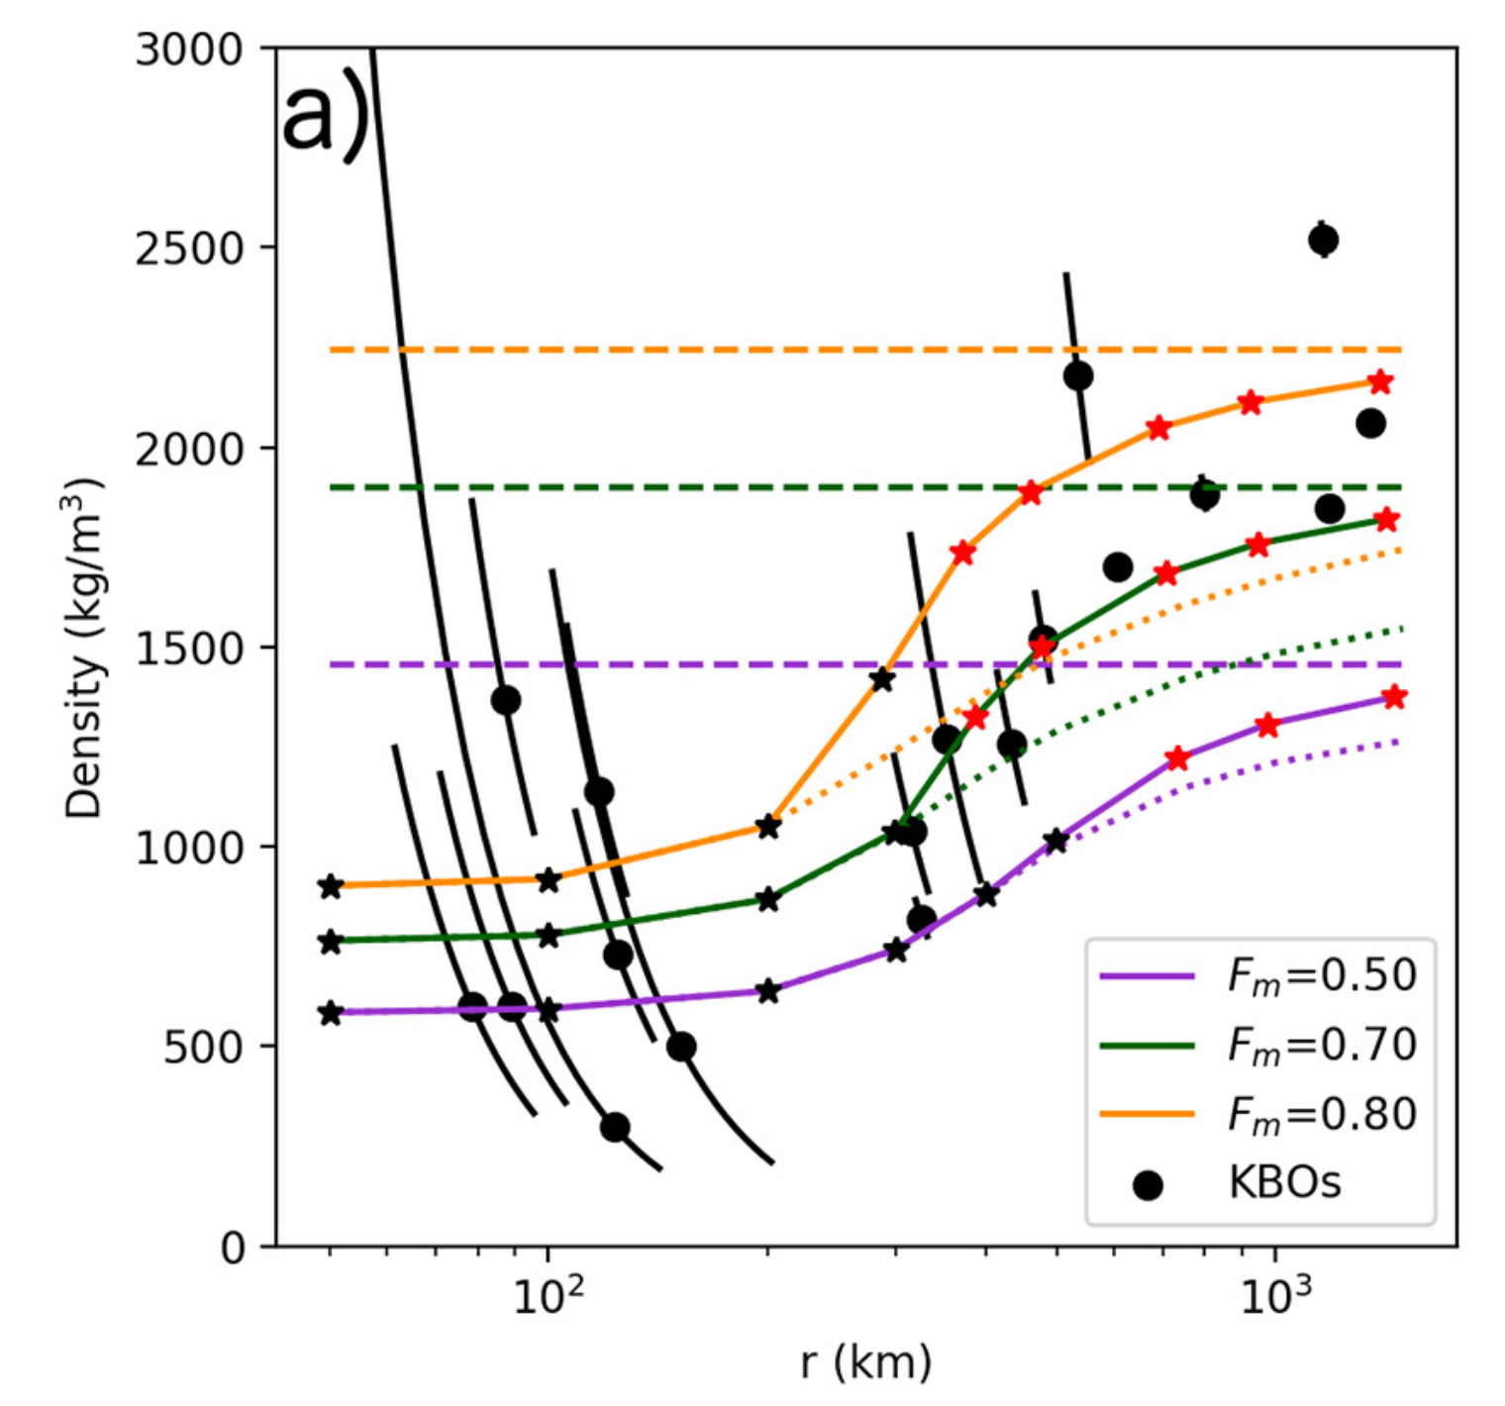

Previous best bet:
Porosity removal by gravitational compaction
Problem
  Timing! ²⁶Al would melt if formed within 4 Myr
Fully compact
Assumptions
  Constant composition at birth and growth
  Growth by planetesimal accretion
F_{m} = rock mass fraction
Bierson & Nimmo (2019)
Notes:
If the high-mass bodies were formed of many small-mass bodies, why would their densities be so different? Even with gravitational compaction, the low-mass objects would have to be unreasonably porous if they had the same composition of the high-mass ones.

Slide 4
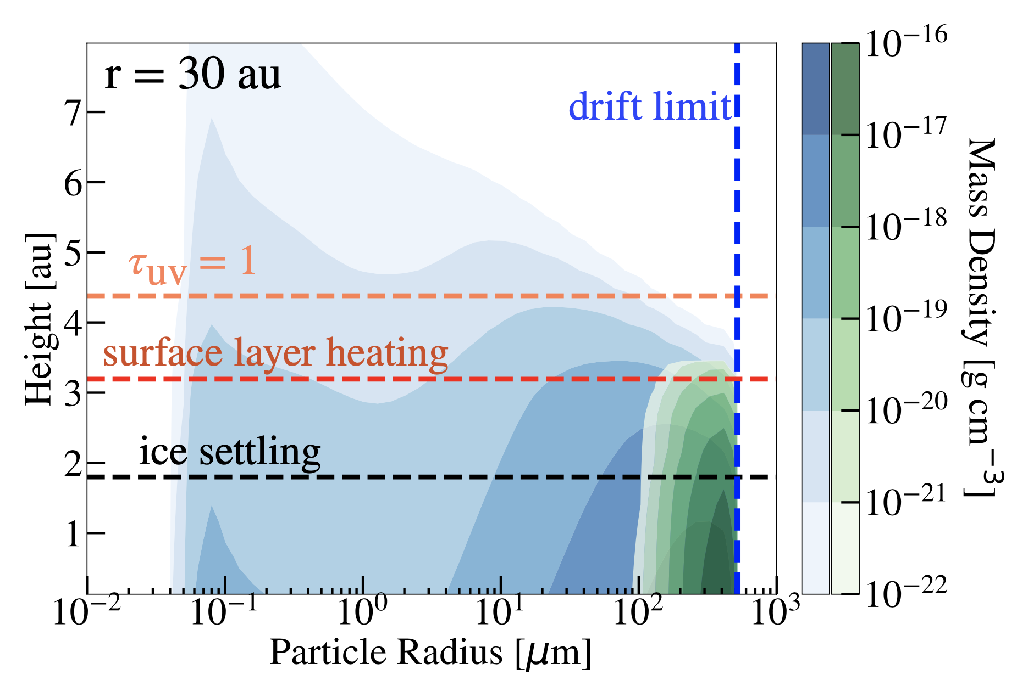
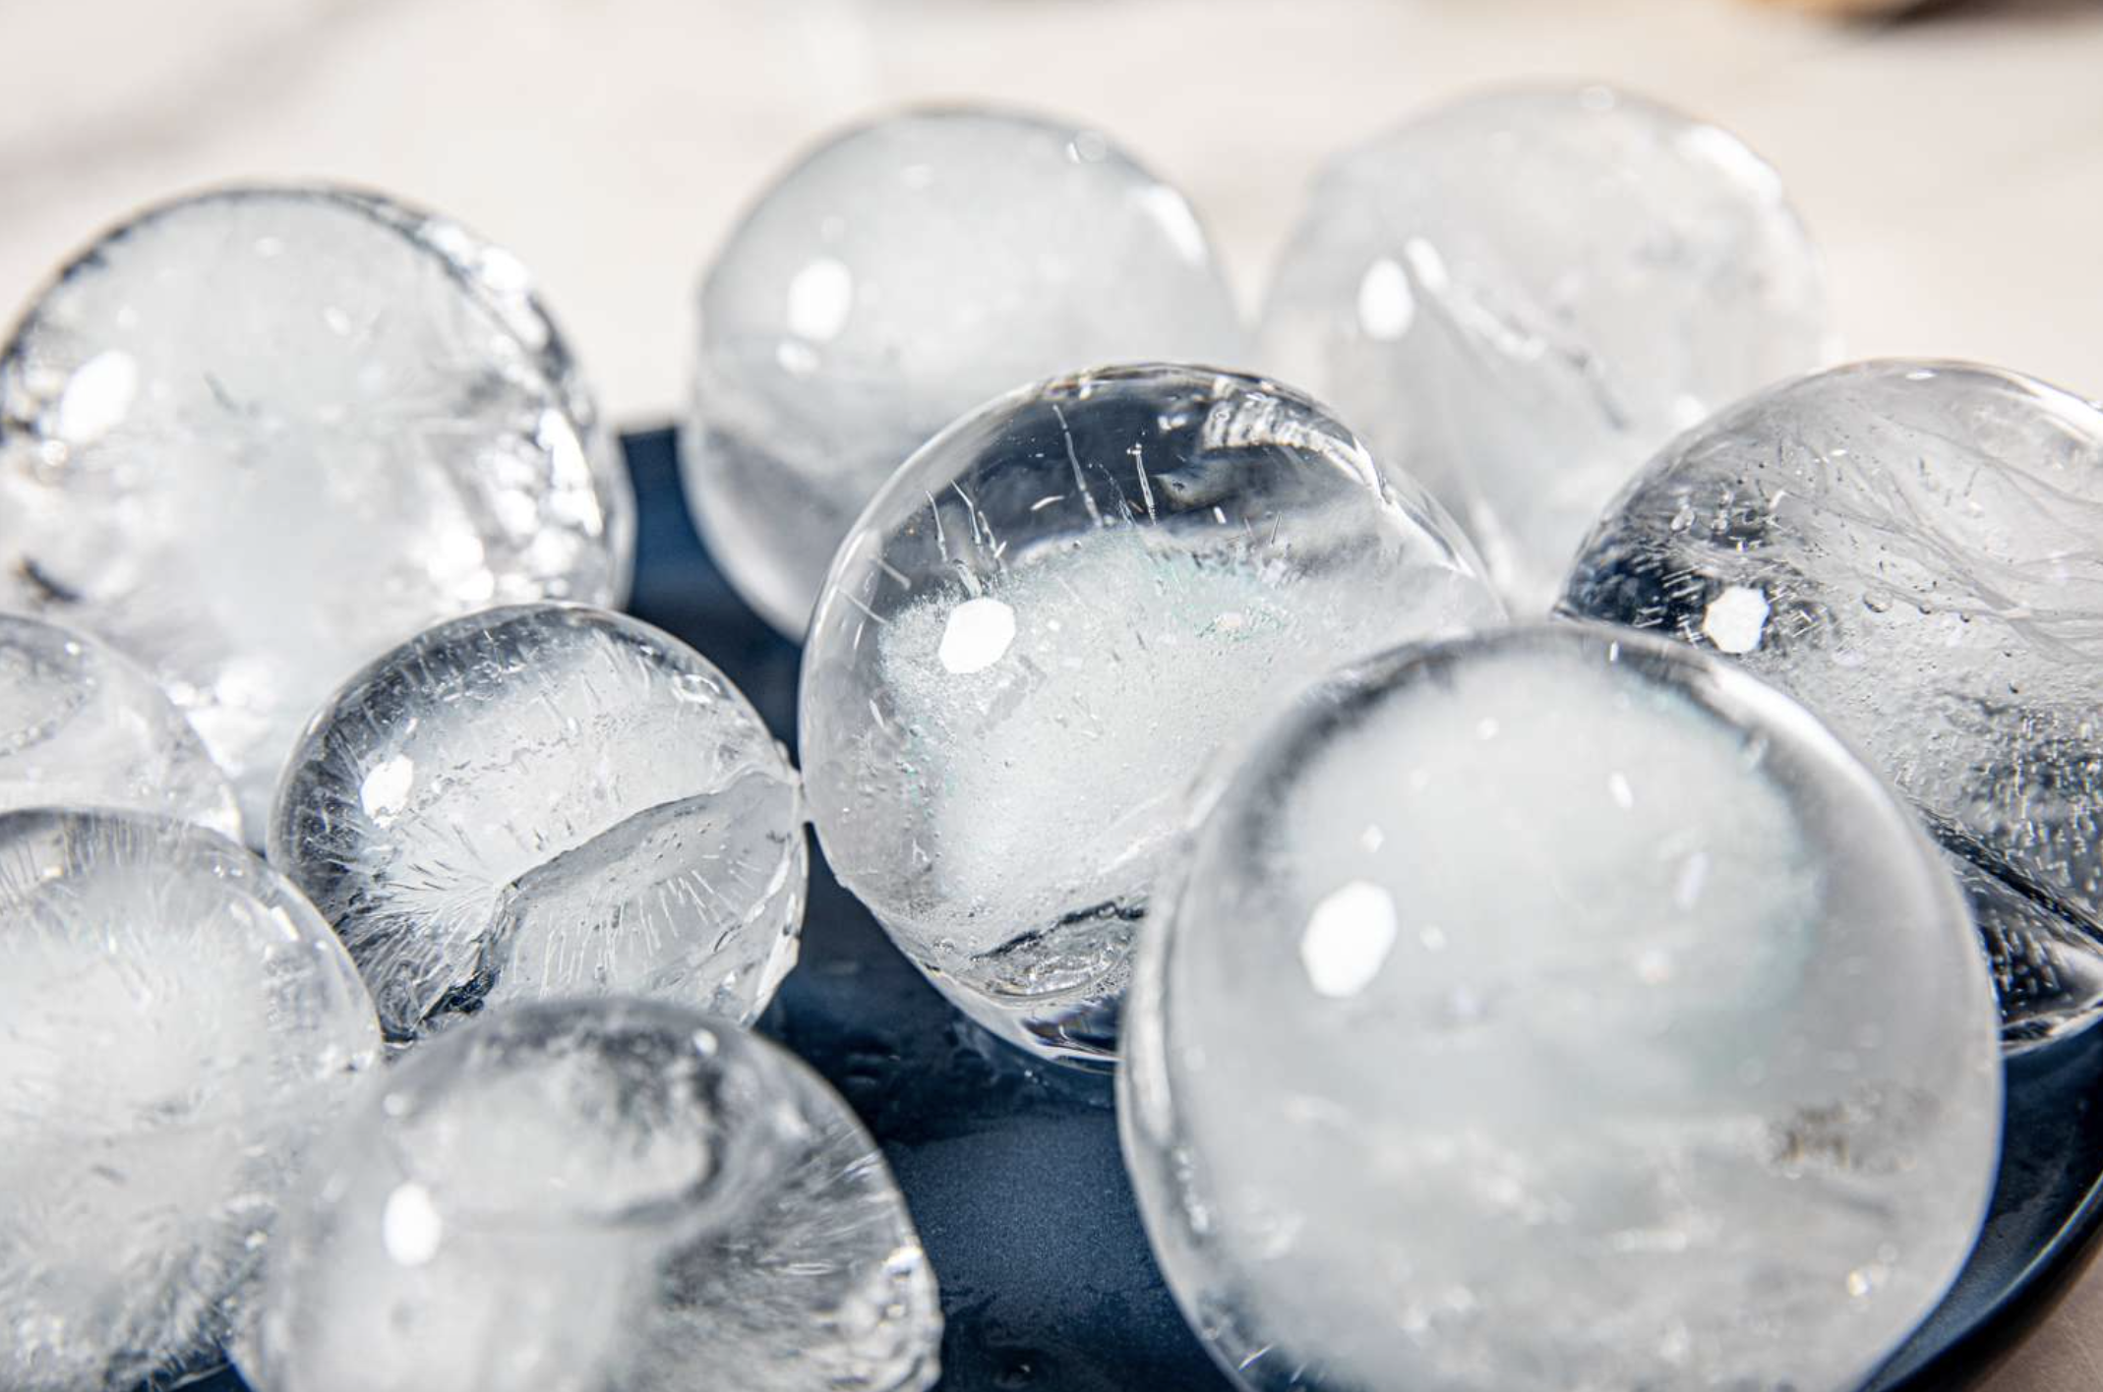
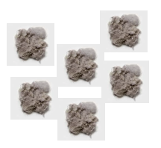
Abandoning Constant Composition
Heating and UV irradiation remove ice on Myr timescales (Harrison & Schoen 1967)
Small grains lofted in the atmosphere lose ice
Big grains are shielded and remain icy.
Ice coated grains
Ice-free grains
Powell et al. 2022
Notes:
The
growth of the large particles is limited by particle drift (blue dashed line). The remaining CO ice-
coated particles settle to the disk midplane (black dashed line) and are not readily lofted to the
upper regions of the disk where surface layer heating occurs (red dashed line) or where the disk
becomes optically thin to UV-photons (the UV optical depth, τUV = 1, dashed orange line). The
ice particles are thus unable to release their volatile material due to either evaporation or
photodesorption.

Slide 5
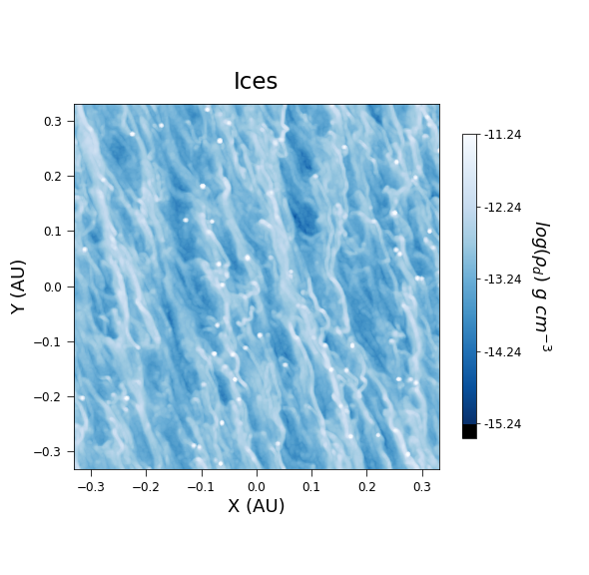
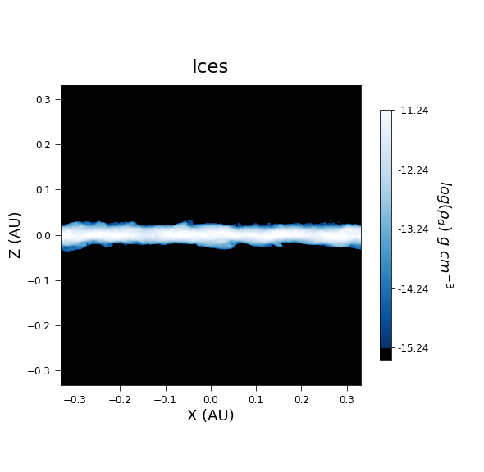
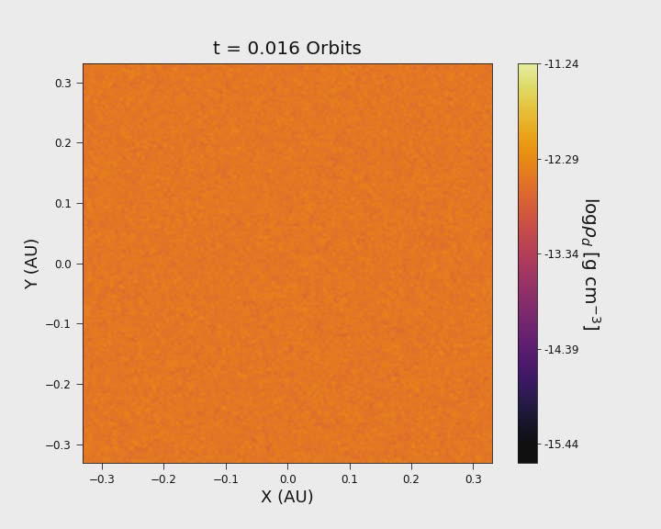
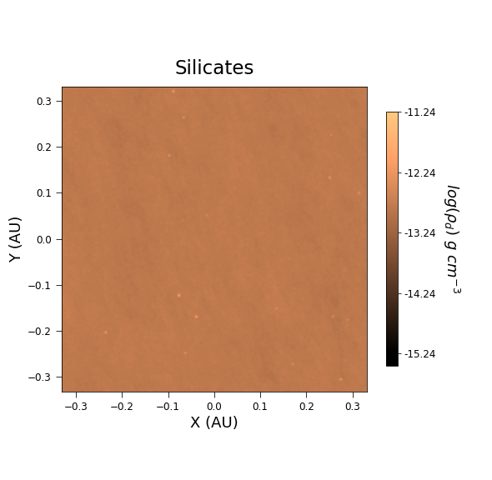
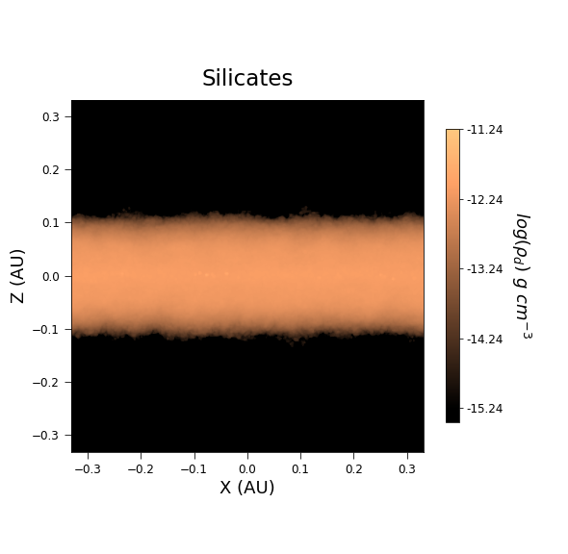
Split into icy and silicate pebbles
Canas+Lyra et al. 2024
Notes:
I thought: abandon constant composition. Follow streaming instability and pebble accretion, then new ideas. Ice coagulates better than silicates, so big pebbles are mostly icy. The streaming instability would be of ice streams, leading to icy planetesimals, and that would explain the low density of the small bodies.

Slide 6
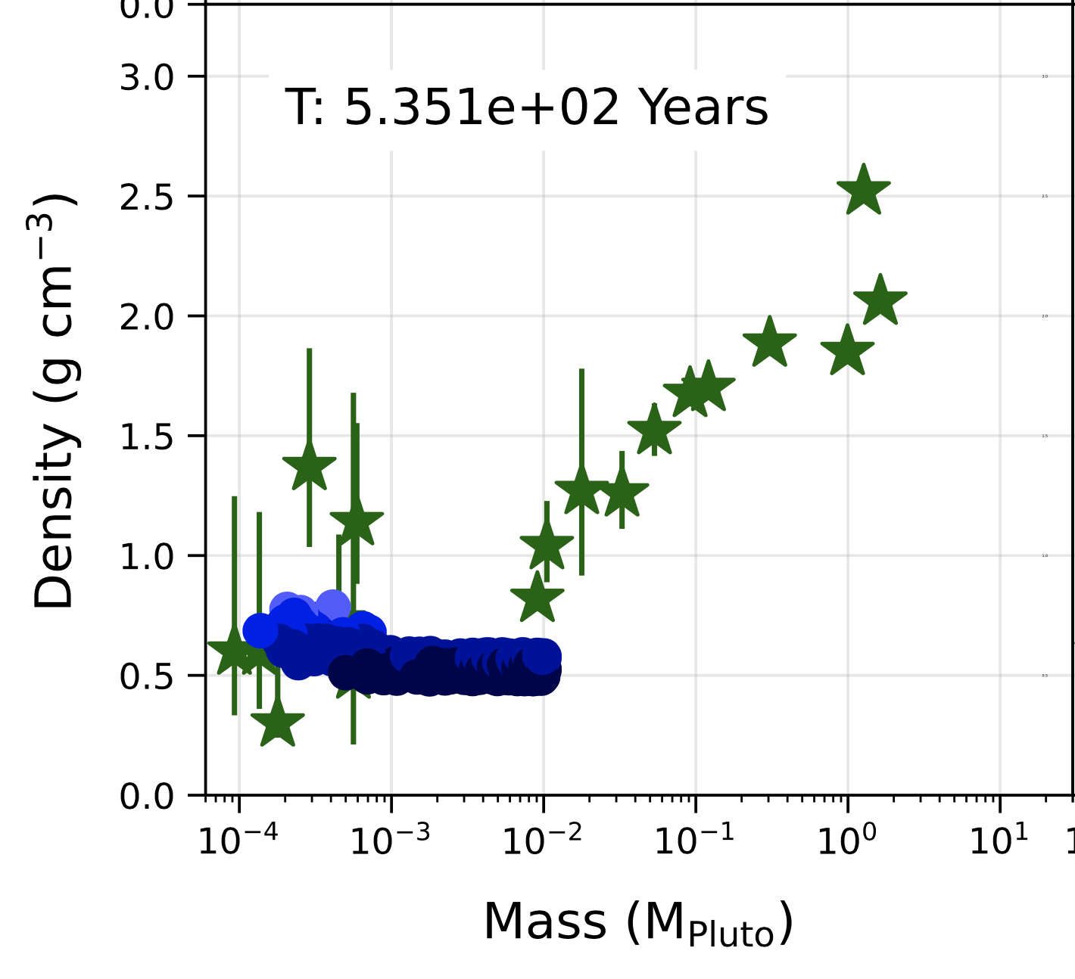
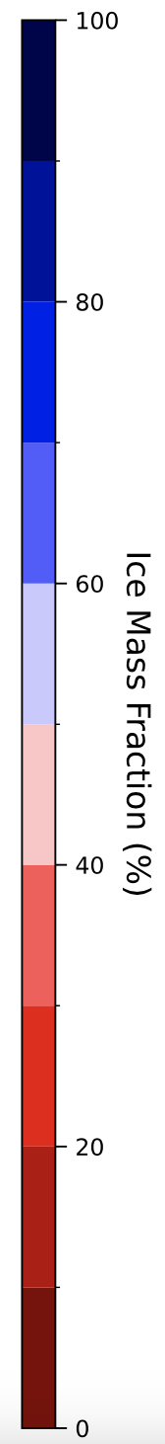
The first planetesimals are icy
Canas+Lyra et al. 2024

Slide 7
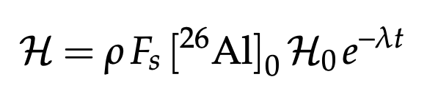
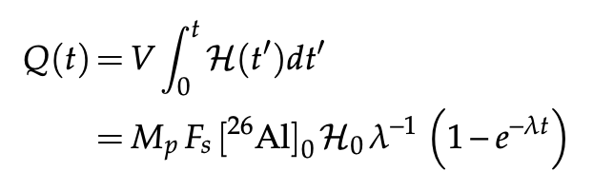


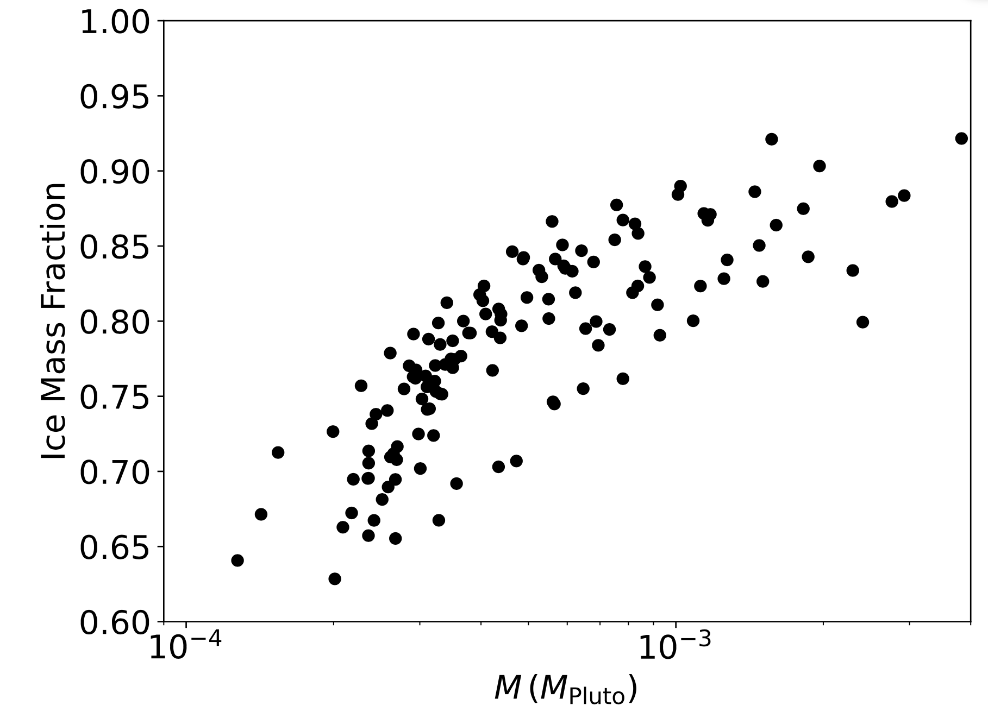
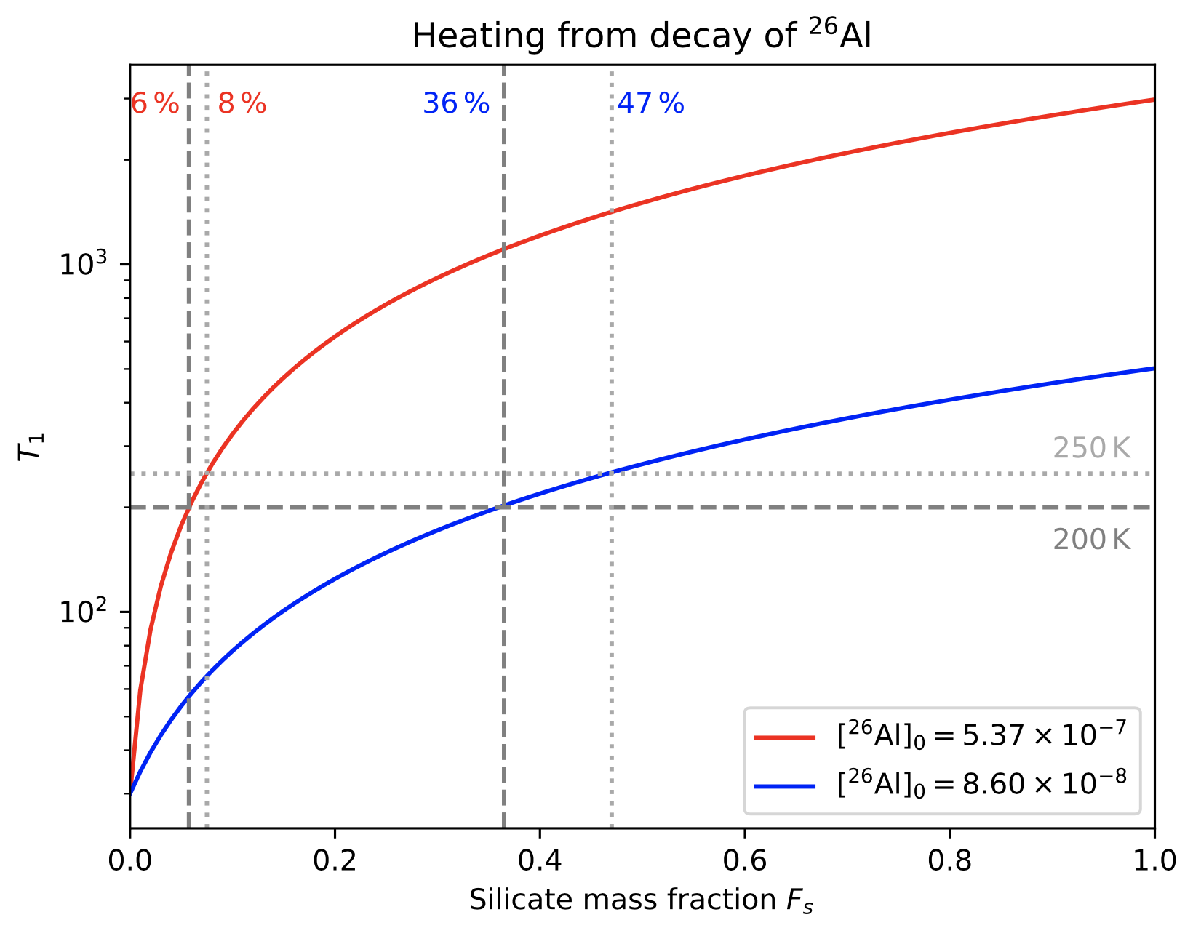
The first planetesimals won’t melt

Slide 8
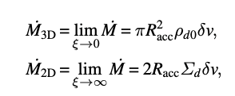
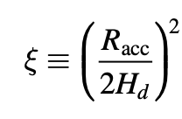
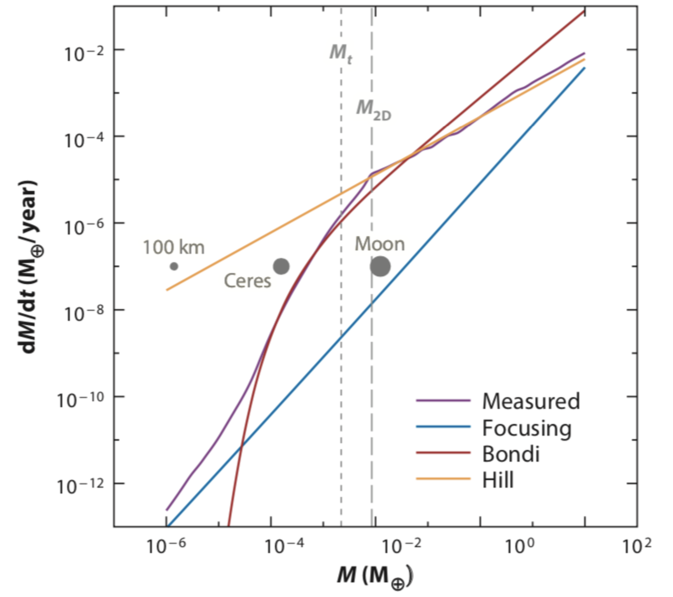
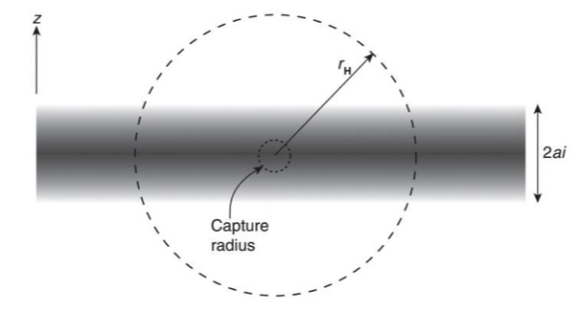
Pebble Accretion: Geometric, Bondi, and Hill regime
Bondi accretion - Bound against headwind
Hill accretion - Bound against stellar tide
Mass Accretion rates
Hill radius
Bondi radius
Pebble scale height
Johansen & Lambrechts ‘17
Notes:
Then, once formed, an icy planetesimal would capture mostly small pebbles -- these pebbles could be silicate-rich if they lost ice by, e.g. spending a lot of time in the disk atmosphere getting UV irradiated.

Slide 9
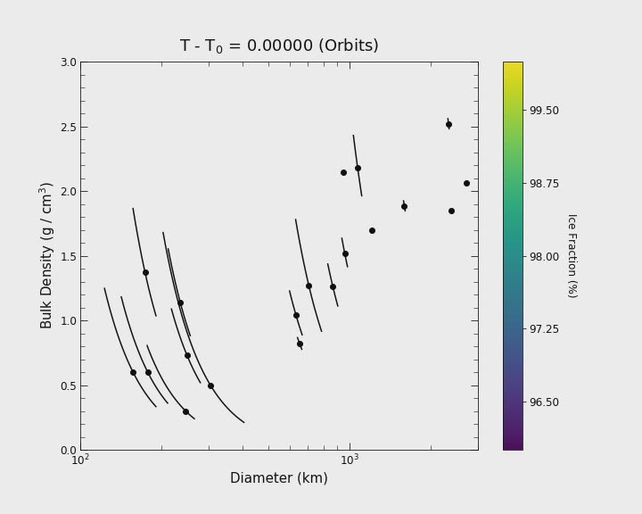
Integrate pebble accretion

Slide 10
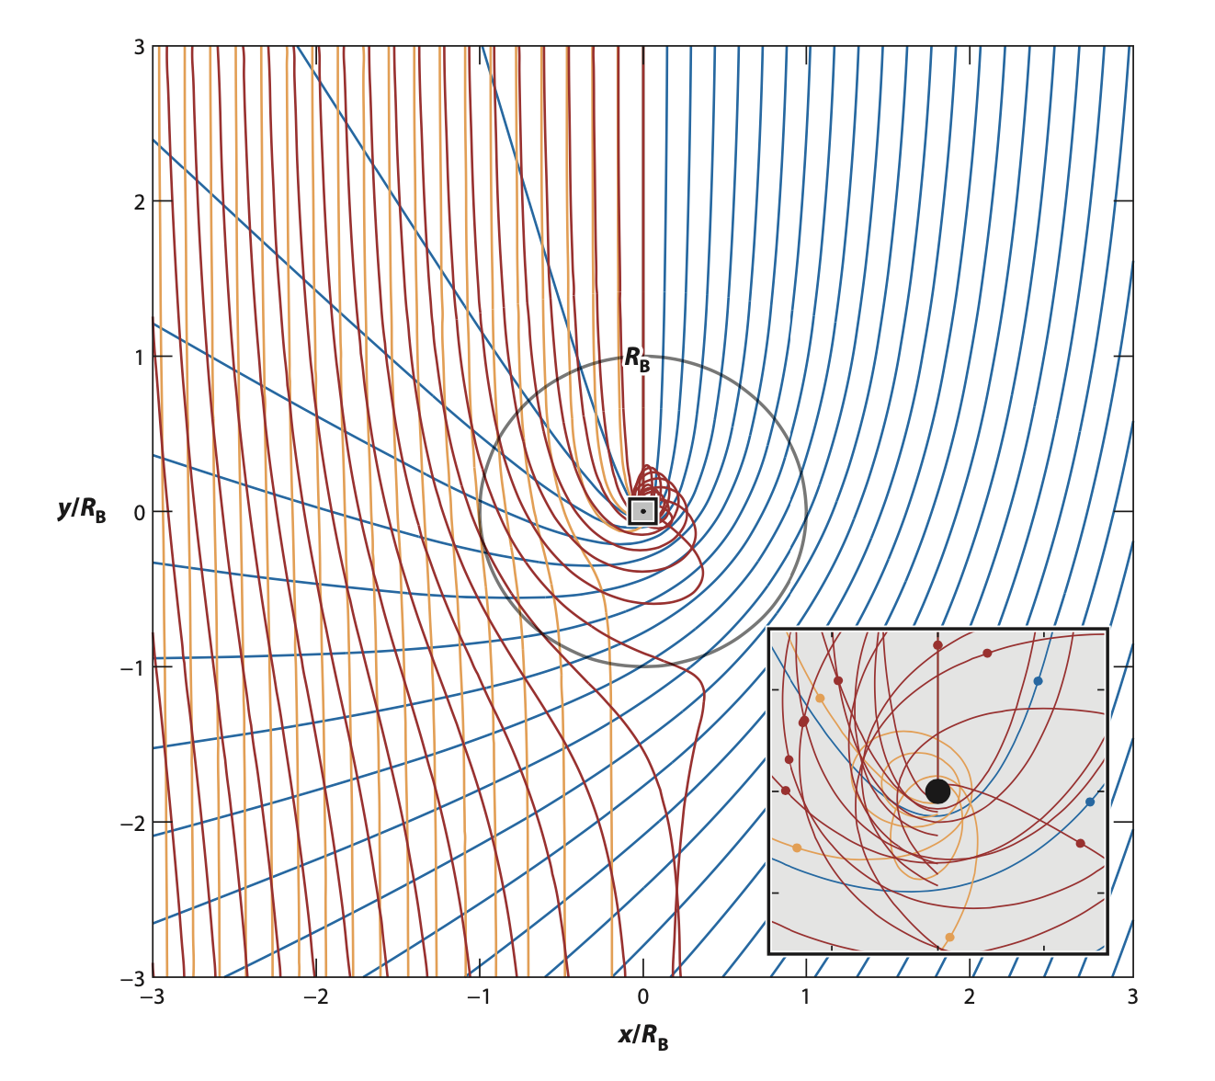
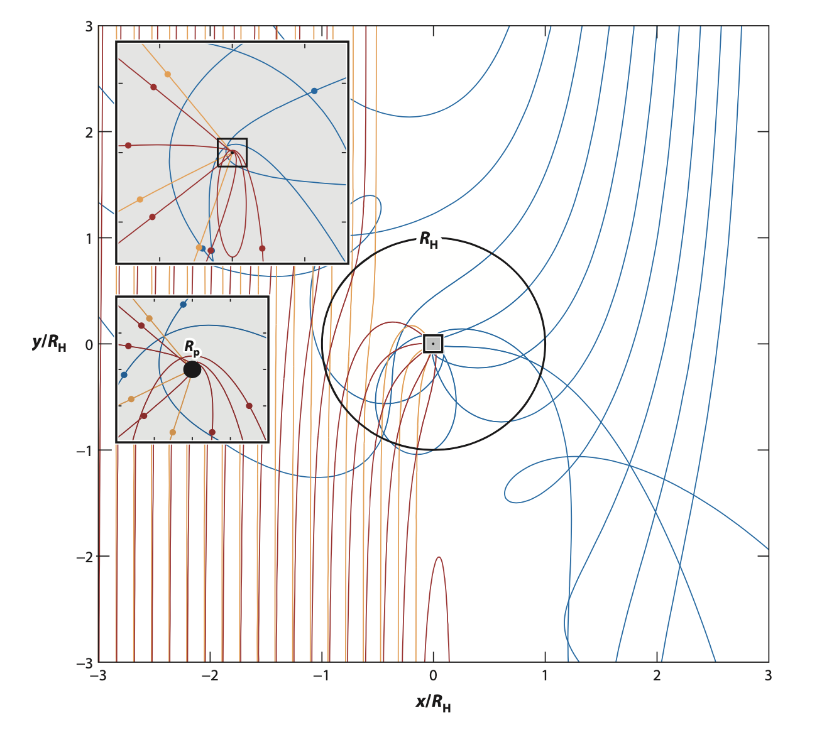
Pebble Accretion: Pebbles of different size accrete differently
Bondi Regime
Hill Regime
Best accreted pebble
Drag time ~ Bondi Time
Best accreted pebble
Drag time ~ Orbital Time
Notes:
Then, once formed, an icy planetesimal would capture mostly small pebbles -- these pebbles could be silicate-rich if they lost ice by, e.g. spending a lot of time in the disk atmosphere getting UV irradiated.

Slide 11
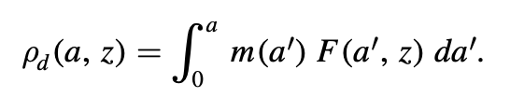

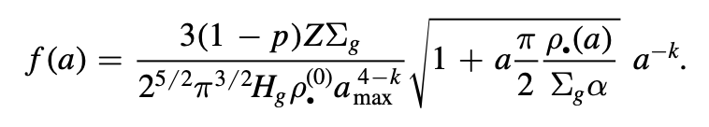
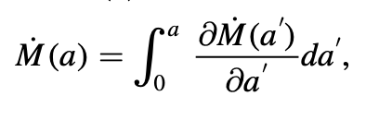
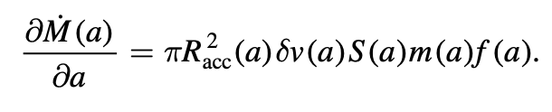
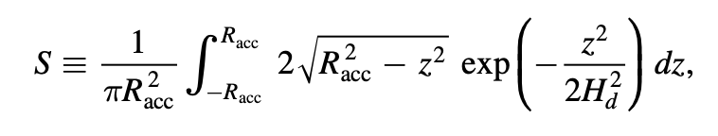
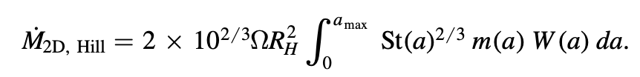
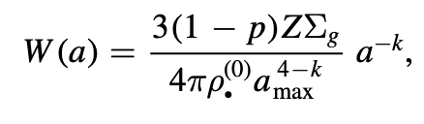
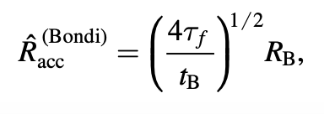
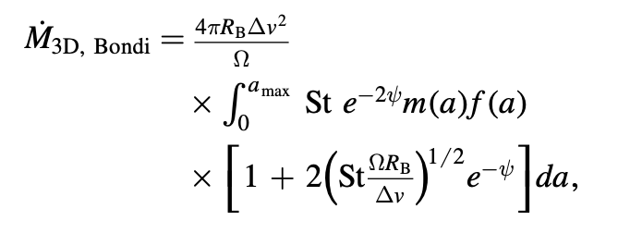

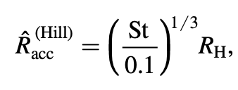


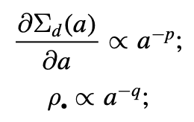
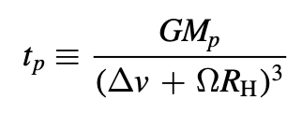
Polydisperse (Multi-Species) Pebble Accretion
Lyra et al. 2023
Notes:
Then, once formed, an icy planetesimal would capture mostly small pebbles -- these pebbles could be silicate-rich if they lost ice by, e.g. spending a lot of time in the disk atmosphere getting UV irradiated.

Slide 12
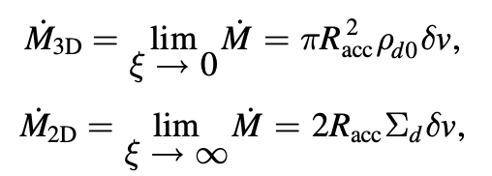
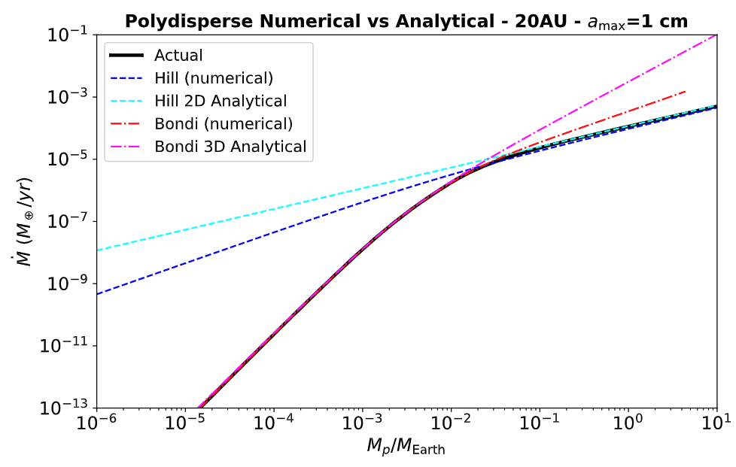
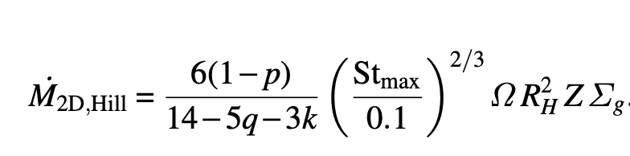
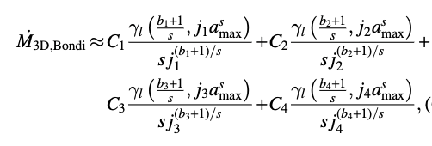
Analytical theory of polydisperse (multi-species) pebble accretion
Monodisperse (single species)
Lambrechts & Johansen (2012)
Polydisperse (multiple species)
Lyra et al. (2023)
Lyra et al. 2023

Slide 13
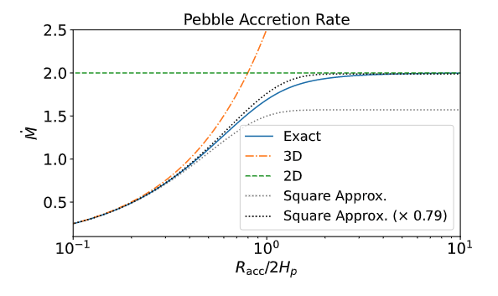




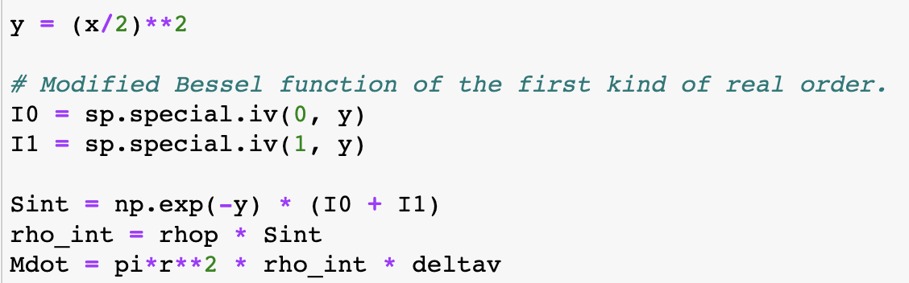
Analytical Solution for
General Monodisperse (single species) Pebble Accretion
Lyra et al. 2023

Slide 14
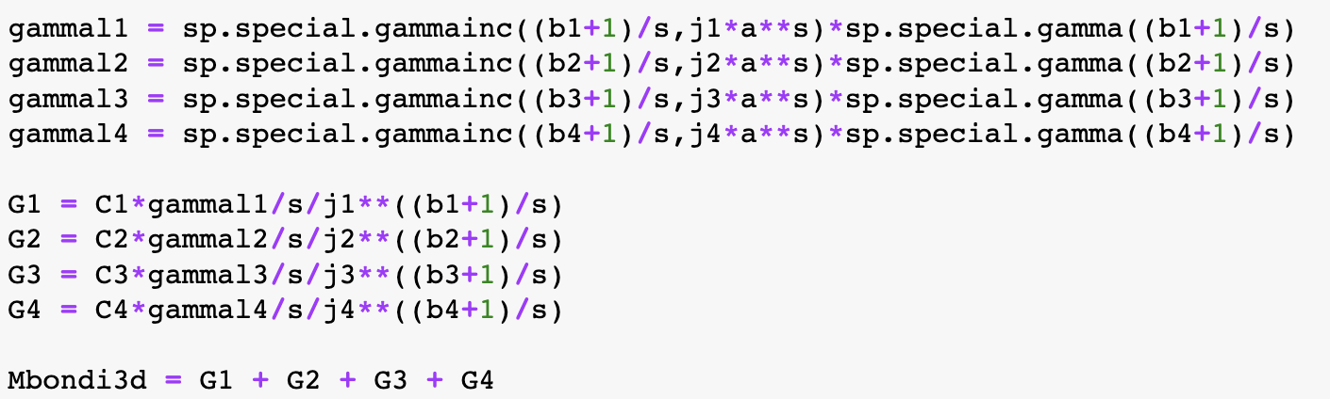
Analytical Solutions for
2D and 3D Polydisperse (multi-species) Pebble Accretion
Lyra et al. 2023

Slide 15
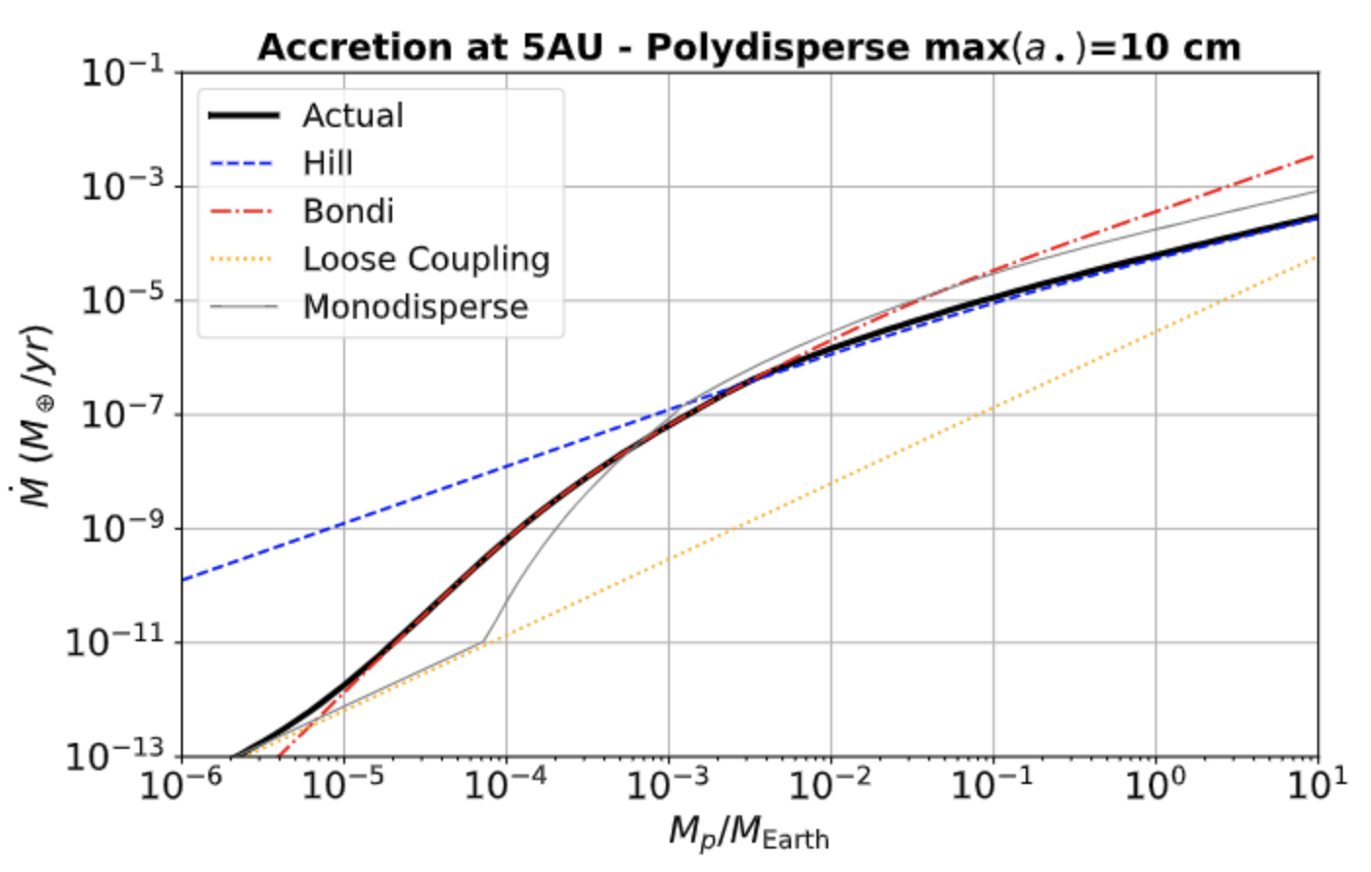
Accretion Rates
Lyra et al. 2023

Slide 16
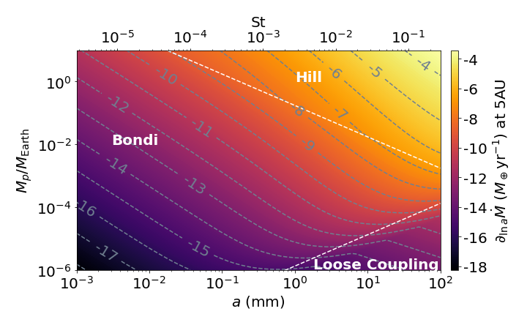
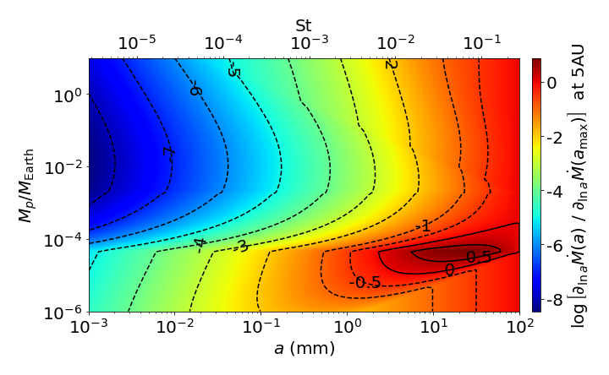
Accretion Rates
Lyra et al. 2023

Slide 17
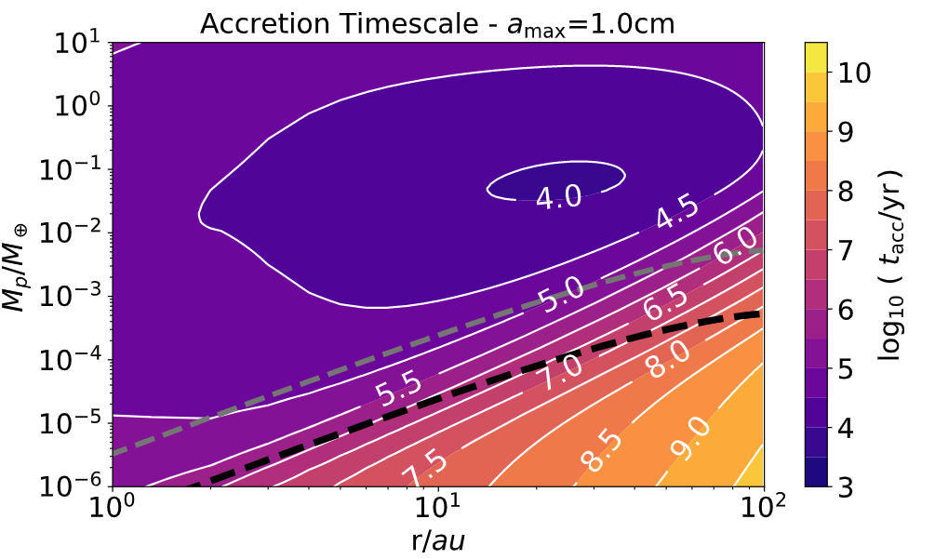
Accretion Timescales
Myr accretion timescales possible on top of planetesimals produces by Streaming Instability
10x typical mass formed
by Streaming Instability
Typical mass formed
by Streaming Instability
Lyra et al. 2023

Slide 18

Growing Pluto by silicate pebble accretion
Canas+Lyra et al. 2024

Slide 19


Pebble Internal Density
Ice Volume Fraction
Mass Accretion rate
Canas+Lyra et al. 2024

Slide 20

Growing Pluto by silicate pebble accretion
Canas+Lyra et al. 2024

Slide 21


Resulting Densities vs Mass relations
Pebble
Internal
Density
Ice
Volume
Fraction

Slide 22

Distance Range
15 - 25AU
Notes:
Too fast accretion at 10 au, and accretion of ices; too slow at 25au

Slide 23

The window of silicate accretion
Notes:
At 1e-2 Pluto mass, 10au is accreting already at ices; at 30au the accretion rate is too slow

Slide 24
Conclusions
Polydisperse Bondi accretion 1-2 orders of magnitude more efficient than monodisperse
  Best accreted pebbles are those of drag time ~ Bondi time, not the largest ones
  The largest ones dominate the mass budget, but accrete poorly
Onset of Bondi accretion 1-2 orders of magnitude lower in mass compared to monodisperse
  Bondi accretion possible on top of Streaming Instability planetary embryos within disk lifetime
  Reaches 100-350km objects within Myr timescales
Analytical solution to
  Monodisperse general case
  Polydisperse 2D Hill and 3D Bondi
KBO density problem:
  Two different pebble populations, maintained by ice desorption off small grains
  Streaming instability: icy-rich small objects; nearly uniform composition
  Polydisperse pebble accretion: silicate-rich larger objects; varied composition
  Melting avoided by
    ice-rich formation
    ²⁶Al incorporated mostly in long (>Myr) phase of silicate accretion
  KBOs best reproduced between 15-25 AU

