Slide 1



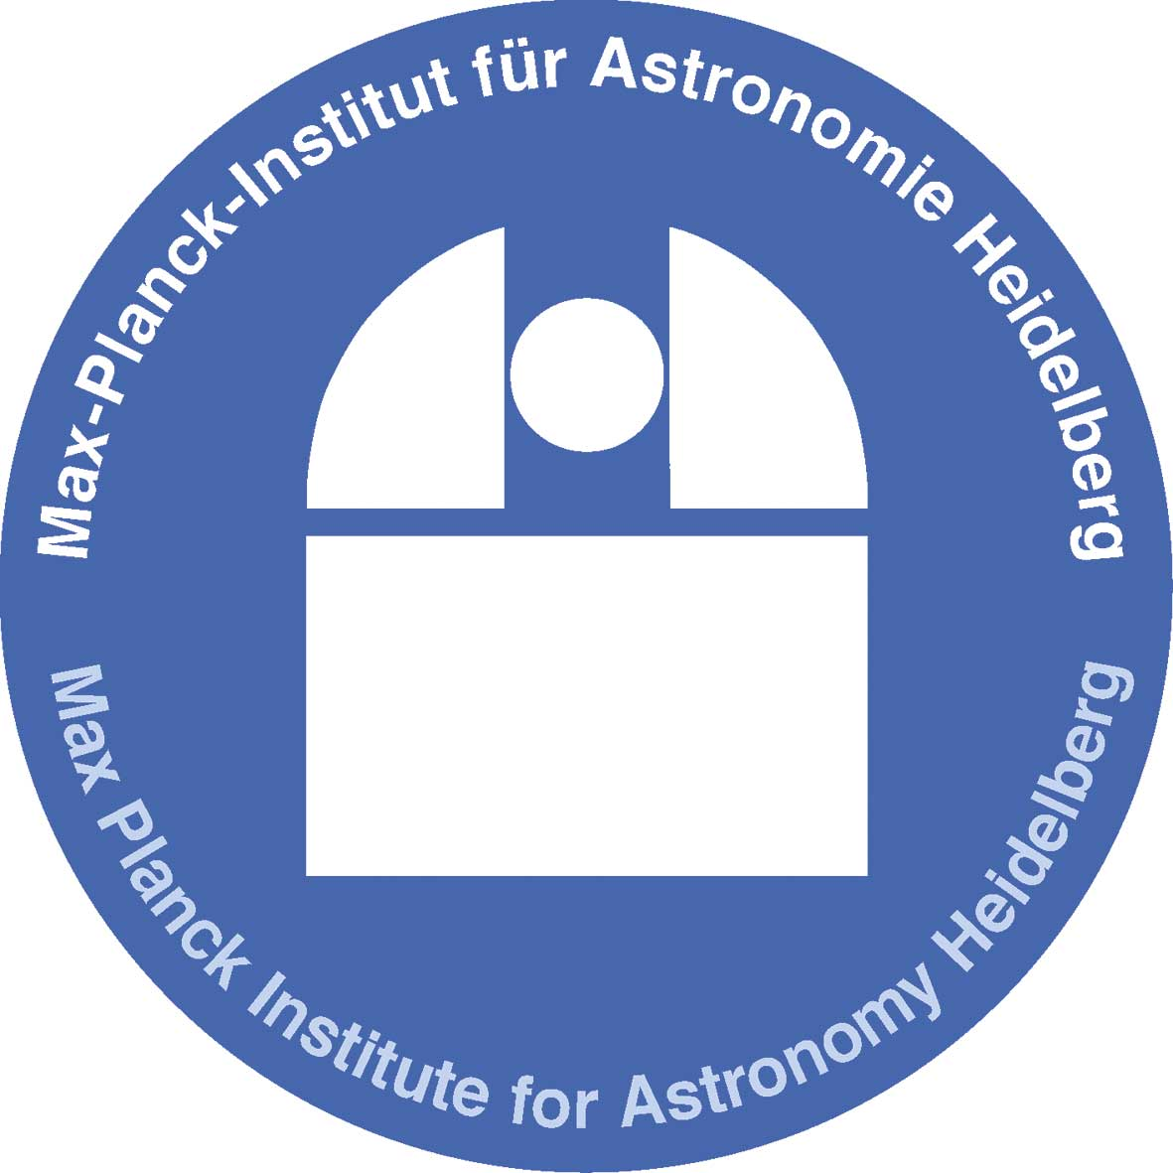







Planet signatures
in transition disks
Wladimir Lyra
California State University
Jet Propulsion Laboratory
Collaborators
Aaron Boley (Vancouver), Axel Brandenburg (Stockholm),
Kees Dullemond (Heidelberg), Mario Flock (JPL), Blake Hord (New York) Anders Johansen (Lund), Tobias Heinemann (KITP), Hubert Klahr (Heidelberg), Marc Kuchner (Goddard), Min-Kai Lin (ASIAA), Mordecai-Mark Mac Low (AMNH), Colin McNally (Copenhagen), Krzysztof Mizerski (Warsaw), Richard Nelson (London) Satoshi Okuzumi (Tokyo), Sijme-Jan Paardekooper (London), Nikolai Piskunov (Uppsala), Natalie Raettig (Heidelberg), b, Zsolt Sandor (Budapest) Neal Turner (NASA JPL), Orkan Umurhan (NASA Ames), Miguel de Val-Borro (NASA Goddard), Nienke van der Marel (IfA Hawaii), Andras Zsom (Brown).
Heidelberg, Jul 27th, 2018

Slide 2
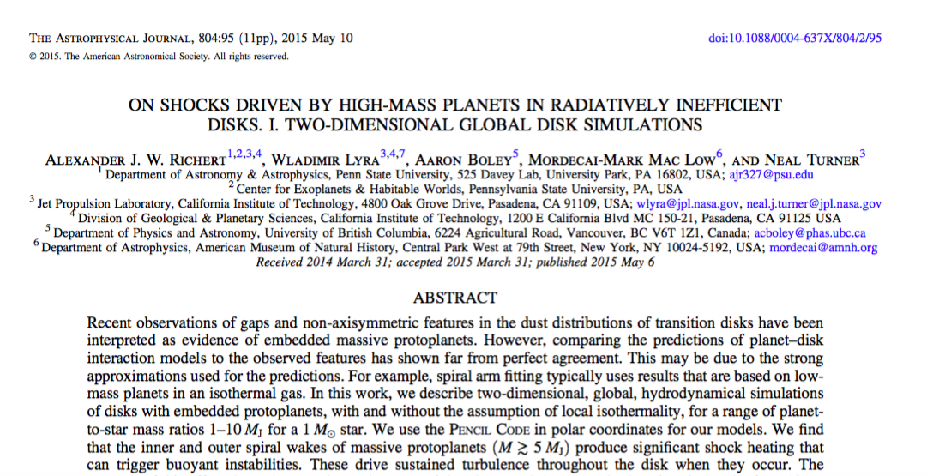
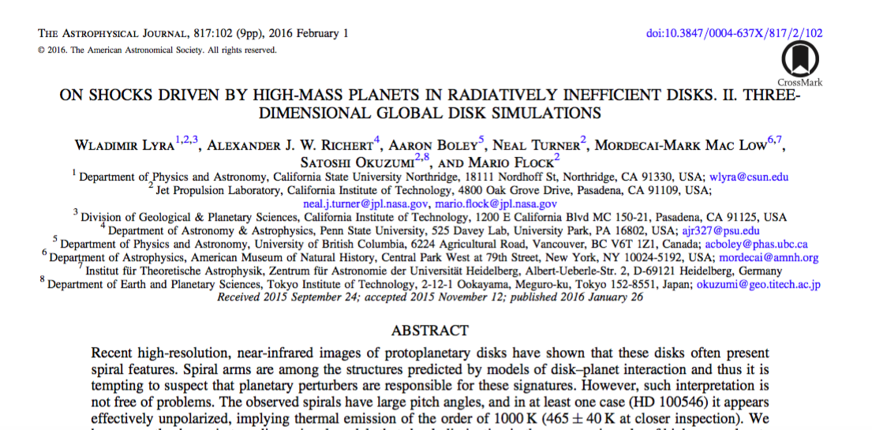
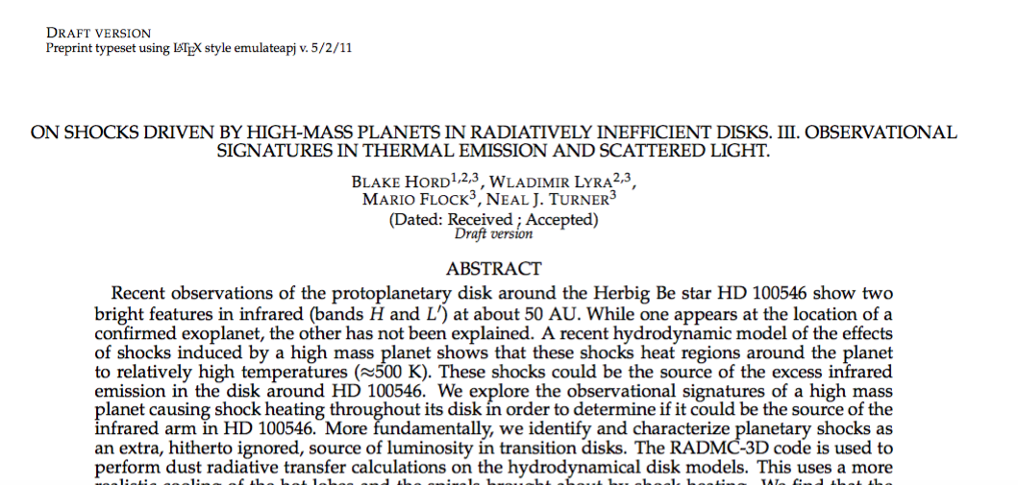
Richert et al. (2015)
Lyra et al. (2016)
Hord et al. (2017)

Slide 3
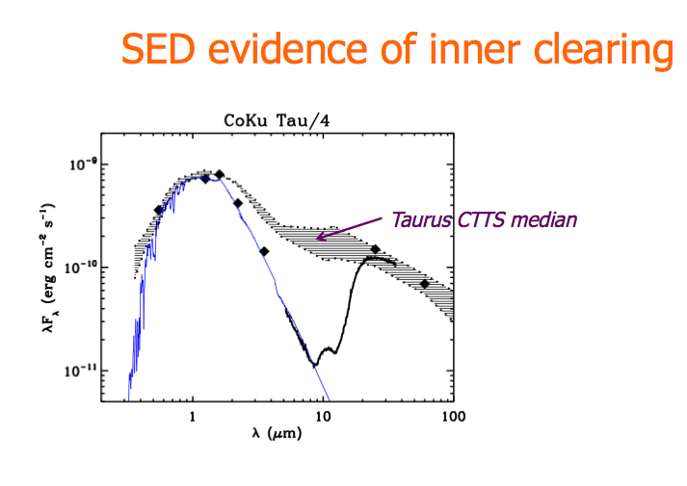
Transition Disks: Disks with missing hot dust.

Slide 4
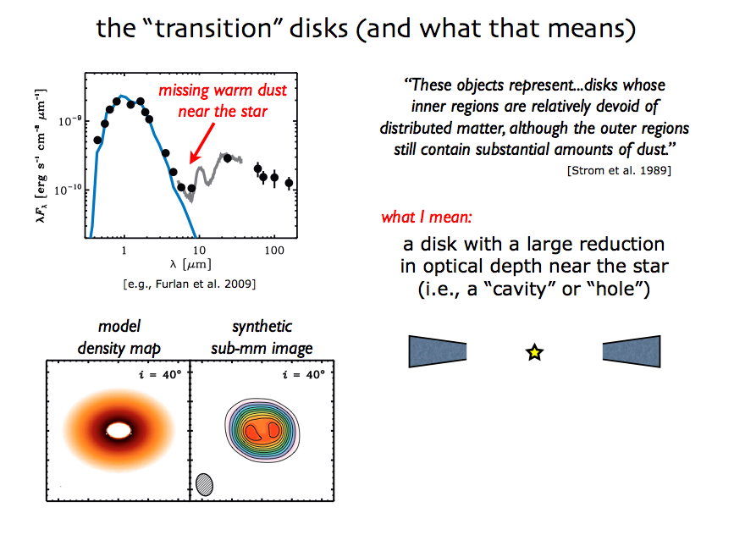
Transition Disks: Disks with missing hot dust.

Slide 5
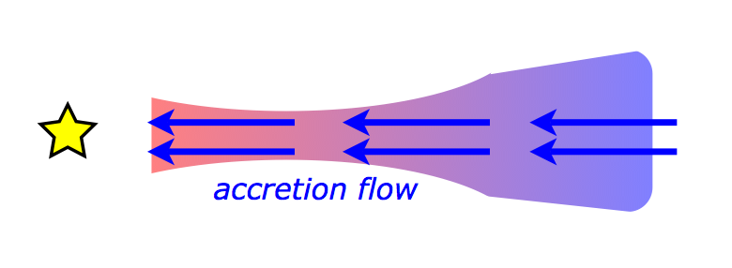
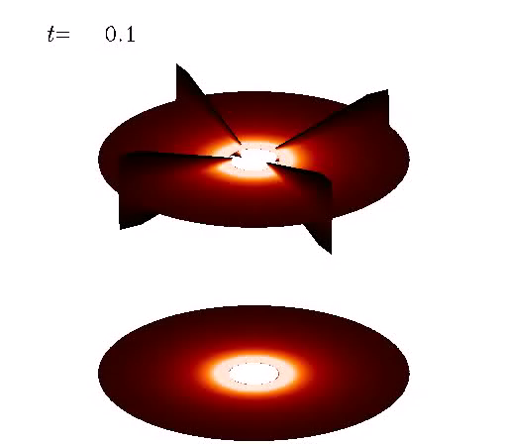
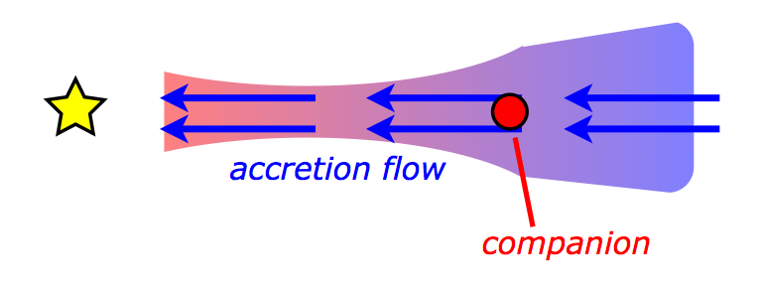
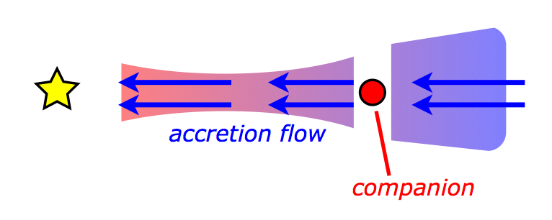
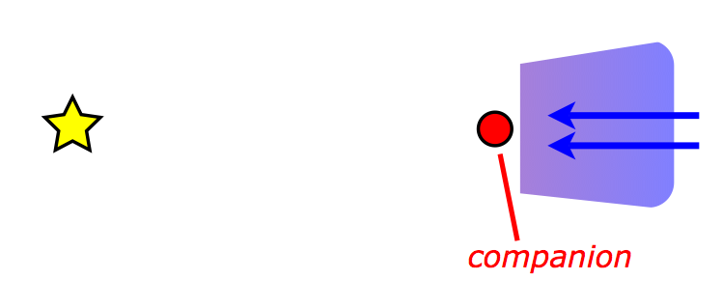
Planetary companion
(Lyra 2009)

Slide 6
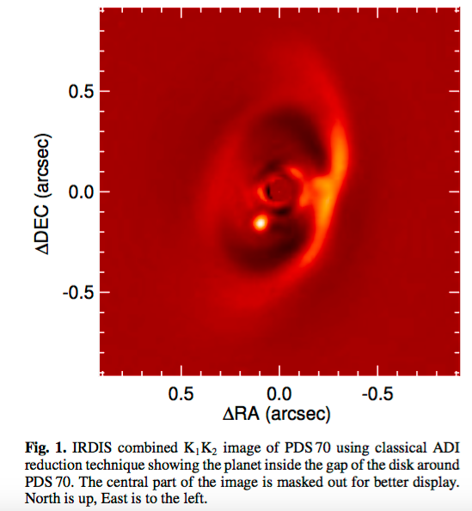
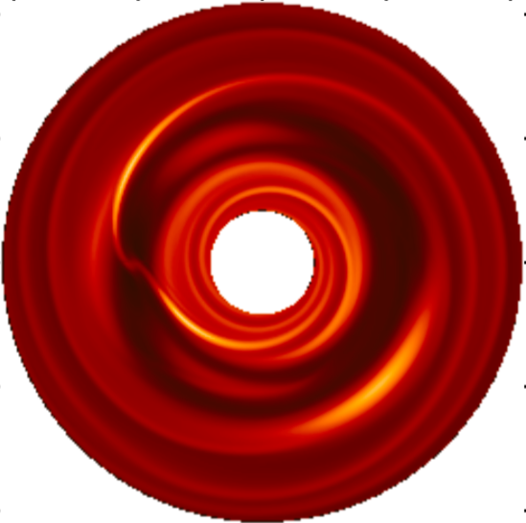
These cavities may be the telltale signature of forming planets
(Lyra et al. 2009b)
A way to directly study planet-disk interaction

Slide 7
Planet-disk interaction: gaps, spirals, and vortices.
(Lyra et al. 2009b)

Slide 8
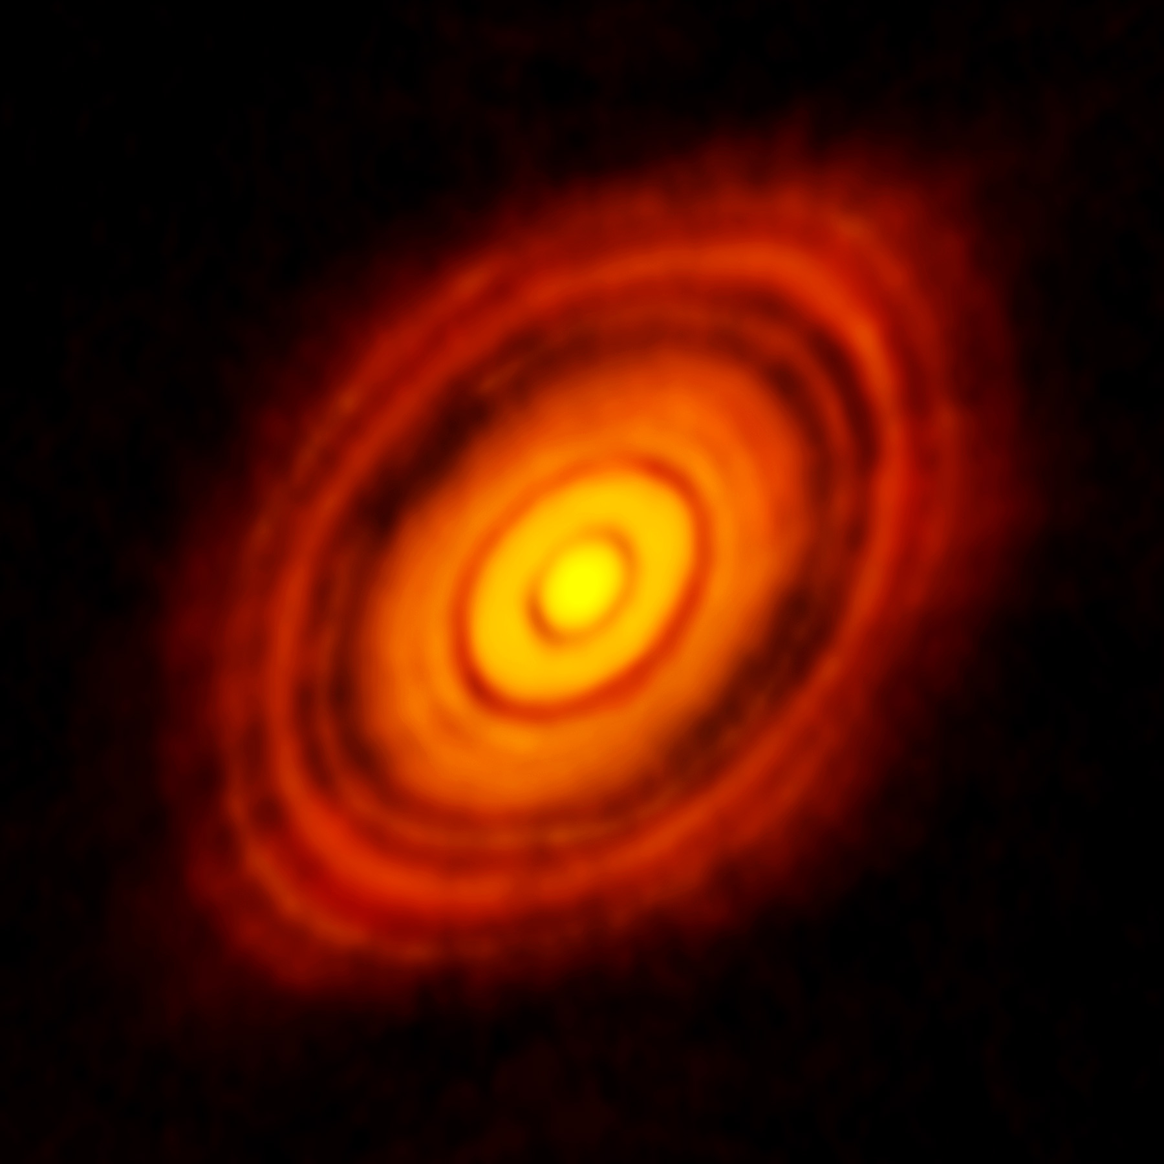
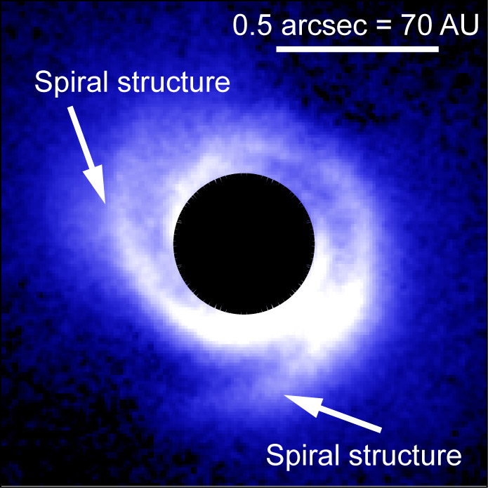
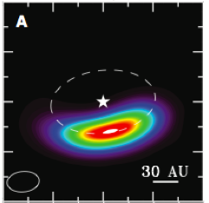
Observational evidence: gaps, spirals, and vortices
HL Tau
SAO 206462
Oph IRS 48
The ALMA Partnership et al. (2015)
Muto et al. (2012)
van der Marel et al. (2013)

Slide 9
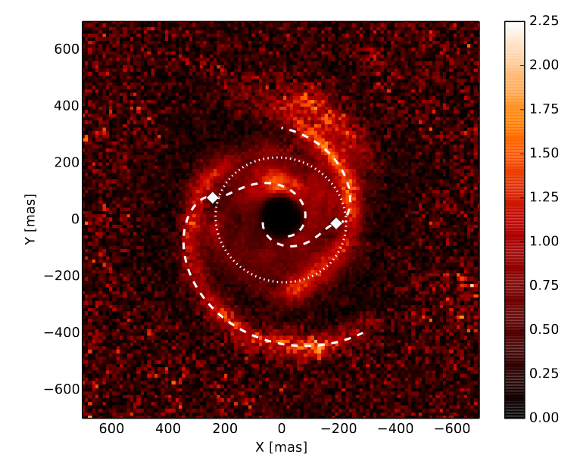
Observational Evidence: Spirals
SAO 206462
MWC 748
Muto et al. (2012)
Benisty et al. (2015)

Slide 10
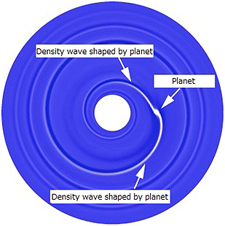
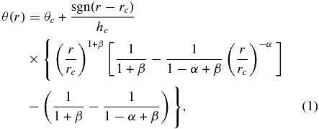
Spiral arm fitting leads to problems
Analytical spiral fit
Spirals are too wide,
hotter (300K) than ambient gas (50K).
Rafikov (2002)
Muto et al. (2012)
Benisty et al. (2015)

Slide 11
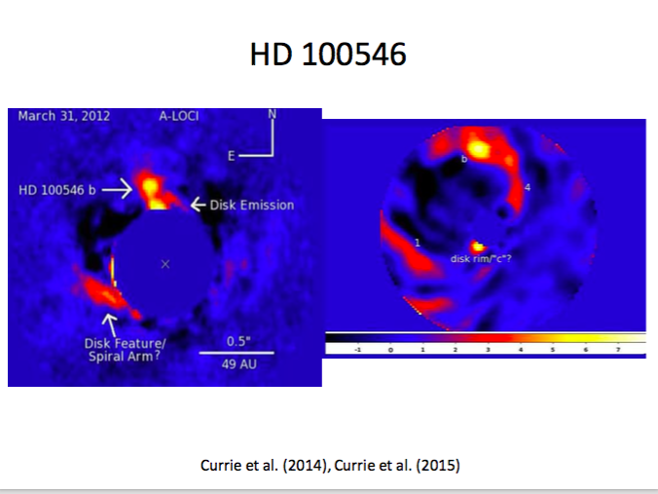
The strange case of thermal emission in HD 100546
L band (~3.5 μm)
H band (~1.6 μm)

Slide 12
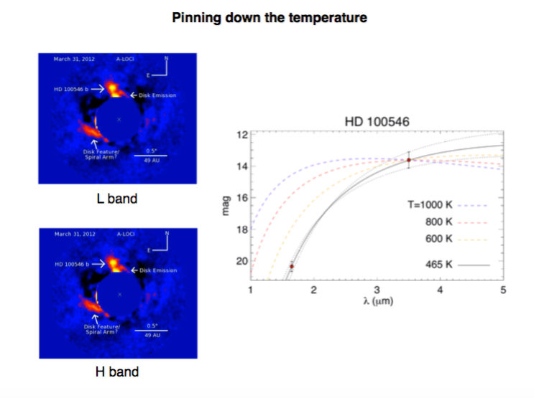
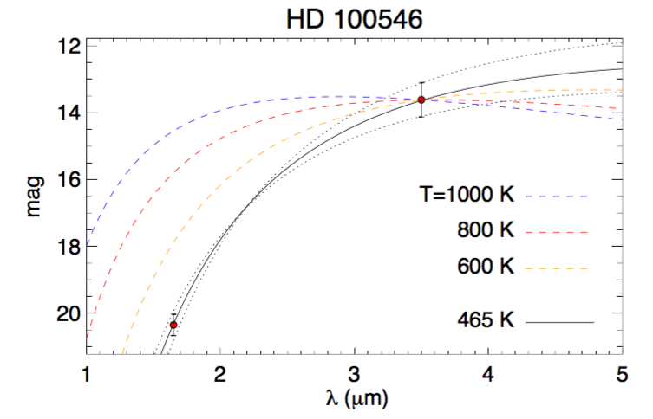
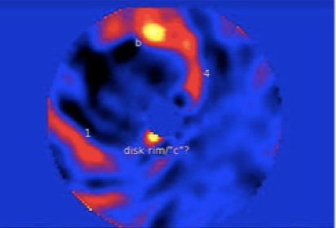
Lyra et al. (2016)

Slide 13
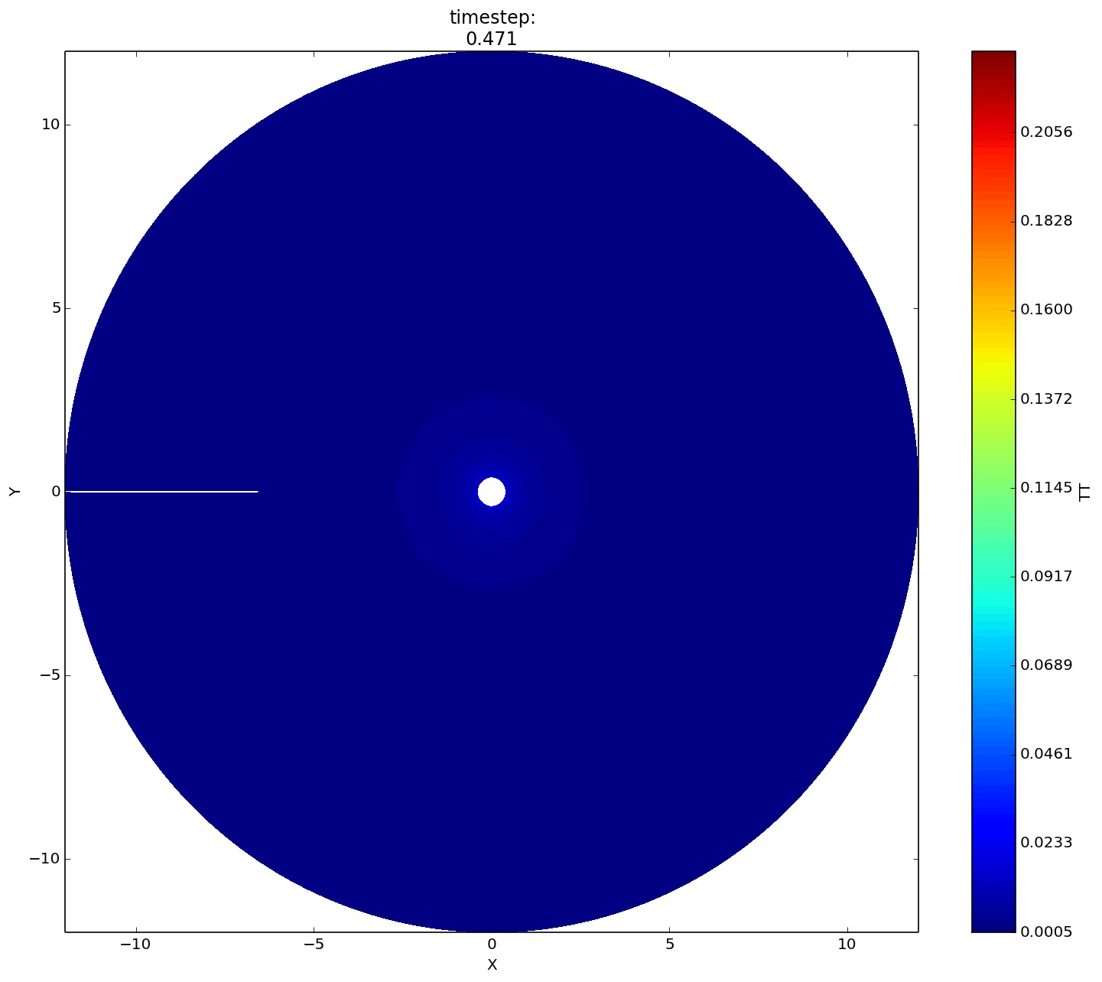
Planet-driven turbulence
Richert et al. (2015)

Slide 14
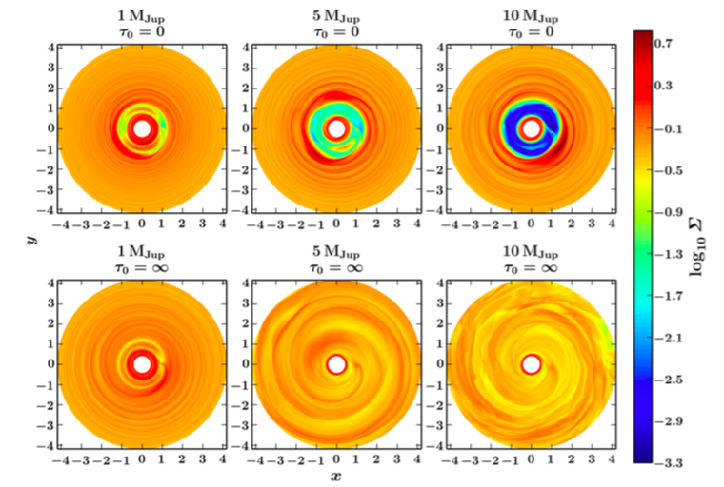
Turbulence in high-mass planets in adiabatic disks
Planet mass
Isothermal
Adiabatic
Richert et al. (2015)

Slide 15
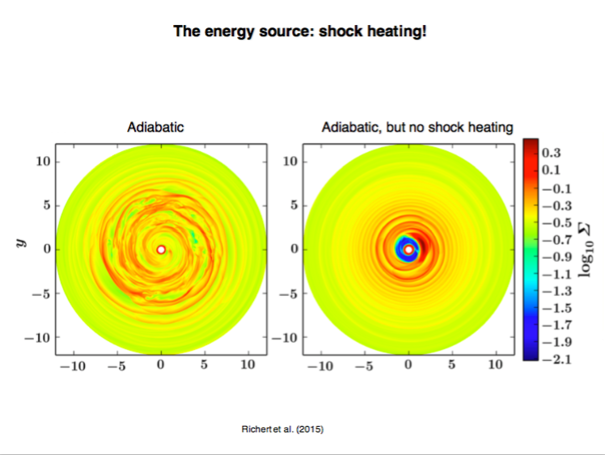

Slide 16
3D: Shock bores
Shocks (velocity convergence)
Temperature
Lyra et al. (2016)

Slide 17
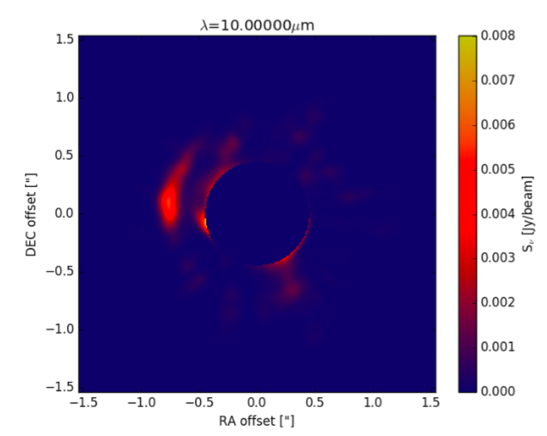
Synthetic image by RADMC3D and shock heating
Hord et al. (2017)

Slide 18
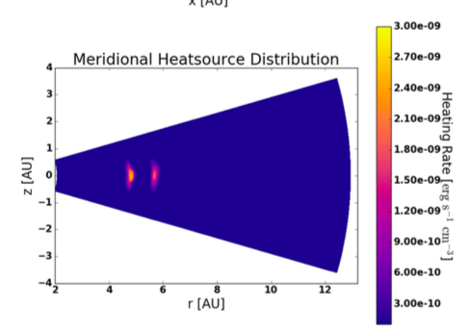
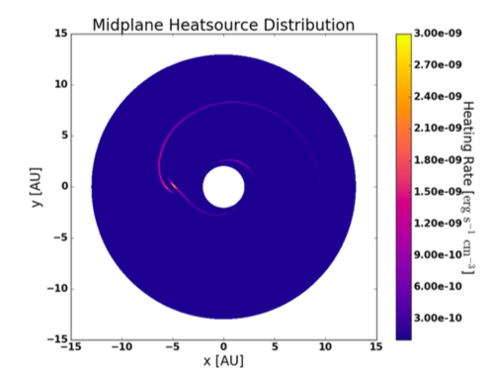

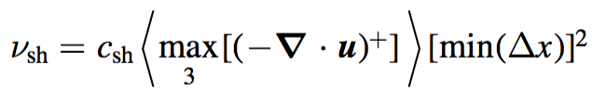
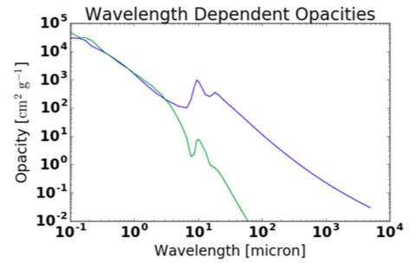
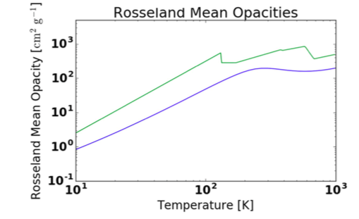
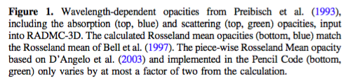
Shock heating and opacities
Hord et al. (2017)

Slide 19
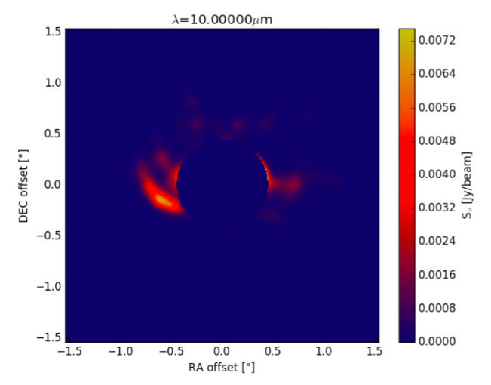
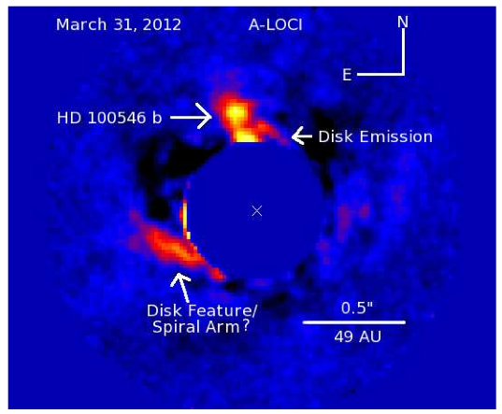
Observation vs Synthetic Image
Hord et al. (2017)

Slide 20
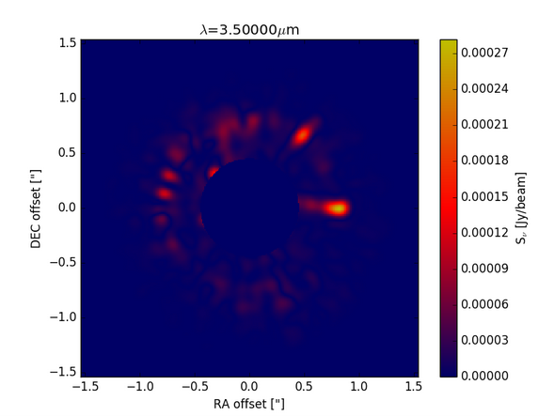
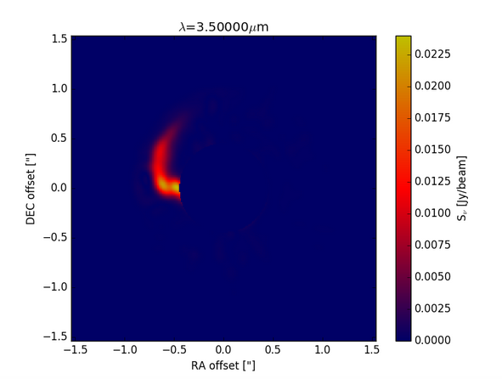
Effect of shocks alone
1 μm
10 μm
Hord et al. (2017)

Slide 21
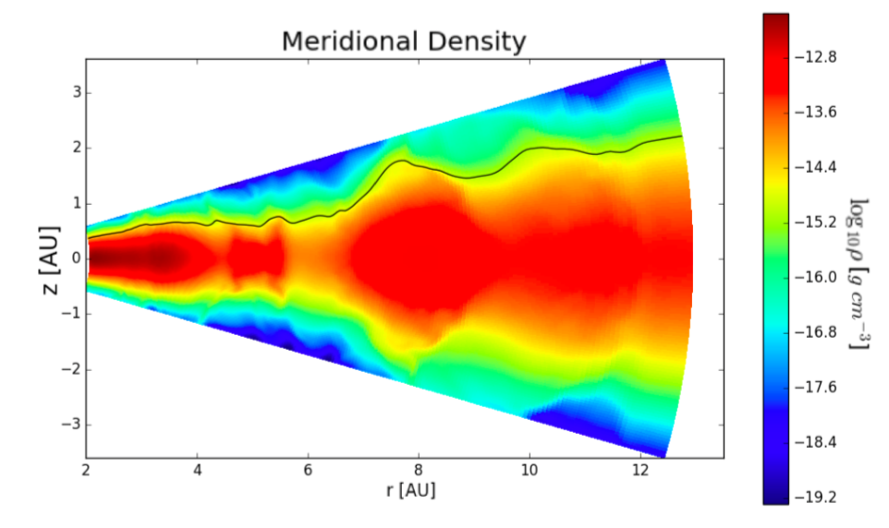
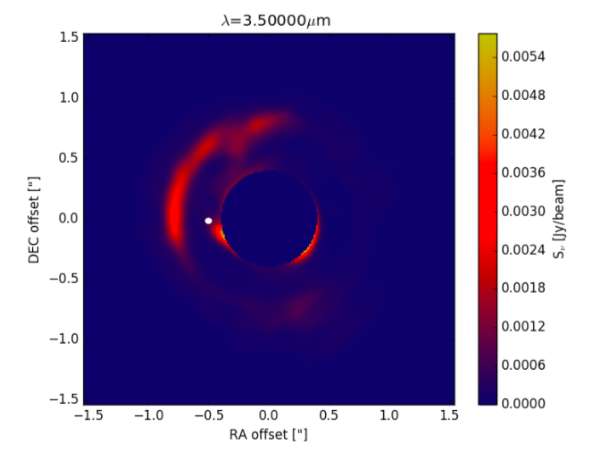
Scattering – A puffed up outer gap
Hord et al. (2017)

Slide 22
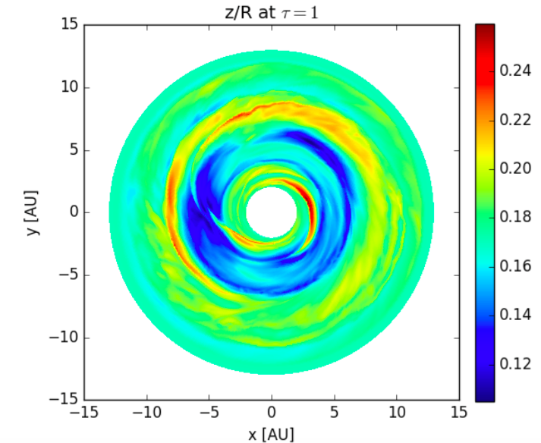
Scattering
Hord et al. (2017)

Slide 23
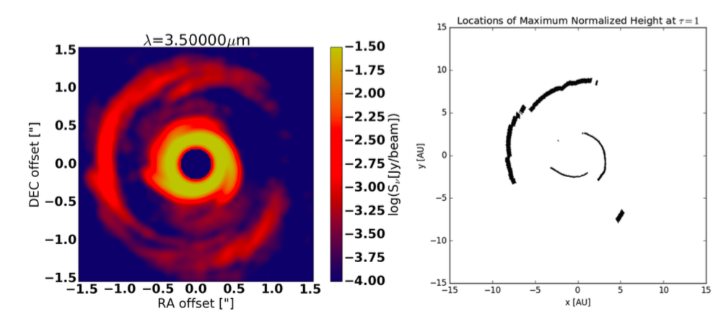
We see what is not in the
shadow of the inner disk spirals
Hord et al. (2017)

Slide 24
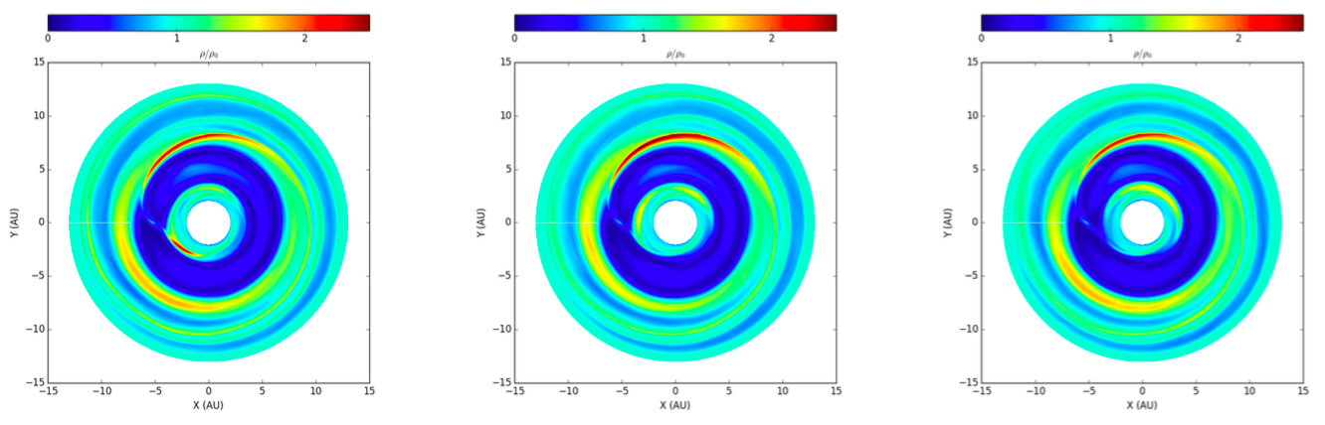
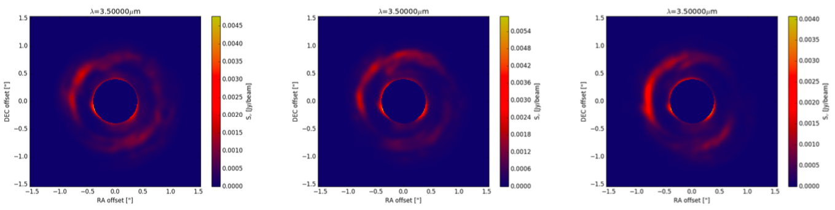
The pattern is stationary
T = 39 orbits
T = 40 orbits
T = 41 orbits
Density
Intensity
Hord et al. (2017)

Slide 25
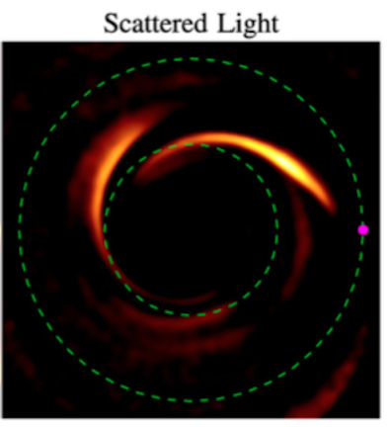
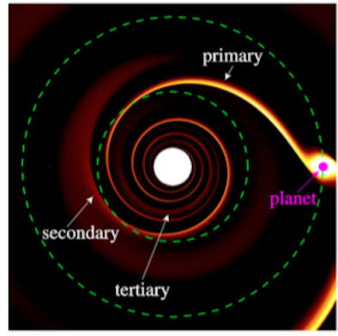
Primary and Secondary spiral arms
Dong et al. (2015)

Slide 26
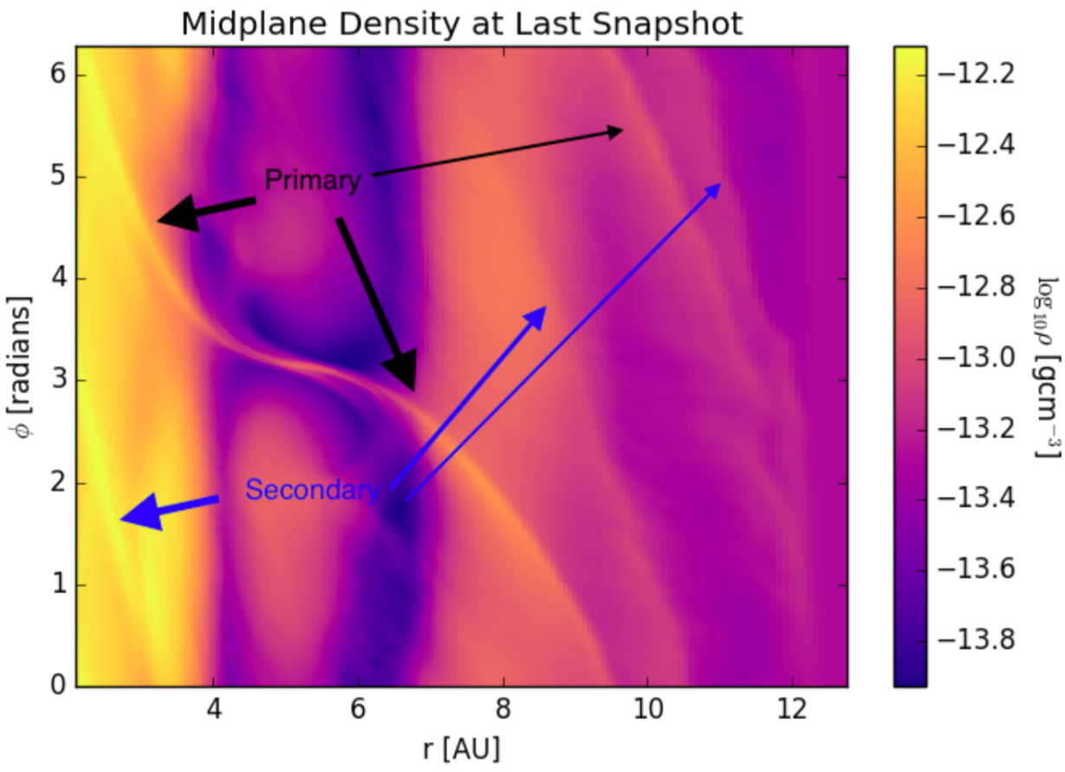
Primary and Secondary spiral arms
Hord et al. (2017)

Slide 27
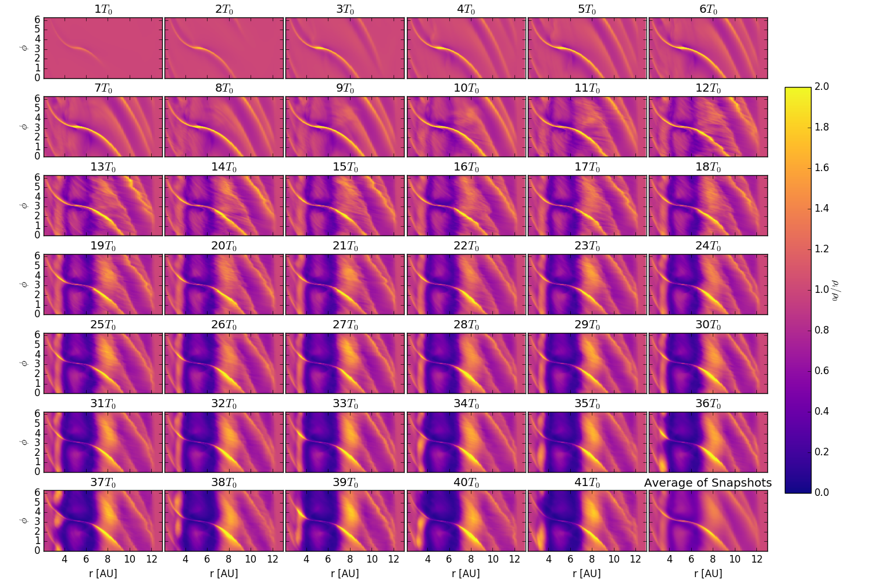
The raised feature has its origins in a secondary spiral arm
Hord et al. (2017)

Slide 28
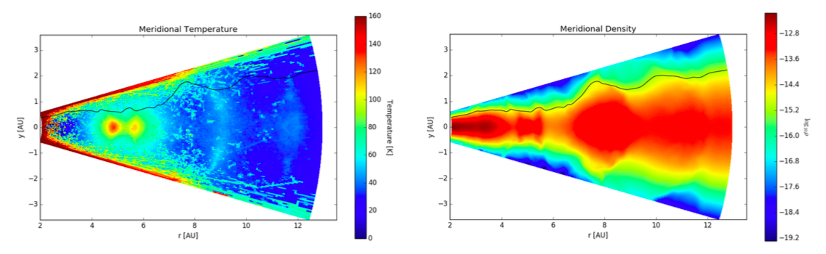
Conclusions
3D radiation-hydro models give results widely different than 2D isothermal
Planet-induced shocks modify disk structure
Hot lobes near high-mass planets in high resolution
Planets puff up their outer gaps – visible in scattered light

Slide 29
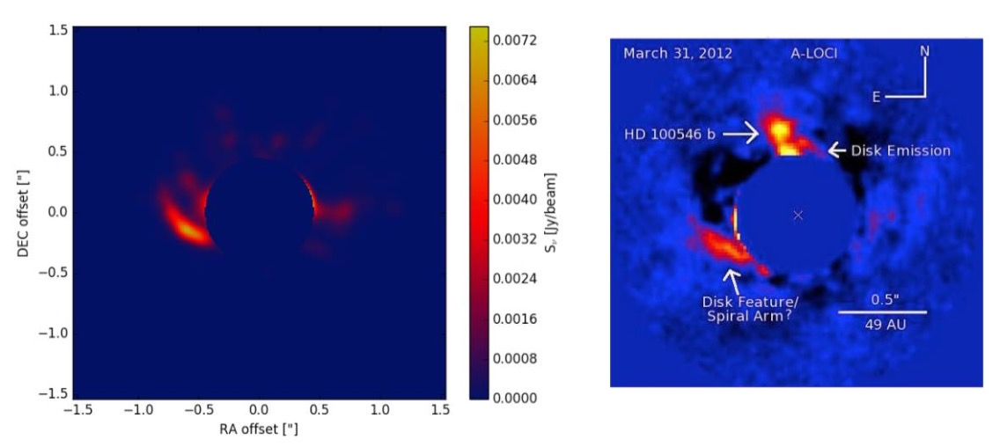
Conclusions
3D radiation-hydro models give results widely different than 2D isothermal
Planet-induced shocks modify disk structure
Hot lobes near high-mass planets in high resolution
Planets puff up their outer gaps – visible in scattered light

