Slide 1
3D Global Models of Streaming Instability
Funding
HST Cycle 24
Wladimir Lyra
California State University
Jet Propulsion Laboratory
Exoplanet Research Program XRP - 2016, 2018
NRAO 2017
Computational Facilities
Frejus, Mar 18th, 2019

Slide 2
3D Global Models of Streaming Instability
Funding Acknowledgement
HST Cycle 24
Wladimir Lyra
California State University
Jet Propulsion Laboratory
Work in Progress
Work in Progress
Work in Progress
Work in Progress
Exoplanet Research Program XRP - 2016, 2018
NRAO 2017
Computational Facilities Acknowledgement
Frejus, Mar 18th, 2019

Slide 3
The M.Sc. students who did this work
Areli Castrejon
Chris Malek

Slide 4
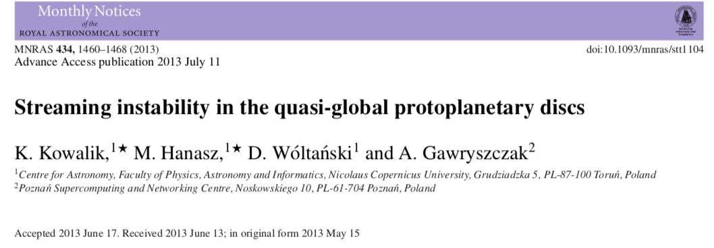
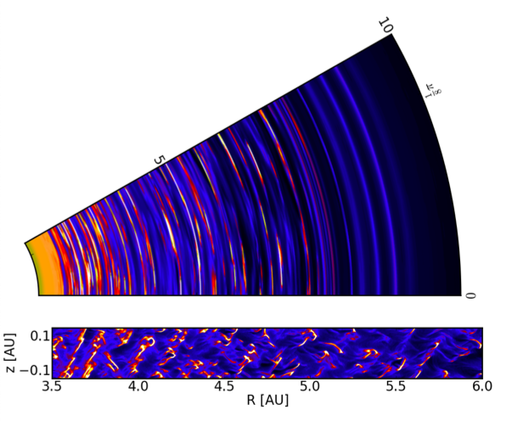
Kowalik et al. (2013)

Slide 5
Missing
Radial variation of clumps’ IMF?
Dominant azimuthal mode?
Lagrangian particles
Selfgravity
Kowalik et al. (2013)

Slide 6
3D Global Models of Streaming Instability

Slide 7
3D Global Models of Streaming Instability

Slide 8
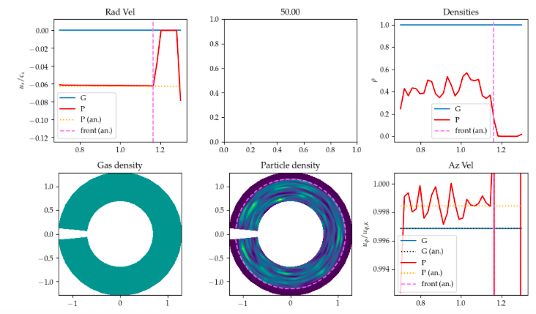
3D Global Models of Streaming Instability
Analytical solution Youdin (2010)

Slide 9
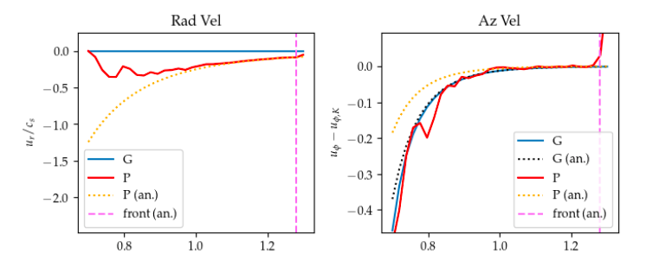
Breakdown
Deviations from analytical solution for u/c ~ 0.5.

Slide 10
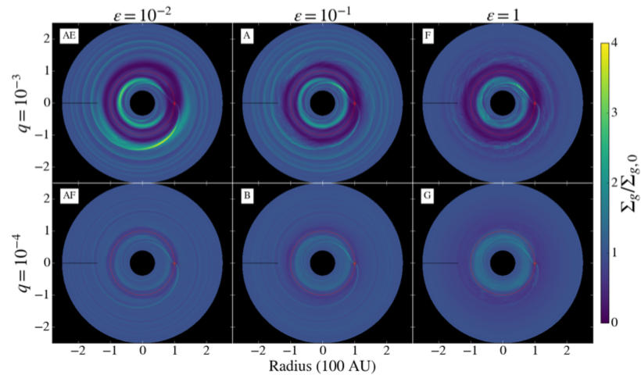
Global Models of Streaming
Dust-to-Gas ratio
Planet Mass

Slide 11
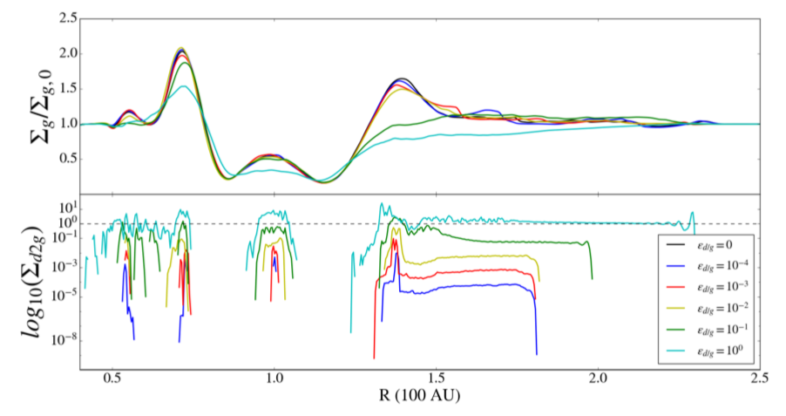
Influence on Gap Carving
Jupiter-mass planet
Gas
Pebbles

Slide 12
Influence on Gap Carving
Jupiter-mass planet
Gap modified at high dust-to-gas ratio.
Gas
Gap
modified
Gap modified
Pebbles

Slide 13
Influence on Gap Carving
Jupiter-mass planet
Gap modified at high dust-to-gas ratio.
Pebble drift slows down at high dust-to-gas ratio and halted at ε=1
Gas
Gap
modified
Gap modified
Pebble flux slowed
down/halted.
Pebbles

Slide 14
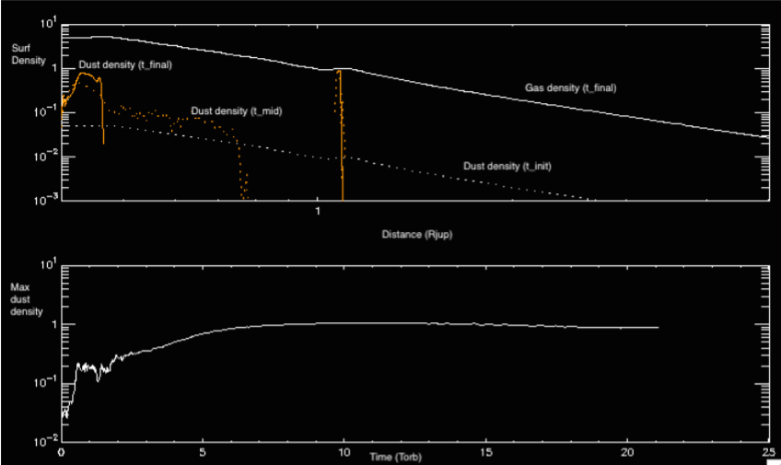
Halting the drift
Localized ε=1 pressure-bump survives during whole simulation

Slide 15
Influence on Gap Carving
Jupiter-mass planet
Gap modified at high dust-to-gas ratio.
Pebble drift slows down at high dust-to-gas ratio and halted at ε=1
Gas
Gap
modified
Gap modified
Pebble flux slowed
down/halted.
Pebbles

Slide 16
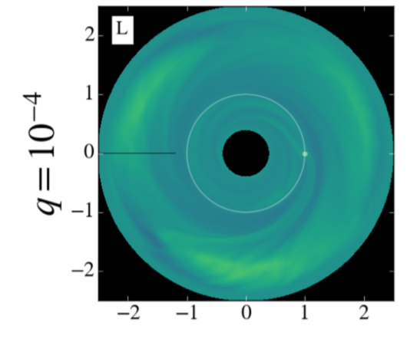
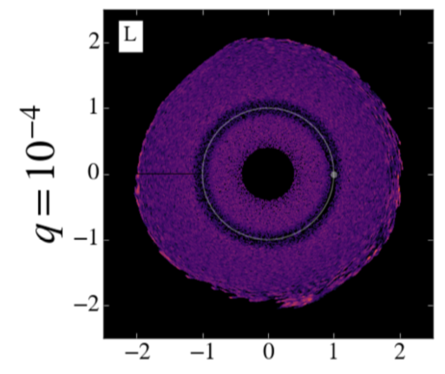
Vortices
Gas
Pebbles
Rossby wave instability at the dust front !

Slide 17
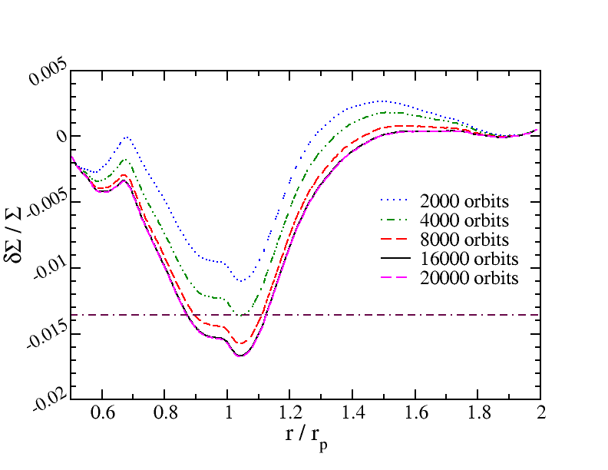
Caveat: Convergence.
10 Earth masses; α=10⁻³
Convergence: 15,000 orbits
Figure by Jeff Fung

Slide 18
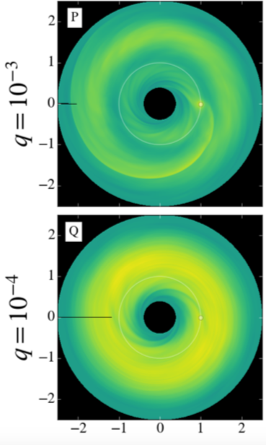
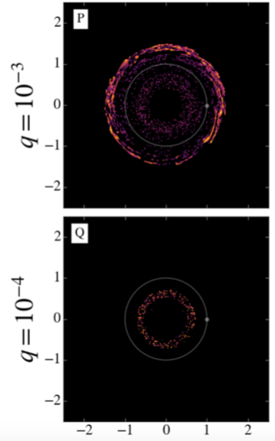
Not all planets are dust dams
Gas
Pebbles
Planet Mass

Slide 19
Not all planets are dust dams
Gas
Pebbles
Dust dam
Planet Mass
Dust able to drift past planet

Slide 20
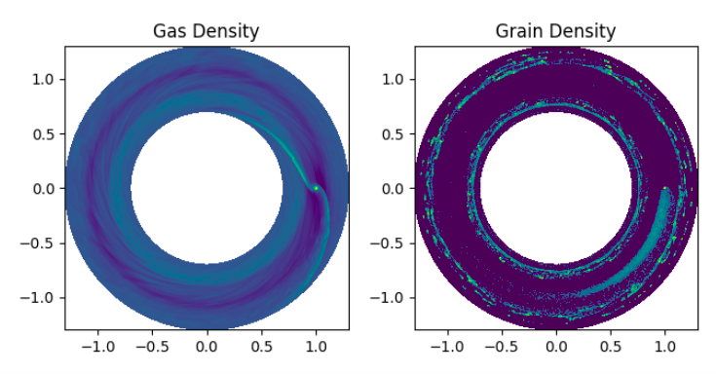
How to drift past a propeller?
A pebble has to cross the co-rotational region
faster than a planet can scatter it

Slide 21
How to drift past a propeller?
A pebble has to cross the co-rotational region
faster than a planet can scatter it

Slide 22
Not all planets are dust dams
Pebbles
Dust dam
Planet Mass
q = planet mass ratio
h = disk aspect ratio
χ = power law of pressure gradient
St = Stokes number
Dust able to drift past planet

Slide 23
Not all planets are dust dams
Pebbles
Dust dam
Θ = 1.4
Planet Mass
Θ = 0.5
q = planet mass ratio
h = disk aspect ratio
χ = power law of pressure gradient
St = Stokes number
Dust able to drift past planet

Slide 24
Streaming Instability
Preliminary Model
H=0.3
Nr,Nphi,Nz = 384,1024,32
12 million particles
λ_{SI}/Δr = 20

Slide 25
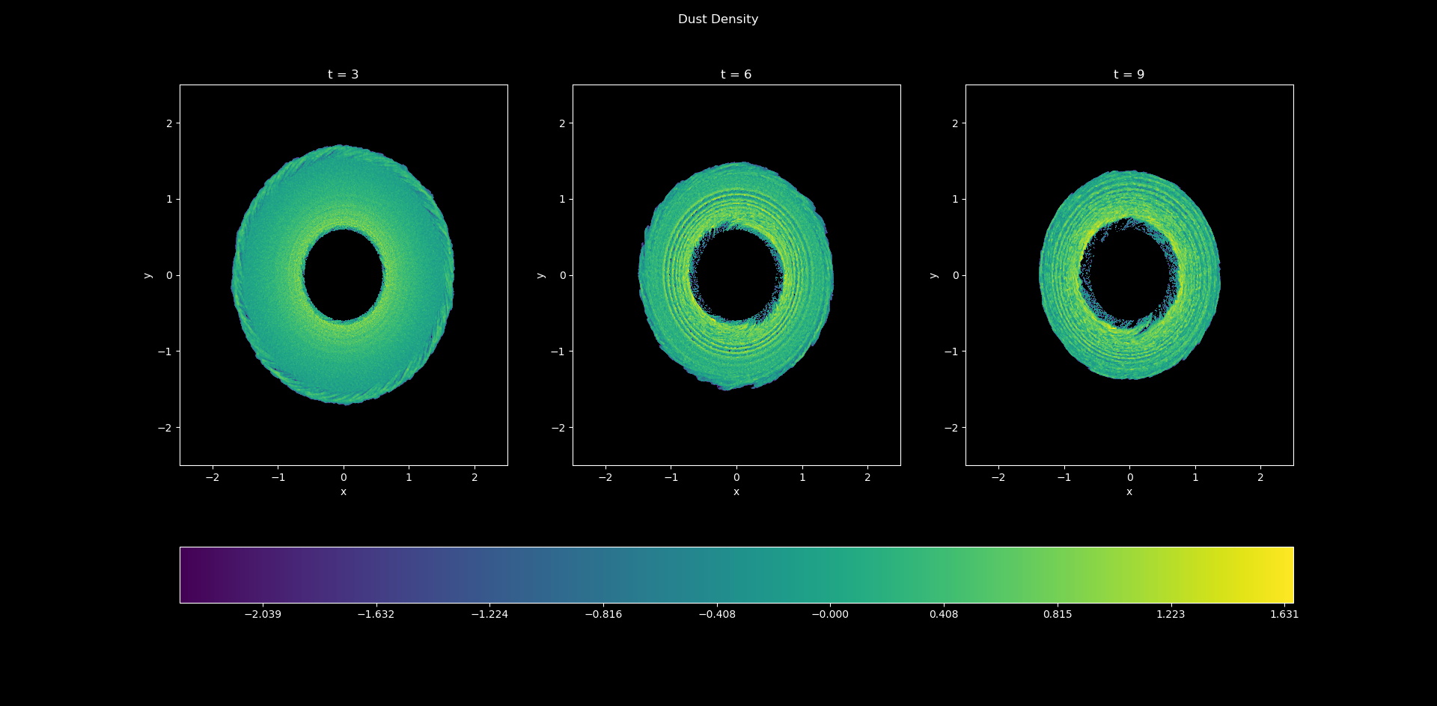
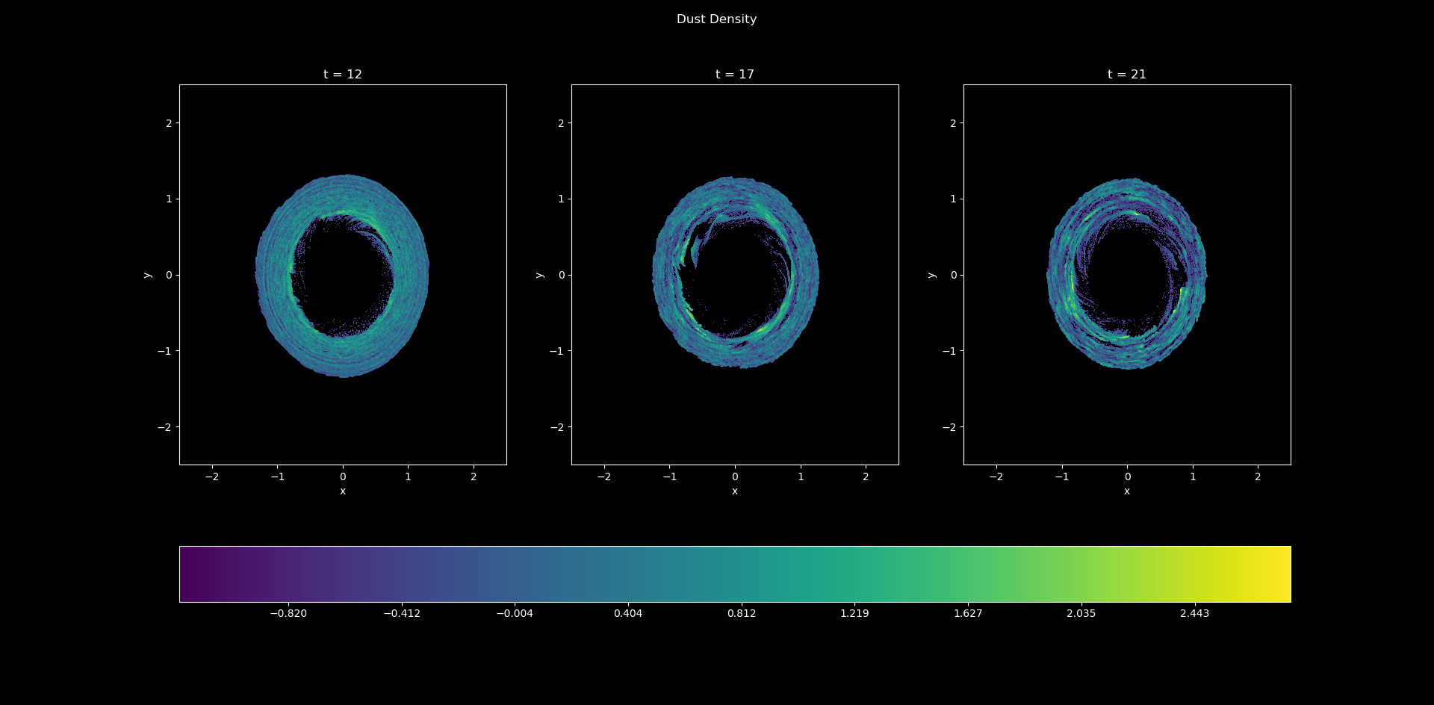
Streaming Instability
Time
Denser.
The drift is not divergenceless.

Slide 26
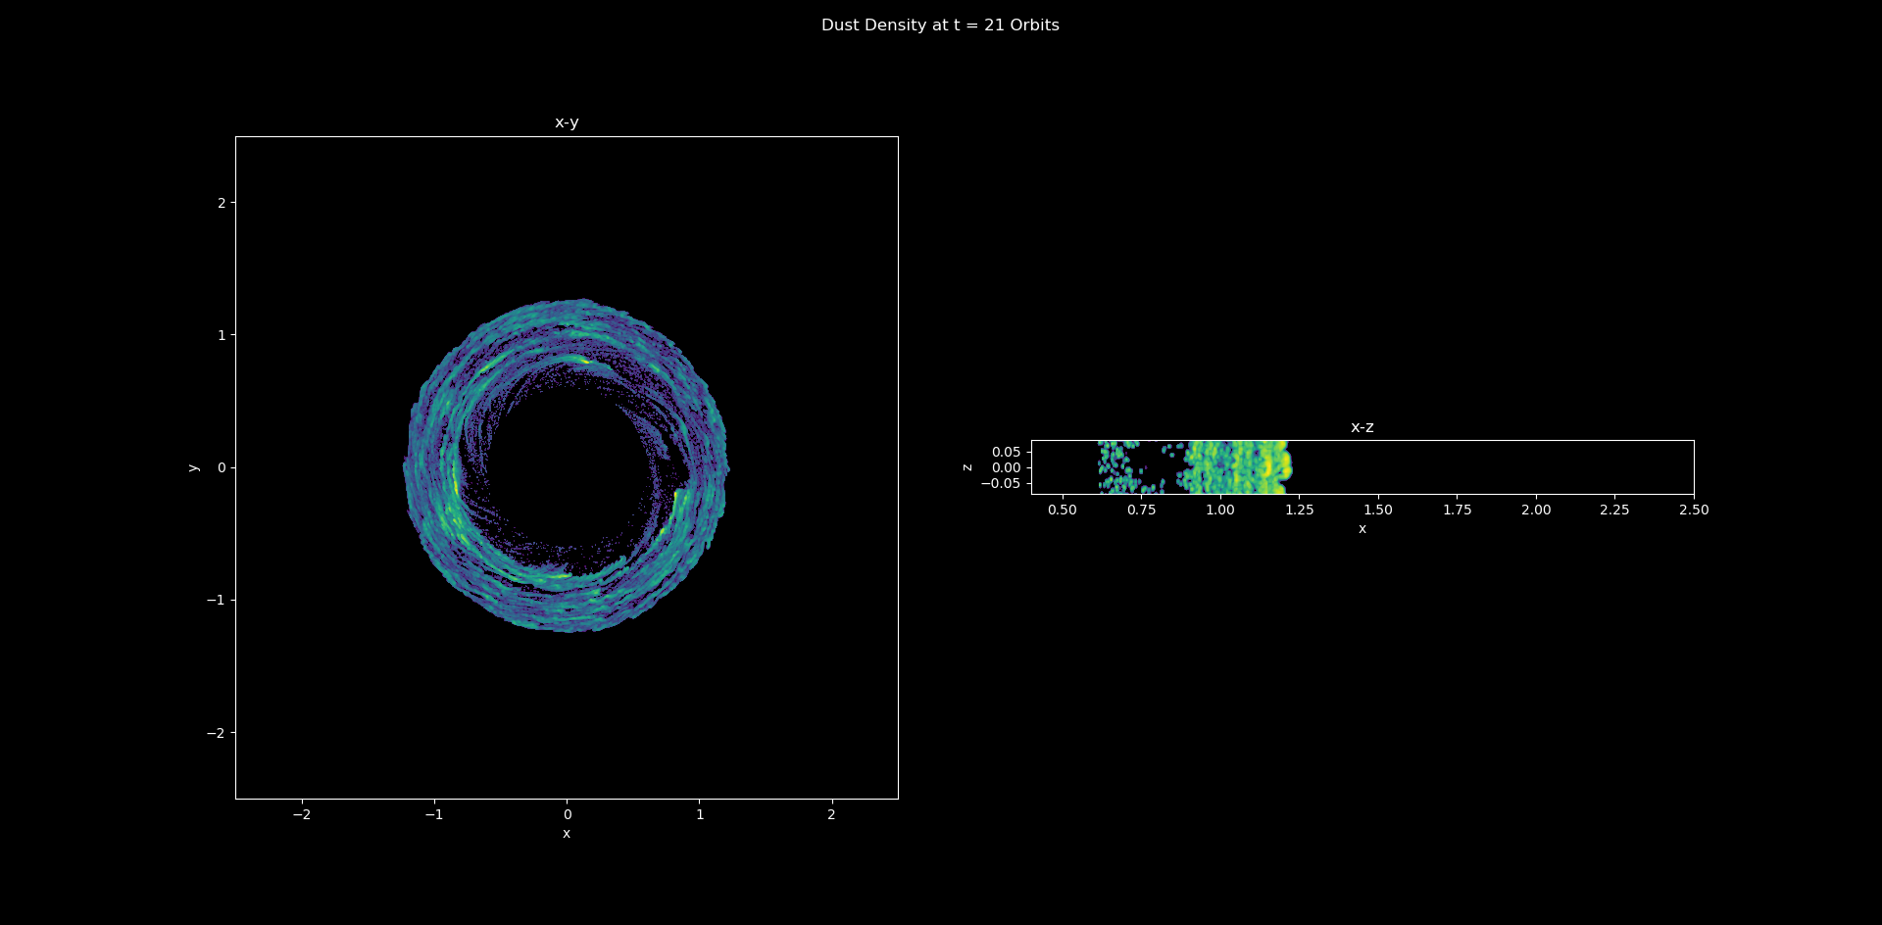
Azimuthal spectral power distribution?
Not axisymmetric!

Slide 27
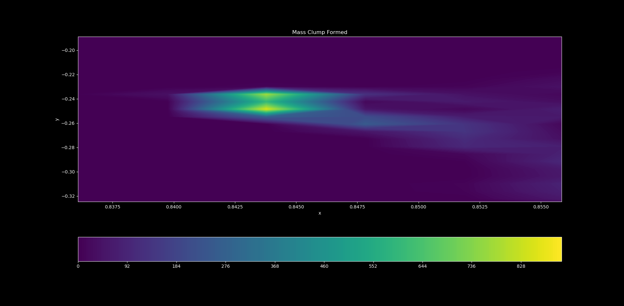
Azimuthal spectral power distribution?
A Ceres-mass
clump
Not axisymmetric!

Slide 28
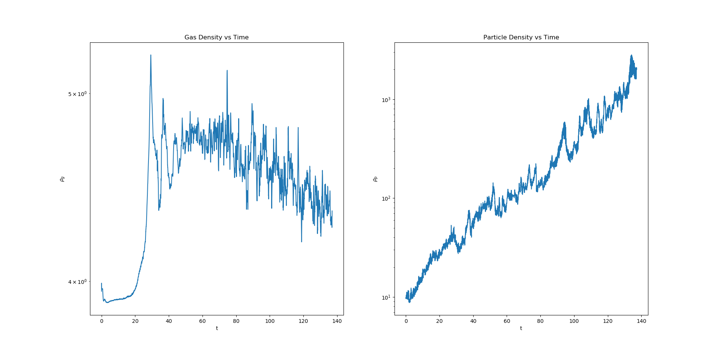
Azimuthal spectral power distribution?
A Ceres-mass
clump
Mass not converged yet

Slide 29
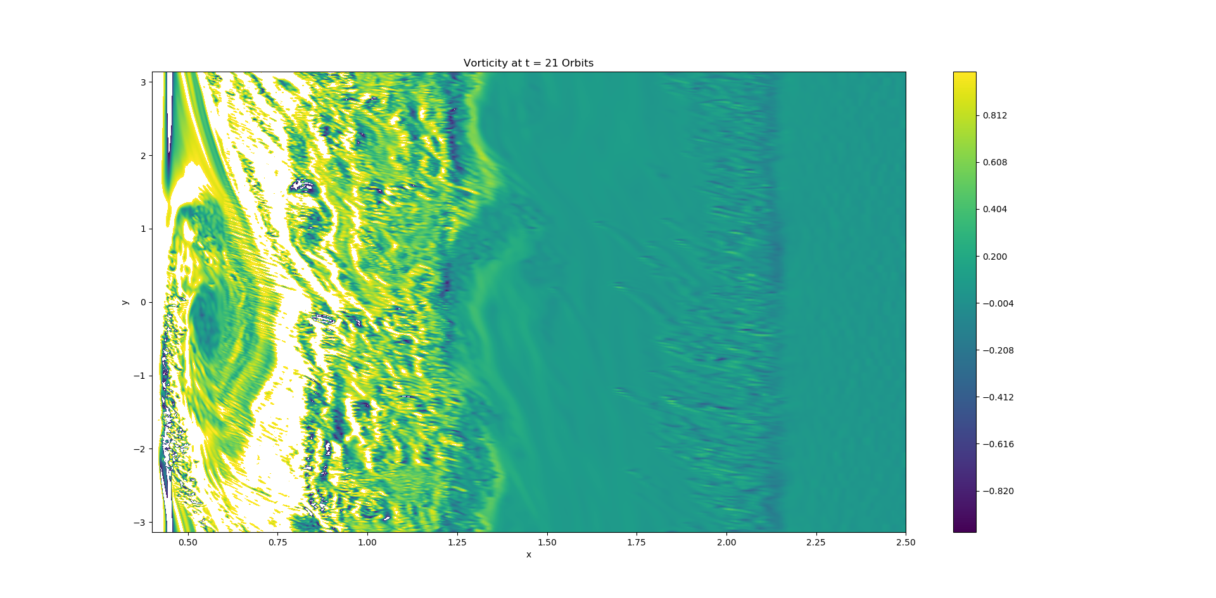
Vortex at inner dust edge
RWI at dust sublimation radius?

Slide 30
Conclusions
High dust-to-gas ratio (ε ∼ 0.1 -1)
Depresses pressure bumps
Slows/halts pebble drift
Vortices (RWI) at dust fronts
Outer front as pebbles drift inwards (?)
Inner -- sublimation radius (?)
Planets as dust dams
Criterion drift vs dynamical time
Low-mass planets (small corotation radius) in hot disks (fast drift) not good dutchmen
Gap
modified
Gap modified
Pebble flux slowed
down/halted.
Streaming Instability in 3D
Non-axisymmetric
High-mass embryos
Convergence….

Slide 31
Conclusions
High dust-to-gas ratio (ε ∼ 0.1 -1)
Depresses pressure bumps
Slows/halts pebble drift
Vortices (RWI) at dust fronts
Outer front as pebbles drift inwards (?)
Inner -- sublimation radius (?)
Planets as dust dams
Criterion drift vs dynamical time
Low-mass planets (small corotation radius) in hot disks (fast drift) not good dutchmen
Streaming Instability in 3D
Non-axisymmetric
High-mass embryos
Convergence….

Slide 32
Conclusions
High dust-to-gas ratio (ε ∼ 0.1 -1)
Depresses pressure bumps
Slows/halts pebble drift
Vortices (RWI) at dust fronts
Outer front as pebbles drift inwards (?)
Inner -- sublimation radius (?)
Planets as dust dams
Criterion drift vs dynamical time
Low-mass planets (small corotation radius) in hot disks (fast drift) not good dutchmen
Streaming Instability in 3D
Non-axisymmetric
High-mass embryos
Convergence….

Slide 33
Conclusions
High dust-to-gas ratio (ε ∼ 0.1 -1)
Depresses pressure bumps
Slows/halts pebble drift
Vortices (RWI) at dust fronts
Outer front as pebbles drift inwards (?)
Inner -- sublimation radius (?)
Planets as dust dams
Criterion drift vs dynamical time
Low-mass planets (small corotation radius) in hot disks (fast drift) not good dutchmen
Streaming Instability in 3D
Non-axisymmetric
High-mass embryos
Convergence….

Slide 34
The M.Sc. students who did this work
Areli Castrejon
Chris Malek

Slide 35
Conclusions
High dust-to-gas ratio (ε ∼ 0.1 -1)
Depresses pressure bumps
Slows/halts pebble drift
Vortices (RWI) at dust fronts
Outer front as pebbles drift inwards (?)
Inner -- sublimation radius (?)
Planets as dust dams
Criterion drift vs dynamical time
Low-mass planets (small corotation radius) in hot disks (fast drift) not good dutchmen
Streaming Instability in 3D
Non-axisymmetric
High-mass embryos
Convergence….

Slide 36
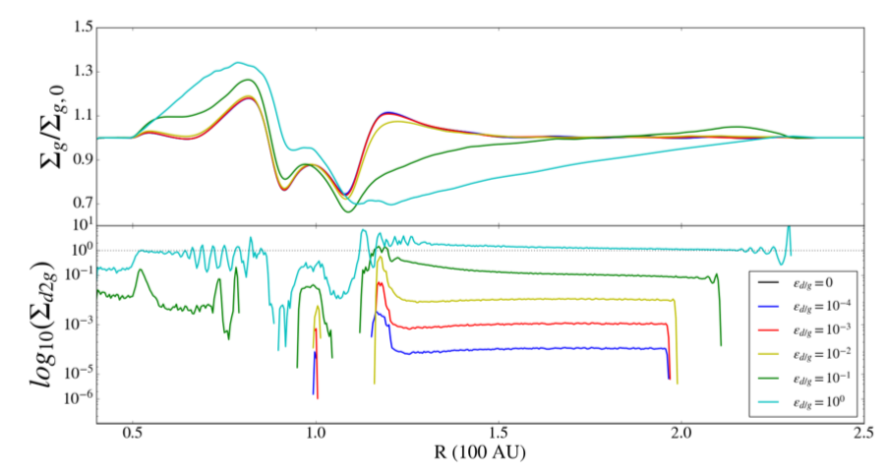
Influence on Gap Carving
Neptune-mass planet
Jupiter-mass planet

Slide 37
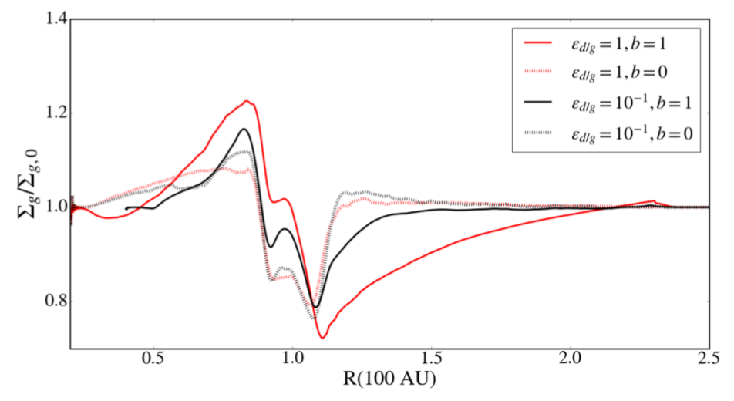
ε=0.1, no drift
ε=1, no drift
ε=0.1, drift
ε=1, drift

