Slide 1
Fitting a snowline at 40AU at V883Ori
Wladimir Lyra
California State University, Northridge
Felipe Alarcón (Universidad de Chile, University of Michigan),
Simon Casassus (Universidad de Chile)
Lucas Cieza (Universidad Diego Portales)
Sebastian Perez (Universidad de Chile)
ExSoCal, Sep 18th, 2018

Slide 2
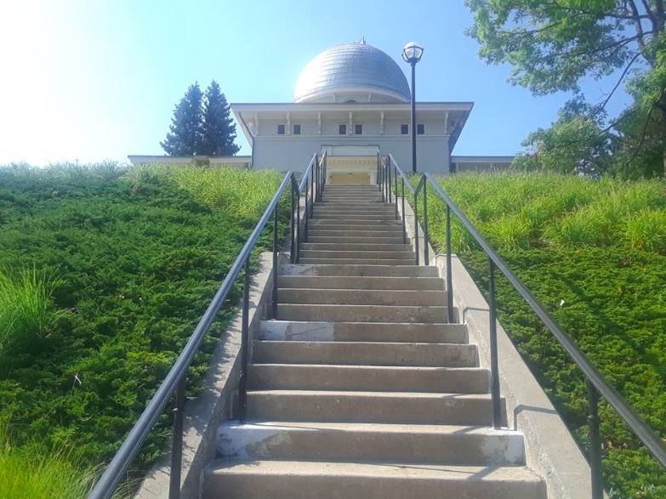
Felipe Alarcon
Michigan
Los
Angeles
Santiago

Slide 3
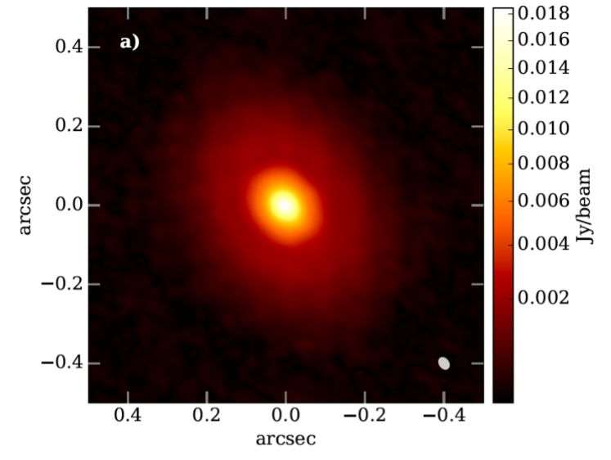
V883Ori
Class I protostar
(Age ~0.5 Myr)
(L * ~ 6 L_{sun})
M* = 1.3 +/- 0.1 M_{sun}
M_{disk} ~ 0.3 M_{sun}
d = 414 +/-7 pc
Ldisk = 400 L_{sun}
50AU
Cieza et al. (2016)

Slide 4
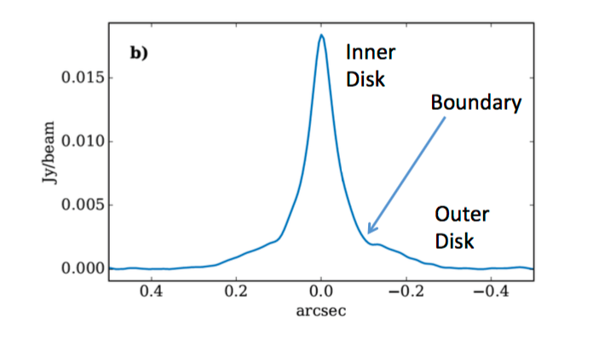
V883Ori
Cieza et al. (2016)

Slide 5
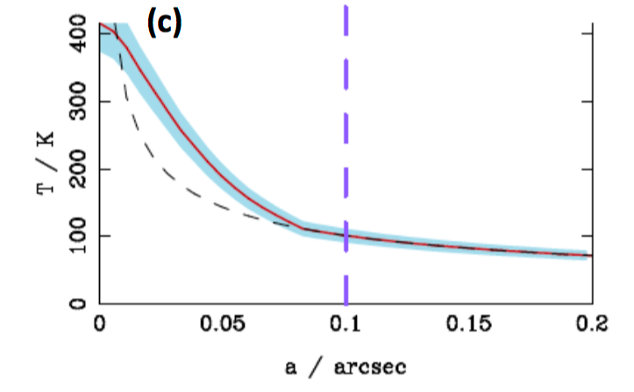
Extra source of heating needed
Measured
Passive disk
Cieza et al. (2016)

Slide 6
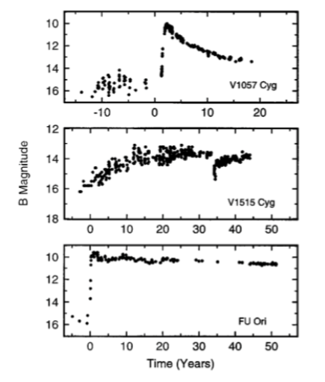
V883 Orionis is an FU Orionis star

Slide 7
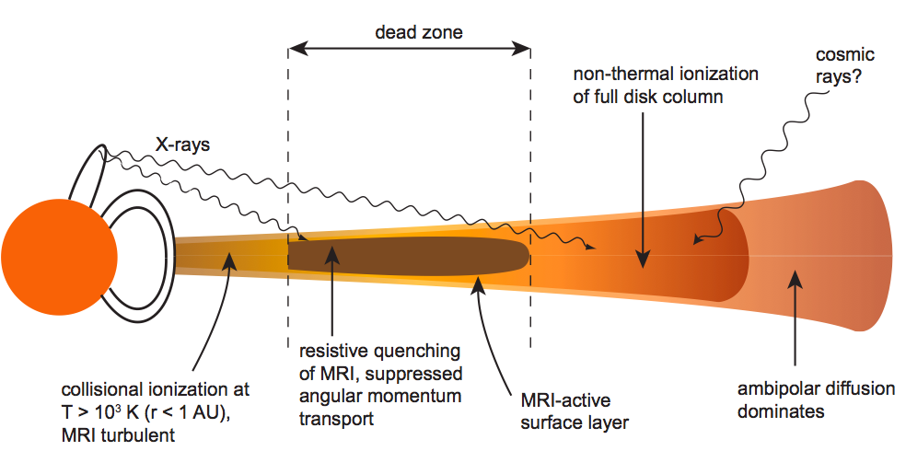
Episodic Accretion – Loading a dead zone
0.1 AU
~30 AU
There should be a magnetized, active zone
and a non-magnetic, dead zone

Slide 8
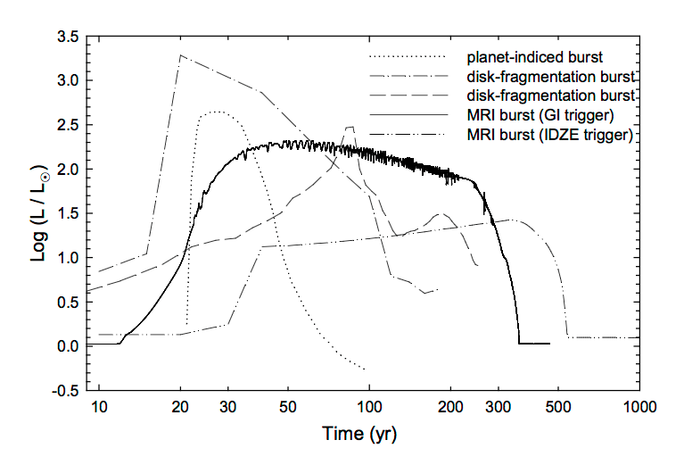
Possible FU Ori triggers
Audard et al. (2014)

Slide 9
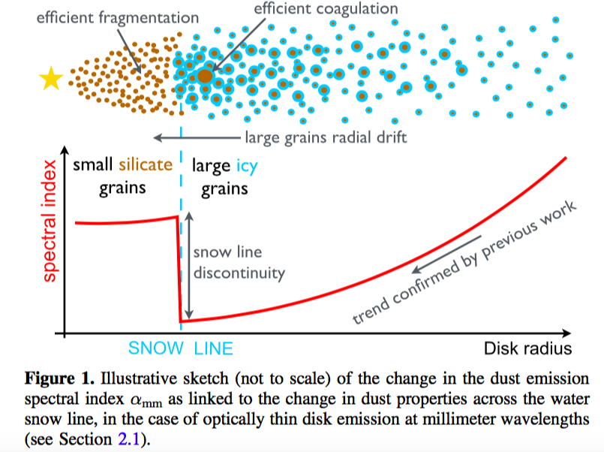
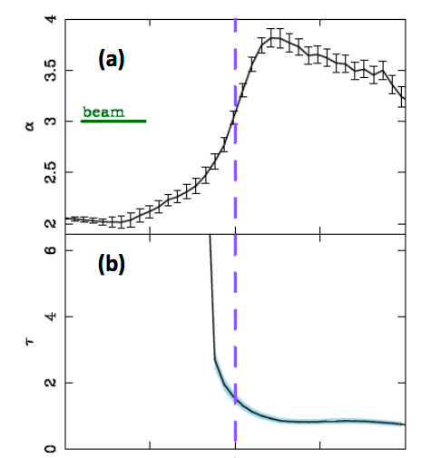
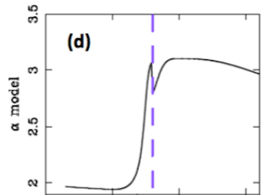
Signature of a snowline: Spectral index
Optically thin
ISM-ilke values
Banzatti et al. (2014)
Optically thick
blackbody emission
Cieza et al. (2016)

Slide 10
Signature of a snowline: Optical depth
Optically thick
Optically thin
T=105+/-11 K
(R ~ 40AU)
Cieza et al. (2016)

Slide 11
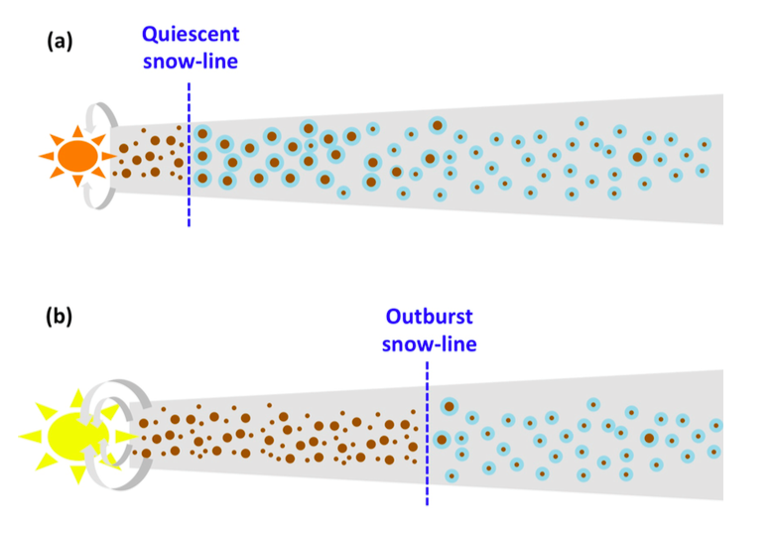
Snowline pushed outward during outburst
Cieza et al. (2016)

Slide 12
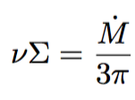
The model
Stellar heating
Viscous heating
Effective temperature
Midplane temperature
Chiang et al. (2001), Alarcon et al. (in prep)

Slide 13
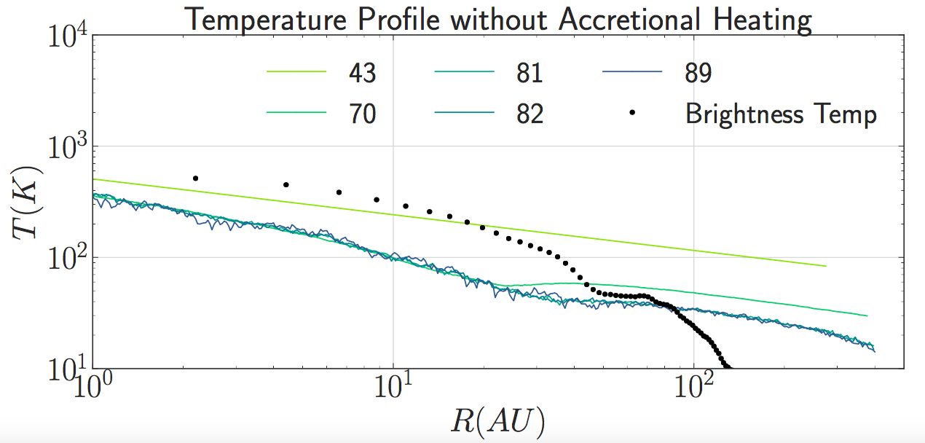
Alarcon et al. (in prep)

Slide 14
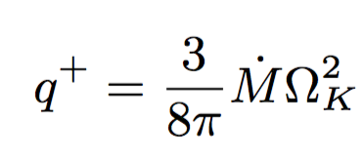
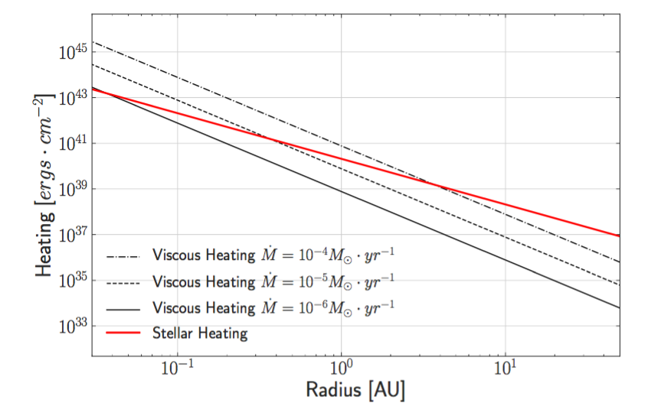
Viscous heating
Alarcon et al. (in prep)

Slide 15
Best fit
Alarcon et al. (in prep)

Slide 16
Self-shadowing
Cieza et al. (2016), Alarcon et al. (in prep)

Slide 17
Conclusions
First water snowline observed;
Brightness temperature needs active heating;
Fit consistent with accretional inner disk, passive outer disk;
Self-shadowing reproduced;
Episodic accretion is powering V883 Ori !
What is the mechanism???
Can we use it to study whatever is causing it?
Gravitational instability?
Magnetorotational instability?
Planet?
All of the above?

