Slide 1


Planet spirals in transition disks:
a cautionary tale
Wladimir Lyra
California State University, Northridge
Jet Propulsion Laboratory
Blake Hord (Dobbs Ferry High School, Stanford University),
Alex Richert (Penn State University)
Mario Flock (JPL),
Neal Turner (JPL),
Aaron Boley (University of British Columbia)
Mordecai-Mark Mac Low (AMNH)
Satoshi Okuzumi (Tokyo Tech)
ExSoCal, Sep 19th, 2017

Slide 2
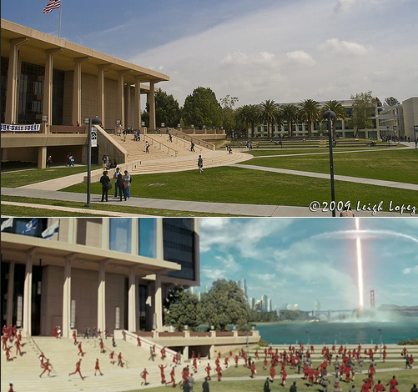
CSUN (pronounced “sea-sun”)
aka Starfleet Academy

Slide 3
Planet spirals in transition disks:
a cautionary tale
Wladimir Lyra
California State University, Northridge
Jet Propulsion Laboratory
Blake Hord (Dobbs Ferry High School, Stanford University),
Alex Richert (Penn State University)
Mario Flock (JPL),
Neal Turner (JPL),
Aaron Boley (University of British Columbia)
Mordecai-Mark Mac Low (AMNH)
Satoshi Okuzumi (Tokyo Tech)
ExSoCal, Sep 19th, 2017

Slide 4
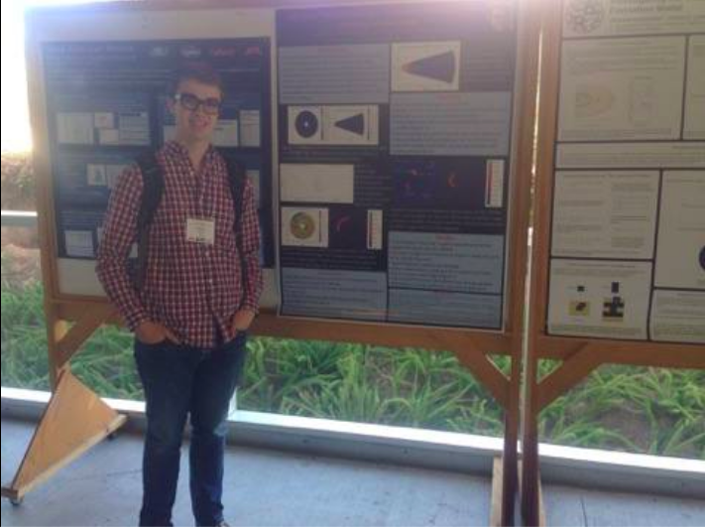
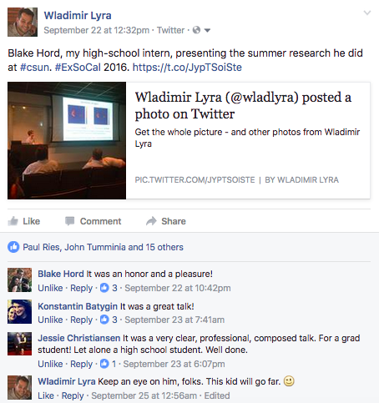
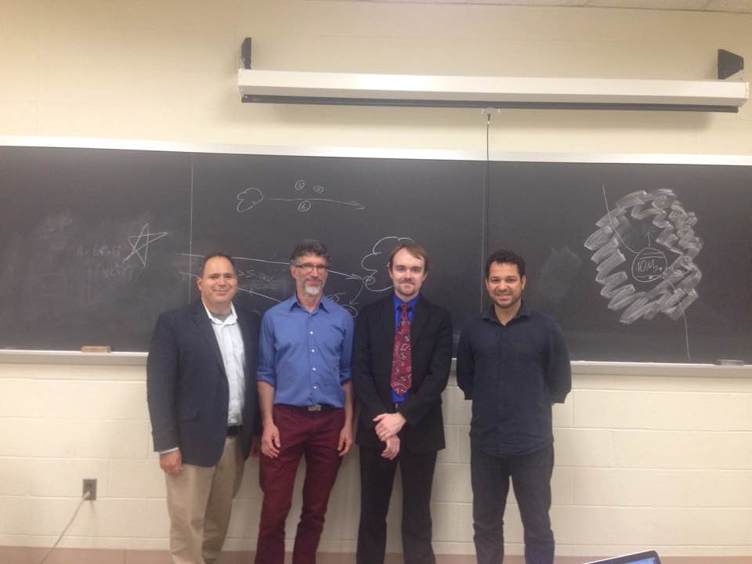
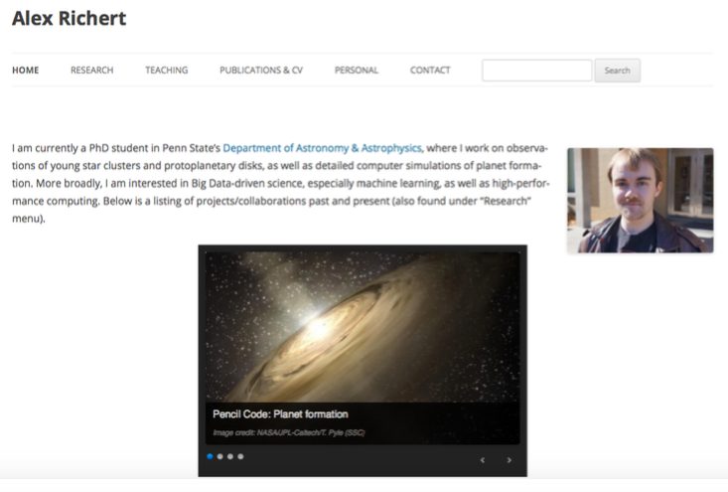
Blake Hord
Associate
Alex Richert

Slide 5
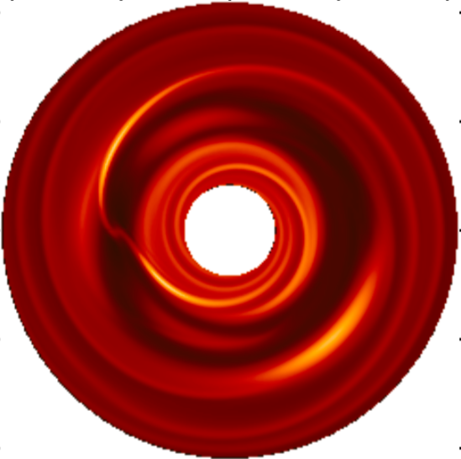
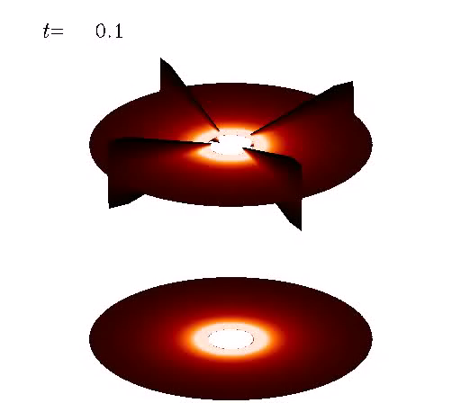
Planet-disk interaction model predictions:
gaps, spirals, and vortices.
(Lyra et al. 2009b)

Slide 6
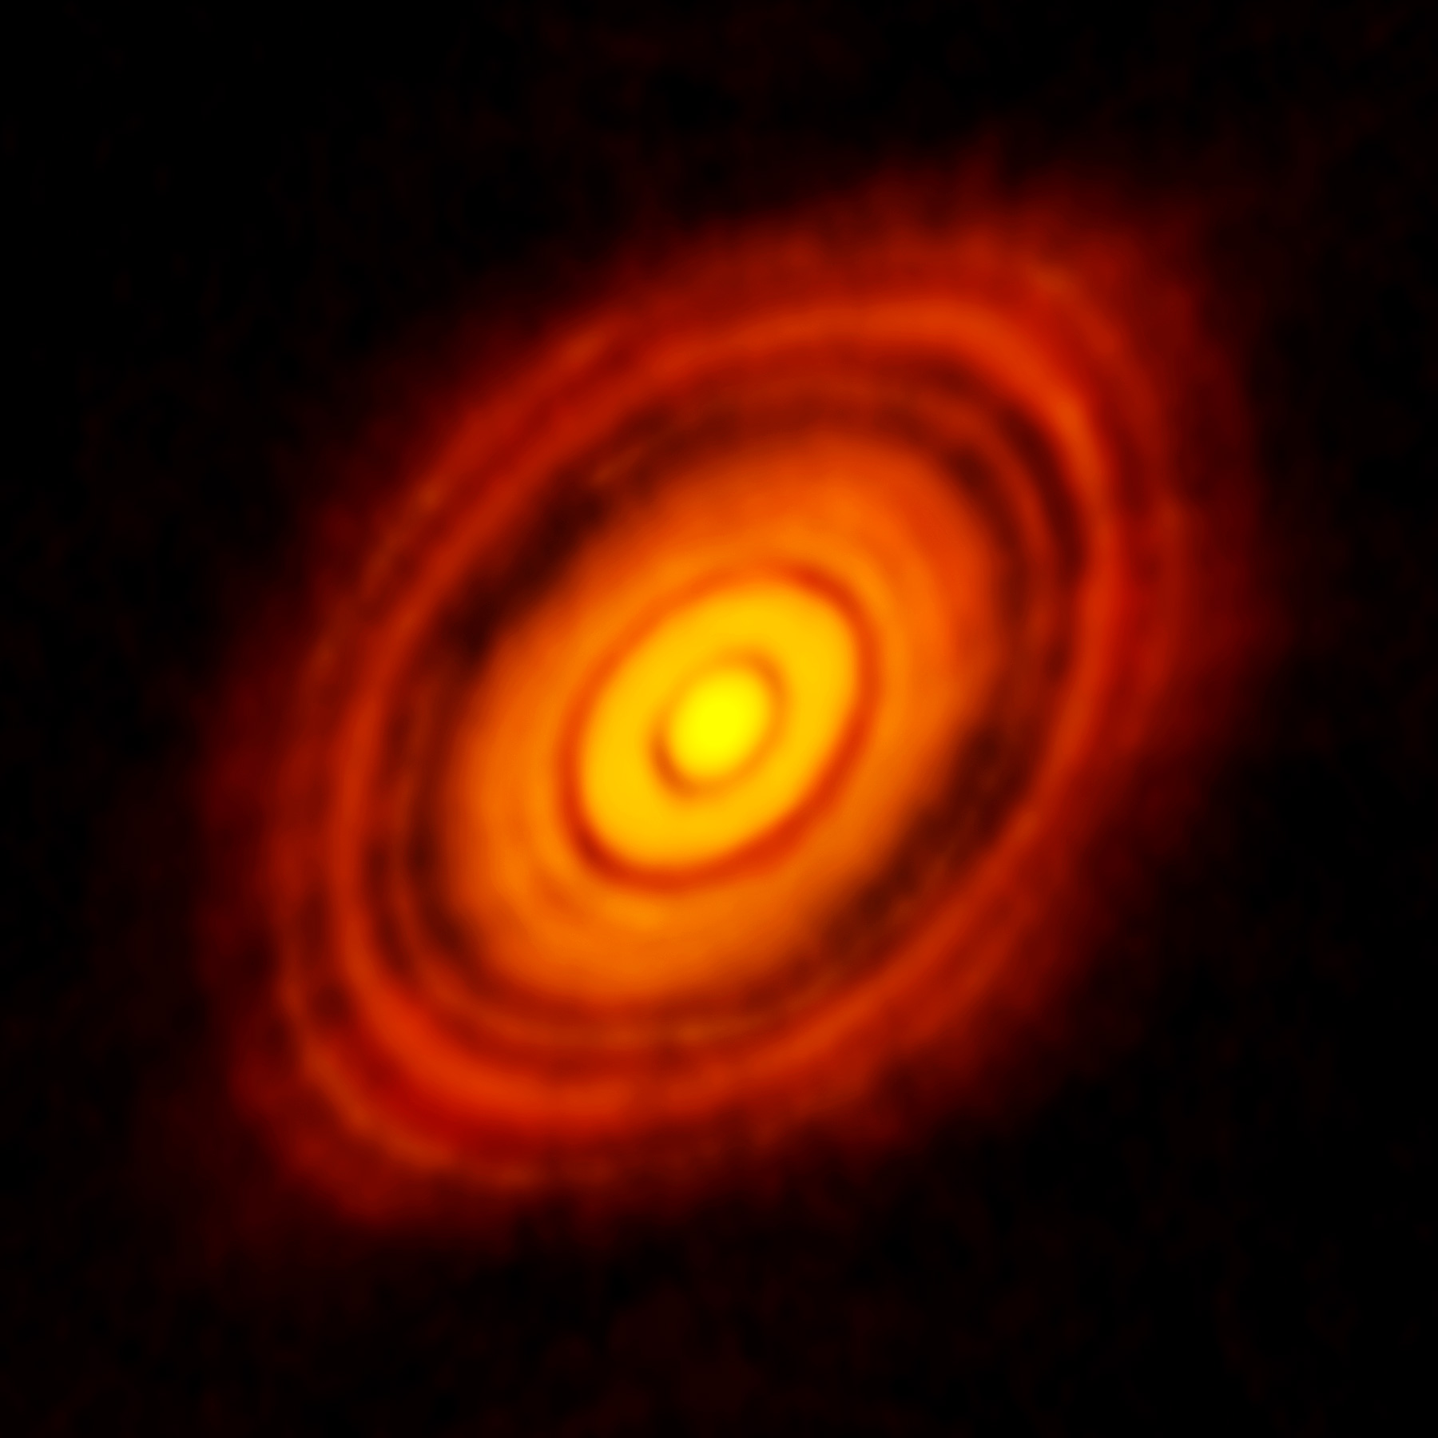
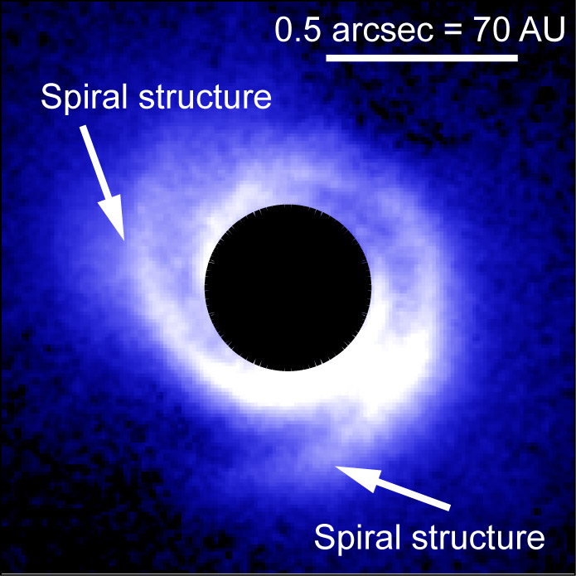
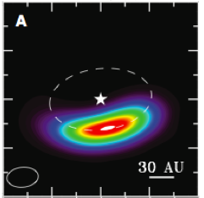
Observational evidence: gaps, spirals, and vortices
HL Tau
SAO 206462
Oph IRS 48
The ALMA Partnership et al. (2015)
Muto et al. (2012)
van der Marel et al. (2013)

Slide 7
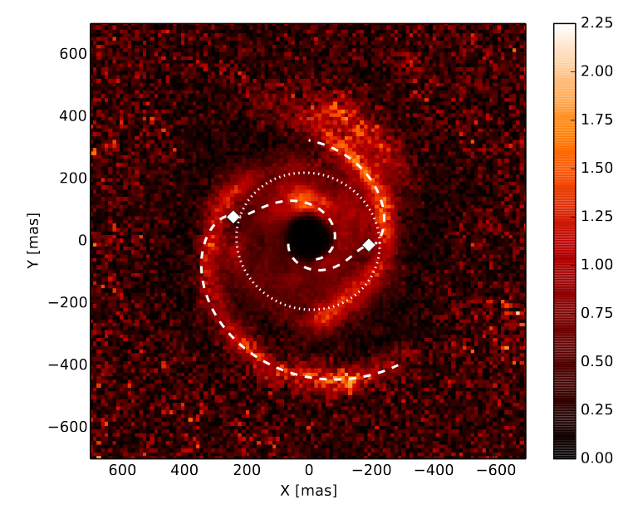
Observational Evidence: Spirals
SAO 206462
MWC 748
Muto et al. (2012)
Benisty et al. (2015)

Slide 8
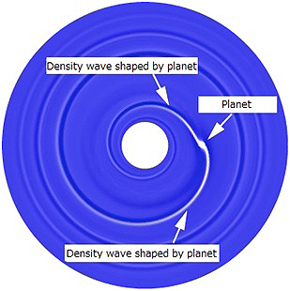
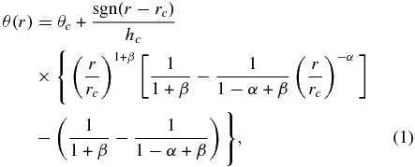
Spiral arm fitting leads to problems
Analytical spiral fit
Spirals are too wide,
hotter (300K) than ambient gas (50K).
Rafikov (2002)
Muto et al. (2012)
Benisty et al. (2015)

Slide 9
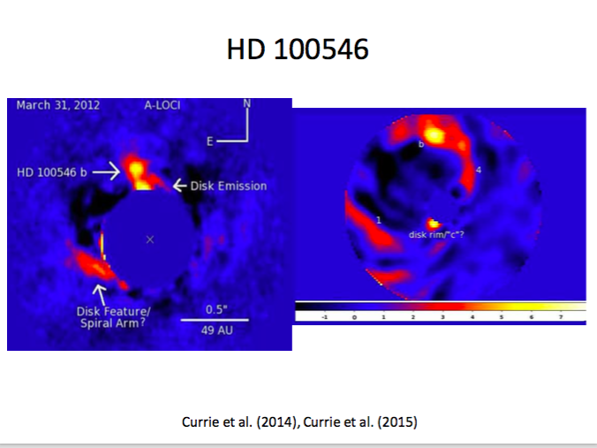
The strange case of thermal emission in HD 100546
L band (~3.5 μm)
H band (~1.6 μm)

Slide 10
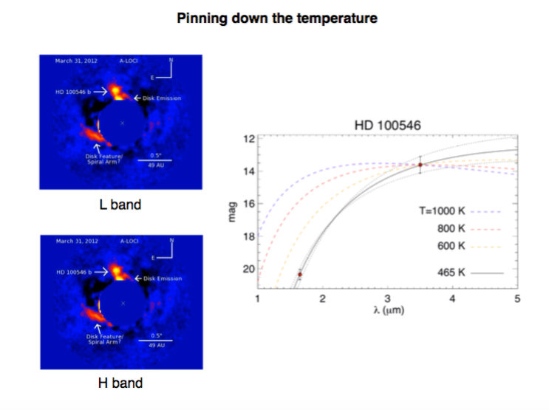
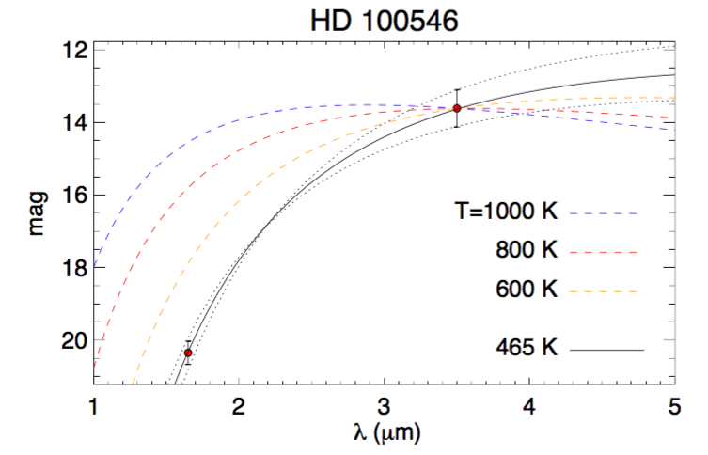
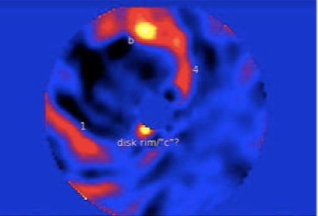
Lyra et al. (2016)

Slide 11
3D: Shock bores
Shocks (velocity convergence)
Temperature
Lyra et al. (2016)

Slide 12
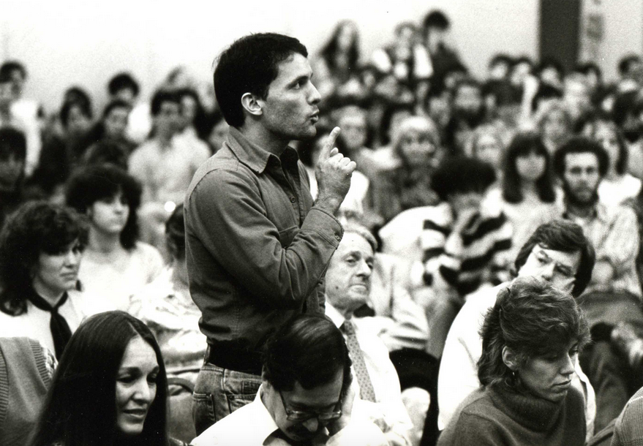
Your model doesn’t look
like my observation.
Why should I care?

Slide 13
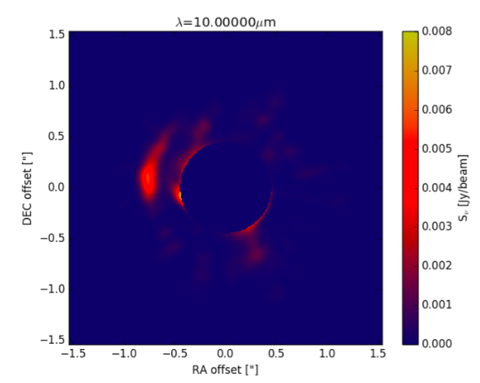
Synthetic image
Hord et al. (2017)

Slide 14
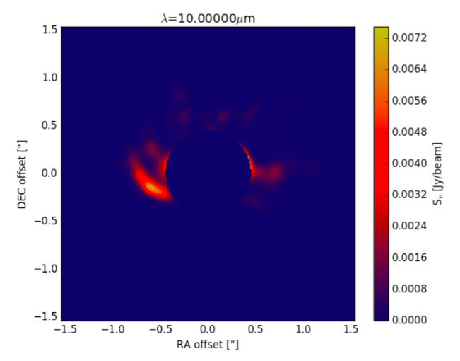
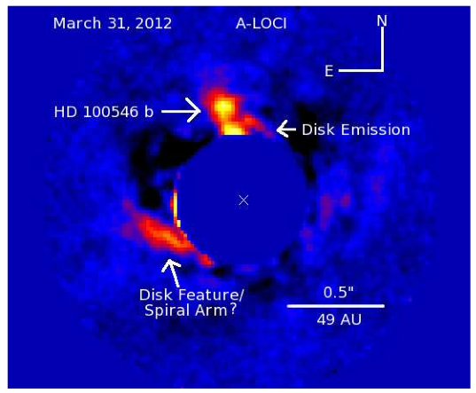
Observation vs Synthetic Image
Hord et al. (2017)

Slide 15
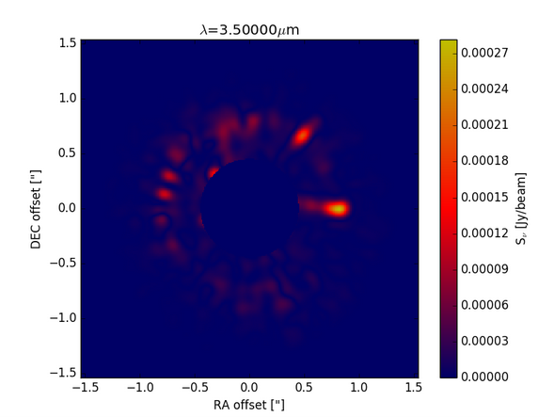
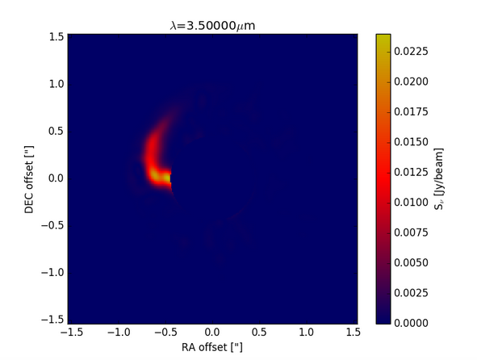
Effect of shocks alone
1 μm
10 μm
Hord et al. (2017)

Slide 16
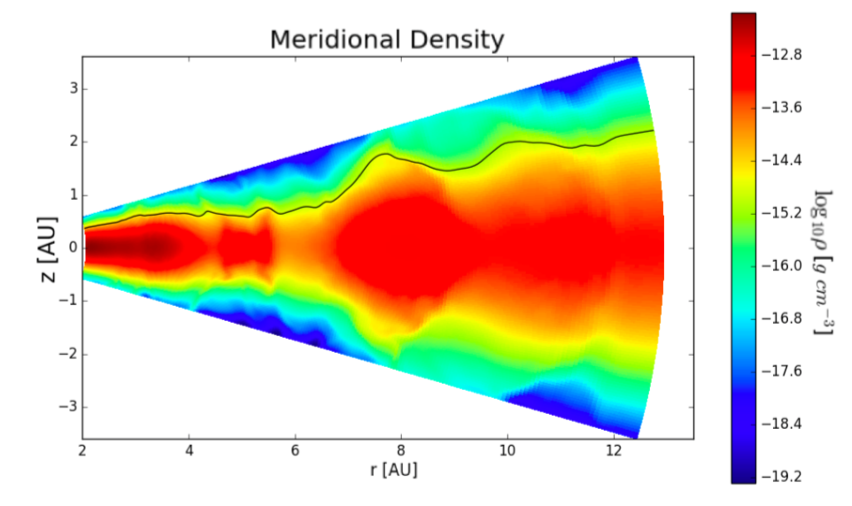
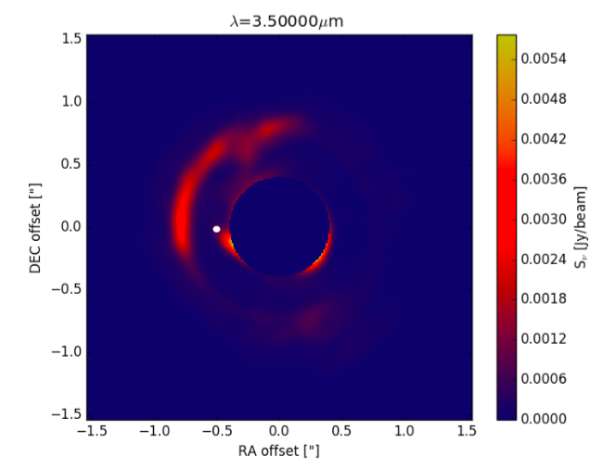
Scattering – A puffed up outer gap
Hord et al. (2017)

Slide 17
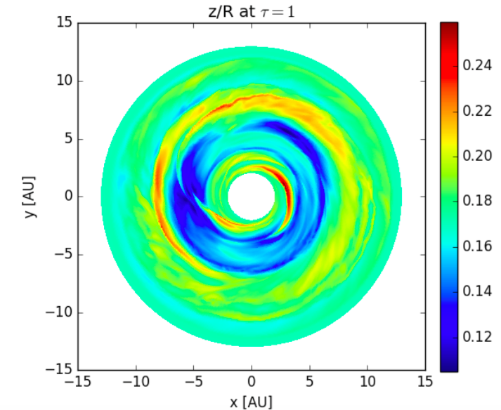
Scattering
Hord et al. (2017)

Slide 18
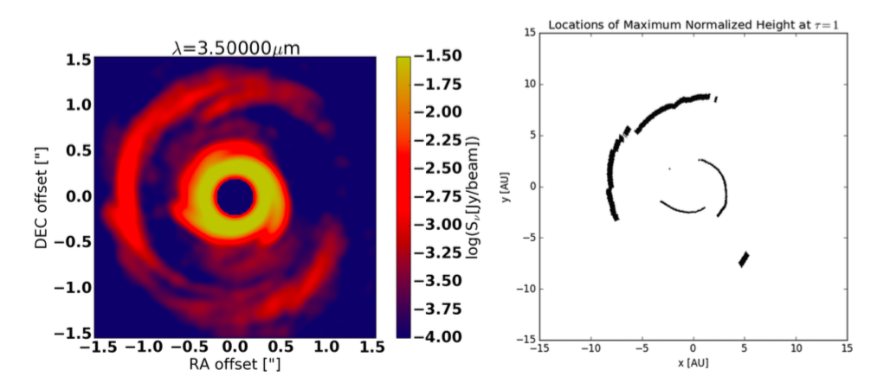
We see what is not in the
shadow of the inner disk spirals
Hord et al. (2017)

Slide 19
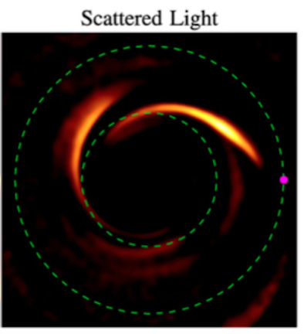
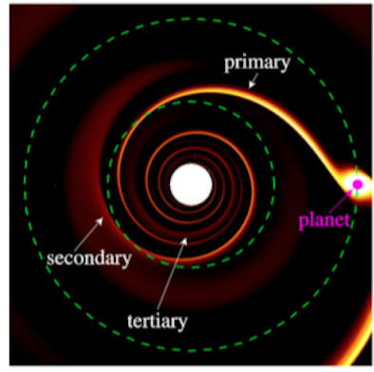
Primary and Secondary spiral arms
Dong et al. (2015)

Slide 20
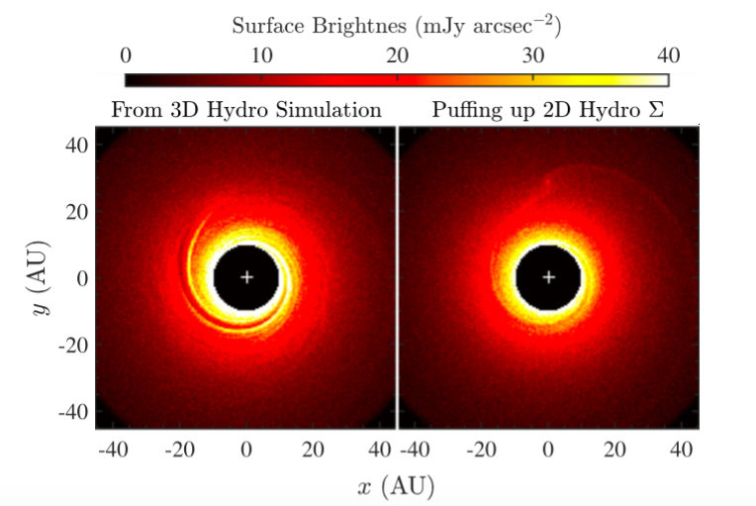
3D is needed
Dong & Fung (2017)

Slide 21
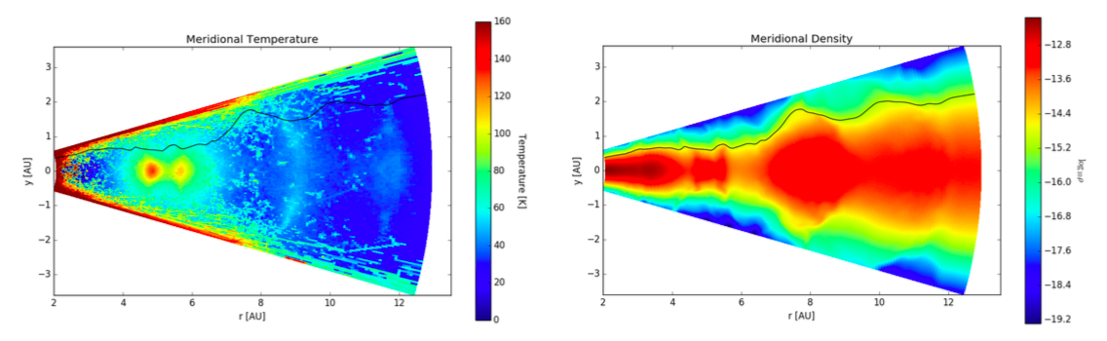
Conclusions
3D radiation-hydro models give results widely different than 2D isothermal
Planet-induced shocks modify disk structure
Hot lobes near high-mass planets in high resolution
Planets puff up their outer gaps – visible in scattered light

Slide 22
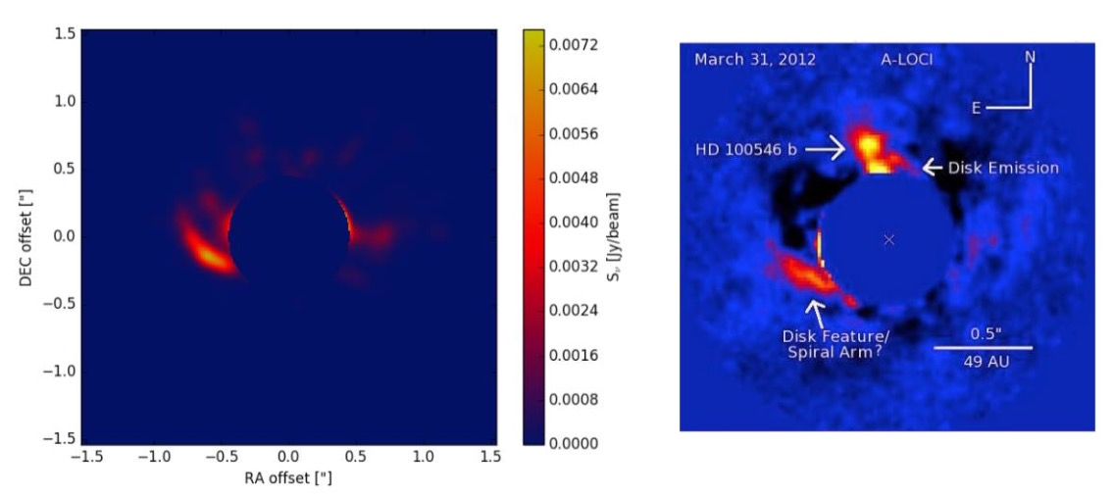
Conclusions
3D radiation-hydro models give results widely different than 2D isothermal
Planet-induced shocks modify disk structure
Hot lobes near high-mass planets in high resolution
Planets puff up their outer gaps – visible in scattered light

Slide 23

Scattering: “the light that never warms”
Hellish glare and in(ter)ference
The Queenly flux, eternal light
Or the light that never warms
Yes the light that never, never warms
Or the light that never
Never warms
Never warms
Never warms
Astronomy… a star
Astronomy
(Metallica, 1998)

