Slide 1











Planet signatures
in transition disks
Wladimir Lyra
California State University
Jet Propulsion Laboratory
Collaborators
Aaron Boley (Vancouver), Axel Brandenburg (Stockholm), Simon Casassus (Chile), Thayne Currie (NASA Ames), Kees Dullemond (Heidelberg), Mario Flock (Heildeberg), Blake Hord (Stanford), Anders Johansen (Lund), Tobias Heinemann (Copenhagen), Hubert Klahr (Heidelberg), Marc Kuchner (Goddard), Michiel Lambrechts (Lund), Min-Kai Lin (ASIAA), Mordecai-Mark Mac Low (AMNH), Frederic Masset (Mexico), Colin McNally (London), Krzysztof Mizerski (Warsaw), Richard Nelson (London) Satoshi Okuzumi (Tokyo), Sijme-Jan Paardekooper (London), Sebastian Perez (Chile), Nikolai Piskunov (Uppsala), Natalie Raettig (Heidelberg), Alex Richert (PSU), Zsolt Sandor (Budapest), Neal Turner (JPL), Orkan Umurhan (NASA Ames), Nienke van der Marel (Victoria), Chao-Chin Yang (UNLV).
Caltech, Dec 7th, 2018

Slide 2

Transits
Radial velocities
Microlensing
Timing variations
Direct imaging
Slide by A. Richert

Slide 3
Transits
Radial velocities
Microlensing
Timing variations
Direct imaging
Disk interactions
Slide by A. Richert

Slide 4
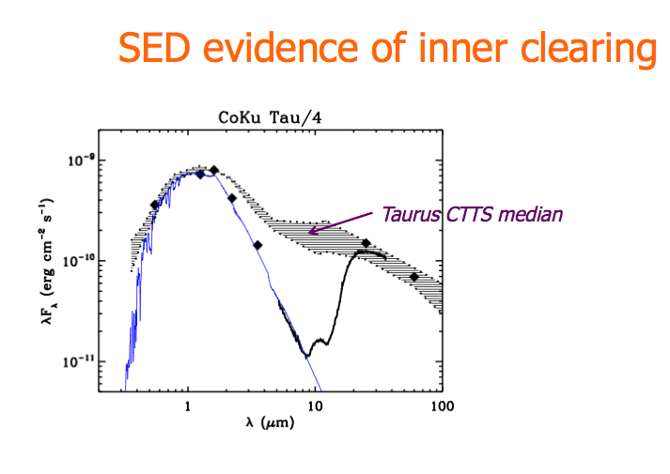
Transition Disks: Disks with missing hot dust.

Slide 5
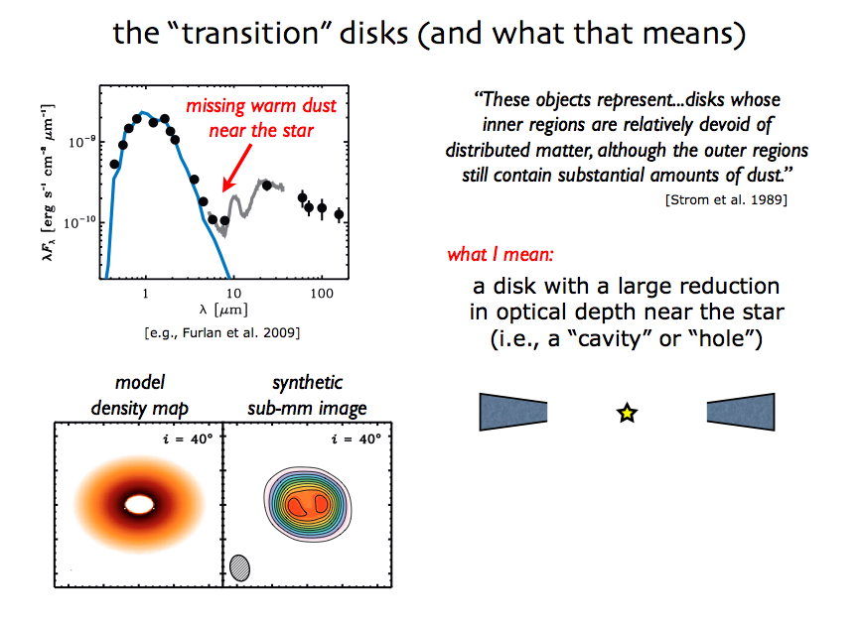
Transition Disks: Disks with missing hot dust.

Slide 6
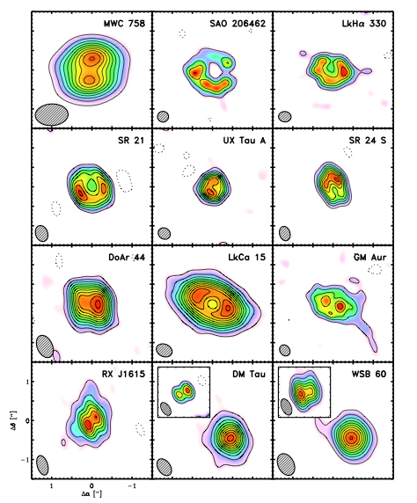
Resolved transition disks with
the Sub-millimeter Array (SMA)
0.85mm
0.3’’ ~ 20 AU resolution

Slide 7
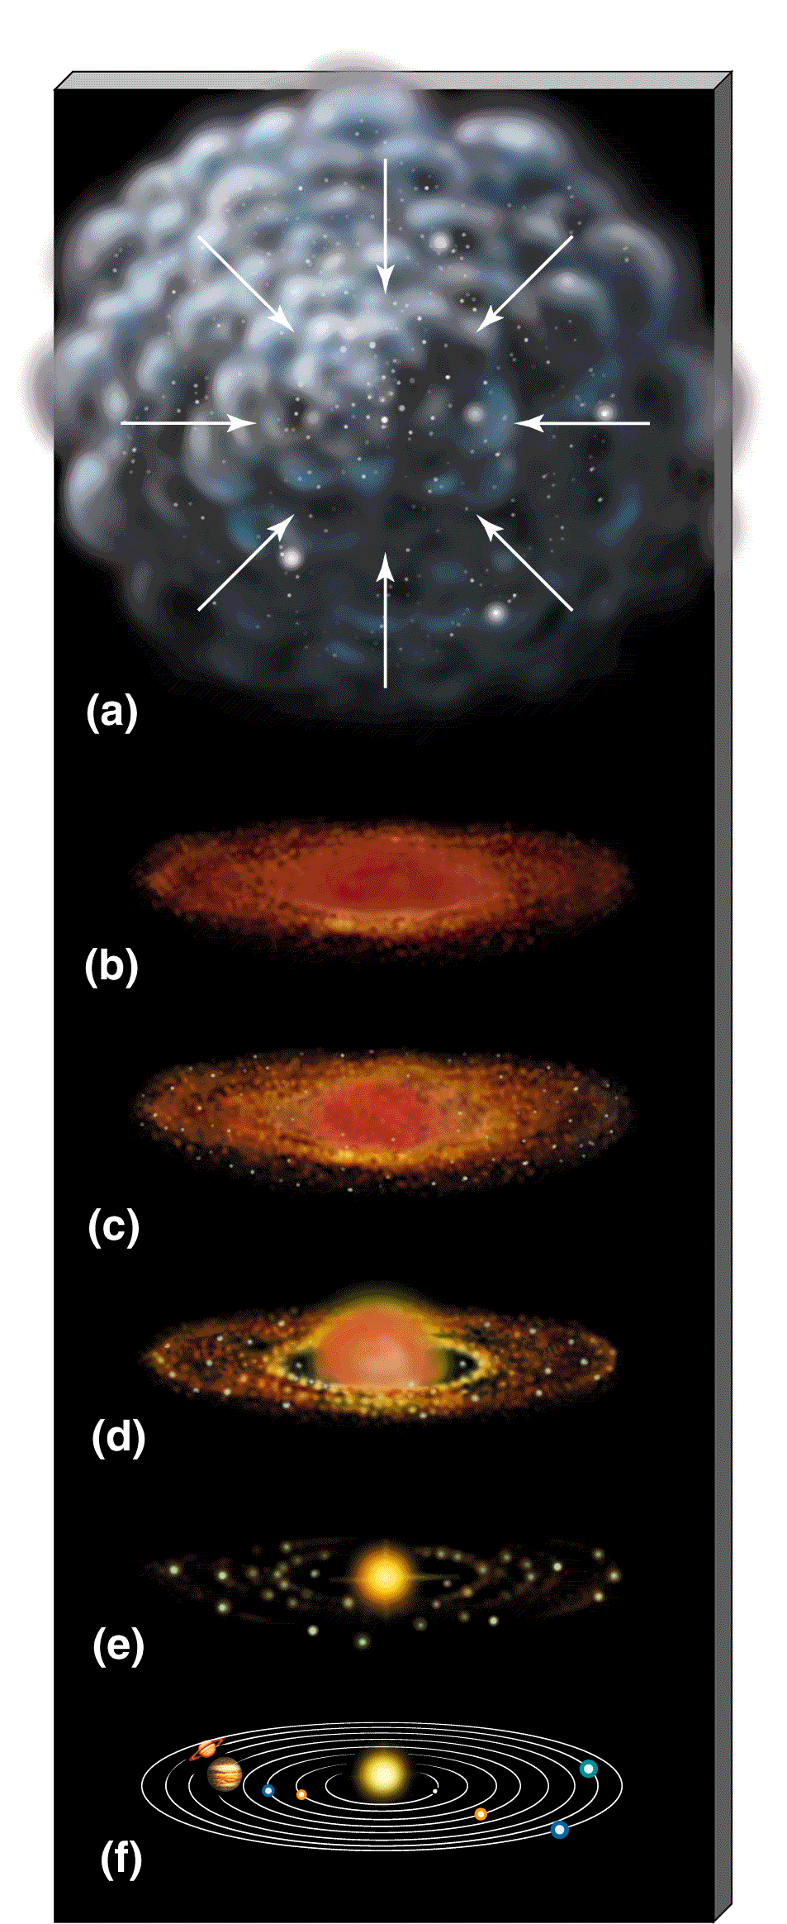
Are transitional disks
related to disk evolution?
Gas-rich phase (< 10 Myr)
Primordial Disks
Thinning phase (~10 Myr)
Transitional Disks
Gas-poor phase (>10 Myr)
Debris Disks

Slide 8
Are transitional disks
related to disk evolution?
Gas-rich phase (< 10 Myr)
Primordial Disks
Conjecture:
Thinning phase (~10 Myr)
Transitional Disks
Gas-poor phase (>10 Myr)
Debris Disks

Slide 9
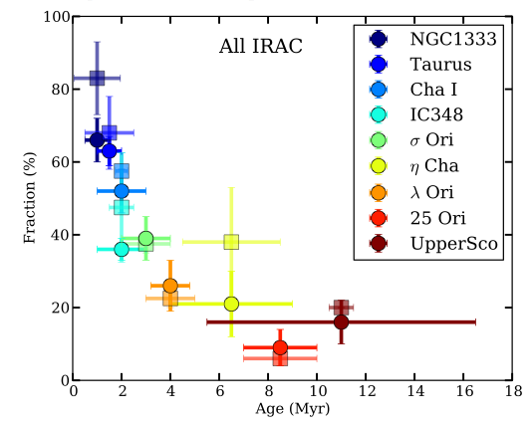
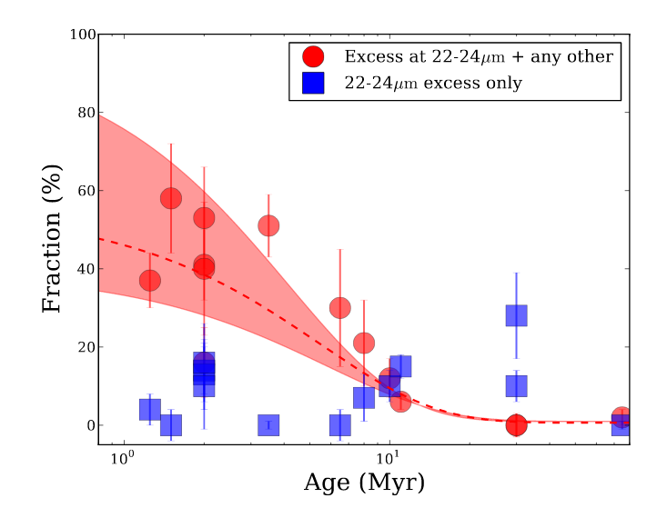
Transition disks and disk evolution
“Total” disk fraction
(Ribas et al. 2014)
Transition disk fraction
(Ribas et al. 2014)

Slide 10
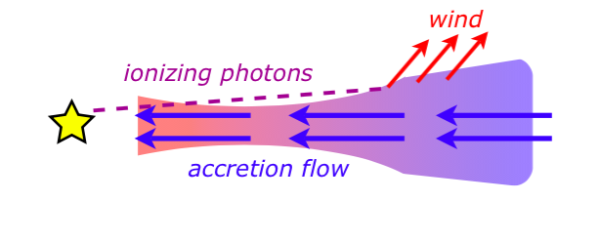
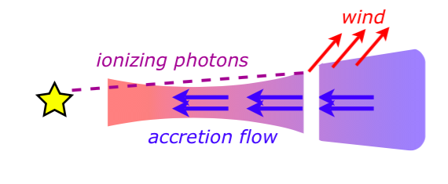
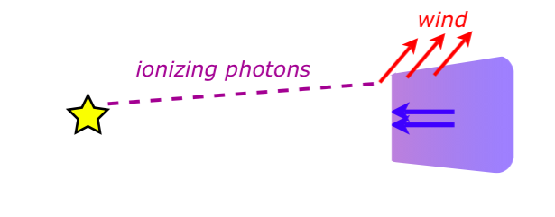
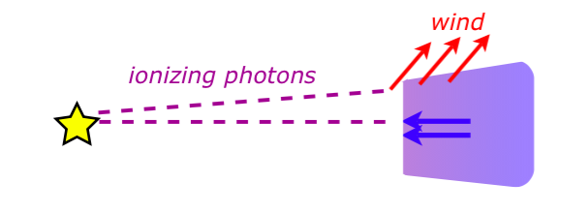
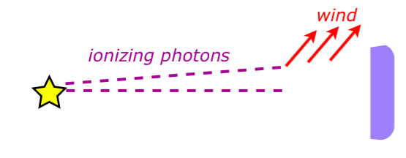
Photoevaporation

Slide 11
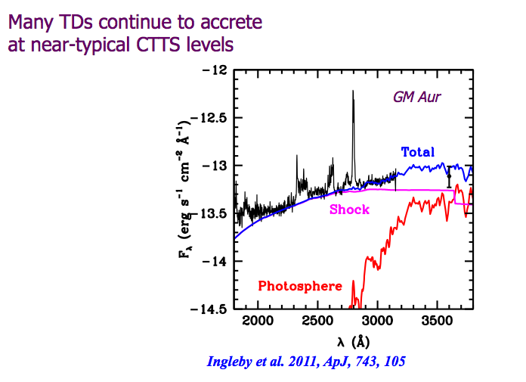
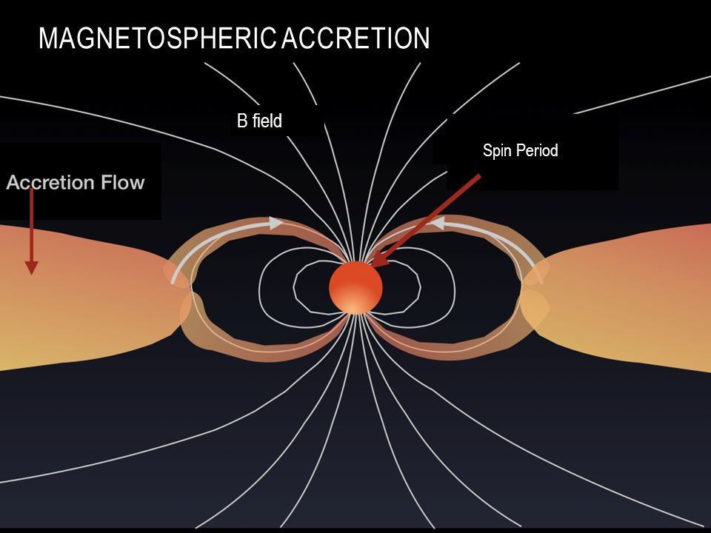
UV excess
Many transitional disks show signs of accretion,
at the level of primordial (classical T-Tauri) disks.
Accretion shock
(Ingleby et al. 2011)

Slide 12
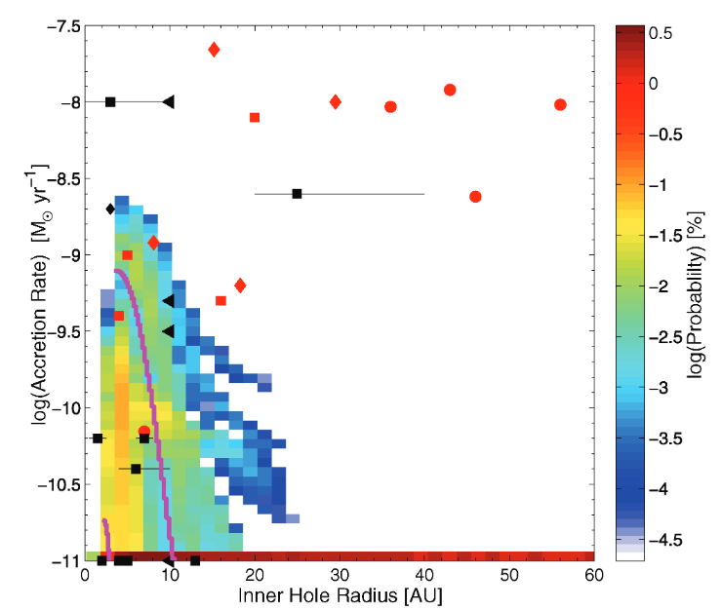
Bimodal distribution of transition disks
(Owen et al. 2011)

Slide 13
Bimodal distribution of transition disks
Not explained by photo-evaporation
Explained by
Photo-
evaporation
(Owen et al. 2011)

Slide 14
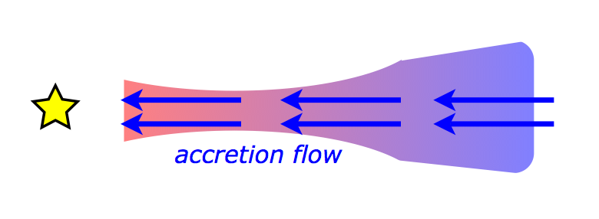
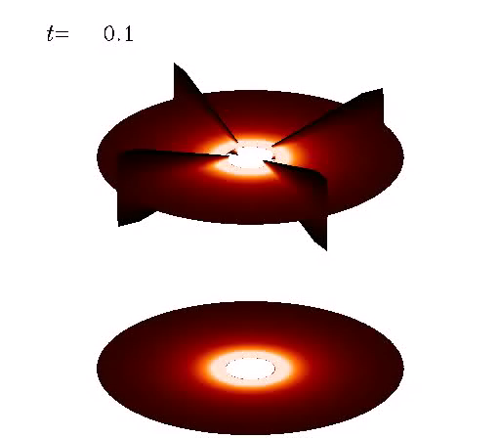
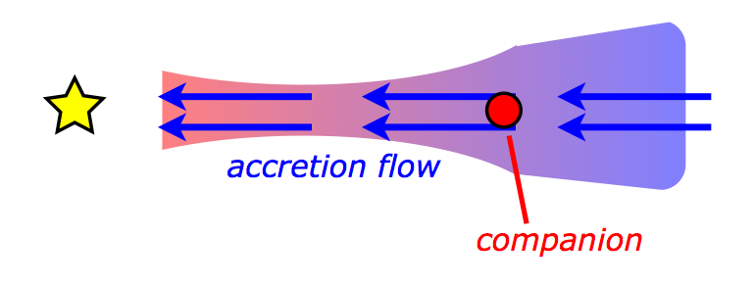
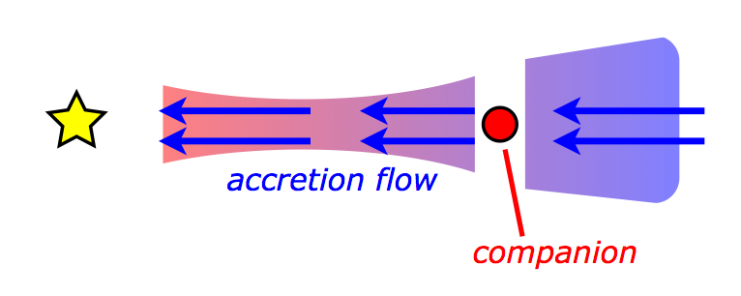
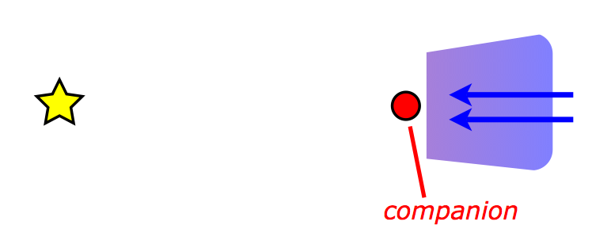
Planetary companion
(Lyra 2009)

Slide 15
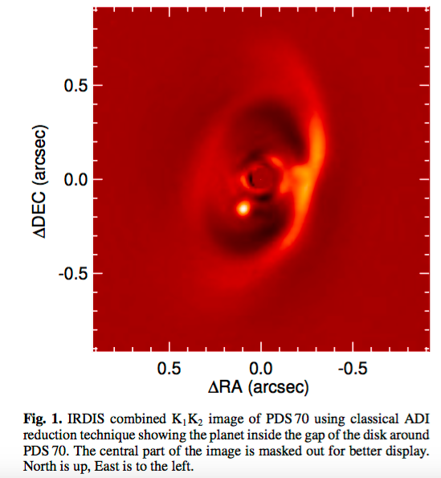
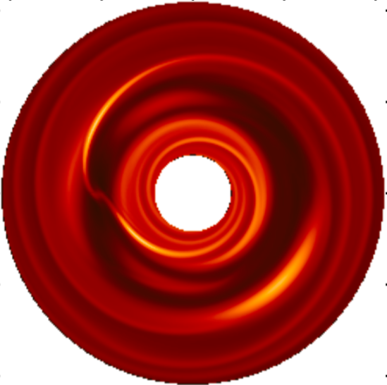
These cavities may be the telltale signature of forming planets
PDS 70 and PDS 70b
(Muller et al. 2018)
(Lyra et al. 2009b)
A way to directly study planet-disk interaction

Slide 16
Planet-disk interaction: gaps, spirals, and vortices.
(Lyra et al. 2009b)

Slide 17
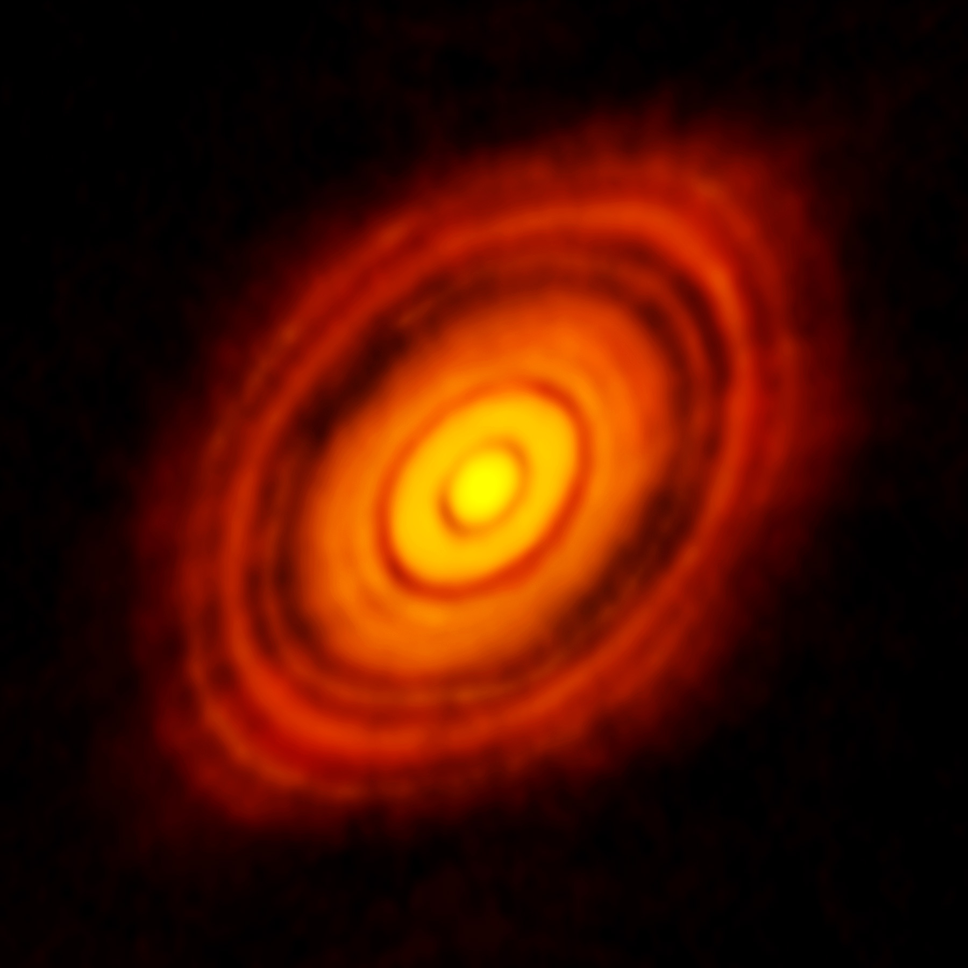
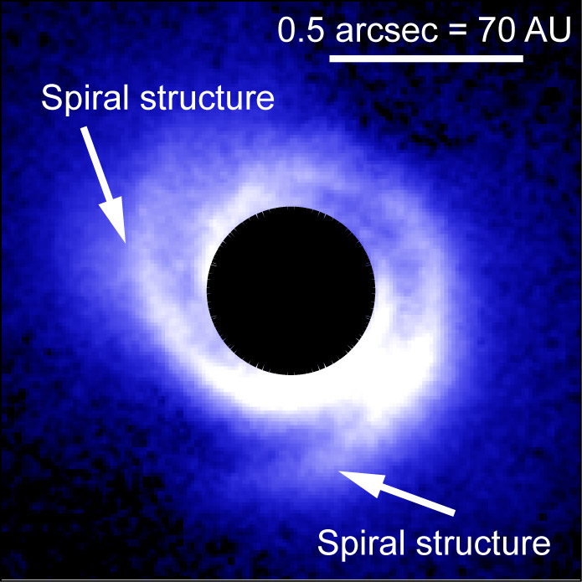
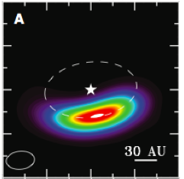
Observational evidence: gaps, spirals, and vortices
HL Tau
SAO 206462
Oph IRS 48
The ALMA Partnership et al. (2015)
Muto et al. (2012)
van der Marel et al. (2013)

Slide 18
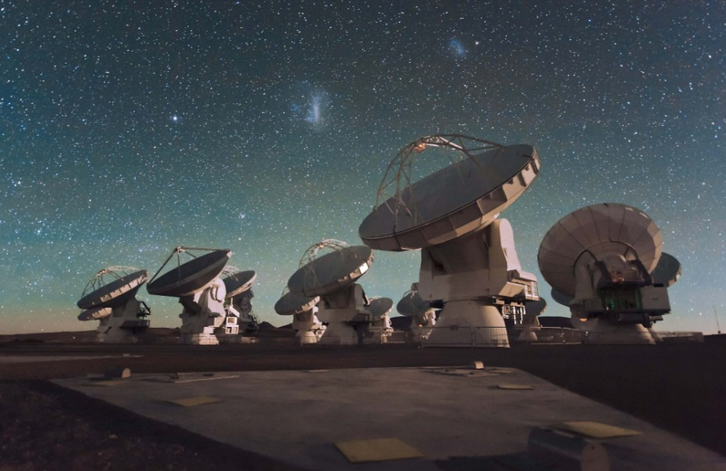
The Atacama Large Millimeter Array (ALMA)

Slide 19
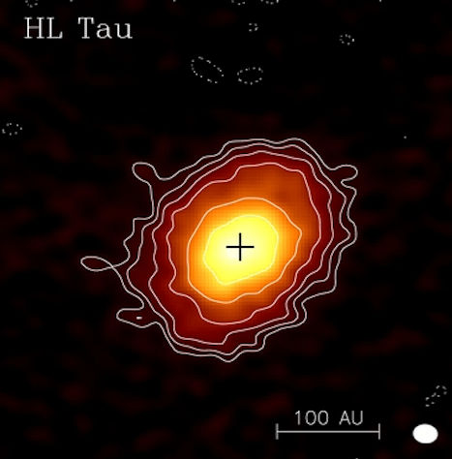
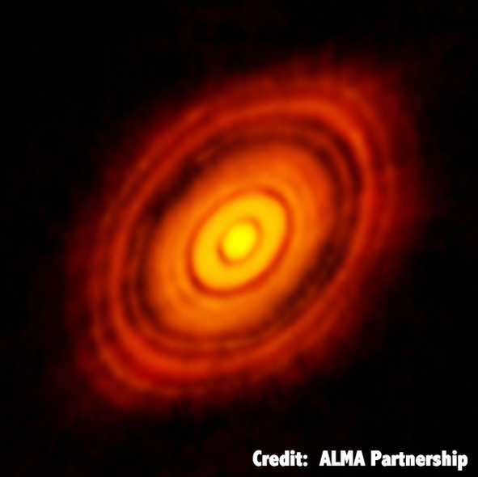
Before ALMA
ALMA

Slide 20
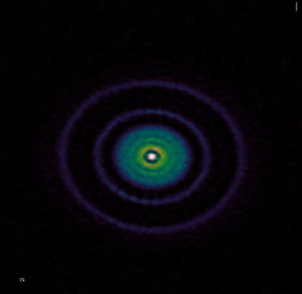
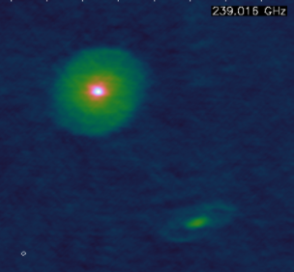
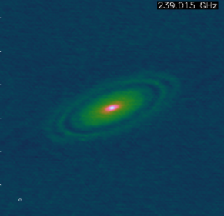
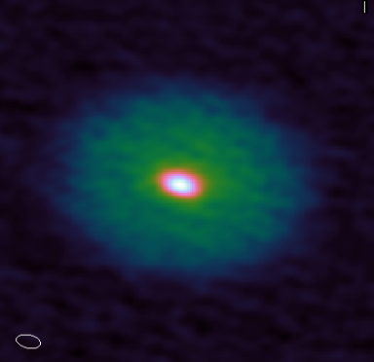
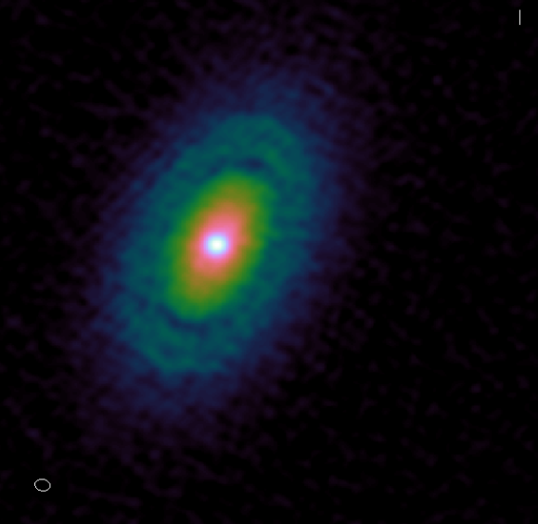
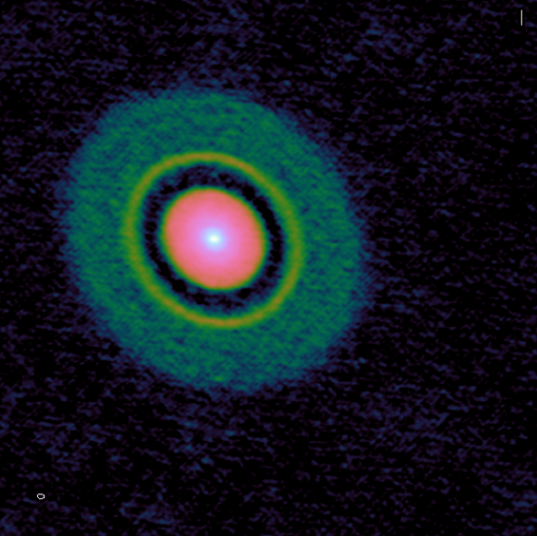
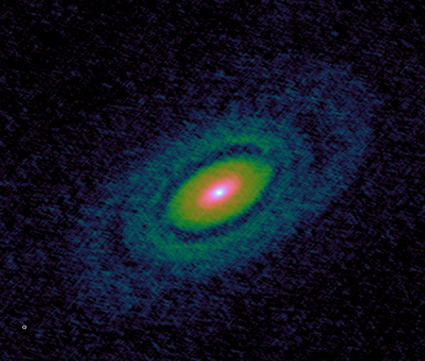
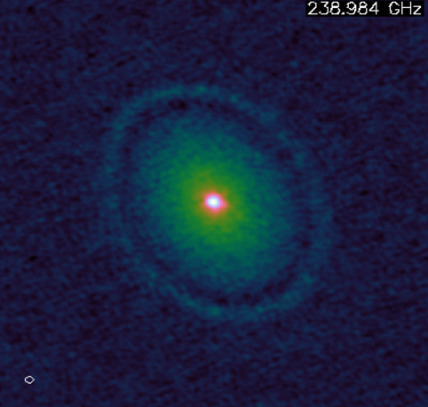
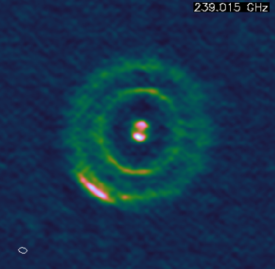
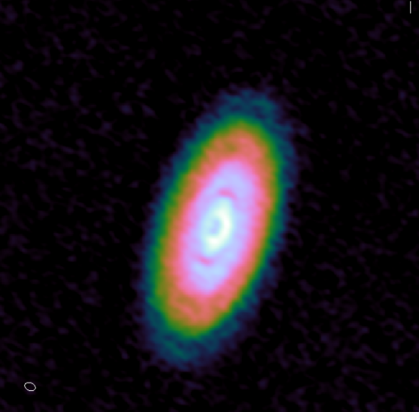
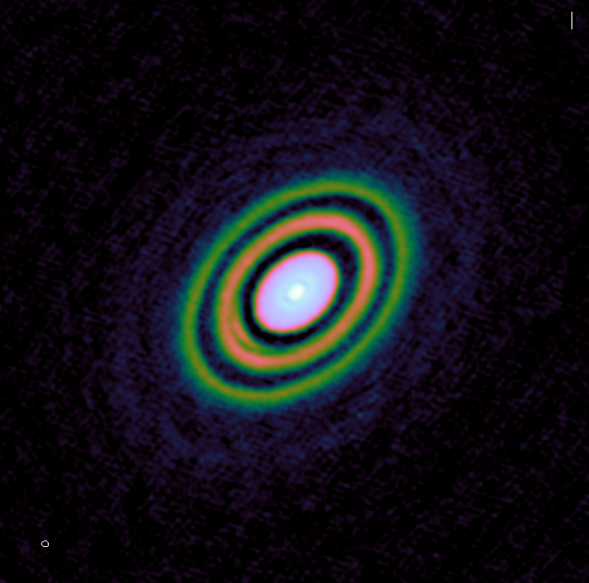
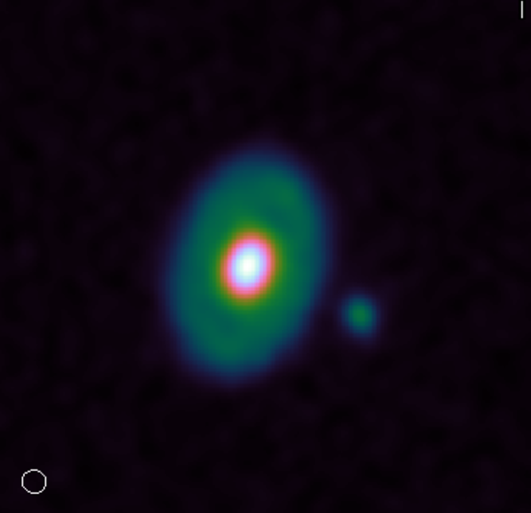
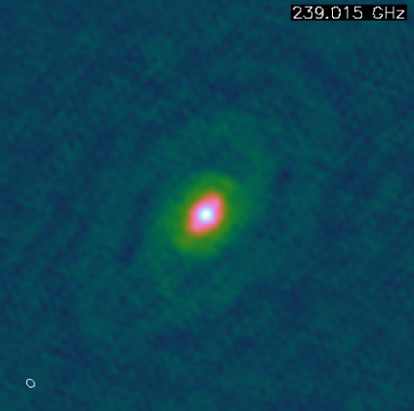
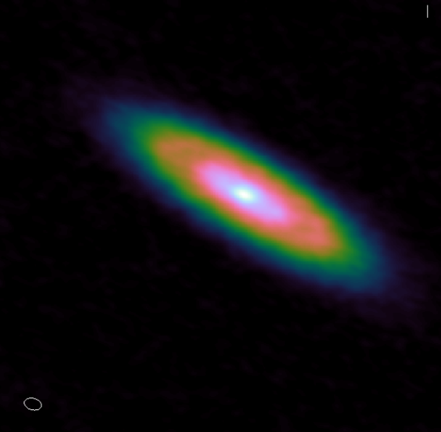
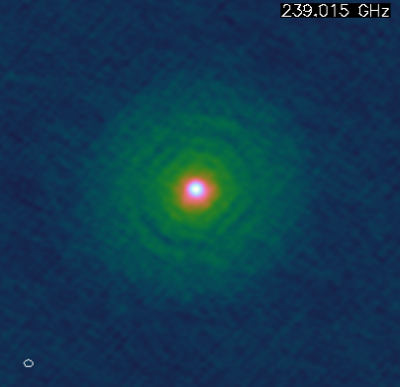
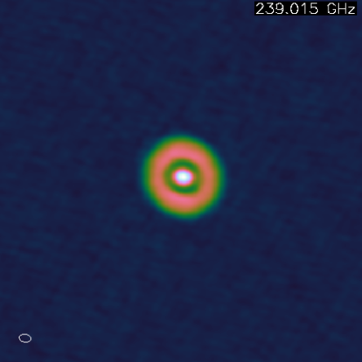
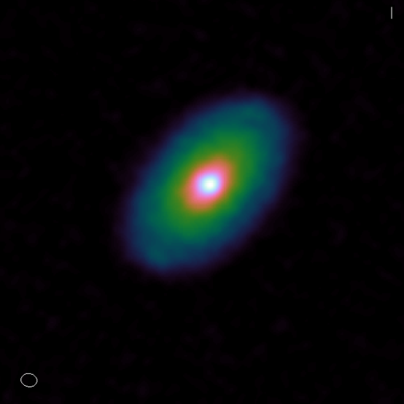
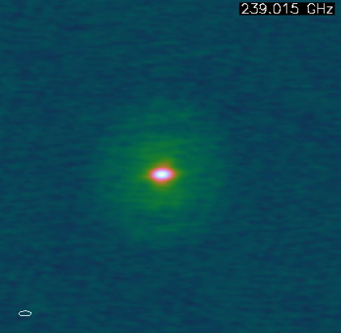
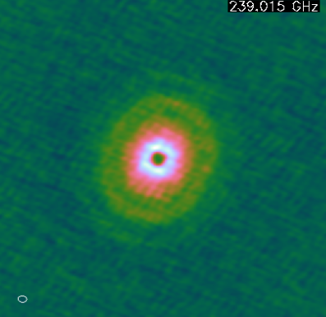
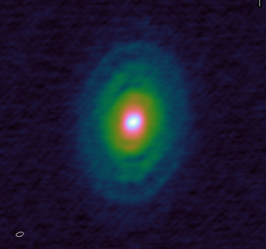

Slide 21
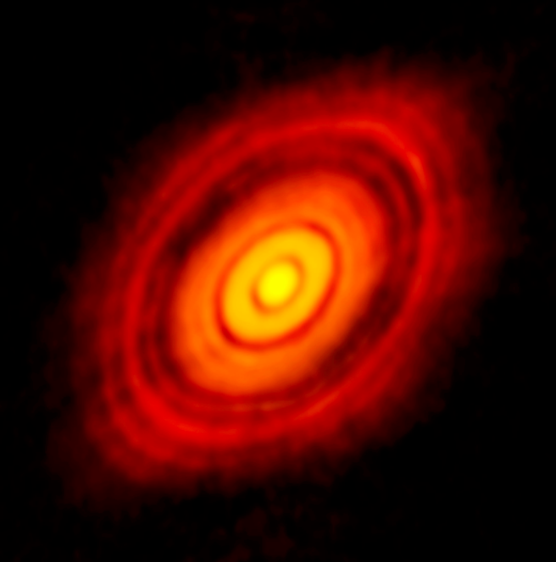
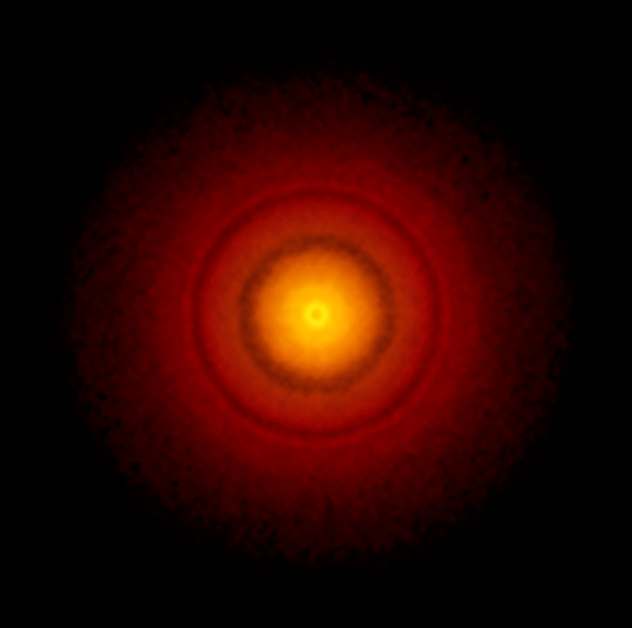
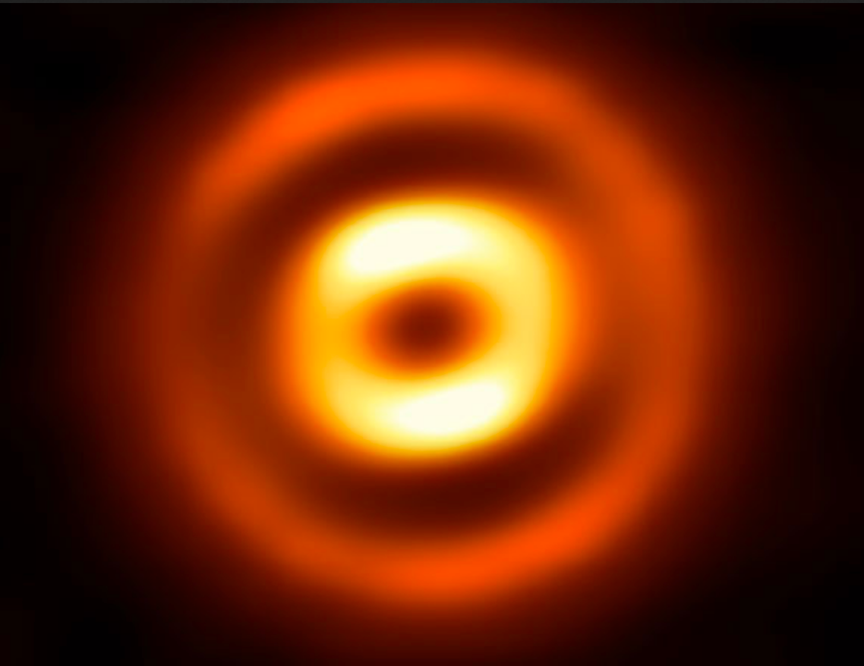


Rings and gaps
HL Tau
TW Hya
HD 169142
HD 163296
V883 Ori
ALMA Partnership+ 15, Andrews, Ricci+ 16, Isella, Ricci+ 16, Cieza+ 16, Fedele+ 17

Slide 22


Oph IRS 48
van der Marel et al. 2013
A huge vortex observed with ALMA

Slide 23


The Oph IRS 48 “comet formation factory”
asymmetric
mm dust
at 63 AU
Gas detection:
Keplerian rotation
Micron-sized
dust follows gas
van der Marel et al. (2013)

Slide 24

Asymmetries everywhere!

Slide 25

SPHERE-ALMA-VLA overlay of MWC 758
SPHERE (μm)
ALMA ( ~ mm)
VLA (cm-m)
Marino et al. (2015)

Slide 26

MWC 758
Dong et al. (2018)

Slide 27



Pebble trapping
Overlay
ALMA
(mm)
VLA
(cm-m)
Casassus et al. (2018)

Slide 28

Vortex Trapping
Geostrophic balance:
Coriolis
force
Pressure
force
Vortex
streamline
Barge & Sommeria (1995)
Grains do not feel the pressure gradient.
They sink towards the center, where they accumulate.
Aid to planet formation
(Barge & Sommeria 1995, Tanga et al. 1996, Barranco & Marcus 2005)
Speed up planet formation enormously
(Lyra et al. 2008b, 2009ab, Raettig et al. 2012)

Slide 29


Vortex Trapping
Geostrophic balance:
Coriolis
force
Pressure
force
Vortex
streamline
Raettig, Lyra, & Klahr (2013)
Grains do not feel the pressure gradient.
They sink towards the center, where they accumulate.
Aid to planet formation
(Barge & Sommeria 1995, Tanga et al. 1996, Barranco & Marcus 2005)
Speed up planet formation enormously
(Lyra et al. 2008b, 2009ab, Raettig et al. 2012)

Slide 30

Drag-Diffusion Equilibrium
Dust continuity equation
Drag force
Diffusion
compression
advection
diffusion
Trapped particle

Slide 31


Drag-Diffusion Equilibrium
Steady-state solution
Lyra & Lin (2013)
Drag force
Diffusion
a = vortex semi-minor axis
H = disk scale height (temperature)
χ = vortex aspect ratio
δ = diffusion parameter
St = Stokes number (particle size)
f(χ) = model-dependent scale function
Trapped particle

Slide 32



Analytical solution for dust in drag-diffusion equilibrium
Solution
a = distance to vortex center
H = disk scale height (temperature)
χ = vortex aspect ratio
δ = diffusion parameter
St = Stokes number (grain size)
f(χ) = model-dependent scale function
Solution for
H/r=0.1 χ=4 S=1
Lyra & Lin (2013)

Slide 33


Analytical vs Numerical
S = St/δ
Lyra & Lin (2013)
Raettig et al (2015)

Slide 34

Analytical vs Numerical

Slide 35
Analytical vs Numerical vs Observational
Lyra & Lin (2013)
ALMA
(mm)
VLA
(cm-m)
Raettig, Lyra , & Klahr et al (2015)
Casassus, Marino, Lyra et al. (2018)

Slide 36

Observational vs Analytical
(Monte Carlo Markov Chain)
Casassus et al. (2018)

Slide 37

Observational Evidence: Spirals
SAO 206462
MWC 758
Muto et al. (2012)
Benisty et al. (2015)

Slide 38


Spiral arm fitting leads to problems
Analytical spiral fit
Spirals are too wide,
hotter (300K) than ambient gas (50K).
Rafikov (2002)
Muto et al. (2012)
Benisty et al. (2015)

Slide 39

Supersonic wake of high mass planets
does not follow the linear prediction

Slide 40

The strange case of thermal emission in HD 100546
L band (~3.5 μm)
H band (~1.6 μm)

Slide 41



Lyra et al. (2016)
Currie et al. (2014, 2015)

Slide 42

Planet-driven turbulence
Richert et al. (2015)

Slide 43


Slide 44

Turbulence in high-mass planets in adiabatic disks
Planet mass
Isothermal
Adiabatic
Richert et al. (2015)

Slide 45


Slide 46
3D: Shock bores
Shocks (velocity convergence)
Temperature
Lyra et al. (2016)

Slide 47
3D shocks: bores and breaking waves
Temperature
Div u
(shock)
Lyra et al. (2016)

Slide 48

Prediction for spectroscopy: Turbulent surf
Lyra et al. (2016)

Slide 49

Synthetic image by RADMC3D and shock heating
Hord et al. (2017)

Slide 50


Observation vs Synthetic Image
Currie et al. (2015)
Hord et al. (2017)

Slide 51


Effect of shocks alone
1 μm
10 μm
Hord et al. (2017)

Slide 52


Scattering – A puffed up outer gap
Hord et al. (2017)

Slide 53

Scattering
Hord et al. (2017)

Slide 54


The pattern is stationary
T = 39 orbits
T = 40 orbits
T = 41 orbits
Density
Intensity
Hord et al. (2017)

Slide 55


Primary and Secondary spiral arms
Fung and Dong (2015)

Slide 56

Primary and Secondary spiral arms
Hord et al. (2017)

Slide 57

Conclusions
3D radiation-hydro models give results widely different than 2D isothermal
Planet-induced shocks modify disk structure
Hot lobes near high-mass planets in high resolution
Planets puff up their outer gaps – visible in scattered light

Slide 58

Conclusions
3D radiation-hydro models give results widely different than 2D isothermal
Planet-induced shocks modify disk structure
Hot lobes near high-mass planets in high resolution
Planets puff up their outer gaps – visible in scattered light

