Slide 1
Primer on disk simulations
Wladimir Lyra
California State University
Jet Propulsion Laboratory
New York, Mar 11th, 2019

Slide 2
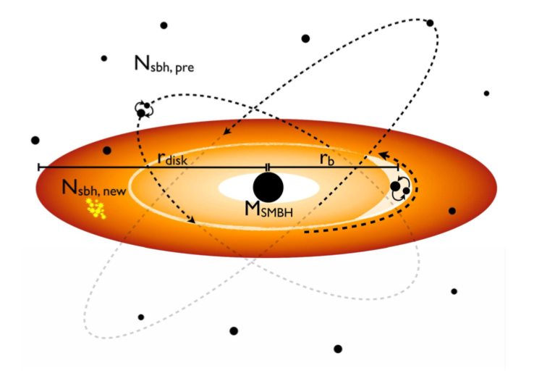
A cartoon AGN

Slide 3
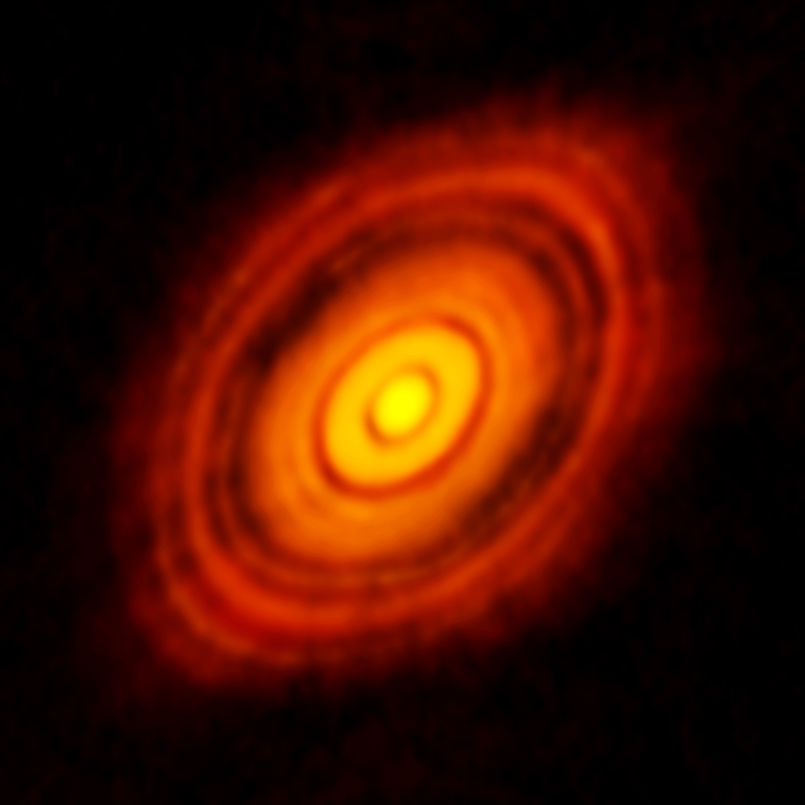
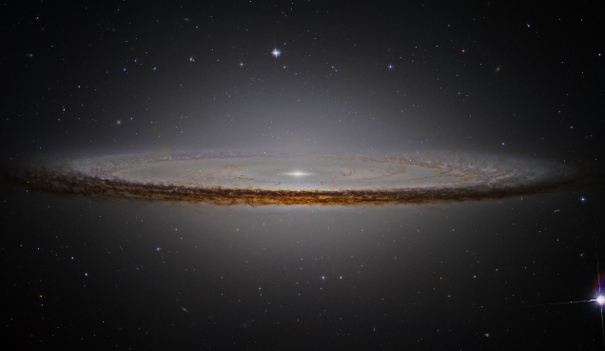
Disks in Astrophysics
Protoplanetary
AGNs
Galaxies

Slide 5
State of the art in pp-disk modeling
MHD (ideal and non-ideal MHD)
Selfgravity
Dust
Chemistry
Radiative Transfer
Post-processing
Radiation hydrodynamics
Flux-limited diffusion
Ray tracing (long or short characteristics) usually done for solar atmospheres but not for disks.

Slide 6
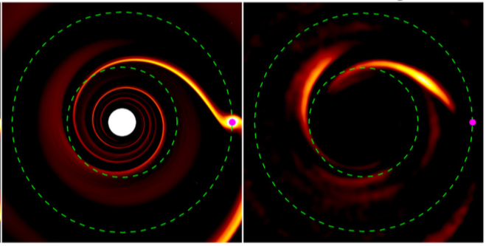
3D Hydro
Scattered light
post-processing
Radiative Transfer
Post-processing
Radiation hydrodynamics
Flux-limited diffusion
Ray tracing (long or short characteristics) usually done for solar atmospheres but not for disks.

Slide 7
Codes
Grid-based (Eulerian)
Geometry of flow and grid align
Self gravity usually a problem in 3D
GPUs vs CPUs
CPU speed-limited but memory-efficient
10³- few x 10⁴ procs
Resolution 1024³
GPU fast but memory limited
4 GPUs 20 orbits/hr, low resolution 3D (128³)
Examples
Pluto / Athena++ / Pencil / Fargo
Lagrangian
SPH
Free boundaries
Contact discontinuities not
well captured (instabilities
Not well modeled)
Particles adaptively trace
Dense regions.
Excellent for gravity
Examples:
Phantom / Gadget

Slide 8
Why can’t we simply sed ‘s/protoplanetary/AGN/g’
Fully ionized
ppdisks poorly ionized
Relativity
Unimportant in ppdisks,
But even for AGNs only important for the central engine
Retrograde and highly inclined orbiters
Inexistent in ppdisks
Feeback
Stellar (SN) / sBH

Slide 9
Why can’t we simply sed ‘s/protoplanetary/AGN/g’
Fully ionized
ppdisks poorly ionized
Relativity
Unimportant in ppdisks,
But even for AGNs only important for the central engine
Retrograde and highly inclined orbiters
Inexistent in ppdisks
Feeback
Stellar (SN) / sBH

Slide 10
Relativity (GRMHD)

Slide 11
Retrograde and Highly Inclined orbiters

Slide 12
Satellite-disk interaction leads to angular momentum exchange (migration)

Slide 13
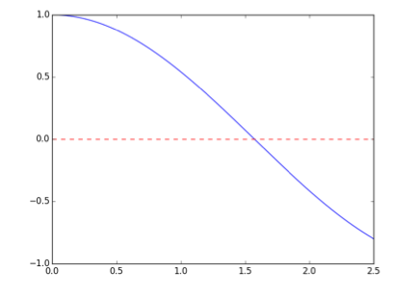
Migration Traps: a simple example
+
TORQUE
-
RADIUS

Slide 14
Migration of a single object
One 30 M₈ BH
Different starting radii
M_{SMBH} = 10⁸ M₈
Orbital Radius (R_{g})
Predicted traps:
331 R_{g}
25 R_{g}
Bellovary et al. in prep

Slide 15
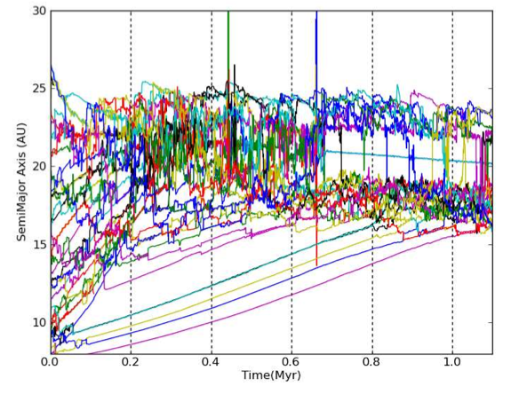
“Crowded” Migration in pp-disks
Horn, et al. (2012)

Slide 16
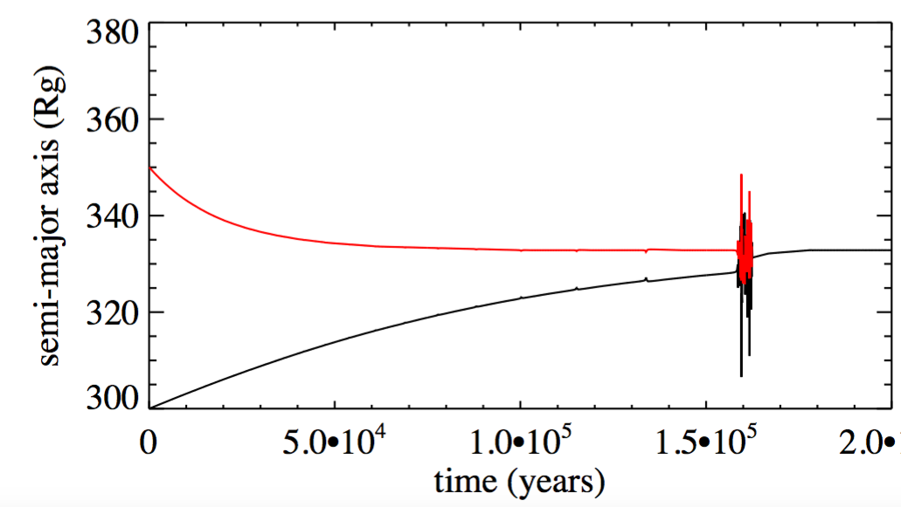
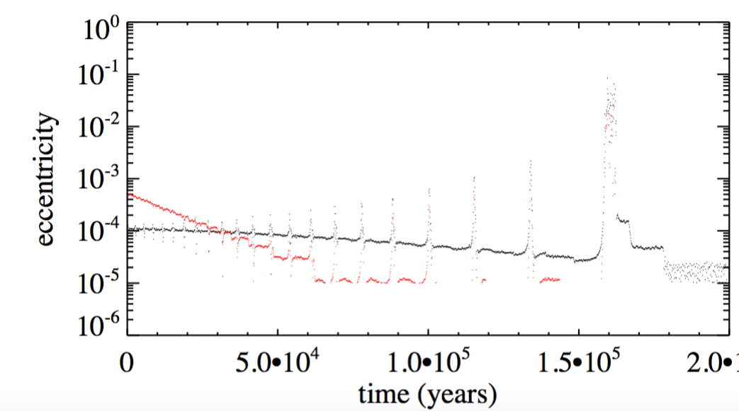
Migration and merger of two objects
50 M₈ BH and 30 M₈ BH
Form a binary upon reaching trap
Secunda et al.
submitted

Slide 17
Retrograde/Inclined Orbiters
Possible Pitfalls
Crowded migration?
Planet migration theory applied to AGNs
Extrapolation from a few (<10 orbiters) to 10⁵ (Dangerous!)
Unexplored regime.
Intuition: As long as they do not overlap corotational regions it is okay to consider they are migrating in isolation.
Question: Would circularization would lead to heating?

Slide 18
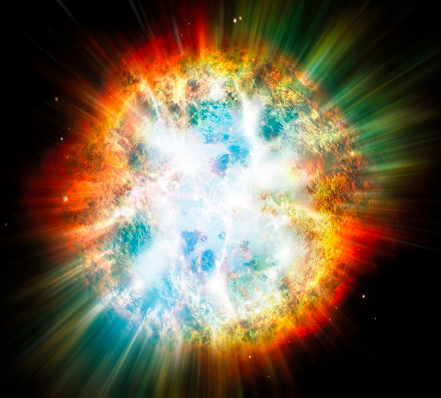
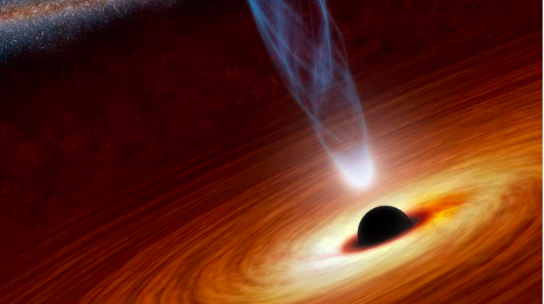
Feedback
Supernovae
sBH / IMBH
accretion disks
Relatively well-known
from galactic disk and
star formation models.
unexplored (?)
Can such source terms be important in disk heating?

Slide 19
Conclusions
State of the art in ppdisks
MHD / Selfgravity / Dust / Chemistry / Radiative Transfer
Types of modeling
Eulerian (grid-based, good for flows matching geometry, shear instabilities)
Lagrangian (meshless, good for free boundaries/gravity)
CPU vs GPU
GPU fast but memory limited
CPU speed-limited but memory-efficient
Differences between ppdisks and AGNs
Fully ionized
Relativity
Crowded (10⁵ orbiters, retro, inclined, heating?)
Feedback

Slide 20
Conclusions
State of the art in ppdisks
MHD / Selfgravity / Dust / Chemistry / Radiative Transfer
Types of modeling
Eulerian (grid-based, good for flows matching geometry, shear instabilities)
Lagrangian (meshless, good for free boundaries/gravity)
CPU vs GPU
GPU fast but memory limited
CPU speed-limited but memory-efficient
Differences between ppdisks and AGNs
Fully ionized
Relativity
Crowded (10⁵ orbiters, retro, inclined, heating?)
Feedback

