Slide 1











LIGO sources in AGN disks
Wladimir Lyra
California State University
Jet Propulsion Laboratory
Collaborators
Jillian Bellovary (AMNH), Saavik Ford (AMNH), Brandon Horn (AMNH),
Bence Kocsis (ELTE), Nathan Leigh (AMNH), Zoltán Haiman (Columbia),
Mordecai Mac Low (AMNH), Barry McKernan (AMNH), Brian Metzger (Columbia),
Hagai Perets (Technion), Zsolt Sándor (ELTE), Lisa Winter (Boulder)
Budapest, June 14rd, 2017

Slide 2
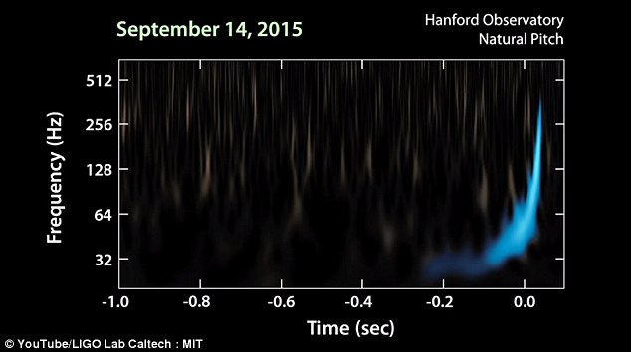
Motivation
LIGO BH Masses:
GW150914: 36 and 29 M₈
LVT151012: 23 and 13 M₈
GW151226: 14 and 7 M₈
GW170104: 31 and 19 M₈
Large masses + misaligned spins challenge stellar evolution-based BH-BH merger theories
We need a new theory!

Slide 3
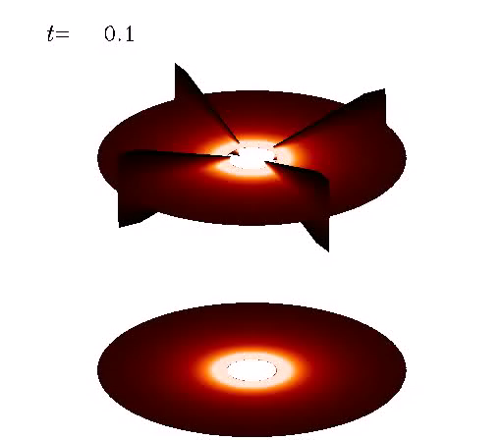
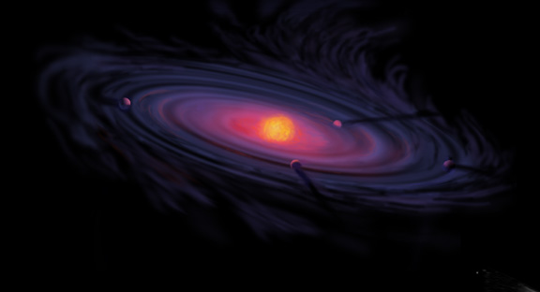
Diversion: Let’s talk about planets
Planets impact the gas dynamics in their parental disk
(Lyra 2009)

Slide 4

Diversion: Let’s talk about planets
Planet-disk interaction leads to angular momentum exchange (migration)

Slide 5
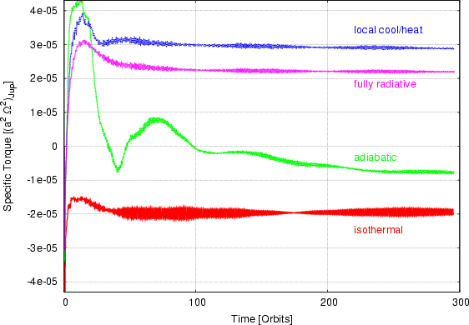
Migration – Thermodynamics matter
Rule of thumb: Migration is
outwards in
steep temperature gradients,
inwards in
isothermal regions.
Paardekooper & Mellema (2006)
Kley & Crida (2008)

Slide 6
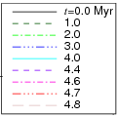
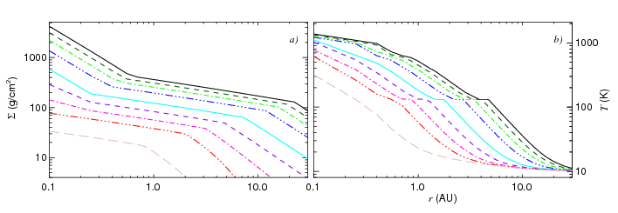
Disk Evolution
Disks evolve in time, due to
photoevaporative winds and viscous evolution
Lyra, Paardekooper, & Mac Low (2010)

Slide 7
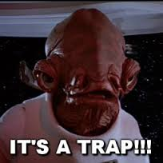
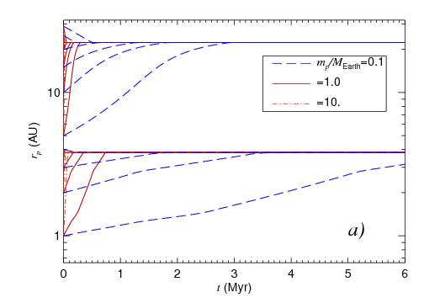
Migration Traps
Planet-disk interaction leads to angular momentum exchange
Rule of thumb: Migration is
outwards in
steep temperature gradients,
inwards in
isothermal regions.
Planet traps where migration is convergent
(τ=0, dτ/dr < 0).
Lyra, Paardekooper, & Mac Low (2010)

Slide 8
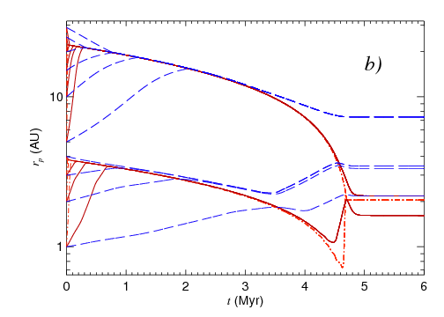

Migration in Evolutionary Models
Rule of thumb: Migration is
outwards in
steep temperature gradients,
inwards in
isothermal regions.
Disks evolve in time, due to
photoevaporative winds and viscous evolution
Single planets in a planetary trap
evolve in lockstep with the gas at the accretion timescale.
At some point, the disk becomes too thin to drive accretion. The planet decouples and is released in a safe orbit.
Lyra, Paardekooper, & Mac Low (2010)

Slide 9
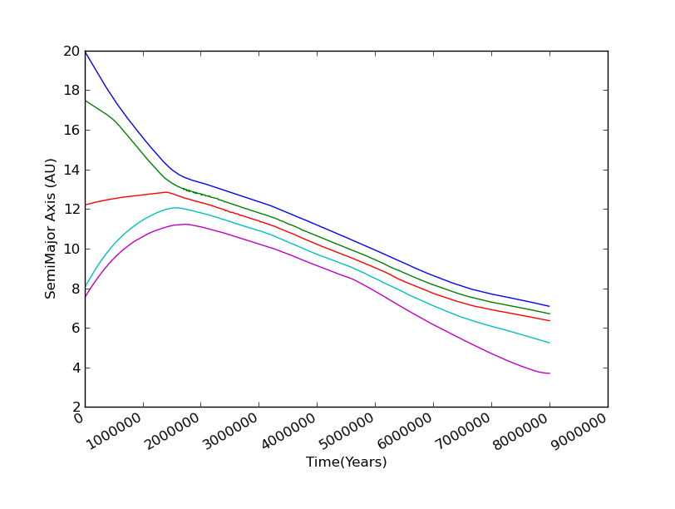
Resonance Trapping
Migration in resonance !
Sandor, Lyra & Dullemond (2011)

Slide 10
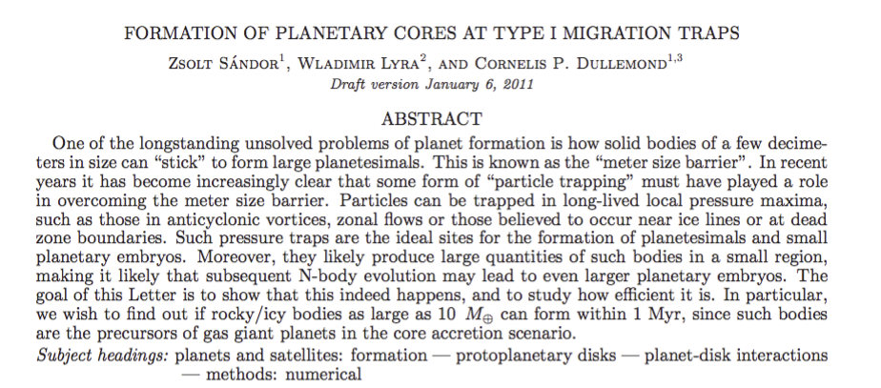
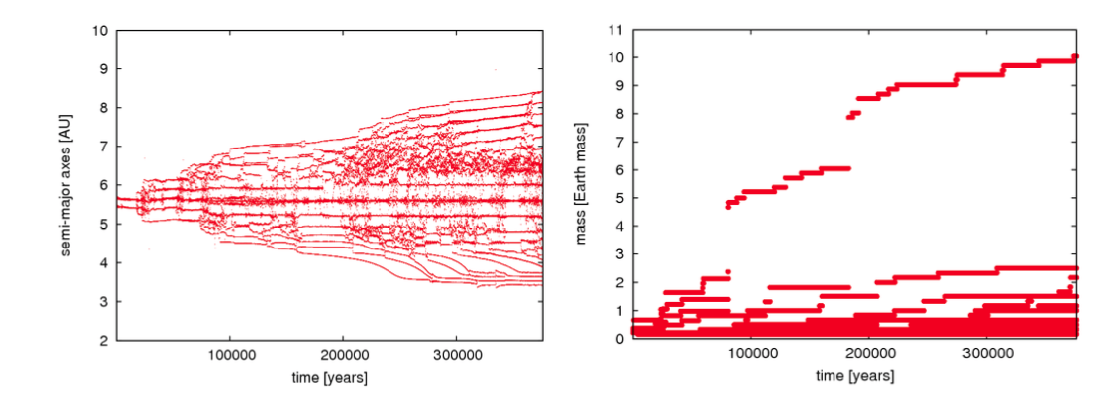
Growing larger stuff in migration traps
Resonance trapping
Mars-mass protoplanets added at migration trap
Resonance broken by N-body interaction, that disturbs the resonance
Sandor, Lyra & Dullemond (2011)

Slide 11
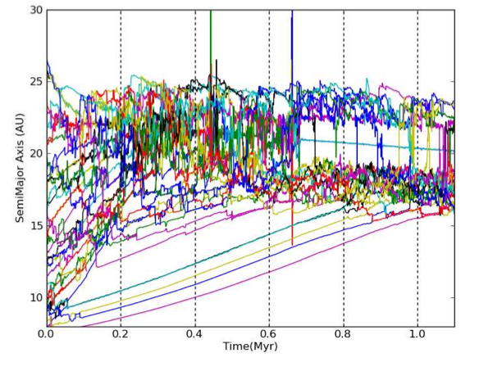
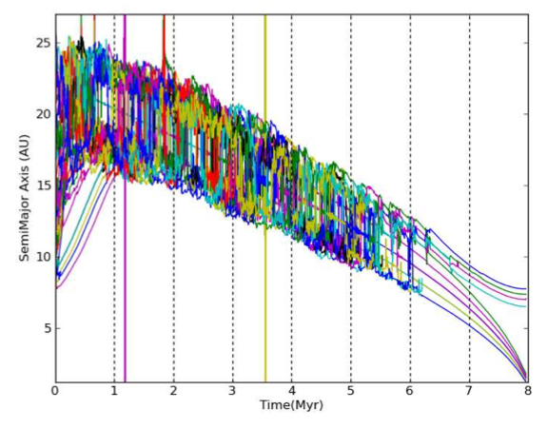
Orbital migration of interacting planets
in a radiative evolutionary model
Combines
migration + N-body + photoevaporation + turbulence
modelled as stochastic forcing
(Laughlin et al. 2004, Ogihara et al. 2007)
Horn, Lyra, Mac Low & Sándor (2012)

Slide 12
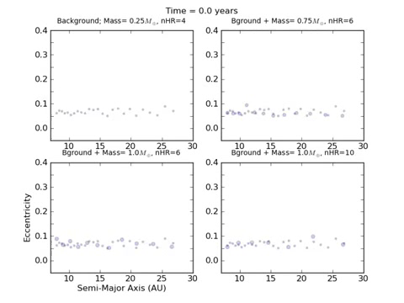
Orbital migration of interacting planets
in a radiative evolutionary model
Horn, Lyra, Mac Low & Sándor (2012)

Slide 13
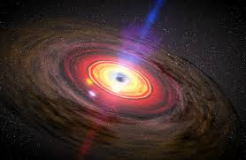
Back to black holes, and migration traps
Protoplanets → stellar mass black holes
Protoplanetary disk → SMBH accretion disk
Black holes can migrate too!
→ MIGRATION TRAPS
Result → lots of black hole mergers, making bigger and bigger black holes?!
McKernan+ 12

Slide 14
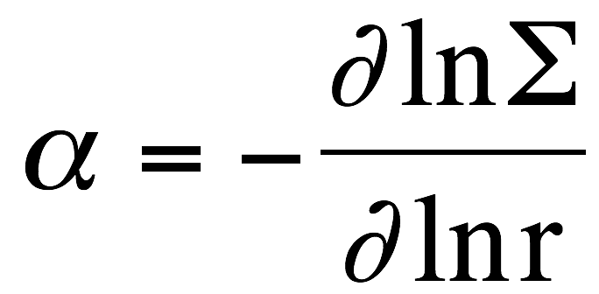
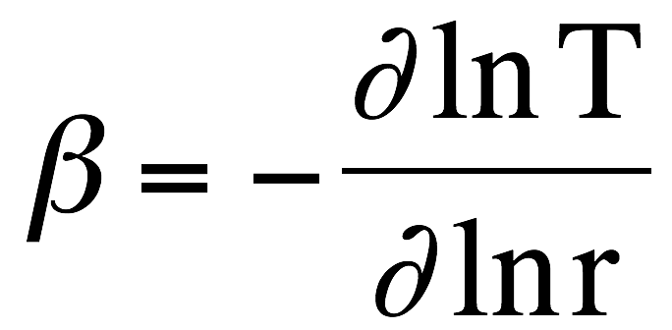
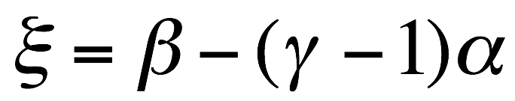
Torque calculation:
Surface density gradient
Temperature gradient
Entropy gradient
Scale height h/r
Optical depth τ
Paardekooper+ 10

Slide 15
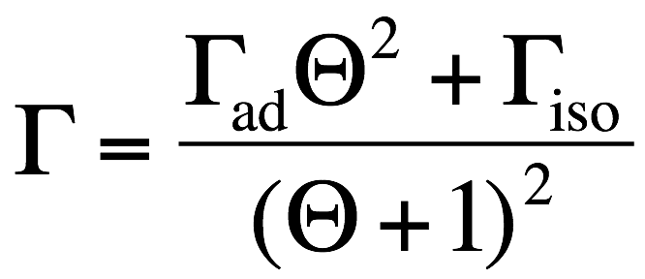
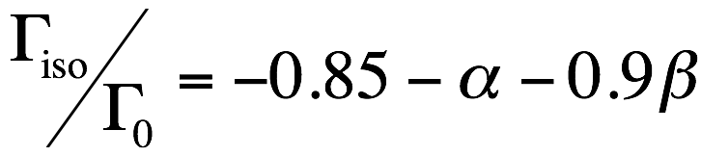
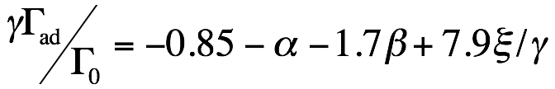
Torque calculation:
Surface density gradient
Temperature gradient
Entropy gradient
Scale height h/r
Optical depth τ
Total torque:
Torques:
Θ = t_{rad}/t_{dyn}
Paardekooper+ 10
Lyra+ 10

Slide 16
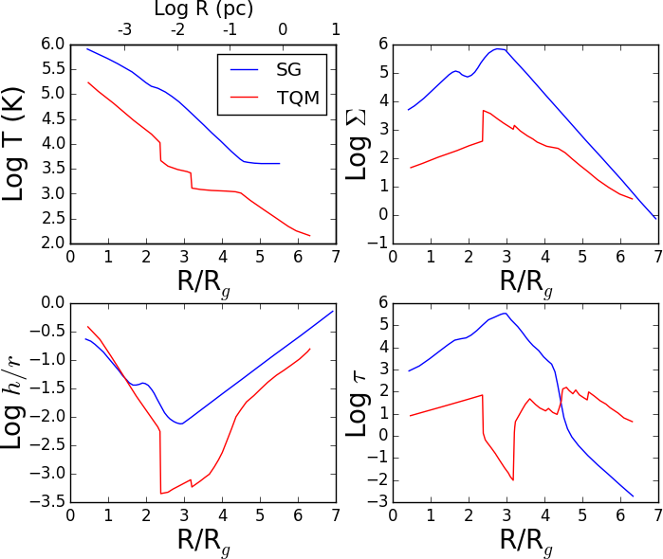
AGN disk models
Sirko & Goodman 2003
Thompson, Quataert & Murray 2005
Notes:
Say which assumptions each model is based on.
SG: alpha disk, inflow driven by viscosity. Star formation in outskirts keeps disk from fragmenting due to SN feedback energy injections.
TQM: ULIRG disk. Inflow driven by dynamical instabilities. Gas replenished efficiently.

Slide 17
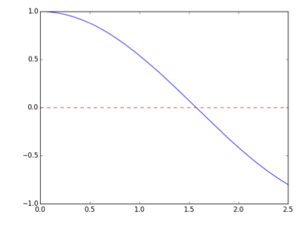

Migration Traps: a simple example
+
TORQUE
-
RADIUS

Slide 18
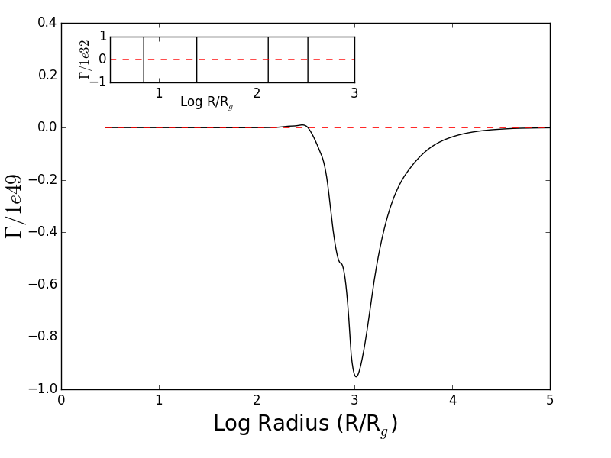
Migration traps in S&G model
Bellovary et al 2016
Linear scale
24.5 and 331 R_{g}
Sirko & Goodman 2003 disk model: TWO TRAPS

Slide 19
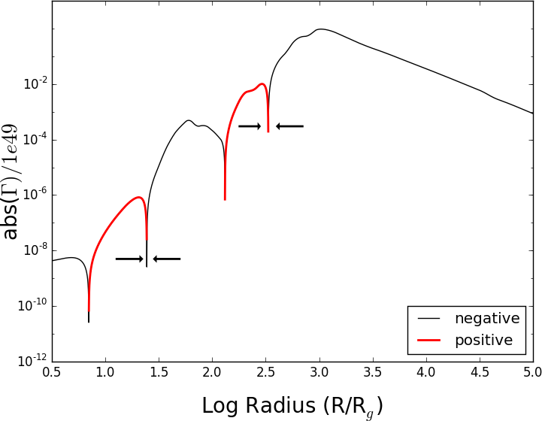
Migration traps in S&G model
Bellovary et al 2016
Log scale
Linear scale
24.5 and 331 R_{g}
Sirko & Goodman 2003 disk model: TWO TRAPS

Slide 20
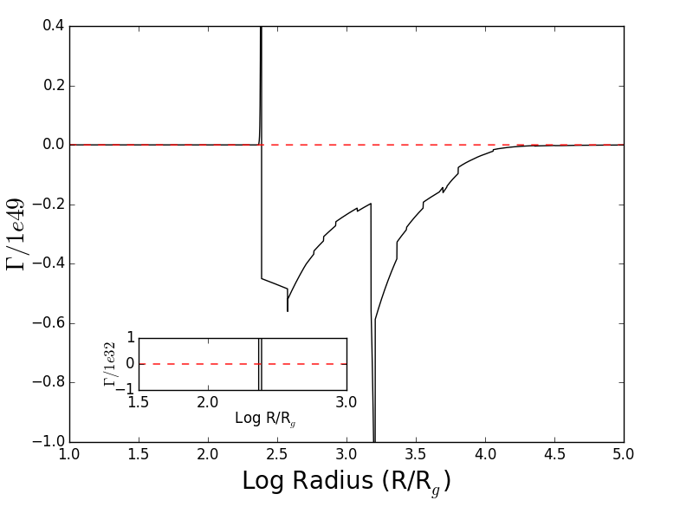
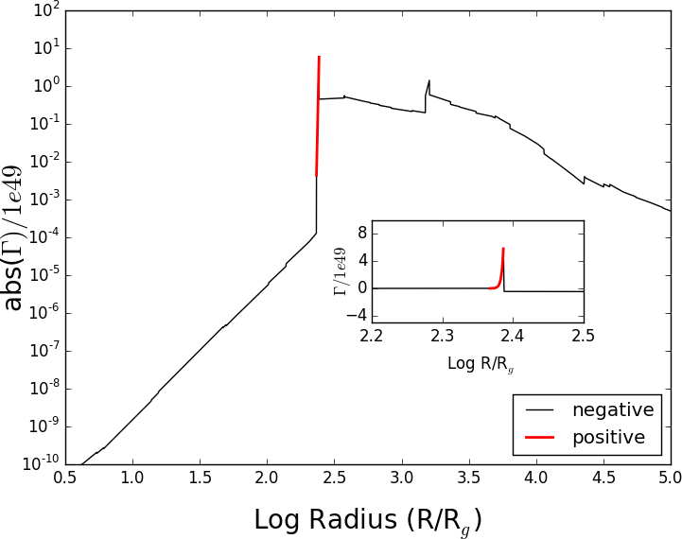
Migration traps in TQM model
Bellovary et al 2016
Log scale
Linear scale
245 R_{g}
Thompson Quataert & Murray 2005 disk model: ONE TRAP

Slide 21
Traps (maybe) exist. What next?
3-D N-body modeling of migrating BHs
1-D static disk based on Sirko & Goodman 2003
Examine migration of single and multiple objects

Slide 22
Migration of a single object
One 30 M₈ BH
Different starting radii
M_{SMBH} = 10⁸ M₈
Orbital Radius (R_{g})
Predicted traps:
331 R_{g}
25 R_{g}
Bellovary et al. in prep

Slide 23
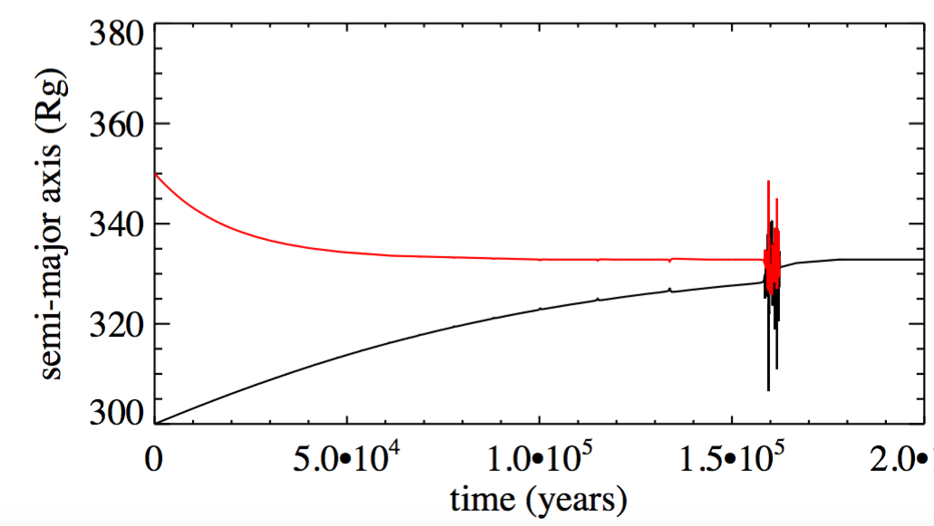
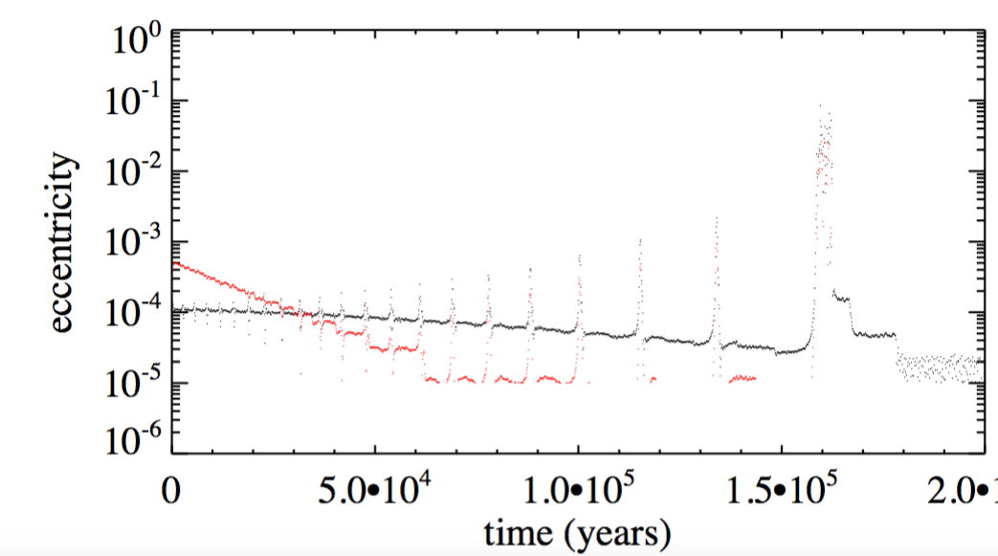
Migration and merger of two objects
50 M₈ BH and 30 M₈ BH
Form a binary upon reaching trap
Bellovary et al. in prep

Slide 24
Binary Details: formation
migration
Binary forms here!

Slide 25
Binary Details: formation
Hill Radius (~2 R_{g})
Binary forms, orbit becomes eccentric
Gas torques tug and perturb the orbit
Bellovary et al. in prep

Slide 26
Binary Details: center of mass frame
Orbital eccentricity
BH 1
BH 2
Orbital energy lost to gas (which we do not track)
Eventually plunging orbits cause merger
Center of Mass
Bellovary et al. in prep

Slide 27
Worst Case scenario!
Physics not included*:
  Gas drag
  GW energy losses
Both will speed up the merger!
*among many many other effects

Slide 28
GW Implications
LIGO: Provides explanation for large masses
LISA: runaway growth in disk creates an IMBH (10²-10³ M₈), if merge with SMBH we get an EMRI
EM Counterparts… the AGN wins (but! target next searches on AGN instead of galaxies for improved efficiency!)

Slide 29
In Summary
Migration traps may exist in AGN disks
Compact objects can grow and merge quickly in the traps (LIGO sources)
Growth can result in IMBH!
The Future
N > 2 bodies
Actual hydro simulations
Modify torque prescription to include retrograde orbiters, multiple orbiters , feedback from BH accretion, ++

