Slide 1










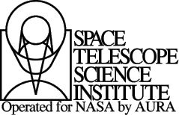
Can shocks from high-mass planets explain
infrared emission in protoplanetary disks?
Wladimir Lyra
California State University Northridge (CSUN)
Tenure-Track Professor
Jet Propulsion Laboratory (NASA-JPL)
Research Associate
Observatorio do Valongo (OV UFRJ, Brazil)
Friend of the department
Collaborators
Aaron Boley (Vancouver), Kees Dullemond (Heidelberg), Mario Flock (JPL),
Blake Hord (Dobbs Ferry High School, NY), Anders Johansen (Lund),
Mordecai Mac Low (AMNH), Satoshi Okuzumi (JPL), Alex Richert (PSU), Neal Turner (JPL).
LARIM, Cartagena de Indias, Colombia, Oct 6th, 2016

Slide 2
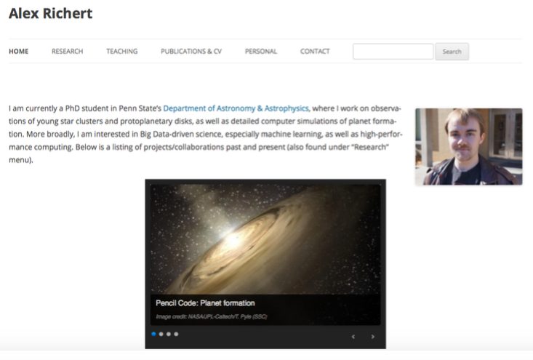

Slide 3
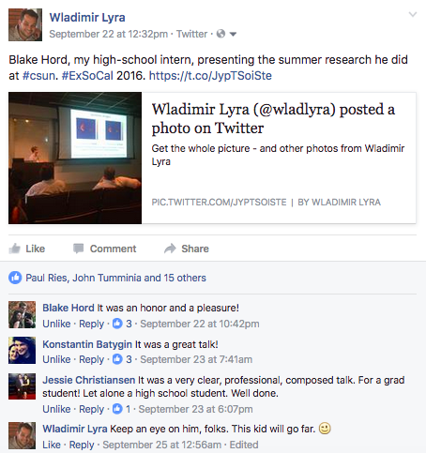
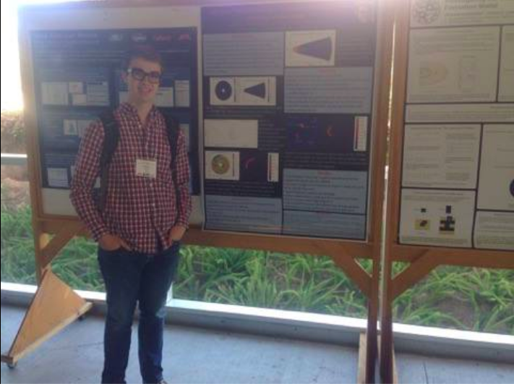
Blake Hord (Dobbs Ferry High School, NY)
Wladimir Lyra
California State University Northridge (CSUN)
Tenure-Track Professor
Jet Propulsion Laboratory (NASA-JPL)
Research Associate
Observatorio do Valongo (OV UFRJ, Brazil)
Visiting Professor (?)

Slide 4
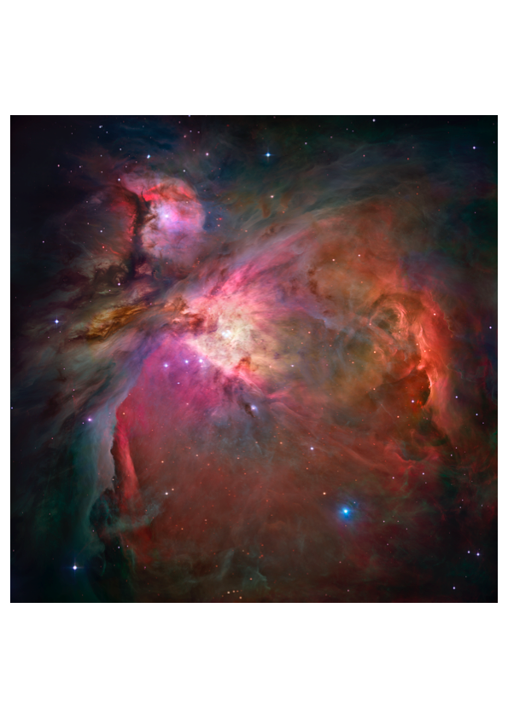
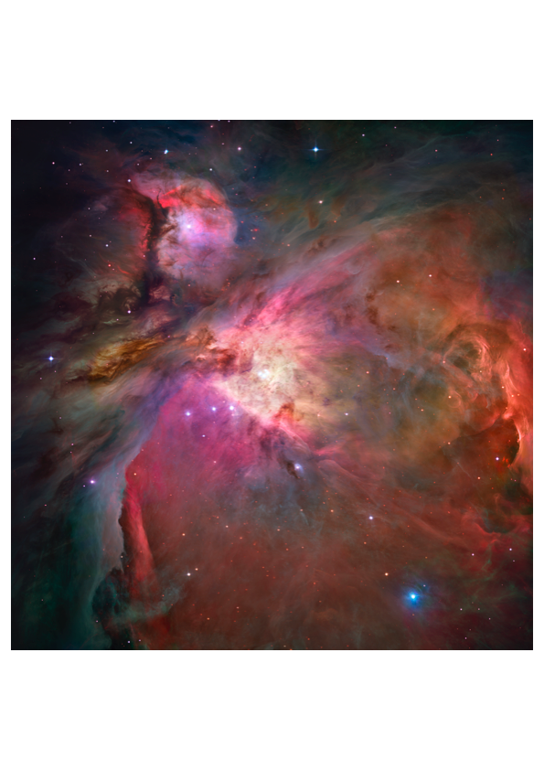
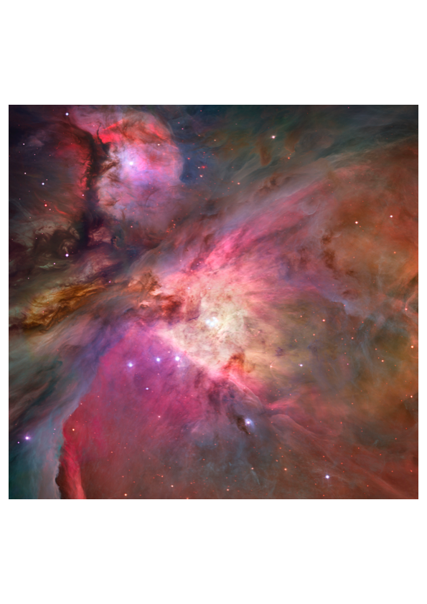
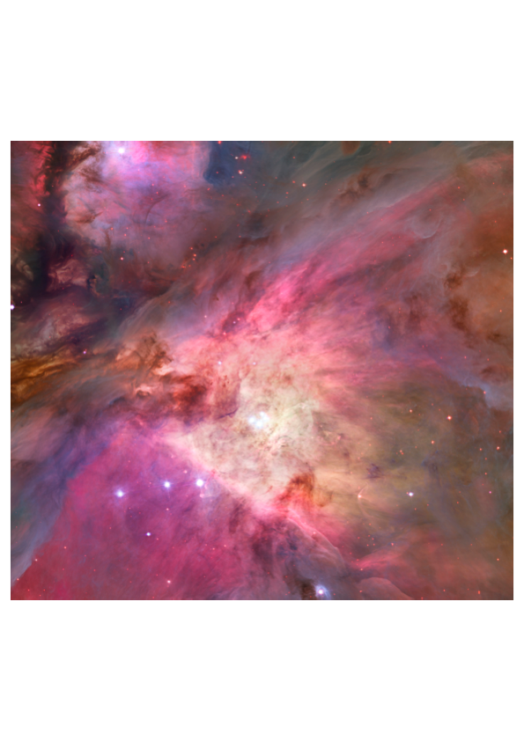
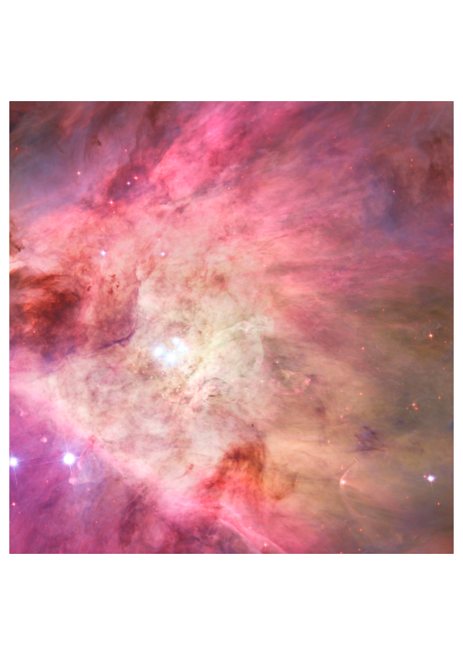
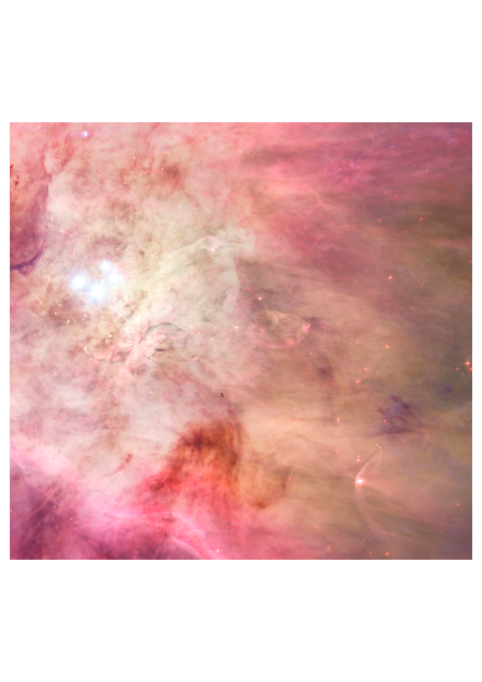
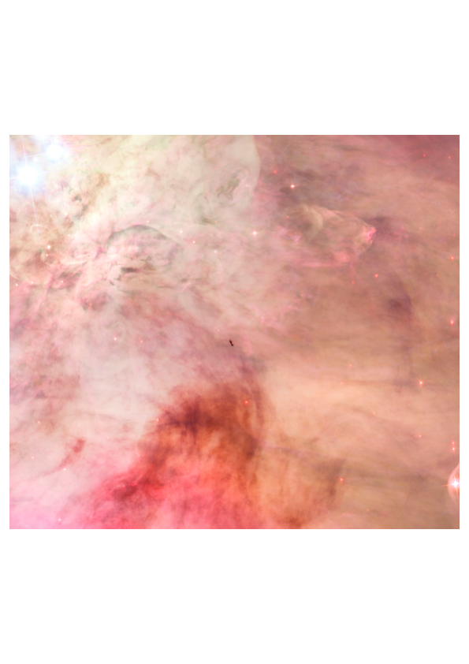
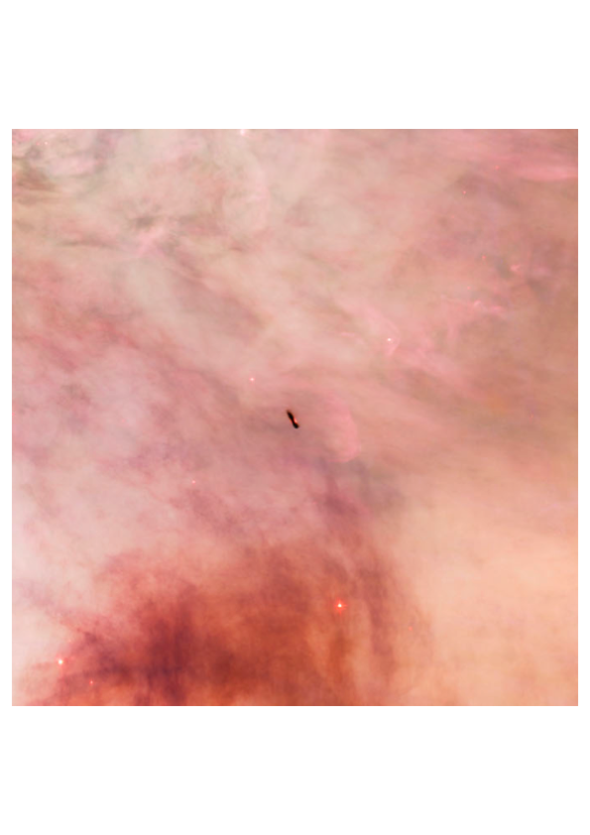
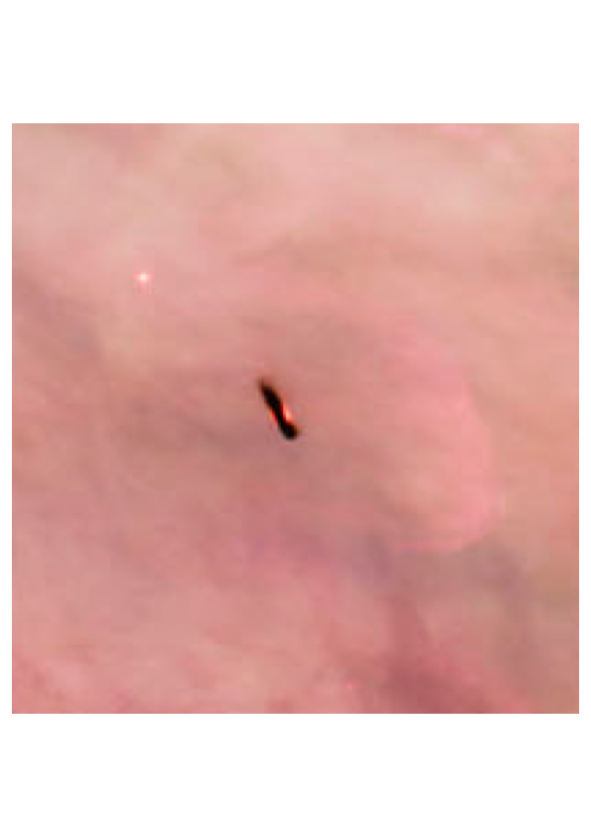
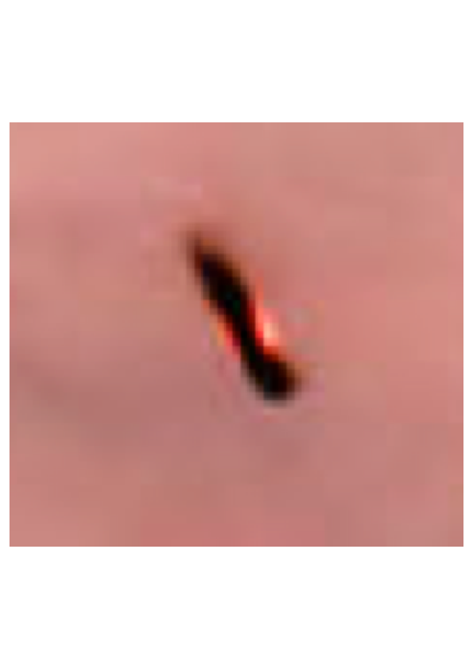
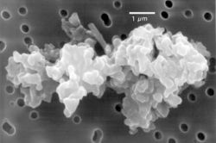

Slide 5
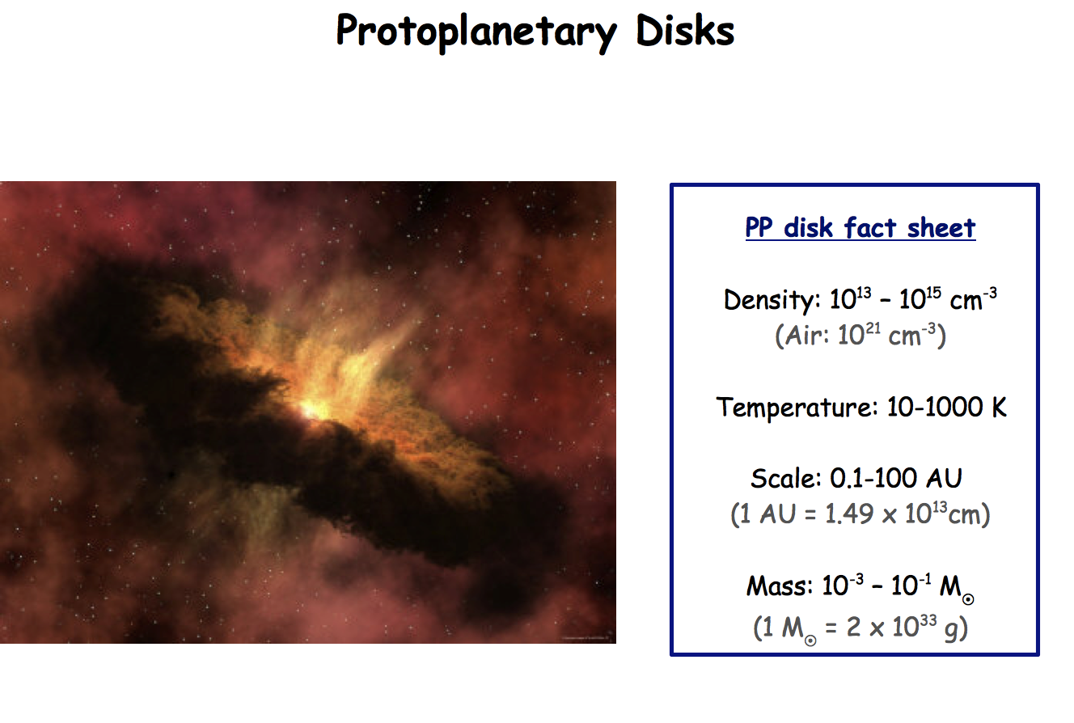
Protoplanetary Disks
PP disk fact sheet
Density: 10¹³ – 10¹⁵ cm⁻³
(Air: 10²¹ cm⁻³)
Temperature: 10-1000 K
Scale: 0.1-100AU
(1 AU = 1.49 x 10¹³ cm)
Mass: 10⁻³ – 10⁻¹ M_{sun}
(1 M_{sun} = 2 x 10³³ g)

Slide 6
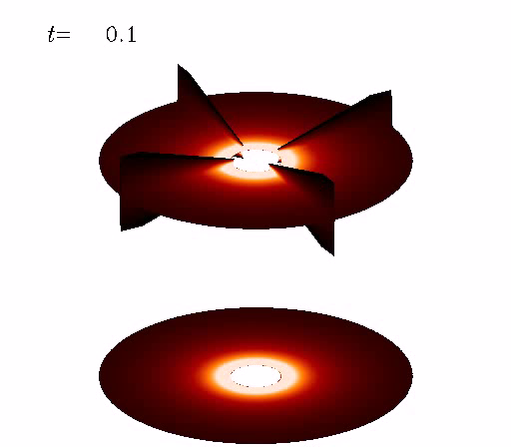
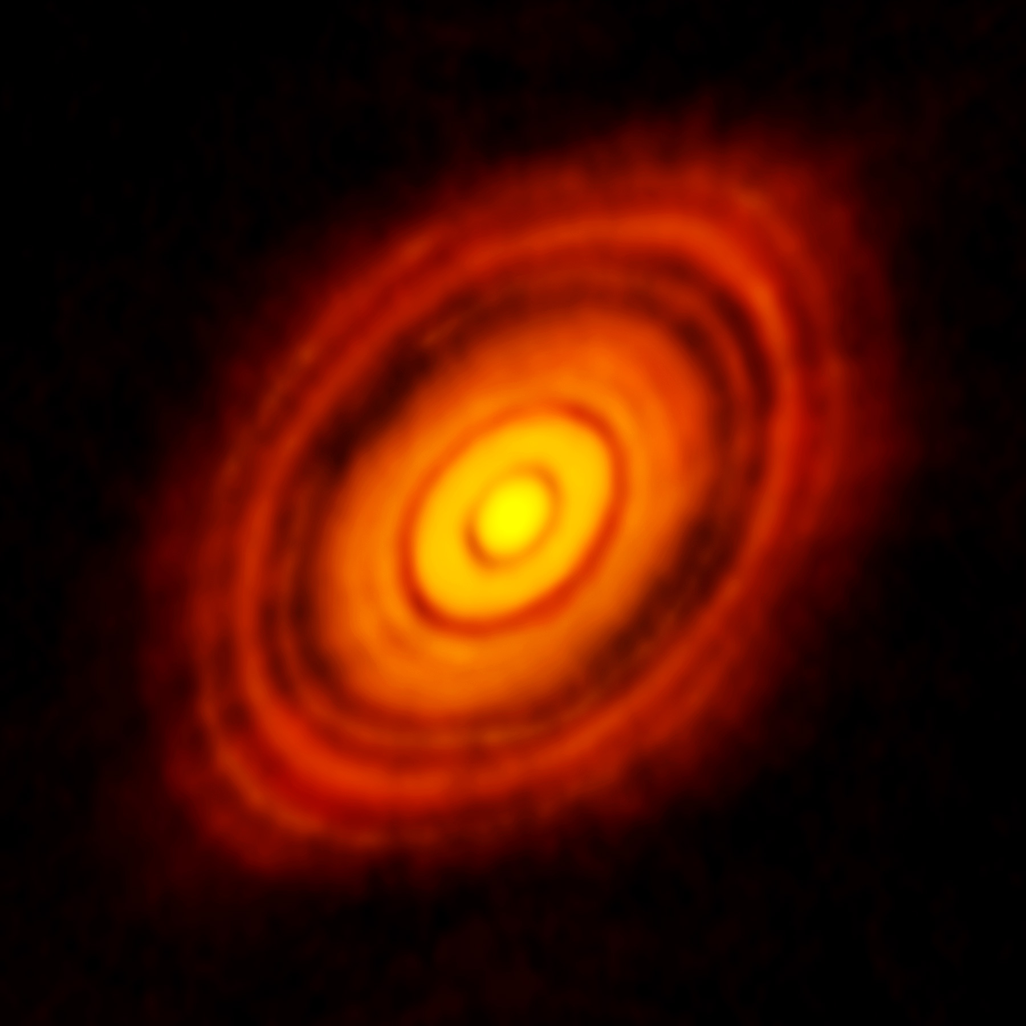
Planet-Disk Interaction
ALMA observation: HL Tau

Slide 7
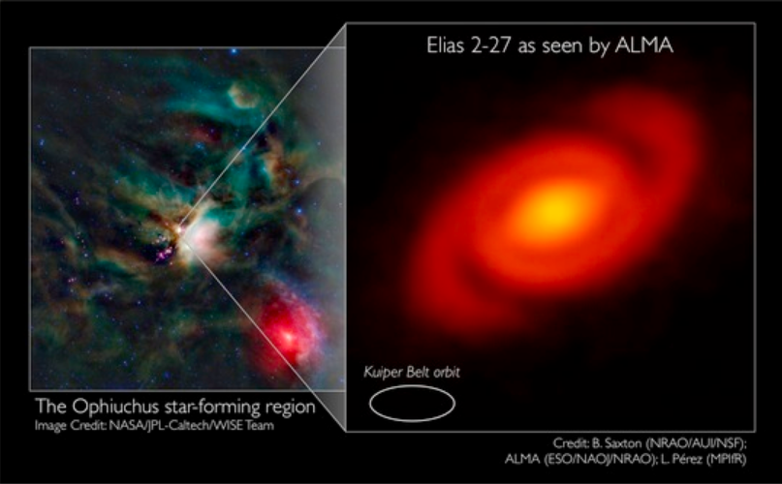
Elias 2-27

Slide 8
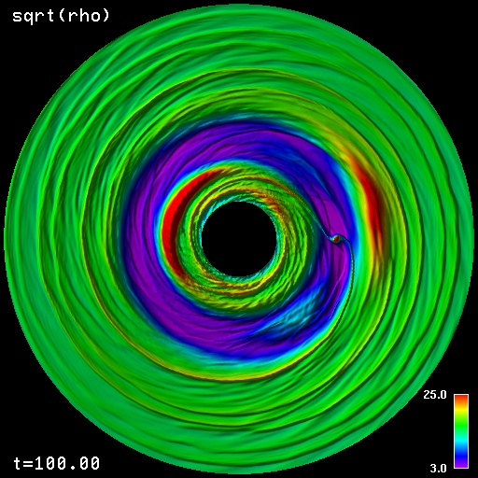
Planet-disk interaction: gaps, spirals, and vortices.

Slide 9
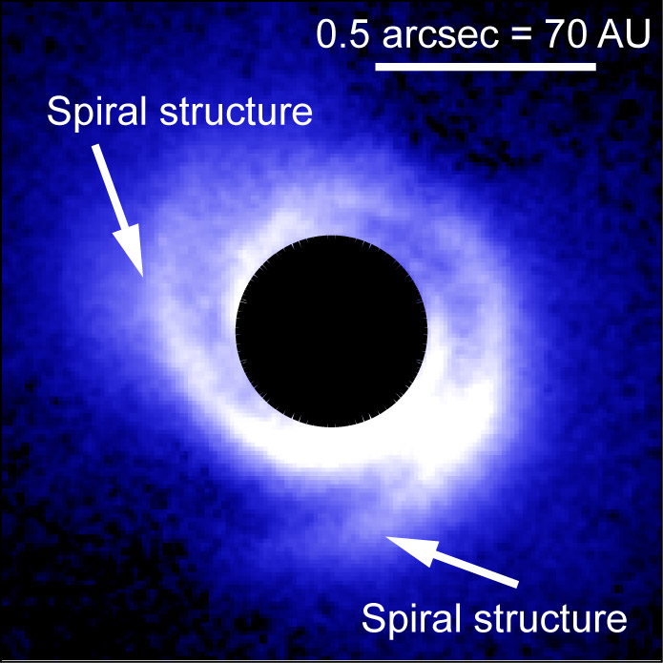
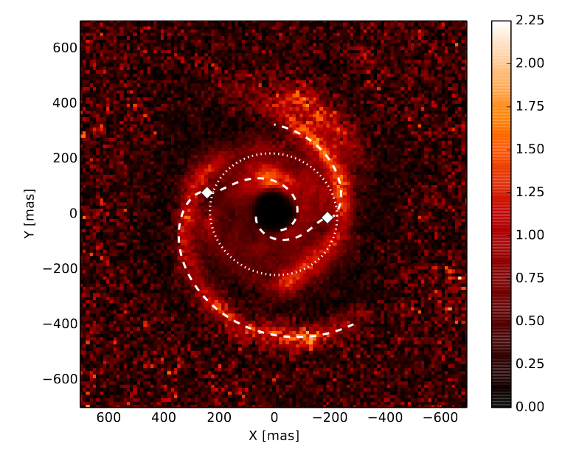
Observational evidence: Spirals
SAO 206462
MWC 748
Muto et al. (2012)
Benisty et al. (2015)

Slide 10
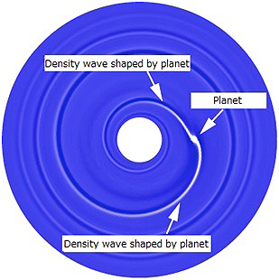
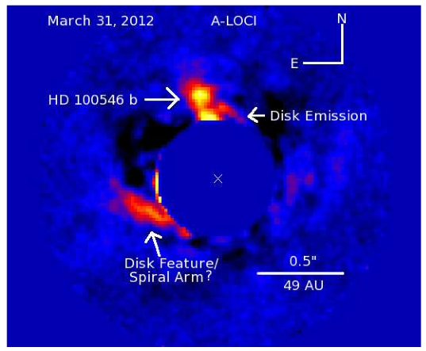
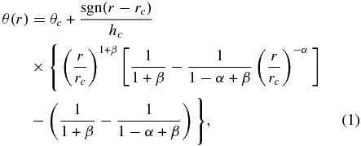
Spiral arm fitting leads to problems
Analytical spiral fit
Spirals are too wide,
hotter (300K) than
ambient gas (50K).
Benisty et al. (2015)
Spiral has little
polarization. Must be
thermal emission at 1000K.
Rafikov (2002)
Muto et al. (2012)
Currie et al. (2014)

Slide 11
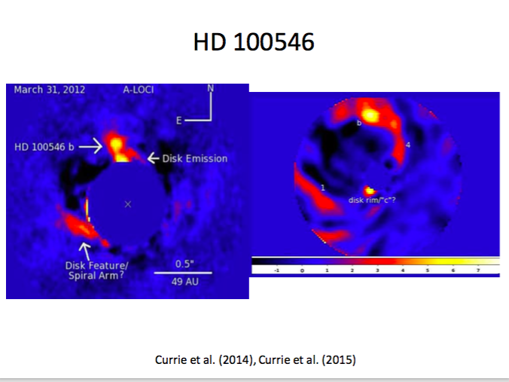
The strange case of thermal emission in HD 100546
L band (~3.5 μm)
H band (~1.6 μm)

Slide 12
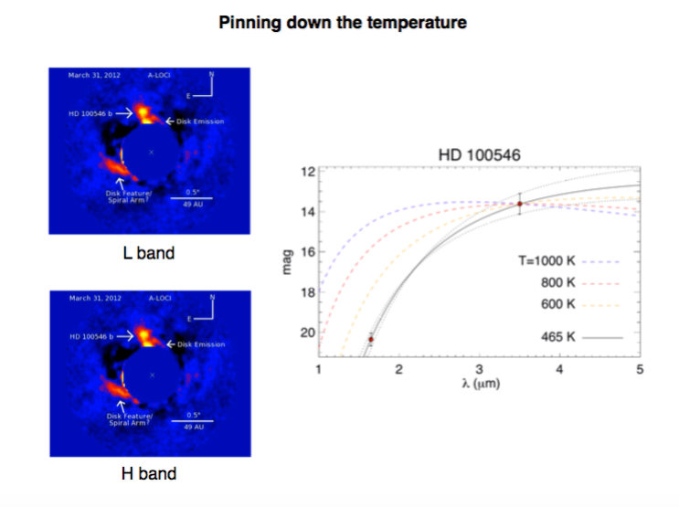
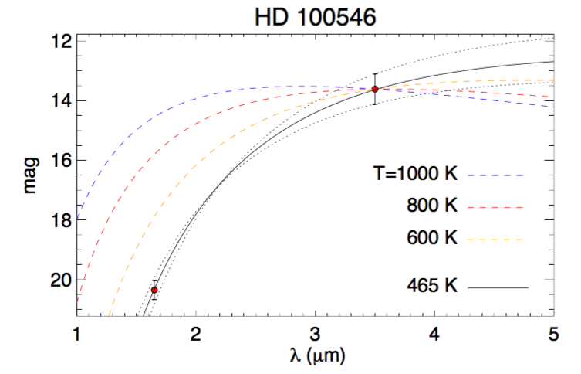
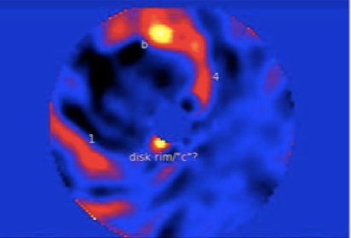
Lyra et al. (2016)

Slide 13
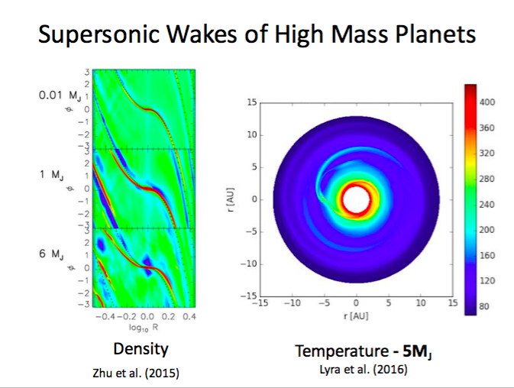

Slide 14
Shock bores
Shocks (velocity convergence)
Temperature
Lyra et al. (2016)

Slide 15
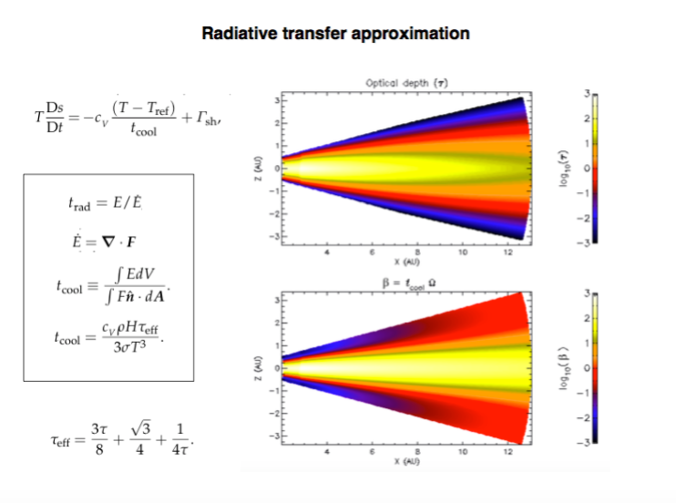
Shock bores

Slide 16
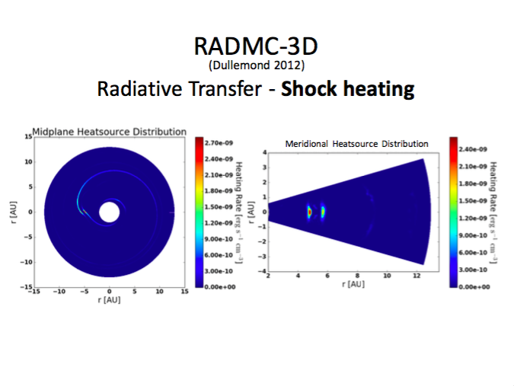
Hord et al. (2016, in prep)

Slide 17
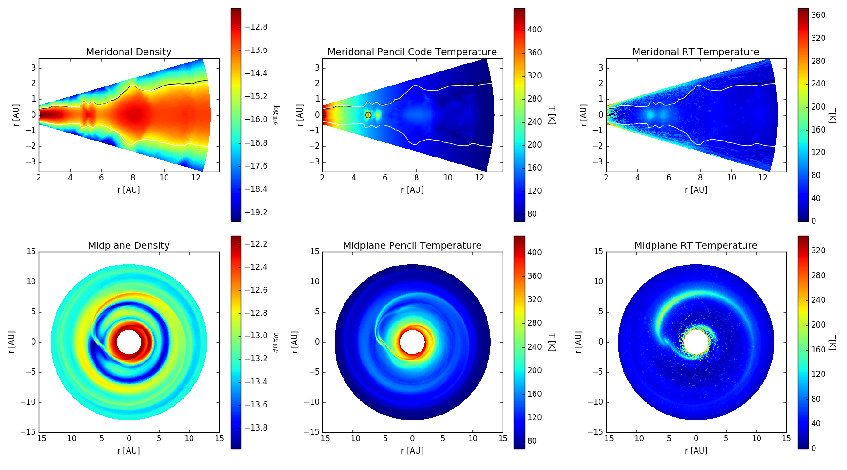
Radiative Transfer post-processing
Hord et al. (2016, in prep)

Slide 18
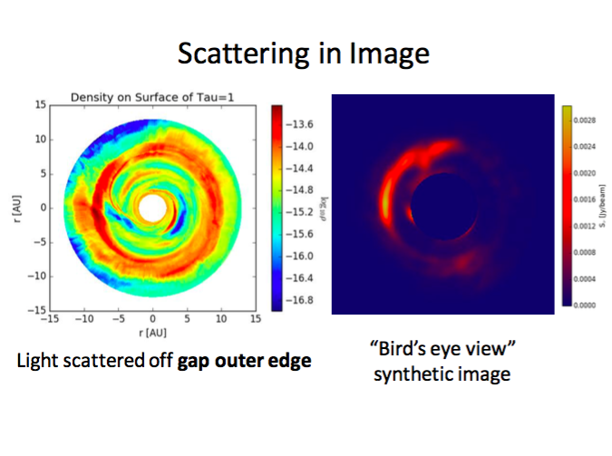
Hord et al. (2016, in prep)

Slide 19
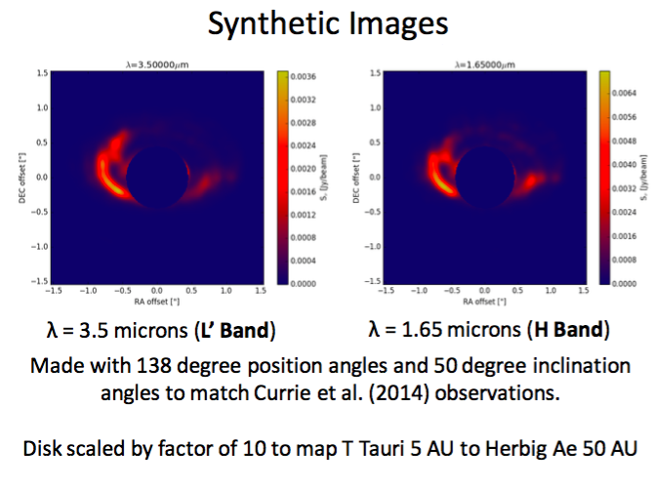
Hord et al. (2016, in prep)

Slide 20
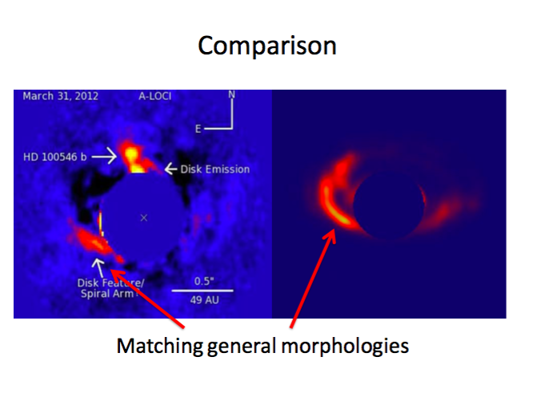
Hord et al. (2016, in prep)

Slide 21
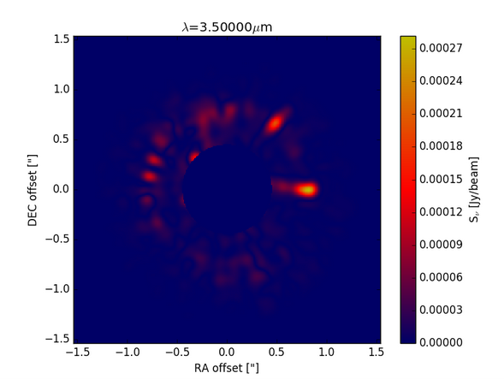
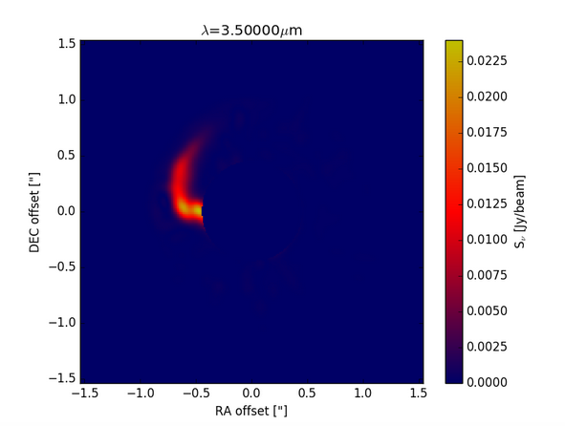
Effect of shocks alone
1 μm
10 μm
Hord et al. (2016, in prep)

Slide 22
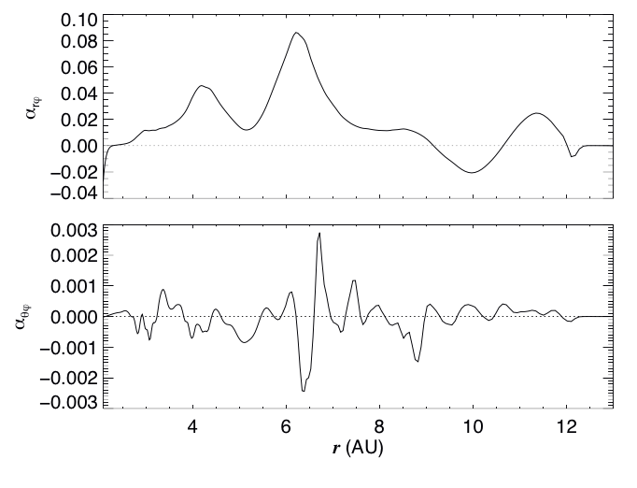
Prediction for spectroscopy: Turbulent surf
Lyra et al. (2016)

Slide 23
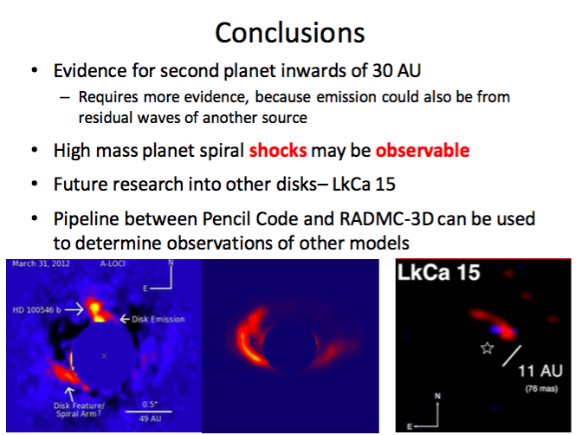
Predictions:
  Hot lobes next to high mass planets at high resolution
  High(er) turbulence around the orbit of a high-mass planet
Shocks from high-mass planets (~> 5 Mjup) is a significant source of radiation in disks.
Shocks due to high mass planets better fits to observed spirals.

