Slide 1
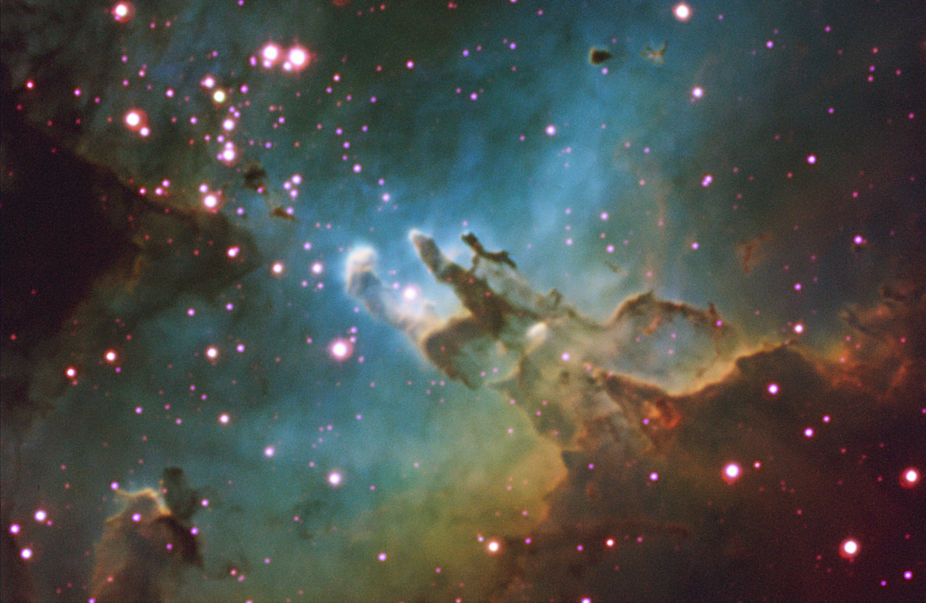
Selected Topics in Astrophysics
Prof Wladimir Lyra
Live Oak, 1119-G
Office Hours: Mon 4pm-5pm
Class hours: Mon/Wed 5pm-6:15pm

Slide 2
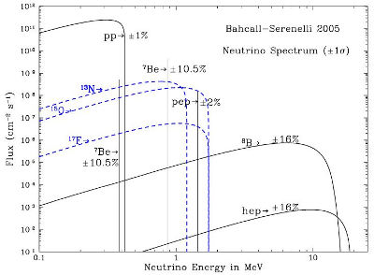

Slide 3
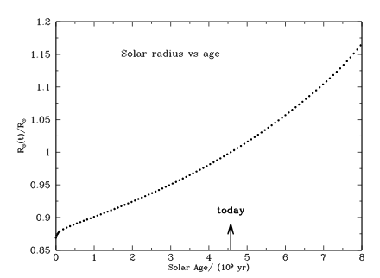
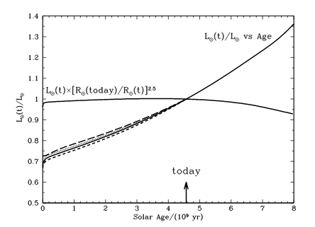
Solar evolution in the main sequence
Bahcall et al. 2001

Slide 4
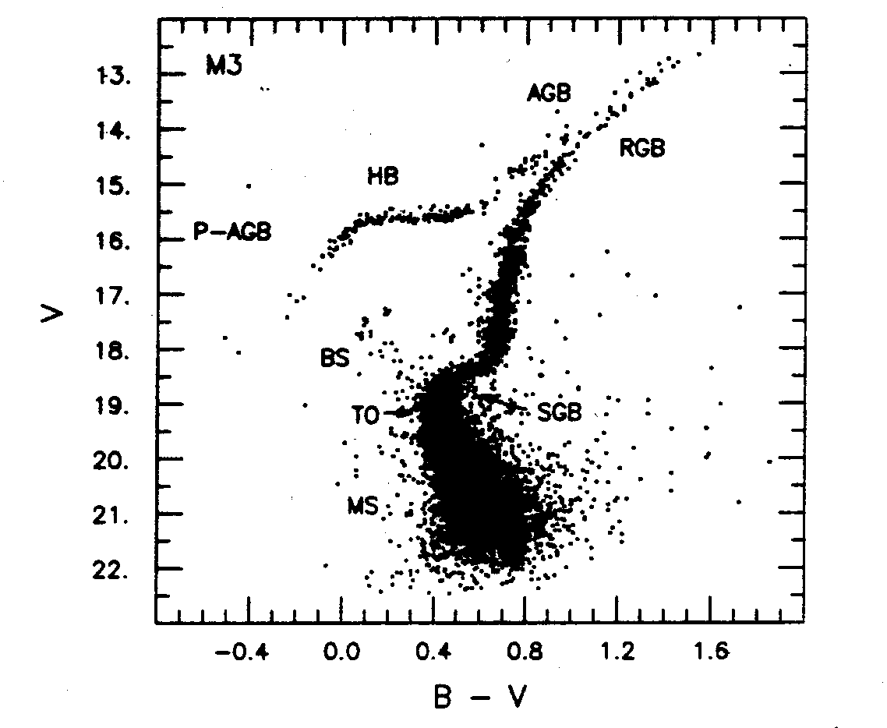

Slide 5
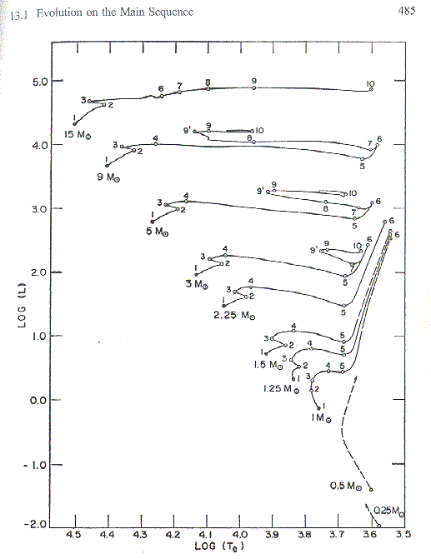
Evolutionary tracks
Schaller et al. (1992)

Slide 6
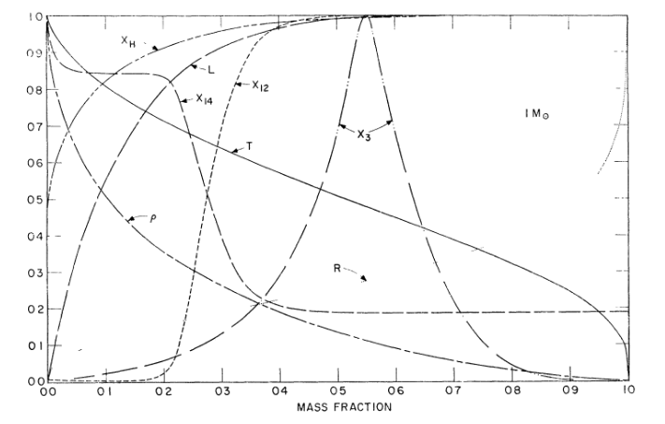
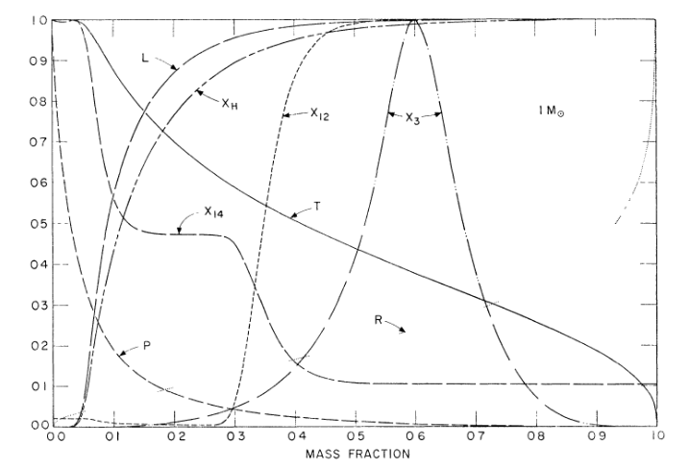
Evolution away from main sequence
Between
1 and 2
At 3

Slide 7
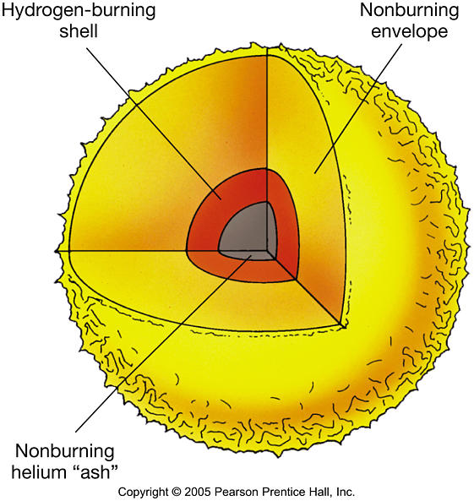
Hydrogen gone in the core
Star stops producing energy.
The star contracts and heats up.
Eventually, the temperature becomes high enough to
burn hydrogen around the Helium core
Hydrogen shell burning
The star reaches
the subgiant branch

Slide 8
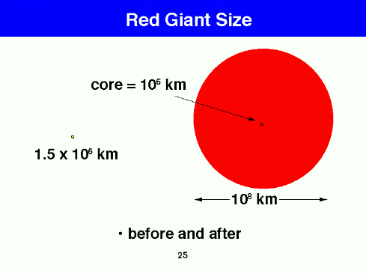
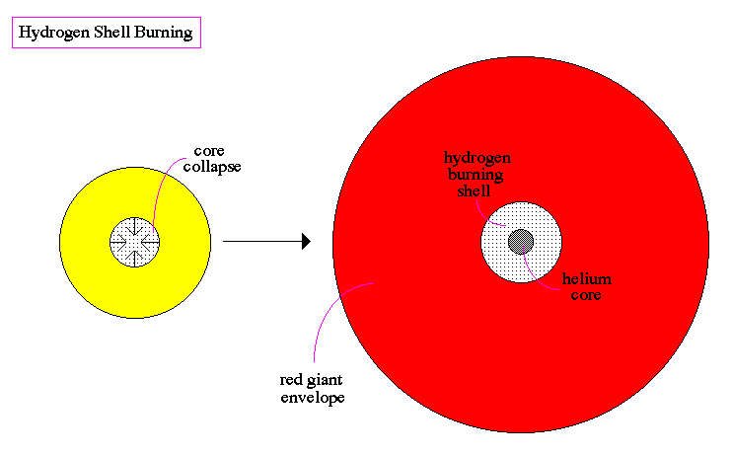
Red giant branch
Hydrogen shell burning involves:
More fuel than in MS-hydrogen burning
Higher temperatures
(thus more efficient)
A lot more of energy is being produced than in the MS-phase.
The star gets very luminous and swells.
The expansion cools the outer layers.
The star becomes a red giant.

Slide 10
What happens to the inert Helium core?
Hydrogen shell burning

Slide 11
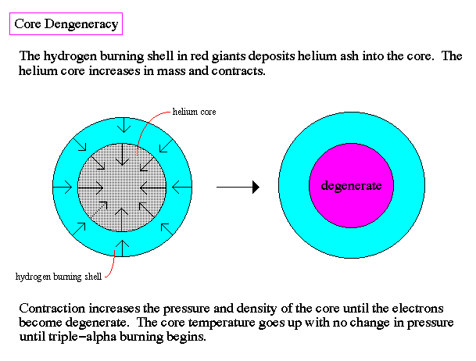
What happens to the inert Helium core?
It keeps contracting and heating
At some point the density is so
high it goes degenerate
A phase transition has occured
The core stops behaving like a gas
and starts behaving more like a solid
Ideal Gas
Temperature rises, pressure rises
Temperature falls, pressure falls
Radiative loss → cooling →
less support against gravity → contraction
Degenerate Matter
If temperature rises or falls, pressure couldn't care less
Radiative losses can continue indefinitely
The degenerate core is stable

Slide 12
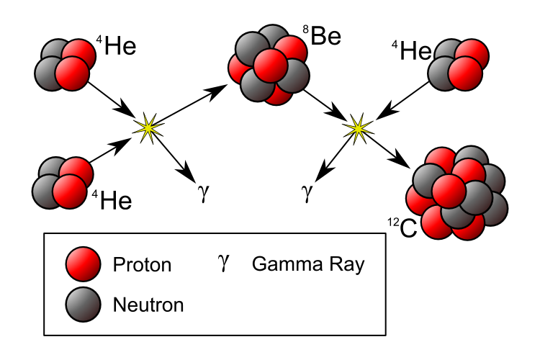
Helium Fusion
The inner degenerate Helium core is stable
But the outer Helium core keeps contracting and heating
At the tip of the Red Giant Branch,
when the temperature reaches 100 million K,
HELIUM FUSION begins
Triple Alpha
3 He → C + energy
(C + He → O + energy)

Slide 13
The Helium Flash
Under normal (non-degenerate) conditions …
Ideal Gas
Nuclear reactions start
Heating → Expansion → Cooling
Cooling = Less nuclear reactions
Cooling → Contraction → Heating
Thermostat keeps nuclear reactions “tuned”
Controlled fusion

Slide 14
The Helium Flash
Fusion ignition in degenerate matter is a bomb ready to explode
Ideal Gas
Nuclear reactions start
Heating → Expansion → Cooling
Cooling = Less nuclear reactions
Cooling → Contraction → Heating
Thermostat keeps nuclear reactions “tuned”
Controlled fusion
Degenerate Matter
Nuclear reactions start
Heating
Star does not expand
Nuclear burning increases
More heating
No thermostat
Runaway temperature rise
Runaway fusion

Slide 15
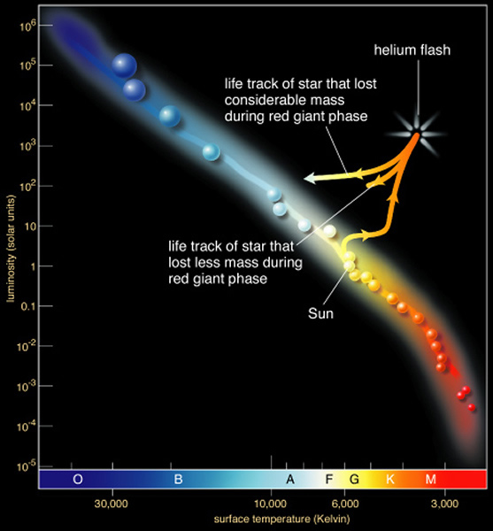
The Helium Flash
Fusion ignition in degenerate matter is a bomb ready to explode
No thermostat! Core just gets hotter and hotter
Runaway Helium burning: 100 billion times the Solar output in just a few seconds
Helium Flash
Yet, nothing is seen
Why?
The energy is ALL used to lift the degeneracy
(i.e., to “melt” the degenerate
core back into a normal gas)
Helium then burns steadily in a core of normal gas

Slide 16
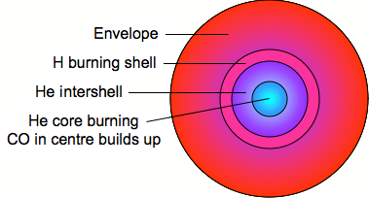
The Horizontal Branch
Helium burning in the core
Hydrogen shell burning
In the HR diagram, the star sets in the Horizontal Branch
The Horizontal Branch is the Helium Main Sequence

Slide 17
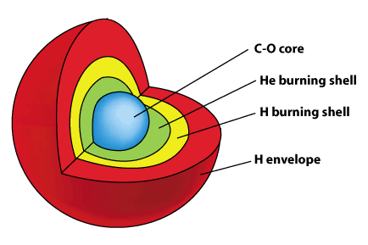
Helium exhausted in the core
The Carbon-Oxygen core contracts and heats up.
Helium shell burning
More energy is available, the star swells and becomes a red giant again
The star reaches the Asymptotic Giant Branch

Slide 18
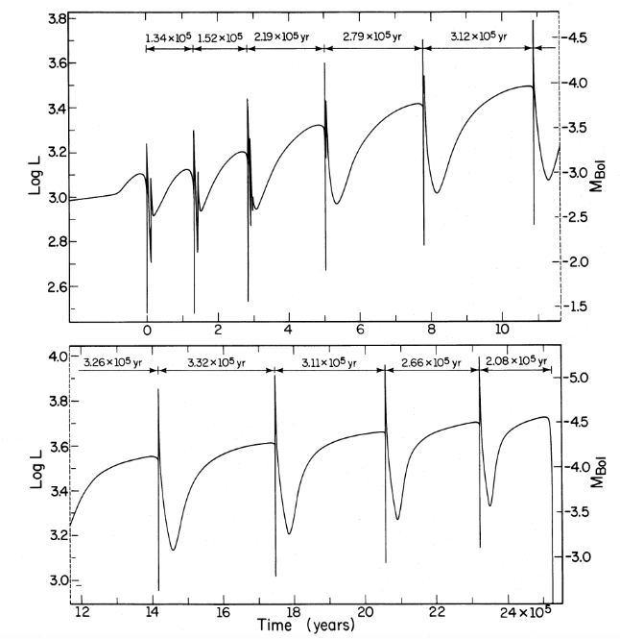
Thermal pulses in AGB stars
A series of Helium flashes

Slide 19
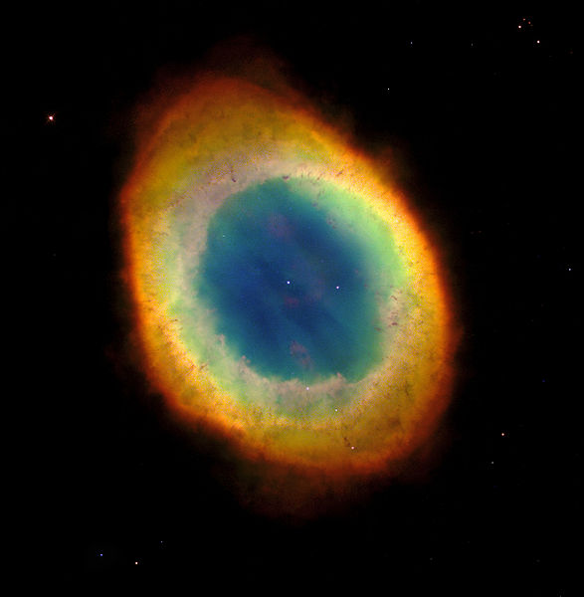
PLANETARY NEBULA
The gracious death of low mass stars

Slide 20
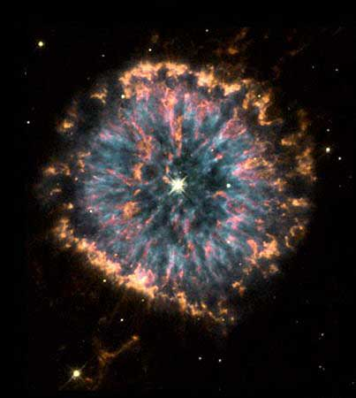

Slide 21
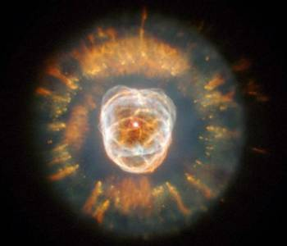

Slide 22
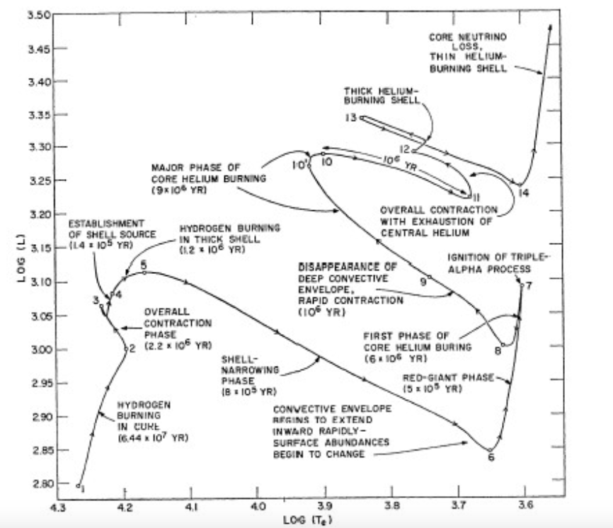

Slide 23
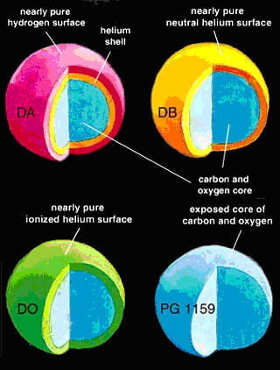
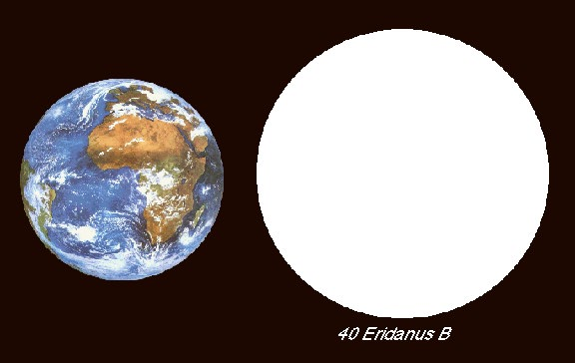
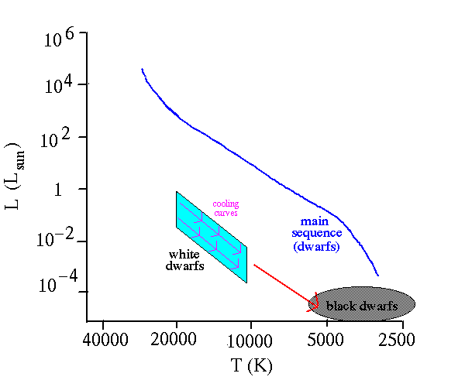
White dwarfs
White dwarfs are the exposed degenerate core of the star
White dwarfs have planetary dimensions...
Types of white dwarfs
… and they do little but cooling.

Slide 24
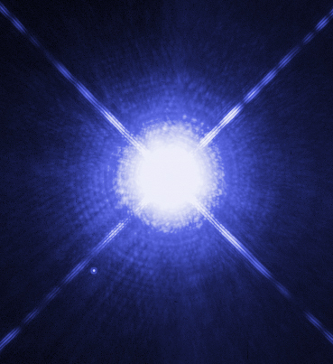
White dwarfs
White dwarfs are the exposed degenerate core of the star
No energy production
Supported by degenerate pressure
Cooling takes a long time
10¹ ⁵ yr to cool down to background temperature
The universe is not old enough to have black dwarfs
Coldest white dwarfs ~5000 K.
Sirius A (Main Sequence star)
and Sirius B (White Dwarf)

Slide 25
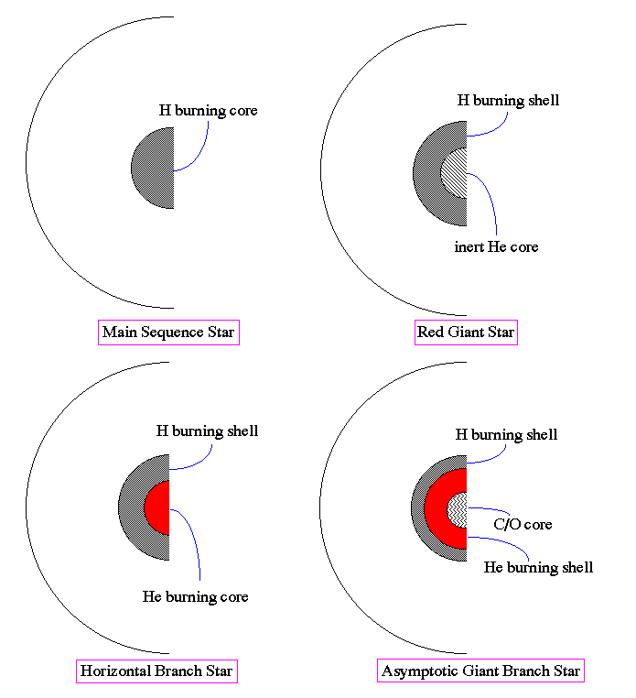
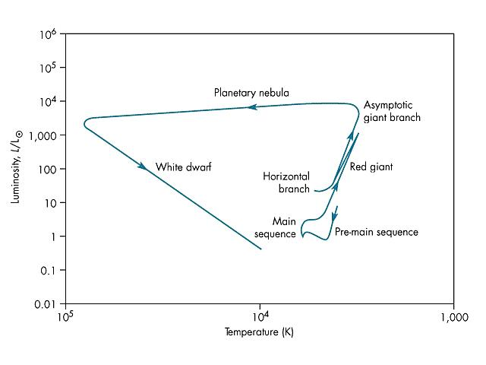
Evolution of a low mass star

Slide 26
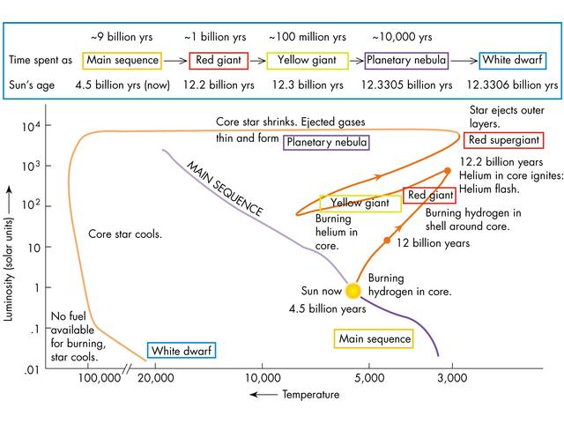
Post-Main Sequence Evolution - Timescales

