Slide 1
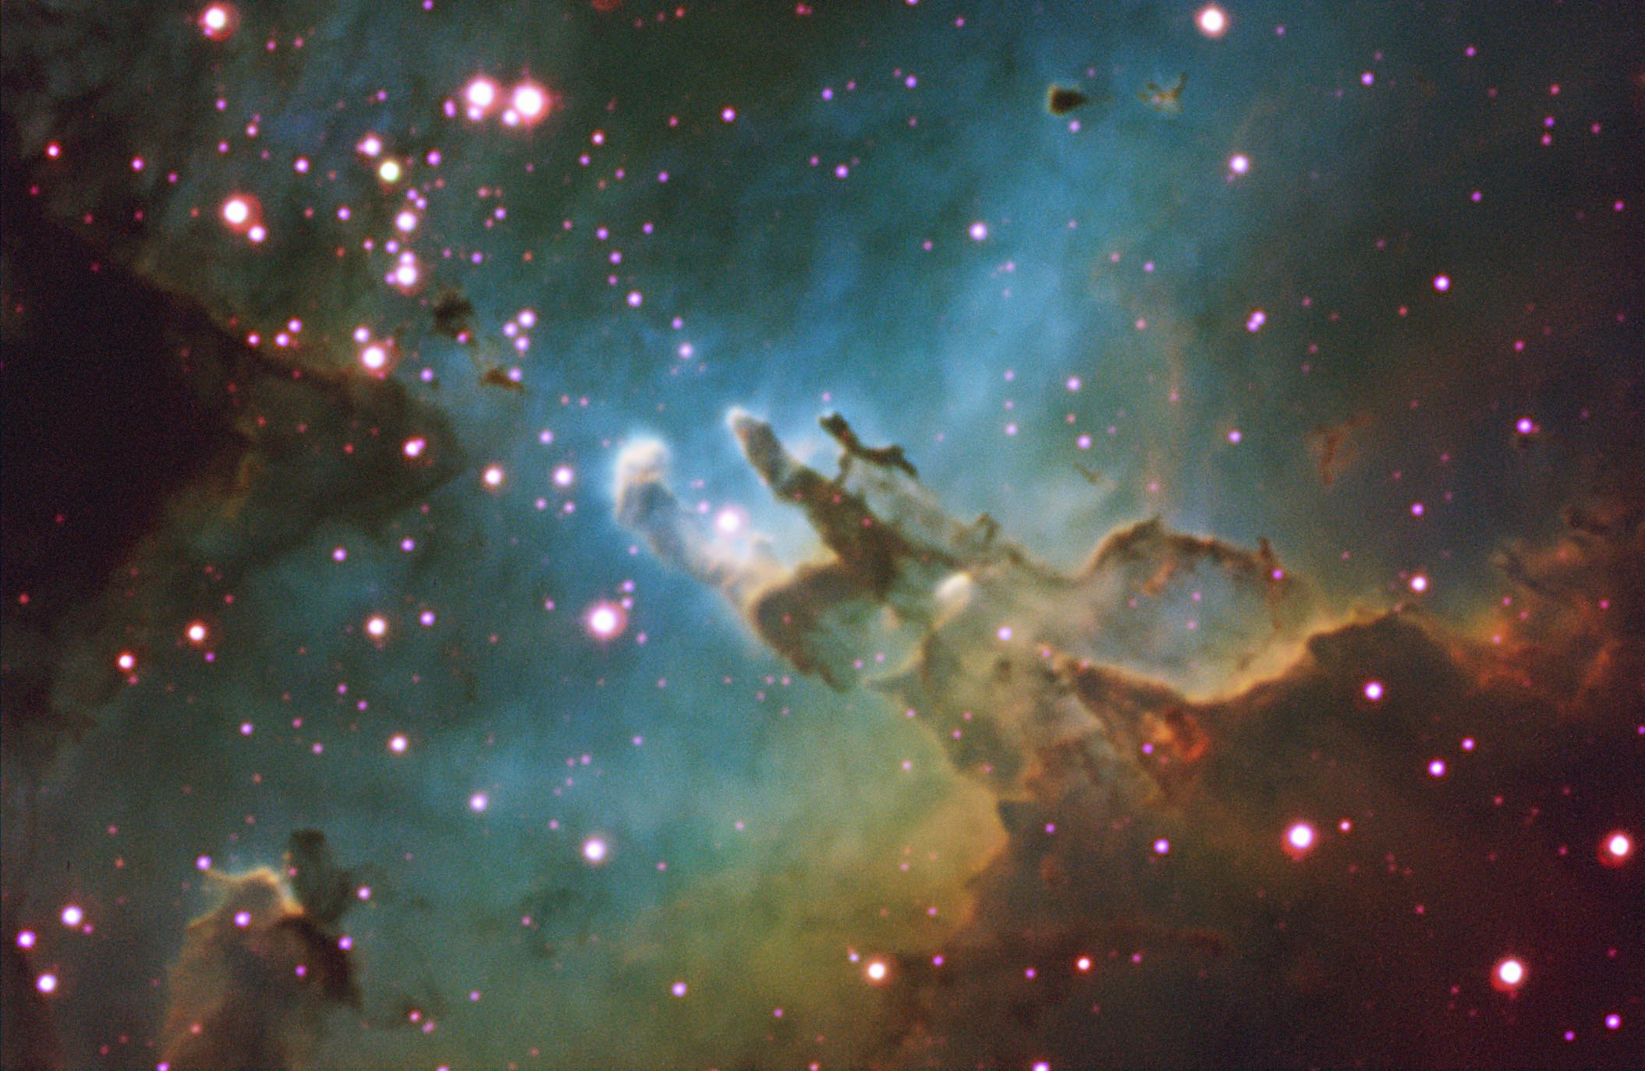
Selected Topics in Astrophysics
Prof Wladimir Lyra
Live Oak, 1119-G
Office Hours: Mon 4pm-5pm
Class hours: Mon/Wed 5pm-6:15pm

Slide 2
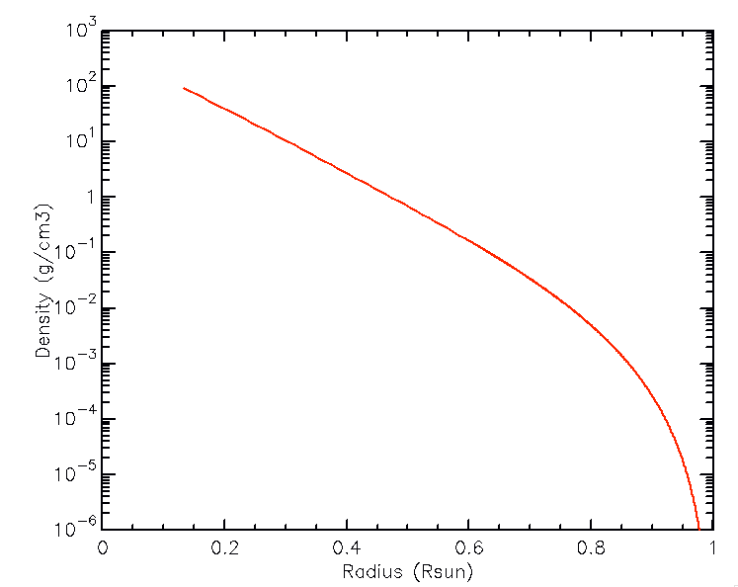
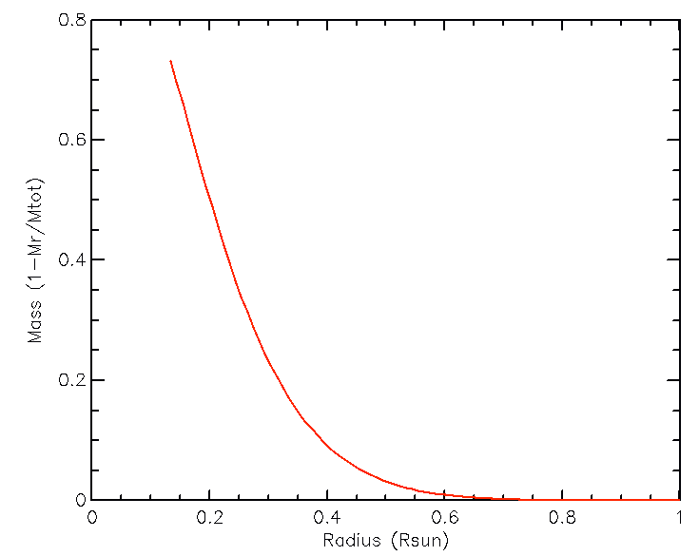
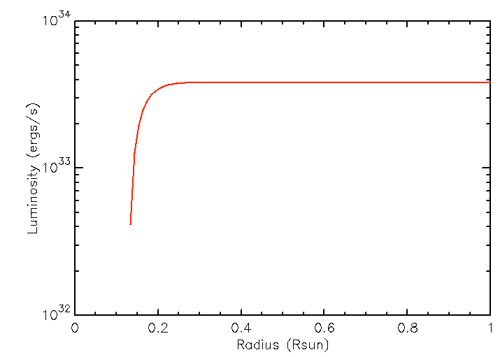
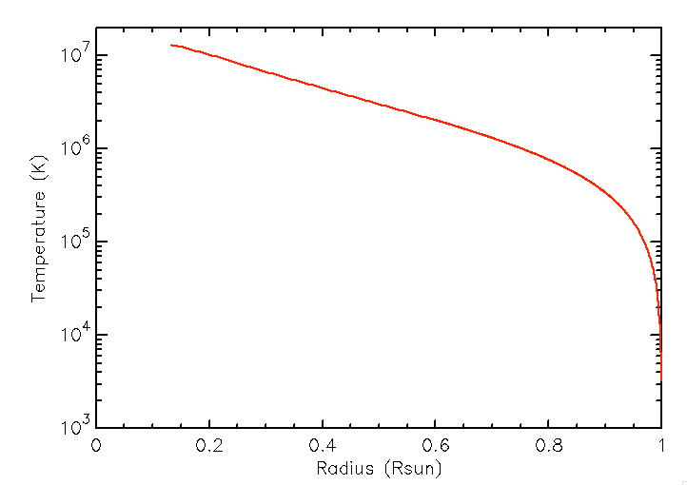
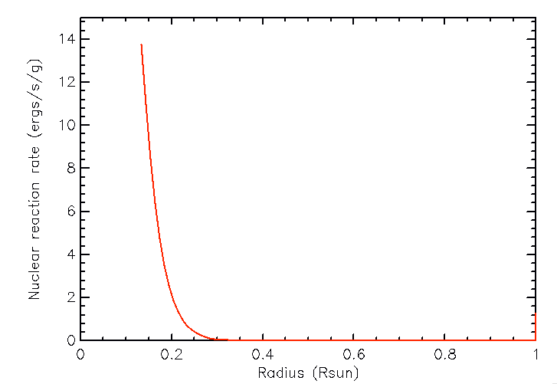
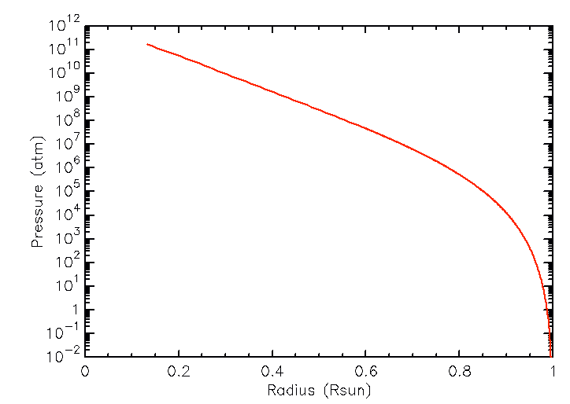
Solar Model (statstar)
Density
Mass
Luminosity
Temperature
Pressure
Nuclear Reaction Rate

Slide 3
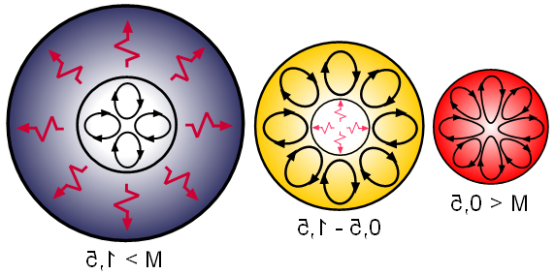
Stellar Structure
M > 1.5
0.5 < M < 1.5
M < 0.5
Convective Core
Radiative Envelope
Radiative Core
Convective Envelope
Fully Convective

Slide 4
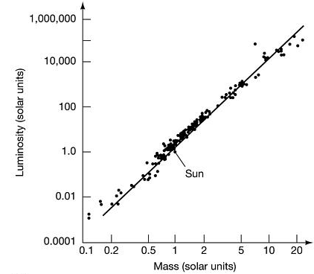
Mass-Luminosity relation

Slide 5
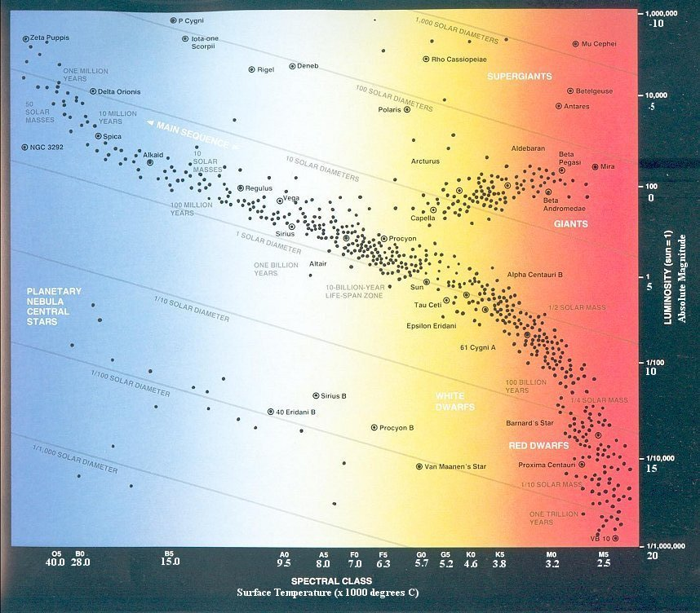
Main Sequence: Temperature-Luminosity relation
L propto T⁶

Slide 6
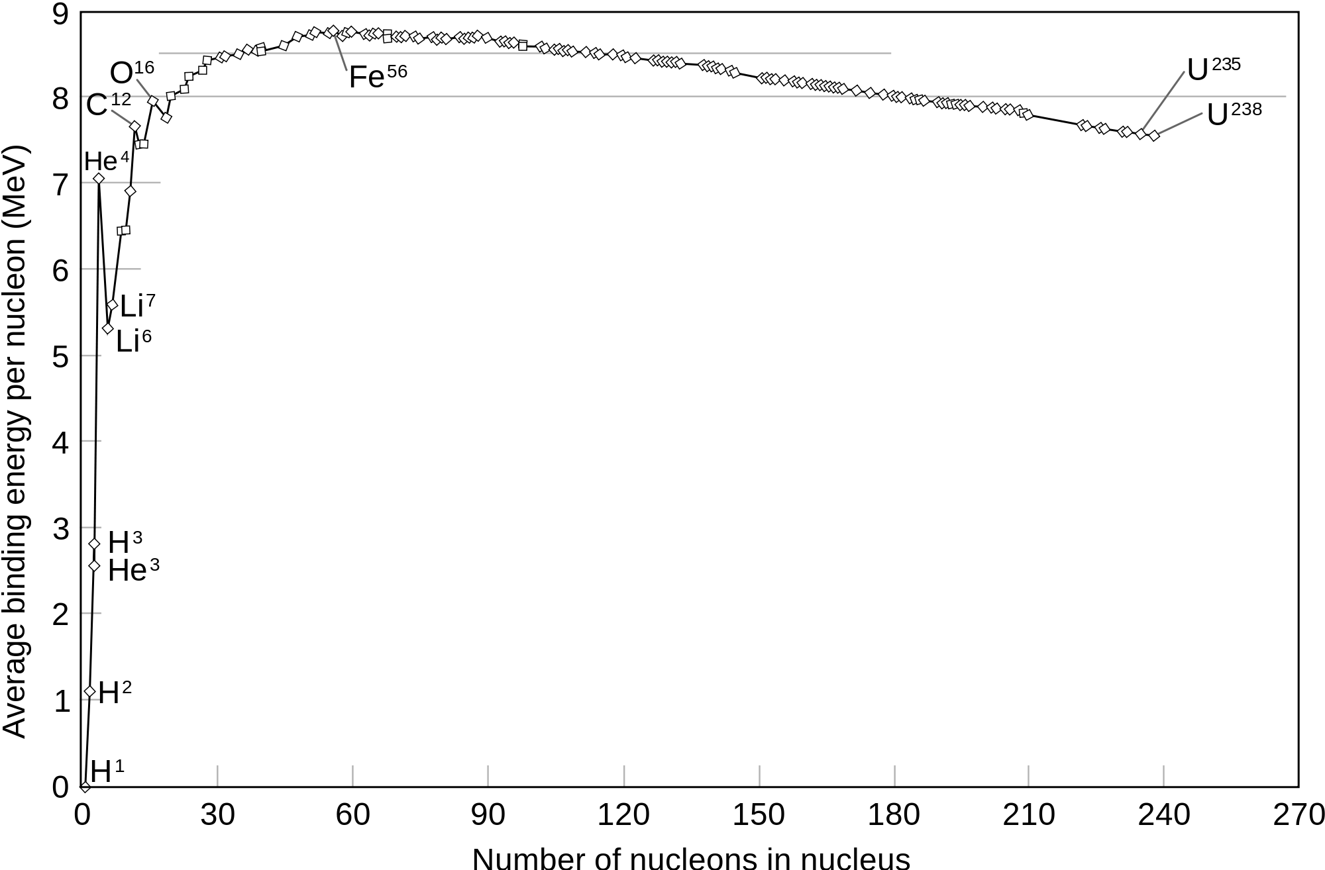
Nucleosynthesis
A nucleus is always found to be less massive than the combined mass of nucleons. The difference is the binding energy. The elements of the iron peak (Fe, Ni, Co) are the most tightly bound nuclei.

Slide 7
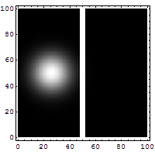
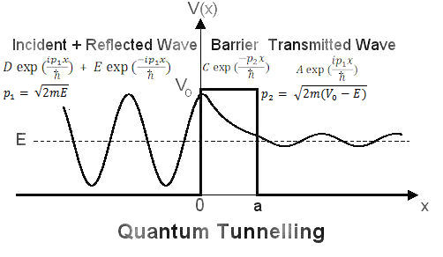
Quantum Tunneling
The temperature in the solar core is still too low to allow fusion considering only the thermal motion of the particles. Tunneling has to be taken into account.

Slide 8
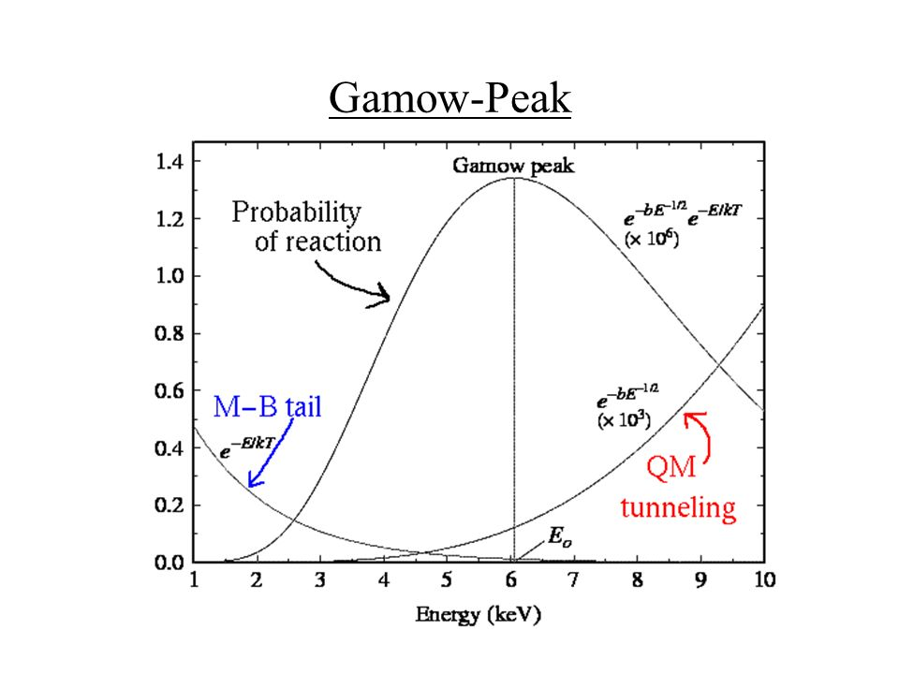
Combining thermal (Maxwell-Boltzmann) with quantum tunnelling.

Slide 9
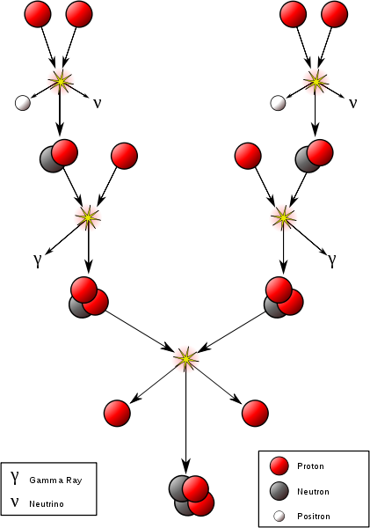
Proton-proton chain

Slide 10
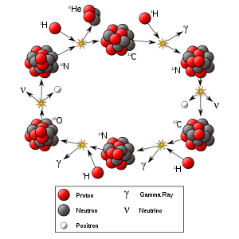
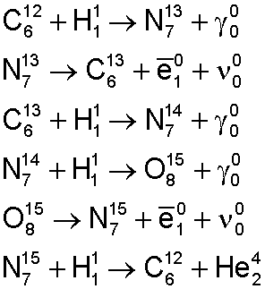
CNO cycle
End of cycle:
4 H burned into He
C used as catalyst

Slide 11
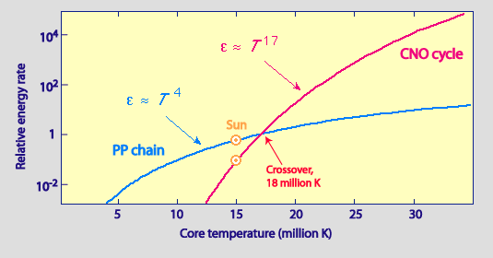
Proton-proton dominates up to 15 x 10⁷ K
CNO takes over after that.

Slide 12
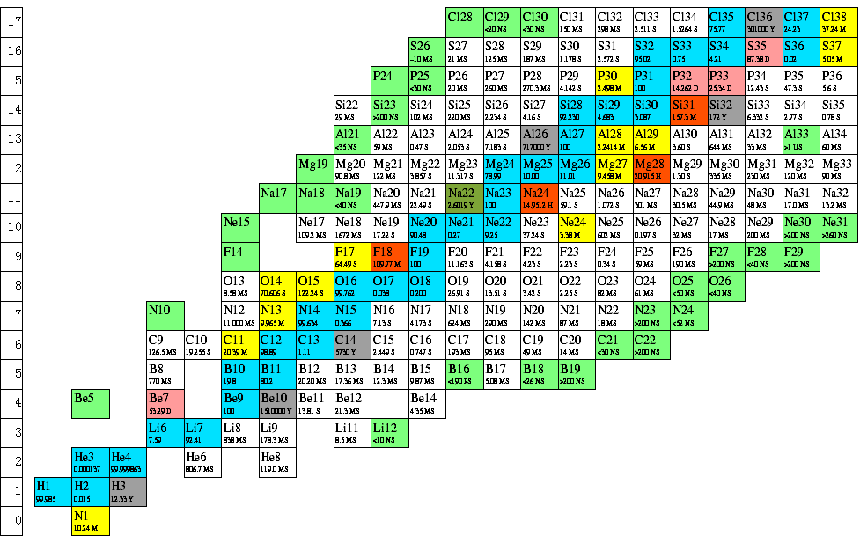
Beyond Helium
¹H + ⁴He = ⁵X
⁴He + ⁴He = ⁸X
But there is no stable nuclide of mass 5 or 8….

Slide 13
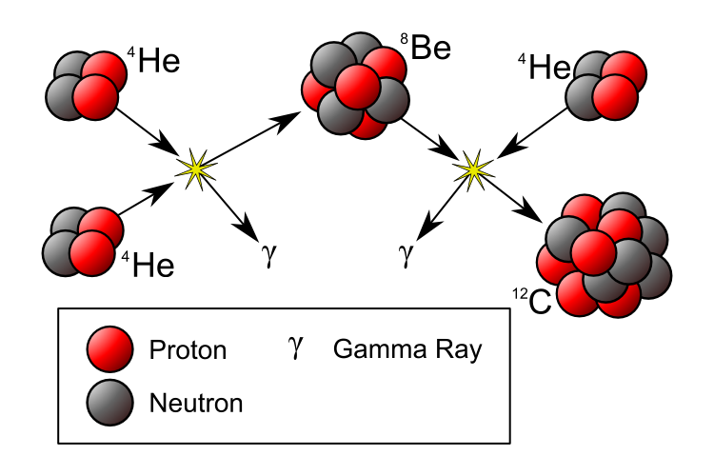
Triple alpha

Slide 14
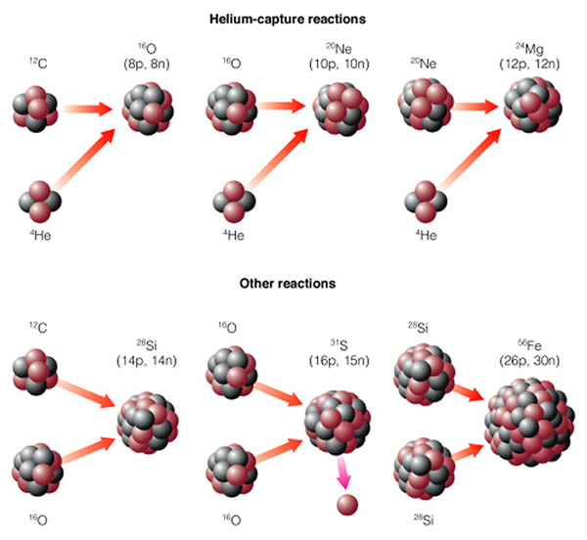
Alpha Ladder
Carbon → O,Ne,Mg (600 million K)
Neon → O, Mg (1.5 Billion K)
Oxygen → Si, S, P (2.1 Billion K)
Silicon → Fe, Ni (3.5 Billion K)

Slide 15
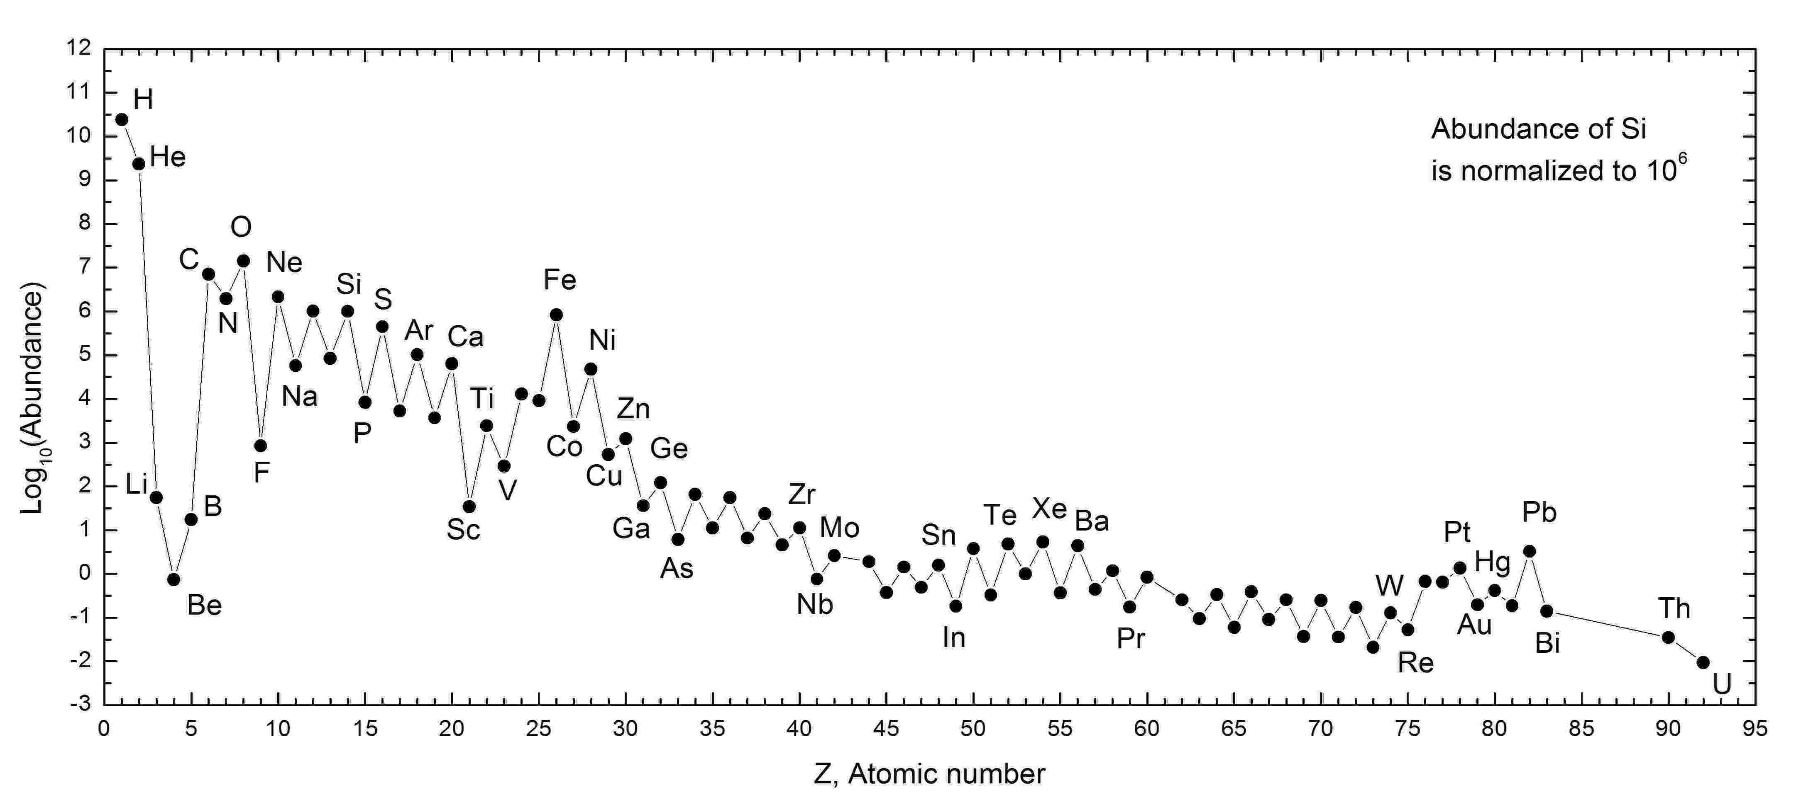
The Sun's abundance pattern
Elements with even atomic number are more abundant than those with odd
Expected, since Iron is the end of the fusion sequence.

