Slide 1
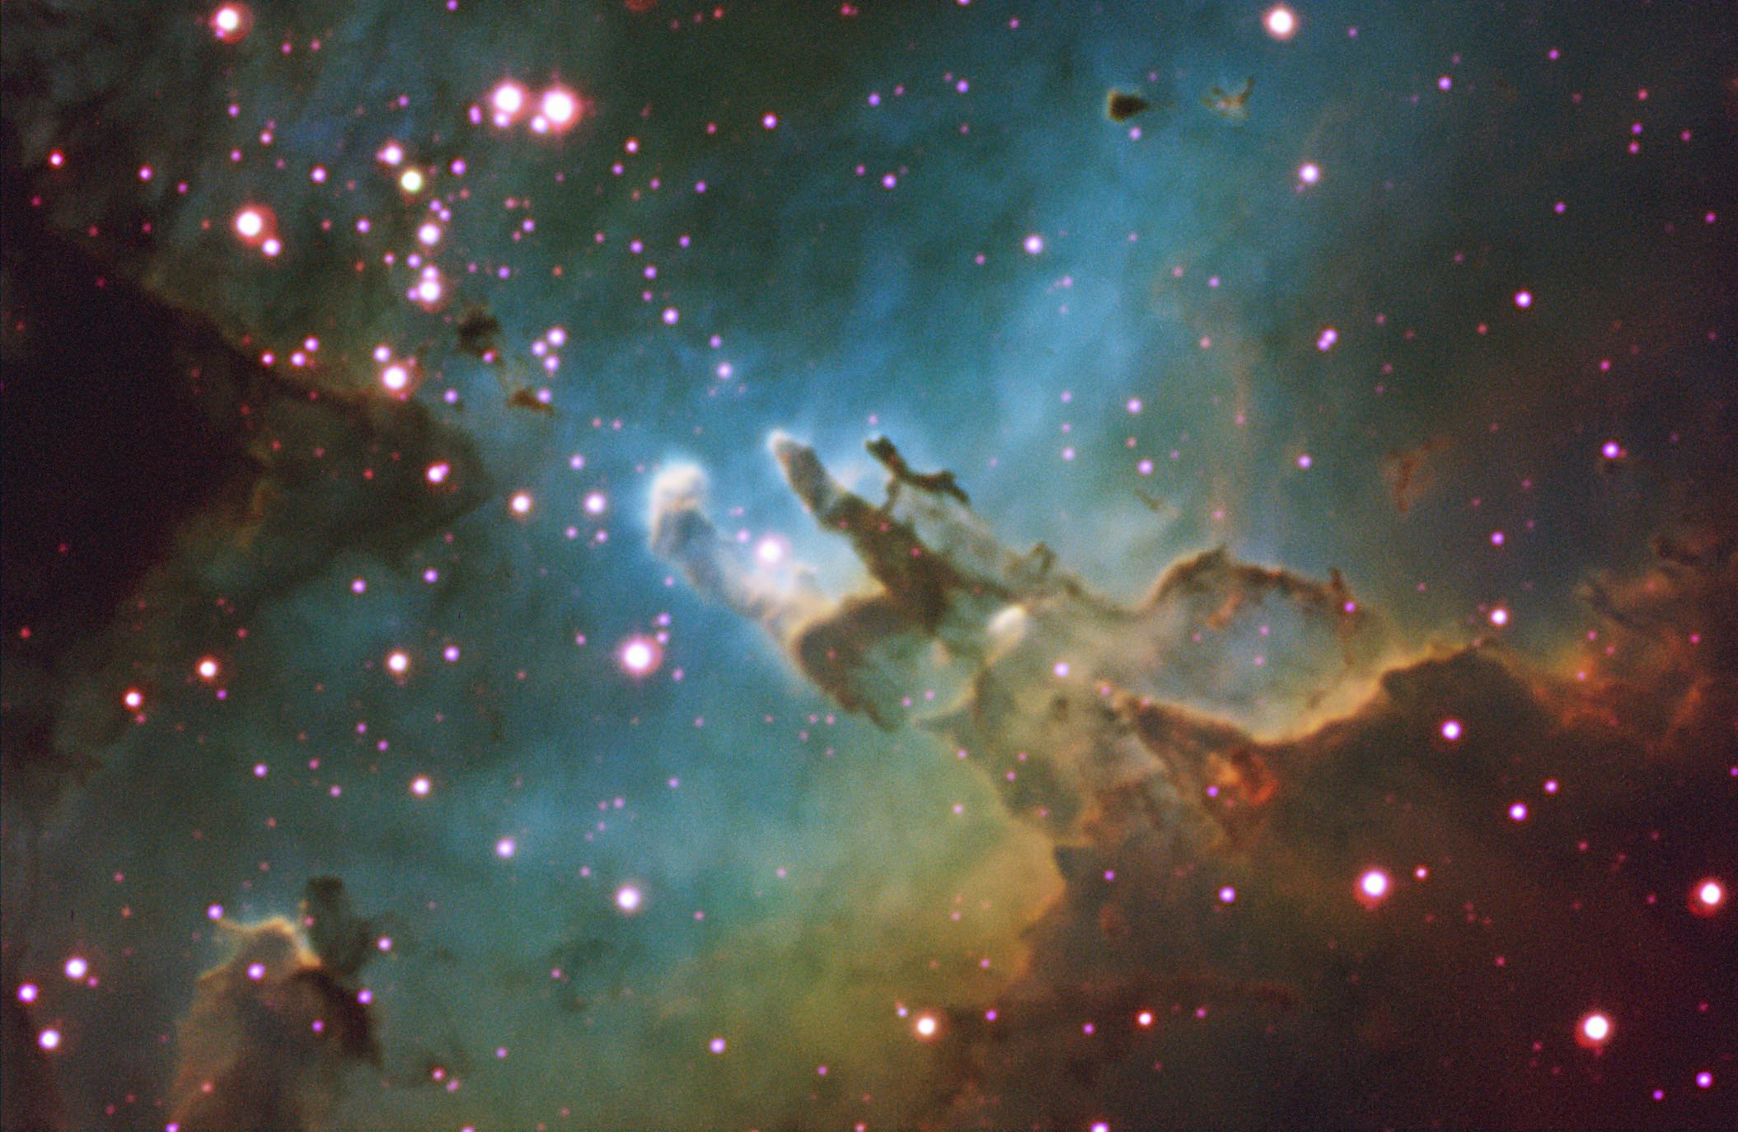
Selected Topics in Astrophysics
Prof Wladimir Lyra
Live Oak, 1119-G
Office Hours: Mon 4pm-5pm
Class hours: Mon/Wed 5pm-6:15pm

Slide 2
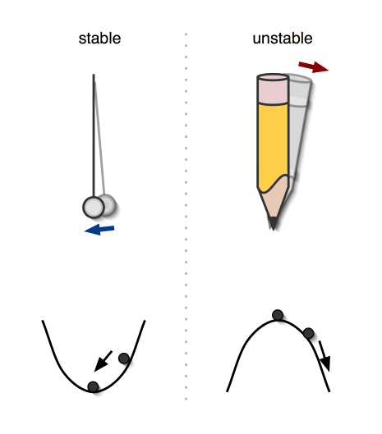
Stable and Unstable Equilibria
Stable Equilibrium
Returns to equilibrium position when disturbed
Unstable Equilibrium
Does not return to equilibrium position when disturbed

Slide 3
Thermal stability
to surface
to core
a perturbation
Hotter than the surroundings, it expands and rises
Equilibrium
Expansion cools the blob
It cools further and sinks
Equilibrium

Slide 4
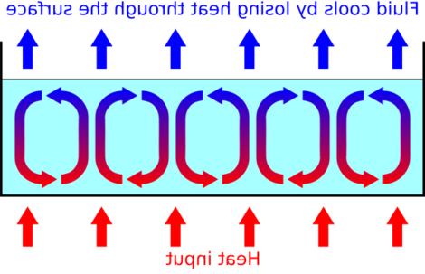
Thermal instability
Hotter than the surroundings
The blob expands and rises
It rises faster than it cools
It keeps rising
It travels a great distance
before cooling and sinking
CONVECTION

Slide 5
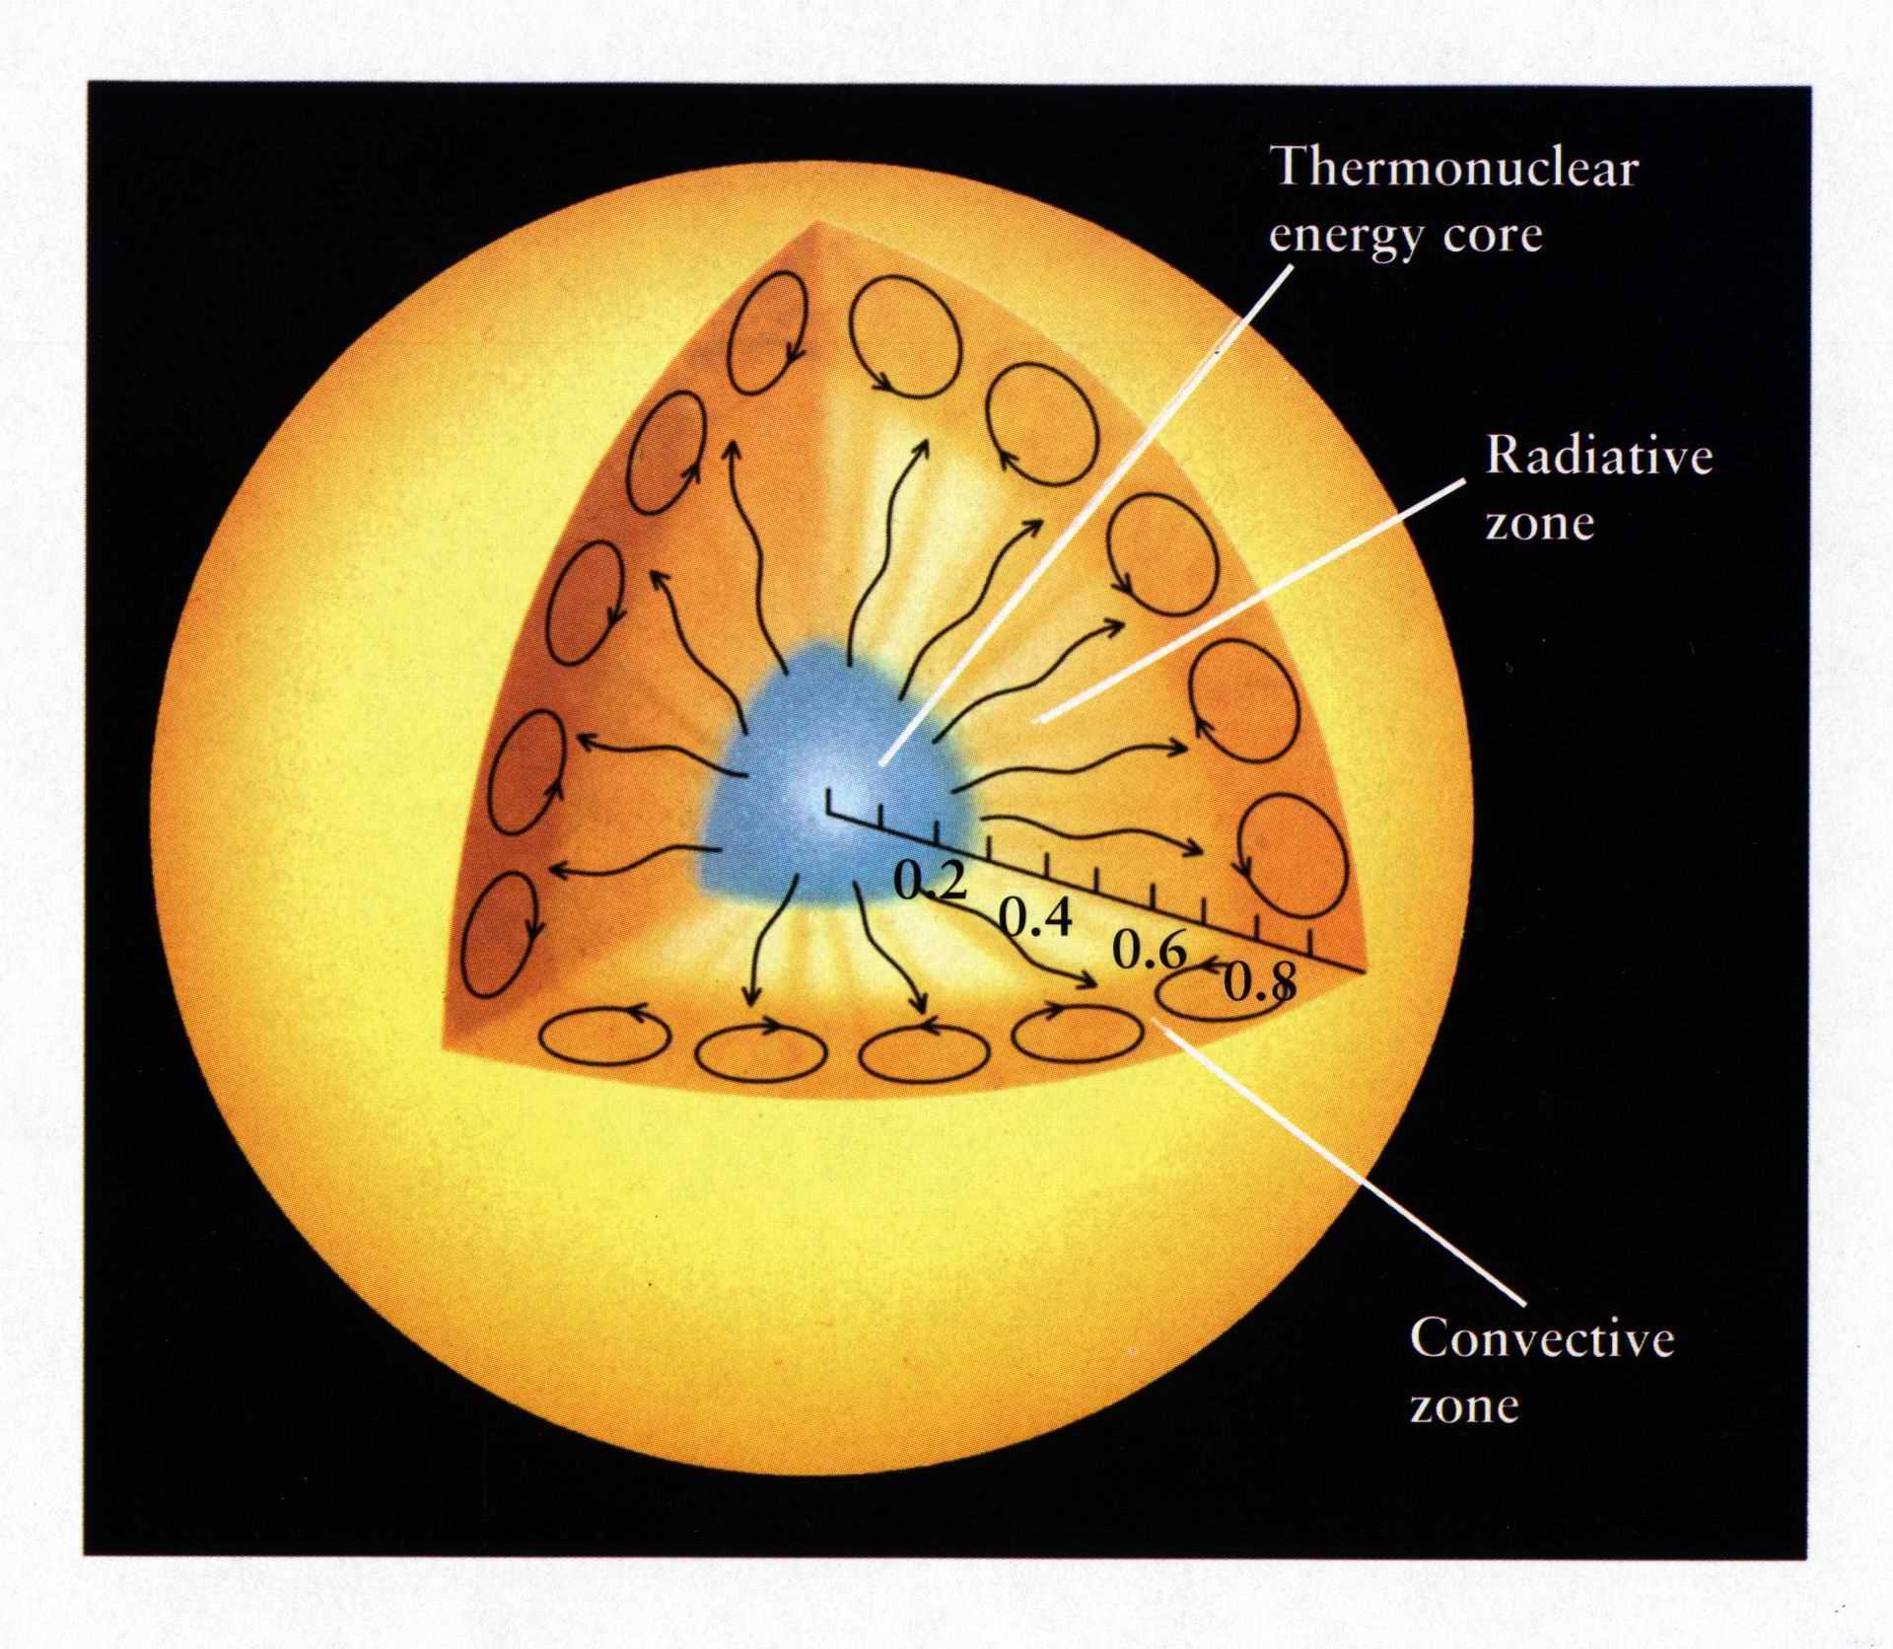
Solar Structure
In stable equilibrium,
heat is transported by radiation (without transport of mass).
In unstable equilibrium,
heat is transported by convection (with transport of mass).
The Sun has a
radiative zone
in the interior
And a
convective zone
near the surface

Slide 6
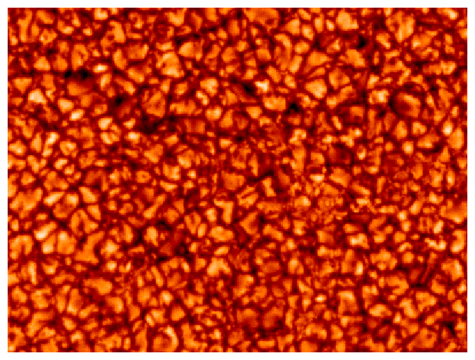
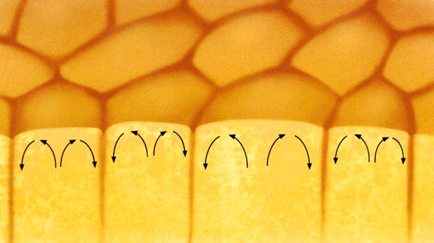
Granulation
Convective cells
Close-up of the surface of the Sun

Slide 7
Simulation by Remo Collet.
Surface intensity

Slide 8
Simulation by Remo Collet.
Vertical slice.
Atmosphere
Surface
Interior

Slide 9
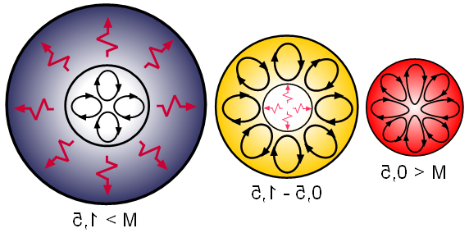
Stellar Structure
M > 1.5
0.5 < M < 1.5
M < 0.5
Convective Core
Radiative Envelope
Radiative Core
Convective Envelope
Fully Convective

