Slide 1
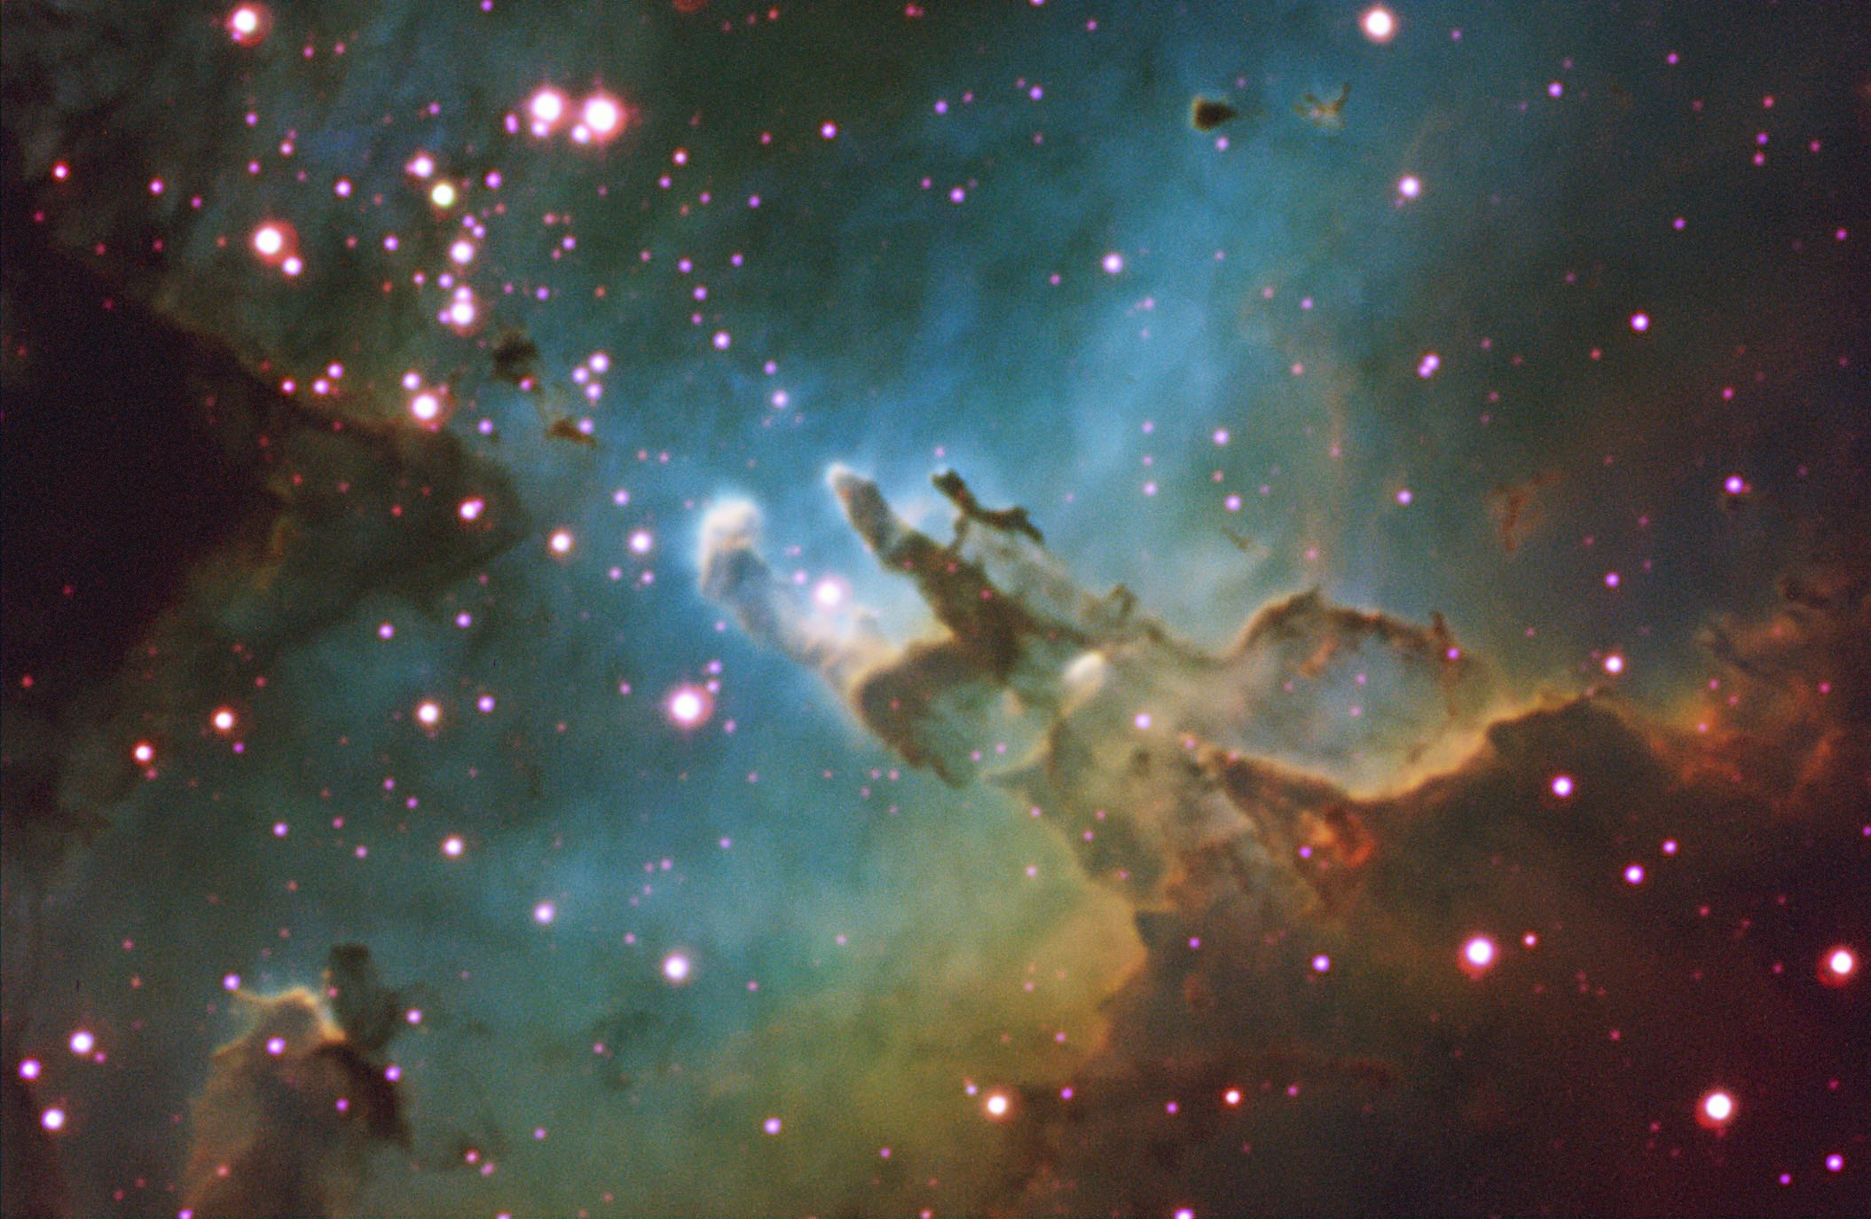
Selected Topics in Astrophysics
Prof Wladimir Lyra
Live Oak, 1119-G
Office Hours: Mon 4pm-5pm
Class hours: Mon/Wed 5pm-6:15pm

Slide 2
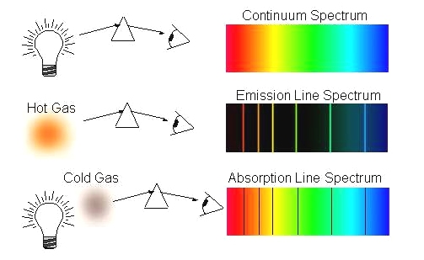
Spectroscopy
Spectral lines – Kirchhoff's three empirical laws of spectroscopy
A hot solid or a hot dense gas produces a continuum spectrum.
A hot low-density gas produces an emission-line spectrum.
A continuos source viewed through a cold gas produces an absorption-line spectrum.

Slide 3
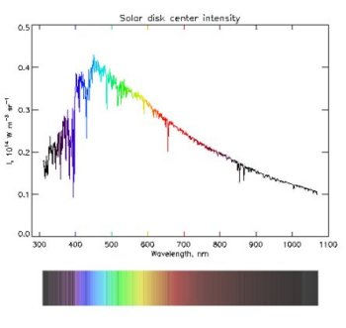
Spectroscopy
Spectral lines – Kirchhoff's three empirical laws of spectroscopy
==
Colder gas
Hot source

