Slide 1
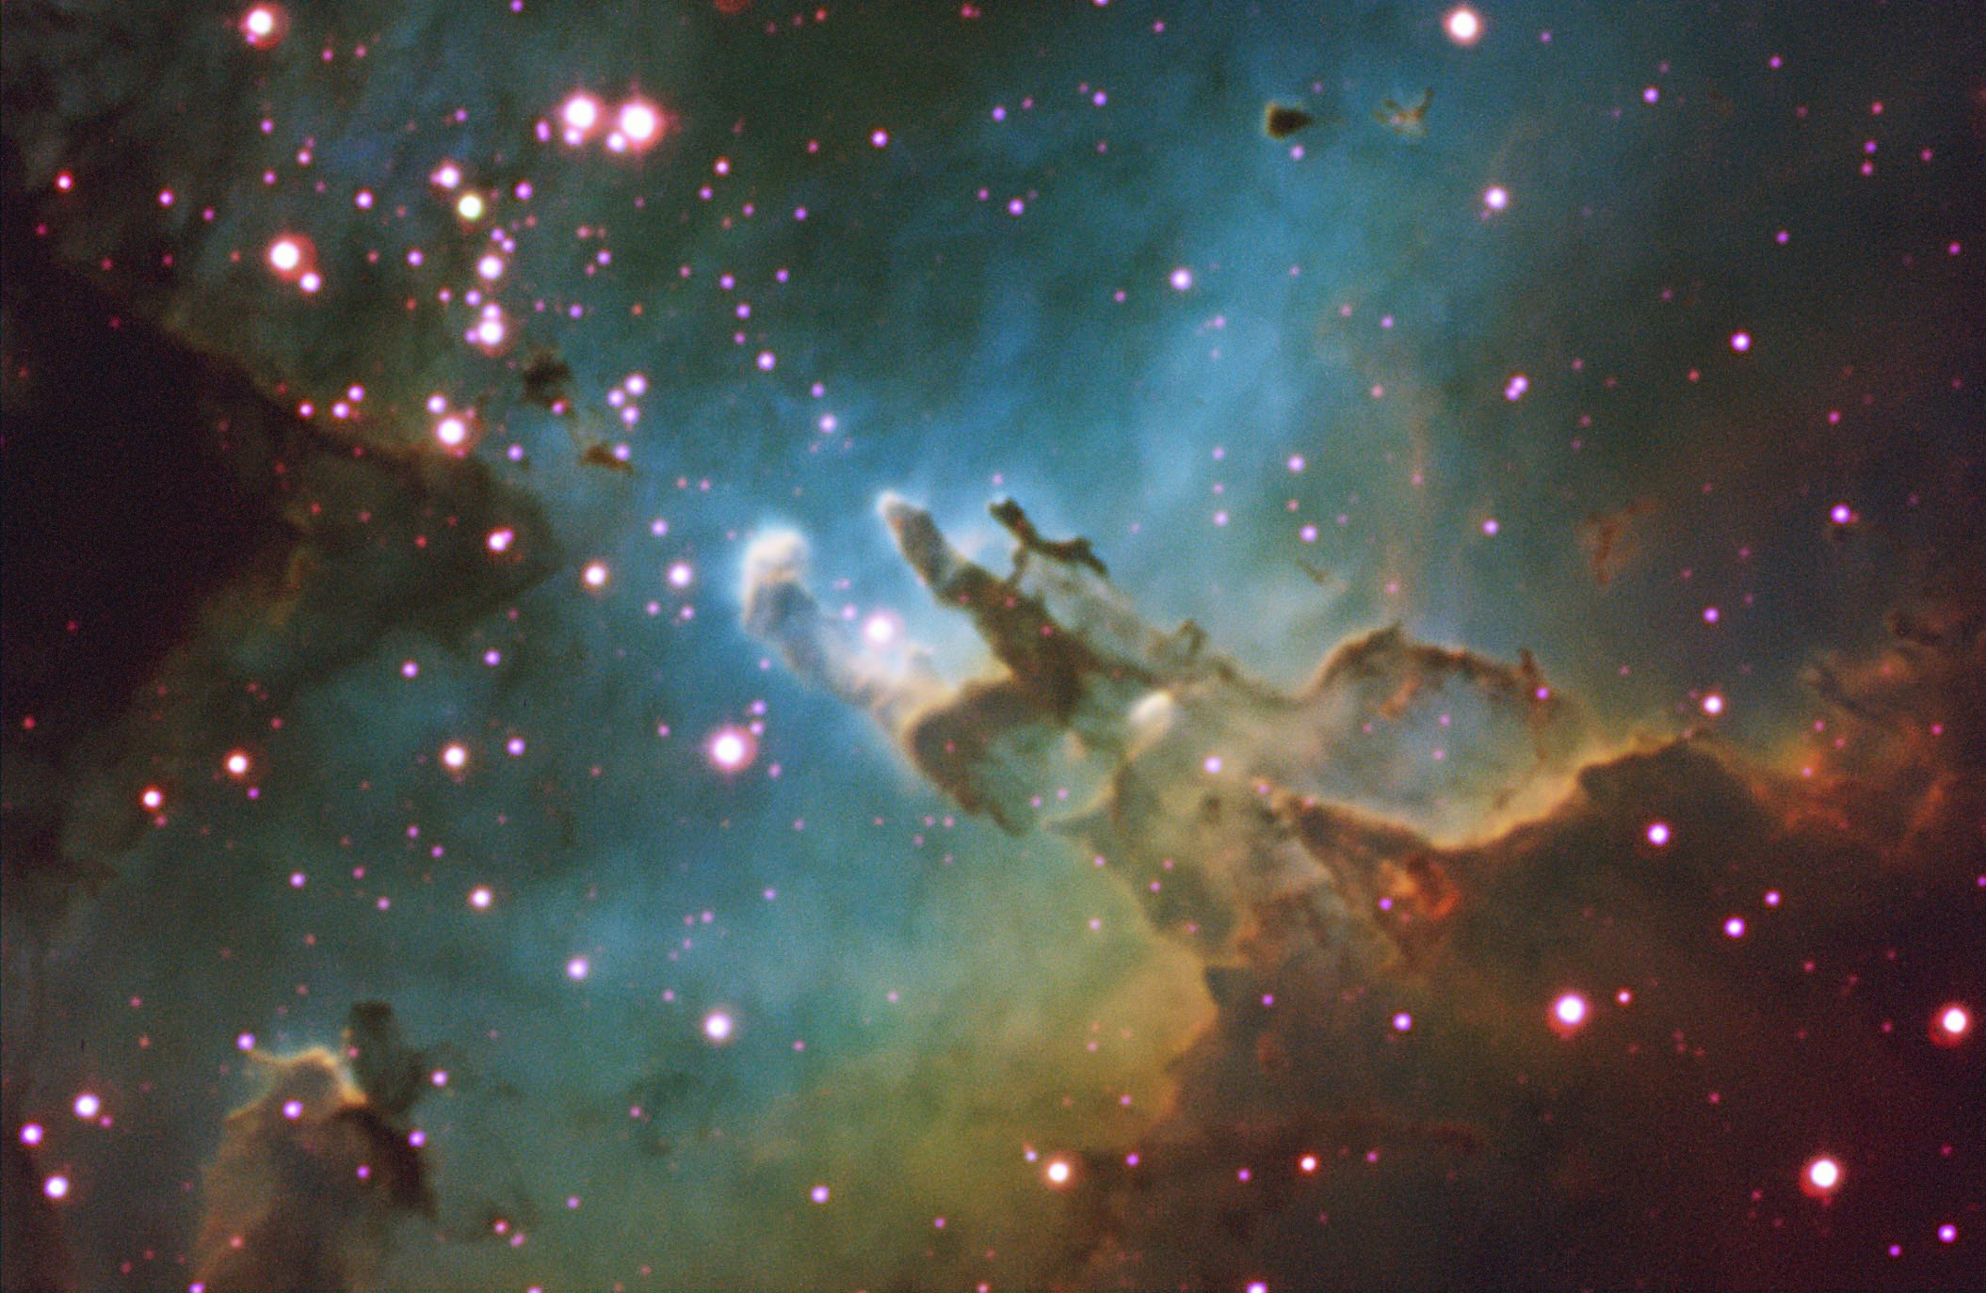
Selected Topics in Astrophysics
Prof Wladimir Lyra
Live Oak, 1119-G
Office Hours: Mon 4pm-5pm
Class hours: Mon/Wed 5pm-6:15pm

Slide 2
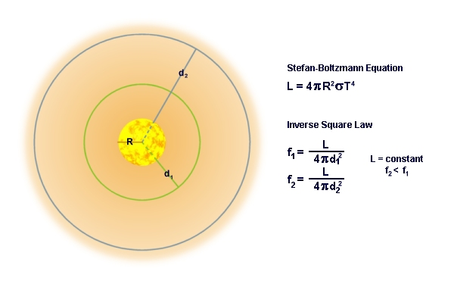
Principles of Radiative Transfer
A statement of energy conservation:
Gaussian surfaces of different radii have
the same energy flowing through them.

Slide 3
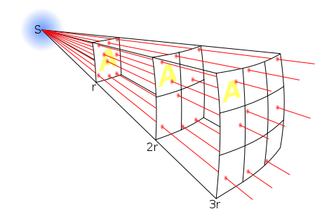
Principles of Radiative Transfer
As distance increases, the same energy spreads through a larger area.
This gives rise to an inverse square law.

Slide 4
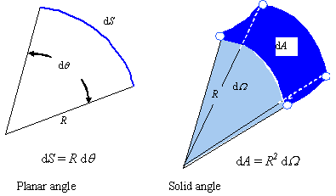
Principles of Radiative Transfer
Solid angle: a 3D generalization of the plane angle.

Slide 5
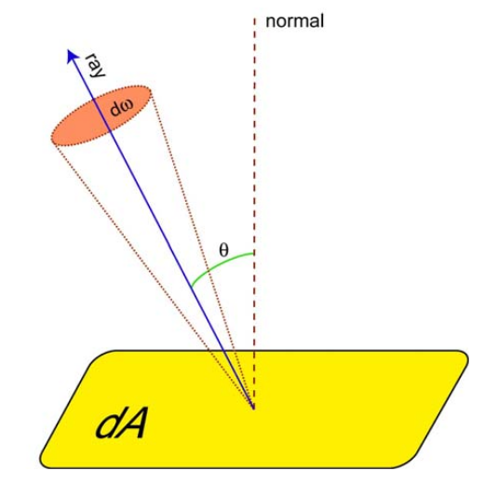
Intensity: geometry
An intuitive quantity related to radiation is flux, which is simply the energy dE crossing an area dA.
Yet, a more fundamental quantity is intensity, which defines also the direction where the radiation is coming from. So, it is the energy dE crossing an area dA, coming from a direction making a angle θ with that area.
The concept of intensity is an attempt to define a fundamental unit of the radiation field. In quantum mechanics, that would be a single photon. In macroscopic terms, we define a set of rays, spanning a range Δω in solid angle. Then, a single radiation ray, the fundamental unit of the radiation field, is found in the limit where this range of solid angles is infinitesimal.

Slide 6
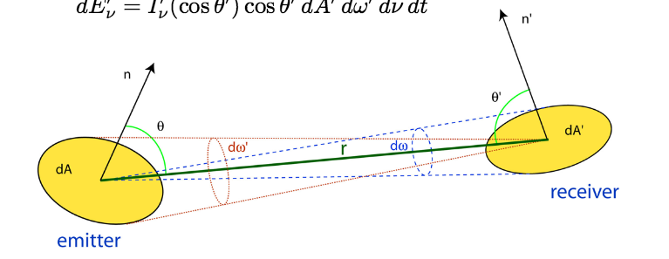
Intensity does not depend on distance
Consider a ray going from point P1 to point P2. The intensity does not change along the path. To prove this, consider the geometry below. Call P1 the emitter and P2 the receiver. Assume at first that I₁ != I₂.
Energy flowing from P1 toward P2
Energy reaching P2, coming from P1
Because dω₁=dA₂/r² and dω₂=dA₁/r² the conclusion is that I₁=I₂
Intepretation: In the limit Δω −> 0, the energy stops spreading out, so intense does not depend on distance. The surface of the sun is as bright as seen from Earth as it is when seen from Pluto. Microscopically, it means that a single photon is coherent, it does not spread its energy.

Slide 7
Root finding

