Slide 1
Selected Topics in Astrophysics
Prof Wladimir Lyra
Live Oak, 1119-G
Office Hours: Mon 4pm-5pm
Class hours: Mon/Wed 5pm-6:15pm

Slide 2
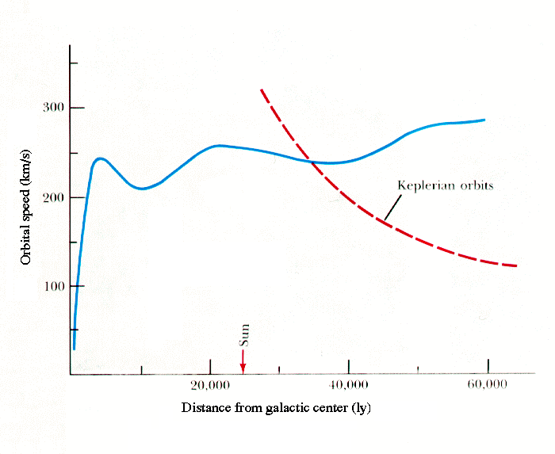
Galactic rotation curve

Slide 3
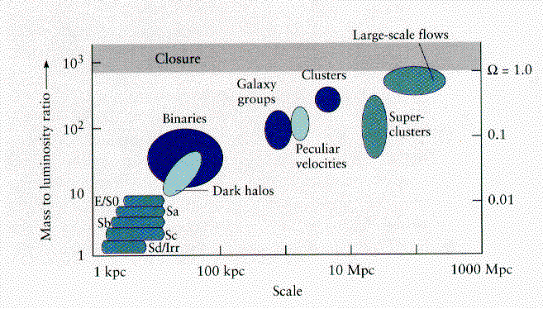
Mass to luminosity ratio

Slide 4
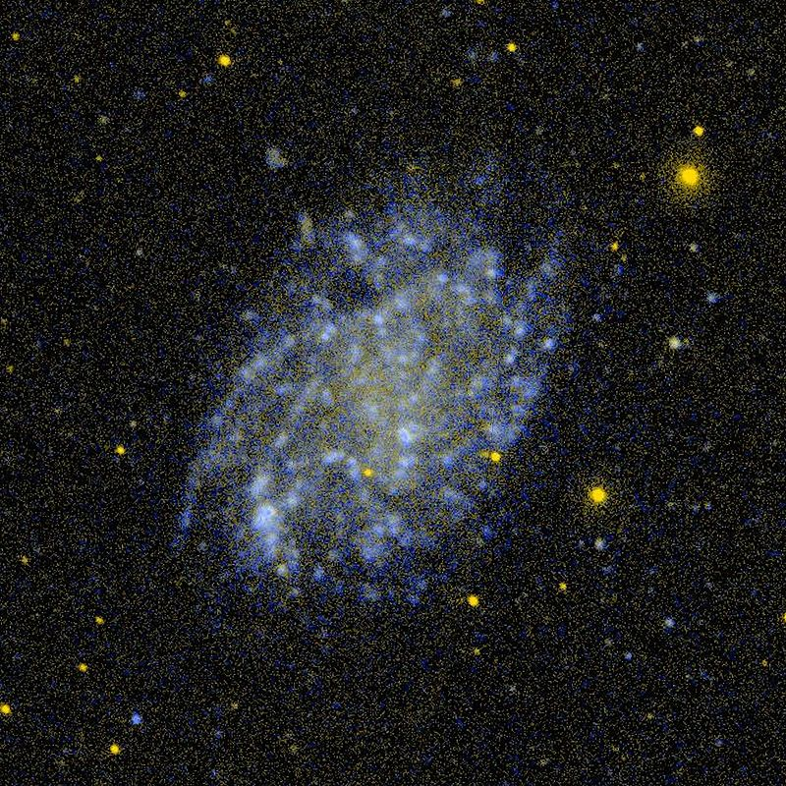
Low surface brightness galaxies

Slide 5
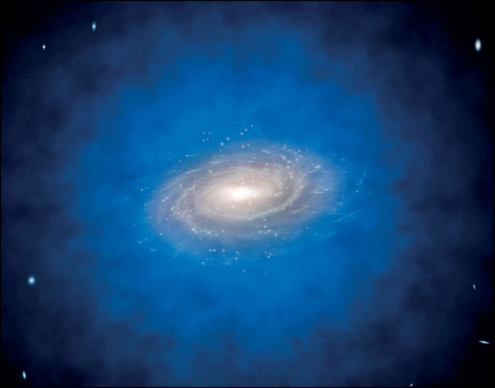
Dark matter haloes

Slide 6
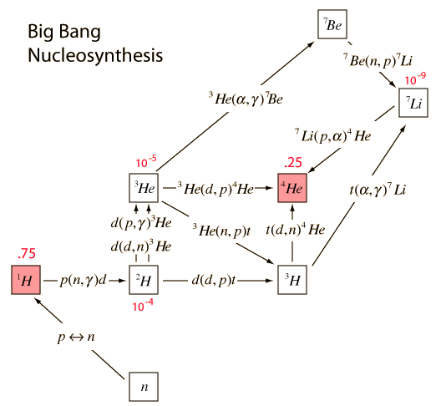
Ruling out baryonic dark matter

Slide 7
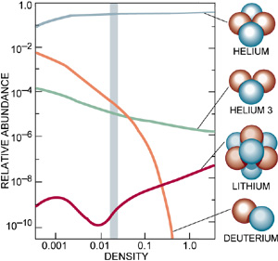
Dark matter haloes
The abundance of He-4 is independent
of density. Yet the other products of
Big bang nucleosynthesis do depend
on density. The range allowed by the
observations (grey line). Rules out a substantial amount of baryonic dark matter.

Slide 8
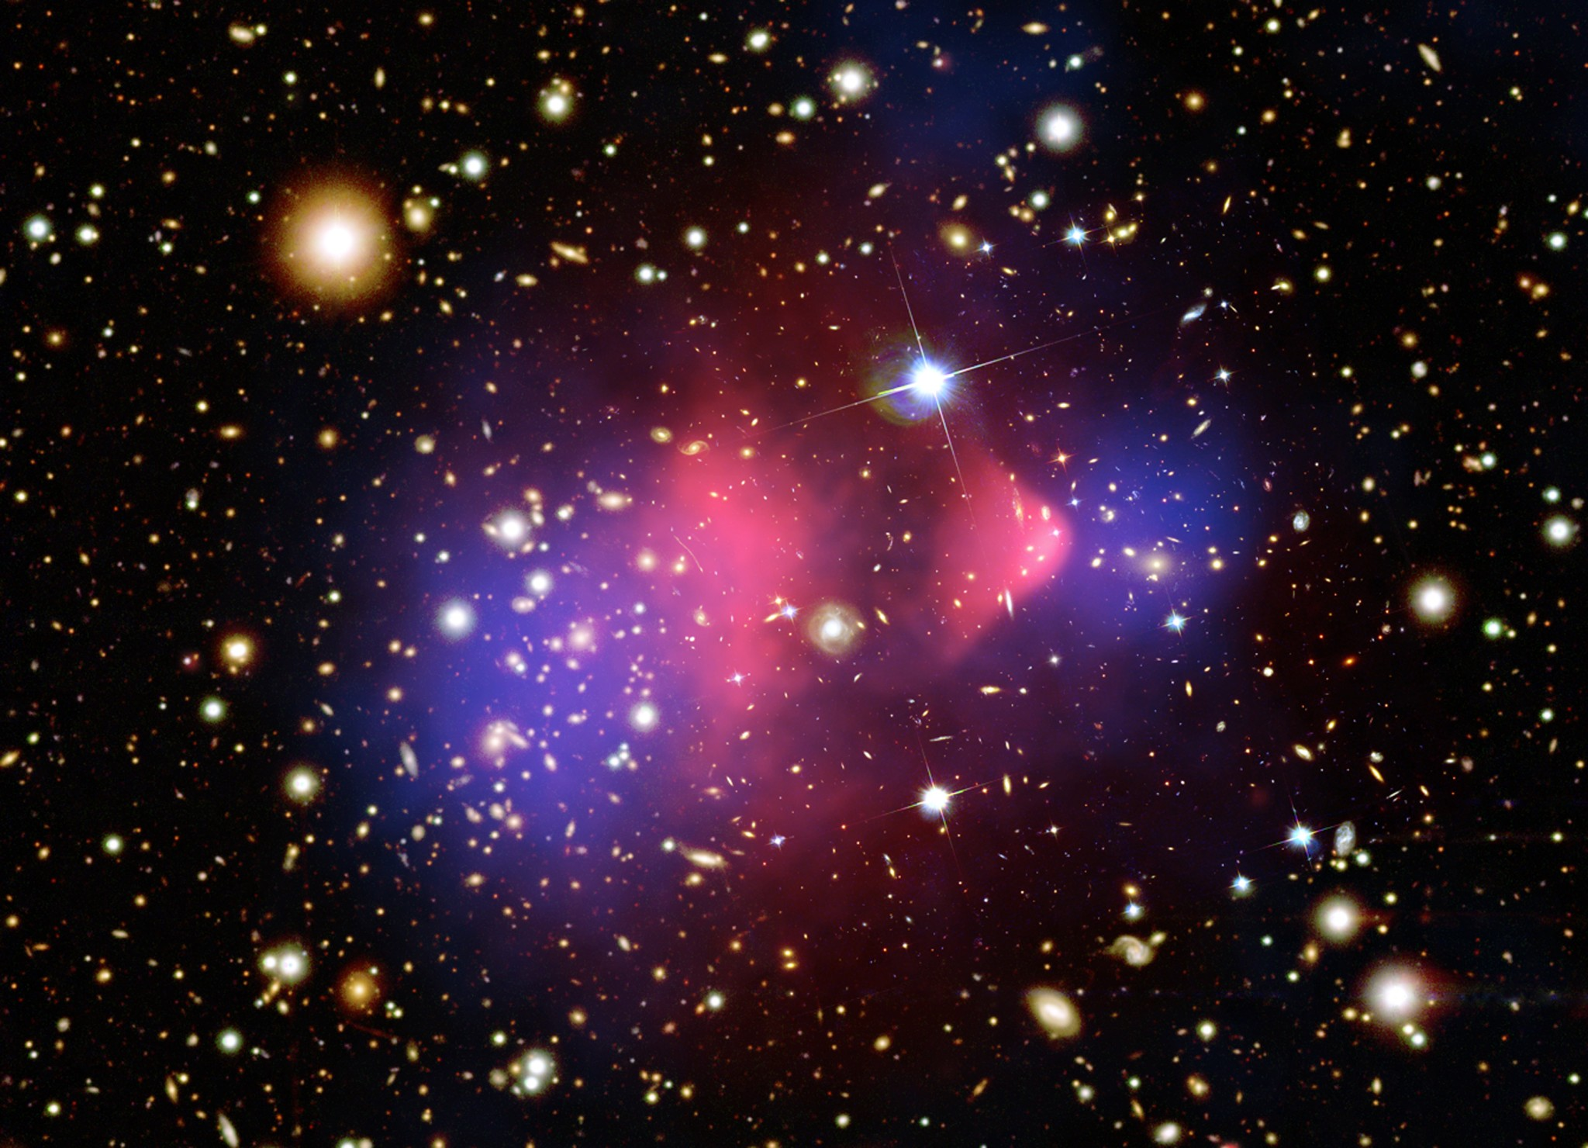
The Bullet Cluster

Slide 9
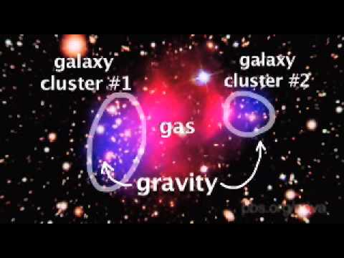

Slide 10
