Slide 1
Selected Topics in Astrophysics
Prof Wladimir Lyra
Live Oak, 1119-G
Office Hours: Mon 4pm-5pm
Class hours: Mon/Wed 5pm-6:15pm

Slide 2
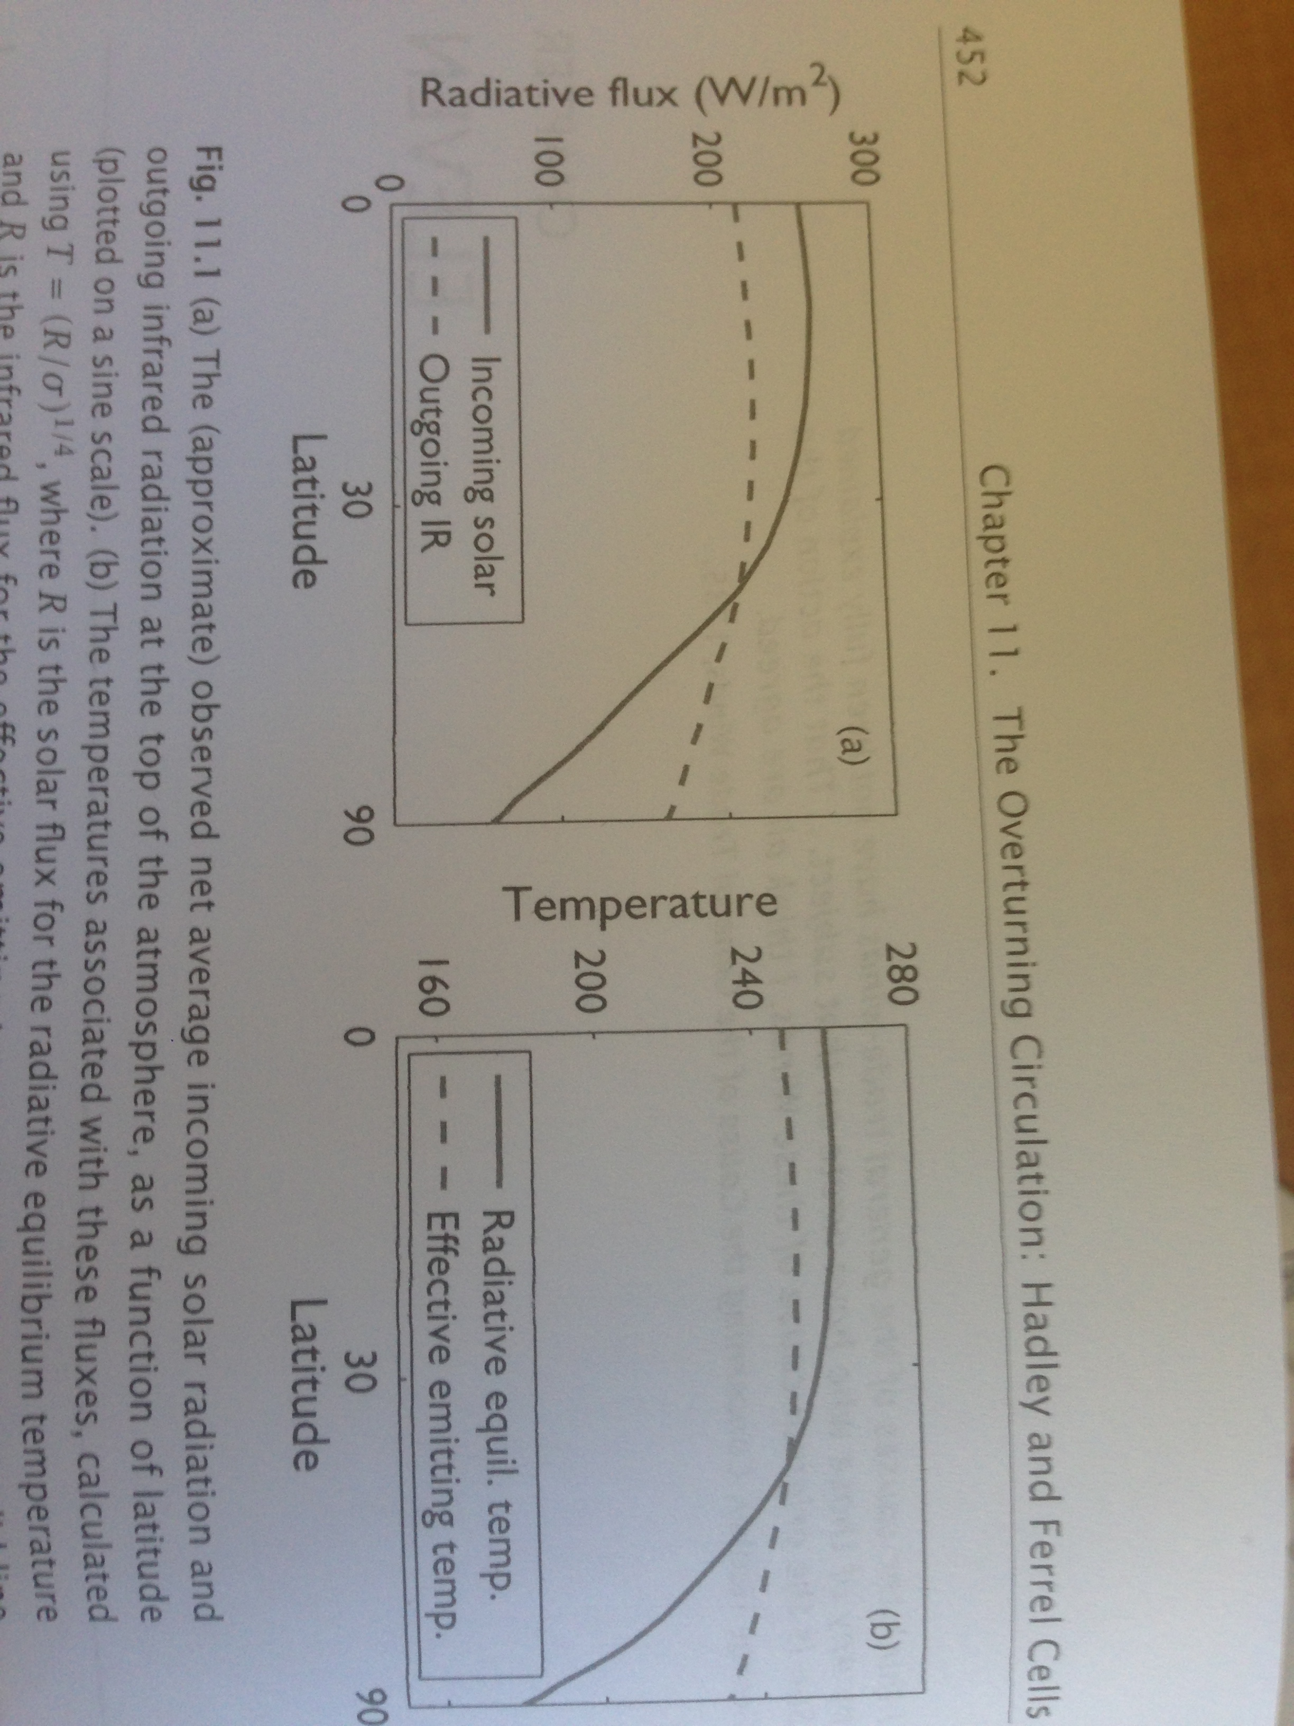
Radiative equilibrium.
A function of latitude.
Evidence of transport!

Slide 3
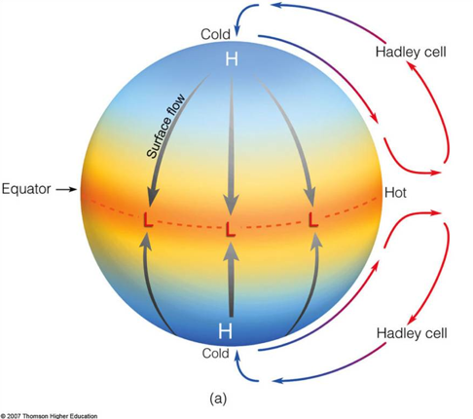
Hadley circulation

Slide 4
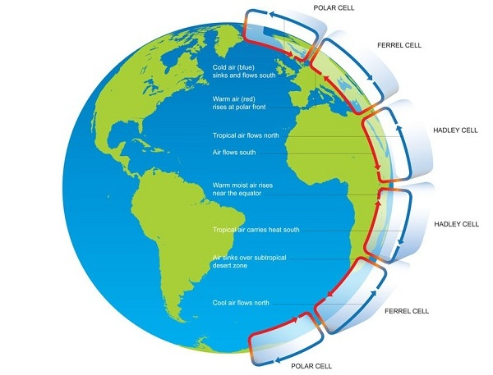
Hadley circulation with planetary rotation

Slide 5
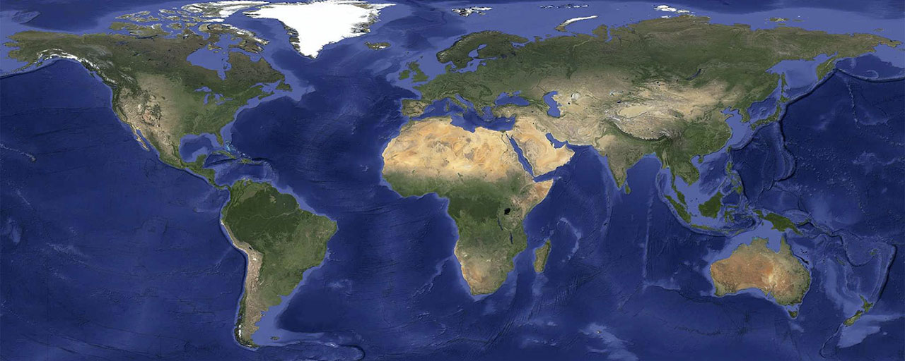
The deserts are found in a line
Boundary between descending Hadley cells.
Ascent: aircools and cannot hold moist, raining down. Makes the rain forests.
Descent: Dry air creates deserts.

Slide 6
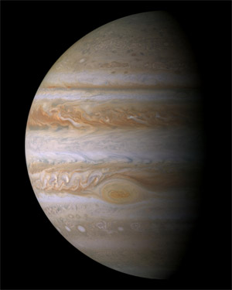
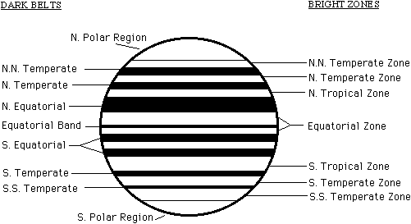
Atmospheres of the Giant Planets
Bands and Storms

Slide 7
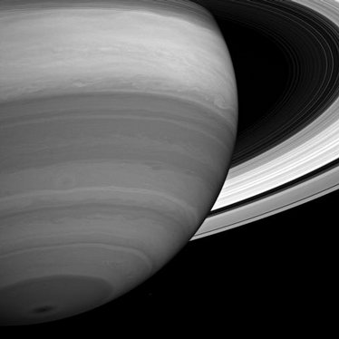
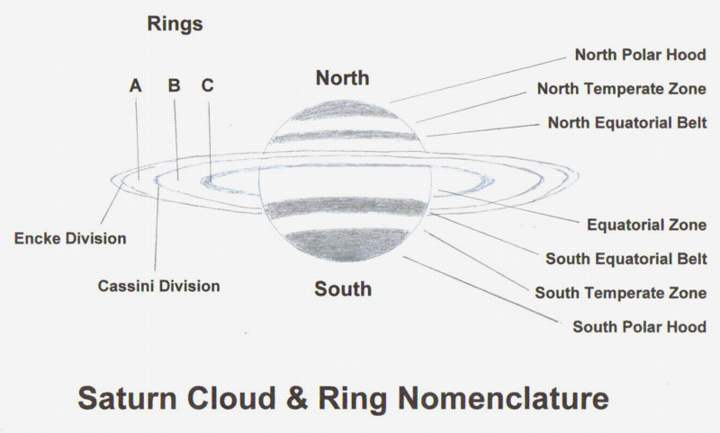
Atmospheres of the Giant Planets
Bands and Storms

Slide 8
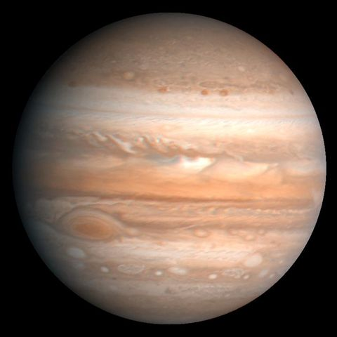
Clouds of Jupiter
Bright Zones
Dark Belts
Dark brown color:
compounds of sulfur (S) and phosphorus (P)
Bright zones:
High ammonia clouds
shielding brown stuff below

Slide 9
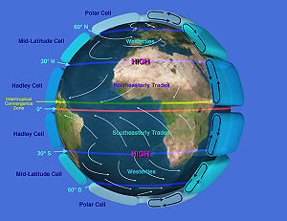
Clouds of Jupiter
Bright Zones
Dark Belts
Dark brown color:
compounds of sulfur (S) and phosphorus (P)
Bright zones:
High ammonia clouds
shielding brown stuff below
In Jupiter
Hot gas rises, cools,
ammonia condenses -> Zones.
Cold air sinking,
dry in ammonia - > Belts.

Slide 10
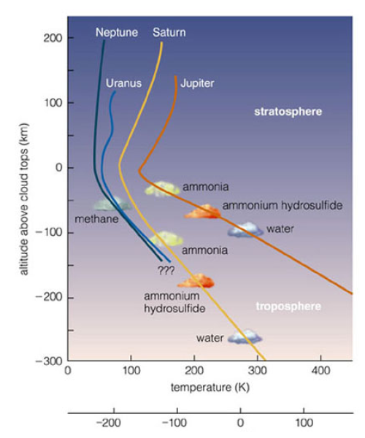
Clouds
H₂0 ~300K
NH₃ ~140K
CH₄ ~80K

Slide 11
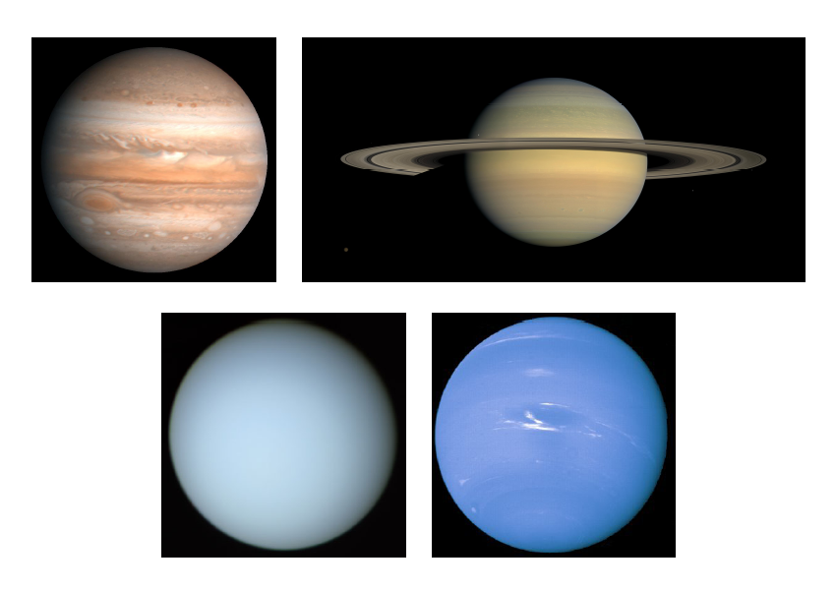
Ammonia and Methane Clouds
Jupiter and Saturn have ammonia clouds
Colder Uranus and Neptune have methane clouds

Slide 12
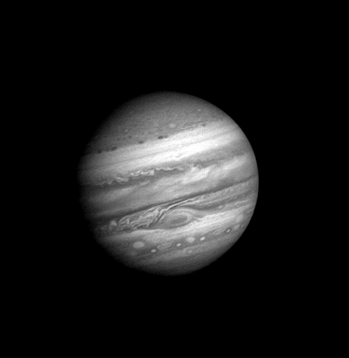

Slide 13
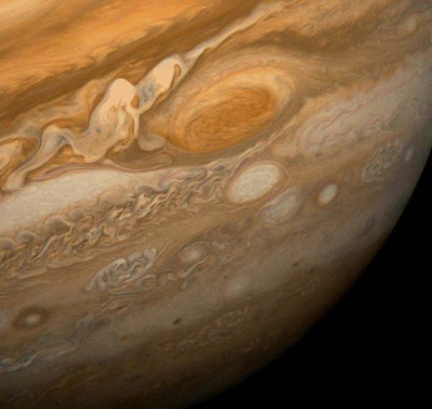
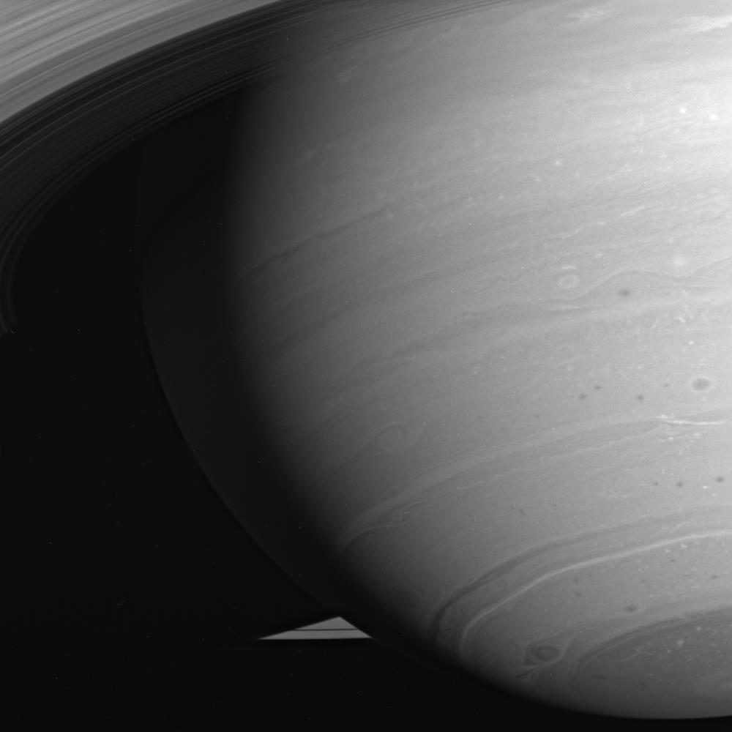
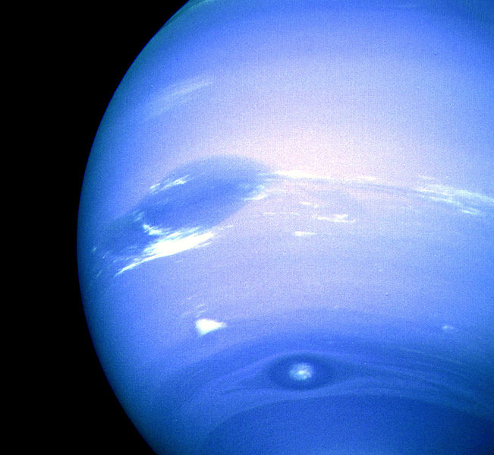
Storms

Slide 14
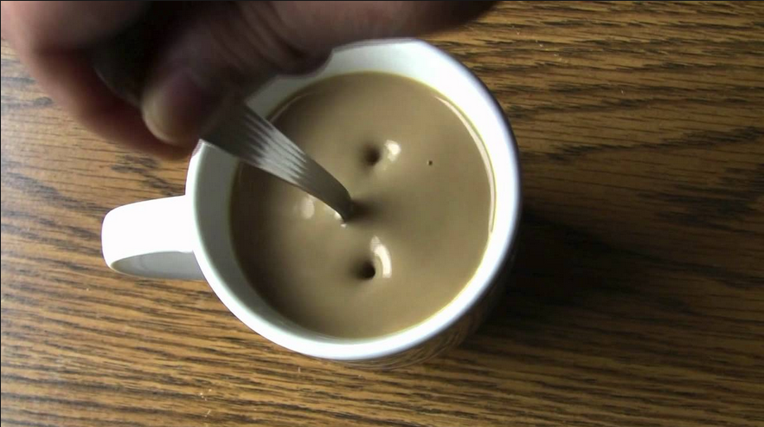
Conservation of vorticity

Slide 15
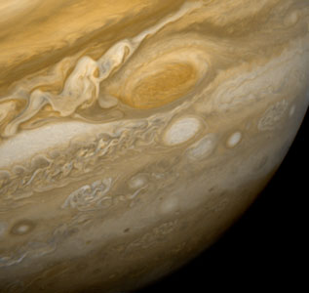
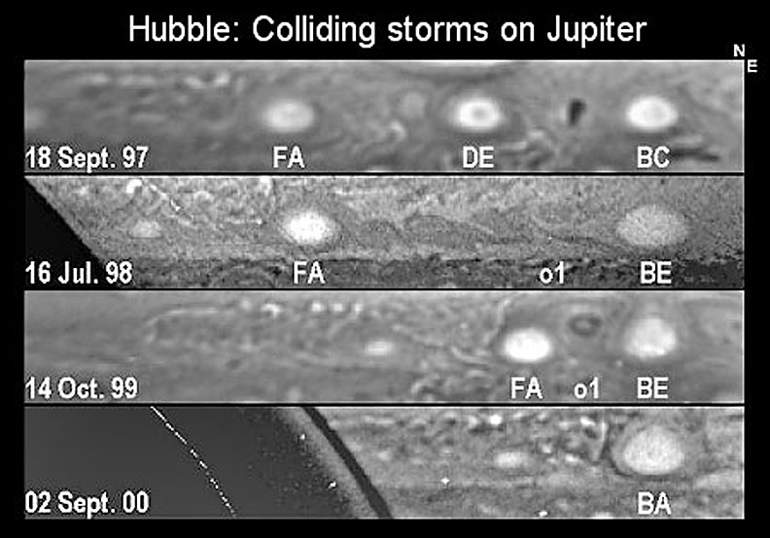
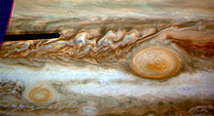
Merging Vortices

Slide 16
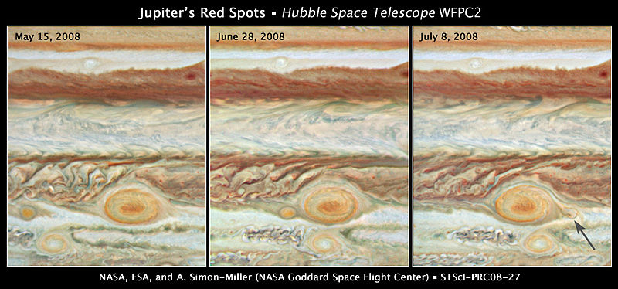
Jupiter's Red Spots

Slide 18
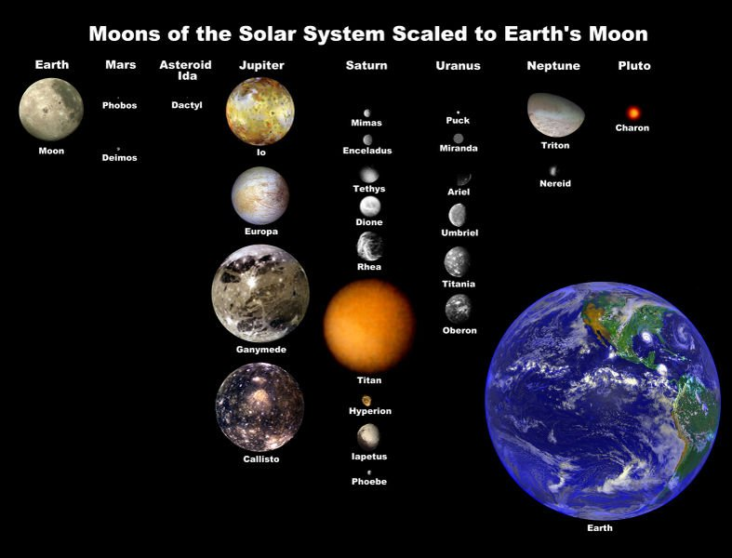
Satellites of the Outer Planets

Slide 19
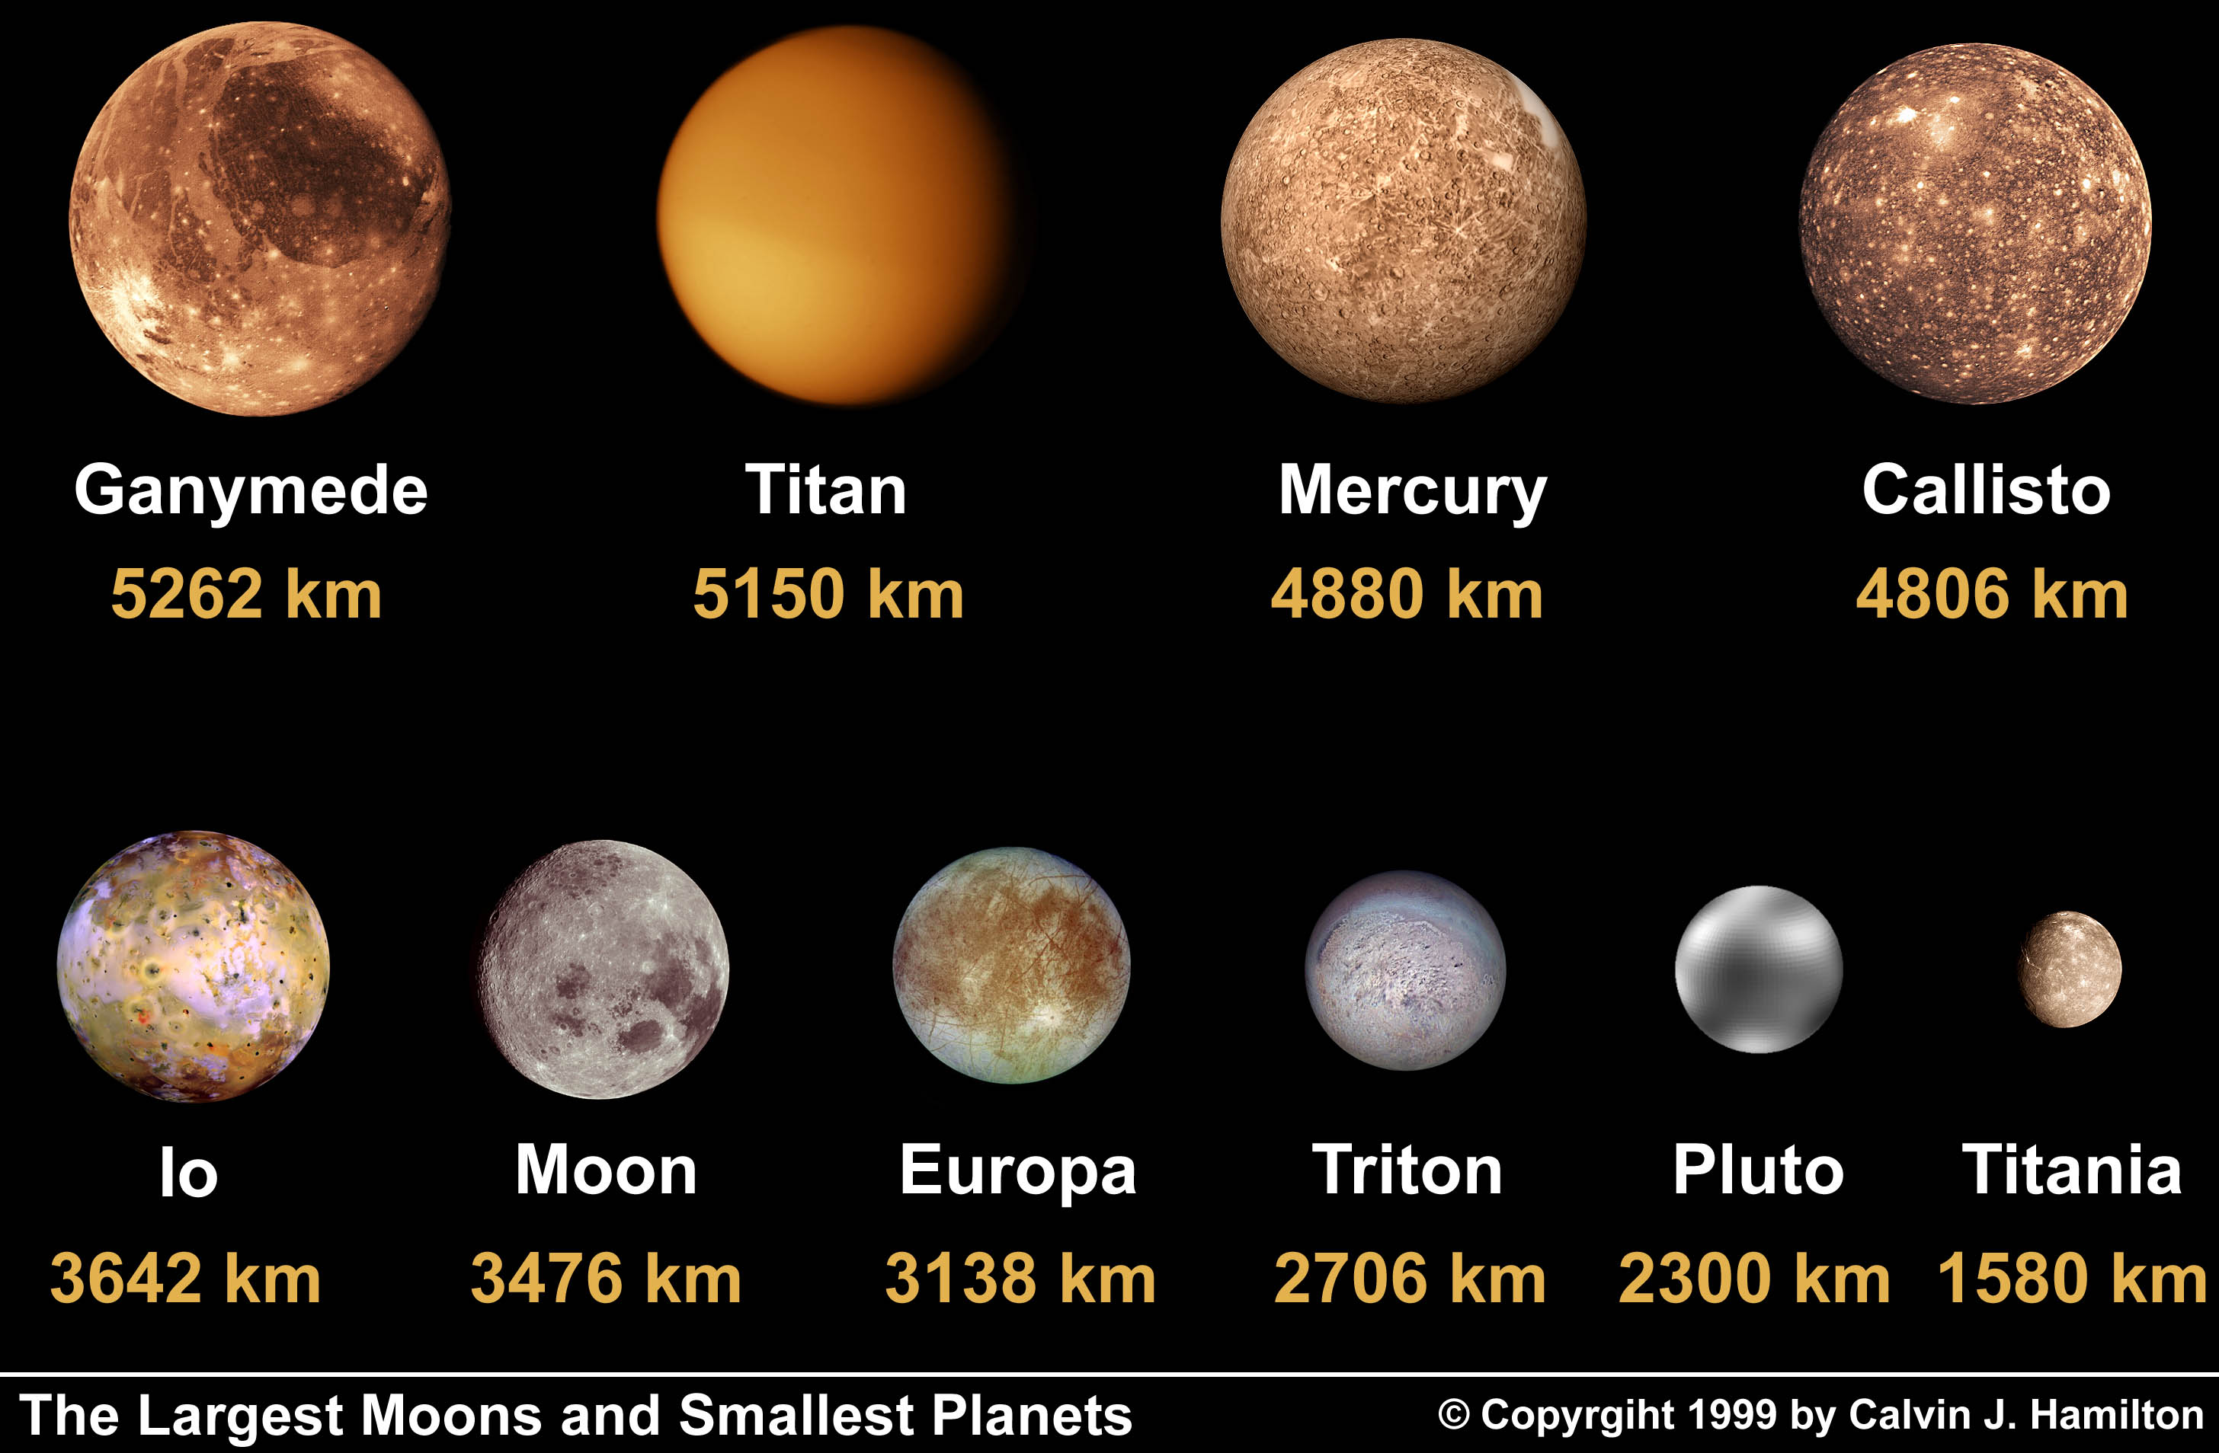
Size Comparison

Slide 20
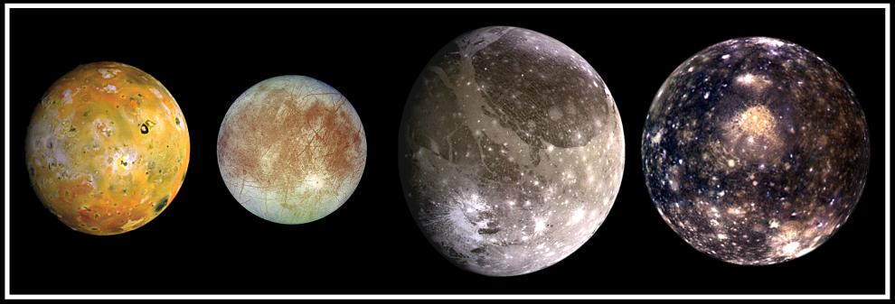
Jupiter's family portrait
The Galilean Moons

Slide 21
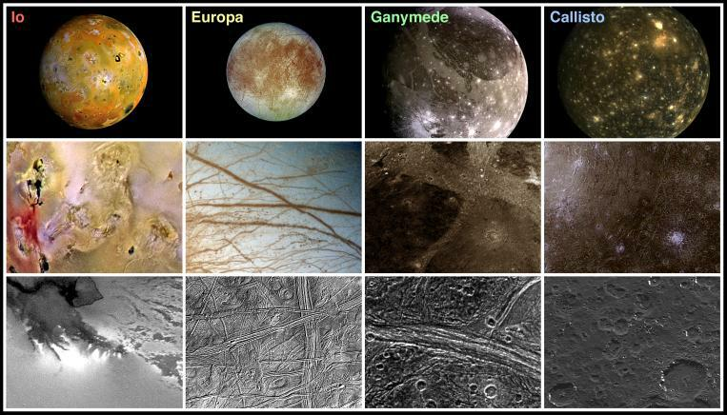
Surfaces of the Galilean Satellites
Young surfaces
Old surface
(Geologically Active)

Slide 22
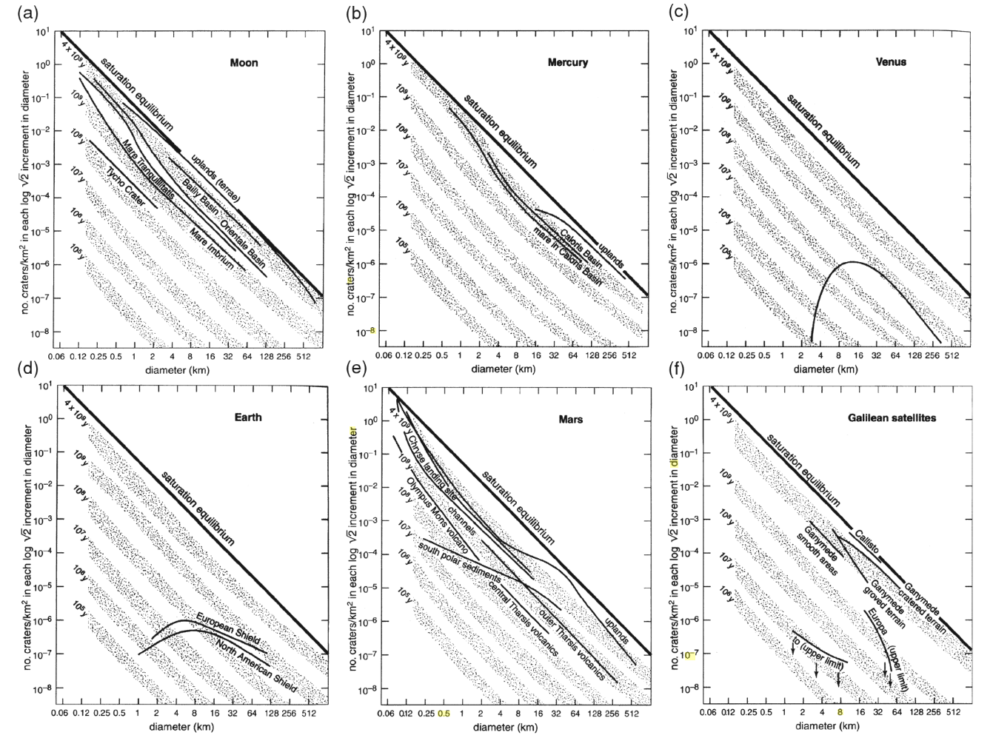
Crater Counting

Slide 23
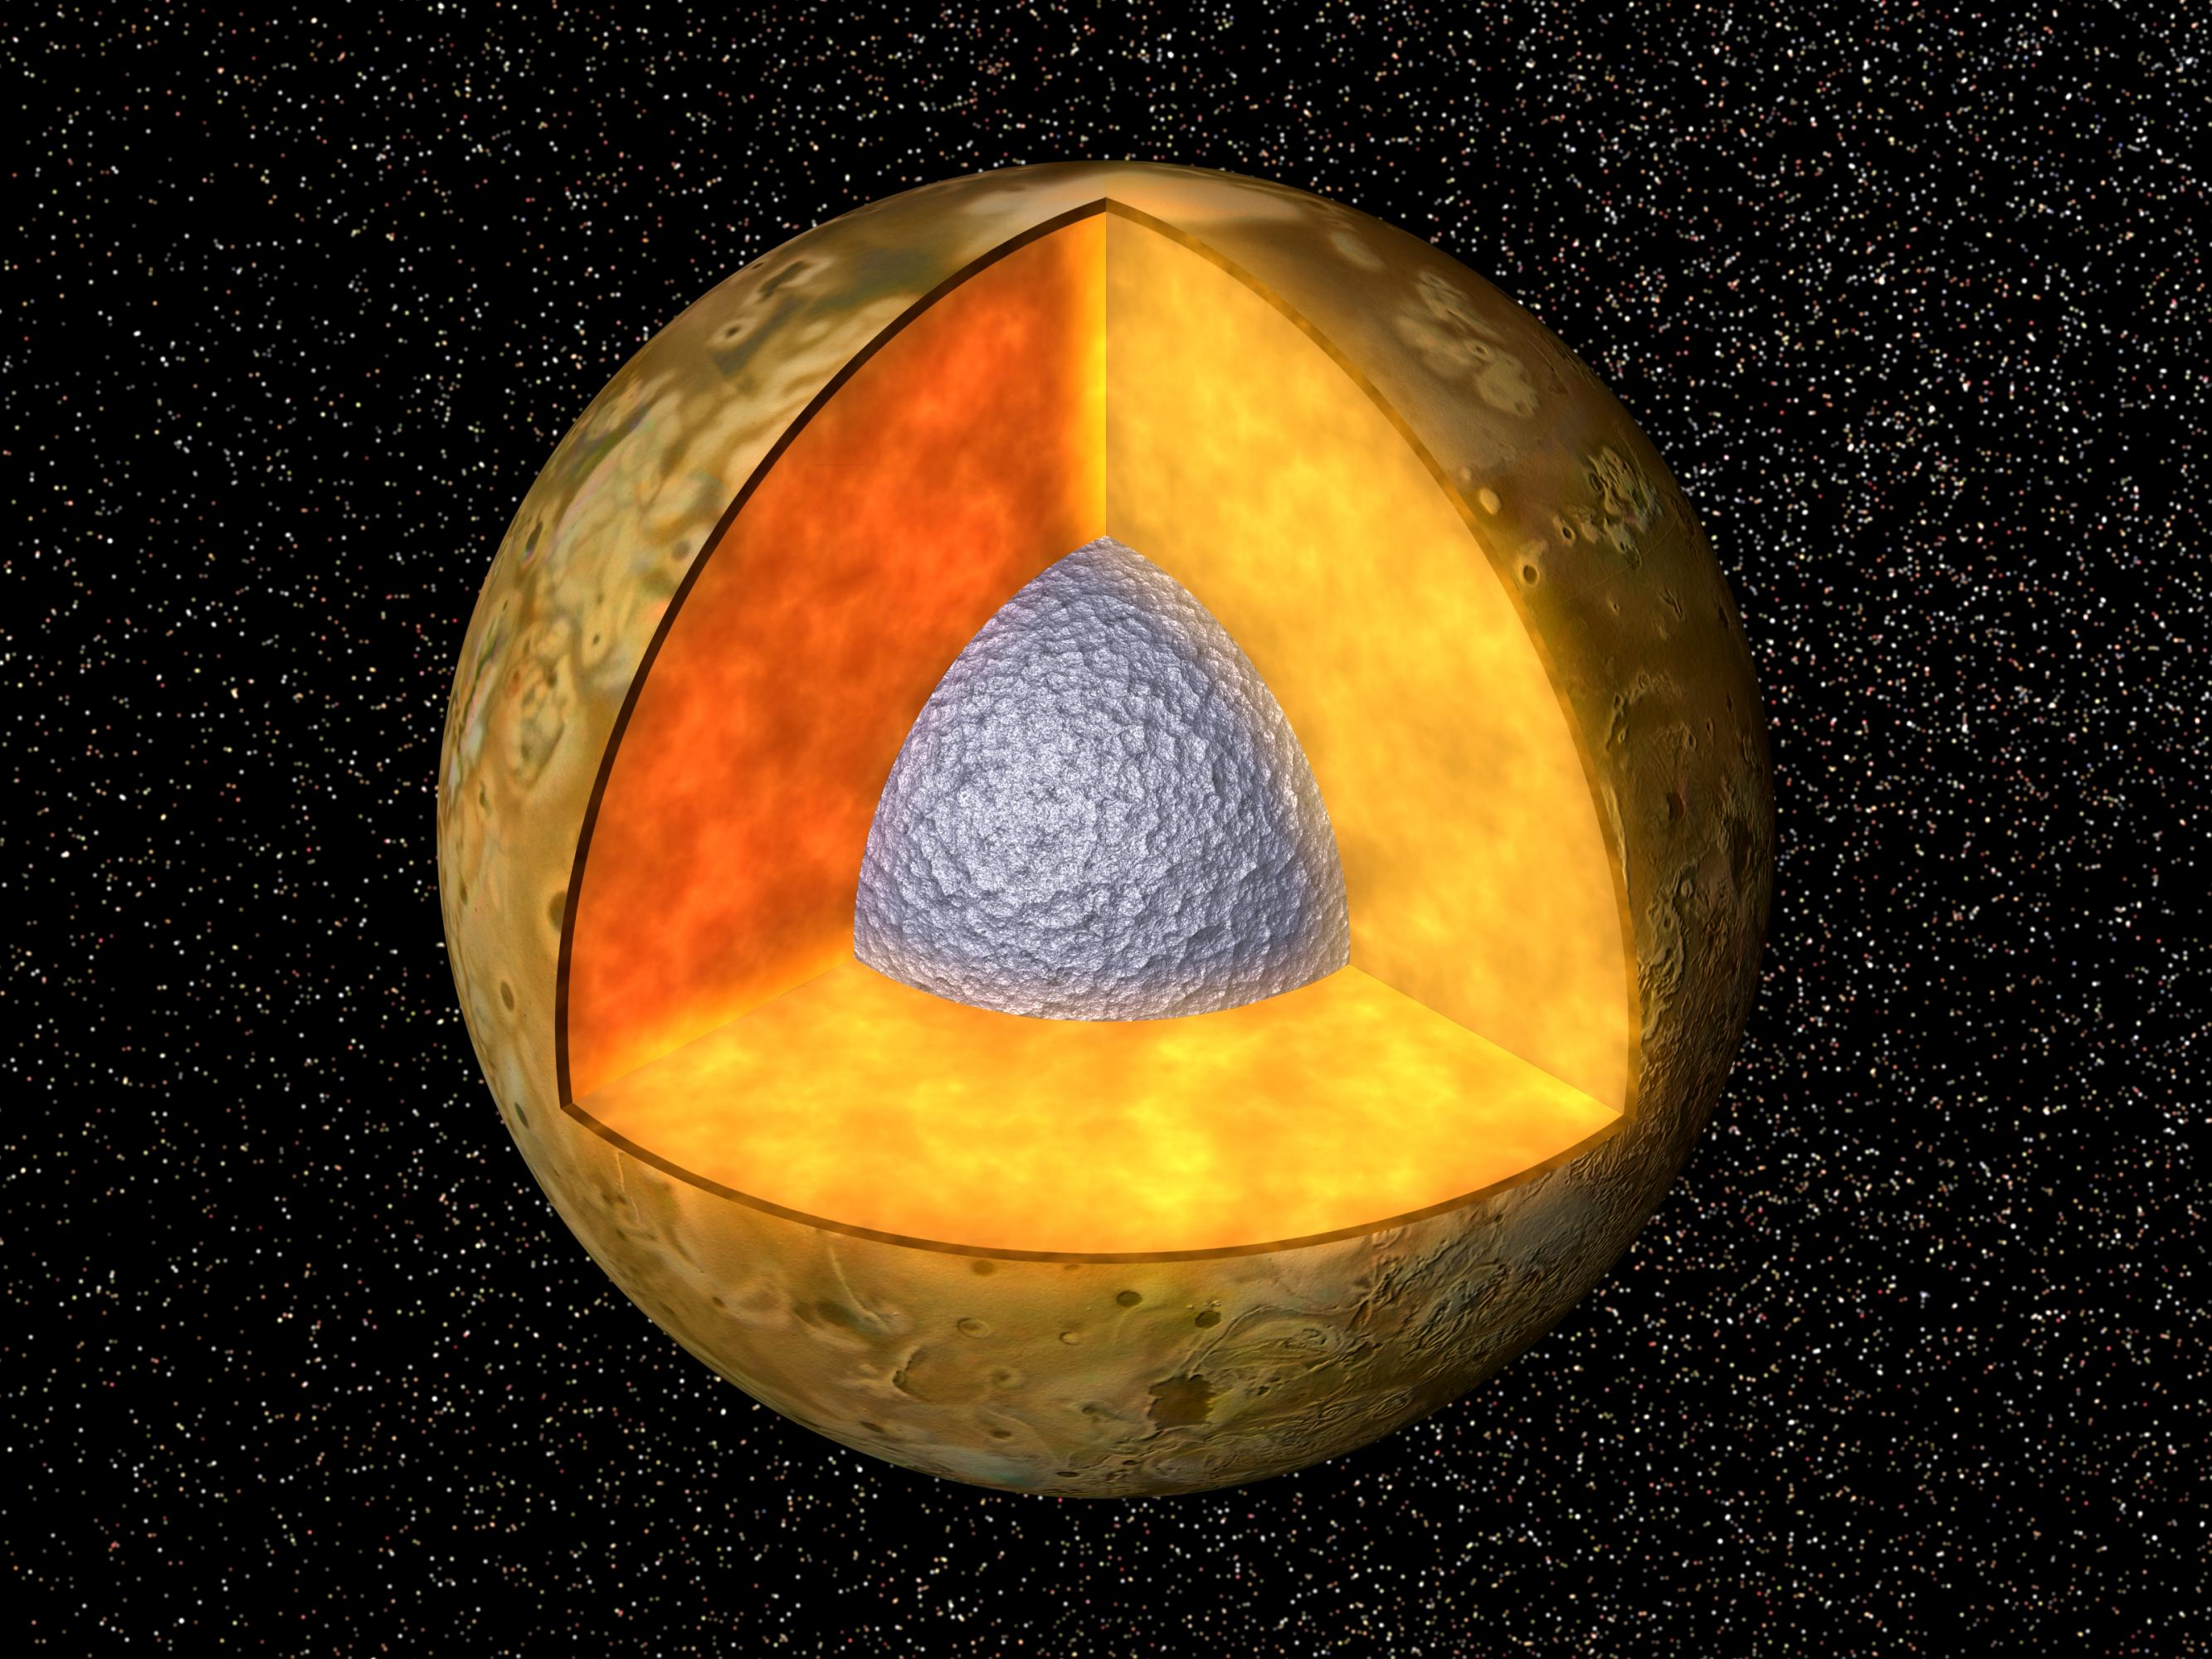
Io's interior
Thin silicate crust
Molten silicate interior
Iron rich core
Io is roughly the size of the Moon.
How does such a small body retain such a hot interior?

Slide 24
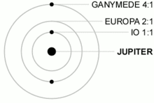
Laplace Resonance

Slide 25
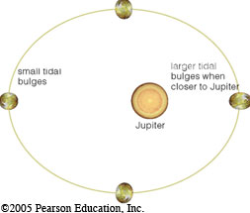
Tidal Heating
Periodic tug of Europa makes Io's orbit slightly elliptic (e ~ 0.004)
Difference in tidal bulge
from closest to farthest from Jupiter:
100m
MASSIVE FRICTION!!!

Slide 26
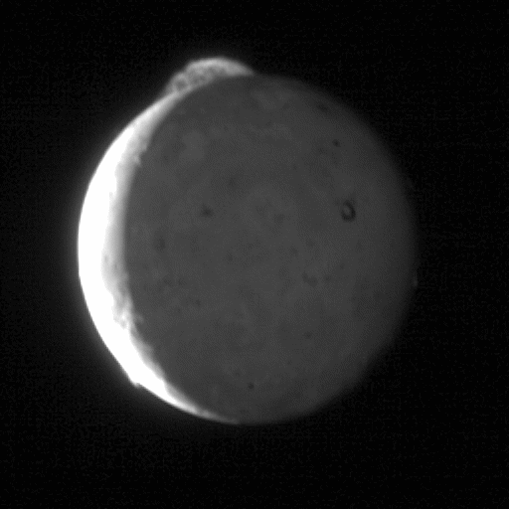
Io's Volcanoes

Slide 27
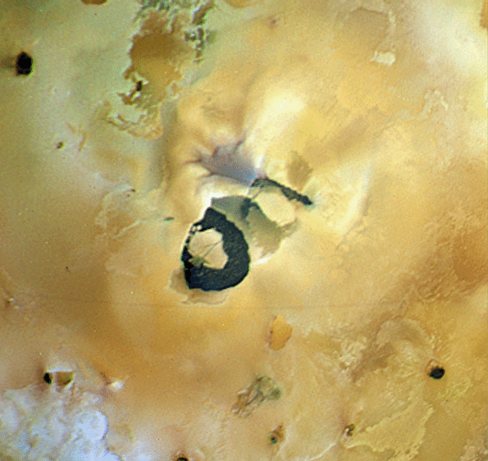
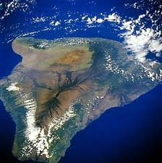
Io's Volcanoes
Loki

Slide 28
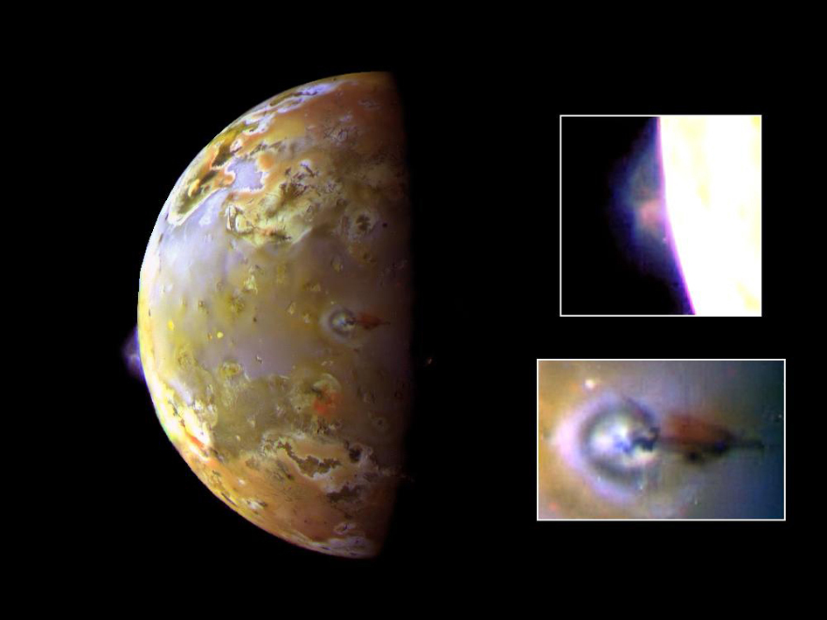
Active plumes

Slide 29
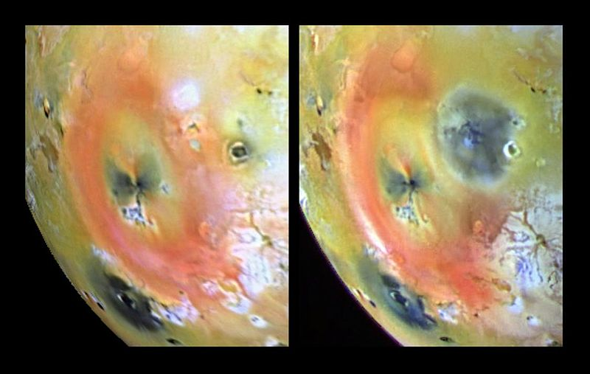
Io in action
April 2007
September 2007

Slide 30
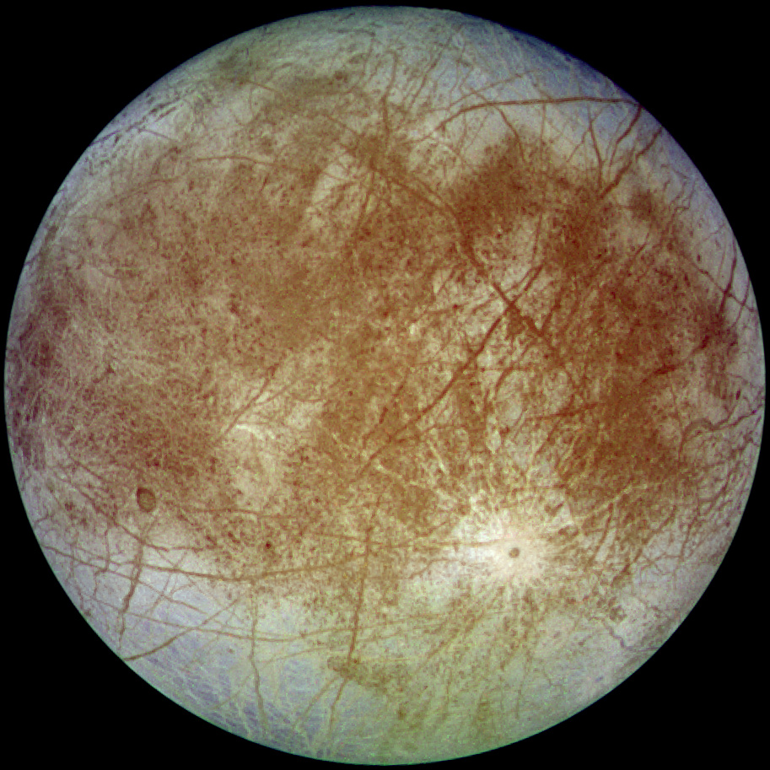
Europa

Slide 31
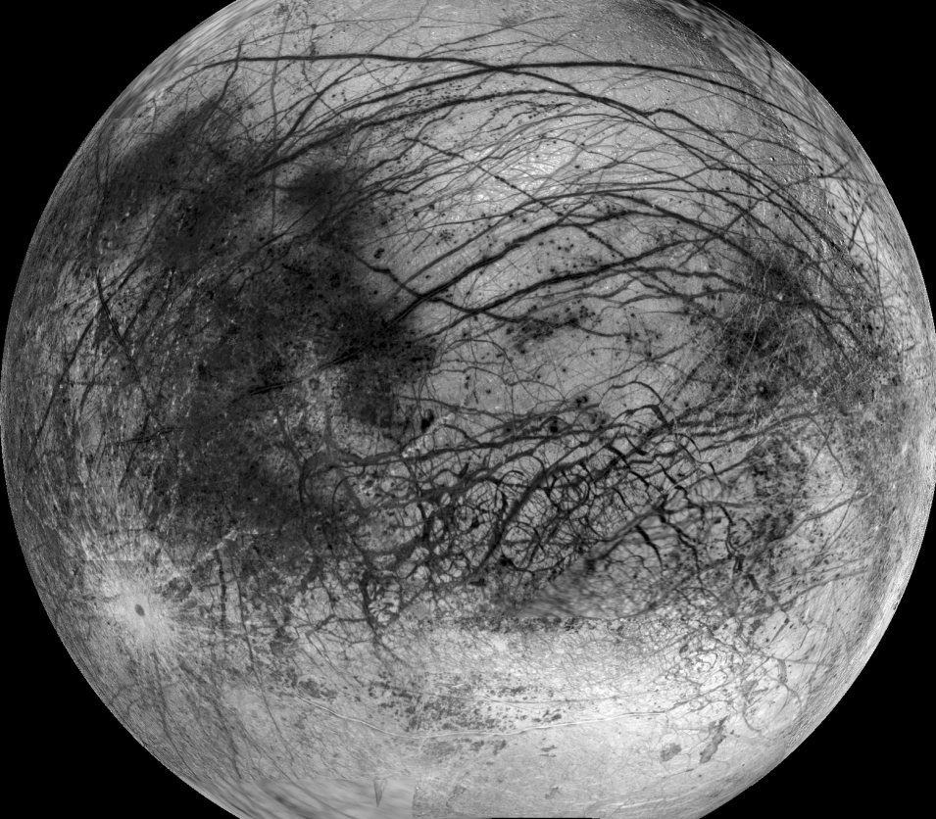
Europa

Slide 32
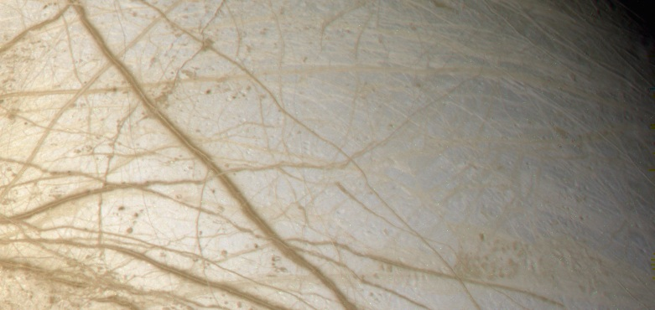
Ice Tectonics

Slide 33
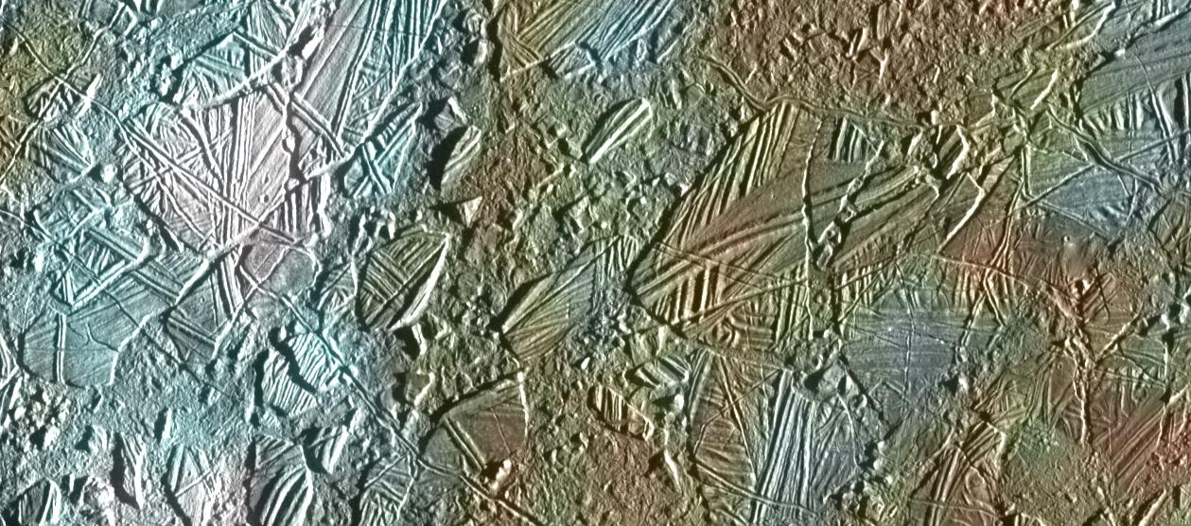
Surface features
“Chaotic” terrain, as if subject to melting and refreezing

Slide 34
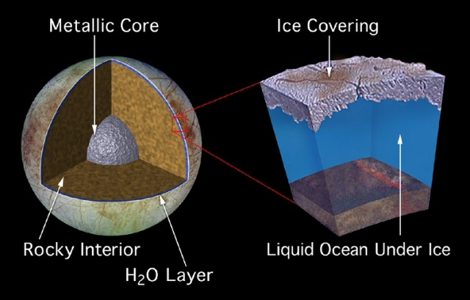
Europa Interior model
Icy crust floating on top of liquid ocean.
Very interesting for Life!

Slide 35
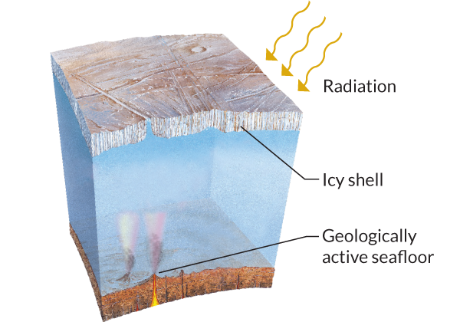
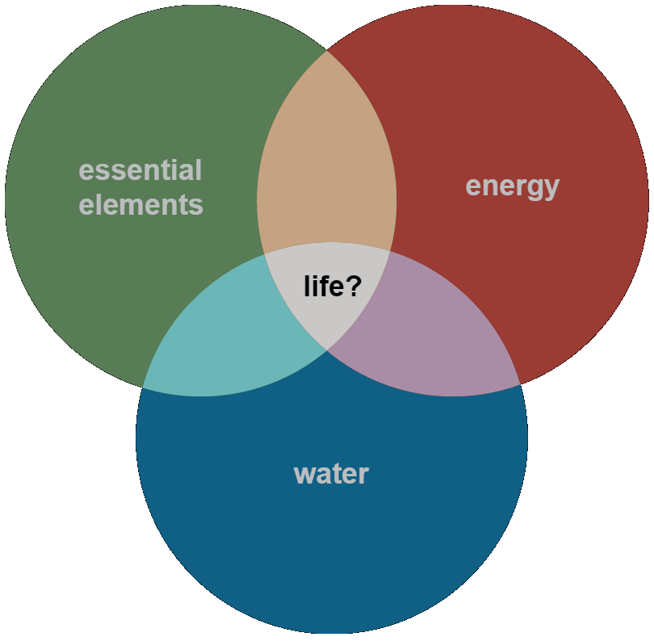
Life?

Slide 37
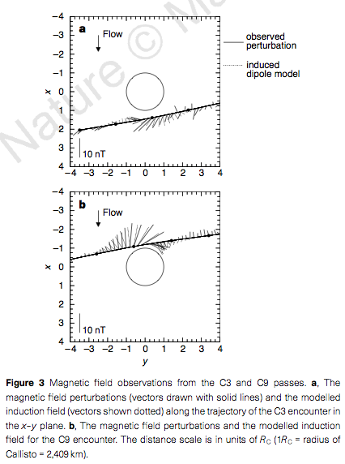
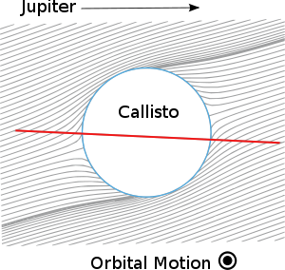
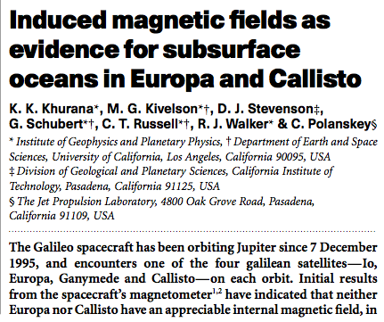
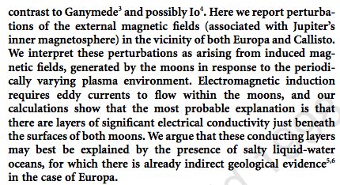
Induced magnetic field

Slide 38
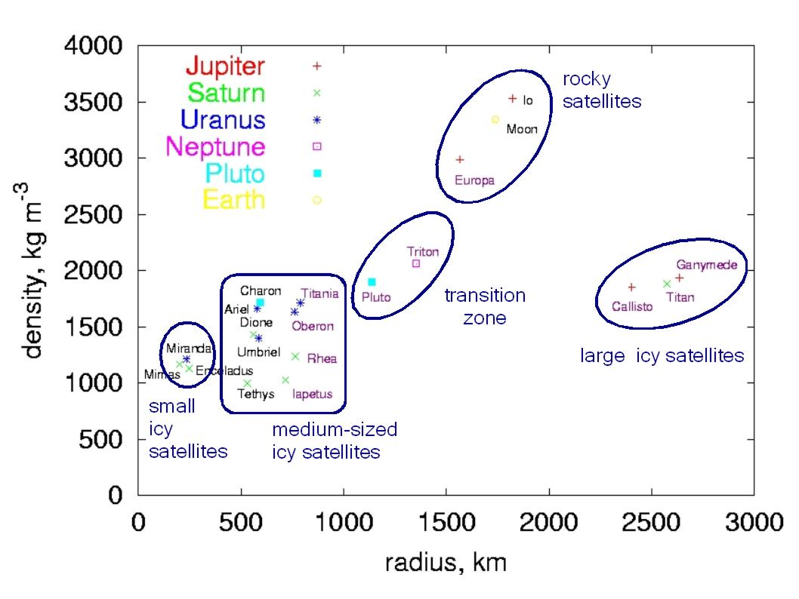

Slide 39
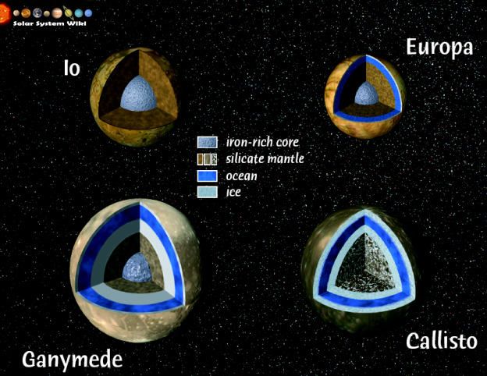

Slide 41
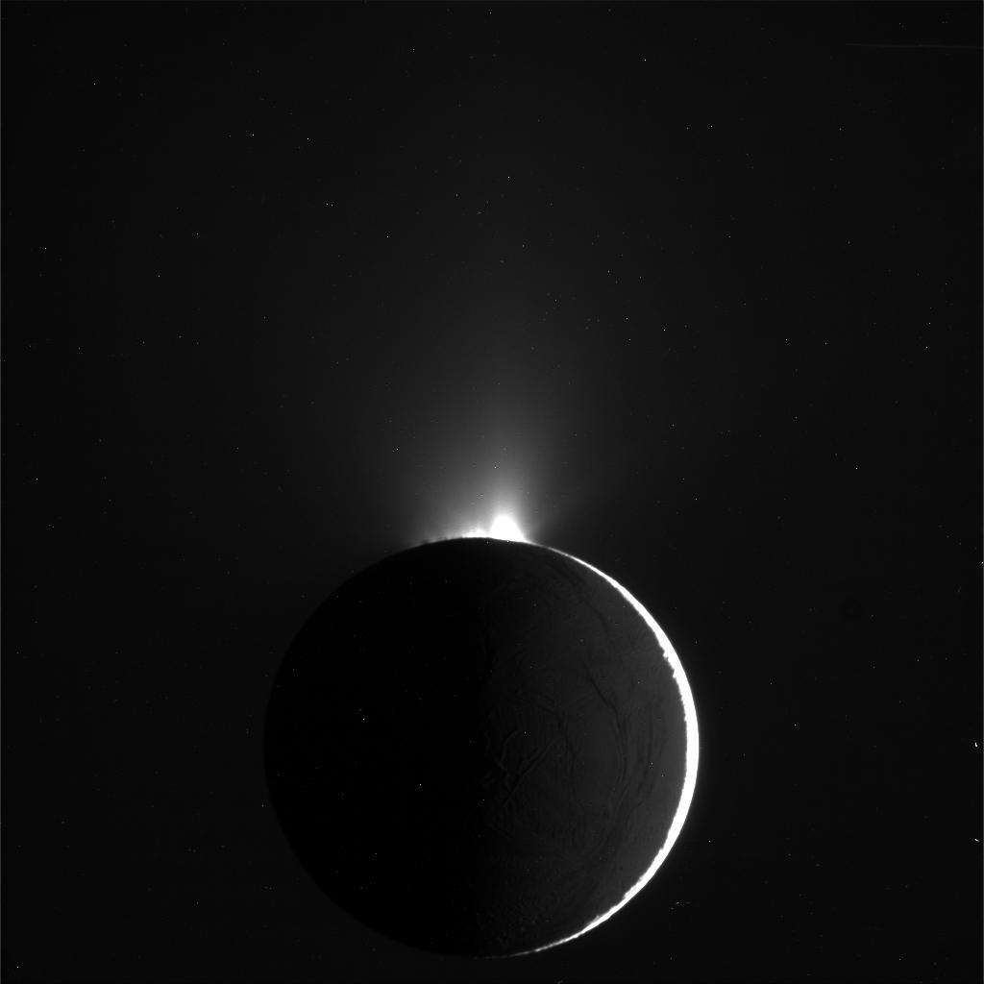
Enceladus
Plumes imaged by Cassini

Slide 42
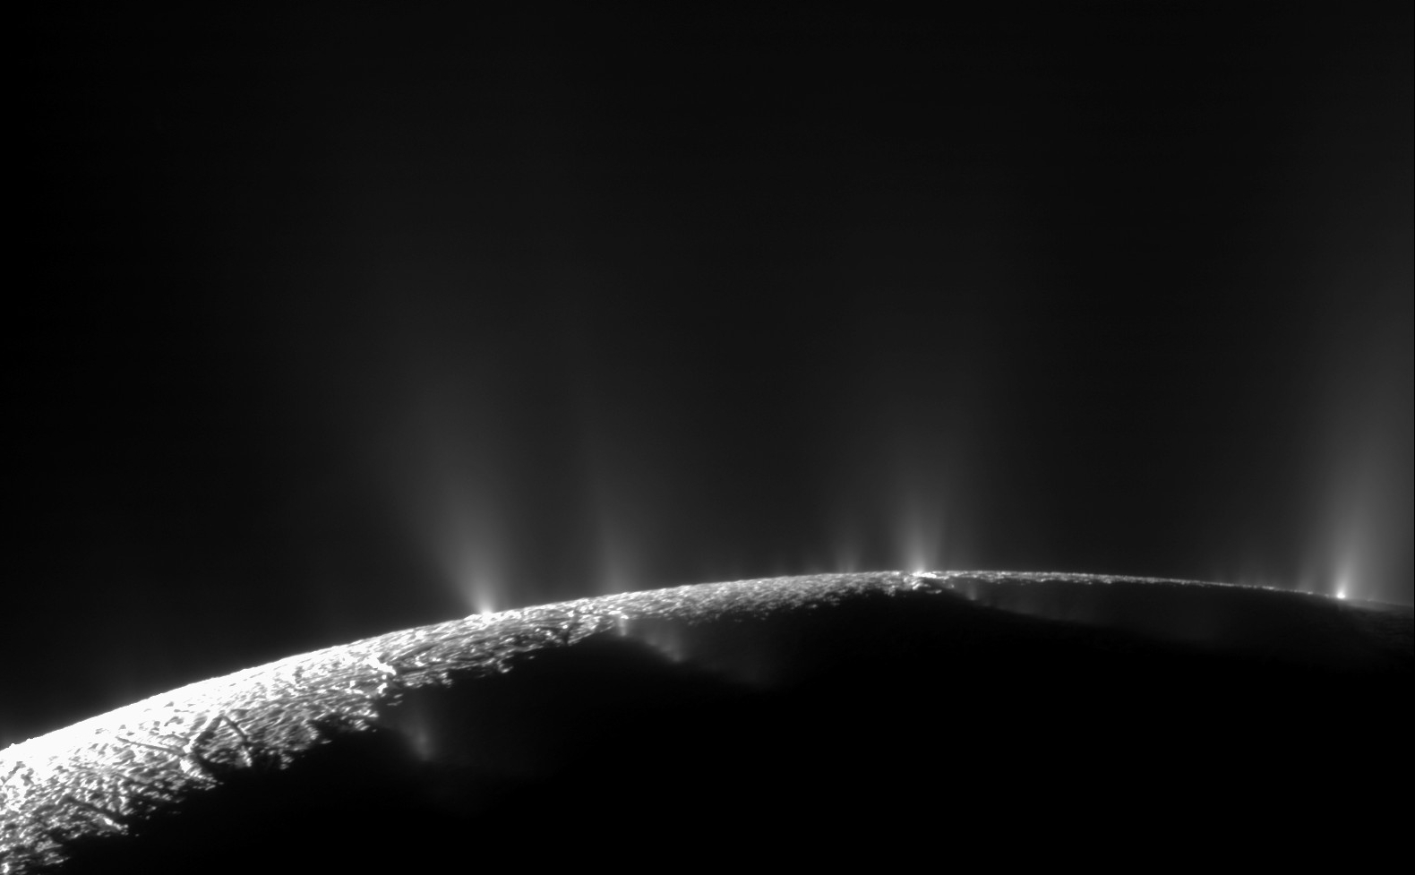
Enceladus
Close up of the plumes

Slide 43
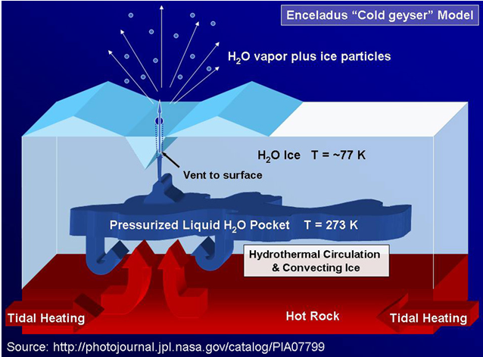
Enceladus

Slide 44
Enceladus
Enceladus and Titan

Slide 45
Tidal Heating!
2:1 resonance with Dione
keeps Enceladus' orbit eccentric
(e ~ 0.004)

Slide 46
Triton – Neptune's large moon.
Frigid temperatures of 38K
All volatiles are either rock-solid or snow.
Yet, no craters. The surface is young.
Triton is geologically active !

Slide 47
Triton – Neptune's large moon.
Cantaloupe terrain
Dark streaks
Nitrogen snow
Frigid temperatures of 38K
All volatiles are either rock-solid or snow.
Yet, no craters. The surface is young.
Triton is geologically active !

Slide 48
Clouds on Triton
Nitrogen is near the sublimation point,
Forming a thin atmosphere

Slide 49
Dark streaks
Geysers, caught by the wind
Powered not by tides,
But by solid state greenhouse
(solar heating
under the nitrogen snow).

