Slide 1
Selected Topics in Astrophysics
Prof Wladimir Lyra
Live Oak, 1119-G
Office Hours: Mon 4pm-5pm
Class hours: Mon/Wed 5pm-6:15pm

Slide 2
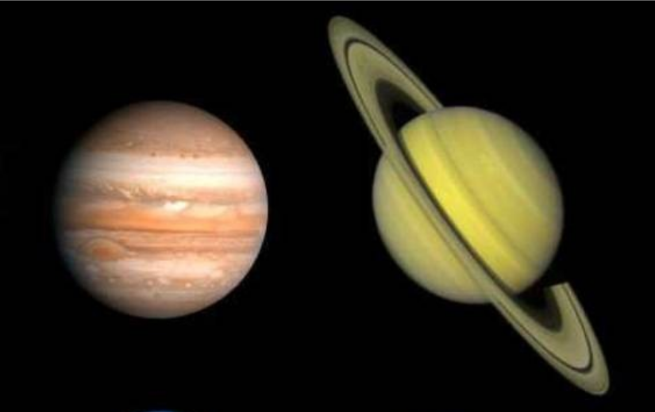
Jupiter and saturn differ by almost a factor 3 in mass, but have almost the same radius.
Why?

Slide 3
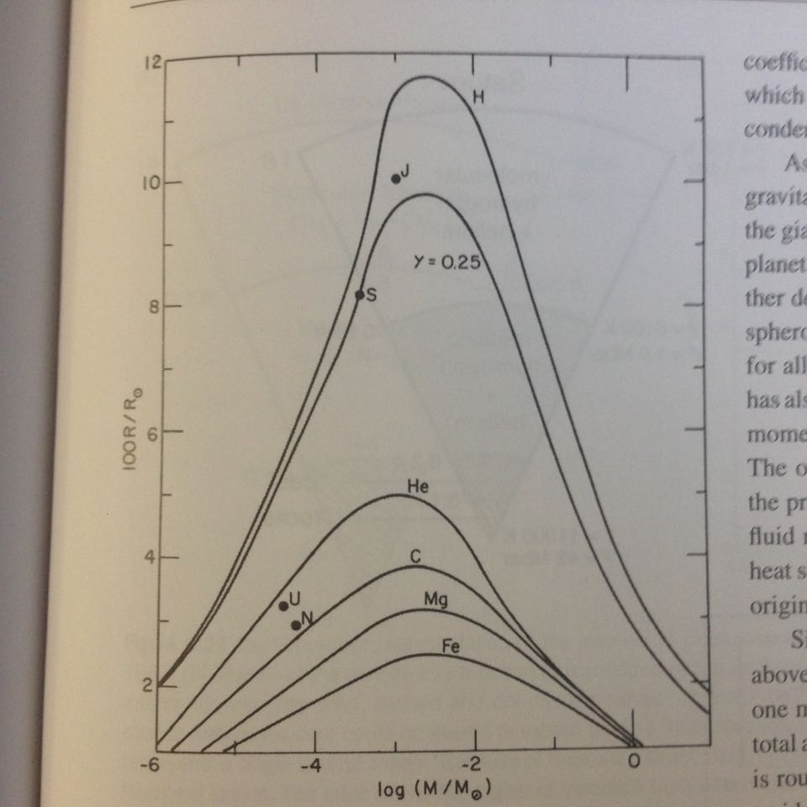
Radius vs mass curves for different compositions.
N=1 polytrope
Flat on top, over almost two orders of magnitude in mass

Slide 4
Phase diagrams

Slide 5
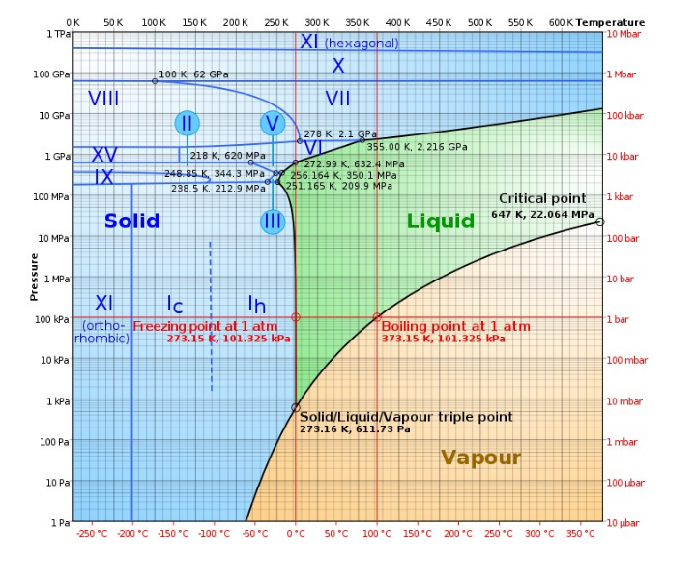
A lot more happens at high pressure

Slide 6
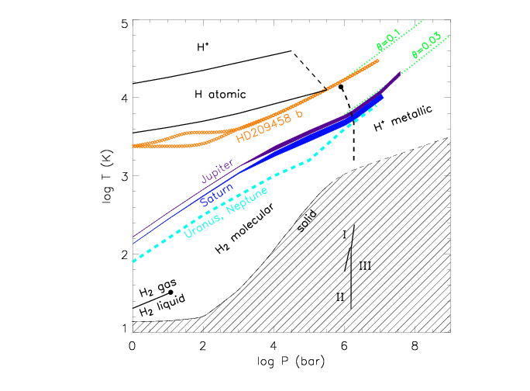
Γ=1
θ=1
Molecular
Metallic

Slide 7
Phases of hydrogen

Slide 8
Interior of Jupiter

Slide 9
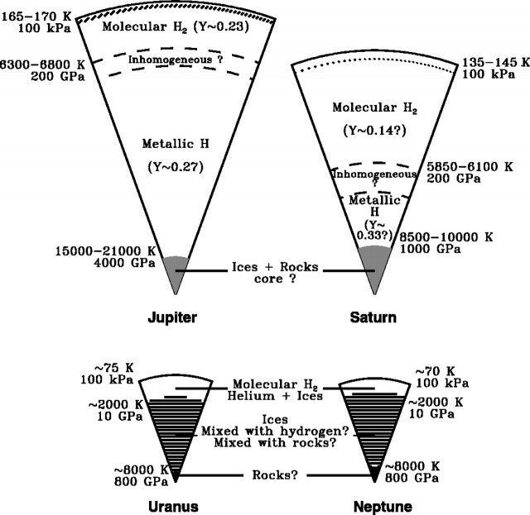

Slide 10
