Slide 1
Selected Topics in Astrophysics
Prof Wladimir Lyra
Live Oak, 1119-G
Office Hours: Mon 4pm-5pm
Class hours: Mon/Wed 5pm-6:15pm

Slide 3
Migration
Asymmetries in the wake generated by the planet lead to non-zero angular momentum exchange between planet and disk, and the planet starts to migrate.

Slide 4
Migration
Asymmetries in the wake generated by the planet lead to non-zero angular momentum exchange between planet and disk, and the planet starts to migrate.

Slide 7
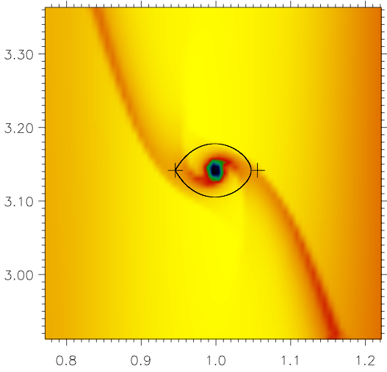

Slide 8
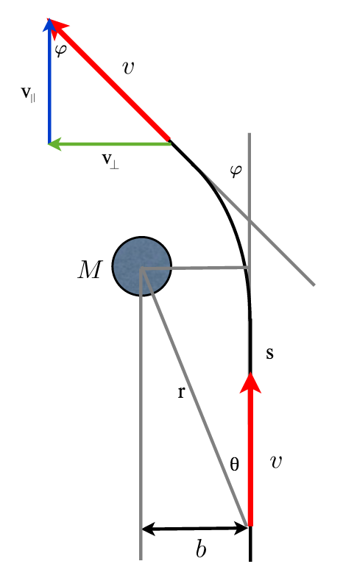
Migration: Impulse approximation

Slide 9
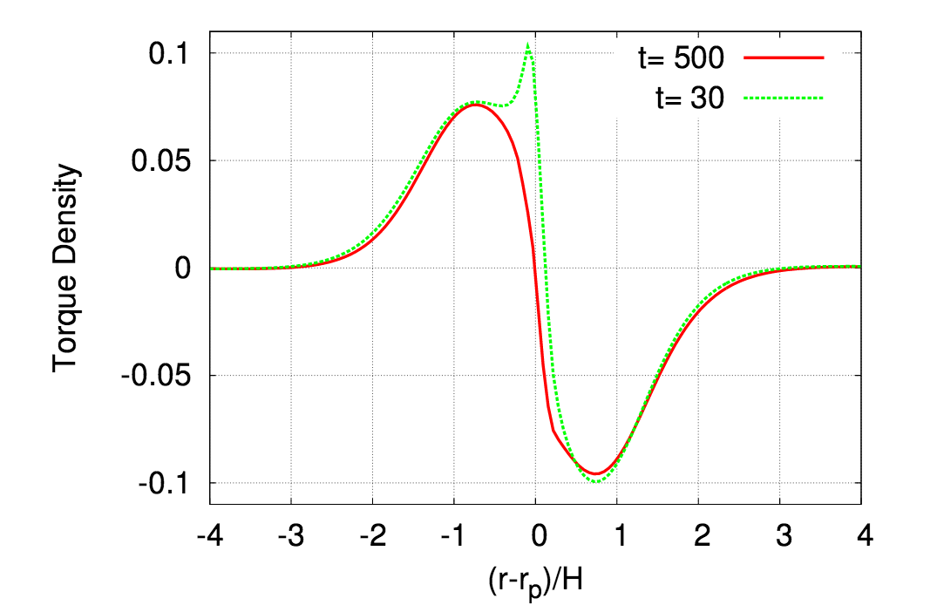

Slide 11
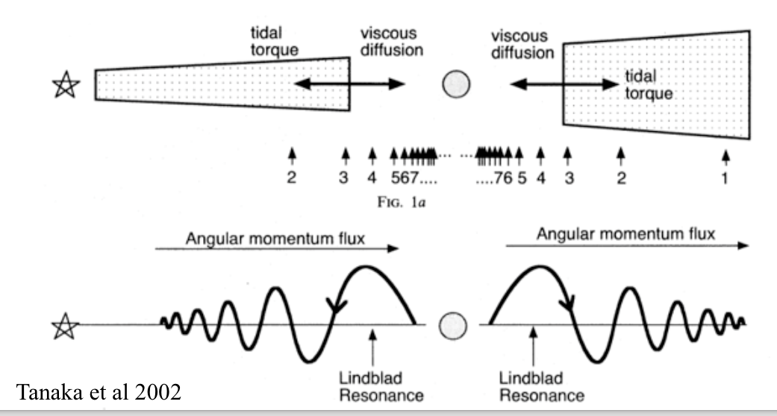

Slide 12
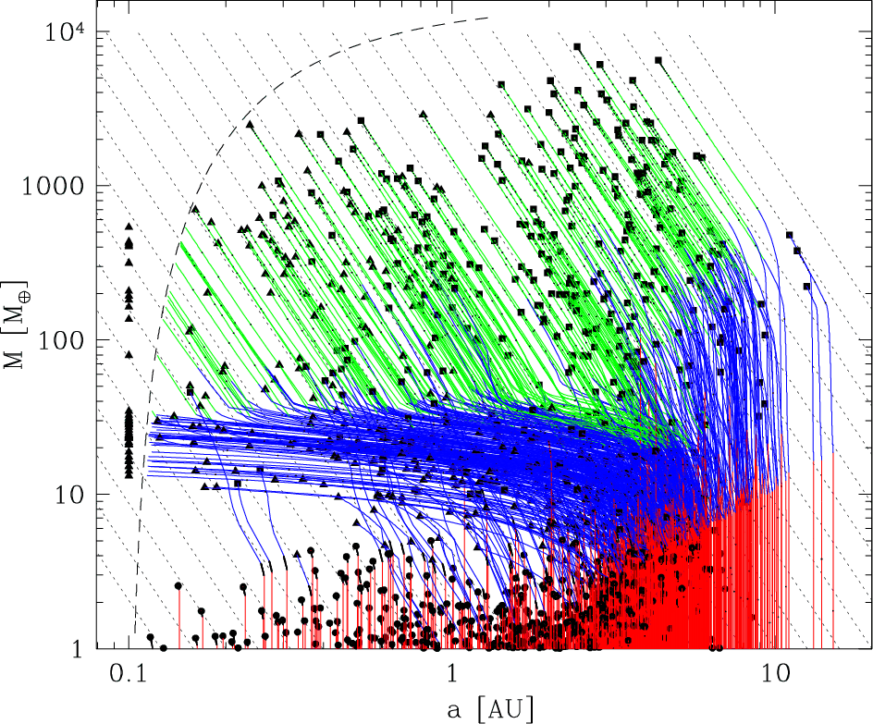
Planet Population Synthesis

Slide 15
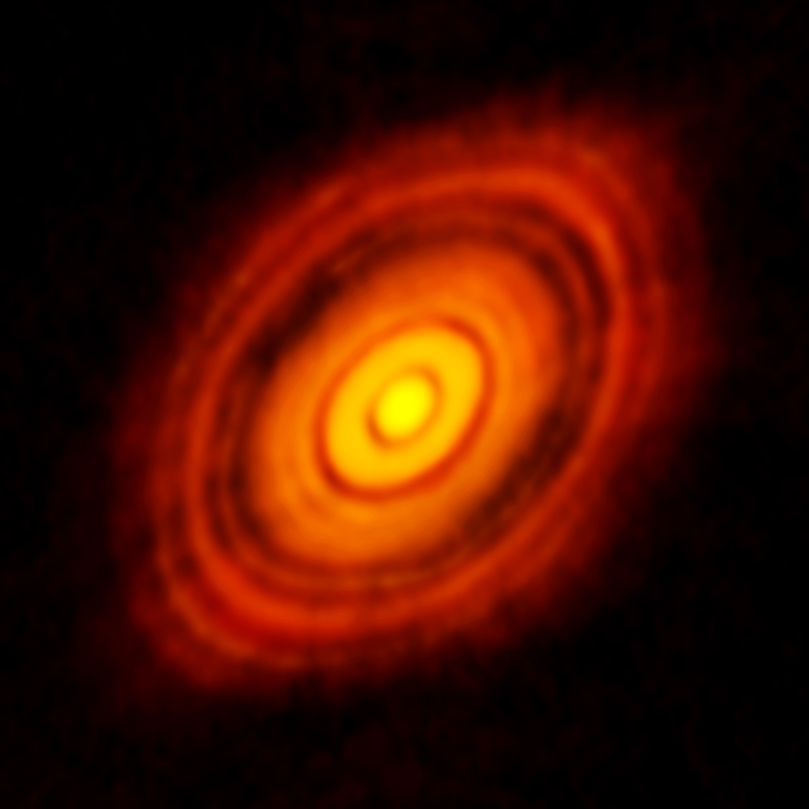

Slide 16
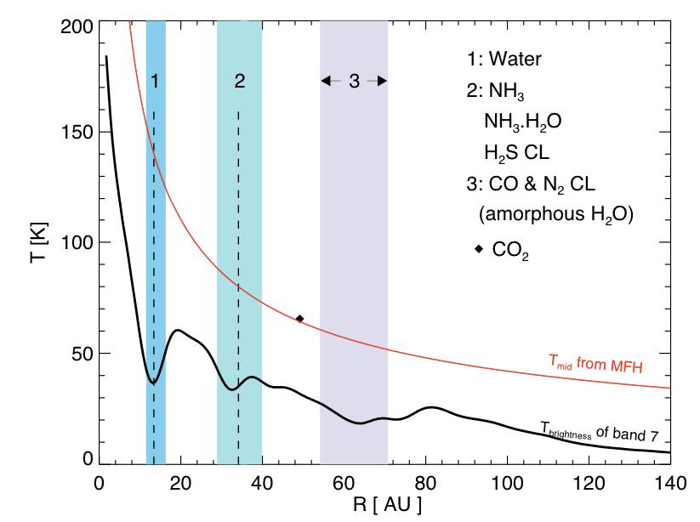
HL Tau

