Slide 1
Selected Topics in Astrophysics
Prof Wladimir Lyra
Live Oak, 1119-G
Office Hours: Mon 4pm-5pm
Class hours: Mon/Wed 5pm-6:15pm

Slide 2
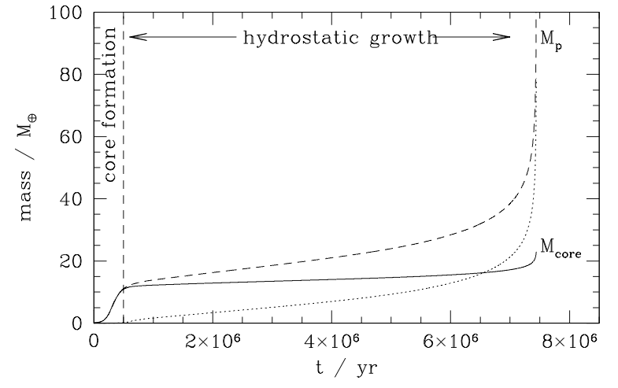
Core accretion

Slide 3
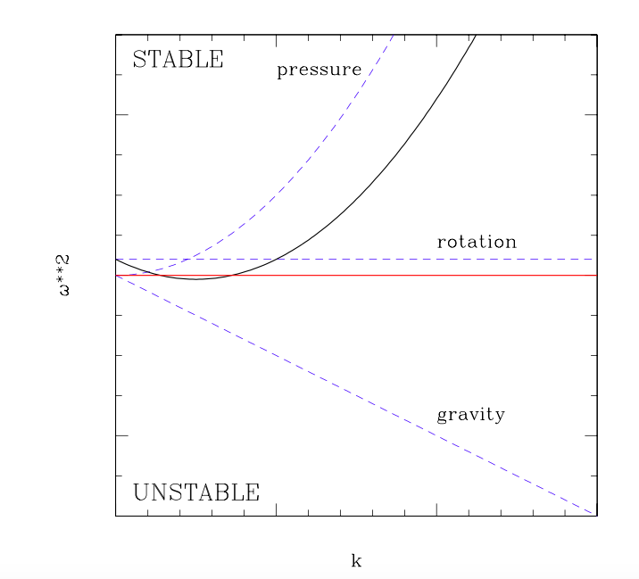
Gravitational Instability

Slide 5
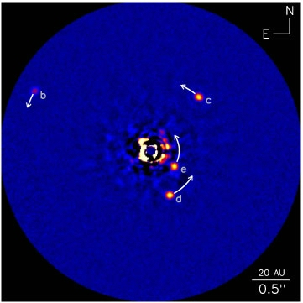
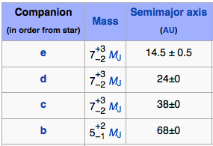
HR 8799: Four high-mass planets at wide orbits

Slide 6
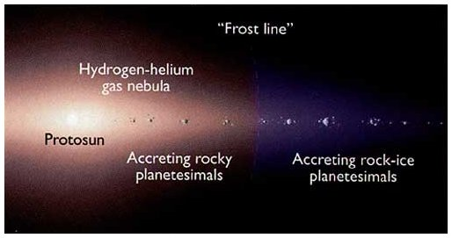
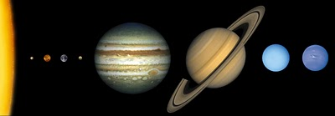
Formation by Core Accretion
Inward of snowline
Accreting
rocky cores
(small)
Outward of snowline
Ice comes to aid!
Growing big
icy/rocky cores.
These guys got so big
they started accreting
gas from the nebula!
These ones never did.
They are just the icy/rocky cores.

Slide 7
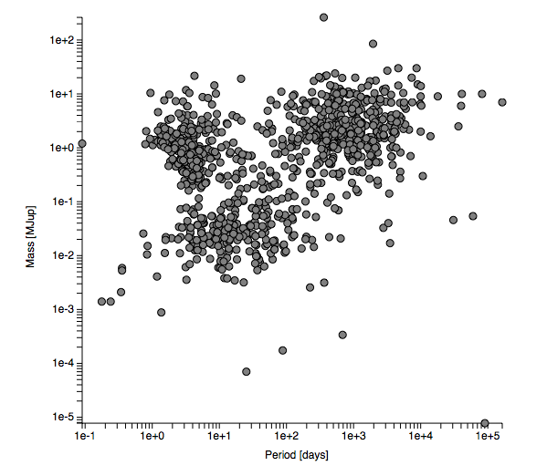
Mass-period distribution of planets
J
S
U
N
T
V
M
M

Slide 8
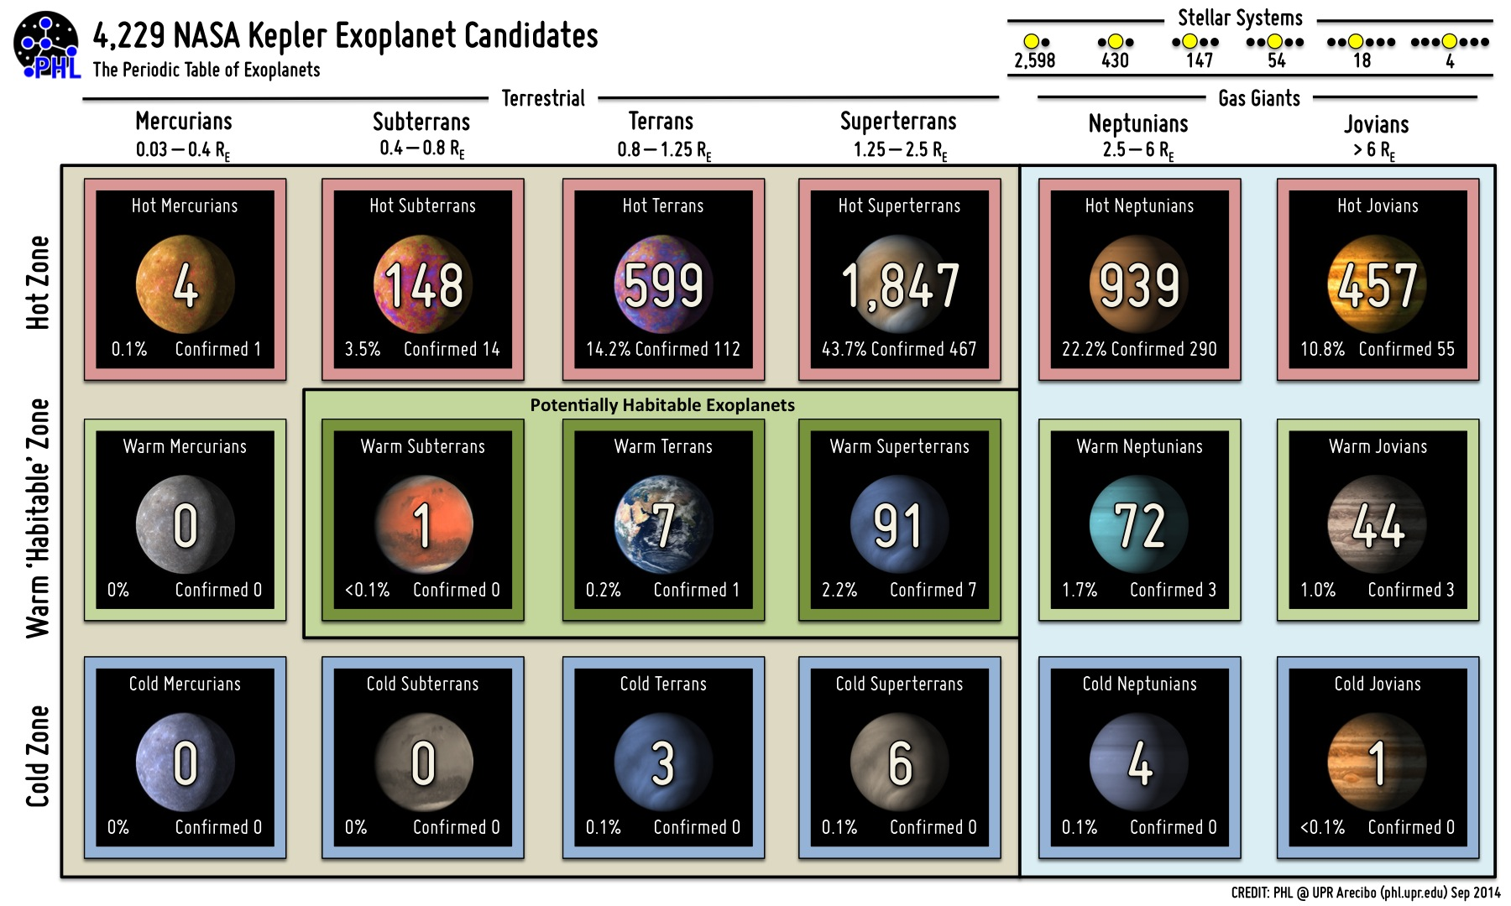
Kepler: “Period table” of exoplanets

Slide 9
Migration
Asymmetries in the wake generated by the planet lead to non-zero angular momentum exchange between planet and disk, and the planet starts to migrate.

Slide 10
Migration
Asymmetries in the wake generated by the planet lead to non-zero angular momentum exchange between planet and disk, and the planet starts to migrate.

Slide 13
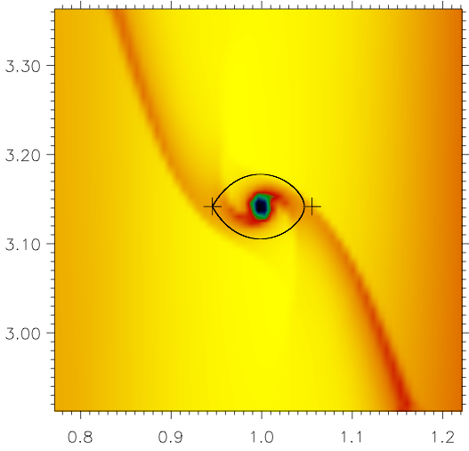

Slide 14
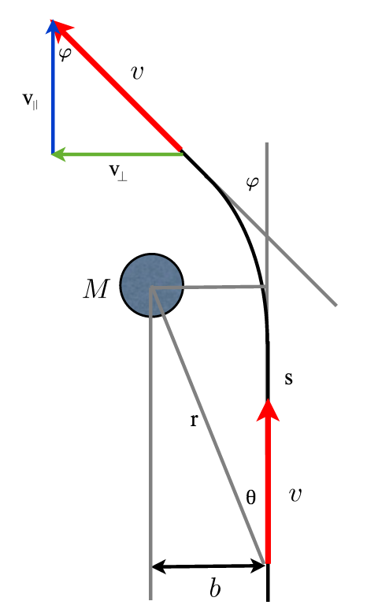
Migration: Impulse approximation

Slide 15
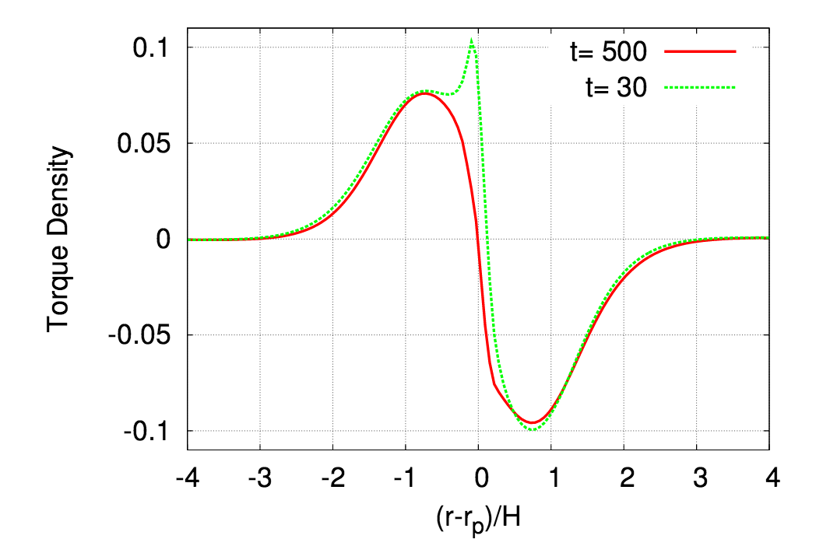

Slide 18
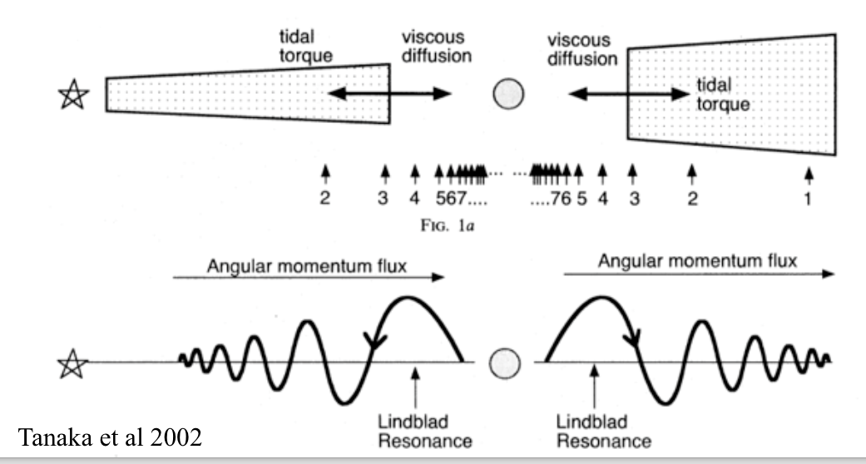

Slide 19
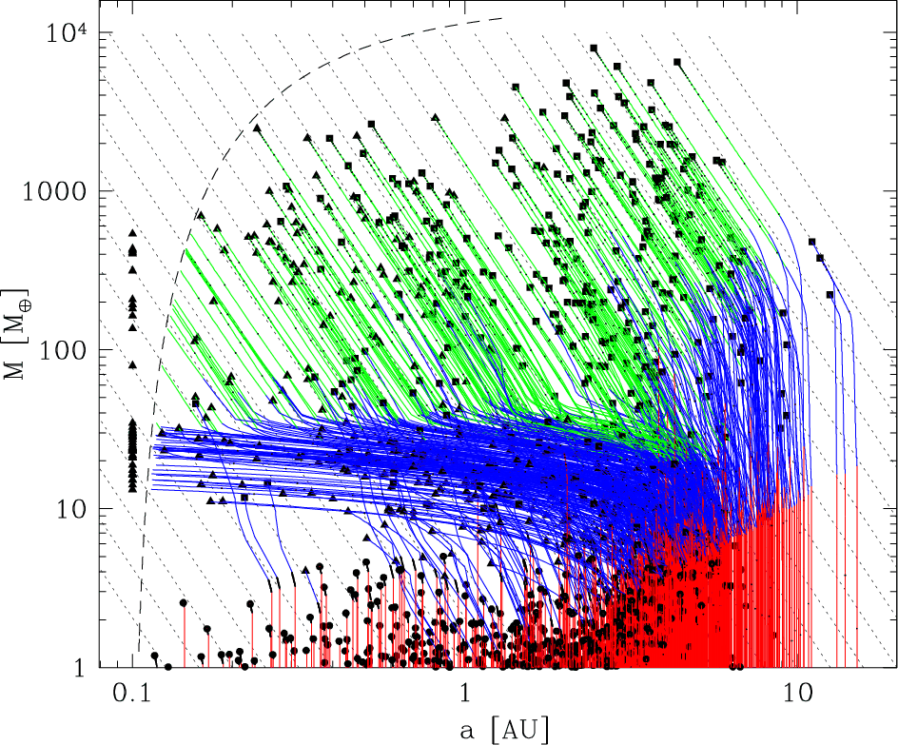
Planet Population Synthesis

Slide 21
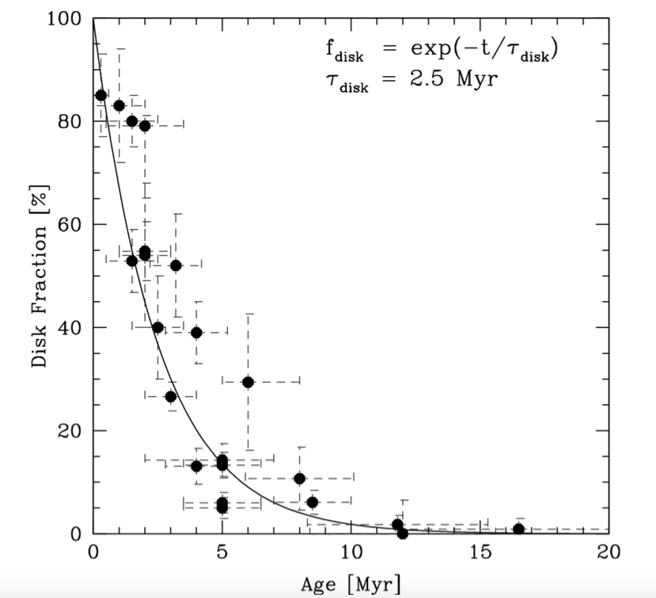
Disk lifetime
Disks dissipate with an e-folding time of 2.5 Myr

