Slide 1
Selected Topics in Astrophysics
Prof Wladimir Lyra
Live Oak, 1119-G
Office Hours: Mon 4pm-5pm
Class hours: Mon/Wed 5pm-6:15pm

Slide 2
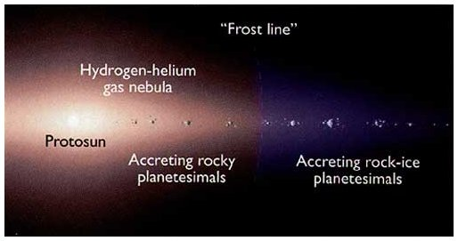
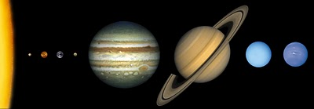
Formation by Core Accretion
Inward of snowline
Accreting
rocky cores
(small)
Outward of snowline
Ice comes to aid!
Growing big
icy/rocky cores.
These guys got so big
they started accreting
gas from the nebula!
These ones never did.
They are just the icy/rocky cores.

Slide 3
Potential of oblate bodies
Newton’s second theorem
“A spherically symmetric body affects external objects as if all its mass was concentrated in its center”

Slide 4
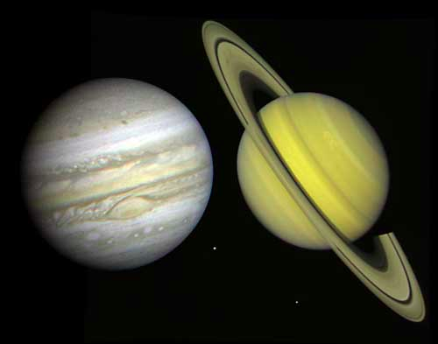
But planets are not spherically symmetric

Slide 5
Oblateness caused by rotation
Gravitational Potential
J₂ (x10⁻⁶)
J₄ (x10⁻⁶)
J₆ (x10⁻⁶)
Jupiter
Saturn
14696.4+/-0.2
16290.7+/-0.3
587+/-2
936+/-3
34+/-5
86+/-9

Slide 6
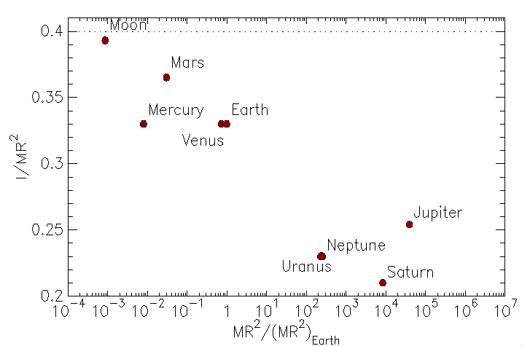

Slide 7
