Slide 1
Selected Topics in Astrophysics
Prof Wladimir Lyra
Live Oak, 1119-G
Office Hours: Mon 4pm-5pm
Class hours: Mon/Wed 5pm-6:15pm

Slide 2
Concentration of solids

Slide 3
Sedimentation

Slide 4
Gravitational collapse into planetesimals

Slide 5
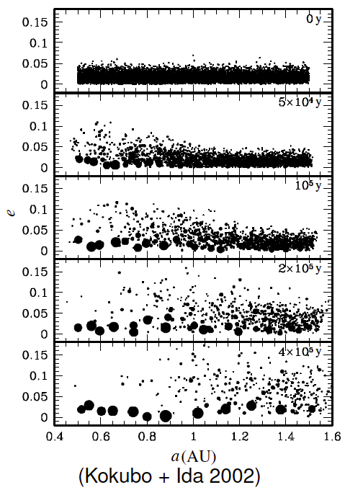
Oligarchs

Slide 6
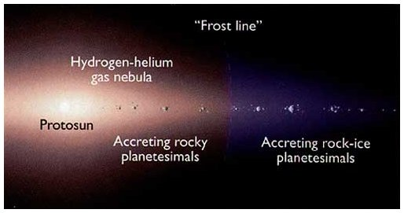
The Snowline
Volatiles in gas phase
Volatiles in solid phase
Colder than ~150K, the volatiles (H₂0, CH₄, NH₃)
condense into ices.

Slide 7
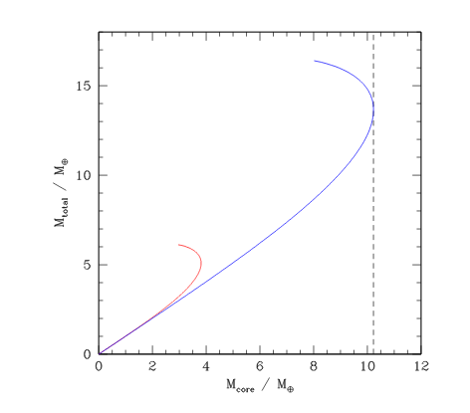
Critical core mass

Slide 8
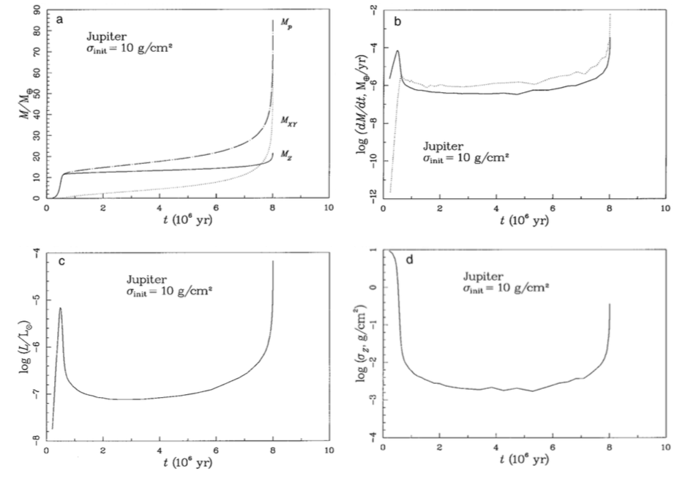
Core Accretion

Slide 9
Formation
Volatiles in gas phase
Volatiles in solid phase
Colder than ~150K, the volatiles (H₂0, CH₄, NH₃)
condense into ices.

Slide 10
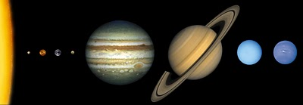
Formation
Inward of snowline
Accreting
rocky cores
(small)
Outward of snowline
Ice comes to aid!
Growing big
icy/rocky cores.
These guys got so big
they started accreting
gas from the nebula!
These ones never did.
They are just the icy/rocky cores.

