Slide 1
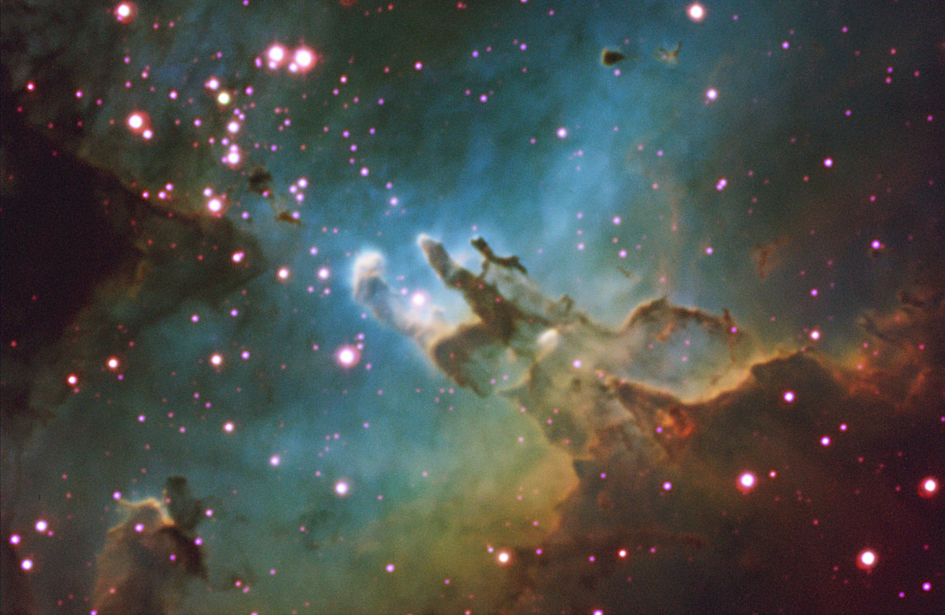
Selected Topics in Astrophysics
Prof Wladimir Lyra
Live Oak, 1119-G
Office Hours: Mon 4pm-5pm
Class hours: Mon/Wed 5pm-6:15pm

Slide 2
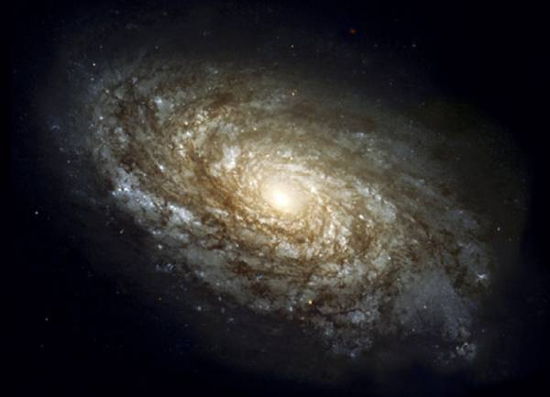
Star Formation
The space between stars is NOT EMPTY, it is just very low density
Some of it is gas (99%), some of it is dust (1%).
This matter is called INTERSTELLAR MEDIUM (ISM)

Slide 3
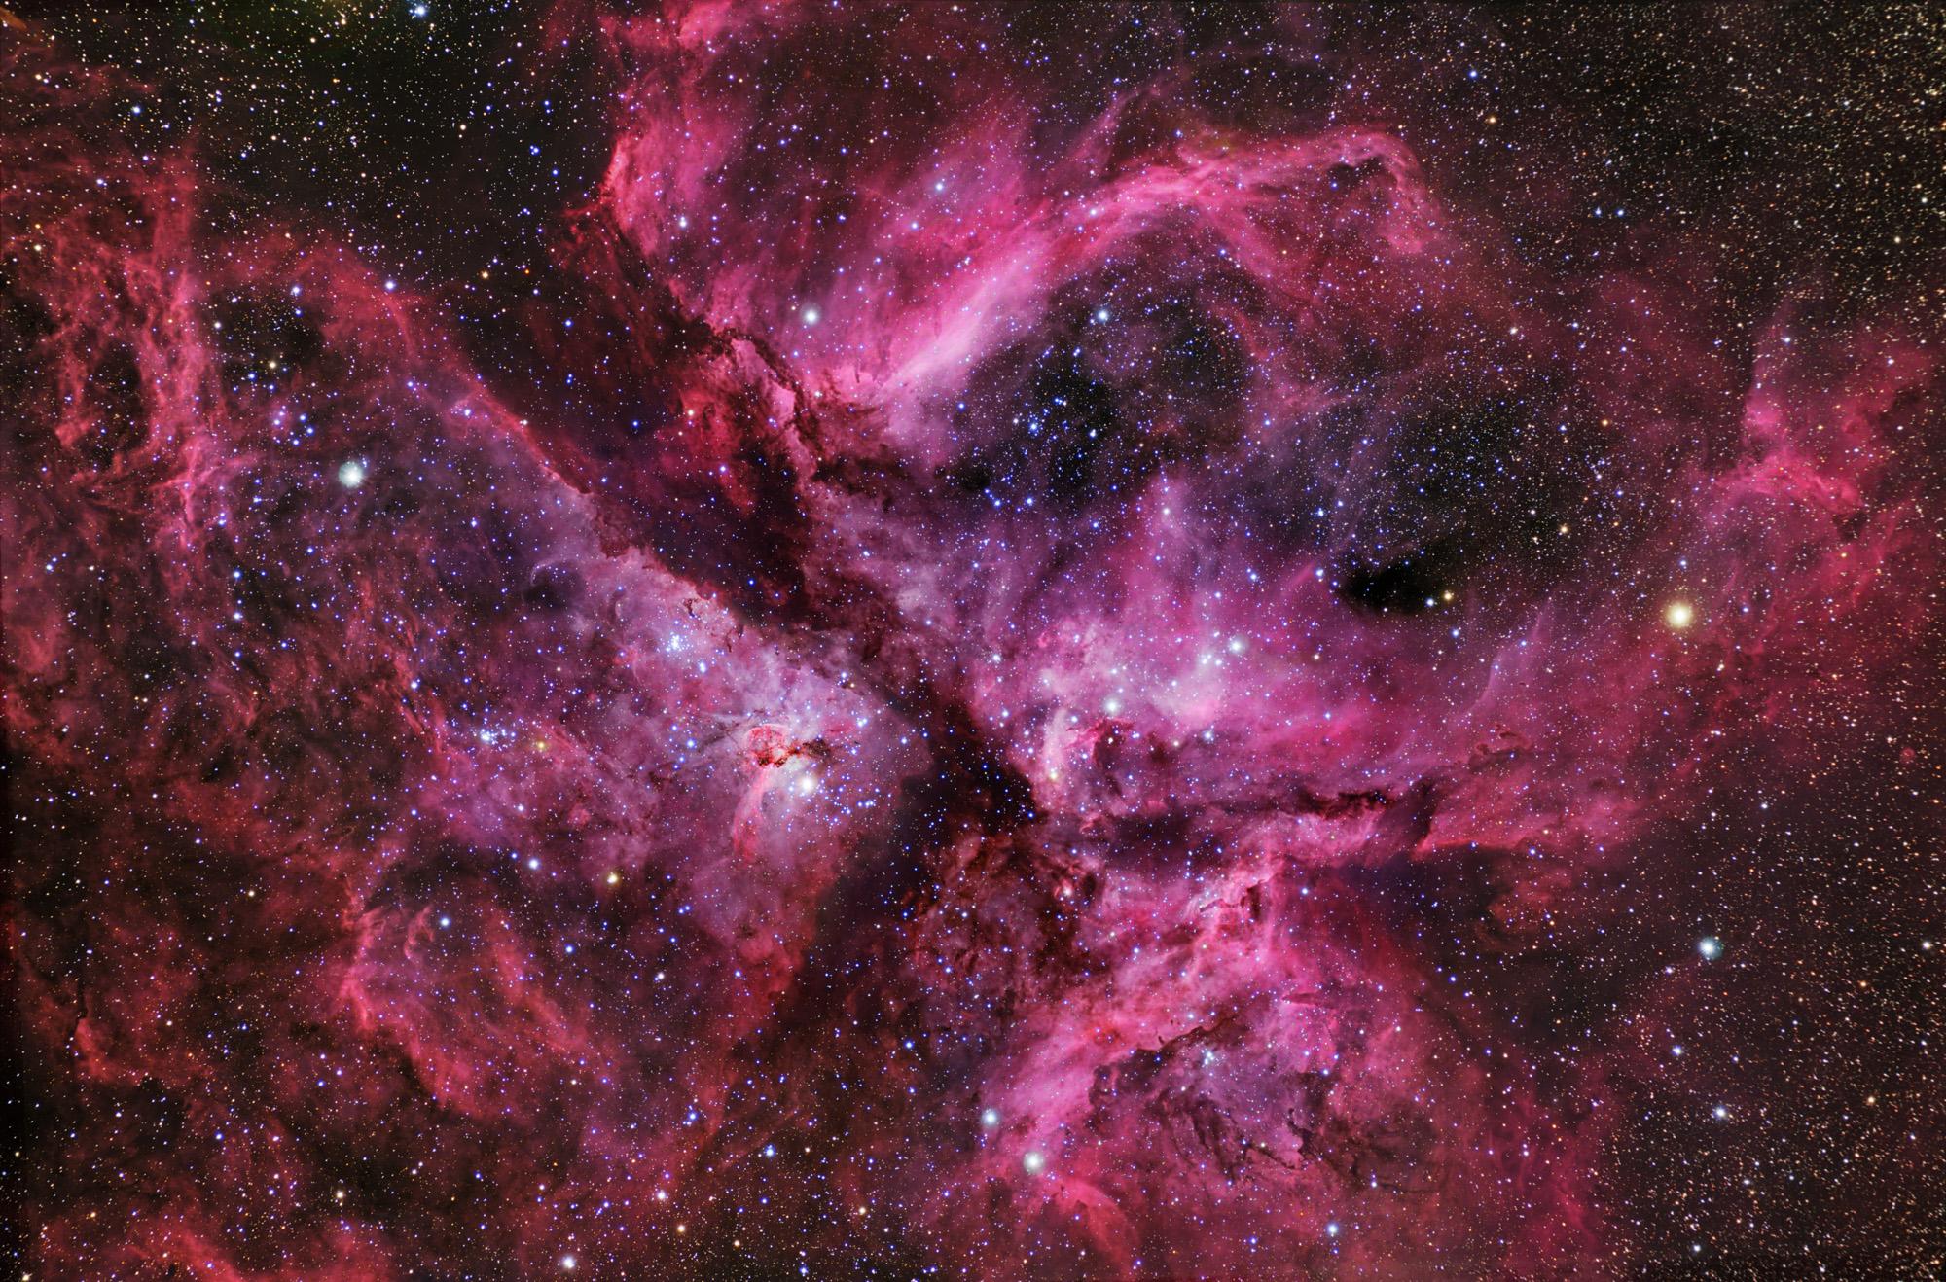
Star Formation
Gas collapses gravitationally, to form stars.
Star formation occurs in the densest regions of the ISM, called Molecular Clouds

Slide 4
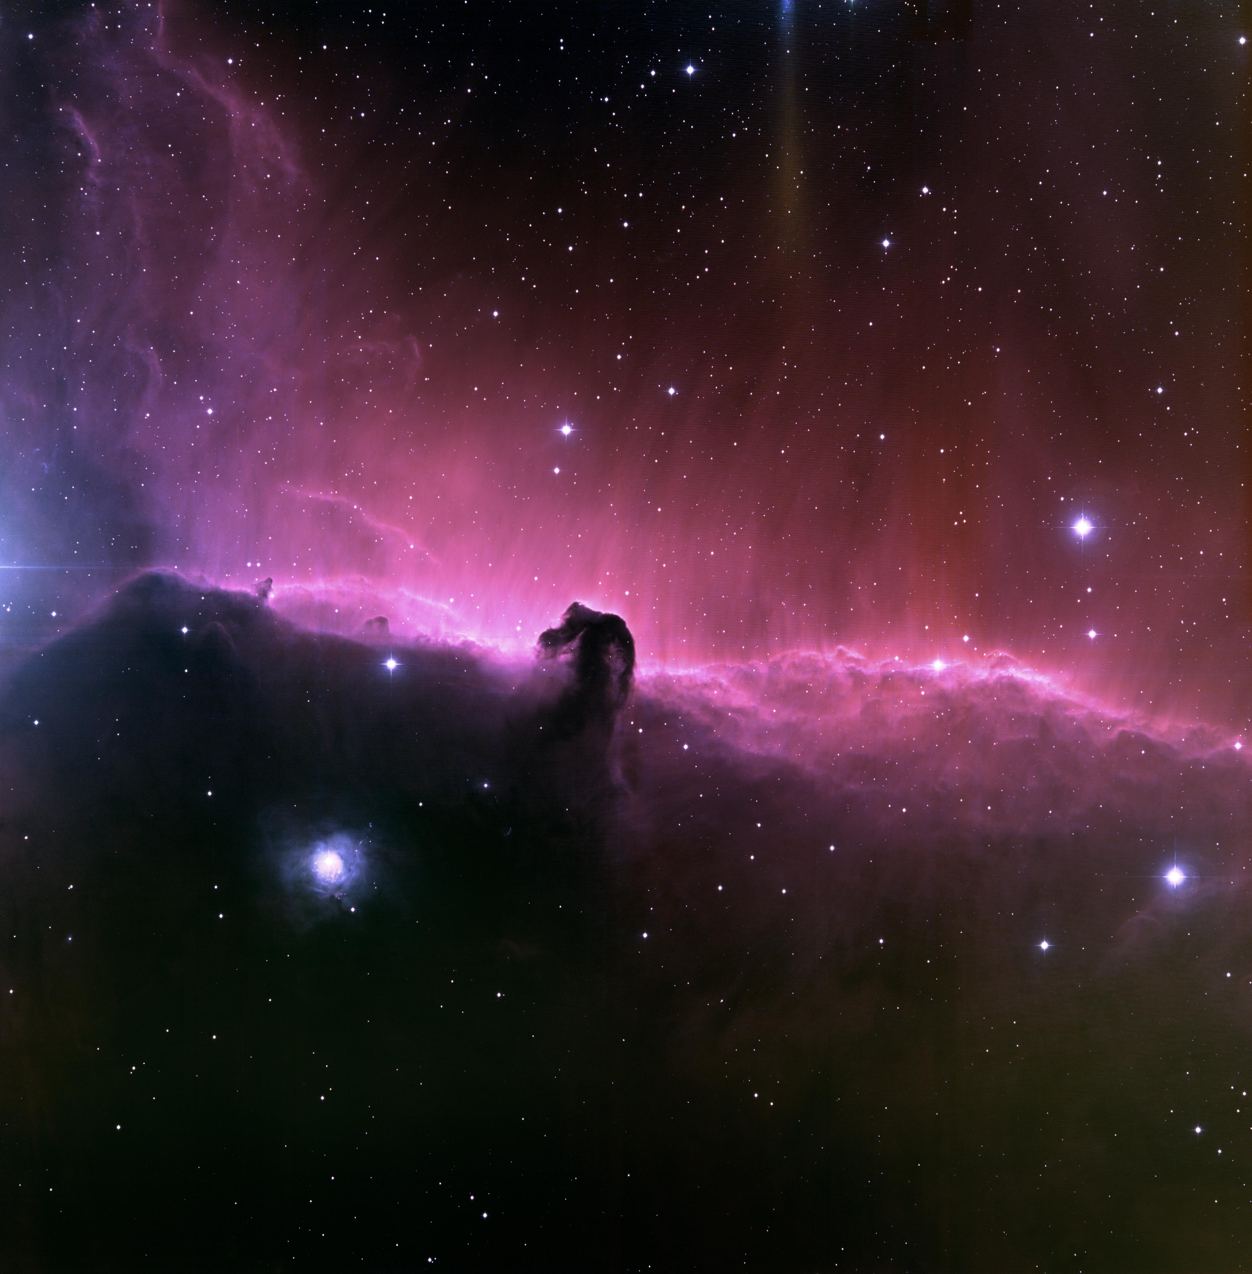

Slide 5
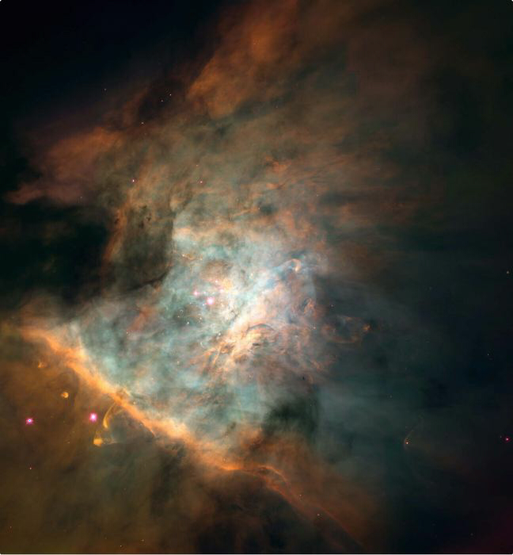

Slide 6
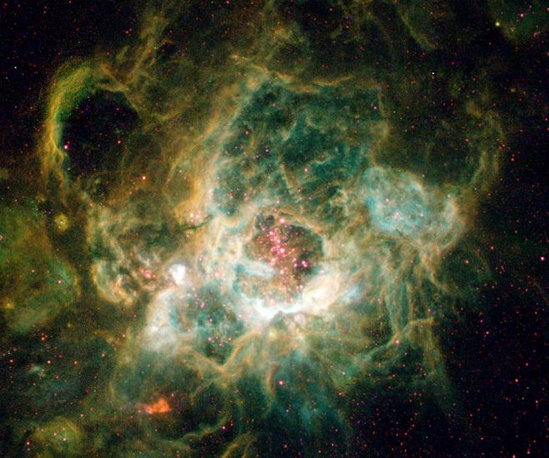

Slide 7
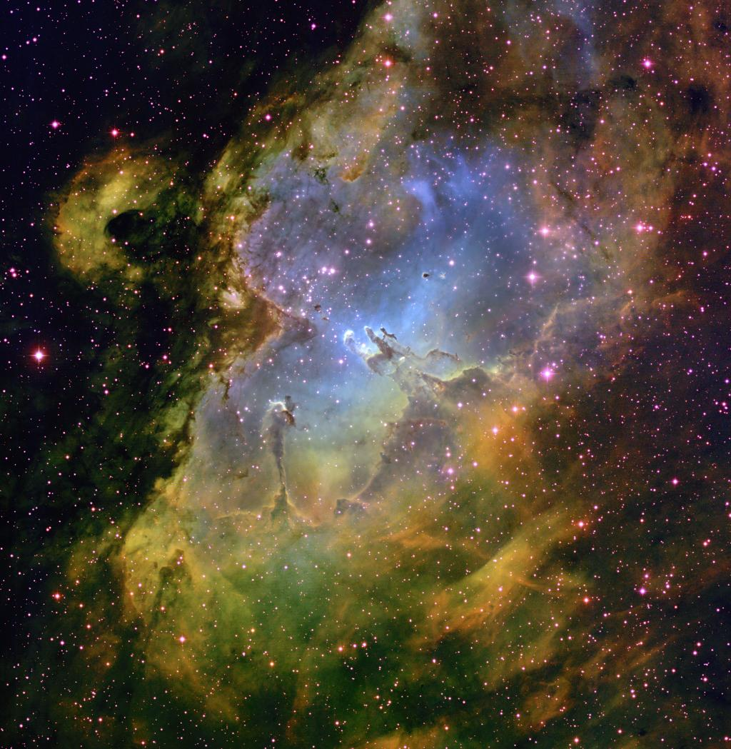

Slide 8
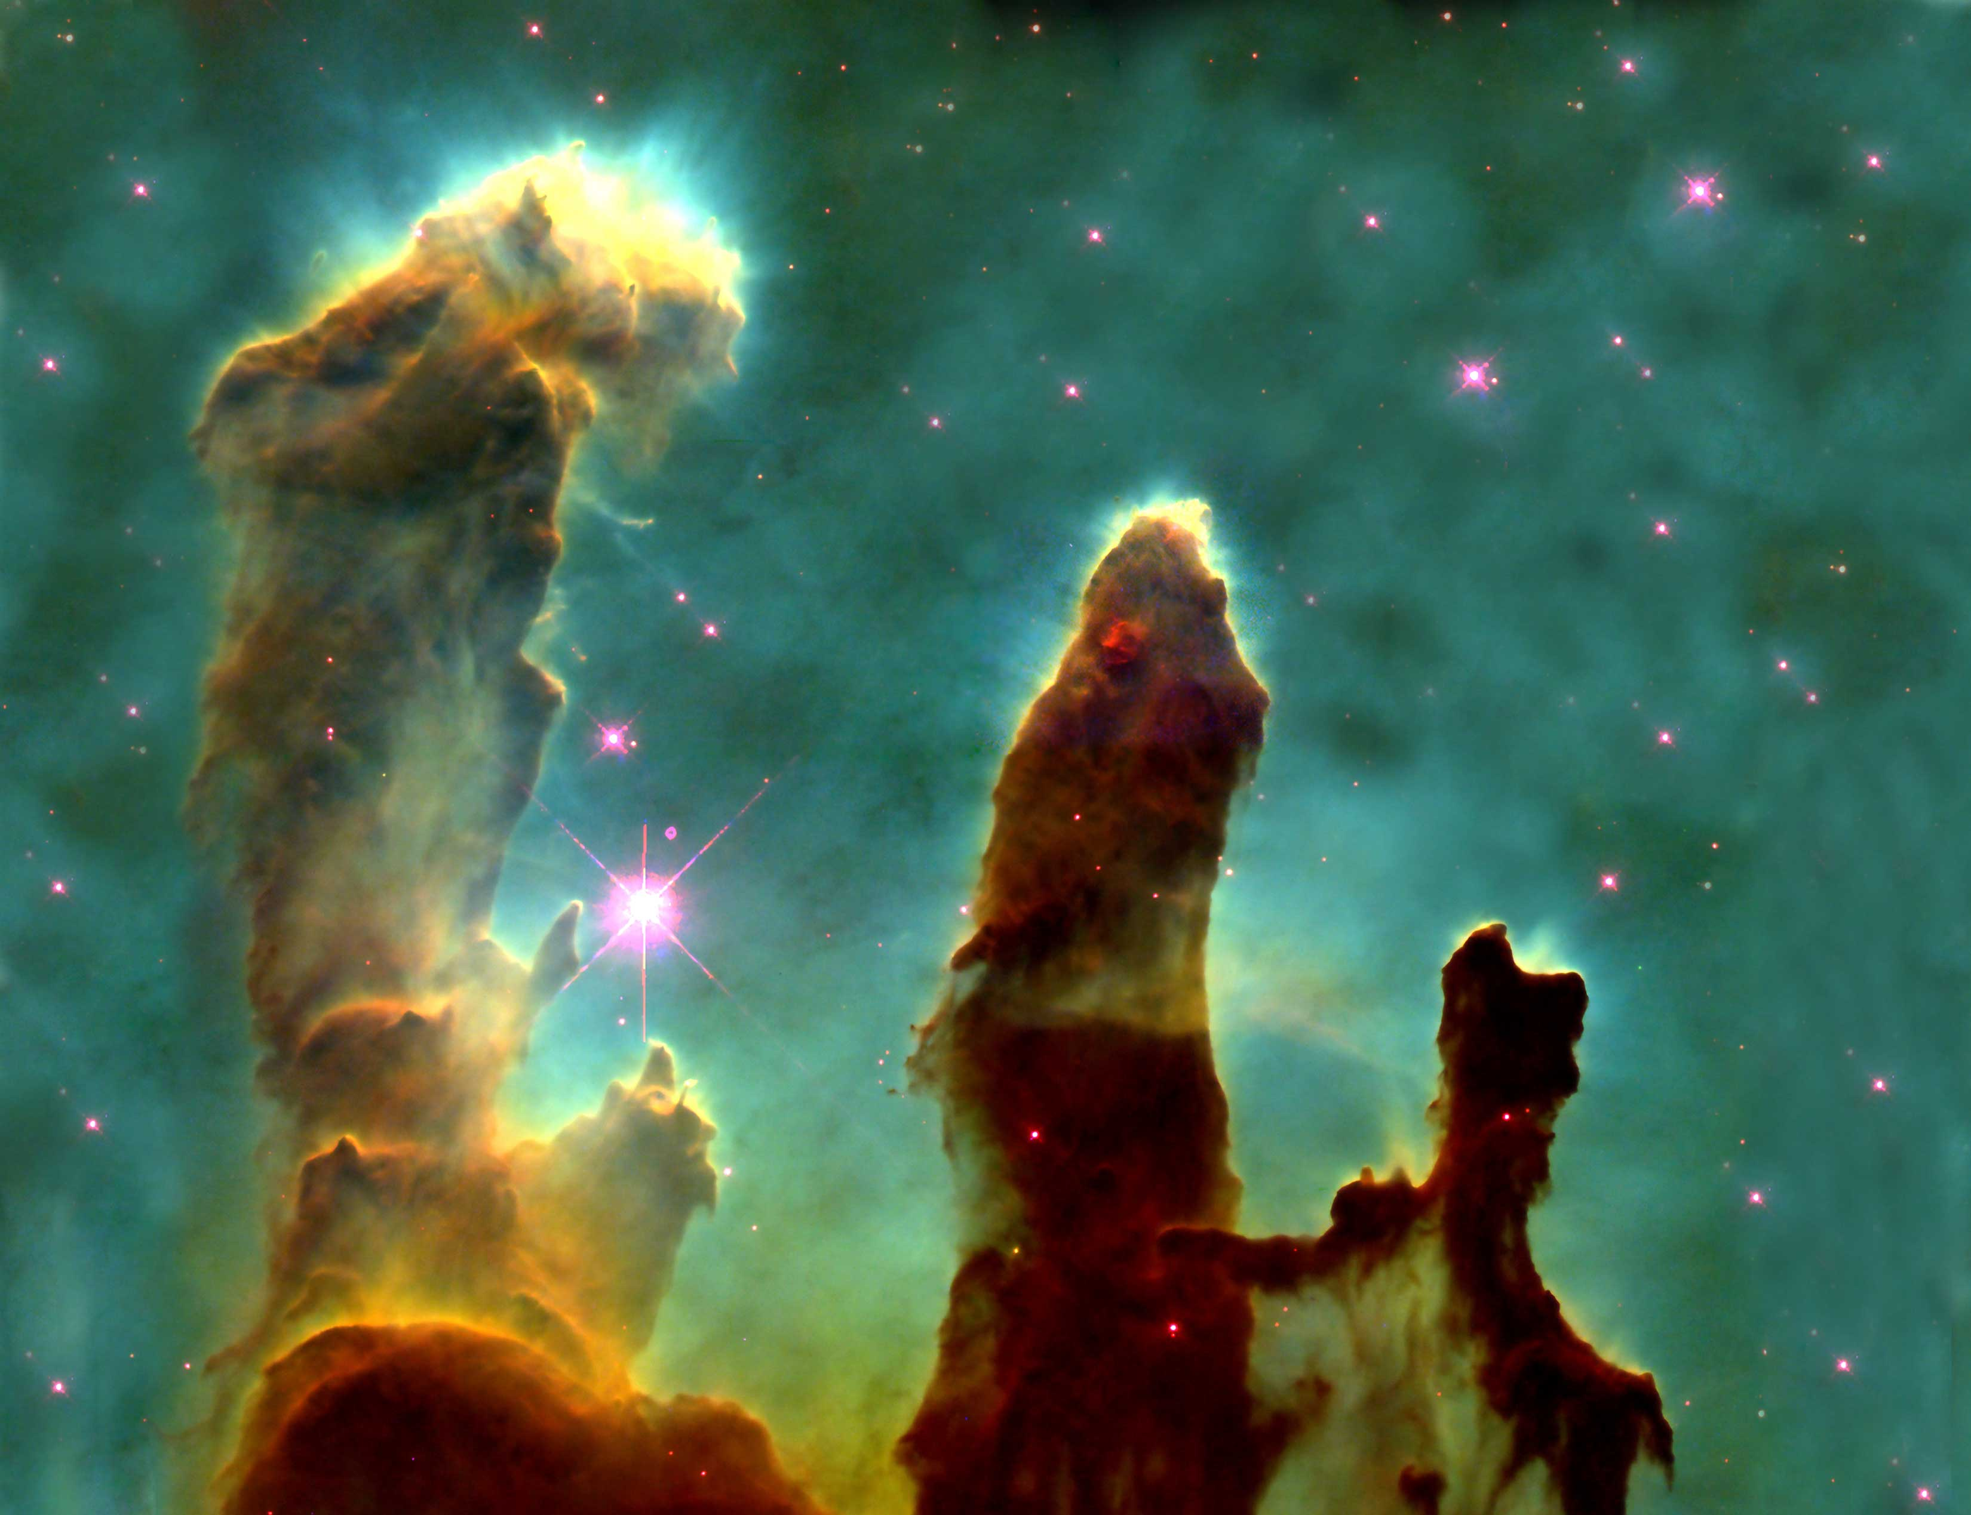

Slide 10
Star Formation

Slide 11
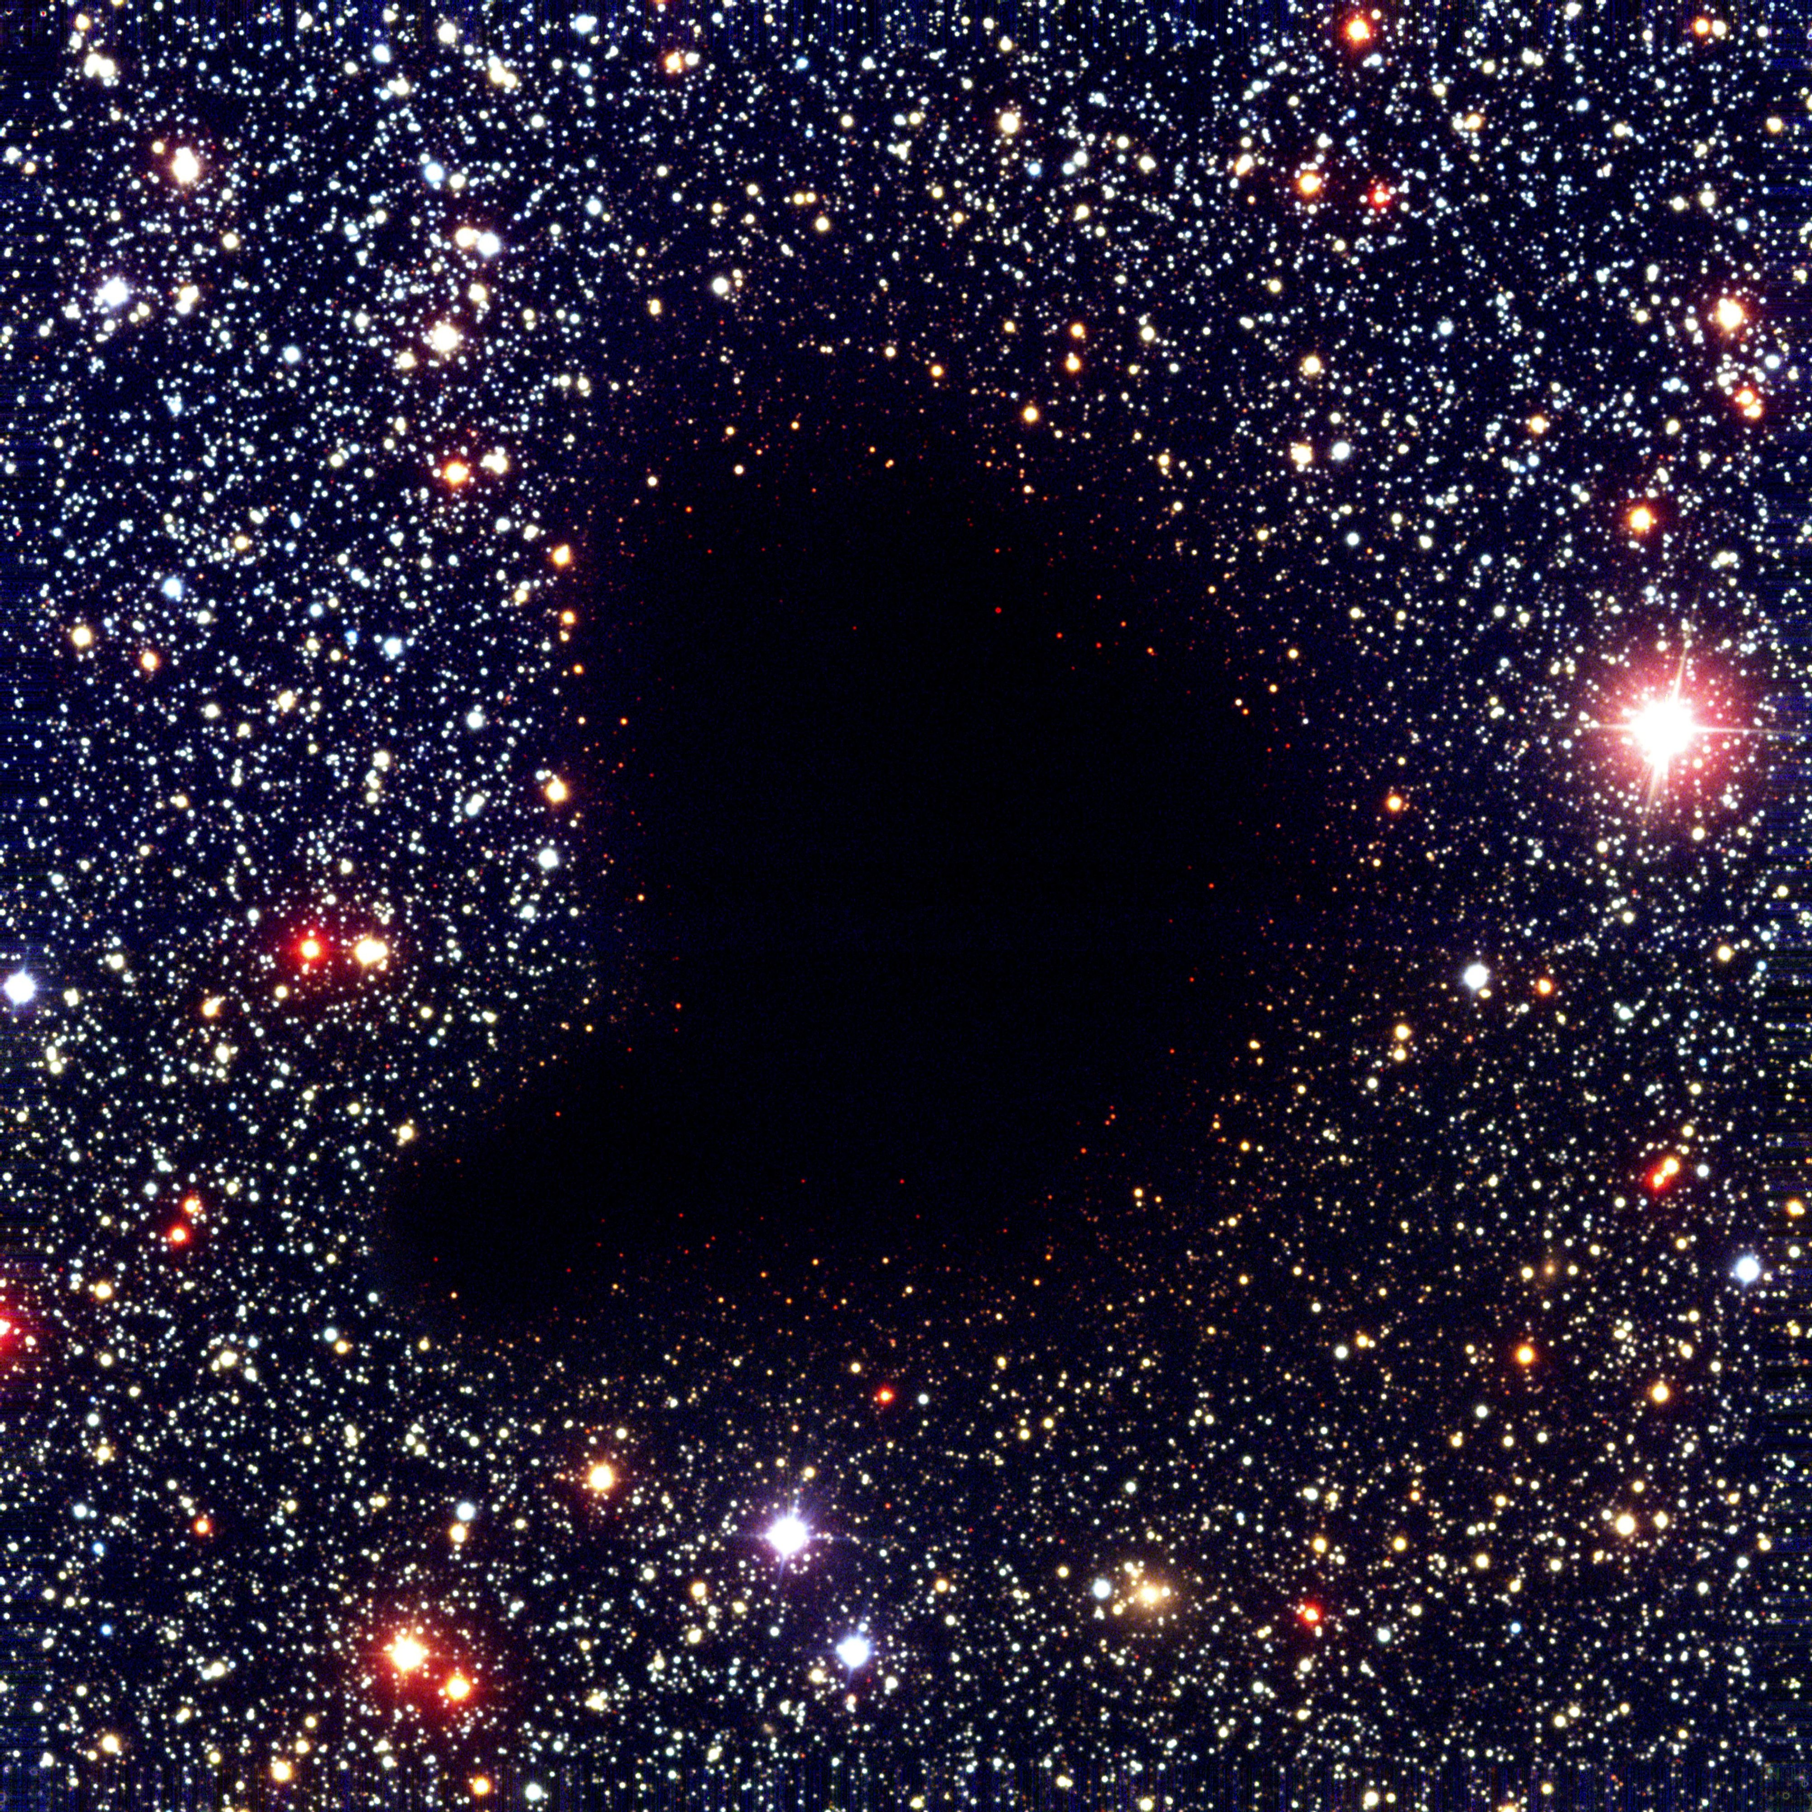

Slide 12
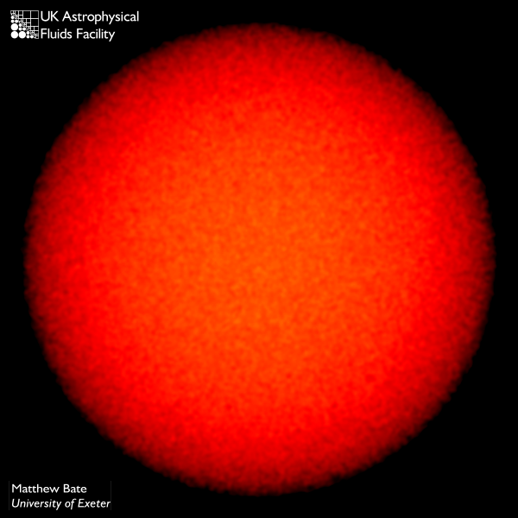
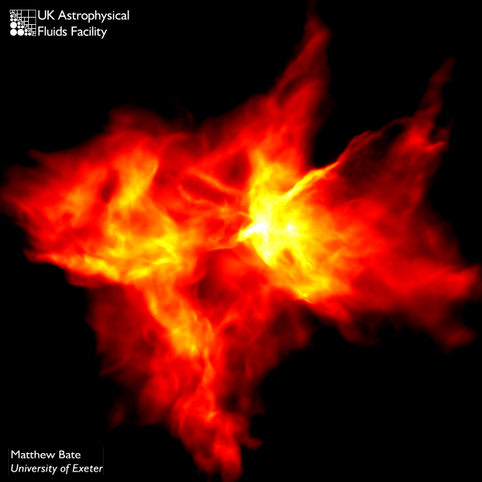
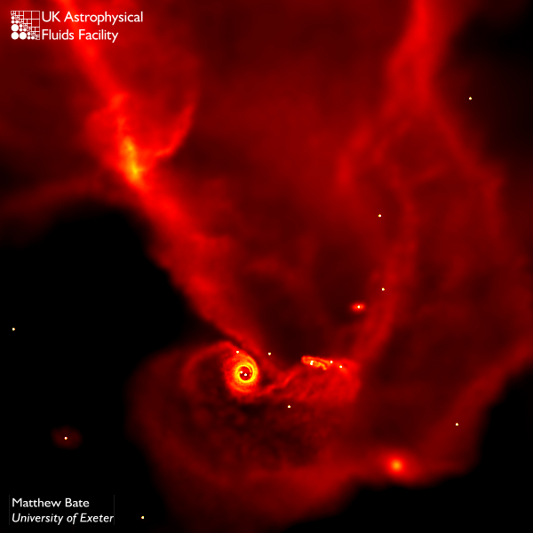
Star Formation
time
A Molecular cloud fragments into a clumpy structure of high and low density regions
The densest clumps are massive enough to undergo gravitational collapse and form stars

Slide 14
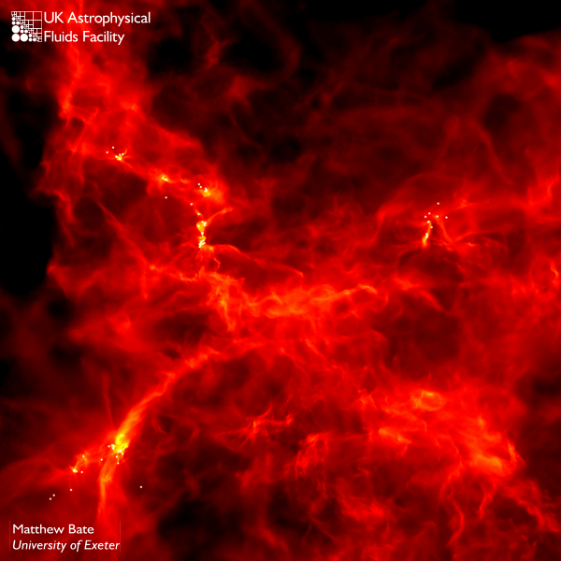
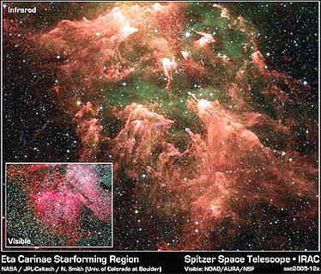
Star Formation
Computer simulation
Observation

Slide 15
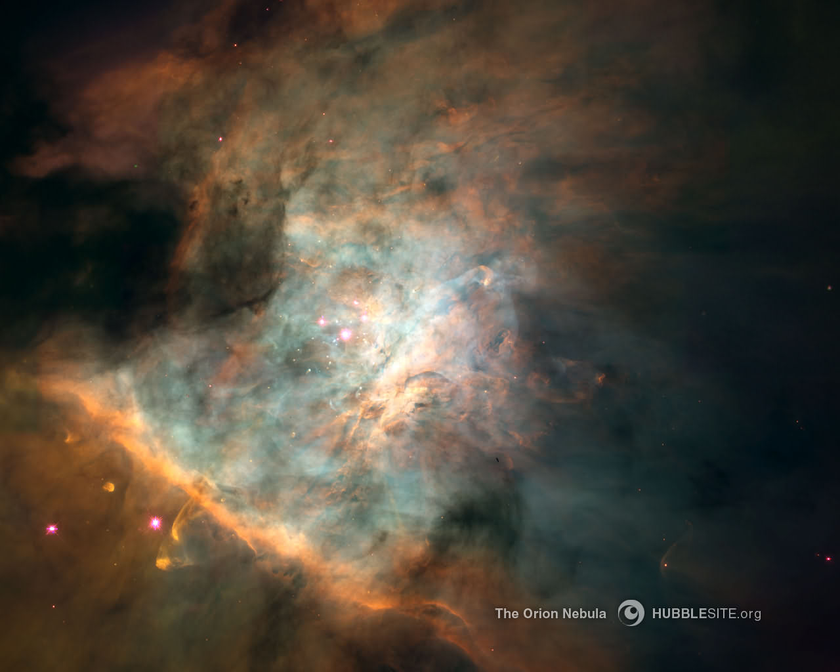
Notes:
15

Slide 16
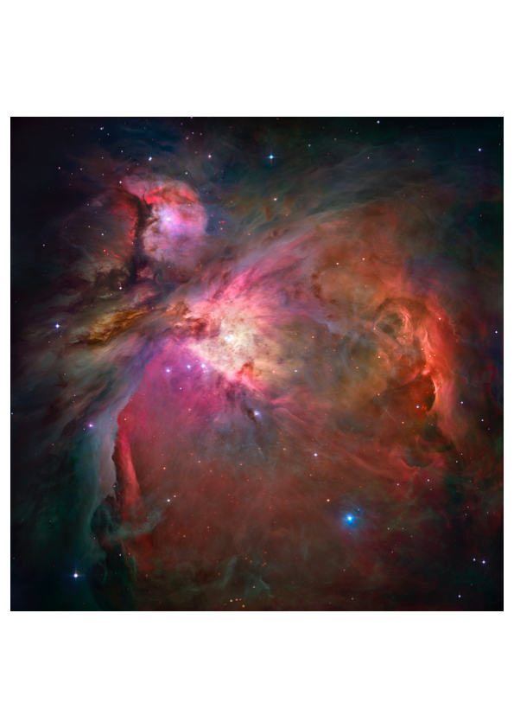
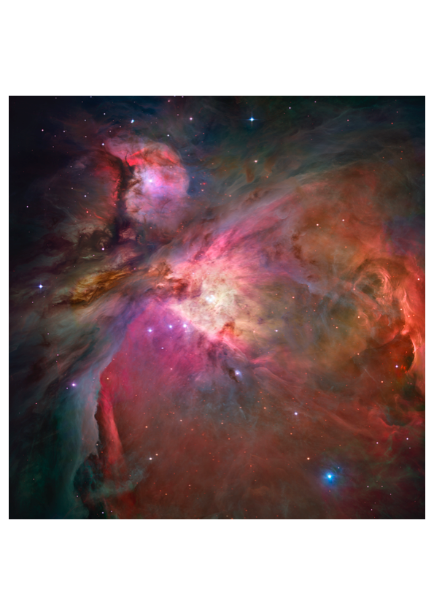
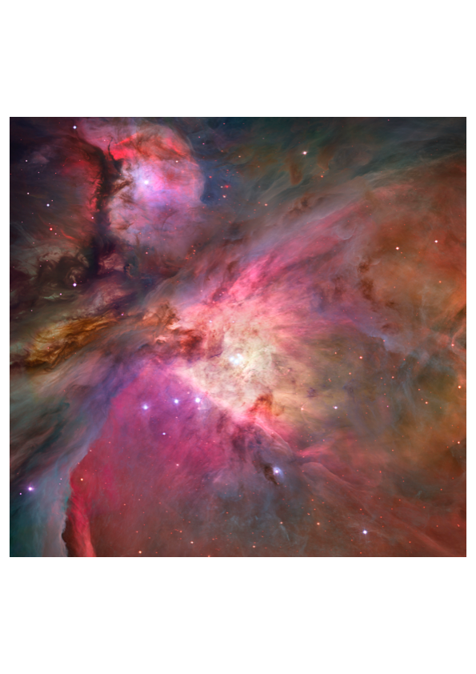
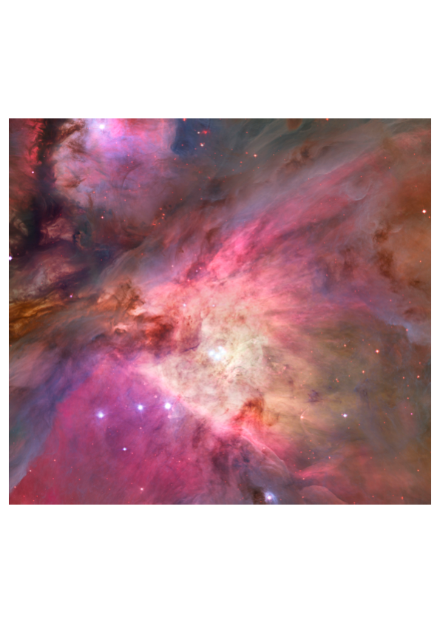
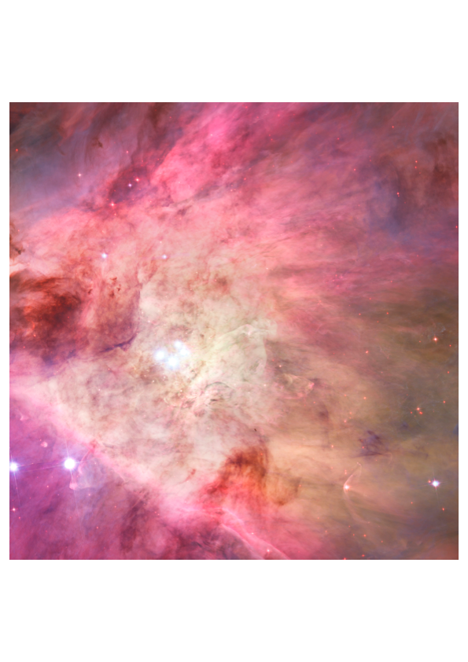
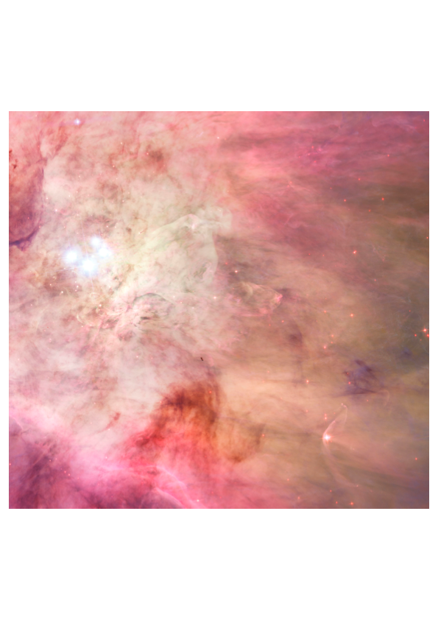
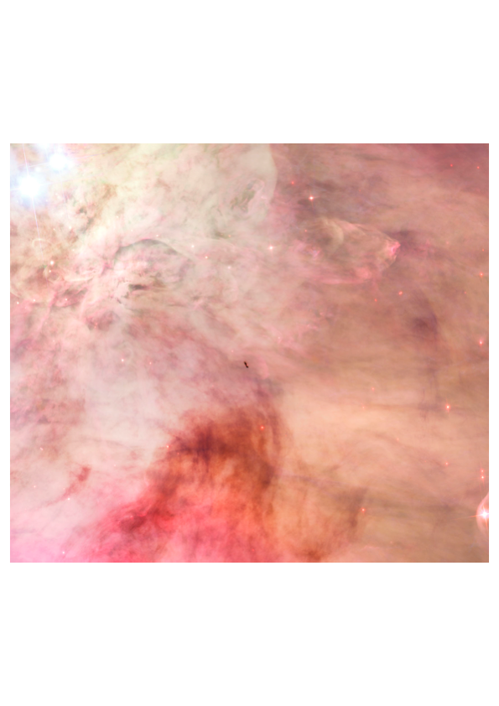
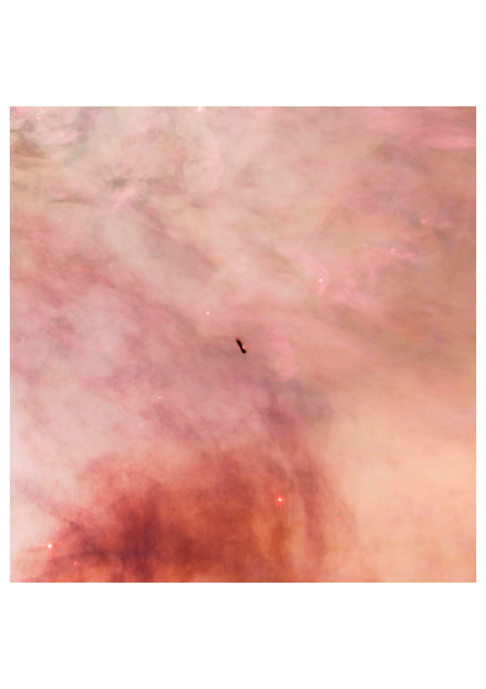
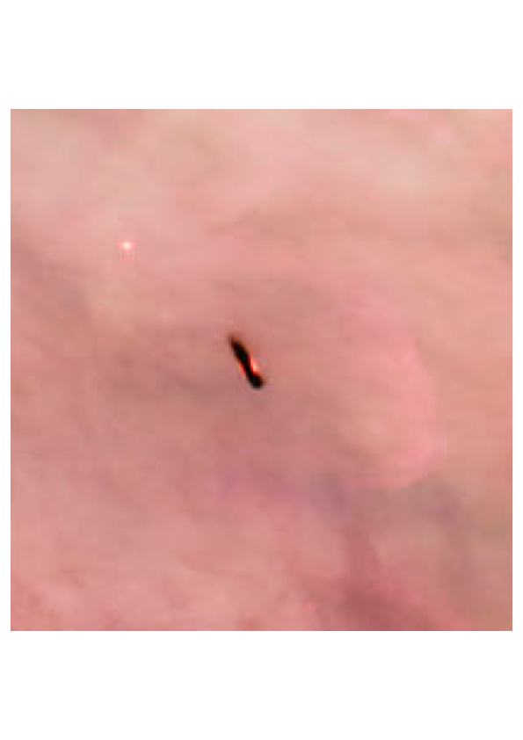
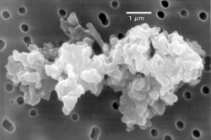

Slide 17
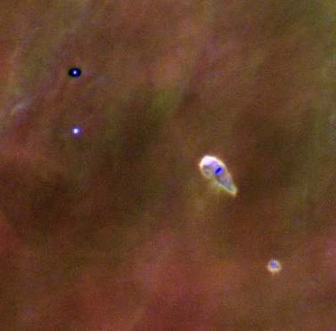
Accretion Disks in the Orion Nebula
Notes:
17
NASA image

Slide 18
Protoplanetary Disks
PP disk fact sheet
Density: 10¹³ – 10¹⁵ cm⁻³
(Air: 10²¹ cm⁻³)
Temperature: 10-1000 K
Scale: 0.1-100AU
(1 AU = 1.49 x 10¹³ cm)
Mass: 10⁻³ – 10⁻¹ M_{sun}
(1 M_{sun} = 2 x 10³³ g)

Slide 20
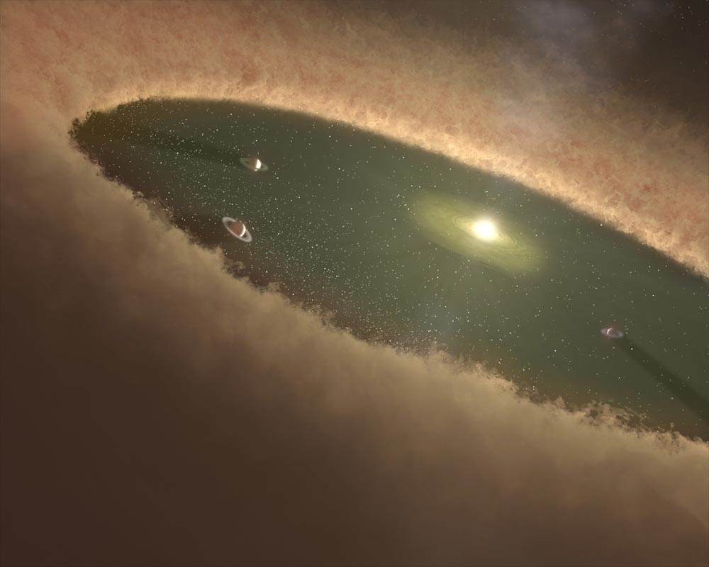

Slide 21
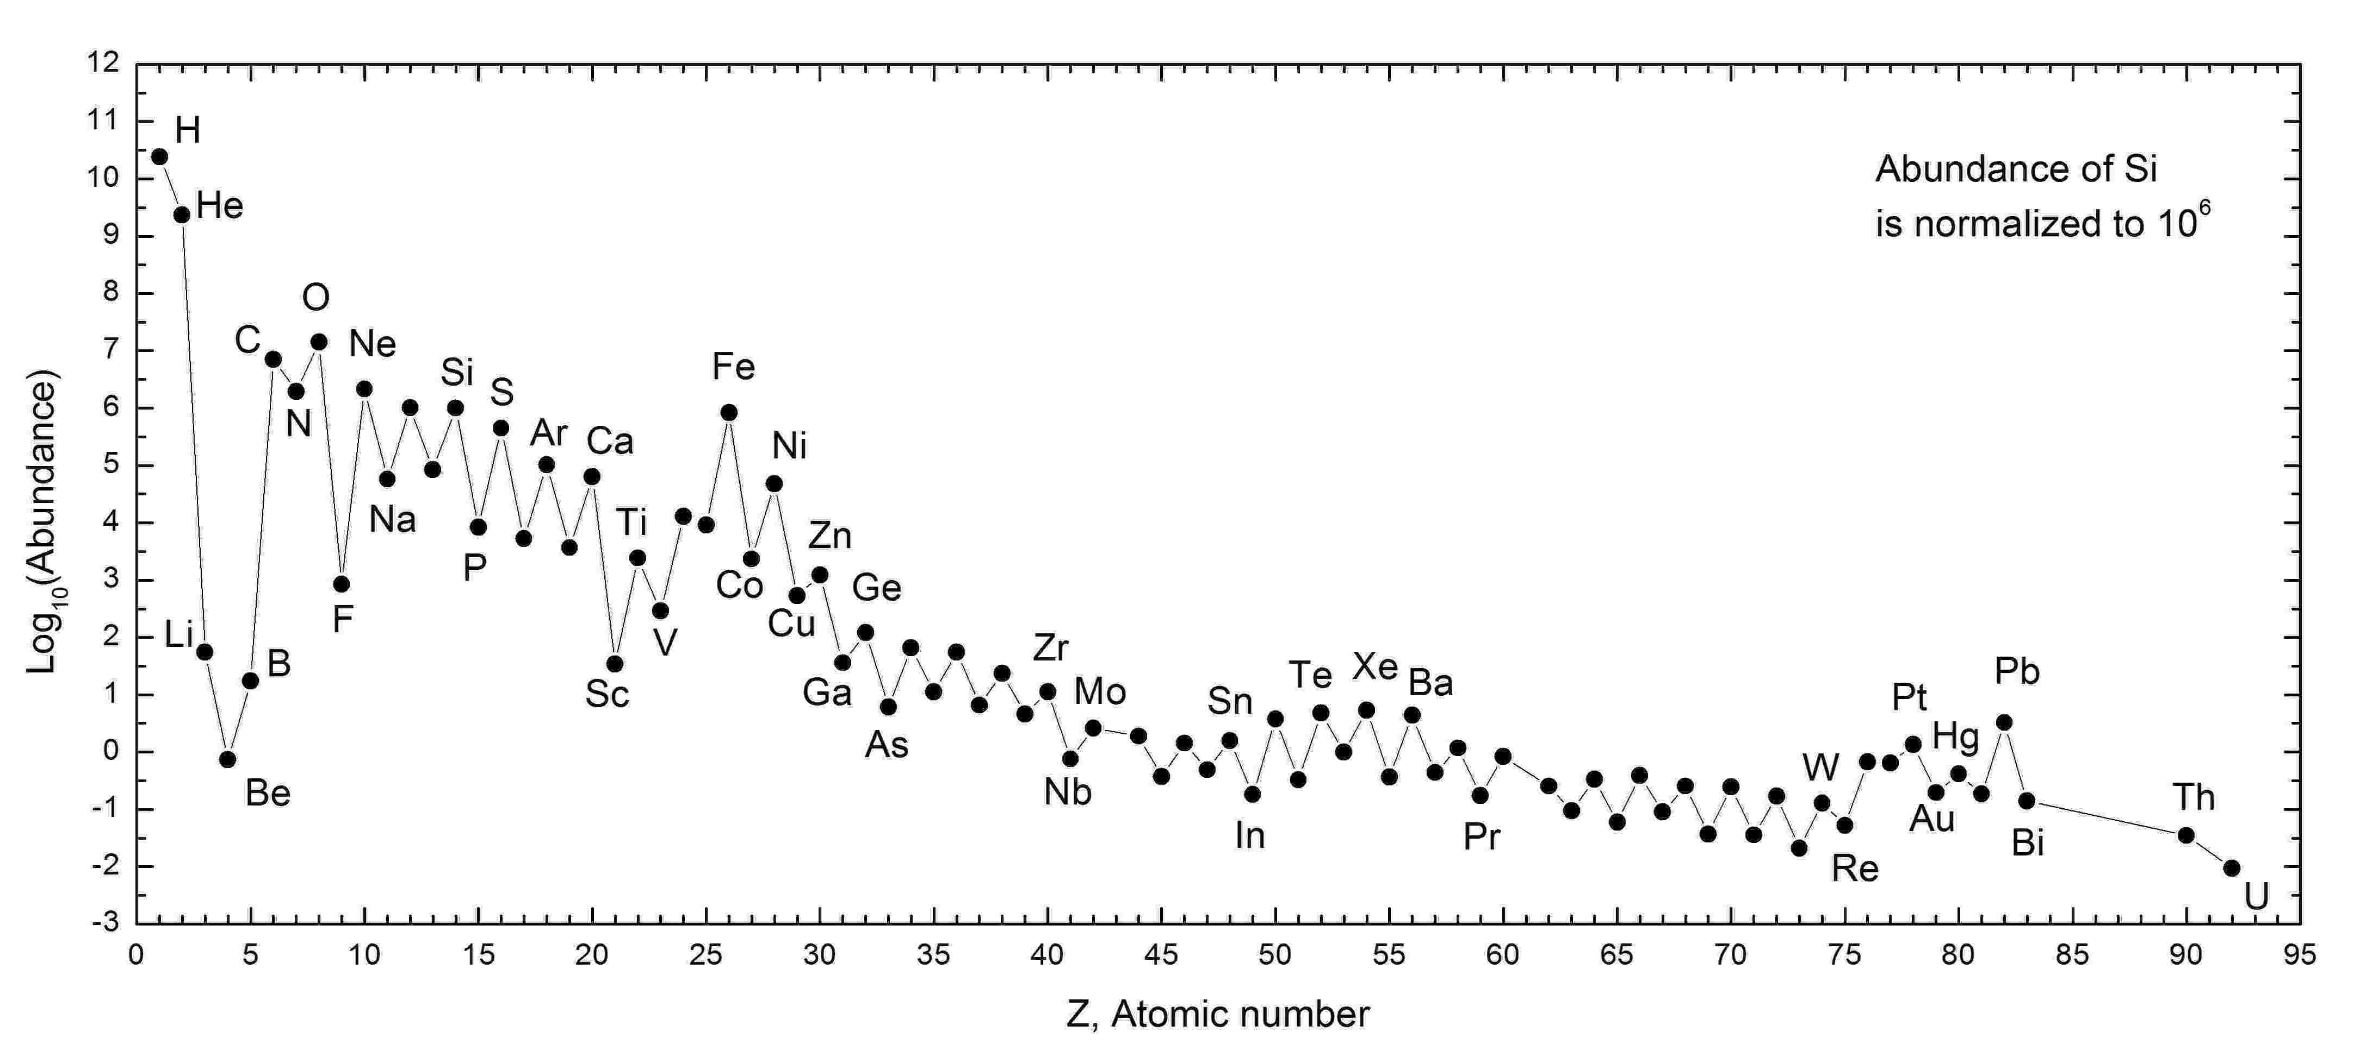
Chemical Composition
The chemical composition of the Sun
Most abundant elements, in order:
H (71%) He (27%)
0 (1.04%) C (0.46%)
Ne (0.13%) Fe (0.11%) N (0.1%)
Si (0.06%), Mg (0.05%), S (0.04%)

Slide 22
What will the chemistry of the mixture be?
H (71%)
He (27%)
0 (1.04%)
C (0.46%)
Ne (0.13%)
Fe (0.11%)
N (0.1%)
Si (0.06%)
Volatiles
Refractory

Slide 23
What will the chemistry of the mixture be?
H H H H H He H H H H H H H H H H H H H H H H H H H H H H H He H H H H H H H H H H H H H H H H H H He H H H H H H H H H H H O H H H H H H H H H H H H H H H H H H H H H H H H H H H H H H H H H C H H H H H H H H He H H H H H H H H H H H H H H H H H H H H H H H H H H H H H H H H He H H H H H H H H H H H H H H H H H H H H H H H H H He H H H H H H H H O H H H H H H H H H H H H H H H H H He H H H H H O H H H H H H H H H H H H H H H H H H H H H Ne H H H H H H H H H H H H H H H H He H H H H H H H H H H H H H H H H H H H H H H H H H H H H H H He H H H O H H H H H H H H H H H H H H He H H H H H H H O H H H H H H He H H H HH H H H H H H H H H H H H H H H H H H H H H H H H H H H H H H H H H H H H H H H H He H H H H H H H H H H H H H H H H He H H H H H C H H H H H H H H H H H H H H H H H H H H O H H H H H H H H He H H H H H H H H H H H H H H H H H H H H H H He H H H H H H H H H H H H H H H H H H H H H H He H H H H H H H H H H H H H H H H H H H H H C H H H H H H H H H H H H H H H H H H H H H H H H H H H H H H He H H H H H H H H H H H H H He H H H H He H H H H H H H H H H H HH H H H H H H N H H H H H H H H H H H H H H H H H H H H H H H H H H H H He H H H H H H O H H H H H H H H H H H H H O H H H H H H H H H H H H H H He H H H H H H H H H H H H H H H H H H H H H H H H H H H H H H H H H H H H O H H H H H H H H H H H C H H H H H H H H H He H H H H H H H H H H H H H H H H H H H H HH H H H H H H H H H H H H H H H H H H H H H O H H H H H H He H H He H H H H H H H H H H H H H Fe H H H H H H H H H H H H H H H H H H H H H H H H H H H H H
H₂
He
H₂0
CH₄
Ne
NH₃
Fe, Si

Slide 24
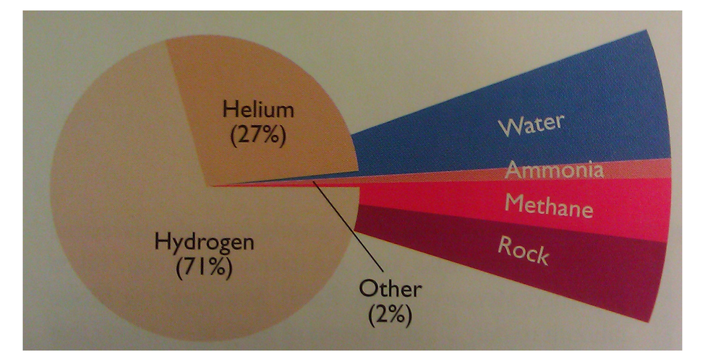
What will the chemistry of the mixture be?
H (71%)
He (27%)
0 (1.04%)
C (0.46%)
Ne (0.13%)
Fe (0.11%)
N (0.1%)
Si (0.06%)
H₂ He
H₂0 - Water
CH₄ - Methane
Ne
NH₃ - Ammonia
Fe, Si – Rocks (metals and silicates)

Slide 25
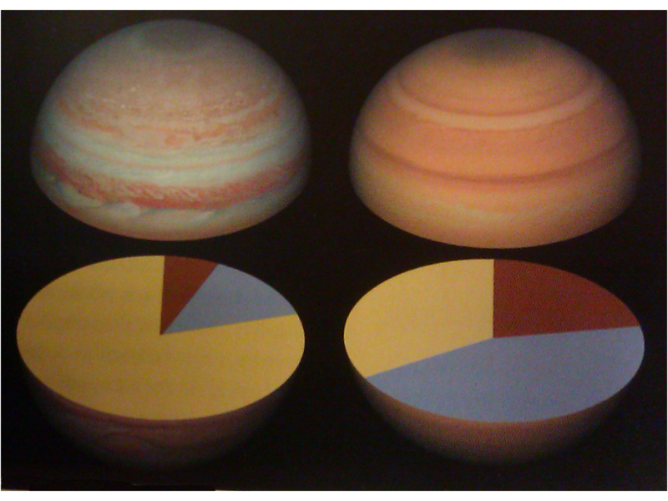
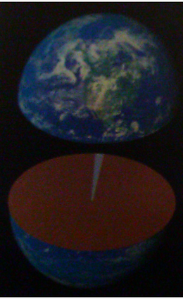
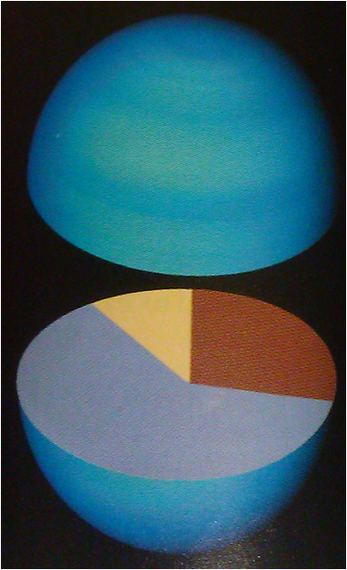
Classes of planets
Rocky Planets
Gas Giants
Ice Giants
Jupiter
Saturn
Uranus/Neptune
Earth
Rock
Gas
Ice

