Slide 1
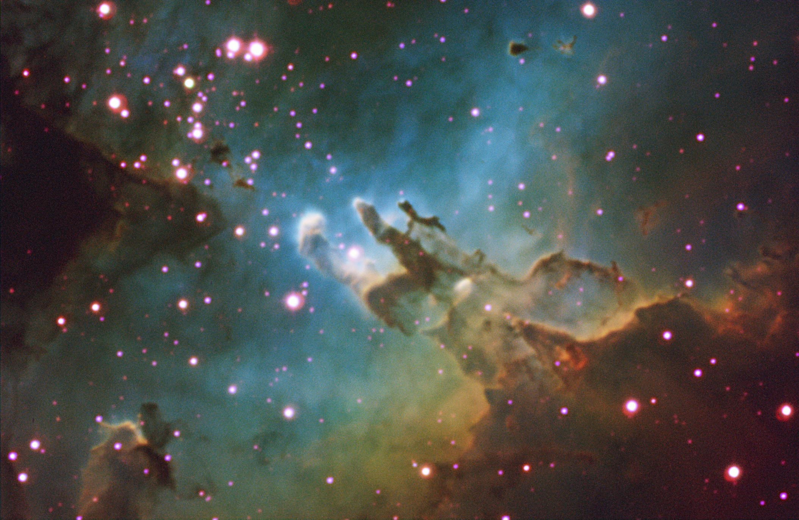

Selected Topics in Astrophysics
Prof Wladimir Lyra
Live Oak, 1119-G
Office Hours: Mon 4pm-5pm
Class hours: Mon/Wed 5pm-6:15pm

Slide 2
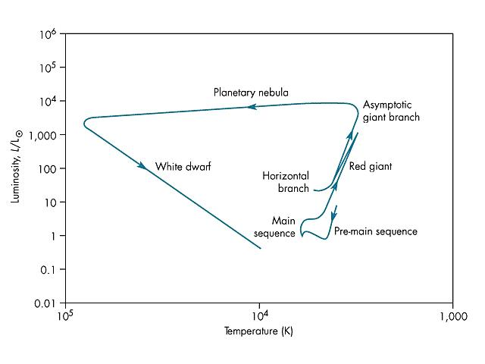
Evolution of high mass stars
The evolution we covered in last class is for low mass stars (M < 4 M⊙)
High mass stars differ basically due to the temperature of the core.

Slide 3
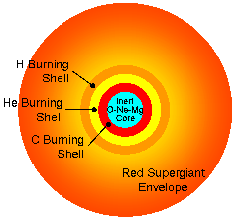
Evolution of high mass stars (4 < M/M⊙ < 8)
The Helium Flash never happens
The star reaches Helium burning temperatures
before the core becomes degenerate
They also reach temperatures
hot enough to burn Carbon
600 million K
Leaves a O-Ne-(Mg)
white dwarf.

Slide 4
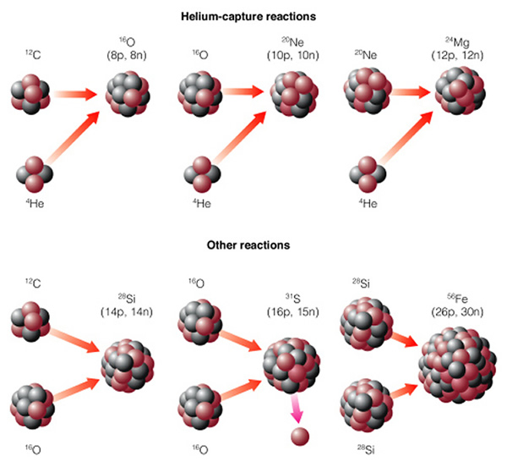
Evolution of high mass stars
M > 8 M⊙
Carbon → O,Ne,Mg (600 million K)
Neon → O, Mg (1.5 Billion K)
Oxygen → Si, S, P (2.1 Billion K)
Silicon → Fe, Ni (3.5 Billion K)

Slide 5
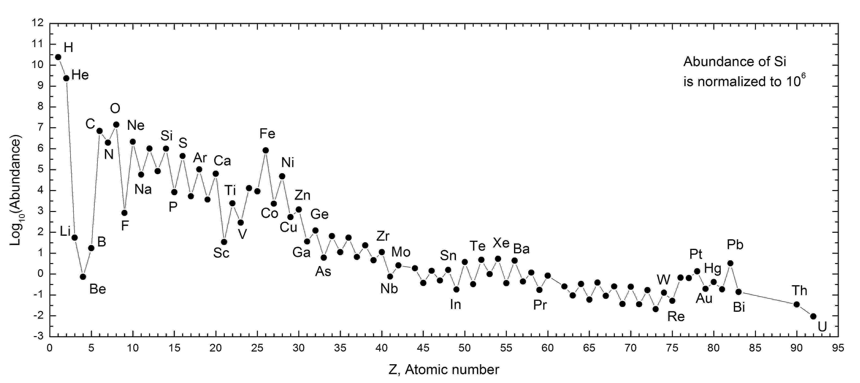
The Sun’s abundance pattern
Because of the alpha ladder, elements with even atomic number are more abundant than those with odd
Elements are made by Helium (alpha) capture.
Expected, since Iron is the end of the fusion sequence.

Slide 6
Evolution of high mass stars
M > 8 M⊙
TIMESCALES FOR NUCLEAR BURNING
Hydrogen – 10 Myr
Helium – 1 Myr
Carbon – 1000 yr
Neon ~ 10 yr
Oxygen ~ 1 yr
Silicon ~ 1 day

Slide 7
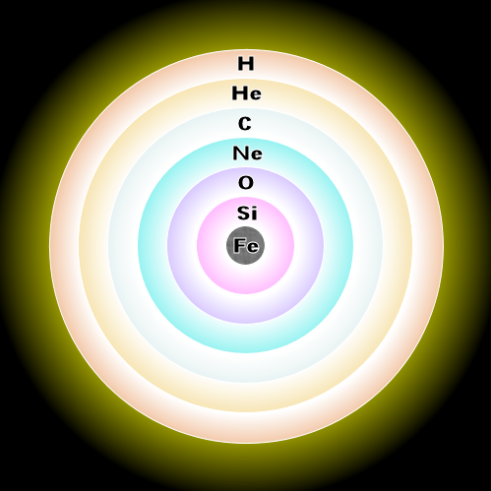
Evolution of high mass stars M > 8 M⊙
The star develops an “onion layers structure” of burning shells
Carbon → O,Ne,Mg (600 million K)
Neon → O, Mg (1.5 Billion K)
Oxygen → Si, S, P (2.1 Billion K)
Silicon → Fe, Ni (3.5 Billion K)
But Iron is a DEAD END !!

Slide 8
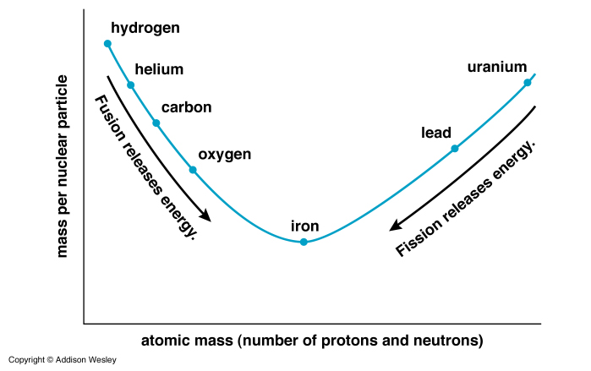
Iron is a dead end
Iron is the most tightly bound element
Fusion beyond Iron TAKES energy
Fusion takes energy.
No fusion reactions left to yield energy!!

Slide 9
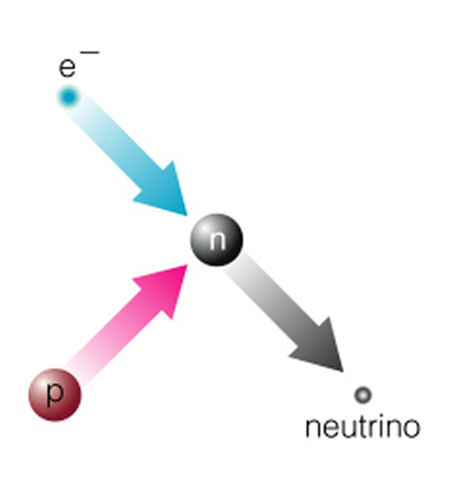
Core collapse
At densities of 10¹ ⁰ g/cm³
(remember: nuclear densities are ~10¹ ⁴ g/cm³)
Neutronization
Proton + electron → neutron + neutrino
(p + e⁻ → n + ν)
Electrons lost: electron degeneracy pressure is gone

Slide 10
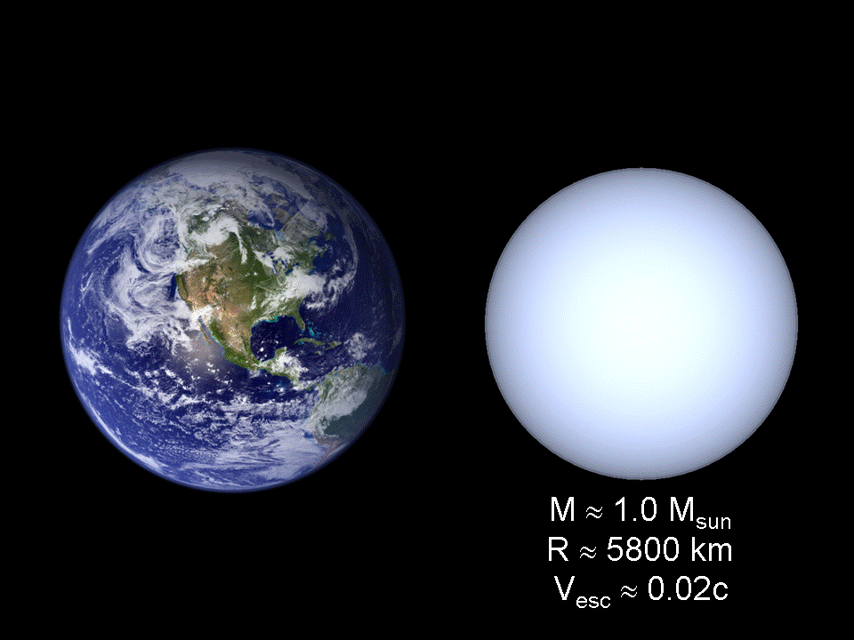
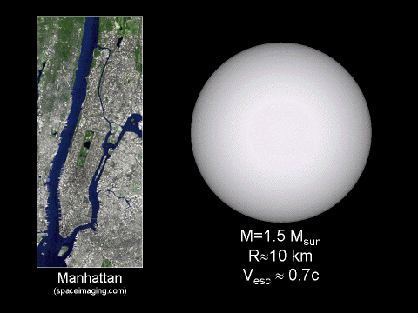
Catastrophic collapse
A second later
Collapse speed: 0.25c
10 km
10¹ ⁴ g/cm³
6000 km
10¹ ⁰ g/cm³
Nuclear densities!
Neutron degeneracy
provides support against gravity

Slide 11
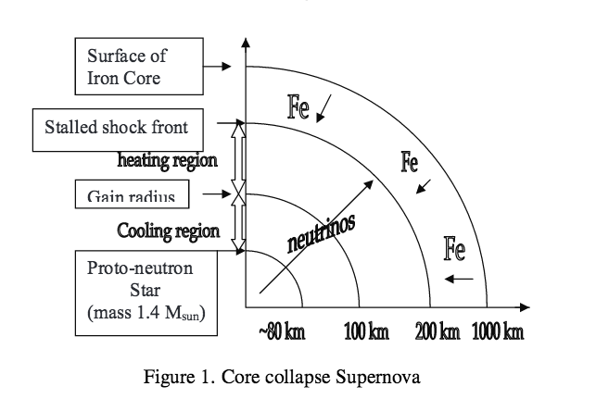

Slide 12
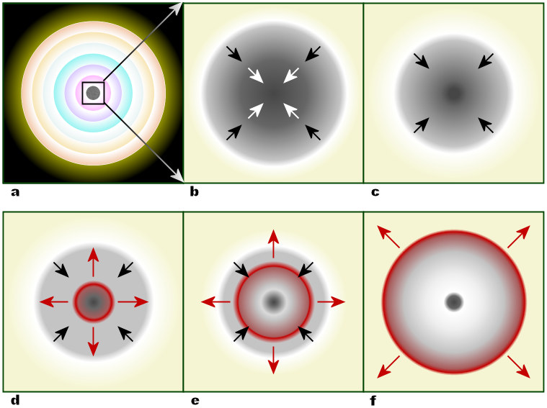
Core Bounce
Neutronization
Iron core
collapses
The inner core stabilizes
and stops collapsing.
The kinetic energy
that was directed
inwards is redirected
outwards
The core overshoots the
equilibrium radius
and bounces.
Pressure wave hits infalling gas

Slide 13
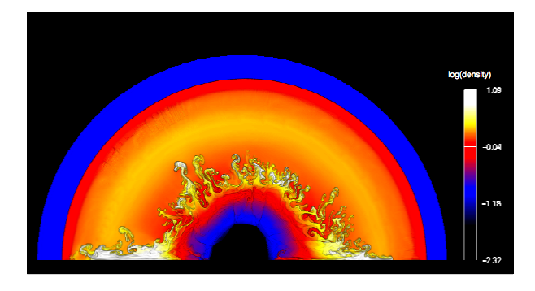
The Thermonuclear Shock Wave
Infalling gas meeting the rebouncing core generates a shock wave
The blastwave generates explosive nuclear reactions along its path
Violently heats and accelerates the stellar envelope

Slide 14
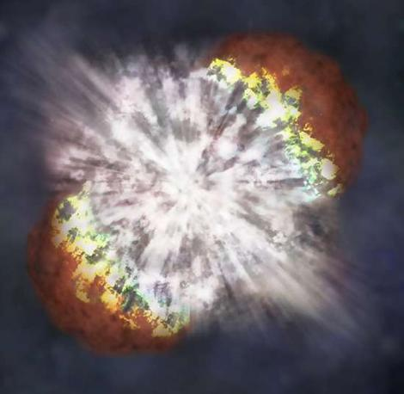
Supernova!
In a few hours, the shockwave reaches the surface
From the outside, the star is seen to explode.

Slide 15
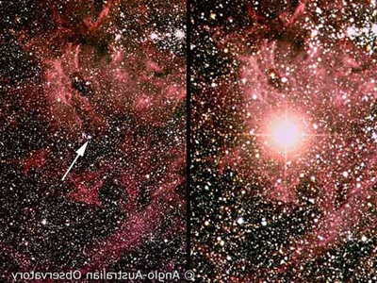
Supernova 1987A
Confirmation of the theory
A burst of neutrinos 4 hours before the event
The progenitor had a mass of 20 M⊙.

Slide 16
Alpha ladder
Low mass stars produce elements up to Carbon and Oxygen
High mass stars produce all the rest of the periodic table
Up to Iron we have basically alpha reactions

Slide 17
Neutron capture
Beyond the Iron peak, nucleosynthesis occur by neutron capture and beta decay
(n → p + e⁻ + ν)
The process is classified according to the neutron flux
S-process
(slow neutron capture)
Neutron capture occurs
slower
than beta decay
Works up to bismuth (Z=83)
Where?
AGB stars + Supernovae
R-process
(rapid neutron capture)
Neutron capture occurs
faster
than beta decay
Really heavy stuff
All the way to Uranium
Where?
Supernovae

Slide 18
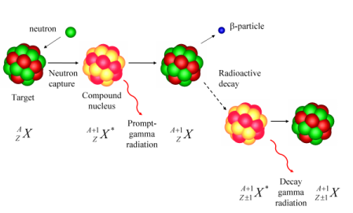
Neutron capture
Beyond the Iron peak, nucleosynthesis occurs by neutron capture and beta decay
(n → p + e⁻ + n)
Neutron capture produces isotopes
Neutron capture proceeds until the nuclide goes unstable (radioactive)
If a proton decays, the atomic number decreases
But if a neutron decays, the atomic number increases!

Slide 19
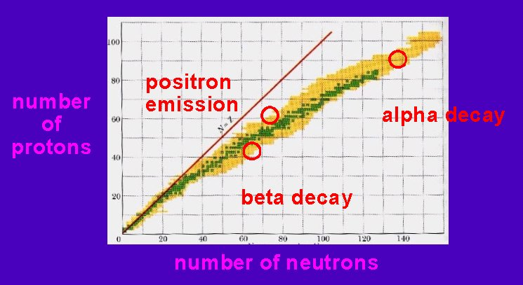
Climbing the periodic table
Proton decays
Neutron decays

Slide 20
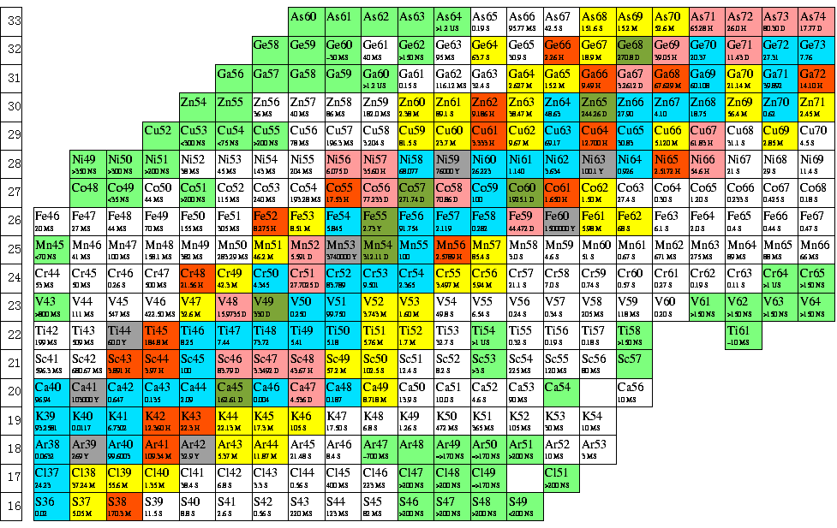
Ta-dah!

Slide 21
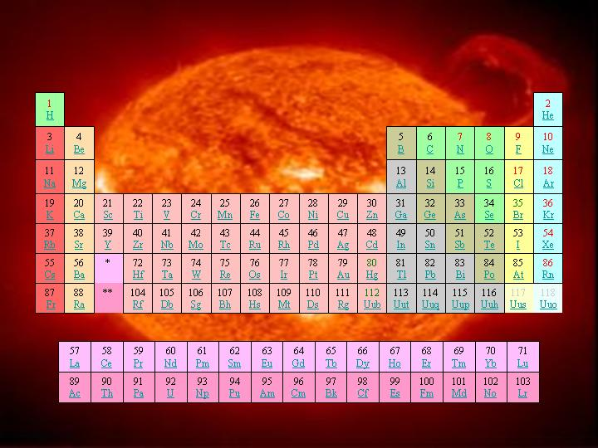
Nucleosynthesis summary
Element | # of Protons | Site
H | 1 | Big Bang
He, C, O | 2,6,8 | Big Bang + Low and High Mass stars
Ne - Fe | 10-26 | High mass stars
Co - Bi | 27-83 | S and R process, AGB and SN
Po - U | 84-92 | R process in SN

