Slide 1
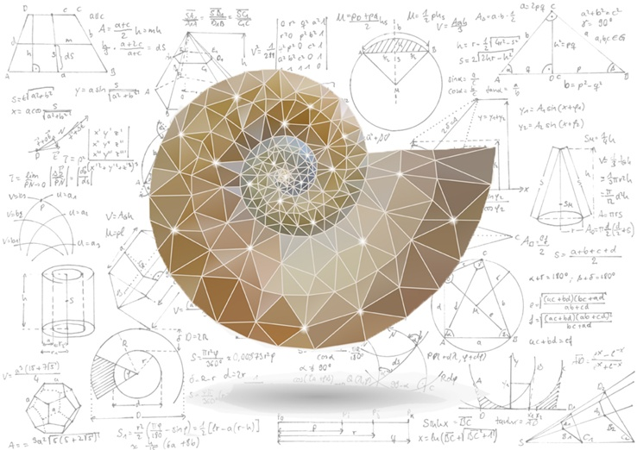

Mathematical Methods in Physics I
Prof Wladimir Lyra
Live Oak, 1119-G
Office Hours: Tue 2:30pm-3:30pm
Class hours: Tue/Thu 3:30pm-4:15pm

Slide 2
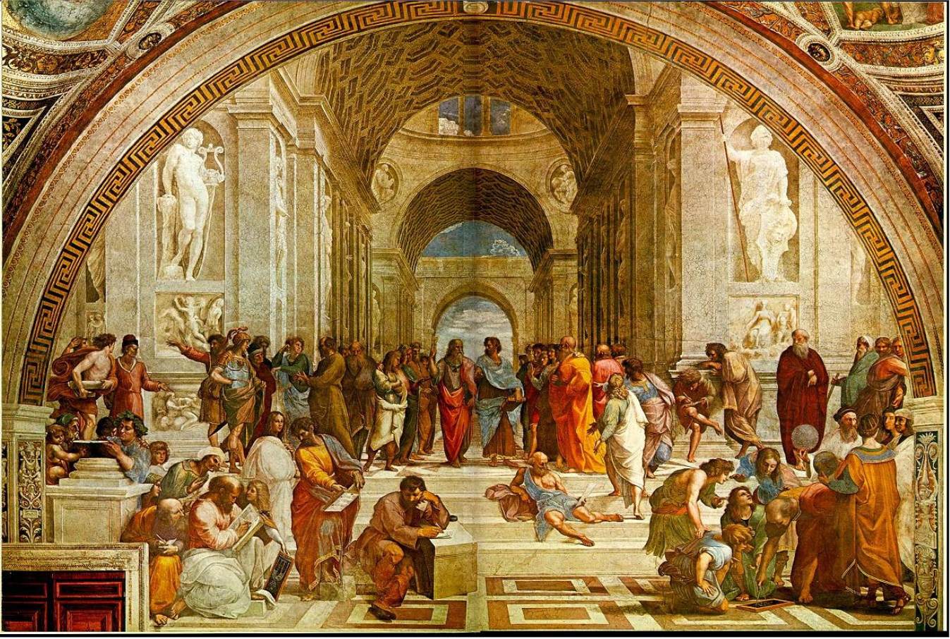
Raphael’s
School of Athens

Slide 3
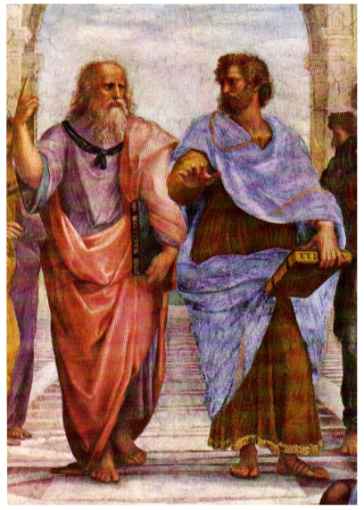
Aristotle

Slide 4
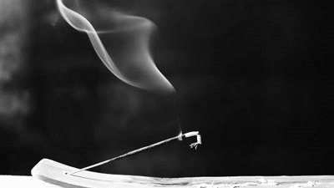
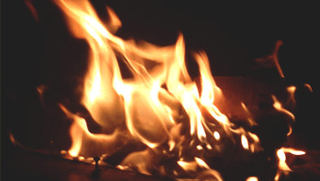

Slide 5
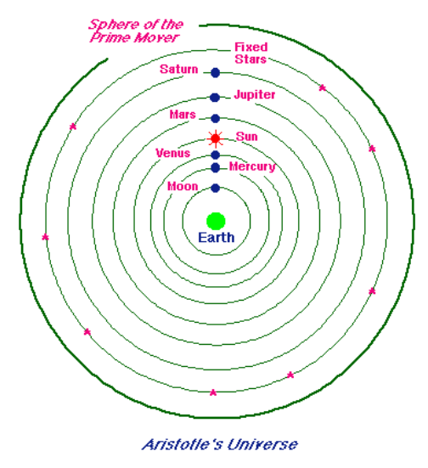
Aether

Slide 6
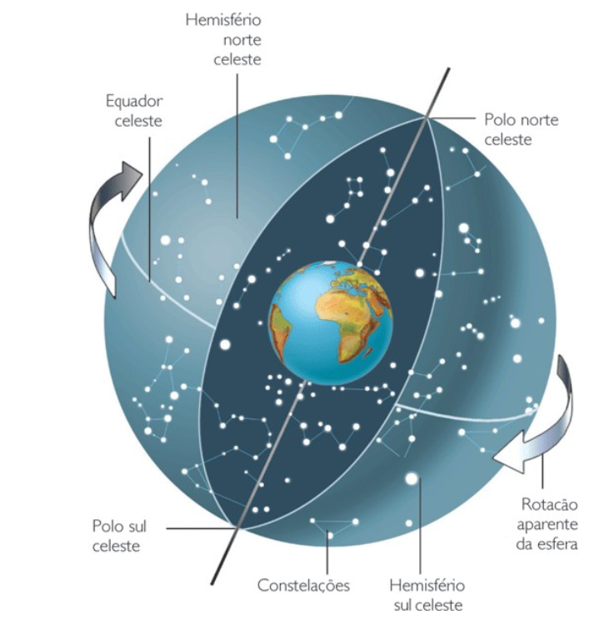
The celestial sphere

Slide 7
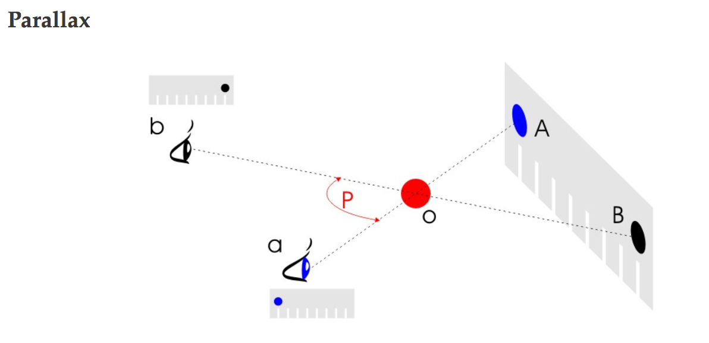
Evidence for Geocentrism

Slide 8
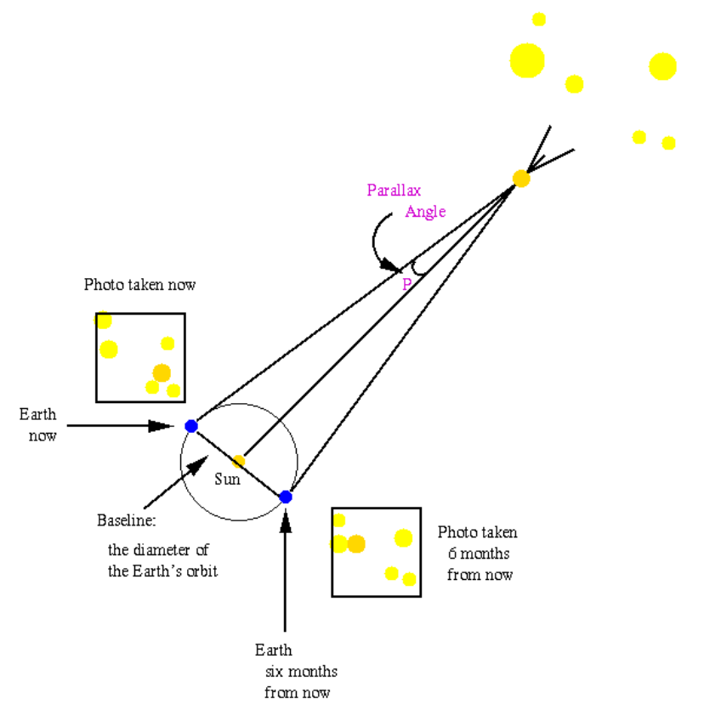
Evidence for Geocentrism
If the Earth moved,
the stars would
show a parallax.

Slide 9
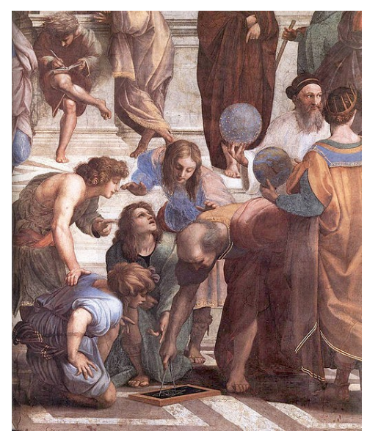
Ptolemy

Slide 10
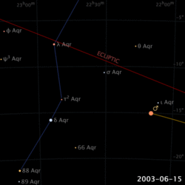
Retrograde Motion

Slide 11
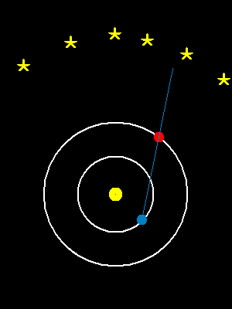
Retrograde Motion

Slide 12
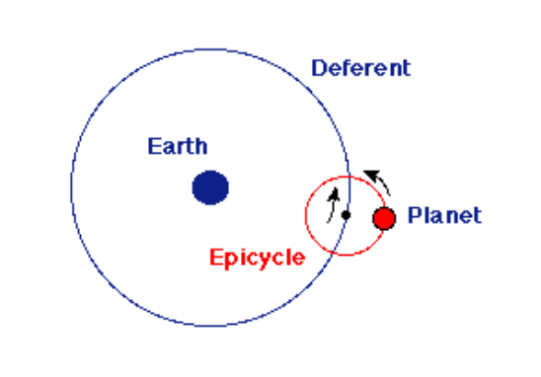
An ingenious idea: Epicycles
Two circles!
The planet executes an orbit (epicycle) around a point
This point executes an orbit (deferent) around Earth

Slide 13
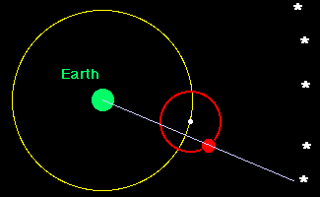
An ingenious idea: Epicycles
Two circles!
The planet executes an orbit (epicycle) around a point
This point executes an orbit (deferent) around Earth

Slide 14
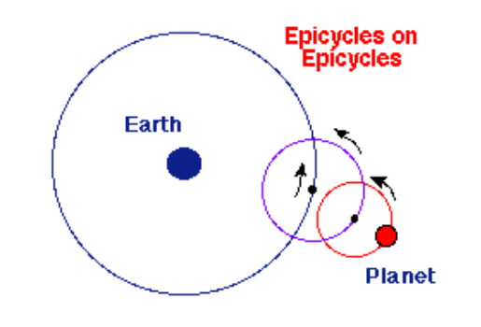
Sophistications
Sometimes more epicycles were needed
to accurately predict the position of the planets

Slide 15
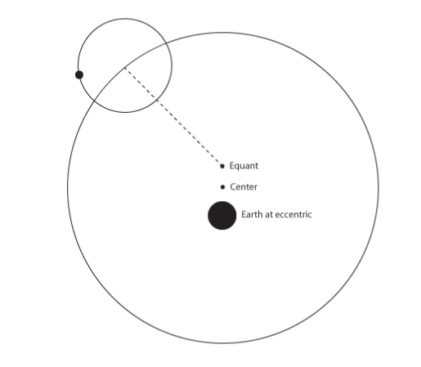
Sophistications: The Equant
Earth is at an “eccentric” point, off the center of the deferent.
The center of the epicycle moves with constant speed around the Equant.

Slide 16
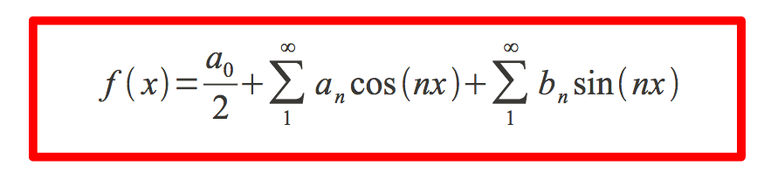
Why does the geocentric model work?

Slide 17
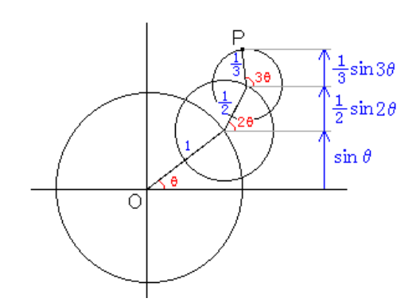
Why does the geocentric model work?
Epicycles!

Slide 18
Why does the geocentric model work?
Equant
Epicycles

Slide 19
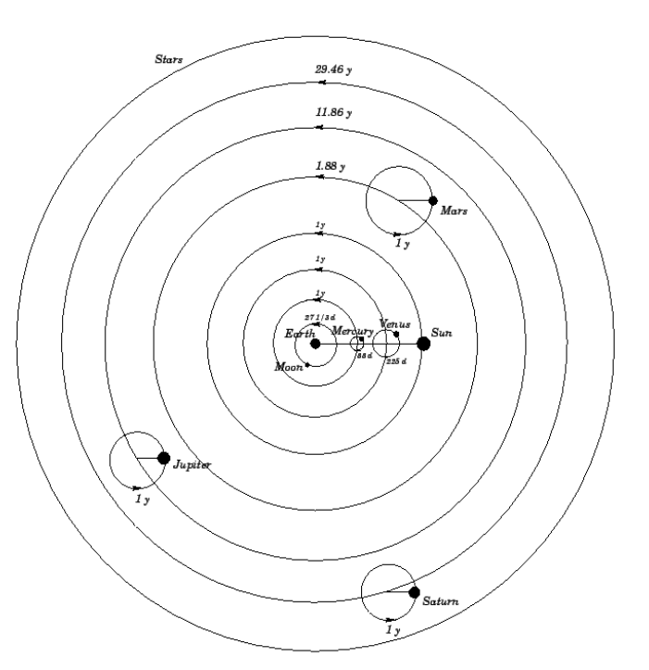
The geocentric model
Equant
Epicycles

