Slide 1
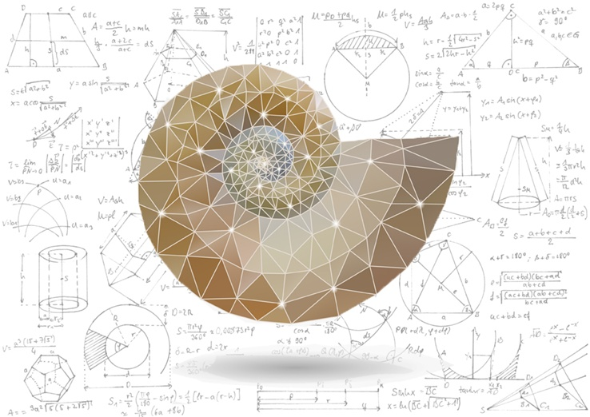
Mathematical Methods in Physics I
Prof Wladimir Lyra
Live Oak, 1119-G
Office Hours: Tue 2:30pm-3:30pm
Class hours: Tue/Thu 3:30pm-4:15pm

Slide 3
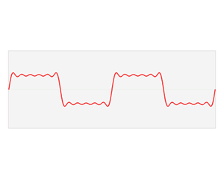

Slide 5
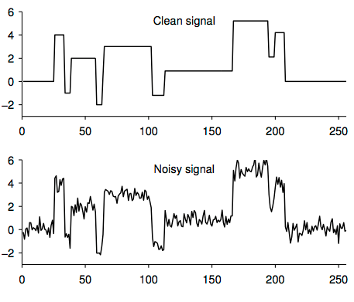

Slide 6
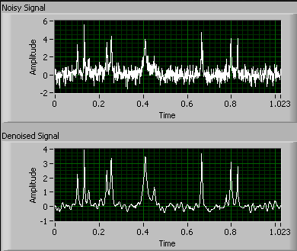

Slide 7
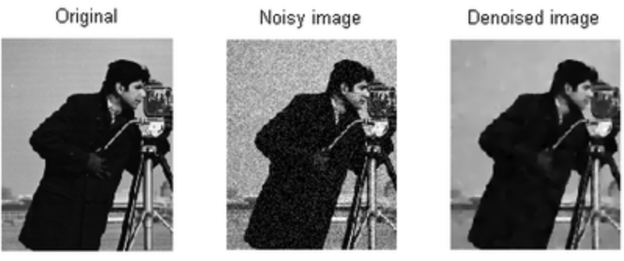

Slide 10
