Slide 1
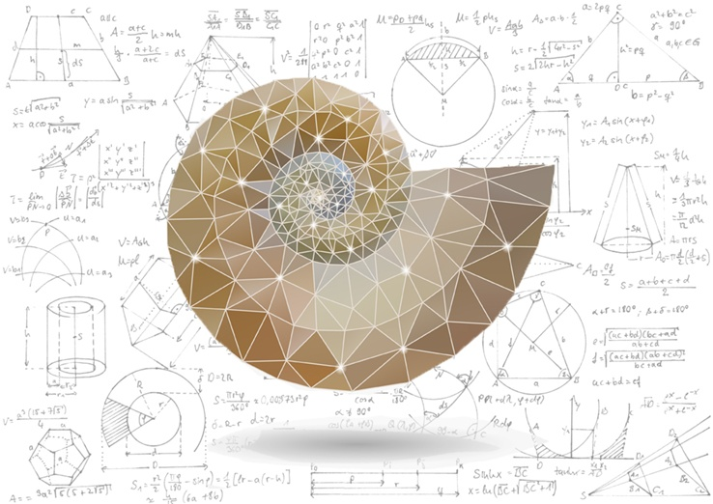
Mathematical Methods in Physics I
Prof Wladimir Lyra
Live Oak, 1119-G
Office Hours: Tue 2:30pm-3:30pm
Class hours: Tue/Thu 3:30pm-4:15pm

Slide 2
f(x) = c
+ a1 cos(x) + a2 cos(2x) + a3 cos(3x) + a4 cos(4x) + …
+ b1 sin(x) + b2 sin(2x) + b3 sin(3x) + b4 sin(4x) + …

