Slide 1
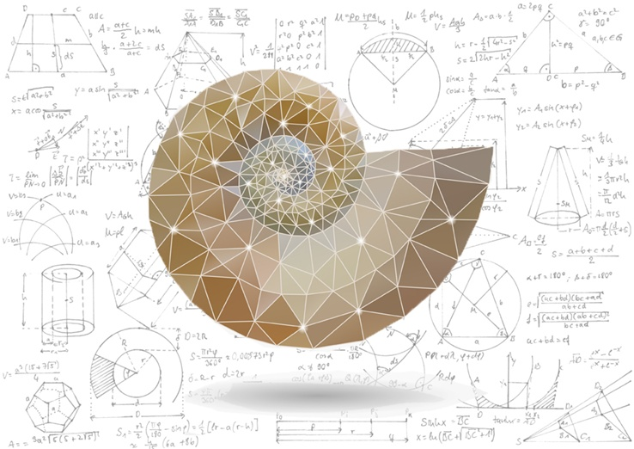
Mathematical Methods in Physics I
Prof Wladimir Lyra
Live Oak, 1119-G
Office Hours: Tue 2:30pm-3:30pm
Class hours: Tue/Thu 3:30pm-4:15pm

Slide 2
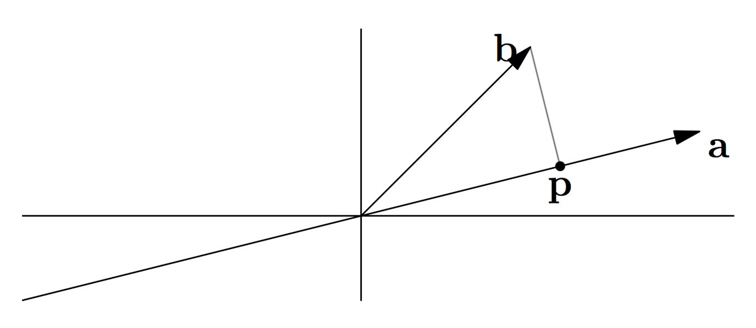
Projection
What is the point closest to b on the line determined by a?

Slide 3
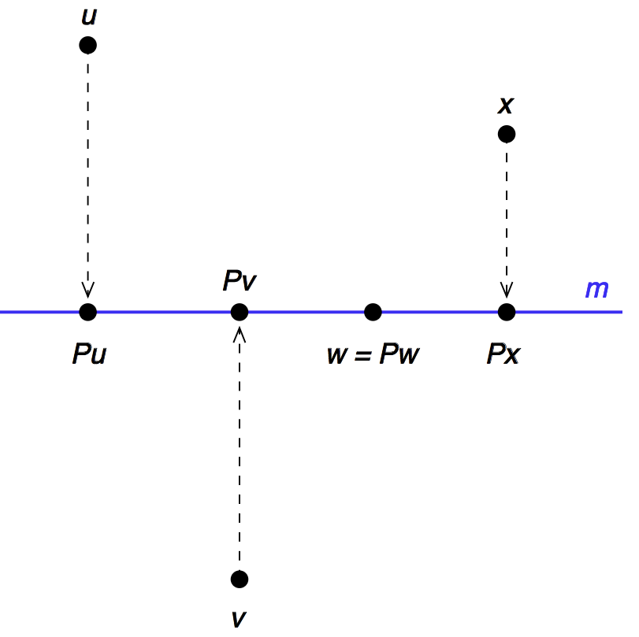

Slide 4
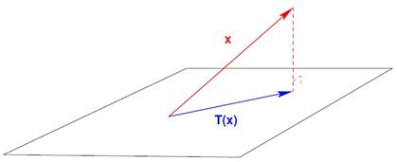
Projection onto plane
b
p
Pb
a₂
a₁

Slide 5
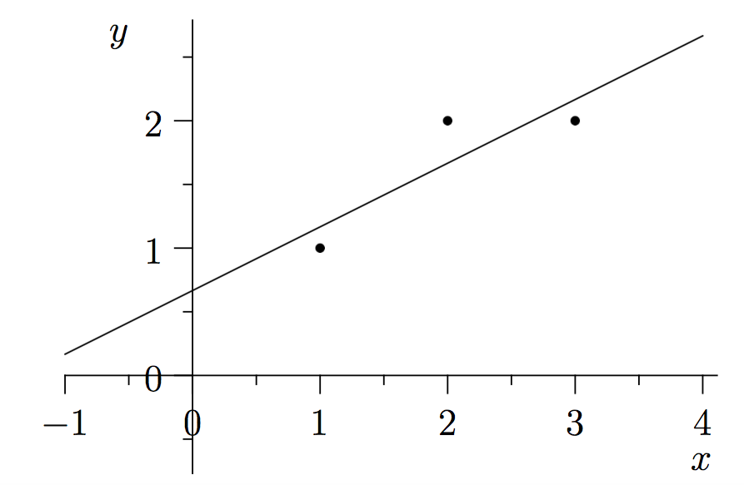
Least Squares via Linear Algebra

