Slide 1
The Surface of the Moon

Slide 2
Maria (mare, sing.)
Flat lowlands
~3 billion years old (young)
Dark, heavy metals (Fe)
The Moon’s Near Side
Old Crust
Bumpy highlands
~4 billion years old
Bright, light silicates
rays of ejecta from meteor impacts

Slide 3
Maria Formation: ~3-5 Billion Years Ago
KE from coalescing rocks + GPE from enormous mass = heated molten core
Heat escape through crust + other energy escape = cooling core
Decreasing temperature + constant mass = shrinking liquid mantle + growing solid core
Tiny solid core + tiny mantle = no geologic activity today!

Slide 4
Crater Density, Crater Size, Flatness, & Color as Age Indicators
Old Lunar Highlands
Maria: Lunar Lowlands

Slide 5
Why are Almost All Maria on the Near Side? (+5 EC)

Slide 6
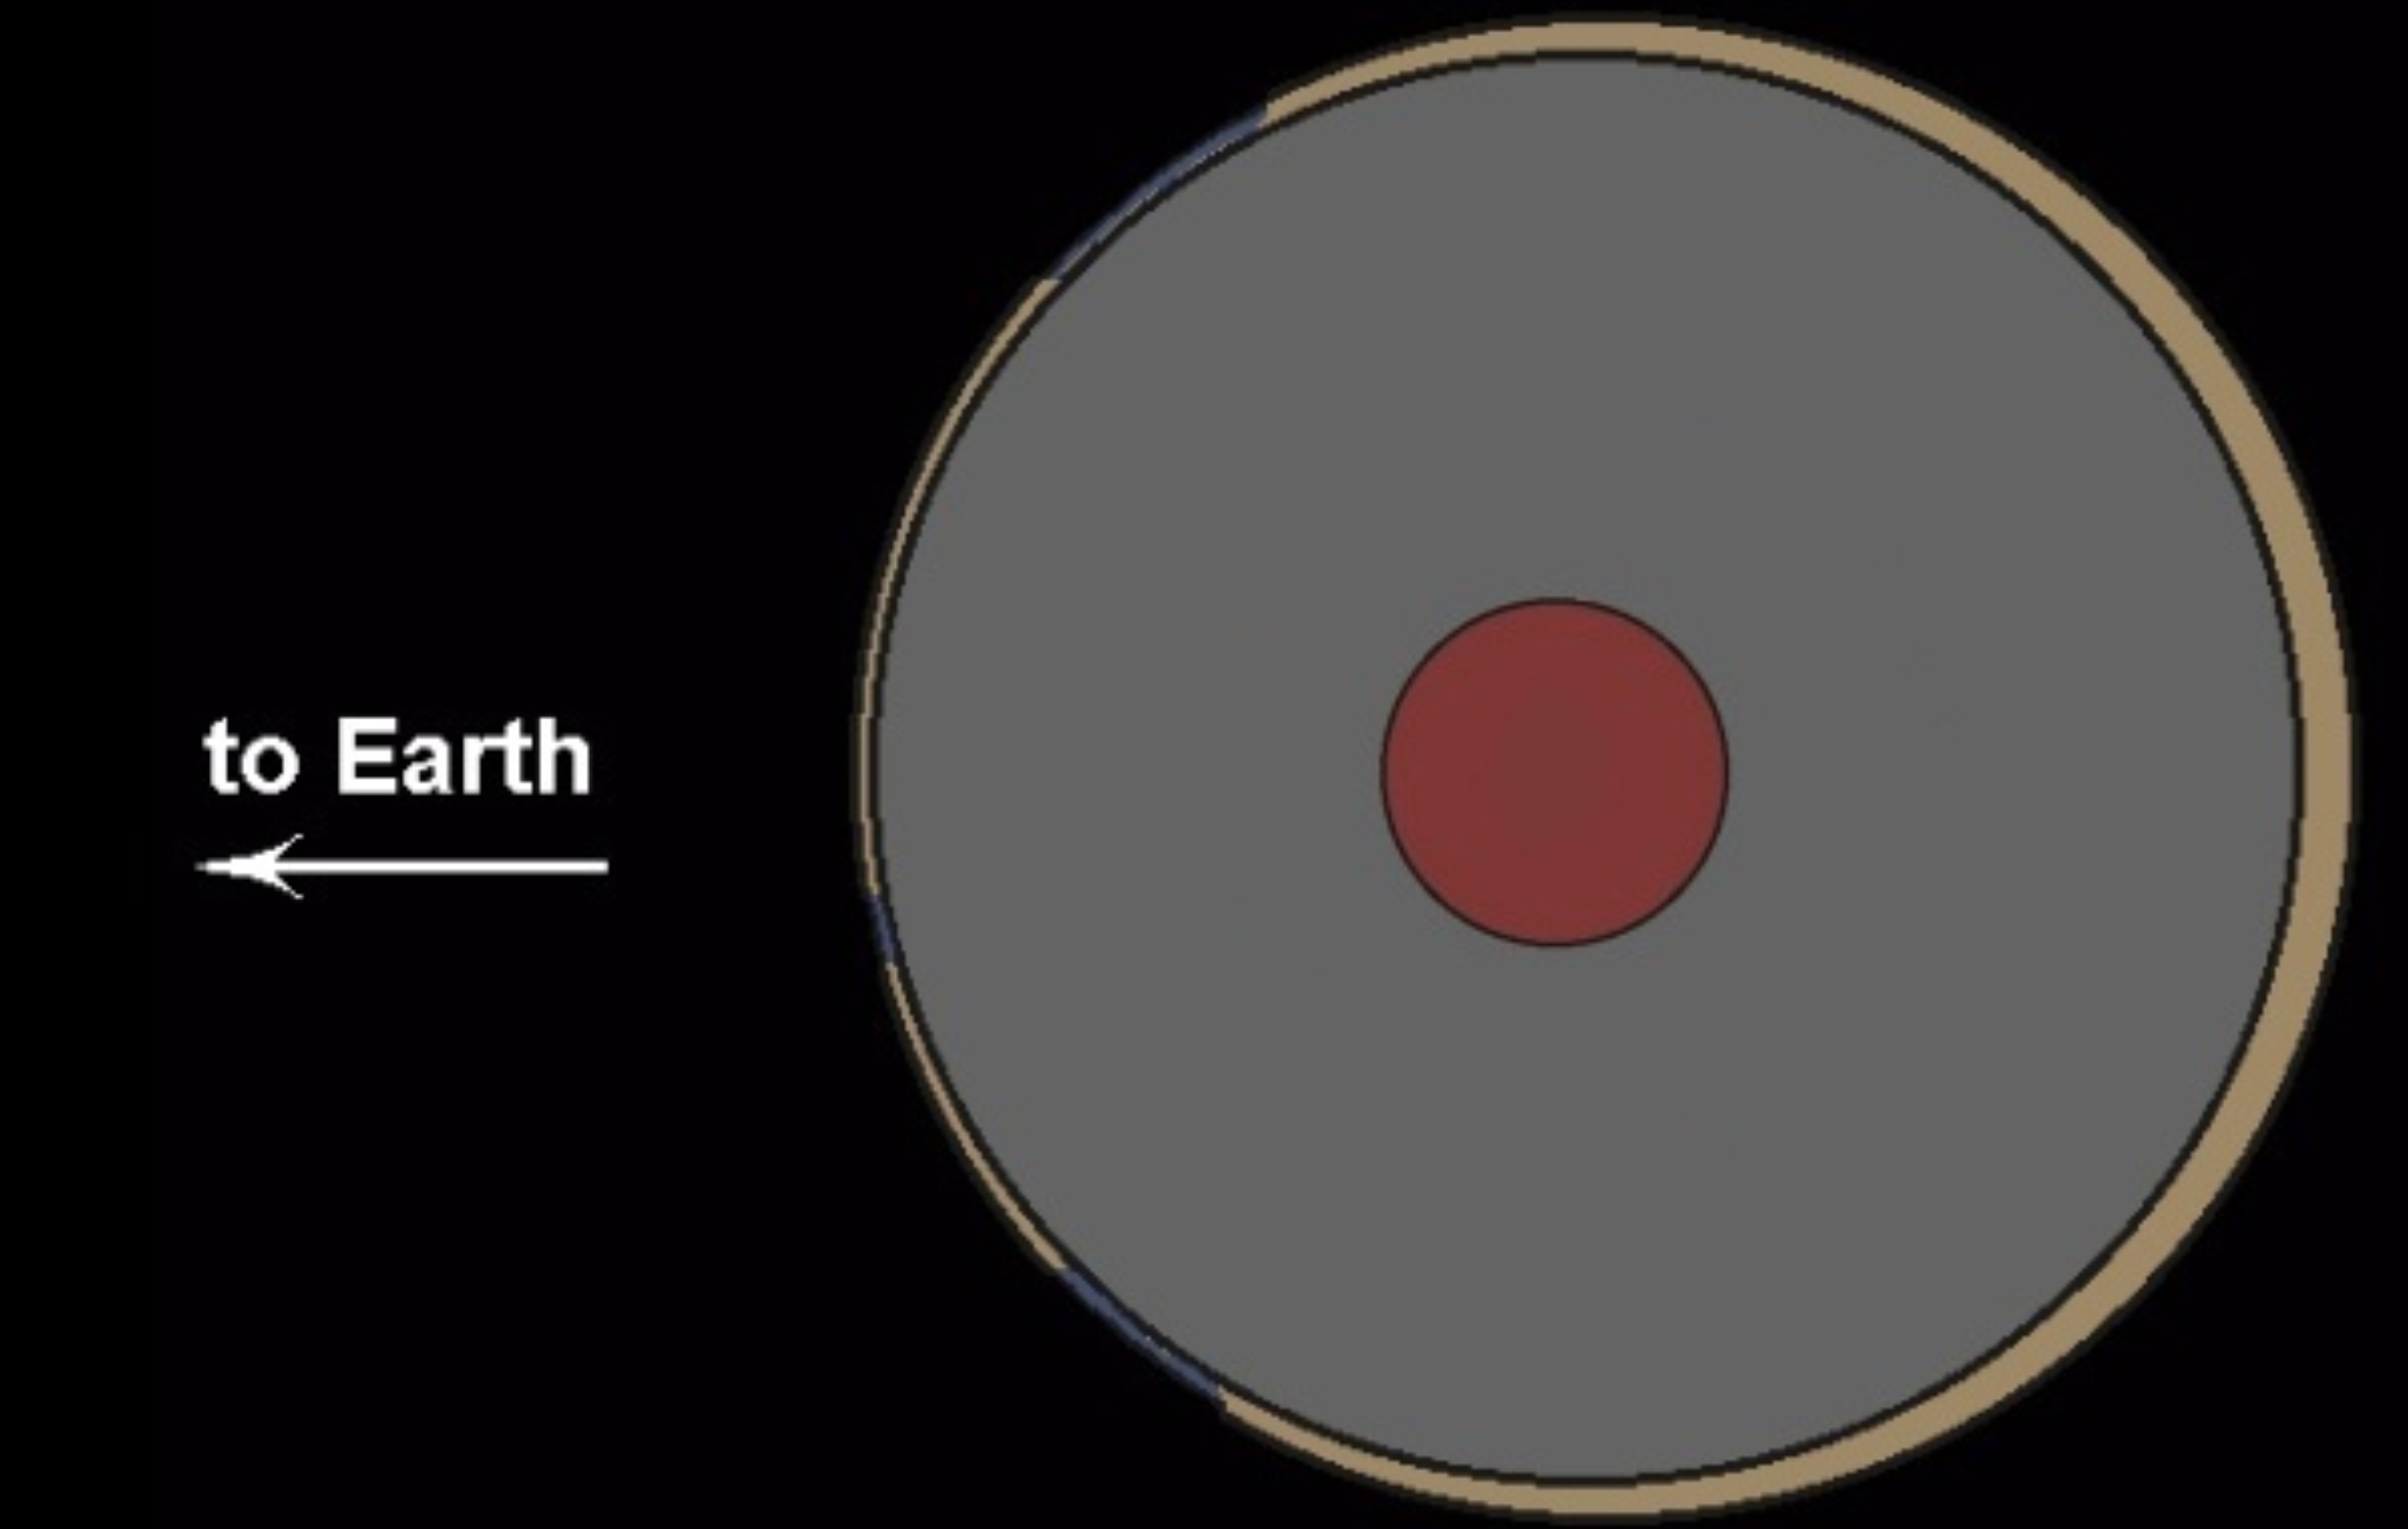
Gravity/Material Differential
Core: heavier metals
Crust: dust + silicates

Slide 7
How the Heck Did the Moon Form Anyway?

Slide 8
Best Solution: The Giant Impact Hypothesis
“How did that form? Probably things smashing together and exploding.” -Every Astronomer

Slide 9
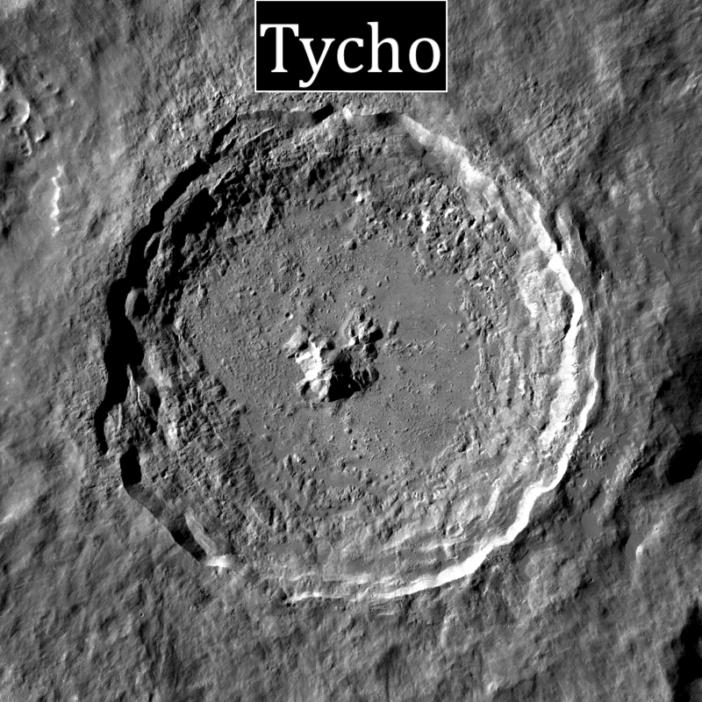
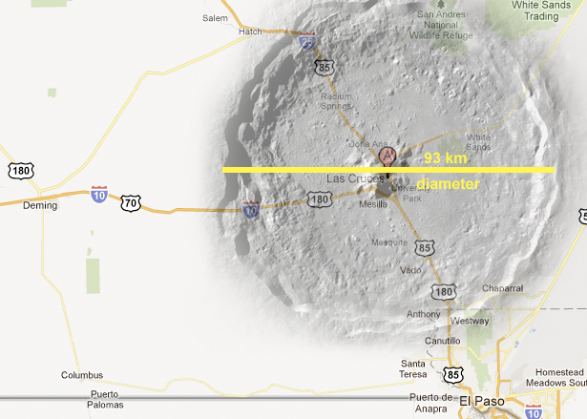
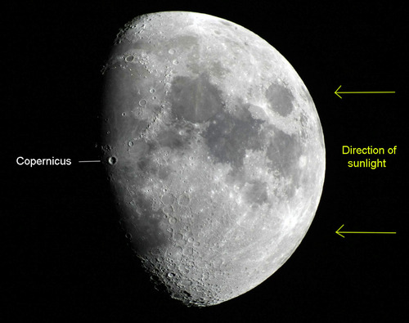
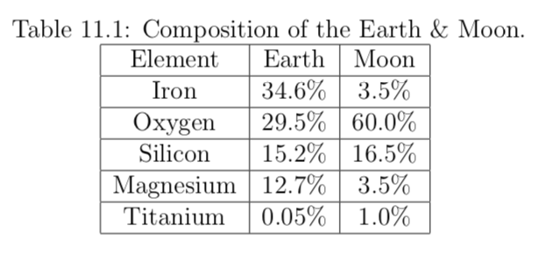
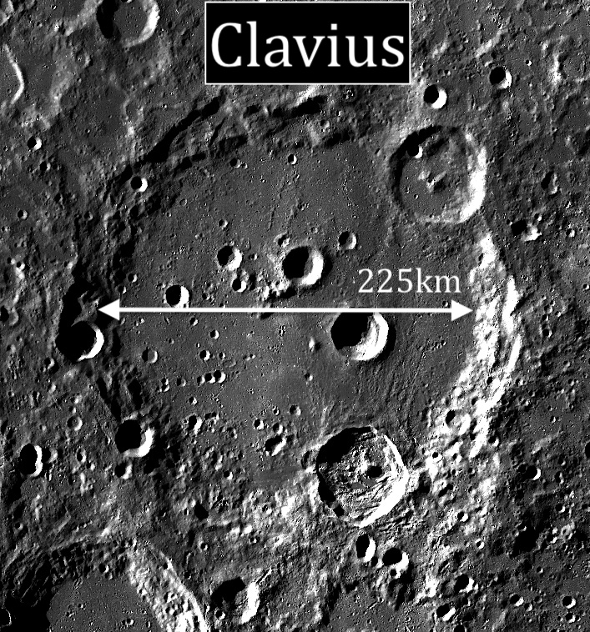
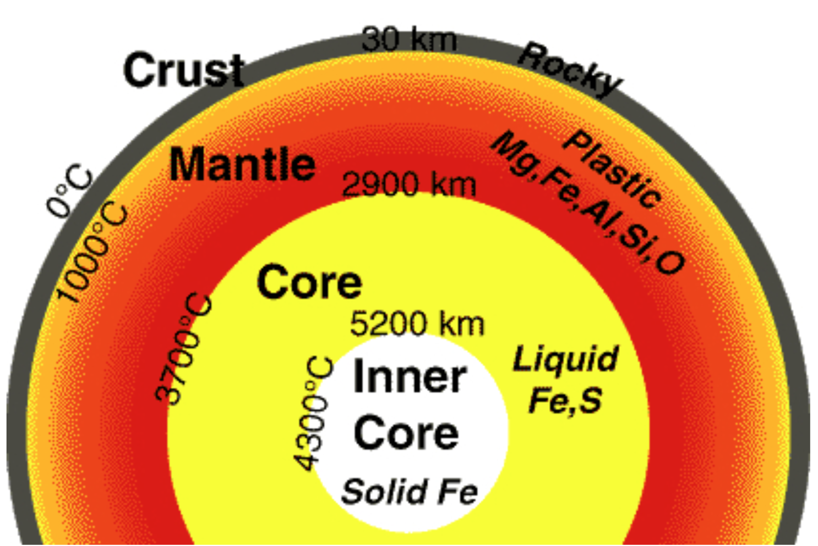
Copernicus
Earth’s Interior

