Slide 1
Spectroscopy Overview
Nancy Chanover
NMSU Astronomy Department
Sloan REU Program Coordinator

Slide 2
Outline
Introduction
Electromagnetic Spectrum (light!)
Atomic Physics
Continuous Spectrum
Absorption Spectrum
Emission Spectrum

Slide 3
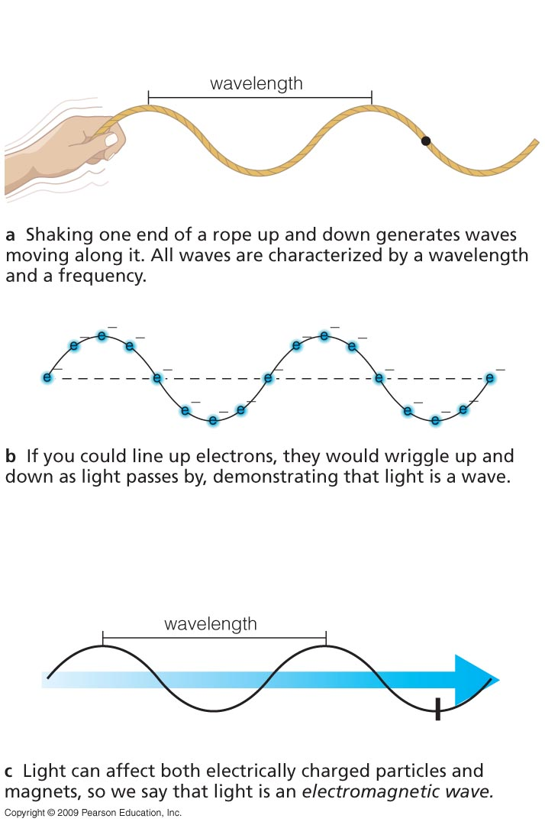
Light is an electromagnetic wave.
But what do waves do?
they propagate through space!
and in doing so, they can also:
reflect
refract
diffract
interfere
Copyright © 2009 Pearson Education, Inc.

Slide 4
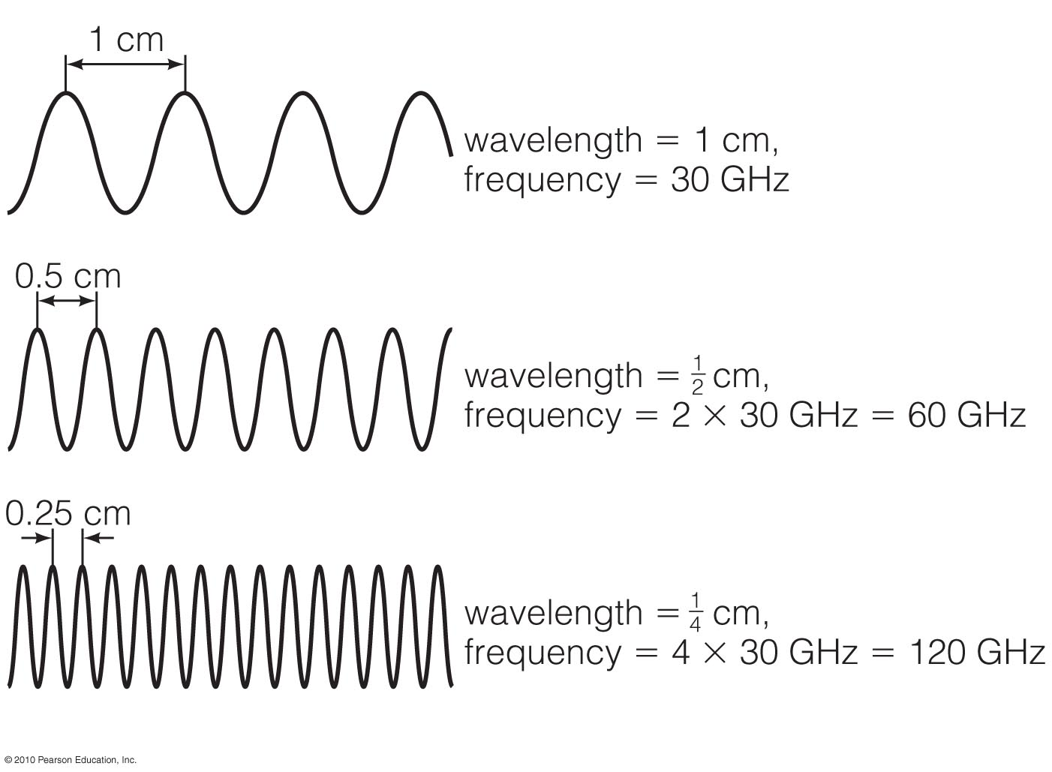
Wavelength and Frequency
Wavelength x frequency = speed of light (constant) = 3.00 x 10⁸ m/s
wavelength × frequency = speed of light = constant
wavelength × frequency = speed of light = constant

Slide 5
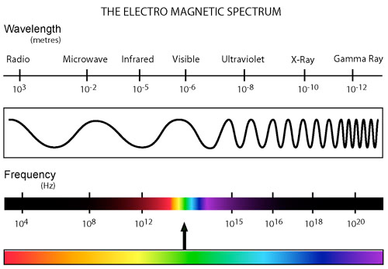
http://www.kollewin.com/EX/09-15-03/electromagnetic-spectrum.jpg
http://www.kollewin.com/EX/09-15-03/electromagnetic-spectrum.jpg

Slide 6
Multiwavelength Studies
astronomical objects look very different depending on what wavelength you study them in
this is because different wavelengths, or different kinds of electromagnetic radiation, are produced by different physical processes
see http://coolcosmos.ipac.caltech.edu/cosmic_classroom/multiwavelength_astronomy/multiwavelength_museum/gallery.html for examples

Slide 7
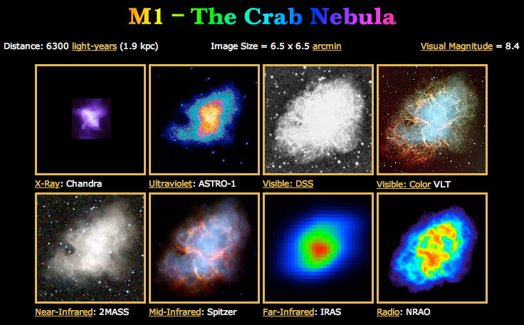

Slide 8
Now, what are some things we can learn about distant objects by studying their radiation?
position
velocity (radial, transverse)
distance
mass
size
density
pressure
luminosity
temperature
chemical composition
rotation
magnetic fields
From the analysis of SPECTRA!

Slide 9
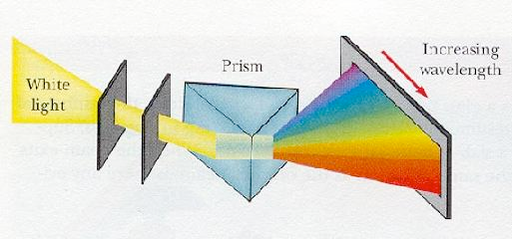
Spectroscopy
study of distribution with wavelength of the electromagnetic energy released by a source
the light is dispersed into its component colors (wavelengths), usually by a prism or diffraction grating
http://www.astro.virginia.edu/class/oconnell/astr1230/7.2-spectroscopy.html
http://www.astro.virginia.edu/class/oconnell/astr1230/7.2-spectroscopy.html
http://www.astro.virginia.edu/class/oconnell/astr1230/7.2-spectroscopy.html
http://www.astro.virginia.edu/class/oconnell/astr1230/7.2-spectroscopy.html
http://www.astro.virginia.edu/class/oconnell/astr1230/7.2-spectroscopy.html
http://www.astro.virginia.edu/class/oconnell/astr1230/7.2-spectroscopy.html
http://www.astro.virginia.edu/class/oconnell/astr1230/7.2-spectroscopy.html

Slide 10
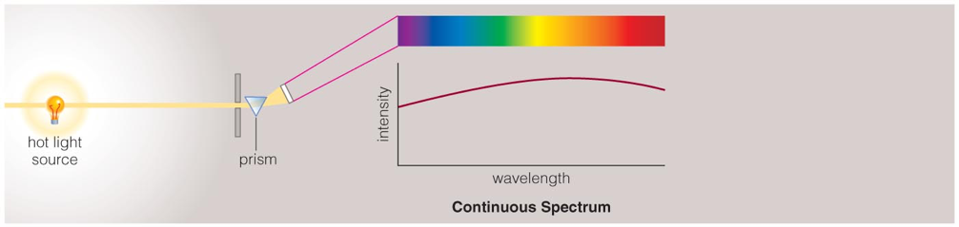
Blackbody
The spectrum of a common (incandescent) light bulb spans all visible wavelengths, without interruption.

Slide 11
Look at Sources
With the spectrographs provided, look at the two example blackbody sources
Draw their spectra on the axes provided
How do your two graphs differ?

Slide 12
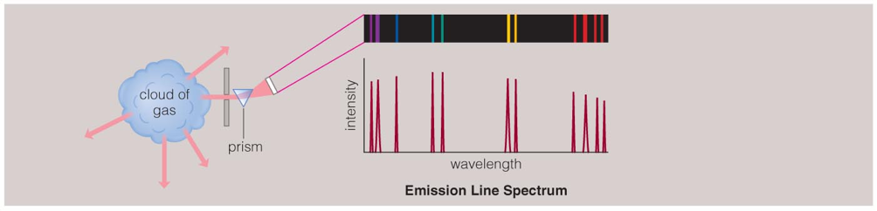

Line Formation
A thin or low-density cloud of gas emits light only at specific wavelengths that depend on its composition and temperature, producing a spectrum with bright emission lines.

Slide 13
Look at Sources
With the spectrographs provided, look at the example emission line tubes
Draw their spectra on the axes provided
How do your graphs differ?

Slide 14
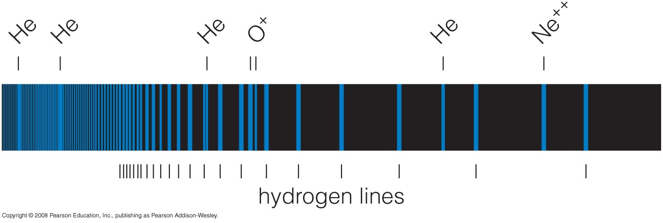
Chemical Fingerprints
Observing the emission lines (“fingerprints”) in a spectrum tells us which kinds of atoms are present.
Copyright © 2009 Pearson Education, Inc.

Slide 15
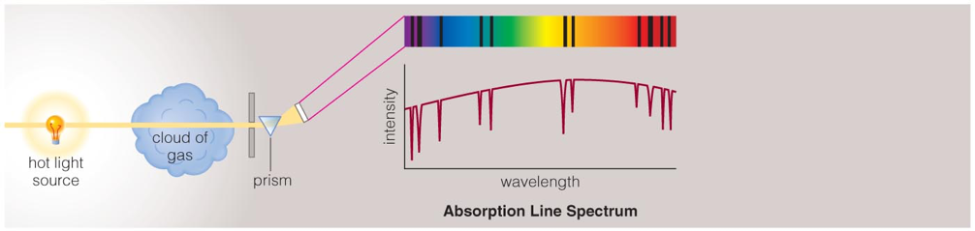
Line Formation (2)
A cloud of gas between us and a continuum source can absorb light of specific wavelengths, leaving dark absorption lines in the spectrum.

Slide 16
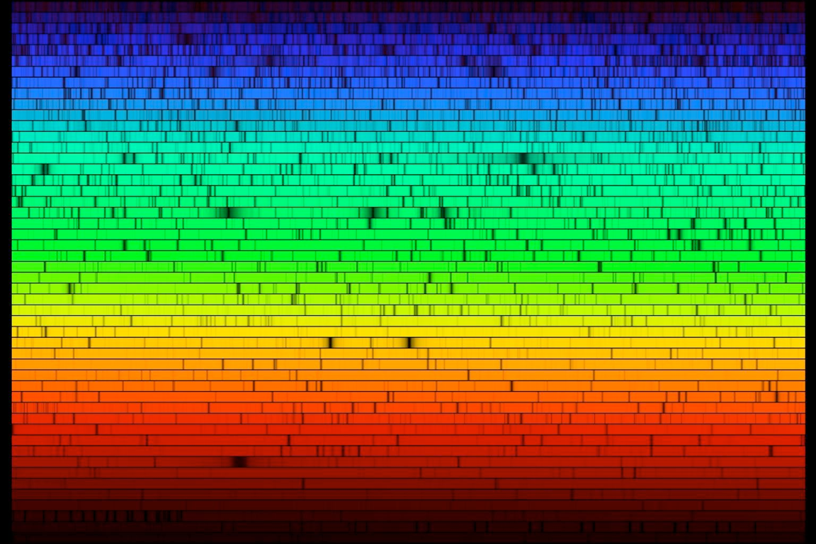
Sun Spectrum

Slide 17
Look at Poster/Slide
Pick a row
Draw spectrum (we are supplying axes)
(absorption sources)

Slide 18
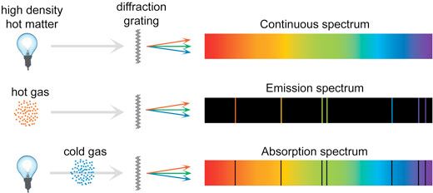
3 Types of Spectra

Slide 19
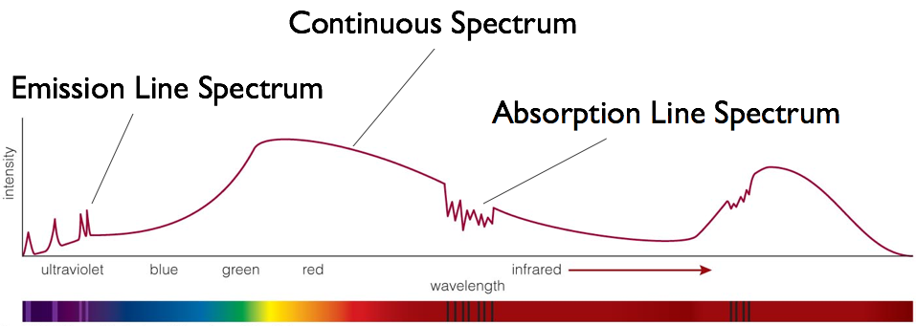
3 Types of Spectra
Spectra of astrophysical objects are usually combinations of these three basic types.

Slide 20
By carefully studying the features in a spectrum, we can learn a great deal about the object that created it.

Slide 21
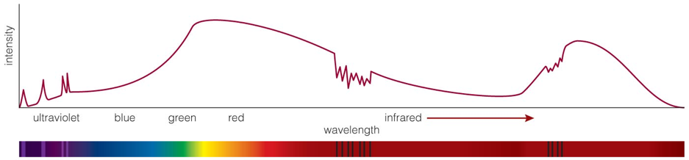
What is this object?
Reflected sunlight: Continuous spectrum of visible light is like the Sun’s except that some of the blue light has been absorbed—object must look red.

Slide 22
What is this object?
Thermal radiation: Infrared spectrum peaks at a wavelength corresponding to a temperature of 225 K.

Slide 23
What is this object?
Carbon dioxide: Absorption lines are the fingerprint of CO₂ in the atmosphere.

Slide 24
What is this object?
Ultraviolet emission lines: Indicate a hot upper atmosphere

Slide 25
What is this object?
Mars!

Slide 26
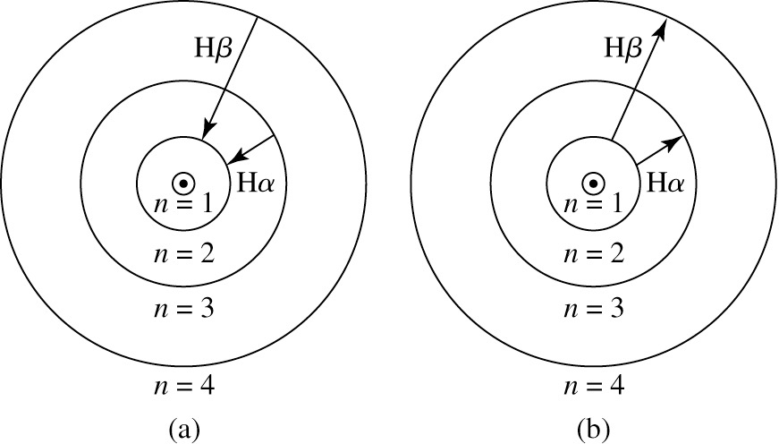

Slide 27

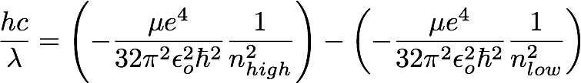
Origin of Spectral Lines
photon is emitted or absorbed when electron makes transition from one orbit to another
when electron goes from higher orbit to lower orbit (nhigh to nlow), it loses energy (dE = Ehigh - Elow), which is carried away by photon

Slide 28
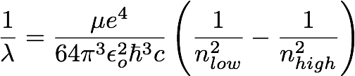
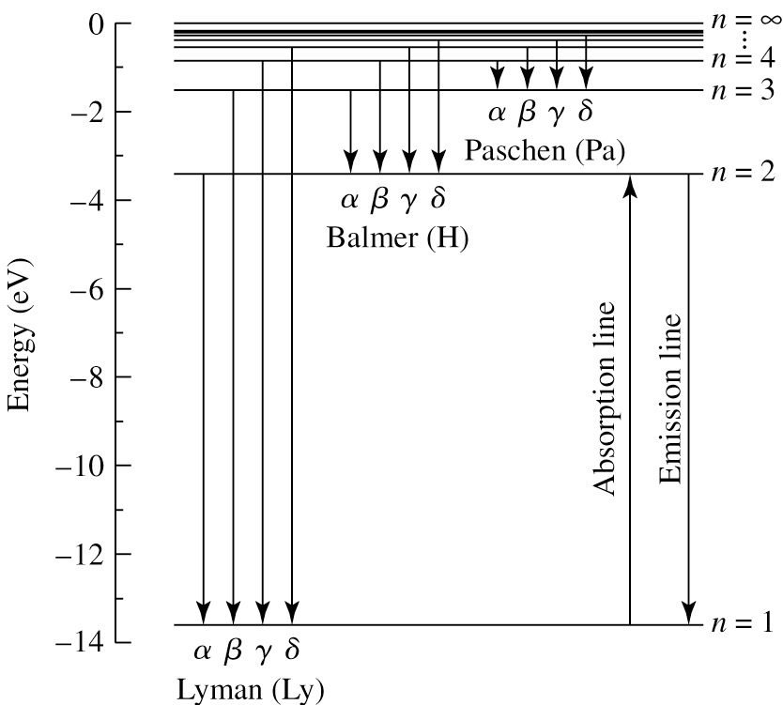
= RH = 1.097 x 10⁷ m⁻¹
Example: what is the wavelength of the photon that is emitted when an electron makes the transition from the n=3 to n=2 orbits of the Bohr hydrogen atom? This is the H-α spectral line (Balmer series).

Slide 29
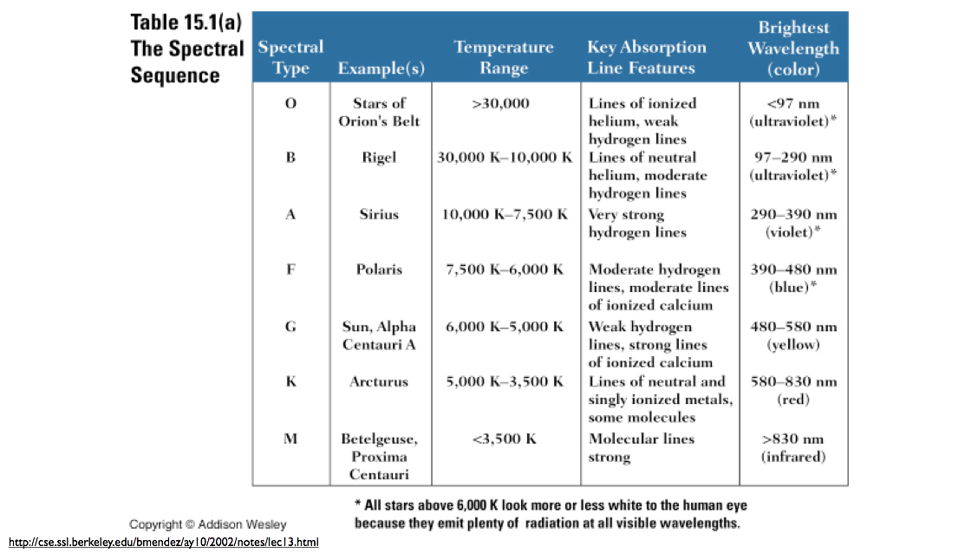
Stellar Classification
“early-type”
original classification based on strength of hydrogen lines in stellar spectra
“late-type”

Slide 30
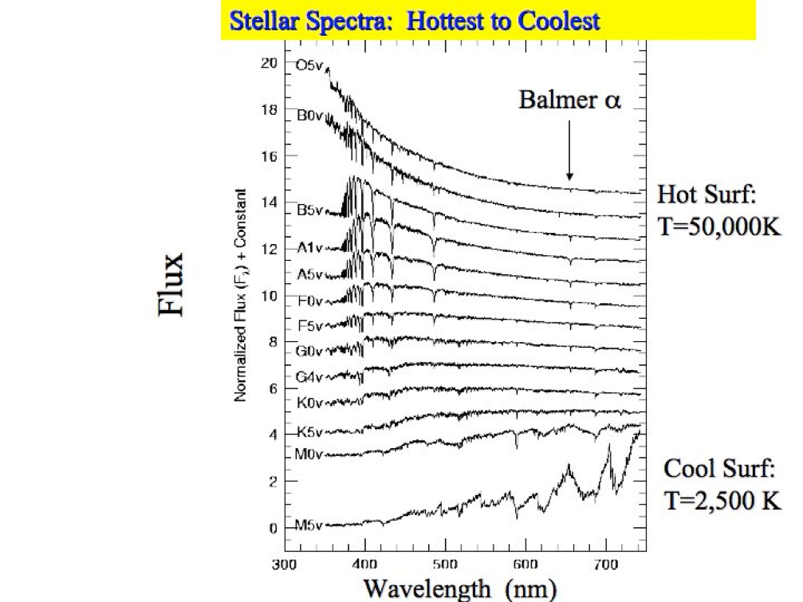

Slide 31
Why Spectroscopy?
Stars:
Spectral class
Radial velocity
Metallicity
Gravity (luminosity class)
Effective temperature
And more
Galaxies:
Velocity dispersion
Rotation curves
Redshift (distance)
And more

Slide 32
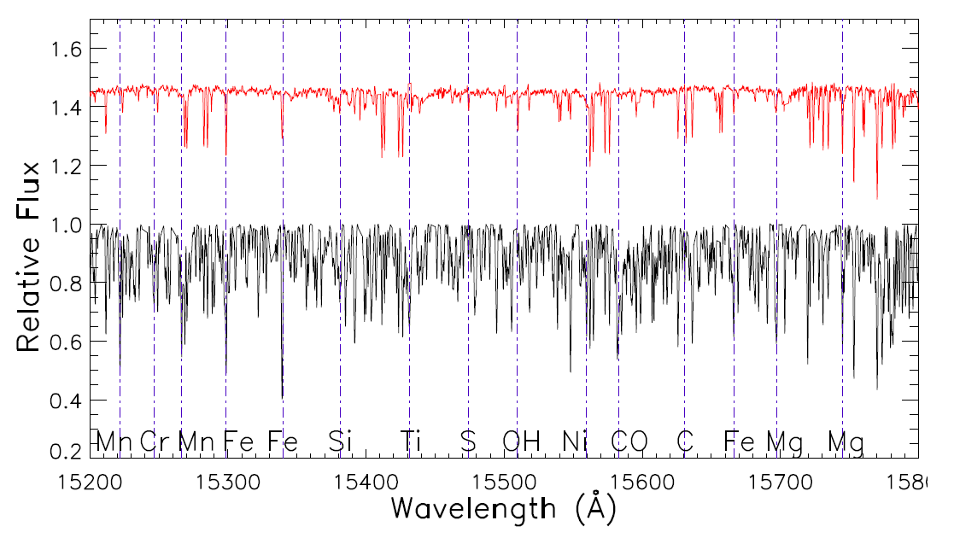
Star Spectra
Two stars with similar temperature and gravity, but…
metal poor
metal rich

Slide 33
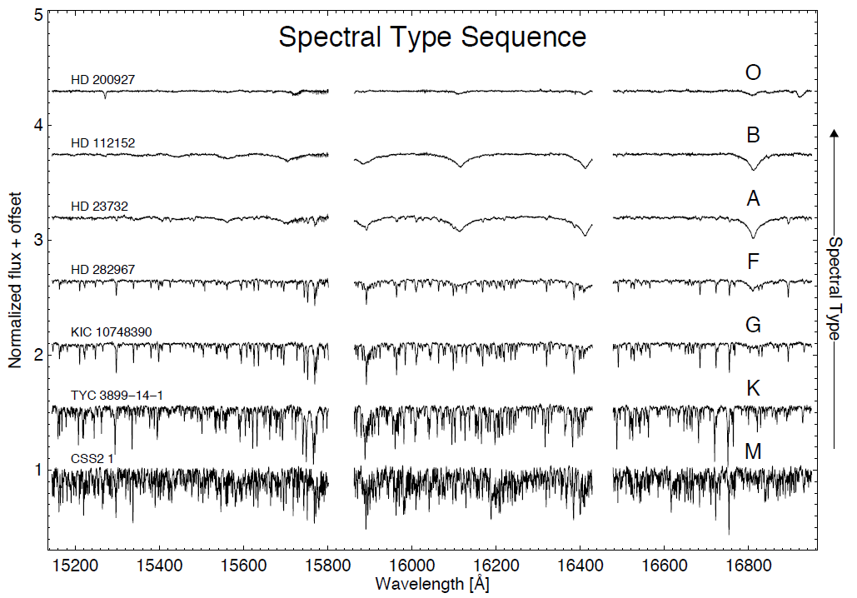
Spectral Sequence
SDSS/APOGEE data!
Hasselquist, pers. comm.

Slide 34
Galaxy Spectra
Galaxies contain multiple components:
Stars
Interstellar matter (gas and dust)
Central black holes and surrounding gas
Dark matter
As a result, galaxy spectra are “composite” spectra, with contributions from different components depending on where you look

Slide 35
Stellar Component of Galaxy Spectra
Galaxies contain stars of different masses, ages, and compositions
For a single star of a given composition, mass and age give a specific temperature, radius
Composite stellar spectra of galaxies depends on distributions of masses and ages
A stellar population model attempts to predict the spectrum for some input distributions
One goal of galaxy spectral analysis is to try to recover the distributions from the composite spectra
Since stars move in galaxies, composite spectra generally have broader lines, since they come from stars moving at a range of different velocities

Slide 36
ISM Component of Galaxy Spectra
Hot, low density gas between stars generally produces emission lines
Young stars ionize HII regions
Older stars die and leave planetary nebulae or supernovae remnants
Some diffuse gas may be heated by nearby stars
Character of the emission lines depends on temperature, density, and composition of gas

Slide 37
Central galactic nucleus contribution to spectrum
Many, if not all, galaxies contain central black holes
Gas can be heated as it falls into these
Generally, this gas produces emission lines, and if they are moving rapidly in the inner regions, these can have very broad profiles
Many flavors of galactic nucleus emission, depending on mass of black hole, fuel supply
active galactic nuclei (AGN), Seyferts, radio galaxies, LINERS, quasars, etc.

Slide 38
Spectral Comparisons
Applet comparing stellar and AGN spectra: http://astronomy.nmsu.edu/geas/labs/html/lab09.shtml
Get out SDSS flash cards from your folders and
Examine images; note any differences
Examine graph headings; note any differences
Compare with your neighbor
Try to come up with spectral indicator that tells you what you’re looking at

