Slide 1
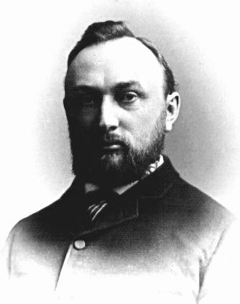
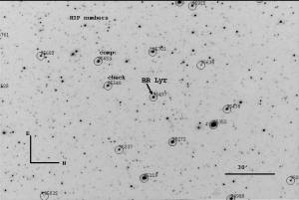
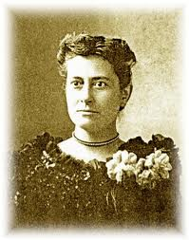
RR Lyrae variable stars
Population II stars (old as globular clusters!)
Pulsating stars
Distance indicator
Found in all Galactic components and then some
Stellar characteristics and correlations: metallicity!
Great tools to study Galaxy formation

Slide 2
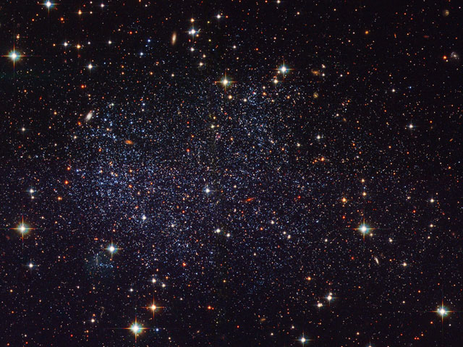
Dwarf Galaxies in the Local Group
Use RR Lyrae stars to understand galaxy’s composition and motion
Nature of galaxy formation – e.g. in the Milky Way
Future surveys, expect to find lots of galactic building blocks
Credit: Hubble Heritage Team, Y. Momany et al. ESA, NASA

