Slide 1
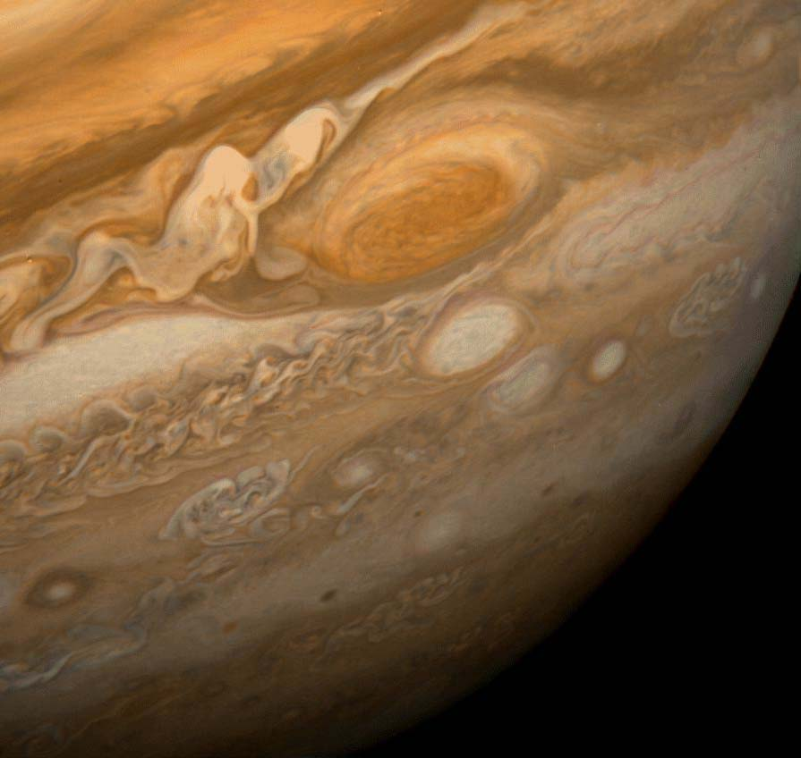
Studying Jupiter’s Atmosphere with the NMSU Acousto-optic Imaging Camera
Emma Dahl
June 9, 2016

Slide 2
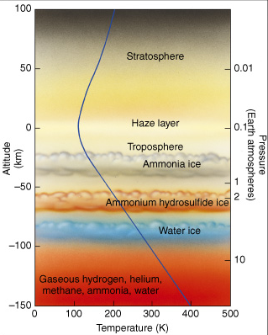
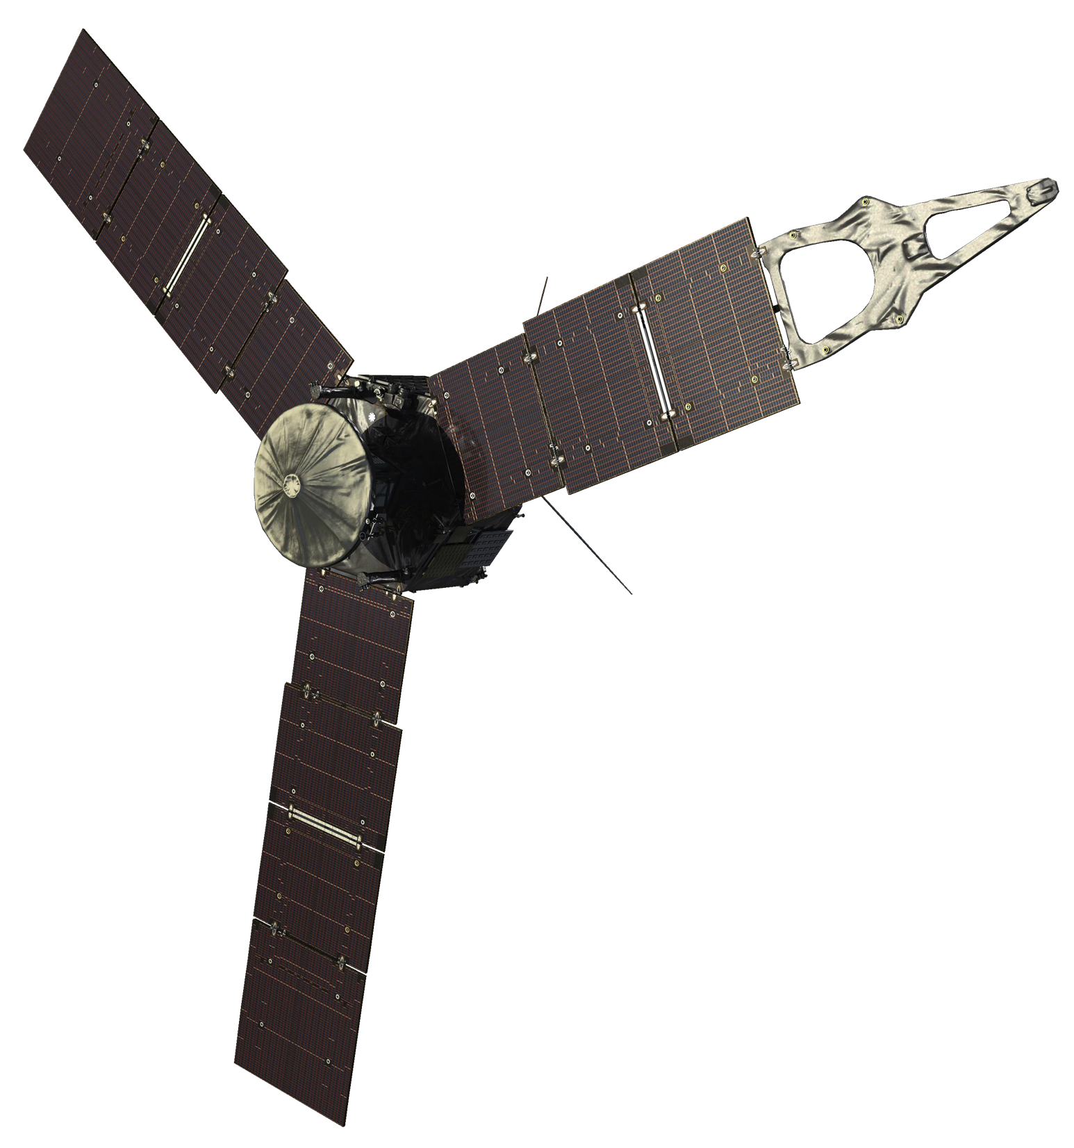
Jupiter’s Atmosphere
Notes:
Optical can only see down to ammonium hydrosulfide ice.
JIRAM, MWR can see deeper.
Observe at the same time to provide context for Juno obs and to model the vertical structure of the atmosphere.
Why is this important??

Slide 3
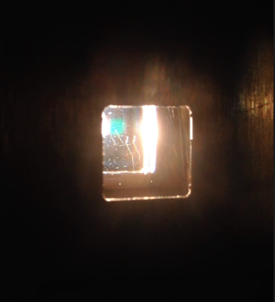
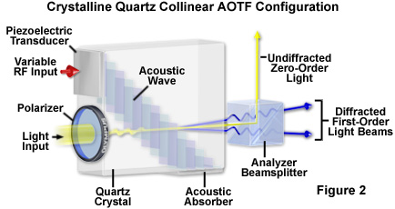
The NMSU Acousto-optic Imaging Camera (NAIC)
Olympus America

Slide 4
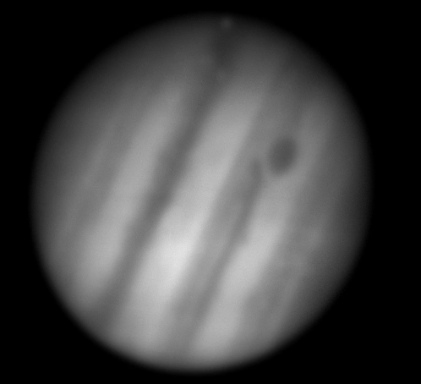
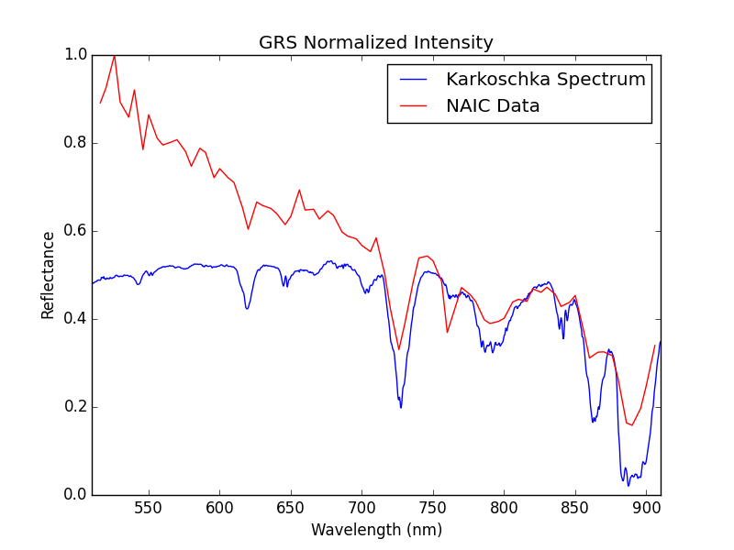
Notes:
From APO in March using the 3.5-m
Future: Apply radiative transfer code

