Slide 1
Considering the transition region when studying coronal heating
Sam Schonfeld
Jim Klimchuk
12/2/2020, Work Package meeting

Slide 2
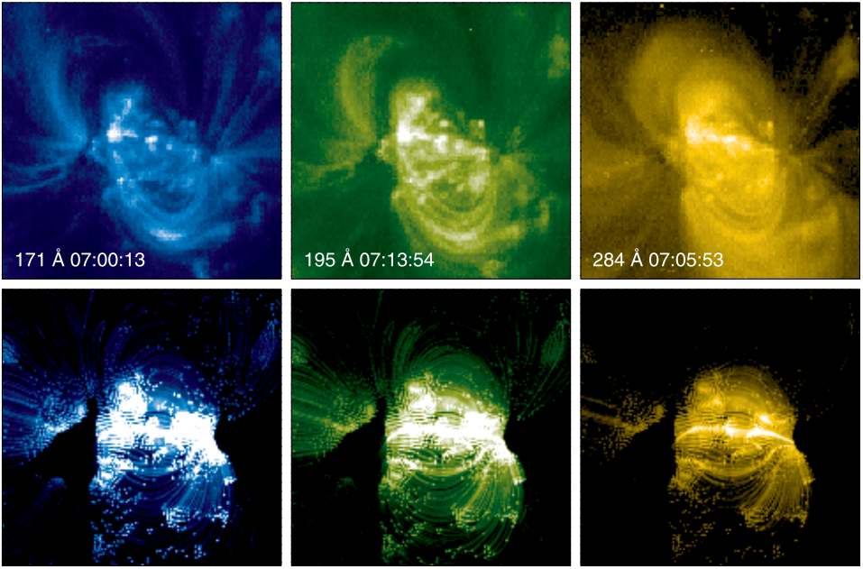
Modeling Active Regions in EUV
Warren and Winebarger 2007

Slide 3
Theory vs. Observations of Transition Region
Temperature [K]
10⁷
6x10⁶
Corona
Transition Region
Wedemeyer 2016, SDO/NASA

Slide 4
Complications Including the Transition Region
171 Å
Steep gradients
Leads to strong dynamics
Magnetic field expansion
Overproduced in models
With TR
No TR
211 Å
Nita et al. 2018

Slide 5
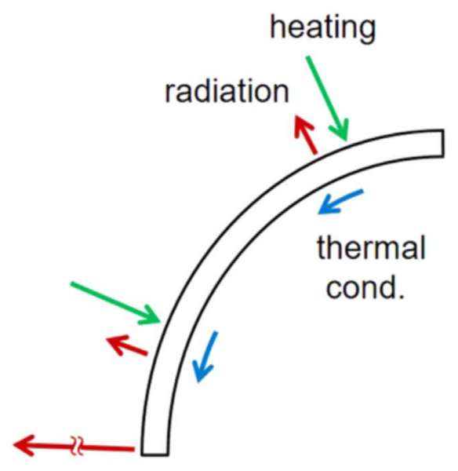
The transition region in EBTEL
EBTEL defines $C_{1}={R_{TR}}/{R_{C}}$
Ratio of total radiated emission
$C_{1}= \frac{2C_{1,eq}+C_{ var}\left({\left({n_{eq}}/n\right)}^{2}−1\right)}{1+{\left({n_{eq}}/n\right)}^{2}}$
$C_{var}=\left\{\begin{aligned}C_{1,cond}=2 ;n≤n_{eq} \\ C_{1, rad} =0.6 ;n≫n_{eq}\end{aligned}\right.$
$C_{1,eq}=2$ in equilibrium
Emission in different channels determined by atomic physics and plasma conditions
Klimchuk and Luna 2019

Slide 6
Exploring Distribution of Heating Events
Parameter | Symbol | Low Value | High Value
Loop half-length [Mm] | L | 20 | 80
Heating flux [erg cm⁻² s⁻¹] | F | 5x10⁶ | 2x10⁷
Minimum delay time [s] | t_{min} | 100 | 1000
Heating distribution slope | α | -2.5 Lopez Fuentes and Klimchuk 2015 | -1 Knizhnik and Reep 2020

Slide 7
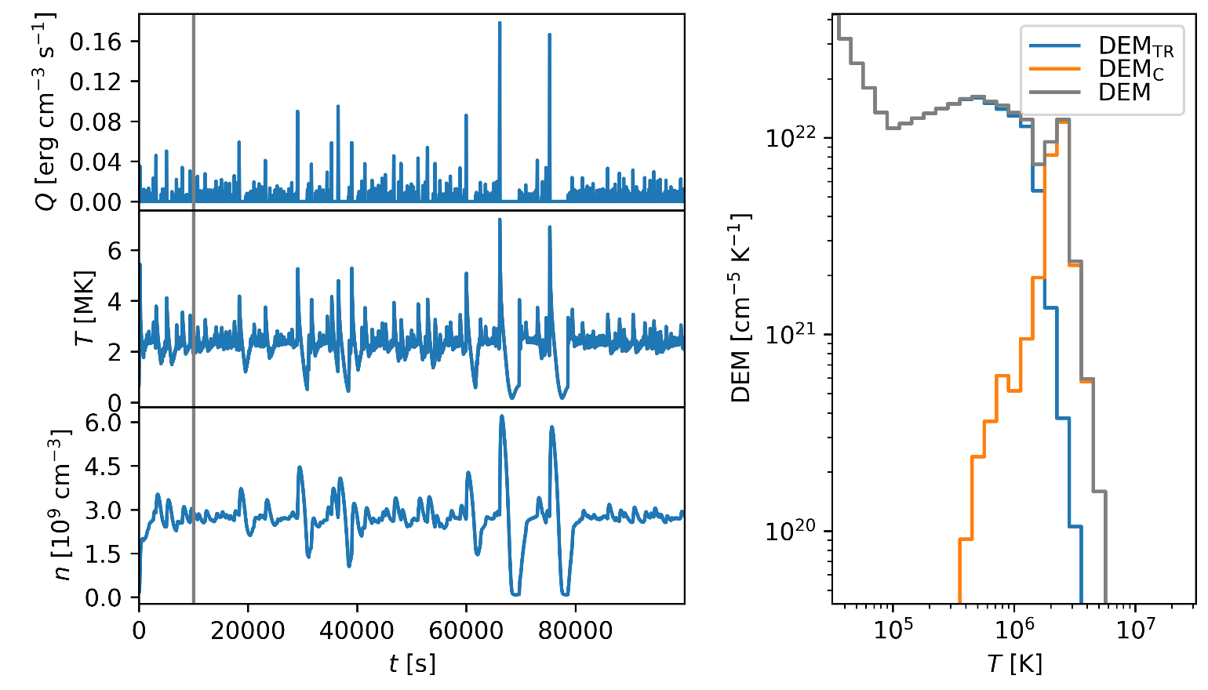
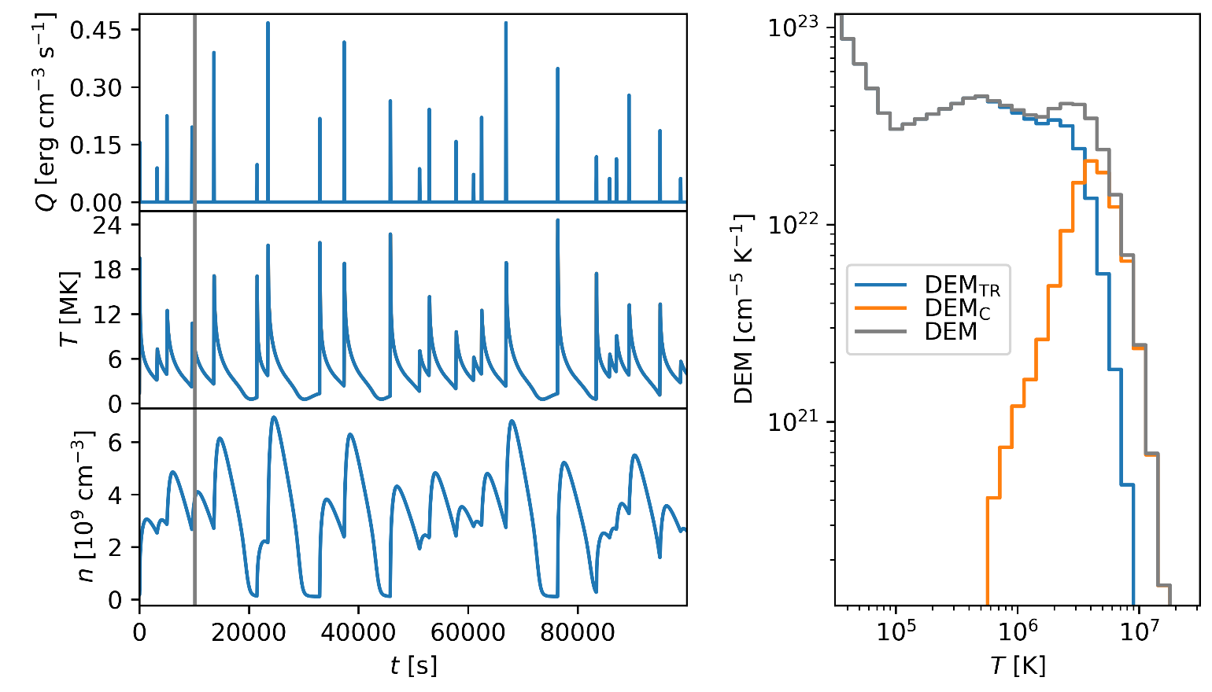
Example EBTEL++ models
L = 20 Mm
F = 5x10⁶ erg cm⁻² s⁻¹
t_{min} = 100 s
α = -2.5
L = 80 Mm
F = 2x10⁷ erg cm⁻² s⁻¹
t_{min} = 1000 s
α = -1.0
R_{C/TR}
R_{C/TR}

Slide 8
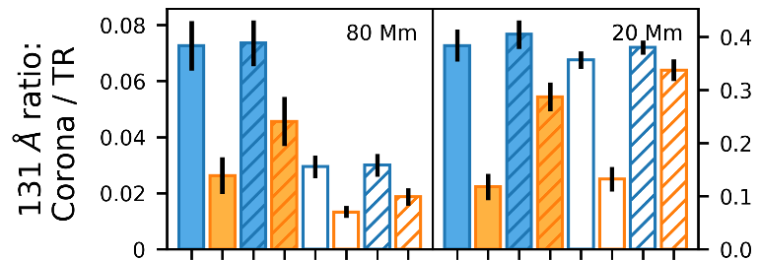
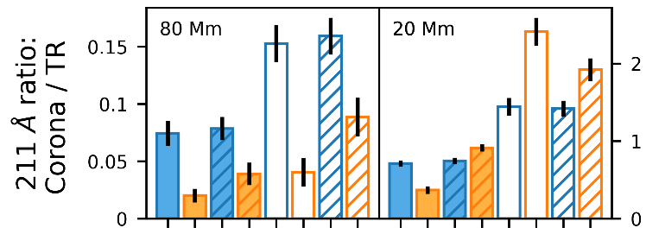
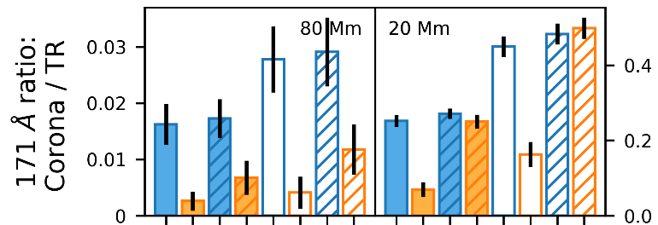
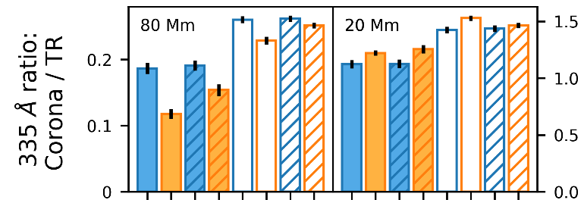
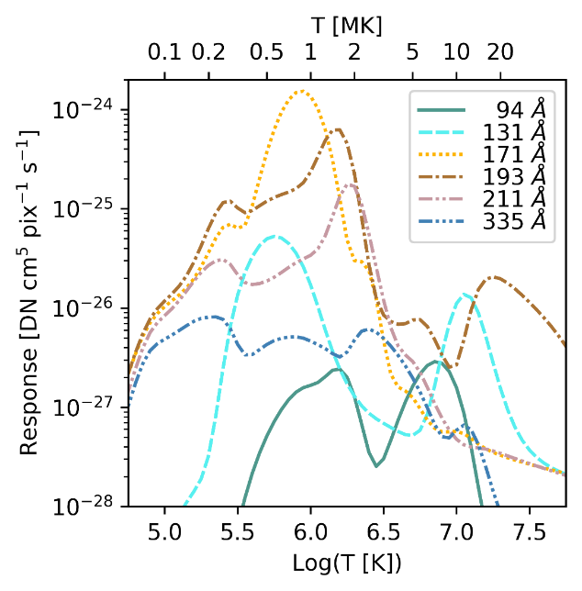
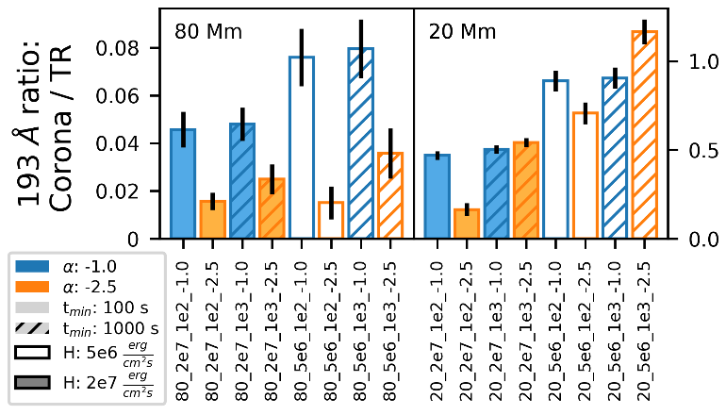
R_{C/TR} in EBTEL++ modeled AIA
Notes:
TR contributes much or most of the emission in each channel
Can understand all the trends in terms of high or low-frequency heating
R_{C/TR} has diagnostic potential to understand heating frequency
Results from paper:
-Ratio larger in 20 Mm strands than 80 Mm
-Partly due to assumptions about emitting volume
-Also because longer loops reach higher temperatures
-Channels with higher temperature responses have larger R_{C/TR}
-R_{C/TR} inversely related to F in 171 Å, 193 Å, 211 Å, 335 Å channels
-t_{min} not important when α=-1 (hashed in blue)
-t_{min} important when α=-2.5 (hashed in orange)
-Cooling time of L=20 Mm strand is ~1,000 s
-In 80 Mm strands, R_{C/TR} is largest in low-frequency heating
-High Frequency heating doesn’t have much cooling
-Large R_{C/TR} indicates channel better “tuned” to respond to coronal temperature

Slide 9
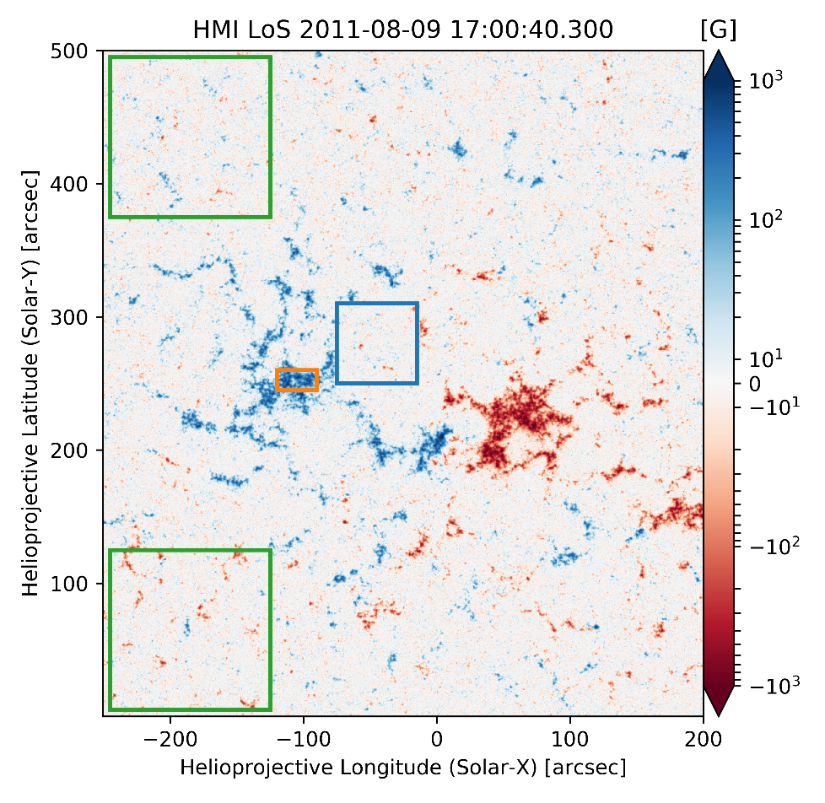
Measuring AIA Transition Region and Corona

Slide 10
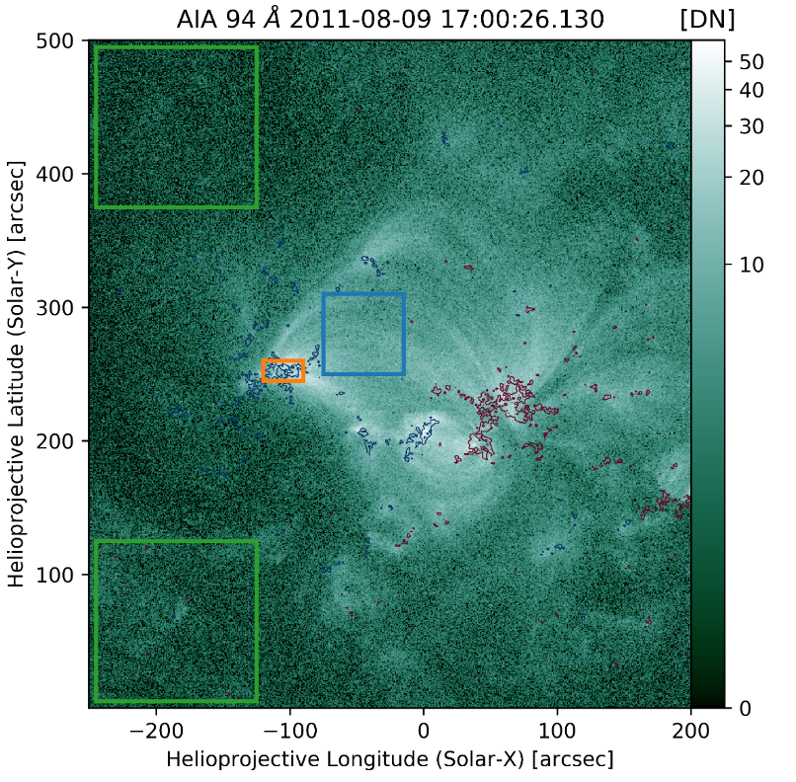
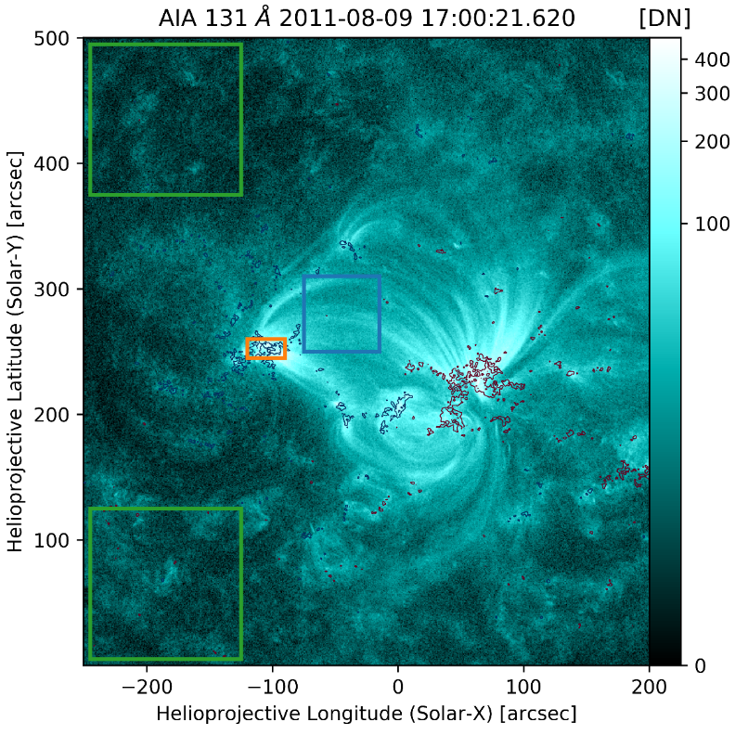
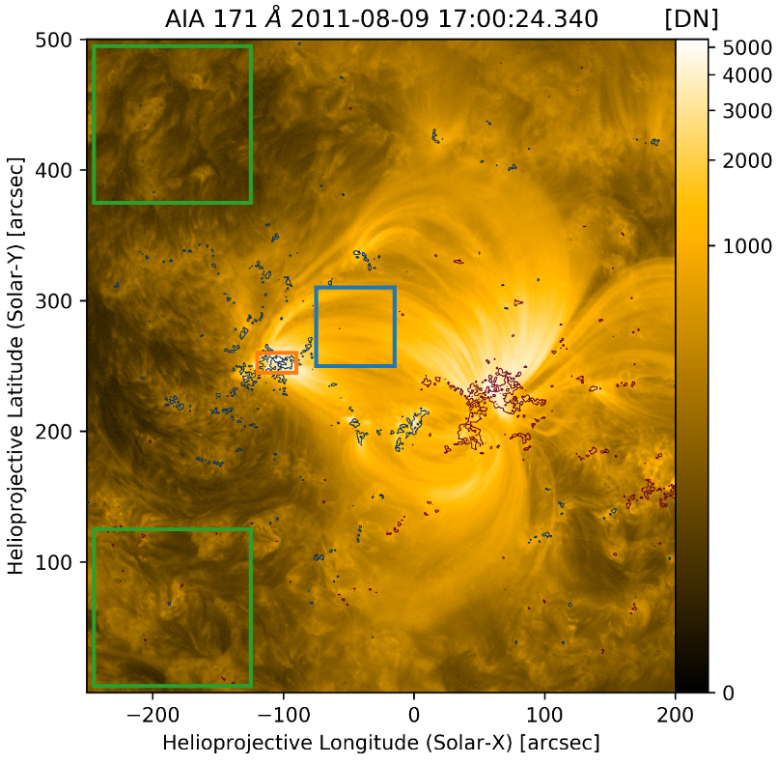
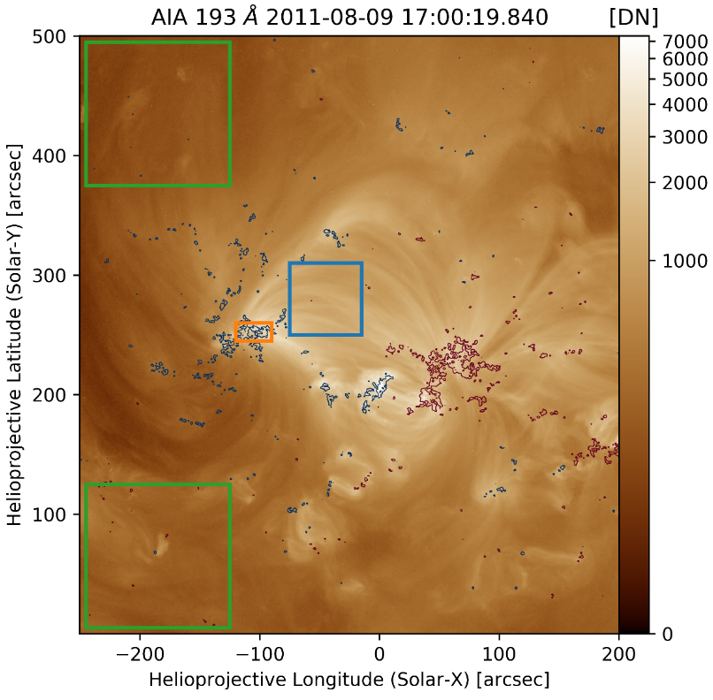
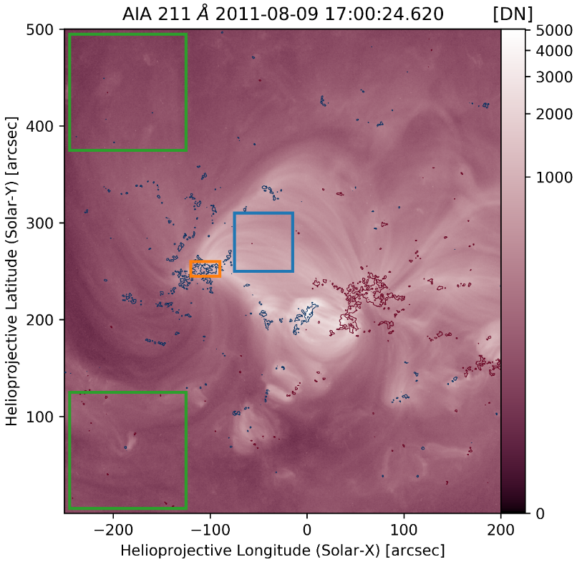
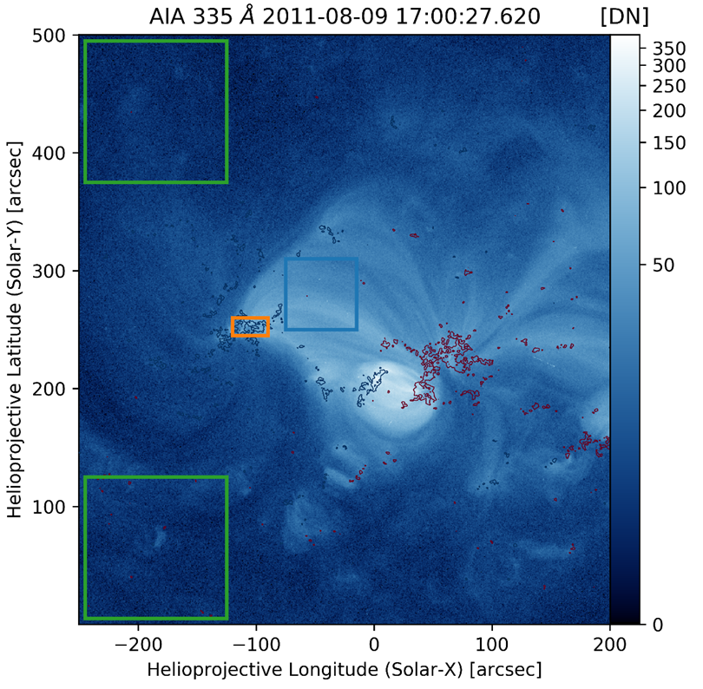

Slide 11
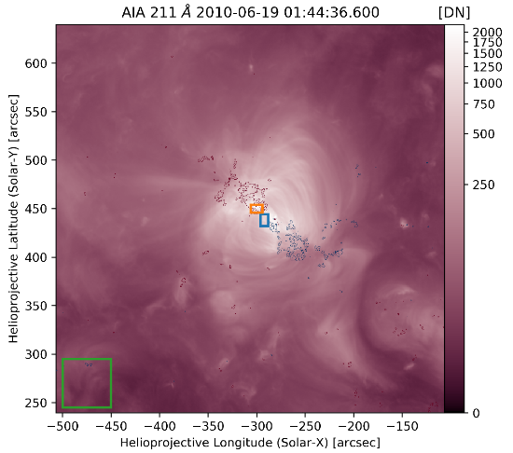
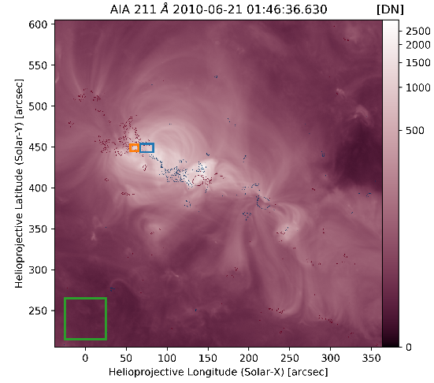
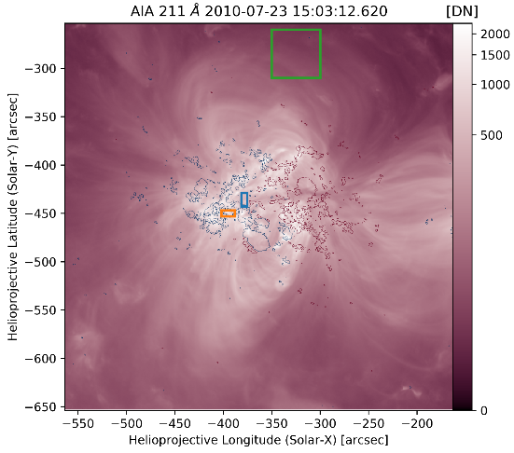
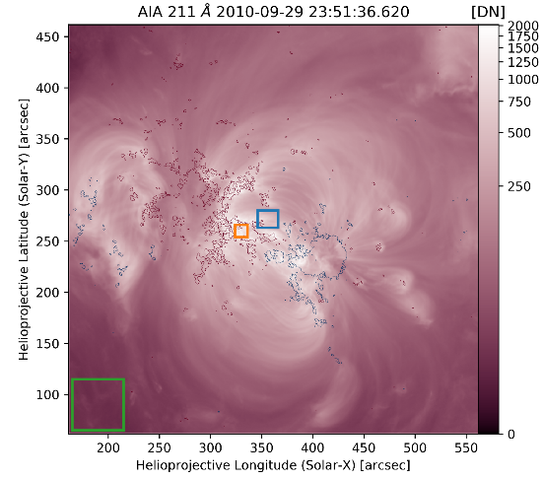
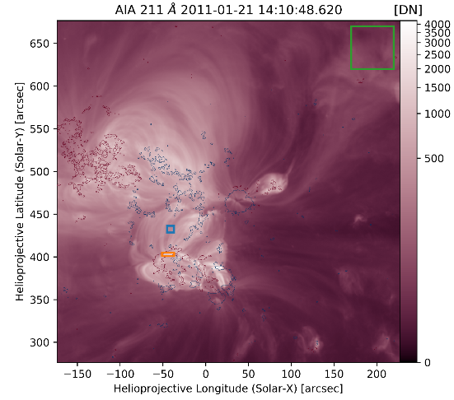
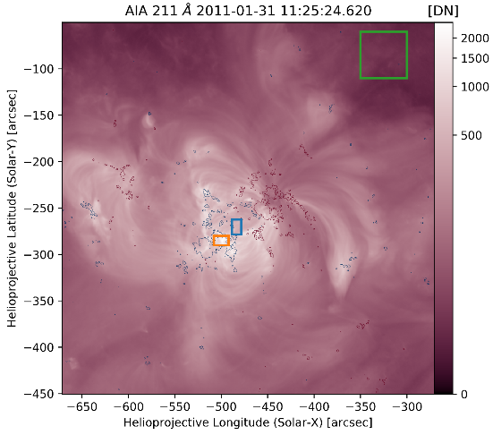
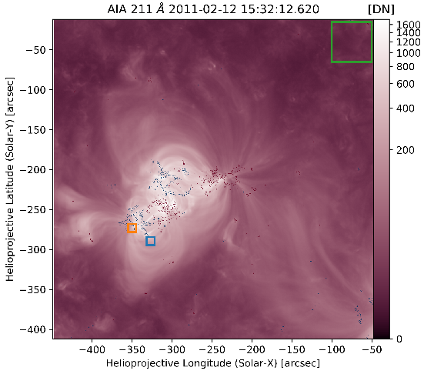
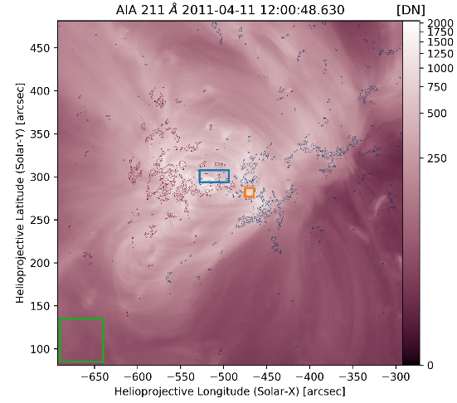
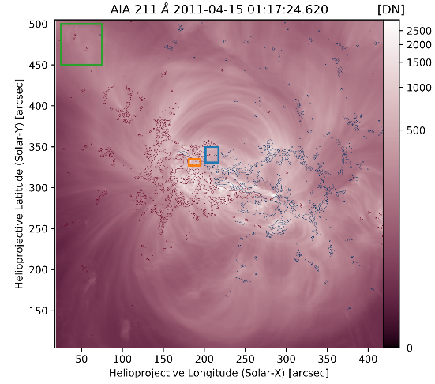
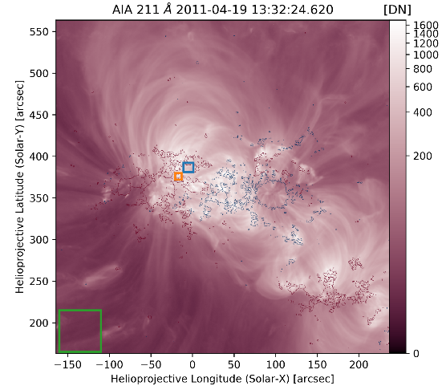
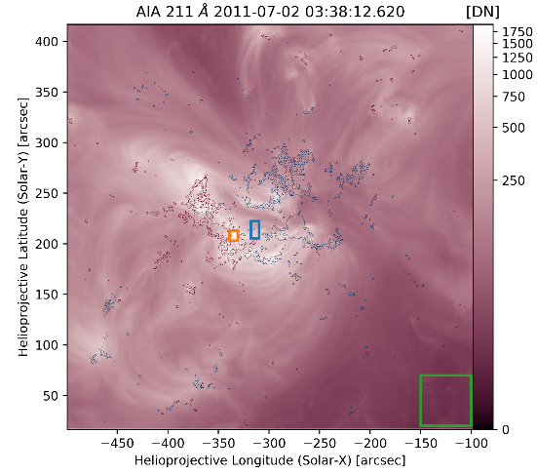
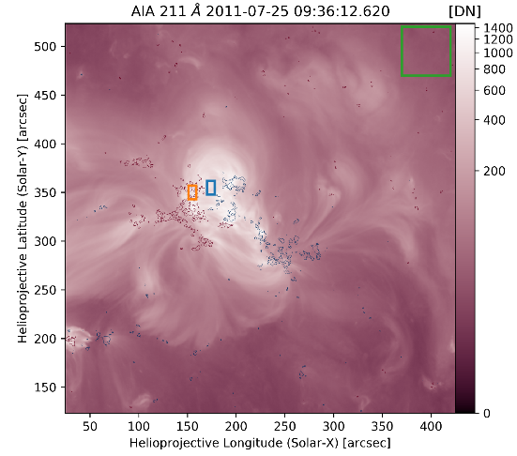
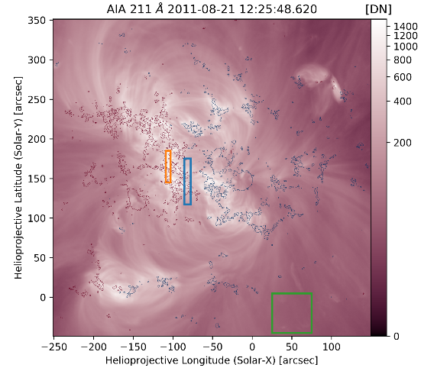
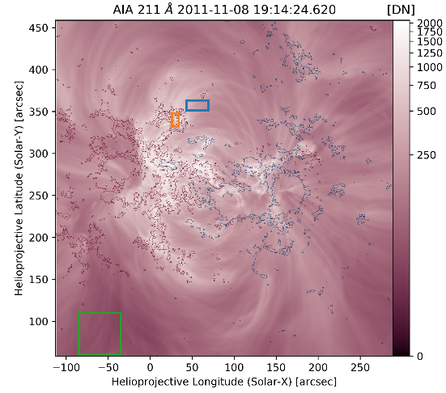
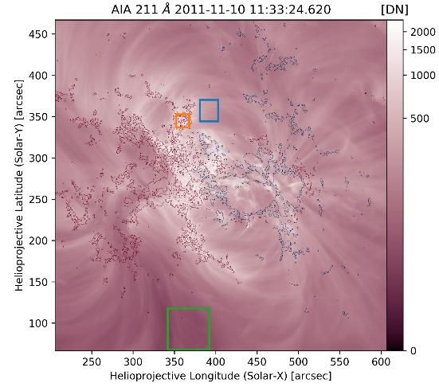

Slide 12
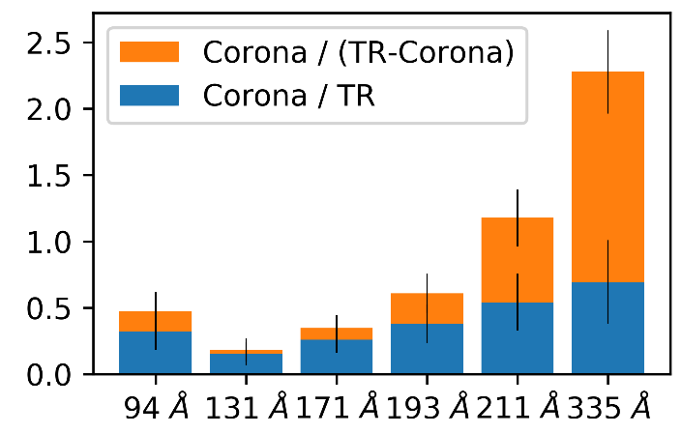
Modeled R_{C/TR} Observed
L = 20 Mm
F = 5x10⁶ erg cm⁻² s⁻¹
t_{min} = 100 s
α = -2.5
Single Region
L = 80 Mm
F = 2x10⁷ erg cm⁻² s⁻¹
t_{min} = 1000 s
α = -1.0
Warren et al. 2012

Slide 13
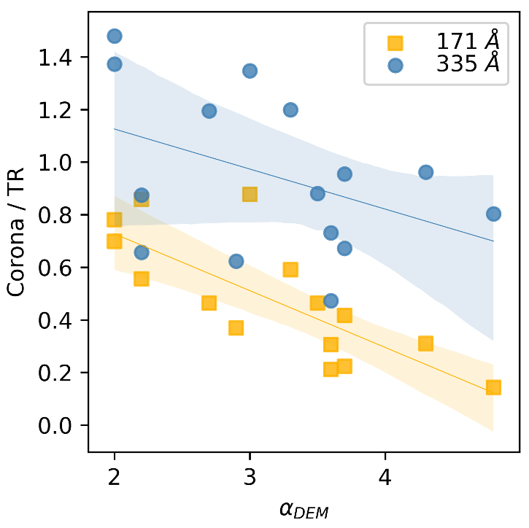
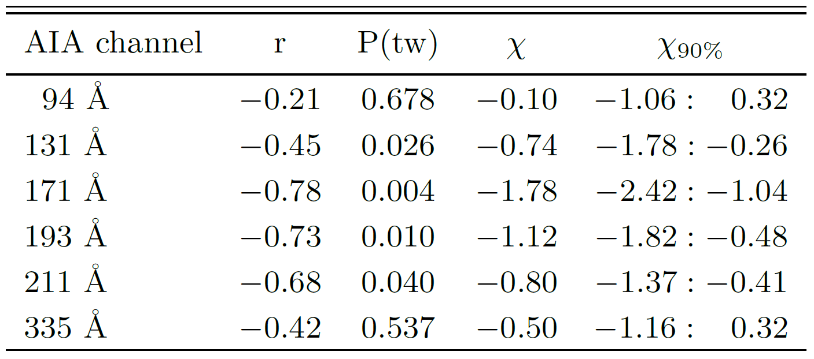
Relationship between DEM slope and R_{C/TR}
Inverse relationship with DEM slope calculated in Warren et al. 2012
α_{DEM}
β_{DEM}
Notes:
High Frequency:
-strands evolve little, shallow slope -> more low temperature loops -> larger R_{C/TR}
Low Frequency:
-higher initial T -> smaller R_{C/TR}
-α_{DEM} calculated from 6 <= log(T) <= 6.6
-smaller slope means more loops below log(T) = 6.6 -> larger R_{C/TR}
Intermediate Frequency:
-additional effect, if heated before cooling through coronal sensitivity causes steeper slope and lower R_{C/TR}

Slide 14
Conclusions
Heating frequency has detectable impacts on average plasma state
Observable differences in R_{C/TR} in AIA channels
For this set of parameters, distribution slope is more important than minimum delay time
Transition region must be considered when studying coronal heating
Transition region contributes a significant fraction of AIA intensity
R_{C/TR} has diagnostic properties
Active regions observed in AIA display similar R_{C/TR}
Inverse relationship between R_{C/TR} and low temperature DEM slope
Notes:
SAY MAIN POINT:
FOR AN ARBITRARY PATCH OF THE SUN THAT INLCUDES LOOP FOOTPOINTS AND APEXES, ~HALF OF THE EMISSION IN ALL CHANNELS (EVEN THOSE CONSIDERED “CORONAL”) IS COMING FROM THE TRANSITION REGION (FOOTPOINTS)
Active regions observed in AIA display similar Corona / TR trend
Assumes components are isolated correctly
Effects such as specular absorption could reduce observed AIA TR emission
Importance of getting solar spectral irradiance

Slide 15
Future Work
Investigate R_{C/TR} in 3D active region models
Groundwork has been laid
Verify observed R_{C/TR} with loops identified in magnetic field extrapolations of active regions
Utilize R_{C/TR} as a constraint when studying coronal heating parameterizations

