Slide 1
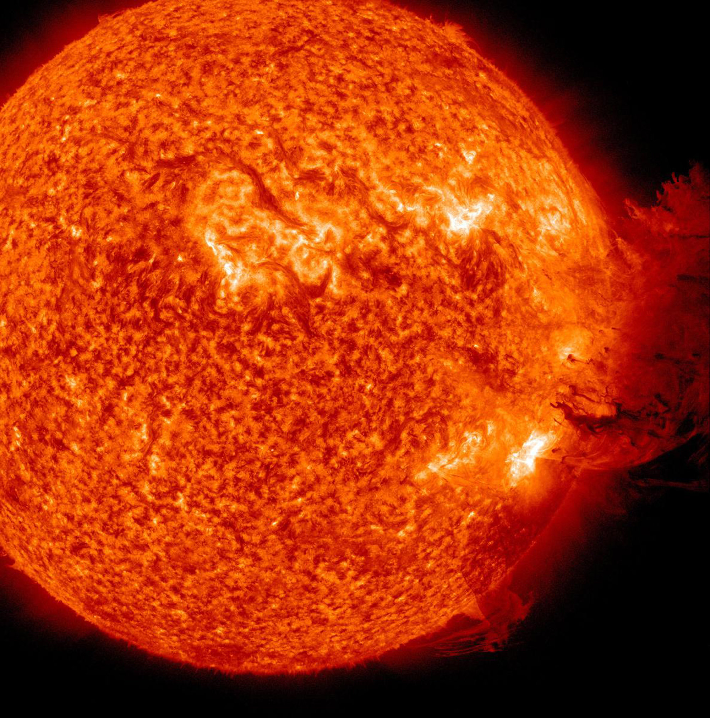


Identifying the Sources and Variability of Solar F_{10.7} with Differential Emission Measures
Sam Schonfeld
Stephen White, Rachel Hock-Mysliwiec, Carl Henney, James McAteer
3/15/18

Slide 2

The Big Picture
$∝$
+
Gyroresonance
Bremsstrahlung
=
EUV
F_{10.7}
?
Thermosphere/Ionosphere
Ground

Slide 3
Outline
Physics Background
  Solar activity, F_{10.7}, and DEMs
F_{10.7} Imaging Analysis
  VLA observation, bremsstrahlung image, and gyroresonance sources
DEM Time Series
  Thermal evolution and the two-state corona
F_{10.7} Bremsstrahlung and Gyroresonance variability
  EUV parameterization and photospheric B-fields

Slide 4
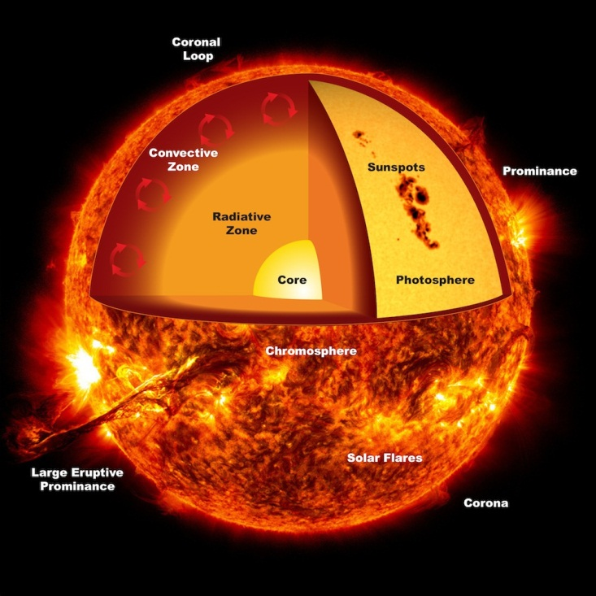
Spaceplace.nasa.gov

Slide 5
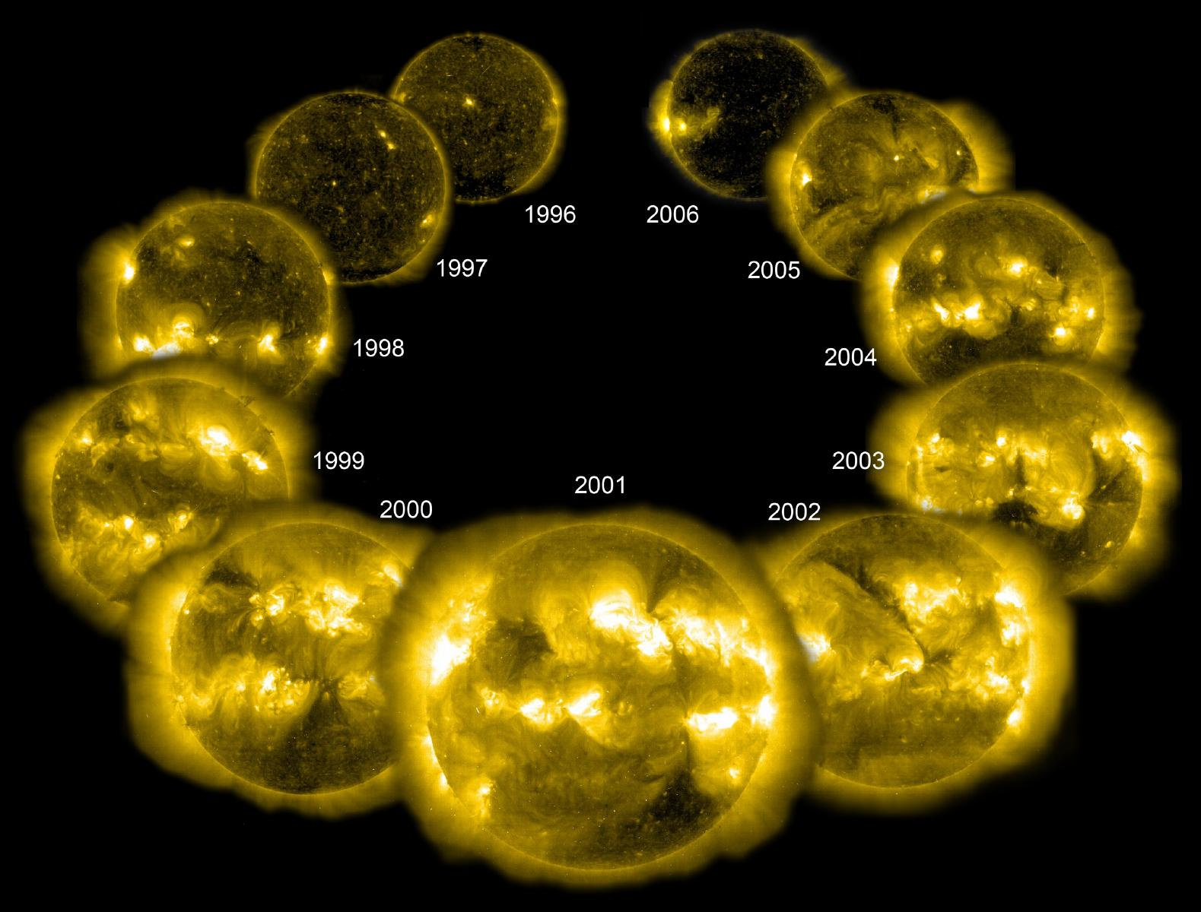
NASA/ESA SOHO EIT assembled by Steele Hill

Slide 6
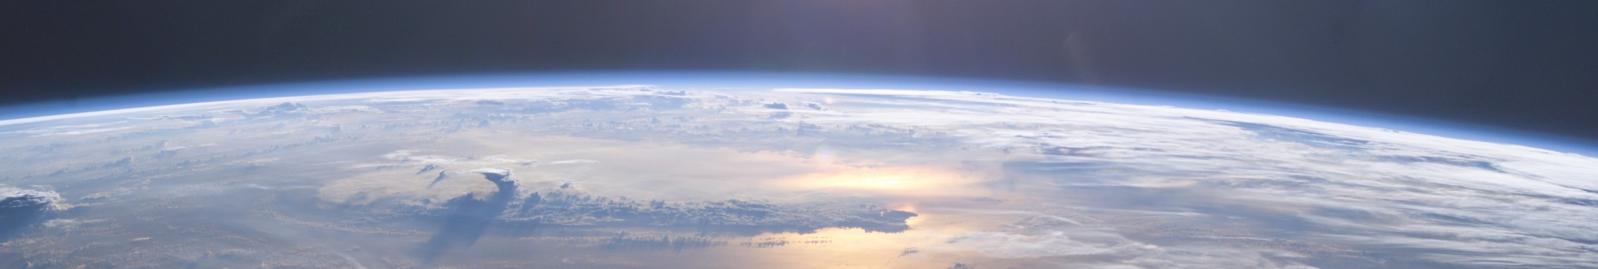
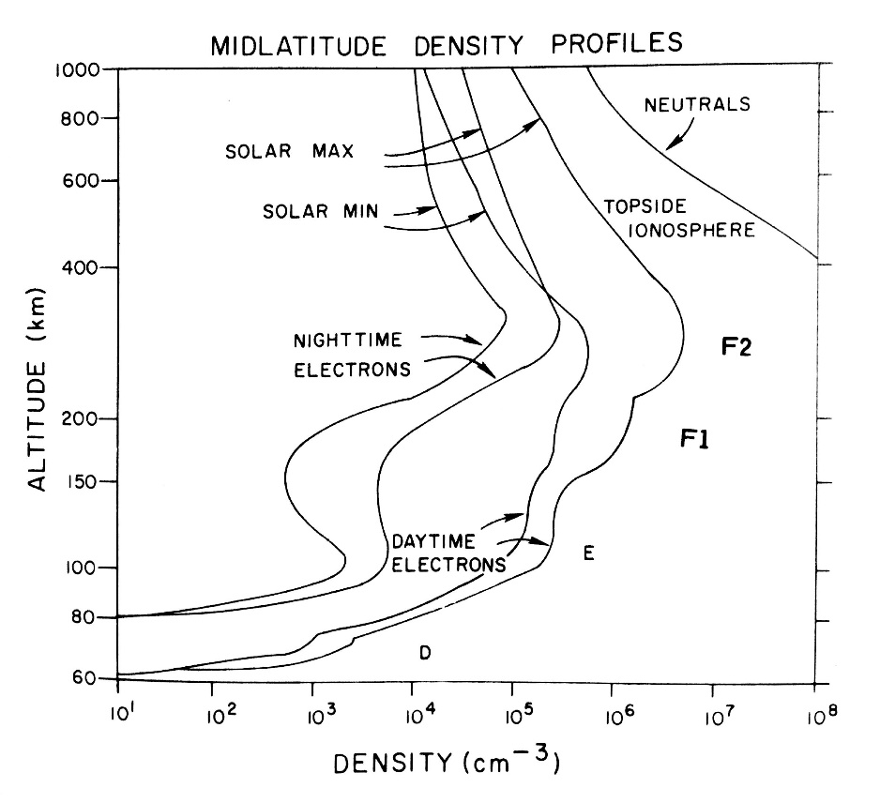
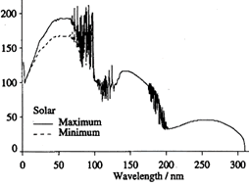
NASA
Altitude [km]
Thermosphere/Ionosphere
EUV
Solar Min
Solar Max
Haigh 2004
Wavelength [nm]
Rich 1985

Slide 7
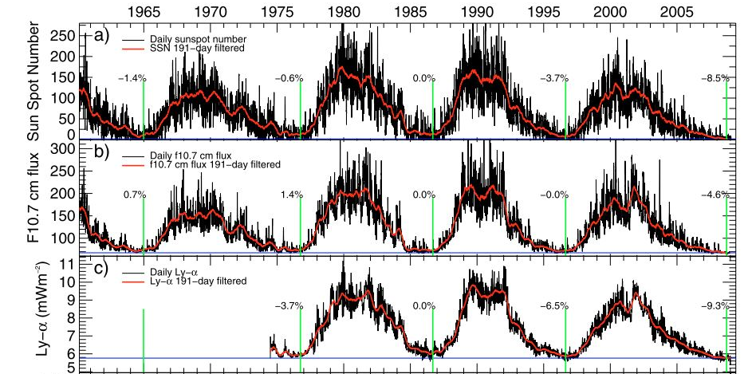
F_{10.7} Index (10.7 cm, 2.8 GHz)
EUV proxy used for atmospheric research
1 sfu = 10⁴ Jy =
10⁻¹⁹ erg s⁻¹ cm⁻² Hz⁻¹
Fröhlich 2009

Slide 8
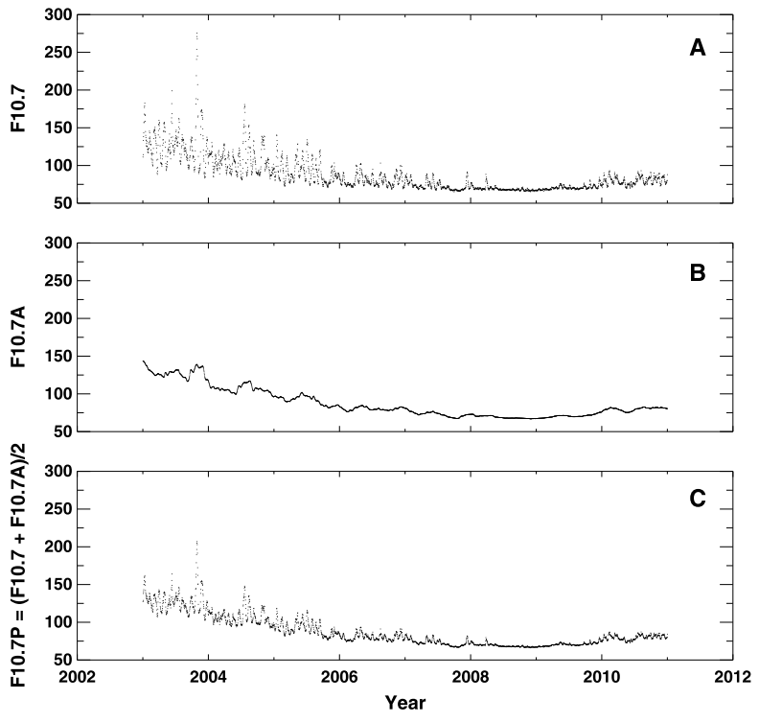
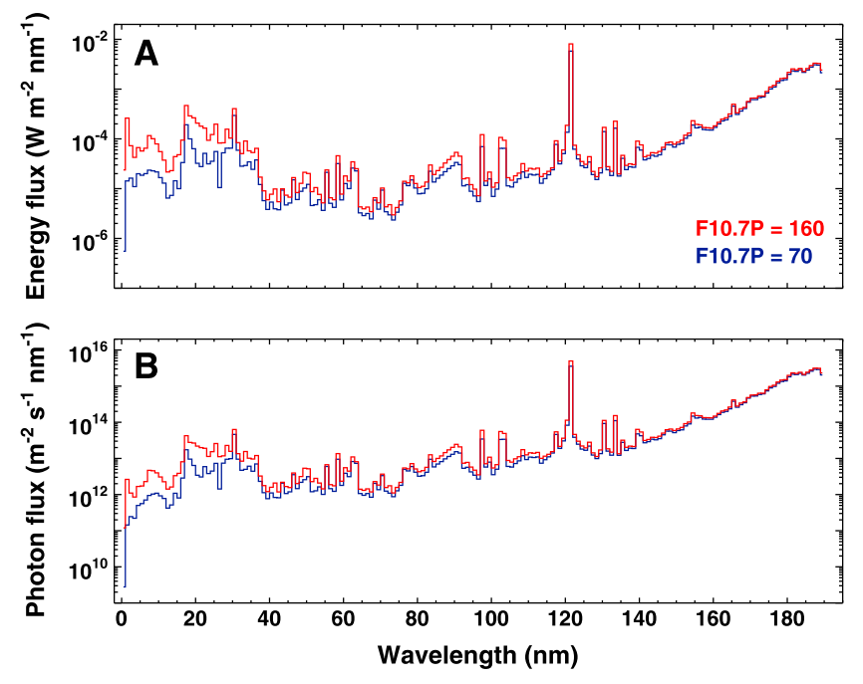
F_{10.7} as an EUV Proxy
F_{10.7} time series
F_{10.7} averaged over 81 days
Used to scale EUV spectrum
EUV spectra
Maximum
Minimum
Girazian and Withers 2014

Slide 9
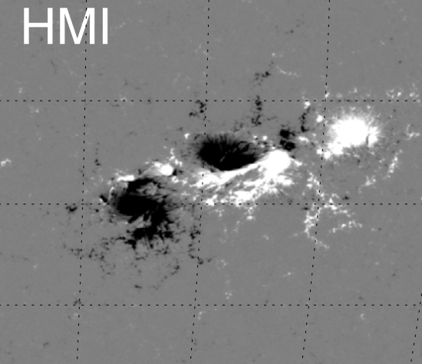
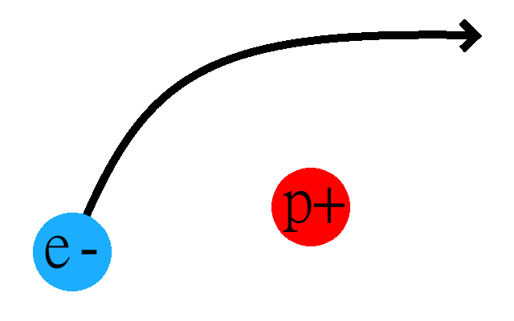
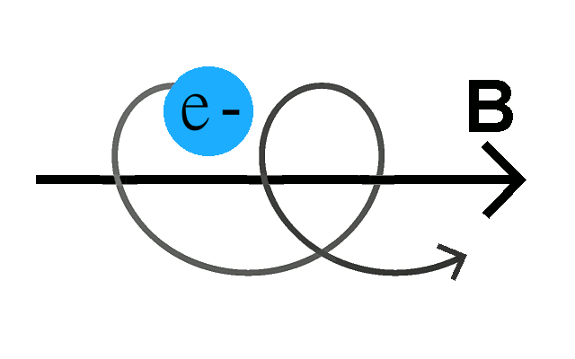
F_{10.7} Generation Mechanisms
Bremsstrahlung
  Free-free electron-ion interactions
  Active regions and plage
  Traces density
  Unpolarized
  Spectrally “flat“
Gyroresonance
  Electrons spiraling around magnetic fields
  Active region cores
  Traces magnetic field
  Circularly polarized
  Spectrally peaked at 2—5 GHz
Aschwanden, Sun, and Liu 2014

Slide 10
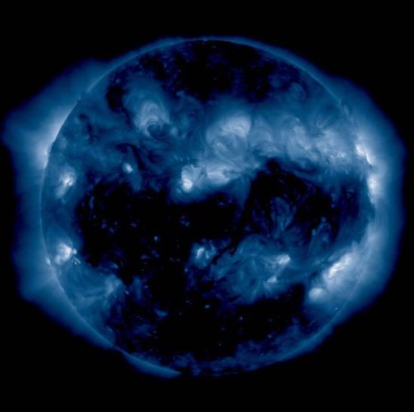
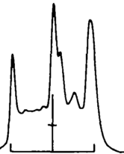
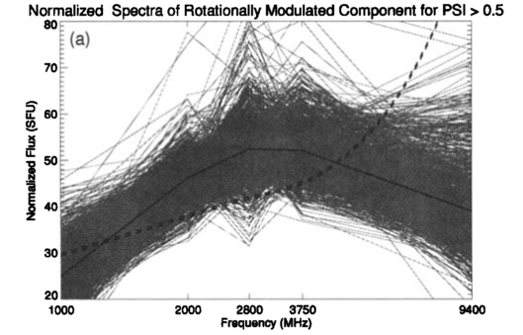
Historical Source Studies
Disagreement about source mechanism
  Imaging typically suggests bremsstrahlung dominance
  Spectral analysis suggests gyroresonance dominance
Active region
Gyroresonance peak
F_{10.7} flux
Solar minimum level
Diffuse bremsstrahlung
Schmahl and Kundu 1995
Tapping and DeTracey 1990
F_{10.7}

Slide 11
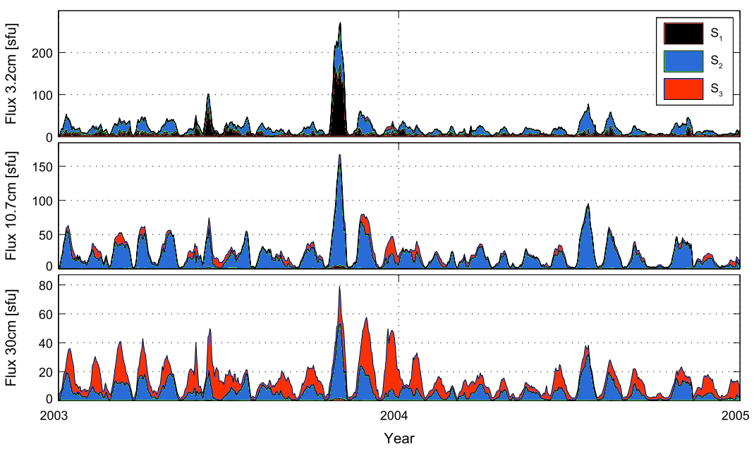
Recent F_{10.7} Times Series Analysis
F_{10.7} plus 1.0, 2.0, 3.75, and 9.4 GHz
  Blind Source Separation, correlation with solar activity proxies
90% of rotational variability due to gyroresonance emission
  Identified by spectral and temporal characteristics and relationship to sunspots
Bremsstrahlung
Gyroresonance
Dudok de Wit, Bruinsma, Shibasaki 2014

Slide 12
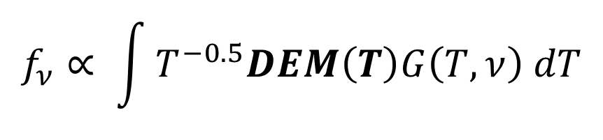
How We Separate Gyroresonance Emission
Radio
(ground)
Predict
Bremsstrahlung
Detected Gyroresonance
$$f_{ν}∝ \int{T^{−0.5}DEM\left(T\right)G\left(T,ν\right) dT}$$
Observe
EUV
(space)
Compute DEM

Slide 13
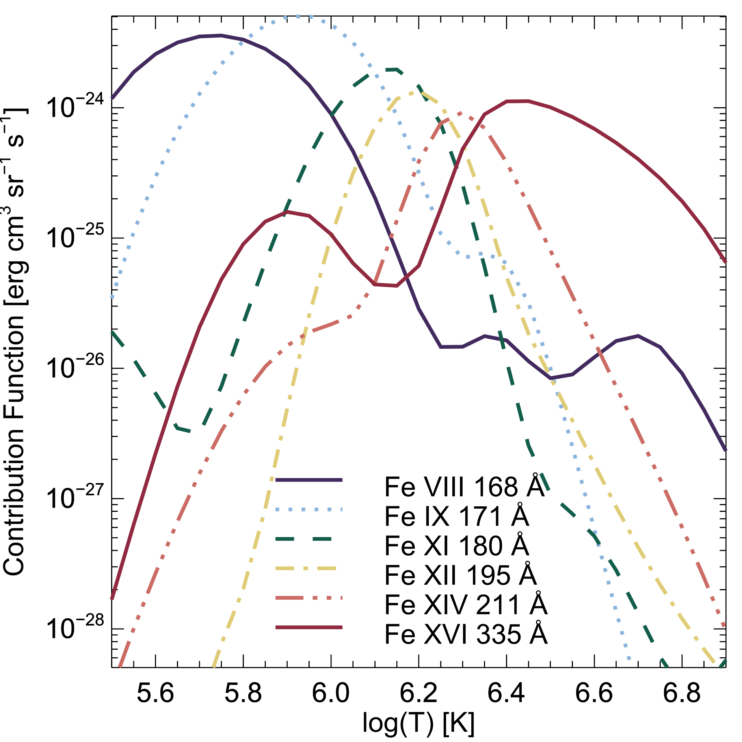
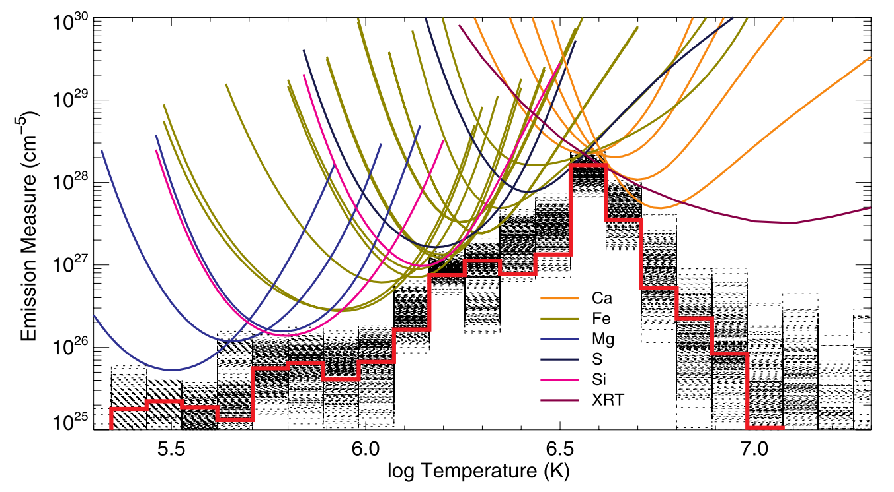
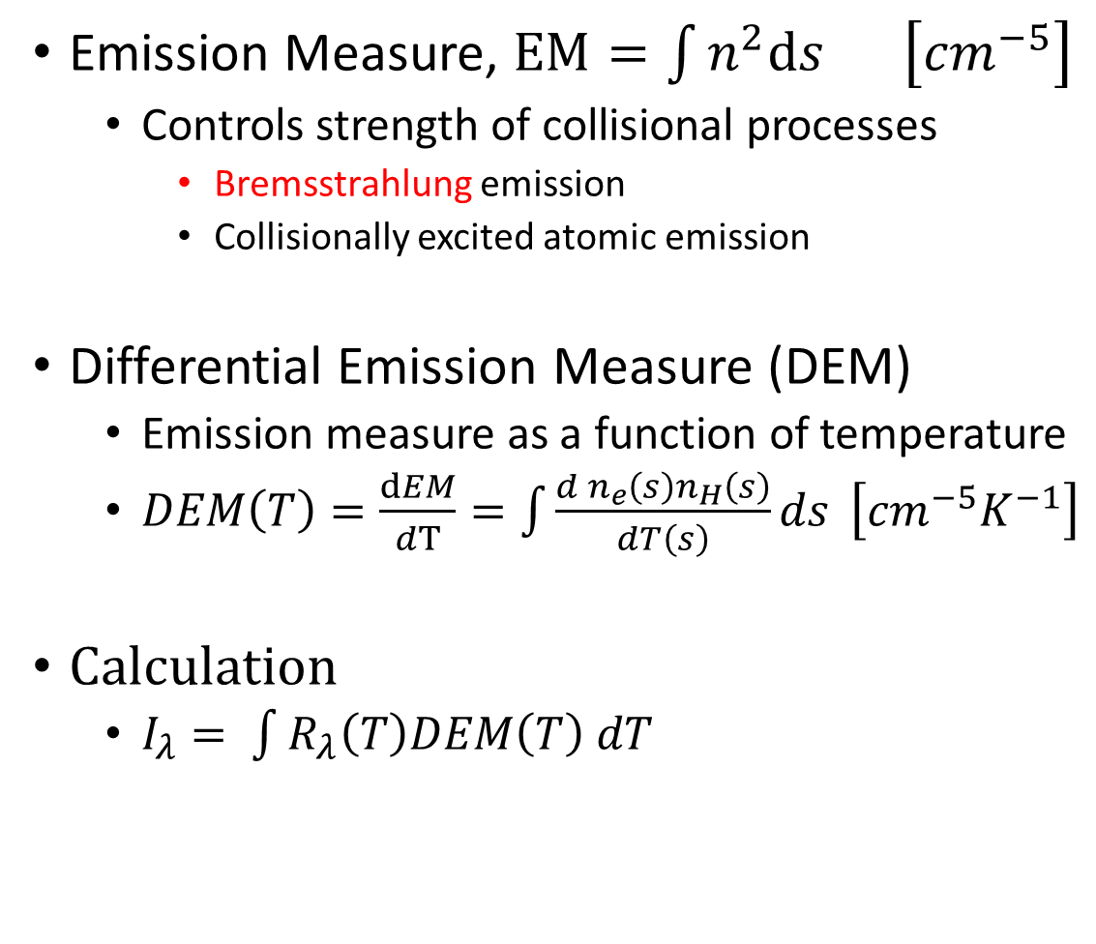
Differential Emission Measure
Emission Measure, $EM=\int{n^{2}ds}$ $\left[{cm}^{−5}\right]$
  Controls strength of collisional processes
    Bremsstrahlung emission
    Collisionally excited atomic emission
Differential Emission Measure (DEM)
  Emission measure as a function of temperature
  $DEM\left(T\right)=\frac{dEM}{dT}=\int{\frac{d n_{e}\left(s\right)n_{H}\left(s\right)}{dT\left(s\right)}ds} \left[{cm}^{−5}K^{−1}\right]$
Calculation
  $I_{λ}= \int{R_{λ}\left(T\right)DEM\left(T\right) dT}$
EM [cm⁻⁵]
Warren, Brooks, and Winebarger 2011
Log(T) [K]

Slide 14
Outline
Physics Background
  Solar activity, F_{10.7}, and DEMs
F_{10.7} Imaging Analysis
  VLA observation, bremsstrahlung image, and gyroresonance sources
DEM Time Series
  Thermal evolution and the two-state corona
F_{10.7} Bremsstrahlung and Gyroresonance variability
  EUV parameterization and photospheric B-fields

Slide 15
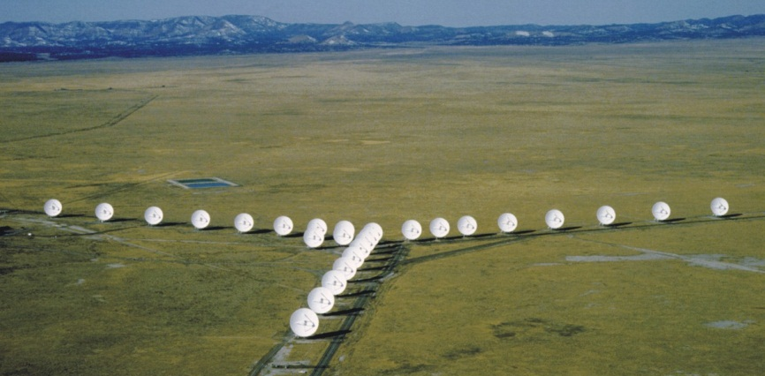
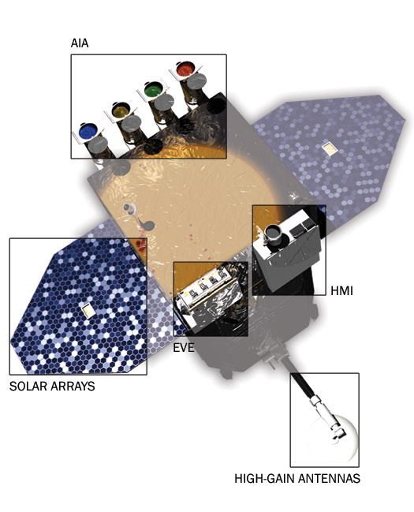
Imaging Analysis with the VLA
Image courtesy of NRAO/AUI
Radio data
  Karl G. Jansky Very Large Array (VLA)
  Eight hour integration
    Seven pointing mosaic
  S-band 2—4 GHz coverage
    10.7 cm = 2.8 GHz
EUV data
  Atmospheric Imaging Assembly (AIA)
  12 second cadence
  Six coronal EUV bands
sdo.gsfc.nasa.gov/mission/spacecraft.php

Slide 16
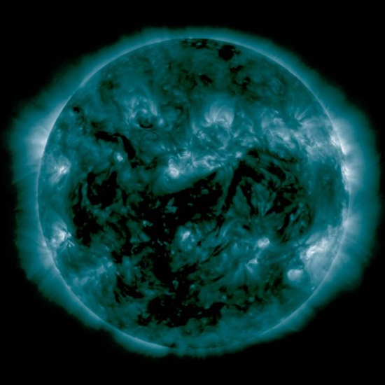
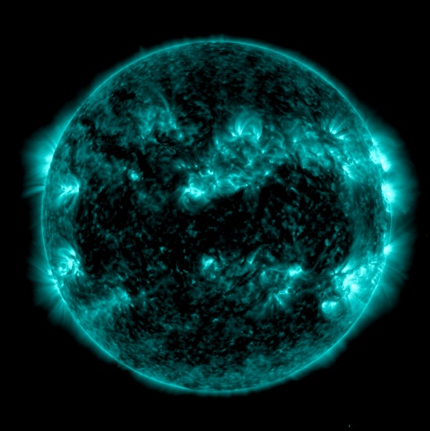
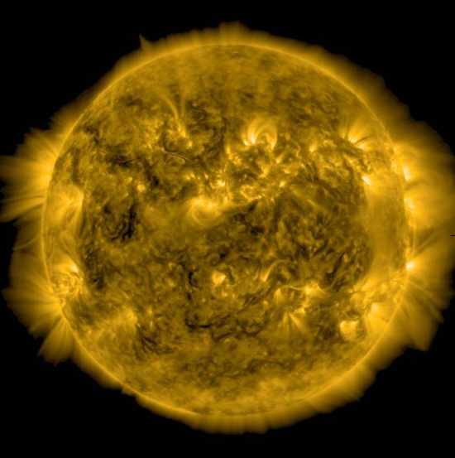
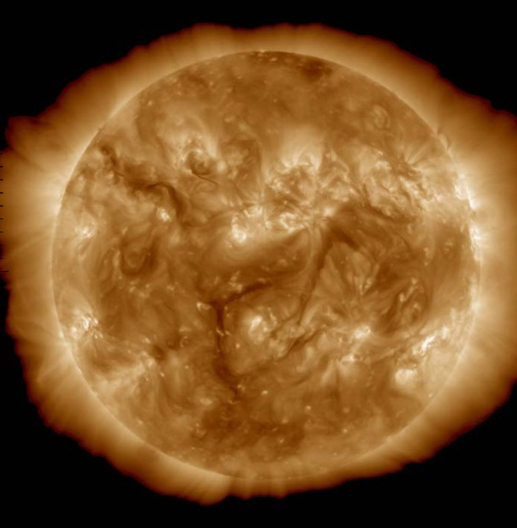
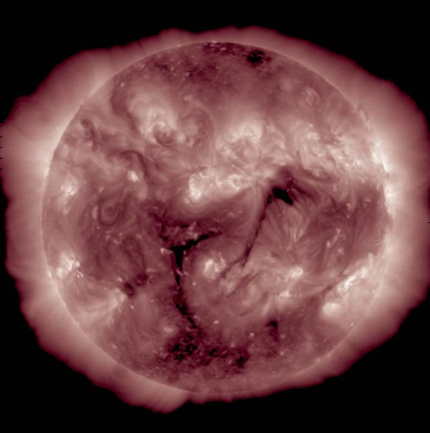
94 Å
131 Å
171 Å
193 Å
10.7 cm (2.8 GHz)
211 Å
335 Å

Slide 17
F_{10.7} VLA observation
Bremsstrahlung prediction from EUV DEMs

Slide 18
Individual Region Fluxes
F_{10.7} flux

Slide 19
Imaging Results
Bremsstrahlung prediction successful
  Active region morphology matches observations
  Identified discrepancy on the limb
    5.9 ± 0.3 sfu, 7.7% of variable F_{10.7}
    Due to height of optically thick chromospheric layer
    Causes ≈1 day delays in F_{10.7} response to solar rotation
Gyroresonance sources identified
  6.2 ± 0.4 sfu, 8.1% of variable F_{10.7}
F_{10.7}
Polarized F_{10.7}

Slide 20
Outline
Physics Background
  Solar activity, F_{10.7}, and DEMs
F_{10.7} Imaging Analysis
  VLA observation, bremsstrahlung image, and gyroresonance sources
DEM Time Series
  Thermal evolution and the two-state corona
F_{10.7} Bremsstrahlung and Gyroresonance variability
  EUV parameterization and photospheric B-fields

Slide 21
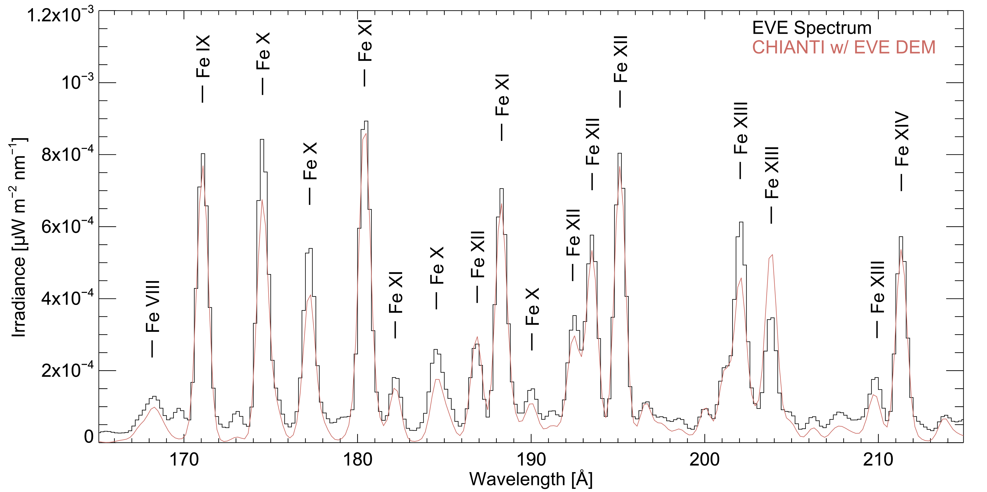
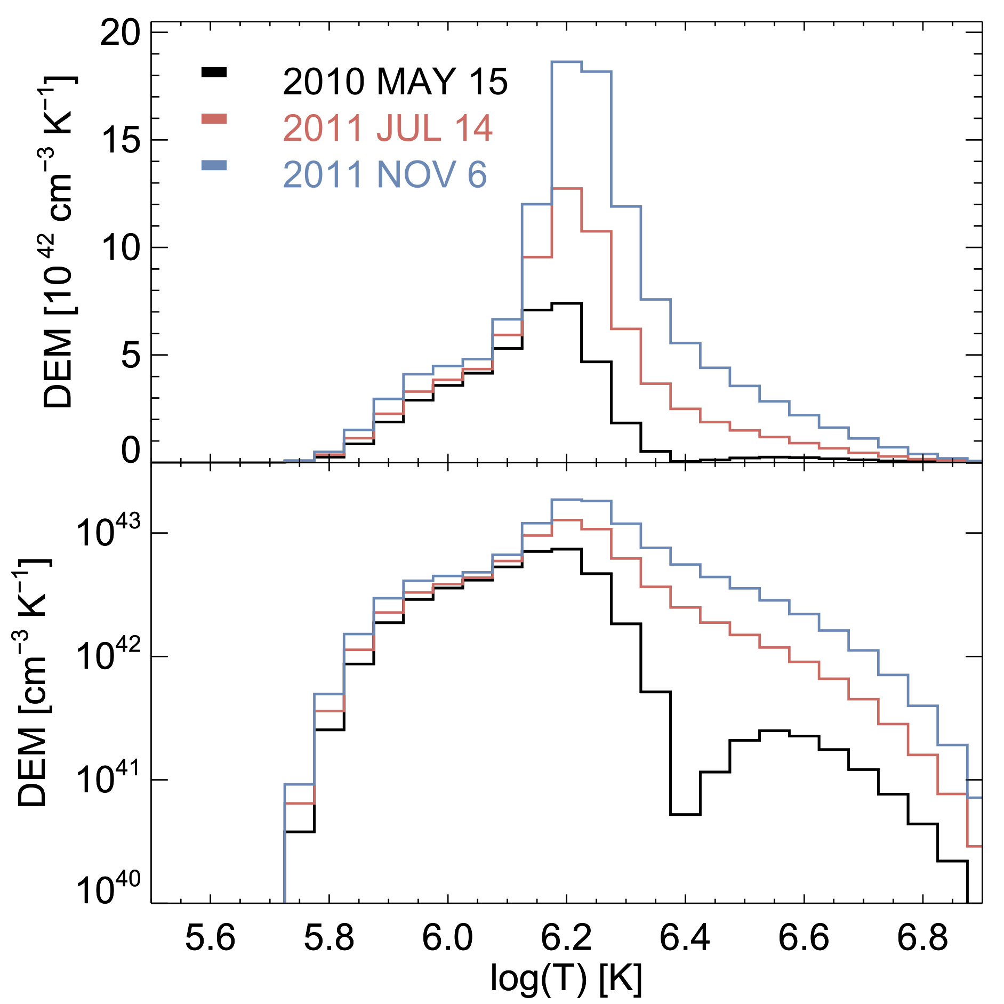
Time Series Study Using EVE MEGS-A
EUV irradiance spectra
Four-year data set
  Rise of Solar Cycle 24
  Only missing 12 days
Rocket calibrated
Two hours daily median
  10 s cadence observations
  Long sample period to minimize the influence of transient activity

Slide 22
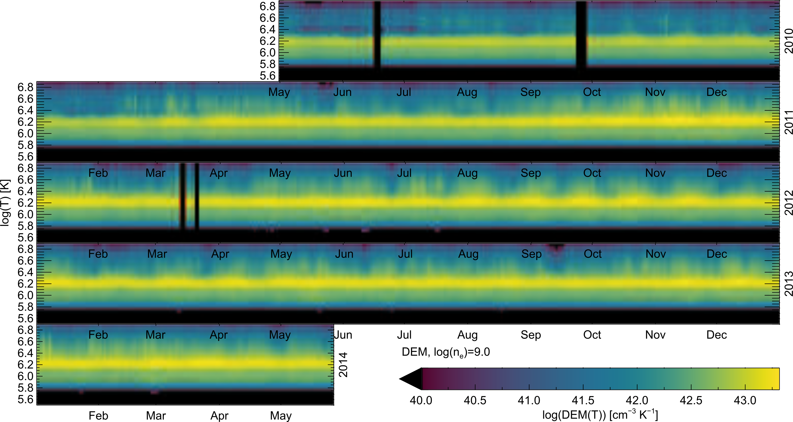
Jan Feb Mar Apr May Jun Jul Aug Sep Oct Nov Dec
2010
2011
log(T)
2012
2013

Slide 23
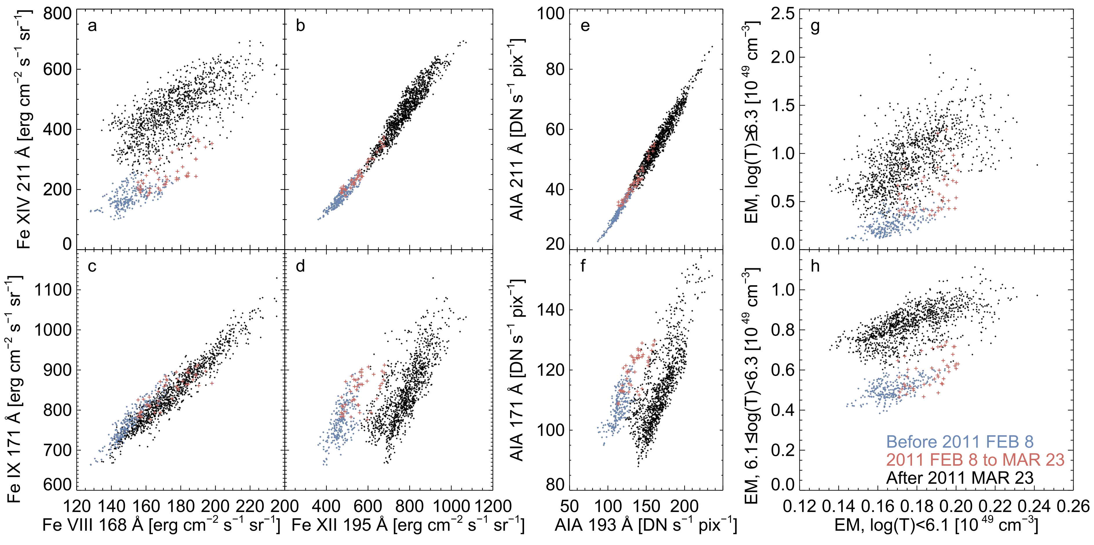
EVE lines
DEM components
Warm
Warm
Solar min
Cool
Solar max
Cool
Warm
Cool

Slide 24
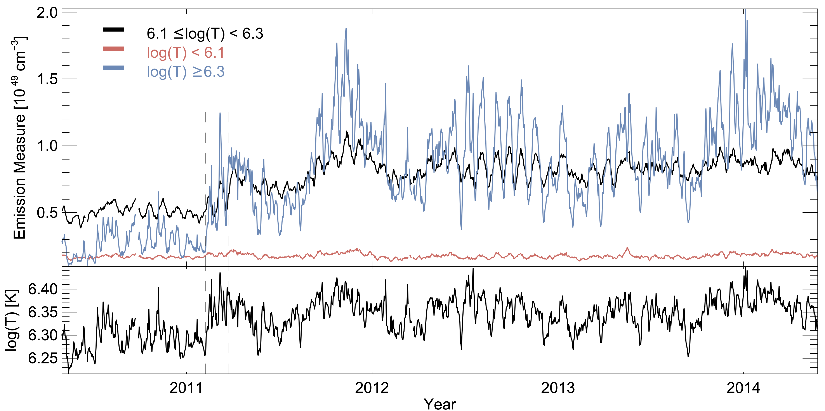
DEM Time Series

Slide 25
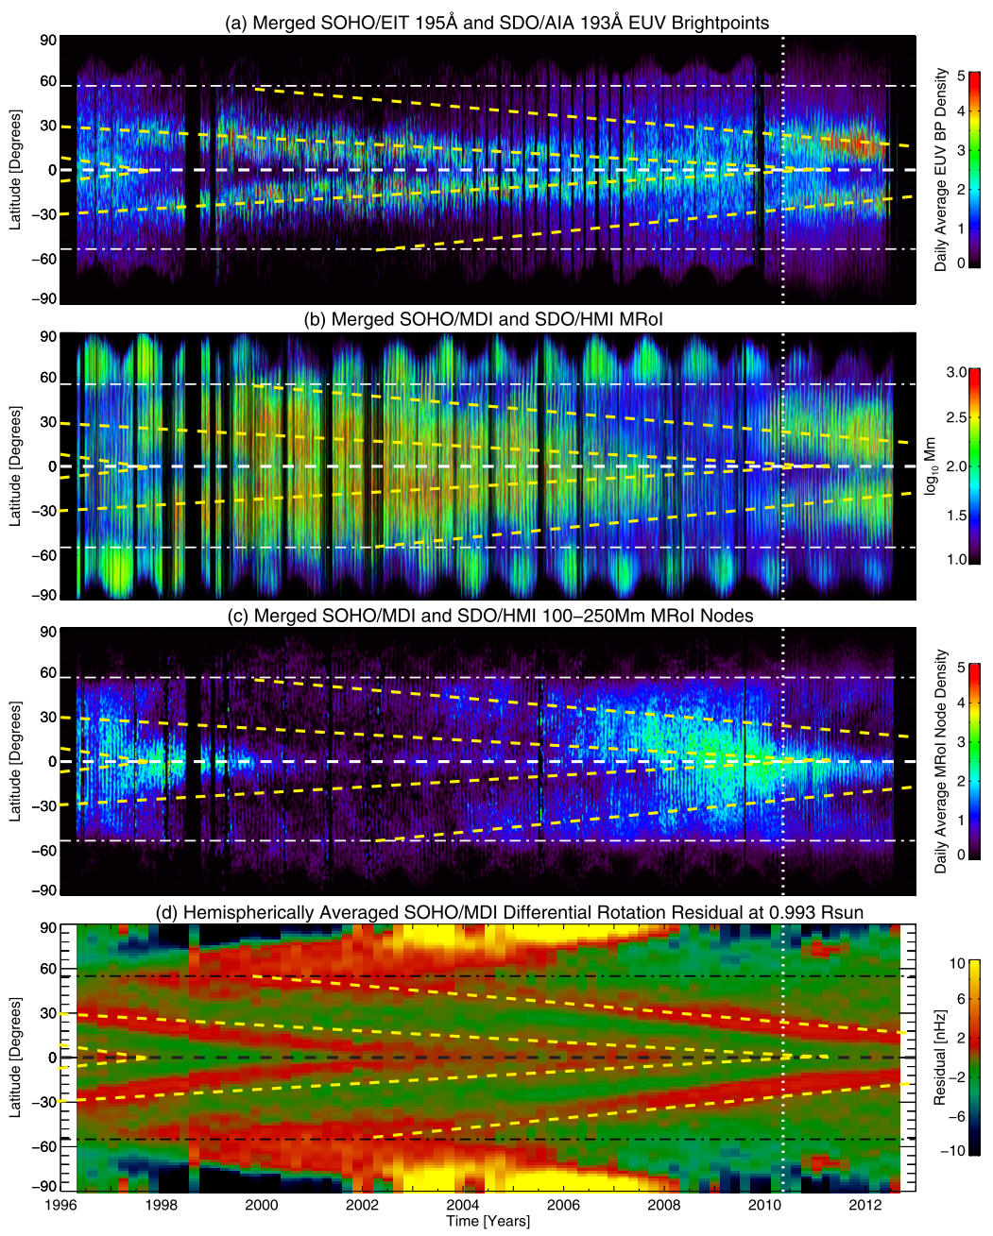
Magnetic Activity Band Interpretation
Coronal EUV
Photospheric Magnetic Field
McIntosh et al 2011

Slide 26
DEM Time Series Results
Global DEM characterized over the rise of solar cycle 24
  Consistent DEMs
  rotational modulation
Two-state coronal DEMs identified
  Result of low temperature consistency
  May be related to bands of magnetic activity

Slide 27
Outline
Physics Background
  Solar activity, F_{10.7}, and DEMs
F_{10.7} Imaging Analysis
  VLA observation, bremsstrahlung image, and gyroresonance sources
DEM Time Series
  Thermal evolution and the two-state corona
F_{10.7} Bremsstrahlung and Gyroresonance variability
  EUV parameterization and photospheric B-fields

Slide 28
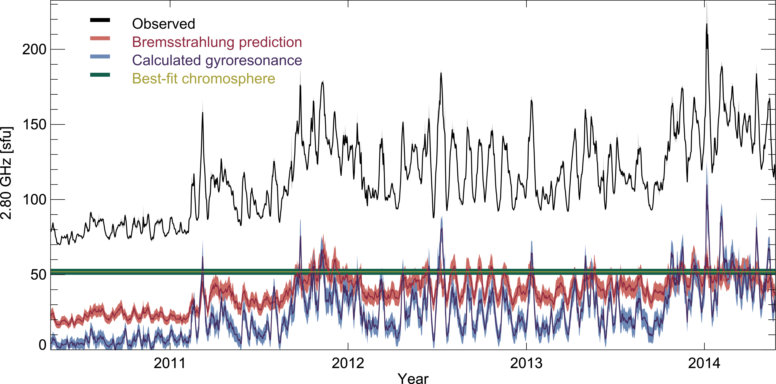

Slide 29
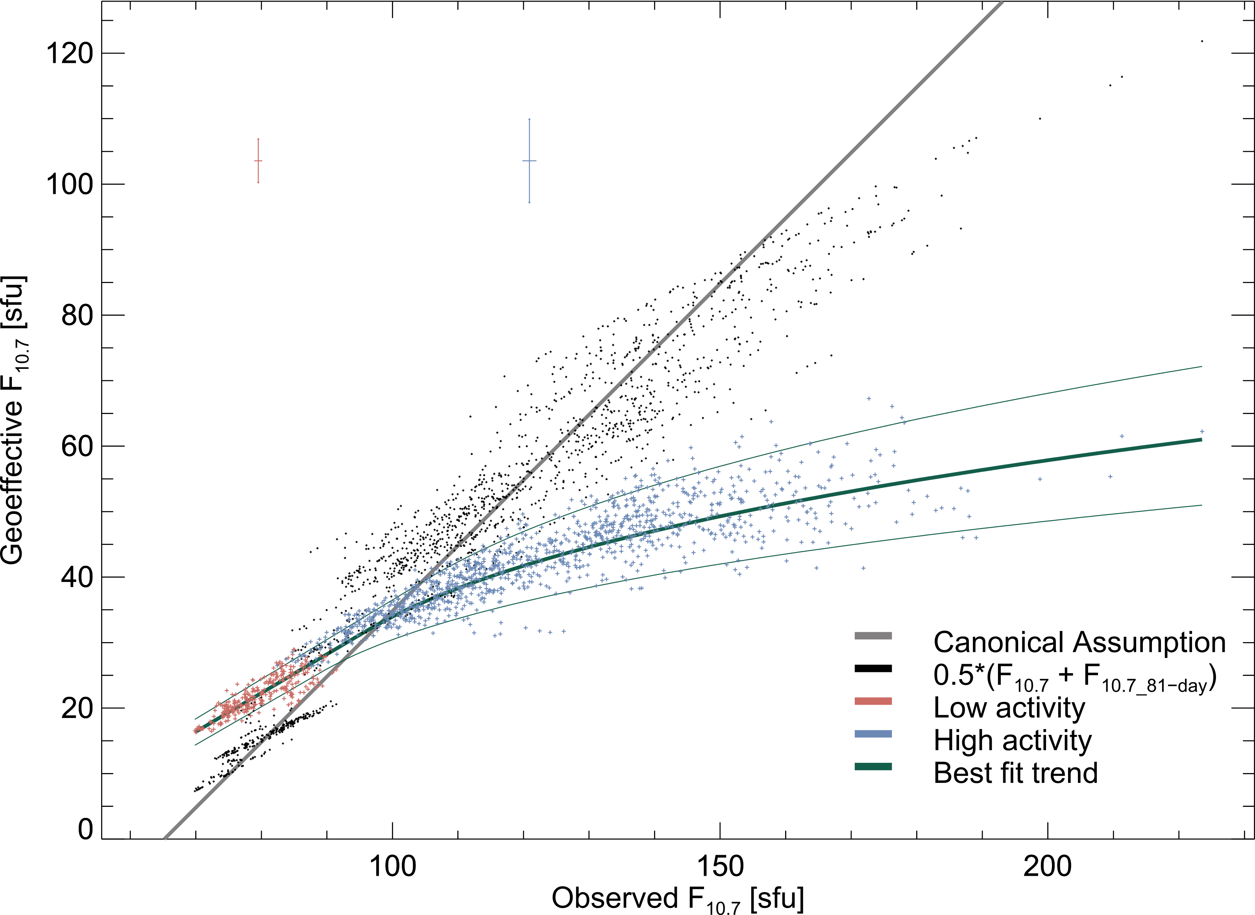
F_{10.7}
EUV

Slide 30
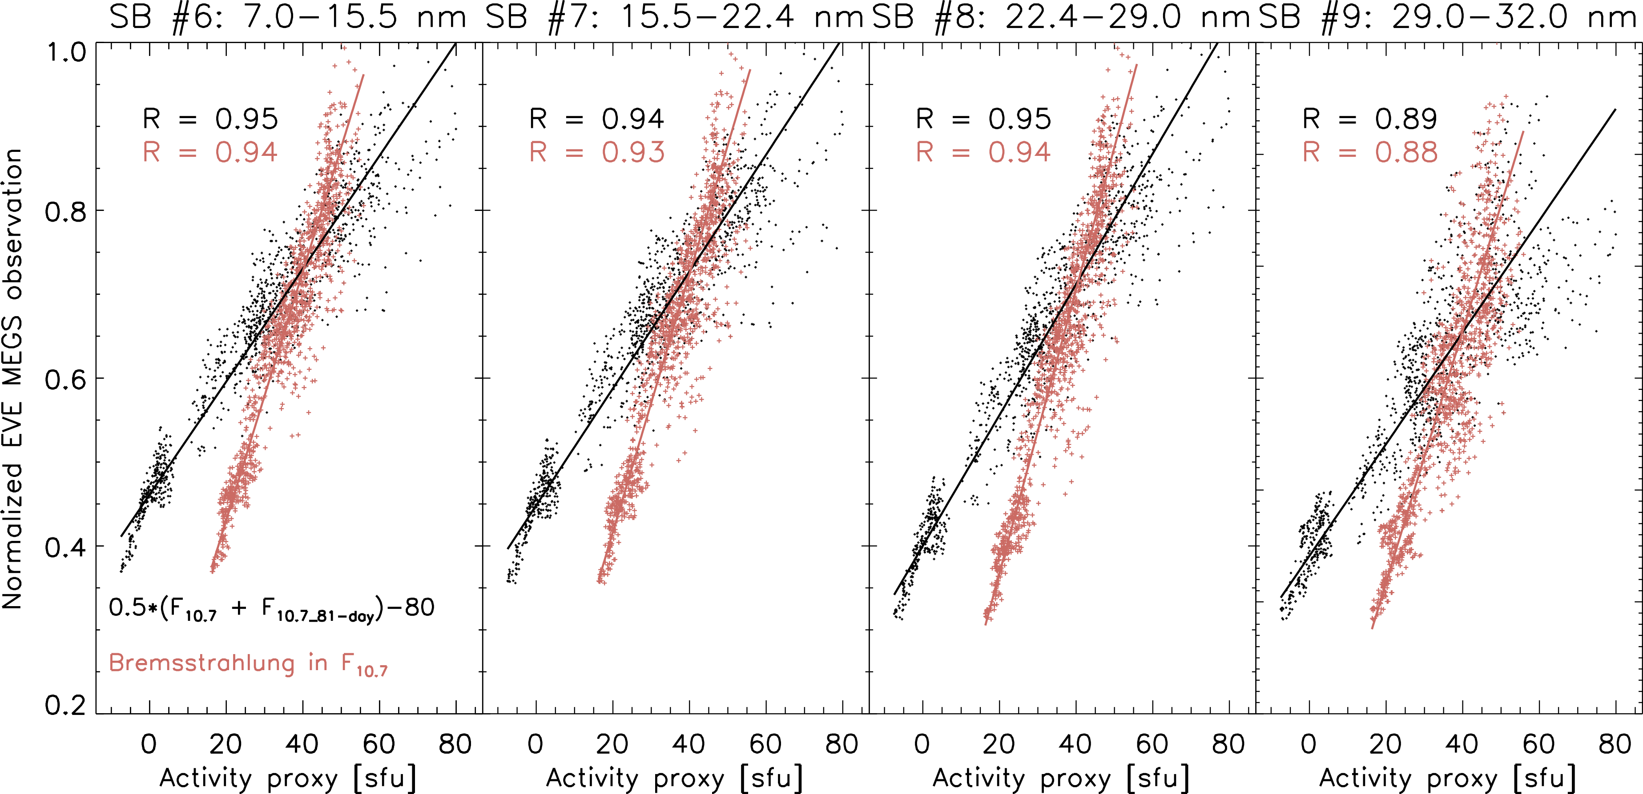
F_{10.7} as an EUV Proxy
EUVAC model (Richards, Fennelly, and Torr 1994) scales the EUV spectrum between two solar minimum and maximum observations using F_{10.7}

Slide 31
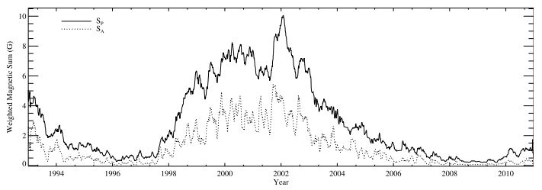
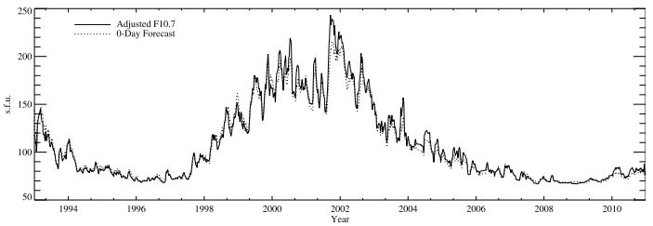
F_{10.7} from Photospheric B field
Bremsstrahlung
Gyroresonance
Weak field
Strong field
F_{10.7} observation
Prediction
Henney et al 2012
Aschwanden, Sun, and Liu 2014

Slide 32
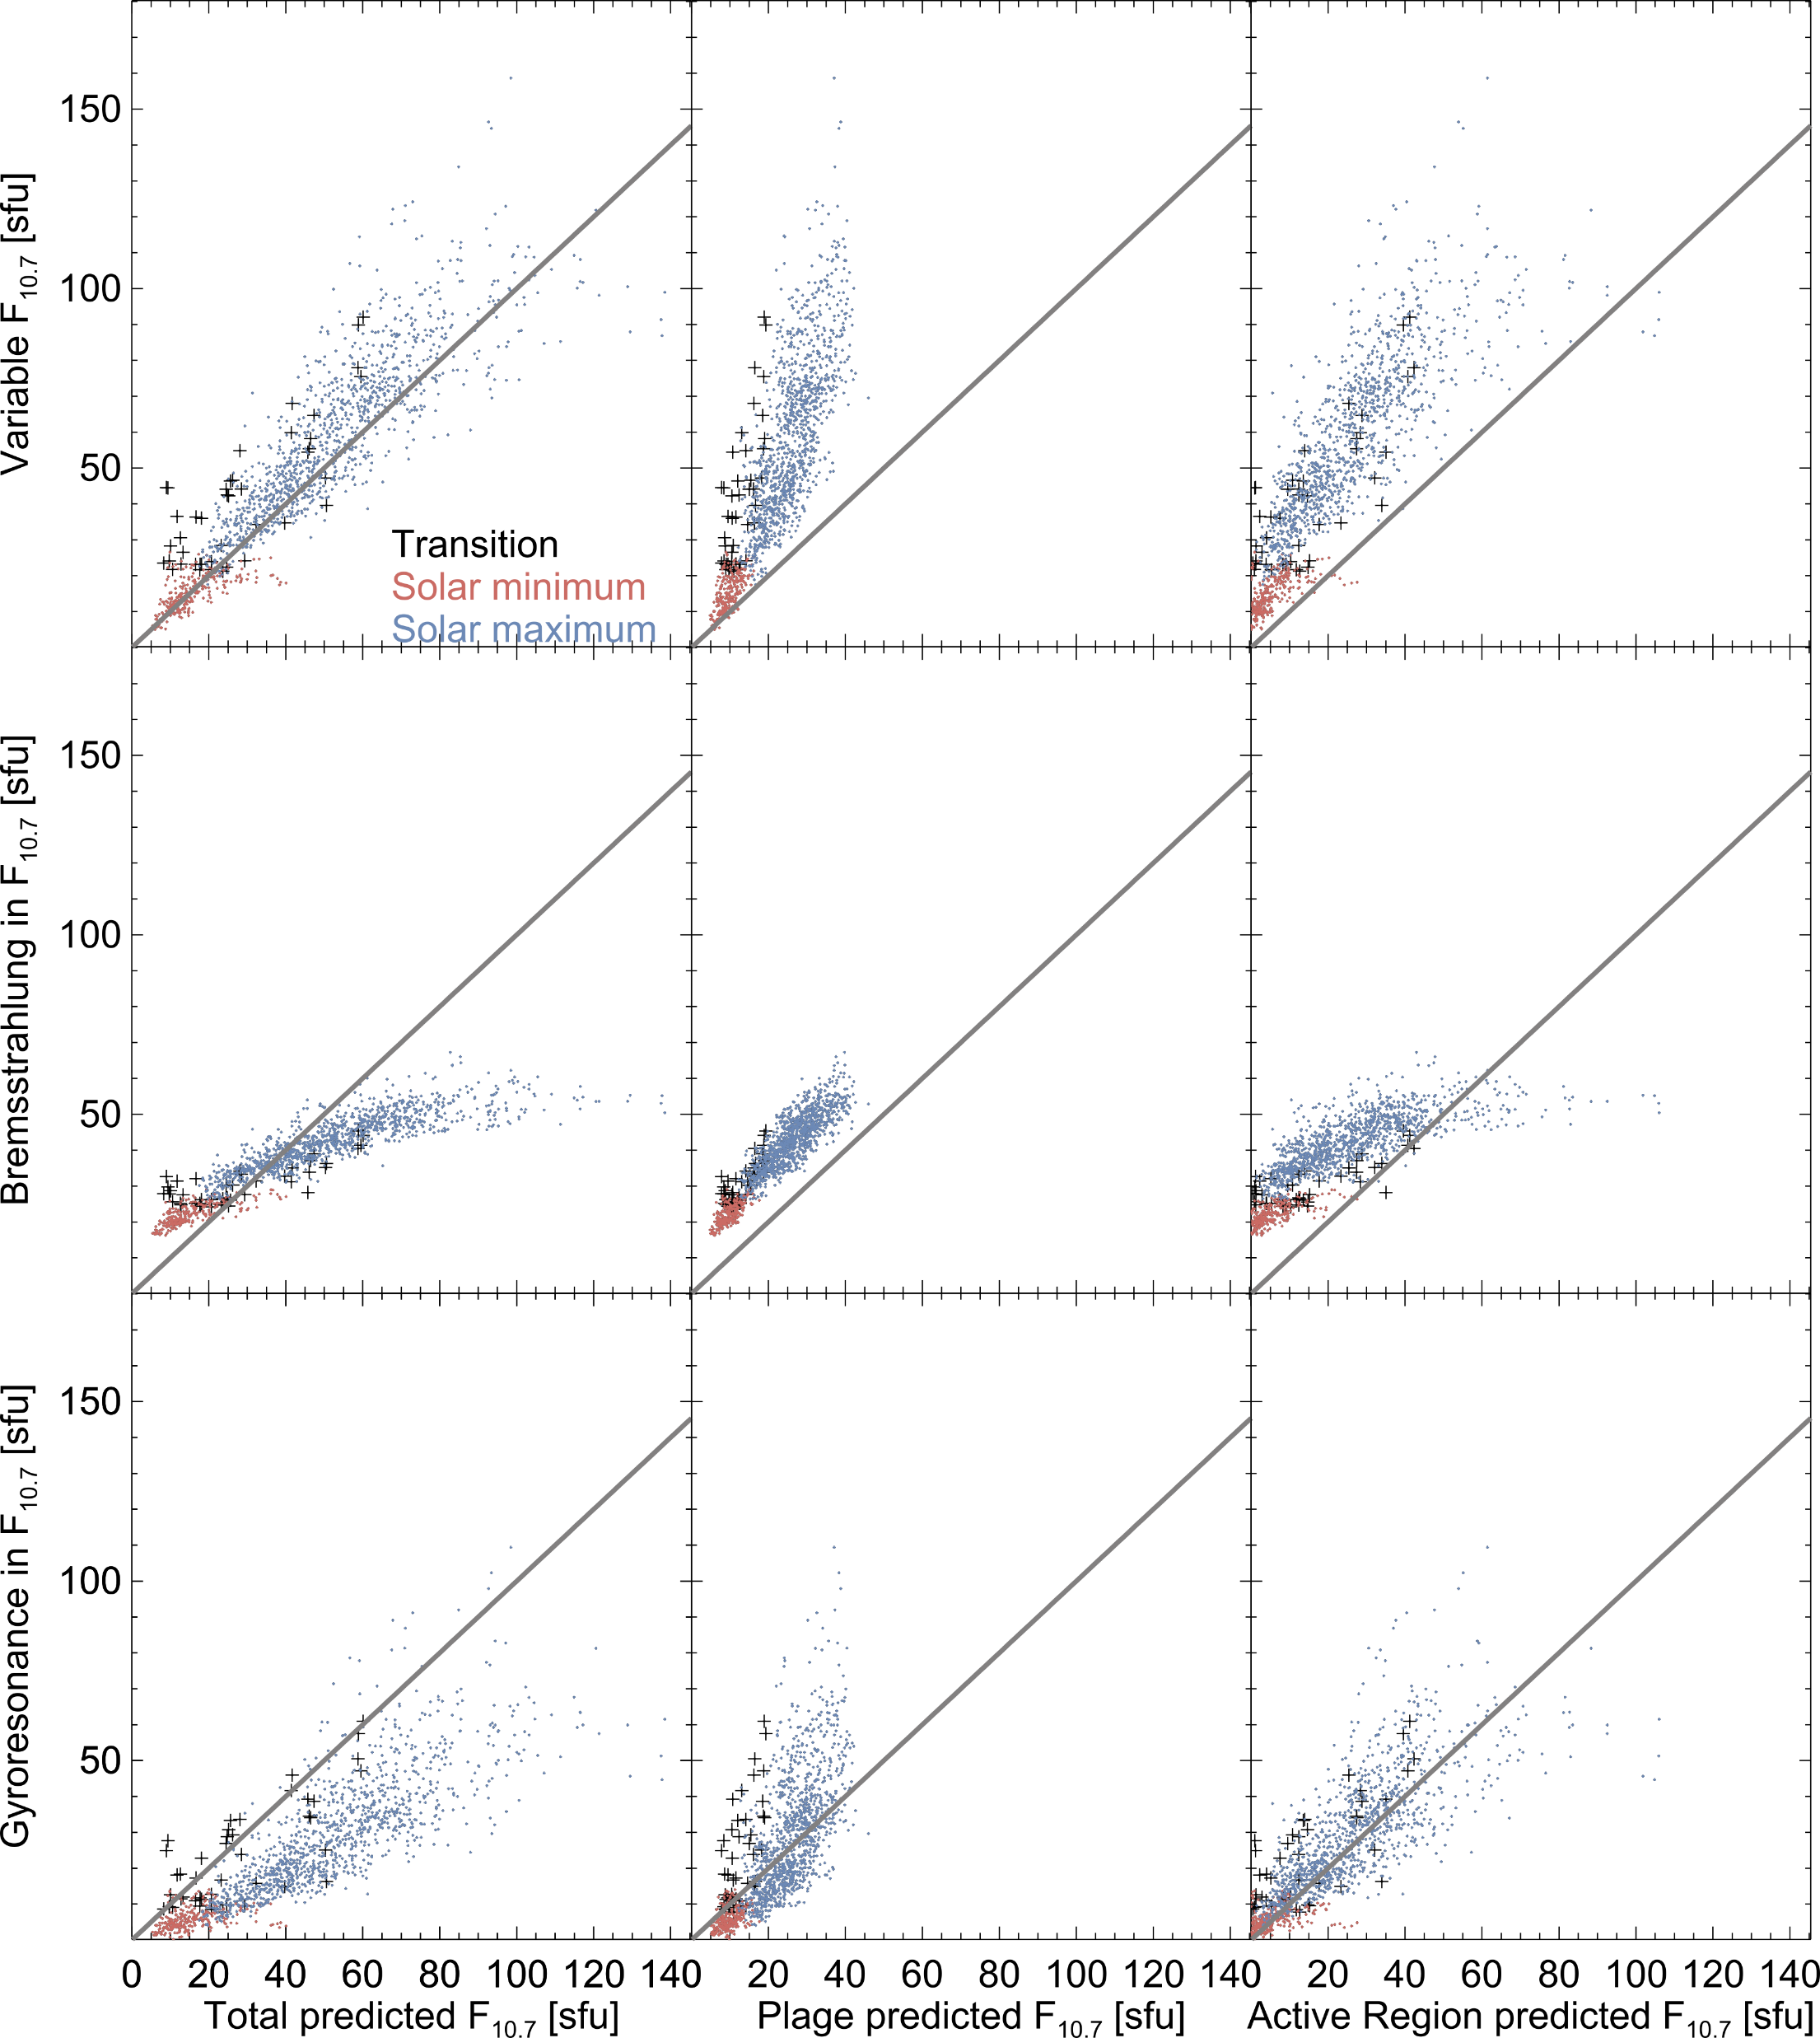
F_{10.7} Component Correlation with B-field

Slide 33
Emission Series Results
F_{10.7} is bremsstrahlung dominated except during the most active periods
  Non-linear bremsstrahlung-F_{10.7} relationship
  Bremsstrahlung just as predictive as 81-day averaged F_{10.7}
Henney et al. 2012 magnetic fields
  Parameterization correlates well with emission sources

Slide 34
Conclusions
Two-state coronal DEMs separated by activity level
  Possibly related to magnetic activity cycle
Bremsstrahlung emission accounts for 60-90% of coronal F_{10.7}
  Only the most intense active regions cause gyroresonance > bremsstrahlung
F_{10.7} 81-day averaging is a slightly better EUV proxy than isolated bremsstrahlung
  Evidence of variability in the EUV-F_{10.7} relationship

Slide 35
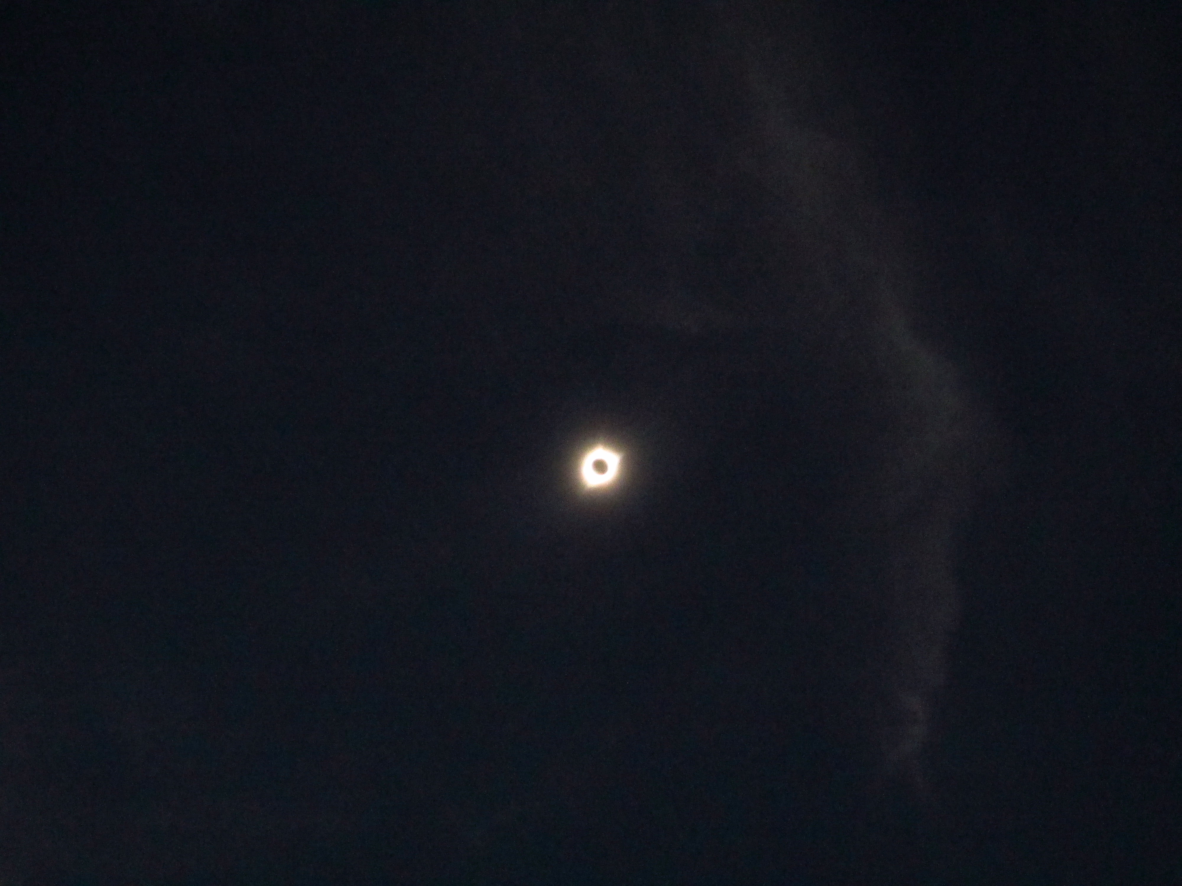
Thank you
Questions?
Candace Gray

Slide 36
Future Work
Investigate the split DEM effect on bremsstrahlung-EUV correlation
Compare specific EUV spectral bands with microwave emission
Use AIA images to compute daily DEMs and bremsstrahlung images
  Stephen White and Tim Henry at AFRL in Albuquerque are working on this
EOVSA daily spectral radio imaging

Slide 37
Outline
Physics Background
  Solar activity, F_{10.7}, and DEMs
F_{10.7} Imaging Analysis
  VLA observation, bremsstrahlung image, and gyroresonance sources
DEM Time Series
  Thermal evolution and the two-state corona
F_{10.7} Bremsstrahlung and Gyroresonance variability
  EUV parameterization and photospheric B-fields
Multi-frequency Considerations
  Spectral comparison and the variable chromosphere

Slide 38
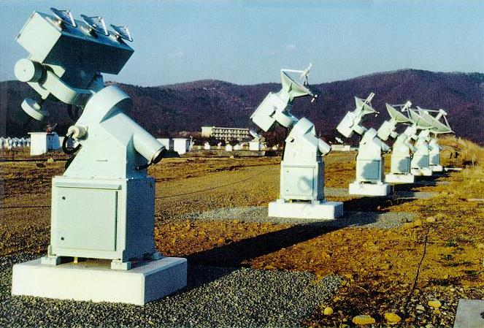
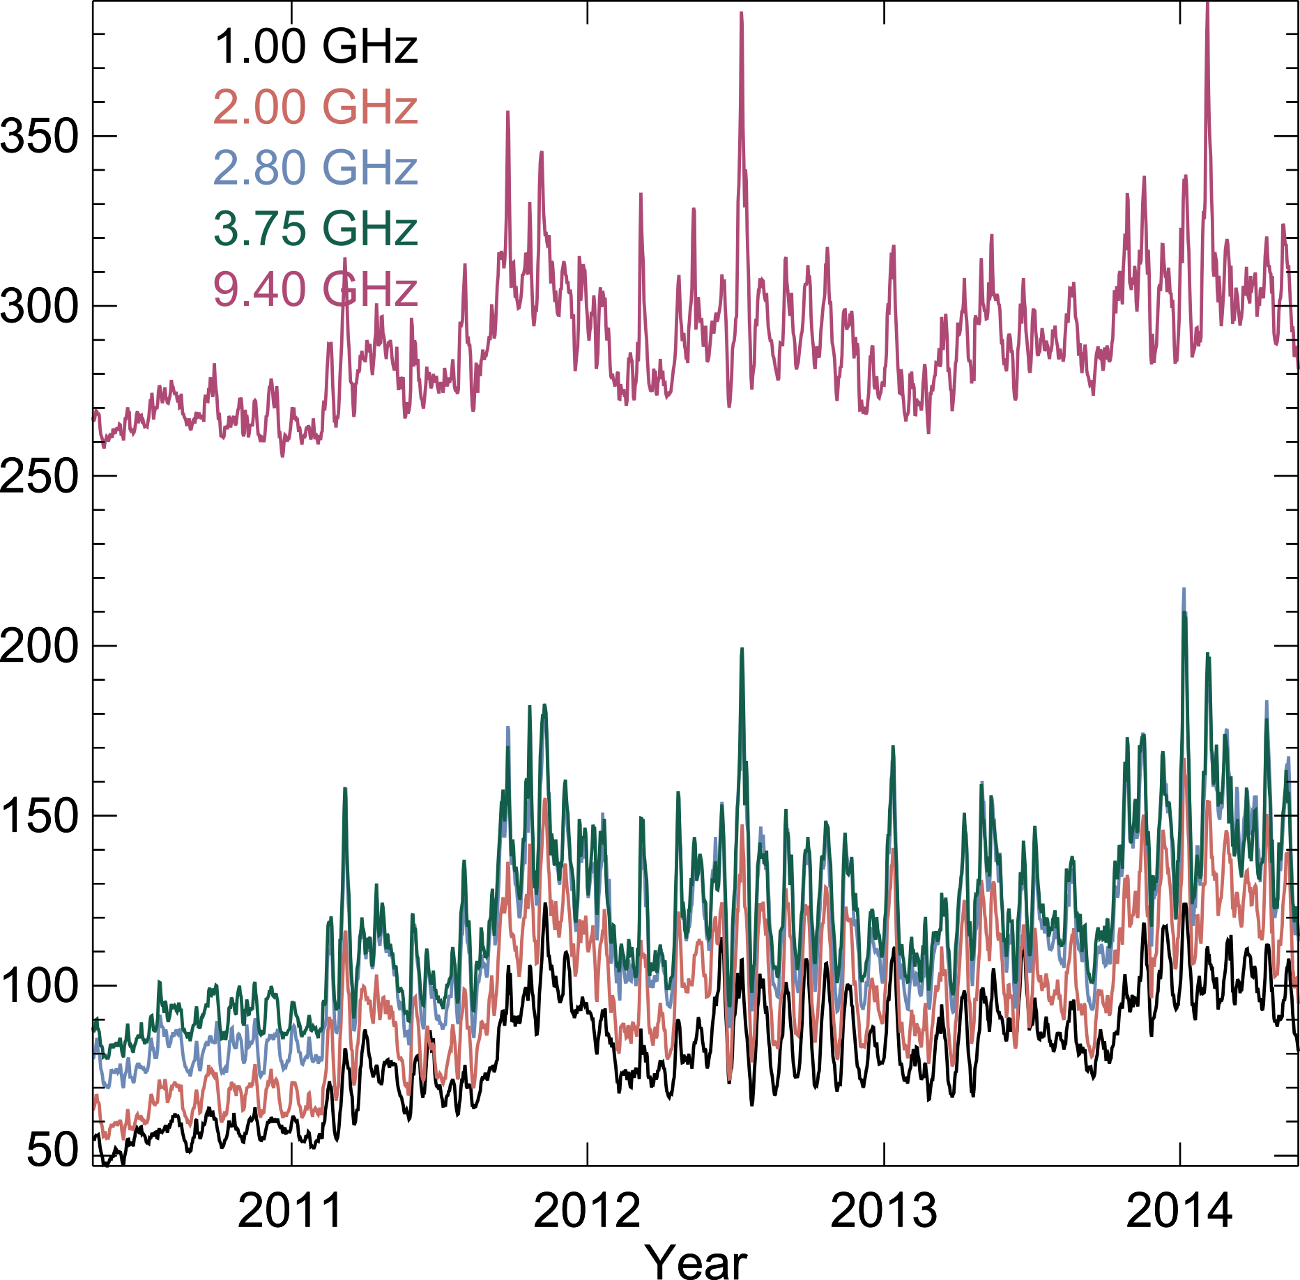
Multi-Frequency Analysis
Nobeyama Radio Polarimeters
  1.0, 2.0, 3.75, 9.4 GHz daily irradiance
Each frequency can be studied with the same analysis as F_{10.7}
Spectra allow source identification
  Can be compared with DEM identification
http://solar.nro.nao.ac.jp/norp/html/introduction.html

Slide 39
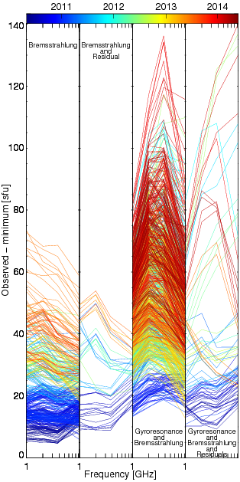
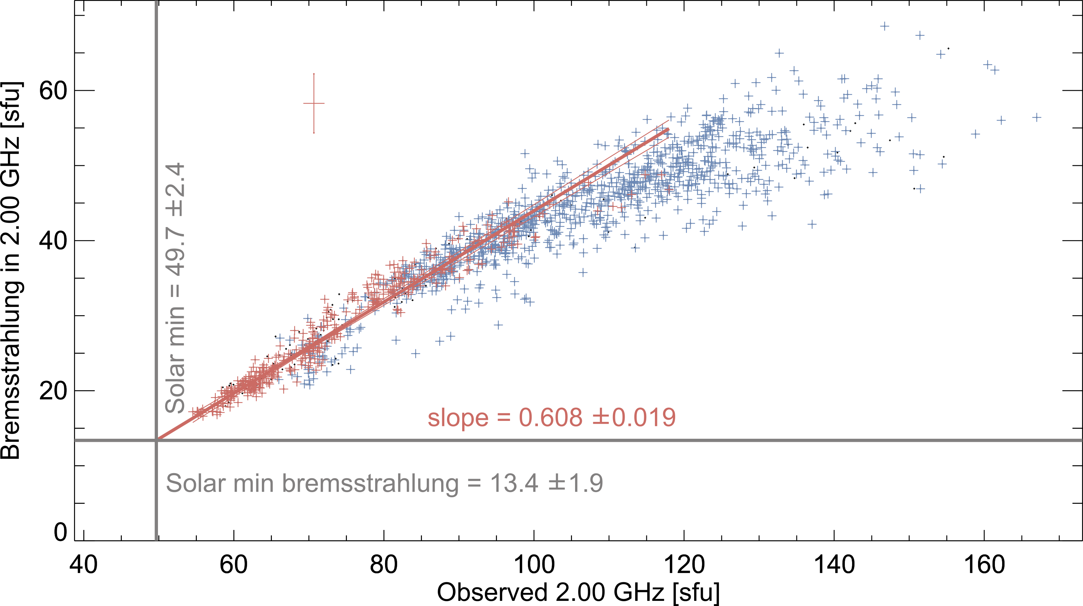
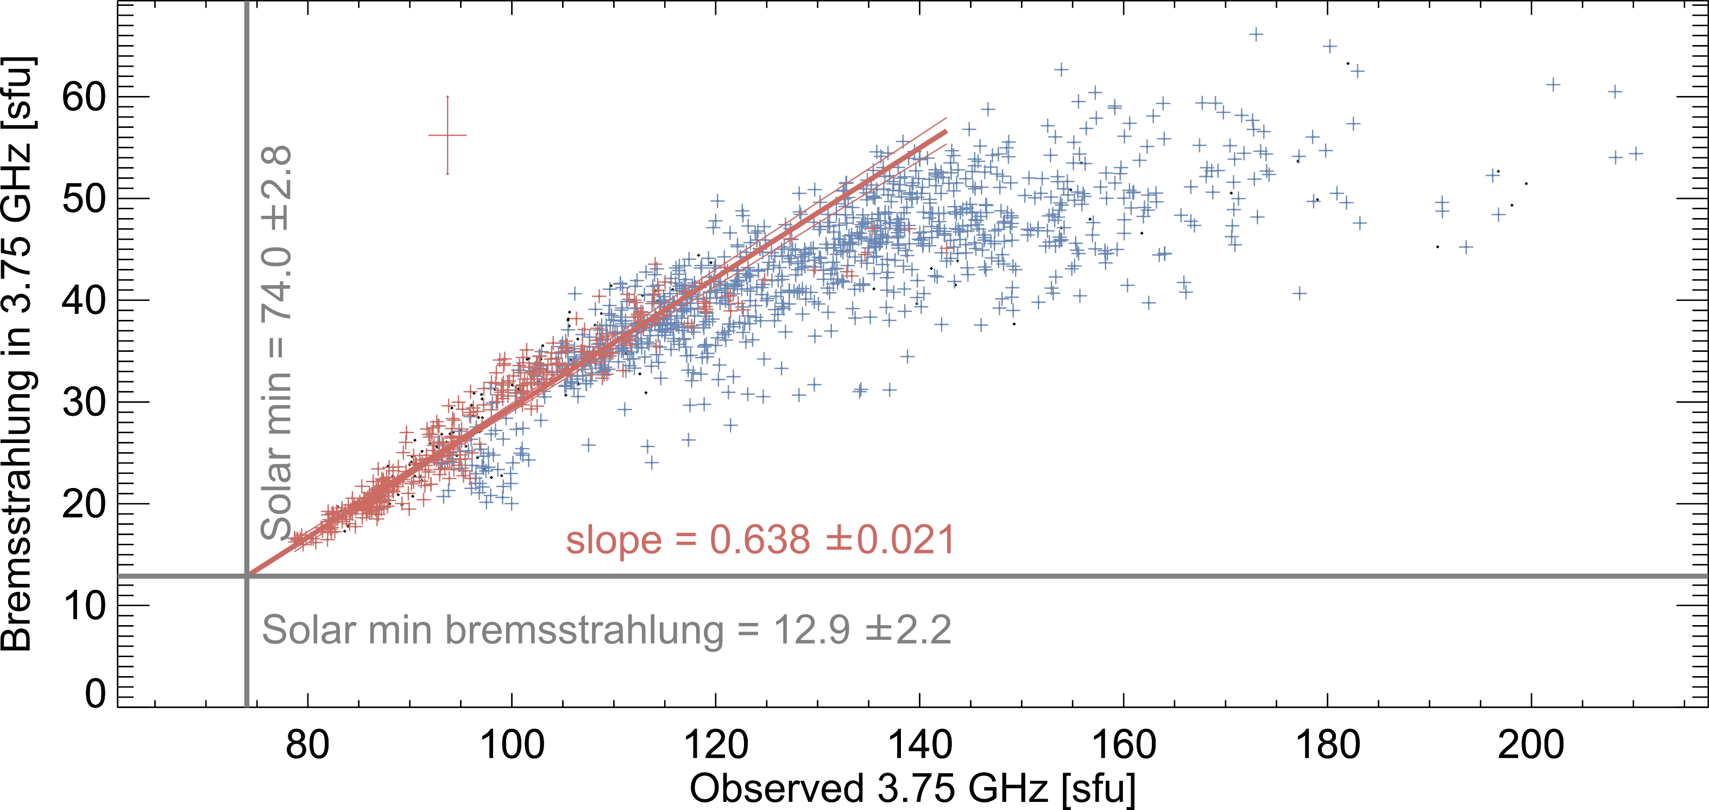
Bremsstrahlung
Gyroresonance

Slide 40
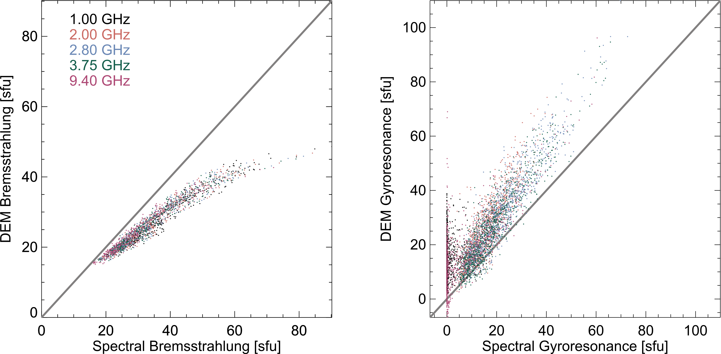
DEM and Spectral Comparison

Slide 41
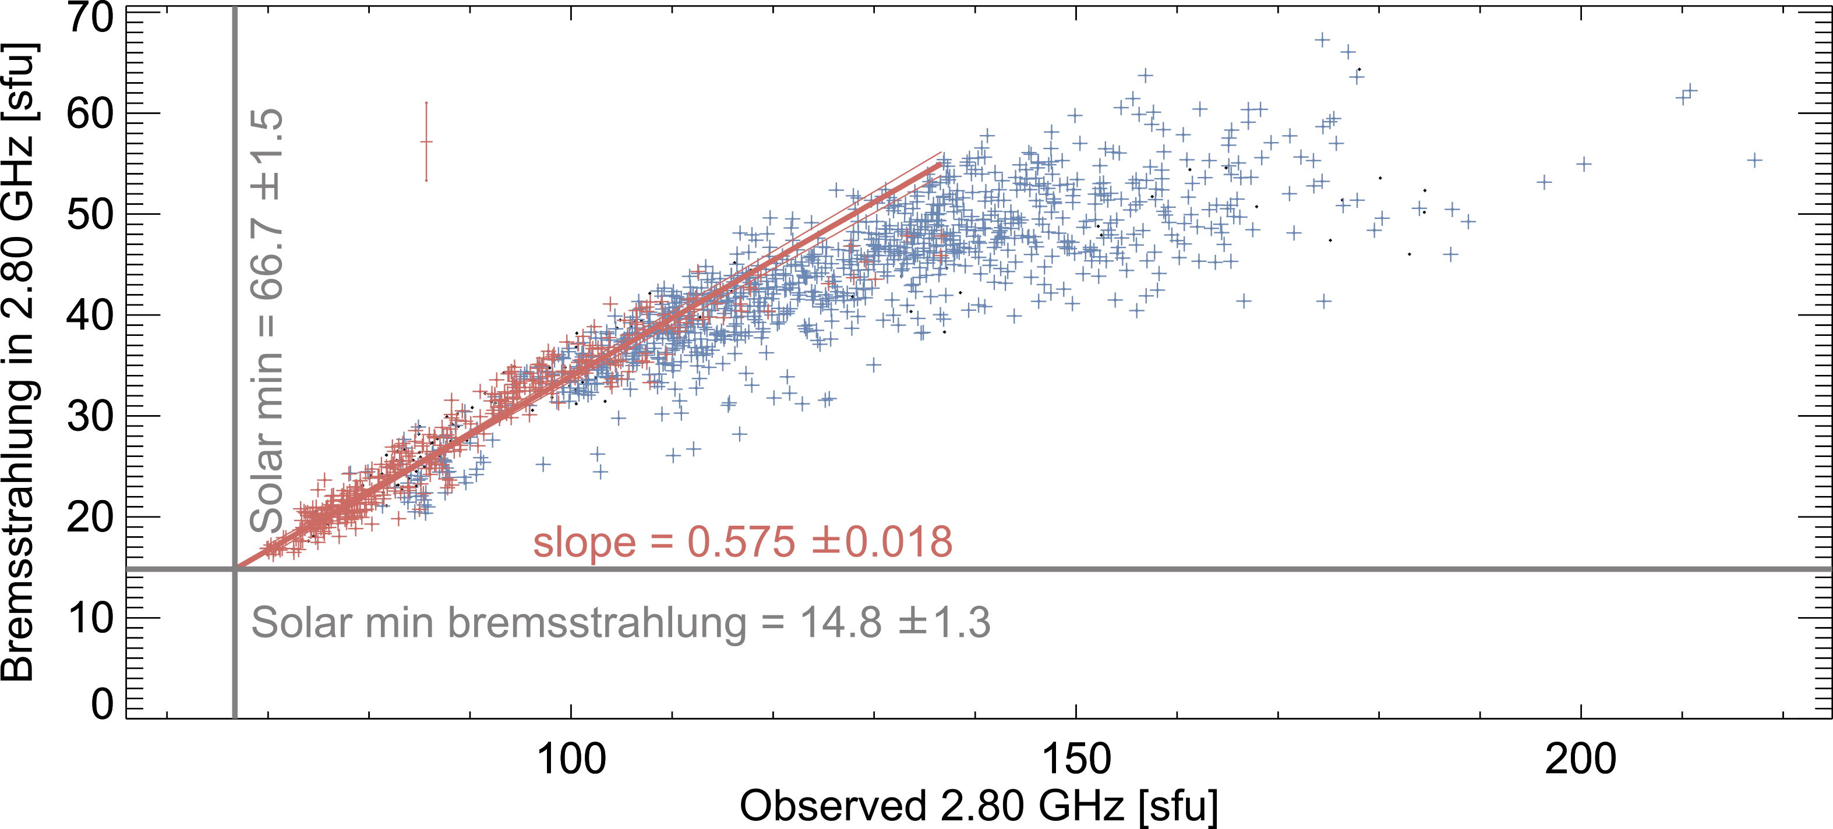
Bremsstrahlung Slope Correction
Bremsstrahlung-only days should have slope=1
Constant chromospheric radio emission?
Bremsstrahlung
Gyroresonance

Slide 42
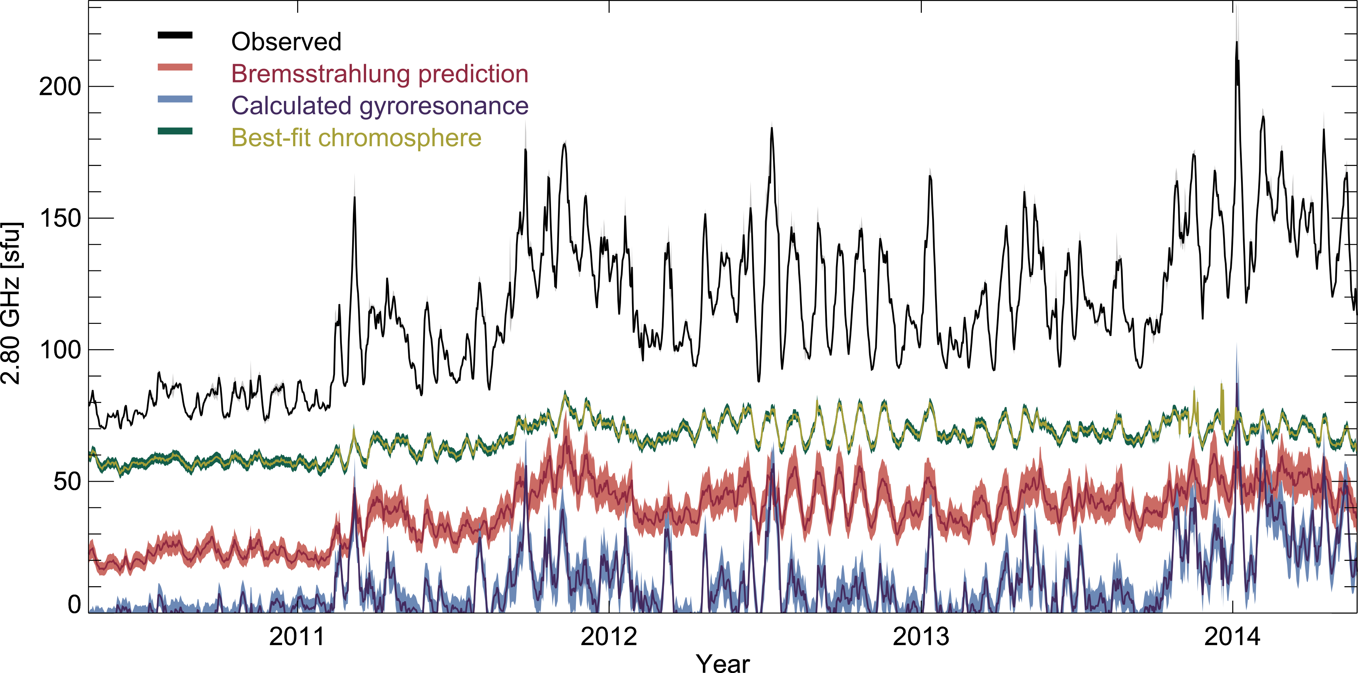
Variable Chromosphere

Slide 43
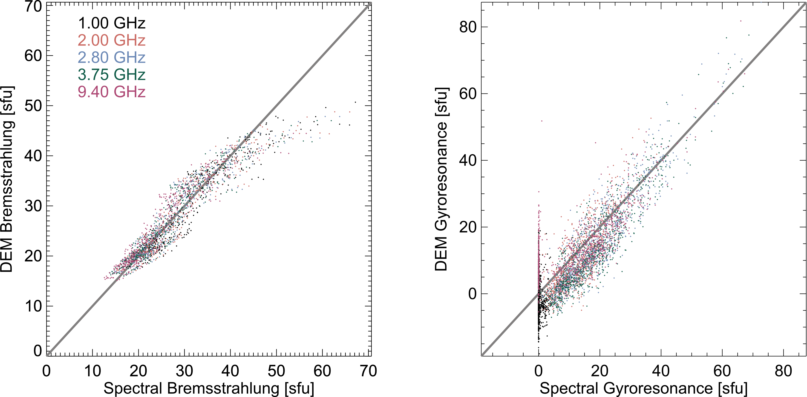
Variable Chromosphere Comparison

Slide 44
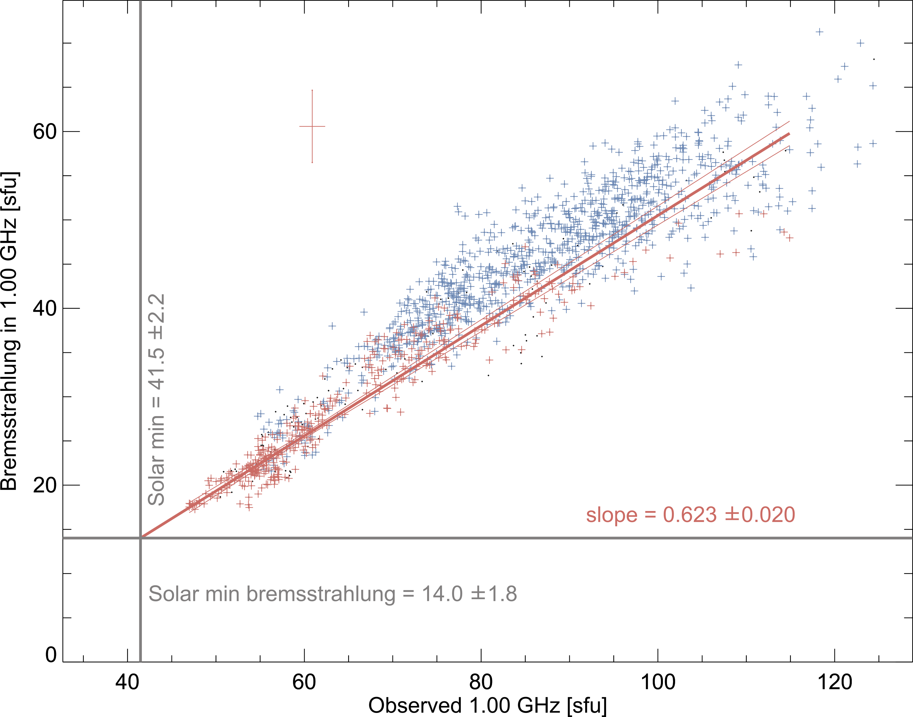
Multi-frequency Results
Spectral separation of bremsstrahlung and gyroresonance
Determination of solar minimum chromosphere
Bremsstrahlung slope discrepancy
  Chromospheric variability

Slide 45

Recent F_{10.7} Imaging Study
Allen Telescope Array
  1.43—6 GHz with 3.15' –0.75' resolution
    1.63' at 2.75 GHz (10.9 cm)
Identified gyroresonance from spectral index of active regions
  Estimated gyroresonance ≈75% of active region at 2.75 GHz
  Others pure bremsstrahlung
Saint-Hilaire et al 2012

Slide 47
High Polarization Regions
Region 3
Region 4
Region 10
Region 15

Slide 48
Individual Region Fluxes
F_{10.7} flux
To Earth

Slide 49
EVE lines
AIA filters
DEM components
Warm
Hot
Solar min
Cool
Warm
Solar max
Cool
Warm
Cool

Slide 50


Coronal Radiative Loss

Slide 51


Slide 52

Scaled F_{10.7} Relationship
Scaled averaging

Slide 53

F_{10.7} as Proxy of Extended EUV
EUV observations by the TIMED SEE low resolution spectrograph
Longer EUV wavelengths have more chromospheric emission
  e.g. Lyman continuum
  Weaker correlation with coronal DEMs
High activity saturation and low activity splitting

Slide 54


Bremsstrahlung
Gyroresonance

Slide 55


Rotation Delay Theory

Slide 56


Slide 57





Slide 58

Gyroresonance Significance with a Variable Chromosphere

Slide 59

Corrected Iron Abundance Comparison

