Slide 1
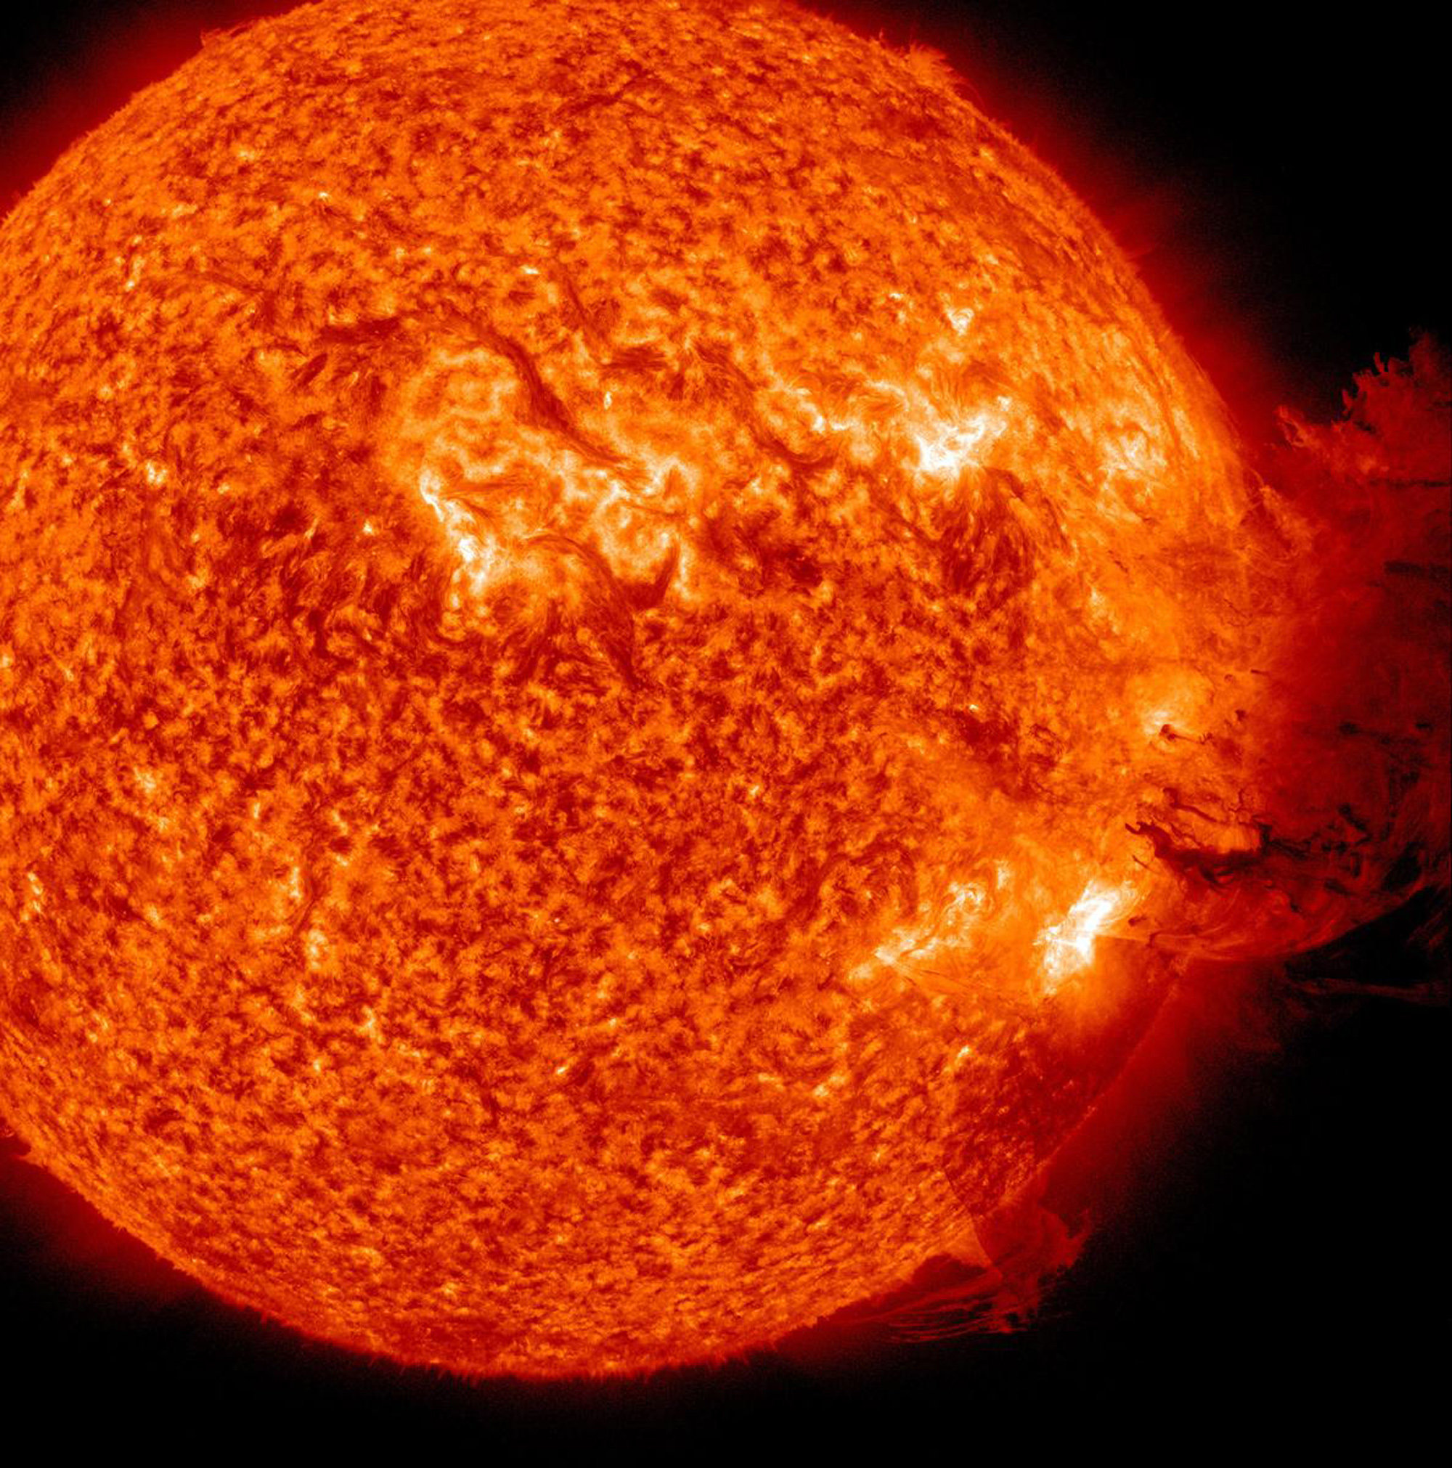


The Slowly Varying Corona: Findings using DEMs from the EVE MEGS-A Dataset
Sam Schonfeld
Stephen White, Rachel Hock-Mysliwiec, Carl Henney, James McAteer
SPD Dissertation Talk, 8/25/2017

Slide 2
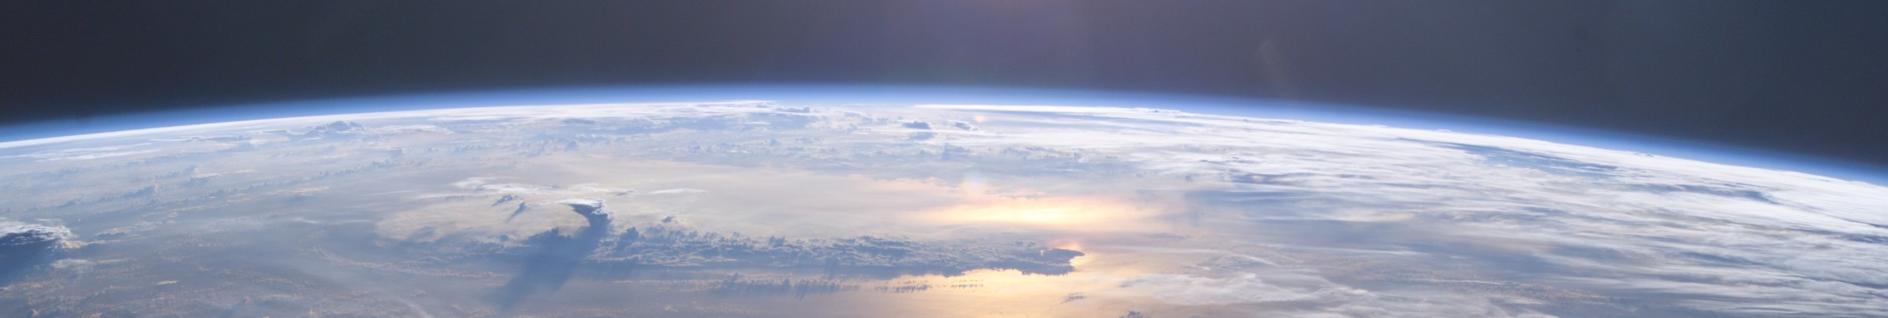
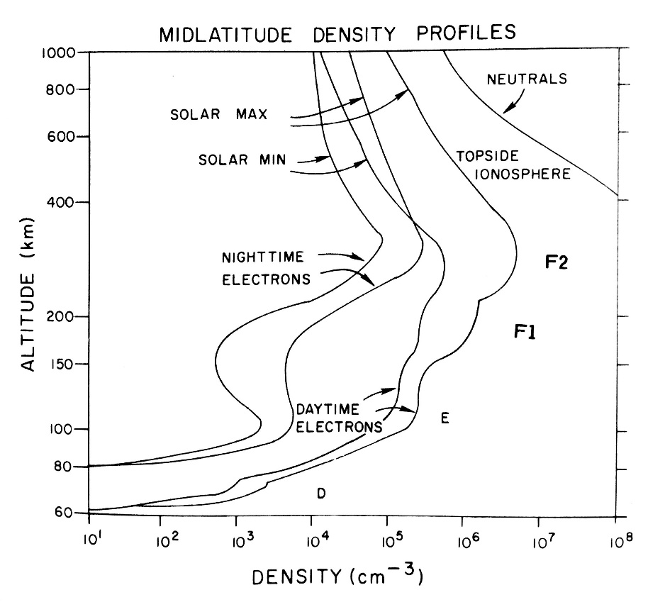
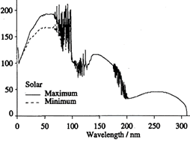
NASA
Altitude [km]
Thermosphere/Ionosphere
EUV
Solar Min
Solar Max
Haigh 2004
Wavelength [nm]
Rich 1985

Slide 3
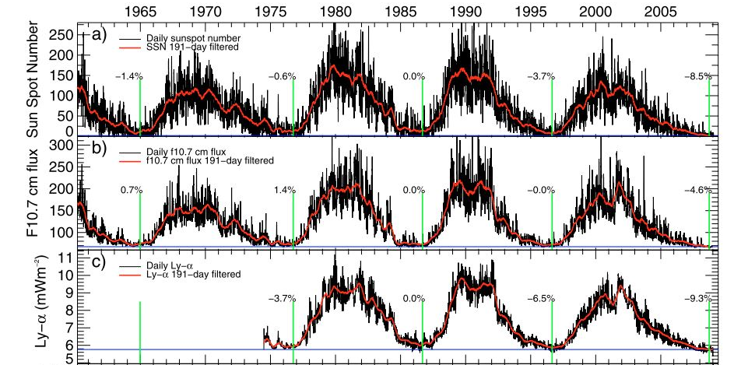
F_{10.7} Index
10.7 cm (2.8 GHz) radio flux, 70 year dataset (Tapping 1987)
EUV proxy used for atmospheric research
1 sfu = 10⁴ Jy
Fröhlich 2009

Slide 4
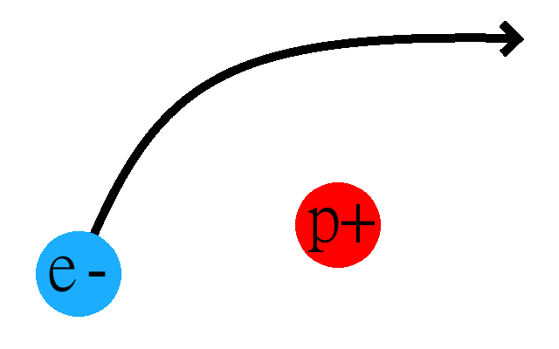
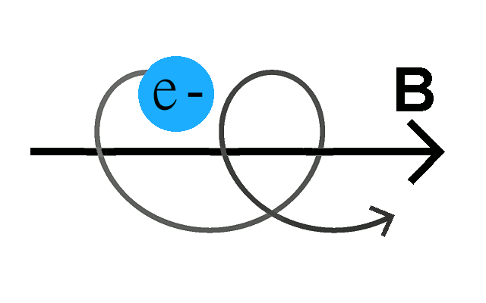
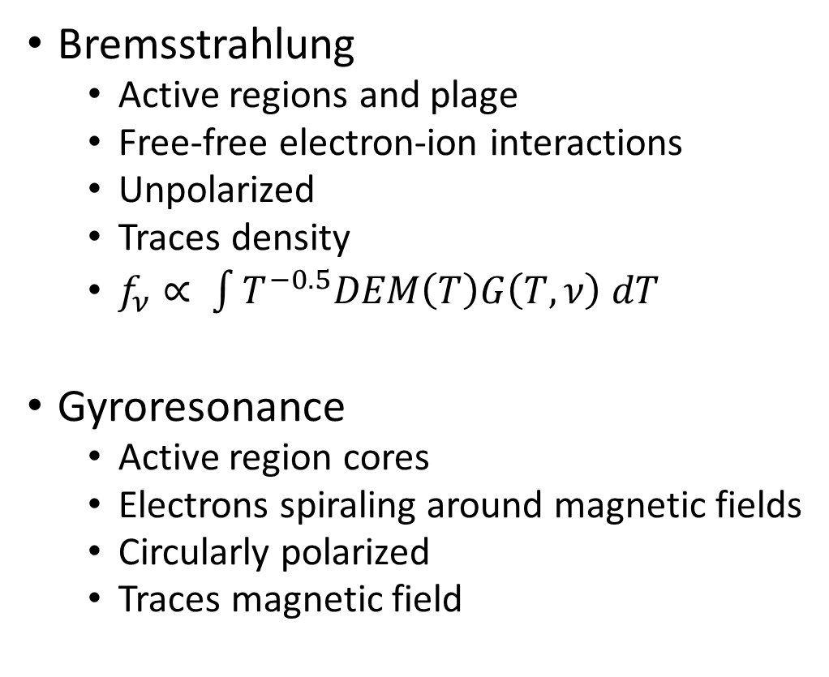
F_{10.7} Generation Mechanisms
Bremsstrahlung
  Active regions and plage
  Free-free electron-ion interactions
  Unpolarized
  Traces density
  $f_{ν}∝ \int{T^{−0.5}DEM\left(T\right)G\left(T,ν\right) dT}$
Gyroresonance
  Active region cores
  Electrons spiraling around magnetic fields
  Circularly polarized
  Traces magnetic field

Slide 5
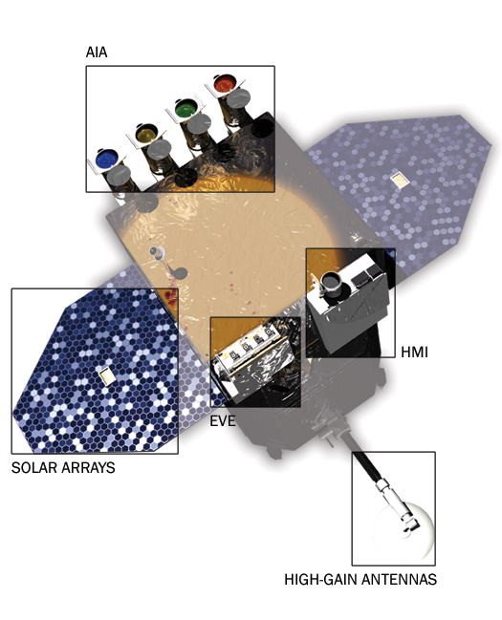
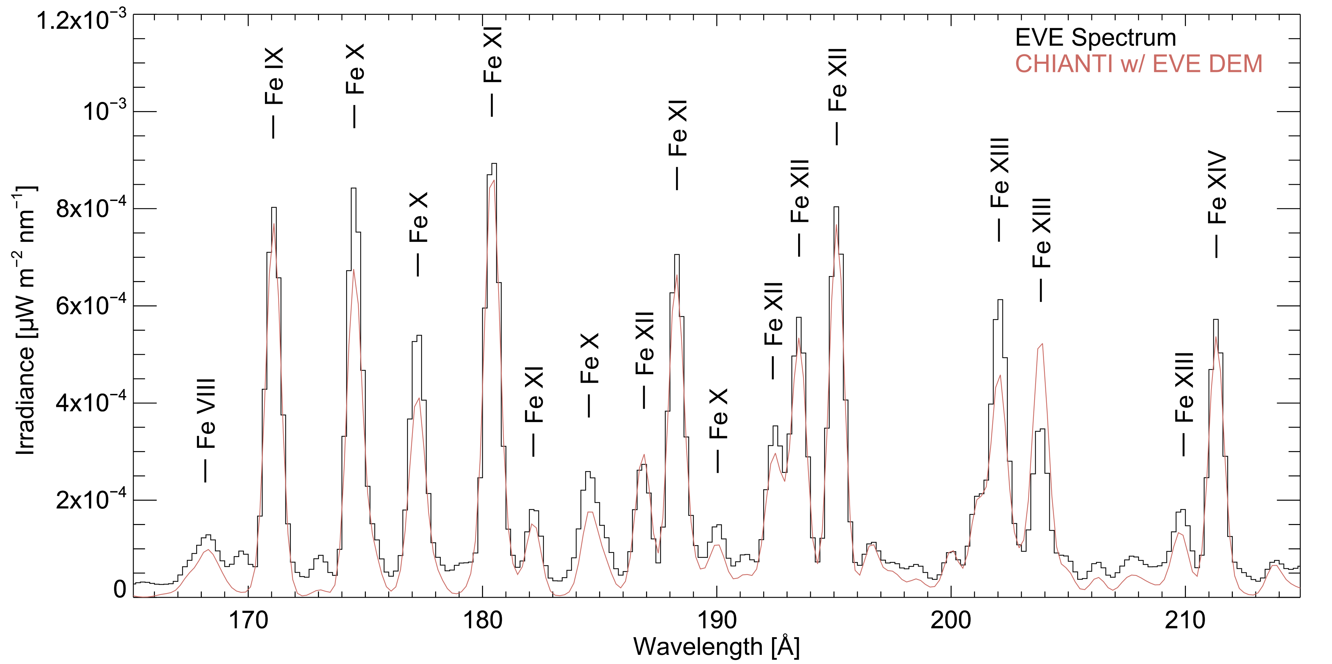
EVE MEGS-A Irradiance Spectroscopy
Four-year, calibrated, EUV irradiance spectra covering the rise of Solar Cycle 24
CHIANTI 8.0.2 line identification

Slide 6
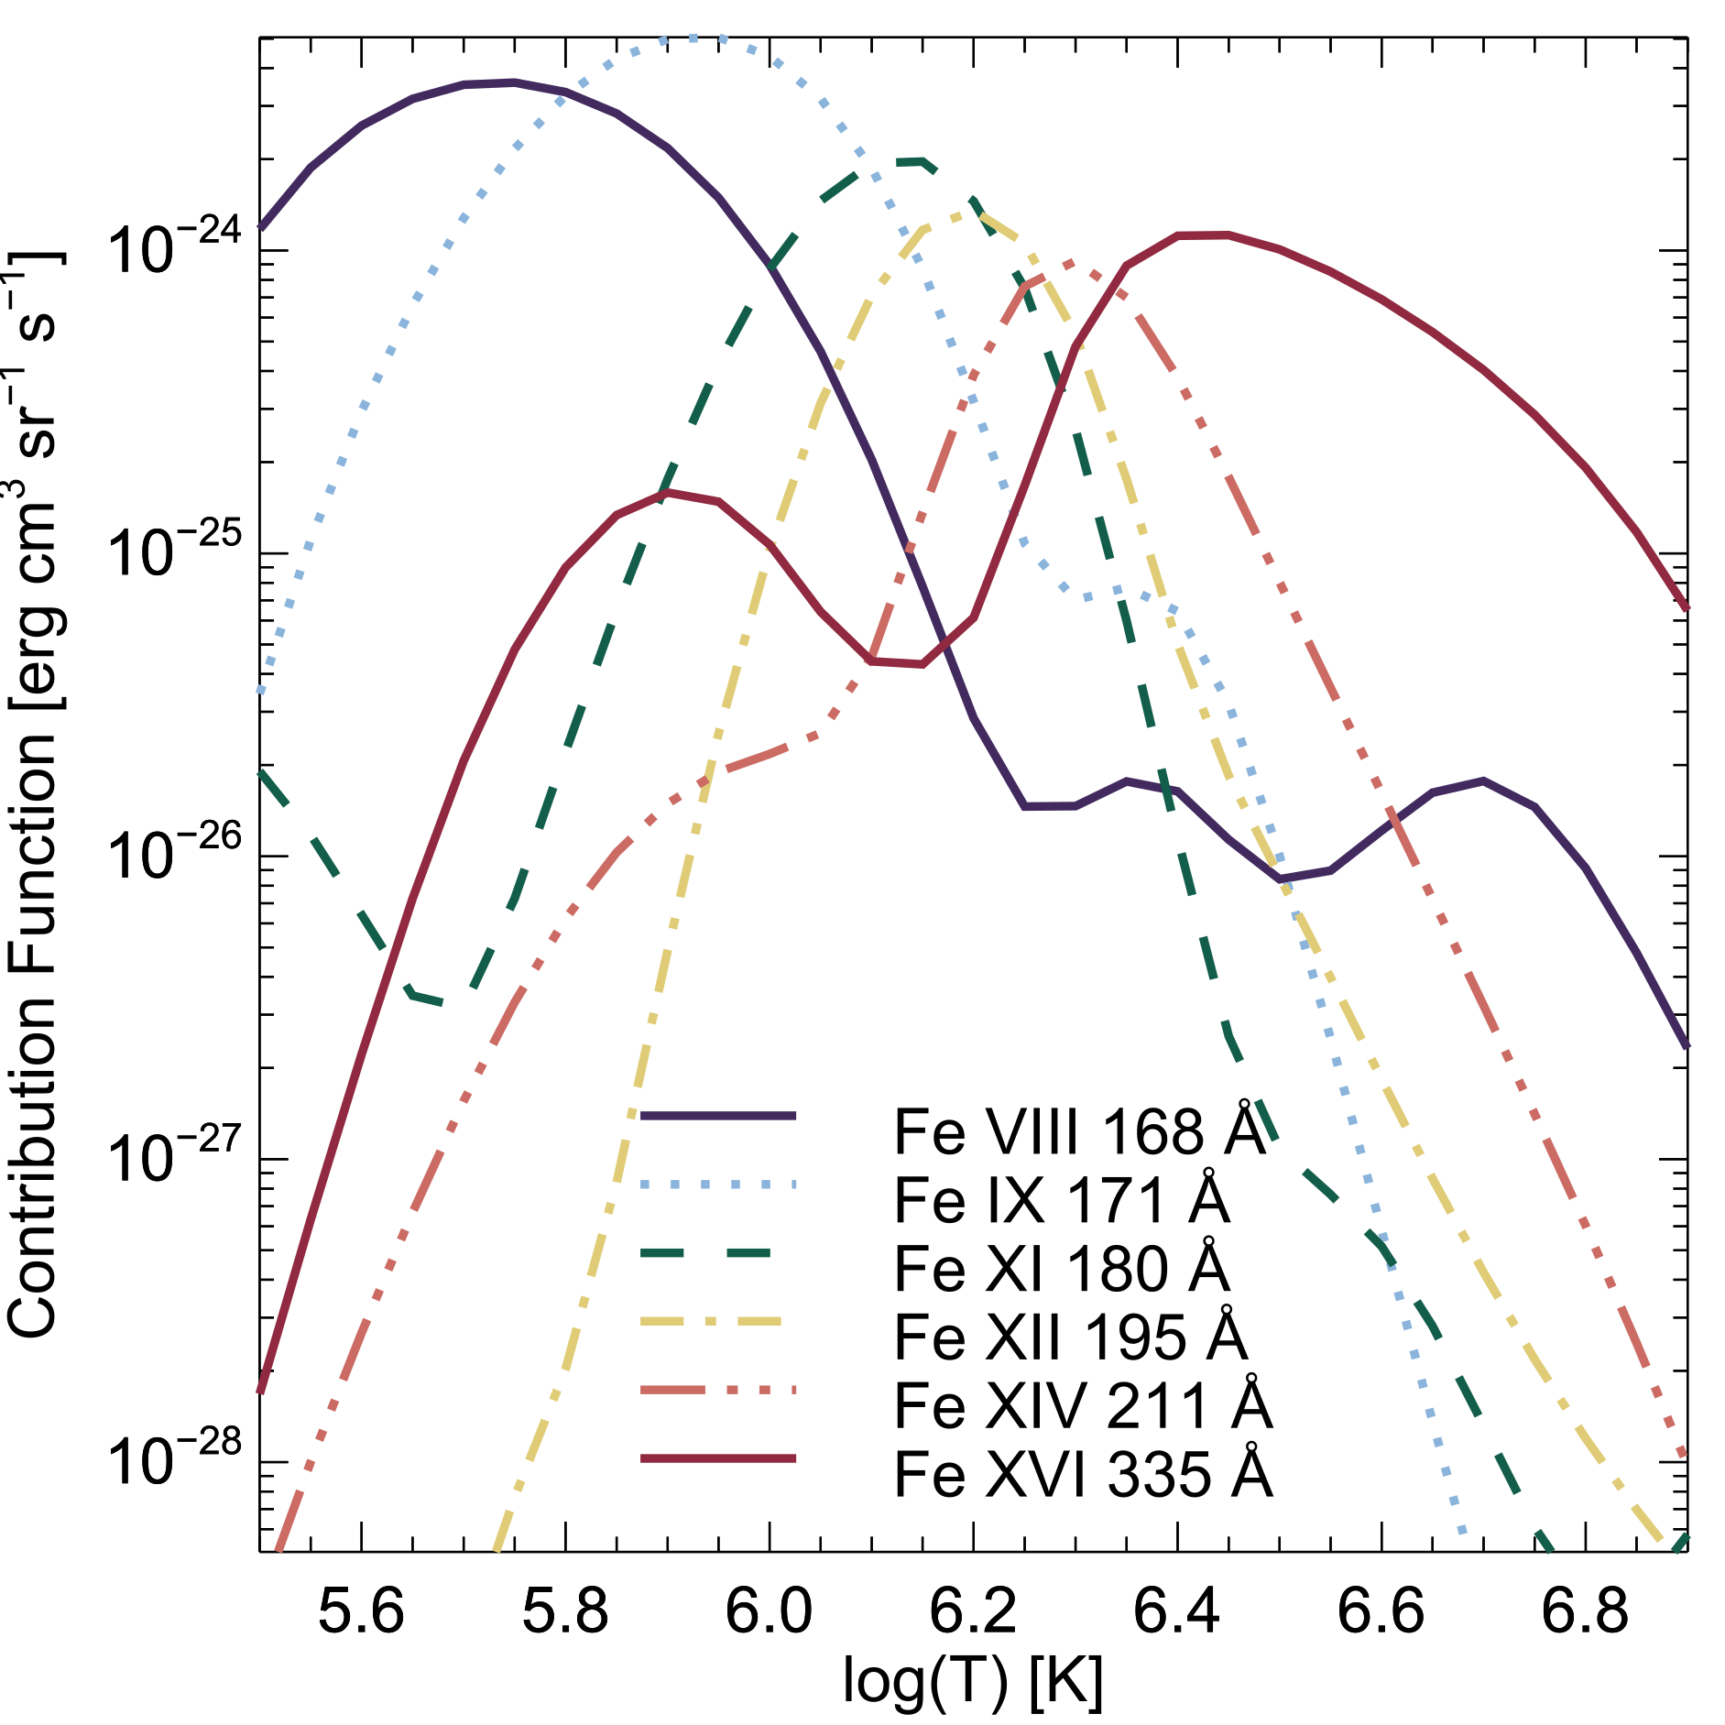
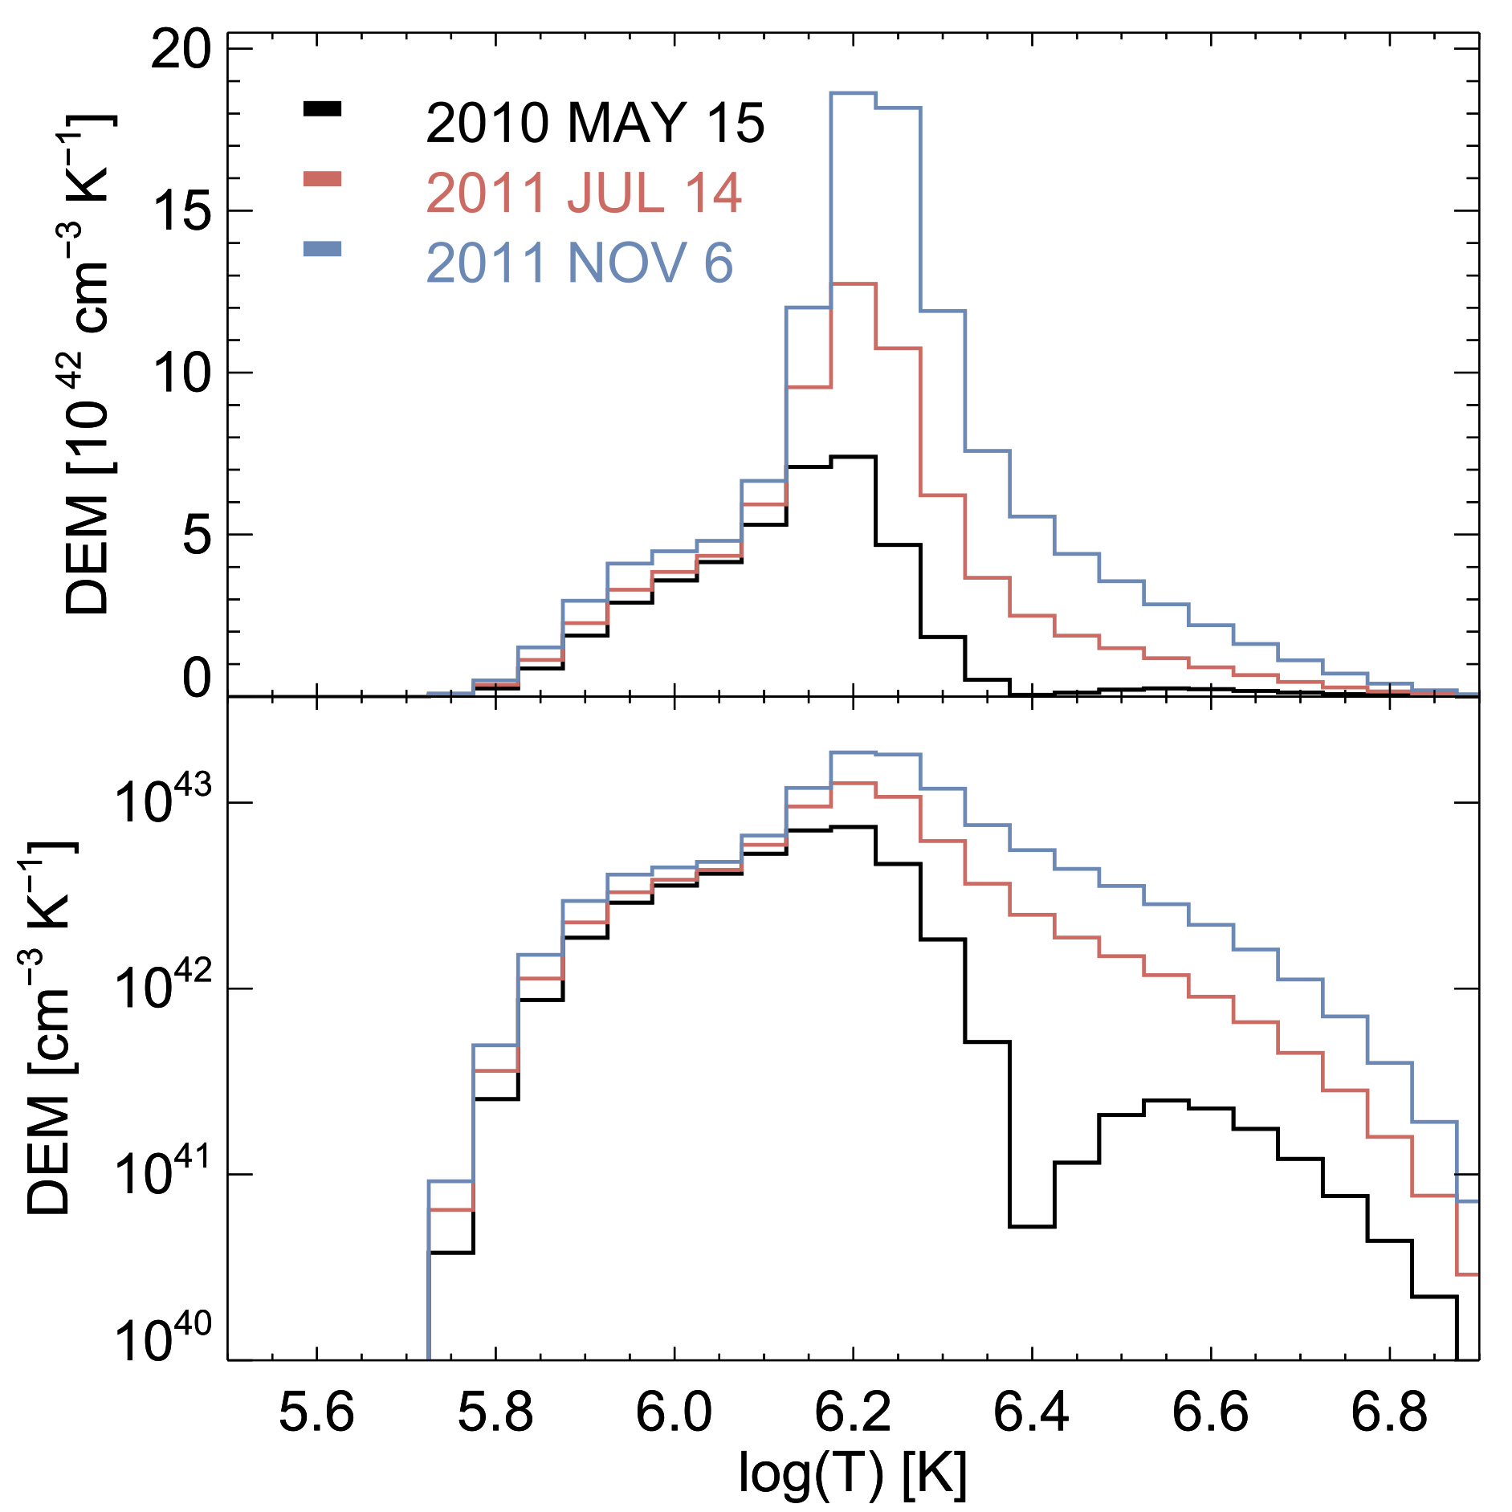

DEM Calculation
$DEM\left(T\right)= \int{\frac{d n_{e}\left(s\right)n_{H}\left(s\right)}{dT\left(s\right)}ds}$
$I_{λ}= \int{R_{λ}\left(T\right)DEM\left(T\right) dT}$

Slide 7
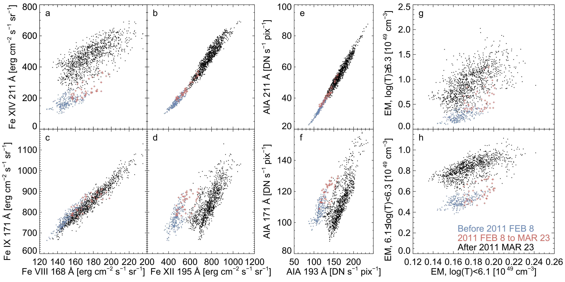
EVE lines
AIA filters
DEM components
Warm
Hot
Cool
Warm
Cool
Warm
Cool

Slide 8
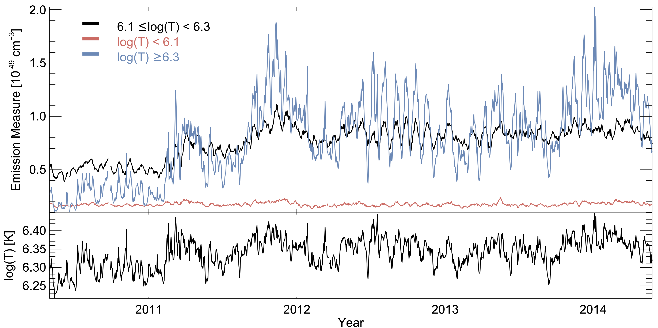
DEM Time Series

Slide 9
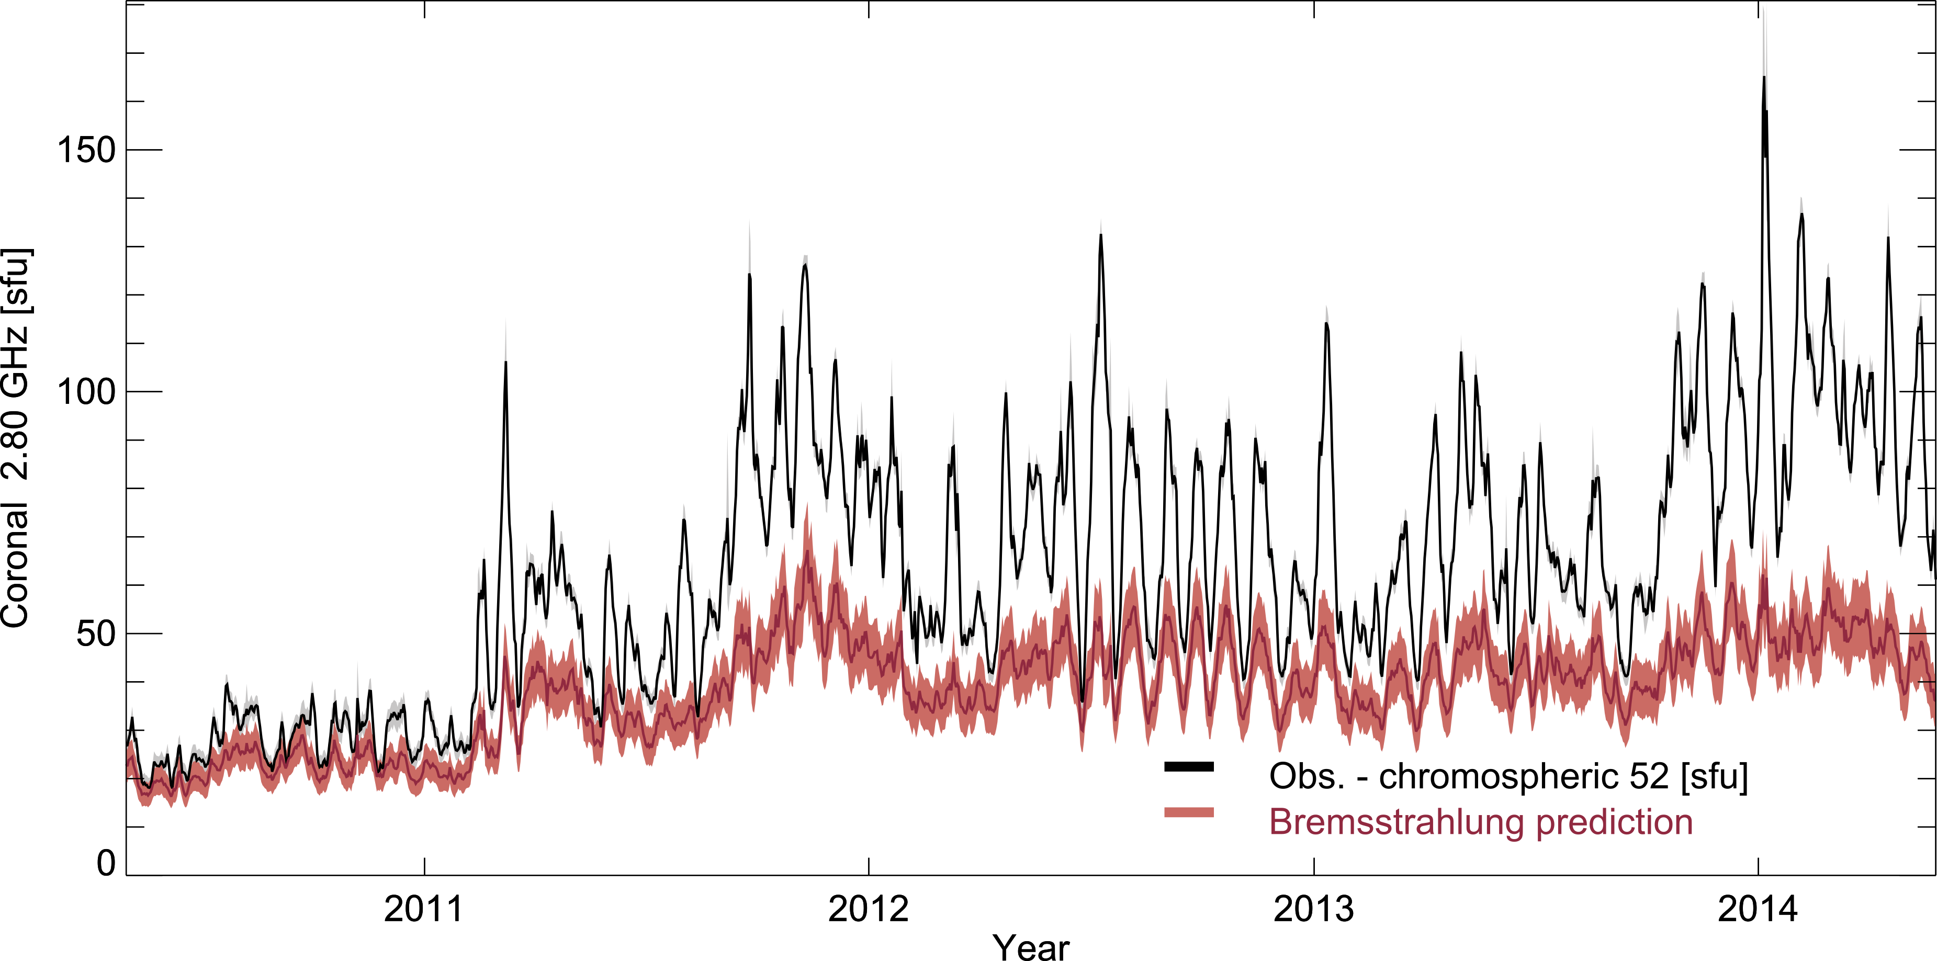

Slide 10
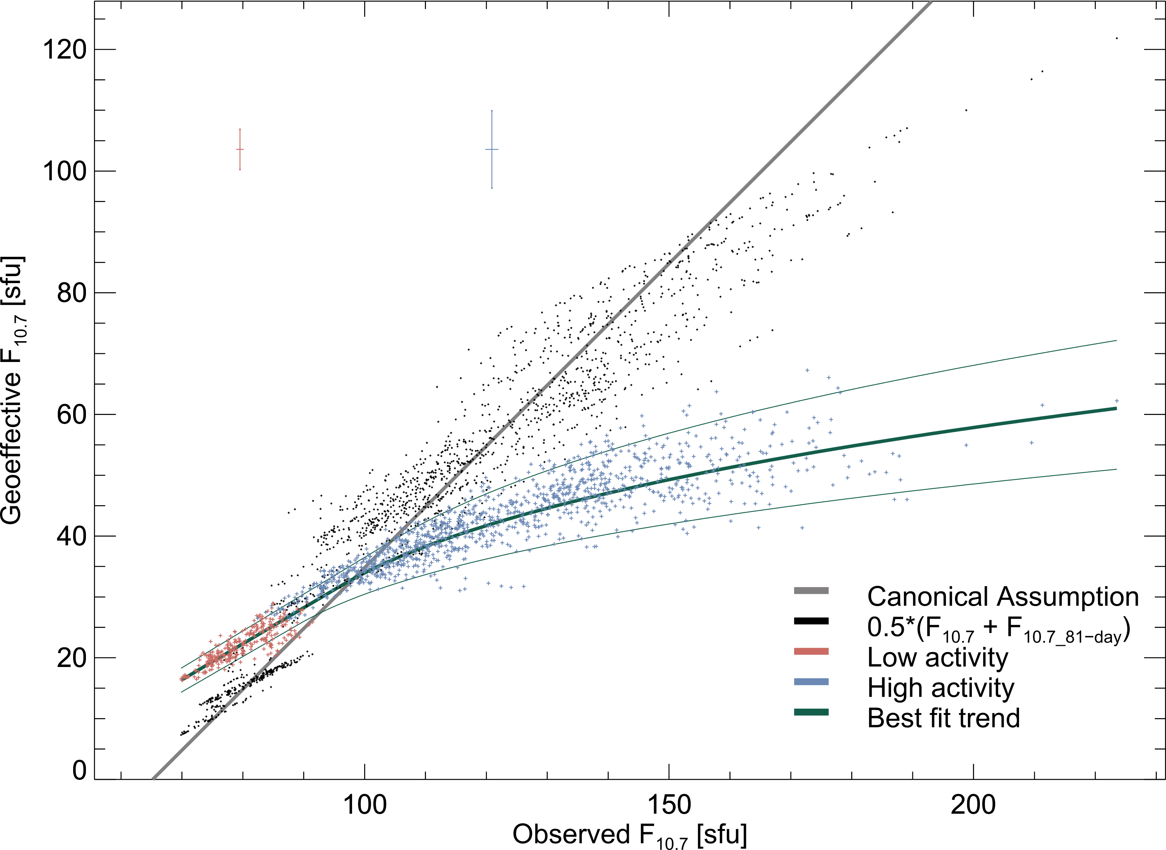

Slide 11
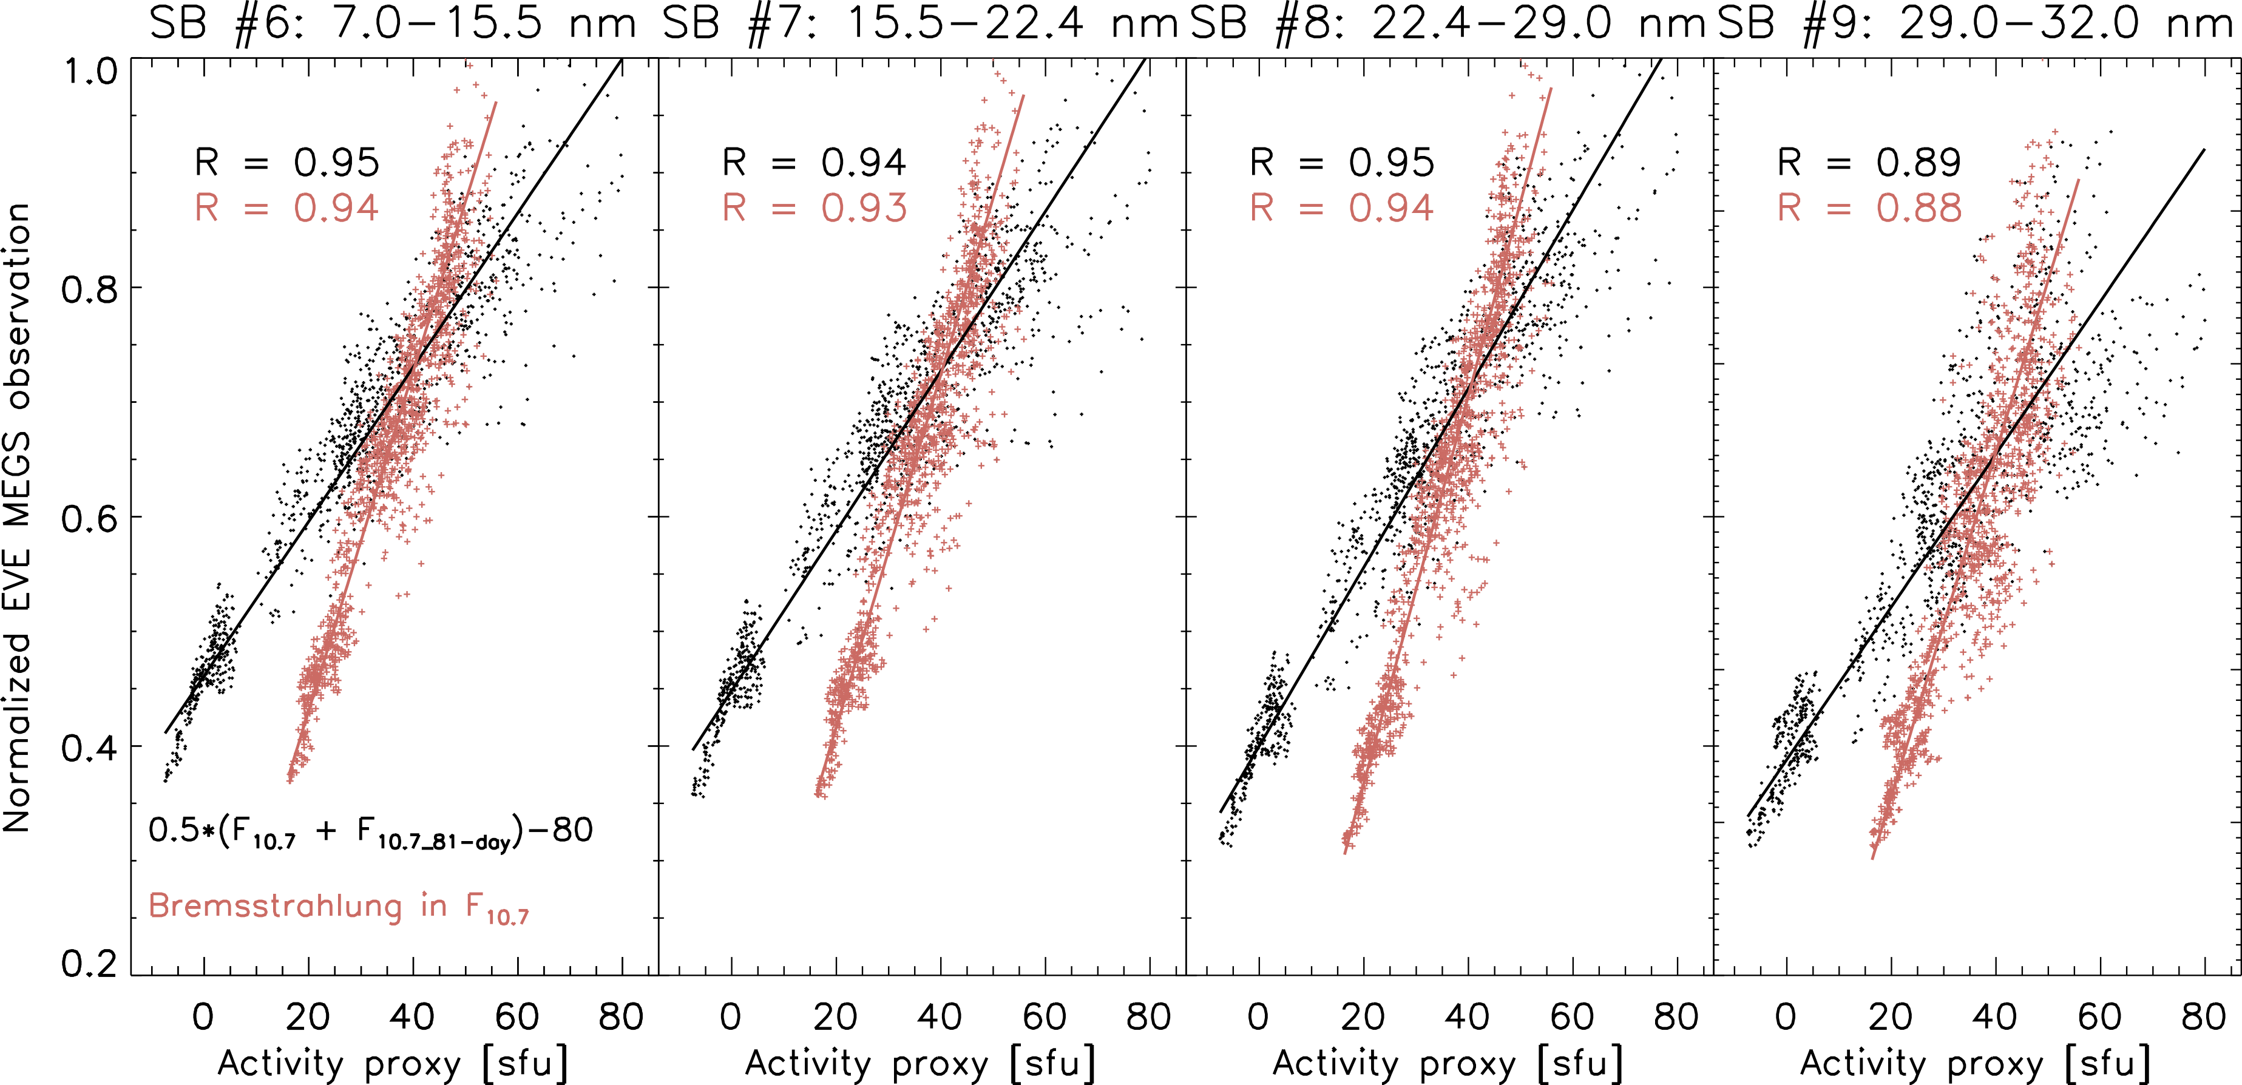
F_{10.7} as an EUV Proxy
EUVAC model (Richards, Fennelly, and Torr 1994) scales the EUV spectrum between two solar minimum and maximum observations using F_{10.7}

Slide 12
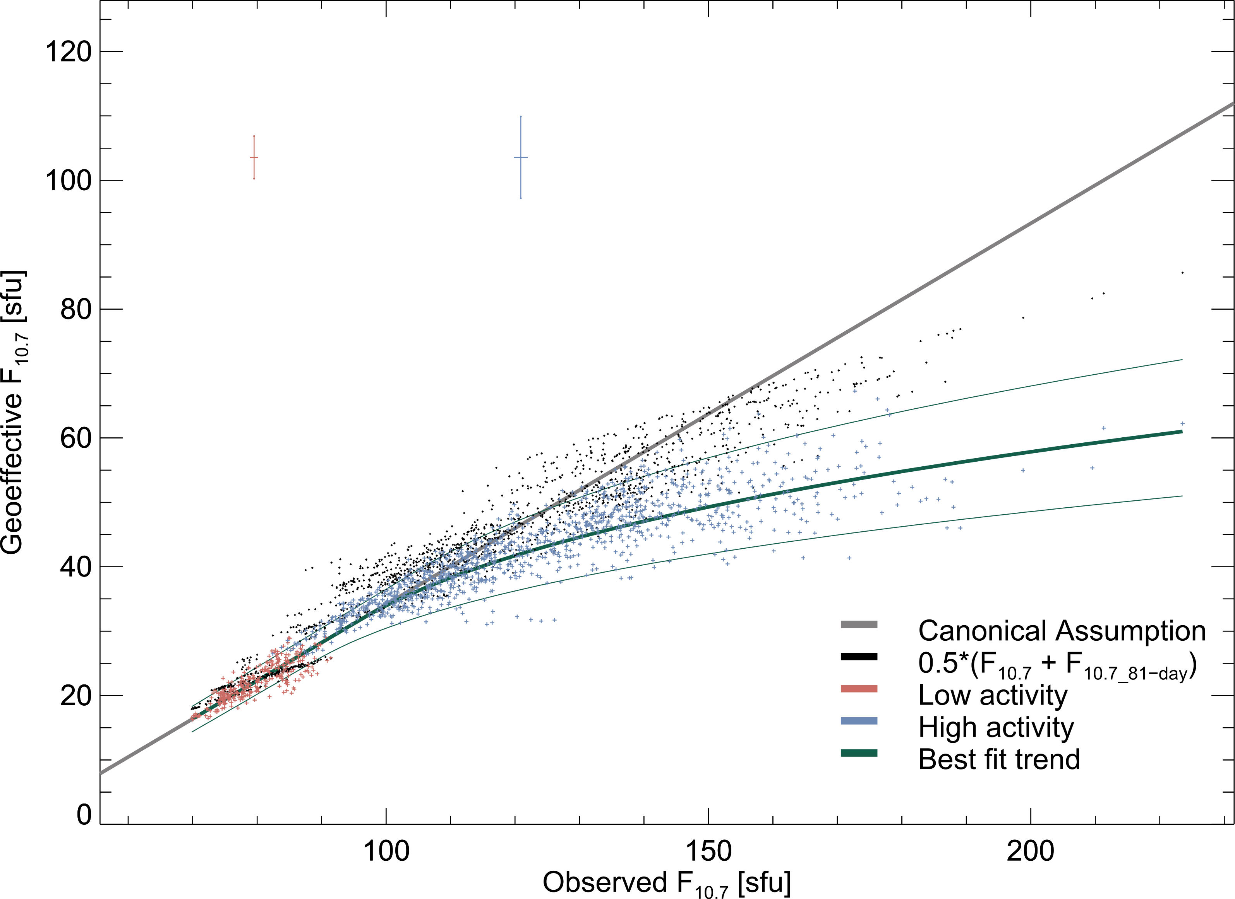
Scaled F_{10.7} Relationship
Scaled averaging

Slide 13
Conclusions
Schonfeld et al. 2017 ApJ 844 163

Slide 14
Thank you
Questions?

Slide 15
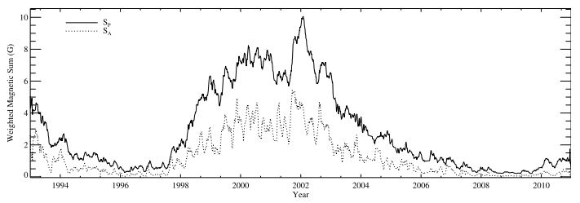
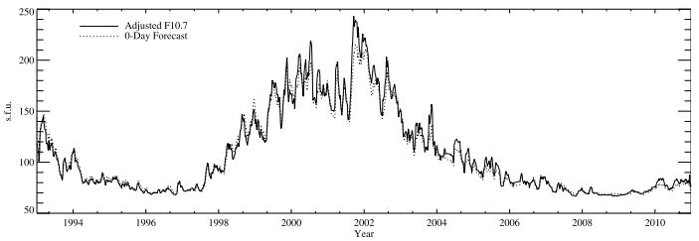
F_{10.7} from Photospheric B field
Henney et al 2012

Slide 16
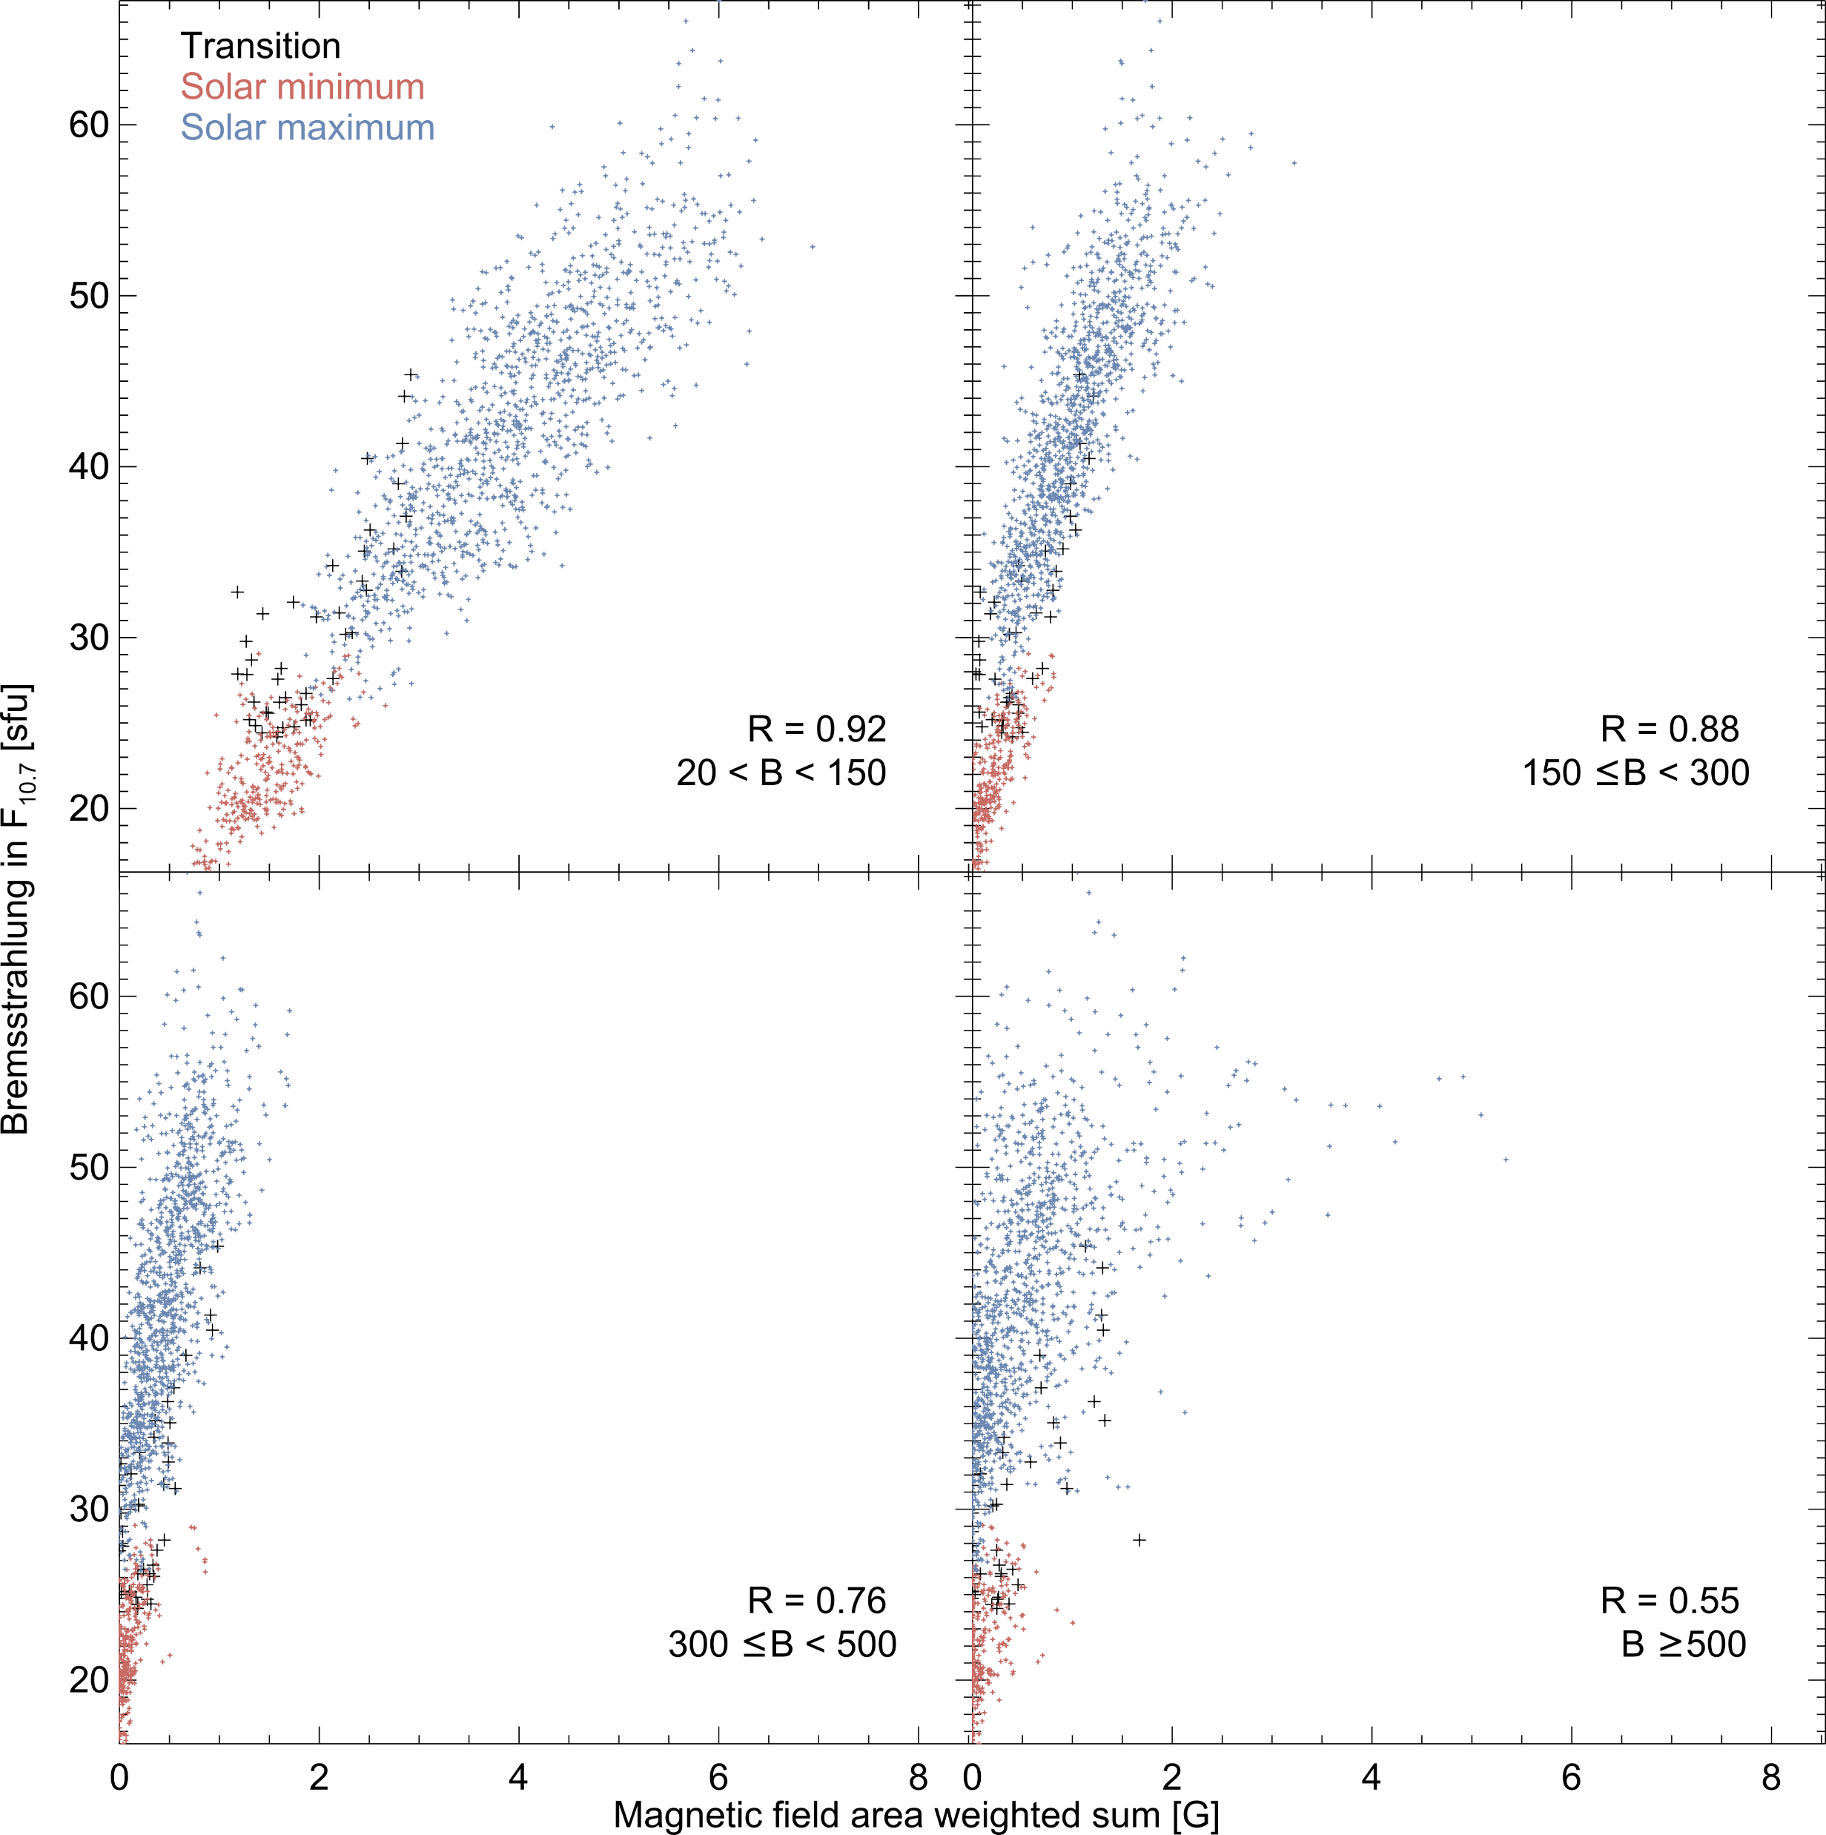
F_{10.7} and B-field
Henney et al 2012 used photospheric B-field (plage and active region) to forecast F_{10.7}
Bremsstrahlung compared with same B-field observations
  Correlates best with the weakest field strengths
R = 0.92
20 < B < 150
R = 0.88
150 < B < 300
Bremsstrahlung in F_{10.7} [sfu]
R = 0.76
300 < B < 500
R = 0.76
B ≥ 500
Area weighted magnetic field [G]

Slide 17
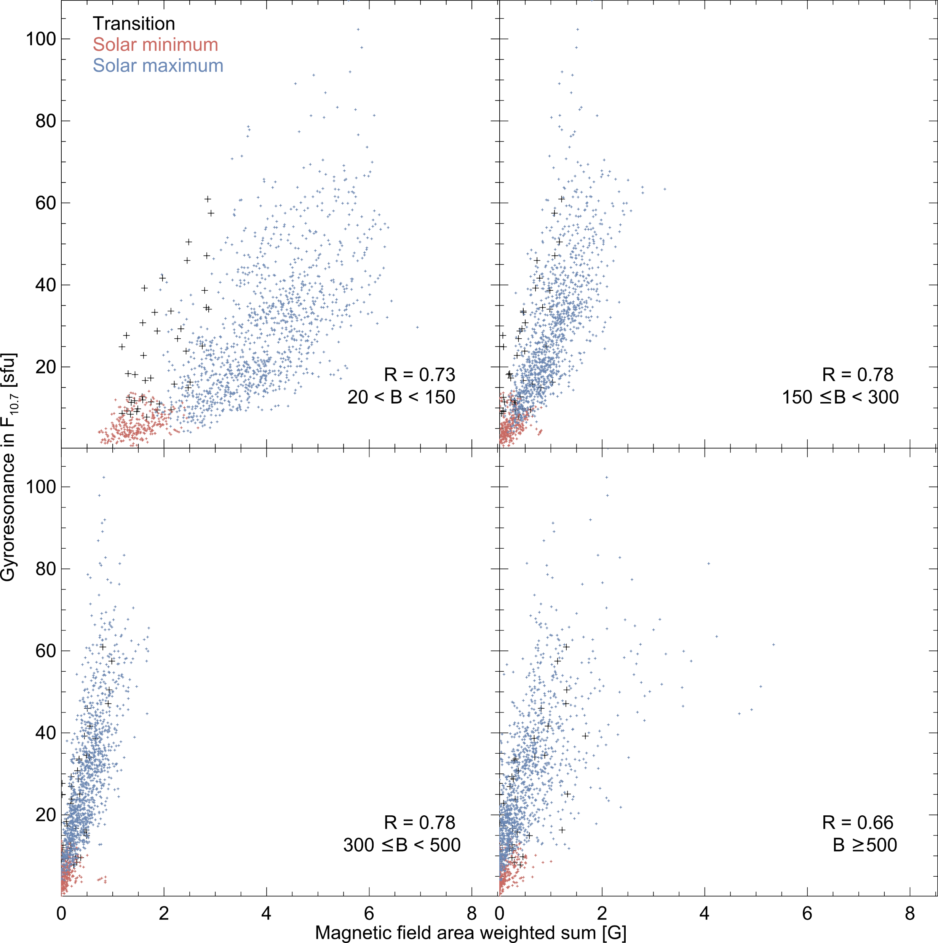
Bremsstrahlung
Gyroresonance

Slide 18
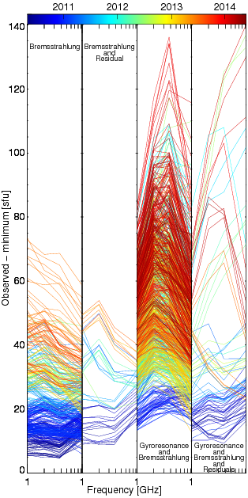
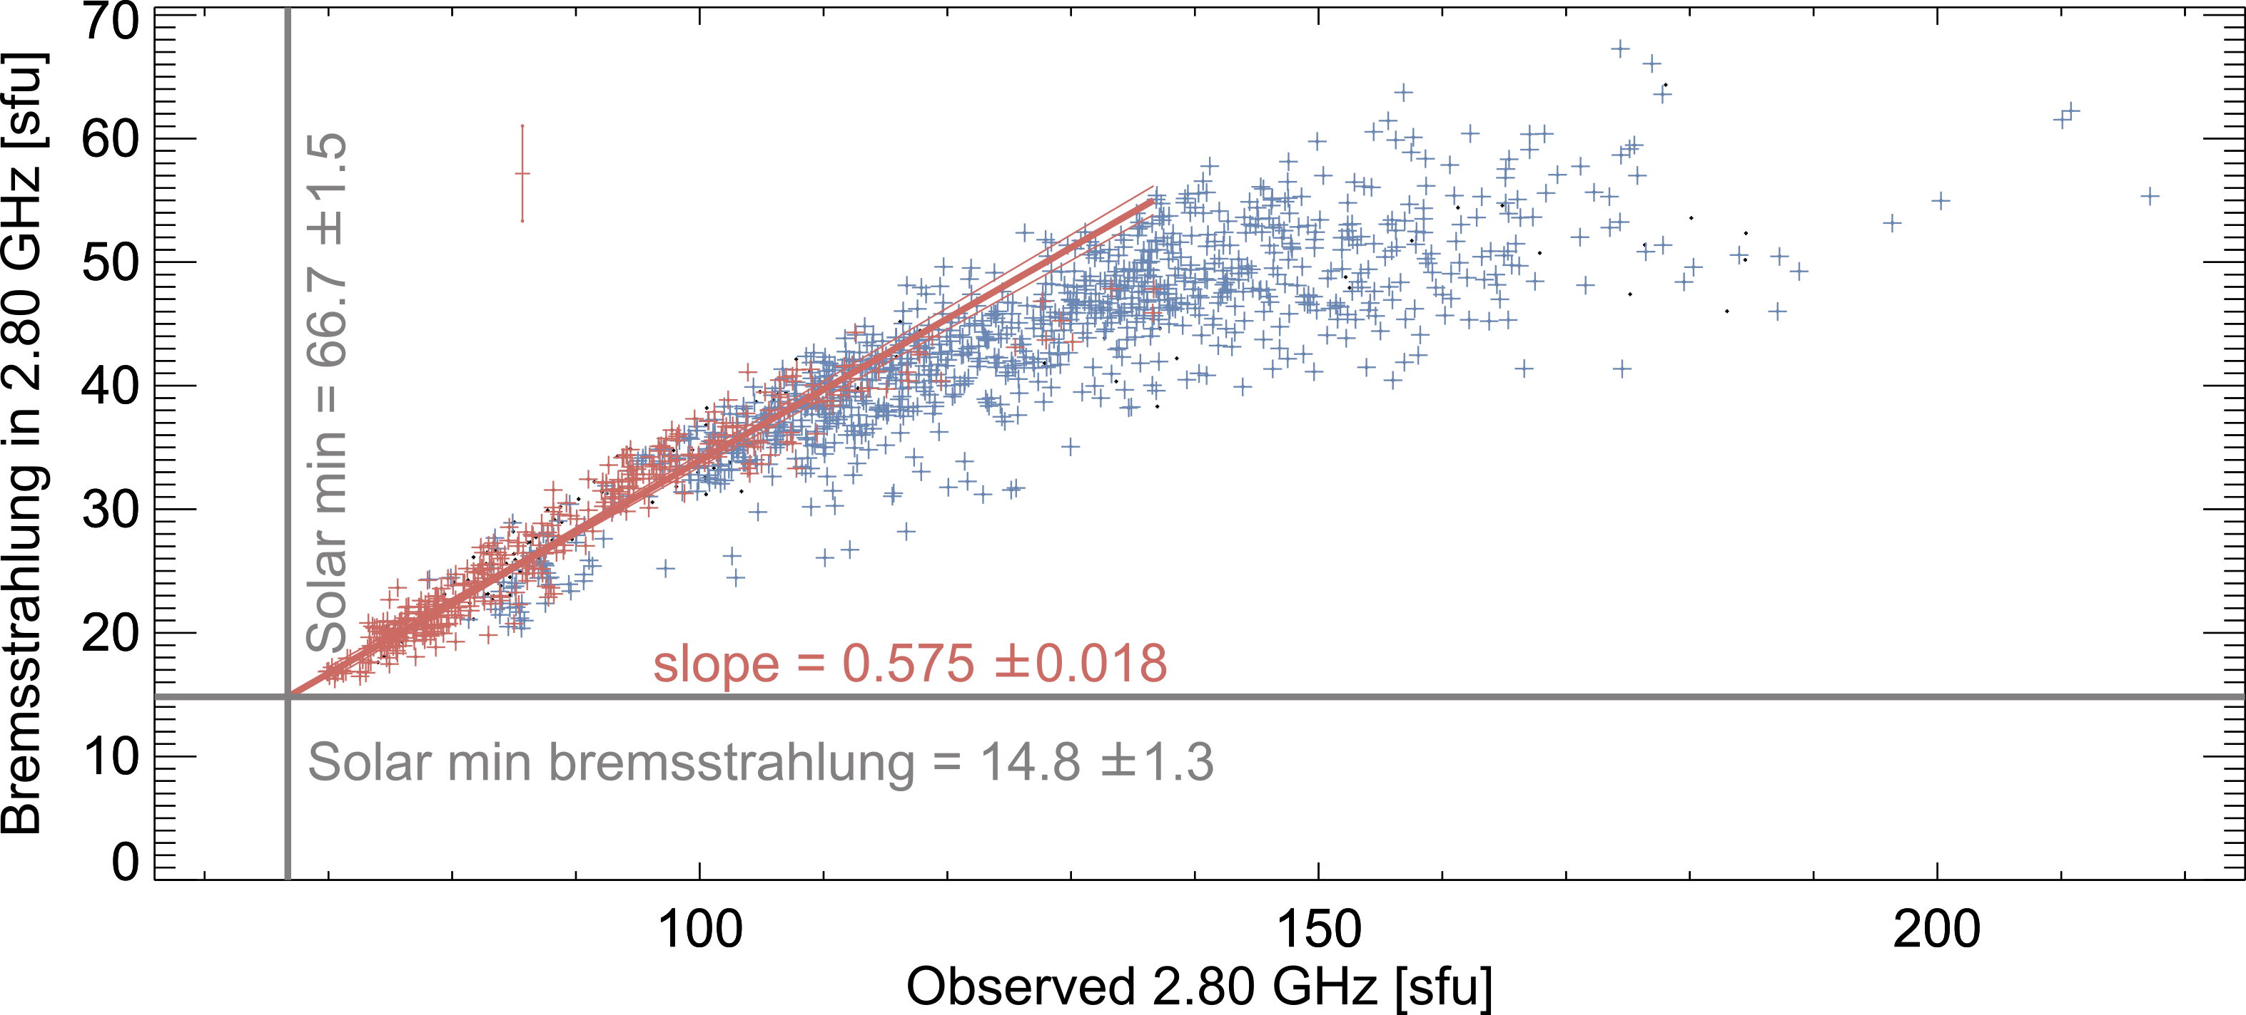
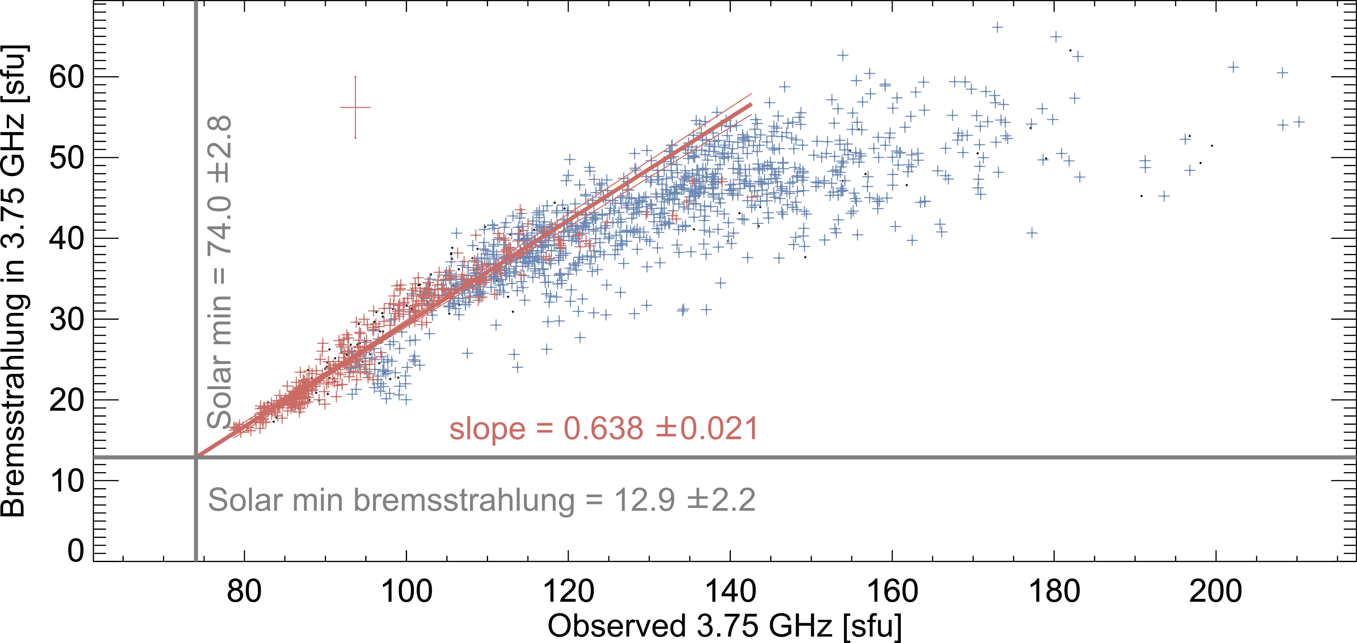

Slide 19
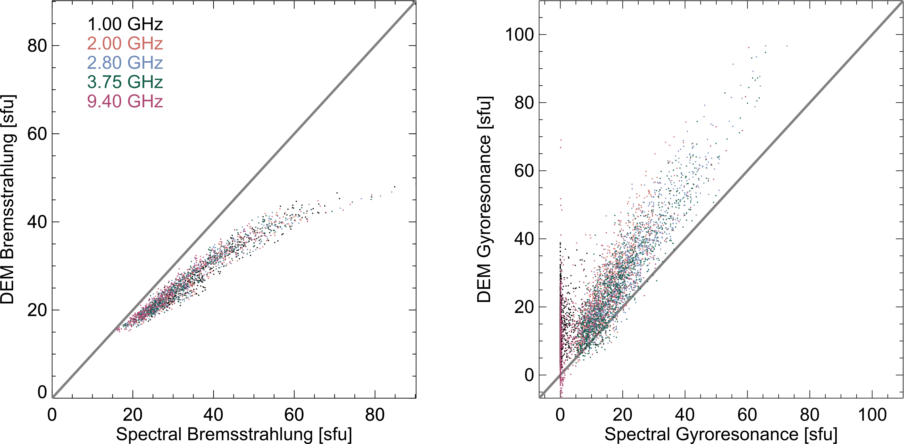
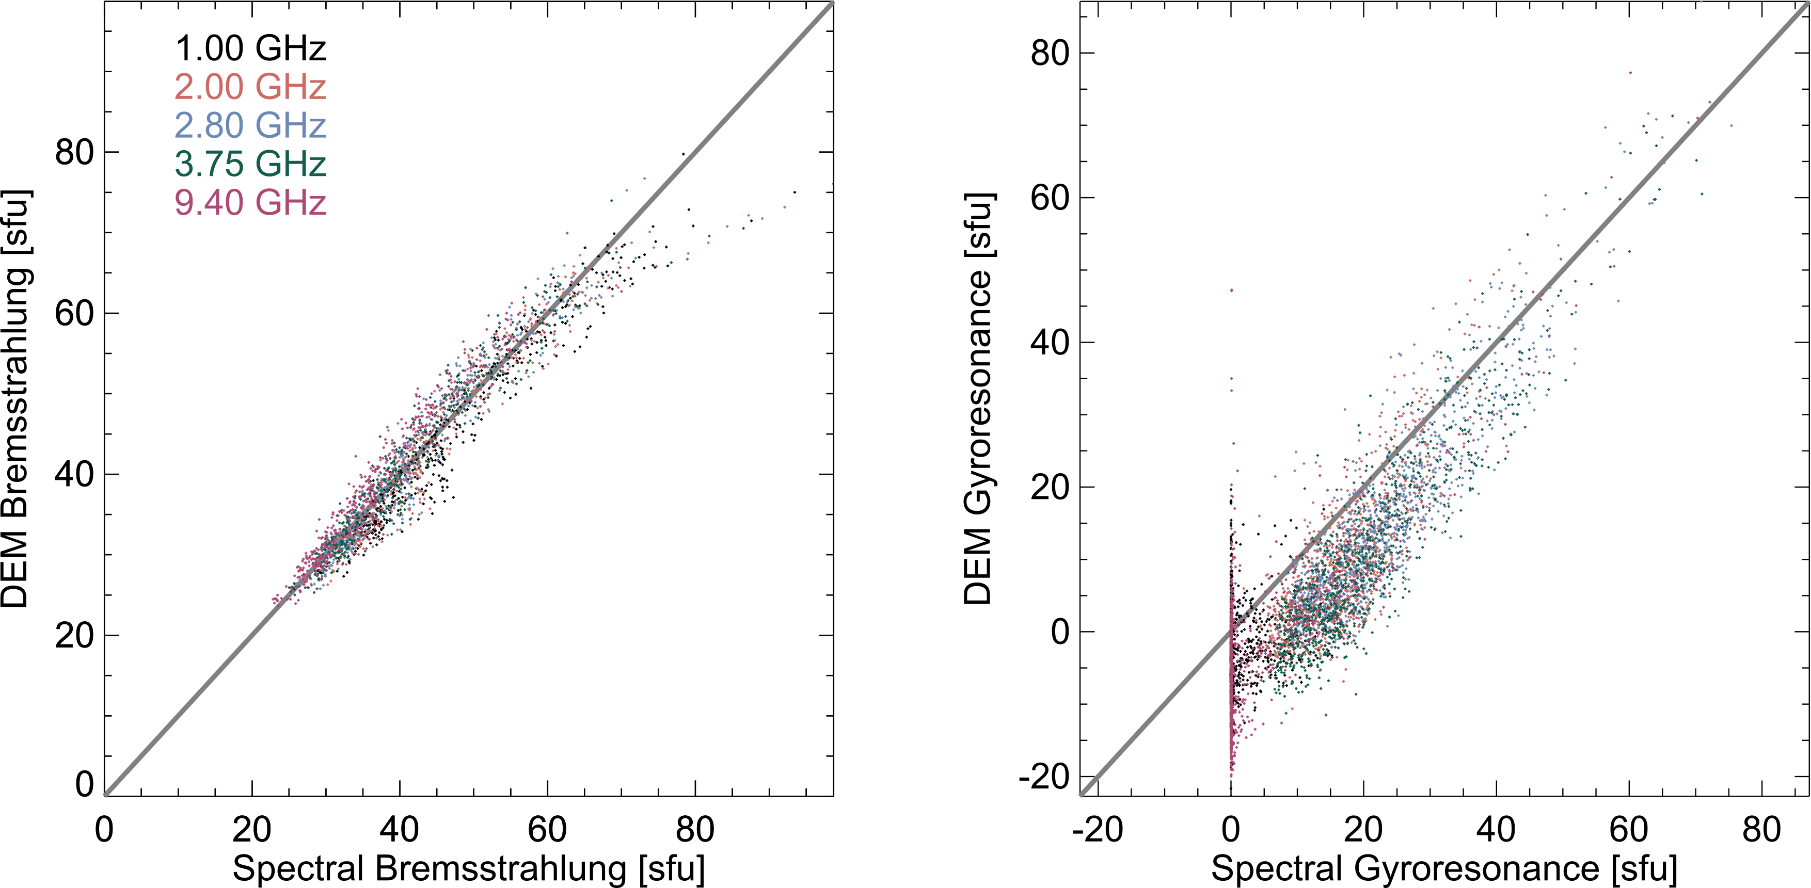
Fe Abundance
4 times photospheric
Inversely scales the bremsstrahlung prediction
  We assumed 4 times photospheric
2.5 times photospheric

Slide 20
Motivation: Full Disk F_{10.7} Imaging
Schonfeld et al. 2015 ApJ 808 29
2.783 GHz VLA observation
Bremsstrahlung prediction from AIA DEMs

Slide 21
High Polarization Regions
Region 3
Region 4
Region 10
Region 15

Slide 22
Individual Region Fluxes

Slide 23
Conclusions
Identified solar minimum and EUV emission trends and DEM shape
  Rapid change in coronal properties at the beginning of solar maximum
  Implications for coronal heating/cooling?
Computed bremsstrahlung component of F_{10.7}
  Bremsstrahlung has a non-linear relationship with F_{10.7}
    Correlates well with area of weak-moderate magnetic fields
  Used as a predictor of EUV emission
    Behavior very similar to empirically corrected F_{10.7}
    Suggests ad hoc averaging correction isolates bremsstrahlung emission as well as possible

Slide 24
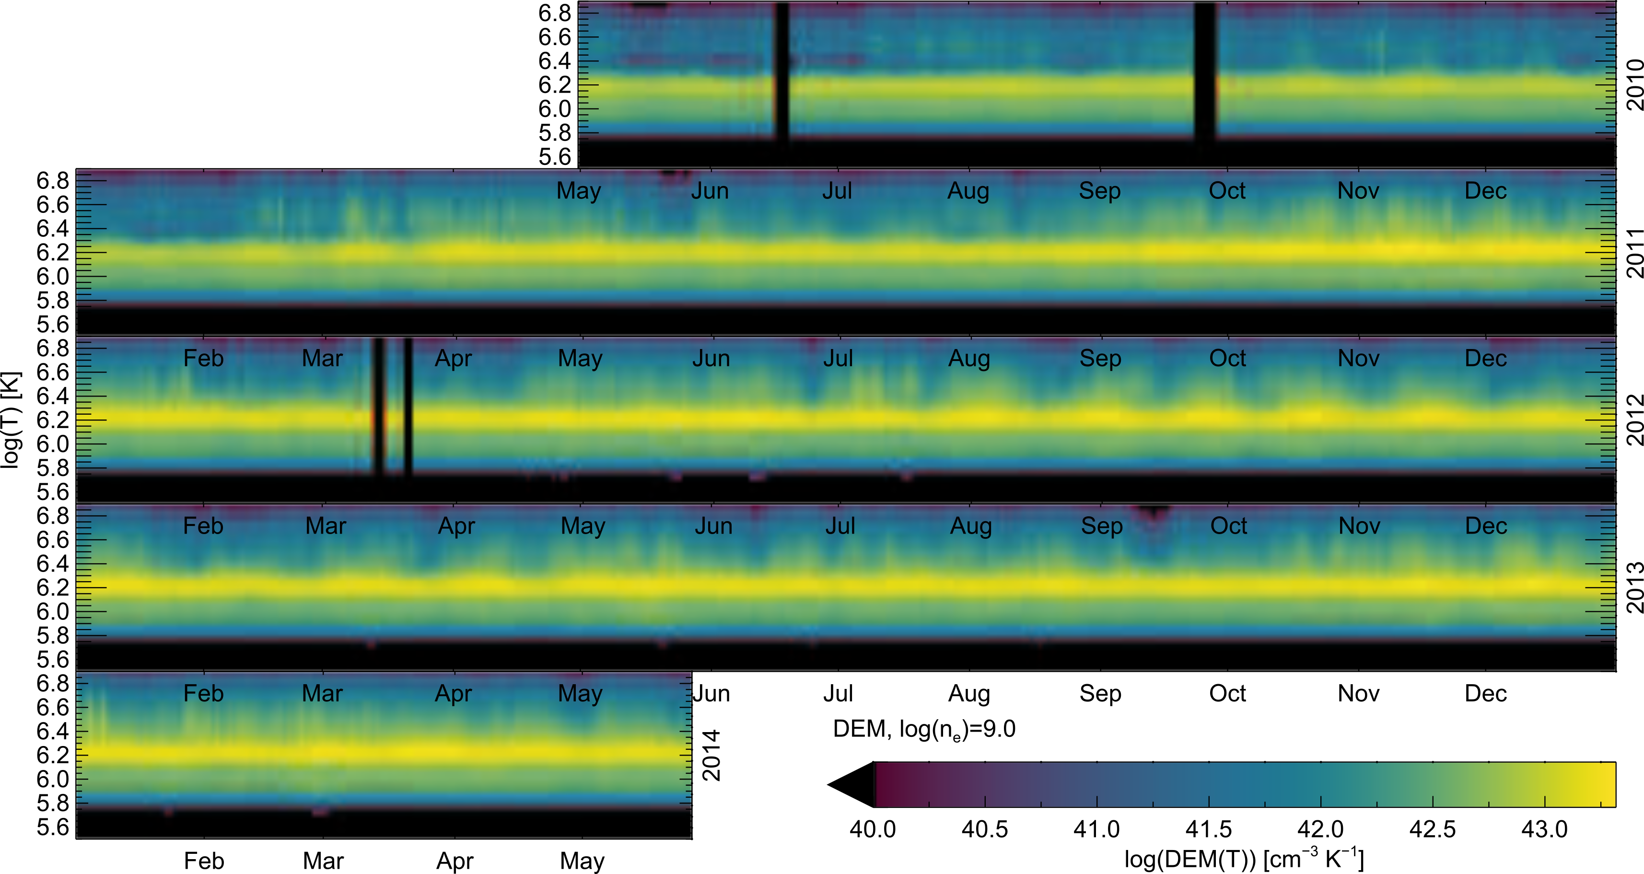
Jan Feb Mar Apr May Jun Jul Aug Sep Oct Nov Dec
2010
2011
log(T)
2012
2013

Slide 25
Day of year
Year
Log (T)

