Slide 1




JIVE/JOVIAL
Atmospheric Dynamics
Patrick Gaulme
New Mexico State University Apache Point Observatory

Slide 2
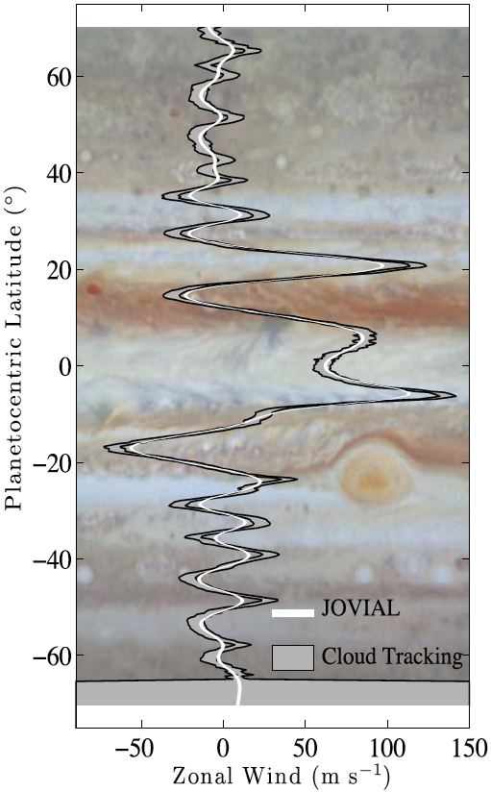
Atmospheric Dynamics
JIVE’s output: radial velocity maps
Sunlight reflected by uppermost clouds
Current knowledge of atmospheric dynamics based on cloud tracking
  Cloud tracking reflects mostly the displacement of iso-pressure regions.
  RVs not affected by moving condensation fronts
Venus, Jupiter, Saturn: we search for signals of about 100 m/s amplitude.
Expected precision on measurements
  10 − 20ms⁻¹ for each Jovian rotation
  1 − 2ms⁻¹ averaged latitudinal profile
Notes:
The measurement of Jupiter's zonal wind as function of planetocentric latitude by JOVIAL can be usefully compared with that from cloud tracking (here from Simon & Beebe 1996). Although the spatial resolution of JOVIAL is lower, the velocity measurement is direct and is not affected by moving condensation fronts.

Slide 3
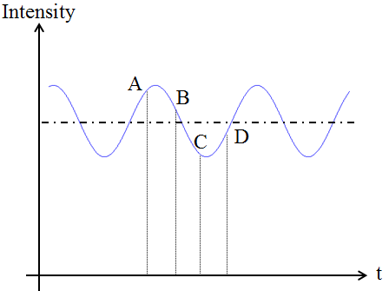
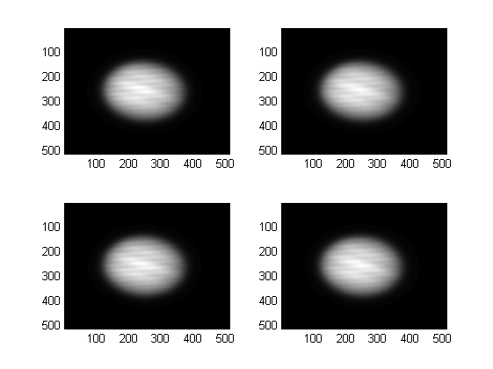
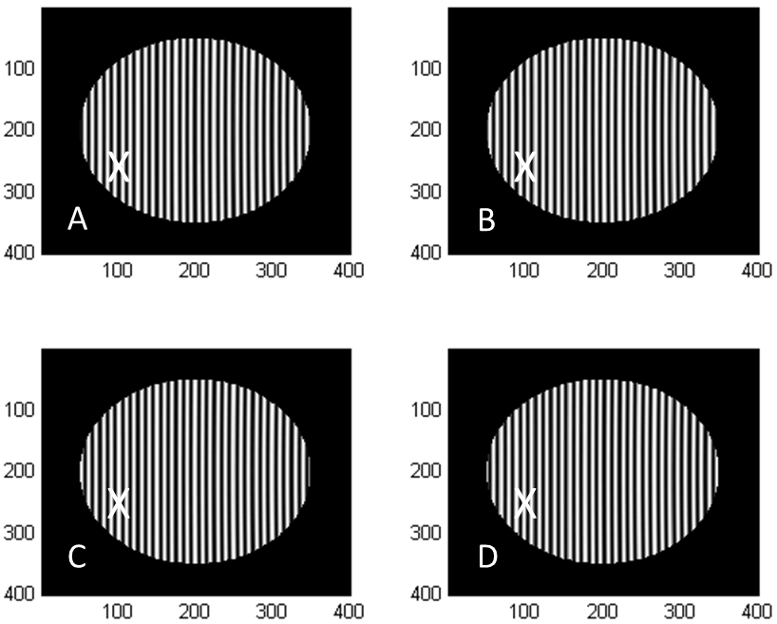
Atmospheric dynamics
With current telescopes: Venus, Jupiter, Saturn
Doppler effect
  At 5500 Å, a 100-m/s radial velocity means a Doppler shift of δλ = 0.0018 Å
  JOVIAL/JIVE 2440 m/s/rad: 100m/s ⬄ 2.38°phase shift
δv
δλ
=
c
λ

Slide 4
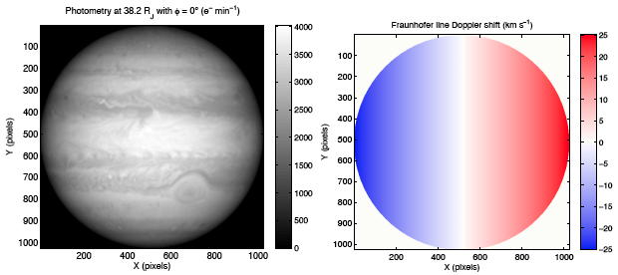
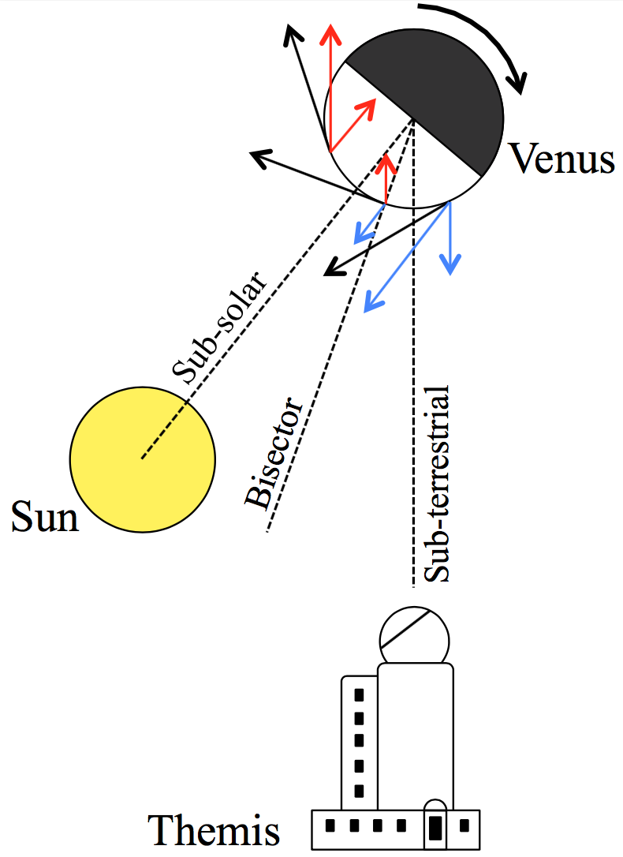
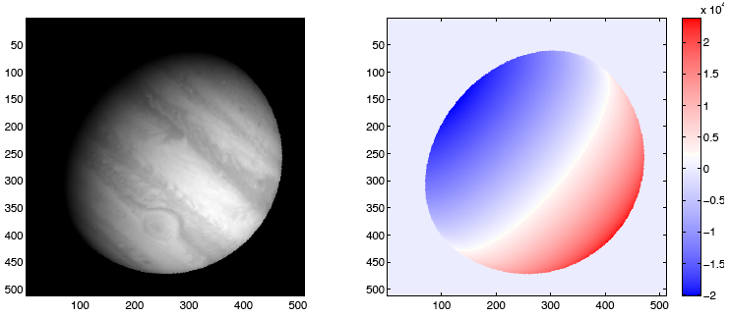
Radial velocity maps
What do we aim at measuring for atmospheric dynamics

Slide 5
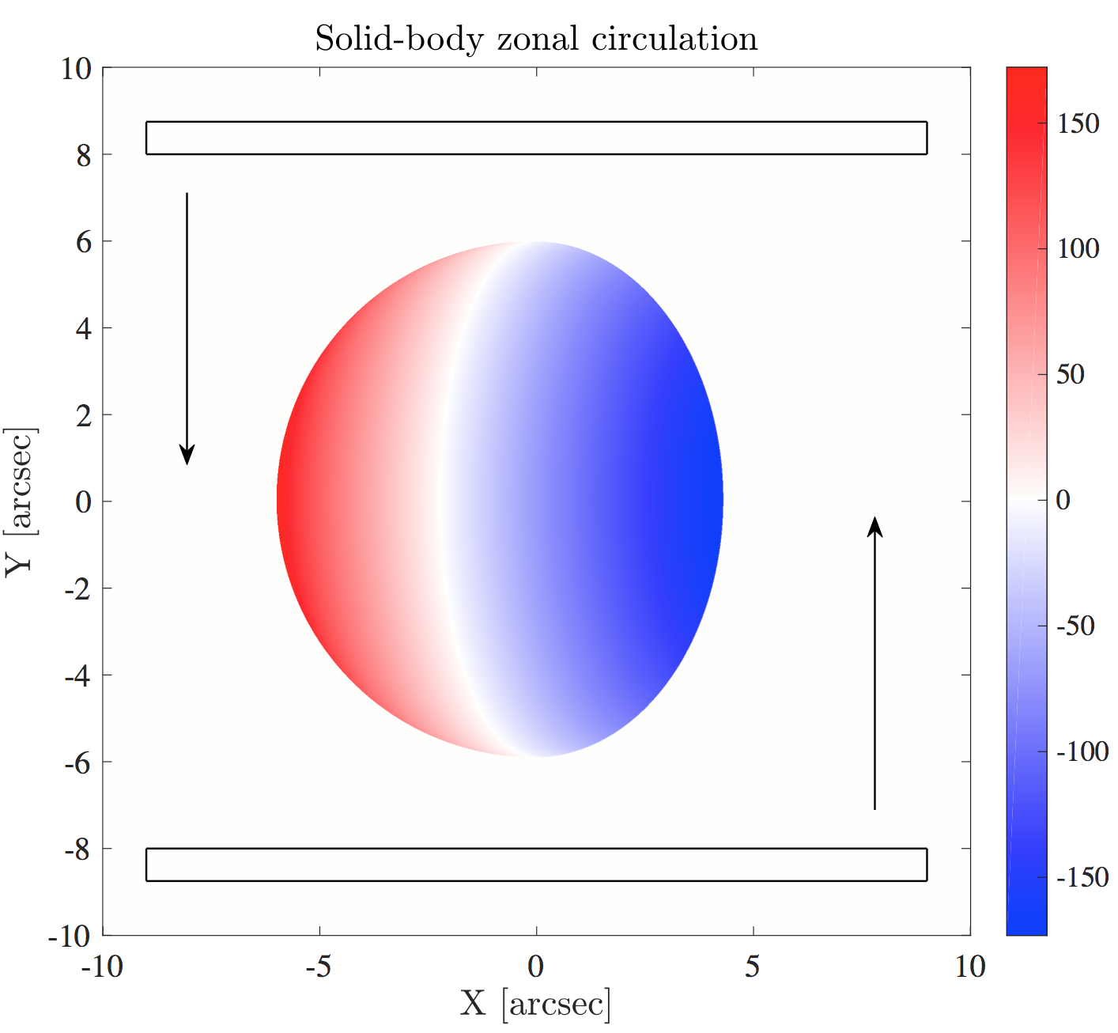
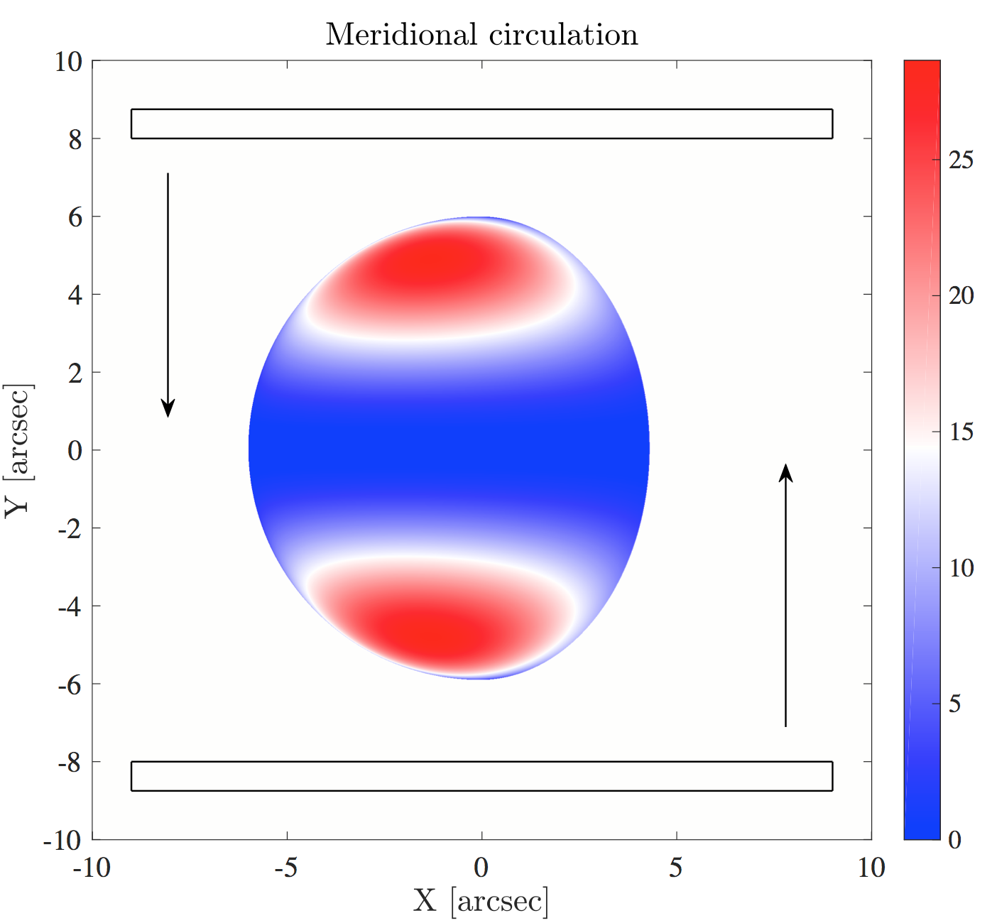
Radial velocity maps
What do we aim at measuring for atmospheric dynamics
JOVIAL/JIVE: theoretical work about atm. observations
  P. Gaulme, I. Gonçalves, F.-X. Schmider
  Gaulme et al. in prep., Gonçalves et al. in prep

Slide 6
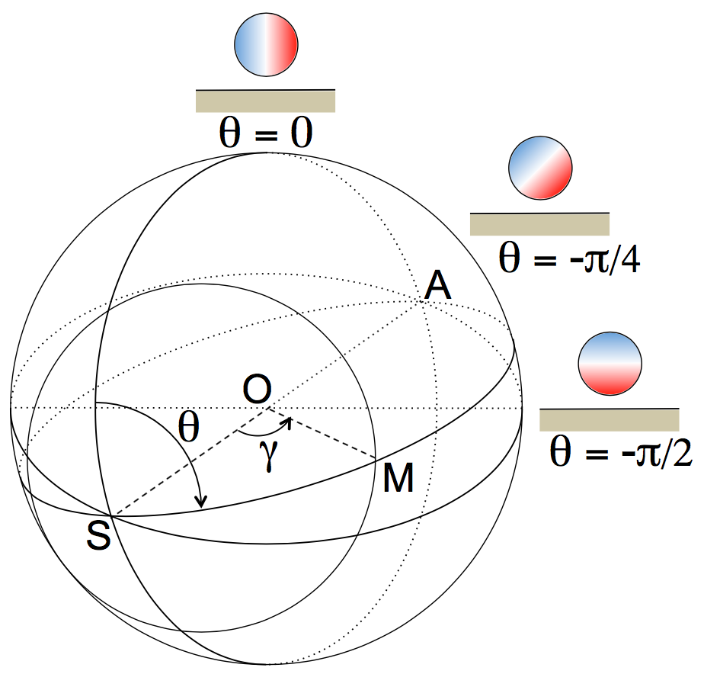
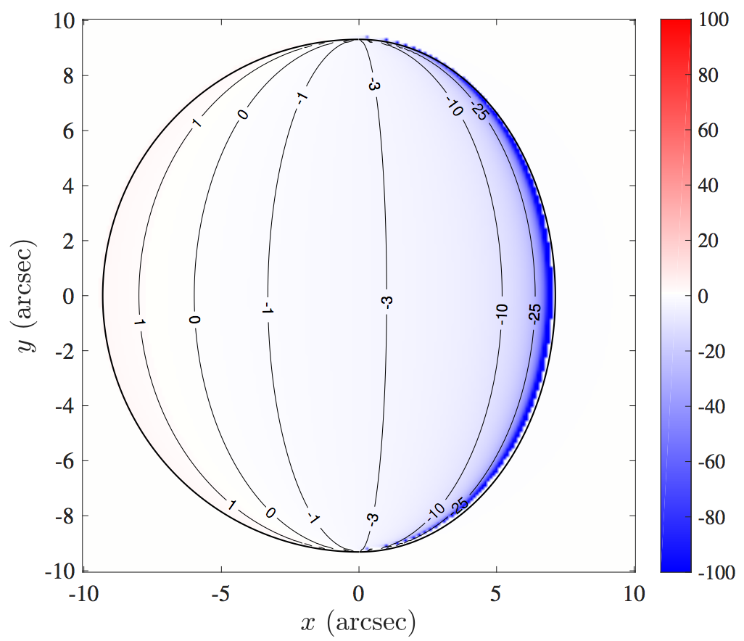
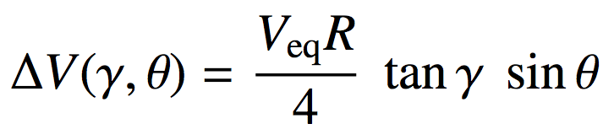
Real-life conditions
The Sun is an extended source as seen from Venus
  The Sun is a rotating body (≈2km/s at equator)
  Light from blue and red-shifted areas of the Sun reach the planet with differential incidence angle.
  This leads to artificial RV signal
  Young (1975) studied the effect for the first time, with erroneous formulation despite extensive use by other authors since then.
  We re-considered the effect from scratch (analytical + simulations)

Slide 7
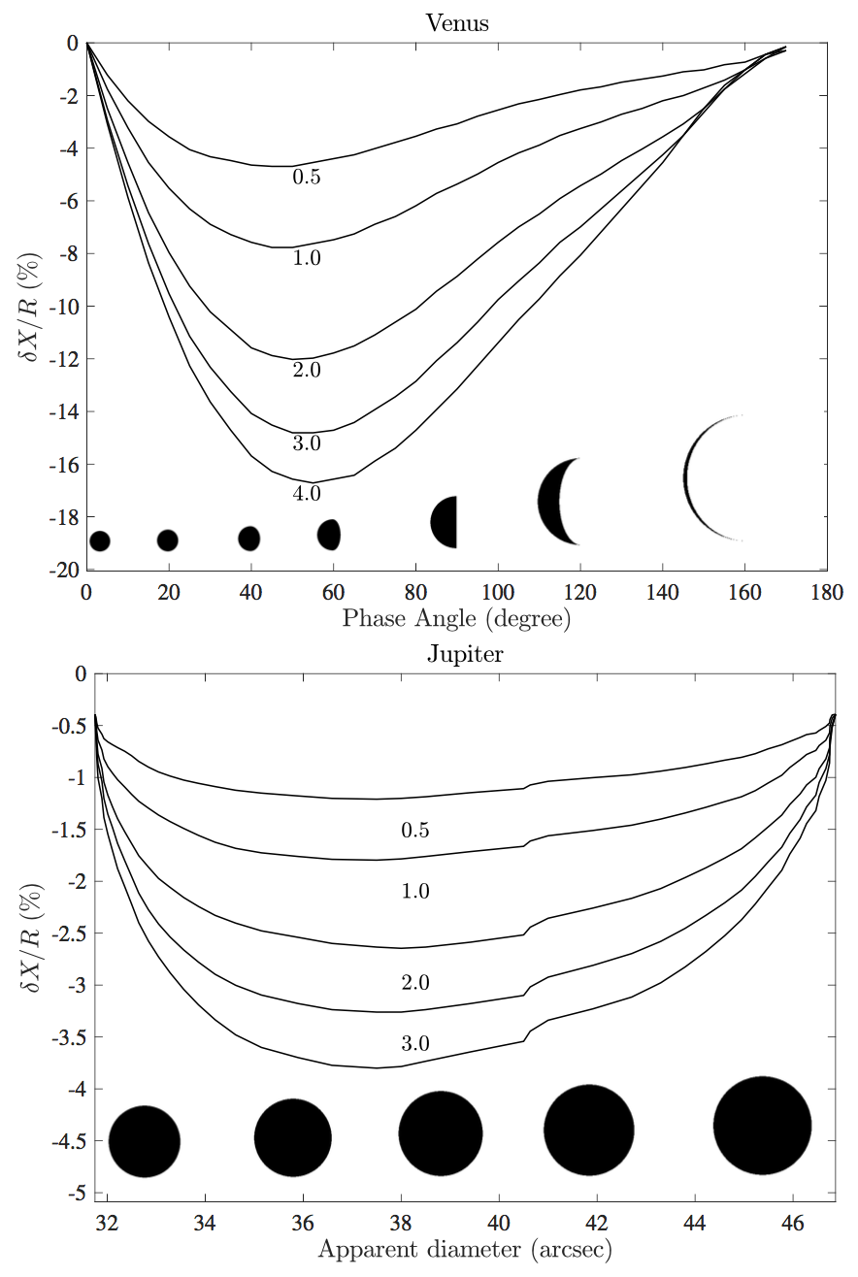
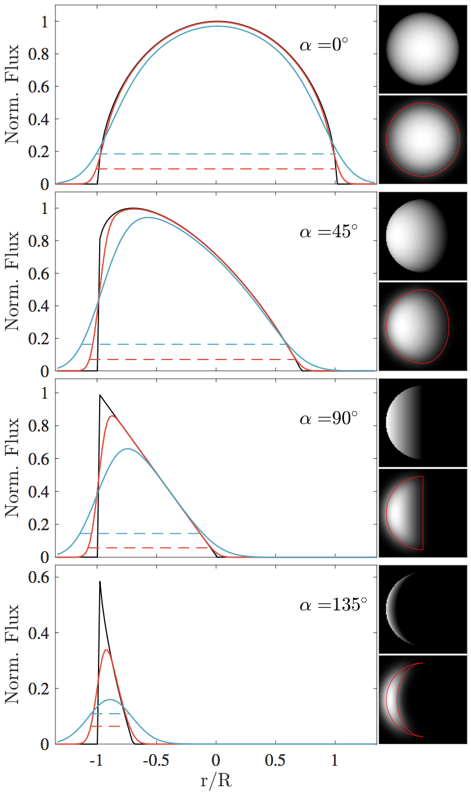
Real-life conditions
Atmospheric seeing confuses a planet’s position
  For non-zero phase angles
  Limb vs. terminator
  Lambert sphere approximation
  Photometry = profile convolved with PSF
  Planet seem to shift towards the Sun
  Mispositioning location on a planet can lead to significant RV biases

Slide 8
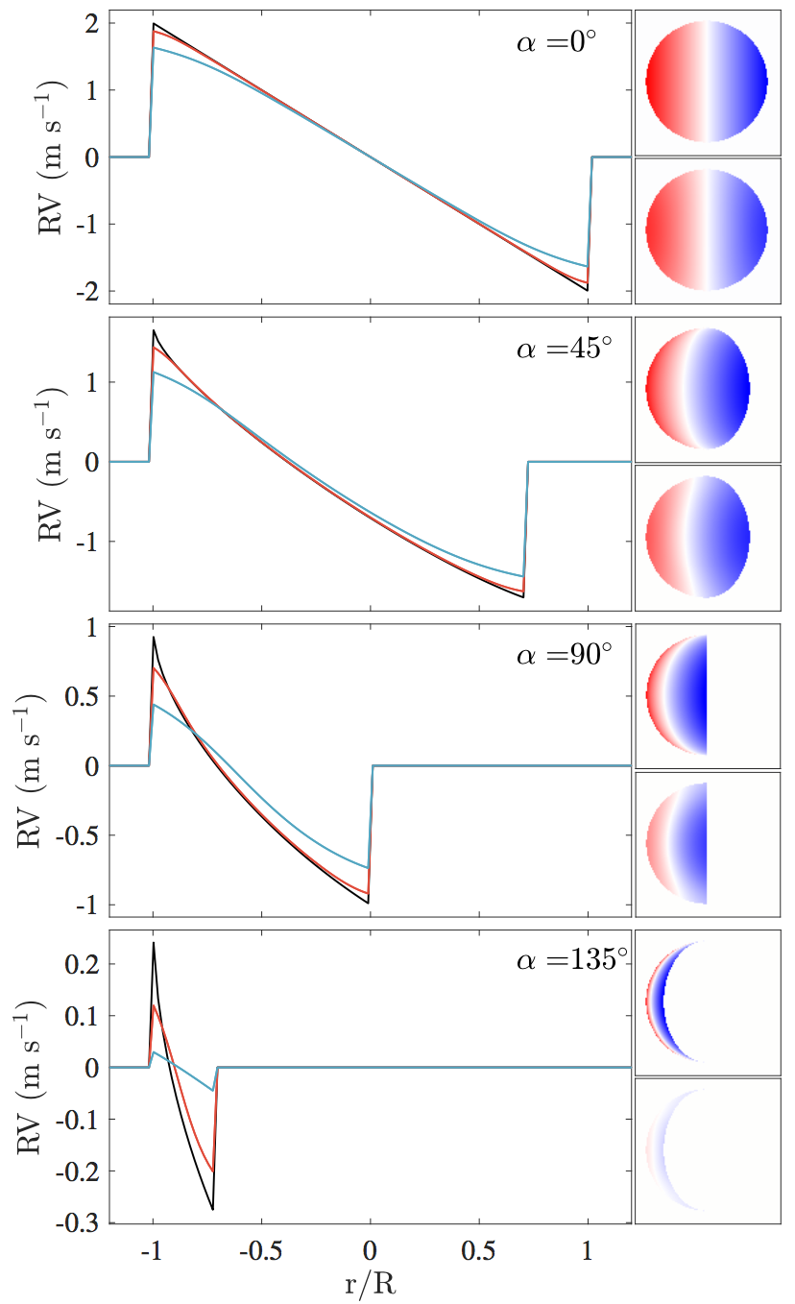
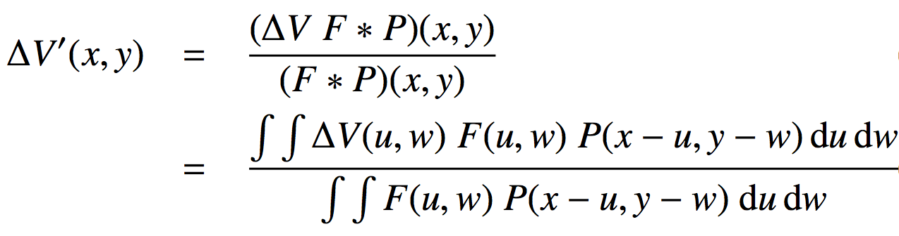
Real-life conditions
Atmospheric seeing confuses a the radial velocity field
  At any phase angle
  Areas with different RV and photometry blend together (Civeit+05)
  Especially significant towards the edge

Slide 9
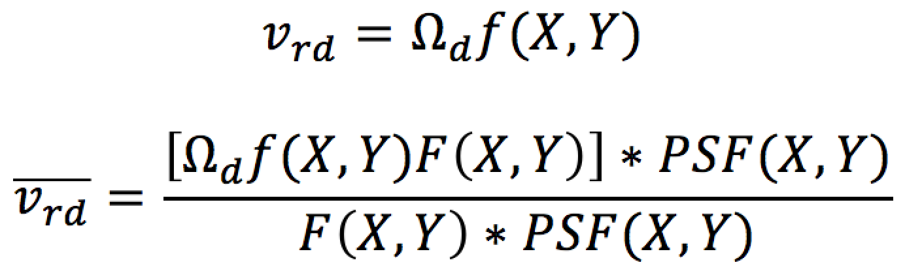
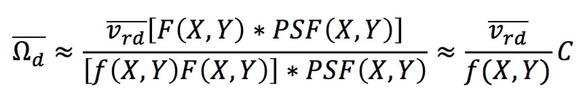
Inversion techniques
How extract wind amplitudes from RV maps?
  RV = sum of projected zonal + meridional + possibly vertical motions.
Global fitting
  Assume a model and fit it: e.g., zonal + meridional components
  Many refinements are possible: latitudinal variations of zonal wind, local hour variations, etc.
Direct inversion by “deprojecting” RVs
  RVs are true motions projected towards the Sun and the observer.
  Projection coefficient f(X,Y)

Slide 10
Inversion techniques
Direct inversion
  RVs of a zonal wind is 0 half-way between sub-solar and sub-terrestrial meridians.
  RVs of a meridional wind are 0 at equator and poles.
Need to properly weigh regions when inverting, to not divide by 0.
Real RV map and std dev map obtained by JOVIAL on Jupiter (Gonçalves et al., in prep)

Slide 11
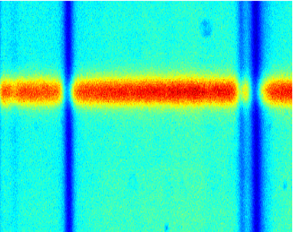
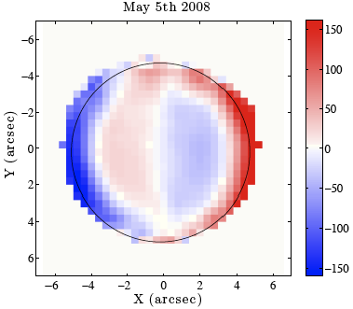
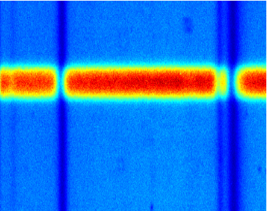
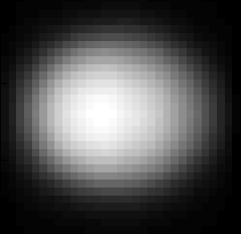
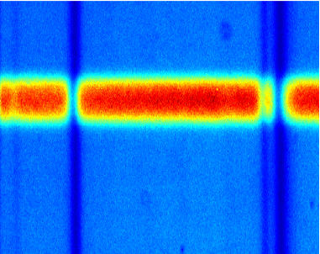

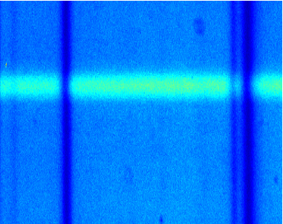
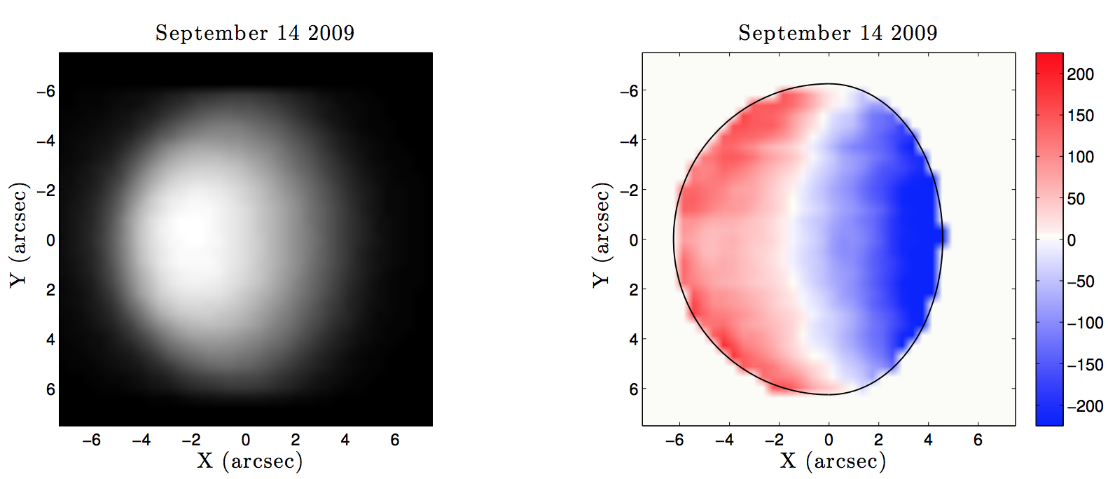
Early results
Preliminary observations of the Venus with THEMIS (2009)
Surprising RV map: strong local-hour zonal wind variation and much larger meridional winds than expected from cloud tracking
Gaulme et al., in prep

Slide 12
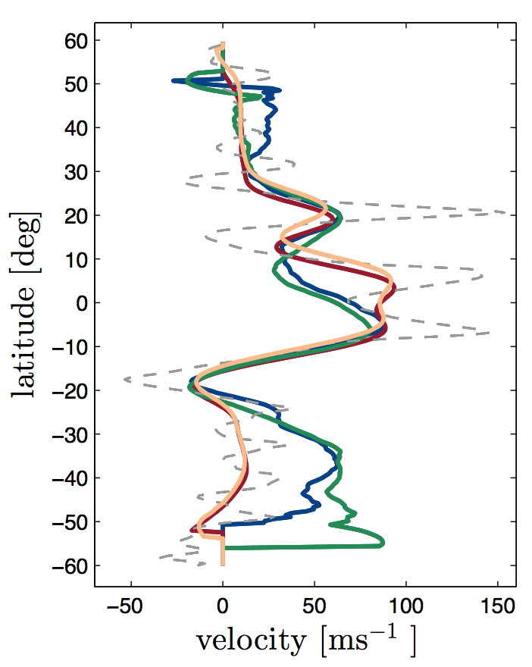
Early results
Preliminary observations of Jupiter with JOVIAL prototype
Surprising RV map at hot spot latitude
Gonçalves et al., in prep

Slide 13
Conclusions
Delayed instrument delivery
Theoretical work on how to analyze such kind of data: Gaulme et al., in prep. Young effect, seeing impact on measurements, inversion. This is a comprehensive and new approach
Test our routines and approach on Venus THEMIS observations (Gaulme et al. b, in prep).
Ivan is finalizing the analysis of 2015 and 2016 test campaigns with JIVE/JOVIAL prototype in France (Calern).
Both Venus and Jupiter early results bring surprising results. This is just the beginning
JIVE first obs. I would focus in Venus (bright, short campaign).

