Slide 1
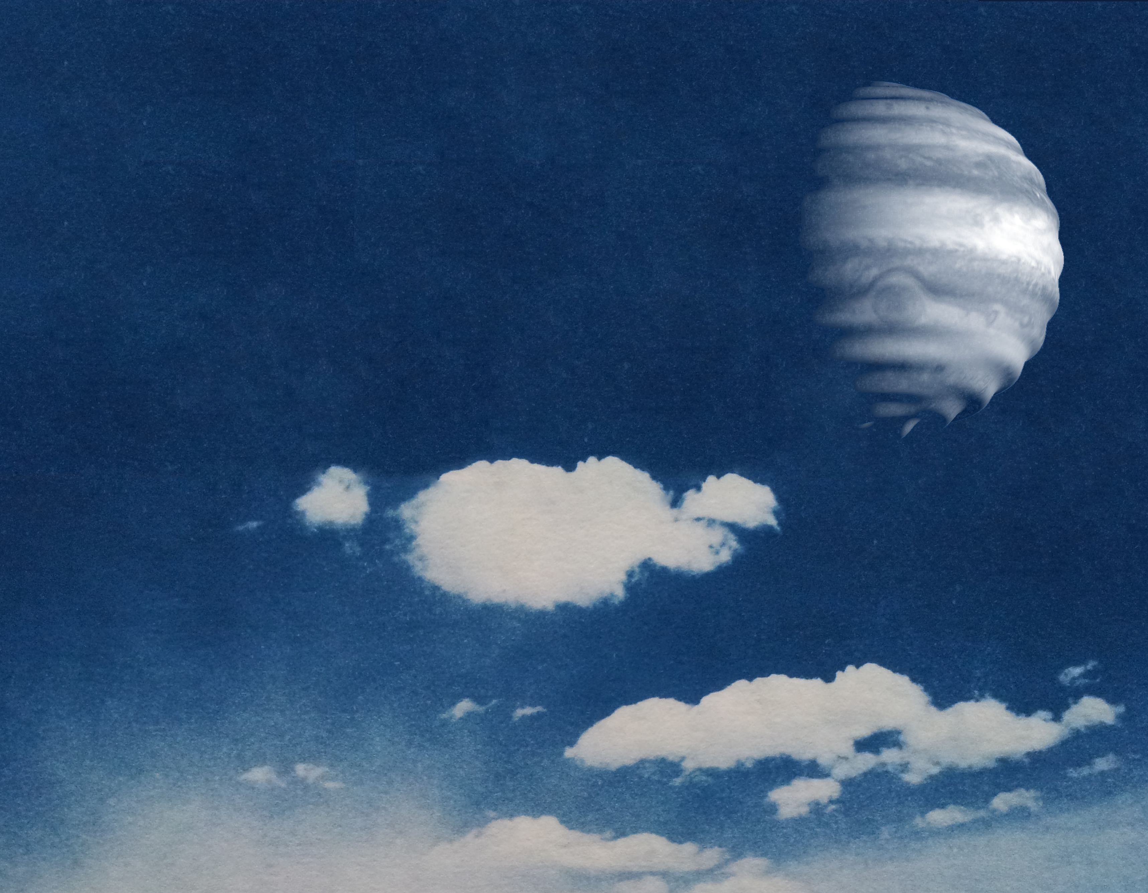



JIVE/JOVIAL Instrumental Concept
Patrick Gaulme
New Mexico State University Apache Point Observatory

Slide 2
Science Objectives
JIVE/JOVIAL: provides radial velocity maps (Doppler imaging)
Jovian seismology
  cm/s displacement of uppermost clouds
  Frequency range of expected oscillations [1-3] mHz, i.e., ≈[5-20] min periods.
  Long time series of fast sampling data (at least 1 measurement per minute).
Venus, Jupiter, Saturn’s atmospheric dynamics
  Venus zonal (100 m/s) + meridional (20 m/s?) winds
  Jupiter/Saturn differential rotation ≈ ±100 m/s
  Stack observations: average wind profile, average wind per longitude. Do not need long times series.

Slide 3
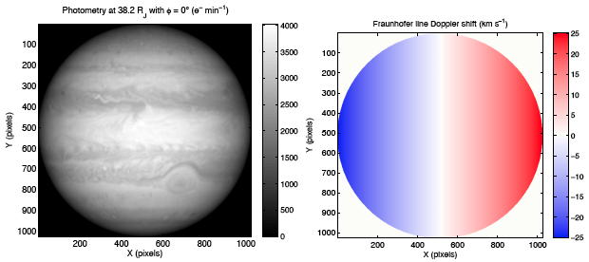
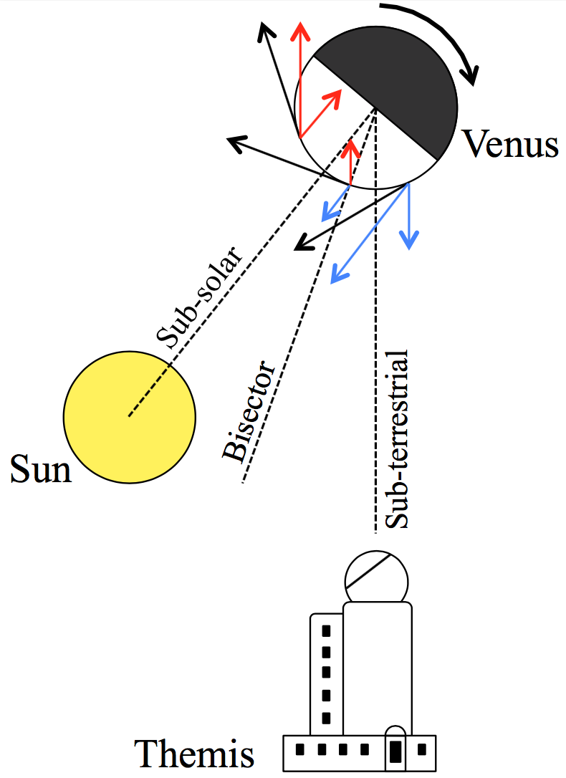
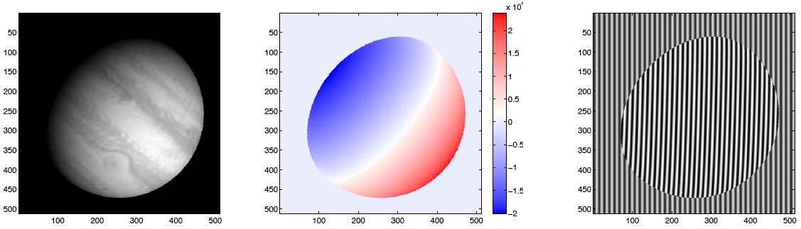
Radial velocity maps
What do we aim at measuring for atmospheric dynamics

Slide 4
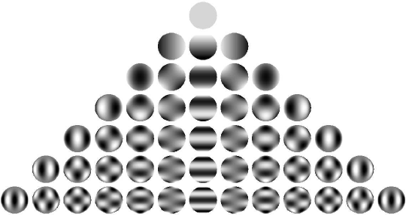
Radial velocity maps
What do we aim at measuring for seismology
  Subtraction of wind contribution to RVs
  Filter each RV map by a set of spherical harmonics
  Compute Fourier spectra of times series

Slide 5
SYMPA/JIVE/JOVIAL are Fourier transform tachometers
Spectrum S(σ)
σ
σ₀
Telescope
TF
Interferogram
OPD
I(Δ) =A(Δ)e^{2iΠΔσ}0
^{(1+v/c)}
Detector
FTS
OPD

Slide 6
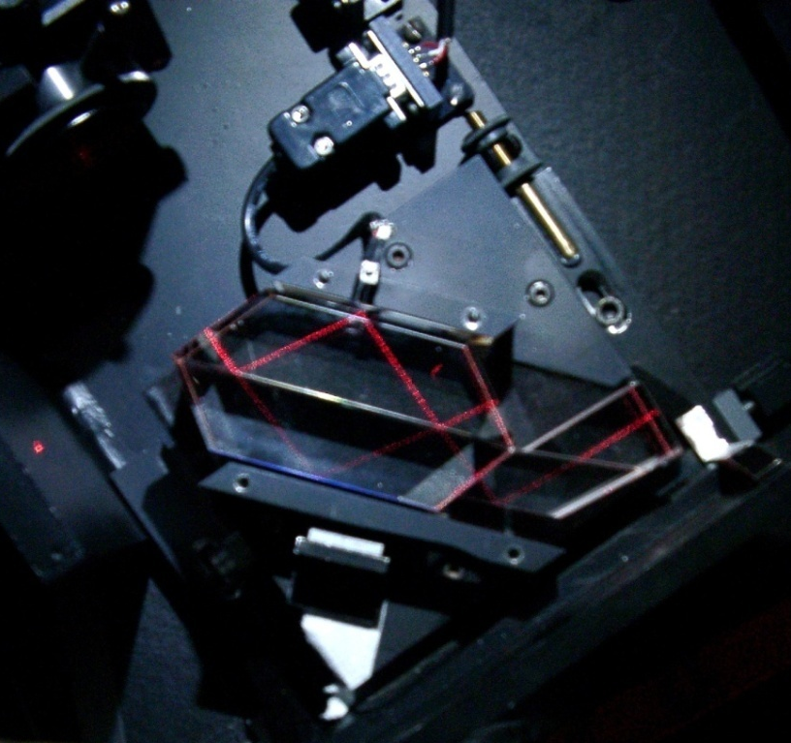
The SYMPA prototype
Fourier-transform imaging-spectrometer (Schmider+07, Gaulme+08, Gaulme+11)

Slide 7



The SYMPA prototype
Fringes parallel to rotation axis
⬄
signature of Jupiter’s rotation
Gaulme et al. 2008

Slide 8
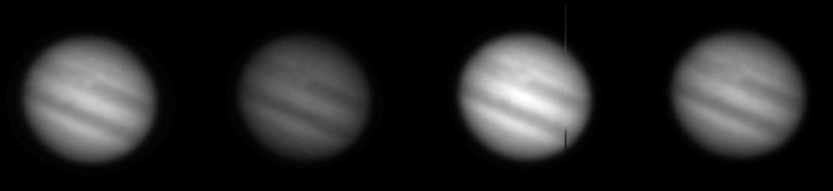
The SYMPA prototype
Fringe
Contrast
γ ≈ 0.6%
I₁
I₂
I₃
I₄
I₁ = I₀ (1 + γ cos φ)
I₃ = I₀ (1 – γ cos φ)
I₂ = I₀ (1 + γ sin φ)
I₄ = I₀ (1 – γ sin φ)
U α cos φ
V α sin φ
Avec φ = 2πσΔ(1+v/c) et σ = nombre d’onde, Δ = OPD et v = vitesse radiale
Doppler shift = argument of complex interferogram: Z = U + iV

Slide 9
Observational techniques
Doppler spectrometry
Fourier transform spectrometers

Slide 10
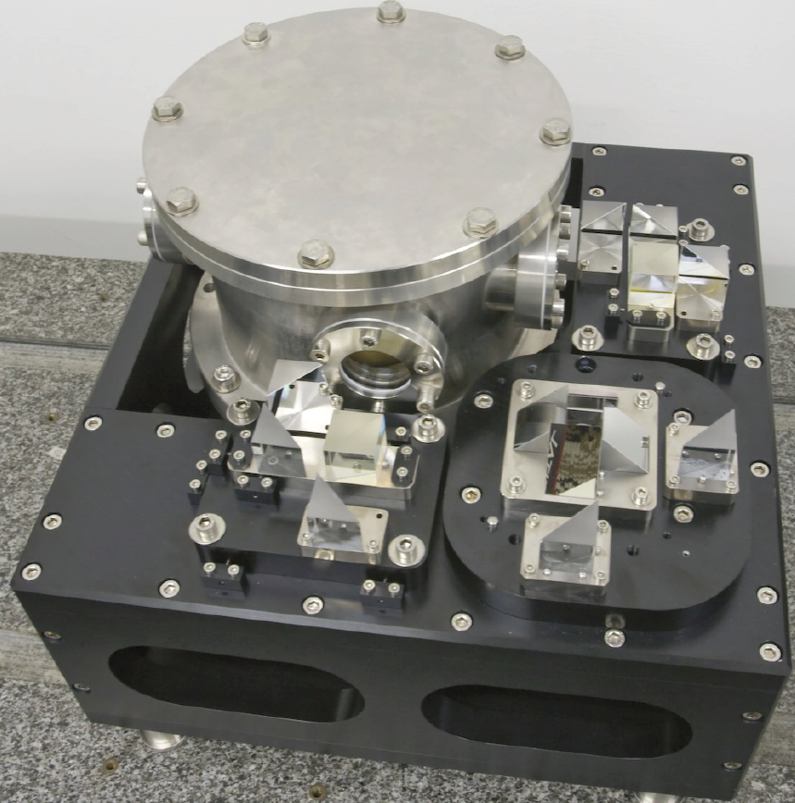
JOVIAL/JIVE vs. SYMPA
JOVIAL
  Based on SYMPA experience
  Modified Mach-Zehnder design
  OPD modulation for calibration
Optimisation of measurement stability, precision, resolution
  Vacuum tank to insulate the interferometer
  Simultaneous multi-sites observations
  Noise level < 4 cm/s in 2 weeks

Slide 11
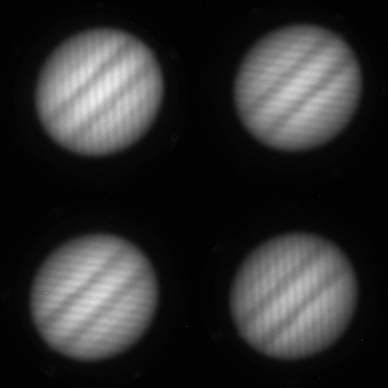
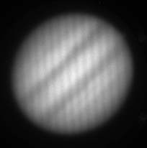
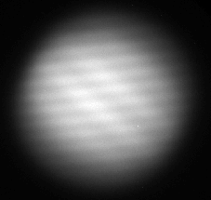
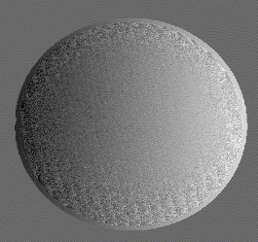
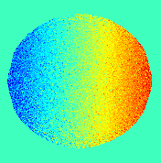
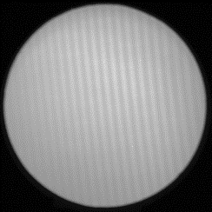
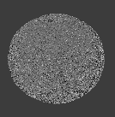
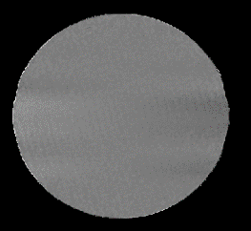
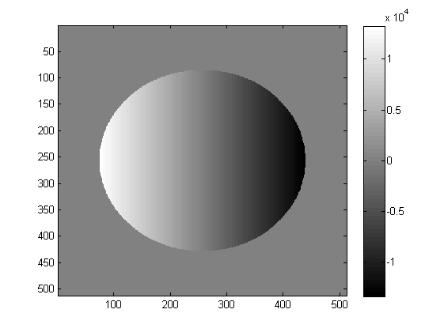


Data processing with real data
Adjustment of the four images
  Position, geometrical distortion
  Photometric response
Radial velocity map construction
velocity map (unwrapped)
Arg(Z_{p})
Z_{p} = Z Z*_{inst}
Residual velocity map
Z_{inst}
Solid Rotation Model

Slide 12
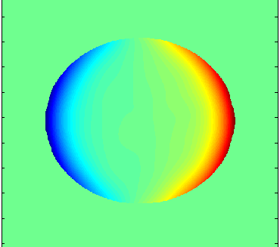
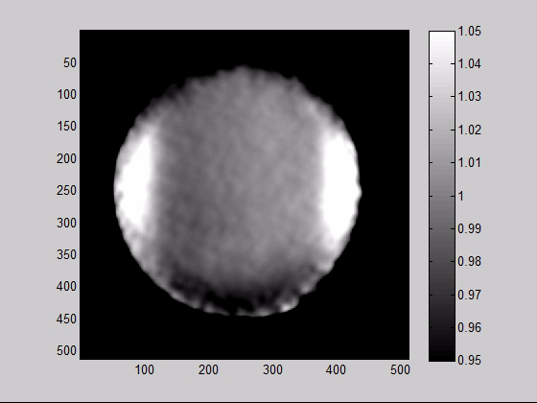
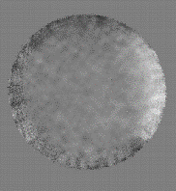
Biases and drifts issues
PSF effect and atmospheric seeing
  Positioning and RV biases
  (see my presentation at 3:30pm)
Jupiter polarization
  Remember, we split light according to polarization
Telescope polarization
Pupil drift
  Determines where the light beam passes through the interferometer
Jupiter rotation in the field

Slide 13
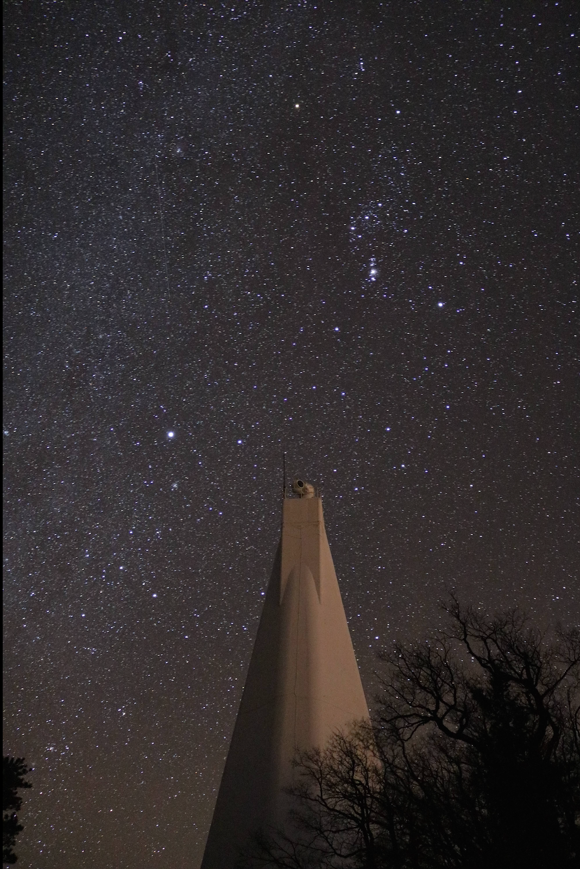
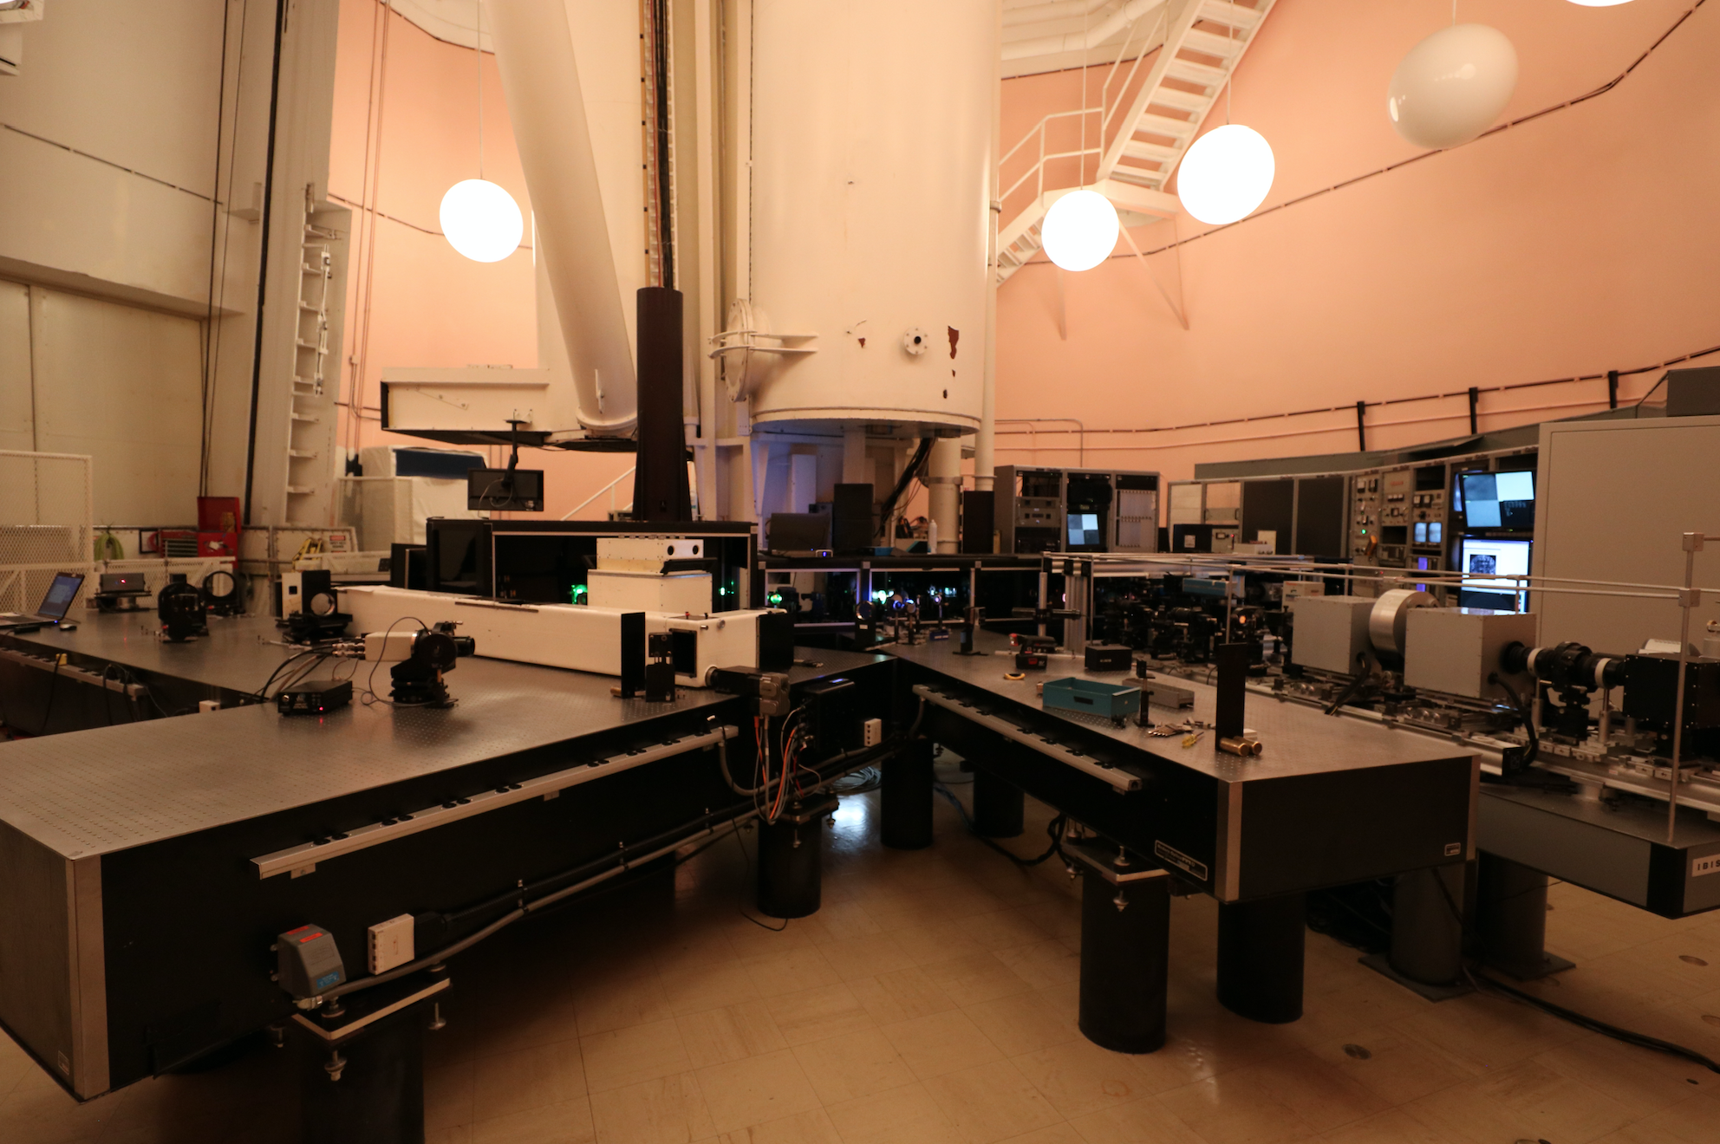
JIVE at Sunspot
See Tom’s presentation

