Slide 1
ASTR 630
Numerical and Statistical Methods in Astrophysics
Spring 2022
Probability

Slide 2
Basics of probability
Why study probability?
  We want to characterize probability that a hypothesis is consistent with data, or perhaps, the probability of one hypothesis over another
  When data has variation (either intrinsic or experimental), we want to describe the probability of obtaining different values
Different approaches to probability
  Classic probability: if we have finite number of outcomes with equal probability
    What are the odds of rolling a 3 on a fair die?
  Frequentist probability: determine probabilities by experiment
    What are the odds of rolling a 3 on a loaded die?
  Subjective probability
    What are the odds it will rain tomorrow?

Slide 3

Axioms of probability
Logical set of axioms to work with probabilities, however determined
Given an experiment with multiple possible outcomes (the "description space” 𝛺,) and an individual outcome, E
  0 < P(E) < 1
If E_{i} is the set of all mutually exclusive events
  ∑ P(E_{i}) = 1
  P(not E_{i}) ≡ P(~E_{i}) = 1 – P(E_{i})
For mutually exclusive events (no overlap)
  P (A or B) ≡ P (A ∪ B ) = P(A) + P(B)
  Examples: dice, colors, colored shapes

Slide 4
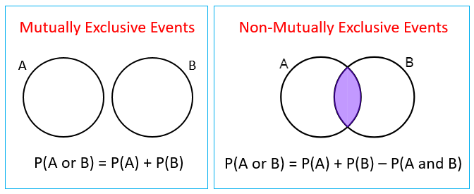
Axioms of probability
What about non mutually-exclusive events?
P(A∪B) = P(A) + P(B) – P(A∩B)
where P(A∩B) = P(A and B) = P(A,B) in different notations
e.g. P(blue or square) = P(blue) + P(square) - P(blue and square)
A and B are said to be independent if
  P(A∩B) = P(A) P(B)
  i.e. the probability of one event doesn’t depend on the knowledge about the other
  e.g. probability that roll of die is 1 and that roll of die is odd:
  1/6 * 1/2 ≠ 1/6
  probability that roll is in {1,2} and probability that roll is in {2,3,4}
  1/3*1/2 = 1/6
  probability that roll is in {1,2} and probability that roll is in {2,3,4,5,6}
  1/3 * 5/6 ≠ 1/6
Probability of both A and B is product of individual probabilities if events are independent

Slide 5
Formulating probability problems
Are the events independent?
If so, can calculate probability of A and B, P(A∩B) = P(A) P(B)
Probability of A or B is only sum of probabilities if events are mutually exclusive
Often easier to formulate a probability problem in terms of and rather than in terms of or , perhaps by taking the complement of a proposition, i.e.
P(A∪B) = 1 - P(~A) ∩ P(~B)
P(A or B) = 1 - P(not A and not B)
A card is randomly selected from a standard deck of 52 playing cards. What is the probability that it is a face card or a spade?
P(face or spade) = P(face) + P(spade) – P(face and spade) = 12/52+13/52-3/52 = 22 / 52
P(face or spade) = 1 - P(not face) * P(not spade) = 40/52 * 3/4 = 1 - 30/52 = 22/52

Slide 6
Summary
What is P(A∪B)? How is it related to P(A) and P(B)? Under what conditions?
What is P(A∩B)? How is it related to P(A) and P(B)? Under what conditions?
Understand how you can formulate probability problems in different ways

Slide 7
Example questions
If there’s a 20% chance of rain today and a 20% chance of rain tomorrow, what are the chances it will rain before the end of the day tomorrow?
You draw 2 cards from a shuffled deck. What are the odds that you will get two aces if a) you replace the first card and reshuffle after the first draw, b) you discard the first draw before the second draw?
Consider a set of 9 objects of 3 different shapes (e.g., circle, triangle, square) and 3 colors (red, green blue). If you draw a single object at random, what’s the probability you’ll get a triangle? A blue object? A blue triangle? Are these two events (triangle and blue) independent?

Slide 8
ASTR 630
Numerical and Statistical Methods in Astrophysics
Spring 2022
Conditional probabilities

Slide 9
Conditional probabilities
Sometimes we have non-independent events, i.e., the probability of one is related to the probability of another, so knowledge of one event affects the probability of another
This is described by a conditional probability, P(A|B) (read as probability of A given B). If P(A|B) = P(A) then the events are independent
What are some astronomy examples?
  Probability that a galaxy is an elliptical if it is red
  Probability that an object is a planet given an effective temperature

Slide 10
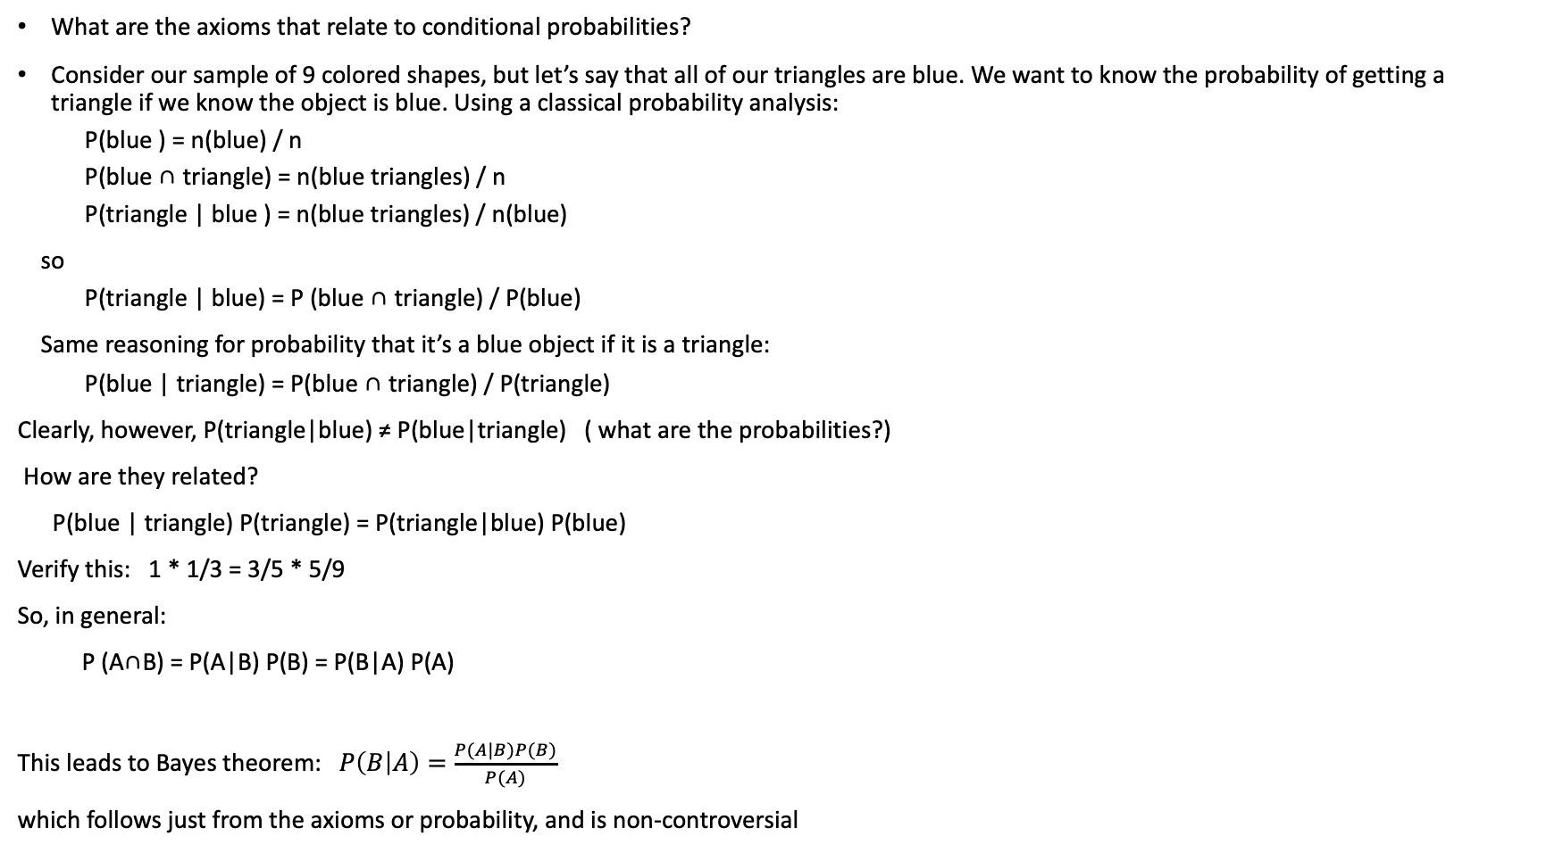
Conditional probabilities
What are the axioms that relate to conditional probabilities?
Consider our sample of 9 colored shapes, but let’s say that all of our triangles are blue. We want to know the probability of getting a triangle if we know the object is blue. Using a classical probability analysis:
  P(blue ) = n(blue) / n
  P(blue ∩ triangle) = n(blue triangles) / n
  P(triangle | blue ) = n(blue triangles) / n(blue)
so
  P(triangle | blue) = P (blue ∩ triangle) / P(blue)
Same reasoning for probability that it’s a blue object if it is a triangle:
  P(blue | triangle) = P(blue ∩ triangle) / P(triangle)
Clearly, however, P(triangle|blue) ≠ P(blue|triangle) ( what are the probabilities?)
How are they related?
P(blue | triangle) P(triangle) = P(triangle|blue) P(blue)
Verify this: 1 * 1/3 = 3/5 * 5/9
So, in general:
P (A∩B) = P(A|B) P(B) = P(B|A) P(A)
This leads to Bayes theorem: $P\left(B | A\right)=\frac{P(A|B)P(B)}{P(A)}$
which follows just from the axioms or probability, and is non-controversial

Slide 11
Independent events using conditional probabilities
We said that events A and B are independent if
P(A∩B) = P(A) P(B)
We can state this using conditional probabilities:
P(A|B) P(B) = P(A) P(B)
So events are independent when
P(A|B) = P(A) P(B|A) = P(B)
This is a more intuitive definition of independence, but note that the conditional probability can be undefined if the probability of one event is zero (e.g. P(blue|diamond) )

Slide 12
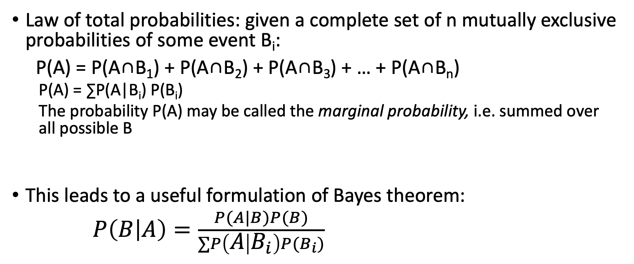
Conditional probabilities
Law of total probabilities: given a complete set of n mutually exclusive probabilities of some event B_{i}:
P(A) = P(A∩B₁) + P(A∩B₂) + P(A∩B₃) + … + P(A∩B_{n})
  P(A) = ∑P(A|B_{i}) P(B_{i})
  The probability P(A) may be called the marginal probability, i.e. summed over all possible B
This leads to a useful formulation of Bayes theorem:
$P\left(B | A\right)=\frac{P(A|B)P(B)}{∑P\left(A | B_{i}\right)P(B_{i})}$

Slide 13
Example
Three bags of 100 marbles:
  Bag 1 has 75 red and 25 blue marbles
  Bag 2 has 60 red and 40 blue marbles
  Bag 3 has 45 red and 55 blue marbles
I choose one of the bags at random and then pick a marble from the chosen bag, also at random. What is the probability that the chosen marble is red?
Let R be the event that the chosen marble is red. Let B_{i} be the event that I choose Bag i.
  P(R|B₁)=0.75 P(R|B₂)=0.60 P(R|B₃)=0.45
  P(R) = P(R|B₁)P(B₁) + P(R|B₂)P(B₂) + P(R|B₃)P(B₃)

Slide 14
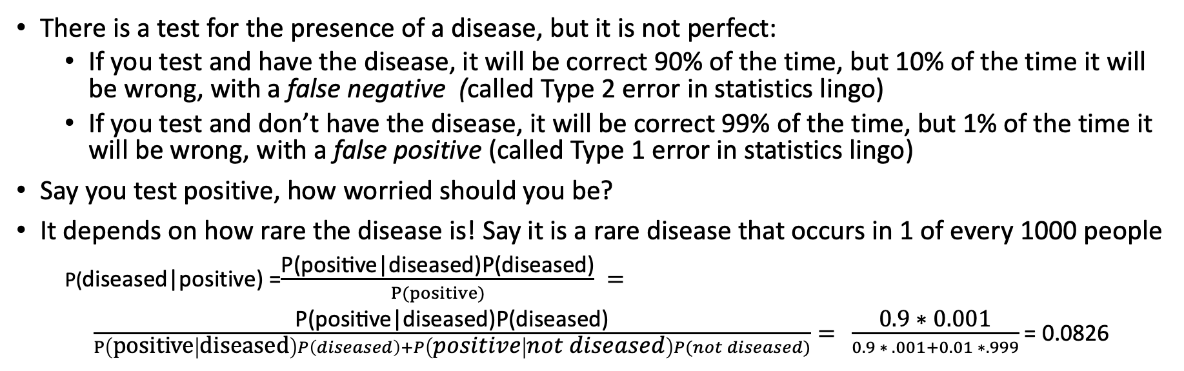
Bayesian probability example
There is a test for the presence of a disease, but it is not perfect:
  If you test and have the disease, it will be correct 90% of the time, but 10% of the time it will be wrong, with a false negative (called Type 2 error in statistics lingo)
  If you test and don’t have the disease, it will be correct 99% of the time, but 1% of the time it will be wrong, with a false positive (called Type 1 error in statistics lingo)
Say you test positive, how worried should you be?
It depends on how rare the disease is! Say it is a rare disease that occurs in 1 of every 1000 people
P(diseased|positive) =$\frac{\text{P}\text{(}\text{positive}\text{|}\text{diseased}\text{)}\text{P}\text{(}\text{diseased}\text{)}}{P(positive)} =$
$\frac{\text{P}\text{(}\text{positive}\text{|}\text{diseased}\text{)}\text{P}\text{(}\text{diseased}\text{)}}{P\left(positive | diseased\right)P\left(diseased\right)+P\left(positive | not diseased\right)P(not diseased)}=$ $\frac{\text{0.9 ∗ 0.001}}{0.9 ∗ .001+0.01 ∗.999}$ = 0.0826
 | Test positive | Test negative | Total people
diseased | 90 | 10 | 100
Not diseased | .01*99900 = 999 | .99*99900 = 98901 | 99900
 | 1089 | 98911 | 100000
Another way to look at the problem is to use a contingency table : 90/189 = .0826
For rare occurances of the condition, false positives can lead to very misleading results
See, e.g. https://www.bmj.com/content/373/bmj.n1411/rr

Slide 15
Summary
What is P(A|B)?
What is Bayes theorem?
What is the law of total probabilities?
Recognize how to formulate conditional probability problems using Bayes theorem

Slide 16
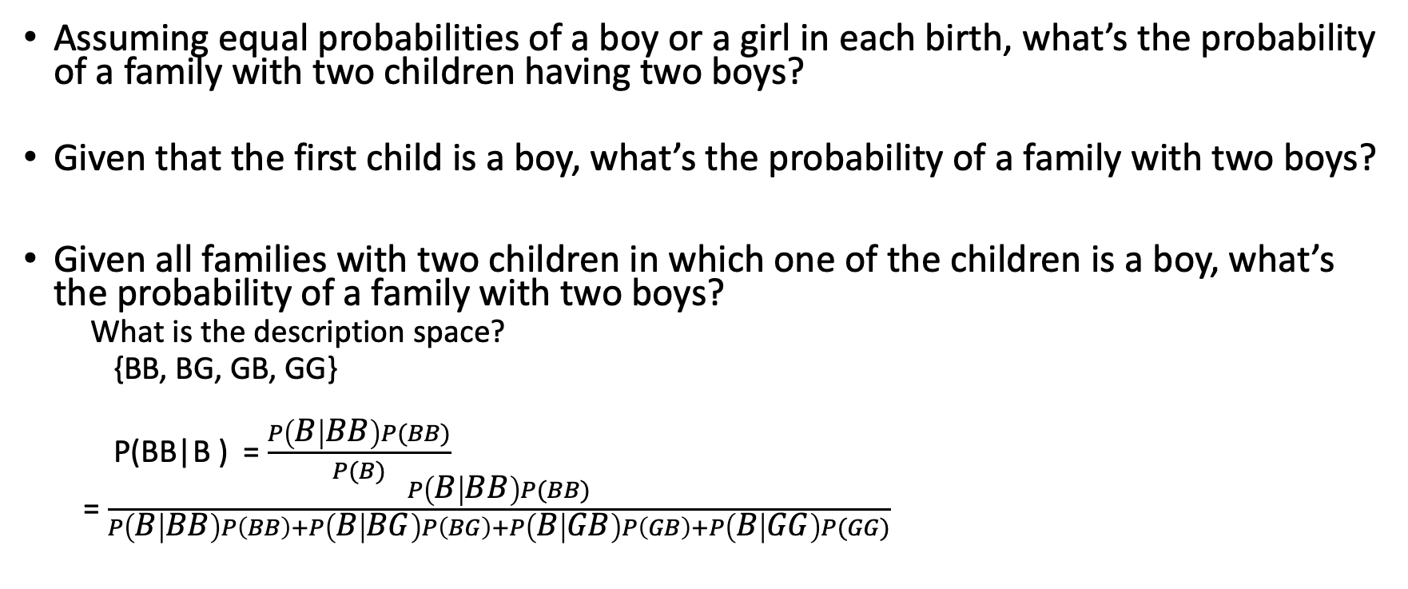
Some examples
Assuming equal probabilities of a boy or a girl in each birth, what’s the probability of a family with two children having two boys?
Given that the first child is a boy, what’s the probability of a family with two boys?
Given all families with two children in which one of the children is a boy, what’s the probability of a family with two boys?
  What is the description space?
  {BB, BG, GB, GG}
  P(BB|B ) = $\frac{P\left(B | BB\right)P(BB)}{P(B)}$
  = $\frac{P\left(B | BB\right)P(BB)}{P\left(B | BB\right)P\left(BB\right)+P\left(B | BG\right)P\left(BG\right)+P\left(B | GB\right)P\left(GB\right)+P\left(B | GG\right)P(GG)}$

Slide 17
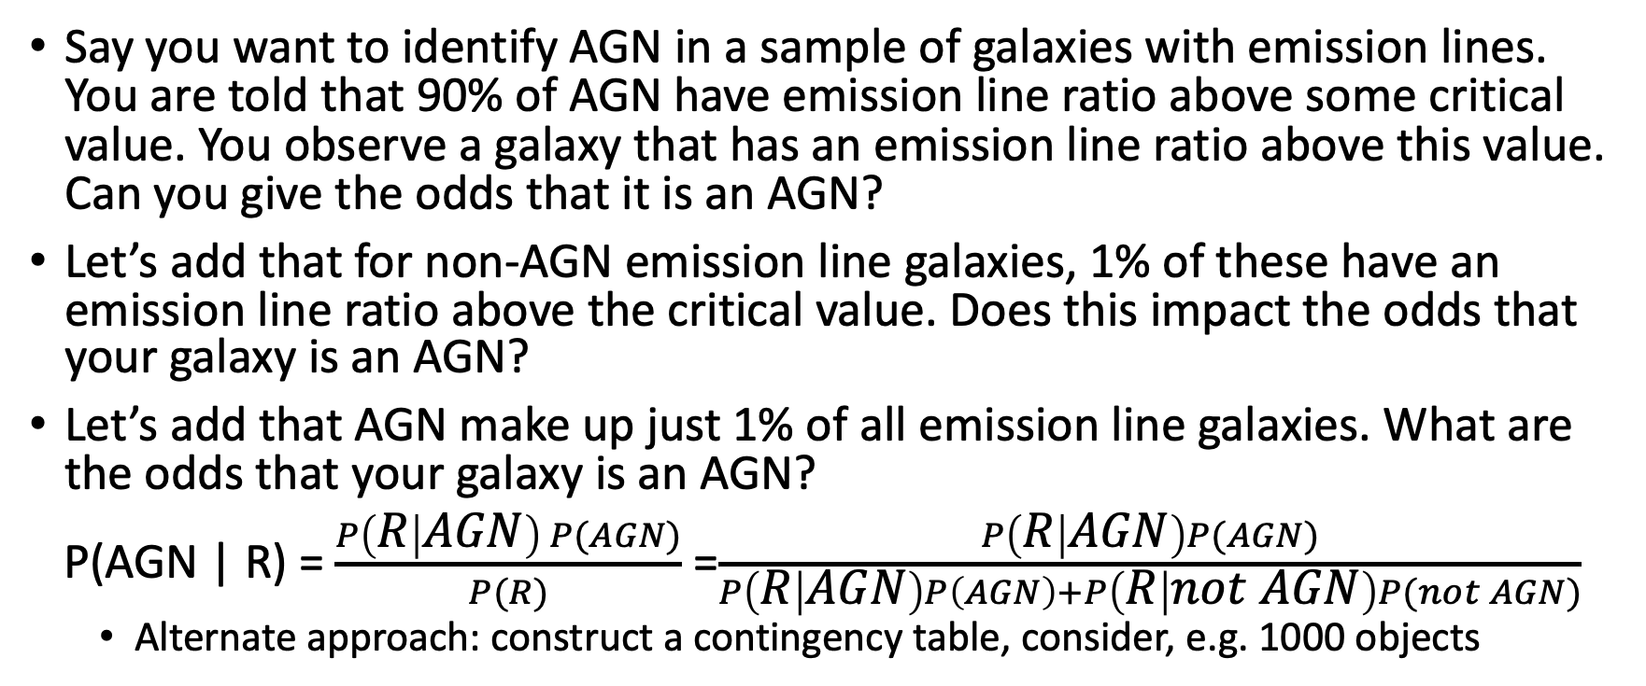
Astronomy example (with fake numbers!)
Say you want to identify AGN in a sample of galaxies with emission lines. You are told that 90% of AGN have emission line ratio above some critical value. You observe a galaxy that has an emission line ratio above this value. Can you give the odds that it is an AGN?
Let’s add that for non-AGN emission line galaxies, 1% of these have an emission line ratio above the critical value. Does this impact the odds that your galaxy is an AGN?
Let’s add that AGN make up just 1% of all emission line galaxies. What are the odds that your galaxy is an AGN?
P(AGN | R) = $\frac{P\left(R | AGN\right) P(AGN)}{P(R)}$ =$\frac{P\left(R | AGN\right)P(AGN)}{P\left(R | AGN\right)P\left(AGN\right)+P\left(R | not AGN\right)P(not AGN)}$
  Alternate approach: construct a contingency table, consider, e.g. 1000 objects

Slide 18
Sample questions
An Astronomy 110 student was extremely keen on astronomy. After graduating she takes a job in a local company in order to keep living in a region with such clear skies. Which is greater: the probability that her occupation is that of electrical engineer, or the probability that she is an electrical engineer who is active in local amateur astronomy circles?
  This is an example of the law of total probabilities. The probability of an event (occupation is electrical engineer) is the sum of the probability of the event under all mutually exclusive conditions. Since there could be electrical engineers who are not active in local astronomy circles, the probability that she is an electrical engineer (without conditions) is higher

Slide 19
Sample questions
A fair coin is flipped three times. (A coin is said to be fair if the possible outcomes, heads and tails, are equally likely). The sample description space is defined to be 𝛺={H, T}. What is the probability of obtaining two heads and one tail?
  There are eight possible choices: HHH, HHT, HTH, HTT, THH, THT, TTH, TTT. Of these, 3 have two heads and one tails, so 3/8
A fair die is tossed twice. Given that a 3 appears on the first toss, what is the probability obtaining the sum 7 in two tosses?
  If the first toss is a 3, the second toss must be a 4, so 1/6

Slide 20
Sample questions
You are given a set of cards, one for each of four galaxies, that list morphological type on one side and V −I color on the other. You are asked to test the rule: A spiral galaxy has a V − I color between -0.5 and 1.0. Which of the following cards should you turn over to test directly the veracity of the rule?
  S
  E
  0.5
  2.0
  The hypothesis says nothing anout elliptical galaxies, nor does it say that all galaxies with color between -0.5 and 1 are spirals. So only the S and 2.0 cards can test the hypothesis

Slide 21
Sample questions
A subsample contains five galaxies numbered 1, 2, 3, 4, 5. A galaxy can be selected at random, and is then replaced before the next galaxy is selected. (This is called sampling with replacement.) What is the probability of drawing the same galaxy (any one) twice in two tries?
Two galaxies are drawn at random, with replacement. Three students were asked to compute the probability p that the sum of their numbers was equal to 5. The first computed p = 2/15 , arguing that there are 15 distinguishable pairs and only 2 are favorable. The second computed p = 1/ 9, arguing that there are 9 distinguishable sums, of which only 1 was favorable. The third computed p = 4/ 25 , arguing that there were 25 distinguishable ordered outcomes of which 4 were favorable. What is the correct answer? Explain what is wrong with the reasoning of the two incorrect answers.

Slide 22
Sample questions
For a subsample of 800 stellar objects, 200 are identified as variable, 200 are identified as M dwarfs, and the remaining are identified as variable M dwarfs. One element is drawn at random from the sample. Let A and B represent the events of observing states variable and M dwarf, respectively. Find P(A), P(B), and P(A) ∩P(B). Are A and B independent?
  P(A) is 600/800 = 3/4
  P(B) is 600/800 = 3/4
  P(A∩B) = 400/800 = ½
  Since P(A∩B) ≠ P(A)P(B), the events are NOT independent

Slide 23
Sample questions
Assume that 0.1% of the objects within a subsample are quasars. You examine 100 spectra from the subsample in detail. What is the probability that at least one of the spectra will be that of a quasar?
  Because you have a problem answering the question as an “or” question since it is possible that multiple of the first 100 will be quasars, formulate it as an “and” question: what is the probability that all 100 won’t be quasars? The probability that at least one will be is 1 minus this probability: P = 0.999^100 = 0.095
  This seems reasonable: since quasars are rare, the odds that you’ll get more than one isn’t too high, so the correct answer is
  close to 0.1
For the same sample, you write a spectral analysis routine that fits absorption lines to each spectrum and compares it to a set of template quasar spectra. The program successfully detects all quasars, but also misidentifies 0.5% of other spectral candidates as quasars. If the first object which you analyze is identified by your program as a quasar, what is the probability that it actually is one?
Use Bayes theorem:
P(QSO|detected) = P(detected|QSO) P(QSO) /
(P(detected|QSO)*P(QSO) + P(detected|not QSO)P(not QSO)
= 0.167

Slide 24
Sample questions
A group of Astronomy 110 students is taking a final exam. For a particular multiple-choice question on the test, the fraction of students who know the answer is p. The probability of answering the question correctly is unity for those who know the answer, and 1/ m for those who guess, given m possible multiple-choice answers. Compute the probability that a student knew the answer to the question, given that they answered correctly.
P(know|correct) = P(correct|know)P(know) /
(P(correct|know)P(know) + P(correct|don't know)P(don't know)
= p / (p + 1/m (1-p))

Slide 25
Sample questions
Monty Hall, or three doors, problem. You're on a game show where you are asked to choose a door from 3 doors, labelled A, B, and C, with a car behind one of them. After you make your choice, the host, who knows where the car is, opens one of the remaining doors to show nothing, and asks whether you want to change your guess. Statistically, does it increase your chances to change or not?
P(C) = P(C|A) P(A) + P(C|not A) P(not A)

Slide 26
ASTR 630
Numerical and Statistical Methods in Astrophysics
Spring 2022
Random variables and probability distribution functions

Slide 27
Random variables and probability distribution functions
Random variables are measured values of a quantity that has some random variation
  May result from variation in a population of the physical quantity being measured
  May result from measurement uncertainty
Discrete and continuous random variables
Distribution of a random variable described by probability distribution function (PDF)
  Discrete random variable: ∑ PDF(x_{i})=1
  Continuous random variable: ∫PDF(x_{i}) = 1

Slide 28
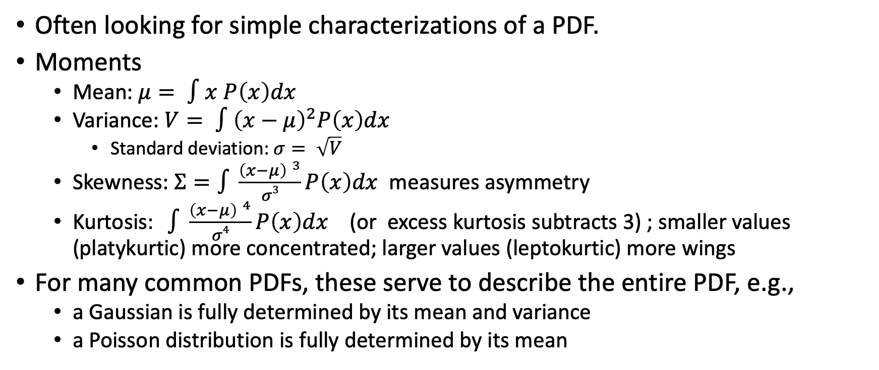
Descriptors (descriptive statistics) of a PDF
Often looking for simple characterizations of a PDF.
Moments
  Mean: $μ= ∫x P\left(x\right)dx$
  Variance: $V= ∫{\left(x−μ\right)}^{2}P\left(x\right)dx$
    Standard deviation: $σ= \sqrt{V}$
  Skewness: $Σ=∫\frac{{\left(x−μ\right) }^{3}}{σ3}P\left(x\right)dx$ measures asymmetry
  Kurtosis: $∫\frac{{\left(x−μ\right) }^{4}}{σ4}P\left(x\right)dx$ (or excess kurtosis subtracts 3) ; smaller values (platykurtic) more concentrated; larger values (leptokurtic) more wings
For many common PDFs, these serve to describe the entire PDF, e.g.,
  a Gaussian is fully determined by its mean and variance
  a Poisson distribution is fully determined by its mean

Slide 29
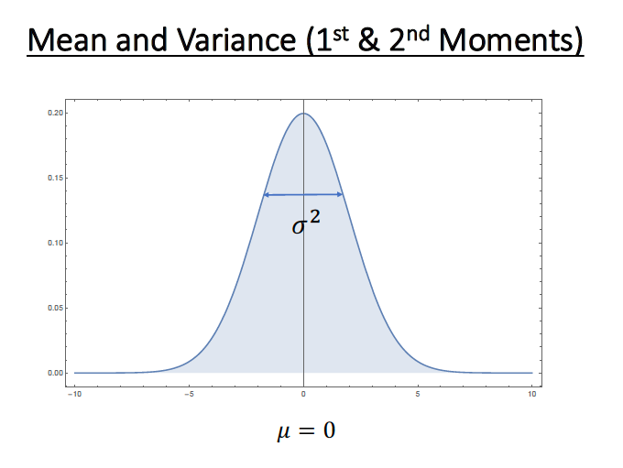
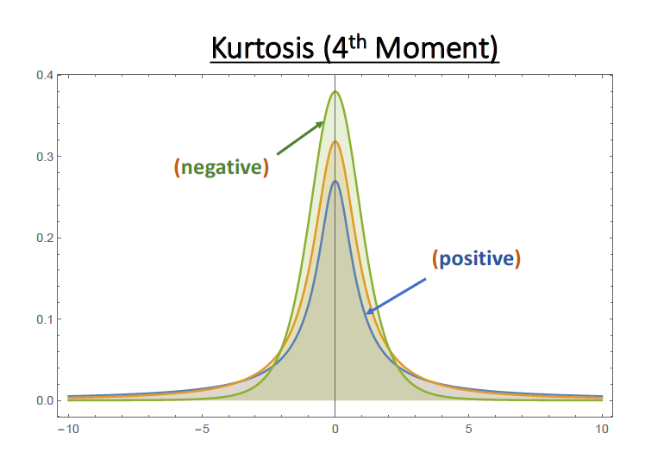
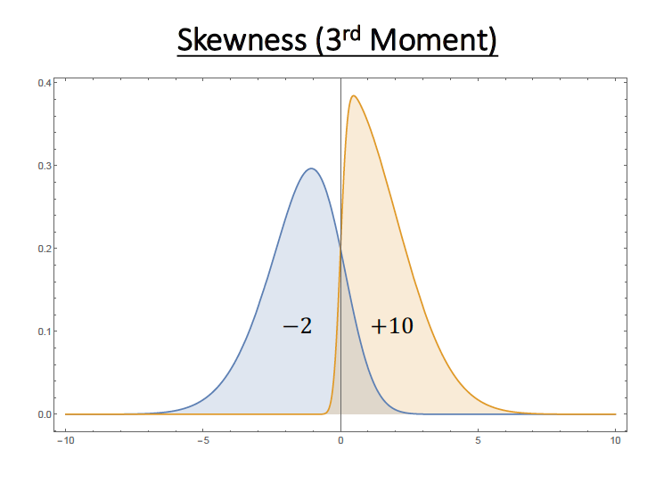
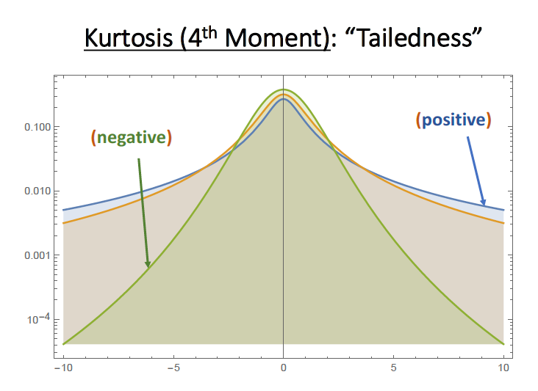
Graphical demonstration of moments

Slide 30
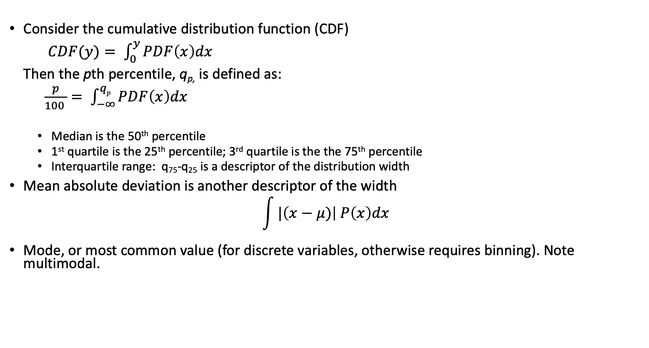
Other descriptors
Consider the cumulative distribution function (CDF)
$CDF(y)= \int_{0}^{y}{PDF\left(x\right)dx}$
Then the pth percentile, q_{p,} is defined as:
$\frac{p}{100 }= \int_{−∞}^{qp}{PDF\left(x\right)dx}$
  Median is the 50th percentile
  1st quartile is the 25th percentile; 3rd quartile is the the 75th percentile
  Interquartile range: q₇₅-q₂₅ is a descriptor of the distribution width
Mean absolute deviation is another descriptor of the width
$$\int{|\left(x−μ)\right| P\left(x\right)dx}$$
Mode, or most common value (for discrete variables, otherwise requires binning). Note multimodal.

Slide 31
ASTR 630
Numerical and Statistical Methods in Astrophysics
Spring 2022
Estimators

Slide 32
Estimators
Values that estimate the population quantities (descriptors) from a finite sample, (sometimes called sample statistics)
Desirable characteristics of an estimator
  Unbiased : expectation value of estimator is equal to quantity being estimated
  Consistent: converges to true value in limit of infinite data
  Efficient: has low variance around true value
  Robust: isn’t overly sensitive to outliers or extreme values
Any single estimator may not be the optimum in all of these!

Slide 33
Expectation values
To evaluate an estimator, we calculate the expectation value, which is the average of the quantity over many different samples of the underlying population
E(x) = ∫x P(x) dx
E(f(x)) = ∫f(x) P(x) dx
It is possible to calculate the expectation value of many estimators and to do so requires some development of this expectation operator. It is also possible to calculate the variance of the expectation value. See Bailer-Jones 1.3
One can also calculate the variance of a sample:
Var(x) = ∫ (x – E(x))² P(x) dx = E(x²) - E(x)²
We will sidestep the derivations, quote some results, and then calculate some expectation values numerically

Slide 34
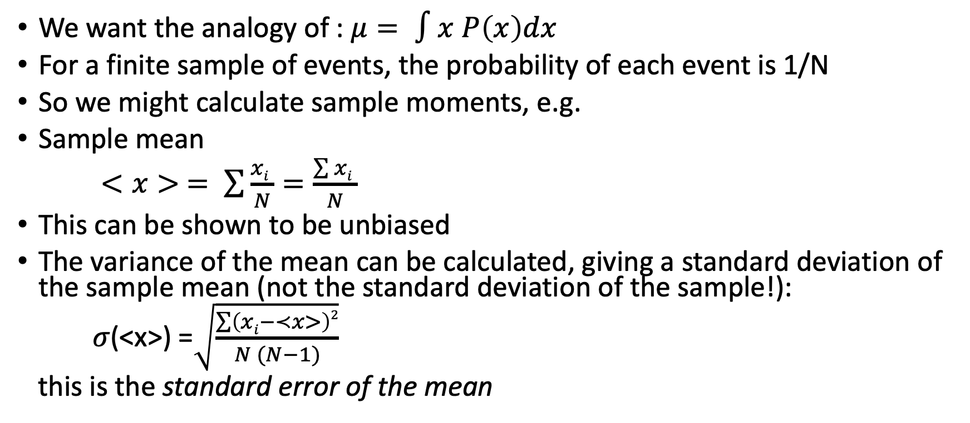
Sample moments : mean
We want the analogy of : $μ= ∫x P\left(x\right)dx$
For a finite sample of events, the probability of each event is 1/N
So we might calculate sample moments, e.g.
Sample mean
$<x> = \sum{\frac{xi }{N}}=\frac{\sum{xi }}{N}$
This can be shown to be unbiased
The variance of the mean can be calculated, giving a standard deviation of the sample mean (not the standard deviation of the sample!):
𝜎(<x>) =$\sqrt{\frac{\sum{\left(xi−≺x>\right)2}}{N (N−1)}}$
this is the standard error of the mean

Slide 35
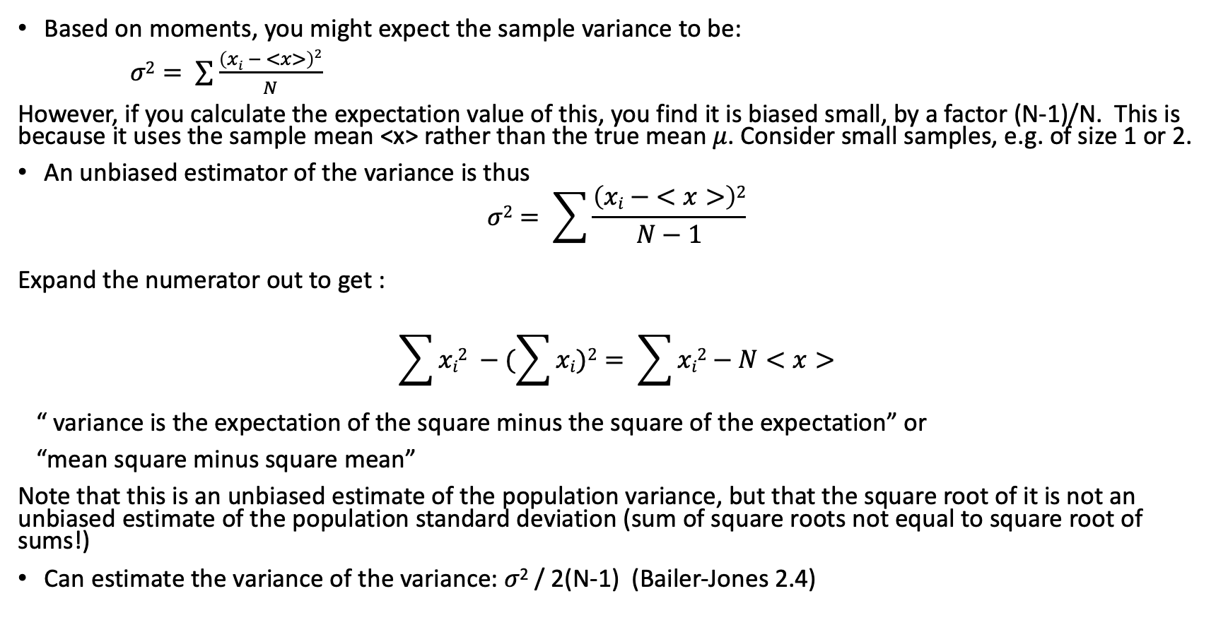
Sample moments : variance
Based on moments, you might expect the sample variance to be:
$σ2= \sum{\frac{\left(xi − <x>\right)2}{N}}$
However, if you calculate the expectation value of this, you find it is biased small, by a factor (N-1)/N. This is because it uses the sample mean <x> rather than the true mean 𝜇. Consider small samples, e.g. of size 1 or 2.
An unbiased estimator of the variance is thus
$$σ2= \sum{\frac{\left(xi − <x>\right)2}{N−1}}$$
Expand the numerator out to get :
$$\sum{xi2 −(\sum{xi)2= \sum{xi2}−N<x>}}$$
“ variance is the expectation of the square minus the square of the expectation” or
“mean square minus square mean”
Note that this is an unbiased estimate of the population variance, but that the square root of it is not an unbiased estimate of the population standard deviation (sum of square roots not equal to square root of sums!)
Can estimate the variance of the variance: 𝜎² / 2(N-1) (Bailer-Jones 2.4)

Slide 36
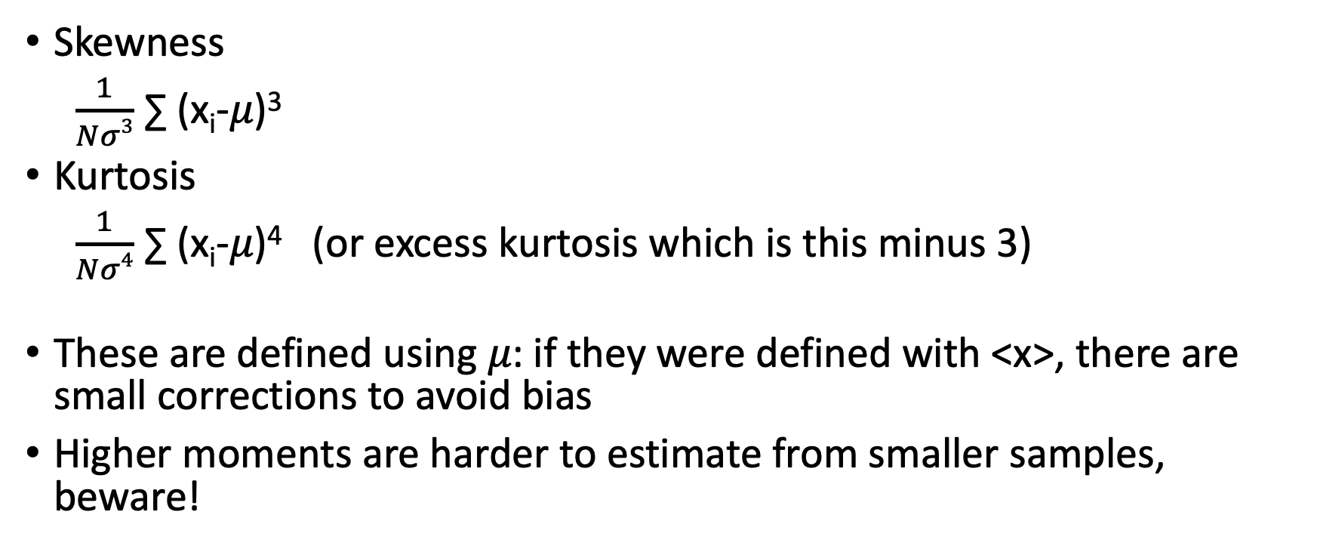
Sample moments: skewness and kurtosis
Skewness
$\frac{1}{Nσ3}$ ∑ (x_{i}-𝜇)³
Kurtosis
$\frac{1}{Nσ4}$ ∑ (x_{i}-𝜇)⁴ (or excess kurtosis which is this minus 3)
These are defined using 𝜇: if they were defined with <x>, there are small corrections to avoid bias
Higher moments are harder to estimate from smaller samples, beware!

Slide 37
Other estimators:
Estimators of the mean
  Nth value
  Median
  Midrange (average of smallest and largest values)
  Sigma clipping : estimate mean and variance (perhaps with a robust estimator), reject unlikely values and recompute
  Least-squares estimator
    Minimizes ∑(x_{i}-𝜇_{LS})²
  Maximum likelihood estimator
    Maximizes 𝜫 P(x_{i}|𝜇_{MLE}) where 𝜫 represents a product (here, of probabilities)
Estimators of the variance
  Mean absolute deviation (MAD) : note for Gaussian, 𝜎 = 1.253 MAD
  Interquartile range : note for Gaussian, 𝜎_{G} = 0.7413 (q₇₅-q₂₅)

Slide 38
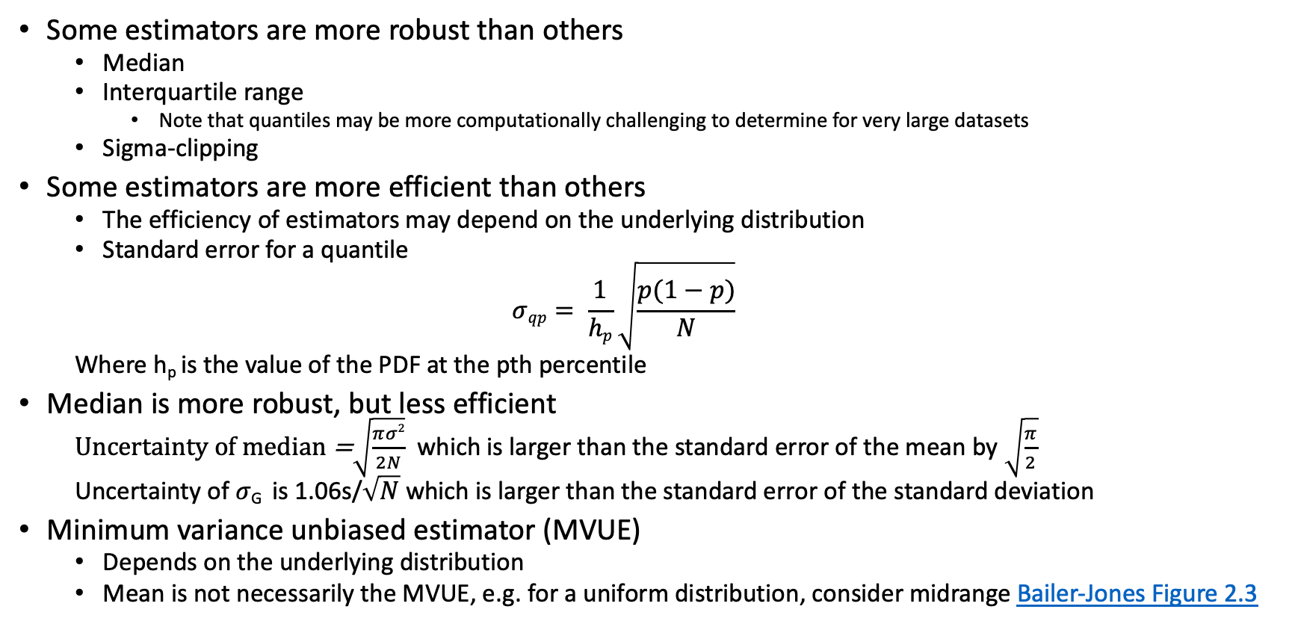
Bias, consistency, efficiency, and robustness
Some estimators are more robust than others
  Median
  Interquartile range
    Note that quantiles may be more computationally challenging to determine for very large datasets
  Sigma-clipping
Some estimators are more efficient than others
  The efficiency of estimators may depend on the underlying distribution
  Standard error for a quantile
  $$σqp= \frac{1}{hp}\sqrt{\frac{p(1−p)}{N}}$$
  Where h_{p} is the value of the PDF at the pth percentile
Median is more robust, but less efficient
  Uncertainty of median =$\sqrt{\frac{πσ2}{2N}}$ which is larger than the standard error of the mean by $\sqrt{\frac{π}{2}}$
  Uncertainty of 𝜎_{G} is 1.06s/$\sqrt{N}$ which is larger than the standard error of the standard deviation
Minimum variance unbiased estimator (MVUE)
  Depends on the underlying distribution
  Mean is not necessarily the MVUE, e.g. for a uniform distribution, consider midrange Bailer-Jones Figure 2.3

Slide 39
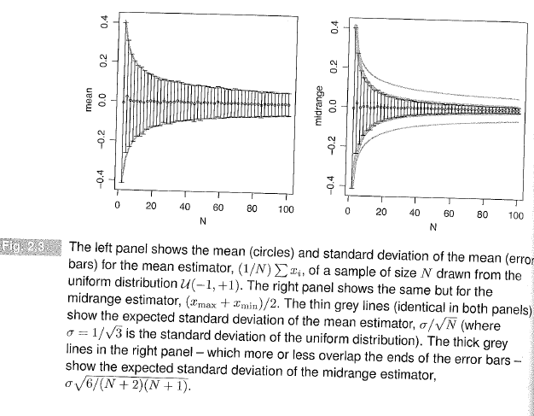

Slide 40
Precision and accuracy
Accuracy is related to bias
Precision is related to efficiency

Slide 41
Exercise: numerical experiments with estimators
Work on sample-unfilled Jupyter notebook from Notebooks page on Canvas

Slide 42
ASTR 630
Numerical and Statistical Methods in Astrophysics
Spring 2022
Propagation of uncertainty

Slide 43
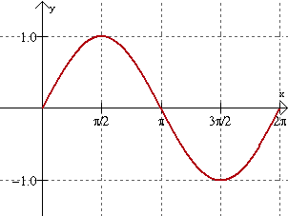
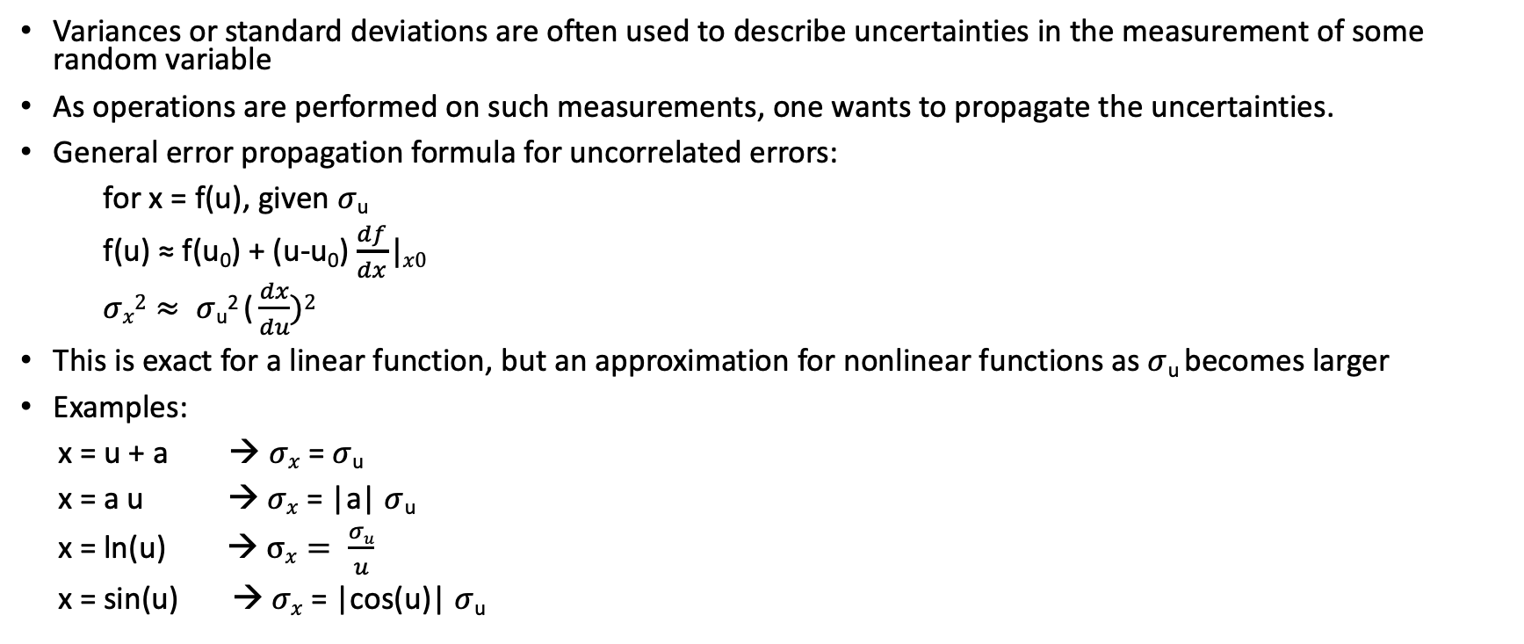
Propagation of uncertainties
Variances or standard deviations are often used to describe uncertainties in the measurement of some random variable
As operations are performed on such measurements, one wants to propagate the uncertainties.
General error propagation formula for uncorrelated errors:
for x = f(u), given $σ$_{u}
f(u) ≈ f(u₀) + (u-u₀) $\frac{df}{dx}|x0$
$σx2≈ σ$_{u}² ( $\frac{dx}{du})2$
This is exact for a linear function, but an approximation for nonlinear functions as $σ$_{u} becomes larger
Examples:
x = u + a → $σx$ = $σ$_{u}
x = a u → $σx$ = |a| $σ$_{u}
x = ln(u) → $σx= \frac{σu}{u}$
x = sin(u) → $σx$ = |cos(u)| $σ$_{u}

Slide 44
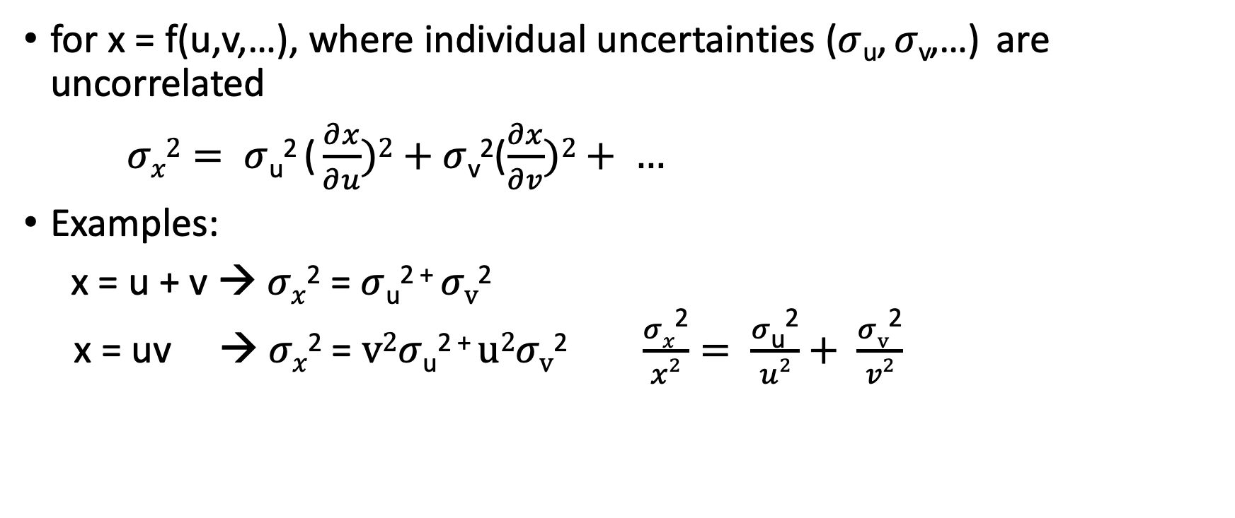
Propagation of uncertainties: multiple variables
for x = f(u,v,…), where individual uncertainties ($σ$_{u}, $σ$_{v},…) are uncorrelated
$σx2= σ$_{u}² ( $\frac{∂x}{∂u})2+σ$_{v}²($\frac{∂x}{∂v})2+ …$
Examples:
x = u + v → $σx$² = $σ$_{u}² ⁺ $σv$²
x = uv → $σx$² = $v2σ$_{u}² ⁺ $u2σv$² $\frac{σx\text{2}}{x2}= \frac{σ\text{u}\text{2}}{u2}+ \frac{σv\text{2}}{v2}$

Slide 45
ASTR 630
Numerical and Statistical Methods in Astrophysics
Spring 2022
Multivariate distributions

Slide 46
Multivariate distributions
In many cases, you may be measuring two quantities of a population that are each random variables
You can then make a 2-dimensional probability distribution function, p(x,y)
If the quantities are independent of each other, then
p(x,y) = p(x) p(y)
just as we had for classic probabilities
If the quantities are not independent, we have correlated quantities

Slide 47
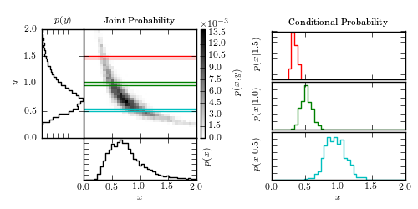
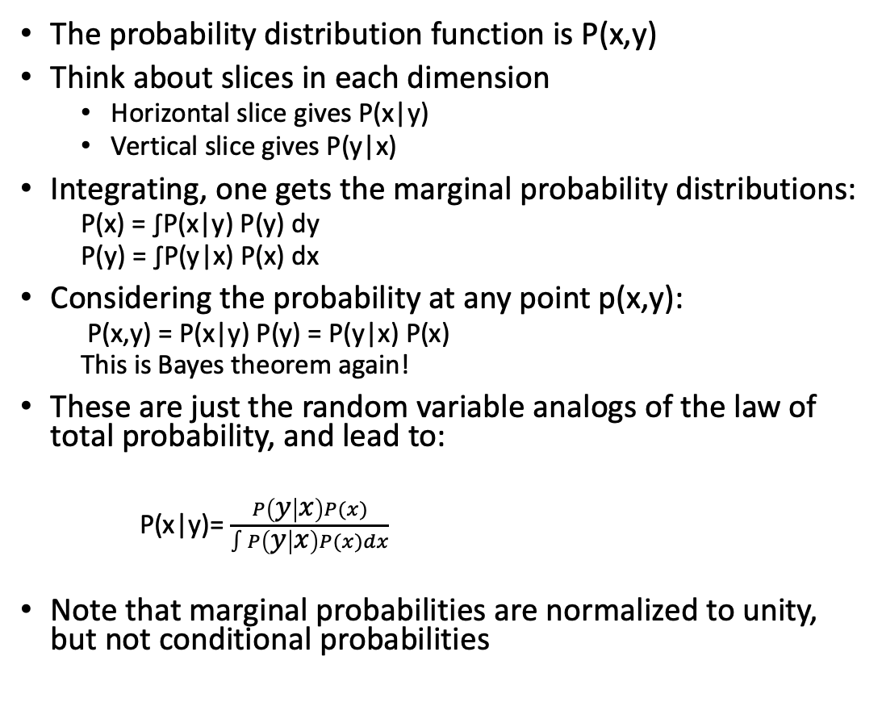
Multivariate distributions
The probability distribution function is P(x,y)
Think about slices in each dimension
  Horizontal slice gives P(x|y)
  Vertical slice gives P(y|x)
Integrating, one gets the marginal probability distributions:
  P(x) = ∫P(x|y) P(y) dy
  P(y) = ∫P(y|x) P(x) dx
Considering the probability at any point p(x,y):
  P(x,y) = P(x|y) P(y) = P(y|x) P(x)
  This is Bayes theorem again!
These are just the random variable analogs of the law of total probability, and lead to:
  P(x|y)= $\frac{P\left(y | x\right)P(x)}{∫P\left(y | x\right)P(x)dx}$
Note that marginal probabilities are normalized to unity, but not conditional probabilities
astroML 3.2

Slide 48
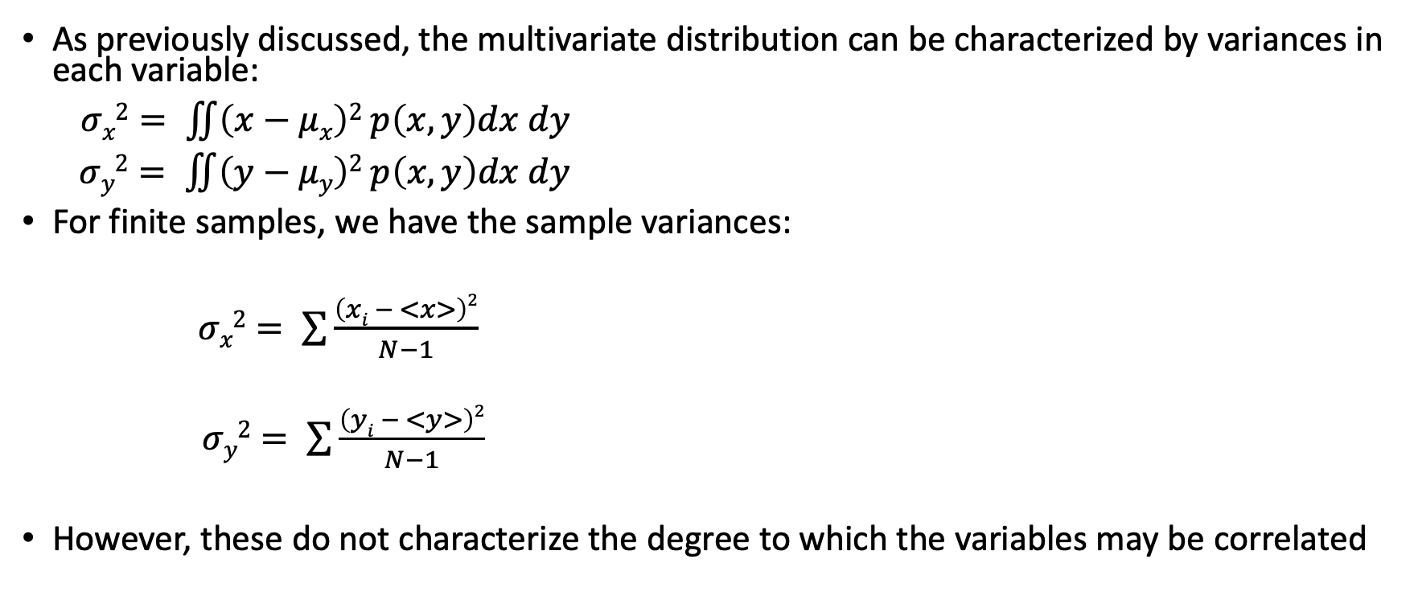
Variances
As previously discussed, the multivariate distribution can be characterized by variances in each variable:
$σx2= \iint{\left(x−μx\right)2 p\left(x,y\right)dx dy}$
$σy2= \iint{\left(y−μy\right)2 p\left(x,y\right)dx dy}$
For finite samples, we have the sample variances:
$σx2= \sum{\frac{\left(xi − <x>\right)2}{N−1}}$
$σy2= \sum{\frac{\left(yi − <y>\right)2}{N−1}}$
However, these do not characterize the degree to which the variables may be correlated

Slide 49
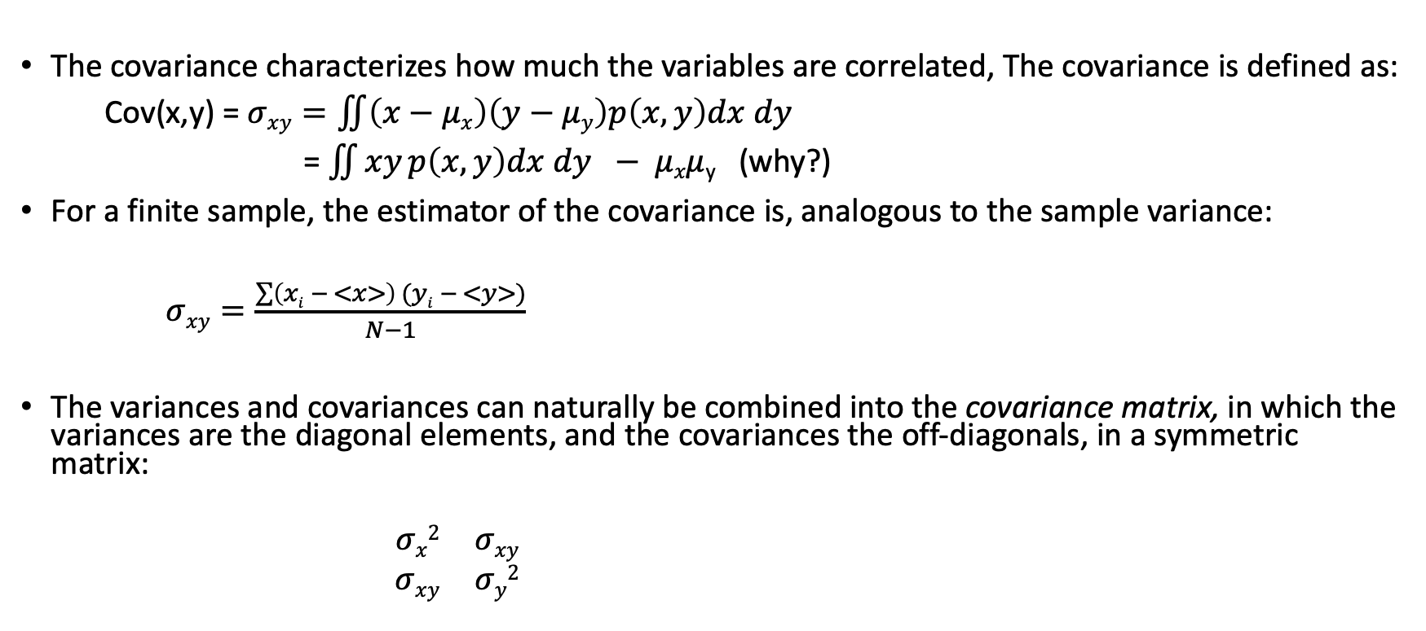
Covariance
The covariance characterizes how much the variables are correlated, The covariance is defined as:
Cov(x,y) = $σxy=\iint{\left(x−μx\right)\left(y−μy\right)p\left(x,y\right)dx dy}$
= $\iint{xy p\left(x,y\right)dx dy} − μxμ$_{y} (why?)
For a finite sample, the estimator of the covariance is, analogous to the sample variance:
$σxy=\frac{\sum{\left(xi − <x>\right) (yi − <y>)}}{N−1}$
The variances and covariances can naturally be combined into the covariance matrix, in which the variances are the diagonal elements, and the covariances the off-diagonals, in a symmetric matrix:
$\begin{matrix}σx2 & σxy \\ σxy & σy2\end{matrix}$

Slide 50
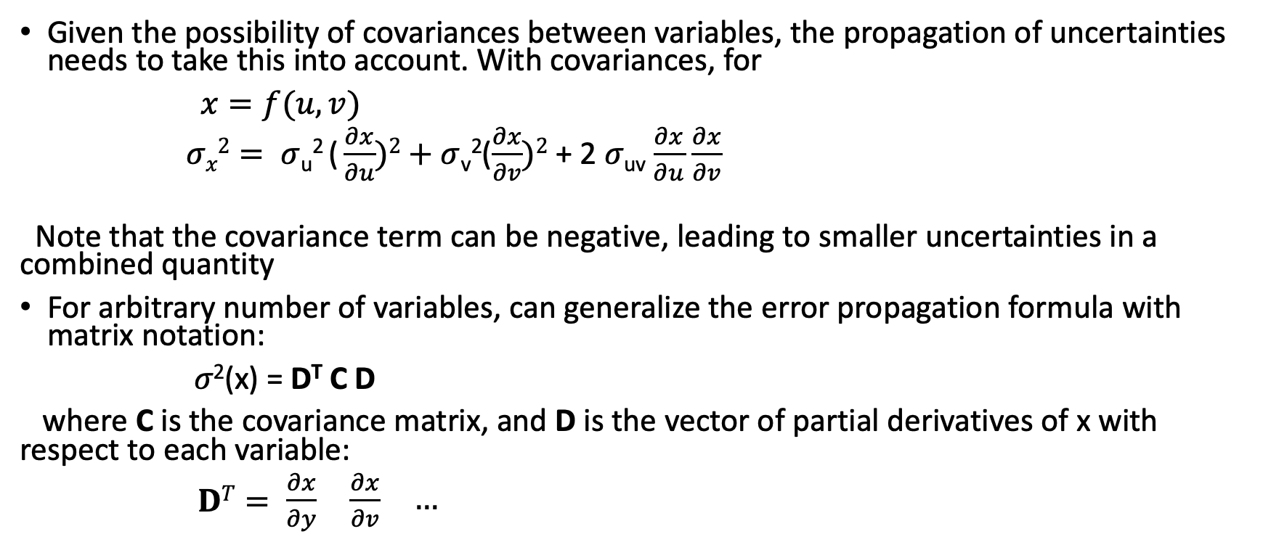
Covariance
Given the possibility of covariances between variables, the propagation of uncertainties needs to take this into account. With covariances, for
$x=f(u,v)$
$σx2= σ$_{u}² ( $\frac{∂x}{∂u})2+σ$_{v}²($\frac{∂x}{∂v})2$ + 2 𝜎_{uv} $\frac{∂x}{∂u}$ $\frac{∂x}{∂v}$
Note that the covariance term can be negative, leading to smaller uncertainties in a combined quantity
For arbitrary number of variables, can generalize the error propagation formula with matrix notation:
𝜎²(x) = D^{T} C D
where C is the covariance matrix, and D is the vector of partial derivatives of x with respect to each variable:
$DT= \begin{matrix}\frac{∂x}{∂y} & \frac{∂x}{∂v} & …\end{matrix}$

Slide 51
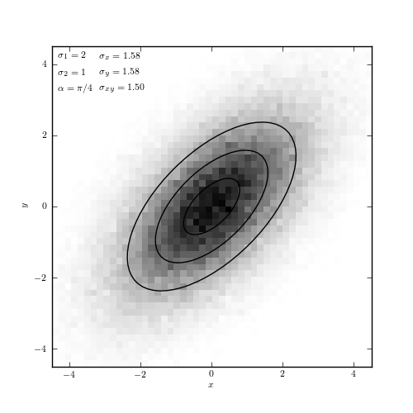
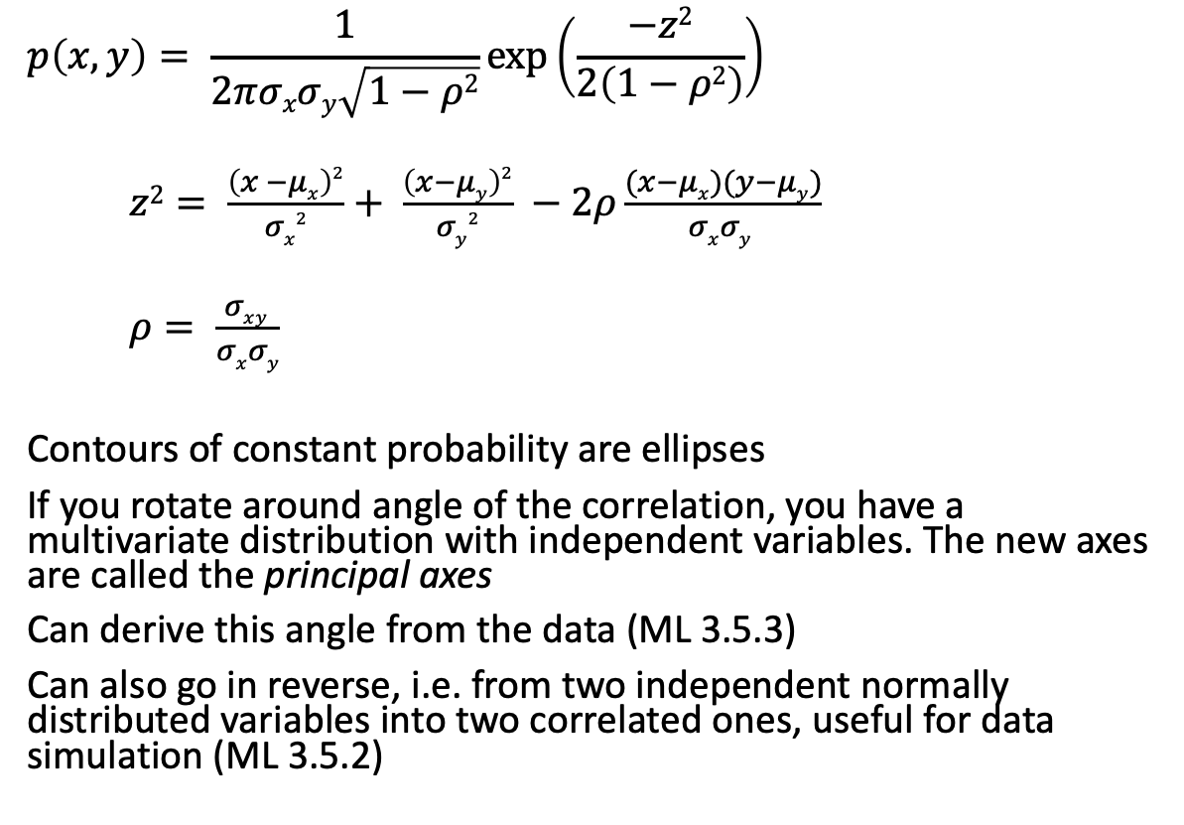
Example: multivariate Gaussian distribution
$$p\left(x,y\right)= \frac{1}{2πσxσy\sqrt{1−ρ2}}\exp\left(\frac{−z2}{2\left(1−ρ2\right)}\right)$$
$z2= \frac{\left(x −μx\right)2}{σx2}+ \frac{\left(x−μy\right)2}{σy2} −2ρ\frac{(x−μx)(y−μy)}{σxσy }$
$ρ= \frac{σxy }{σxσy}$
Contours of constant probability are ellipses
If you rotate around angle of the correlation, you have a multivariate distribution with independent variables. The new axes are called the principal axes
Can derive this angle from the data (ML 3.5.3)
Can also go in reverse, i.e. from two independent normally distributed variables into two correlated ones, useful for data simulation (ML 3.5.2)
astroML 3.22

Slide 52
ASTR 630
Numerical and Statistical Methods in Astrophysics
Spring 2022
Correlation coefficients

Slide 53
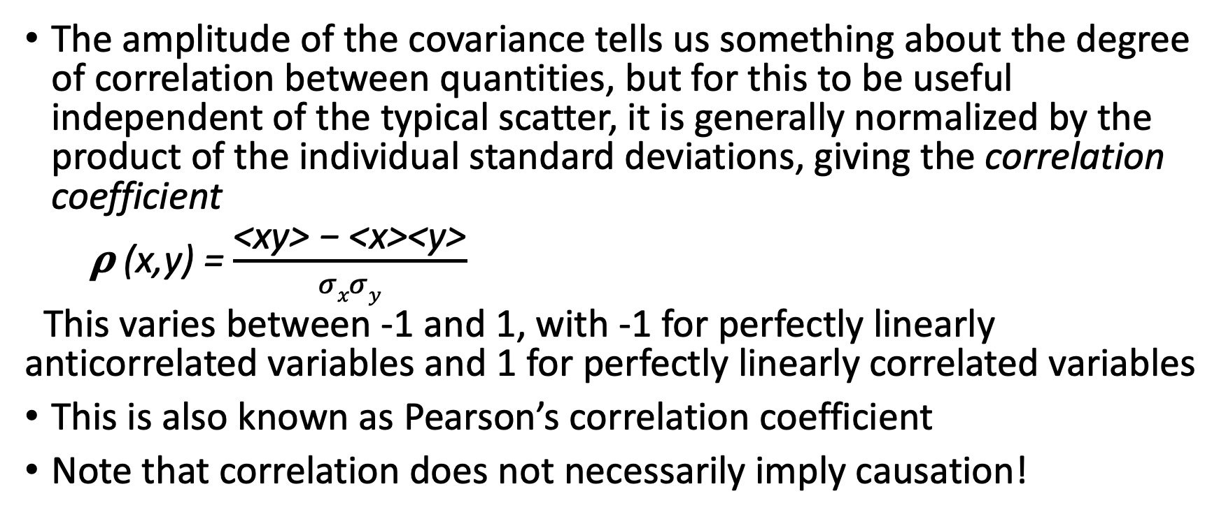
Correlation coefficients
The amplitude of the covariance tells us something about the degree of correlation between quantities, but for this to be useful independent of the typical scatter, it is generally normalized by the product of the individual standard deviations, giving the correlation coefficient
𝛒 (x,y) = $\frac{\text{<}\text{xy}\text{> − <}\text{x}\text{><}\text{y}\text{>}}{σxσy}$
This varies between -1 and 1, with -1 for perfectly linearly anticorrelated variables and 1 for perfectly linearly correlated variables
This is also known as Pearson’s correlation coefficient
Note that correlation does not necessarily imply causation!

Slide 54
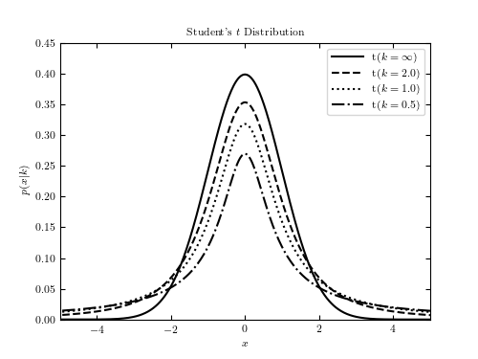
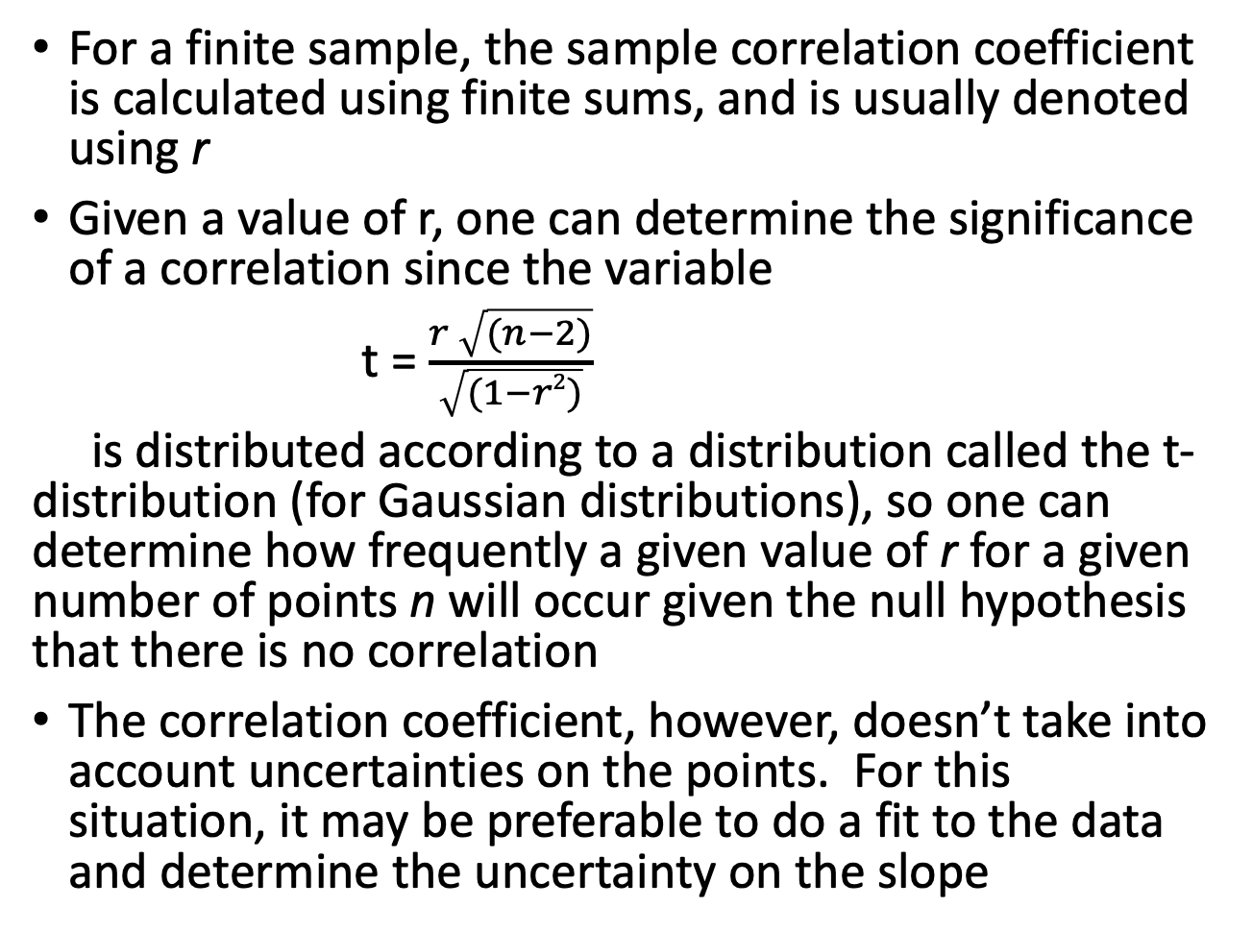
Correlation coefficients
For a finite sample, the sample correlation coefficient is calculated using finite sums, and is usually denoted using r
Given a value of r, one can determine the significance of a correlation since the variable
t = $\frac{r \sqrt{(n−2)}}{\sqrt{(1−r2)}}$
is distributed according to a distribution called the t-distribution (for Gaussian distributions), so one can determine how frequently a given value of r for a given number of points n will occur given the null hypothesis that there is no correlation
The correlation coefficient, however, doesn’t take into account uncertainties on the points. For this situation, it may be preferable to do a fit to the data and determine the uncertainty on the slope

Slide 55
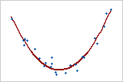
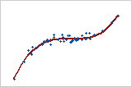
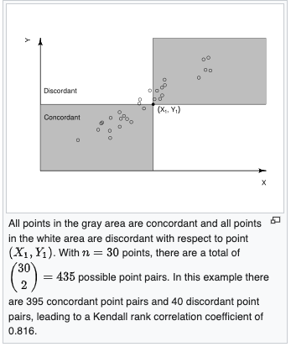
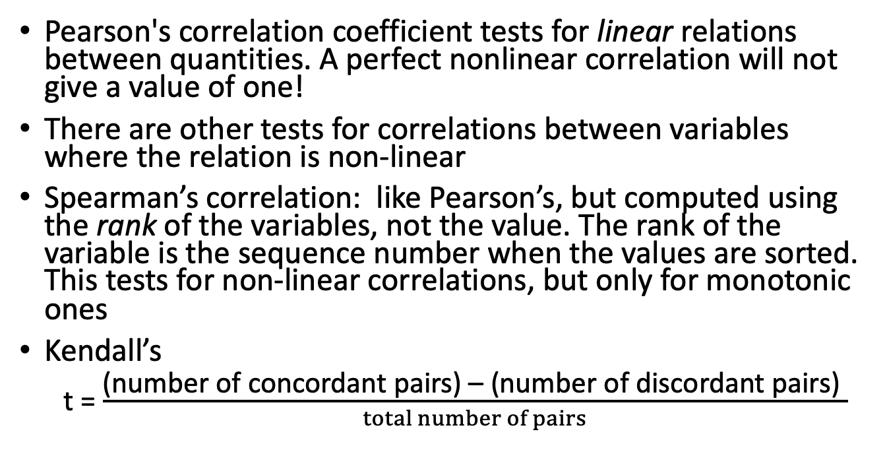
Nonlinear correlations
r=.244
Pearson's correlation coefficient tests for linear relations between quantities. A perfect nonlinear correlation will not give a value of one!
There are other tests for correlations between variables where the relation is non-linear
Spearman’s correlation: like Pearson’s, but computed using the rank of the variables, not the value. The rank of the variable is the sequence number when the values are sorted. This tests for non-linear correlations, but only for monotonic ones
Kendall’s
t = $\frac{\text{(}\text{number} \text{of} \text{concordant} \text{pairs}\text{) – (}\text{number} \text{of} \text{discordant} \text{pairs}\text{) }}{total number of pairs}$
r=.843

Slide 56
ASTR 630
Numerical and Statistical Methods in Astrophysics
Spring 2022
Common probability distribution functions

Slide 57
Common distributions
Several probability distribution functions (PDFs) commonly arise in multiple different situations
Good to be familiar with basic properties: characteristic shape, mean, variance, etc

Slide 58
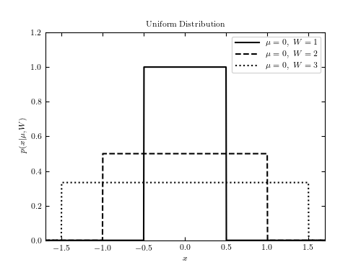
Uniform distribution
equal probability across some range
Mean is middle of range
Amplitude is 1/(x_{max}-x_{min})
Variance is (x_{max}-x_{min})²/12
Example: central location of an object/spectral line within a pixel
AstroML 3.7

Slide 59
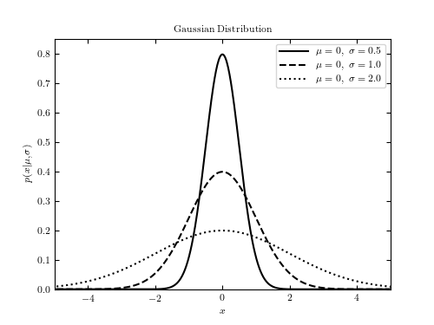
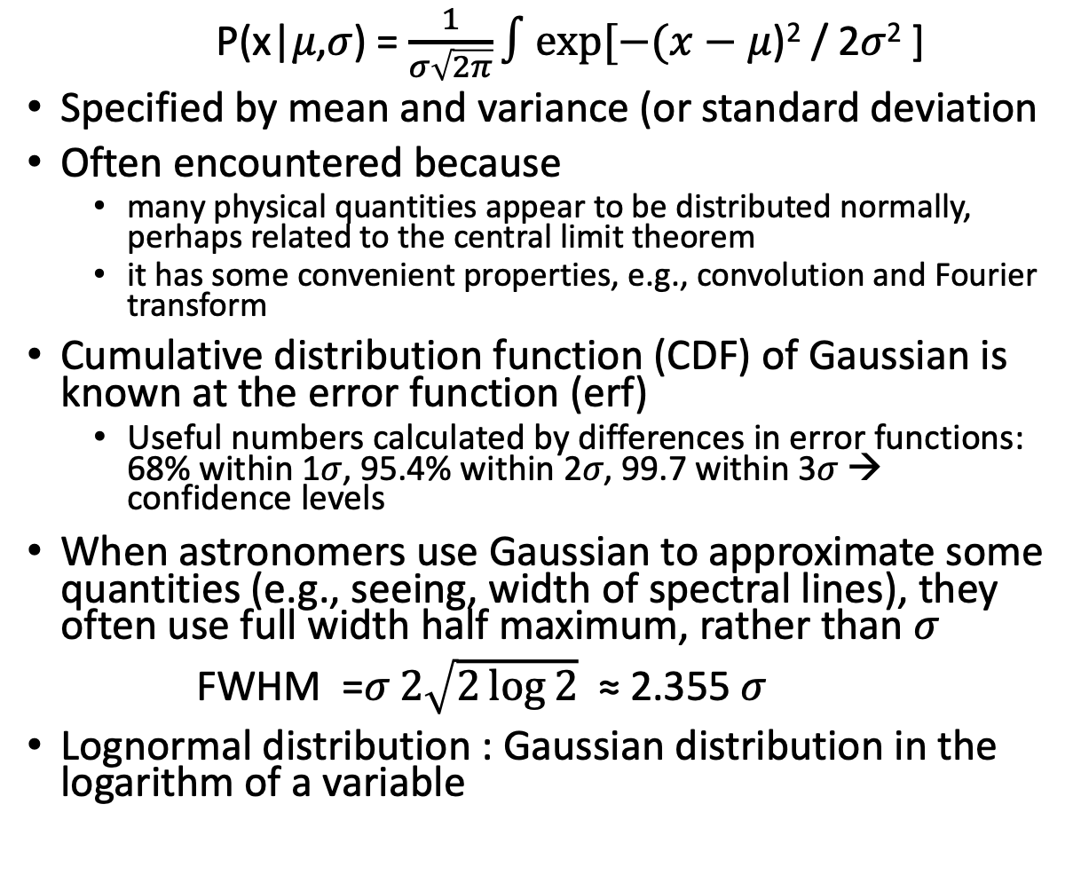
Gaussian (normal) distribution
P(x|𝜇,𝜎) = $\frac{1}{σ\sqrt{2π}}∫exp⁡[−(x−μ$)² / 2𝜎² ]
Specified by mean and variance (or standard deviation
Often encountered because
  many physical quantities appear to be distributed normally, perhaps related to the central limit theorem
  it has some convenient properties, e.g., convolution and Fourier transform
Cumulative distribution function (CDF) of Gaussian is known at the error function (erf)
  Useful numbers calculated by differences in error functions: 68% within 1𝜎, 95.4% within 2𝜎, 99.7 within 3𝜎 → confidence levels
When astronomers use Gaussian to approximate some quantities (e.g., seeing, width of spectral lines), they often use full width half maximum, rather than 𝜎
FWHM =𝜎$2\sqrt{2\log{2}}$ ≈ 2.355 𝜎
Lognormal distribution : Gaussian distribution in the logarithm of a variable

Slide 60
Binomial distribution
Binomial distribution relates to situations where there are two possible outcomes (not necessarily with equal probability), and gives the probability of observing one of the outcomes k times in a series of n trials, given that the probability of that outcome in a single trial is p (e.g., flipping a coin: probability of getting 3 heads in 10 tosses)
P (k|n,p)
What is this probability?
  Consider one (unlikely) way of getting k of the desired outcome: the situation where the first k event are the desired outcome, and the rest of the events (n-k) are the undesired outcome, e.g. For our coin toss example: HHHTTTTTTT
  P (this sequence) = p^{k} (1-p)^{(n-k)}
  ⁼ (0.5)¹⁰
  This is actually the probability of getting any single sequence that has the desired outcome: although any one is unlikely, there are a lot of possibilities

Slide 61
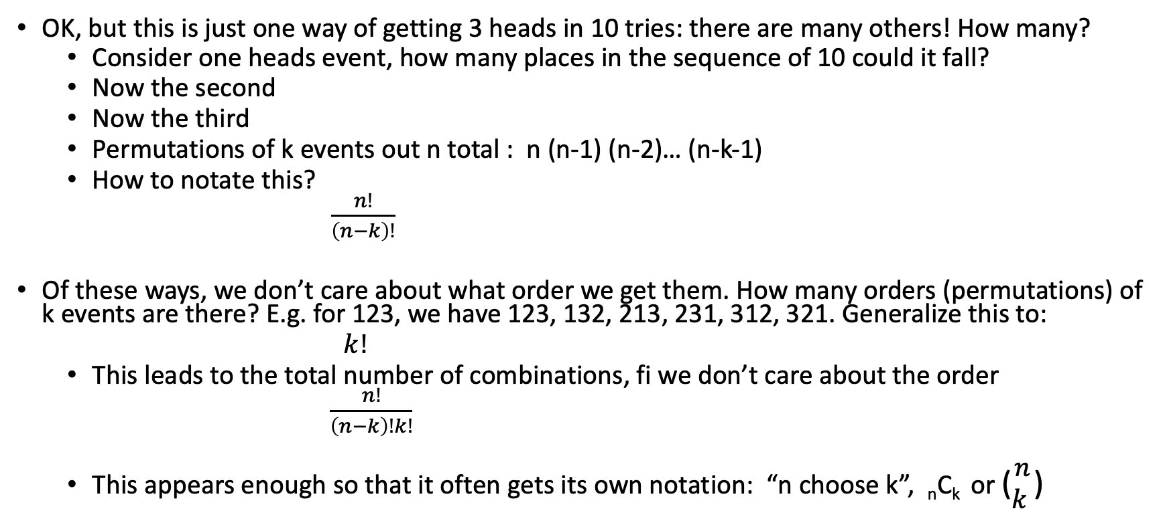
Permutations and combinations
OK, but this is just one way of getting 3 heads in 10 tries: there are many others! How many?
  Consider one heads event, how many places in the sequence of 10 could it fall?
  Now the second
  Now the third
  Permutations of k events out n total : n (n-1) (n-2)… (n-k-1)
  How to notate this?
  $\frac{n!}{\left(n−k\right)!}$
Of these ways, we don’t care about what order we get them. How many orders (permutations) of k events are there? E.g. for 123, we have 123, 132, 213, 231, 312, 321. Generalize this to:
  $k!$
  This leads to the total number of combinations, fi we don’t care about the order
  $\frac{n!}{\left(n−k\right)!k!}$
  This appears enough so that it often gets its own notation: “n choose k”, _{n}C_{k} or ($\begin{matrix}n \\ k \end{matrix}$)

Slide 62
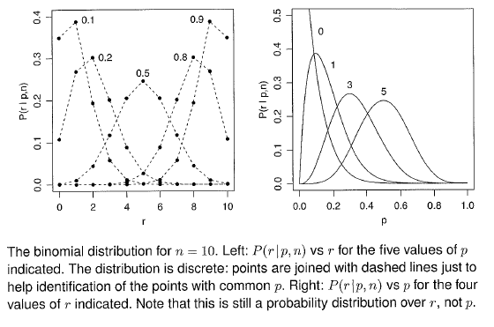
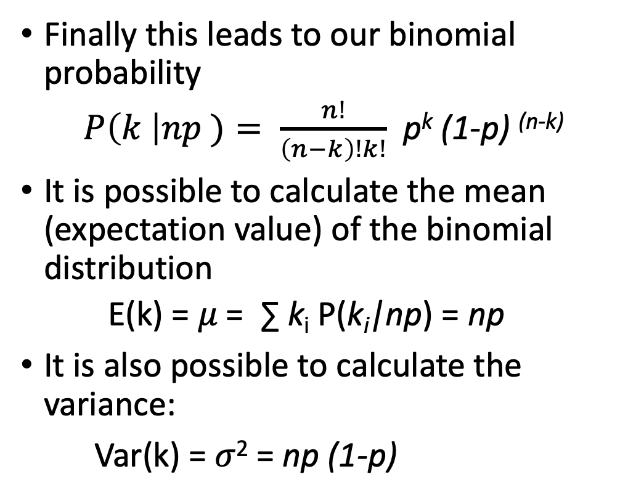
Binomial distribution: mean and variance
Finally this leads to our binomial probability
  $P\left(k \right|np )= \frac{n!}{\left(n−k\right)!k!}$ p^{k} (1-p) ^{(n-k)}
It is possible to calculate the mean (expectation value) of the binomial distribution
  E(k) = 𝜇 = ∑ k_{i} P(k_{i}|np) = np
It is also possible to calculate the variance:
Var(k) = 𝜎² = np (1-p)
Bailer-Jones 1.1
Binomial distribution common for probability problems, but perhaps less in astronomy applications: however, it is the basis for a critical distribution used in astronomy: the Poisson distribution

Slide 63
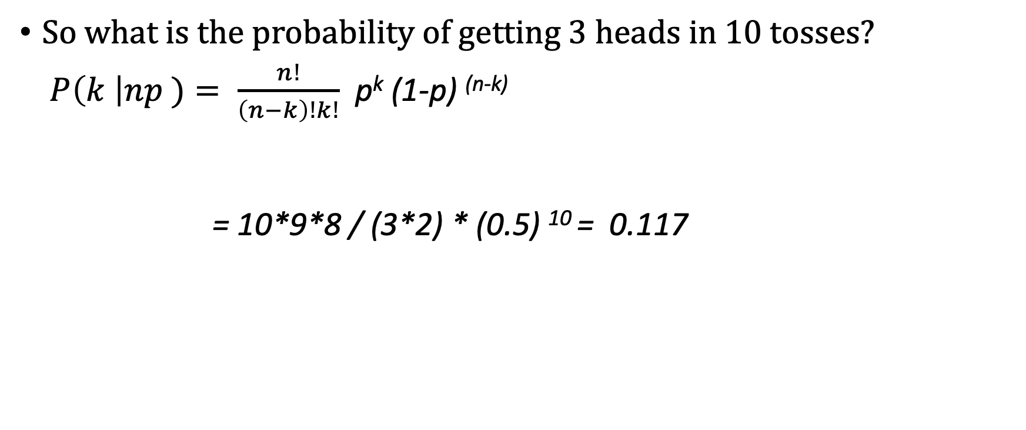
Binomial distribution: example
So what is the probability of getting 3 heads in 10 tosses?
$P\left(k \right|np )= \frac{n!}{\left(n−k\right)!k!}$ p^{k} (1-p) ^{(n-k)}
= 10*9*8 / (3*2) * (0.5) ¹⁰ = 0.117

Slide 64
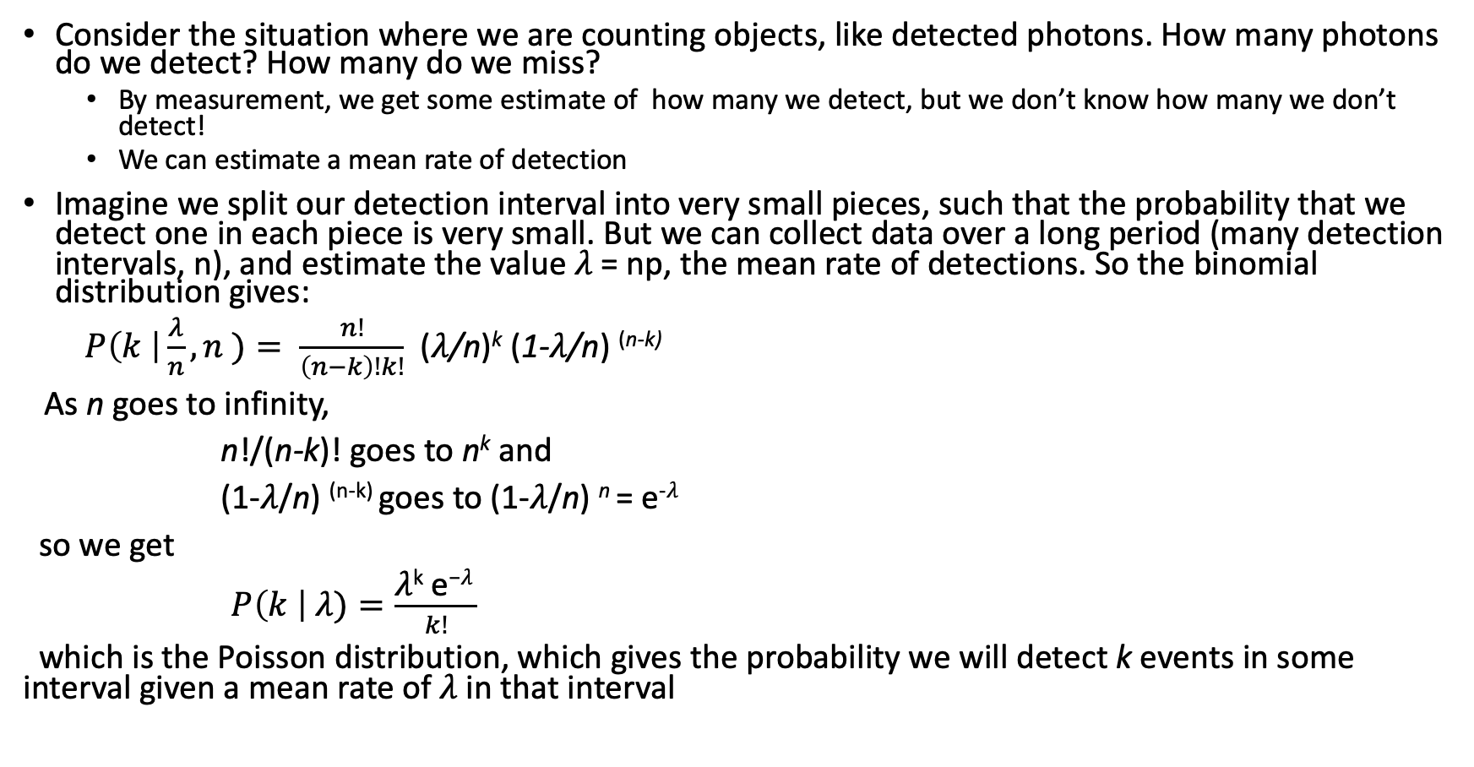
Poisson distribution
Consider the situation where we are counting objects, like detected photons. How many photons do we detect? How many do we miss?
  By measurement, we get some estimate of how many we detect, but we don’t know how many we don’t detect!
  We can estimate a mean rate of detection
Imagine we split our detection interval into very small pieces, such that the probability that we detect one in each piece is very small. But we can collect data over a long period (many detection intervals, n), and estimate the value 𝜆 = np, the mean rate of detections. So the binomial distribution gives:
$P\left(k \right|\frac{λ}{n},n )= \frac{n!}{\left(n−k\right)!k!}$ (𝜆/n)^{k} (1-𝜆/n) ^{(n-k)}
As n goes to infinity,
n!/(n-k)! goes to n^{k} and
(1-𝜆/n) ^{(n-k)} goes to (1-𝜆/n) ^{n} = e^{-𝜆}
so we get
$P\left(k \right| λ)=\frac{\text{λ}\text{k} \text{e}\text{−}\text{λ} }{k!}$
which is the Poisson distribution, which gives the probability we will detect k events in some interval given a mean rate of 𝜆 in that interval

Slide 65
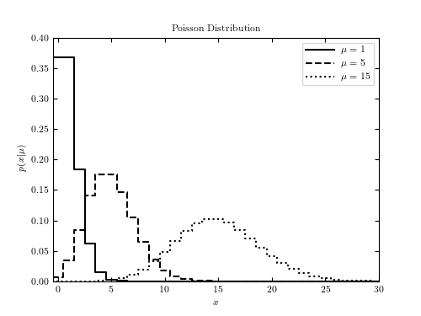
Poisson distribution: mean and variance
Poisson distribution only for positive values
Approaches Gaussian for large 𝜆
We can calculate the mean and variance of the Poisson distribution given the mean and variance from the binomial distribution in the limit of p<<1
E(k) = 𝜇 = ∑ k_{i} P(k_{i}|np) = np = 𝜆
Var(k) = 𝜎² = np (1-p) ≈ np = 𝜆
This is a key important result!
The variance of the Poisson distribution is equal to the mean

Slide 66
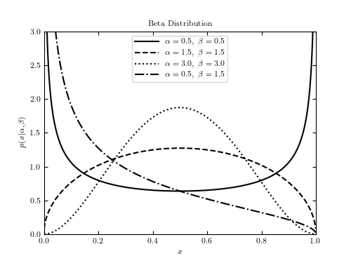
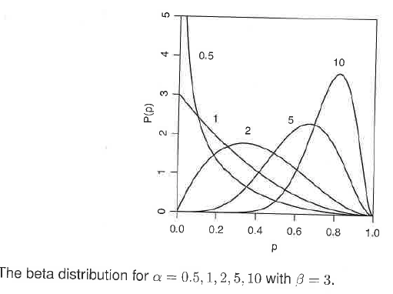
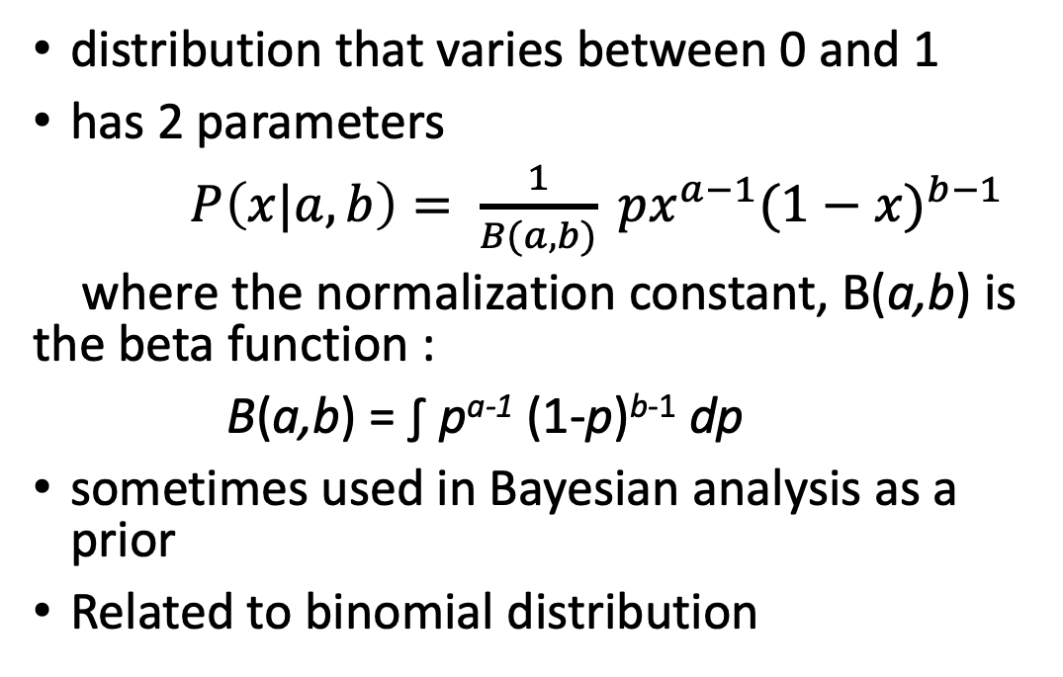
Beta distribution
distribution that varies between 0 and 1
has 2 parameters
$P\left(x|a,b\right)= \frac{1}{B(a,b)} px^{a−1}{(1−x)}^{b−1}$
where the normalization constant, B(a,b) is the beta function :
B(a,b) = ∫ p^{a-1} (1-p)^{b-1} dp
sometimes used in Bayesian analysis as a prior
Related to binomial distribution

Slide 67
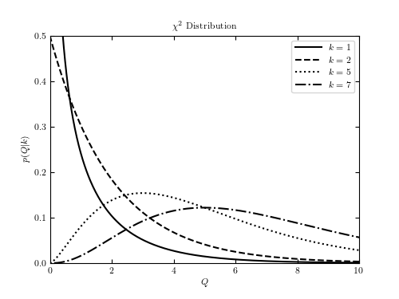
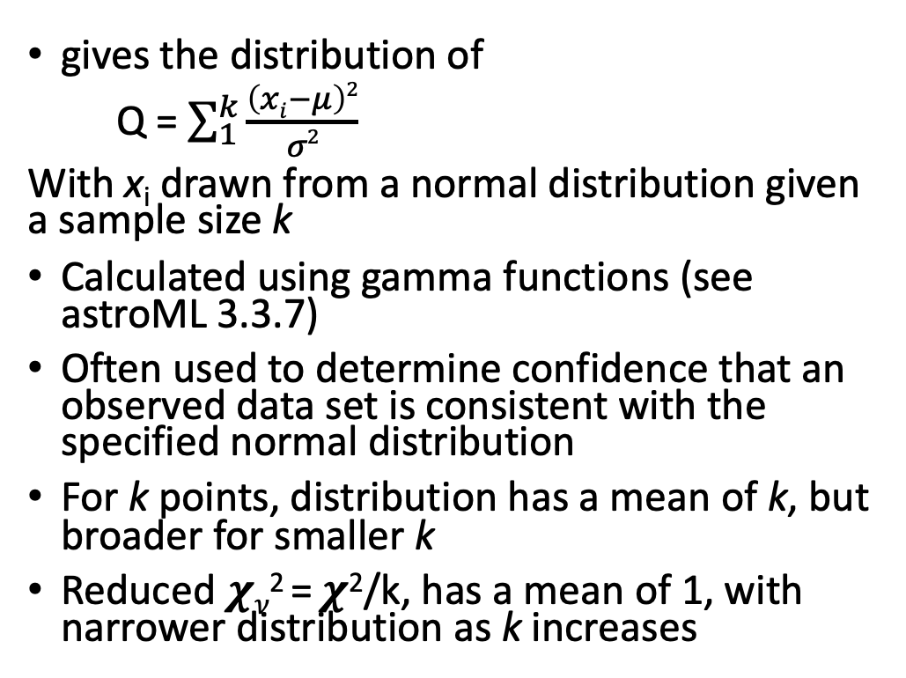
𝝌² distribution
gives the distribution of
Q = $\sum_{1}^{k}{\frac{\left(xi−μ\right)2}{σ2}}$
With x_{i} drawn from a normal distribution given a sample size k
Calculated using gamma functions (see astroML 3.3.7)
Often used to determine confidence that an observed data set is consistent with the specified normal distribution
For k points, distribution has a mean of k, but broader for smaller k
Reduced 𝝌_{𝜈}² = 𝝌²/k, has a mean of 1, with narrower distribution as k increases
astroML 3.14

Slide 68
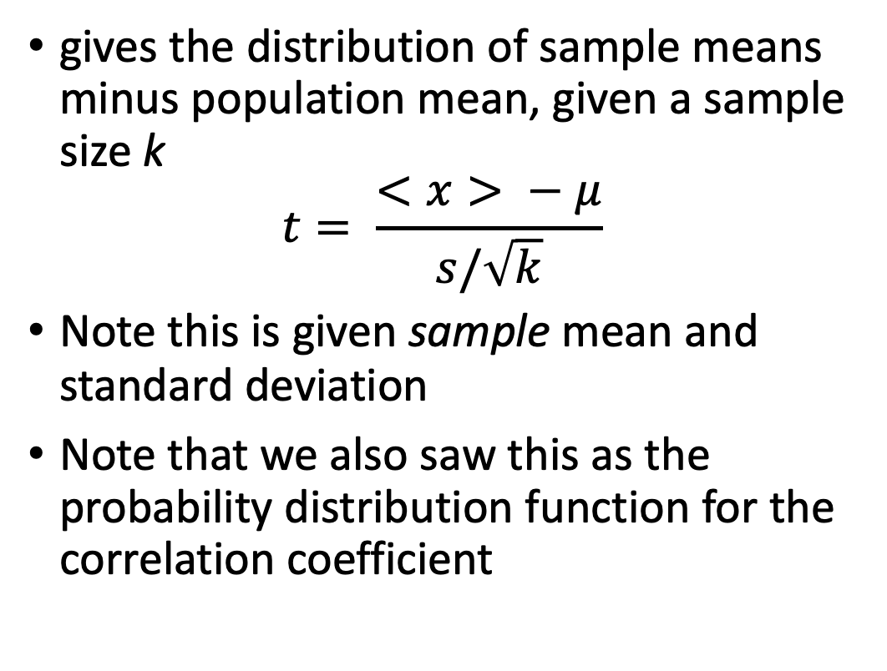
Students t-distribution
gives the distribution of sample means minus population mean, given a sample size k
$$t= \frac{<x> − μ}{s/\sqrt{k}}$$
Note this is given sample mean and standard deviation
Note that we also saw this as the probability distribution function for the correlation coefficient

Slide 69
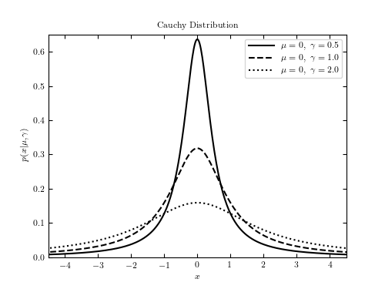


Cauchy (Lorentzian) distribution
$p\left(x | μ,γ\right)= \frac{1}{πγ}(\frac{γ2}{γ2+\left(x−μ\right)2})$
Has broader wings than Gaussian, which go as x^{-2,} which means that the mean and variance are undefined or infinite!
Classic example of a pathological distribution
Examples:
  Ratio of two Gaussian distributions
  Spectral line shapes

Slide 70
ASTR 630
Numerical and Statistical Methods in Astrophysics
Spring 2022
Central limit theorem

Slide 71
Central limit theorem

