Slide 1
ASTR 535
Observational Techniques
Fall 2019 (10/23)
Instruments / Detectors

Slide 2
11/2
Questions
Imaging data reduction
  World coordinate systems
  Running notebooks remotely

Slide 3
11/7
Questions
Discussion
Imaging data reduction

Slide 4
11/9
Questions
Discussion
  Fibers
Different types of spectrographs : data
  Data puzzles
Imaging data reduction

Slide 5
11/14
Questions
Discussion
Spectrographs
  Imagine someone said they were building a new spectrograph for the 3.5m. What performance information would you like to know about it to assess its scientific capabilities?
  Canvas: Spectrograph resolution

Slide 6
11/16
Questions
Discussion
Detectors
  Basic principles
  Characteristics
  Digitization
  Optical and IR detectors
KOSMOS : measuring the gain and dispersion

Slide 7
11/28
Discussion/questions
Final
IR observing and data reduction
Similar techniques in the optical for faint objects
  Dithering
  Nod and shuffle
KOSMOS : measuring the gain and dispersion
IR data inspection: TSPEC slit viewer

Slide 8
11/30
Discussion/questions
Final
Measuring the gain
Spectroscopy data reduction demo:
  KOSMOS
  ARCES
  TSPEC

Slide 9
Instruments
General considerations
  Location of optics: near focal plane vs near pupil
  Throughput : transmission and reflection
  Refractive vs reflective optics
    achromats

Slide 10
Instrument examples
Field flatteners
Focal plane reimagers
  Why?
Pupil reimagers
  Field lens
  Motivations
    Adaptive optics
    Minimize size of optics, e.g. https://www.rp-photonics.com/field_lenses.html
    Coronagraphs
    IR instruments and cold pupil stops

Slide 11
Filters
classification by width
  Broad-band
  Medium-band
  Narrow band
Classification by type
  Colored glass
  Interference filters: partially reflecting parallel surfaces
    mλ = 2nd cosθ
    Dependences on angle of incidence: implication for filter location and bandpass variation in different optical systems (c.f. Coronado solar telescopes)
    Note also antireflection coatings

Slide 12
Imaging spectroscopy: Fabry-Perot interferometer
the etalon: a tunable interference filter
  Tuned by changing index of refraction, tilt
Location of etalon in collimated beam
  Implication: different bandpass at different field angle
Fabry-Perot data cubes

Slide 13
Dispersing spectrographs
Basic design
  Focal plan reimager, with a dispersing element
  Dispersing elements:
    Diffraction grating
    Prism
Basic spectrograph user characteristics
  dispersion
    Angular dispersion (angle per wavelength, e.g. radians/A) : dispersing element
    Linear dispersion (distance per wavelength e.g. mm/A) : dispersing element + camera lens
    Inverse linear dispersion (wavelength per distance, e.g. A/mm or A/pixel)
  resolution
  throughput

Slide 14
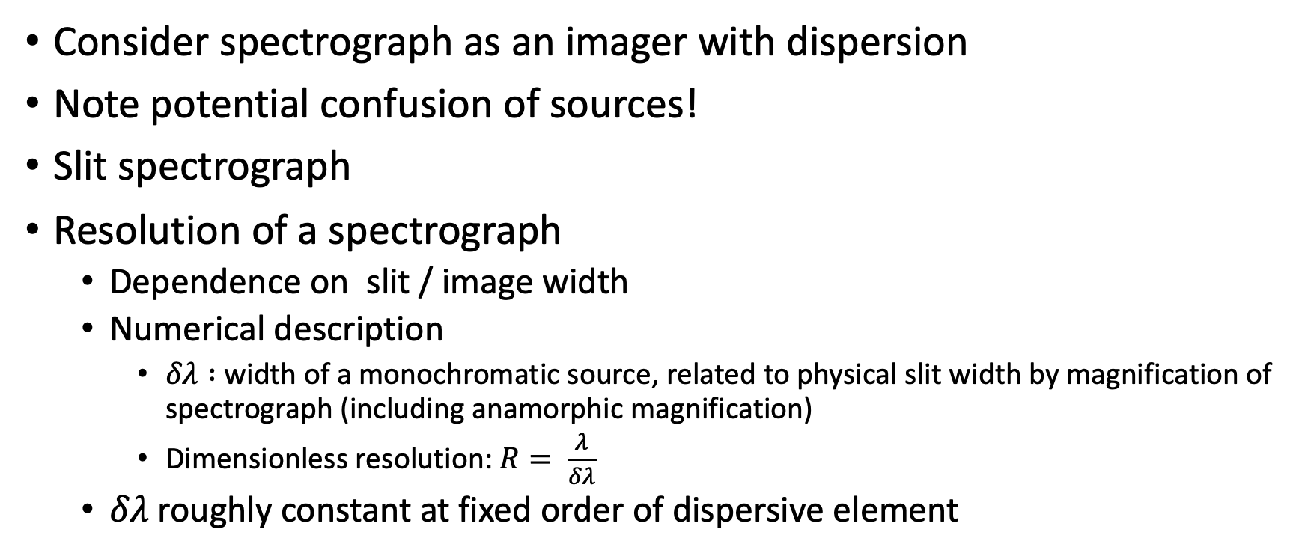
Spectrographs
Consider spectrograph as an imager with dispersion
Note potential confusion of sources!
Slit spectrograph
Resolution of a spectrograph
  Dependence on slit / image width
  Numerical description
    $δλ :$ width of a monochromatic source, related to physical slit width by magnification of spectrograph (including anamorphic magnification)
    Dimensionless resolution: $R= \frac{λ}{δλ}$
  $δλ$ roughly constant at fixed order of dispersive element

Slide 16
Astronomical spectrographs
Slitless spectroscopy
  E.g. grism
  Implication for sky background
Long-slit spectroscopy
multiobject spectroscopy with slitlets
Image slicers:
Fiber spectrographs
Integral field spectrograph

Slide 17
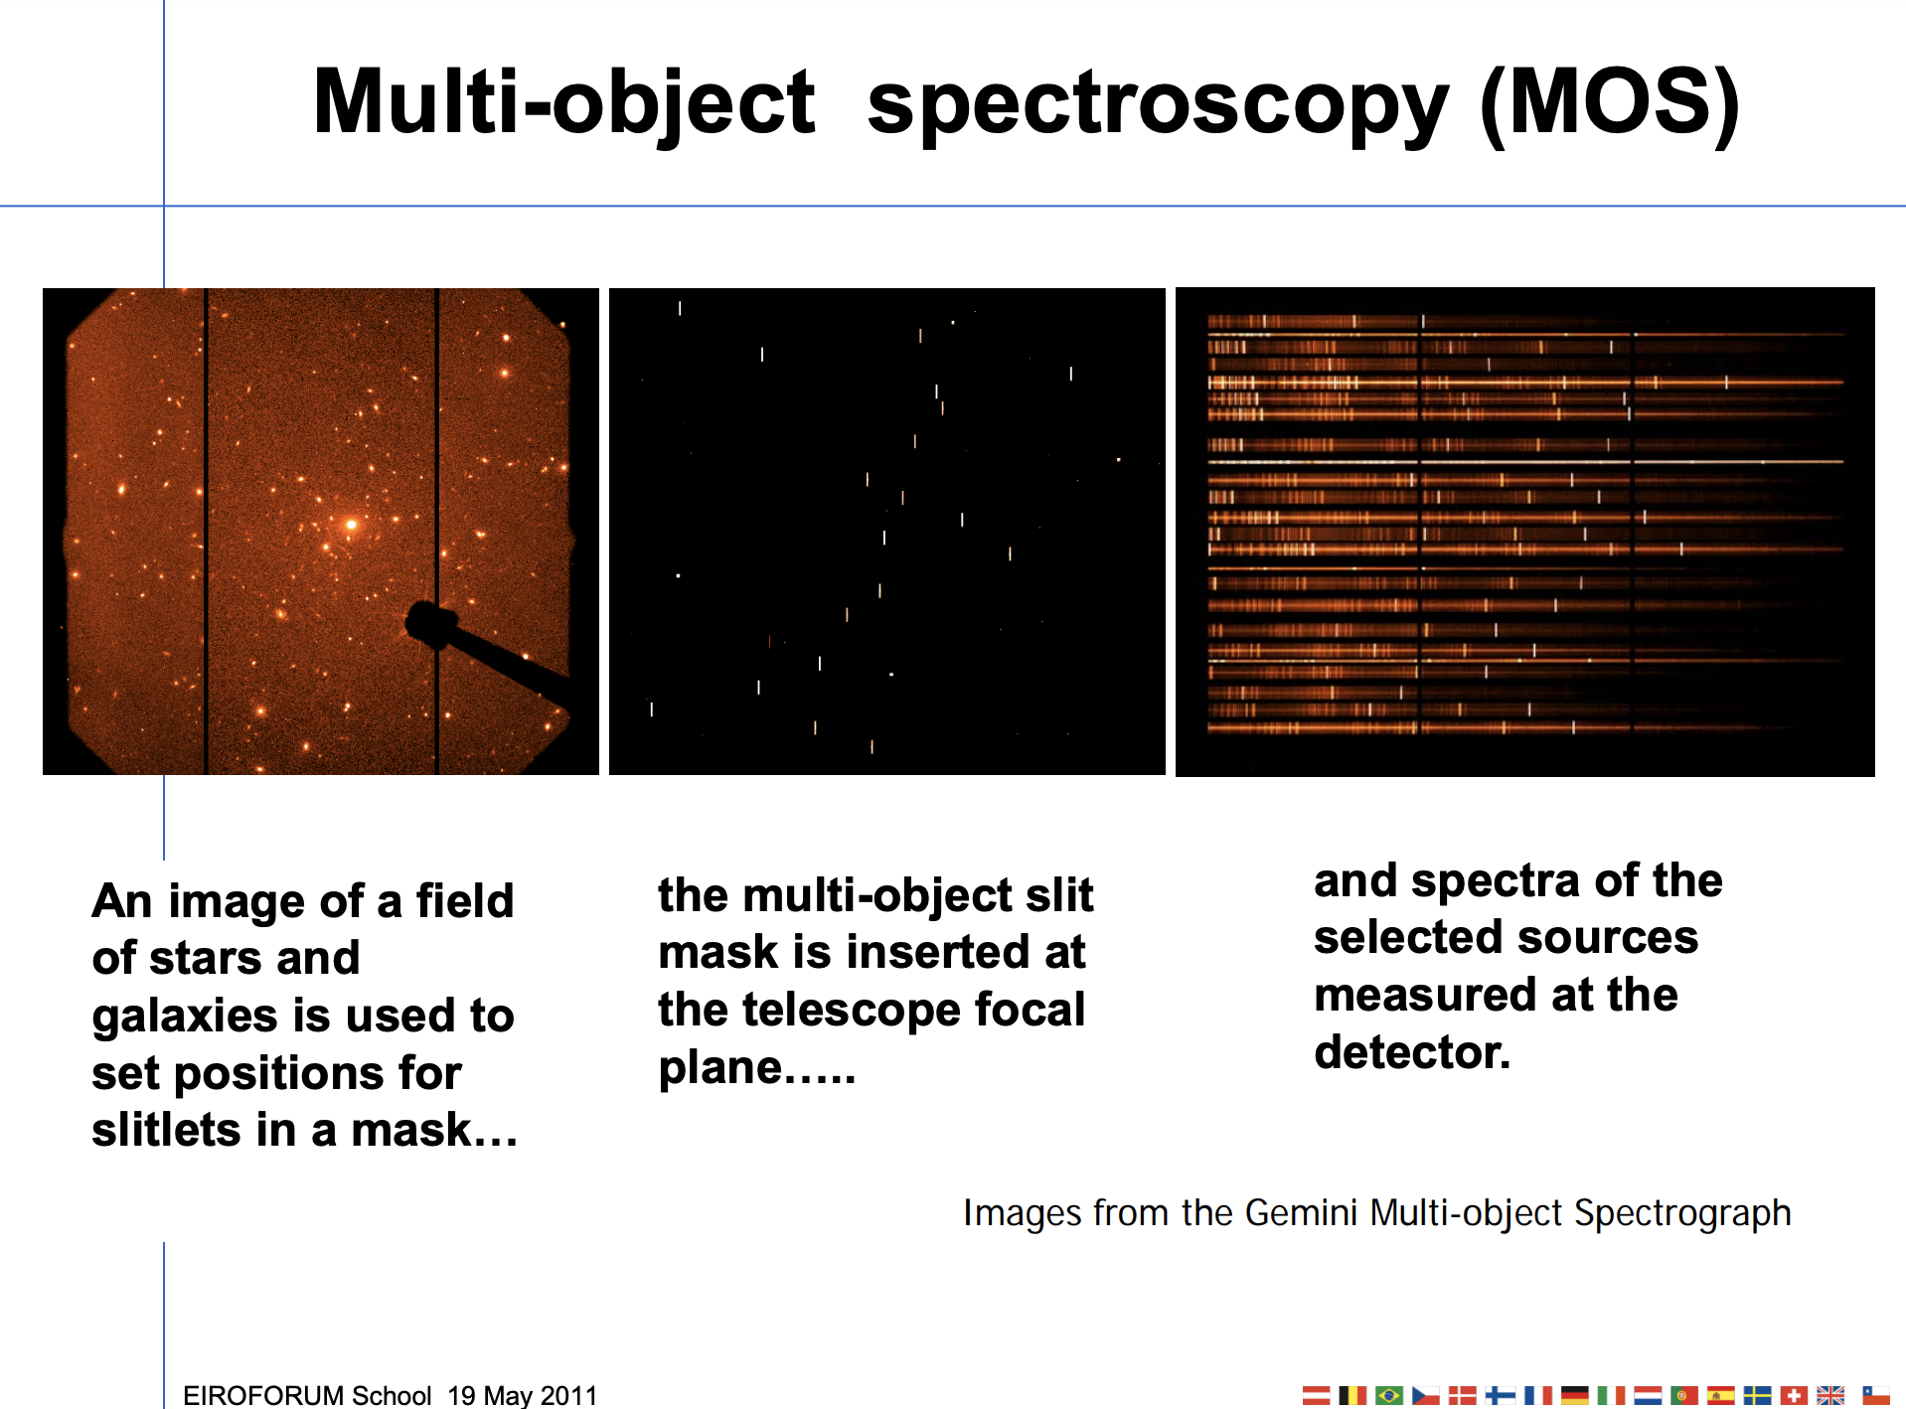

Slide 18
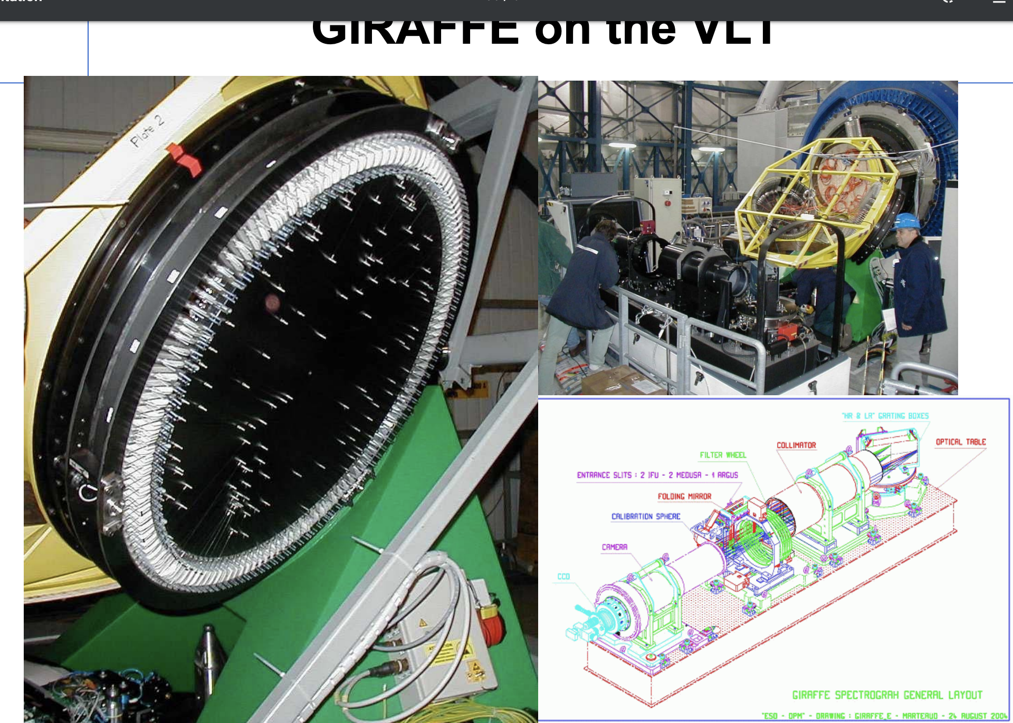

Slide 19
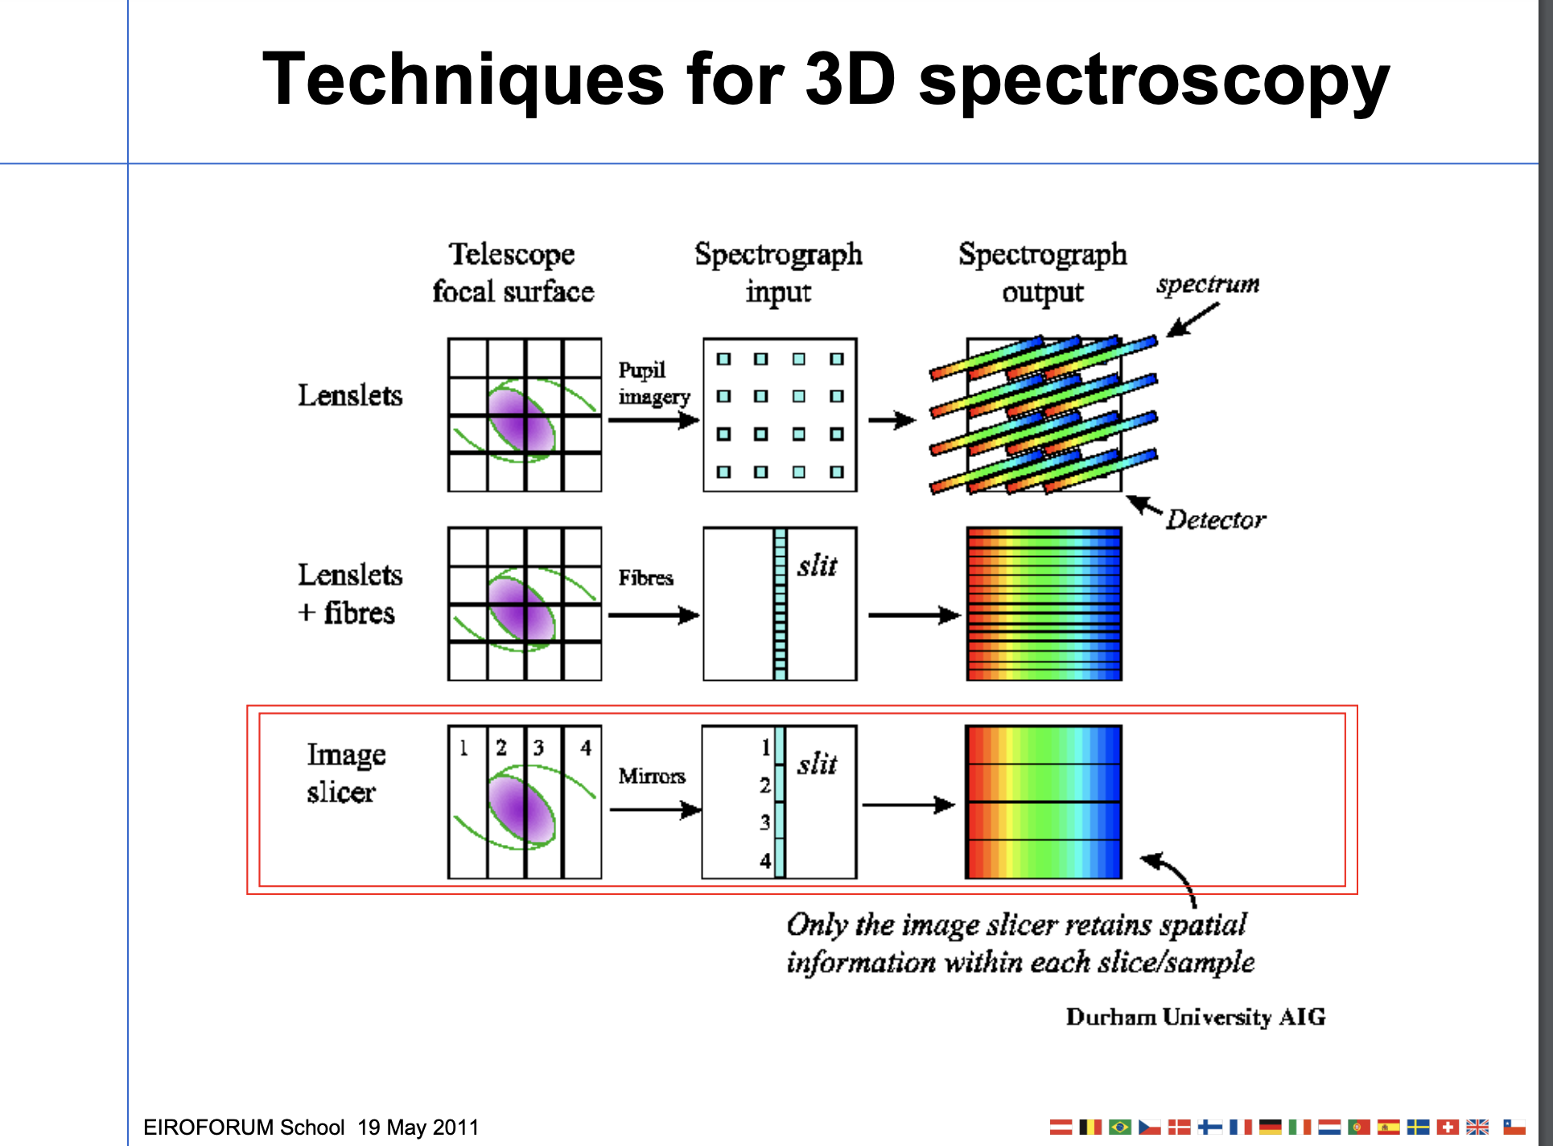

Slide 20
Dispersing elements
Prisms
Diffraction gratings: multi-slit interference (note this is not spectrograph slit!)
  Grating equation
    mλ = σ(sinβ + sinα)
  Orders and order overlap
  Echelle spectroscopy
  Anamorphic magnification
  Grating throughput/efficiency and grating blaze
    Volume phase holographic (VPH) gratings

Slide 21
Detectors
Basic types:
  Photographic
  Photoelectric detectors
    Photoelectric effect
    Photon counter: photons make “events”
      Photomultipliers
      Photon counting arrays
    Photon collector: photons generate photoelectrons
      Different materials: Si, HgCdTe, InSb, PtSi
      Different readout electronics: CCD, CMOS, IR multiplexer

Slide 22
Detector characteristics
Quantum efficiency
Size / resolution elements
Discovery efficiency : size * QE
Readout effects
  Readout noise
  Pattern noise / fixed pattern noise
Dark current
Linearity
Full well

Slide 23
More detector characteristics
Others
  Defects
  Modulation transfer function
    fringing
  Readout speed
  Saturation behavior
  Hysteresis
  reciprocity

Slide 24
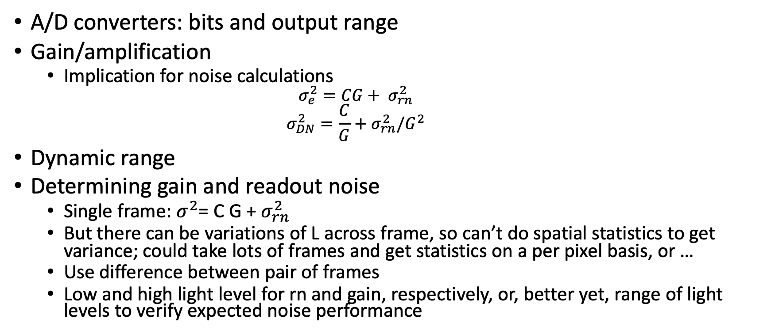
Digitization
A/D converters: bits and output range
Gain/amplification
  Implication for noise calculations
    $$σ_{e}^{2}=CG+ σ_{rn}^{2}$$
    $$σ_{DN}^{2}=\frac{C}{G}+σ_{rn}^{2}/G^{2}$$
Dynamic range
Determining gain and readout noise
  Single frame: $σ^{2}$= C G + ${σ_{rn}^{2}}_{ }$
  But there can be variations of L across frame, so can’t do spatial statistics to get variance; could take lots of frames and get statistics on a per pixel basis, or …
  Use difference between pair of frames
  Low and high light level for rn and gain, respectively, or, better yet, range of light levels to verify expected noise performance

Slide 25
CCDs
Readout method
Charge transfer
  CTE
  Deferred charge
binning
QE
  Front side vs back side thinned

Slide 26
CMOS detectors
Complementary metal oxide semiconductor
Readout method
Readout speed
Pros/cons vs CCDs

Slide 27
IR detectors
Readout method: multiplexer
Non-destructive readout
Reset (kTC) noise
Readout noise
Readout modes
  Doubly correlated sampling
  Fowler sampling
  Up the ramp sampling

Slide 28
UV detectors
Because of low background, photon counting devices are often preferred

